Slide 1
Post-Harvest 2025
Val OBerbroeckling
563-543-7979

Slide 2
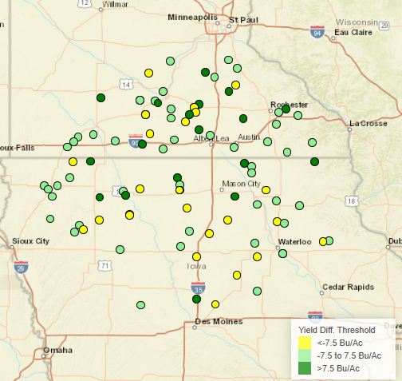
NK0252-D
Agronomic Attributes (1-9 scale) | Moisture +/- (%)
Ear Flex - SF | Root Type - Modified
Root Strength - 2 | Stalk Strength - 3
NCLB | 4
GLS | 4
Tar Spot | 4
Anthracnose Stalk Rot | 3
Drought Prone Soils | Variable Soils
Highly Productive Soils | Poorly Drained Soils
102 RM
Placement flexibility across allows for excellent yield potential across broad array of soil textures.
Strong choice for first planting option with excellent emergence and seedling vigor.
Semi-flex ear allows for planting population flexibility – 32-36k, will respond to additional population in high yield environments.
Above average disease package but can benefit from fungicide application.
Product 2 | Yield +/- (bu/ac) | #Trials | Moisture +/- (%)
DKC105-33 | -2.3 | 87 | 0.1
DKC104-14 | -3.4 | 74 | -0.7
DKC101-33 | 0.7 | 9 | 0.6
DKC103-63 | -2.3 | 9 | -0.2
DKC102-13 | 14.5 | 4 | 1.2
P0035AM | 4.5 | 60 | 1
P0622Q | -5.8 | 68 | -0.5
P0529Q | 5.4 | 3 | -1.6
Cropwise Product Analyzer, 11/1/25

Slide 3
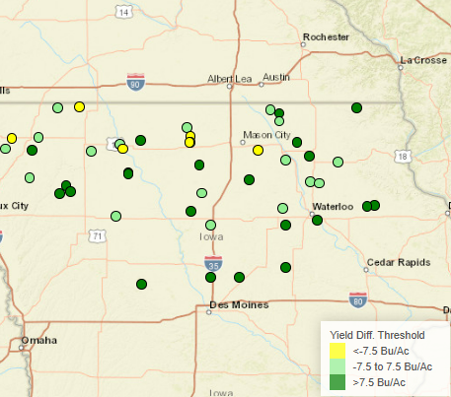
NK0415-AA
Agronomic Attributes (1-9 scale) | Moisture +/- (%)
Ear Flex - SF | Root Type - Modified
Root Strength - 3 | Stalk Strength - 3
NCLB | 4
GLS | 4
Tar Spot | 3
Anthracnose Stalk Rot | 4
Drought Prone Soils | Variable Soils
Highly Productive Soils | Poorly Drained Soils
104 RM
Outstanding emergence with very good early season vigor allows for early planting.
Excels on highly productive acres with good water holding capacity.
Moderate planting populations recommended (34K and below).
Best performance in zone, does not like being pushed south of zone.
Dependable Tar Spot rating.
Product 2 | Yield +/- (bu/ac) | #Trials | Moisture +/- (%)
DKC105-33 | 10.8 | 20 | 0.9
DKC101-35 | 8.9 | 2 | 2.7
DKC104-08 | 9.2 | 2 | 0.6
B05D47PCE | -12.9 | 4 | -0.2
DKC103-07 | 1.7 | 3 | 0
DKC107-11 | -4.4 | 4 | -1.2
P0404AM | 10.9 | 17 | 0.3
P0622Q | 11.4 | 15 | -0.1
Cropwise Product Analyzer, 11/1/25

Slide 4
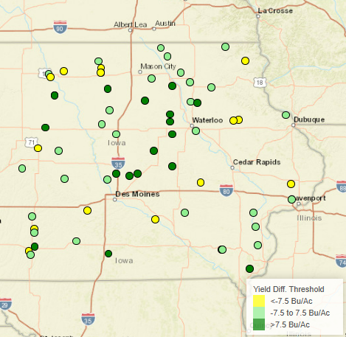
NK0880-V
Agronomic Attributes (1-9 scale) | Moisture +/- (%)
Ear Flex - SF | Root Type - Penetrating
Root Strength - 2 | Stalk Strength - 4
NCLB | 4
GLS | 5
Tar Spot | 2
Anthracnose Stalk Rot | 3
Drought Prone Soils | Variable Soils
Highly Productive Soils | Poorly Drained Soils
108 RM
Broadly adapted, performs well across all soil types and textures.
Most competitive in high to medium high fertility soils.
Good emergence and strong seedling vigor.
Mid planting hybrid, not a plant me first hybrid.
Ideal planting population around 34K and does not tend to respond with additional populations.
Responds to fungicide application and irrigation.
Product 2 | Yield +/- (bu/ac) | #Trials | Moisture +/- (%)
DKC105-33 | 5.6 | 36 | 3.7
P0622Q | 7.9 | 35 | 2.7
DKC59-82 | 8.3 | 62 | 3
P0924Q | -13.4 | 74 | 1.5
B05D47PCE | 11.6 | 2 | 2.5
B08R32AM | -6.9 | 2 | 1.1
DKC106-98 | 0.3 | 2 | 1.5
DKC107-11 | 3.1 | 2 | 2
Cropwise Product Analyzer, 11/1/25

Slide 5
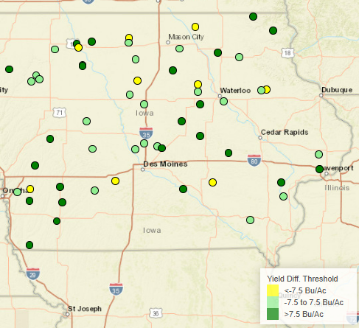
NK1188-D
Agronomic Attributes (1-9 scale) | Moisture +/- (%)
Ear Flex - SF | Root Type - Fibrous
Root Strength - 4 | Stalk Strength - 4
NCLB | 3
GLS | 4
Tar Spot | 3
Anthracnose Stalk Rot | 3
Drought Prone Soils | Variable Soils
Highly Productive Soils | Poorly Drained Soils
111 RM
Broadly adapted – farmer friendly hybrid.
Performs well across all soil types and drainage types.
Great choice on variable/stress acres.
Performs well across wide population range 28-34K.
Responds well to increased management. (Nitrogen, Potassium, and Fungicide)
Product 2 | Yield +/- (bu/ac) | #Trials | Moisture +/- (%)
NK1307-DV | -0.3 | 29 | -1.4
DKC111-35 | -13.3 | 42 | 1.1
DKC59-82 | 12.5 | 35 | 2
P1027AM | -14.6 | 43 | 1.2
DKC114-43 | -2.3 | 17 | 0.2
P13050AM | 12.8 | 15 | 0.4
DKC110-41 | 8.3 | 3 | 0.5
DKC111-62 | 18.4 | 2 | 1.4
Cropwise Product Analyzer, 11/1/25

Slide 6
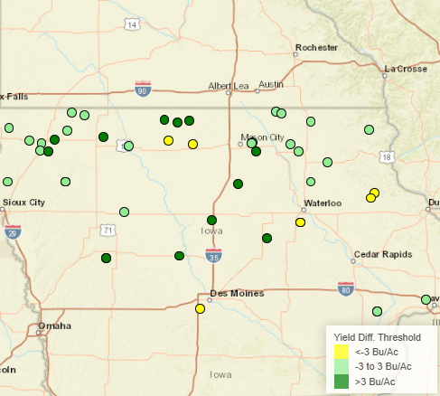
NK19-T8E3S
Agronomic Attributes | Moisture +/- (%)
Standability | 3
SCN Source | Peking
SWM | 4
SDS | 3
Phytophthora Field Tolerance PRR Source | 3 Rps1k
Drought Prone Soils | Variable Soils
Highly Productive Soils | Poorly Drained Soils
1.9 RM
Best performance in high yielding environments where SCN can be an issue.
Peking SCN.
Elite yield potential in high yielding environments.
Moderate plant type works in any row width.
Great pairing with NK21-C2E3.
Product 2 | Win % | Yield +/- (bu./ac.) | #Trials
B194EE | 38 | -0.5 | 8
B205EE | 38 | 2 | 8
B214EE | 29 | 0.3 | 7
XO 1986E | 50 | 4.3 | 4
XO 2075E | 83 | 0.9 | 6
A18E35 | 100 | 4.2 | 5
A19E36 | 50 | 1.3 | 2
P21Z71E | 23 | -4.9 | 31
P17Z39E | 33 | -1.1 | 3
Cropwise Product Analyzer, 11/1/25

Slide 7
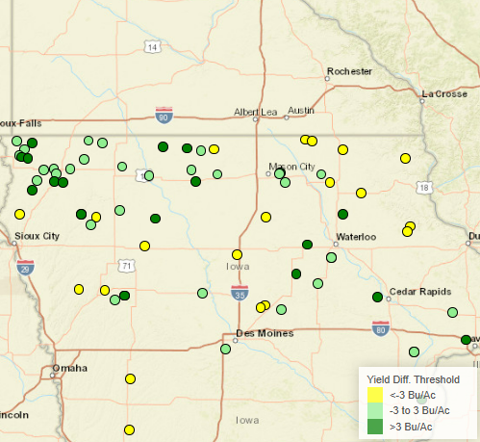
NK21-C2E3
Agronomic Attributes | Moisture +/- (%)
Standability | 2
SCN Source | PI88788
SWM | 3
SDS | 2
Phytophthora Field Tolerance PRR Source | 2 Rps1c
Drought Prone Soils | Variable Soils
Highly Productive Soils | Poorly Drained Soils
2.1 RM
Great choice for variable and highly productive soils.
Broad adaptation, dependable standability, and good SWM allow for planting in high yield environments.
Strong PRR field tolerance allow for planting in poorly drained soils.
Sister line to NK22-C4E3.
Product 2 | Win % | Yield +/- (bu./ac.) | #Trials
B205EE | 52 | 0.9 | 21
B214EE | 47 | 0.4 | 19
B224EE | 39 | 0.2 | 18
XO 2075E | 73 | 1.7 | 11
XO 2206E | 73 | 3.4 | 11
A21E34 | 100 | 6.5 | 7
A23E36 | 62 | 0.4 | 8
P21Z71E | 35 | -1.7 | 31
Cropwise Product Analyzer, 11/1/25

Slide 8
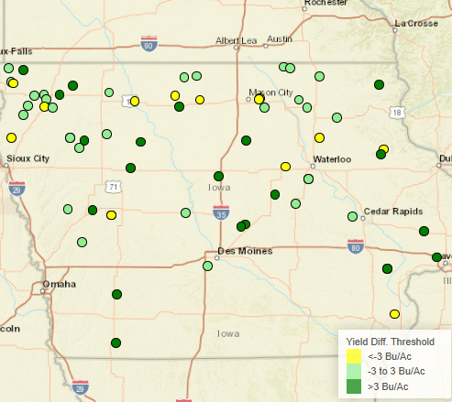
NK23-P1E3
Agronomic Attributes | Moisture +/- (%)
Standability | 2
SCN Source | Peking
SWM | 4
SDS | 3
Phytophthora Field Tolerance PRR Source | 2 Rps1c, Rps3a
Drought Prone Soils | Variable Soils
Highly Productive Soils | Poorly Drained Soils
2.3 RM
Performs best on highly productive soils but will still performs well on variable and drought prone soils too.
Excellent standability along with very strong SDS rating.
Strong PRR field tolerance and stacked Rps. genes allow placement on poorly drained soils.
Peking SCN source.
Will move south of zone well.
Product 2 | Win % | Yield +/- (bu./ac.) | #Trials
B214EE | 43 | -0.6 | 14
B224EE | 62 | 0.5 | 13
B243EE | 67 | -0.3 | 9
XO 2206E | 88 | 5.2 | 8
XO 2366E | 50 | 0 | 6
XO 2556E | 50 | 0.7 | 4
A21E34 | 100 | 7.7 | 7
A23E36 | 57 | 2 | 7
P21Z71E | 23 | -3.3 | 31
Cropwise Product Analyzer, 11/1/25

Slide 9
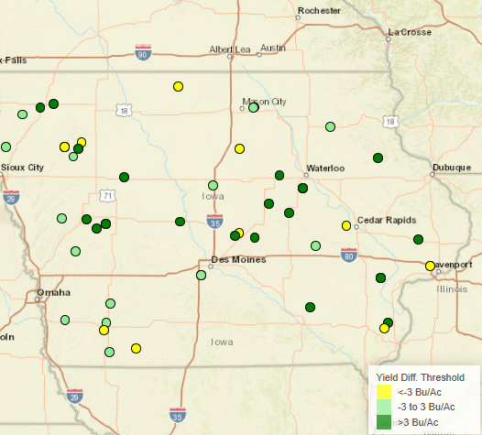
NK26-M6E3
Agronomic Attributes | Moisture +/- (%)
Standability | 2
SCN Source | PI88788
SWM | 3
SDS | 3
Phytophthora Field Tolerance PRR Source | 3 Rps1c
Drought Prone Soils | Variable Soils
Highly Productive Soils | Poorly Drained Soils
2.6 RM
Broad placement variety - “goes on any acre” – from highly productive to drought prone soils.
Strong agronomics: Standability, SWM, SDS, and PFT help make this a farmer friendly bean.
Well suited for all row widths and a positive response to irrigation.
#1 bean for 2025.
Product 2 | Win % | Yield +/- (bu./ac.) | #Trials
NK28-G7E3S | 62 | 1.4 | 45
A27E35 | 67 | 2 | 3
B243EE | 33 | -2.5 | 3
B275EE | 67 | 2.7 | 3
P26Z78E | 62 | 3.4 | 26
NK28-B9E3S | 85 | 7.6 | 13
Cropwise Product Analyzer, 11/1/25

