Slide 1
Giant's Burn Wind Farm
Dunoon Community Council
9 September 2024 www.giants-burn.co.uk

Slide 2
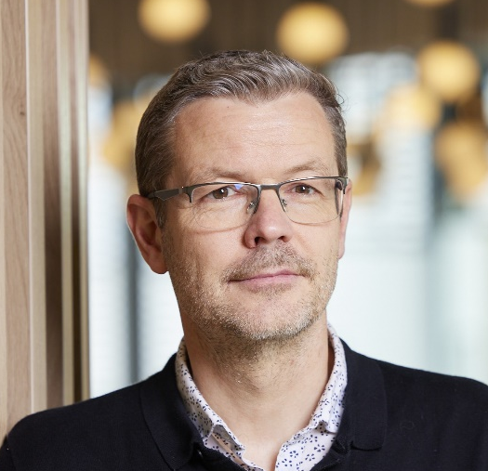
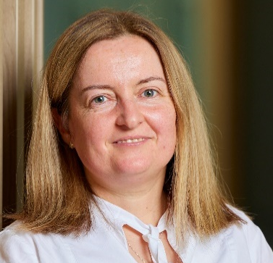
Project Team
Iain Robertson
Head of Statkraft Scotland
Head of Development Services UK
Project Manager, Giant’s Burn
Ruth Semple
Senior Community Liaison Manager

Slide 3
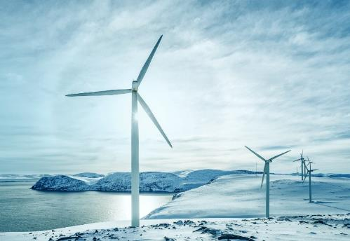

About Statkraft
Europe’s largest renewable energy producer
Norwegian state-owned
125+ years of hydropower heritage
6000+ employees
21 countries
Operating in the UK since 2006
  500 employees
Scottish HQ in Glasgow
  50 employees

Slide 4


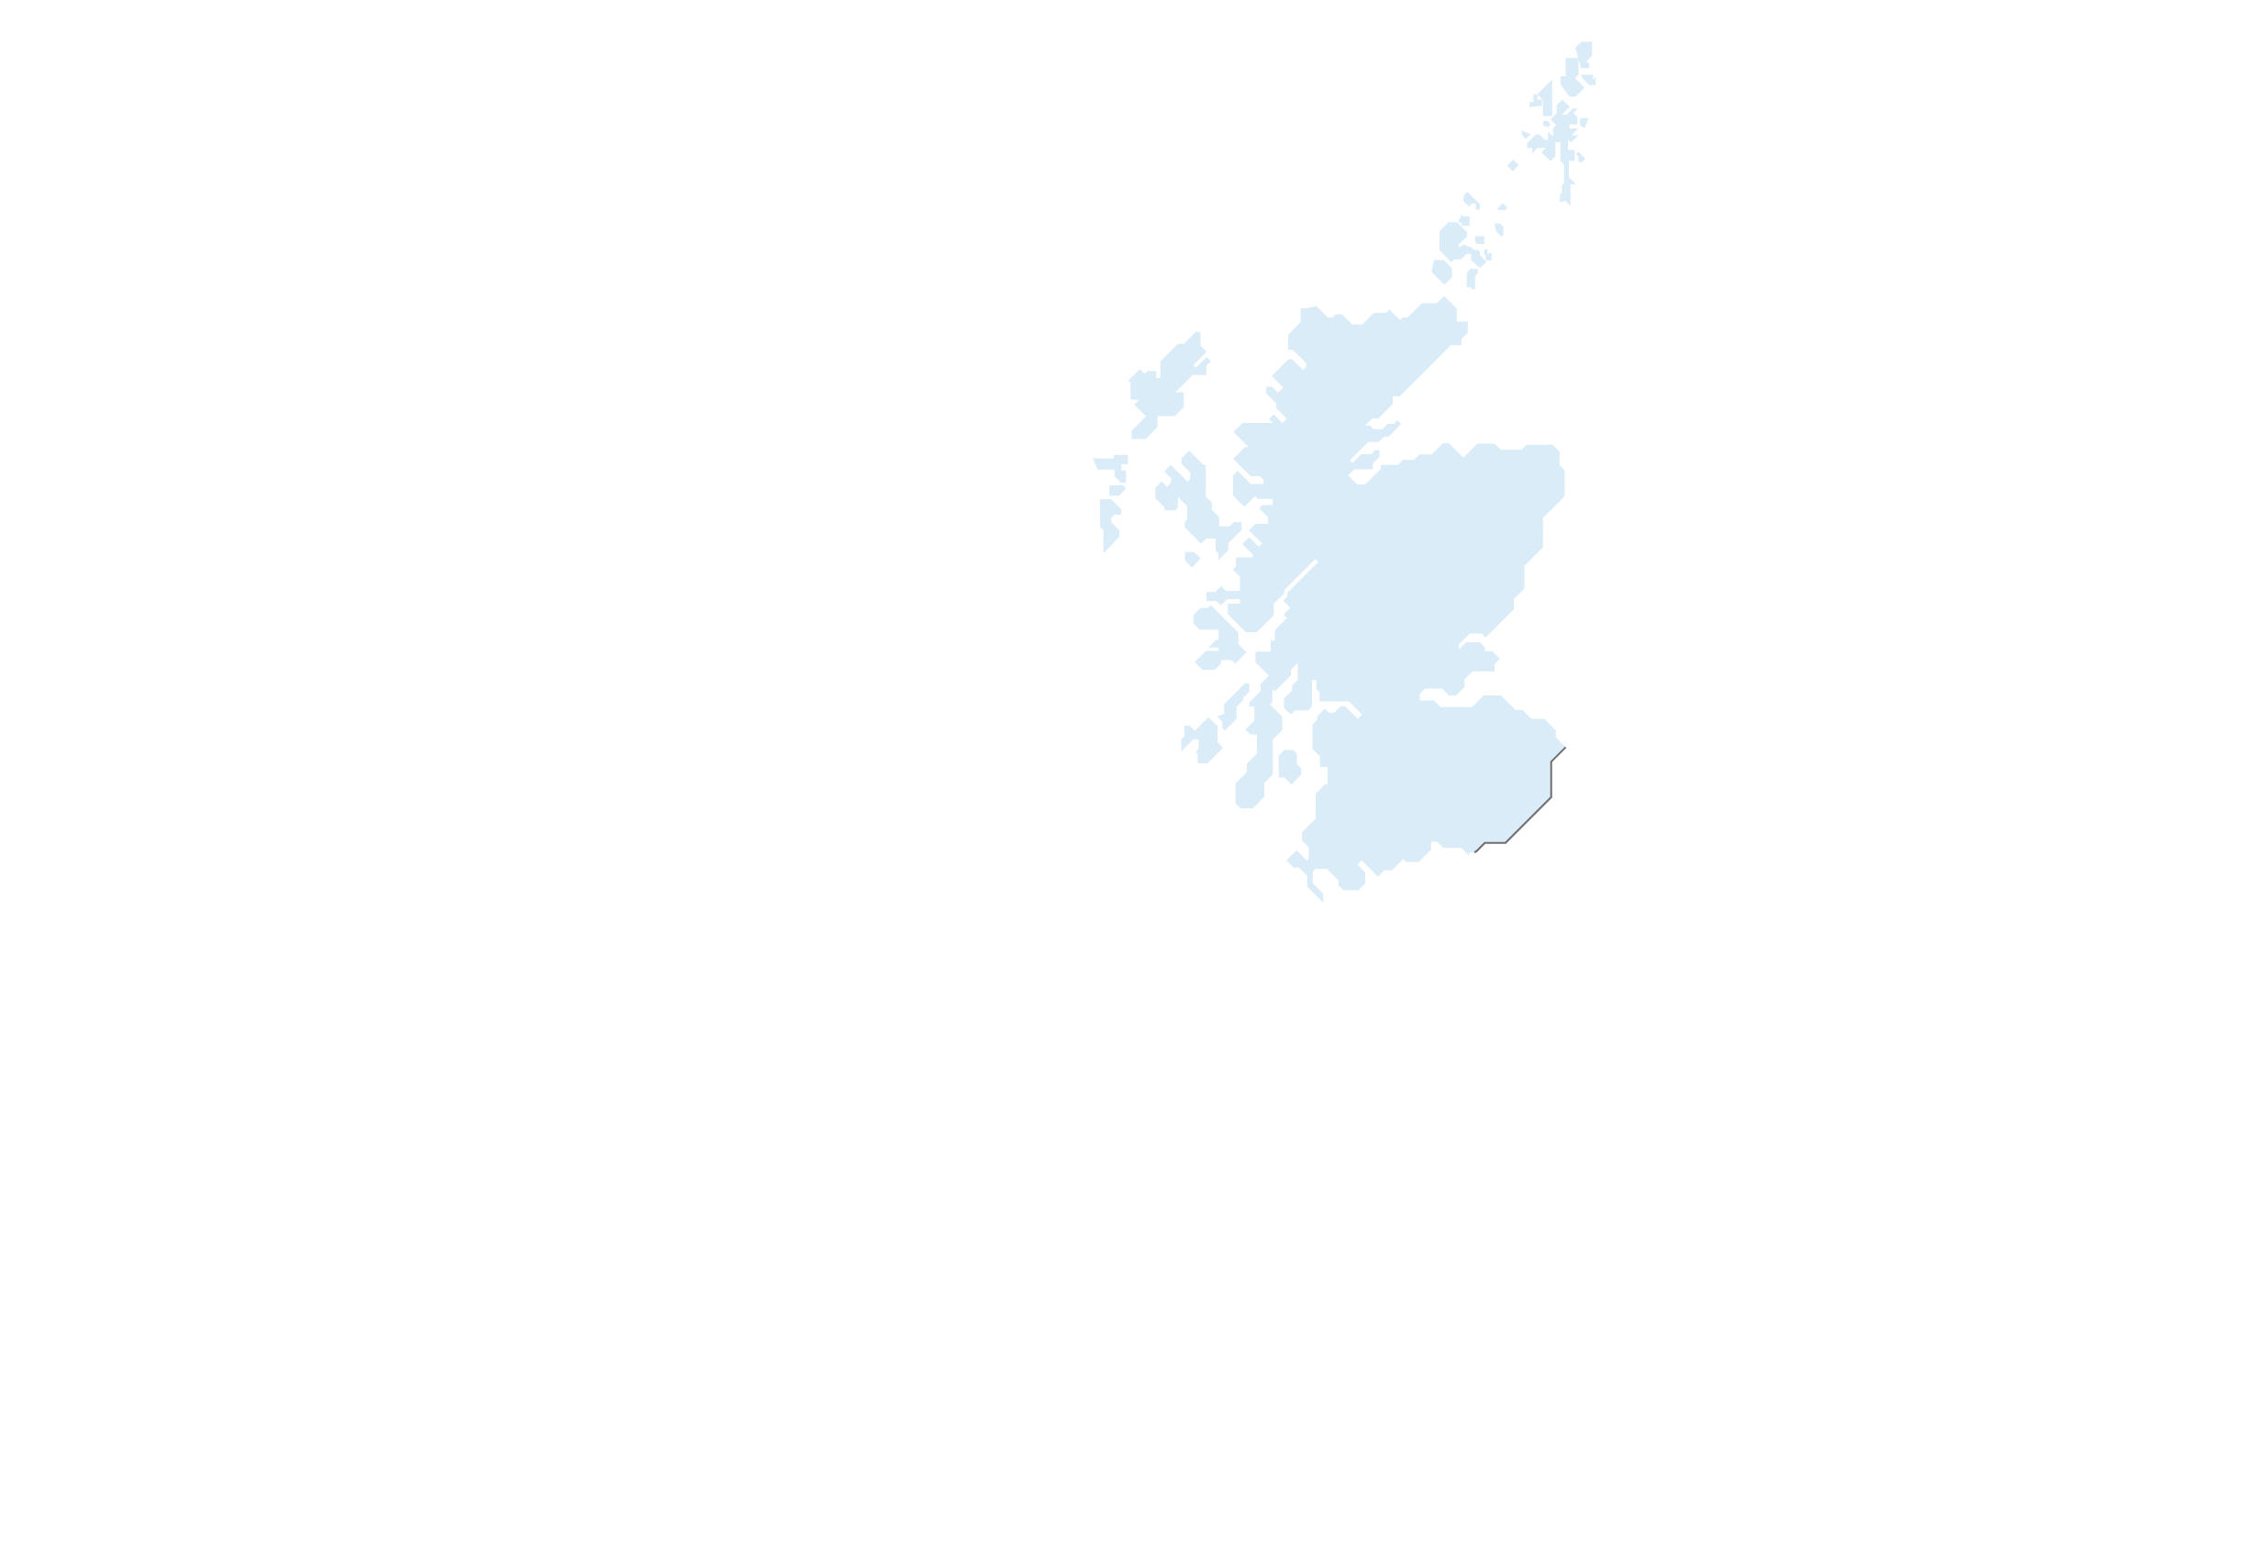






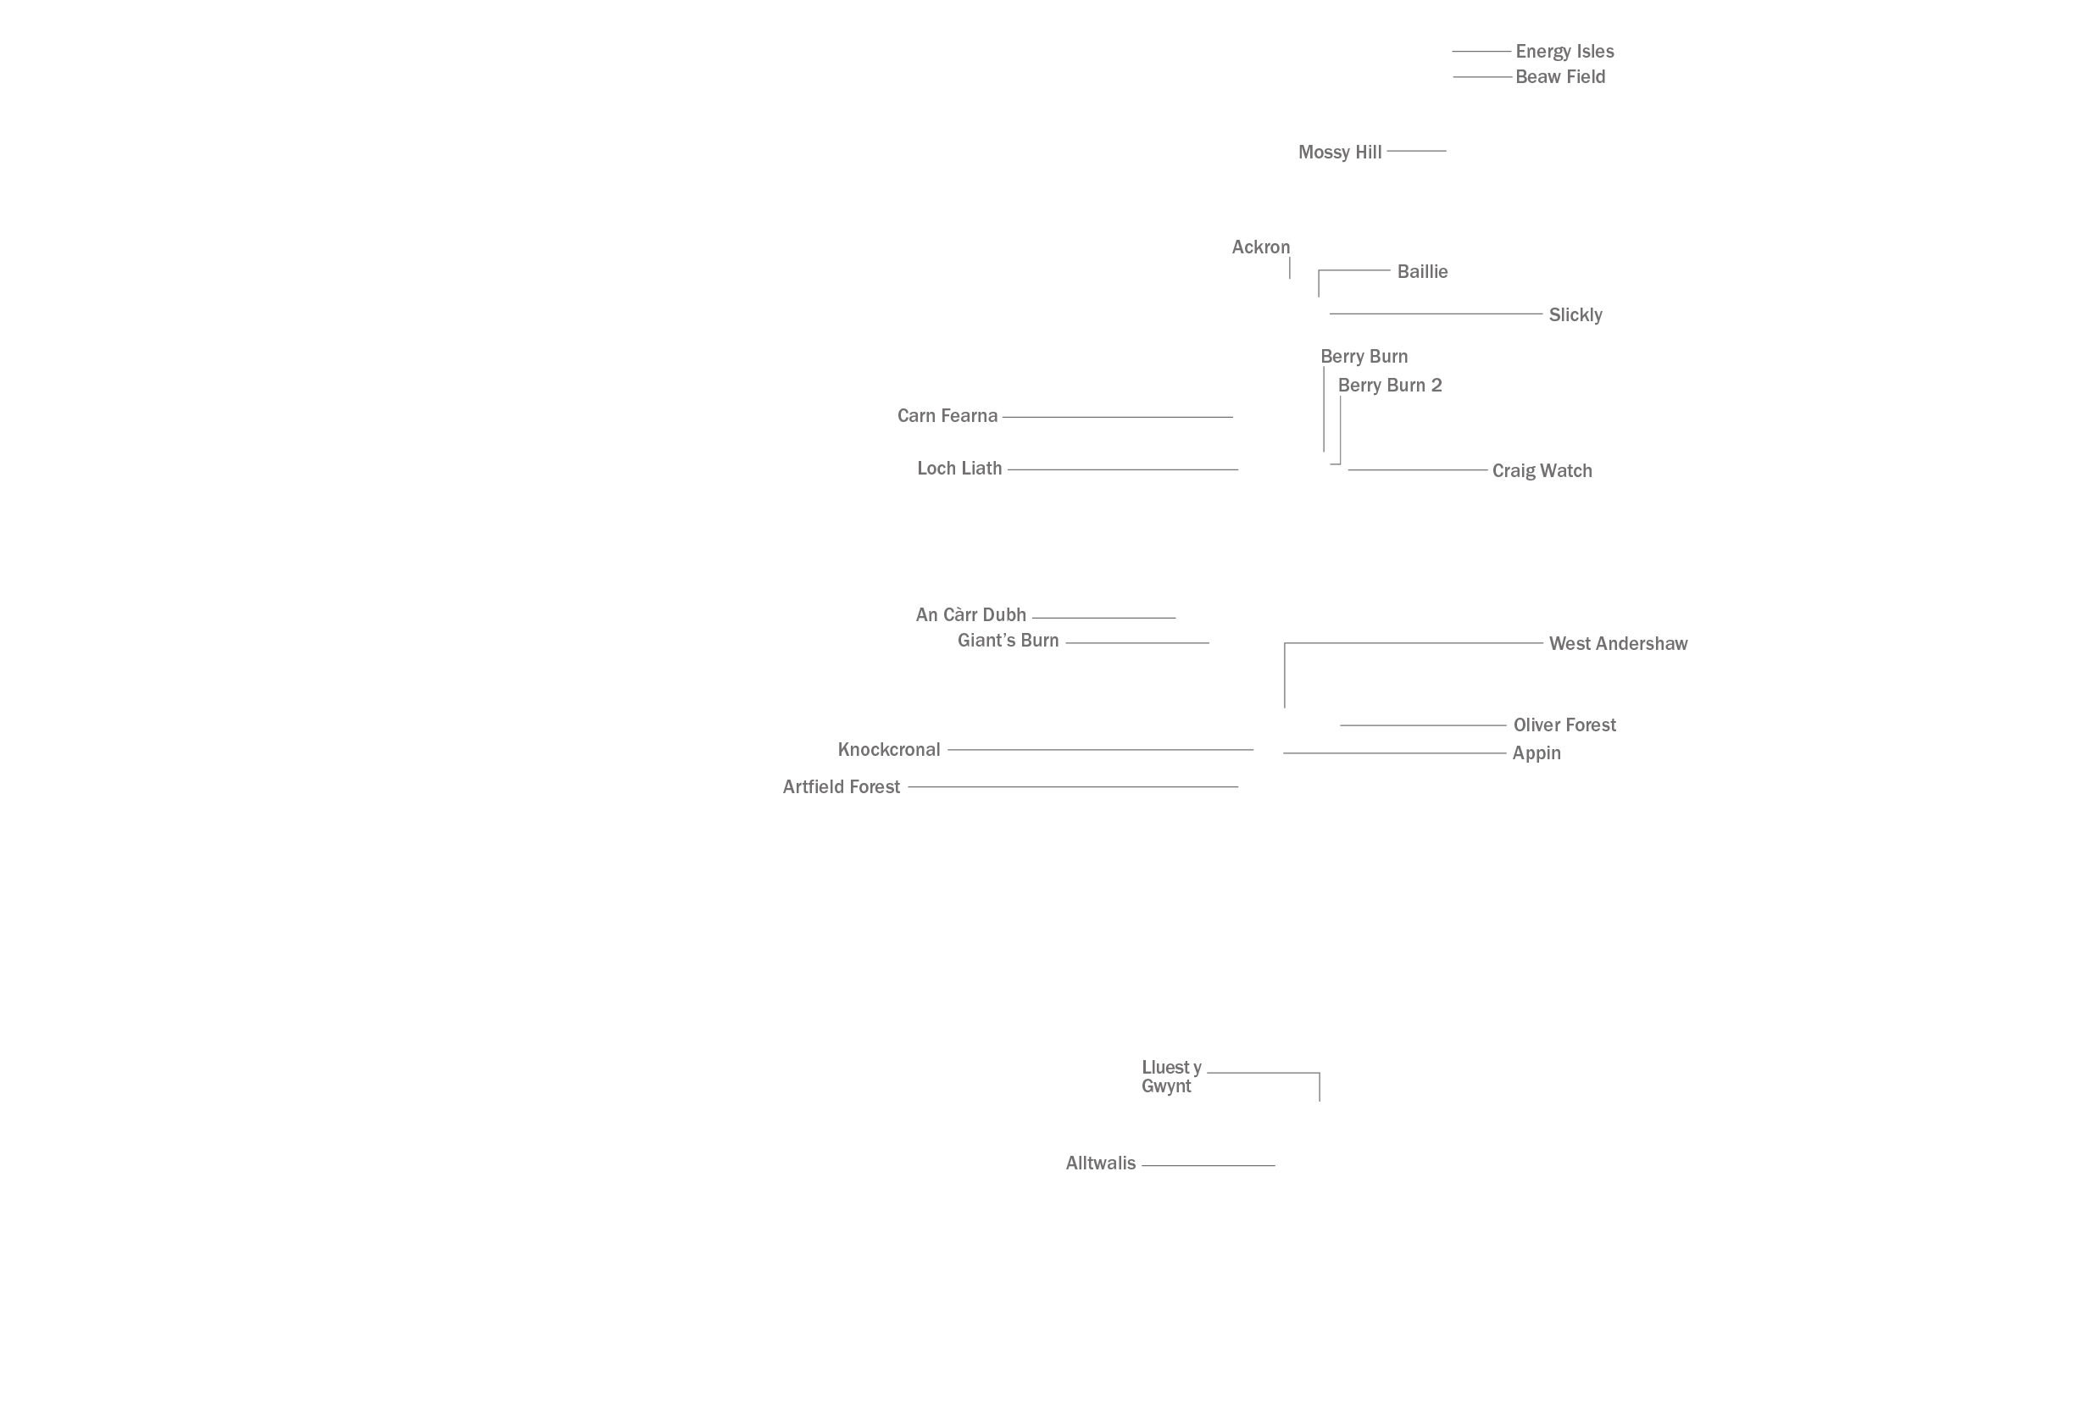




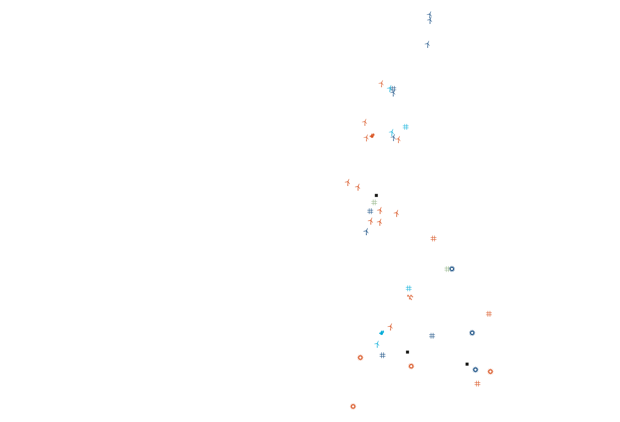



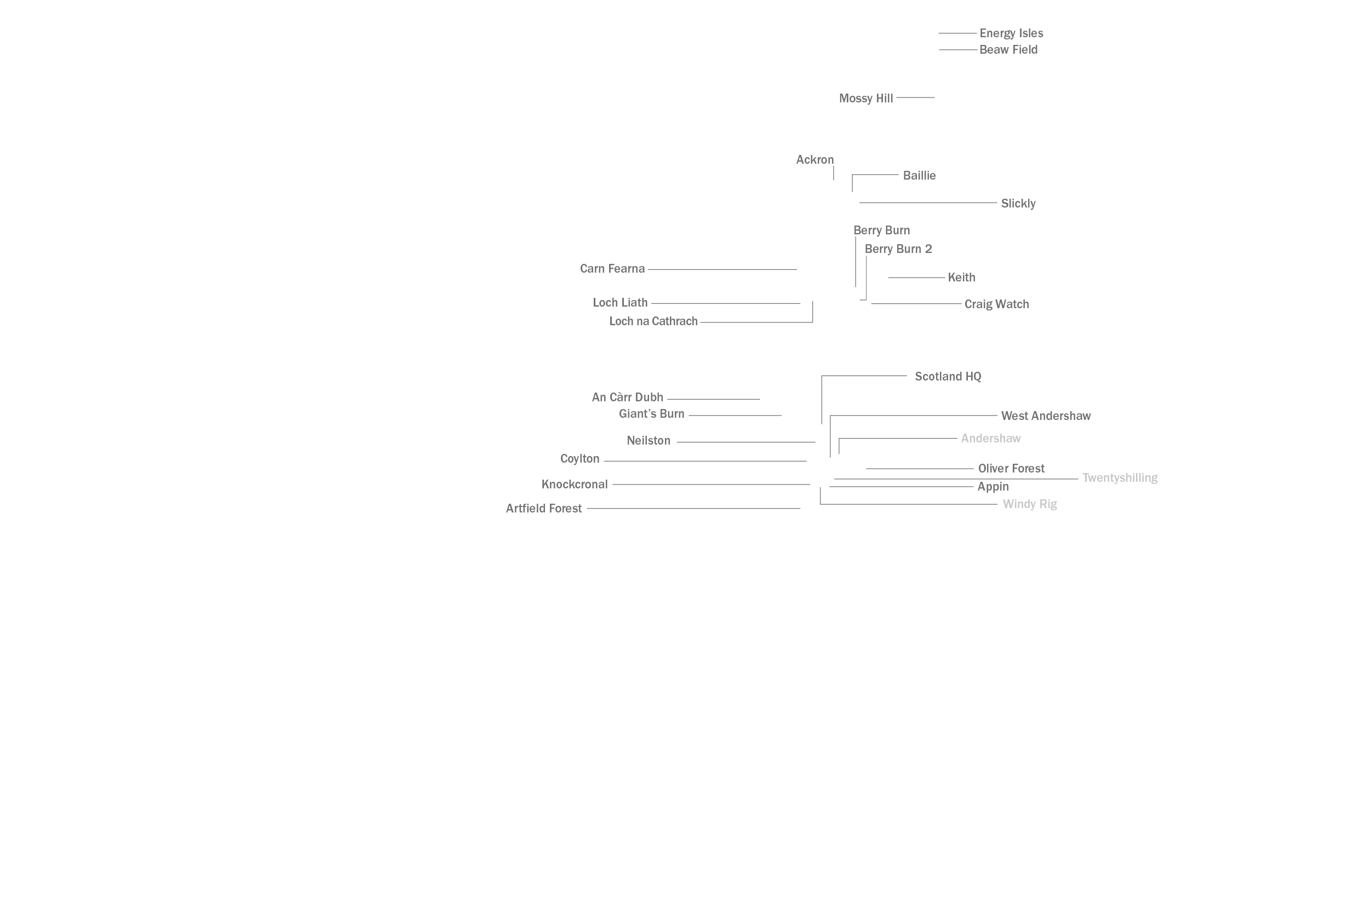

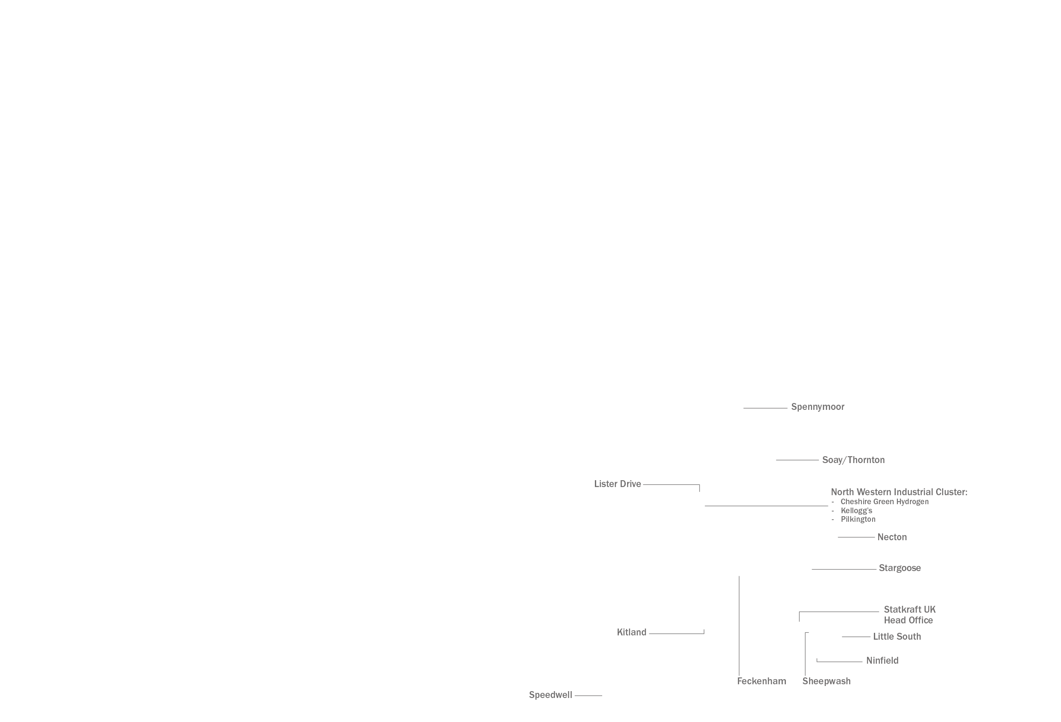



UK Projects Map
Giant’s Burn

Slide 5
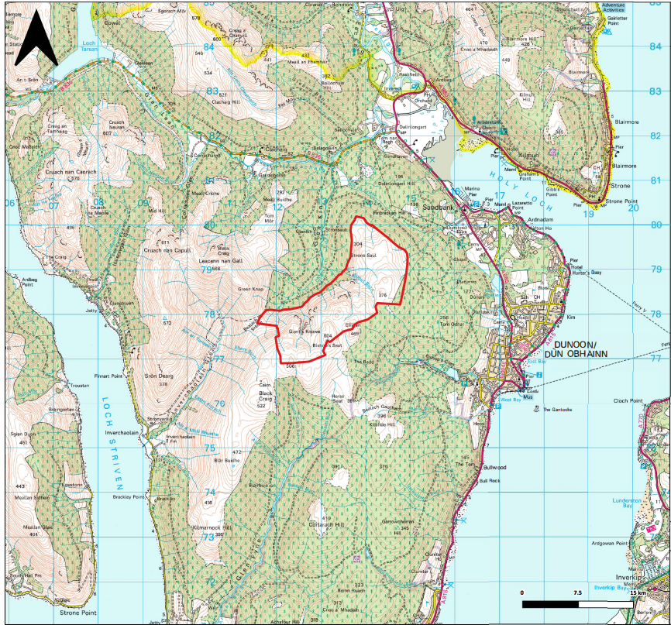
Giant’s Burn - About the Site
Project at Scoping stage, since February 2024
A maximum of 9 wind turbines
Considering turbines up to 200m tip height
Installed capacity > 50MW
Considering co-location of battery storage to maximise the potential of the green electricity produced

Slide 6
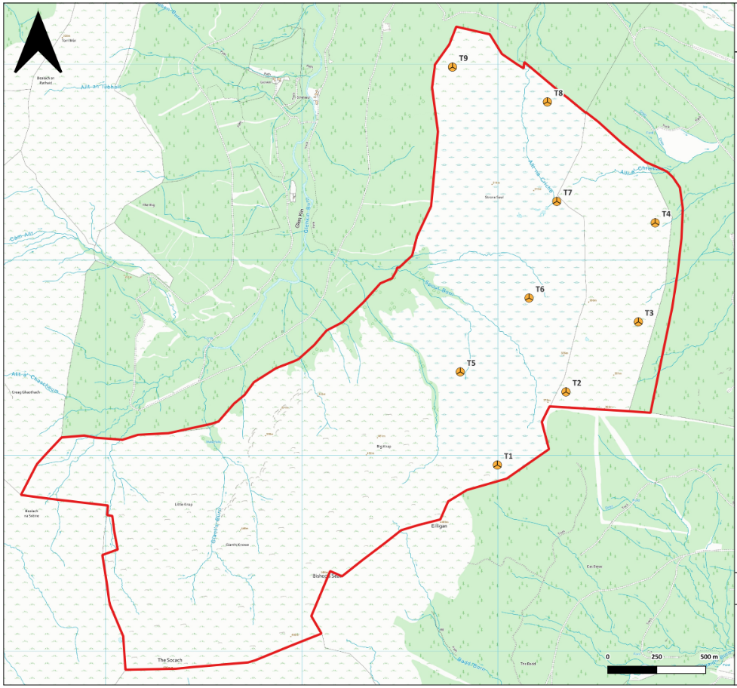
About the Site
Scoping layout as shown
Turbine numbers, tip heights and locations still to be fixed
Design and layout evolving based on:
  the findings of ongoing baseline studies
  consultation feedback
  future design milestones

Slide 7
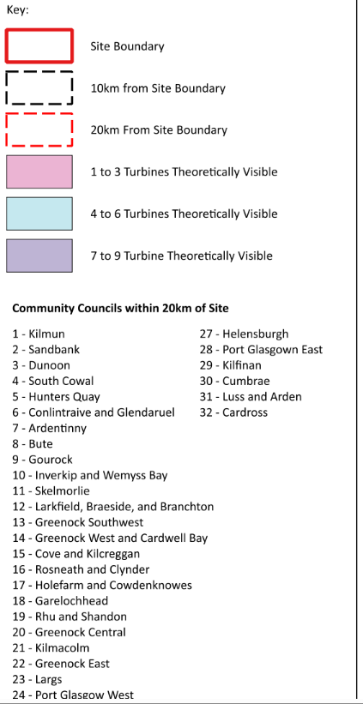
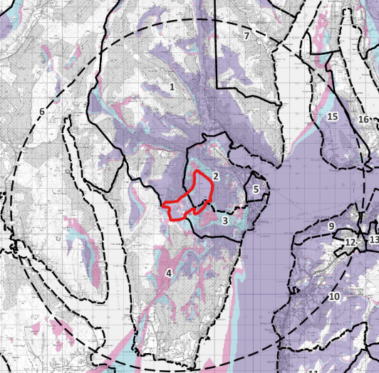
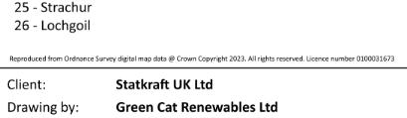
Public Consultation – Community Council Engagement
Host Community Councils:
  Dunoon
  Sandbank
  Kilmun
Wider engagement:
  South Cowal
  Hunter’s Quay
  Cove & Kilcreggan
Keep Informed, Argyll & Bute, Inverclyde:
  Helensburgh
  Cardross
  Gourock
  Inverkip & Wemyss Bay

Slide 8
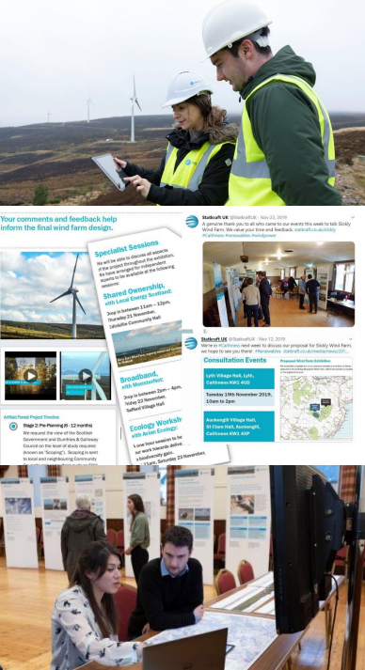
Public Consultation – Overview
First online & physical public consultation events complete
  Online 15 April to 5 May
  In-person events 24 and 25 April
    Innellan, Dunoon, Kilmun and Cove
We wrote to over 10,000 homes & business in Argyll & Bute
Nearly 400 people attended the in-person events
Over 440 feedback cards received to date
  Last date for feedback for first round of exhibitions was 25 May
  But we are happy to receive feedback throughout the development

Slide 9
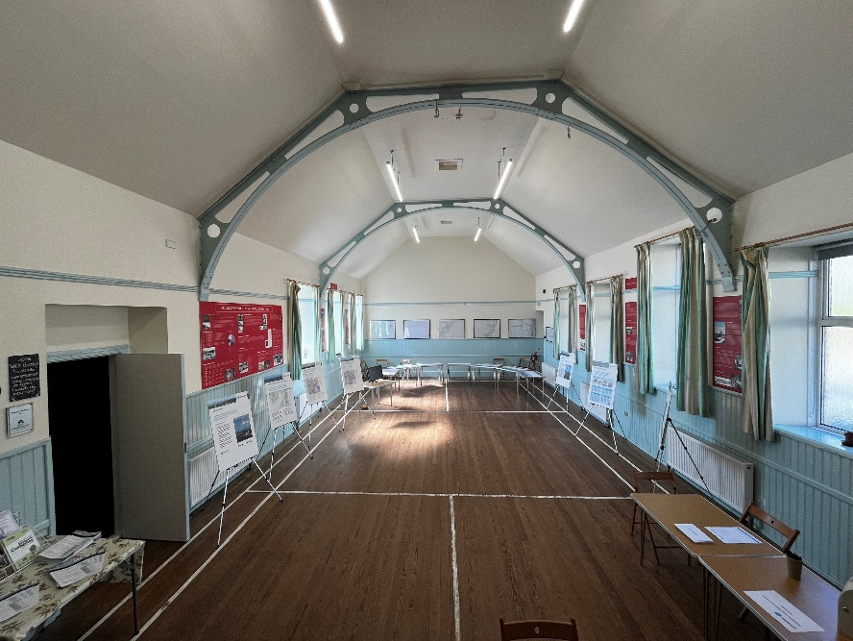
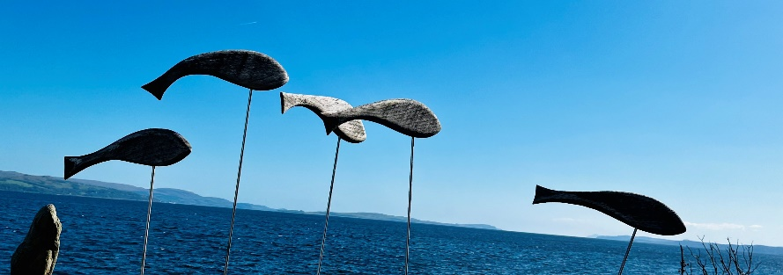
Public Consultation – Key Themes
Landscape and Visual
Community Benefit
Community Shared Ownership
Tourism and other Socio-Economic impacts
Grid Connection Route
Recreational access
Transport route and access to site
Ecology & Ornithology

Slide 10
Public Consultation – Overview
Initial results from the feedback reveal the following: | Yes | No | Unsure | No response/prefer not to say
Do you think that the country needs to generate more electricity from renewable sources? | 73% | 19% | 6% | 2%
Do you agree that onshore wind is a good way to help achieve this? | 43% | 45% | 11% | 2%
Do you think this site is an acceptable location for a wind farm? | 32% | 55% | 13% | 0.45%
We will explore the potential to assist in bringing improved broadband to the area. Is this of interest to you? | 41% | 47% | 9% | 3%
We are open to offering shared ownership on our projects. If this project went ahead, would this be of interest? | 29% | 52% | 18% | 1%

Slide 11
Next Steps: 2024-2025
Ongoing feasibility studies
Further engagement with Community Councils
Respond to online and feedback and produce consultation report
Complete and share Broadband feasibility study
Encourage local businesses to register on our Supplier Register
Second set of public exhibitions in early 2025
Aiming to submit into Planning 2025

Slide 12
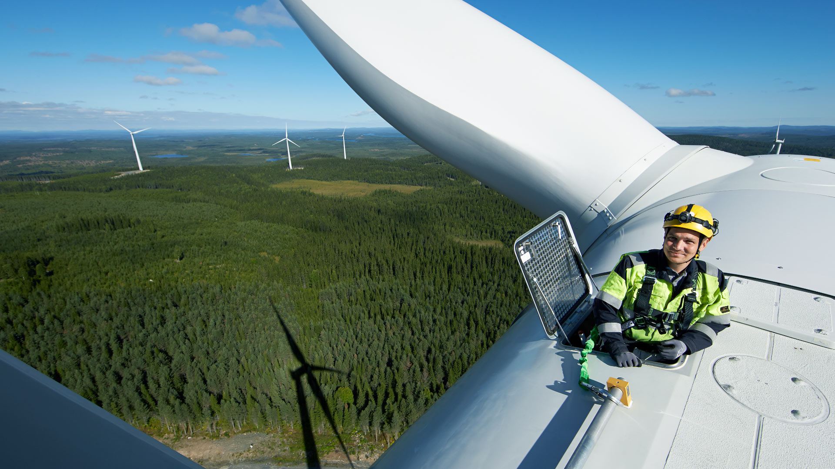
Iain Robertson
Iain.Robertson@statkraft.com
Ruth Semple
Ruth.Semple@statkraft.com
statkraft.co.uk www.giants-burn.co.uk

