Slide 1


2026 – 2027 Edition
Mr. Briganti – grade 5
Please sign in.
Take a copy of tonight’s presentation.

Slide 2


Reside in Oxford, CT
Born in Stamford, grew up in Trumbull, CT
High School - Fairfield Prep
University of Connecticut – Business degree
Sacred Heart Univ. - Master’s degree (MBA)
Business World – 15 years
Purposeful career change in 2009
Student Teaching, Frenchtown Elementary School, Trumbull, CT
Professional Teaching Certification K-6 & Master’s degree
17th Year Teaching
New Haven:
Brennan Rogers Technology & Communications Magnet School
Derby:
Irving School, 2016 District Teacher of the Year
Shelton:
10th year at Perry Hill School
Married (24 years)
Daughter - third year of college. Go Stags!!!
1 dog – Rocky (Australian Shepherd)
Enjoy fitness, cars, spending time with family & friends.

Slide 3







PHS
Back To School Night!
September 22, 2026

Slide 4
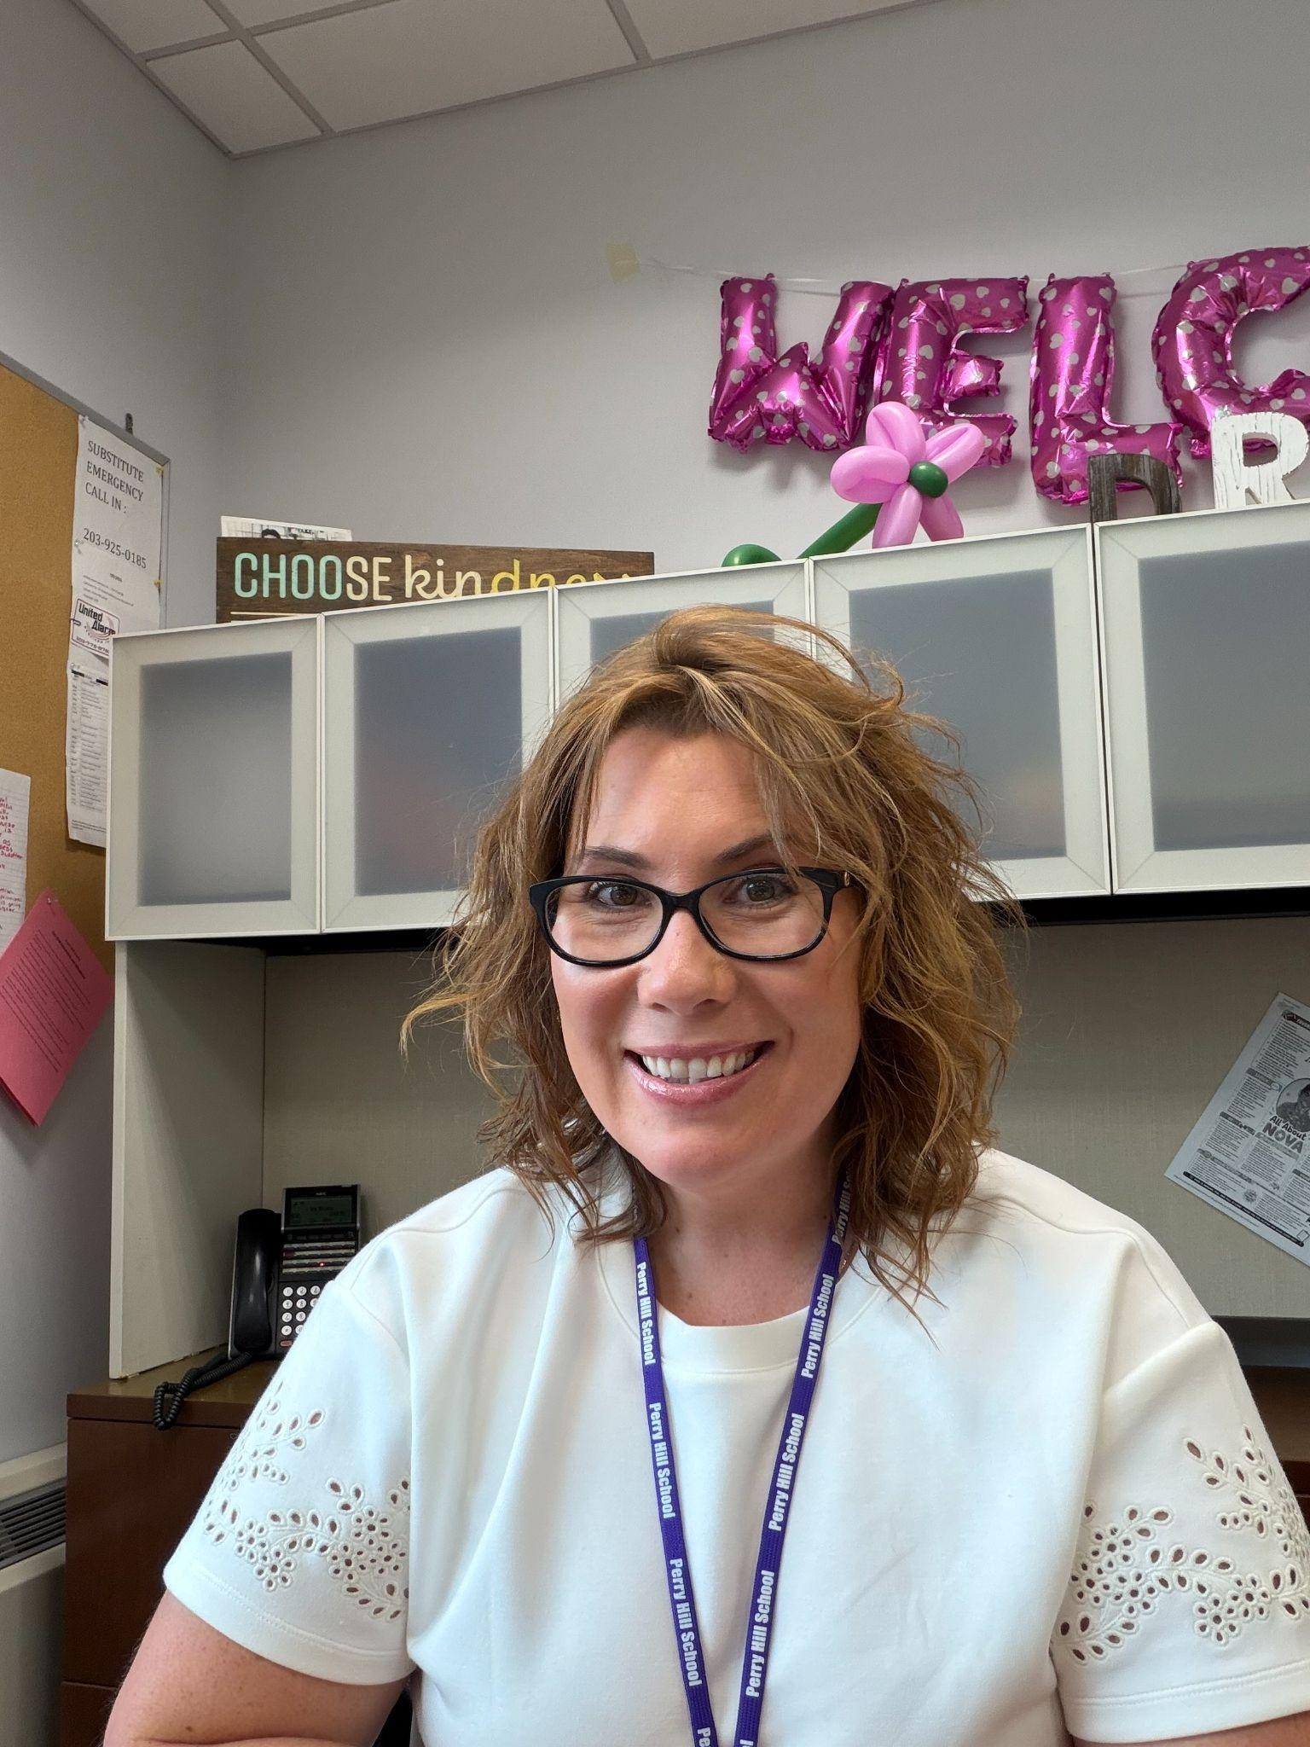
Welcome to Perry Hill!
We are so excited to welcome our Perry Hill families to the 2026–2027 school year!
Tonight is a wonderful opportunity to connect, learn more about your child’s school experience, and build the strong partnership between home and school that helps our students thrive.
Thank you for being here and for your continued support of our students and our Perry Hill community. We are looking forward to an amazing year together!
-Ms. Victoria Sargeant
Interim Principal

Slide 5

Attendance Matters
1
Start Time 8:15 am
At the upper elementary level, stakes are higher. Elementary schools are the foundation for reading, writing, and mathematics. If a student misses a significant amount of school, they may lack the foundational skills needed to advance to the next grade level.
2
All Absences Count
This includes excused absences, unexcused absences, mental health wellness days, and disciplinary absences/suspensions.
3
Need To Miss School?
Call the main office at 203-924-4002. Follow up with a note or medical documentation with the reason for the office.

Slide 6

Chromebooks
Every student at PHS will be assigned a chromebook.
Chromebooks will be kept at school overnight.
Students will not be allowed to bring chromebooks home.
Homework/Independent Practice will require little to no use of technology.
We HIGHLY RECOMMEND purchasing the chromebook protection fee!

Slide 7



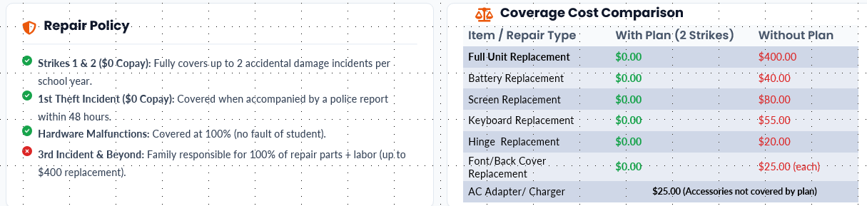
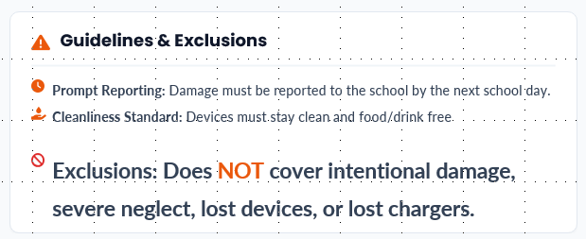
1:1 Chromebook Protection Fee Guide
Shelton Public Schools • 2026–2027 School Year Coverage (August 31 – June 30)
How to Pay & Enroll
Log into your Infinite Campus Parent Portal.
Navigate to Fees → My Accounts → Optional Payments.
Add Chromebook Protection Fee ($35) to cart & checkout.
*Instructions to sign up were sent to Parents/ Guardians via IC Message*
Financial Hardship: Waiver requests can be submitted directly to a school administrator.

Slide 8


IC Parent Portal
Teachers often relay information this way.
Grade information
Teacher links provided
Inbox message
Lunch account information
If not signed up, sign up at elementary school or when you begin at Perry Hill.
  Please see main office administrative assistant before you leave today to sign up!

Slide 9

Positive Behavior Supports
Be Respectful
Be Responsible
Be Safe
We challenge students to be safe and kind as well as responsible and respectful citizens of the school and community.
Student of the Month
Gold Card
Rewards

Slide 10





Morning Meeting
Occurs daily for
15-19 minutes
Prioritizes teacher-student
and peer-to-peer relationships.
Fosters student self-awareness, self-management, social awareness, relationship skills, responsible decision-making, student voice and choice.

Slide 11
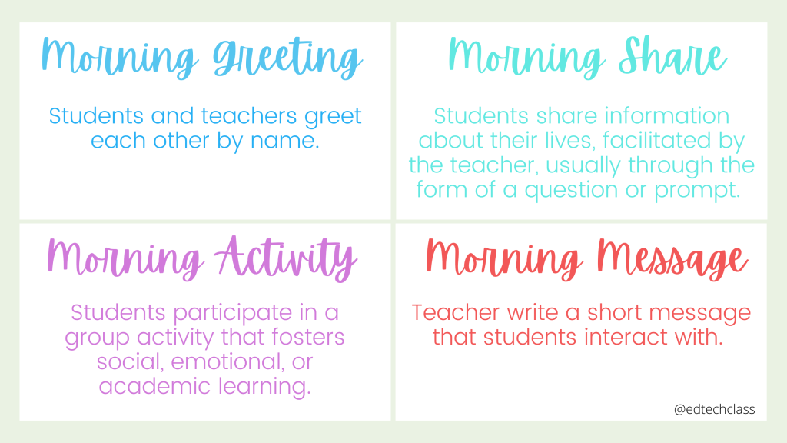
4 Core Components

Slide 12

class schedule
8:15 – 8:34 Morning Meeting
8:36 – 9:12 WIN
9:13 – 9:48 SPECIAL (Health or Art)
9:49 – 10:24 Math Block #1
10:25 – 11:00 Math Block #2
11:01 – 11:31 LUNCH
11:32 – 11:52 RECESS
11:54 – 12:29 ELA Block #1
12:45 – 1:05 ELA Block #2
1:06 – 1:41 Gym or Small Group
1:43 – 2:18 Science / Social Studies – Block 1
2:20 – 2:55 Science / Social Studies – Block 2

Slide 13
Tonight’s Schedule
HR
6:00 – 6:10
HR /Morning Meeting
P1
6:10 – 6:20
W.I.N. – School Counselor: Mrs. Mackniak
P2
6:20 – 6:30
Special – Art: Mrs. Giordano
P3
6:30 – 6:40
Math – Block 1
P4
6:40 – 6:50
Math – Block 2
P5
6:50 – 7:10
Lunch / Recess
P6
7:10 – 7:30
Go to Room 322: ELA – Mrs. Sedlock
P7
7:30 – 7:40
Gym: Mr. Porto
P8
7:40 – 7:50
Science / Social Studies
P9
7:22 – 7:30
Science / Social Studies
Thank you for attending!

Slide 14

5th Grade – A Turning Point in Learning & Student Development
Students will reinforce the skills they have gained in the primary grades and develop new skills in preparation for middle school.
Students will learn to think and analyze in deeper ways.
Students are encouraged and expected to be more independent in their learning, requiring less guidance and support from adults and teachers.

Slide 15
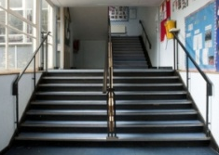
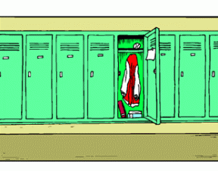





At PHS… we show Respect, Responsibility, and Safety everywhere we go!
PBIS: Positive Behavioral Interventions & Supports
Hallways & Stairways
Lockers
Cafeteria
Recess
Bathroom
Assemblies
Dismissal
I move quietly and stay to the right in a straight line.
I gather my belongings quietly and do not interfere with other peer’s space.
I talk with quiet voices, use table manners, and I am courteous.
I play fair by treating everyone with respect and kindness.
I maintain privacy and keep areas clean.
I listen politely and respond kindly to presenters .
I pay attention during bus calls and move quietly through the hallways
I am… Respectful
I always have a pass and I go directly to my destination.
I keep my combination private and keep my locker organized.
I follow procedures for getting lunch and clean up.
I line up when time is up and return all equipment.
I use my time wisely.
I keep appropriate personal space.
I make sure to have all personal items that need to be brought home.
I am… Responsible
I take one step at a time and walk at an appropriate pace.
I use lockers properly and lock them when I am done.
I stay seated and eat my own food.
I use equipment or games appropriately.
I wash my hands with soap.
I follow procedures for entering and exiting.
I walk at an appropriate pace and keep my hands and feet to myself.
I am… Safe

Slide 16


PBIS “Gold Card” Initiative
A student is chosen each month by their homeroom teacher and their peers.
Demonstrates consistent effort in all subject areas.
Shows a willingness to try, even when unsure about a skill or concept.
Exhibits positive behavior throughout the day.
Consistently shows respect to adults and peers.
Demonstrates a willingness to help peers and work cooperatively with others.
Consistently completes class and homework assignments on time
Gathers all necessary materials from lockers during designated time.
Is a role model for others
Privileges:
First in line in the Cafeteria
No hall passes needed
Called first to the buses
Coupon Book:
No homework pass
Lunch in the courtyard or conference room w/ friends
Game Room with a friend during recess

Slide 17






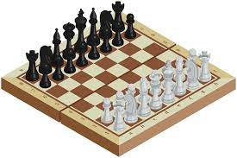








Slide 18



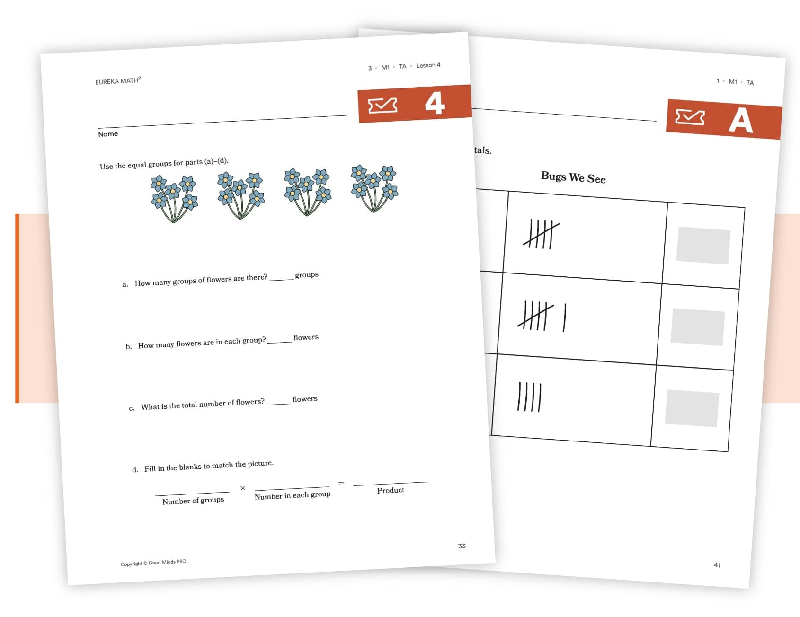
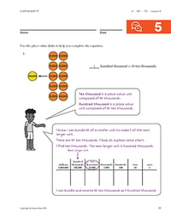

Our 5th Grade Math Curriculum!

Slide 19
Module 1 – Place Value Concepts for Multiplication & Division (Whole Numbers)
Module 2 – Addition and Subtraction with Fractions
Module 3 – Multiplication and Division with Fractions
Module 4 – Place Value Concepts for Decimal Operations
Module 5 – Addition and Multiplication with Area and Volume
Module 6 – Foundations to Geometry in the Coordinate Plane

Slide 20


Our 5th Grade Science Curriculum!
Unit 1 - Space Systems
Unit 2 - Earth Systems
Unit 3 - Structure and Properties of Matter
Unit 4 - Matter and Energy in Organisms and Ecosystems

Slide 21

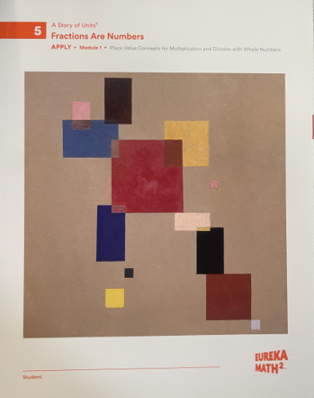

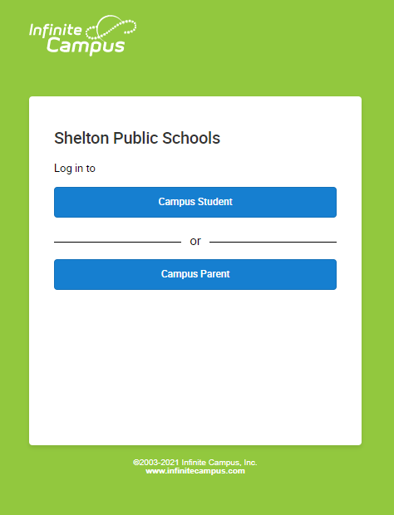
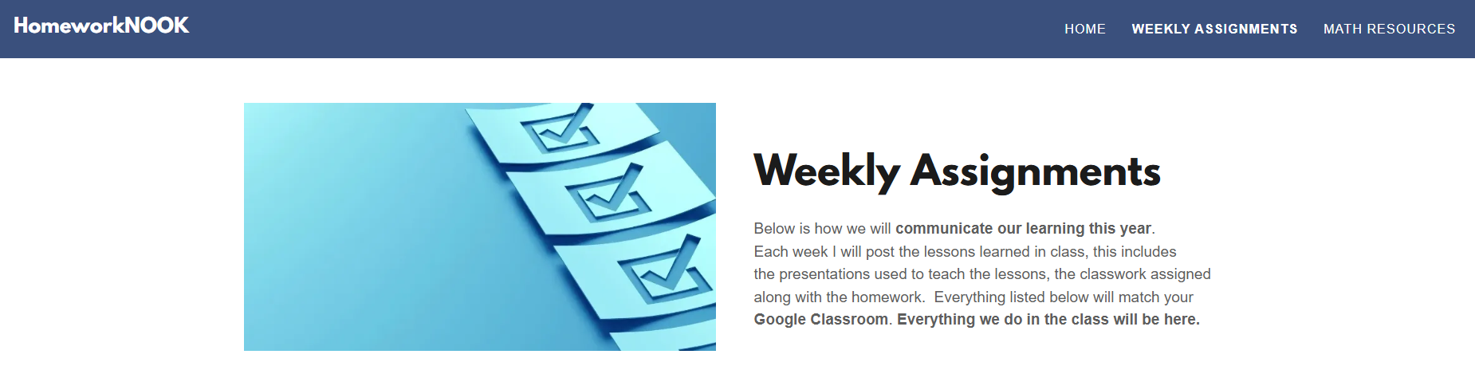


Virtually Connected
Apply Book, Google Classroom, Infinite Campus & Classroom Website
www.homeworknook.com

Slide 22


Grade weight
Math & Science
Level 2 Tests: 45%
Level 1 Quizzes: 35%
Independent Practice: 20%
80% is based on academic performance.
20% is based on effort through independent practice.

Slide 23
Grade Types
Level 2
Tests
Level 1
Quizzes
Independent practice
End-of-Module Assessments (scored out of 100%)
“Level 2 –Module 1 Test”
GRASP
Project-based assessments
Goal
Role
Audience
Situation
Product/Performance
Topic Quizzes
“Level 1 – Module 1 – Topic A Quiz”
HOMEWORK: Apply book
(at least 1 per week)
“IP – Homework Week of Sept X”
EXIT TICKETS: Classwork after a lesson
Learn book
“IP – Exit Ticket #”
(all of these are scored on a 0-to-4point scale)

Slide 24

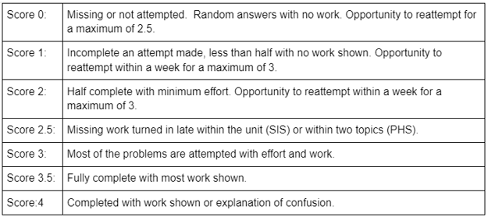
Grade Types
Independent practice
25%
50%
63%
75%
88%
100%

Slide 25
Raw ScoreS vs Adjusted ScoreS
Proficiency
Highly proficient
Proficient
Inconsistently Proficient
Partially Proficient
Partially Proficient
Partially Proficient
Partially Proficient
Not yet proficient
Not yet proficient
Not yet proficient
Not yet proficient
Not yet proficient
Not yet proficient
Not yet proficient
Raw Score
93 – 100%
80 - 92
70 - 79
60 - 69
50 - 59
40 - 49
36 - 39
30 - 35
25 - 29
20 - 24
15 - 19
10 -14
5 - 9
0 - 4
Adjusted Score
No change
No change
No change
69 %
67
65
63
59
57
55
53
50
47
45

Slide 26
Grading & report cards
Letter Grade Scale
A+ 4.33
A 4.00
A- 3.67
B+ 3.33
B 3.00
B- 2.67
C+ 2.33
C 2.00
C- 1.67
High Honors 3.67 or higher
Honors 3.33 – 3.66
All grades are submitted electronically through Infinite Campus.
Please make sure you have access to the Parent Portal.
High Honors and Honors based on overall GPA.

Slide 27


assessments
Core Math Program for Shelton District
Every Lesson – Exit Ticket
Every Topic – Post-test (4 or 5 lessons per Topic)
Every Module – End of Module Test (16 lessons per Module)
Diagnostic & Weekly Skills
(SBAC) State-wide assessments

Slide 28
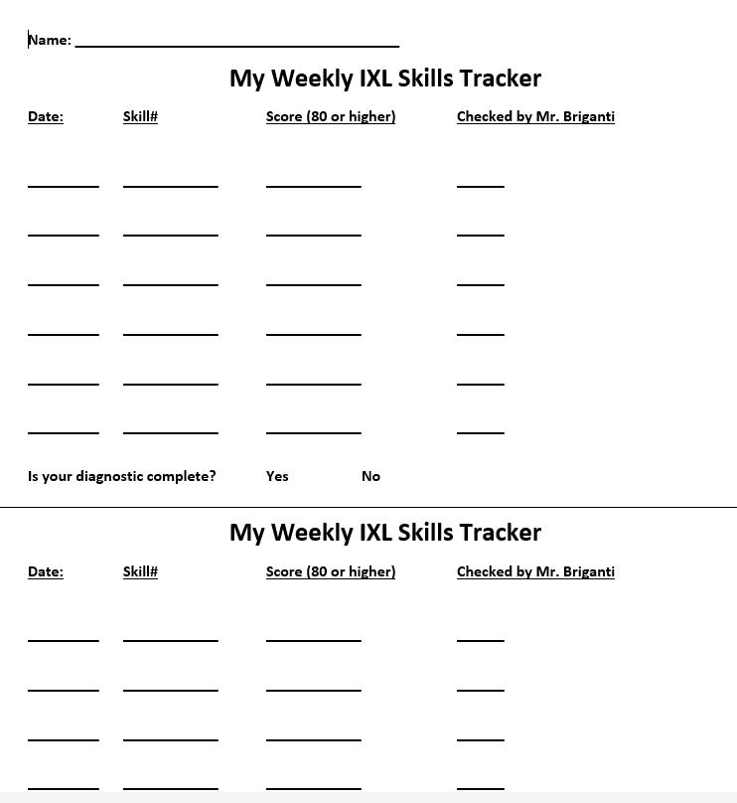
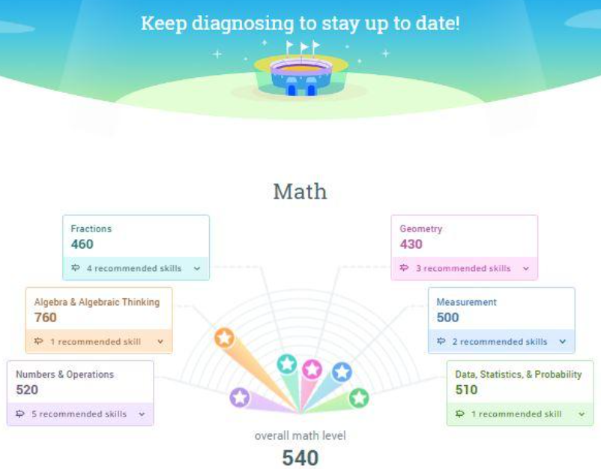

Slide 29

Questions or concerns ?

Slide 31
2026 – 2027 Edition
Mr. Briganti – grade 5
Please sign in.
Take a copy of tonight’s presentation.

Slide 32
Reside in Oxford, CT
Born in Stamford, grew up in Trumbull, CT
High School - Fairfield Prep
University of Connecticut – Business degree
Sacred Heart Univ. - Master’s degree (MBA)
Business World – 15 years
Purposeful career change in 2009
Student Teaching, Frenchtown Elementary School, Trumbull, CT
Professional Teaching Certification K-6 & Master’s degree
17th Year Teaching
New Haven:
Brennan Rogers Technology & Communications Magnet School
Derby:
Irving School, 2016 District Teacher of the Year
Shelton:
10th year at Perry Hill School
Married (24 years)
Daughter - third year of college. Go Stags!!!
1 dog – Rocky (Australian Shepherd)
Enjoy fitness, cars, spending time with family & friends.

Slide 33
Our 5th Grade Math Curriculum!

Slide 34
Module 1 – Place Value Concepts for Multiplication & Division (Whole Numbers)
Module 2 – Addition and Subtraction with Fractions
Module 3 – Multiplication and Division with Fractions
Module 4 – Place Value Concepts for Decimal Operations
Module 5 – Addition and Multiplication with Area and Volume
Module 6 – Foundations to Geometry in the Coordinate Plane

Slide 35
Our 5th Grade Science Curriculum!
Unit 1 - Space Systems
Unit 2 - Earth Systems
Unit 3 - Structure and Properties of Matter
Unit 4 - Matter and Energy in Organisms and Ecosystems

Slide 36
Virtually Connected
Apply Book, Google Classroom, Infinite Campus & Classroom Website
www.homeworknook.com

Slide 37
Grade weight
Math & Science
Level 2 Tests: 45%
Level 1 Quizzes: 35%
Independent Practice: 20%
80% is based on academic performance.
20% is based on effort through independent practice.

Slide 38
Grade Types
Level 2
Tests
Level 1
Quizzes
Independent practice
End-of-Module Assessments (scored out of 100%)
“Level 2 –Module 1 Test”
GRASP
Project-based assessments
Goal
Role
Audience
Situation
Product/Performance
Topic Quizzes
“Level 1 – Module 1 – Topic A Quiz”
HOMEWORK: Apply book
(at least 1 per week)
“IP – Homework Week of Sept X”
EXIT TICKETS: Classwork after a lesson
Learn book
“IP – Exit Ticket #”
(all of these are scored on a 0-to-4point scale)

Slide 39
Grade Types
Independent practice
25%
50%
63%
75%
88%
100%

Slide 40
Raw ScoreS vs Adjusted ScoreS
Proficiency
Highly proficient
Proficient
Inconsistently Proficient
Partially Proficient
Partially Proficient
Partially Proficient
Partially Proficient
Not yet proficient
Not yet proficient
Not yet proficient
Not yet proficient
Not yet proficient
Not yet proficient
Not yet proficient
Raw Score
93 – 100%
80 - 92
70 - 79
60 - 69
50 - 59
40 - 49
36 - 39
30 - 35
25 - 29
20 - 24
15 - 19
10 -14
5 - 9
0 - 4
Adjusted Score
No change
No change
No change
69 %
67
65
63
59
57
55
53
50
47
45

Slide 41
Grading & report cards
Letter Grade Scale
A+ 4.33
A 4.00
A- 3.67
B+ 3.33
B 3.00
B- 2.67
C+ 2.33
C 2.00
C- 1.67
High Honors 3.67 or higher
Honors 3.33 – 3.66
All grades are submitted electronically through Infinite Campus.
Please make sure you have access to the Parent Portal.
High Honors and Honors based on overall GPA.

Slide 42
assessments
Core Math Program for Shelton District
Every Lesson – Exit Ticket
Every Topic – Post-test (4 or 5 lessons per Topic)
Every Module – End of Module Test (16 lessons per Module)
Diagnostic & Weekly Skills
(SBAC) State-wide assessments

Slide 44
Questions or concerns ?

