Slide 1
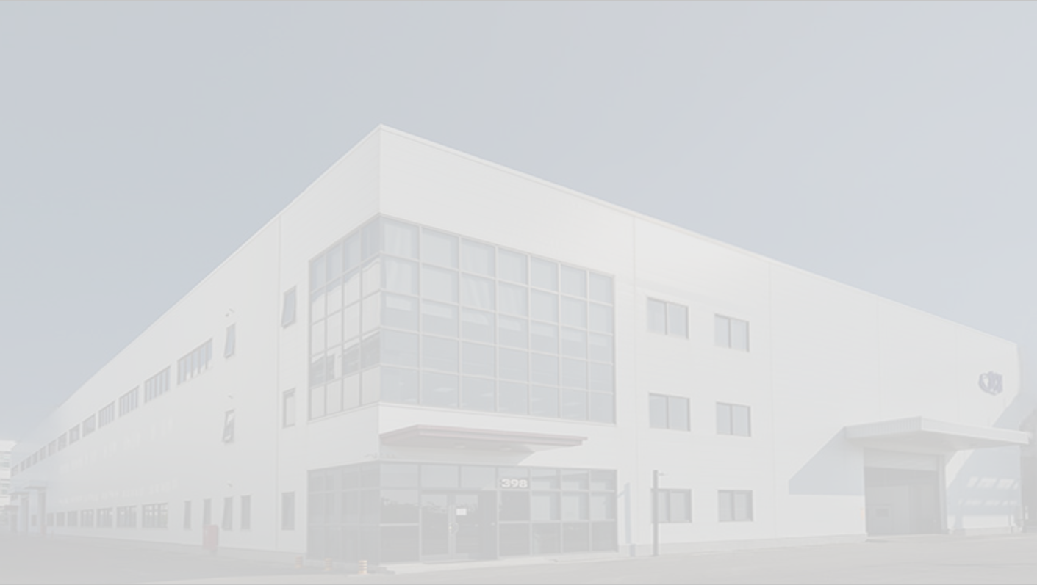

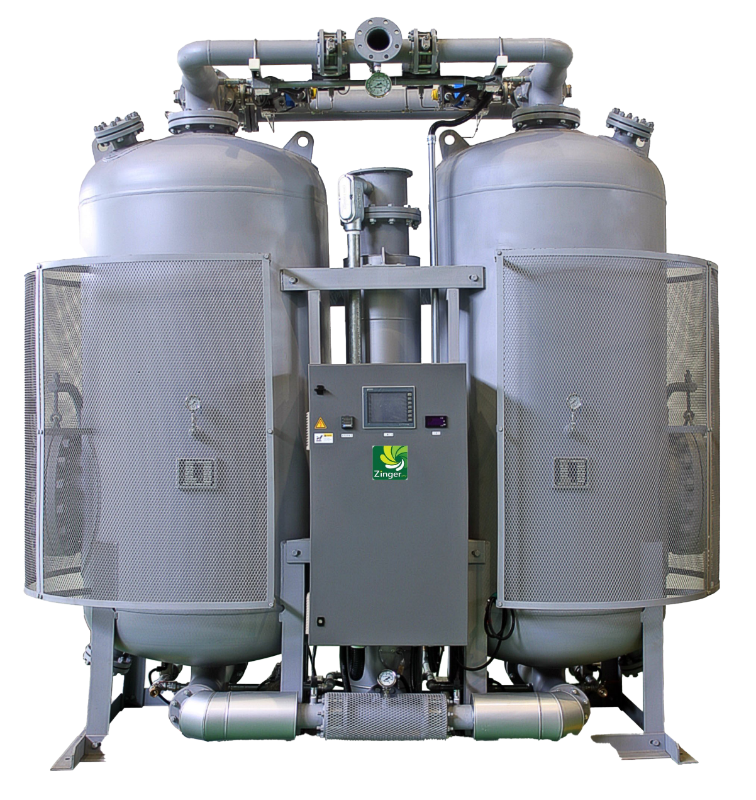
Desiccant Air Dryer
Air Purification
Proposal of Zinger Water Cooling Dryer
Corporate Overview
Updated April 2025

Slide 2
Custom Design
ESG
Energy Saving
Milestones
2008
Quan Yang established, Air cooling models launched.
2011
Sales exceeded 100 units
2012
Water cooling (Zero purge) and compression heat recovery models launched
2013
Selected for the Industrial Development Bureau and the Industrial Technology Research Institute
Energy Saving and Carbon Reduction Service Team
2018
Sales exceeded 500 units
Suzhou Shang Yang Purification Equipment Co., Ltd. & Manufacturing Center established.
2019
New factory expansion completed in Xinji Industrial Park
2020
Quan Yang Singapore Branch was established.
2025
Sales target of 1000 units achieved
Semiconductor industry market share exceeds 70%

Slide 3
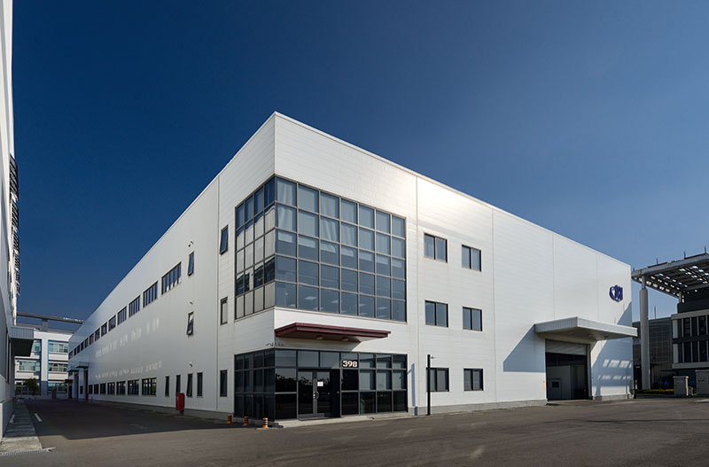
Custom Design
ESG
Energy Saving
Business Philosophy
Business Philosophy
Energy-Saving
Eco-Friendly
Consistent Fulfillment of Requirements
Quality Policy
Consistent Performance
Meeting Quality Standards
Client Satisfaction

Slide 4
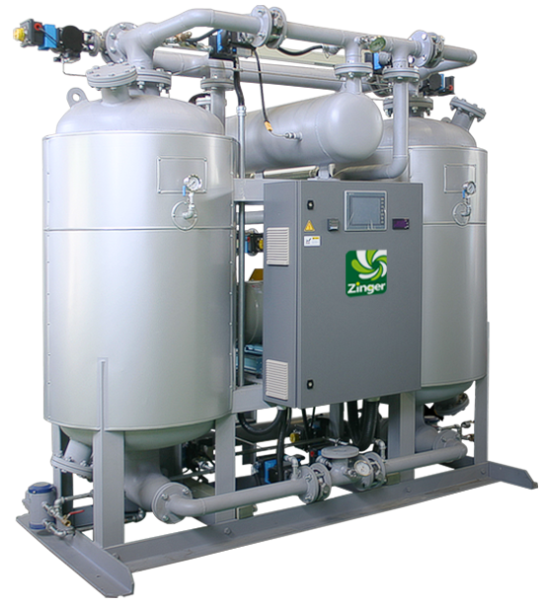
Custom Design
ESG
Energy Saving
Business Scope
1
The Manufacturing of Heated Dryer
2
Modification of Heatless Dryer
3
Installing Patented of Energy Saving Device
4
Repair, Maintenance, Parts-Replacing of Heated Dryer (24/7 on call service)
5
Planning, Design & Improve CDA System

Slide 5
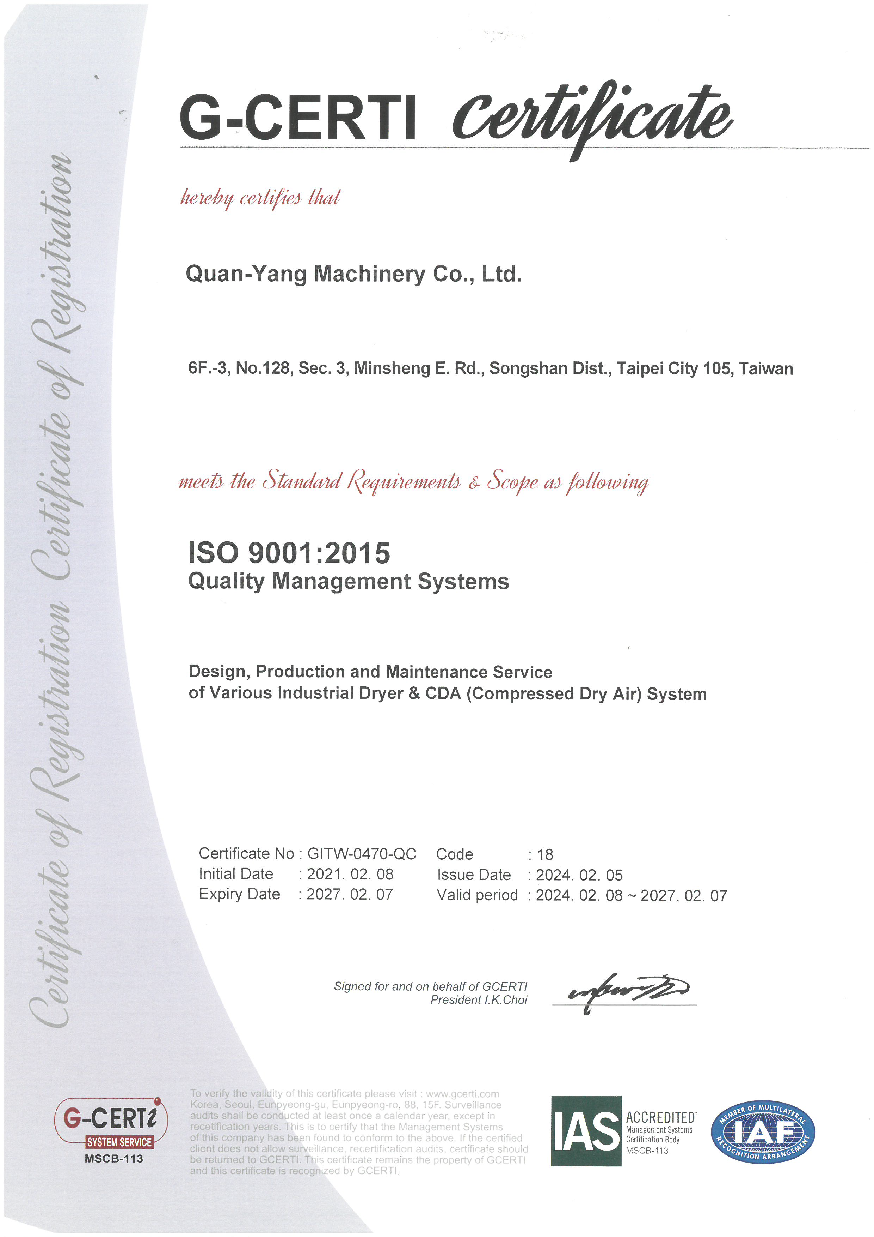
Custom Design
ESG
Energy Saving
Quality Certification
Certified for stable production quality
ISO9001:2015

Slide 6
Custom Design
ESG
Energy Saving
Specification Comparison
Model | AFE VEHDD 2217 | ZIN100WH (Water cooling -Zero Purge)
Flowrate | 8000 CMH | 8000 CMH
Dryer Inlet Temperature | 30.5 ˚C | 25.0 ˚C
Dryer Inlet Pressure | 8.0 kg/cm2 | 8.5 kg/cm2
Outlet dew point | -40 ˚C | -50 ˚C
Heater | No Info | 45.7 kW
Blower | No Info | 15.0 HP | 12.0 kW
Ave. power consumption | 61.9 kW | 26.8 kW
Chiller Power Consumption | N/A | 22.00 kW
Ave. CDA consumption | 0.0 % | 0.0 %
Desiccant volume |  | 900 kg
 | OPEX (Power)
Power Consumption (kWh) | 61.9 * 24h *365d = | 542,244.00 kW/Y | 26.8 * 24h *365d = | 234,768.00 kW/Y
Chiller Power consumption | N/A |  | 22 kW*24h*365d= | 192,720.00 kW/Y
Total Power consumption(kWh) | 542,244.00 kW / Year |  | 427,488.00 kW / Year
CAPEX (exchange rate: 1.35) |  | USD 144,380 | SGD 194,913
OPEX (Year) | SGD 103,026.36 | SGD 81,222.72
Comparison of Savings (%/SGD) |  | 26.84% | SGD 21,803.64
ROI (Year) |  | 0.9
Electricity fee | 0.19 | SGD/kWh
Cooling water cost | 0.003 | kW/m3
Chilled water cost | 1.5 | kW/m3

Slide 7
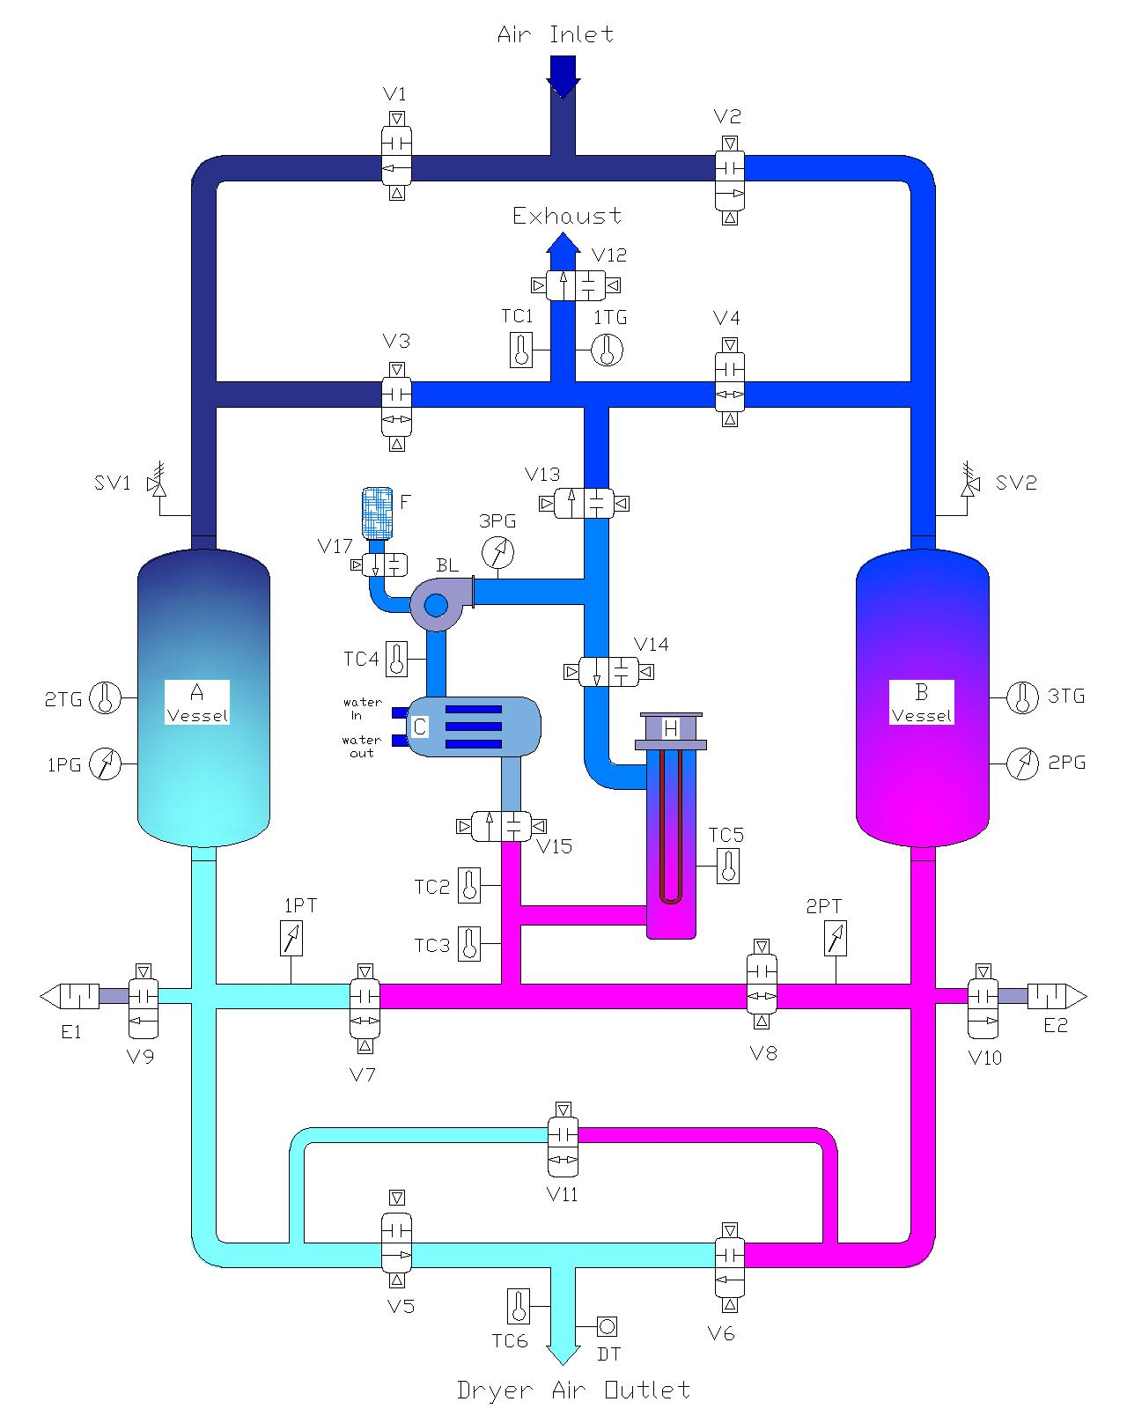
Custom Design
ESG
Energy Saving
Water Cooling
No CDA consumption for the cooling process
Reverse adsorption and regeneration process avoids repeated adsorption, improving efficiency
Closed-loop Cooling Process to prevent moisture contamination, ensuring complete regeneration.

Slide 8
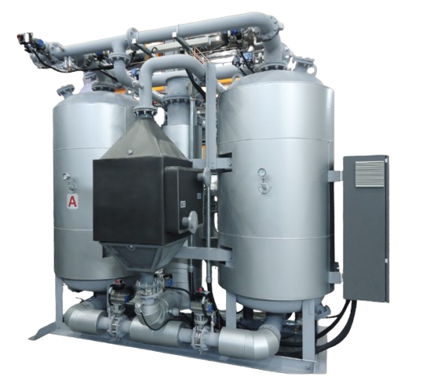
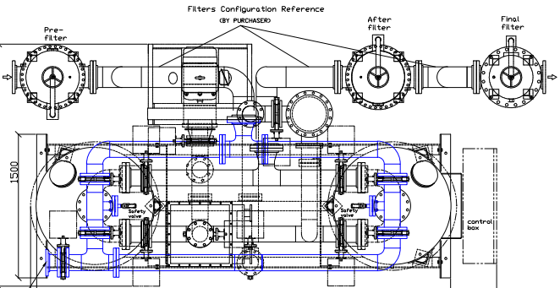
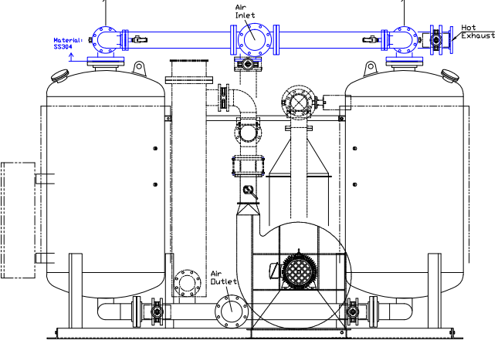
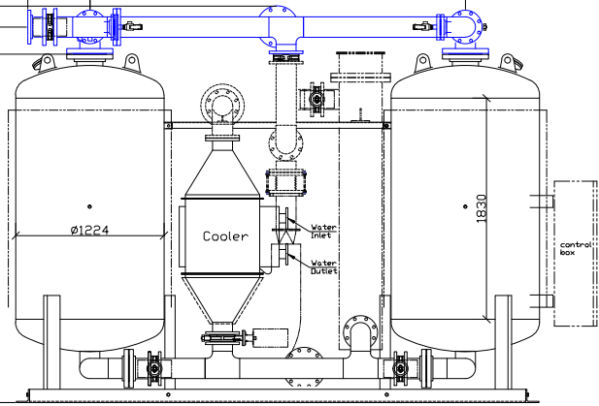
Custom Design
ESG
Energy Saving
Water Cooling dryer drawing

Slide 9
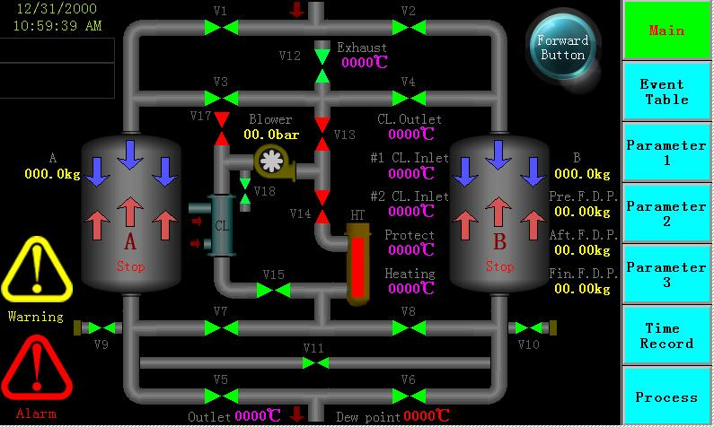
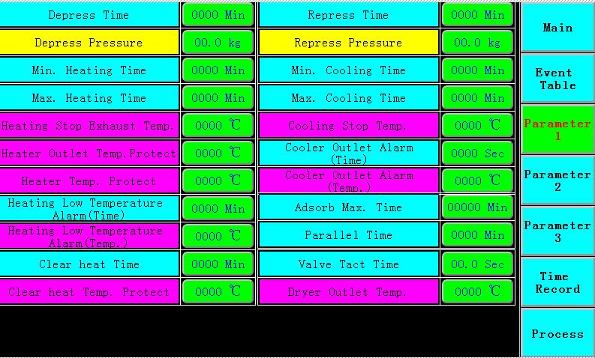
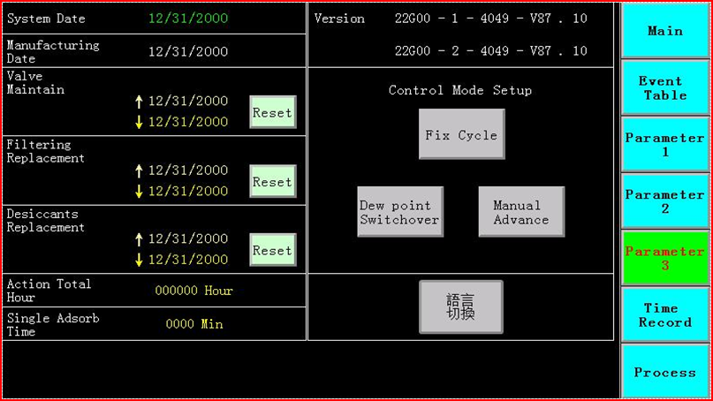
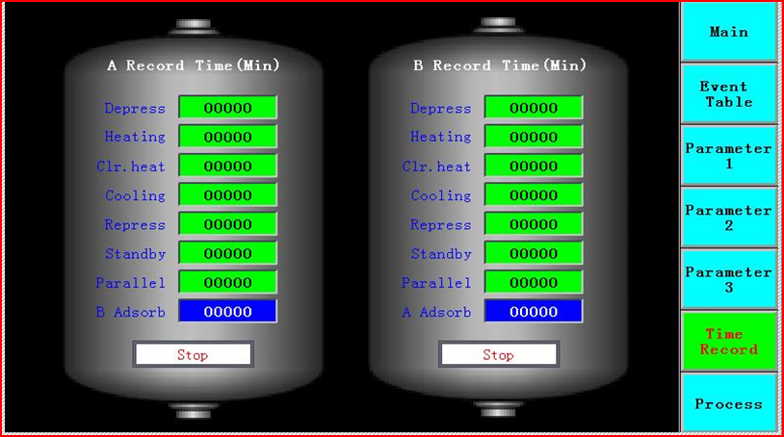
Custom Design
ESG
Energy Saving
Features
Operation Condition
Parameters
System Date
Operation Record

Slide 10
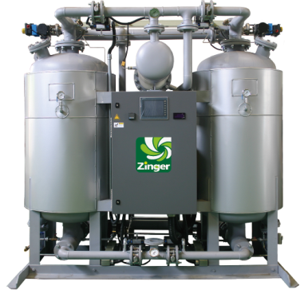
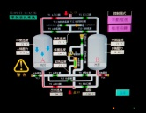

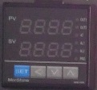
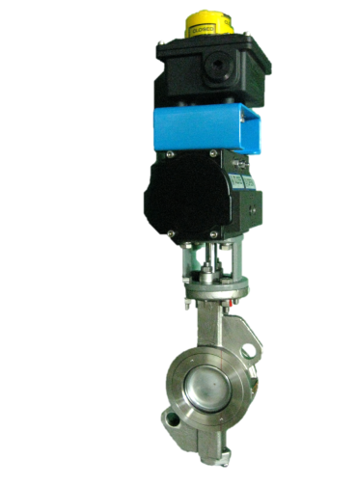
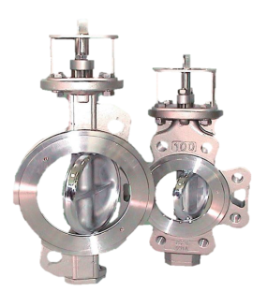
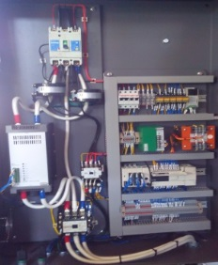
Custom Design
ESG
Energy Saving
Features
HMI：
ZINGER series heated dryers have the function of self-detection, and adopt PLC with HMI design.
Watt table:
Monitor the power consumption and the costs can be checked.
Temperature Controller：
Controlling the SCR output percentage, allows the heater to warm up and increase life time.
Valve:
Double eccentric pneumatic disc valve prevent the air from leaking.
Switch:
Ensure the valve position reaches the right position.
Control panel:
easy to maintain NFB, SCR, PLC and control components

Slide 11
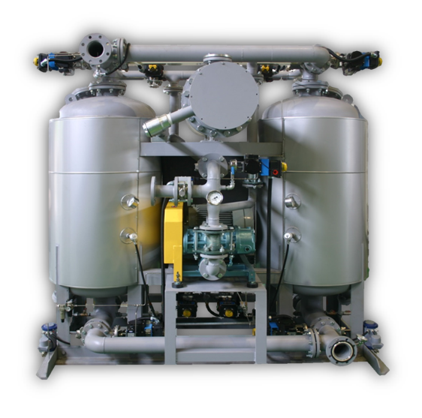
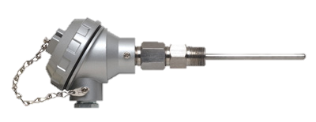
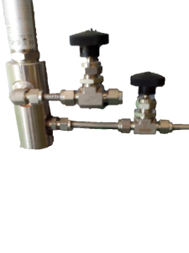
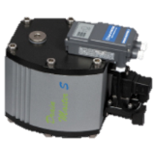
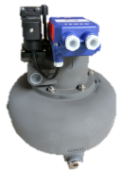
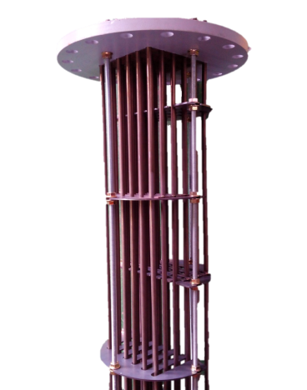
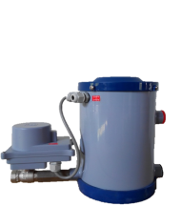
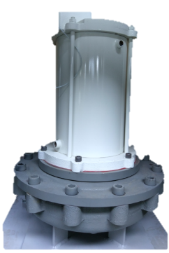
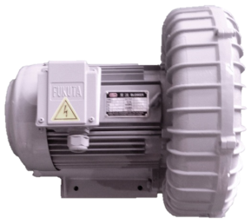
Custom Design
ESG
Energy Saving
Features
Waste heat utilization of energy-saving device patent：
saving energy ≧ 20% efficiently, better than other same types of dryers
Dew point meter:
A standard configuration for monitoring hot end-exhaust quality.
A needle valve is installed at the inlet and outlet to ensure pressure dew point.
Condensate Auto Drain Trap：
Only drain without air, save valuable CDA. Increase life time.
Electric heaters：
SUS or INCOLOY materials, temperature resistance up to 400 ~ 800 ° C, good thermal conductivity.
INTELLIGENT CONTROL
Blower or booster：
According to model requirements

Slide 12
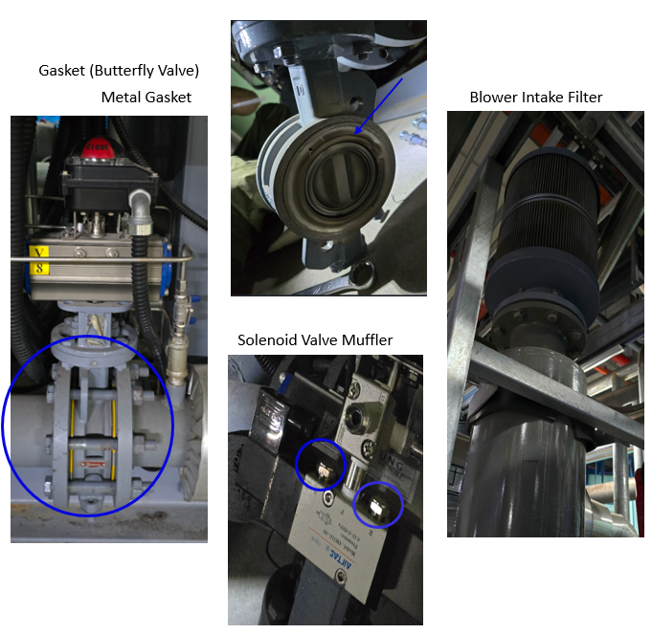
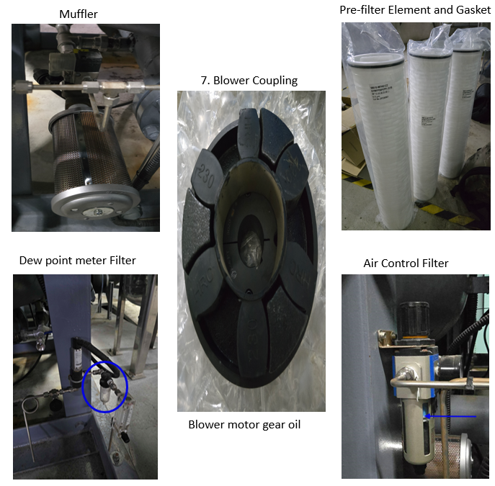
Custom Design
ESG
Energy Saving
Zinger W-Type Dryer Yearly PM
Consumable Parts
No | Description | Unit Q'ty
1 | Muffler 1/2" | 2
2 | Solenoid Valve Muffler 1/4" | 26
3 | Air Control Filter | 1
4 | Intake Filter | 1
5 | Filter (for dew point meter) | 1
6 | Pre-filter Element | 4
7 | After-filter Element | 4
8 | Gasket 2.5" (Butterfly Valve) | 3
9 | Gasket 3" (Butterfly Valve) | 7
10 | Gasket 4" (Butterfly Valve) | 5
11 | Gasket (65A*10K) | 6
12 | Gasket (80A*10K) | 4
13 | Gasket (80A* 16K) | 10
14 | Gasket (100A*10K) | 2
15 | Gasket (100A* 16K) | 8

Slide 13
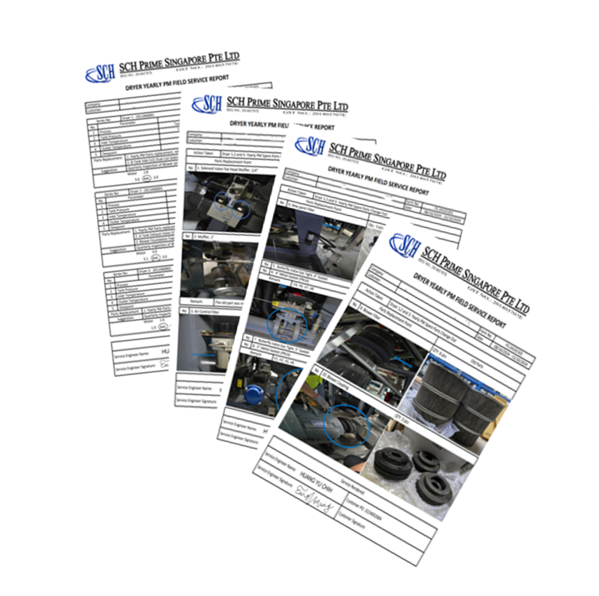
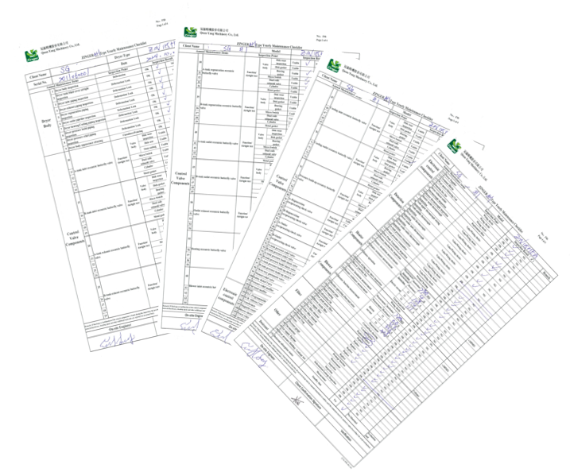
Custom Design
ESG
Energy Saving
Yearly PM Field Service and Inspection
Inspection & Checklist report

Slide 14


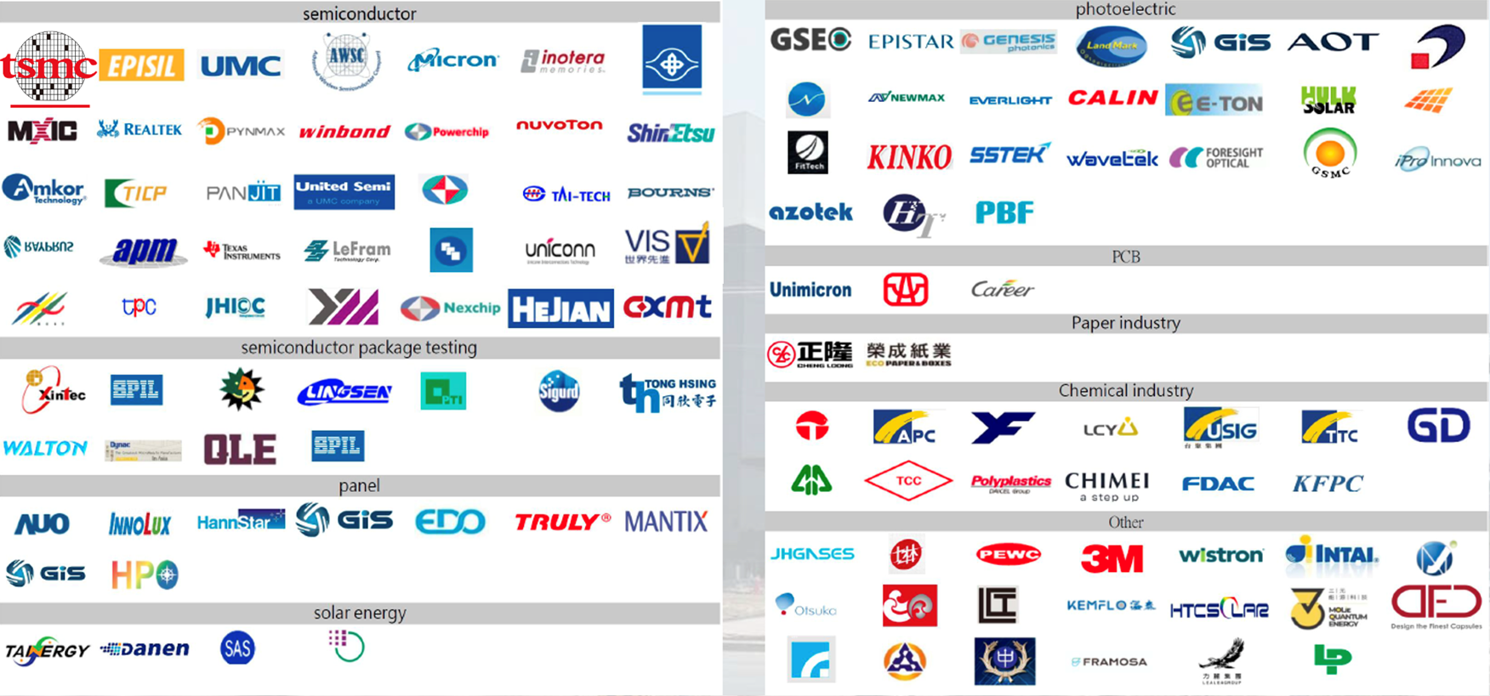
Custom Design
ESG
Energy Saving
Customer References
Singapore
-70°C
14 Dryers
China & Taiwan
-40°C
280++ Dryers
-70°C
293++ Dryers
-80°C
214++ Dryers
-90°C
24 Dryers

Slide 15

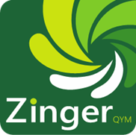
Quan-Yang Machinery Co.,Ltd.
Zinger Heated Dryer
Thank You
Tainan Head Office: B, No. 398, Anxin 5th Road, Annan District, Tainan City

