Slide 1



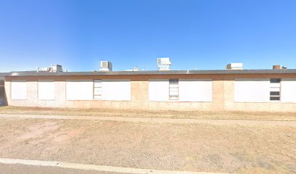

CHS All Class Reunion We Honor Crane, Texas
1927-2025
Jun 20-21, 2025 Crane, Texas

Slide 2
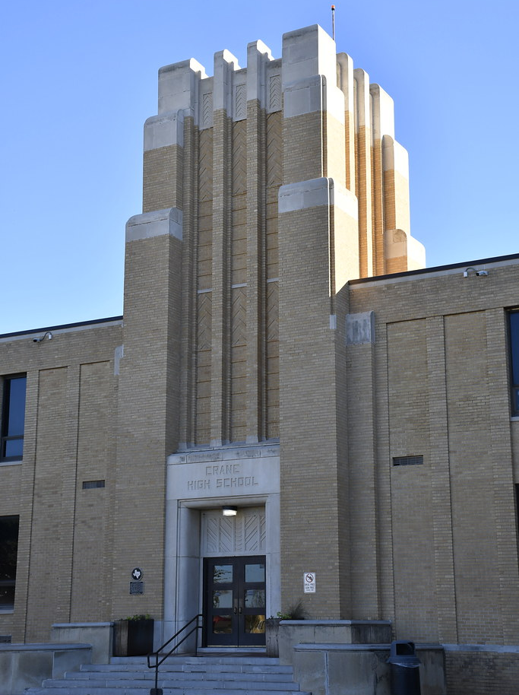
Crane ISD Crane, Texas
BHS
1957 to 1965
Crane High School 1927-2025
Bethune School 1957-1965

Slide 3
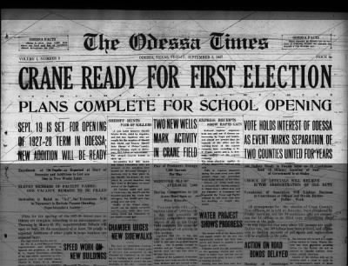
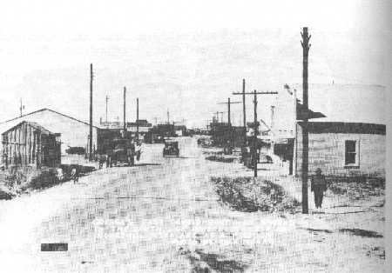
Sep 6, 1927
Crane, Texas
First Election1927
CHS 1st School Year 1st School Year 1927-1928

Slide 4
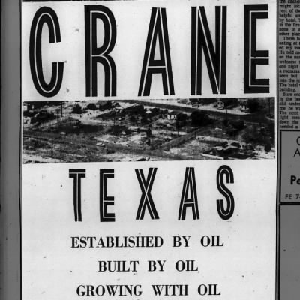
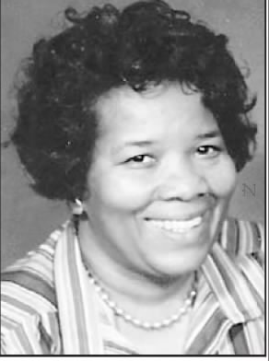
Oct 18, 1964
CHS 1929 First Graduates
1929 Floyd Kiphart (1910-1983)
1929 Orel R Kiphart (1908-1993)
Grandmother born Germany
Bethune First Graduate
1. Irene Morris (1939-2013) born Crane
Great Grandmother born VA, RIP MS

Slide 5
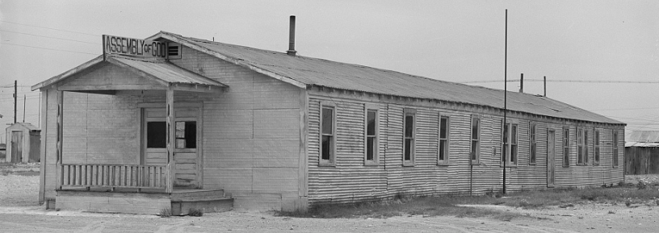
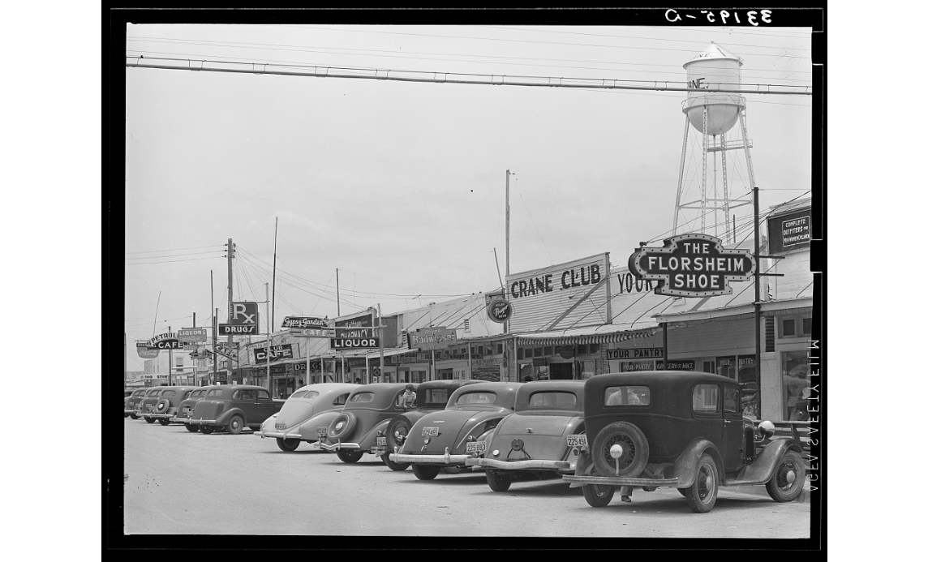
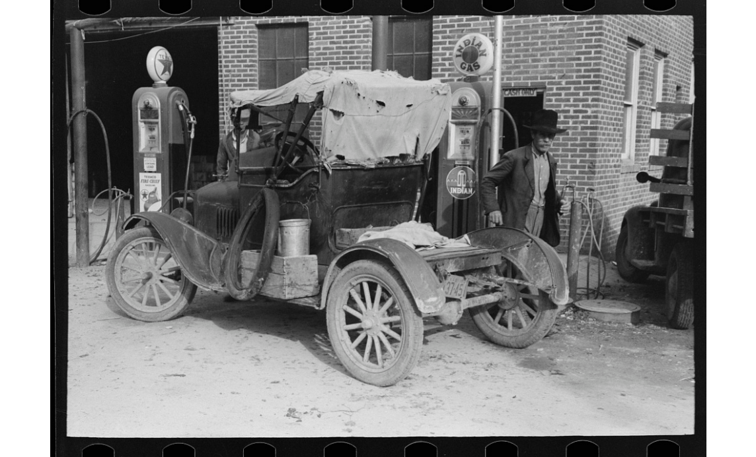
Library of Congress
Crane, Texas
Assembly of God Church
Crane Gaston Street
Brownwood, Texas Automobile Pumping Gas
1939

Slide 6
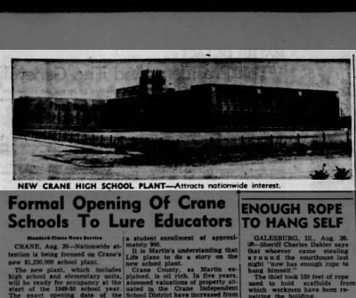
Aug 21,1949
New CHS Building 1949-1950

Slide 7
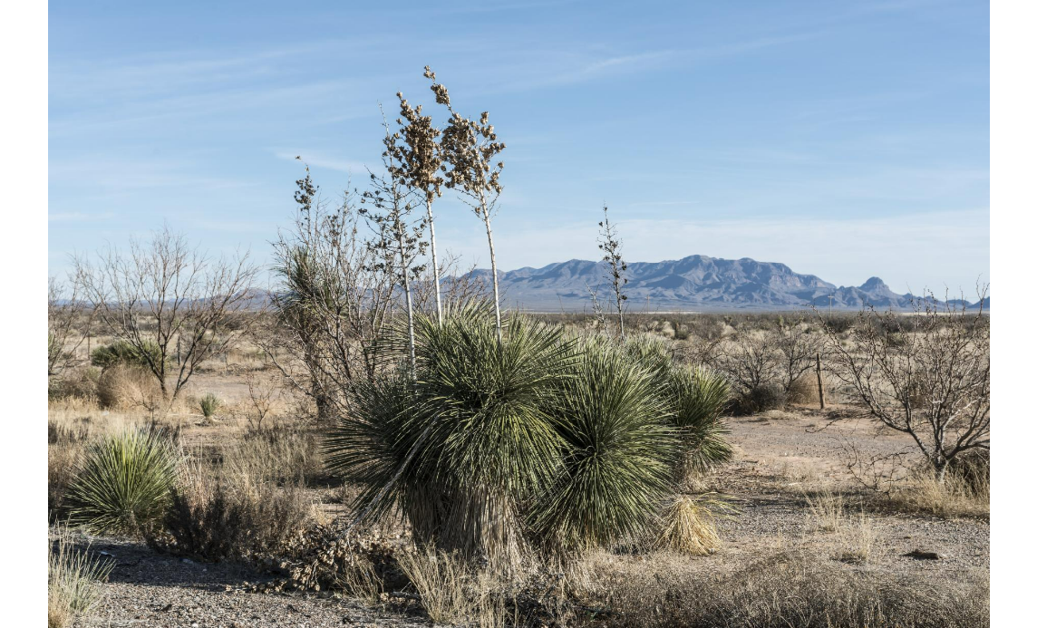
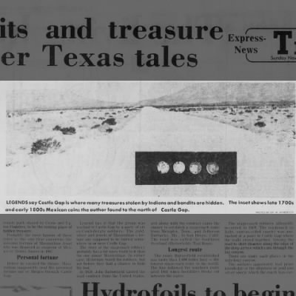

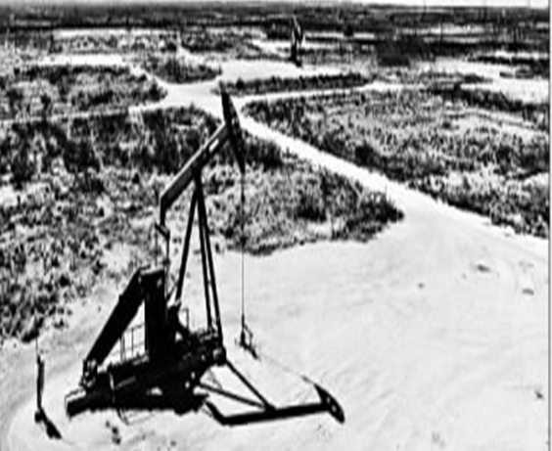
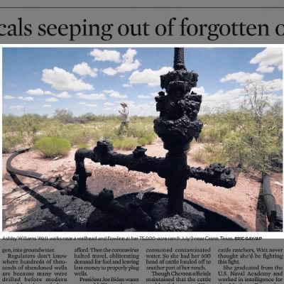
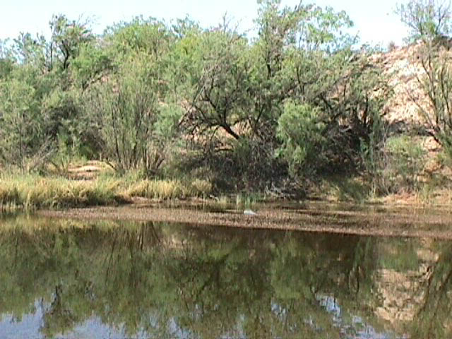
Crane Texas Legends
Black Gold
Maximilian Gold
Civil War Gold
1886-2025
Crane Lost Lake

Slide 8

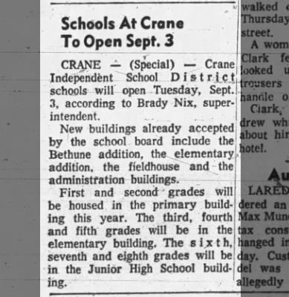
Crane Schools Started Sep 3, 1957
Superintendent: Brady Nix
2. New Bethune Building
3. New Crane Elementary Bldg
4. New Sports Fieldhouse
5. New Primary Building: 1, 2
6. Old Elementary: 3, 4, 5
7. Crane JR High: 6, 7, 8
8. Crane High School: 9, 10, 11, 12
9. Crane Administration Building

Slide 9
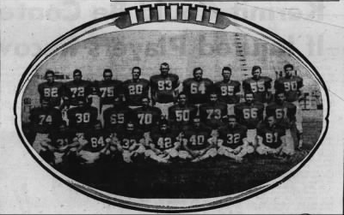
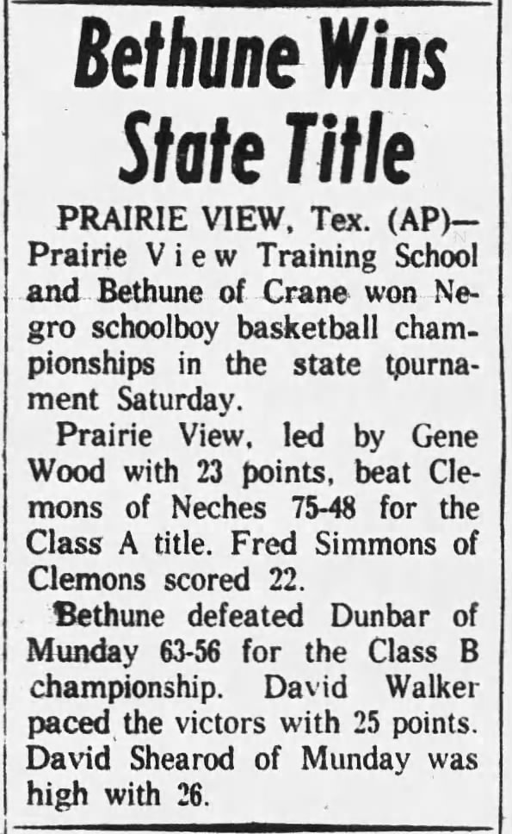
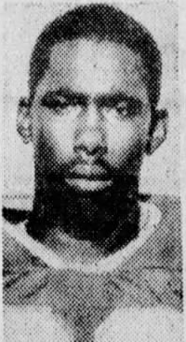
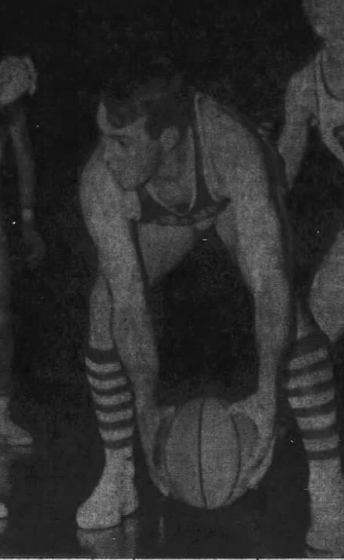
Sep 4, 1964
CHS Football Team
Feb 19, 1961
Bethune Basketball Team Wins State Championship
CHS 1986 Kenny Walker
CHS 1967 Gary Gaines

Slide 10
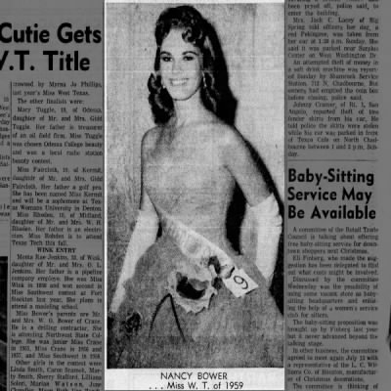
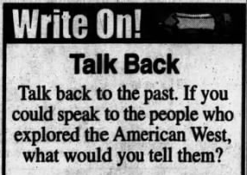
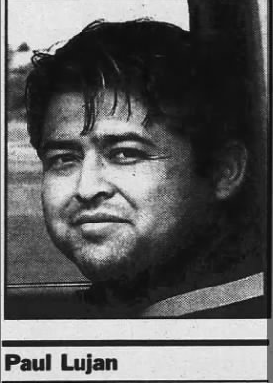
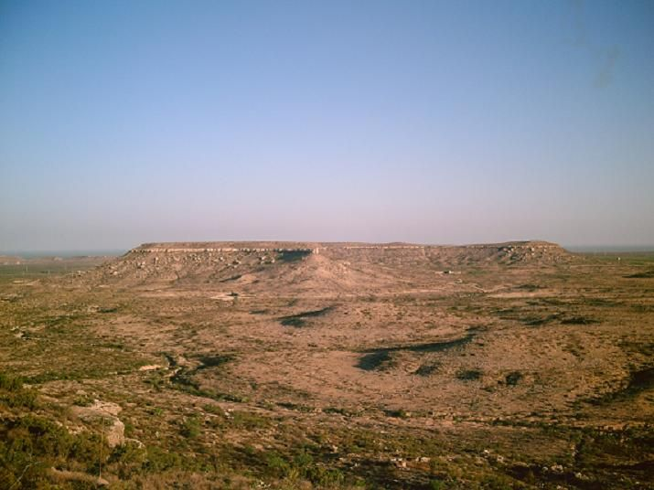
Talk to Future What Would You Say
CHS 1959 Nancy Bower Miss West Texas
Kings Mountain
CHS 1990 Paul Lujan (1970-2004) RIP Helping Save Others

Slide 11
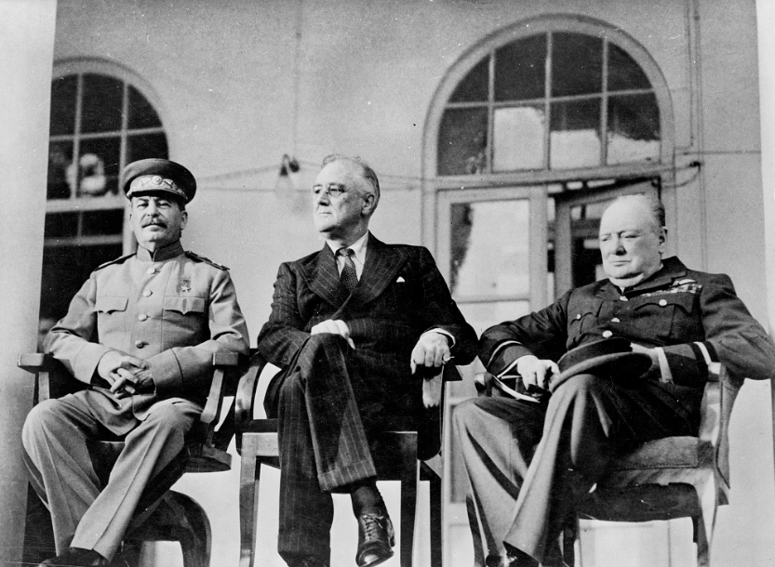
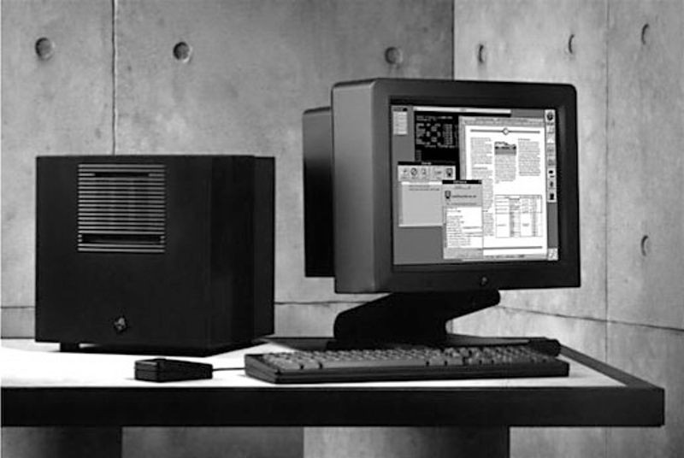

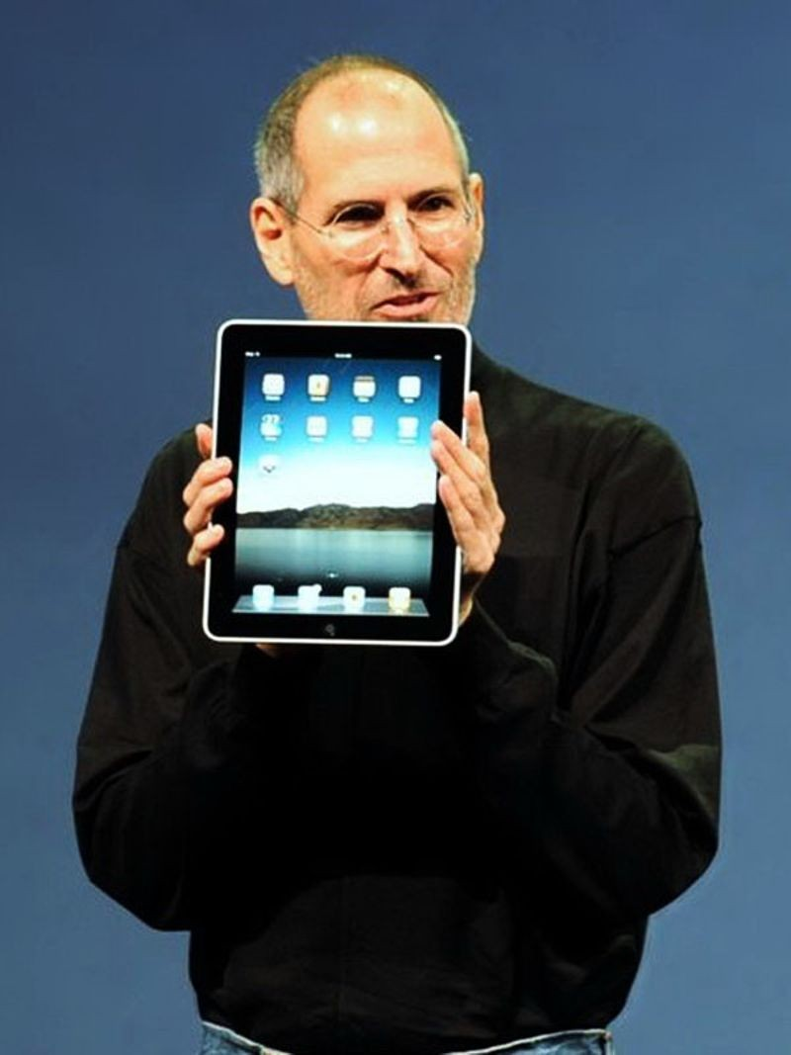
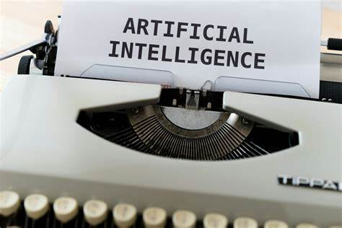
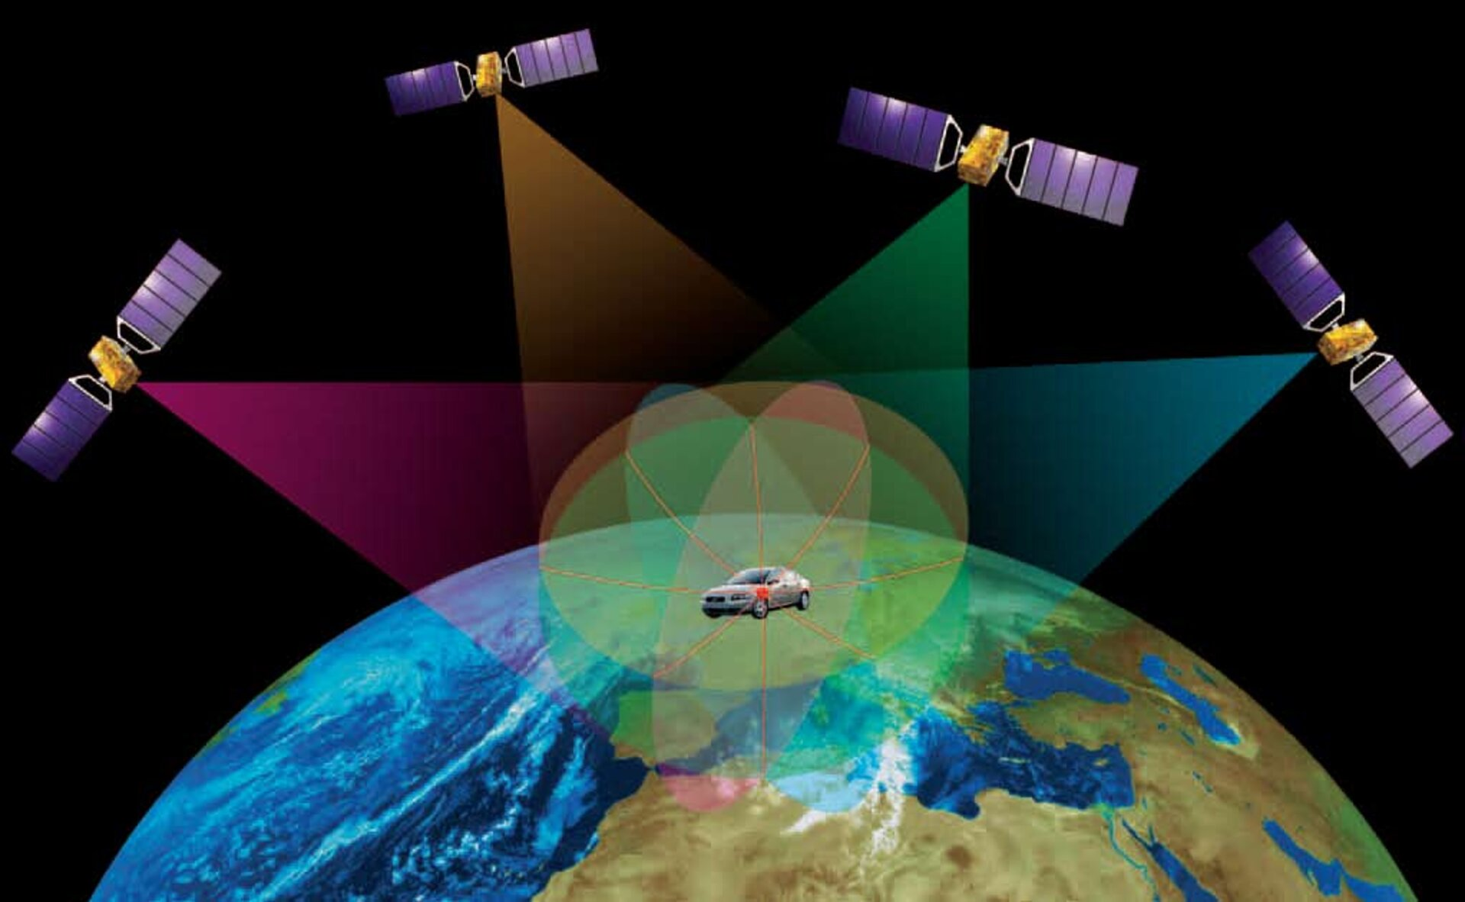
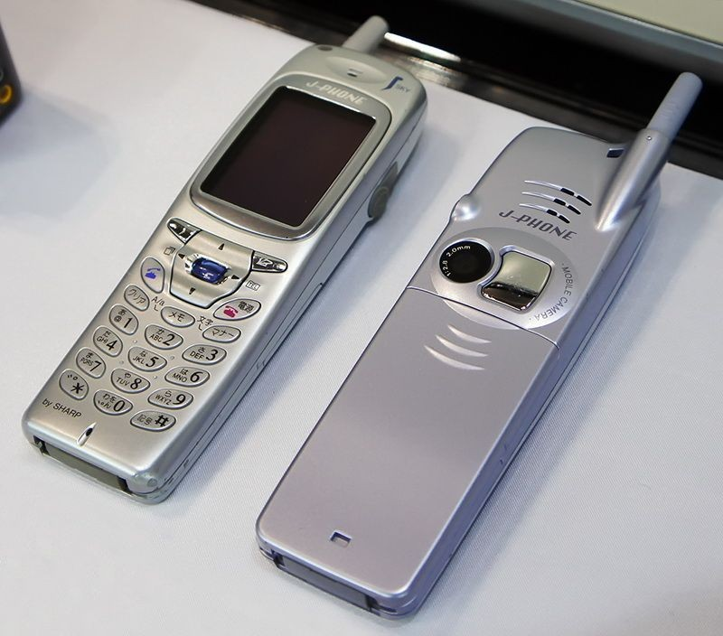
Korean War 1950-1953
Vietnam War 1961-1975
Cold War 1947-1991
Persian Gulf 1991
Afghanistan 2001-2021
Iraq 2003-2011
CHS Graduates Estimates by Decade 1929-2021
Great Depression
Stock Market Crash Oct 1929
1929 | 1930-1939 | 1940-1949 | 1950-1959 | 1960-1965 | 1965-1969 | 1970-1979
002 | 162 | 297 | 544 | 397 | 391 | 827
1980-1989 | 1990-1999 | 2000-2009 | 2010- 2019 | 2020-2021 | 1929-2021 | Time
727 | 762 | 728 | 709 | 157 | 5,778 | 97-years

Slide 12

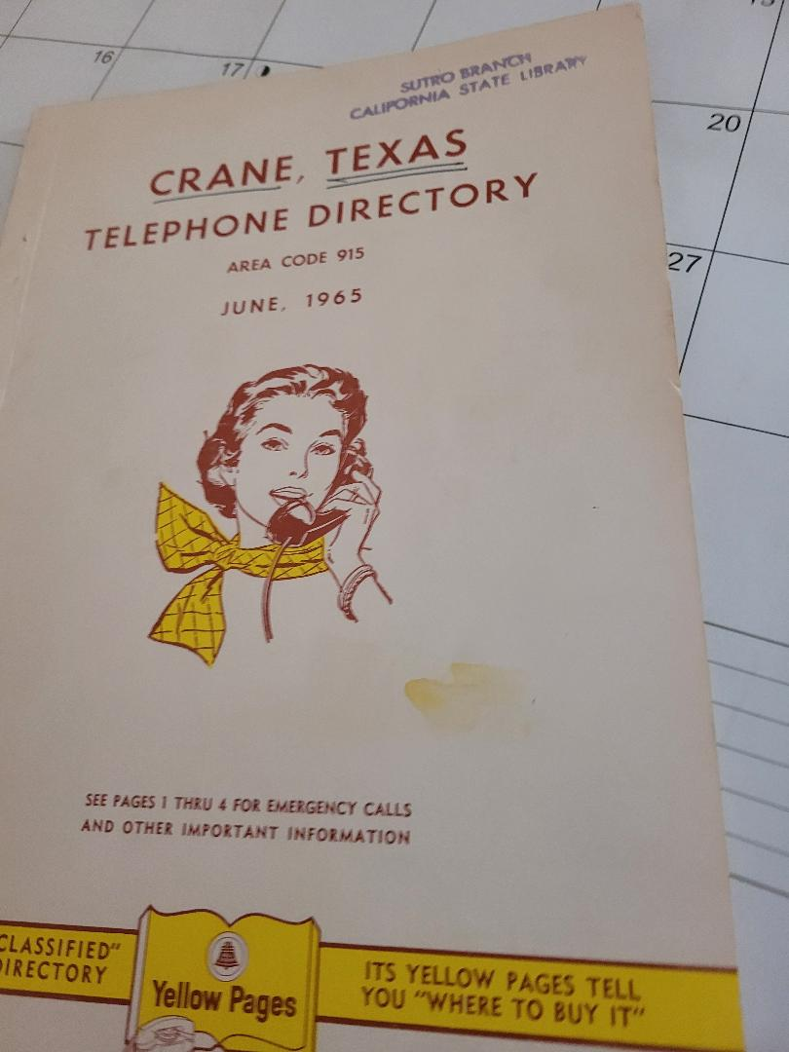

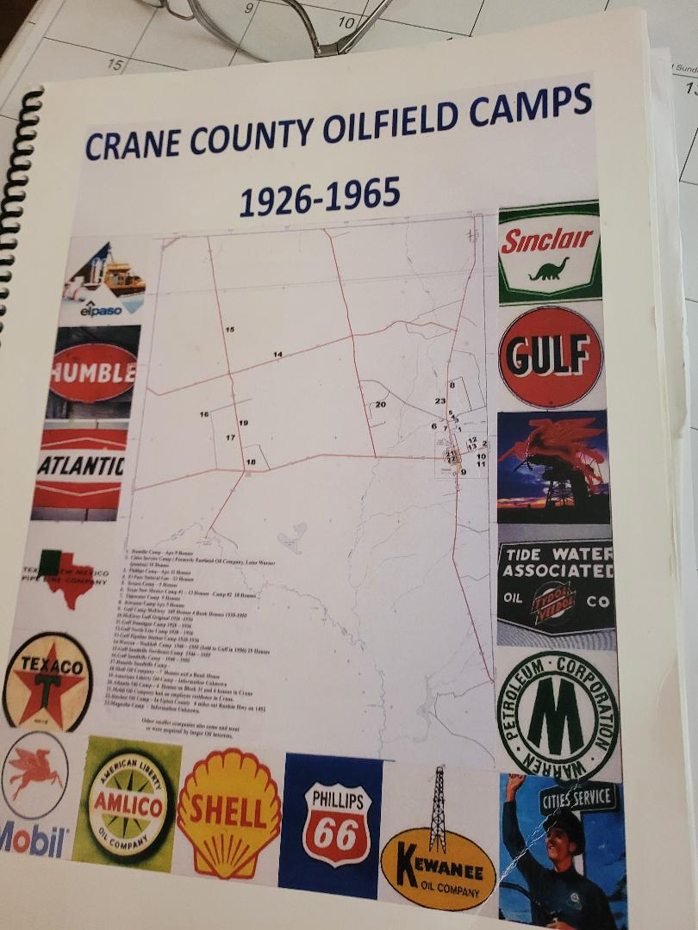
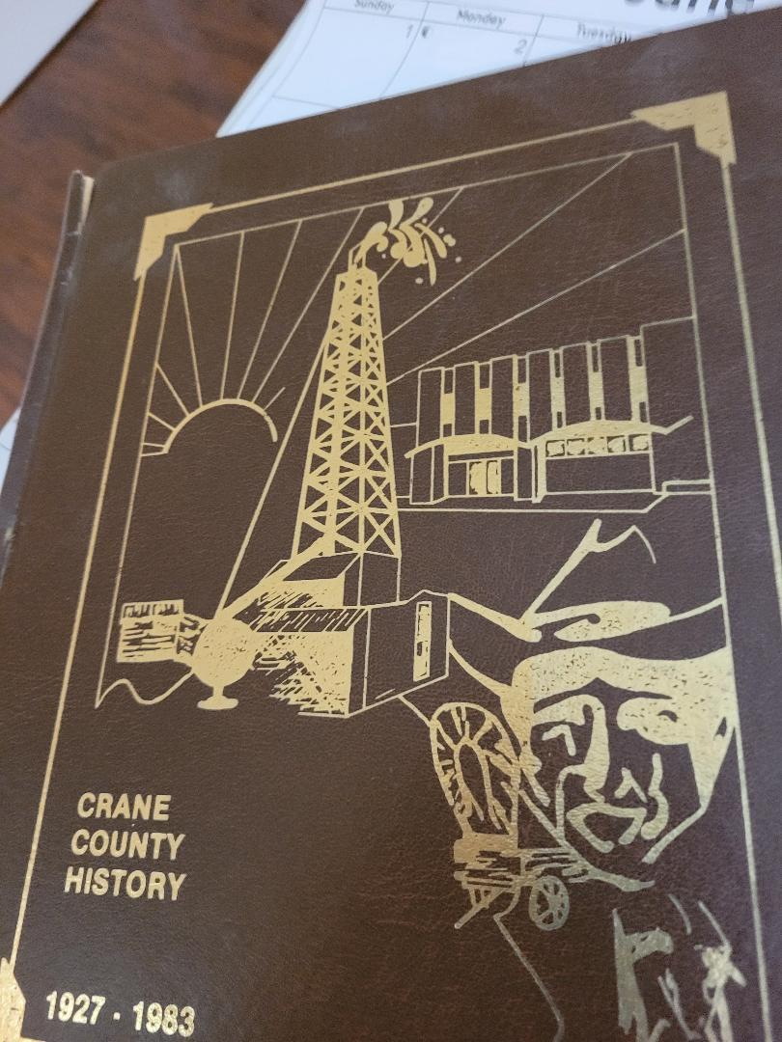
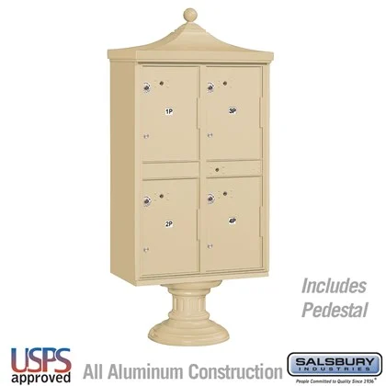
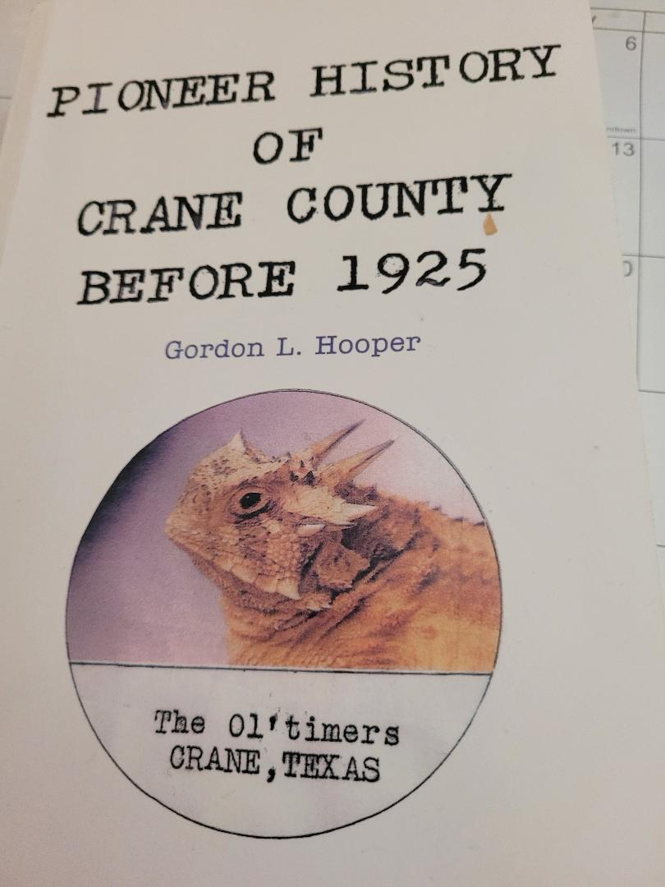
Crane Time Capsule Concept
Honor All Crane Student, Teachers & Administrators
Honor Our Past and Present
Honor Our Past & Present Heros
Establish Guardianship
Establish Care and Handling
Establish Collections Care
Establish Collections Storage
Establish Conservation & Preservation
Submit Documents & Photo to US Library of Congress

Slide 13

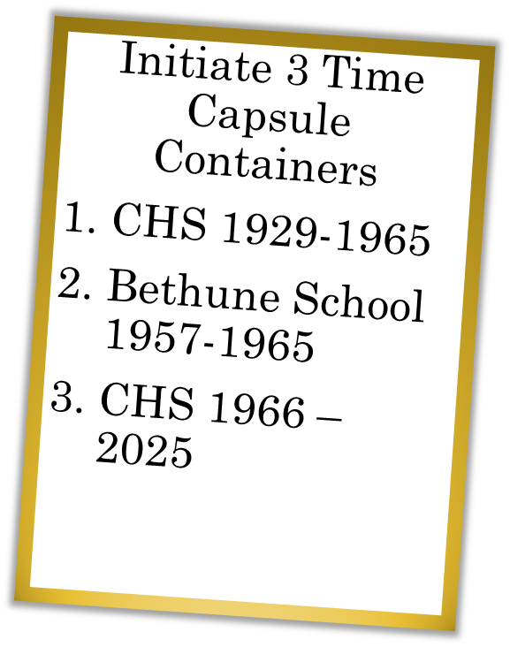
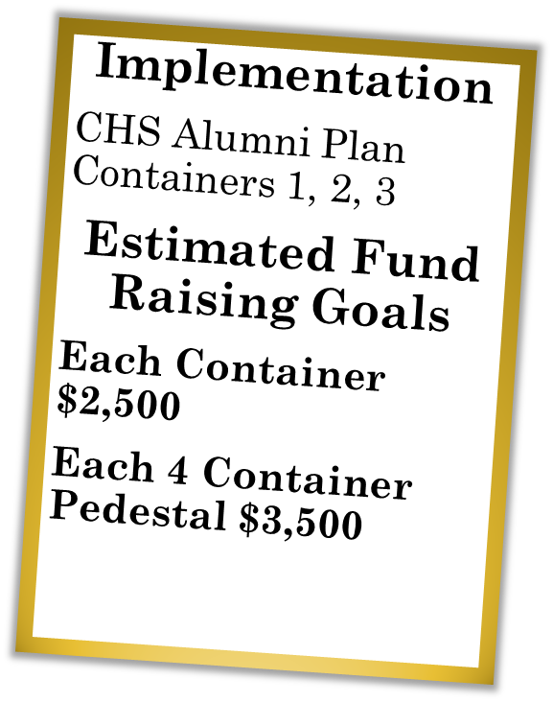
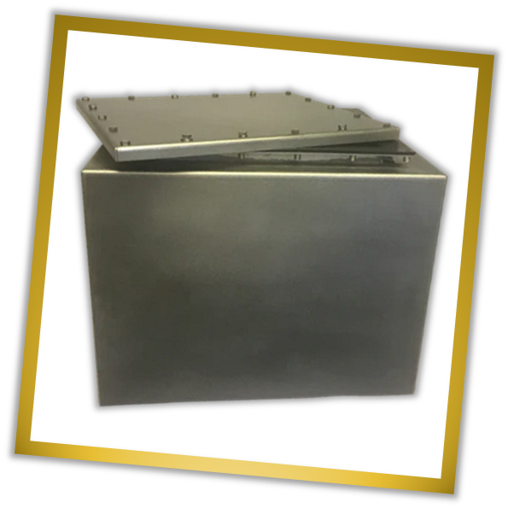
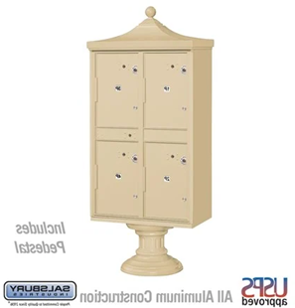
Fund Raising
Individual
Class
Corporate
Grants
Donation Levels
Silver
Gold
Platinum
Legacy
We can’t duplicate Library of Congress & Smithsonian that contain treasured artifacts, but we will seek every option to ensure all artifacts are preserved by understanding how to deal with temperature, humidity light inhibition & protection.

Slide 14

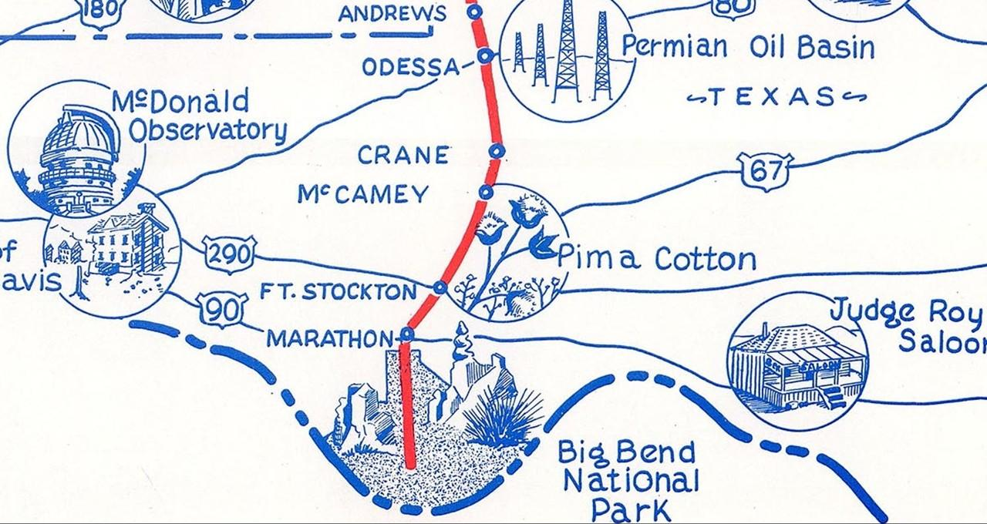



Your Donation Today Will Make a Difference & Help Honor Others
Individual
Class
Corporate
This project was conceived by CHS 1966 DSmith as an outcome of his Facebook Group “Crane High School Since 1929” created March 2020 as he was being treated for cancer, with the help of his wife Sandy, that he has been with for 38-years. We have used scholastic standards to research & publish 1,500 accurate & historical accounts about CHS & Crane County, Texas. We will use same rigorous standards to ensure full accountability & transparency of all resources and funds received for this project made payable to “CHS Time Capsule” & we will continue to consult with Crane ISD & Alumni.
Fund Raising
Individual
Class
Corporate
Grants
Donations
Silver $100
Gold $200
Platinum $500
Legacy $1,000

Slide 15
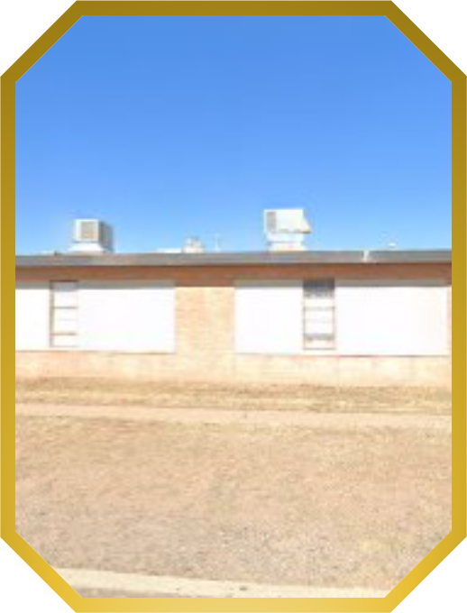
CHS All Class Reunion 2025
.
BHS
1957 to 1965
Time capsules provide tangible reminders of moments & help preserve memories that might otherwise fade.
Students grades K-12 can participate & see how their perspectives & goals evolve.
End of Presentation

