Slide 1
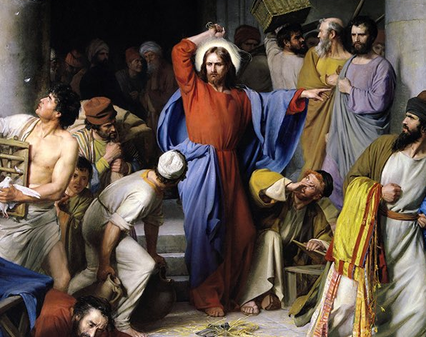
Cryptocurrenices and The Christian Conscience
Compatible, Perfectly in Line, or Avoid at All Cost?

Slide 2
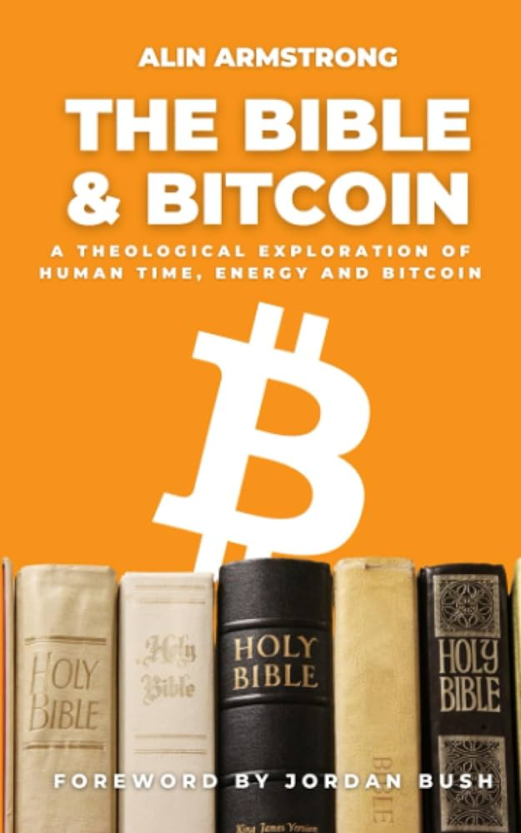
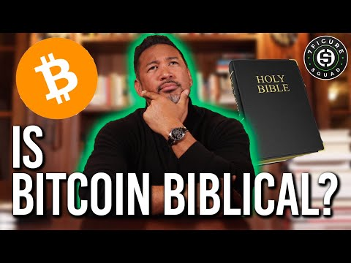
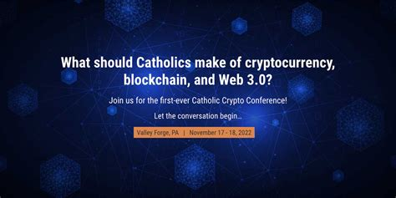
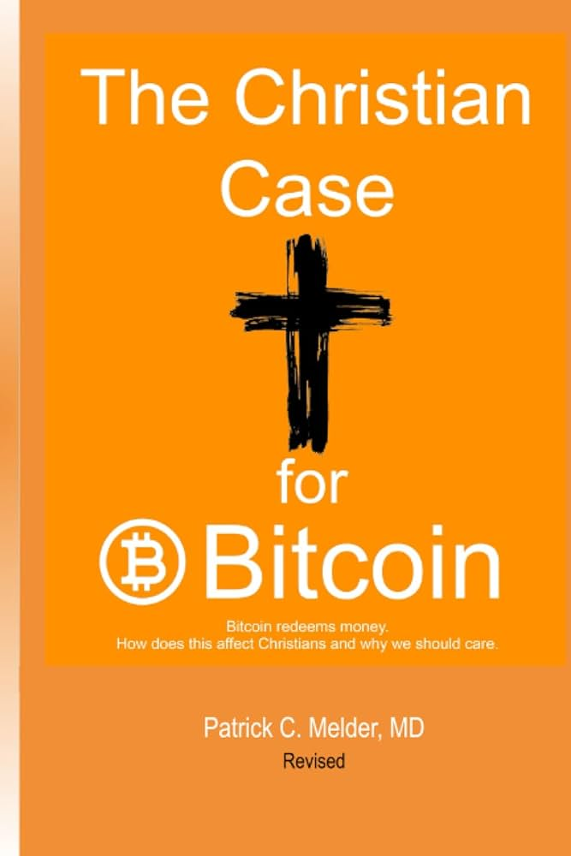
Books
Podcasts
YouTube Channels
Conferences

Slide 4
Bitcoin / bitcoin / blockchain
Bitcoin
A protocol for a decentralized peer-to-peer network that creates consensus without needing a central authority to provide trust.
bitcoin
The currency (token) issued as a reward in the proof-of-work mining process.
blockchain
The public ledger where the network records (transactions) are written.
Notes:
The foundational components of Bitcoin (the protocol and system) include:
A blockchain (the Bitcoin blockchain)
A consensus algorithm (Proof-of-Work)
A native digital currency (bitcoin)
Cryptography (hashes and digital signatures)
Peer-to-Peer (P2P) network (the Bitcoin network)
Open source development (the Bitcoin Core software and other implementations of the protocol)
Bitcoin is not only “a blockchain”. The blockchain is one component, like a transmission in a car. The most important component of bitcoin is the consensus algorithm that allows the blockchain to be controlled in a decentralized manner.
Bitcoin, with a capital “B”, is a protocol for a decentralized peer-to-peer network that creates consensus without needing a central authority to provide trust.
Comparatively, bitcoin, with a lowercase “b” is the currency, or token, that is issued during the mining process. We spend and receive bitcoin as a currency. In Bitcoin, currency units are strictly limited (less sthan of 21 million will ever be issued) and have a predictable issuance (a specific amount is issued with every new block).Bitcoin’s monetary policy is based on an Austrian economics and exhibits digital scarcity.
The blockchain is the public ledger where the network records transactions. “Our ancestors said, ‘This is as good as written in stone.’ Our grandchildren will say, ‘It is as good as written on the blockchain.’ This is the new standard of immutability, and it is globally accessible.” (Andreas M. Antonopoulos; The Internet of Money Volume 2)
The Bitcoin network is a live network made of 10’s of thousands of participant computers (nodes) some of which have special purpose (miners) transmitting information (transactions and blocks) to each other in order to synchronize a global ledger (bitcoin blockchain) which tracks ownership of Bitcoin currency units.
In recent years, the word blockchain has been mis-used to talk about ledgers that are neither public nor immutable. The original blockchain is both public and immutable; it is also part of the Bitcoin protocol and bitcoin currency. Detailed explanations about this can be found in Antonopoulos’ talks, one in November 2017 called Bitcoin vs. Blockchain and another in March of 2017 called Blockchain vs. Bullshit.
The graphic in this slide is modified from the original infographic from Bitcoin Designed called The Blockchain without the Bitcoin.

Slide 5
Eary History of Bitcoin
“Satoshi Nakamoto” publishes white paper
Second user Hal Finney joins network and starts mining
Laszlo Hanyecz buys 2 pizzas for 10,000 BTC
October 2008
January 10, 2009
May 22, 2010
January 3, 2009
October 2009
December 12, 2010
Genesis Block is mined and P2P network launched
Bitcoin is sold for “fiat”
$1 = 1000 BTC
Satoshi posts publicly for the last time and “disappears”
Notes:
Satoshi Nakamoto’s original ideas about bitcoin can be found in The White Paper, published on October 31st, 2008.
The White Paper (written text)
The White Paper (audio reading of text)
The White paper (annotated version)
Satoshi’s Identity: It doesn’t matter that we don’t know who Satoshi Nakamoto is.
Just as we don’t know anything about the mathematician Euclid’s identity, we don’t know anything about Satoshi’s identity. More importantly, we don’t need to know their history or identities to prove their discoveries work. Learn more about why Satoshi’s identity doesn’t matter in Andreas’ Who is Satoshi Nakamoto? Video from 2017 or this short video from 2016 discussing the idea that we, the community, get to decide what bitcoin is Why Satoshi's Identity Doesn't Matter.
Bitcoin, as a network, started on January 3rd, 2009.
Embedded in the first Bitcoin code was the message “Chancellor on brink of second bailout for banks.” - hinting at Bitcoin’s creation because of the 2008 financial crisis. From The Ultimate Bitcoin Guide.
First User (not Satoshi Nakamoto): Hal Finney was the first user of bitcoin and mined block #70. You can find more information in this Washington Post article.
First Known Sale of Bitcoin for Fiat: In October 2009, New Liberty Standard Exchange sold first bitcoin at $0.000994 per bitcoin.
First Retail Use: In May 2010, 10,000 bitcoin purchased 2 pizzas, which was worth $25. Therefore, 1 bitcoin = $0.0025 at that time.
Satoshi Nakamoto posts publicly for the last time: December 12, 2010. Learn more about the history of bitcoin at Wikipedia's History of Bitcoin page.

Slide 6
Bitcoin
A public deposit box
Anyone can deposit
Private Key
Like a very long PIN,
only the owner can unlock
A Bitcoin Address
Used to identify where to deposit the payment
Notes:
Bitcoin Private Keys
In order to receive funds, Alice downloaded a bitcoin wallet on her smartphone. Alice’s wallet generates private keys that it will use to lock Alice’s bitcoin. The private keys in a user’s wallet are completely independent of the bitcoin protocol and can be generated and managed by the user’s wallet software without reference to the bitcoin network, the blockchain, or access to the internet.
Private keys are just very (very very) long numbers like this one:
81597298347345525737400564411624107386808700882561792880484837864150238212742
Private keys are generated randomly. The computer’s equivalent to: “Pick any number from 0 to 999999999….99999999” (with 77 consecutive 9’s).
Alice’s wallet knows the private keys that it generated. The private keys are like a PIN number that unlocks Alice’s bitcoin. It’s mathematically improbable that someone can guess Alice’s private keys. There would be far too many guesses required. By using her private keys to unlock her bitcoin, Alice can prove that she owns the bitcoin and has the right and ability to transfer them. If Alice shares her private keys with others, they will be able to unlock her bitcoin too. Whomever has the private keys, has the power to transfer the bitcoin locked to the corresponding address.
Bitcoin Addresses
A bitcoin address is an identifier, used in the Bitcoin network, to transfer value. In this case, Alice’s bitcoin address is where she will receive payments. Alice’s wallet creates bitcoin addresses, on demand, from Alice’s private keys. Alice’s bitcoin address corresponds to a specific private key and bitcoin sent to Alice’s bitcoin address can only be “unlocked” by the corresponding private key.
Note: some bitcoin addresses don’t correspond to a single bitcoin private key but to scripts that contain conditions, or multiple keys. A discussion of these topics are beyond the scope of this course, however if you are interested in learning more, see Mastering Bitcoin. https://github.com/bitcoinbook/bitcoinbook/blob/develop/ch04.asciidoc
A bitcoin address can be shown to anyone! The only thing someone can do with a bitcoin address is send, or deposit, bitcoin into it, like a public deposit box. Importantly, bitcoin addresses never expire and there is no way to “close” them. Once a bitcoin address is known, you cannot prevent people from sending value to it. As long as you don’t lose your private key, you can always unlock the funds your bitcoin address contains.
A bitcoin address is 37 alphanumeric characters. Older bitcoin addresses begin with the number 1, newer bitcoin addresses currently begin with the number 3 or bc1. The newer bitcoin addresses have advanced features, but for our purposes, there’s no need to distinguish between them. At a basic level, they all work exactly the same. Most people use QR codes to represent bitcoin addresses because trying to correctly type a 37 alphanumeric address is difficult, especially when compared to the effort required to scan a QR code.

Slide 7
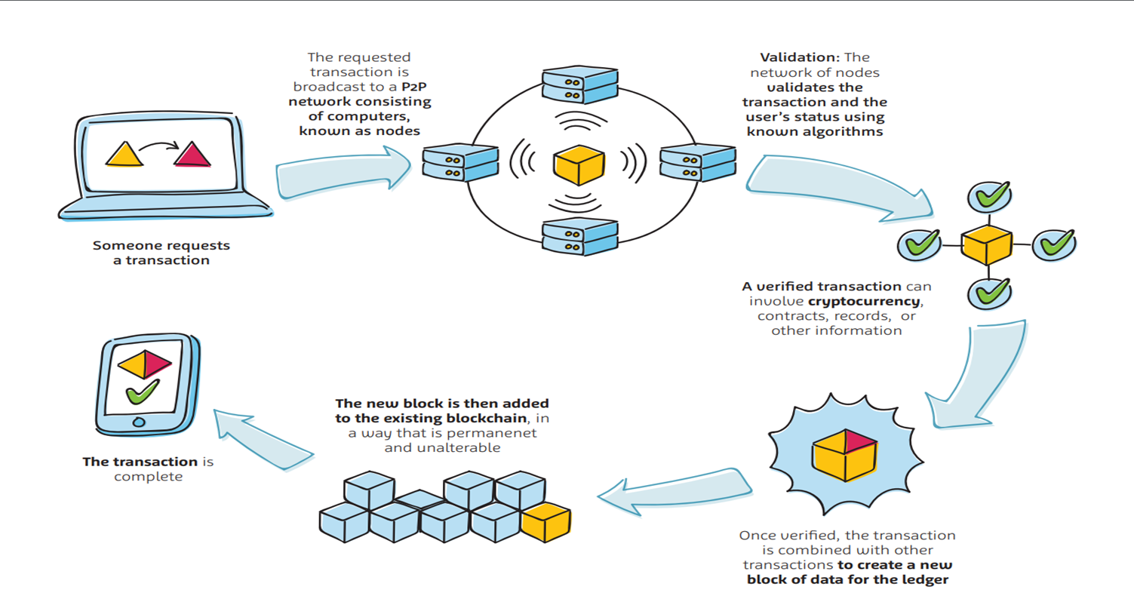

Slide 9
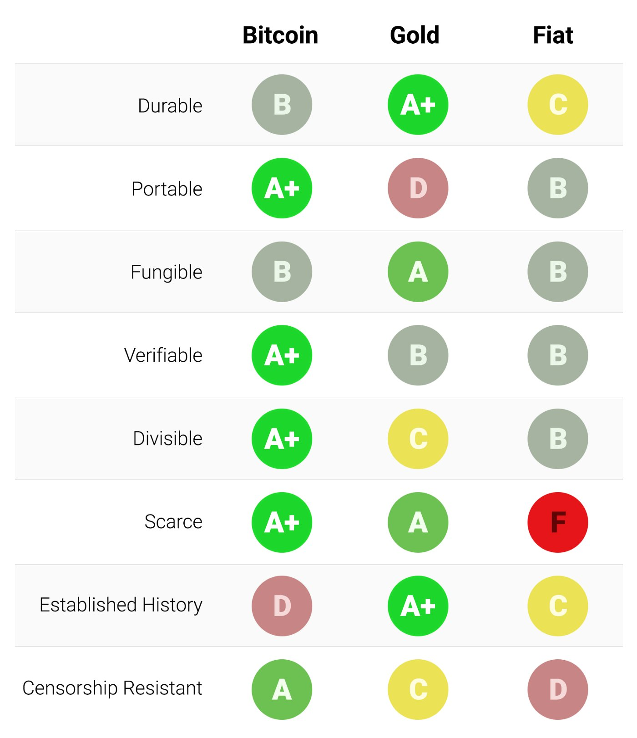

Slide 10
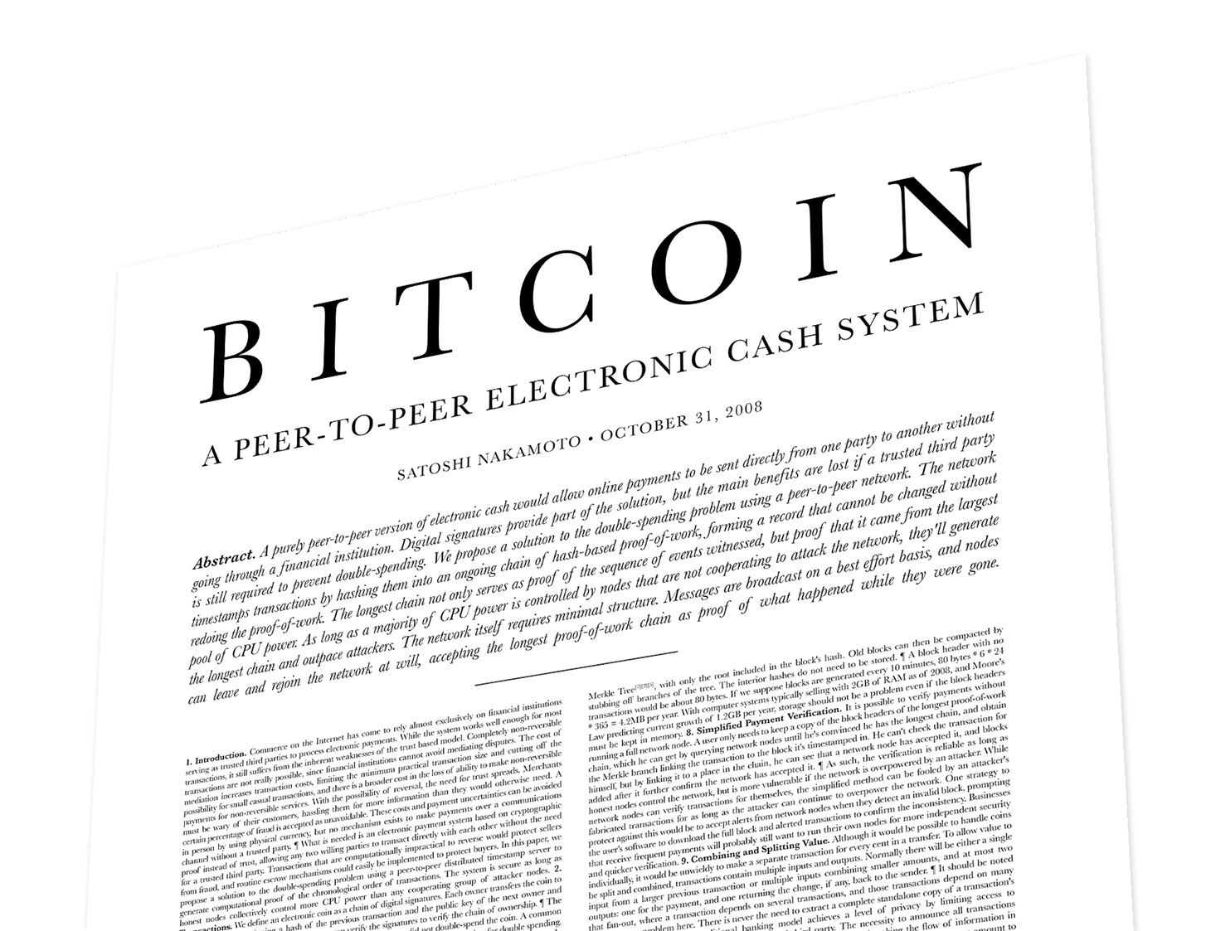

Slide 12
White Paper Points
“purely peer to peer”
No financial institution required appears to not just be a feature of Bitcoin, but in fact, the entire point of the project.
To understand this point, one must understand how many “parties” or companies are involved in modern credit card transactions. Hint: settlement doesn’t actually happen at the point of purchase.
“the double spending problem”
In many respects, this is what Bitcoin solved, as prior to this there was no way to send items digitally across the Internet without the possibility of them being duplicated. In fact, most of us assume when we send a file to someone to look at via e-mail, they will save it, thus creating a duplicate. That’s great for spreadsheets, but really bad for money.
“electronic cash”
Satoshi clearly was attempting to recreate the certainty and private nature of cash that in person transactions allow for, but within a digital environment.

Slide 13
White Paper Points
“proof instead of trust”
This is where the philosophical concept of Bitcoin as a “trust machine” comes from.
“computational proof of the chronological order of transactions”
This feature leads to the ledger being “immutable.” This immutability is a feature, not the accomplishment of solving the double spend problem.
“vote with their CPU power”
As long as the network is operated by 51% honest nodes, then it is secure.
Section 6 “Incentive”
This is perhaps the area that most lends itself to a “moral” or “religious” study.

Slide 14
Papal Encyclicals
Rerum Novarum
“On Capital and Labor”
Issued in 1891 by Pope Leo XIII
Industrial Revolution had pitted labor against employers
Socialist vs Capitalist had emerged as seemingly the only two choices
Encyclical essentially proposed a middle ground, and it is here that subsidiarity was first articulated.
Quadragesimo Anno
“On the Reconstruction of the Social Order”
Issued in 1931 by Pope Pius XI
Reaffirmed Catholic concept of subsidiarity
Subsidiarity sometimes gets defined as simply meaning “limited government” and while that is certainly part of it, it would be unfair to say that it equates to unbridled capitalism, or “profit at any cost.”

Slide 15
Subsidiarity, Private Ownership, and Solidarity
Subsidiarity
At least in the the Catholic sense, & certainly not at odds within most Protestant traditions, subsidiarity pushes for problems to be dealt with by the most “local” authority.
A home owners association is far more capable of establishing rules for trash pick up than would be the governor of that state.
A reasonable assertion according this principle would be that financial transactions of any sort, should, where applicable, be completed with the least amount of intermediaries.
Bitcoin’s “peer to peer” nature is not only in line with the idea of subsidiarity, but actually promotes it.
Private Ownership
Rerum Novarum reiterates the “good” of private ownership repeatedly.
Bitcoin allows for true, private ownership, and in fact promotes this as well, though many Bitcoin holders do outsource the ownership of their Bitcoin (exchanges, brokerages, etc).
Solidarity
Numerous papal encyclicals have spoken of and promoted this concept.
Few financial systems have ever had the built in “game theory” that Bitcoin does, meaning that without coercion, people coming into the Bitcoin network make it inherently more fair and therefore more useful across the globe.
Globally connected without coercion is nearly the definition of “solidarity.”

Slide 16
Features Christians Should Like
21 million BTC cap means the protocol is inherently deflationary
Could some sort of protocol change be implemented that would change this? Yes, but why would they?
There are not really 21 million BTC that will be mined, but rather, 2.1 quadrillion satoshis, as that is what the protocol is actually denominated in.
Proof of Work
You can’t simply own shares in the network in order to receive new bitcoin or receive transaction fees. You actually have to do real work, expending real energy.
The belief in “the truth” is actually what keeps the network operating.

Slide 17
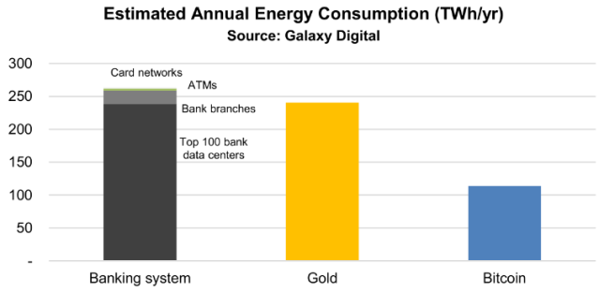
Myth #1 Bitcoin has a Negative Impact on the Environment
Perhaps the Biggest Myth Propagated by Opponents
Bitcoin actually consumes less energy than the traditional financial system.
Bitcoin as “stored energy” is one of the most popular rebuffs to this myth.
In stark contrast to this myth, Bitcoin mining can actually benefit the environment through the use of alternate energy sources that often go wasted, such as flared gas from oil wells, (yes, this is really being used to mine Bitcoin today).

Slide 18
Myth #2 There’s Nothing Backing Bitcoin.
How is the dollar currently “backed?”
Gold?
Global Goodwill?
Guns?
In 2013, it was estimated that the computational power “backing” Bitcoin was 256 times faster than the 500 fastest supercomputers in the world. This highly decentralized network of global computers has no CEO, no board of directors, and has had no outages, stoppages, or hacks since its inception.

Slide 19
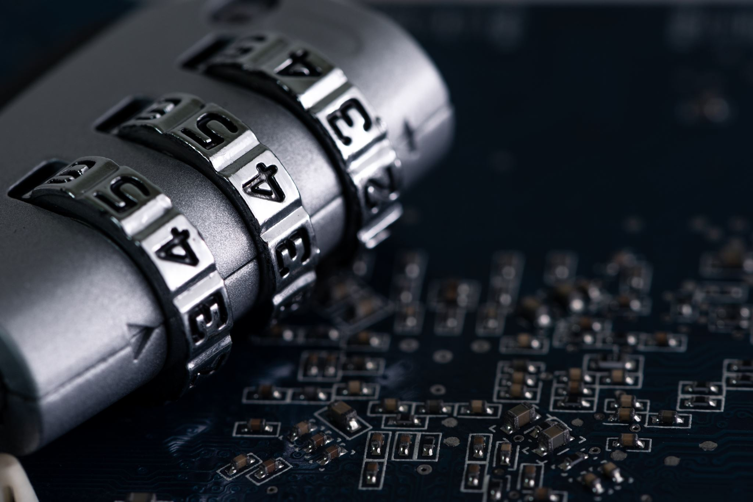
Myth #3 Bitcoin’s Main Use Case is Crime
“Bitcoin is often mistakenly characterized as “anonymous” currency. In fact, it is relatively easy to connect identities to bitcoin addresses and, using big-data analytics, connect addresses to each other to form a comprehensive picture of someone’s bitcoin spending habits.”
~Andreas M. Antonopoulos, Mastering Bitcoin: Unlocking Digital Cryptocurrencies

Slide 20
Other Faiths?
Islam: not likely to innovate in this space, as speculation is frowned upon, but once socially accepted, Bitcoin is certainly not at odds with Sharia Law.
While “friendliest crypto country” lists rarely include Islamic countries, the UAE is definitely an exception, with no personal income tax, it makes buying and selling crypto much more appealing to investors and holders alike.
Judaism:
Israeli crypto industry veteran Danny Brown Wolf thinks crypto and Judaism are quite compatible, saying that “being Jewish, we pretty much all have in our family history some form of immigration story that involves being forced to leave assets behind. Given this history, Jews of all peoples ought to appreciate financial sovereignty.”

Slide 21
Friendliest Crypto Countries
Regardless of who compiles the list, the following countries all appear on “top 10” or “top 20” lists somewhere:
Portugal
Malta
Argentina
El Salvador
These countries all have deep Catholic roots, which may be a coincidence, but may stem from the idea that “Crypto” and “Catholic” are perfectly compatible at a philosophical level.

Slide 22
Reality Check
While crypto in general, and perhaps Bitcoin more particularly are perfectly in line with Catholic tradition, the religious ferver that sometimes overtakes advocates can be questionable….Bitcoin does not solve everything.
Largest Bitcoin holders sometimes being called “Bitcoin Jesus,” is not something we should be promoting.
The first block in the Bitcoin blockchain was aptly called “The Genesis Block” and while there’s clearly nothing wrong with the term, it sometimes sets in motion the idea that Bitcoin is something close to a religious movement.
Because Bitcoin’s inventor has chosen to remain anonymous, it is sometimes said to have been “immaculately conceived.” Again, attributing religious like terms to Bitcoin can be problematic.

Slide 23
Crypto in General vs Bitcoin Specifically
Anyone can build and launch a crypto currency. Sometimes it’s all in fun, sometimes it’s to make a political statement.
“Sponge” token in honor of Sponge Bob Squarepants
“Let’s Go Brandon” token as a mockery of Joe Biden
The ease with which tokens can be created most certainly allows for scams or just dumb ideas to proliferate. Don’t allow the noise of these silly tokens to take away the value of what has been built on Bitcoin’s global network.

Slide 24
Central Bank Digital Currencies (CBDCs)
In July of this year, the Fed quietly launched something called FedNow; something that can be compared to a quicker ACH system.
FedNow can be seen in some ways as a development that helps pave the way for Central Bank Digital Currencies, (CBDCs).
CBDCs should not be misconstrued as “crytpo’s” as they are most certainly not decentralized, rather they are just the opposite.
Just because CBDCs aren’t true cryptos doesn’t mean you have to completely avoid them, but you do need to understand them.
They are programmable (they can be like coupons and expire).
They can be very targeted (only for use at “approved” locations.
They can be turned off.
They can be tracked.

Slide 25
CBDCs (Continued)
If you know what CBDCs are, you can manage them just like you do your other investments, accounts, and holdings.
For example, assume the absolute worst about things, and that CBDCs are truly a surveillance mechanism right out of a George Orwell novel. Knowing that, perhaps you:
Only use them to buy groceries
Only use them to pay your water bill
Only use them to pay for your child’s school tuition
In other words, if money is simply being doled out via a CBDC, it is likely to be very difficult to simply not participate in the “free money” give away.

Slide 26
Closing Comments and Opinions
Bitcoin is now roughly 15 years old. Every day that it’s not dead makes at a little less likely that it is going to die. This does mean that the risk to reward ratio is shrinking.
Bitcoin can not exist in the price range of where it currently sits (roughly $30K). In other words, it has to continue growing, or it dies. There is no world in which Bitcoin trades for roughly $40K per token over the course of the next decade. As it pertains to an investment, it is either going to be the greatest asset you have ever owned, or it’s going to be a complete bust. In the long term, there will be nothing in the middle.
Have you missed the opportunity? How many investments do you own that you expect to triple in value over the next 4 years?

Slide 27
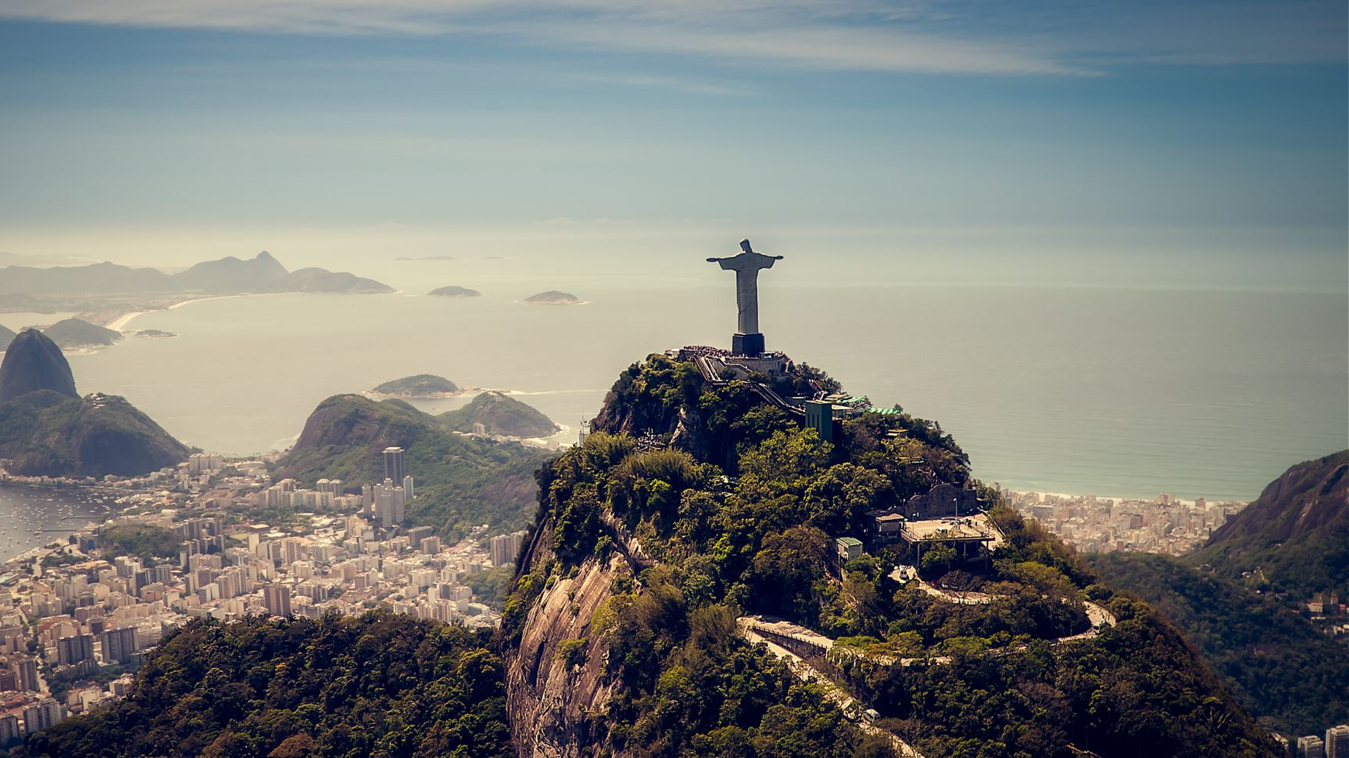
“Behold I send you as sheep in the midst of wolves. Be ye therefore wise as serpents and simple as doves.” ~Matthew 10:16

