Slide 1
Model | T4 SERIES | D4 SERIES | D SERIES | M SERIES
Diagonal size | 65’’, 75’’, 86’’ | 55’’, 65’’, 75’’, 86’’ | 55’’, 65’’, 75’’, 86’’ | 65’’
Resolution | 4k Ultra HD | 4k Ultra HD | 4k Ultra HD | 4k Ultra HD
Touch technology | Projected capacitive | Projected capacitive | Projected capacitive | Projected capacitive
Android system | Android 8.0 | Android 8.0 | Android 6.0 | Android 6.0
Processor | Dual-A73+Dual-A53@1.5GHz | Dual-A73+Dual-A53@1.5GHz | Qual-core A53@1.4GHz | Qual-core A53@1.4GHz
Ram+Rom | 4G+32G | 4G+32G | 2G+32G | 2G+32G
Touch points | 60 points | 60 points | 60 points | 60 points
Camera | 5MP | 5MP | 1MP | ×
Microphone | √ | × | × | ×
Miracast(Eshare) | √ | √ | √ | √
Constrast ratio | 1300:1 | 1300:1 | 1300:1 | 4000:1
Response time | <10ms | <10ms | <15ms | <15ms
PC module(OPS) slot | √ | √ | √ | √
HDMI out | √ | √ | × | ×
Brightness | 350nits | 350nits | 350nits | 300nits
Speaker position | front | downward | downward | front

Slide 2
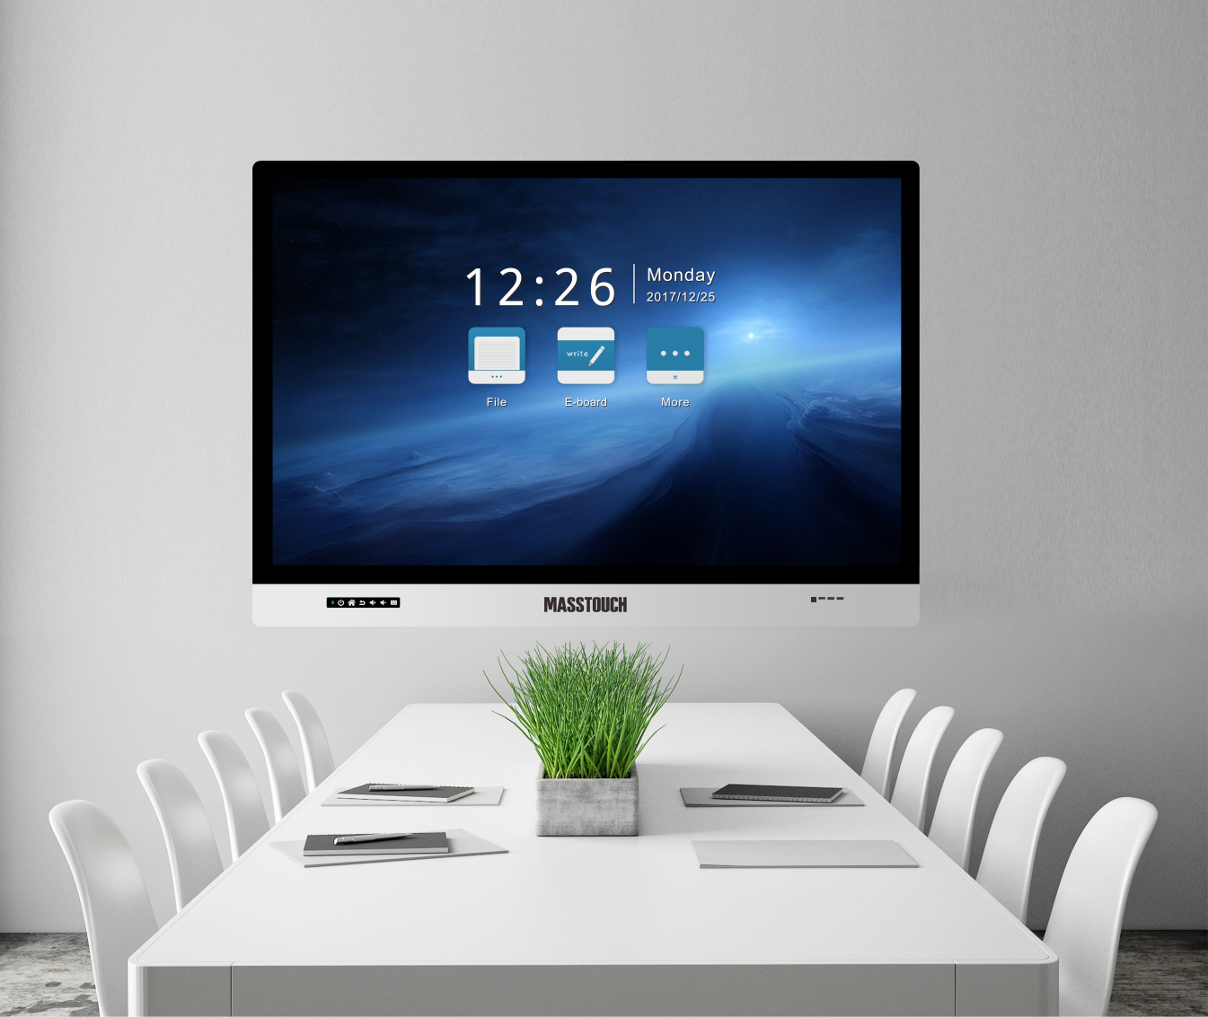
MASSTOUCH （M Series)
4k Ultra HD
Wireless Screen Share
60 Point Capacitive Touch
Smart Whiteboard

Slide 3
Smart Whiteboard
Write, Erase
Zoom In/Out
Drag &Drop
Add/Delete Page

Slide 4
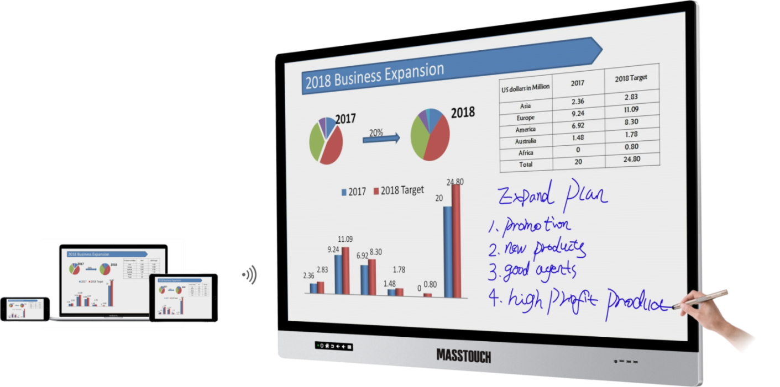
Wireless Screen Sharing
Screen share wirelessly from Android/iOS/Win
Bidirectional control

Slide 5
Annotation
Highlight key points
Add notes and
write on screen
as easily as paper

Slide 6
Scan & Share
Generate QR Code for record or annotation
Scan & Share
Save or Email

Slide 7
Super Cool experience
60 point
Capacitive touch
Highly accurate
& sensitive

Slide 8
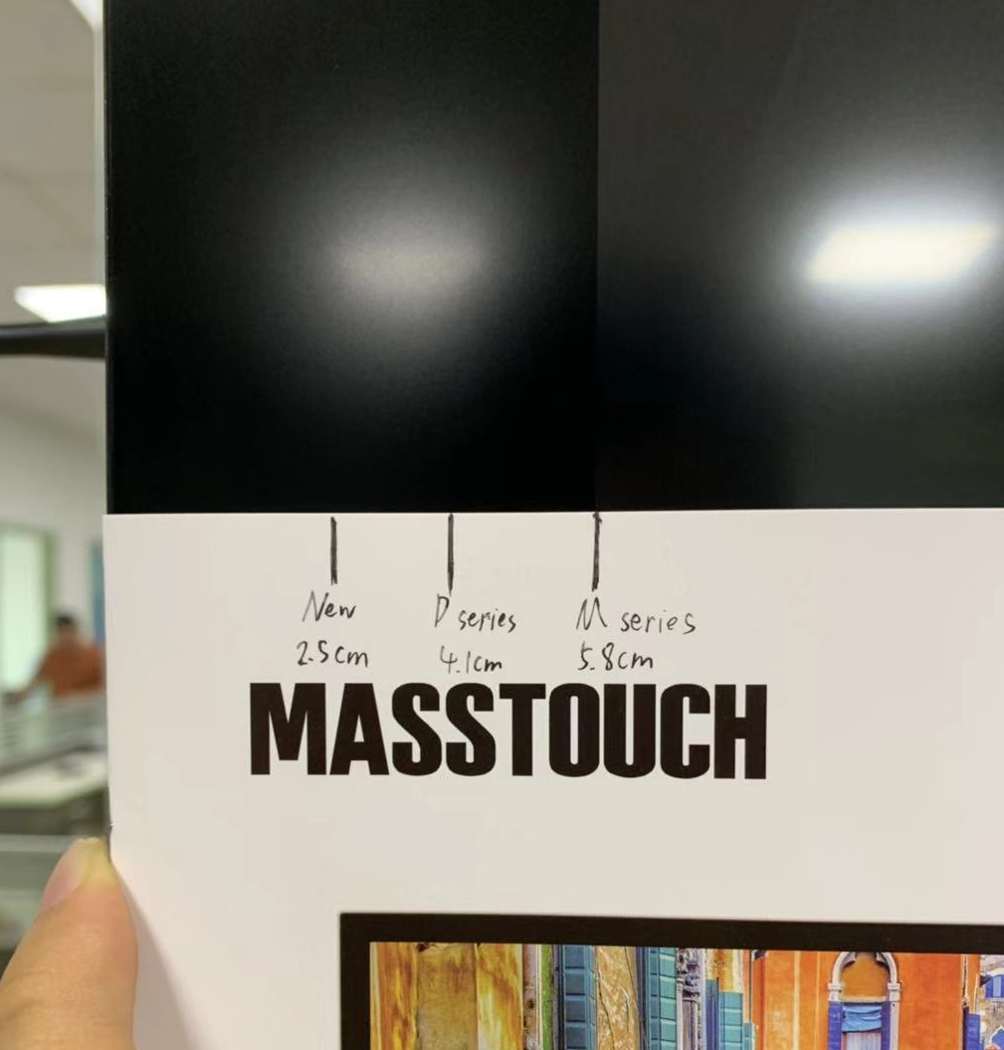
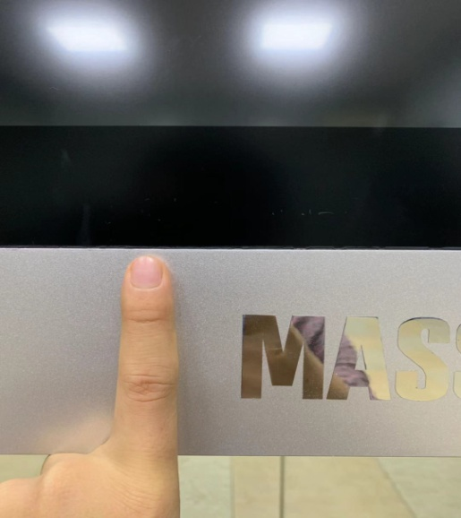
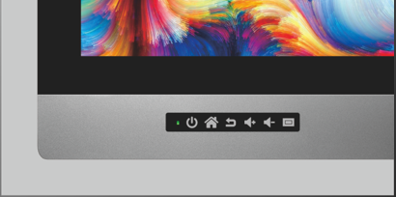
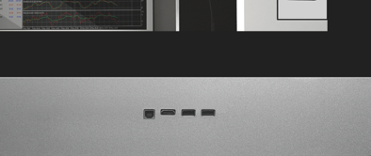
More details
The width of frame
is 58 mm.

Slide 9
MASSTOUCH （D Series)

Slide 10
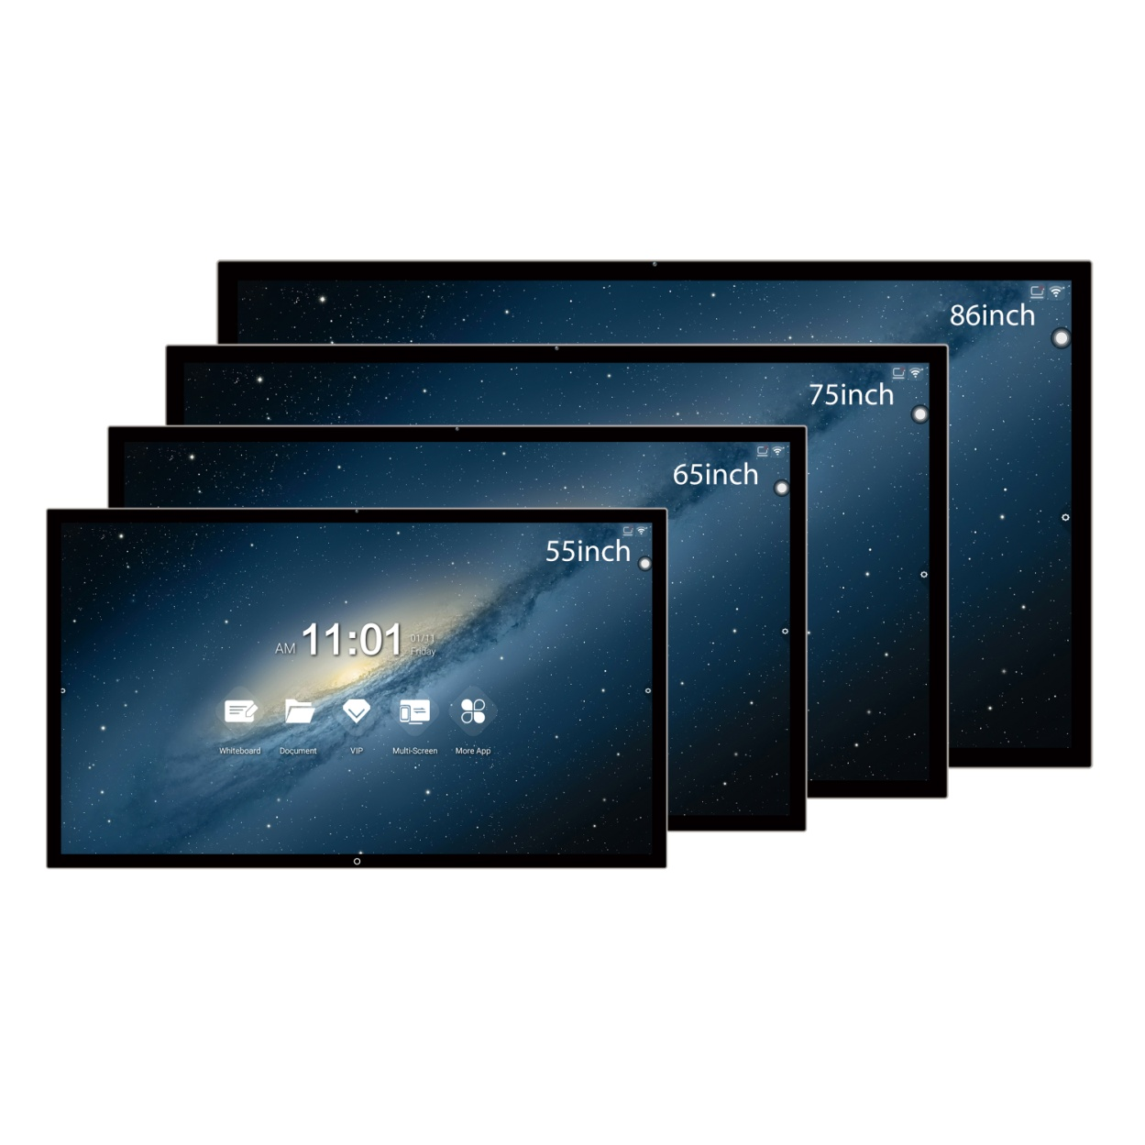
Enjoy
gorgeous
Vision
60-points touch
Reveal True color
Enjoy optimized
picture

Slide 11
Make learning fun and simple
Attractive presentation
Interesting
interaction
Enjoy learning

Slide 12
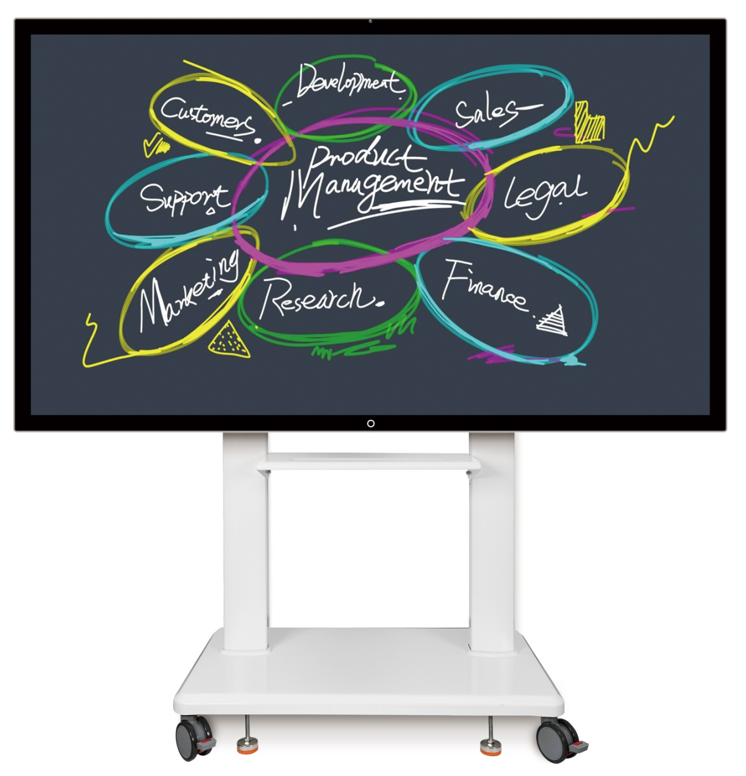
With a simple appearance
Simplifying for true beauty
Security and stability are meanwhile guaranted
Android 5.1/6.0/8.0

Slide 13
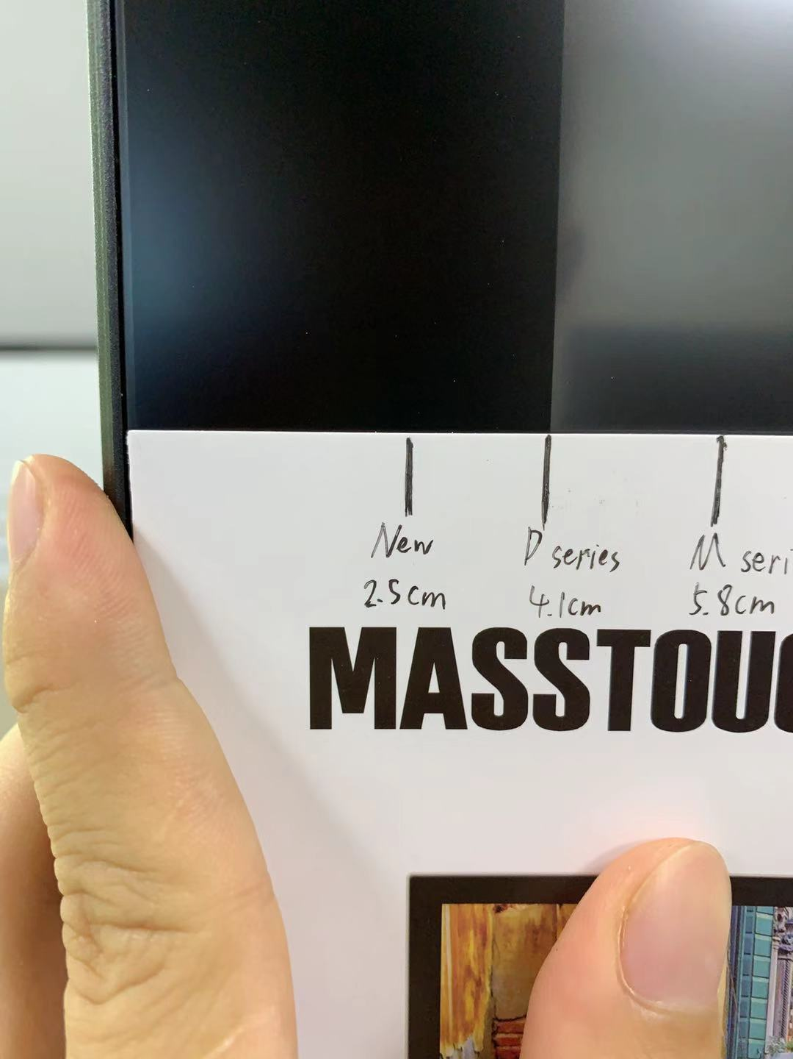
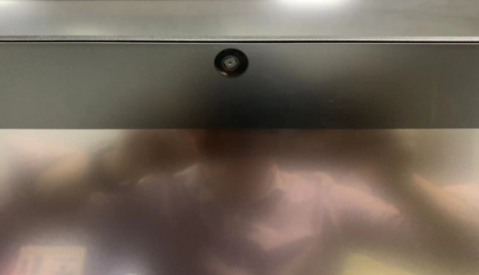
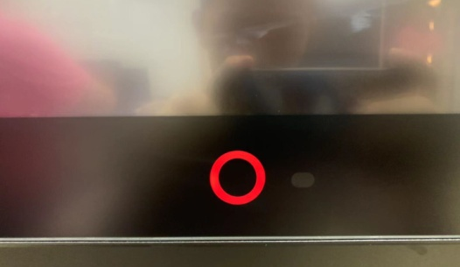
More details
The width of frame
is 41 mm.

Slide 14
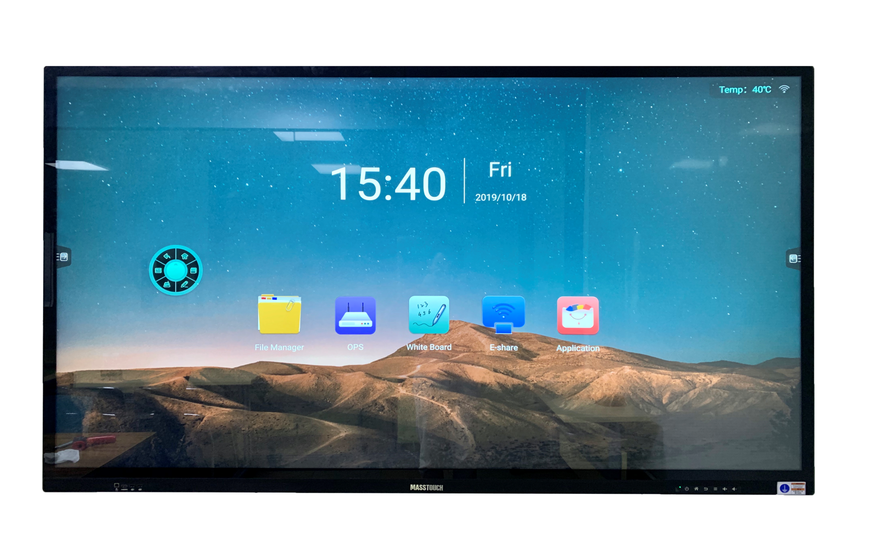
Masstouch T4 series

Slide 15
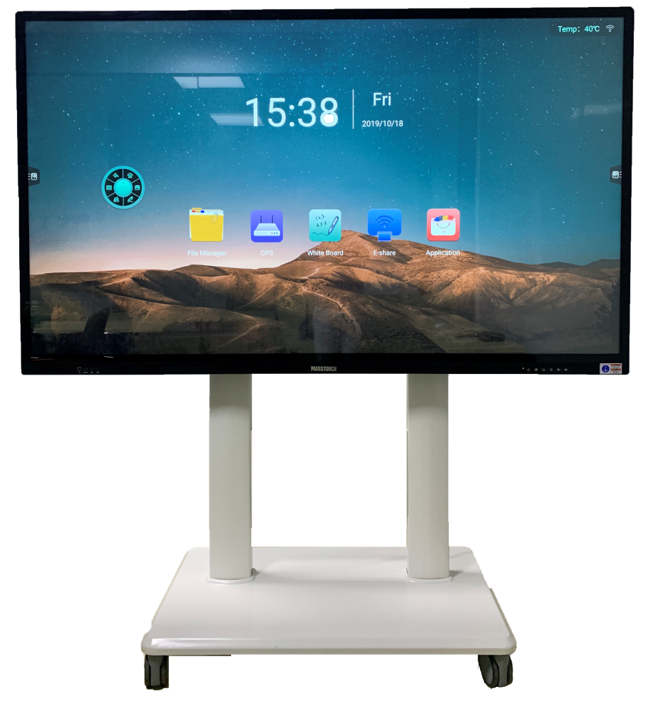
5 MegaPixels
(2560x1960)
Microphone Array
Slim Frame
Capacitive Touch Key

Slide 16
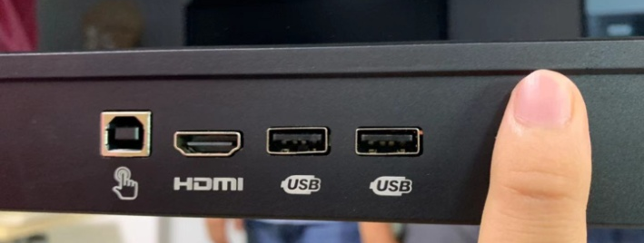
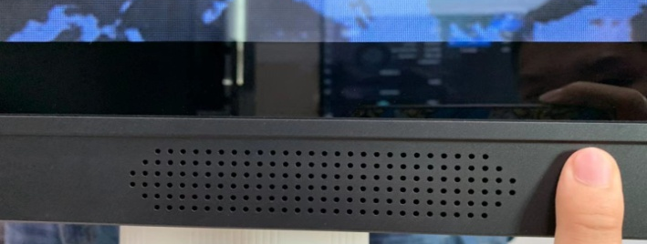
More details
The width of frame is 25 mm.
The thickness of bezel is 21 mm.

Slide 17
MASSTOUCH
MASSTOUCH
www.mstboard.com
ethan@mstboard.com
Mol/whatsapp/Line/Wechat:+86-150-0890-6018
www.mstboard.com
ethan@mstboard.com
Mol/whatsapp/Line/Wechat:+86-150-0890-6018
Our office
4th Floor, Rongshengda Industrial Park, No.8 Liaokeng Road,
Baoan District, Shenzhen,China
Divine International Co.
(Delhi, India)
Website: divineint.in/interactive-panel
Phone: +91 9654779936
Email: Pallavi@divineint.in
Millenium Tower Pitampura , Delhi -34
INDIA
Afara Group Ltd.
(Bangkok, Thailand)
Phone: +66(8)1-436-8887
Email:jack@afaragroup.com
555/20 Moo 4, Ratchaphruek RD, Mahasawat, Bangkruei NONTHABURI 11130

