Slide 1




This presentation and the contents within are intended to provide broad financial education and should not be construed as advice or a recommendation to take any action.
Notes:
(read slide)

Slide 2

FACING THE CHALLENGES
NOT INTERESTED IN THEIR
FINANCIAL FUTURE
Bad habits and
poor decisions can add up.
INCREASING DEBT
PAYCHECK-TO-PAYCHECK
NO EMERGENCY FUND
SPENDS A LOT
What do the wealthy know that the rest
of us do not?
NO GOALS
NO BUDGET
Notes:
(read slide)

Slide 3


PEOPLE ARE LIVING LONGER
Challenges in an aging world:
Lower birth rates²
More single parents³
Increasing health concerns⁴
Appropriate housing and supervision
Transportation, mobility
Wealth transfer, health directives
Financial security: Social Security,
savings, taxes⁵
TOTAL LIFE EXPECTANCY AT BIRTH¹
 | 2023 | 2030 | 2060
TOTAL | 79.8 | 80.7 | 84.3
Males | 77.3 | 78.5 | 82.5
Females | 82.2 | 83 | 86.1
Are you too busy during the first half of your life to prepare for the second half?
1 U.S. Census Bureau, 2023 National Data Population Datasets. https://www.census.gov/data/datasets/2023/demo/popproj/2023-popproj.html
2 National Center for Health Statistics, U.S. Fertility Rate Drops to Another Historic Low. https://www.cdc.gov/nchs/pressroom/nchs_press_releases/2024/20240525.htm
3 U.S. Census Bureau, Census Bureau Releases New Estimates on Families and Living Arrangements. https://www.census.gov/newsroom/press-releases/2024/families-living-arrangements.html
4 Centers for Medicare & Medicaid Services, NHE Fact Sheet 2022. https://www.cms.gov/data-research/statistics-trends-and-reports/national-health-expenditure-data/nhe-fact-sheet
5 Neither World Financial Group Insurance Agency, LLC, its affiliated companies, nor its agents may provide tax or legal advice. Anyone to whom this material is promoted, marketed, or recommended should consult with and rely on their own independent tax and legal professional regarding their particular situation and the concepts presented herein.
Notes:
People are living longer. Take a look at this projected life span of males and females in 2030 and 2060.
With that comes many challenges in an aging world:
We’re seeing a decline in number of people having children, even more single parent families, and the cost for health care increasing.
As we get older there may be hurdles with the proper housing, who watches and cares for us/them, and certainly about our transportation and mobility,
We’re faced with having to deal with transferring wealth, finalizing our health directives.
And of course, making sense of our overall financial security regarding things like government benefits, savings and taxes.
Regardless of the number of challenges we’re faced with, we must over come them.
Ask yourself: are you too busy during the first half of your life to prepare for the second half?

Slide 4
BUILDING A FINANCIAL FOUNDATION
Set goals. Take action.
Your current financial situation
Your future financial goal
?
INVESTMENT
20x income
?
EMERGENCY FUND
6+ months
?
DEBT MANAGEMENT
0
?
PROPER PROTECTION
10x income
LEARN
MORE!
Without a strong foundation, your financial house won’t stand!
SYF
7
Notes:
Like building a house, you should start with a solid financial foundation and build it from the ground up.
First, you should have proper protection in the event of disability, health problems, or premature death.
It’s important to reduce your liability and get out of debt.
A good rule is to set aside at least 3 to 6 months of your income to deal with sudden changes at your job or business or to pay for unforeseen accidents or repairs.
And you should save and invest for the long run. All these tasks should be done as soon as possible.
Consider your financial situation: what does each of these parts look like?
Think about your future financial goal – what would you like to accomplish? What can we work towards?
Without a strong foundation, your financial house won’t stand!

Slide 5
THE X-CURVE CONCEPT
TAKE CARE OF YOUR FAMILY
TAKE CARE OF YOURSELF
DIME METHOD
WEALTH FORMULA
+ Debt
+ Money
+ Income x 10
+ Time
+/- Rate of Return
+ Mortgage
- Inflation
+ Education
- Tax
= Insurable Need
= Wealth
Formula 10/20:
You may need 10 times your income to protect your family.
You may need 20 times your income to take care of your future retirement.
LEARN
MORE!
SYF
The DIME Method is only one method to help determine a client’s insurable need. However, an insurable need of more than 10 times the client’s current income may not be accepted, unless special exceptions apply. Individual situations may vary. Individuals should always consult with their insurance agent/professional to ensure that they have proper protection that meets their unique needs. This is a concept/goal developed by World Financial Group Insurance Agency, LLC (WFGIA) for illustrative purposes only. In no way does this statement offer, guarantee or otherwise imply any financial gain or reward as a result of joining WFGIA. The term “wealth” is subjective and must be defined on an individual basis. World Financial Group and its independent agents do not offer tax and/or legal advice. Please consult with your personal and/or legal professional for further guidance.
24
Notes:
This brings us to our next concept, the X-curve – a powerful concept that shows the general relationship between responsibility and building wealth.
Over time, there are two things we want to be able to take care of…
One curve is about taking care of our family. In the beginning they need much care, protection, and they are a high level of responsibility. One way of ensuring proper protection of our responsibilities is using the DIME Method. By adding up our debt, replacing our income (multiplying it by 10), outstanding mortgage, and lastly adding how much we would like to contribute to our children’s higher education, equals our insurable need. Over time, we can see that responsibility decrease as debt and mortgage get paid off, and kids finish school and grow up.
The other curve is one of building wealth, or a way to look at it, taking care of yourself and your financial future. This increasing curve can be illustrated by a simple method called the Wealth Formula. Money, plus time, plus or minus the rate of return on our money, minus inflation, less taxes equals our wealth.
A good rule to use is something called the Formula 10/20. Meaning you may need 10 times your income to protect your family. And you may need 20 times your income to take care of your future retirement.

Slide 6
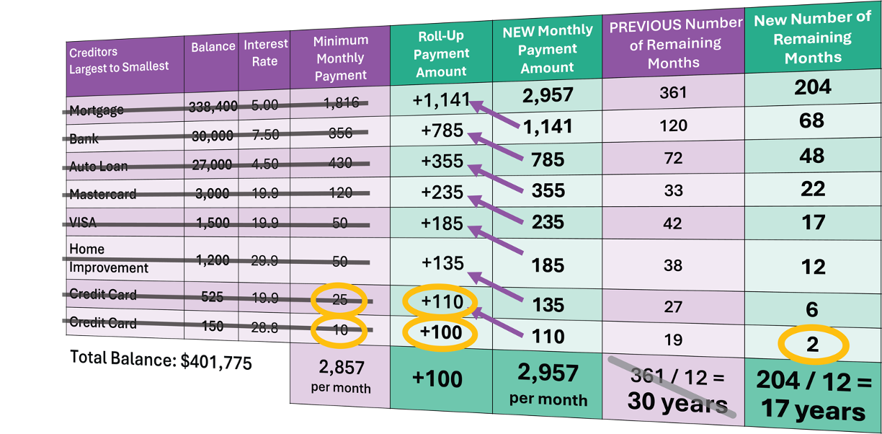
CONTROL YOUR DEBT
Is debt affecting your way of life?
Did you know an extra $100/month can dramatically save time and reduce your debt!
You can prevent debt from impacting your future!
For illustration purposes only.
Notes:
If you remember from the Financial Foundation, one section was about manage debt.
Is debt affecting your way of life?
Here is an example from one of our workshops where we teach about debt roll-up.
It’s a technique to pay off your debt faster that starts with paying off the lowest balances and “rolling up” or using what you would have toward the payments of the higher balances.
In this example, see how they’ve went from paying off their debt in 30 years to 17.5 years.
This concept is our thought on how to handle debt in a systematic way.
Even just an extra $100 per month can dramatically save you time and reduce your debt.
You can prevent debt from impacting your future!

Slide 7
THE COMPOUND EFFECT OF MONEY
Rule of 72: Divide 72 by the rate of return.
The answer is the number of years it takes to double your money.
72 / 6 = .
72 / 8 = 9
72 / 10 = 7.2
Example:
12
If you save
$100.00
Doubles every 12 yrs.
Doubles every 9 yrs.
Doubles every 7.2 yrs.
at 5% interest
+ 5.00
Years
6%
Years
8%
Years
10%
Pay a 25% income tax
- 1.25
Initial Amount
$10,000
Initial Amount
$10,000
Initial Amount
$10,000
(assumed effective tax rate)
12
$20,121
9
$19,990
7
$19,487
Net after Tax
$103.75
24
$40,489
18
$39,960
15
$41,772
Inflation at 3%
- 3.00
36
$81,472
27
$79,881
22
$81,403
Actual return
$100.75
(after tax and inflation)
36
$159,682
29
$158,631
The Real Rate
of Return
36
$309,126
LEARN
MORE!
Note: This is an example to illustrate a concept and does not represent any specific product.
SYF
Divide 72 by an annual interest rate to calculate approximately how many years it takes for money to double (assuming the interest is compounded annually). Keep in mind that this is just a mathematical concept. Interest rates will fluctuate over time, so the period in which money can double cannot be determined with certainty. Additionally, this hypothetical example does not reflect any taxes, expenses, or fees associated with any specific product. If these costs were reflected the amounts shown would be lower and the time to double would be longer.
11
Notes:
Now let’s look more into the Wealth Formula. In the next few sections we’ll be talking about Rate of Return, Inflation and Taxes, and how they can all impact our wealth.
(read slide)
By using the Rule of 72, we can calculate how much an initial principal of $10,000 changes with different interest rates.
By dividing 72 by the rate of return (or interest), equals to the approximate number of years it takes for the money to double.
Note that numbers here are actual values compounded annually. This an example to illustrate a concept and does not represent any specific product.
For example, imagine saving $10,000 in a place with an interest of 6%.
Using the Rule of 72, 72 divided by 6 equals 12, thus every 12 years the money would “double”.
12 years from now, that money would “double” to $20,112.
24 years from now, “double” to $40,489.
36 years from now, “double” to $81,472.
If in a place that grows at 8%, that same $10,000, would now double every 9 years.
From $19,990, 9 years from now, to $39,960 18 years from now.
And 27 years from now, grow to be $79,881.
36 years from now, $159,682.
If in a place that grows at 10%, that same $10,000, would now double every 7.2 years.
7 years from now, ”double” to $19,487.
15 years from now, $41,772.
22 years from now, $81,403.
29 years from now, $158,631.
And finally 36 years from now, $309,126.
So you can see how easy it is to roughly calculate compound interest using the Rule of 72.
Additionally, take a look at year 36, you can see the difference 2% and time makes. The difference between 6% and 8% is two percent, however the resulting amount at age 36 is nearly twice the amount. Also as with 8% and 10%.
Let’s look at an example: if you save $100 and put it into a place that gave you 5% interest, you would have an interest of $5.
Presuming an effective 25% income tax, it would reduce your total by $1.25 giving you a net total of $103.75.
After factoring in inflation (using an average of 3%), you would have an actual return of $100.75. What does this mean?
Do you need around 5% interest to break even on your money? It’s important to understand the real rate of return.

Slide 8
SAVING YOUR FUTURE
Assume your income is $60,000/yr, and you set aside 10%
per month into an account that grows at some interest rate.
How does saving $500/month (or $17/day) compound over time?
In 30 years, you will have:
$745,179
@ 8% =
8%
10%
$1,130,243
$745,179
$1,130,243
@ 10% =
AC
+/-
%
÷
With discipline and budgeting, you can do it!
×
For illustration purposes only. Example calculated with interest compounded monthly.
7
8
9
Notes:
Let’s understand rate of return with this hypothetical example.
Assume your yearly income is $60,000 and you set aside 10% each month.
If you were to save $500/month (or $17/day) at age 30, and put it in a place that hypothetically gets 8% rate of return,
compounded monthly, then in 30 years, you would expect to have $745,179.
If the rate of return was at 10%, then it would grow to $1,130,243.
With discipline and budgeting, you can do it!

Slide 9


INFLATION: THE SILENT KILLER
AVERAGE COST OF LIVING
The 70s
The 90s
TODAY
New Home ²
$23,400
$123,000
$535,800
Gallon of Gas ³
$0.36
$1.34
$3.43
Loaf of Bread ⁴
25 cents
70 cents
$1.54
Wages ⁵
$9,350
$28,970
$65,470
$4,000
PER MONTH
WHAT WILL YOUR $100 DO IN THE NEXT 20 YEARS?
Years
From Now
Purchasing Power Decreases to
Inflation Increase:
Amount to Equal $100
RETIRE IN
TODAY’S DOLLARS
5
$86
$116
10
$74
$134
$7,224
SAME
VALUE
IN 20
YEARS
15
$64
$156
PER MONTH
20
$55
$181
LEARN
MORE!
1 Bureau of Labor Statistics. https://data.bls.gov/pdq/SurveyOutputServlet
2 New Residential Sales – Historical Data. United States Census Bureau. https://www.census.gov/construction/nrs/historical_data/index.html
3 U.S. All Grades All Formulations Retail Gasoline Prices. https://www.eia.gov/dnav/pet/hist/LeafHandler.ashx?n=PET&s=EMM_EPM0_PTE_NUS_DPG&f=A
4 Average Price Data. U.S. Bureau of Labor Statistics. https://www.bls.gov/charts/consumer-price-index/consumer-price-index-average-price-data.htm
5 May 2020 National Occupational Employment and Wage Estimates United States. U.S. Bureau of Labor Statistics. https://www.bls.gov/oes/current/oes_nat.htm
Assuming a 3% inflation rate.
SYF
14
Notes:
We touch upon this in the previous example about the compounding affect of money... Inflation.
Why a ”silent killer”? The decreasing value of our money due to inflation is something we don’t notice daily, but upon decades, you can see it’s affect!
Take the average cost of living for example.
Does anyone remember the cost of living back in the 70’s?
(read table)
Take a look at the increase in wages verse the increase of the loaf of bread, new car, and new home. Are they proportionate?
So what will your $100 do in the next 20 years? Let’s take a look…
(read table)
So if you plan to retire with $4000/month in TODAY’S value, in 20 years, you will need to have around $7,224/month to maintain the same purchasing power!

Slide 10
UNDERSTAND YOUR TAXES
WHERE DO YOU PUT YOUR MONEY?
TAX NOW | TAX LATER | TAX ADVANTAGED
CHECKING SAVINGS CD STOCK* MUTUAL FUND* | 401(k)/403(b) IRA/SEP-IRA ANNUITY PENSION | ROTH IRA 529 COLLEGE SAVINGS MUNICIPAL BOND HEALTH SAVINGS ACCOUNT (HSA) LIFE INSURANCE LONG-TERM CARE BENEFIT
Knowing the tax impact of your money
is important to build your financial future!
LEARN
MORE!
SYF
17
* Stocks and mutual funds are taxed now if the gain is realized.
Neither World Financial Group Insurance Agency, LLC, its affiliated companies, nor its agents may provide tax or legal advice. Anyone to whom this material is promoted, marketed, or recommended should consult with and rely on their own independent tax and legal professional regarding their particular situation and the concepts presented herein.
Notes:
(read slide)

Slide 11
MANAGED GROWTH STRATEGY
Your rate of return must be high enough to beat taxes and inflation.
Manage risk and preserve your principal.
GROWTH
SAFETY
TAX
ADVANTAGE
Protect your income, assets, and your life.
Prepare for long-term
care, disability, and
chronic illness.
Tax deferred and tax advantaged vehicles can play a significant role in building wealth.
PROTECTION
LEARN
MORE!
When saving and investing, consider these important factors.
SYF
79
Notes:
So we’d like to share with you a concept of understanding a more managed growth strategy.
One that looks at growth, understanding that your rate of return should be high enough to beat taxes and inflation.
Safety – something that helps manage risk and preservation of your principal.
Perhaps that has tax advantages, like tax-deferred growth and tax-advantaged access, which can play a significant role in building wealth.
Lastly, thinking about protection – protect your income, assets and your life. Preparing for the possible need for long-term care, disability, and chronic illness services.
When saving and investing, consider these important factors.

Slide 12





BUILDING YOUR FUTURE
When building a house, you need to make sure all aspects of the house (the foundation, roof, electrical, plumbing, interior…) are all working together. The same applies when building
your financial future.
?
?
Retirement
Longevity
Liabilities
?
?
Budgeting
Protection
Longevity
Estate
Assets
Retirement
Taxes
Education
Assets
Estate
Taxes
Education
Protection
Budgeting
Liabilities
Notes:
So it should be clear now, when building your future, it takes having the right foundation and strategy.
(read slide)

Slide 13
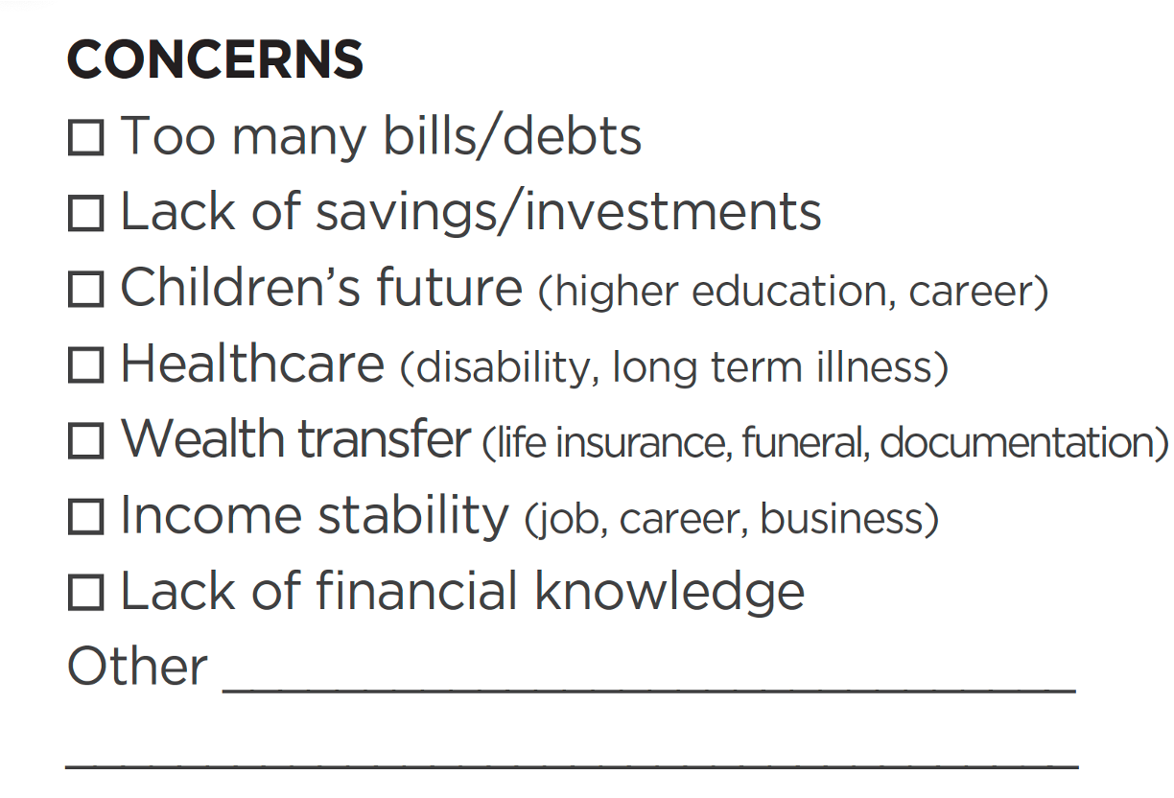
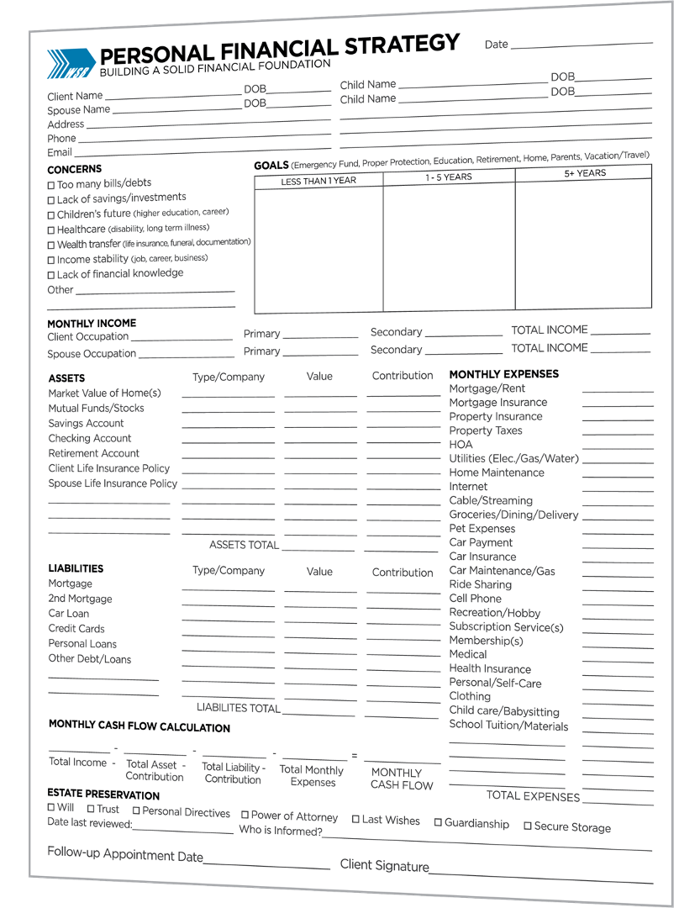
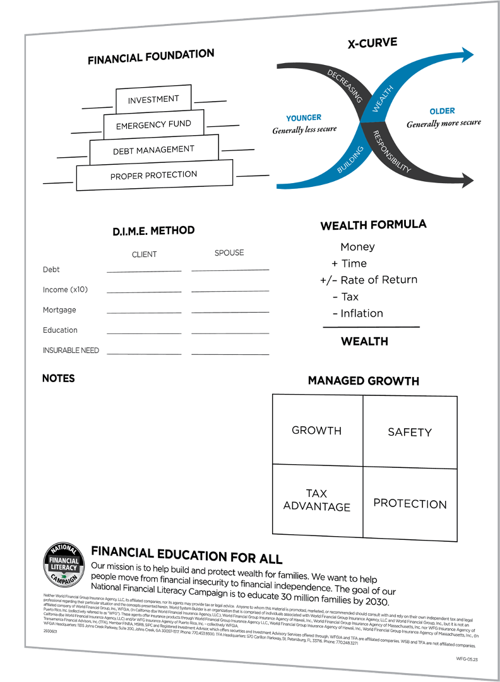
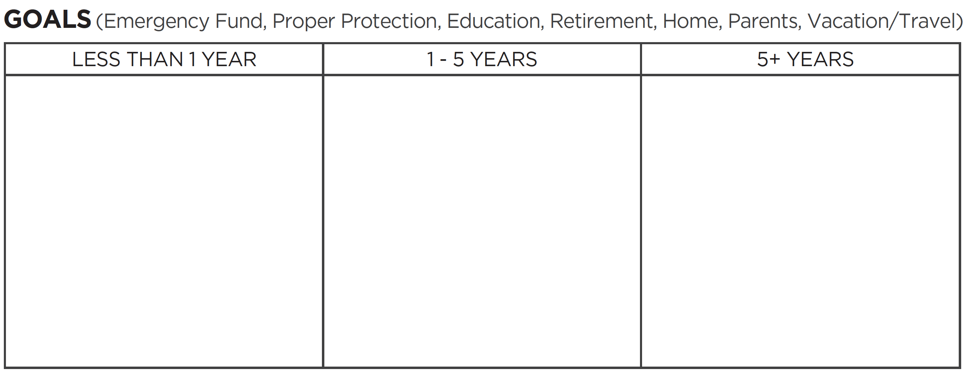



YOU NEED A FINANCIAL CHECK UP
If you have the will, we can provide the vehicle.
Financial security is not a dream. It is a priority.
Notes:
How are you going to move forward without knowing what’s going on first.
You need a financial check up.
What are your concerns right now? (read list of concerns)
Have you written down your goals for the next year, 5 years or more?
Let us work together to build a strong financial foundation.
If you have the will, we can provide the vehicle. Financial security is not a dream. It is a priority.

Slide 14


One more note…
Will your current situation allow you
to reach your goals?
Consider this:
Making extra income on a part-time basis
Multiple sources of income
Be part of the campaign that is revolutionizing the financial industry with a system that bridges financial education and financial independence.
Notes:
(read slide)

Slide 15
World System Builder is an organization that is comprised of individuals associated with World Financial Group Insurance Agency, LLC and World Financial Group, Inc., but it is not an affiliated company of World Financial Group, Inc., WFGIA, (In California dba World Financial Insurance Agency, LLC.), World Financial Group Insurance Agency of Hawaii, Inc., World Financial Group Insurance Agency of Massachusetts, Inc. nor WFG Insurance Agency of Puerto Rico, Inc. (collectively referred to as “WFG”). These agents offer insurance products through World Financial Group Insurance Agency, Inc., World Financial Group Insurance Agency of Hawaii, Inc., World Financial Group Insurance Agency of Massachusetts, Inc., (In California dba World Financial Insurance Agency, LLC) and/or WFG Insurance Agency of Puerto Rico, Inc. – collectively WFGIA.
WSB Headquarters: 2099 Gold Street, Alviso, CA 95002. Phone: 408.941.1838
WFGIA Headquarters: 6400 C Street SW, Cedar Rapids, IA 52499. Phone: 770.453.9300
3657845 WFG 06.24

