Slide 1
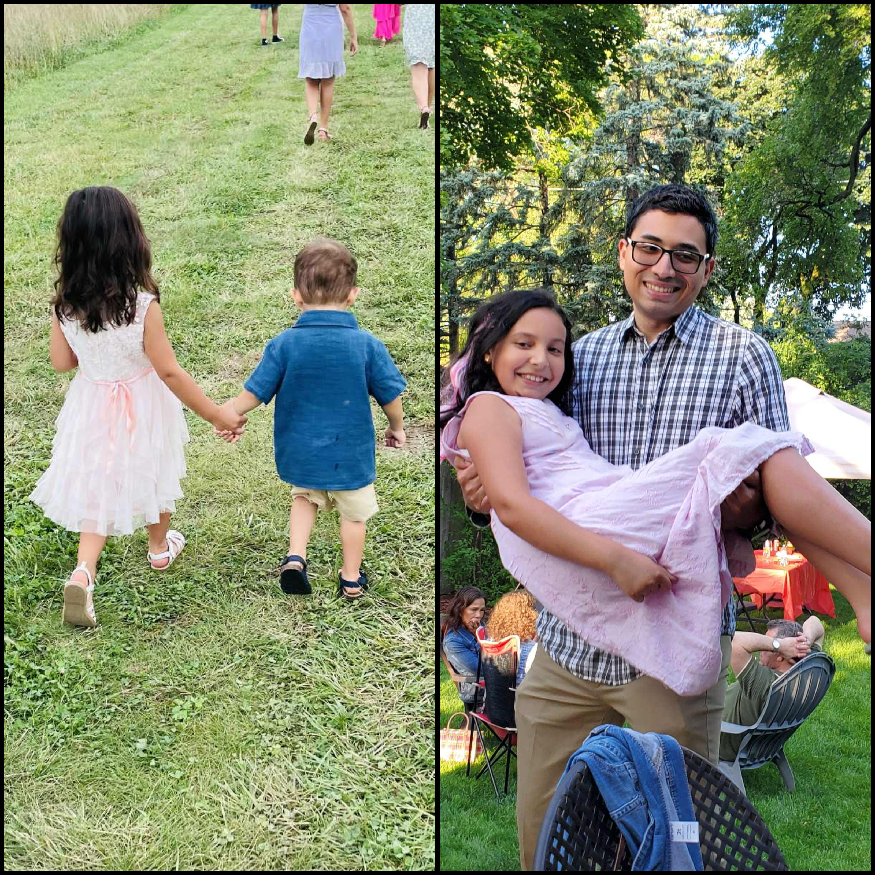
“I tell you that unless you change and become like little children, you won’t even enter the Kingdom of Heaven!”
– Matthew 18:3 CJB
A Child-Like Faith

Slide 2
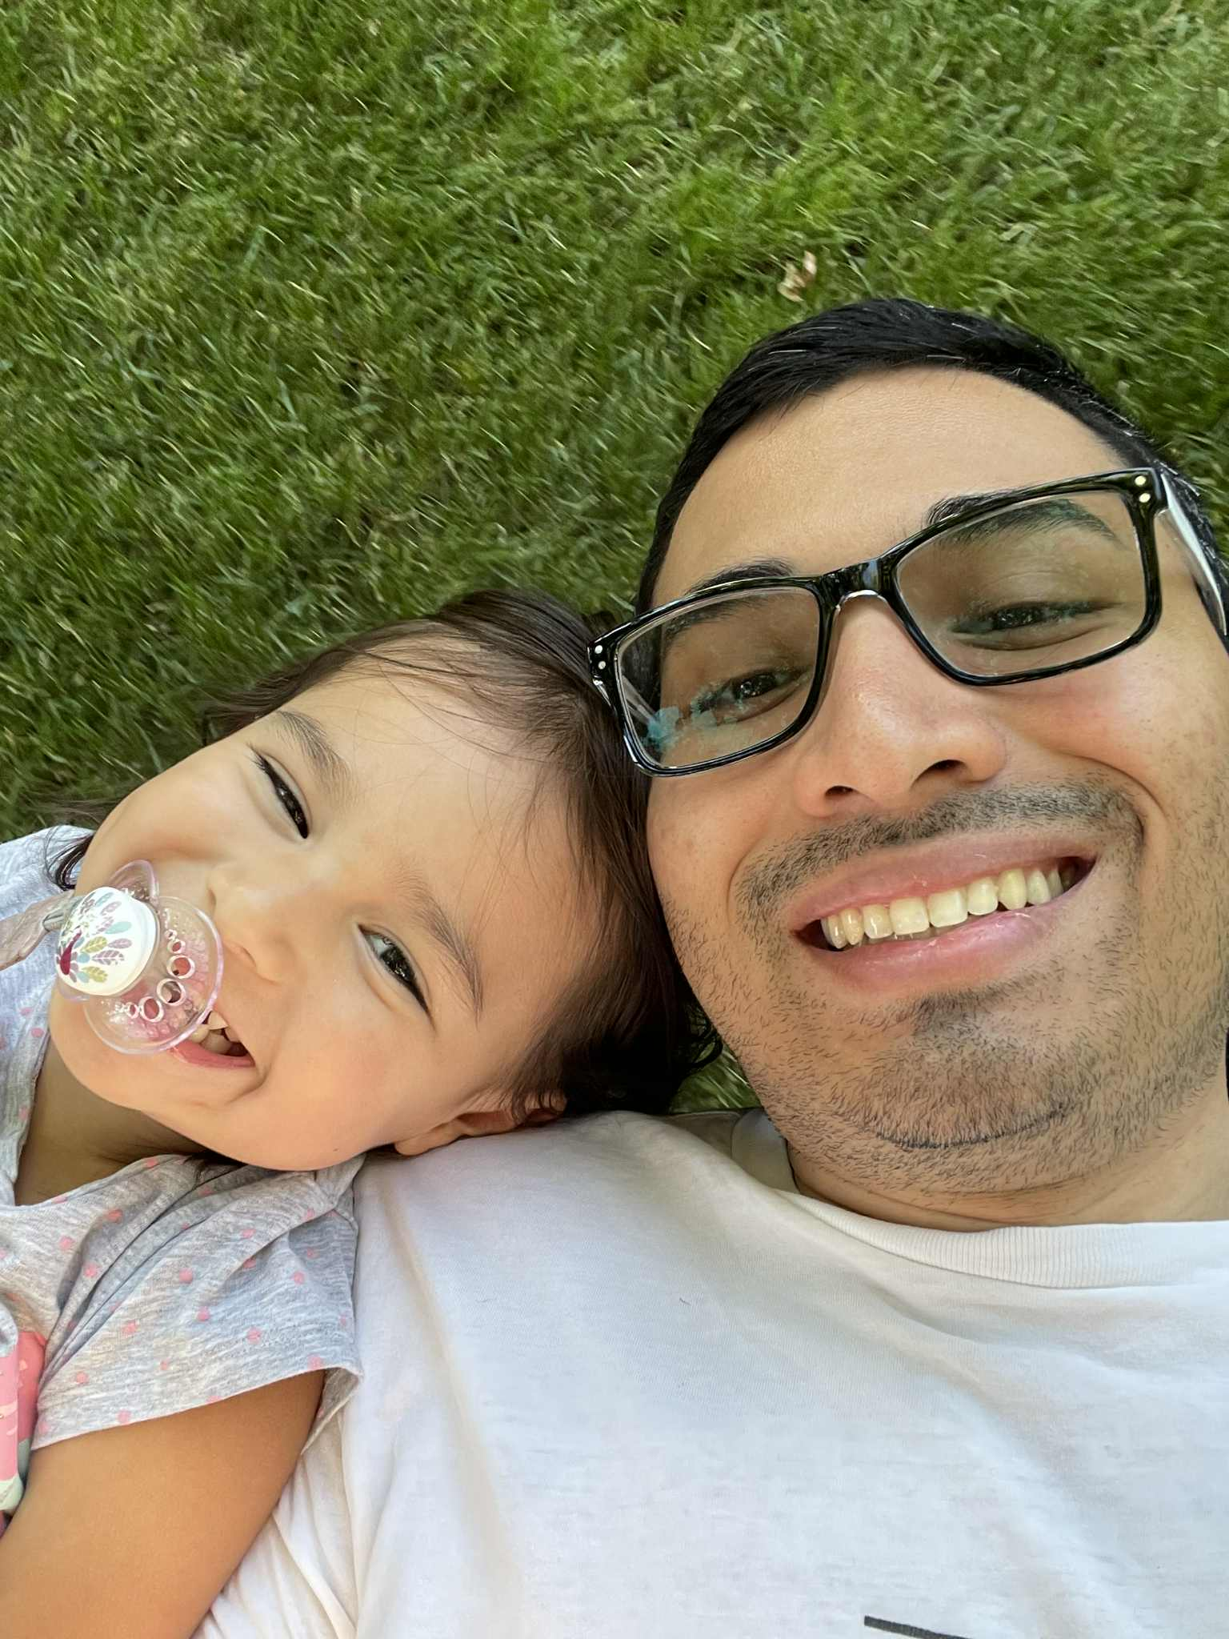
A Child Like Faith
Children Never Stop Asking Their Father Questions
“So the greatest in the Kingdom is whoever makes himself as humble as this child” Matthew 18:4 CJB
Never feel like you’ve figured everything out. Continue asking the Father
“Now if any of you lacks wisdom, let him ask God, who gives to all generously and without reproach; and it will be given to him. ⁶ But let him ask in trust, doubting nothing; for the doubter is like a wave in the sea being tossed and driven by the wind. Indeed that person should not think that he will receive anything from the Lord, because he is double-minded, unstable in all his ways” James 1:5-8

Slide 3
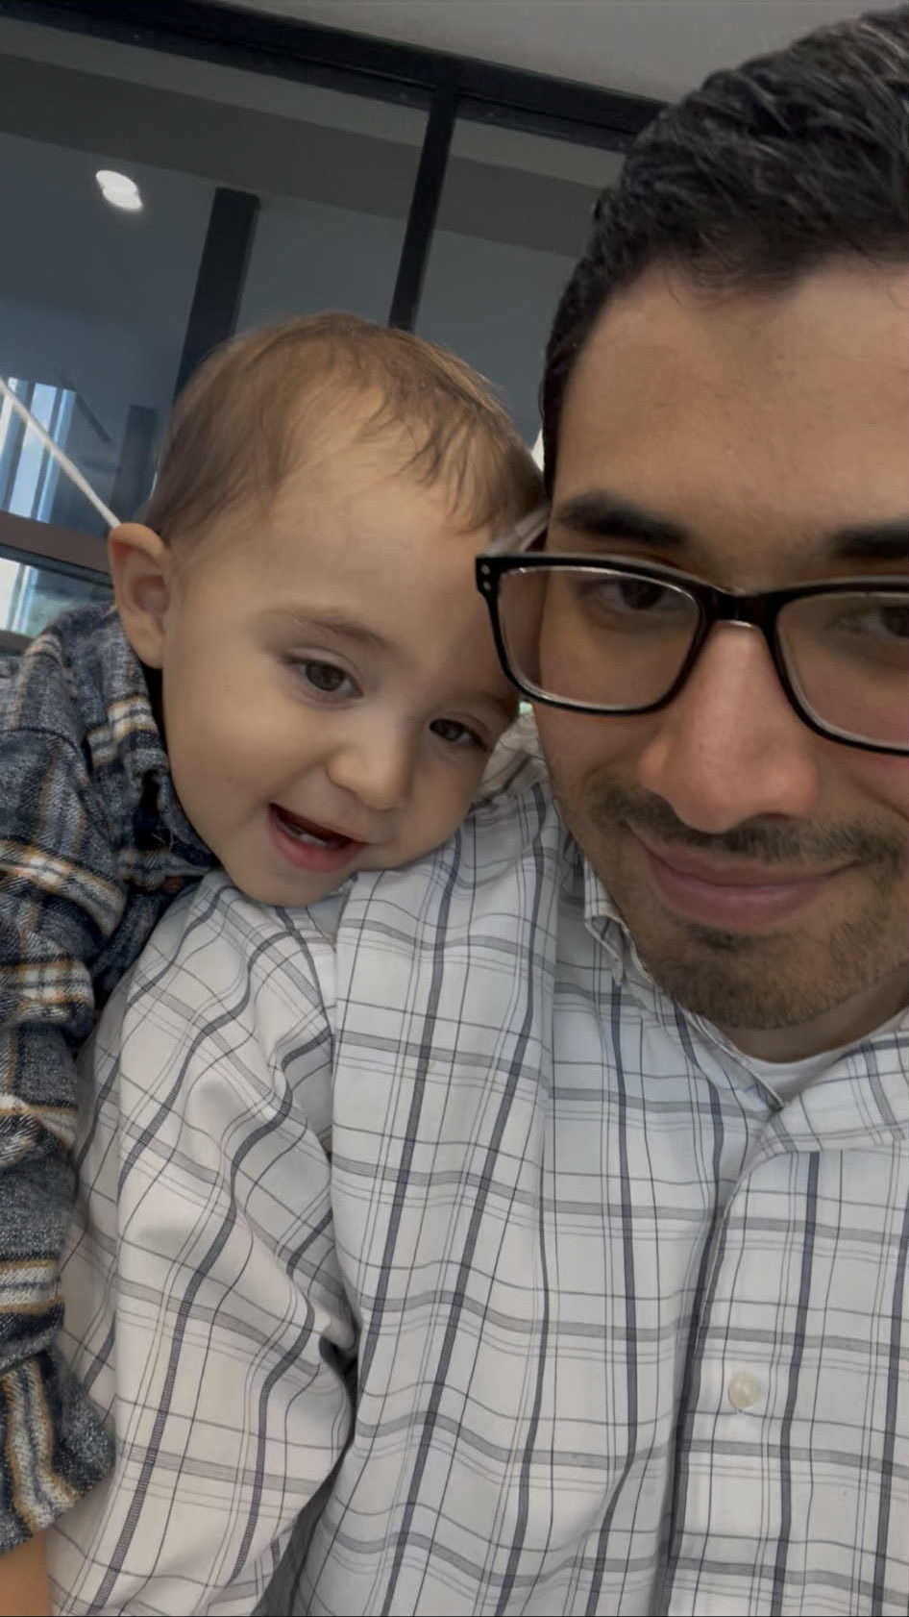
A Child Like Faith
Children Forgive, Forget, And Move On
“Get rid of all bitterness, rage, anger, violent assertiveness and slander, along with all spitefulness. Instead, be kind to each other, tenderhearted; and forgive each other, just as in the Messiah God has also forgiven you” Ephesians 4:31-32 CJB

Slide 4

A Child Like Faith
How Adults Forgive

Slide 5
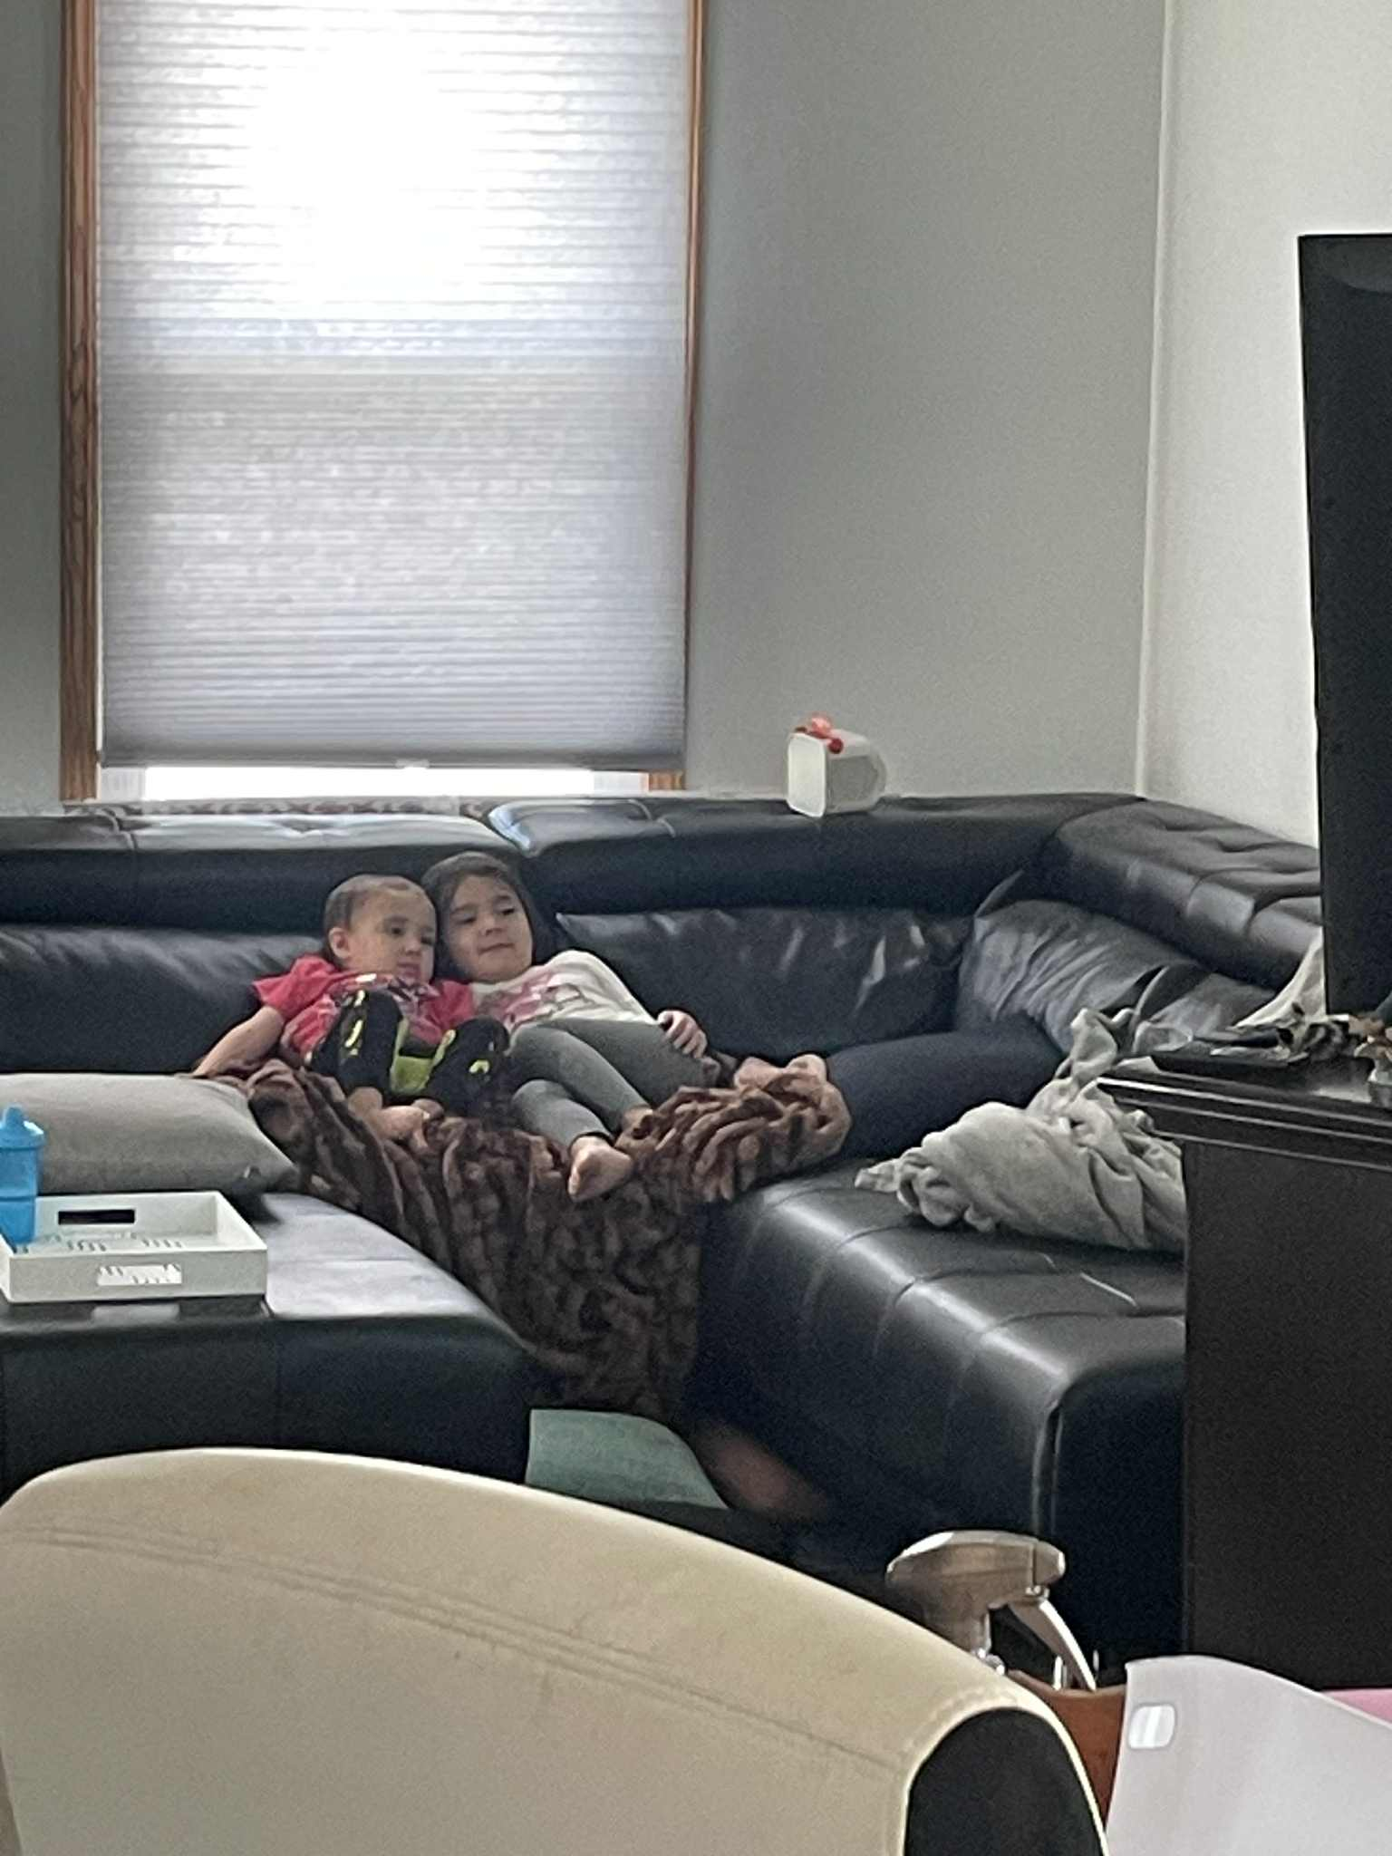
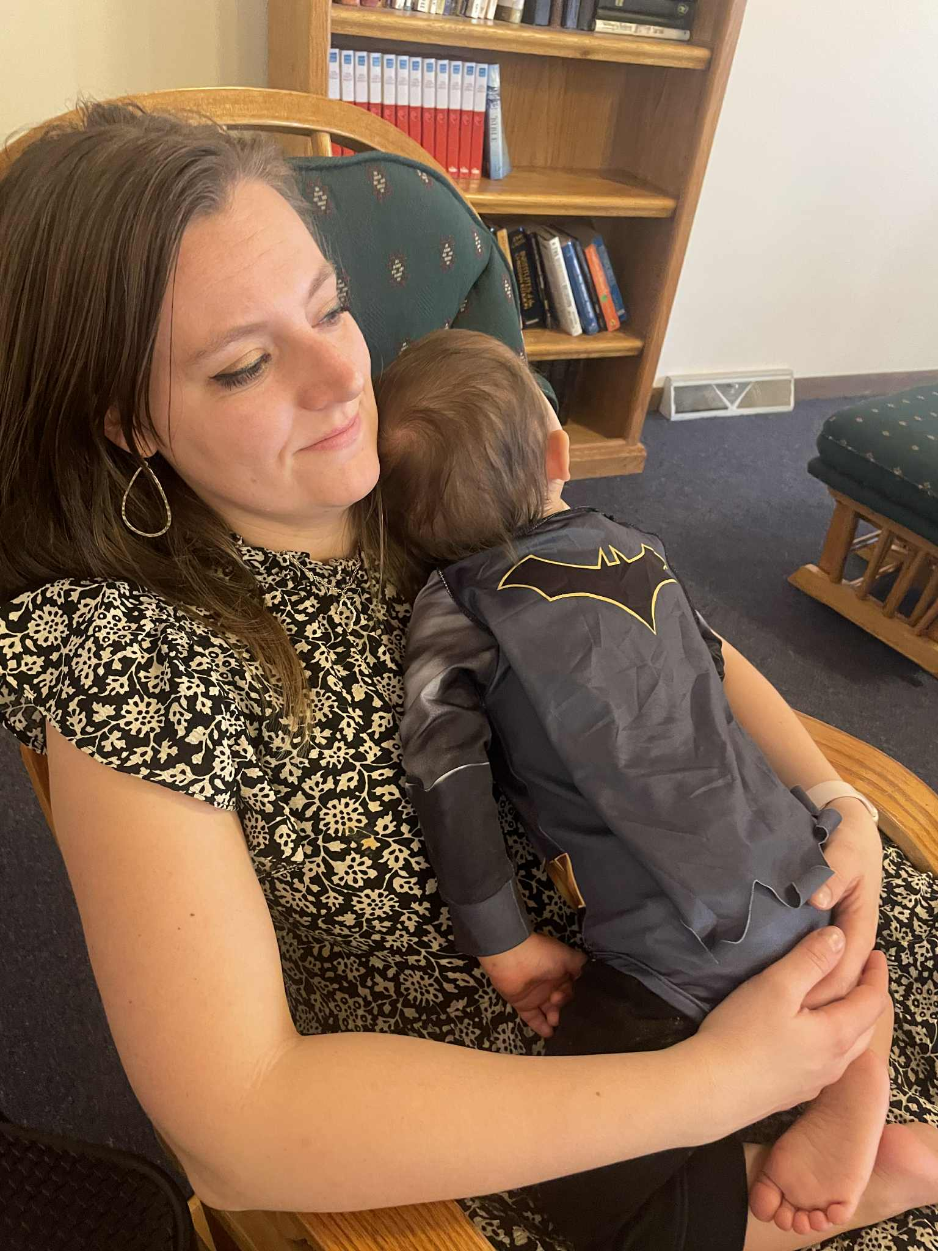
A Child Like Faith
Children Live Carefree - Faith Their Father Will Provide
“Therefore, I tell you, don’t worry about your life — what you will eat or drink; or about your body — what you will wear. Isn’t life more than food and the body more than clothing? Look at the birds flying about! They neither plant nor harvest, nor do they gather food into barns; yet your heavenly Father feeds them. Aren’t you worth more than they are? Can any of you by worrying add a single hour to his life?
“And why be anxious about clothing? Think about the fields of wild irises, and how they grow. They neither work nor spin thread, yet I tell you that not even Shlomo in all his glory was clothed as beautifully as one of these. If this is how God clothes grass in the field — which is here today and gone tomorrow, thrown in an oven — won’t he much more clothe you? What little trust you have!”
Matthew 6:25-30 CJB

Slide 6
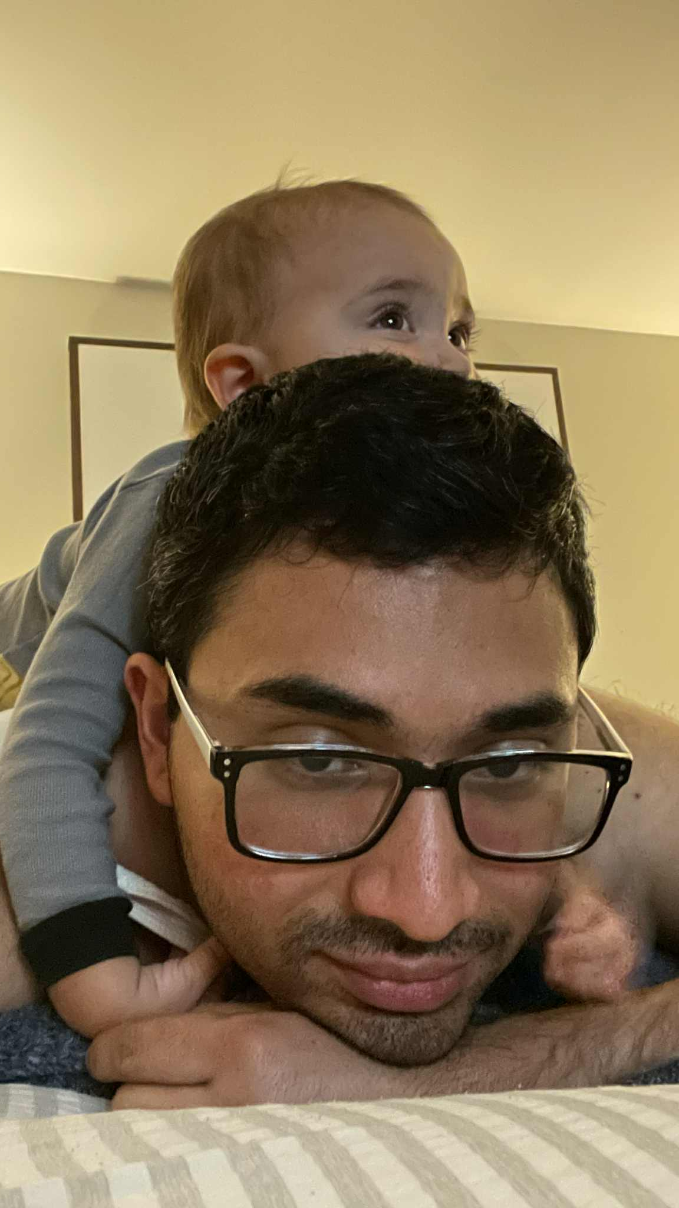
A Child Like Faith
Children Take Complete Refuge In Their Father
“The name of Adonai is a strong tower; a righteous person runs to it and is raised high [above danger]” Matthew 18:5-6 CJB

Slide 7
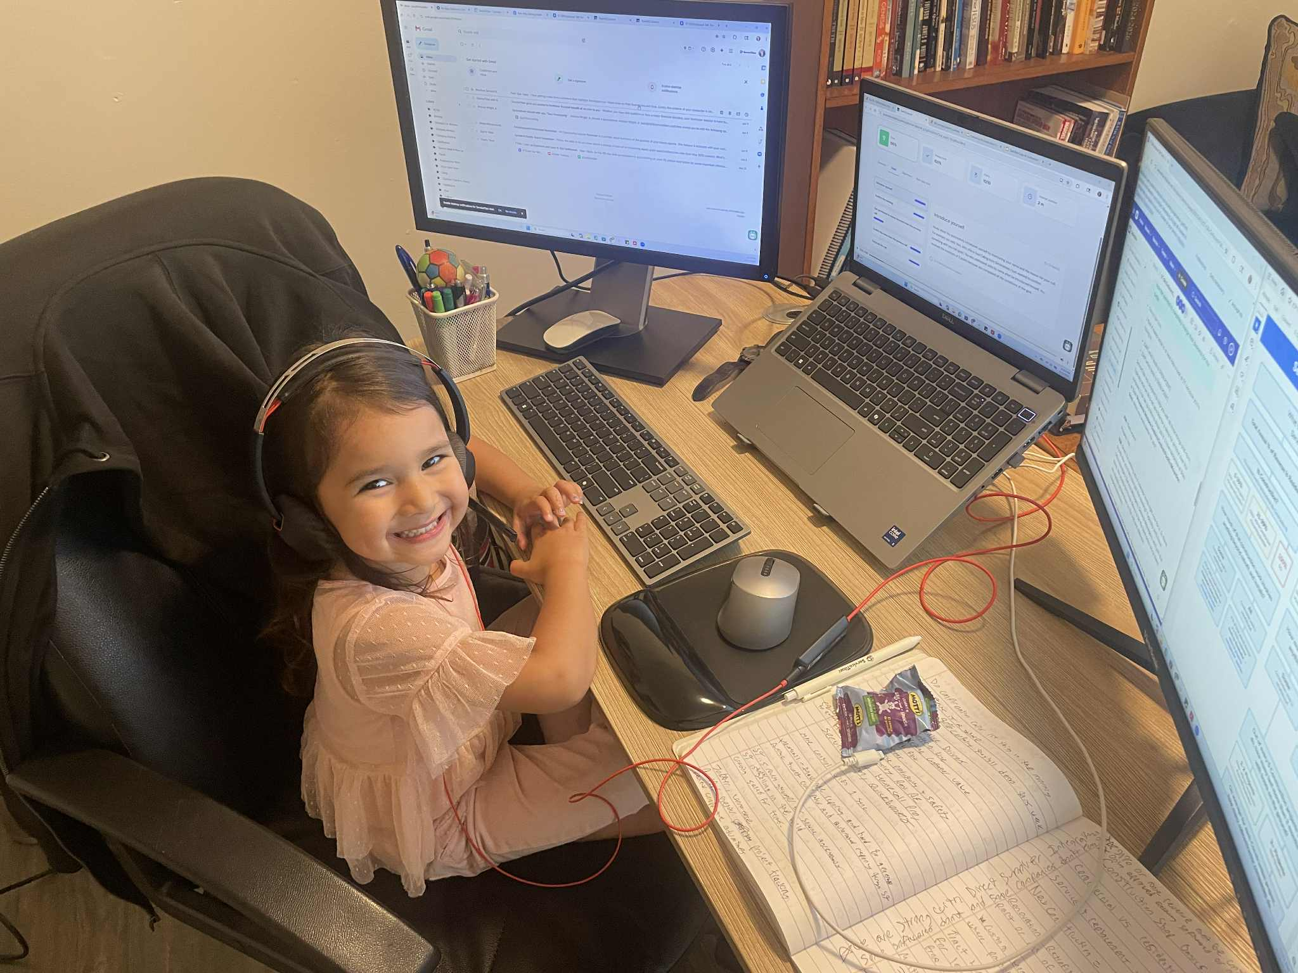
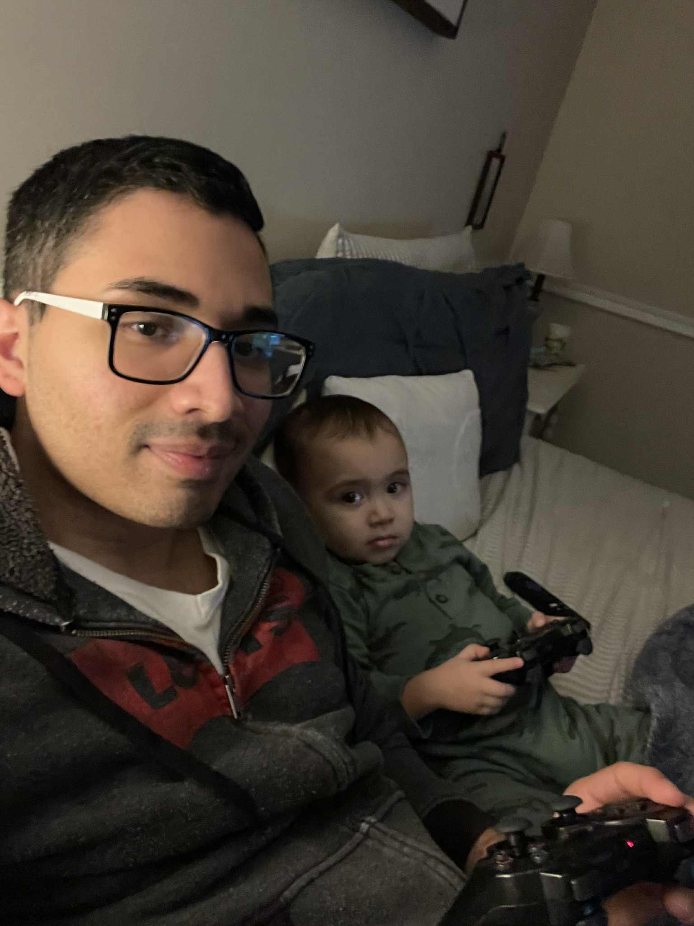
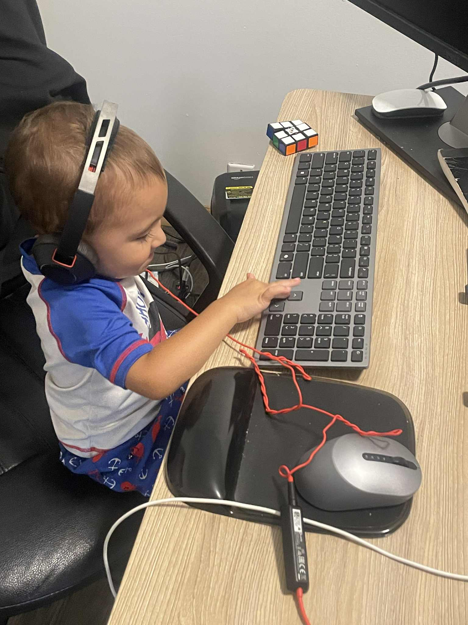
A Child Like Faith
Children Emulate Their Father
“Yeshua replied to him, “Have I been with you so long without your knowing me, Philip? Whoever has seen me has seen the Father” John 14:9 CJB
“A person who claims to be continuing in union with him ought to conduct his life the way he did” 1st John 2:6 CJB

Slide 8
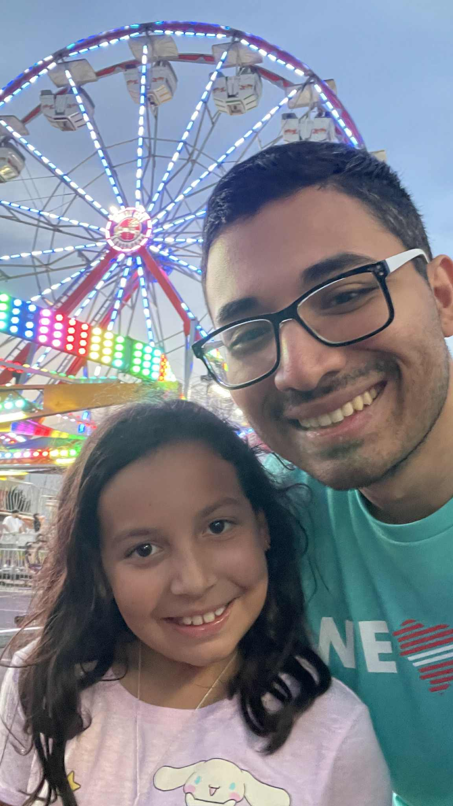
A Child Like Faith
Children Walk In True Joy
“Then he said to them, “Go, eat rich food, drink sweet drinks, and send portions to those who can’t provide for themselves; for today is consecrated to our Lord. Don’t be sad, because the joy of Adonai is your strength.” Nehemia 8:10 CJB
“Rejoice in union with the Lord always! I will say it again: rejoice!” Philippians 4:4 CJB

Slide 9
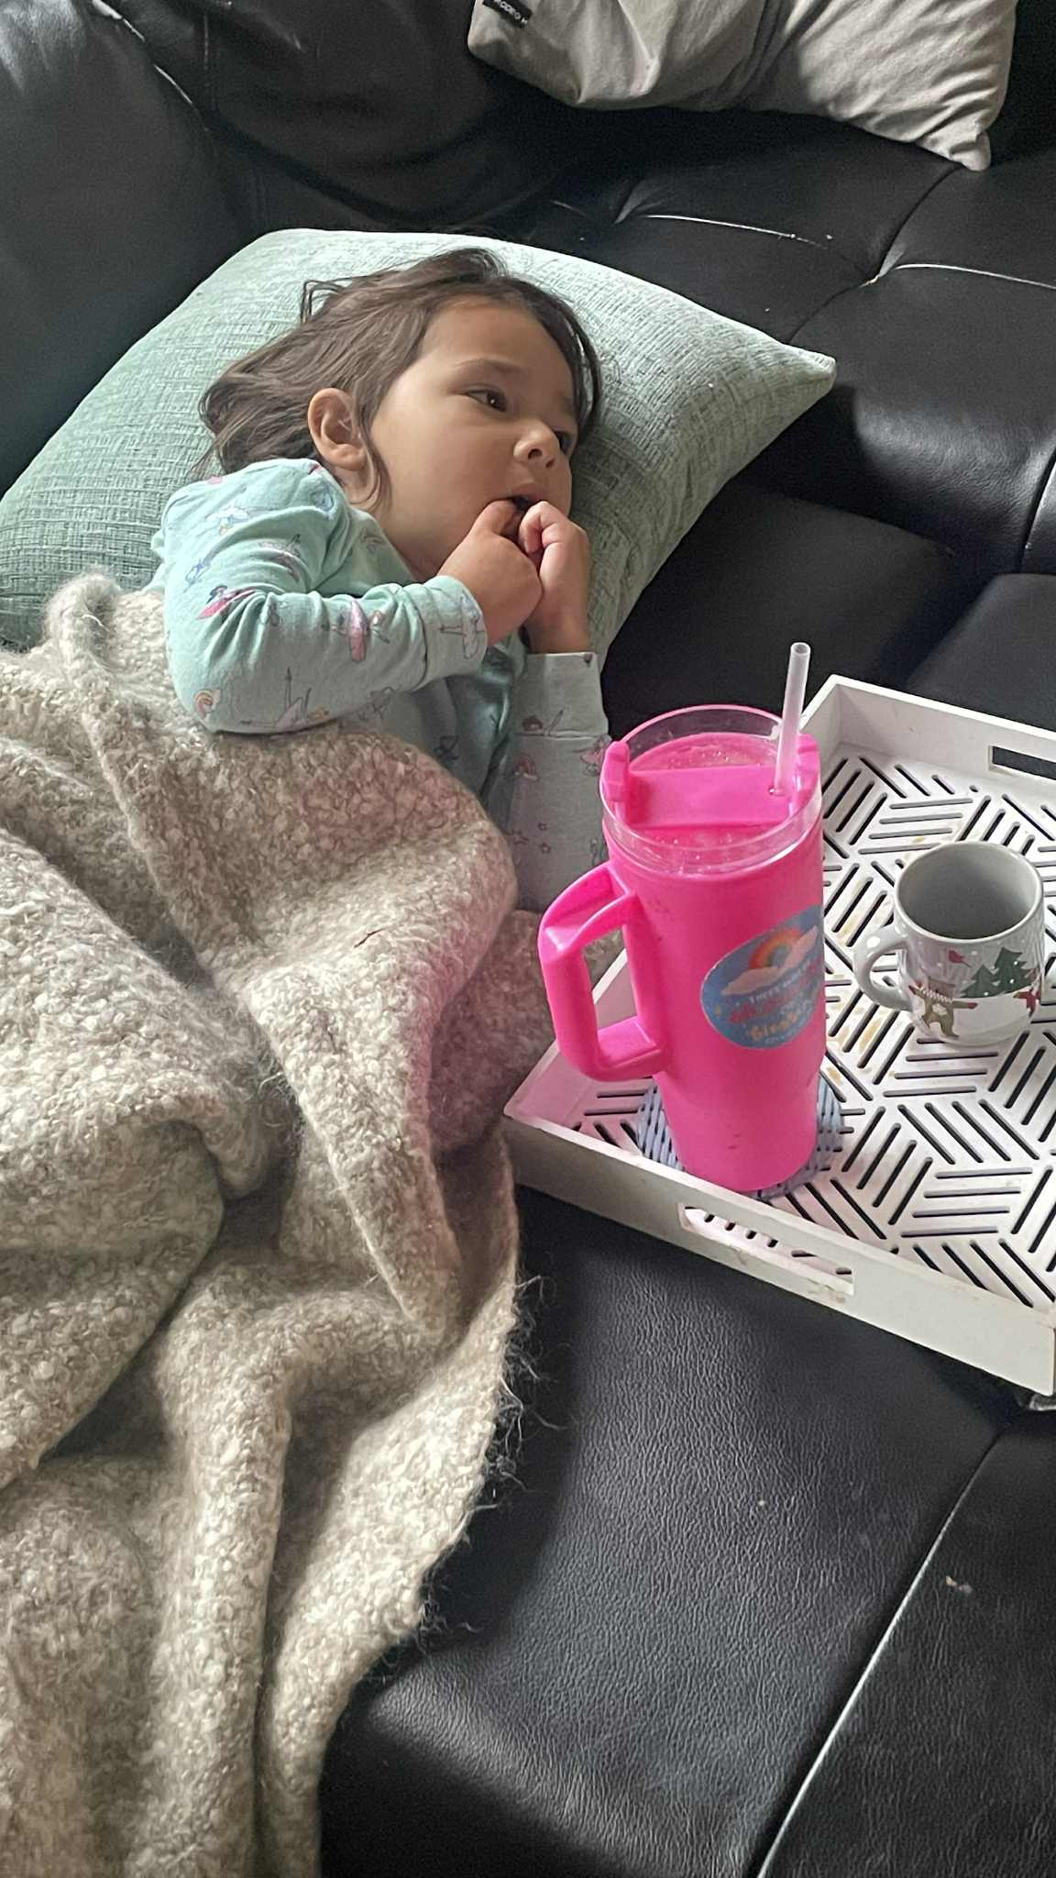
A Child Like Faith
Children Are Precious To The Father
“Whoever welcomes one such child in my name welcomes me; and whoever ensnares one of these little ones who trust me, it would be better for him to have a millstone hung around his neck and be drowned in the open sea!” Matthew 18:5-6 CJB
“My friends, I tell you: don’t fear those who kill the body but then have nothing more they can do. I will show you whom to fear: fear him who after killing you has authority to throw you into Gei-Hinnom! Yes, I tell you, this is the one to fear! Aren’t sparrows sold for next to nothing, five for two assarions? And not one of them has been forgotten by God. Why, every hair on your head has been counted! Don’t be afraid, you are worth more than many sparrows.” Luke 12:4-7 CJB

Slide 10
“I tell you that unless you change and become like little children, you won’t even enter the Kingdom of Heaven!”
– Matthew 18:3 CJB
A Child-Like Faith

