Slide 1
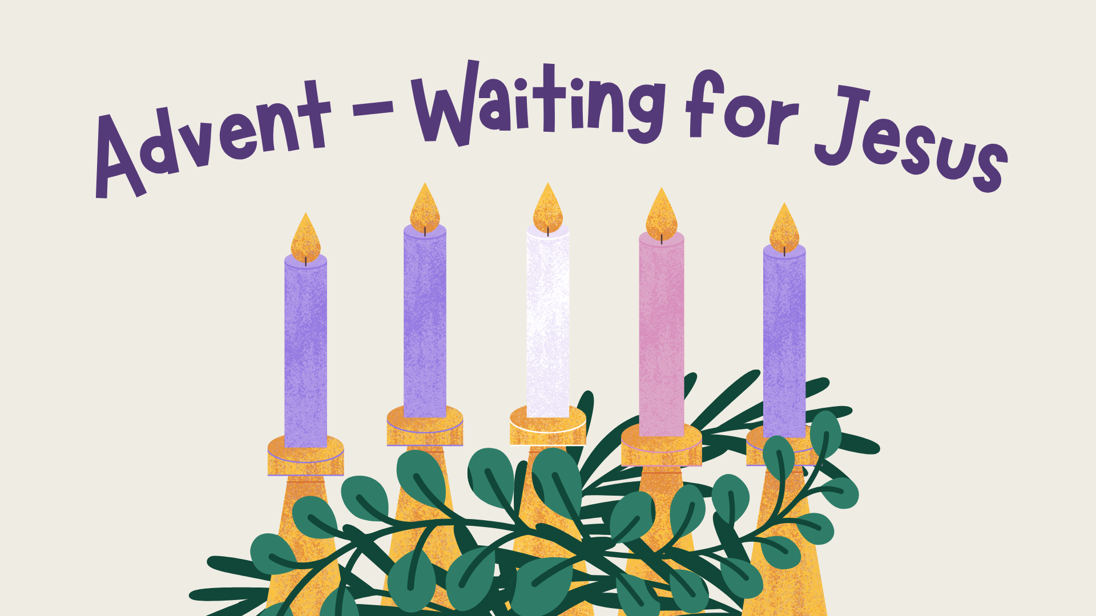


Notes:
There is background gathering music included on this slide which will play automatically and loop until stopped.
Please check volume levels ahead of the start of the assembly.

Slide 2
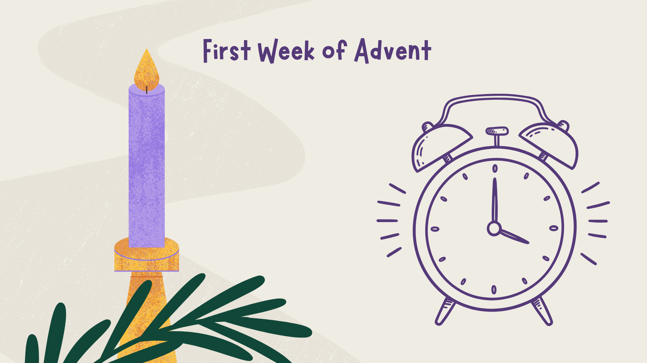


Slide 3


Slide 4

Opening Prayer
Grant your faithful, we pray, almighty God, the resolve to run forth to meet your Christ with righteousness deeds at his coming, so that, gathered at his right hand, they may be worthy to possess the heavenly kingdom.
Through our Lord Jesus Christ, your Son, who lives and reigns with you in the unity of the Holy Spirit, God, for ever and ever. Amen.

Slide 5
Scripture
Leader: A reading from the Holy Gospel according to Mark.
ALL: GLORY TO YOU,
O LORD.
We mark the Cross on our heads, lips and hearts.
Notes:
If you are not already doing this, it is good practice to get the children to mark their foreheads, lips and hearts (as we do during the celebration of the Mass) during assemblies, celebrations of the Word and collective worship. Space depending, you may also like to invite the children to stand to listen to the Gospel proclaimed.

Slide 6
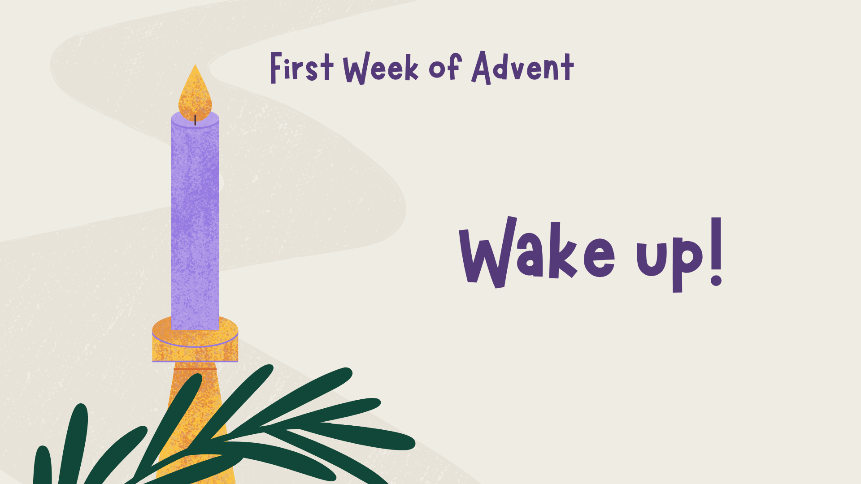

Slide 7
Scripture
Leader: The Gospel of the Lord.
ALL: PRAISE TO YOU, LORD JESUS CHRIST.
In silence, now allow the Word to make His home in
your heart.

Slide 9
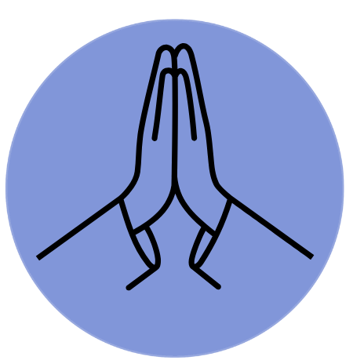
Time of Prayer
Wake us up, Lord!
Notes:
Background music on slide that will play automatically.

Slide 10
Mission
Look for ways to WAKE UP!!
How can you wake up your heart?
What is God asking you to really notice this week?
Notes:
Background music on slide that will play automatically.

Slide 11
Closing Prayer
May the almighty and merciful God, by whose grace you have placed your faith in the First Coming of his Only Begotten Son and yearn for his coming again sanctify you by the radiance of Christ’s Advent and enrich you with his blessing.
As you run the race of this present life, may he make you firm in faith, joyful in hope and active in charity. So that, rejoicing now with devotion at the Redeemer’s coming in the flesh, you may be endowed with the rich reward of eternal life when he comes again in majesty. Through Christ our Lord. Amen.

Slide 12
Notes:
There is background music included on this slide which will play automatically and loop until stopped.
Please check volume levels ahead of the start of the assembly.

