Slide 1



Notes:
There is background gathering music included on this slide which will play automatically and loop until stopped.
Please check volume levels ahead of the start of the assembly.

Slide 2


Slide 3
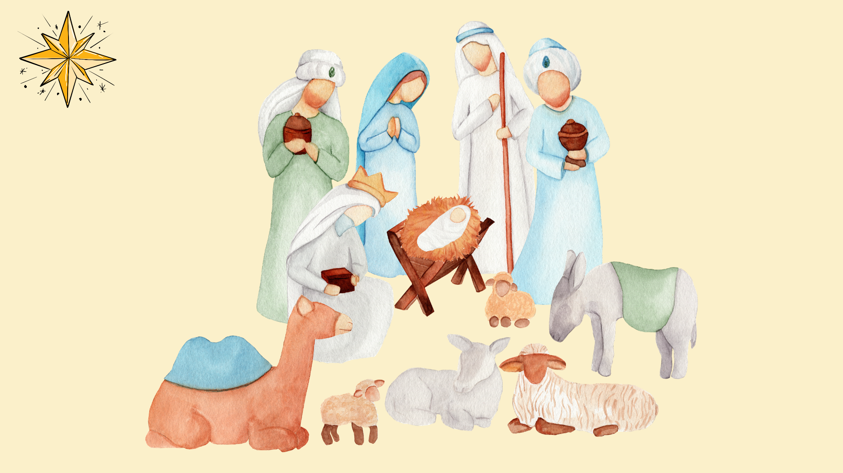


Slide 4
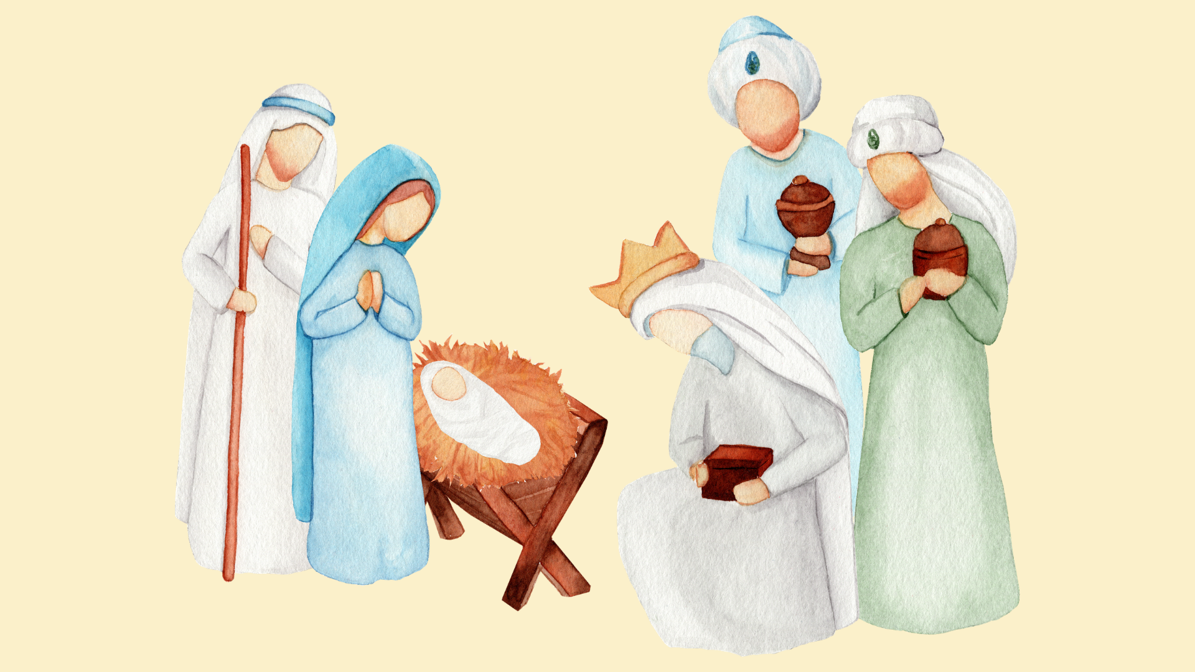

Slide 5
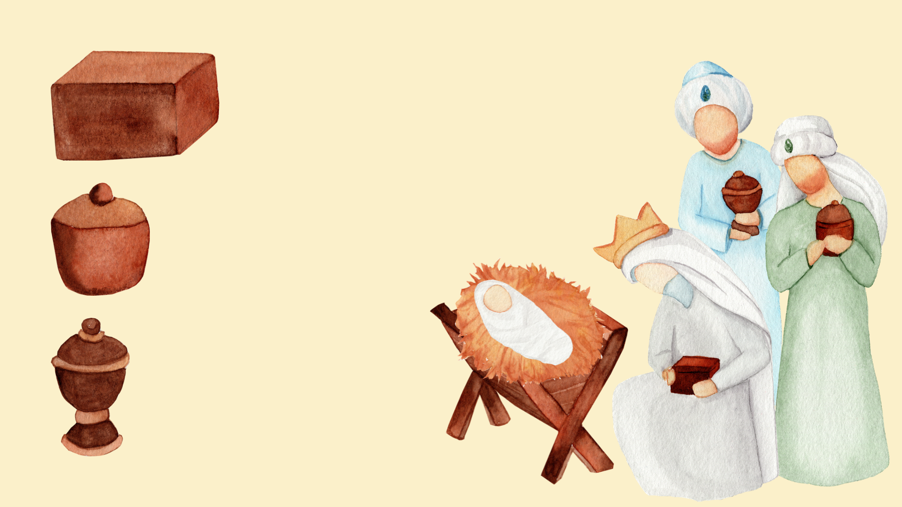




Slide 6
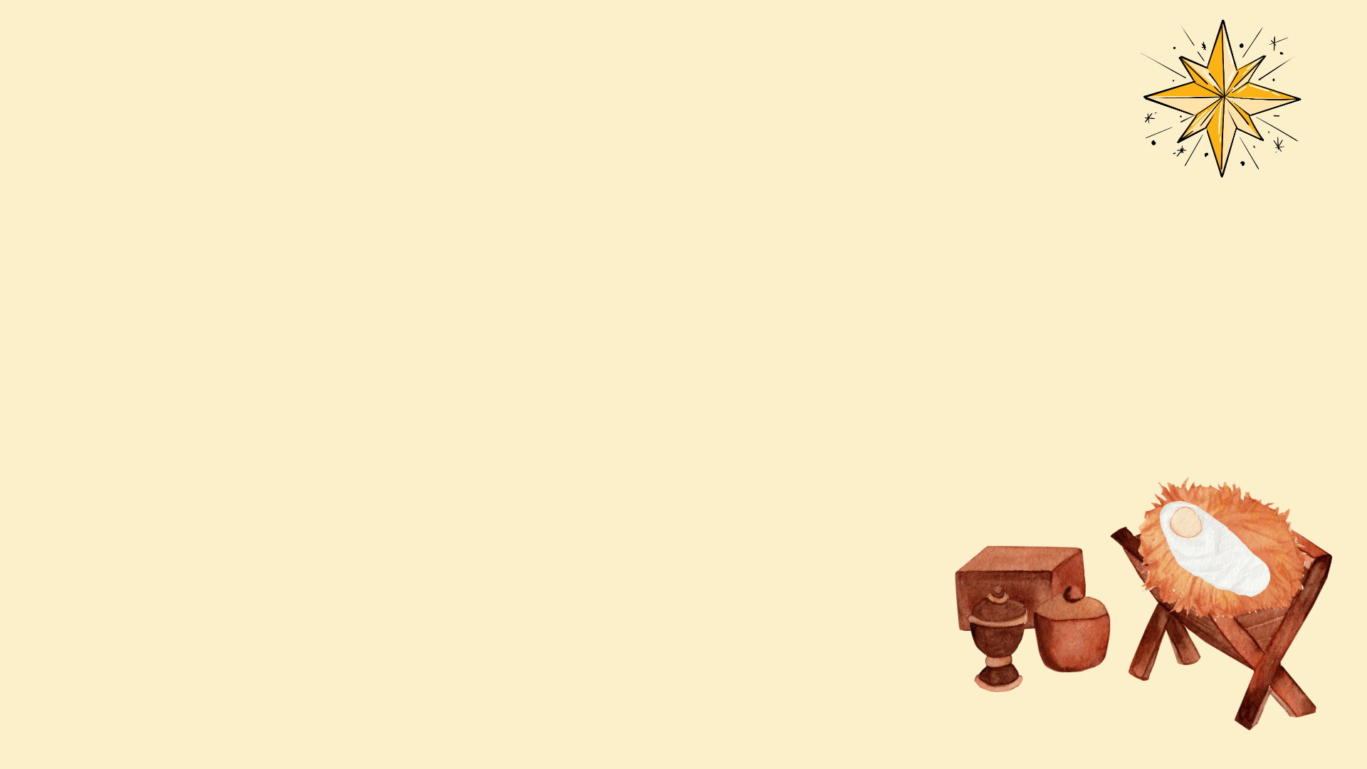
Opening Prayer
O God, who on this day revealed your Only Begotten Son to the nations by the guidance of a star, grant in your mercy, that we, who know you already by faith, may be brought to behold the beauty of your sublime glory.
Through our Lord Jesus Christ, your Son, who lives and reigns with you in the unity of the Holy Spirit, God, for ever and ever.
AMEN.

Slide 7
Scripture
Leader: A reading from the Holy Gospel according to Matthew.
ALL: GLORY TO YOU, O LORD.
We mark the Cross on our heads, lips and hearts.
Notes:
If you are not already doing this, it is good practice to get the children to mark their foreheads, lips and hearts (as we do during the celebration of the Mass) during assemblies, celebrations of the Word and collective worship. Space depending, you may also like to invite the children to stand to listen to the Gospel proclaimed.

Slide 9
Scripture
Leader: The Gospel of the Lord.
ALL: PRAISE TO YOU, LORD JESUS CHRIST.
In silence, now allow the Word to make His home in
your heart.

Slide 10
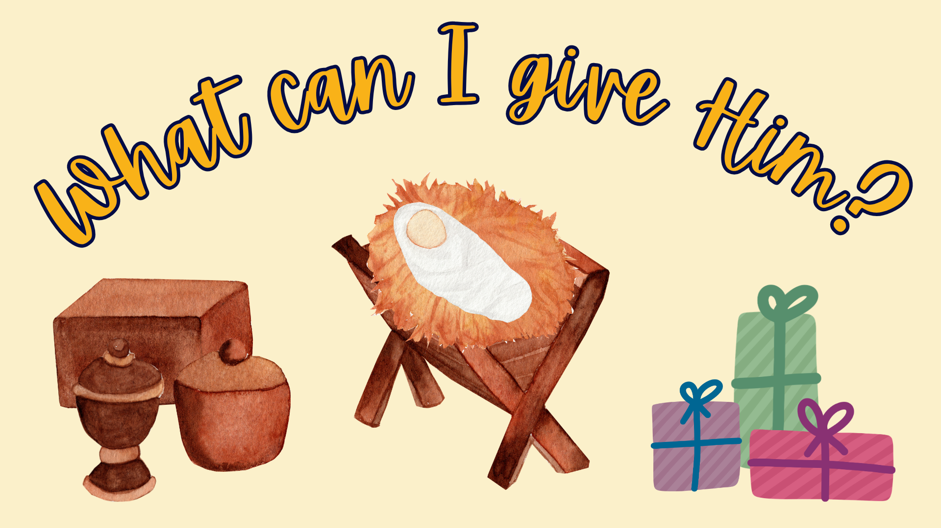

Slide 11

Time of Prayer
We have seen His star…
We are here to worship Him.

Slide 12
Mission
What can we give to the Lord?
What gifts do we have to offer?

Slide 13
Closing Prayer
May God, who has called us out of darkness into his wonderful light, pour out in kindness his blessing upon us and make our hearts firm in faith, hope and charity.
Through Christ our Lord. Amen.

Slide 14
Notes:
There is background music included on this slide which will play automatically and loop until stopped.
Please check volume levels ahead of the start of the assembly.

