Slide 1
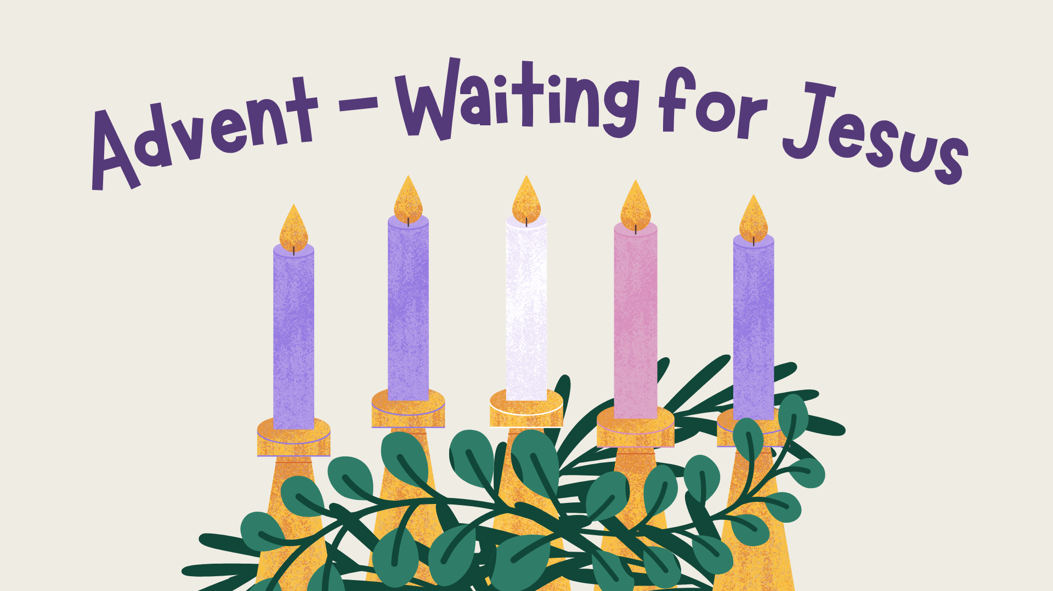


Notes:
There is background gathering music included on this slide which will play automatically and loop until stopped.
Please check volume levels ahead of the start of the assembly.

Slide 2



Slide 3


Slide 4

Opening Prayer
Almighty and merciful God, may no earthly undertaking hinder those who set out in haste to meet your Son, but may our learning of heavenly wisdom gain us admittance to his company. Who lives and reigns with you in the unity of the Holy Spirit, God, for ever and ever. Amen.

Slide 5
Scripture
Leader: A reading from the Holy Gospel according to Mark.
ALL: GLORY TO YOU,
O LORD.
We mark the Cross on our heads, lips and hearts.
Notes:
If you are not already doing this, it is good practice to get the children to mark their foreheads, lips and hearts (as we do during the celebration of the Mass) during assemblies, celebrations of the Word and collective worship. Space depending, you may also like to invite the children to stand to listen to the Gospel proclaimed.

Slide 6


Slide 7
Scripture
Leader: The Gospel of the Lord.
ALL: PRAISE TO YOU, LORD JESUS CHRIST.
In silence, now allow the Word to make His home in
your heart.

Slide 9

Time of Prayer
Bring us Your peace, Lord.
Notes:
Background music on slide that will play automatically.

Slide 10
Mission
How can I prepare the way for Jesus in my heart?
How can we bring peace into the world around us?
Notes:
Background music on slide that will play automatically.

Slide 11
Closing Prayer
May the almighty and merciful God, by whose grace you have placed your faith in the First Coming of his Only Begotten Son and yearn for his coming again sanctify you by the radiance of Christ’s Advent and enrich you with his blessing.
As you run the race of this present life, may he make you firm in faith, joyful in hope and active in charity. So that, rejoicing now with devotion at the Redeemer’s coming in the flesh, you may be endowed with the rich reward of eternal life when he comes again in majesty. Through Christ our Lord. Amen.

Slide 12
Notes:
There is background music included on this slide which will play automatically and loop until stopped.
Please check volume levels ahead of the start of the assembly.

