Slide 1

Terms of Use
Intellectual Property and Acceptable Use
All Content (see here) is the property of Magister Resources Ltd. By continuing to use the Content you acknowledge that it is protected by copyright, trademarks, database rights and other intellectual property rights, unless otherwise stated, in line with the Copyright, Designs and Patents Act 1988.
You may, for your own non-commercial use:
retrieve, display and view the Content on a device
print copies of the Content for use by pupils and staff within the Agreed Institution (see here)
download and store the Content on the Agreed Institution's school network to be accessed through a secure login by staff and pupils
pass the Content to staff in the Agreed Institution for the express purpose of using for pupils at the Agreed Institution
modify or adapt the Content as necessary for your particular class or school
Prohibited Use
upload the Content for general use by the public, for example to shared social media groups
reproduce, transmit or distribute the Content to other schools, staff or pupils outside the Agreed Institution
pass off any of the Content as your own work
redistribute, resell, lease, rent, licence, sublicence, transfer or make the Content available to any other educational institution, individual or legal entity
For the full set of terms and conditions, please see here. Breaching copyright is against the law. Magister Resources can only continue to exist and support Catholic education by people purchasing material.

Slide 2


Notes:
There is background gathering music included on this slide which will play automatically and loop until stopped.
Please check volume levels ahead of the start of the assembly.

Slide 3

Opening Prayer
God our loving Father, thank You for this new school year and all the fun adventures ahead. Help us to learn with happy hearts, to listen to our teachers, and to be kind to everyone.
Jesus, our friend, be with us when we feel scared or worried. Give us courage to try our best and strength to share and play fair.
Holy Mary, our blessed Mother, watch over our school and guide us home safely each day. Bless our families, our friends, and everyone who helps us grow.
We ask this through Christ our Lord.
Amen.

Slide 4

Scripture
Leader: A reading from the Holy Gospel according to Matthew.
ALL: GLORY TO YOU, O LORD.
We mark the Cross on our heads, lips and hearts.
Notes:
If you are not already doing this, it is good practice to get the children to mark their foreheads, lips and hearts (as we do during the celebration of the Mass) during assemblies, celebrations of the Word and collective worship. Space depending, you may also like to invite the children to stand to listen to the Gospel proclaimed.

Slide 5
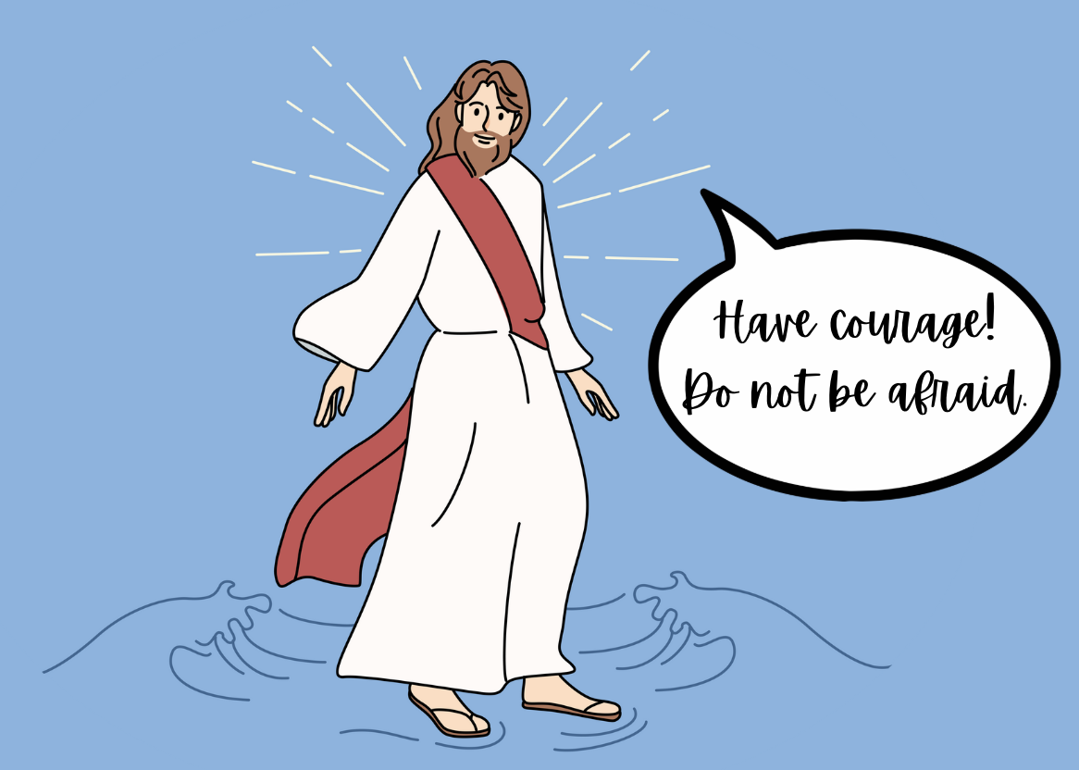
Scripture

Slide 6
Scripture
Leader: The Gospel of the Lord.
ALL: PRAISE TO YOU, LORD JESUS CHRIST.
In silence, now allow the Word to make His home in
your heart.

Slide 7
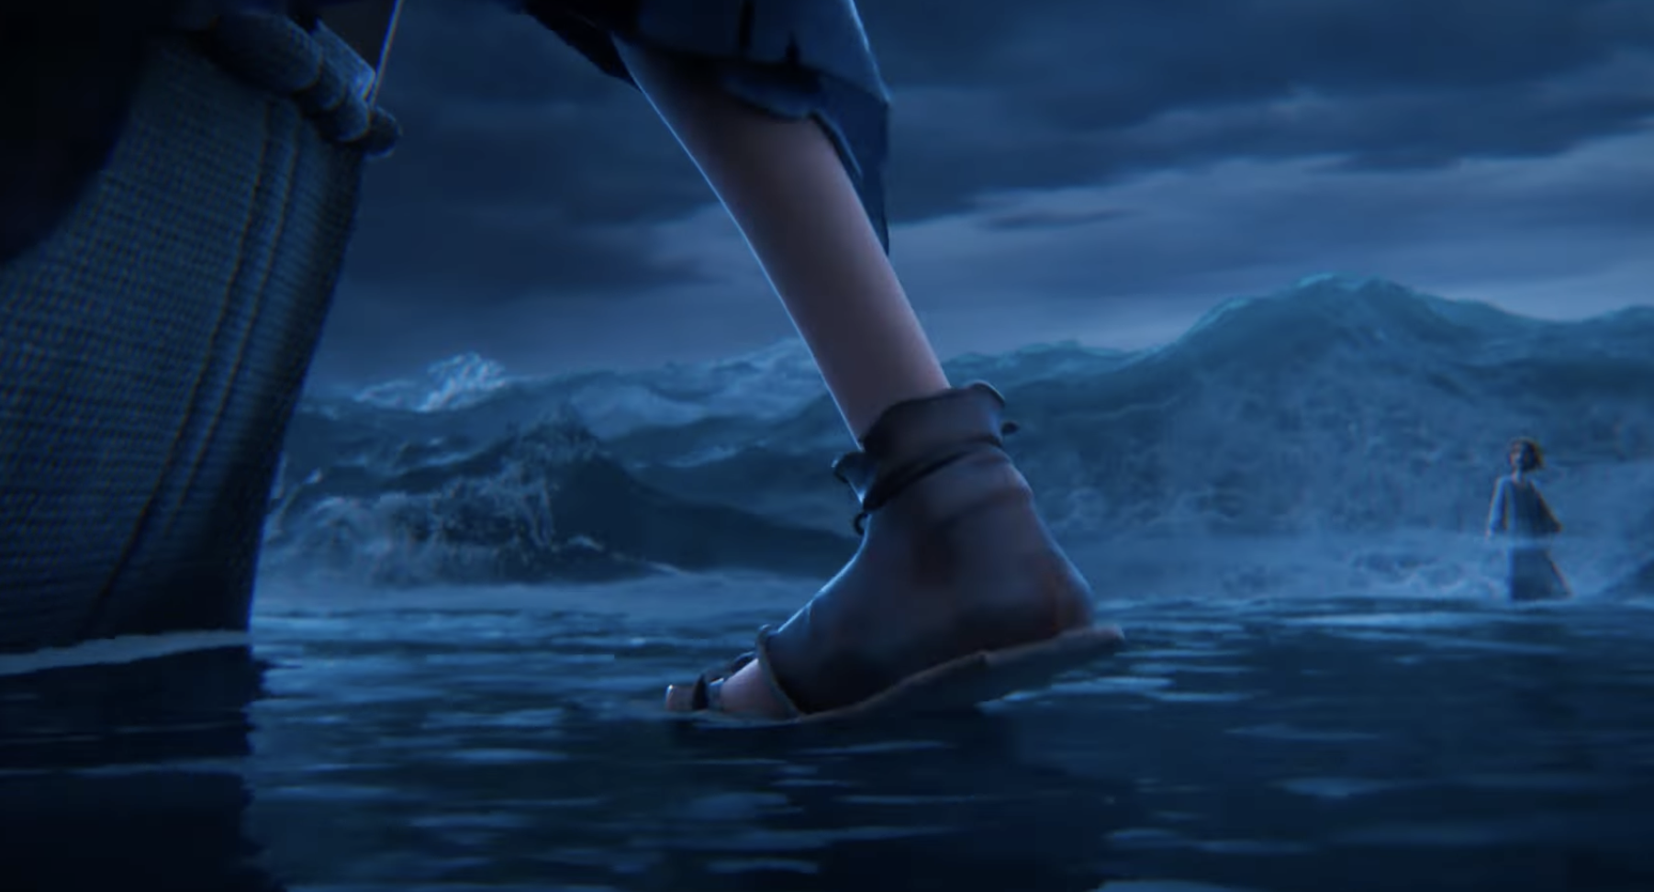

Peter walks on the water…
Notes:
Full video link available here: https://www.youtube.com/watch?v=foQxX0_cei4
Title: Jesus Walking on Water - THE KING OF KINGS Movie Clip (2025)
By: Entertainment Access

Slide 8
Reflection

Slide 9
Time of Prayer
Lord, we call out to You…
Lord, come and save us.

Slide 10
The Lord’s Prayer
Our Father, who art in heaven, hallowed be thy name.
Thy kingdom come, thy will be done, on earth, as it is in heaven.
Give us this day our daily bread and forgive us our trespasses as we forgive those who trespass against us; and lead us not into temptation but deliver us from evil.
Amen.

Slide 11
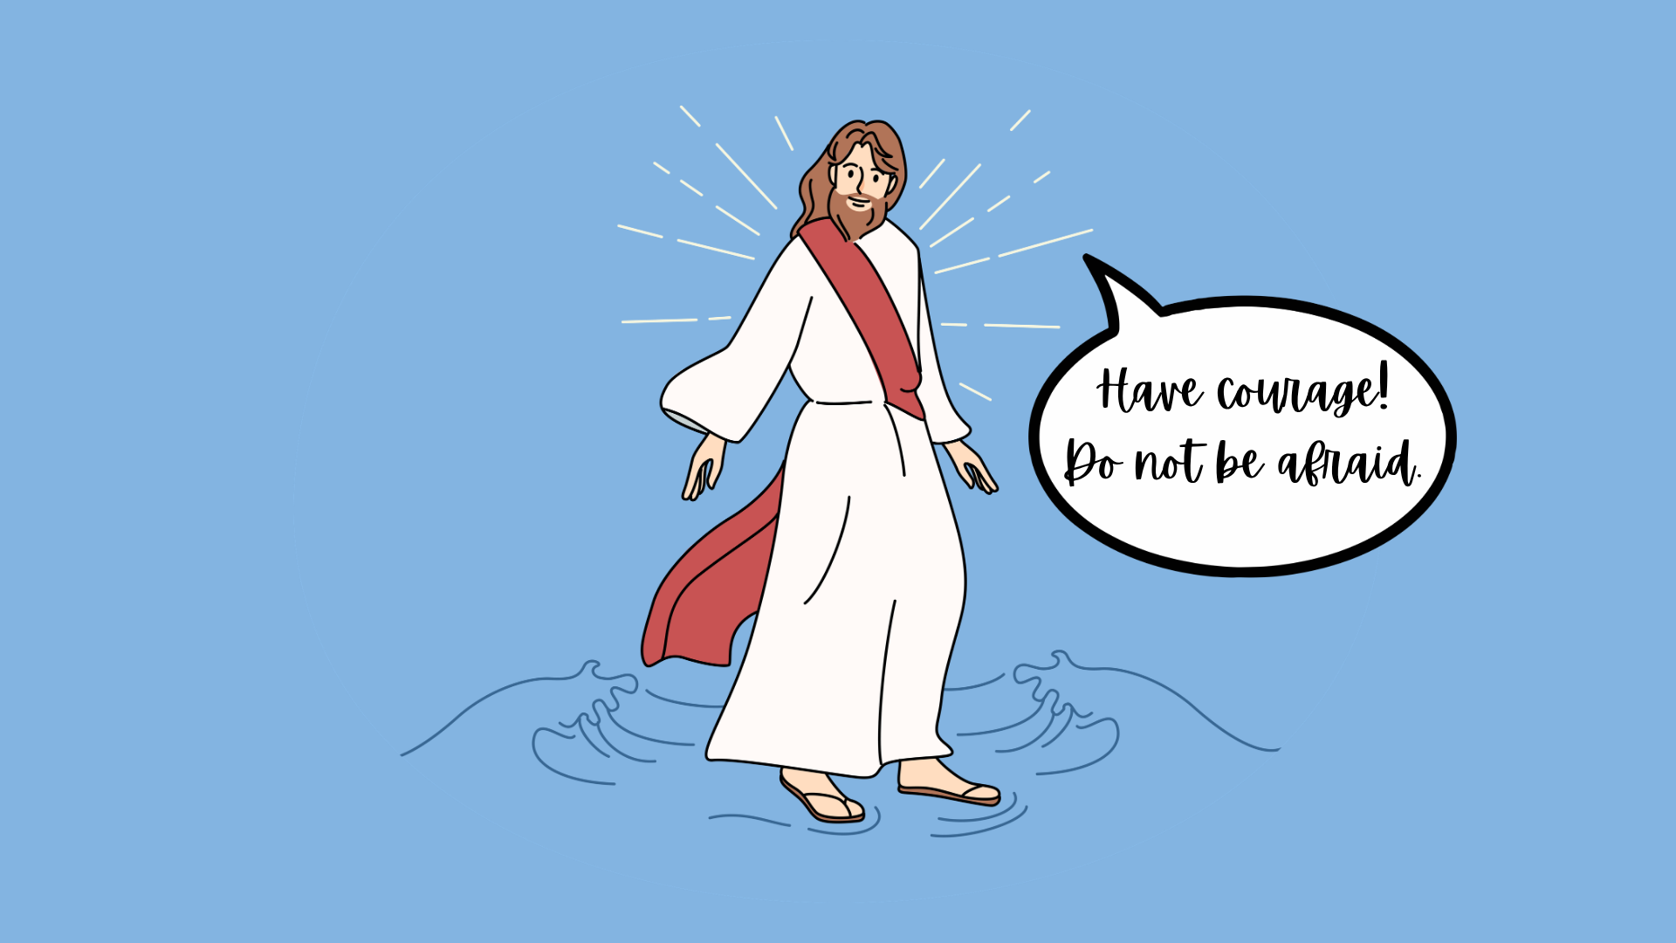
Notes:
There is background music included on this slide which will play automatically and loop until stopped.

Slide 12
Further Information
Accompanying resources:
  Gospel reading
  Class Collective Worship
Prayer & Liturgy Directory Links:
7.3 Celebrations of the Word
The proclamation of scripture is the high point of the celebration. What precedes it (gather) prepares the community to listen attentively; what follows the proclamation allows for our response. Silence will be a key element, either as part of the preparation or to allow time for individual reflection. To say that God still speaks to us in the scriptures today means that those responsible for devising and leading the liturgy seek to enable participants to make connections with their own lives or with current broader issues through reflection, response, or prayer. The concluding section of the celebration reminds participants that what they have heard and prayed impacts on their everyday lives.
8.3. Resources for prayer and liturgy
Guide to classroom/form prayer - Schools will have a wide range of approaches to the provision of resources for daily prayer.
Further resources available at www.magisterresources.com

Slide 13
Acknowledgements
With grateful thanks to the following publishers, illustrators, and authors:
Encyclicals and Catechism references, used with permission from:
© Dicastero per la Comunicazione-Libreria Editrice Vaticana, www.vatican.va
Scripture quotations [marked ESV-CE] are reproduced from The English Standard Version Catholic Edition, copyright © Society for Promoting Christian Knowledge, London, UK. All rights reserved.
OR
Scripture taken from the International Children’s Bible®. Copyright © 1986, 1988, 1999 by Thomas Nelson. Used by permission. All rights reserved.
English translation of the Roman Missal © 2010, International Commission on English in the Liturgy Corporation (ICEL). All rights reserved.
Illustrations of Jesus by Therese Withers, www.firstsaturday.co.uk
Additional images from www.pixabay.com, www.unsplash.com and www.canva.com

