Slide 1
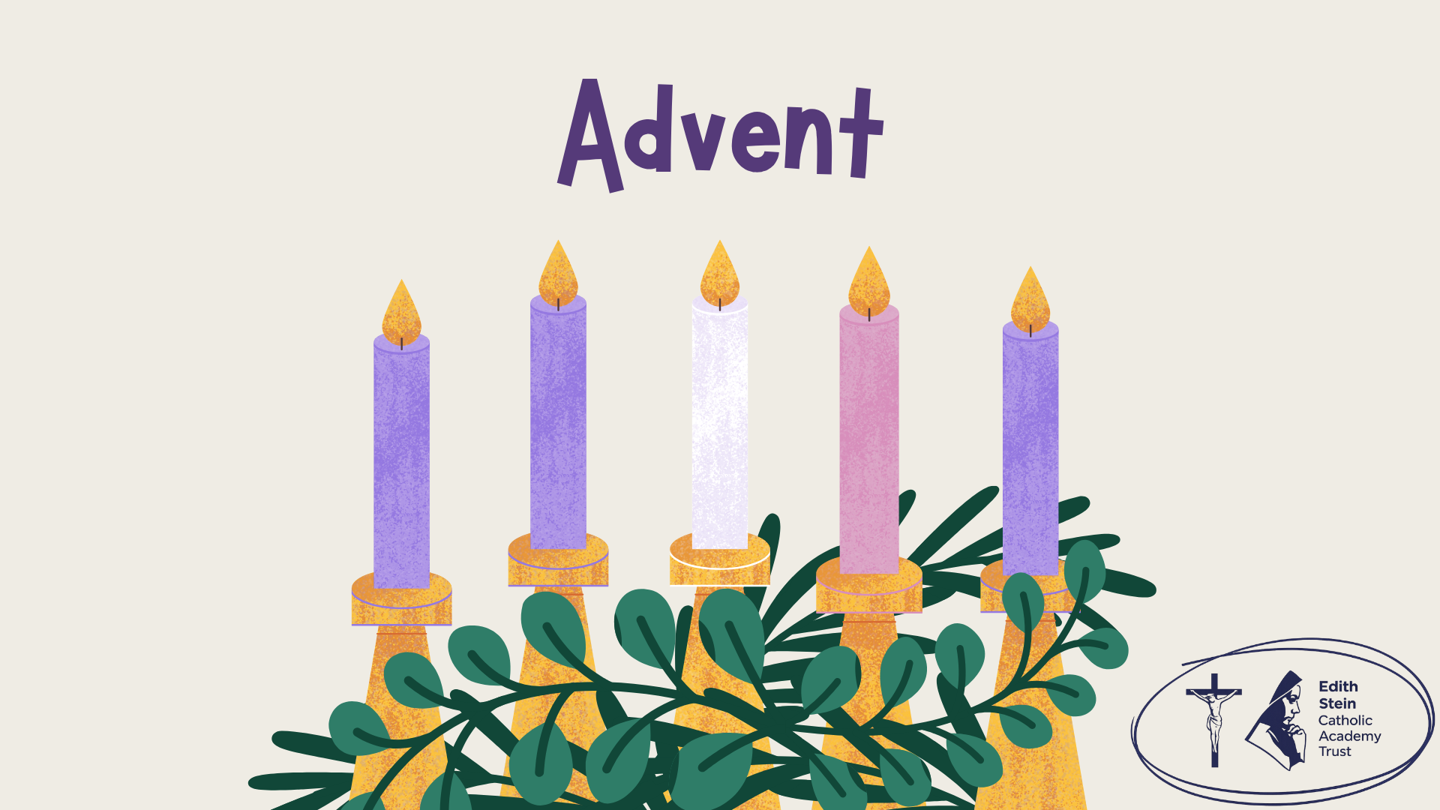

Notes:
There is background gathering music included on this slide which will play automatically and loop until stopped.
Please check volume levels ahead of the start of the assembly.

Slide 2
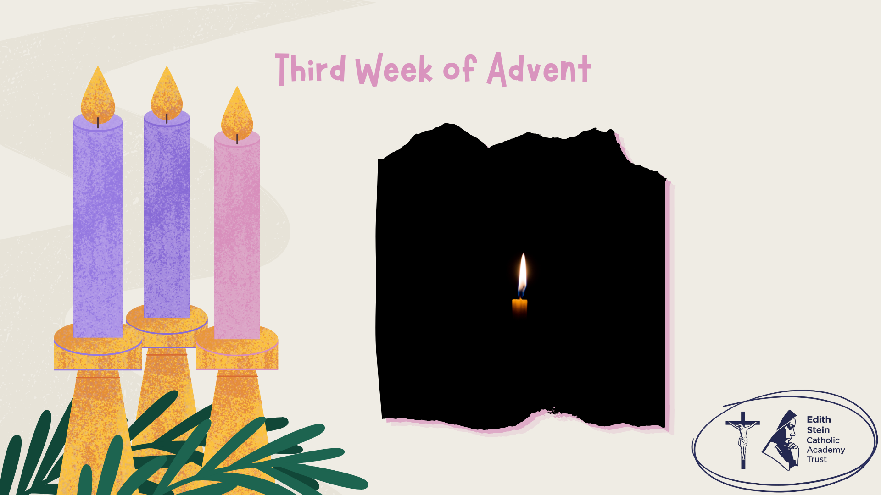


Slide 3


Slide 4

Opening Prayer
O God, who see how your people faithfully await the feast of the Lord’s Nativity, enable us, we pray, to attain to the joys of so great a salvation and to celebrate them always with solemn worship and glad rejoicing. Through our Lord Jesus Christ, your Son, who lives and reigns with you in the unity of the Holy Spirit, God, for ever and ever. Amen.

Slide 5
Scripture
Leader: A reading from the Holy Gospel according to John.
ALL: GLORY TO YOU,
O LORD.
We mark the Cross on our heads, lips and hearts.
Notes:
If you are not already doing this, it is good practice to get everyone present to mark their foreheads, lips and hearts (as we do during the celebration of the Mass) during assemblies, celebrations of the Word and collective worship. Space depending, you may also like to invite everyone to stand to listen to the Gospel proclaimed.

Slide 6


Slide 7
Scripture
Leader: The Gospel of the Lord.
ALL: PRAISE TO YOU, LORD JESUS CHRIST.
In silence, now allow the Word to make His home in
your heart.

Slide 9
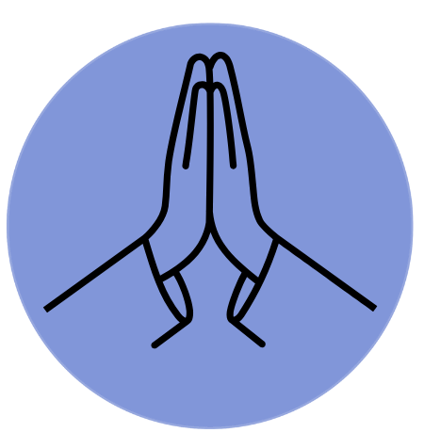
Time of Prayer
Help us to shine!
Notes:
Background music on slide that will play automatically.

Slide 10
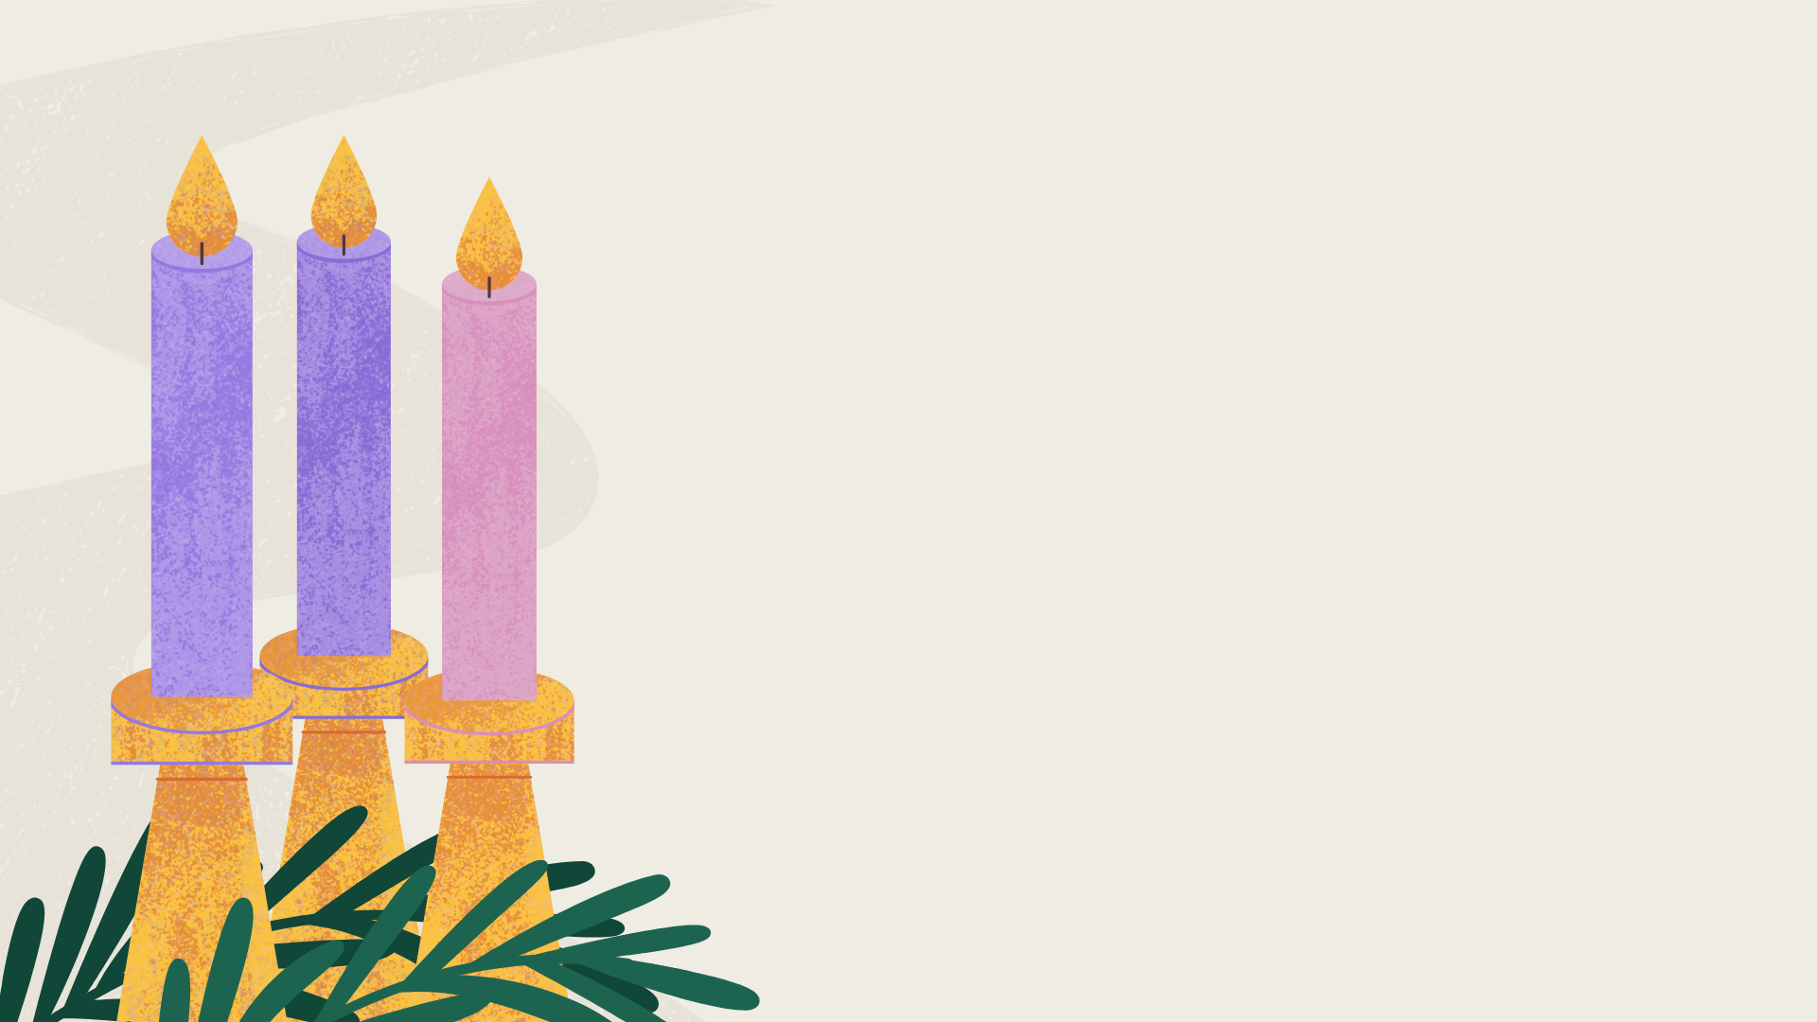

Mission
Be the reason someone sees the light.
This week, choose one action:
Tell someone something you genuinely appreciate about them.
Make an effort to involve someone who is often overlooked.
Use your voice or actions to challenge negativity and build others up.
Who might experience a little more joy because of something you do?
Notes:
Background music on slide that will play automatically.

Slide 11
Closing Prayer
May the almighty and merciful God, by whose grace you have placed your faith in the First Coming of his Only Begotten Son and yearn for his coming again sanctify you by the radiance of Christ’s Advent and enrich you with his blessing.
As you run the race of this present life, may he make you firm in faith, joyful in hope and active in charity. So that, rejoicing now with devotion at the Redeemer’s coming in the flesh, you may be endowed with the rich reward of eternal life when he comes again in majesty. Through Christ our Lord. Amen.

Slide 12
Notes:
There is background gathering music included on this slide which will play automatically and loop until stopped.
Please check volume levels ahead of the start of the assembly.

