Slide 1

Notes:
The purpose of this presentation is to give all adult volunteers an overview of Girlguiding and introduce them to the philosophy behind the organisation before they commit to a role within it

Slide 2
So you would like to join us?
Notes:
At this point all participants should have been through either join us or come through a personal contact so we are presuming they are keen to become a volunteer

Slide 3
This presentation is designed to tell you what is involved is being an adult volunteer with Girlguiding.

Slide 4
Contents:
Girlguiding
Leaders and other roles
What next – how to join
Useful sources of information

Slide 5
Girlguiding:
We are the largest voluntary youth organisation in the UK.
We are the largest voluntary
organisation for girls and women
in the world
Notes:
Many people do not know these facts, lots of people will still view GG as a fairly old fashioned organisation who knit and stitch and so it is worth emphasising the size, importance and influence that we have. It is also worth mentioning the global aspect here

Slide 6
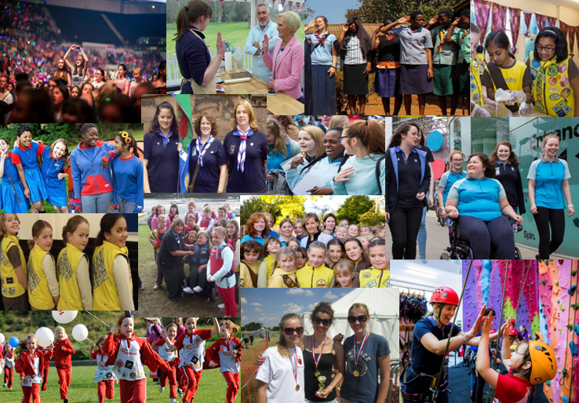
Activity... meet the family
Notes:
Do not click to show the photo – Please print the photo on A3 paper and cut up to make a jigsaw give the volunteers the photo as a jigsaw to put together, it will also enable people to chat and introduce themselves, when they have completed it then show the photo – again this is an opportunity to illustrate the diversity of our members, you can pick out the different groups such as Rainbows etc, the different adults – leaders in uniform and volunteers not in uniform and also the diversity of ethnic backgrounds and disabilities

Slide 7
Our Vision:
An equal world where all girls can
make a positive difference, be happy,
safe and fulfil their potential
Notes:
This is the vision statement from HQ

Slide 8
Our Mission:
Through fun, friendship, challenge
and adventure we empower girls to
find their voice, inspiring them to
discover the best in themselves and
to make a positive difference in their community.
Notes:
This is the mission statement from HQ – note the emphasis on fun and challenge also worth a comment on the empowering of girls and young women to do it for themselves

Slide 9
Our values:
Empowering
Inclusive
Inspiring
Caring
Challenging
Fun

Slide 10
We are…
An educational organisation for girls and young women
A charity created by Royal Charter
Modern and forward-thinking – we are Guiding in the 21st century
Committed to girls taking the lead in planning their programme
Notes:
A little bit more about who we are – note the educational aspect and the girl led guiding element

Slide 11
Guiding is:
Based upon a commitment to the principles embodied in the Promise and Law
Open to all girls and women, provided they are able to understand and willing to make or work towards making, the Promise
Voluntary
Independent of government and political associations
Self-governing
Not a religious or faith organisation
Notes:
This is where there may be some discussion re the promise, and religion. Many people still have the idea that we are a religious organisation and have ideas about church parade etc.

Slide 12
The Five Essentials:
Guiding uses a distinct method:
Girls work in small groups
Girls are encouraged to govern themselves and make their own decisions
Girls have a balanced and varied programme
Girls care for the individual
Girls share a commitment to a common standard embodied in the Promise and Law
The same principles apply in all sections and in all age ranges
Notes:
This is the basis of our programme in all sections again note the idea of girls making the decisions for themselves

Slide 13
Structure:
The Unit Anytown Brownies
The Division/District Midcounty Division
The County/Island Hampshire West
The Region South West England Region
Girlguiding
WAGGGS
Notes:
This structure applies throughout all the Regions and this can be used to illustrate the structure ranging from the local unit to the global organisation

Slide 14
Members
Rainbows Start at 5
Brownies Start at 7
Guides Start at 10
Senior Section 14-26th birthday
Young Leaders 14-18
Adult members Over 18
Notes:
This is our current groupings

Slide 15
Adult Members
Leaders
Unit Helpers
Recognised Volunteers including administrative helpers such as treasurers, shoppers, occasional helpers in the unit etc.
Notes:
Explain the difference between leaders, unit helpers and volunteers – of course all are volunteers !

Slide 16
Volunteers need…
... to enjoy working alongside girls and young women
... to be able to get on with other adult volunteers
... to have energy, enthusiasm, a positive outlook, a big heart and an even bigger sense of humour
...to have a specific skill which could be needed
...abide by the code of conduct
Notes:
An overview of the skills/characteristics of people we need in the organisation
Worth mentioning the code of conduct here which all volunteers in or out of uniform must abide by
If volunteers ask for more details here is the link to the website https://www.girlguiding.org.uk/making-guiding-happen/policies/girlguiding-policies/code-of-conduct/

Slide 17
Activity... What skills do you need?
Leaders
Volunteers
Unit Helpers
Notes:
This activity requires the volunteers to work together to place the range of skills and attributes on the Venn diagram. Again it will engender discussion and there is few right or wrong answers. Clearly some will be very specific to leaders other general attributes applicable to all. You can vary this activity and ask them to only place the essential ones on the diagram or the useful ones etc.
Please print this document on A3 paper if you are going to use it, the skills sheet (separate sheet) will also need to be printed and cut up

Slide 18
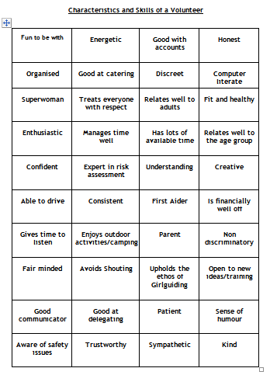
Activity... What skills do you need?
Notes:
This is part of the “skills” document you will need to print and cut up the whole sheet if you are going to use the activity

Slide 19
What next?
Discuss the role which interests you
with the local contact who will
help you decide where your skills
and time will be best used in the
local area
Local contacts tel. number and email address in here
Notes:
Make sure you have completed your local contact details on this slide and ensure you have had time to chat to every volunteer with regards to their preferred role. This is probably the time to have a cup of tea! It may be a good idea if you are doing this with a group of people to have a few other leaders who can also talk to the volunteers about roles

Slide 20
Websites:
www.girlguiding.org.uk
http://www.girlguidingsouthwest.org.uk
https://www.wagggs.org
www.girlguidinghantswest.org.uk
Notes:
Again ensure you complete the local contacts on the slide. You might want to get the volunteers to check they have all these details correct in the booklet in their welcome pack before they leave.

Slide 21
THANK YOU FOR
VOLUNTEERING
Notes:
Make sure you have contact details for every volunteer before they leave and they are happy about the next step they will take. It may be straight into a leadership role so they will need a date to meet their mentor or a surgery date depending on how the qualification is run in your county. If volunteers are unsure if they want to go into a leader role then offer them a chance to experience this is a meeting environment, if they are unsure of the age group again offer them the experience of trying different sectional meetings. If they wish to become a recognised volunteer ensure they are happy with the role they have committed to. If they are just not sure then make a telephone date to talk to them again .... If they decide it is not for them then thank them for their time.

