Slide 1

Sintra International Christian Academy

Slide 2
Who
Head of school is Reverend Dr. Frank Sawyer. Has been the head of schools in the USA and his Doctorate was on education, development psychology, and culture and gender in learning.

Slide 3
Me-
I am the Principal and English and History teacher.
Certified as a teacher through the USA since 1991. Recertified every 5 years.
Have taught on the mission field for the past 15 years in the Philippines, Hawaii and 2 years in Cascais.

Slide 4
One big family

Slide 5
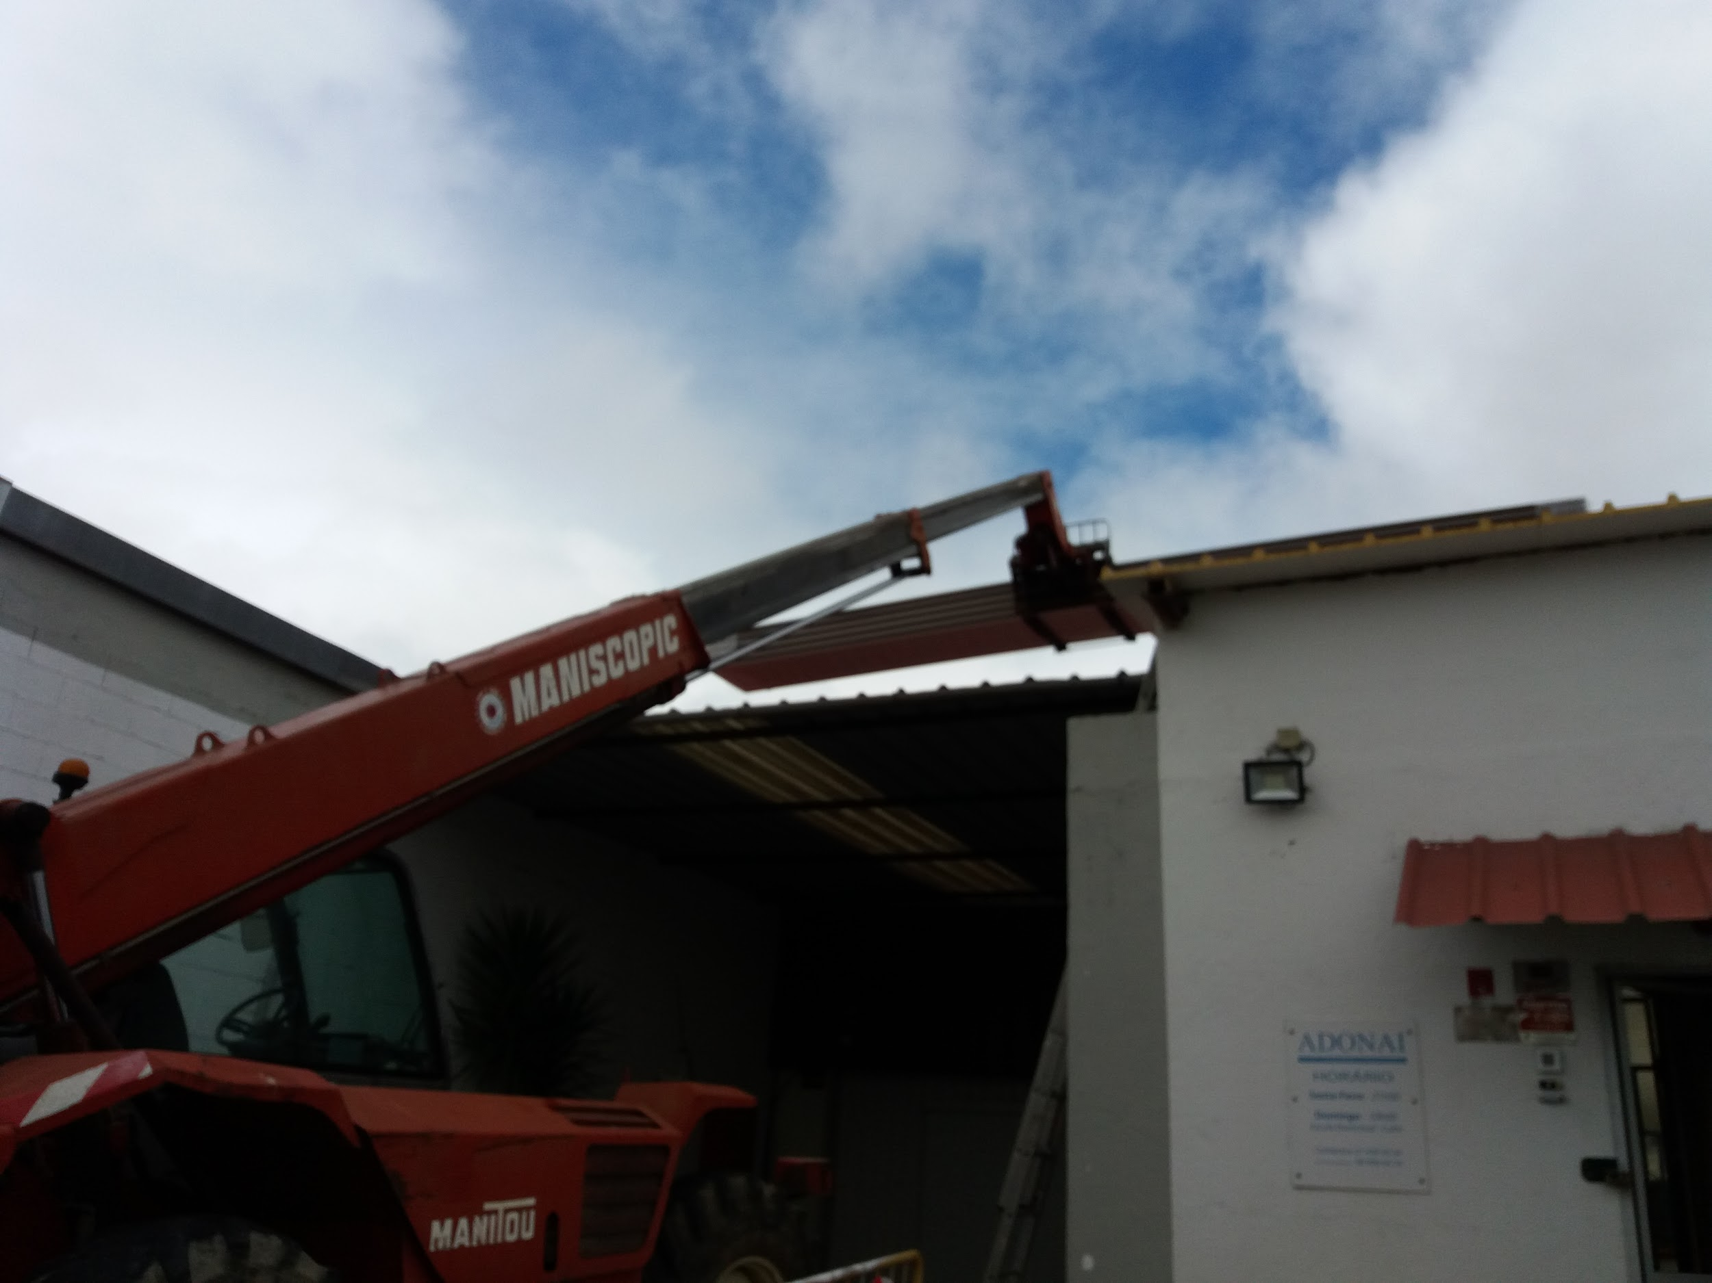
Under Construction- Currently putting new roof on the church

Slide 6
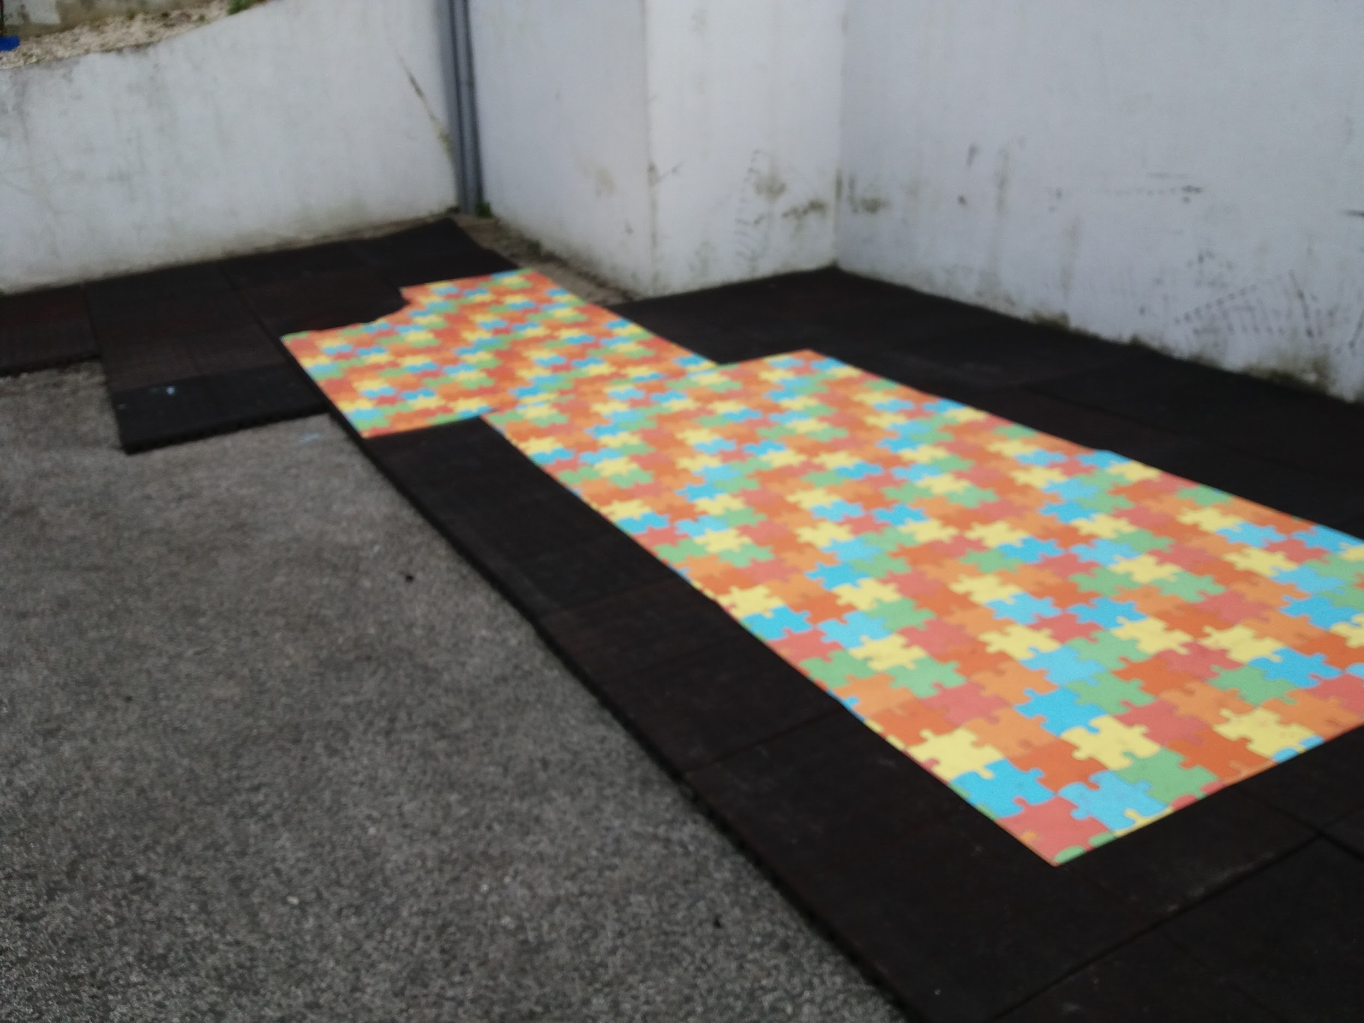
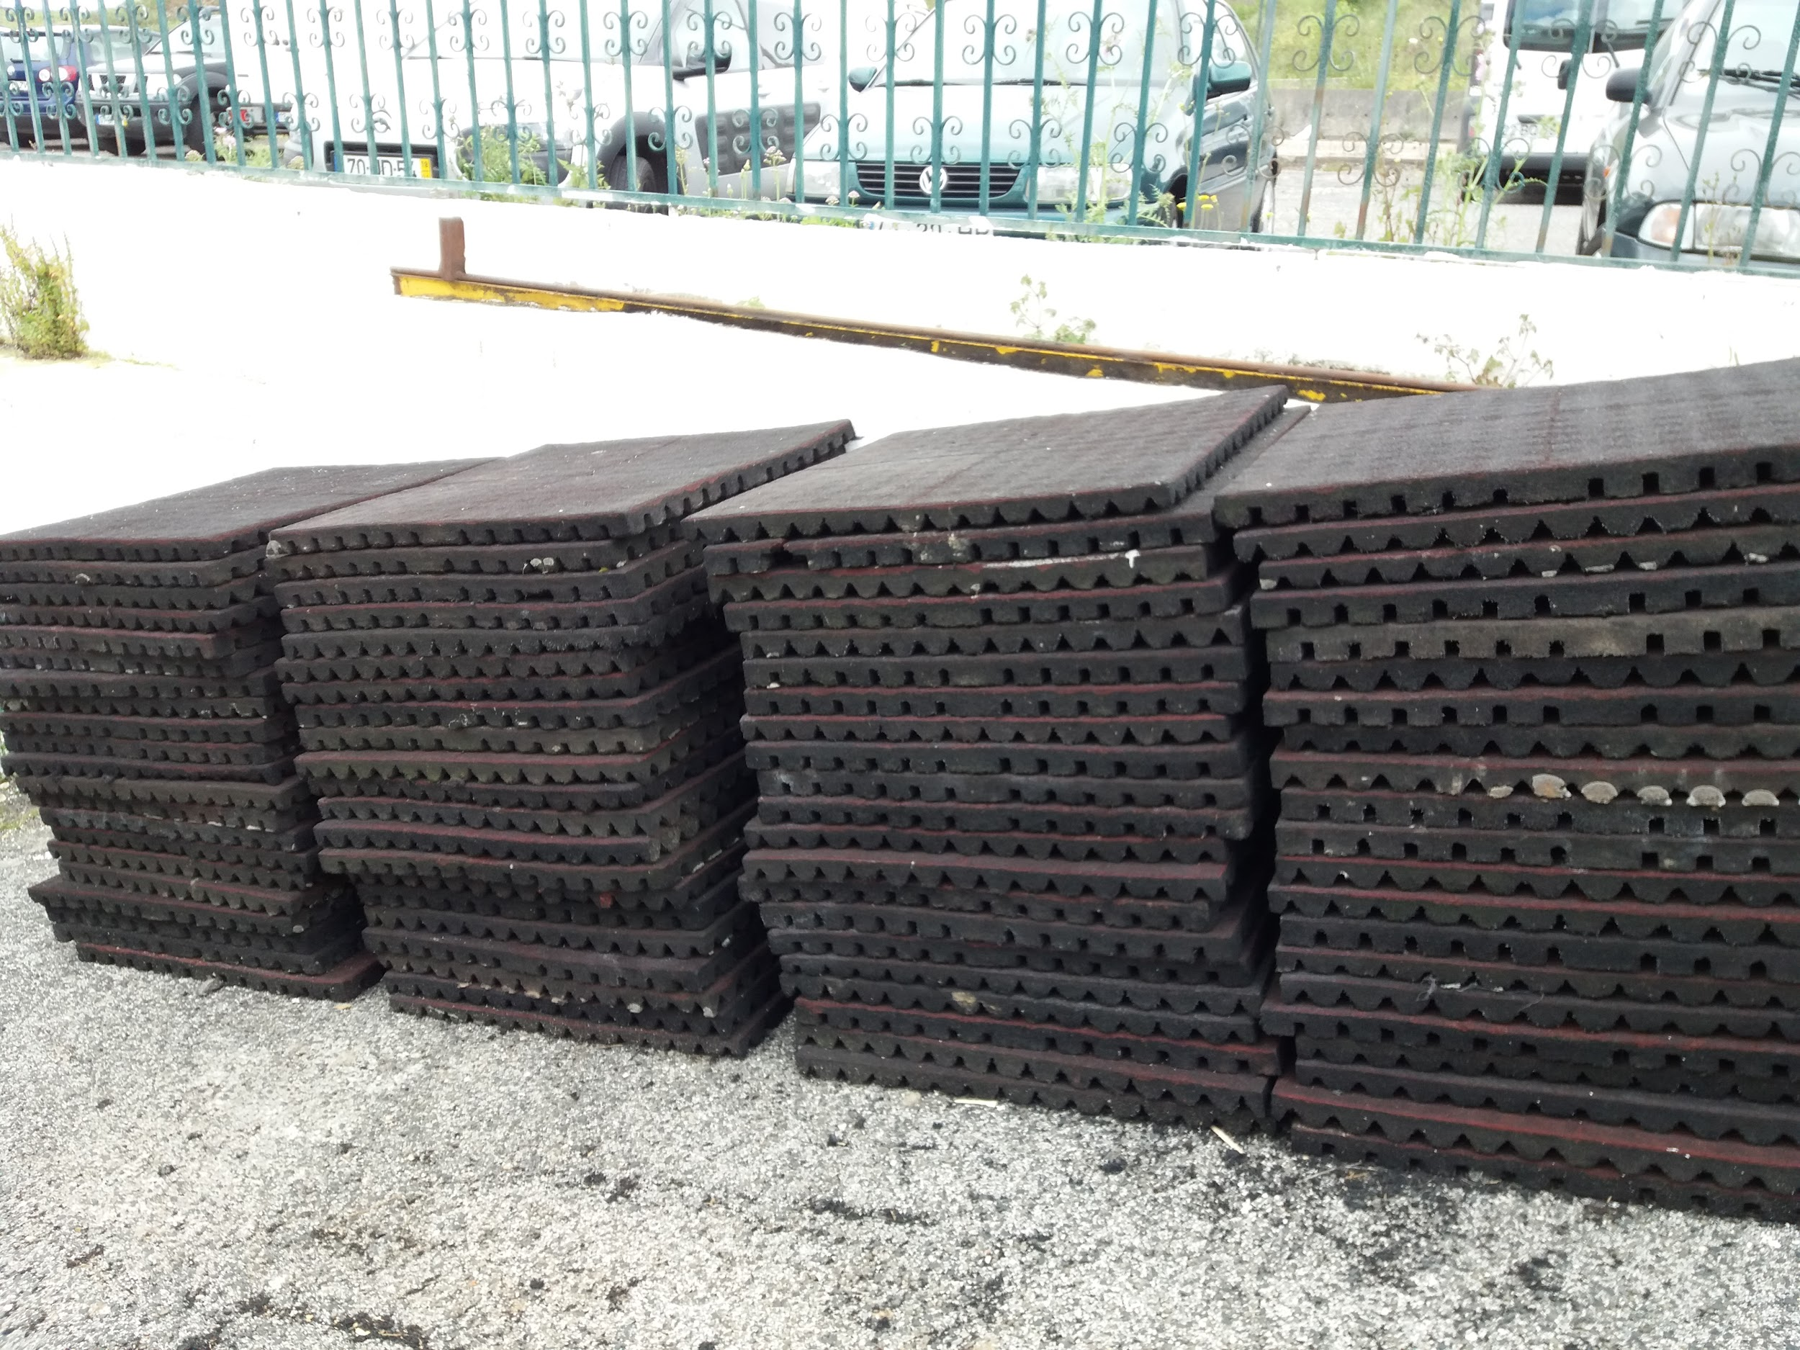
New safe playground- installing rubber matting

Slide 7
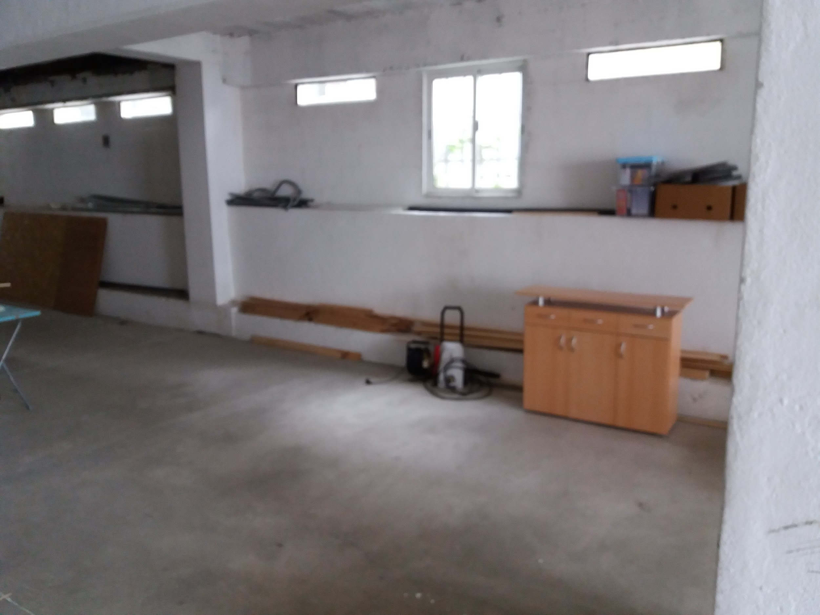
New Classrooms

Slide 8
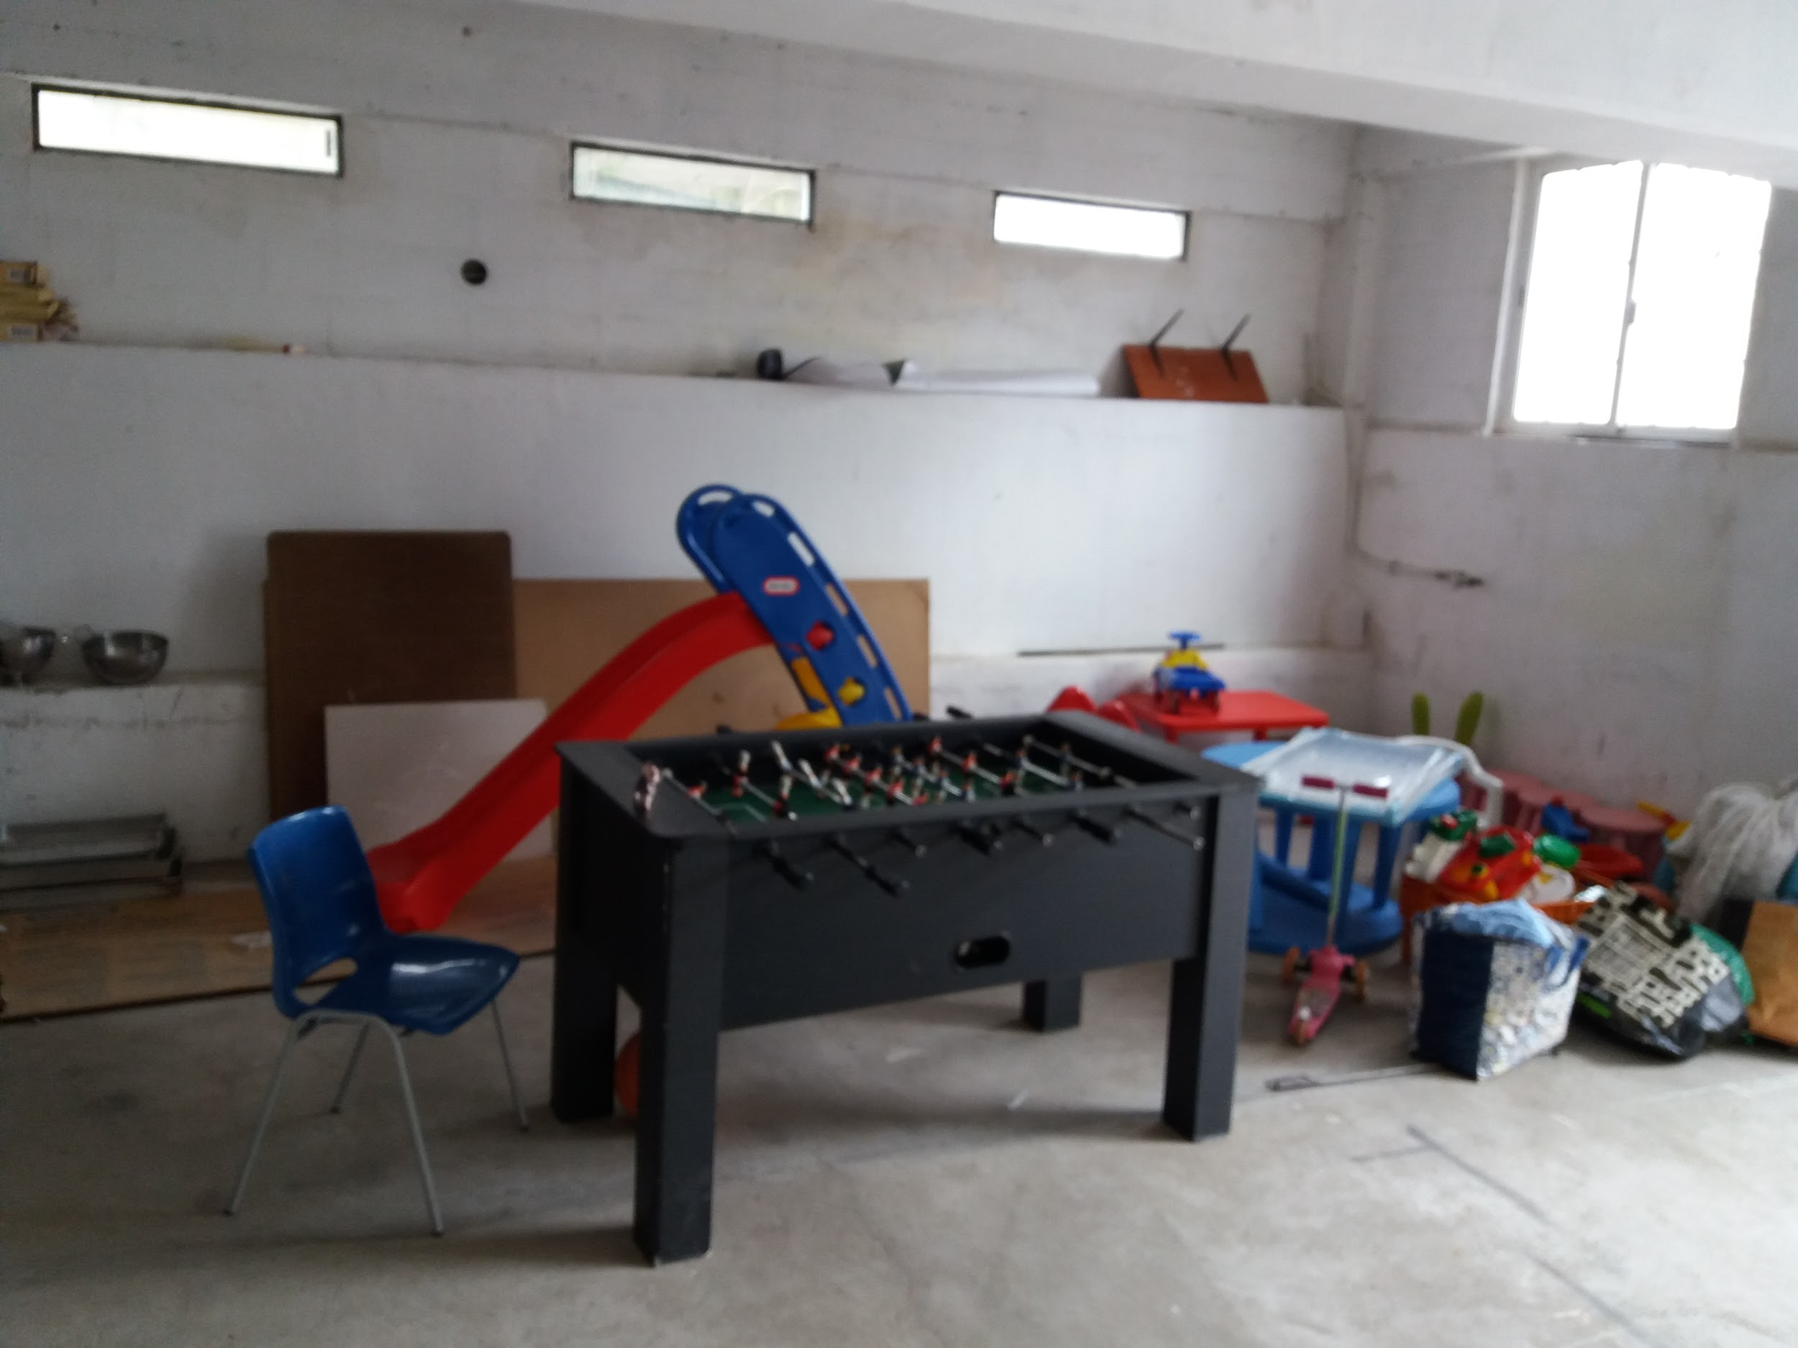
New inside play area

Slide 9
Where? Beautiful Sintra, located right next to Sintra Forum with easy access to the Highway, transportation can be set up through the church.
Why? Need for a Christian Bible based, English speaking homeschool away from home.
What do we offer??
K4-12th grades, also have program for graduates to get an online Associates degree.

Slide 10
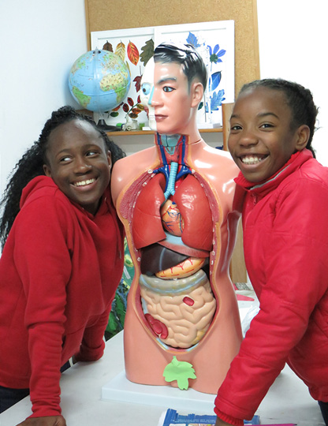
STEM- science, technology, engineering and math
Big push in the USA and it makes Science, Math, Technology and Engineering come to life.
Hands on!
Students do not just sit and do worksheets.

Slide 11
USA diploma
Our Juniors and Seniors take a few courses through Nebraska online school and will receive a diploma from Nebraska that is valid in the USA and internationally!
We will proctor them in these classes and will help them to make sure they are on track.

Slide 12
SAT Prep
I am a certified English SAT prep tutor and worked for a year and a half in Hawaii at a Test prep center.
Our Math teacher is a hands on teacher as well and the kids use the whiteboard daily. He is able to prep students who are preparing for SAT tests for their Math sections.

Slide 13
What about those not fluent yet in English?
Solid ESL program -
Focus on speaking and writing and reading.
They take all their subjects in English and get extra help.

Slide 14
Website and our Facebook page has all of our information: and I have some fliers as well.
WWW. sintrainternationalchristianacademy.org
Or Google
Sintra Academy

