Slide 1

Tidal or Magnetic?
What we can learn from
Star-Planet Interactions.
Christopher Trejo, CSUN Astrophysics
Advisor Dr. Damien Christian
PHYS 497 Senior Project
Professor Tyler Luchko

Slide 2
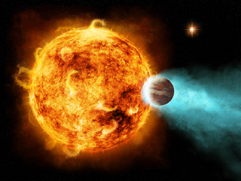
Star-Planet Interactions?
What are SPIs?
Physical and dynamic processes that occur between a star and its orbiting planets.
What drives this research?
SPI can have significant impact in the star system, and we want to know more these processes.
My research?
Using flux in emission lines to study the change in activity of the star as the planet orbits.
Then use modeling to predict if the activity is caused by tidal or magnetic interactions.
What more can we learn?
Exoplanetary Atmospheres, magnetic fields and habitability.
Solar Evolution.
Long term stability of orbits.
(Image credit: NASA/CXC/M.Weiss)

Slide 3
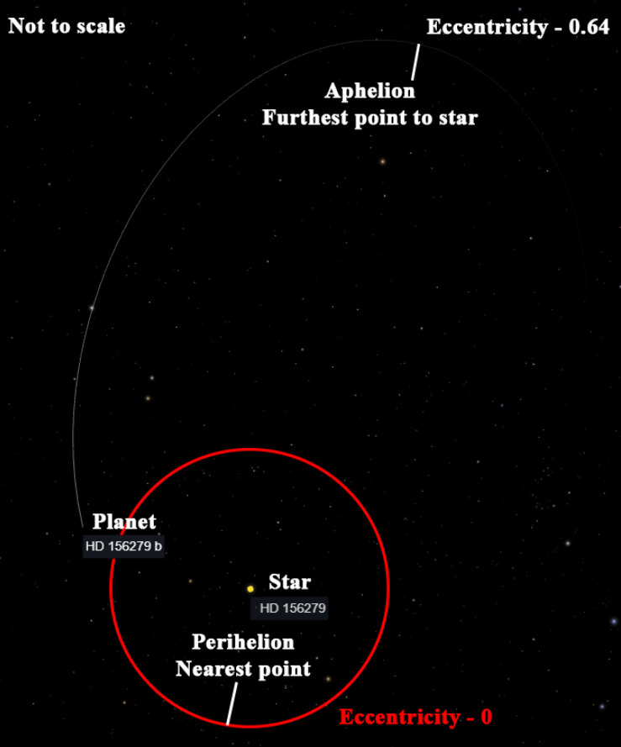
Solution
Ca II H&K Emission lines:
Highly ionized calcium atoms in chromosphere.
Sensitive to gravity or to magnetic fields.
As the planet orbits the star, it will induce stellar activity.
We study Star-Planet systems with:
Hot Jupiter (HJ) in close eccentric orbits.
9.42 times the mass of Jupiter.
1.12 times the radius of Jupiter.
Close to star – 0.50 AU (75m km).
Eccentricity of 0.64.
Important factors because:
HJ are close and large, can produce notable activity.
Compare the changes in activity as our planet goes through its orbit.
If we have a SPI, we can compare our results with models that predict if they are tidal or magnetic interactions.
Star: HD 156279
Planet: HD 156279b
Orbit: 133.4 Days
118 LY from earth
Image: Eyes on Exoplanets (exoplanets.nasa.gov)
1 AU = Avg. Distance from earth to the sun (150m km)

Slide 4
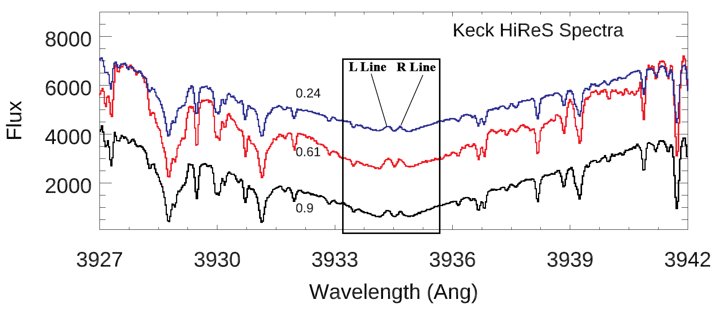
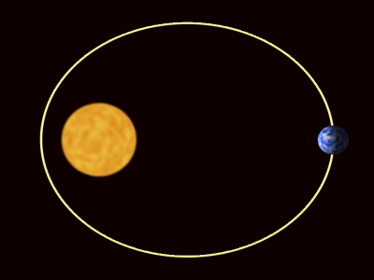
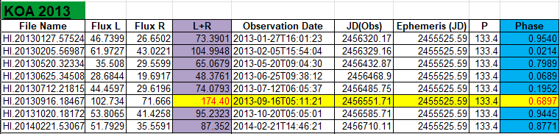
Methods
What’s the Flux?
Change in peaks for Ca II H & K lines.
38 observations spanning four years, from KOA.
Calculated using IRAF and Splot Software.
Phase:
Position of planet relative to star (Phase 0 to 1).
Some math and programing!
Phase Equation and Python Fractional Function.
Sample of Ca II H&K emission lines being used to calculate the flux,
0.75
Phase -
0.0 or 1.0
(Near)
-Phase
0.5
(Far)
Data for 2013, showing flux (L+R), Observation date (JD(obs)), Ephemeris (JD), Period P and Phase.
0.25
Credit: NASA
K.O.A. - Keck Observatory Archive
IRAF – Image Reduction and Analysis Facility

Slide 5
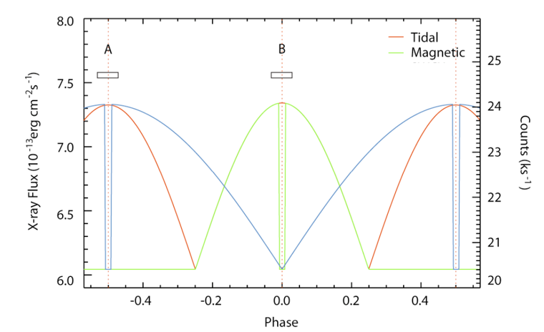
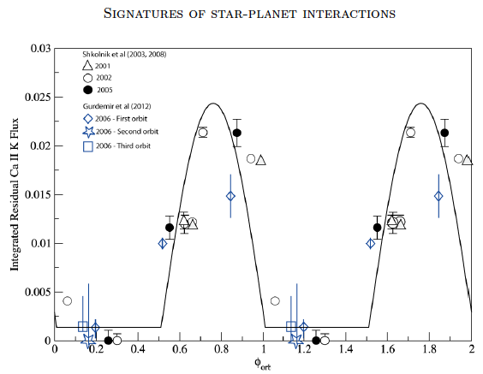
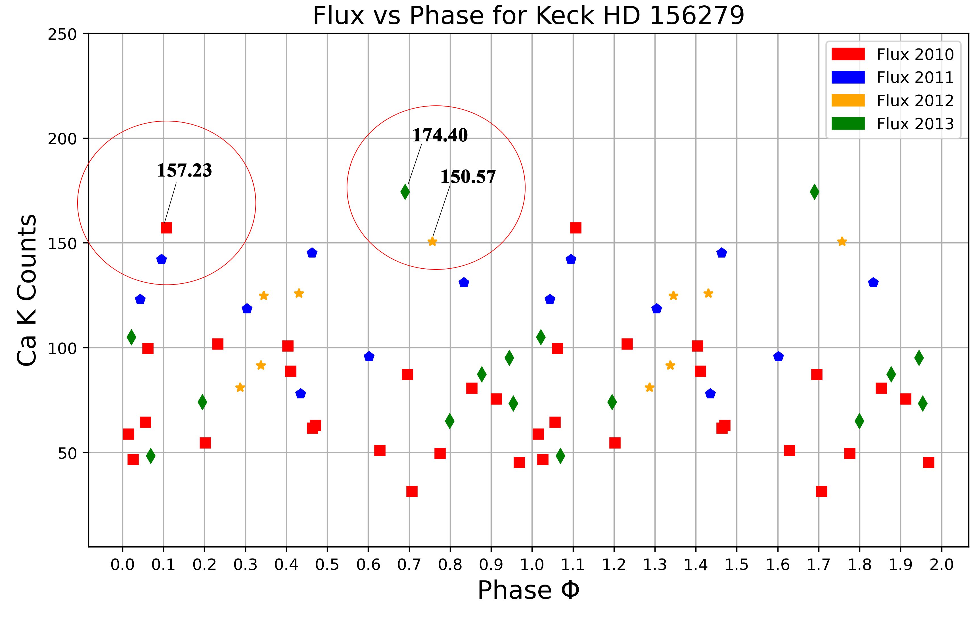
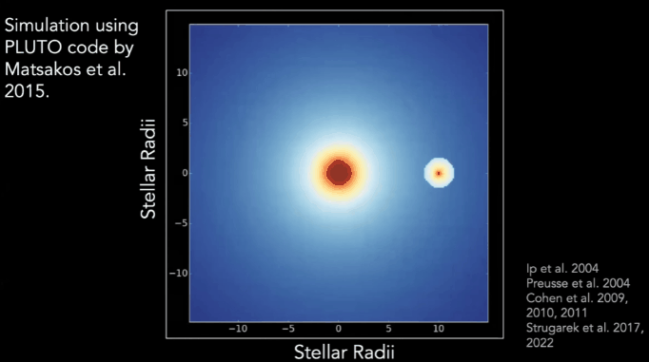
Results
What the models say:
For Tidal, two peaks in the 0.5 phase range.
For Magnetic, single peak in the 0.0 phase range.
What I found:
Peaks in the 0.70 phase range for 2012/2013.
Peak in 0.1 phase for 2010.
No notable peak for 2011?
Expect flux to be ahead of the planets phase.
So, we can predict that this planet has a magnetic field.
Prediction model for Tidal/Magnetic SPI By Dr. Nicolas Iro (Work in Progress)
Shkolink, 2018
Ca II H & K Flux for HJ Host HD 179949
2010, 2012, 2013 show magnetic SPI at ɸ ~ 0.1, 0.75, 0.76.

Slide 6
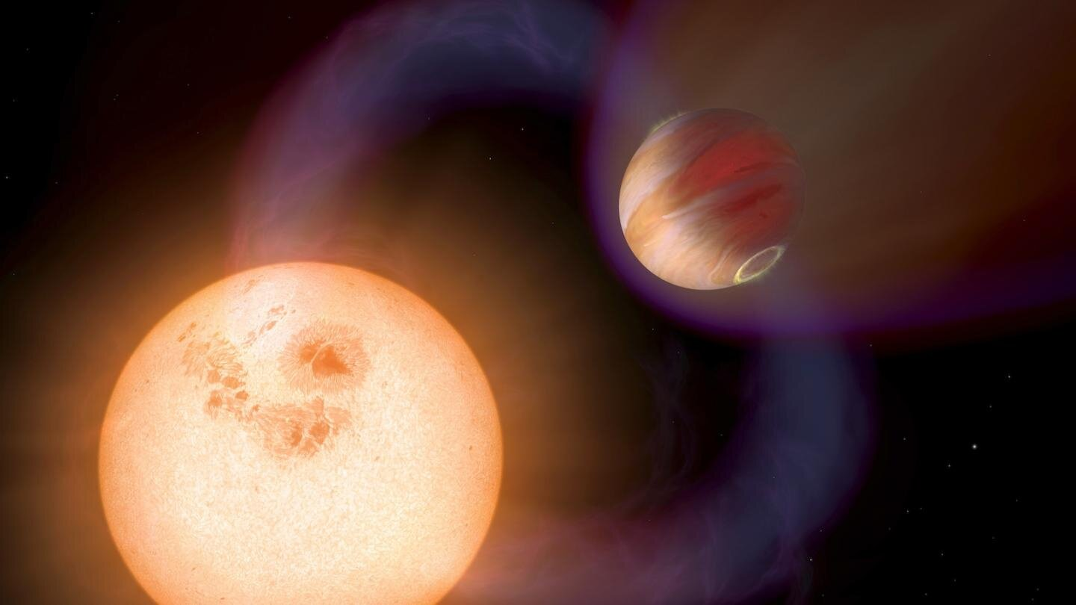
Conclusion
I used Ca II H & K emission lines to measure SPI.
Found a flux for HD 156279 and plotted it against the phase.
Three of our four observations showed an increased flux
My data showed peaks in the 0.70 phase range and 0.1 phase which based on modeling suggest a magnetic interaction and planetary magnetic field.
Further studies of SPI with compatible systems will improve our understanding of the dynamics of stars and exoplanet magnetic fields, atmospheres and habitability.
Credit: NASA, ESA

Slide 7

Questions?

