Slide 1
AFFORDABLE CONNECTIVITY PROGRAM
*Briefings and applications for this program will be Thursdays at 6pm:
August 10, 17, 24, & 31.
POC: cmdr4676@gmail.com
ACP
HELPING HOUSEHOLDS CONNECT TO BROADBAND HIGH-SPEED INTERNET SERVICE

Slide 2
NEWS from the Federal Communications Commission
FCC LAUNCHES AFFORDABLE CONNECTIVITY PROGRAM
On December 31, 2021- WASHINGTON DC-The FCC officially launched Affordable Connectivity Program, a $14.2 billion program to the Emergency Broadband Benefit which helped almost 9 million households to be able to afford internet access during the pandemic.
As of today , elibible households are encouraged to apply to receive up to $30 per month discount on in-home internet service or internet service on a tablet.
“The response to the Emergency Broadband Benefit proved what many knew to be true: the cost of high-speed internet is out of reach for too many of us,”reported by FCC Chairwoman Rosenworcel.
“Now with the long-term Affordable Connectivity Program, we have the opportunity to enroll even more households and help ensure they can afford the internet connections they need for work, school, health care and more.”

Slide 3
WHAT IS IT AND HOW IT WORKS ?
The Affordable Connectivity Program is an FCC government funded program that helps ensure that households can afford the broadband they need for work, school, healthcare, education and more.
The benefit provides a free tablet with internet service for eligible households. Your internet service is for 12 months with no monthly cost.
There is a one time $23 activation fee paid with (cash) or $24 paid with (credit card). Plus, shipping if your tablet is required to be shipped.

Slide 4
WHO QUALIFIES?
Veterans Pension
Medicaid
Food Stamps
Social Security
Section 8 Housing
All Veterans who receives Veterans Disability or Survivors Benefit Programs and Veterans Pension
Federal Health Insurance, Children’s Health Insurance Program (CHIP)
Supplemental Nutrition Assistance Program (FOOD STAMPS)
Social Security or SSI Supplemental Security Income Disability program
HCV Program Housing Choice Voucher, Section 8 Vouchers, Public Housing
FREE And Reduced-Price School Lunch
Or Breakfast Program
Supplemental Nutrition Program for Women, Infants, and Children
School Free Breakfast-Lunch or Reduced School Lunch-Breakfast Programs
Federal Pell Grant for the current year

Slide 5
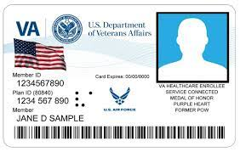
Requirements for Program
**IMPORTANT TO BRING CURRENT PROOF OF BENEFIT AWARD LETTER
Need to provide Proof of Identity and Proof of Benefits
State DL or ID
Passport
Benefit Card
Benefit Award Letter
Valid Drivers License or State Identification
United State Passport
VA Card Medicaid Card
Current Proof of Benefit Award Letter
Current State Drivers License or State ID
Email address
Last 4 of social security number
Current address
Provide proof of benefit documentation

Slide 6
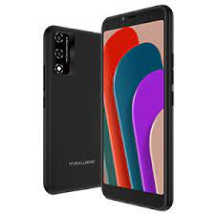
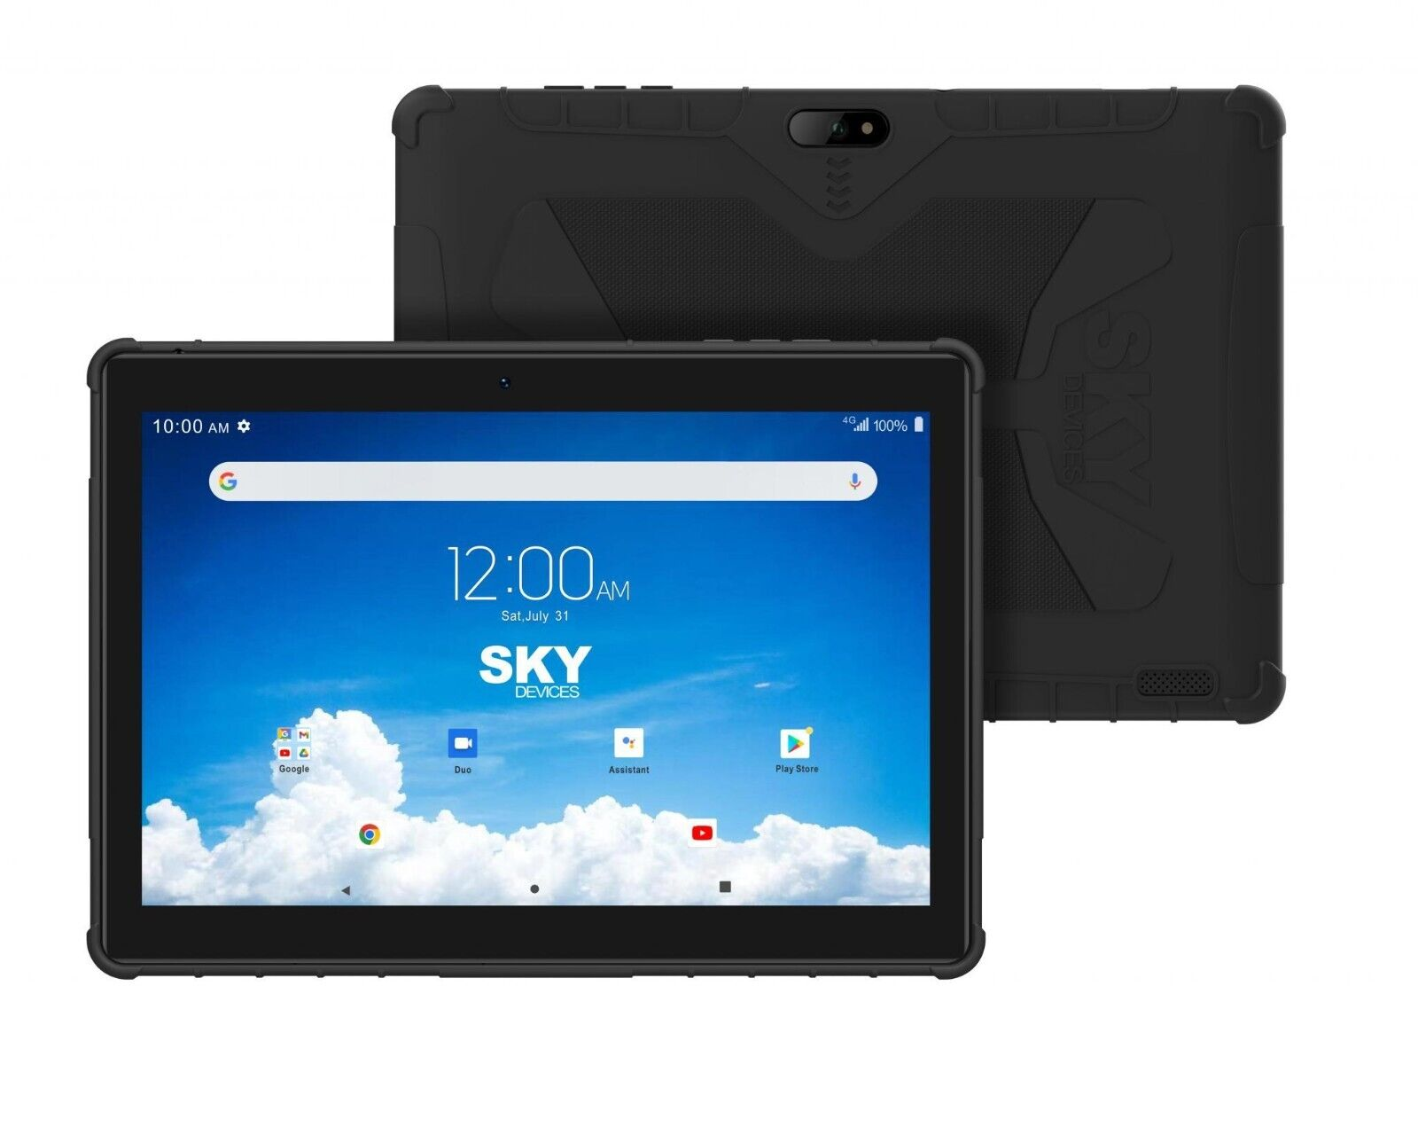
FREE ACP Products and Services Available
Xfinity Internet
or
Mobile Services
Get Xfinity 5g Home Internet for free with the Affordable Connectivity Program Available now in Limited Locations Xfinity Home Internet or Mobile Service
Phones FREE Nitro 55E Cell Phone Unlimited Talk, Text, and 15gb of Internet data FREE every month! NO monthly payments **$12 one-time activation fee+ shipping (IF REQUIRED)
**ONLY IF ALREADY HAVE PHONE
Tablets Free 10" Sky Pad Smart Tablet 25gb Internet data (like your cell phone) FREE every month! NO monthly payments **$23 (CASH) one-time activation fee + shipping (IF REQUIRED)
(Not limited to brand type or size)
***NO MONTHLY PAYMENTS, COMMITMENTS, OR ANY HIDDEN FEES JUST A ONE TIME ACTIVATION FEE AND *SHIPPING (IF REQUIRED)
YOU CAN ONLY RECEIVE ONE ACP BENEFIT PER HOUSEHOLD

Slide 7
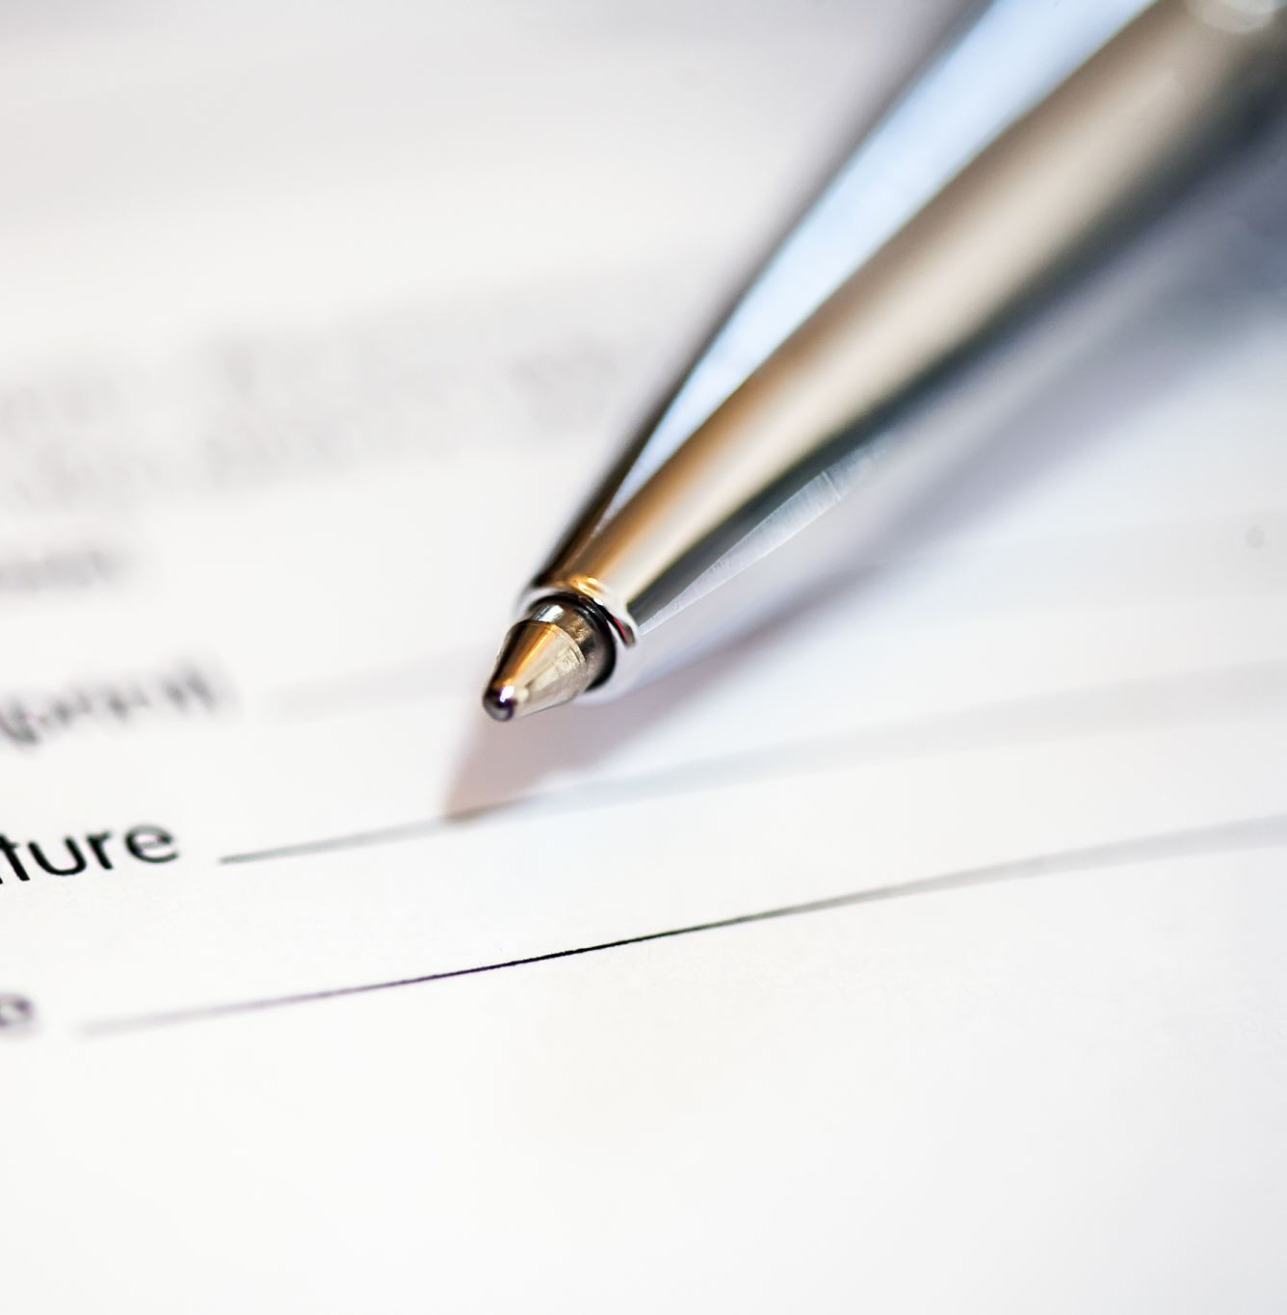
Summary
FREE TABLET WITH 25GB INTERNET DATA PER MONTH
MUST HAVE ANY QUALIFING GOVERNMENT ASSISTANTANCE BENEFITS
MUST PROVIDE PROOF OF IDENTITY AND BENEFITS
ONE TIME ACTIVATION FEE REQUIRED $23 CASH/ $24 CREDIT CARD
NO MONTHLY COST FOR PROGRAM (MUST USE INTERNET SERVICE TO KEEP PROGRAM)
YOU CAN ONLY RECEIVE ONE ACP BENEFIT PER HOUSEHOLD

Slide 9
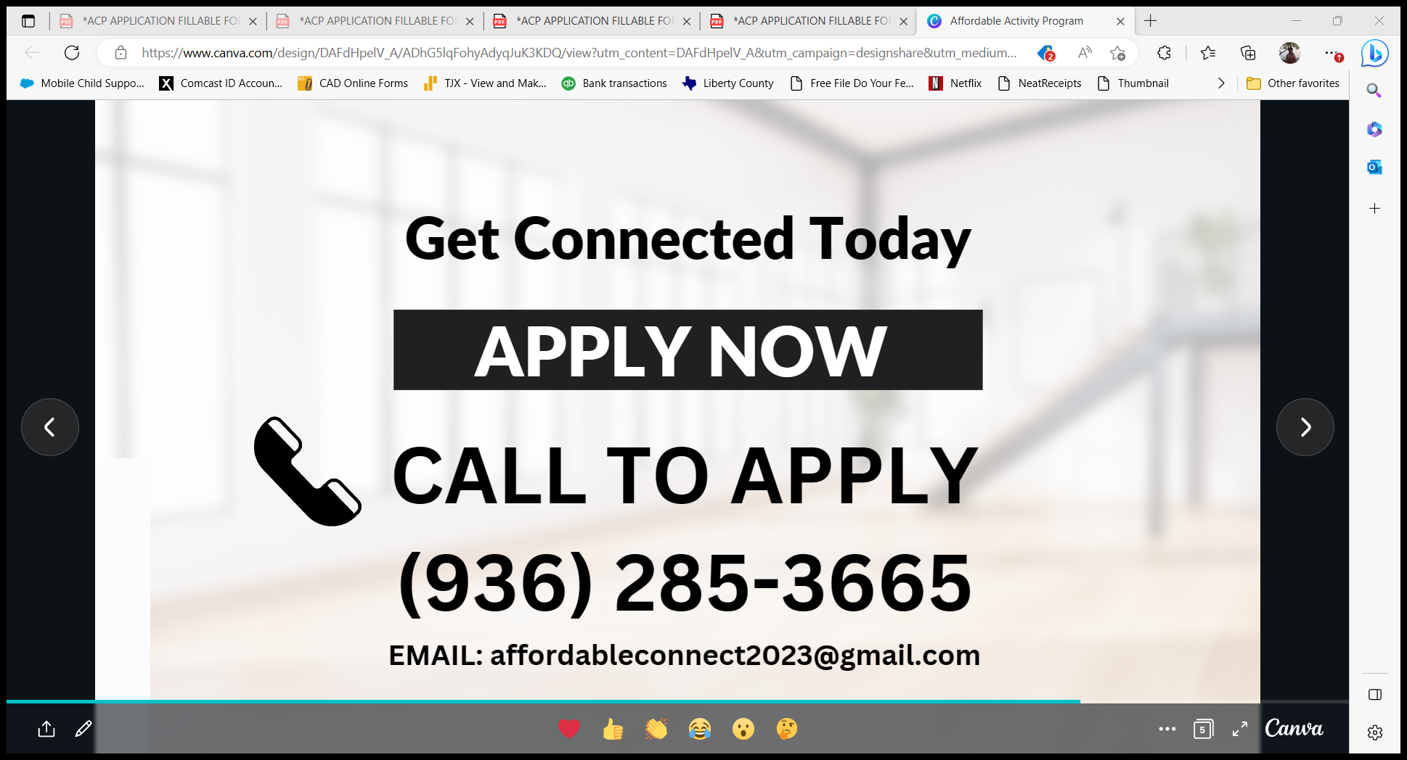

Slide 10
Thank You
For taking the time to review the ACP Program Information
Call for scheduling any upcoming events you would like for me to attend
Linda Chatlin
(936) 285-3665
affordableconnect2023@gmail.com

