Slide 1
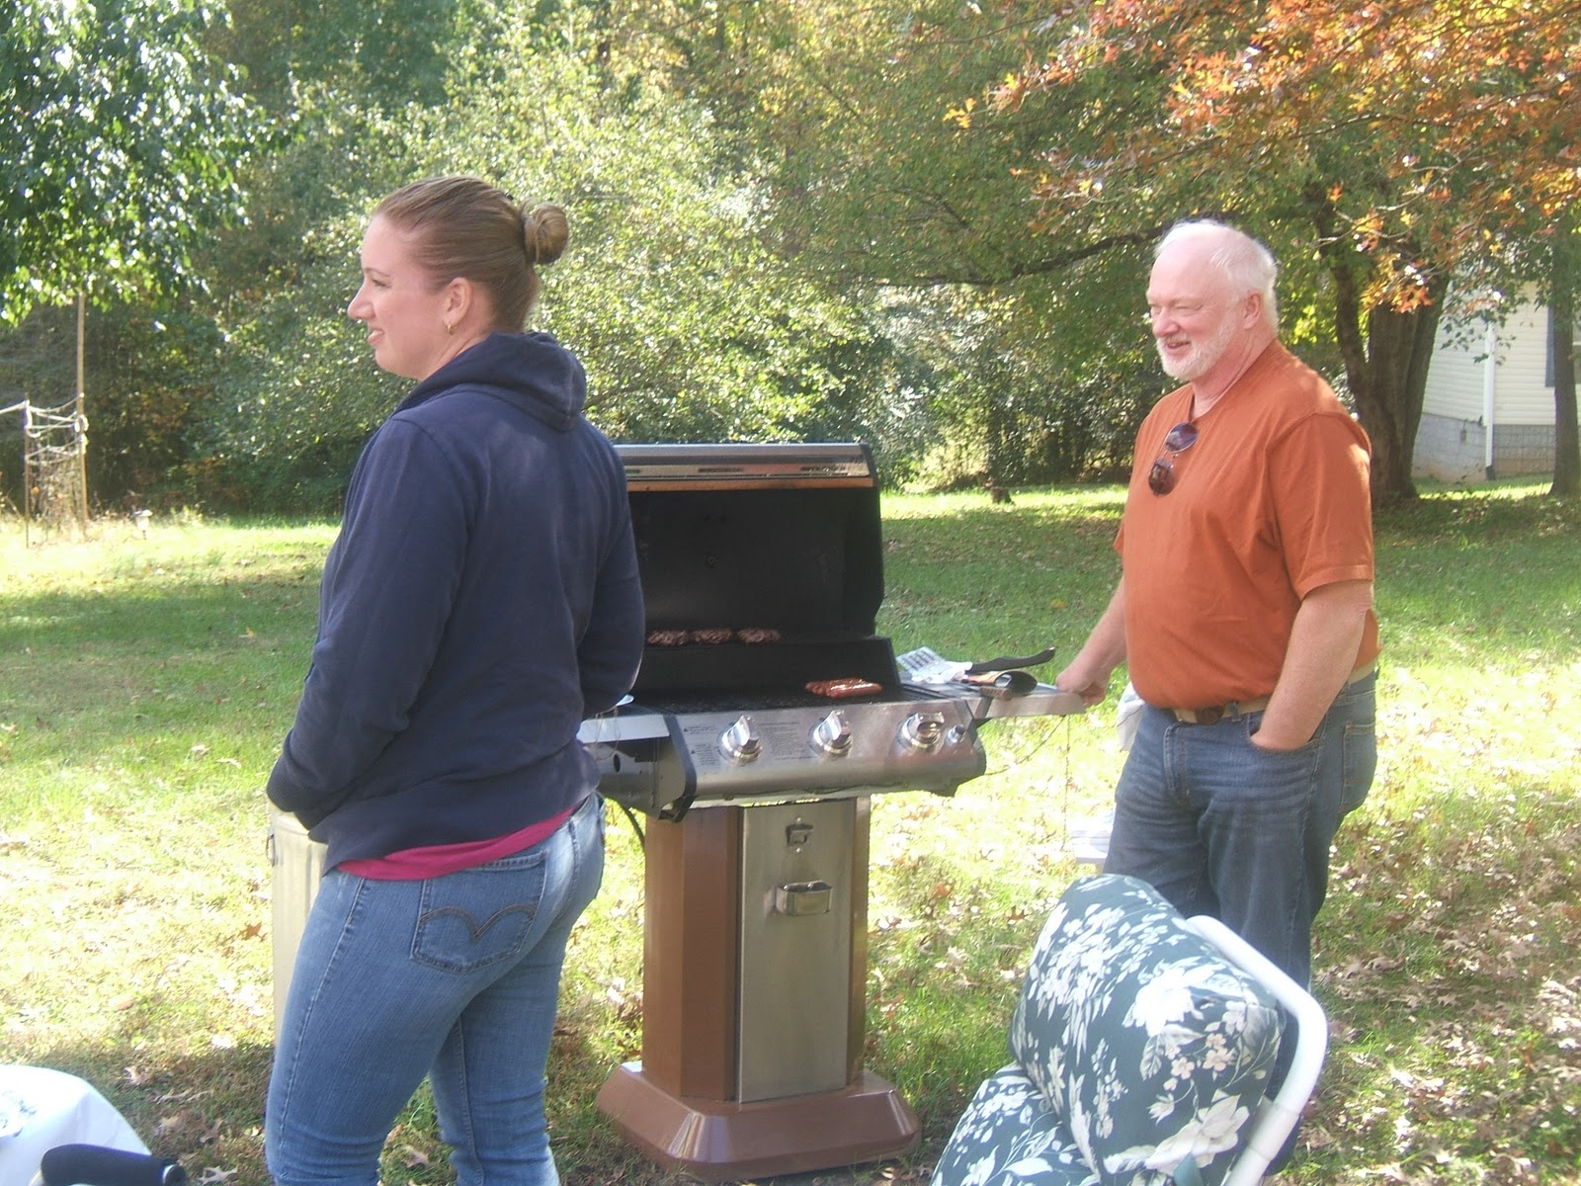
“After dinner rest a while, after supper walk a mile”.
Benefits of activity immediately after meals for better diabetic and weight loss strategies.
This Photo by Unknown Author is licensed under CC BY

Slide 2
Change of BS after a meal without walking (BS at 0 min means the BS just before the meal. BS at 30 min means the BS at 30 min after starting walking. BS at other times mean the same as at 30 min). Hijikata, et. al. Int J Gen Med. 2011 Jun 9;4:447–450.

Slide 3
Change of BS with walking for 30 minutes just after a meal. Hijikata, et al Int J Gen Med. 2011 Jun 9;4:447–450.

Slide 4
 | Subject 1 | Subject 2
Height (cm) | 153 | 162
Weight (kg) | 55 | 60.2
BMI | 23.5 | 22.9
Pulse before walking | 74 | 56
Pulse after walking | 108 | 86
Total cholesterol | 256 | 213
DM family history | (+) | (−)
Walking speed (km/hr) | 5.8 | 4.8
Intake calories at a time (Kcal) | 500 ± 60
Necessary time for finishing meal (min) | 20 ± 5
Table 1.
The background of subjects of this trial
Hijikata et al Int J Gen Med. 2011 Jun 9;4:447–450.

Slide 5
Table 2. Comparison of BS increase after meal with or without walking
ΣΔBS(−)ª |  | ΣΔBS(0)^{b}
2002/4/9 | 292 | 2002/4/17 | 51
2002/4/11 | 217 | 2002/4/23 | 89
2002/4/17 | 178 | 2002/5/3 | 99
2002/4/21 | 191 | 2002/5/6 | 79
Mean±SD Notes: ªWithout walking after a meal; ^{b}Walking just after a meal. Abbreviation: BS, blood sugar. Hijikata, et al Int J Gen Med. 2011 Jun 9;4:447–450. | 219.5 ± 51.0 |  | 79.5 ± 20.7 (P < 0.00001)

Slide 6
Comparison of ΣΔBS walking for 30 minutes just after meal ΣΔBS(0) and wakling for 30 minutes from 60 minutes after meal ΣΔBS(60)
ΣΔBSS(0) |  | ΣΔBS(60)
2006/8/21 | 146 | 2006/8/22 | 193
2006/8/28 | 153 | 2006/8/29 | 173
2006/9/1 | 168 | 2006/9/2 | 179
2006/9/16 | 157 | 2006/9/17 | 185
2006/9/24 | 145 | 2006/9/25 | 199
AVERAGE Hijikata, et al Int J Gen Med . 2011 Jun 9;4:447–450. | 153.8 ± 9.4 | AVERAGE | 185.8 ± 10.4 (P < 0.001)

Slide 7
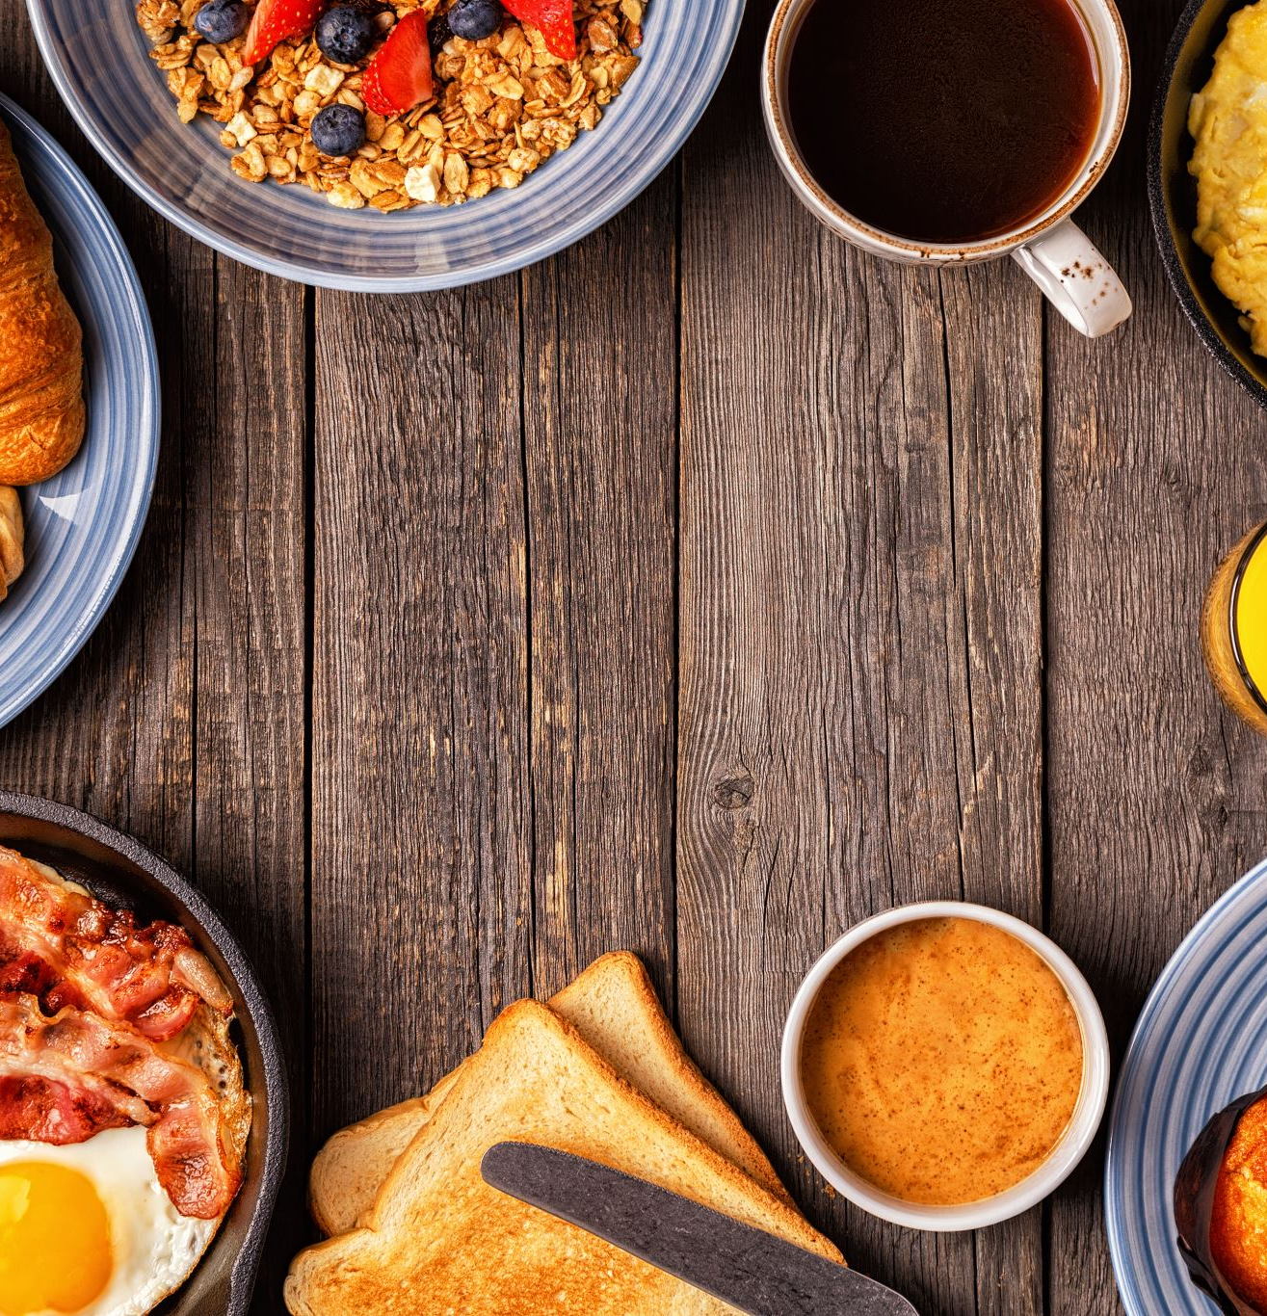
Immediate post-breakfast physical activity improves interstitial postprandial glycemia: a comparison of different activity-meal timings Thomas P. J. Solomon1,2 &Eloise Tarry1 & Chloe O. Hudson1 & Alice I. Fitt1 & Matthew J. Laye3
Low- to moderate-intensity activity should be implemented soon after eating to improve glucose control following breakfast. The type of activity appears less important than the timing. These findings will help optimize exercise-meal timing in general health guidelines.
Pflügers Archiv- European Journal of Physiology (2020) 472:271–280 https://doi.org/10.1007/s00424-019-02300-4

Slide 8
Tobias, et. al, Sports Medicine, 2023 Jan 30;53(4):849–869
After Dinner Rest a While, After Supper Walk a Mile? A Systematic Review with Meta-analysis on the Acute Postprandial Glycemic Response to Exercise Before and After Meal Ingestion in Healthy Subjects and Patients with Impaired Glucose Tolerance
Tobias Engeroff ^{1,✉}, David A Groneberg ², Jan Wilke ²

Slide 9
Tobias, et. al. Sports Medicine, 2023 Jan 30;53(4):849–869
Exercise (such as 20 min of walking) has an acute beneficial impact on postprandial hyperglycemia when undertaken as soon as possible after a meal.
Longer intervals between eating and exercising weaken the acute effect on glucose levels.
Exercise prior to a meal does not blunt postprandial hyperglycemia.
Post-meal exercise minimizes glycemic excursions and therefore might lower the risk for low-grade inflammation diseases and cardiovascular diseases.

Slide 10
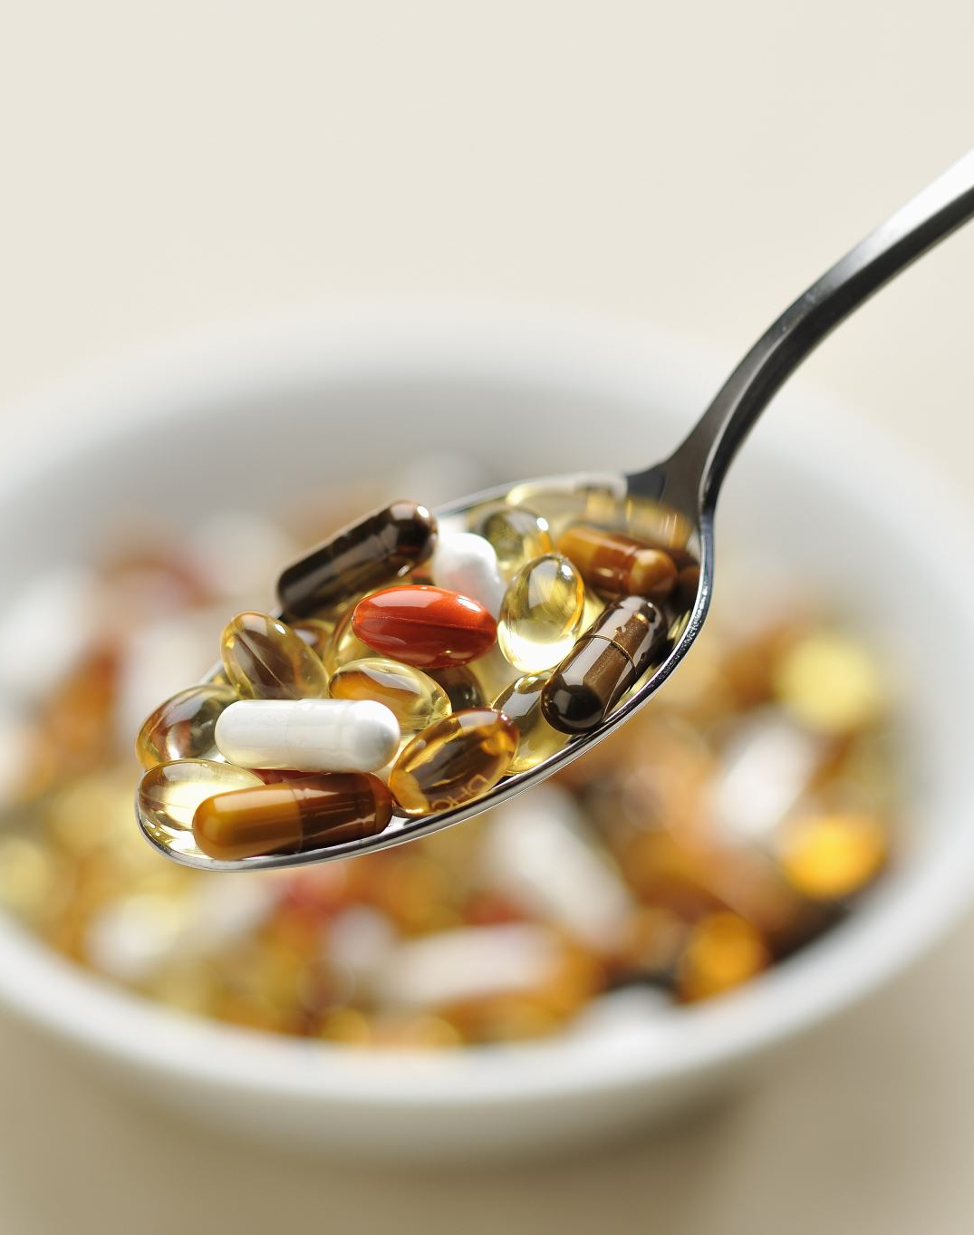
Sports Medicine, 2023 Jan 30;53(4):849–869
It is quite clear that walking suppresses the glucose increase after a meal (Table 2). Because glucose increases to its maximum at 30–60 minutes after a meal, walking must be started before the glucose level reaches a maximum, because once insulin is secreted it will play a role as an obesity hormone. It can be assumed that starting walking as soon as possible seems to be optimal to control BS levels.

Slide 11
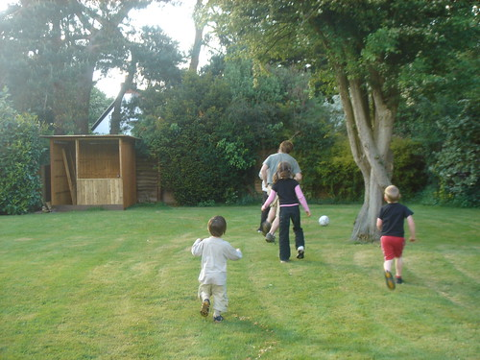
“After dinner walk a while, after supper walk again”.
This Photo by Unknown Author is licensed under CC BY-NC-ND

