Slide 1
First Step, Session Four
Welcome, Introductions, and Recap
August 28, 2024

Slide 2
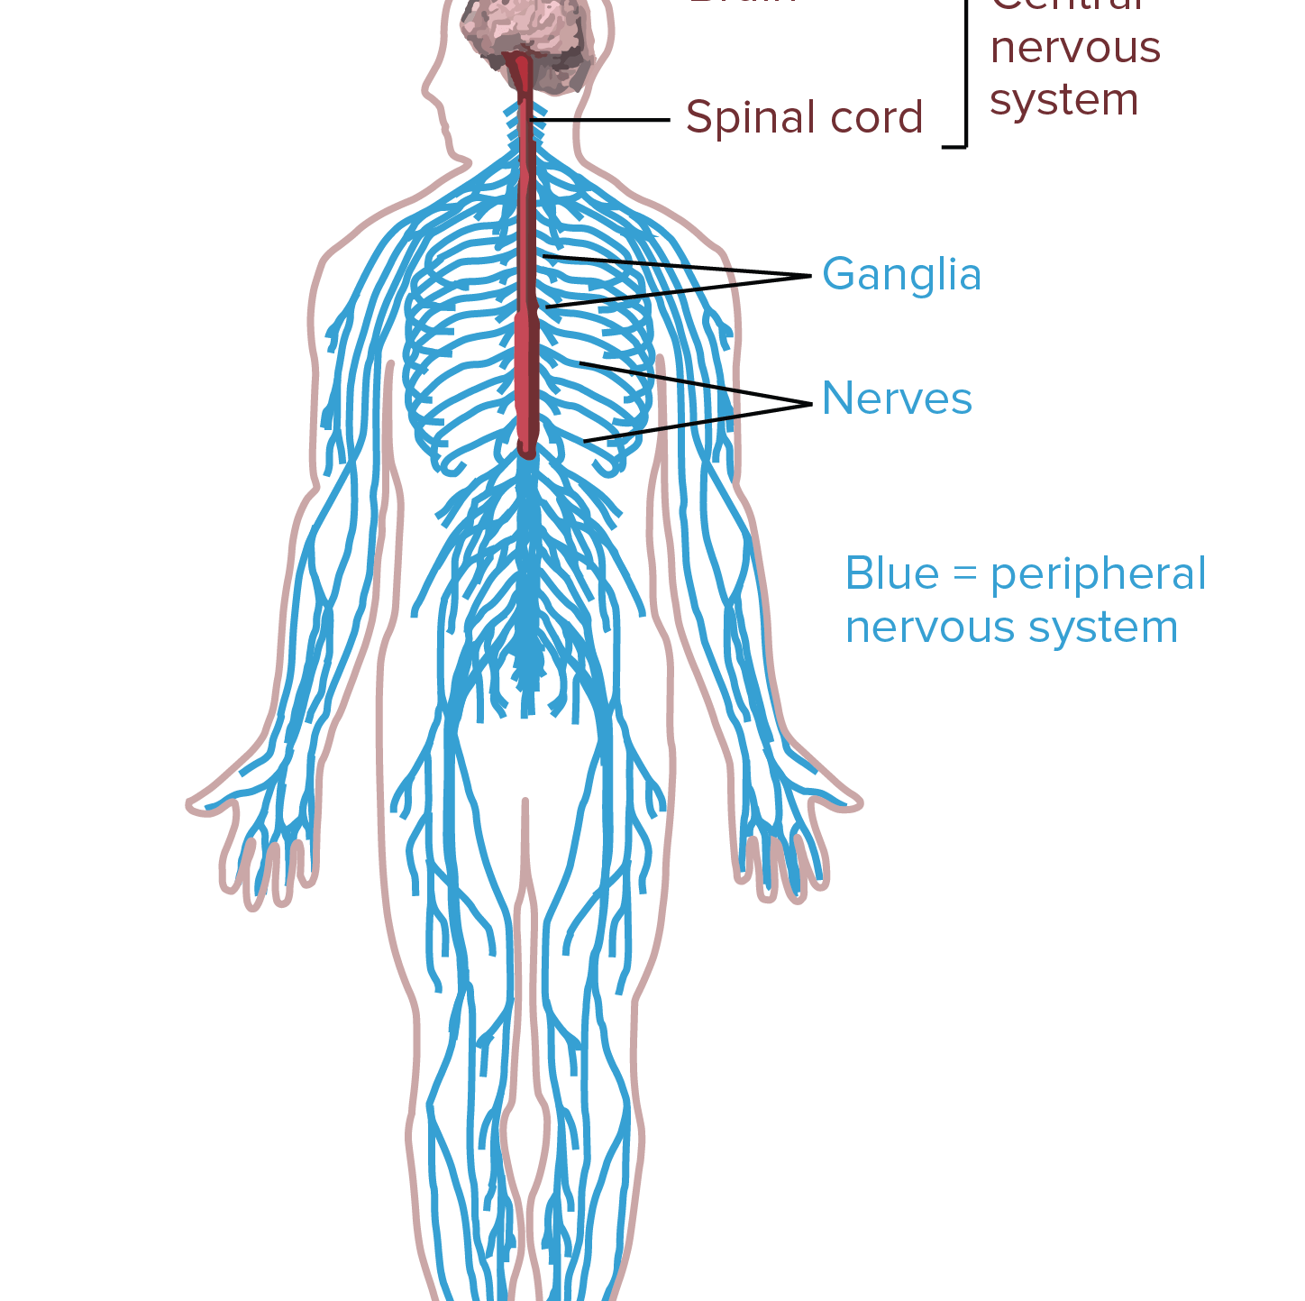
The Body has a Brain!
The amazing body remembers everything!
That’s why we have the commander, our brains!
This Photo by Unknown Author is licensed under CC BY-SA-NC

Slide 3
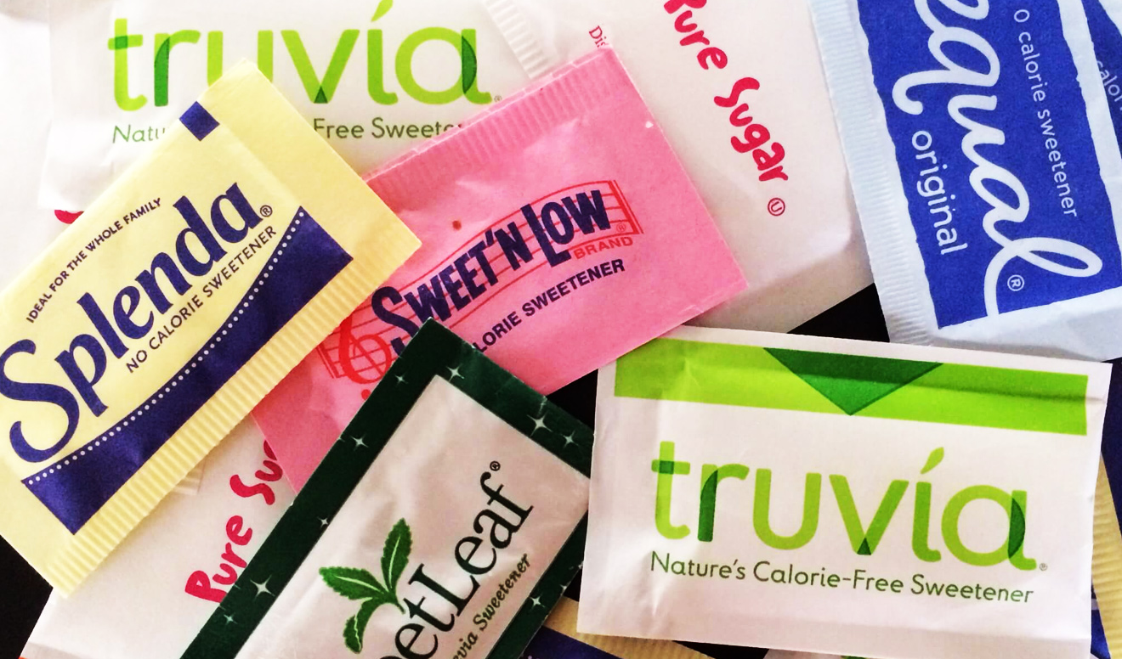
Personal testimony – First Step monthly additions:
1st month:
No additional sweeteners, desserts
Trying to make it a habit
No appreciable change in weight
This Photo by Unknown Author is licensed under CC BY-SA-NC

Slide 4
First Step monthly additions:
2nd month:
Mindful eating!
Be aware of the feeling of hunger passing away
Savor the flavor, the smell, the texture of what I eat
Minimize distracting activities at least at one meal a day
This Photo by Unknown Author is licensed under CC BY-NC-ND

Slide 5
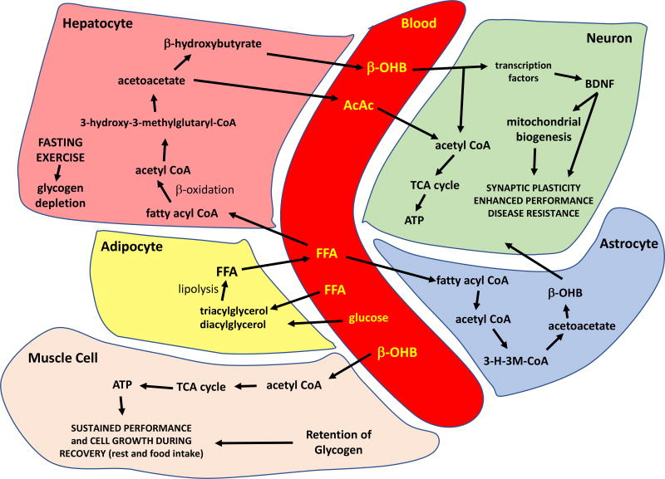
First Step monthly additions:
3rd month:
Intermittent fasting /letting ketones work;
Summary of the major metabolic pathways involved in the metabolic switch and responses of excitable cells to the ketone β-hydroxybutyrate (β-OHB). See text for description. AcAc, acetoacetate; ATP, adenosine tr Obesity (Silver Spring). 2018 Feb; 26(2): 254–268.

Slide 6
First Step monthly additions:
4th month:
Aerobic activity longer than 30 minutes 4 times/week
The body uses glucose as the fuel the first 20 to 30 minutes of aerobic activity
Beyond 30 minutes we borrow from the “Fat Reserve Bank”

Slide 7
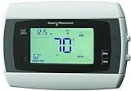
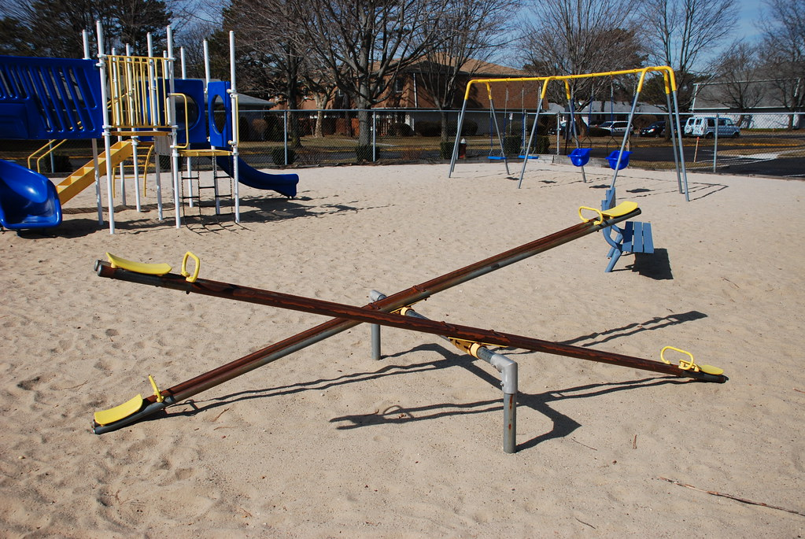
Need to Lower the Fat Thermostat
Recap of why we keep gaining weight – the weight thermostat
No simple “Calories in equals calories out!”
This Photo by Unknown Author is licensed under CC BY-SA
This Photo by Unknown Author is licensed under CC BY

Slide 8
This Photo by Unknown Author is licensed under CC BY-SA

