Slide 1
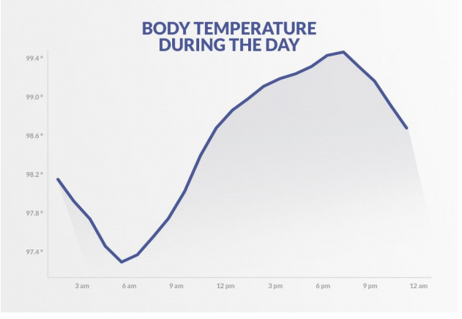
CBT-I-Clinician-Training-Manual-1.pdf

