Slide 1
The Joint Pain Relief Workout
Session 1
15 Steps for Safe Exercise

Slide 2
Six all-around exercise safety tips
Warm up properly
Boost your activity level gradually over time
Pay attention to your body
Avoid overtraining
Respect the weather
Stay hydrated

Slide 3
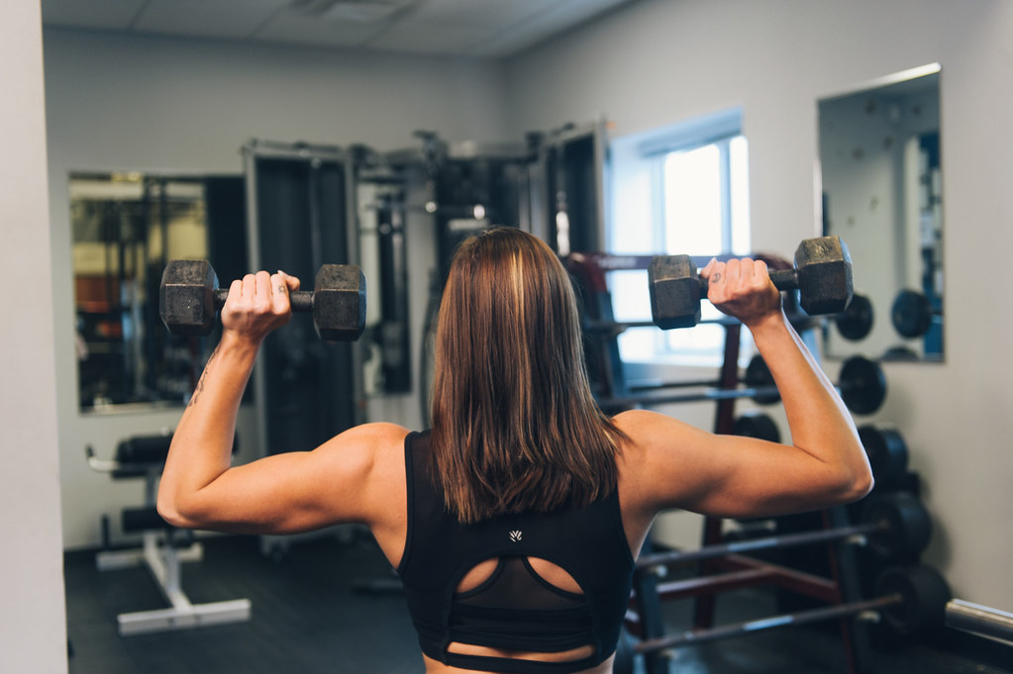
Five strength training safety tips
Use light weight or resistance only
Focus on form
Tempo, tempo
Breathe
Give muscles time off
This Photo by Unknown Author is licensed under CC BY

Slide 4
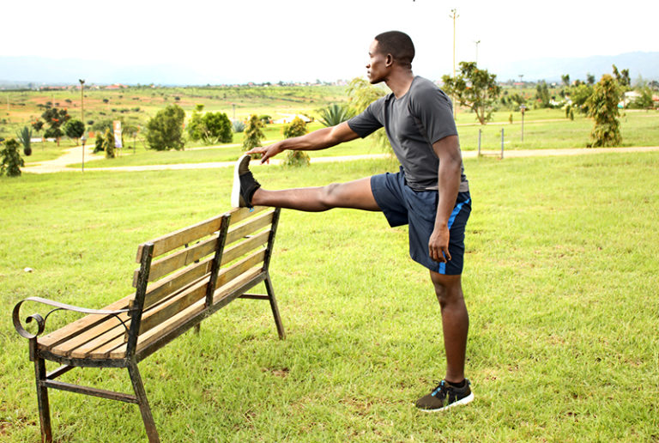
Four stretching safety tips
Warm up first
Feel no pain
Don’t bounce
Practice often

Slide 5
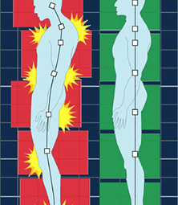
Posture and alignment
Chin parallel to the floor
Both shoulders even
Both arms at your sides with elbows straight and even
Abdominal muscles pulled in
Both hips even
Both knees even and pointing straight ahead
Both feet pointing straight ahead
Body weight distributed evenly on both feet
This Photo by Unknown Author is licensed under CC BY

