Slide 1
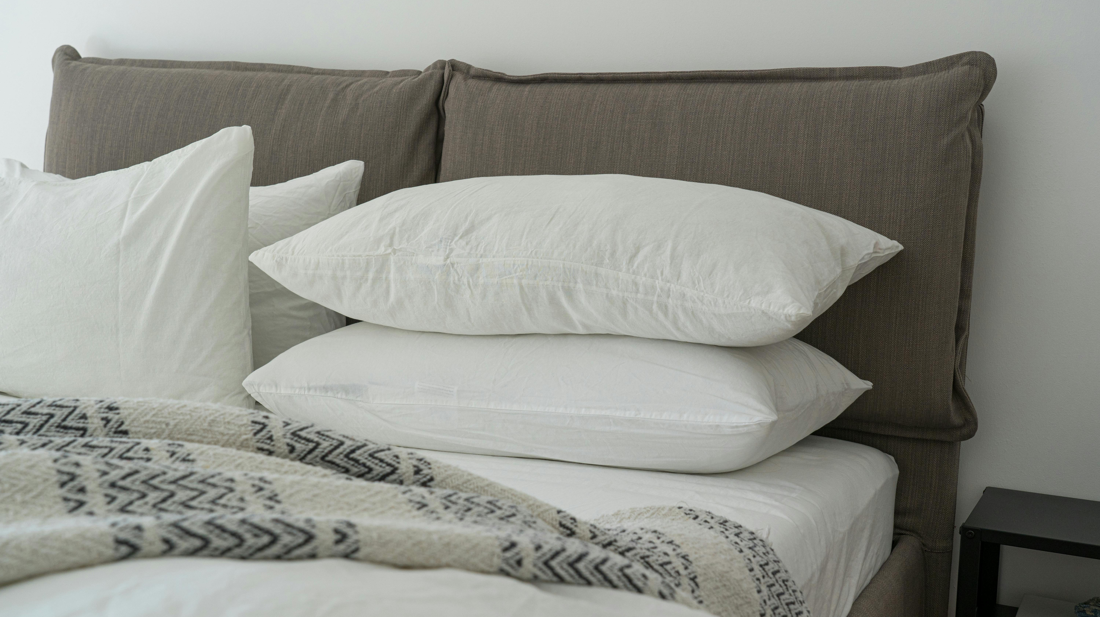
Thoughts on Sleep
How much is needed?

Slide 2
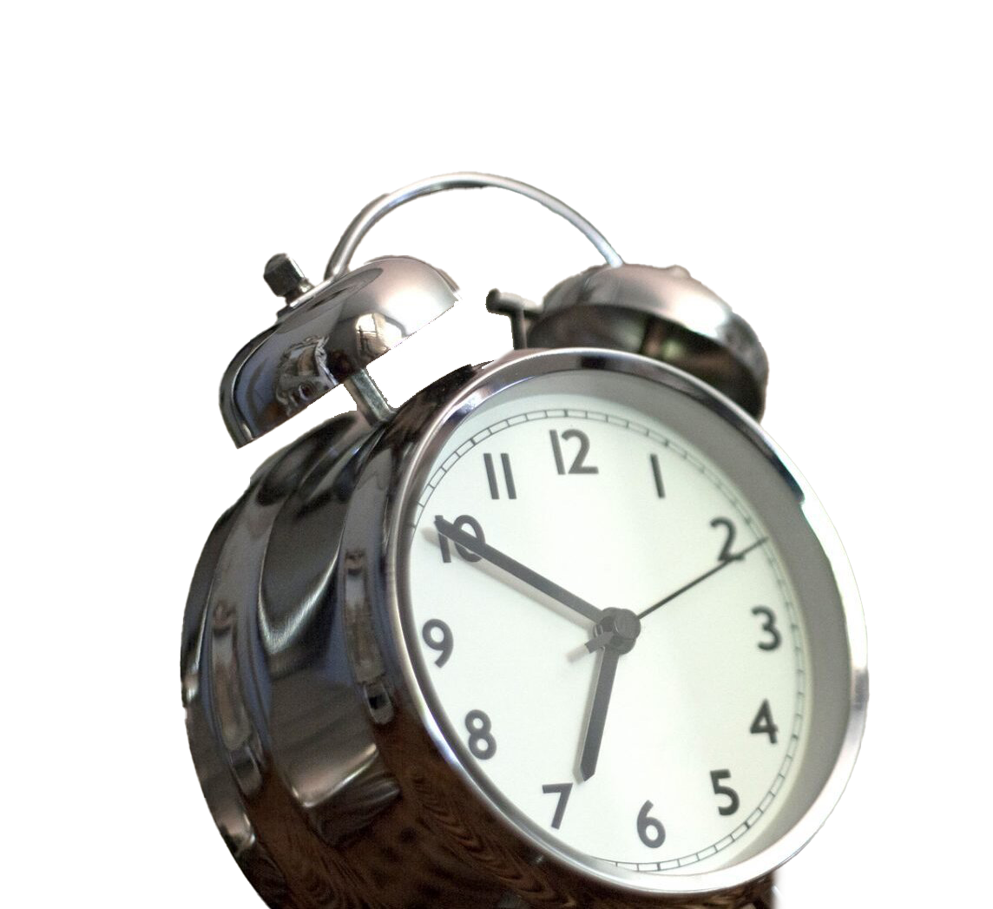
Sleep Duration and Health
Adults average seven hours of sleep, with a typical range of six to eight hours, and that about 75% of adults sleep less than eight hours.
People who sleep seven hours live longer on average than people who sleep eight hours.
These findings suggest that the brain may designed for seven hours of sleep, not eight.
This Photo by Unknown Author is licensed under CC BY-NC

Slide 4
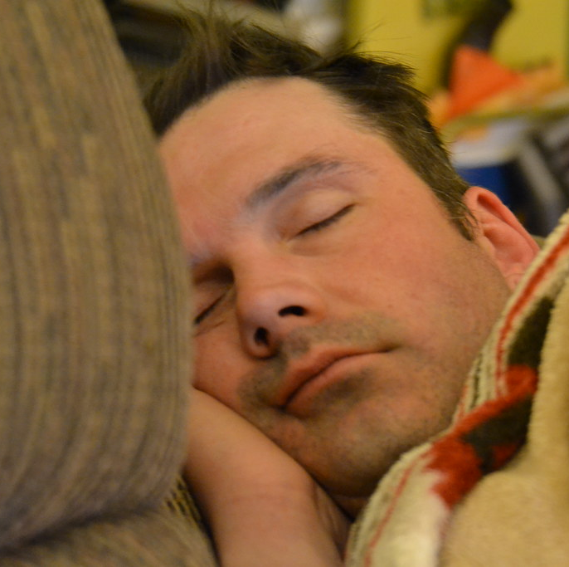
Core Sleep
There is considerable evidence to suggest that, for many individuals, performance on alertness, memory, and problem-solving tasks can be maintained for days, weeks, or even months with about 5.5 hours of sleep, or what is called “core sleep”:
Key Concept: These findings on the effects of sleep loss suggest it is important to differentiate between moderate sleep loss (sleeping 5-6 hours) and severe sleep loss (sleeping 4 or fewer hours). The latter produces more significant effects on daytime performance.
This Photo by Unknown Author is licensed under CC BY

Slide 5
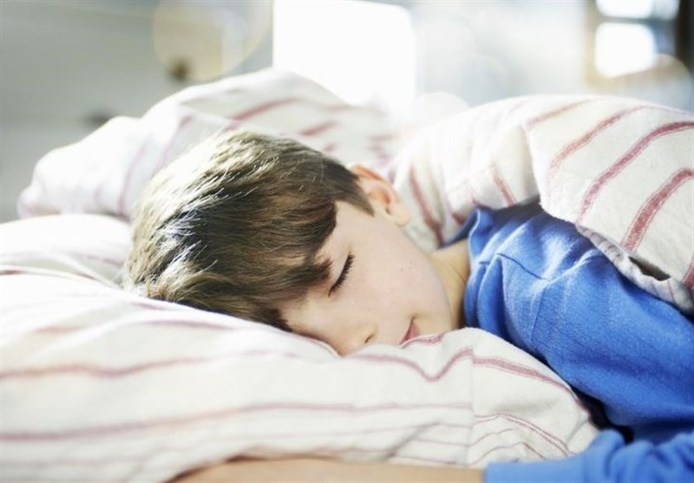
Core sleep = Deep sleep
For the average adult sleep duration of seven hours, core sleep (5.5 hours) is equivalent to the loss of one 90-minute sleep cycle consisting of light sleep and dream sleep. Core sleep probably maintains performance because it contains 100% of our deep sleep, which is the most important stage of sleep, and 50% of REM sleep, which is the second most important stage of sleep.
This Photo by Unknown Author is licensed under CC BY

Slide 6
Core sleep, intermittent sleep
Core sleep does not have to be obtained continuously. In fact, research on soldiers, fire fighters, rescue workers, and astronauts suggest that by breaking up sleep into multiple periods throughout the day (for example, six 30-minute naps taken every four hours), sleep can be reduced below core sleep- to as little as three hours per day- without significant consequences for days or longer.
This Photo by Unknown Author is licensed under CC BY-NC-ND

Slide 7
Core sleep, intermittent sleep
Another important finding about core sleep is that, if it is not obtained one night, the brain will create increased homeostatic sleep pressure to obtain core sleep the next night. How do we know this? Because on nights after core sleep loss, the brain compensates by producing an increased percentage of deep sleep and dream sleep, which explains why we do not have to recover all of the sleep we lose.

Slide 8
Key Concept:
This is not to say that we only need core sleep since most individuals need more than core sleep to feel optimal and energetic. However, believing that one can maintain performance on core sleep is a highly effective strategy for reducing NSTs and improving sleep.

Slide 9
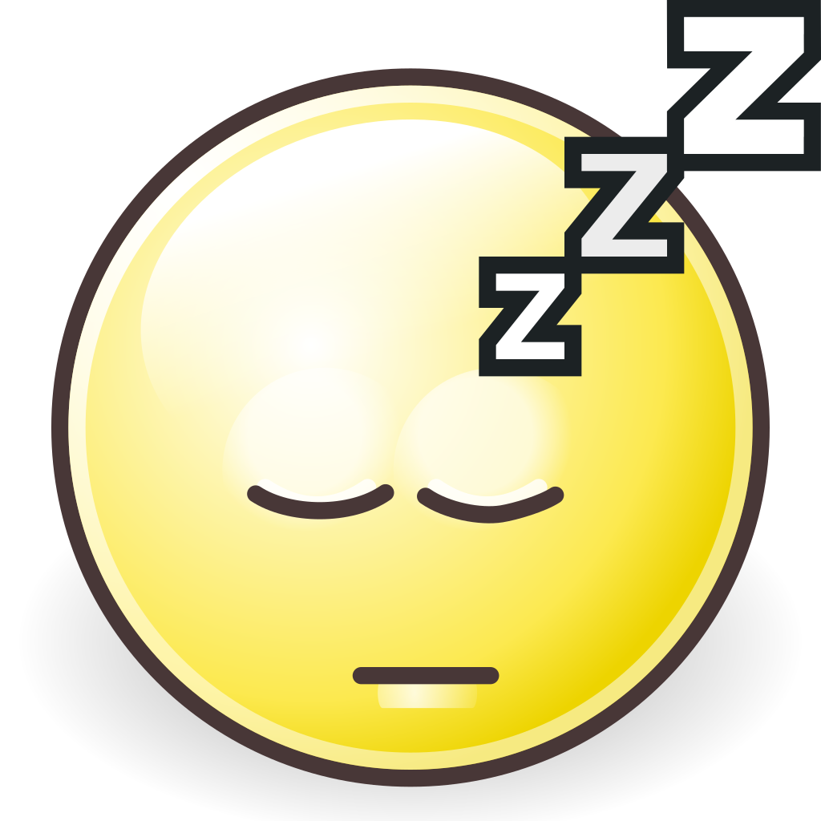
How much sleep do we need?
Do I need an alarm clock to wake up in the morning?
Do I fall asleep during meetings, lectures, boring or sedentary activities, or while watching television?
Do I habitually sleep late on weekends?
If patients answer no to each of these questions, they may be getting enough sleep
This Photo by Unknown Author is licensed under CC BY-SA

Slide 10
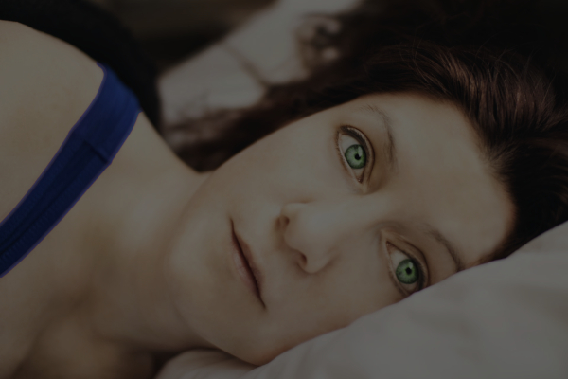
Negative Sleep Thoughts (NSTs)
, if one begins the day with an NST such as "I only slept five hours last night so I'm going to feel miserable today", this NST creates a negative mood and placebo effect that adversely affects daytime functioning.
“I don’t think I can fall back to sleep.”
“I can’t fall asleep without a sleeping pill.”
“This is going to be another night of insomnia.”
“My insomnia is getting worse.”
“I need more sleep”
“Oh no, I am awake.”
This Photo by Unknown Author is licensed under CC BY-NC-ND

Slide 11
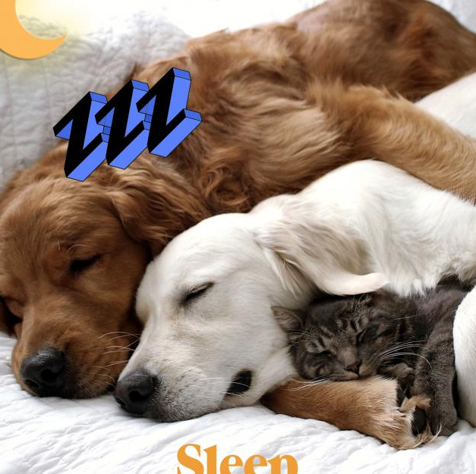
Positive Sleep Thoughts (PSTs)
In contrast, sleep loss due to pleasurable circumstances such as late-night socializing, parties, or vacations does not usually result in impaired daytime mood because these circumstances are under our control and therefore do not cause NSTs.
“I always fall back to sleep sooner or later.”
“I need less sleep than I thought.”
“My sleep is getter better and better.”
“If I get my core sleep, I’ll be able to function during the day.”
This Photo by Unknown Author is licensed under CC BY-NC-ND

