Slide 1
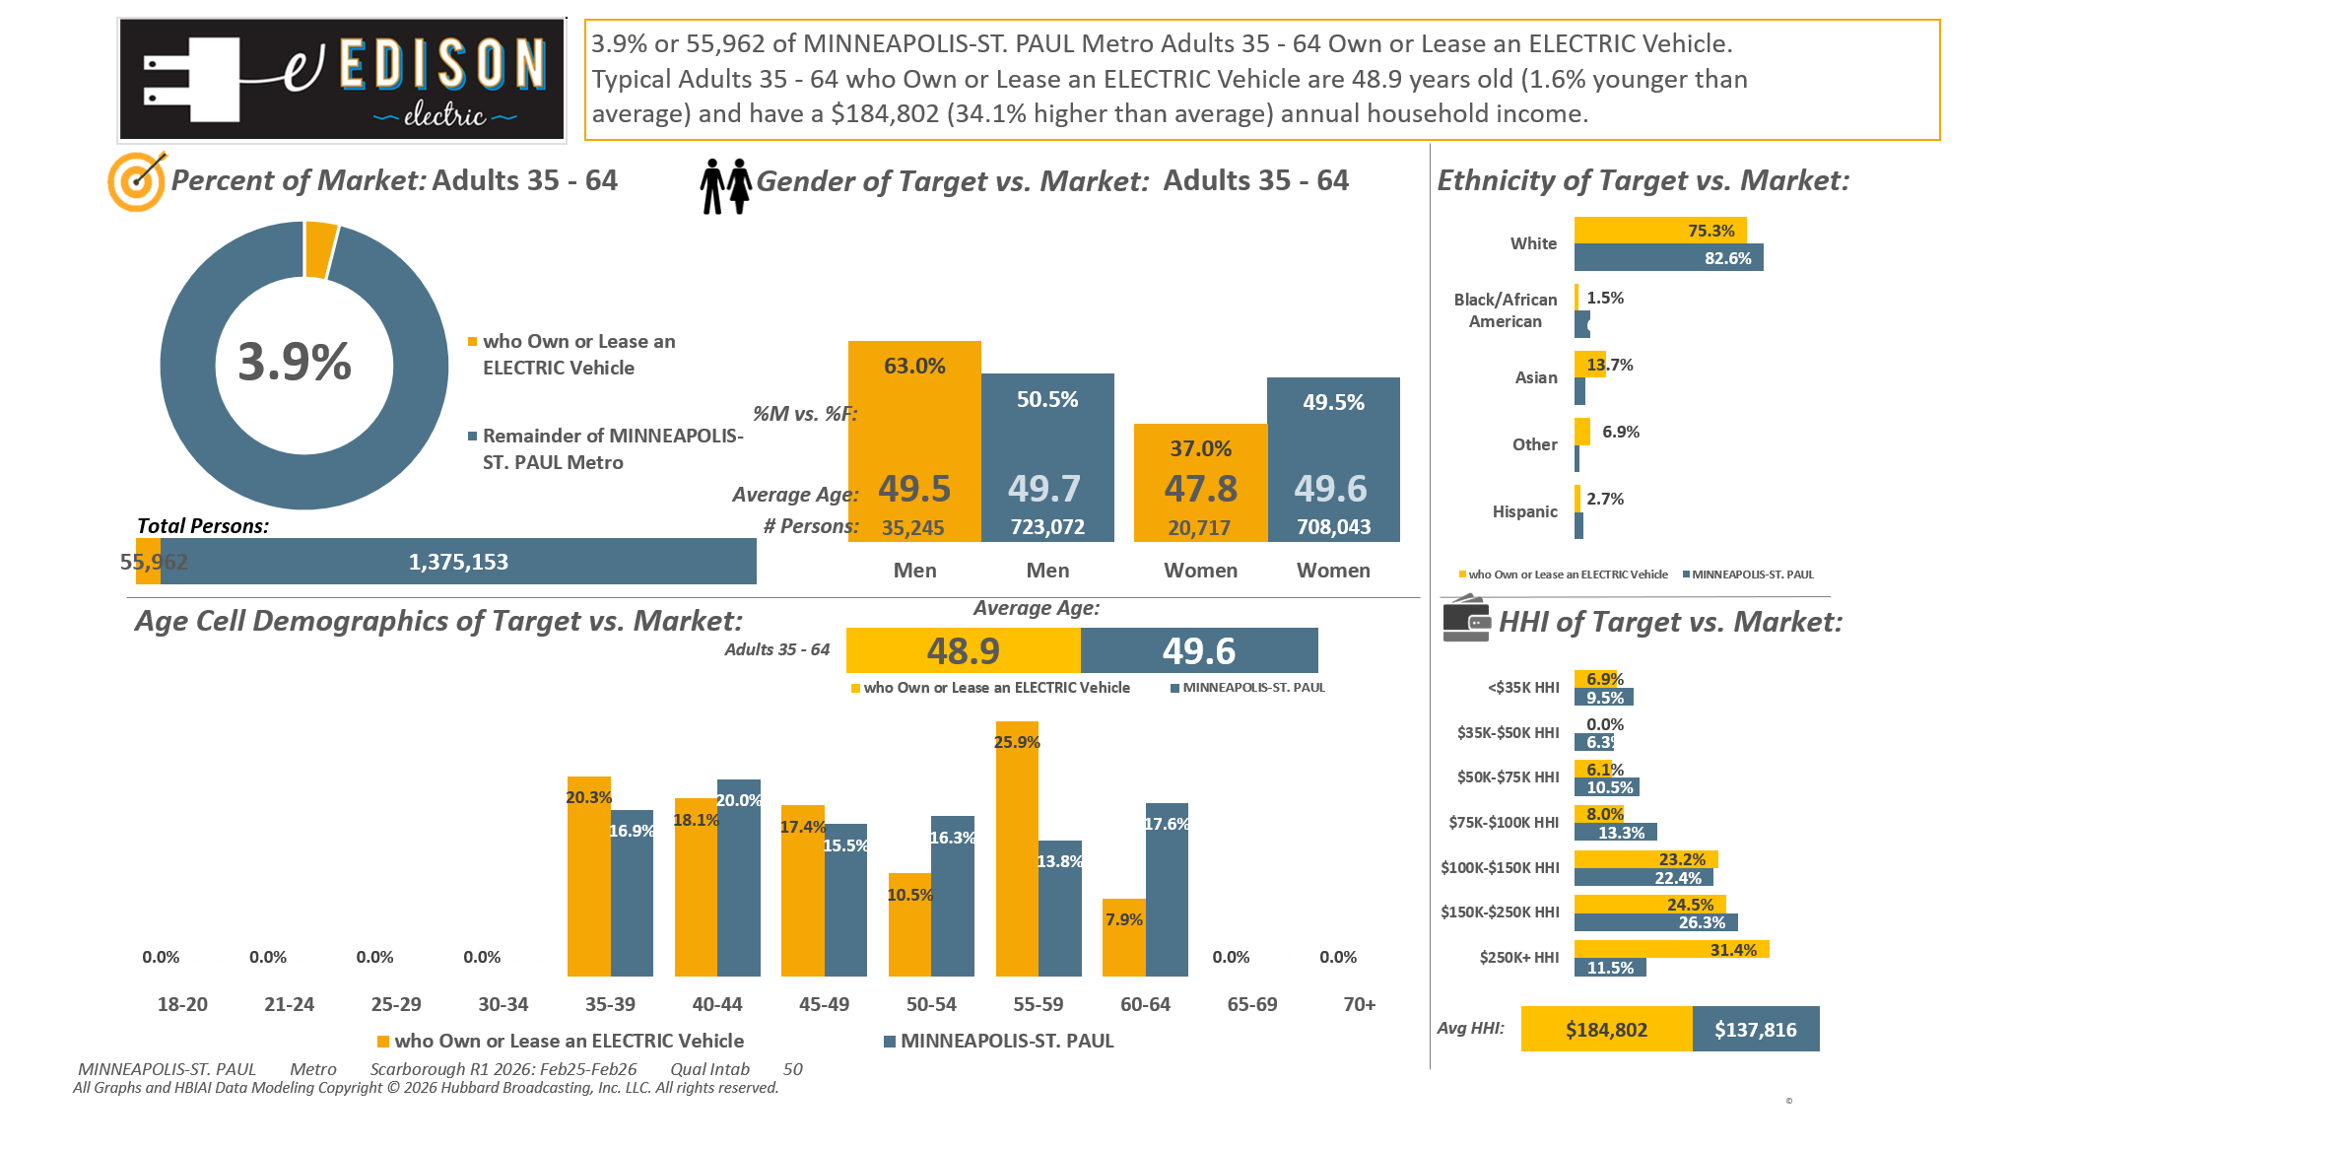





Electric/Hybrid vehicles (HHLD): Own or lease electric vehicle

Slide 2
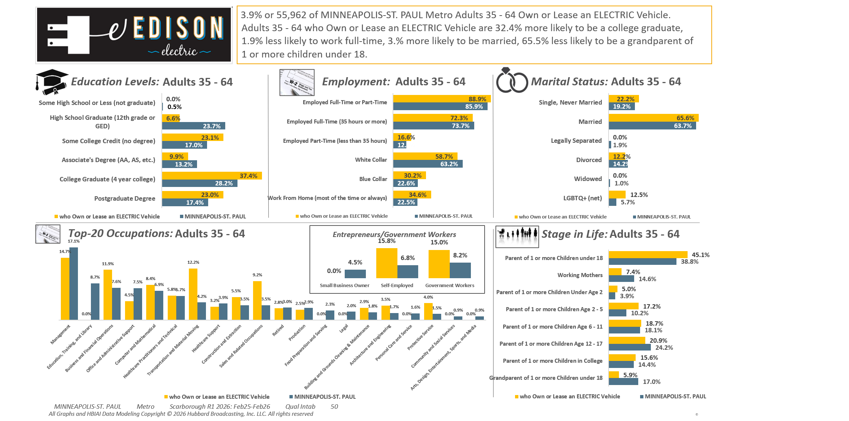
Electric/Hybrid vehicles (HHLD): Own or lease electric vehicle

Slide 3
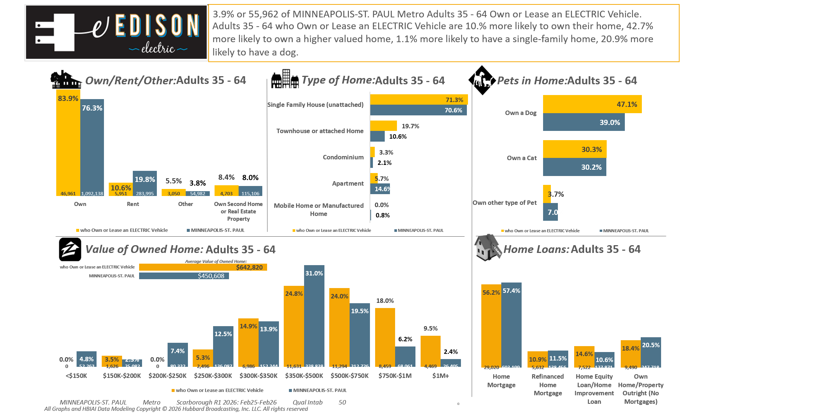
Electric/Hybrid vehicles (HHLD): Own or lease electric vehicle

Slide 4

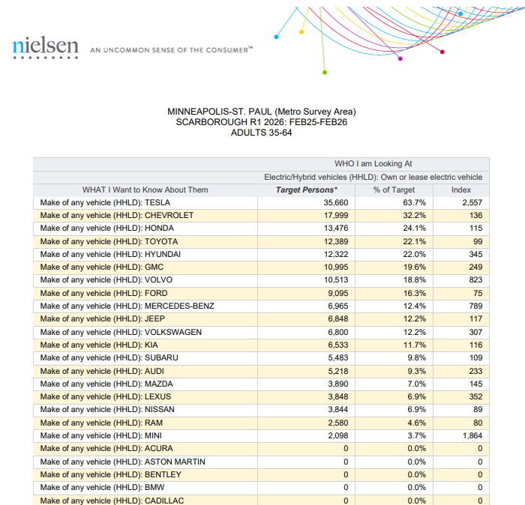
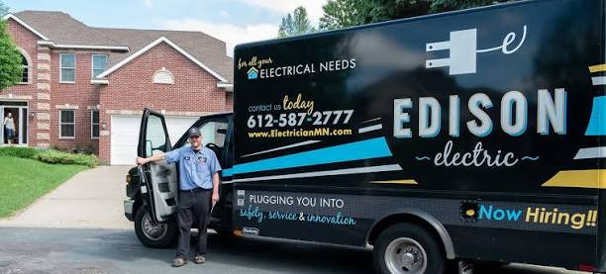
63.7% of...
Twin Cities Metro Area P35-64 who…
Own or Lease an ELECTRIC Vehicle
Own or Lease a TESLA.
(Note: Insufficient Sample Size to Run this Report based on W35-64)
Electric/Hybrid vehicles (HHLD): Own or lease electric vehicle

Slide 5
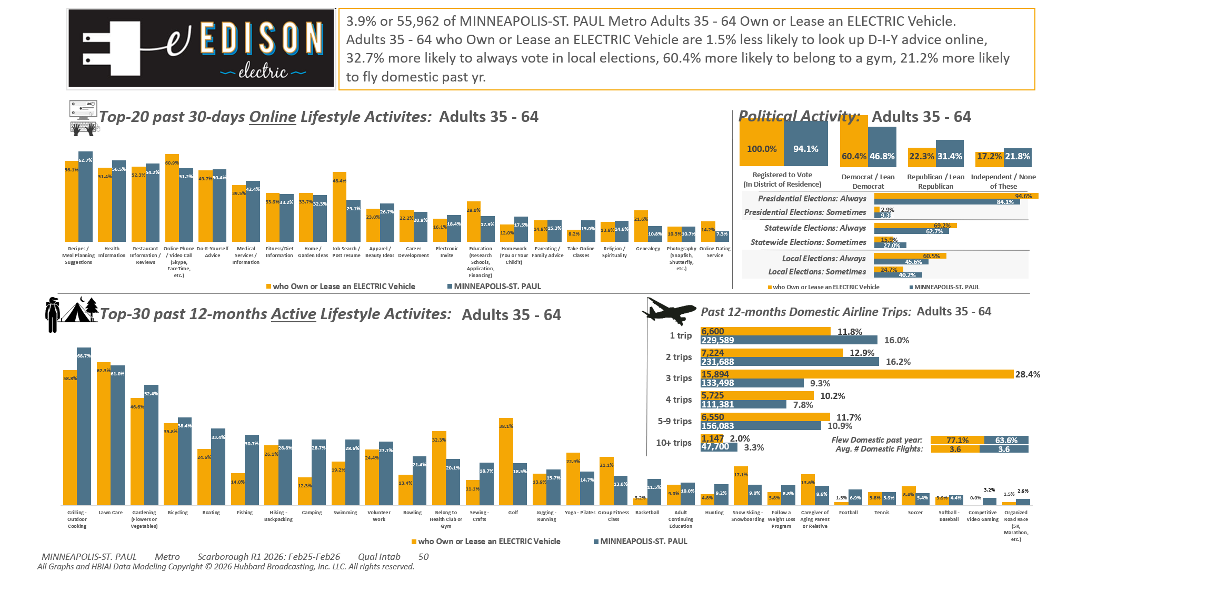
Electric/Hybrid vehicles (HHLD): Own or lease electric vehicle

Slide 6
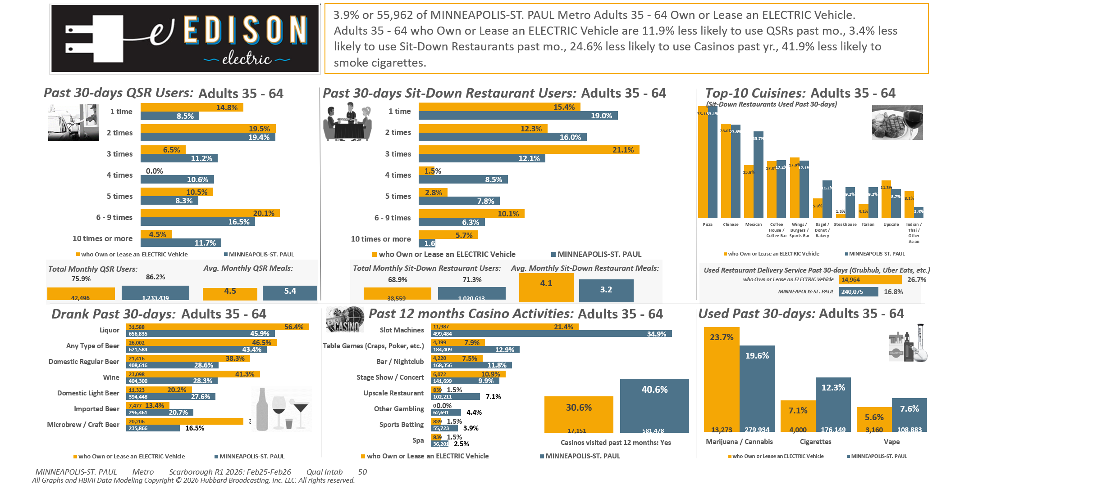
Electric/Hybrid vehicles (HHLD): Own or lease electric vehicle

Slide 7
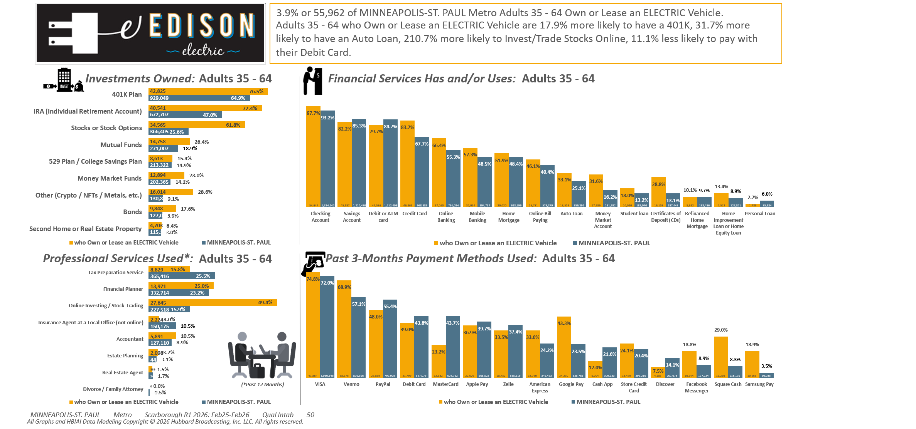
Electric/Hybrid vehicles (HHLD): Own or lease electric vehicle

Slide 8
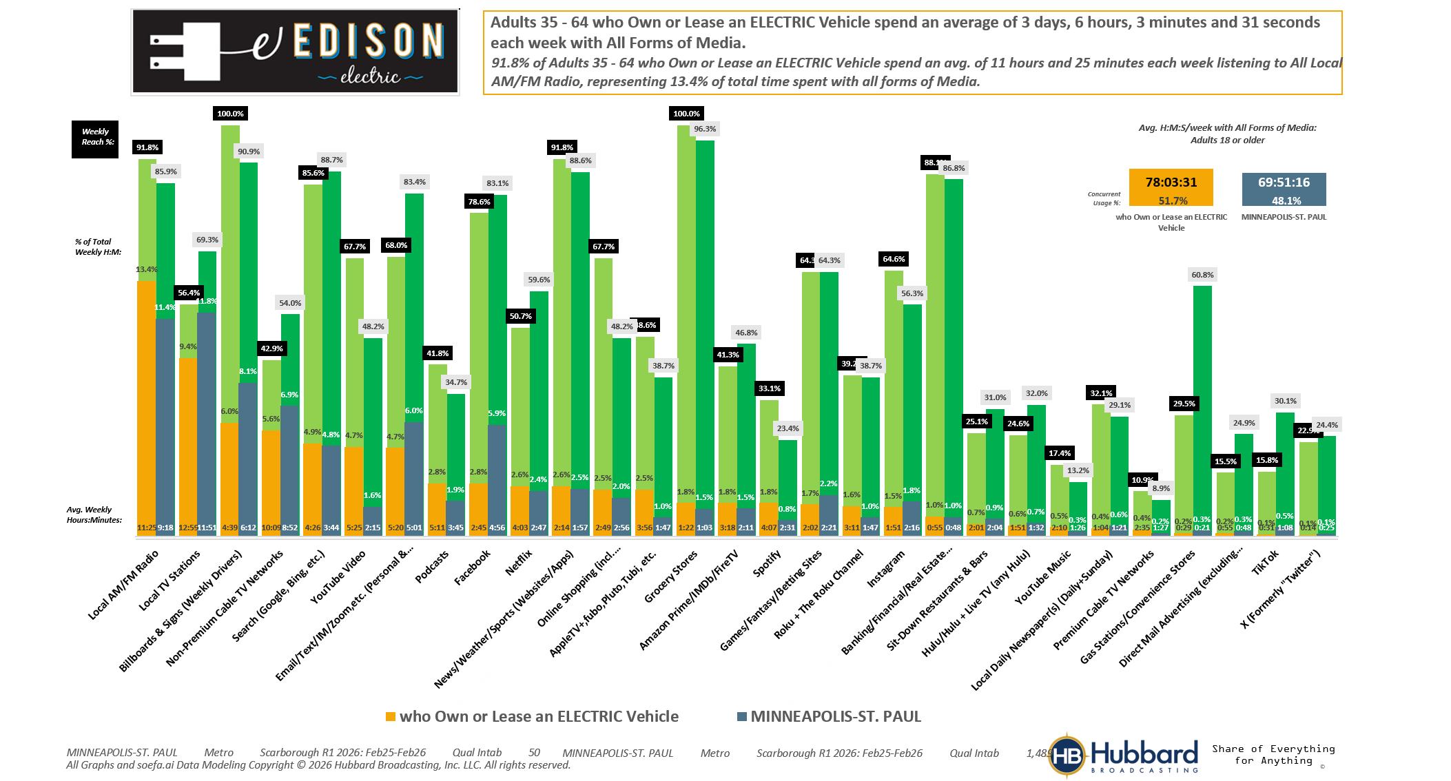
Electric/Hybrid vehicles (HHLD): Own or lease electric vehicle

Slide 9
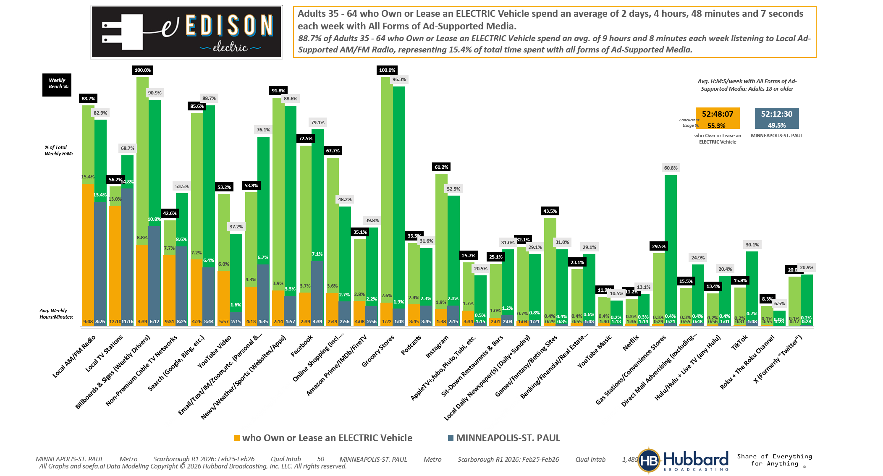
Electric/Hybrid vehicles (HHLD): Own or lease electric vehicle

Slide 10
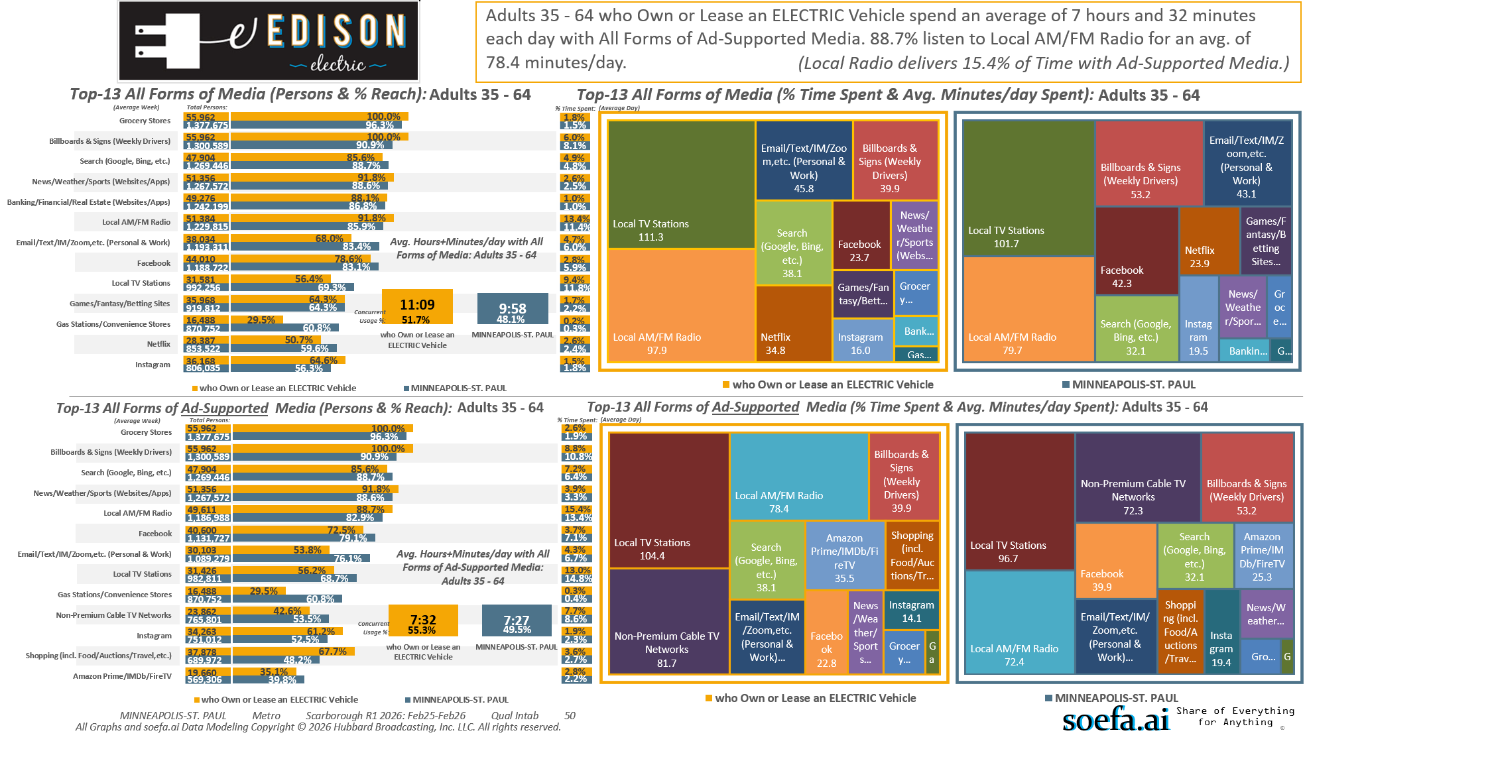
Electric/Hybrid vehicles (HHLD): Own or lease electric vehicle

Slide 11
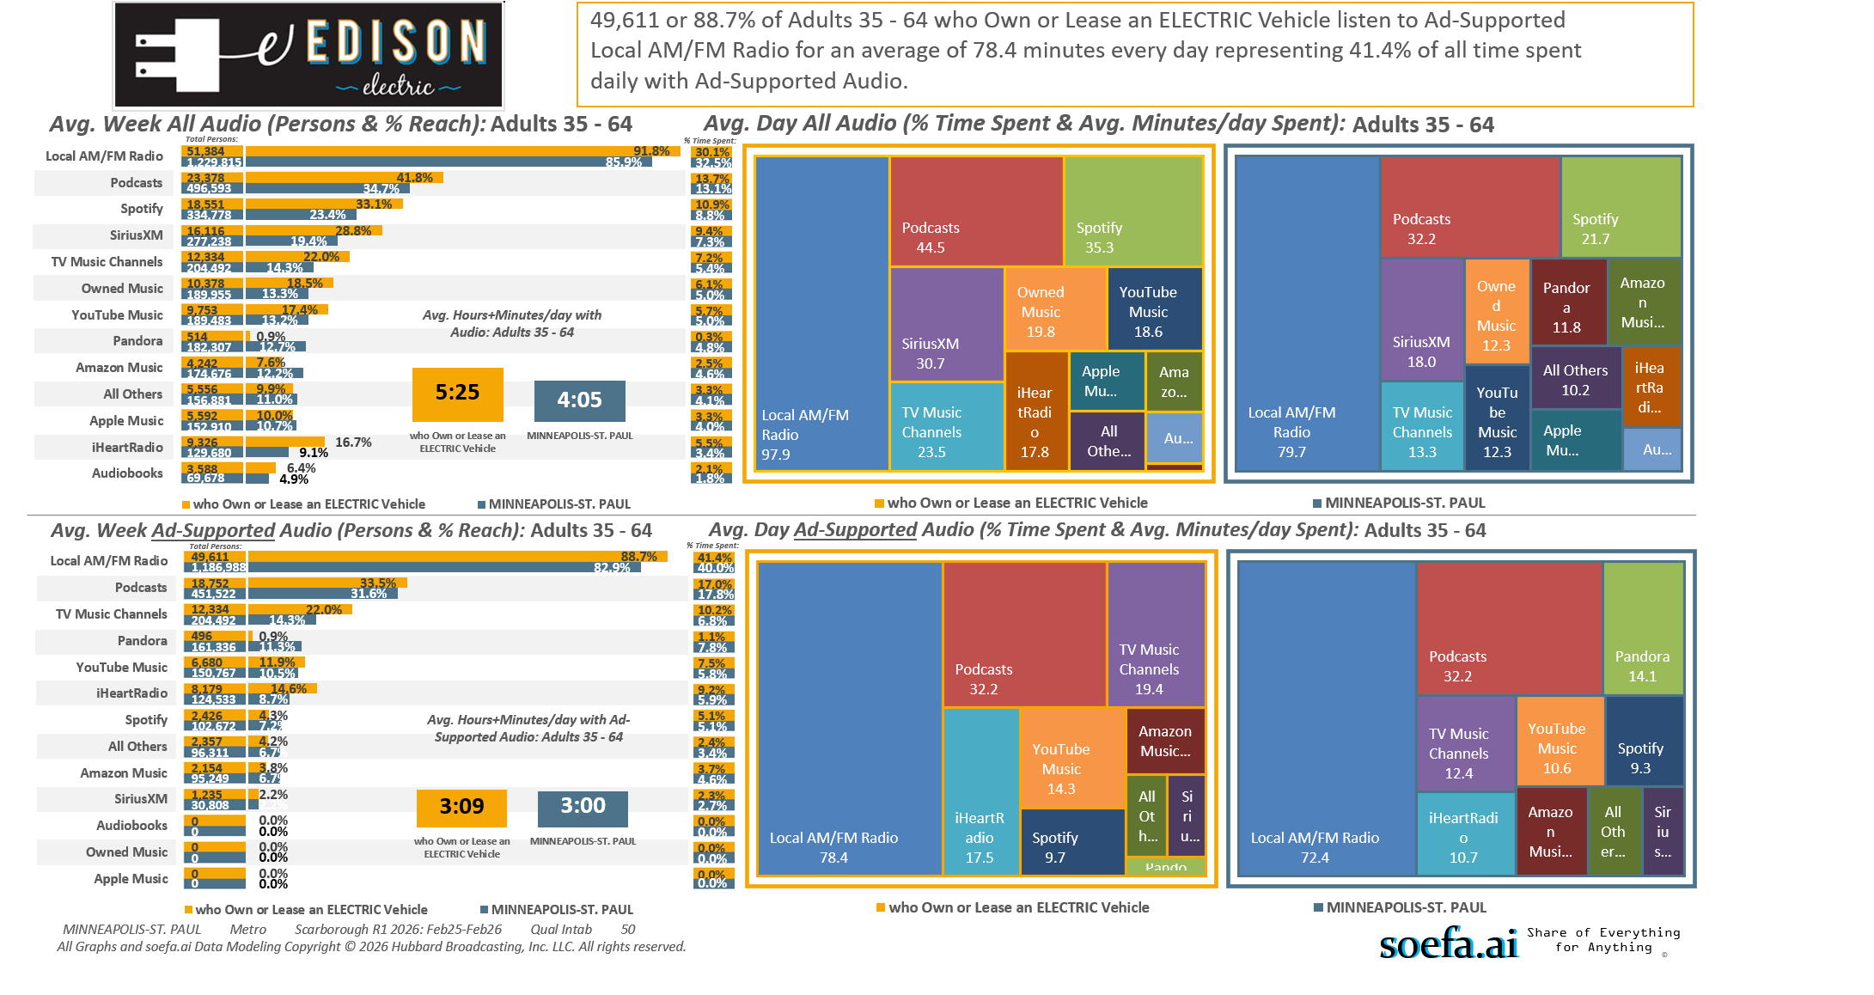
Electric/Hybrid vehicles (HHLD): Own or lease electric vehicle

Slide 12
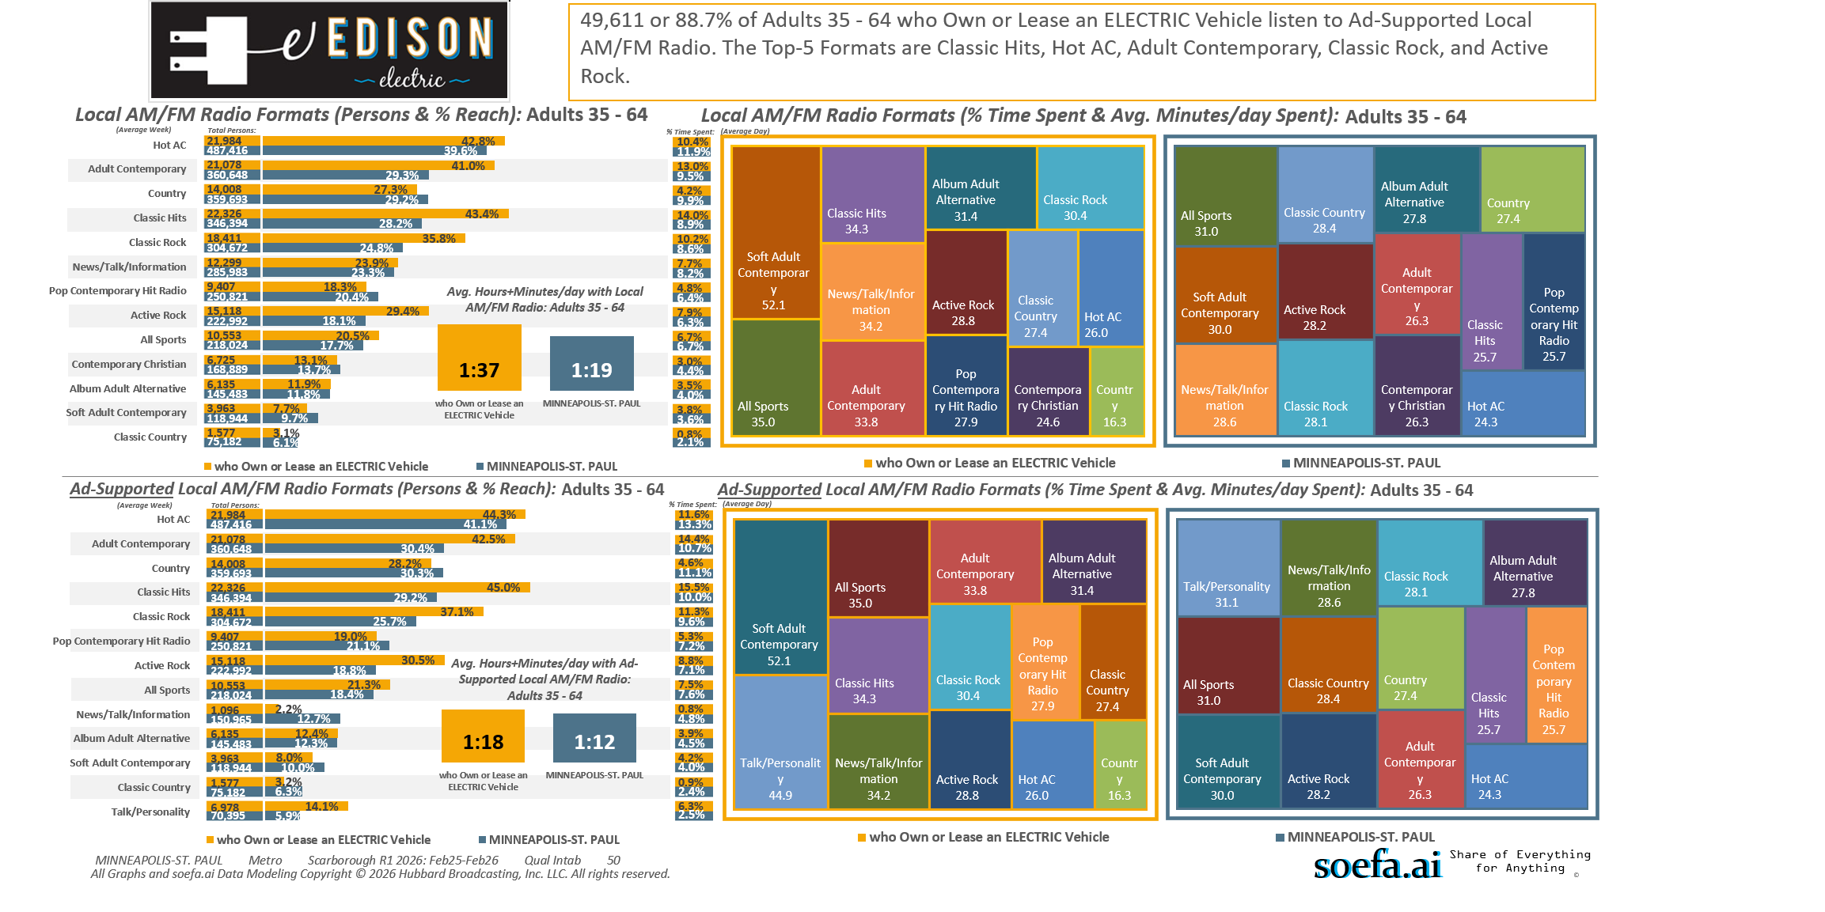
Electric/Hybrid vehicles (HHLD): Own or lease electric vehicle

Slide 13
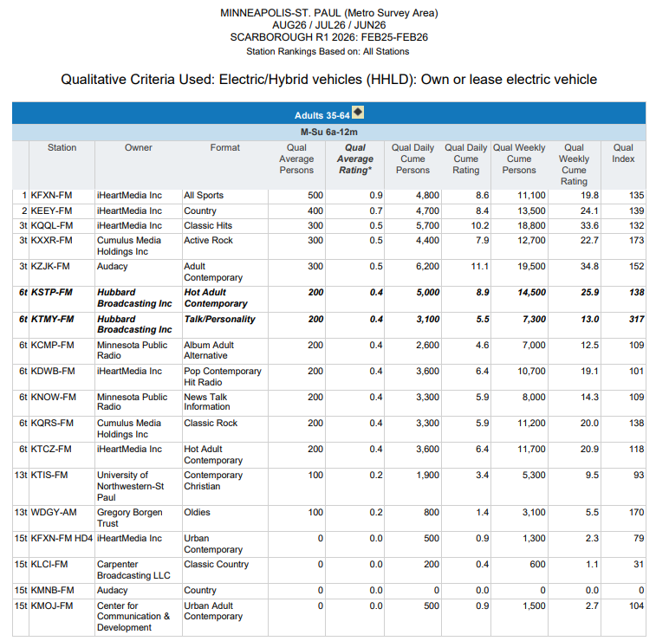
Top Radio Stations reaching...
Twin Cities Metro Area P35-64 who…
Own or Lease an ELECTRIC Vehicle.
(Note: Insufficient Sample Size to Run this Report based on W35-64)
Electric/Hybrid vehicles (HHLD): Own or lease electric vehicle

Slide 14
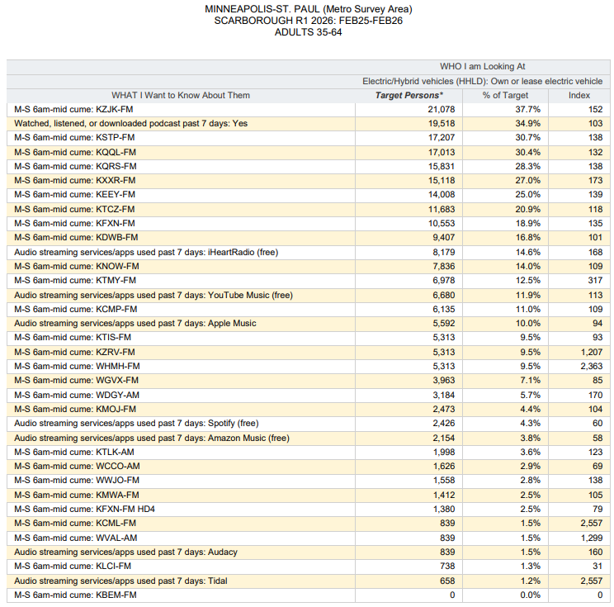
Top Audio Media reaching...
Twin Cities Metro Area P35-64 who…
Own or Lease an ELECTRIC Vehicle.
(Note: Insufficient Sample Size to Run this Report based on W35-64)
Electric/Hybrid vehicles (HHLD): Own or lease electric vehicle

Slide 15
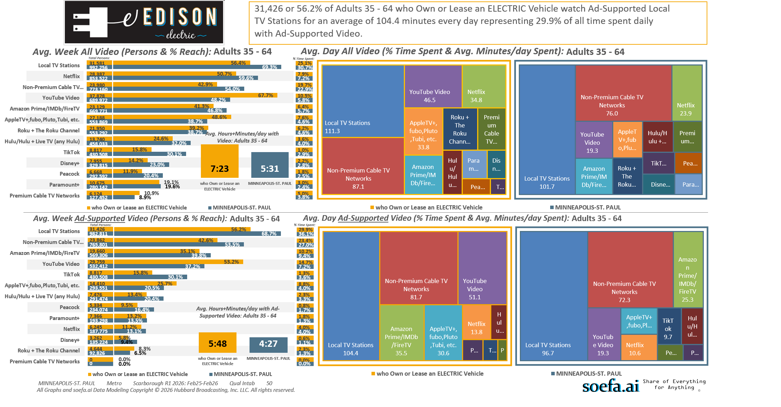
Electric/Hybrid vehicles (HHLD): Own or lease electric vehicle

Slide 16
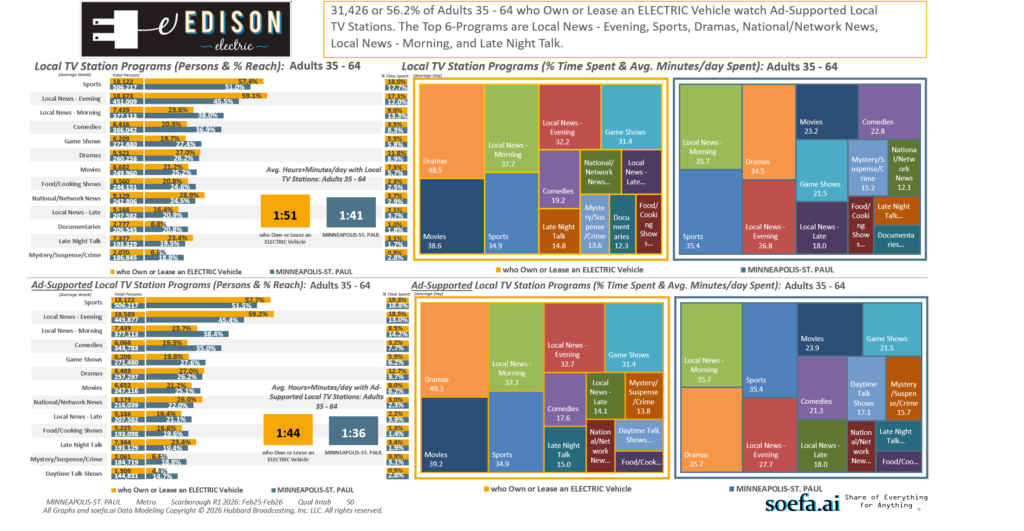
Electric/Hybrid vehicles (HHLD): Own or lease electric vehicle

Slide 17
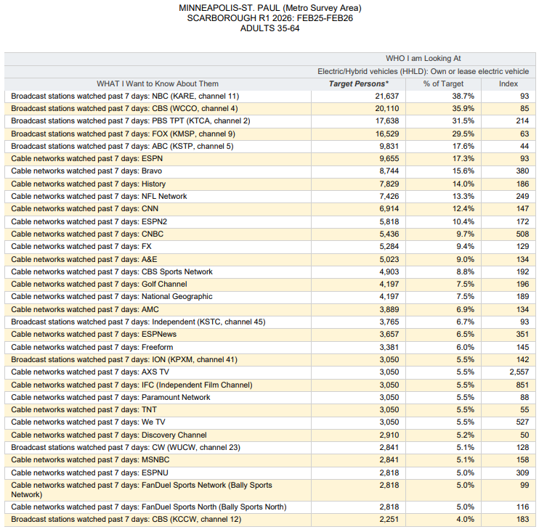
Top Local TV Stations and Cable Networks reaching...
Twin Cities Metro Area P35-64 who…
Own or Lease an ELECTRIC Vehicle.
(Note: Insufficient Sample Size to Run this Report based on W35-64)
Electric/Hybrid vehicles (HHLD): Own or lease electric vehicle

Slide 18
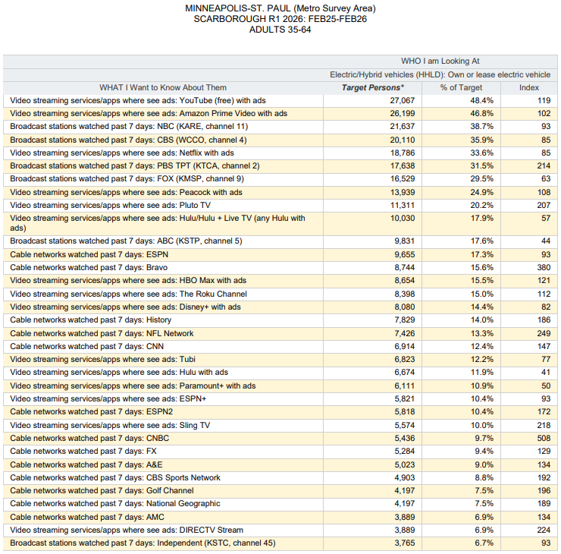
Top Local TV Stations, Cable Networks and
Streaming TV Services with Ads reaching…
Twin Cities Metro Area P35-64 who…
Own or Lease an ELECTRIC Vehicle.
(Note: Insufficient Sample Size to Run this Report based on W35-64)

Slide 19
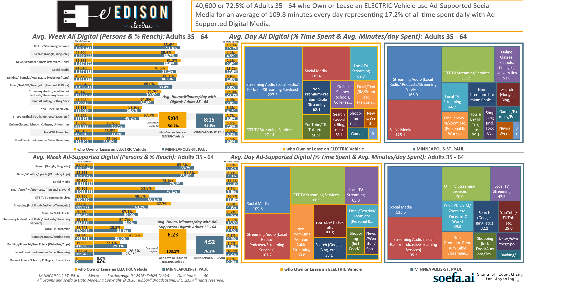
Electric/Hybrid vehicles (HHLD): Own or lease electric vehicle

Slide 20
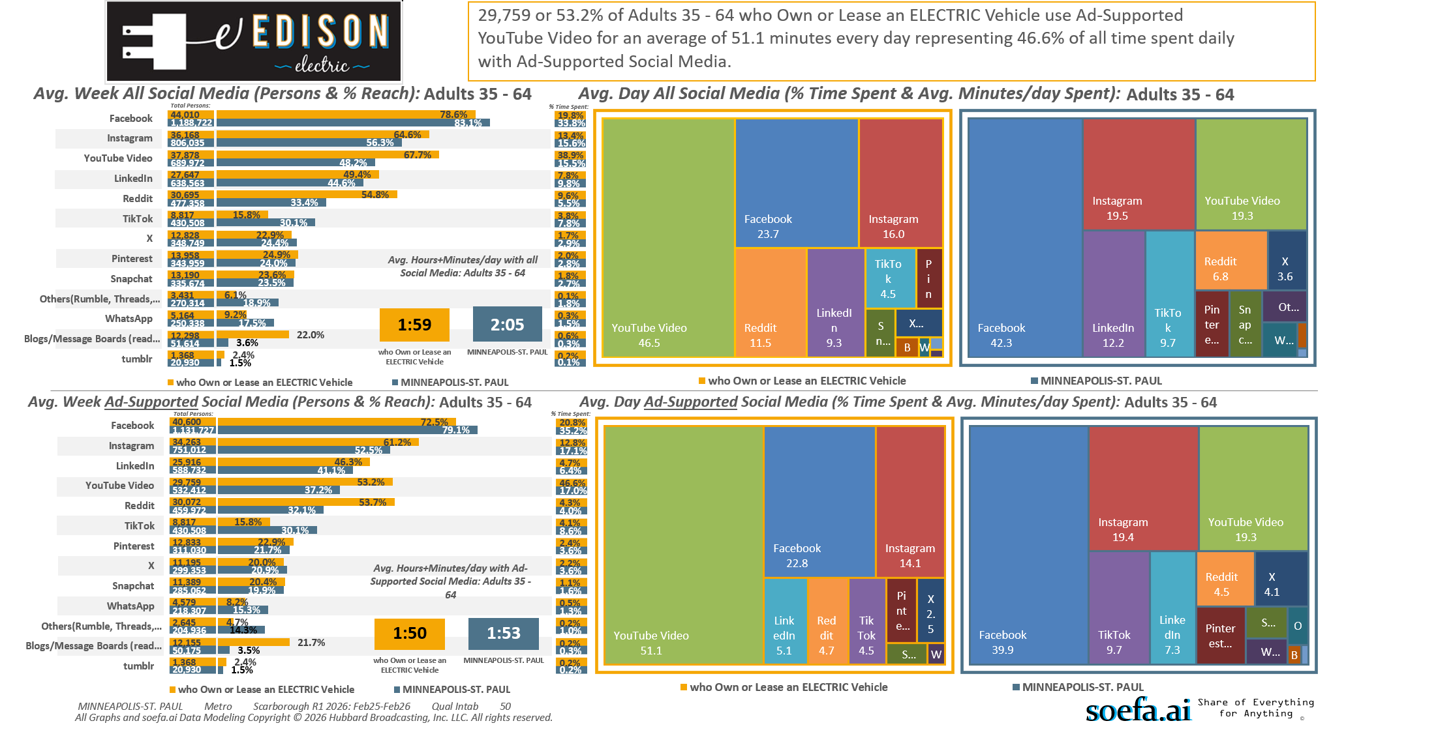
Electric/Hybrid vehicles (HHLD): Own or lease electric vehicle

Slide 21
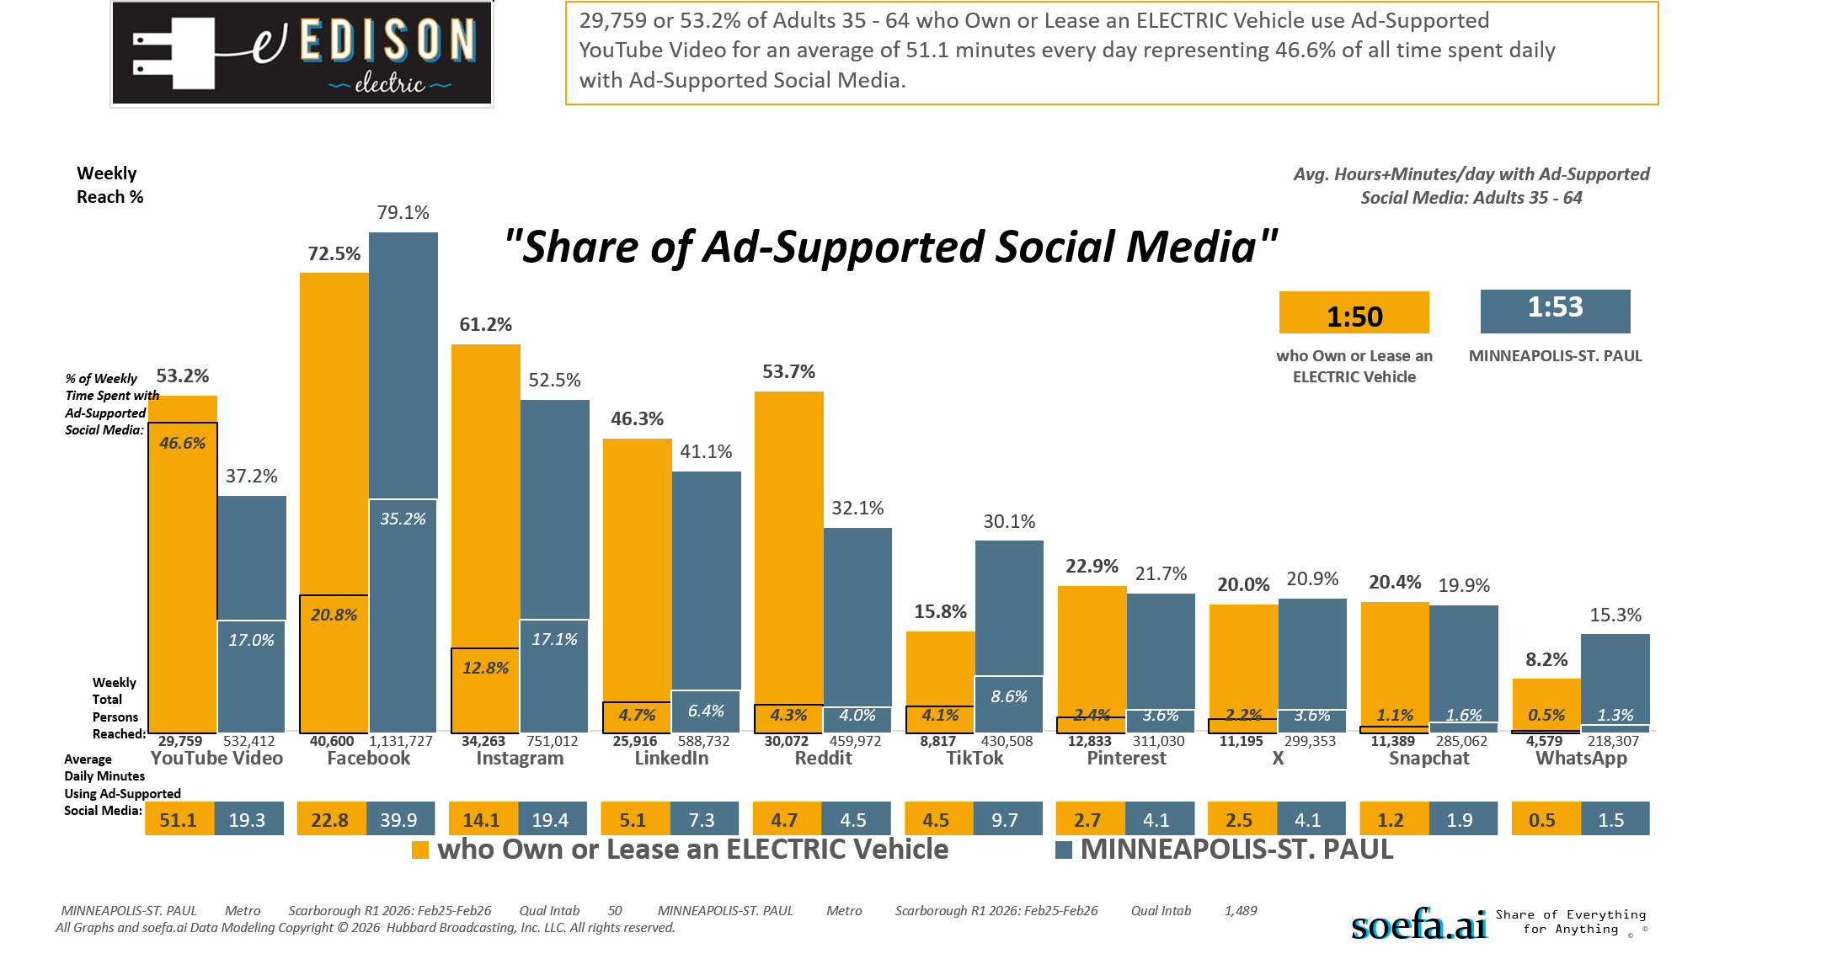
Electric/Hybrid vehicles (HHLD): Own or lease electric vehicle

Slide 22
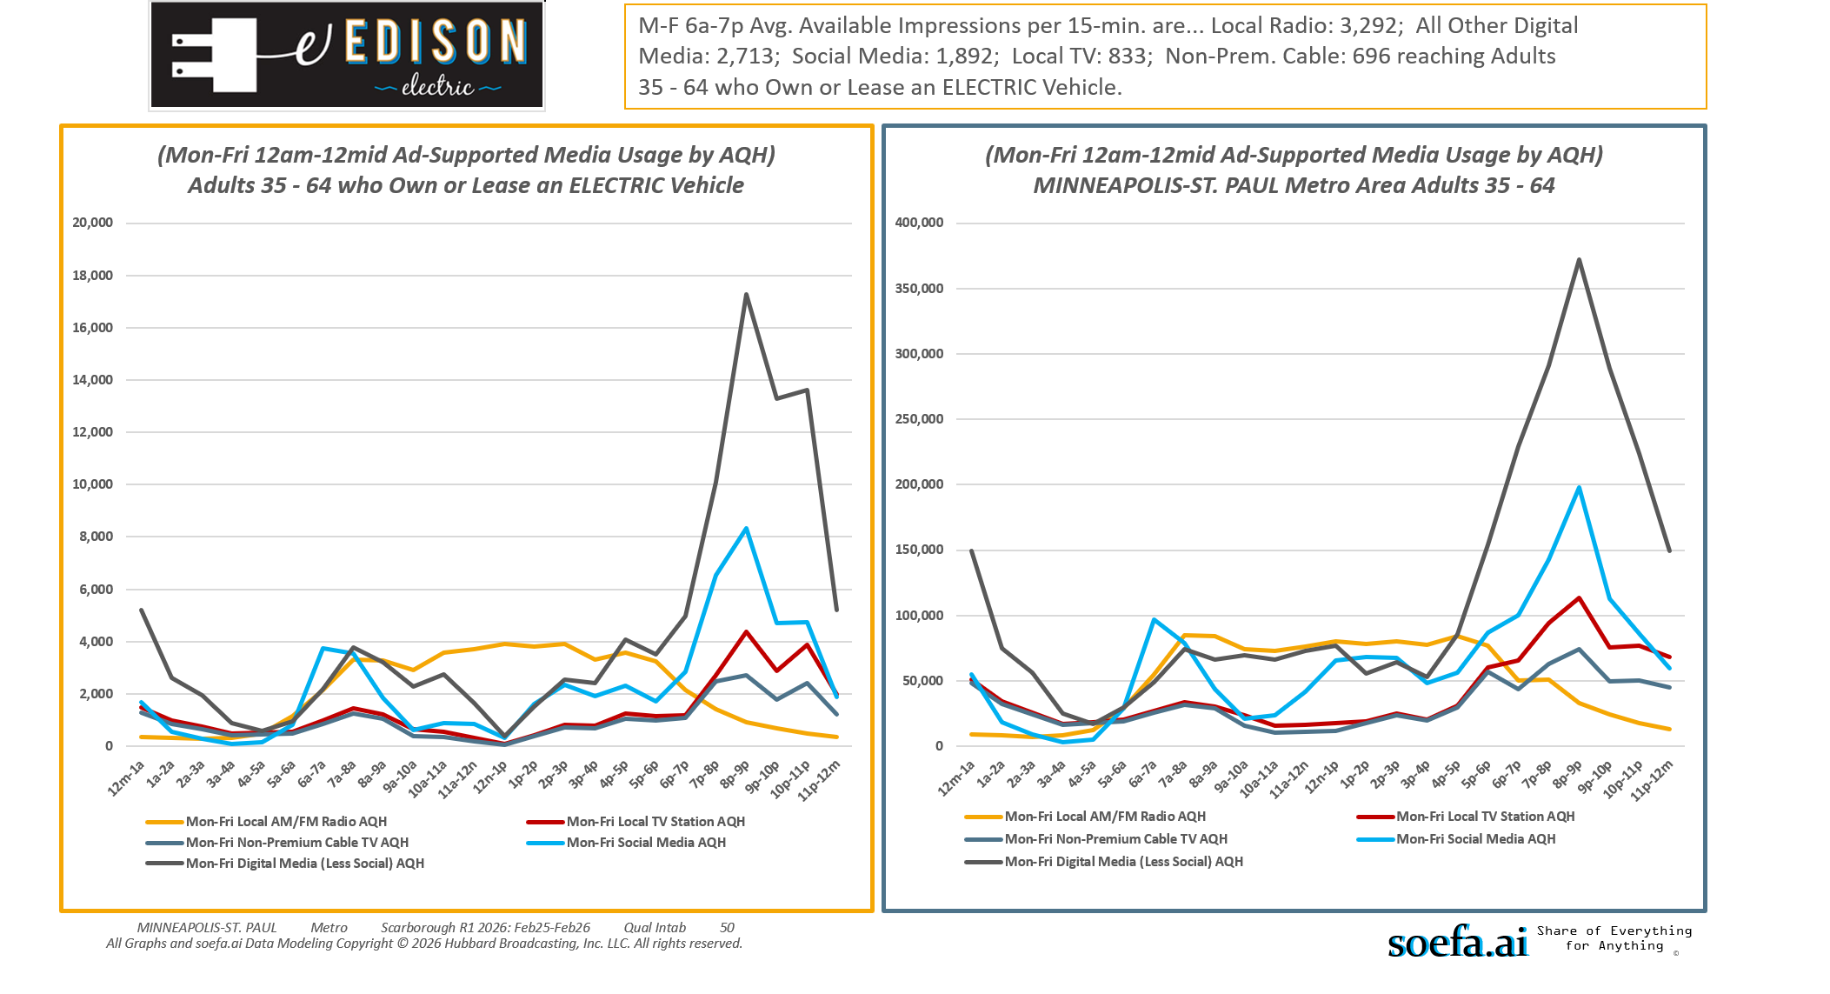
Electric/Hybrid vehicles (HHLD): Own or lease electric vehicle

Slide 23
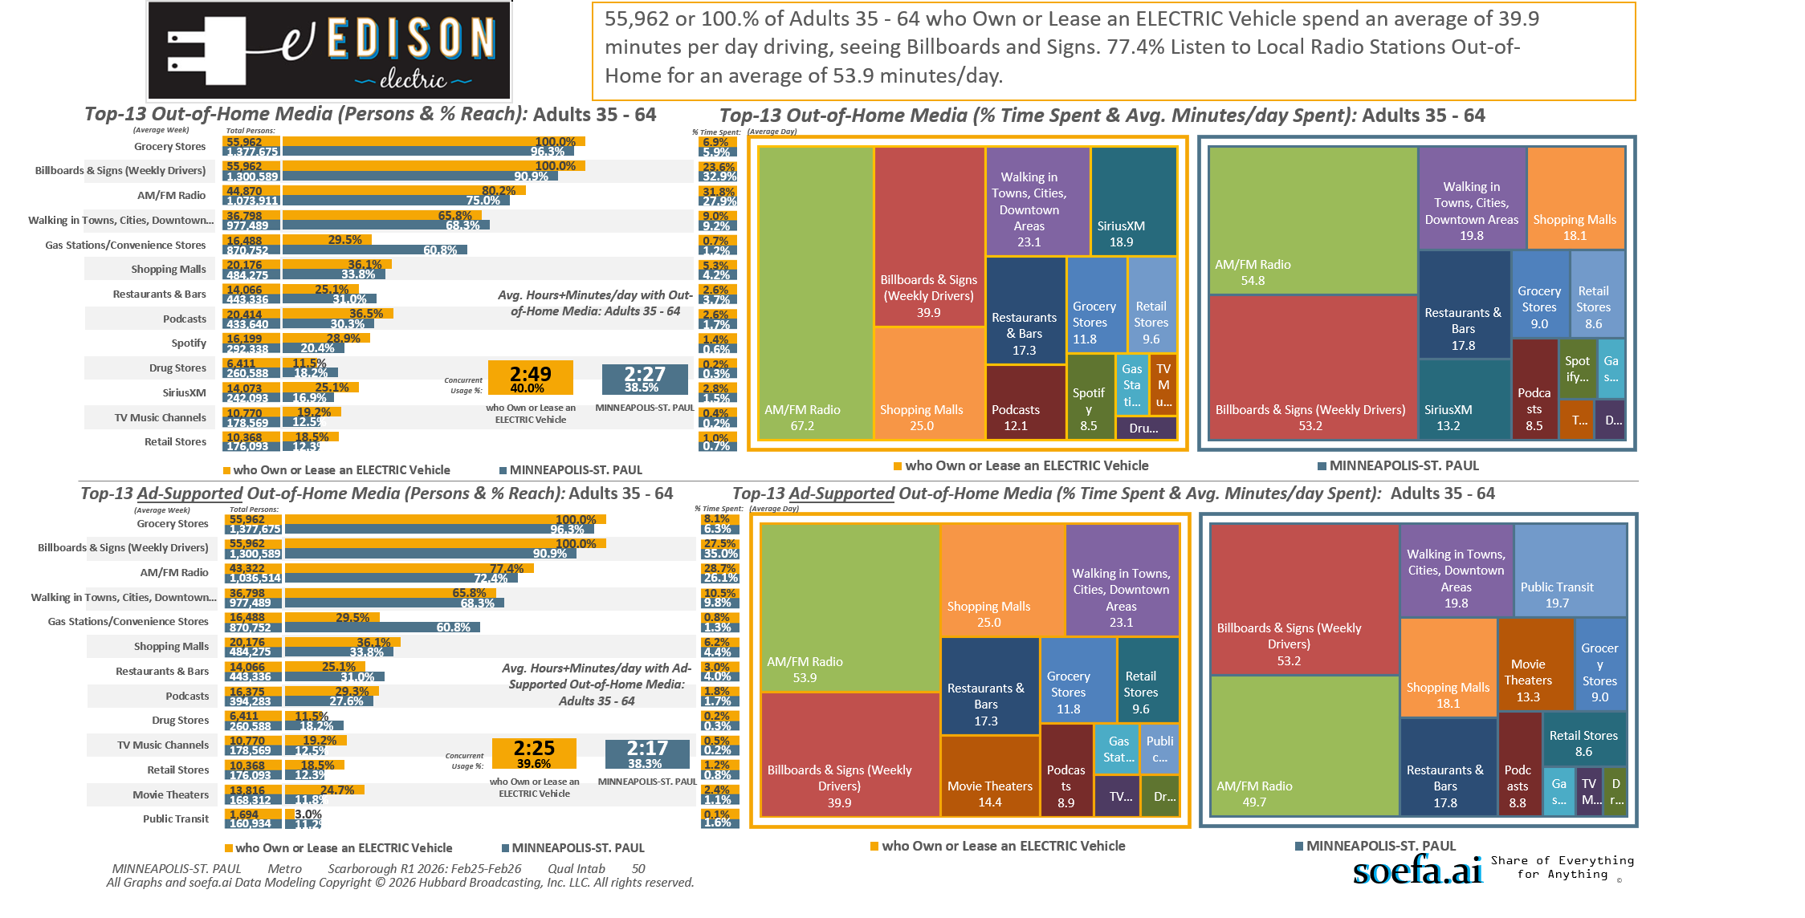
Electric/Hybrid vehicles (HHLD): Own or lease electric vehicle

Slide 24
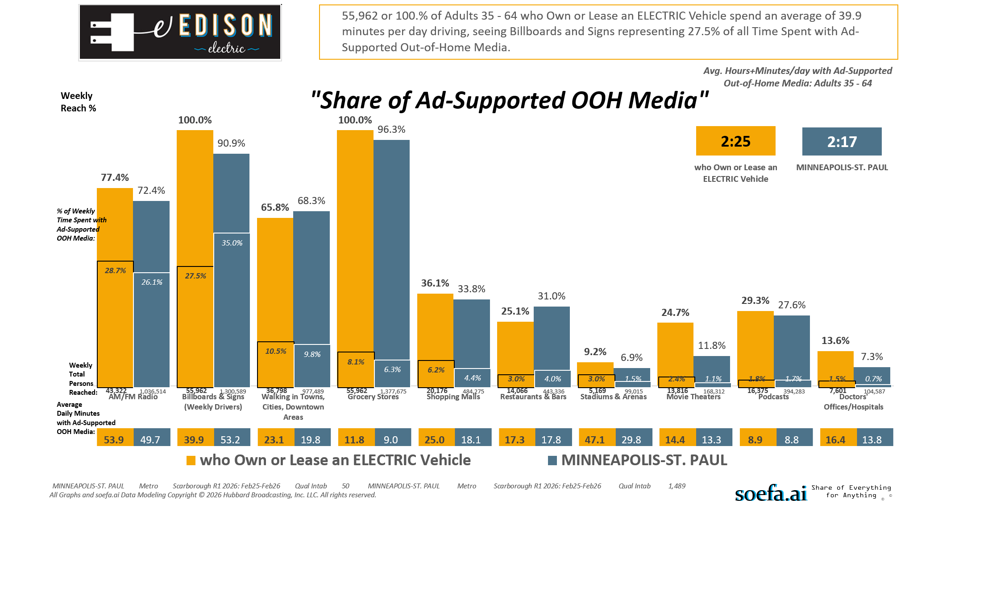
Electric/Hybrid vehicles (HHLD): Own or lease electric vehicle

Slide 25
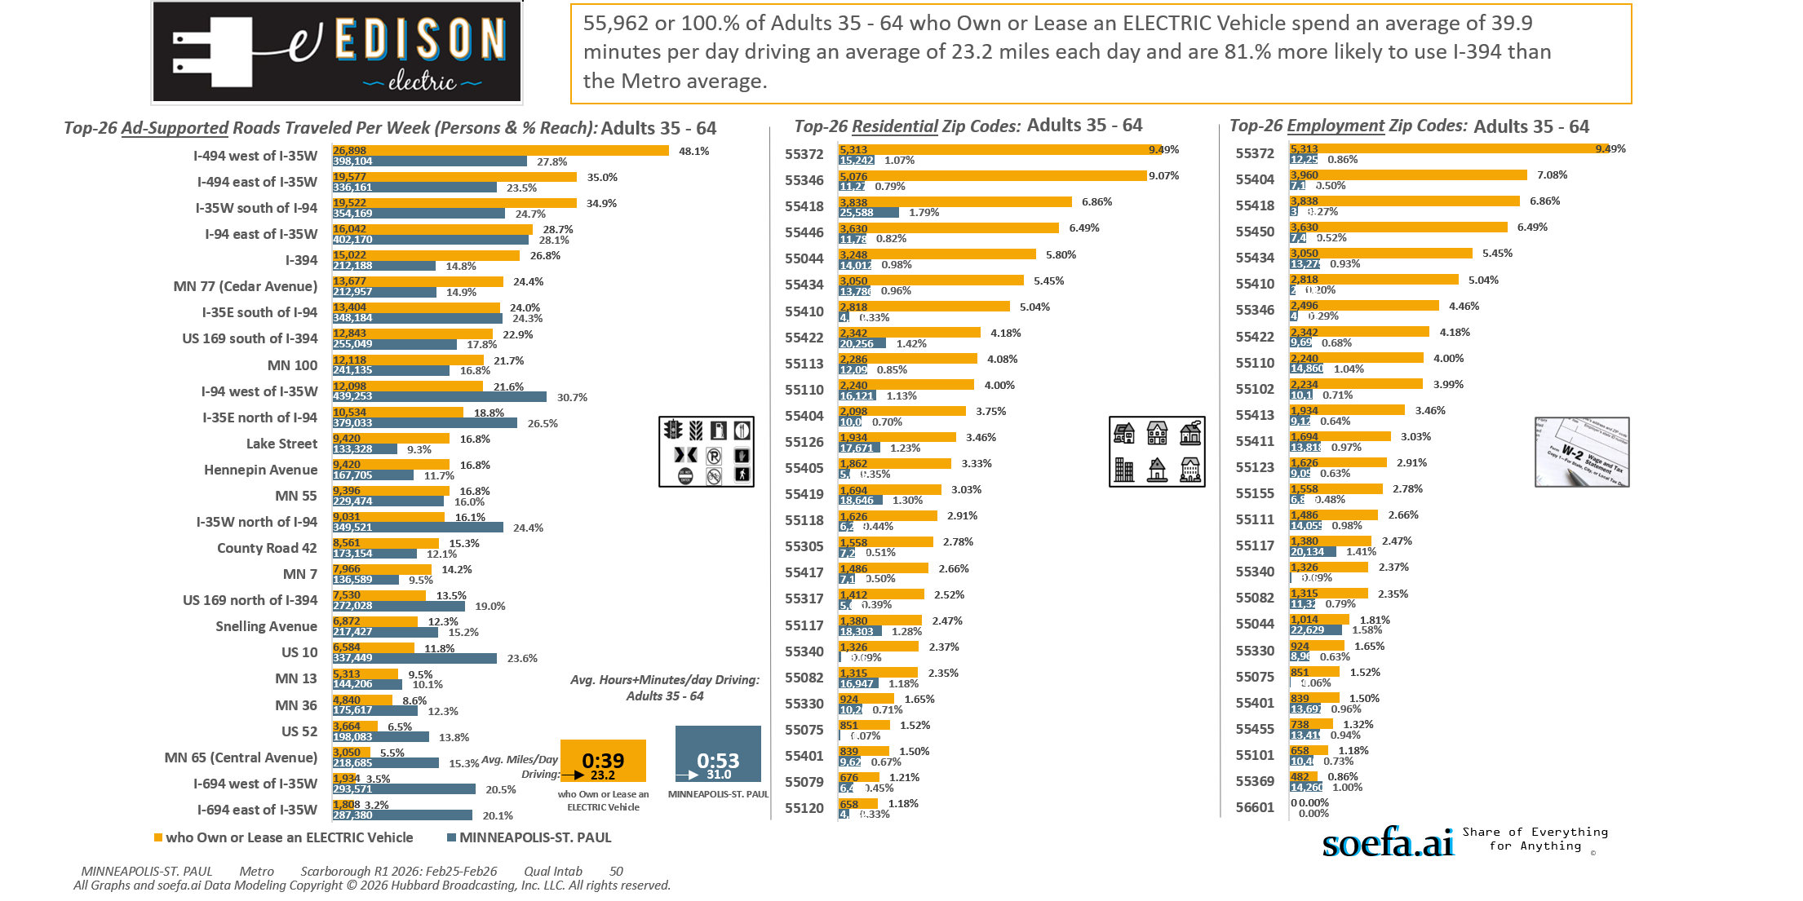
Electric/Hybrid vehicles (HHLD): Own or lease electric vehicle

Slide 26
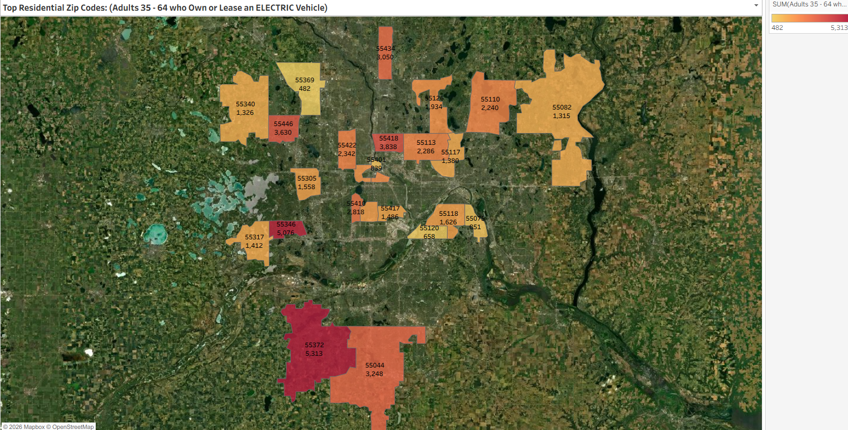
Electric/Hybrid vehicles (HHLD): Own or lease electric vehicle

Slide 27
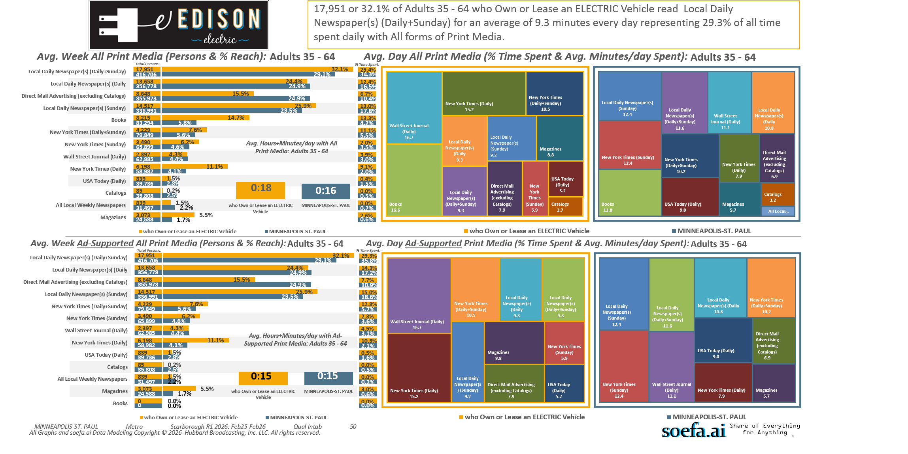
Electric/Hybrid vehicles (HHLD): Own or lease electric vehicle

