Slide 1
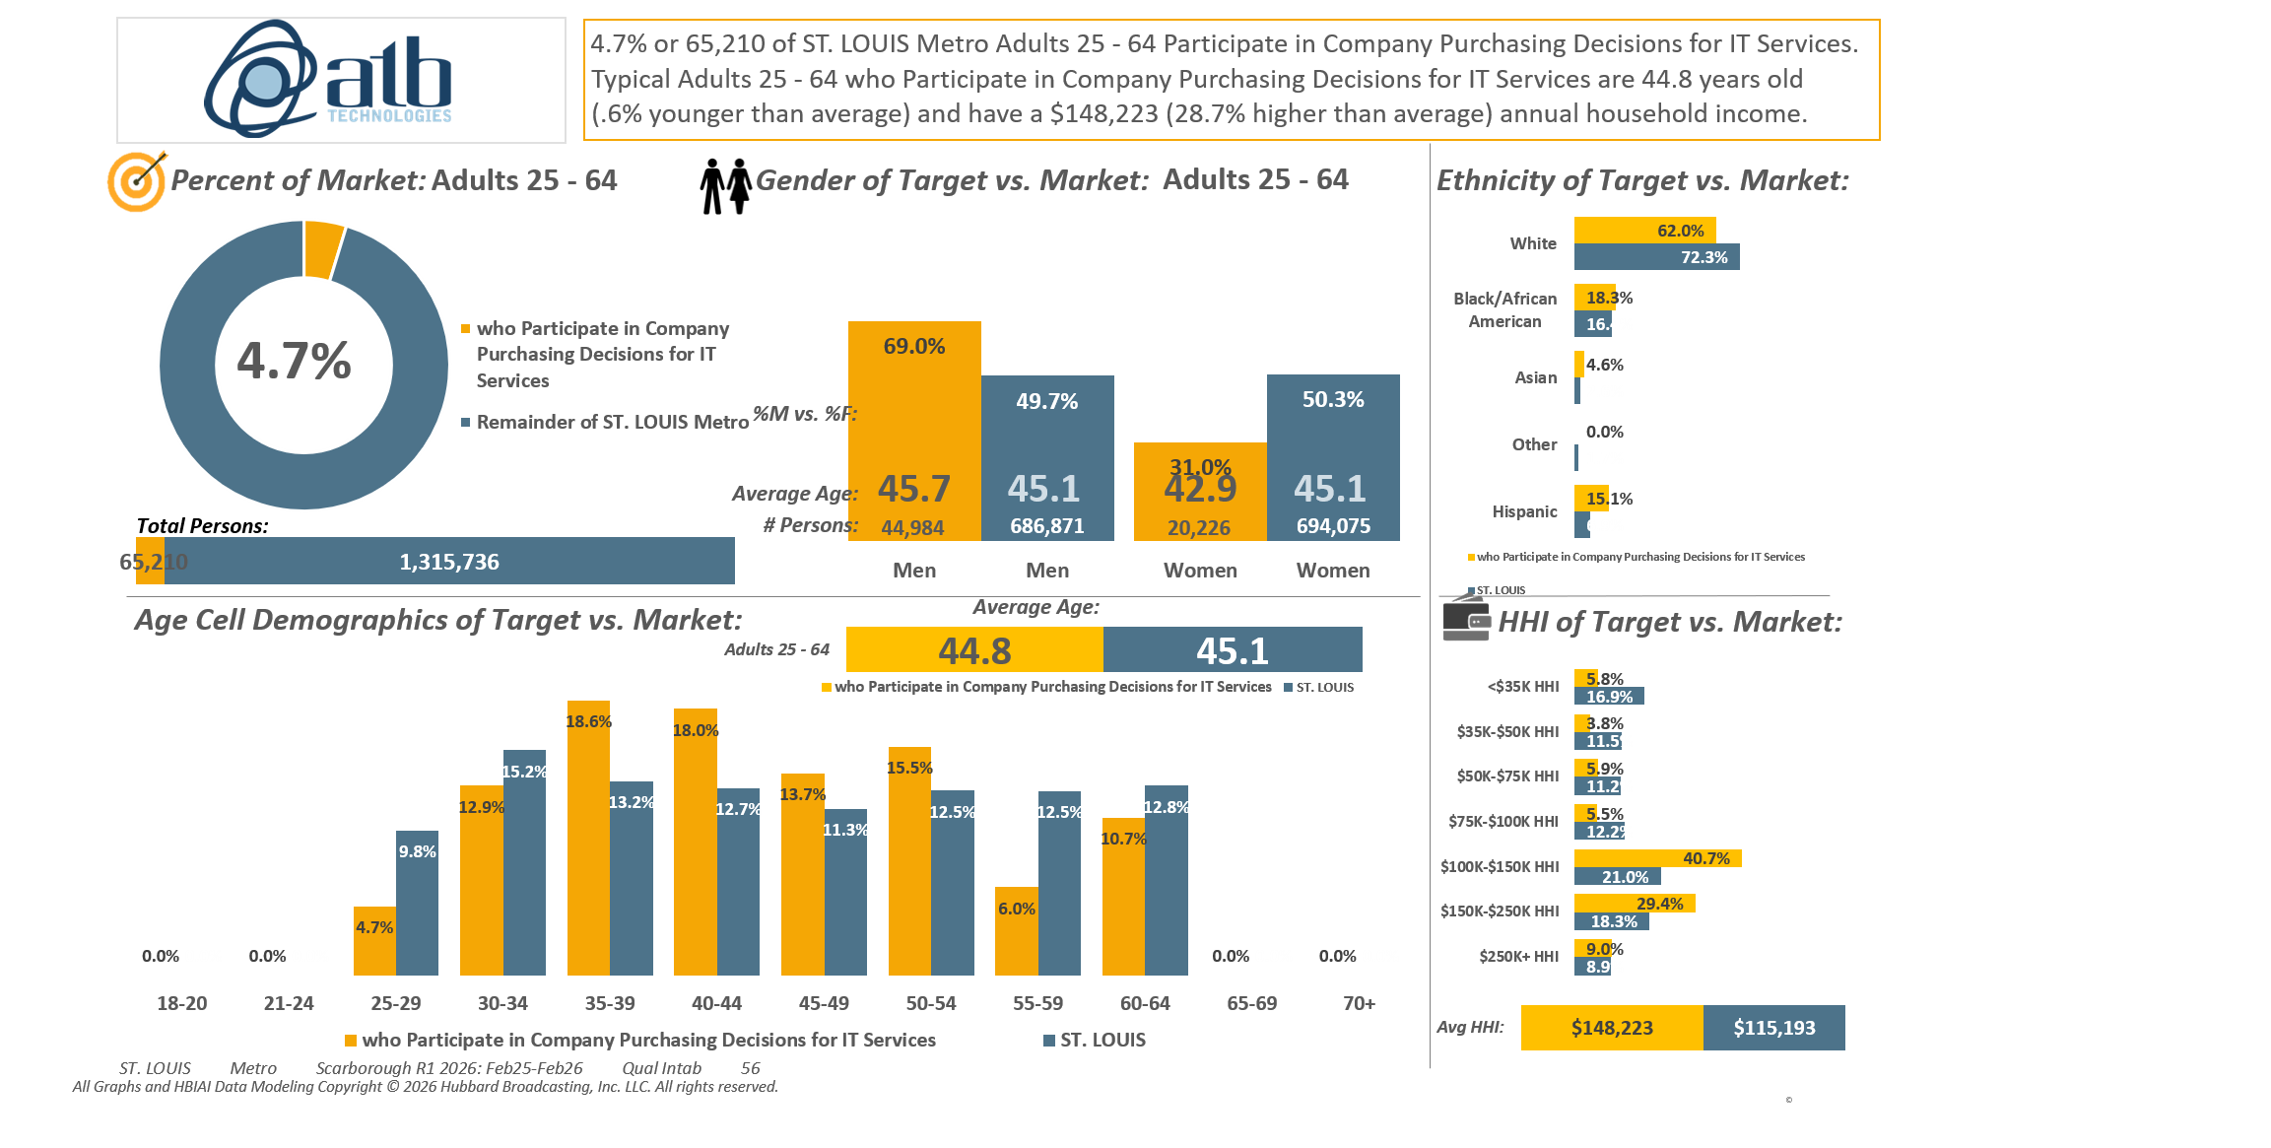







[((Lifestyle characteristics: Small business owner OR Lifestyle characteristics: Senior executive in your company (CEO, CFO, VP, etc.) OR Detailed occupation codes: Management OR Detailed occupation codes: Computer and Mathematical OR Occupation summary: White collar) AND Company purchasing decisions participated in past 12 months: Information technology (network/Internet))]

Slide 2
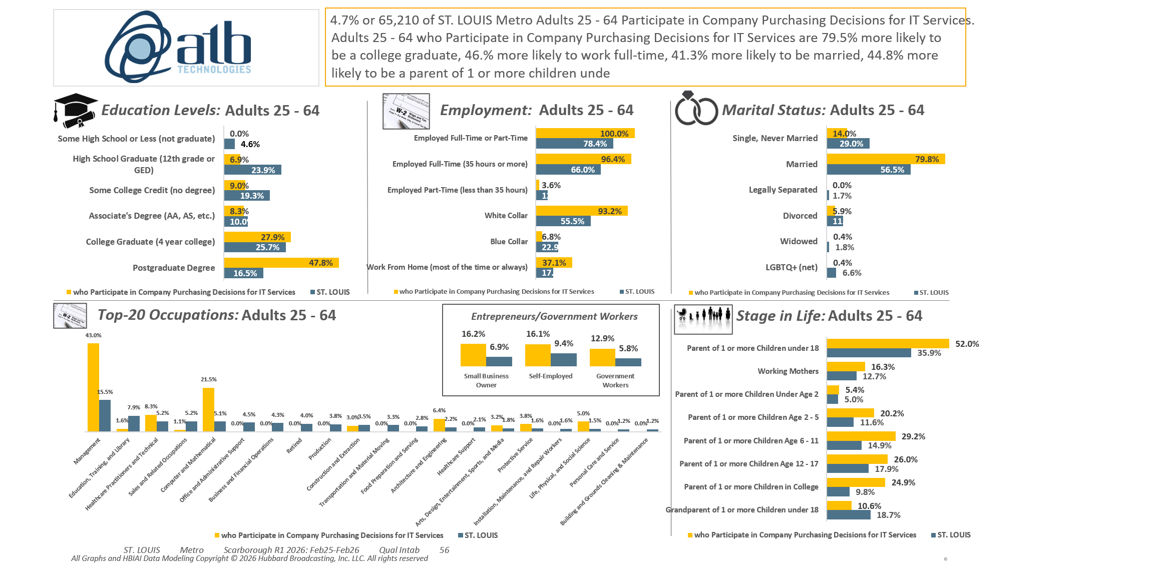
[((Lifestyle characteristics: Small business owner OR Lifestyle characteristics: Senior executive in your company (CEO, CFO, VP, etc.) OR Detailed occupation codes: Management OR Detailed occupation codes: Computer and Mathematical OR Occupation summary: White collar) AND Company purchasing decisions participated in past 12 months: Information technology (network/Internet))]

Slide 3
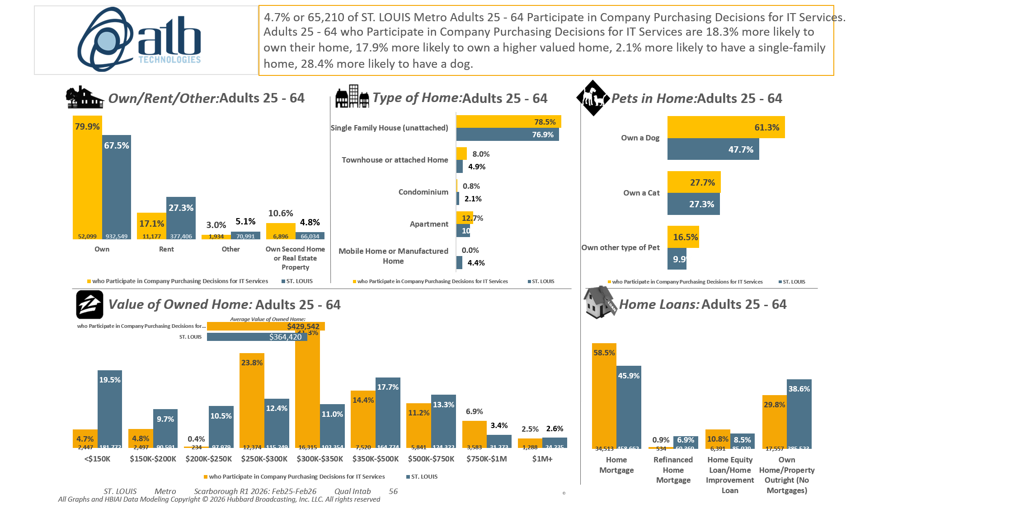
[((Lifestyle characteristics: Small business owner OR Lifestyle characteristics: Senior executive in your company (CEO, CFO, VP, etc.) OR Detailed occupation codes: Management OR Detailed occupation codes: Computer and Mathematical OR Occupation summary: White collar) AND Company purchasing decisions participated in past 12 months: Information technology (network/Internet))]

Slide 4
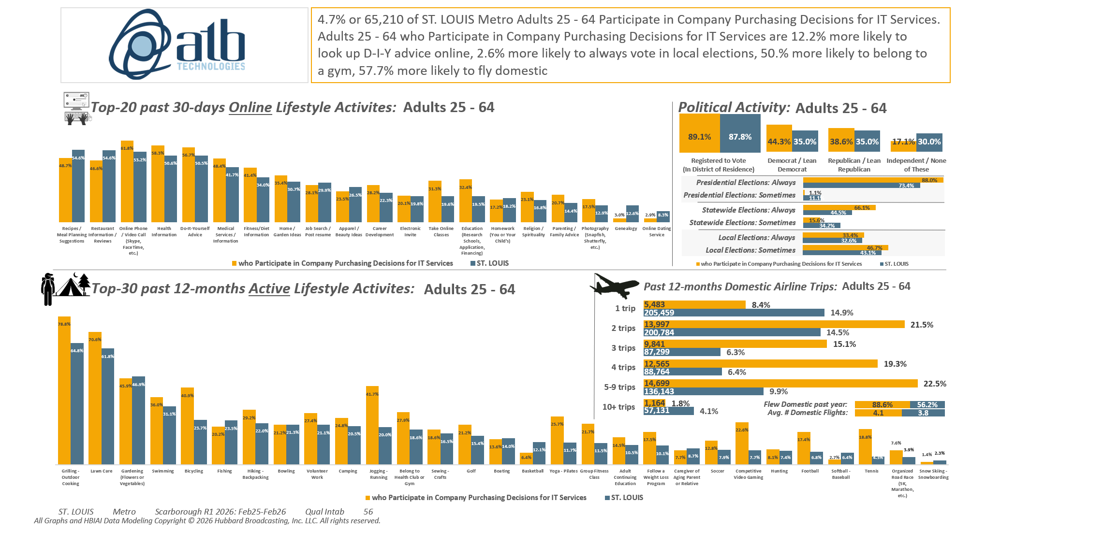
[((Lifestyle characteristics: Small business owner OR Lifestyle characteristics: Senior executive in your company (CEO, CFO, VP, etc.) OR Detailed occupation codes: Management OR Detailed occupation codes: Computer and Mathematical OR Occupation summary: White collar) AND Company purchasing decisions participated in past 12 months: Information technology (network/Internet))]

Slide 5
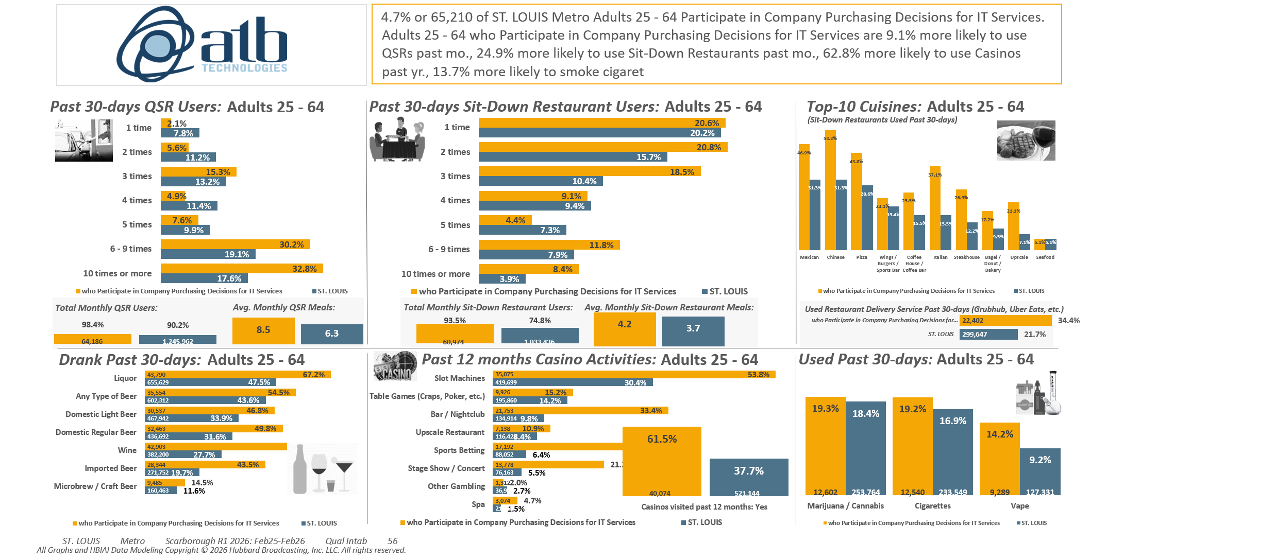
[((Lifestyle characteristics: Small business owner OR Lifestyle characteristics: Senior executive in your company (CEO, CFO, VP, etc.) OR Detailed occupation codes: Management OR Detailed occupation codes: Computer and Mathematical OR Occupation summary: White collar) AND Company purchasing decisions participated in past 12 months: Information technology (network/Internet))]

Slide 6
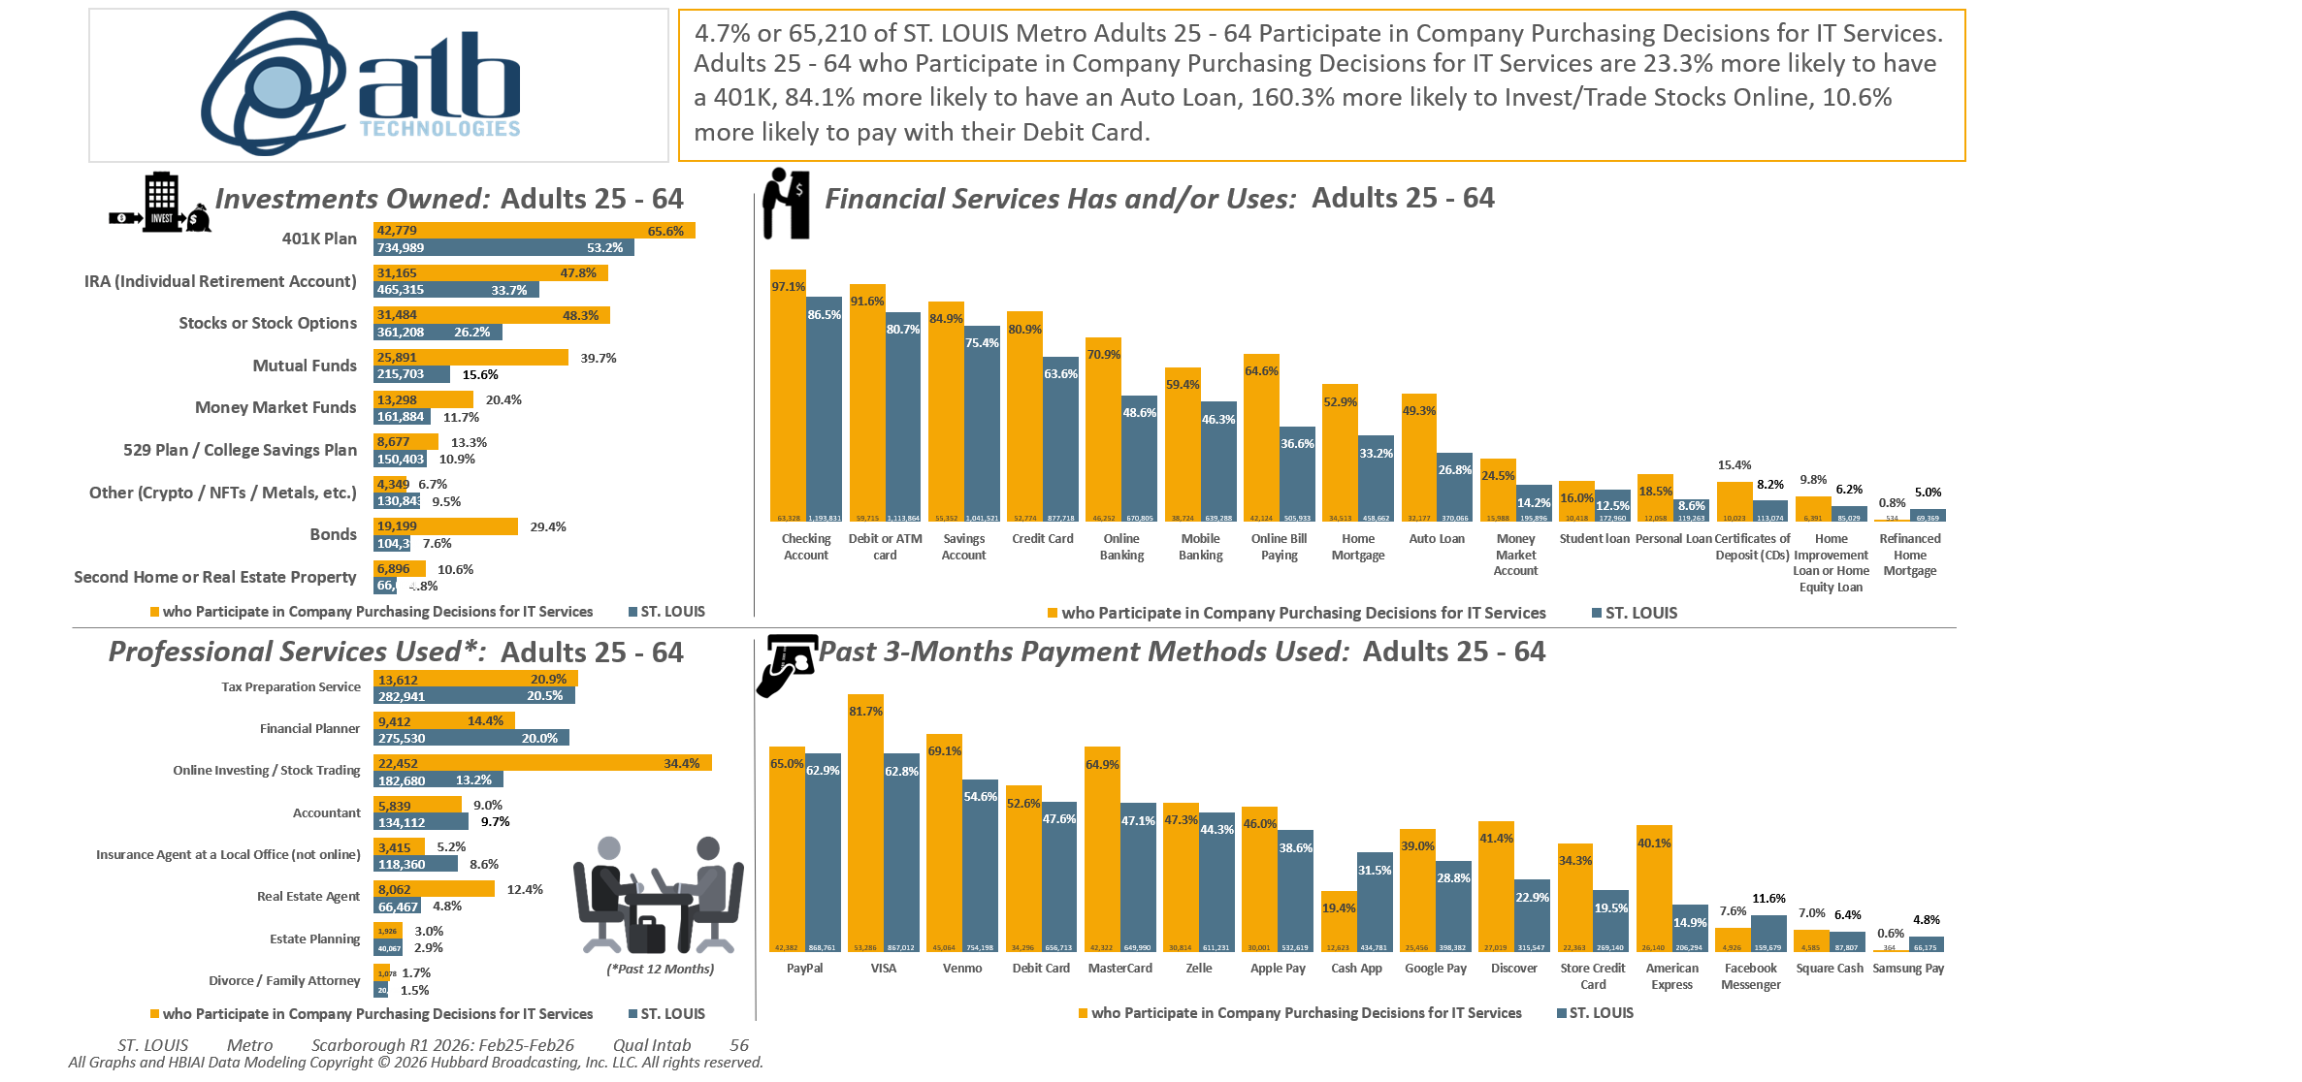
[((Lifestyle characteristics: Small business owner OR Lifestyle characteristics: Senior executive in your company (CEO, CFO, VP, etc.) OR Detailed occupation codes: Management OR Detailed occupation codes: Computer and Mathematical OR Occupation summary: White collar) AND Company purchasing decisions participated in past 12 months: Information technology (network/Internet))]

Slide 7
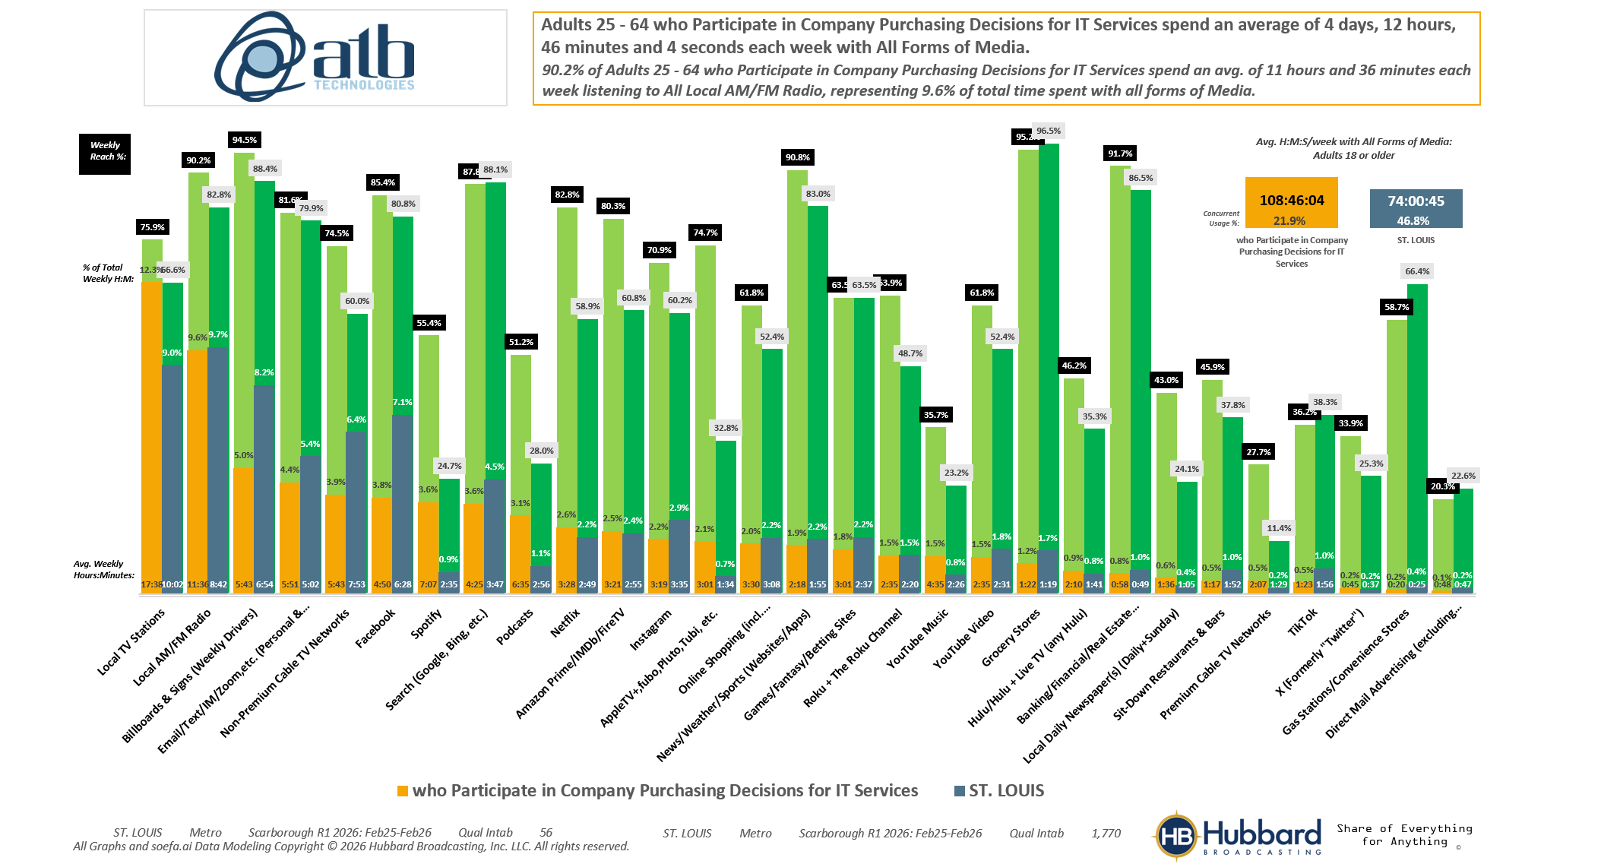

[((Lifestyle characteristics: Small business owner OR Lifestyle characteristics: Senior executive in your company (CEO, CFO, VP, etc.) OR Detailed occupation codes: Management OR Detailed occupation codes: Computer and Mathematical OR Occupation summary: White collar) AND Company purchasing decisions participated in past 12 months: Information technology (network/Internet))]

Slide 8
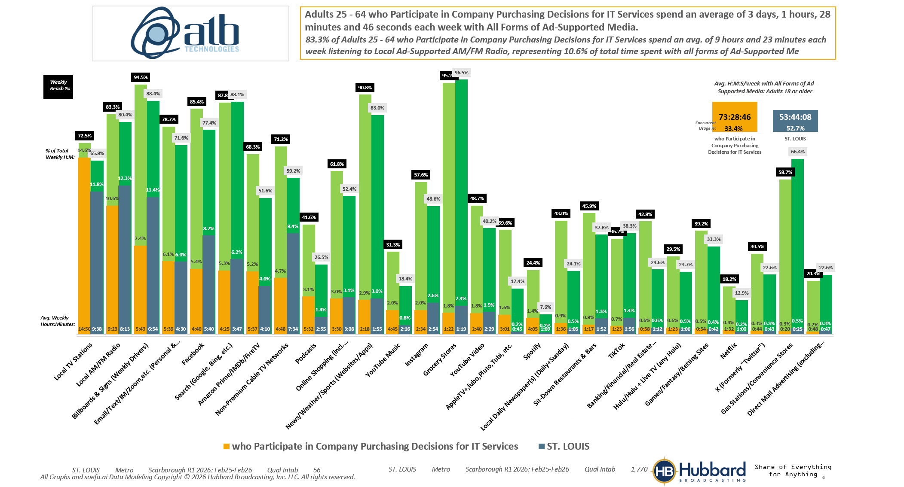
[((Lifestyle characteristics: Small business owner OR Lifestyle characteristics: Senior executive in your company (CEO, CFO, VP, etc.) OR Detailed occupation codes: Management OR Detailed occupation codes: Computer and Mathematical OR Occupation summary: White collar) AND Company purchasing decisions participated in past 12 months: Information technology (network/Internet))]

Slide 9
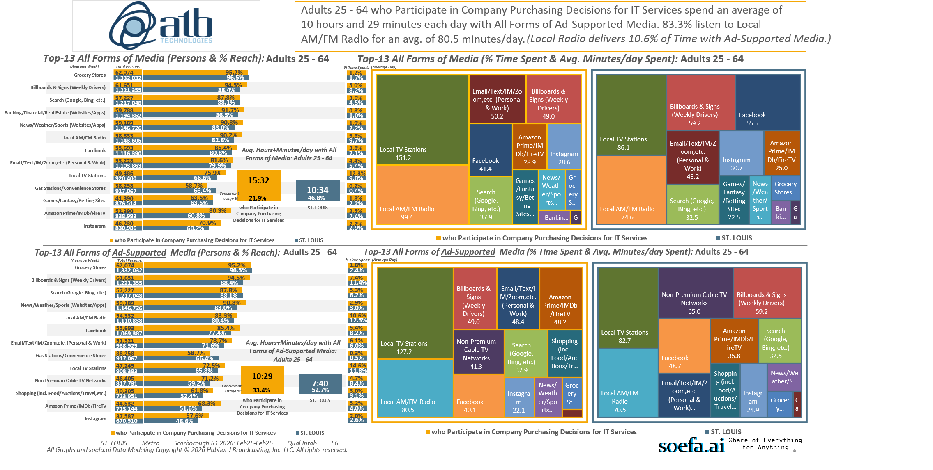
[((Lifestyle characteristics: Small business owner OR Lifestyle characteristics: Senior executive in your company (CEO, CFO, VP, etc.) OR Detailed occupation codes: Management OR Detailed occupation codes: Computer and Mathematical OR Occupation summary: White collar) AND Company purchasing decisions participated in past 12 months: Information technology (network/Internet))]

Slide 10
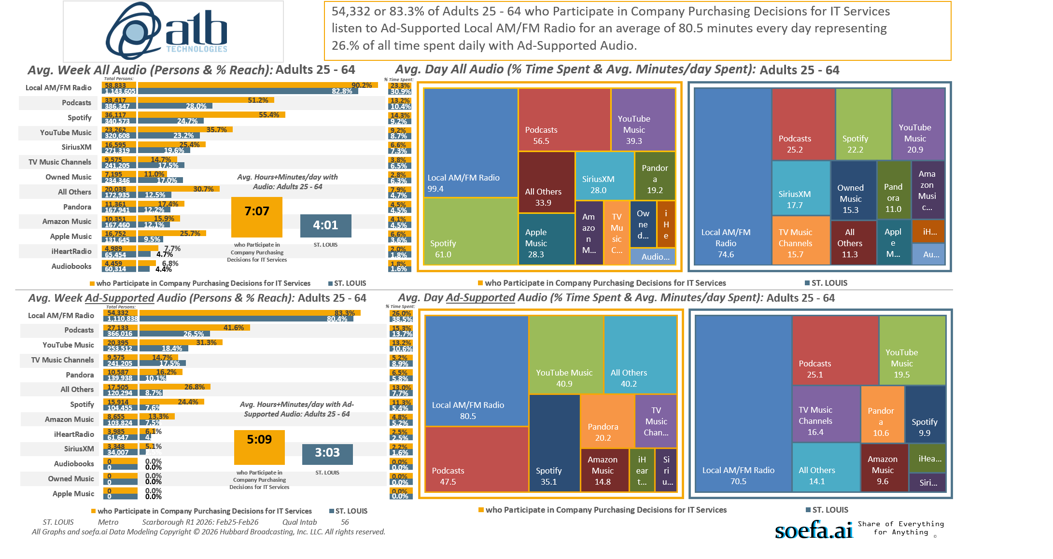
[((Lifestyle characteristics: Small business owner OR Lifestyle characteristics: Senior executive in your company (CEO, CFO, VP, etc.) OR Detailed occupation codes: Management OR Detailed occupation codes: Computer and Mathematical OR Occupation summary: White collar) AND Company purchasing decisions participated in past 12 months: Information technology (network/Internet))]

Slide 11
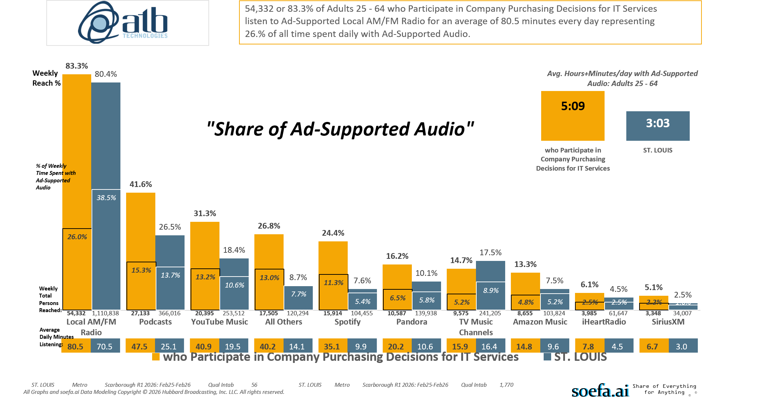
[((Lifestyle characteristics: Small business owner OR Lifestyle characteristics: Senior executive in your company (CEO, CFO, VP, etc.) OR Detailed occupation codes: Management OR Detailed occupation codes: Computer and Mathematical OR Occupation summary: White collar) AND Company purchasing decisions participated in past 12 months: Information technology (network/Internet))]

Slide 12
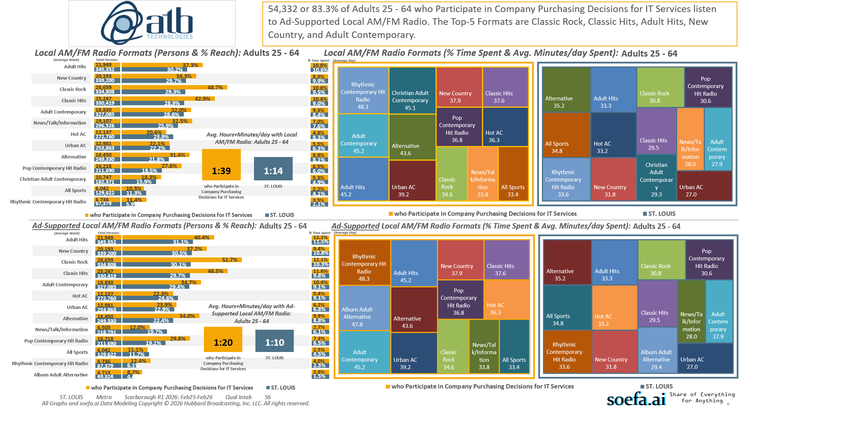
[((Lifestyle characteristics: Small business owner OR Lifestyle characteristics: Senior executive in your company (CEO, CFO, VP, etc.) OR Detailed occupation codes: Management OR Detailed occupation codes: Computer and Mathematical OR Occupation summary: White collar) AND Company purchasing decisions participated in past 12 months: Information technology (network/Internet))]

Slide 13

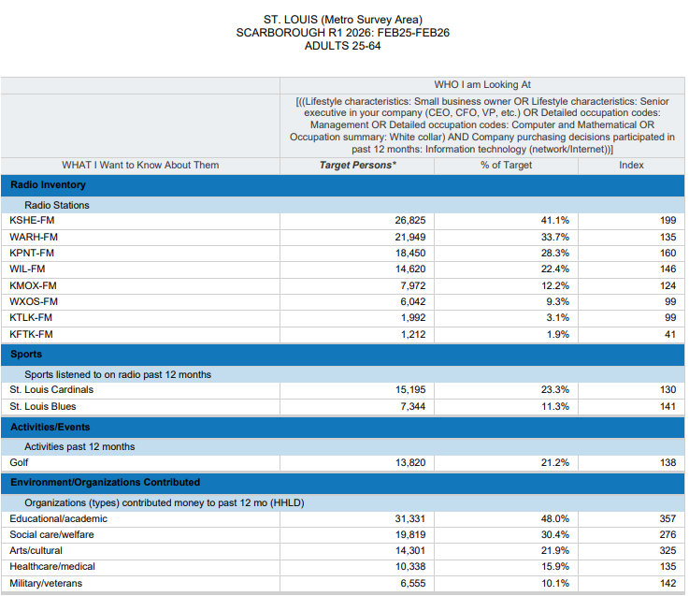


There are over 65,000 Age 25-64 Adults
in the St. Louis Metro Area who Participated
in Company Purchasing Decisions for
IT Services in the past 12 months.
26,825 (41.1%) Listen to KSHE-95 every week
(Index 199).
7,344 (11.3%) Listen to BLUES HOCKEY
(Index 141)
13,820 (21.2%) Like to PLAY GOLF
(Index 138)
31,331 (48.0%) Like to Give Money to
Educational/Academic Charities
(Index 357.)

Slide 14
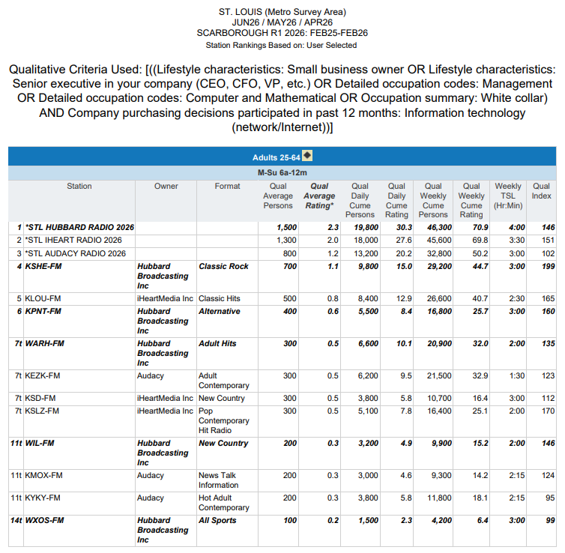



There are over 65,000 Age 25-64 Adults
in the St. Louis Metro Area who Participated
in Company Purchasing Decisions for
IT Services in the past 12 months.
More than 7 out of 10 (70.9% or 46,300)
of them Listen to Hubbard Radio for
4 Hours every week (Index 146).
*STL AUDACY RADIO 2026 = KEZK-F2, KEZK-FM, KFTK-FM, KMOX-FM, KYKY-FM, WFUN-FM;
*STL HUBBARD RADIO 2026 = KPNT-FM, KSHE-FM, WARH-FM, WIL-FM, WXOS-FM;
*STL IHEART RADIO 2026 = KATZ-AM, KATZFM, KLOU-FM, KSD-FM, KSLZ-FM, KTLK-FM

Slide 15
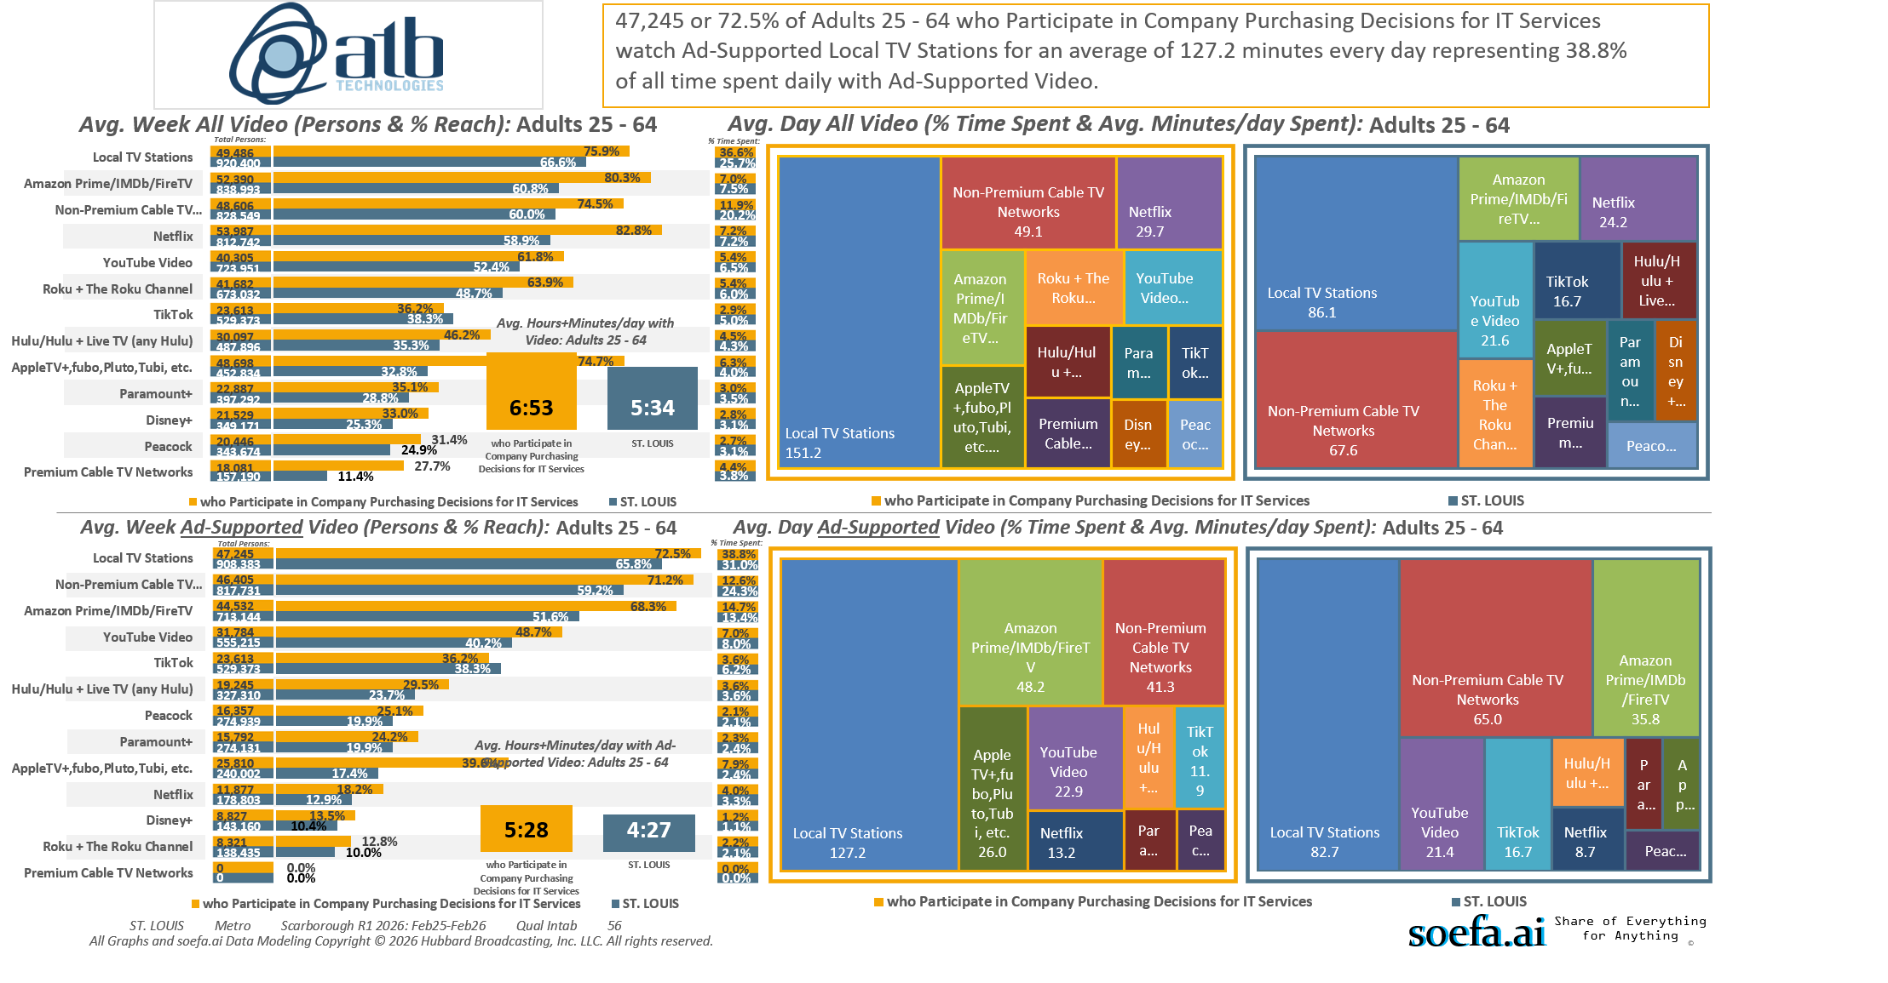
[((Lifestyle characteristics: Small business owner OR Lifestyle characteristics: Senior executive in your company (CEO, CFO, VP, etc.) OR Detailed occupation codes: Management OR Detailed occupation codes: Computer and Mathematical OR Occupation summary: White collar) AND Company purchasing decisions participated in past 12 months: Information technology (network/Internet))]

Slide 16
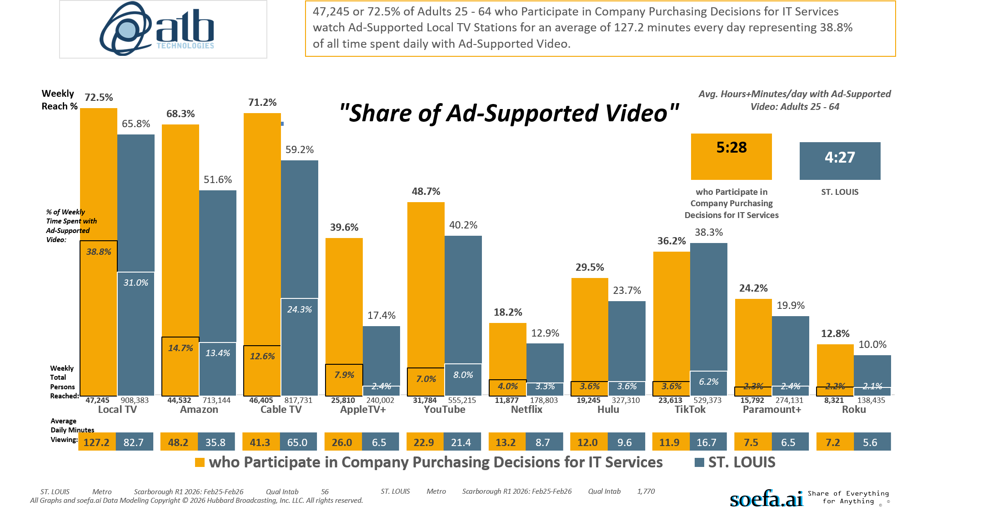
[((Lifestyle characteristics: Small business owner OR Lifestyle characteristics: Senior executive in your company (CEO, CFO, VP, etc.) OR Detailed occupation codes: Management OR Detailed occupation codes: Computer and Mathematical OR Occupation summary: White collar) AND Company purchasing decisions participated in past 12 months: Information technology (network/Internet))]

Slide 17
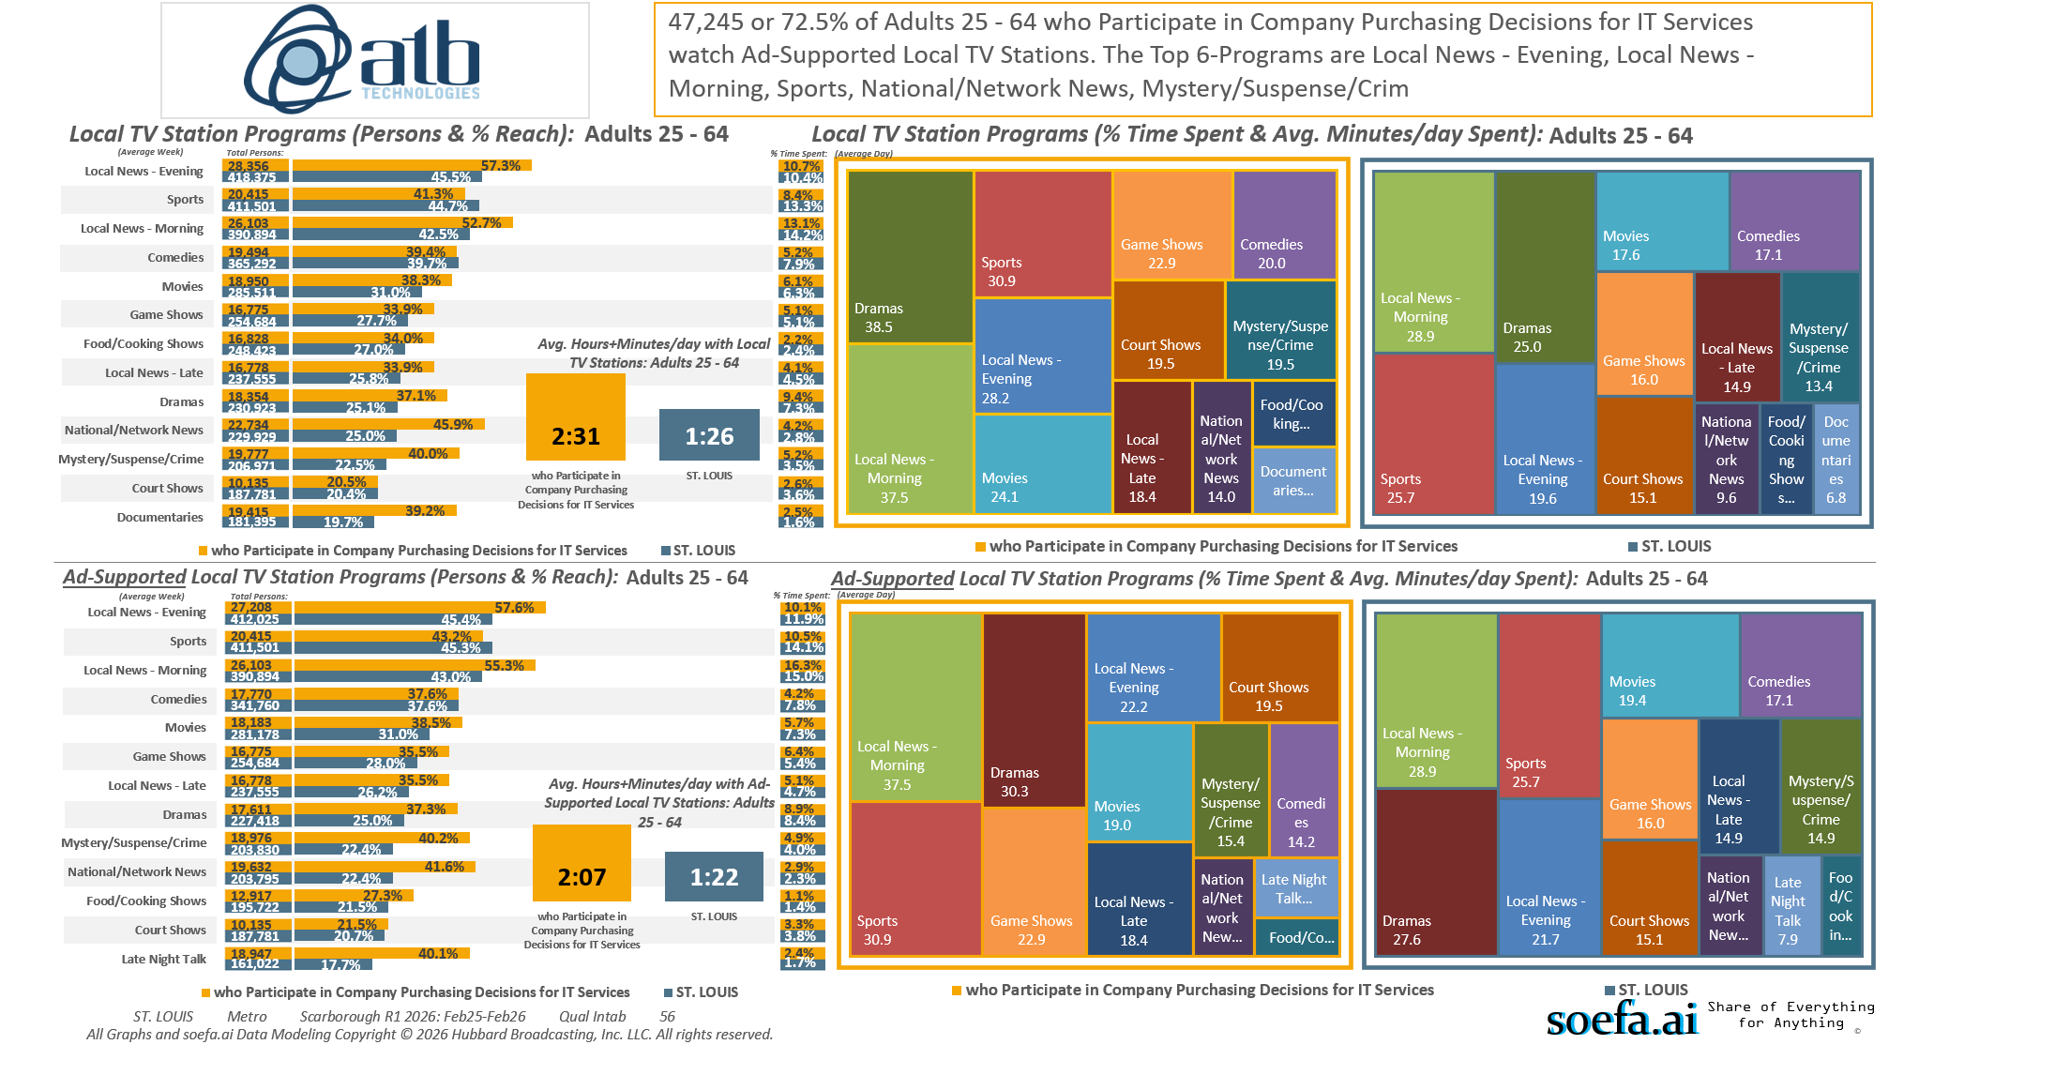
[((Lifestyle characteristics: Small business owner OR Lifestyle characteristics: Senior executive in your company (CEO, CFO, VP, etc.) OR Detailed occupation codes: Management OR Detailed occupation codes: Computer and Mathematical OR Occupation summary: White collar) AND Company purchasing decisions participated in past 12 months: Information technology (network/Internet))]

Slide 18
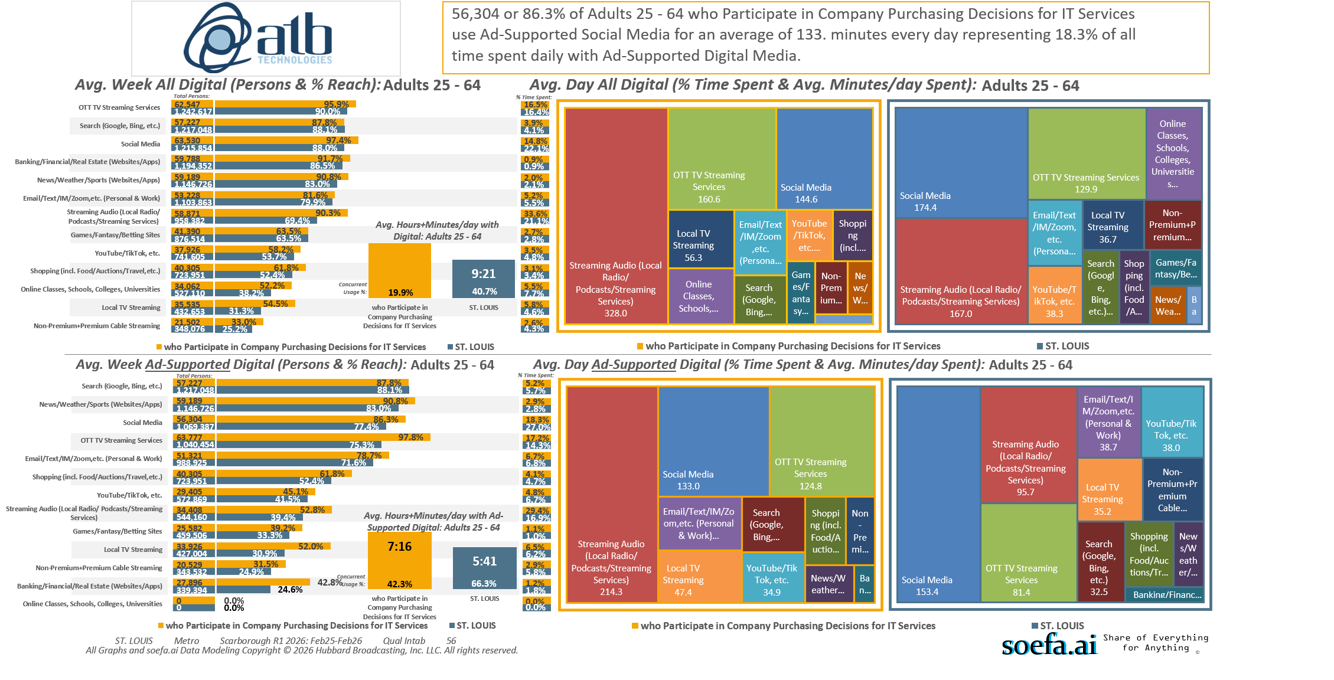
[((Lifestyle characteristics: Small business owner OR Lifestyle characteristics: Senior executive in your company (CEO, CFO, VP, etc.) OR Detailed occupation codes: Management OR Detailed occupation codes: Computer and Mathematical OR Occupation summary: White collar) AND Company purchasing decisions participated in past 12 months: Information technology (network/Internet))]

Slide 19
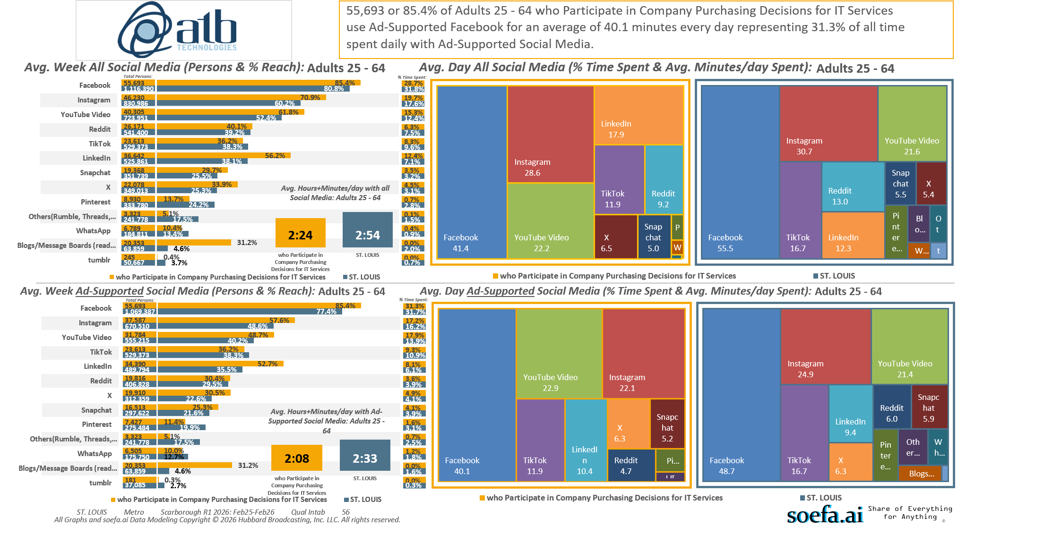
[((Lifestyle characteristics: Small business owner OR Lifestyle characteristics: Senior executive in your company (CEO, CFO, VP, etc.) OR Detailed occupation codes: Management OR Detailed occupation codes: Computer and Mathematical OR Occupation summary: White collar) AND Company purchasing decisions participated in past 12 months: Information technology (network/Internet))]

Slide 20
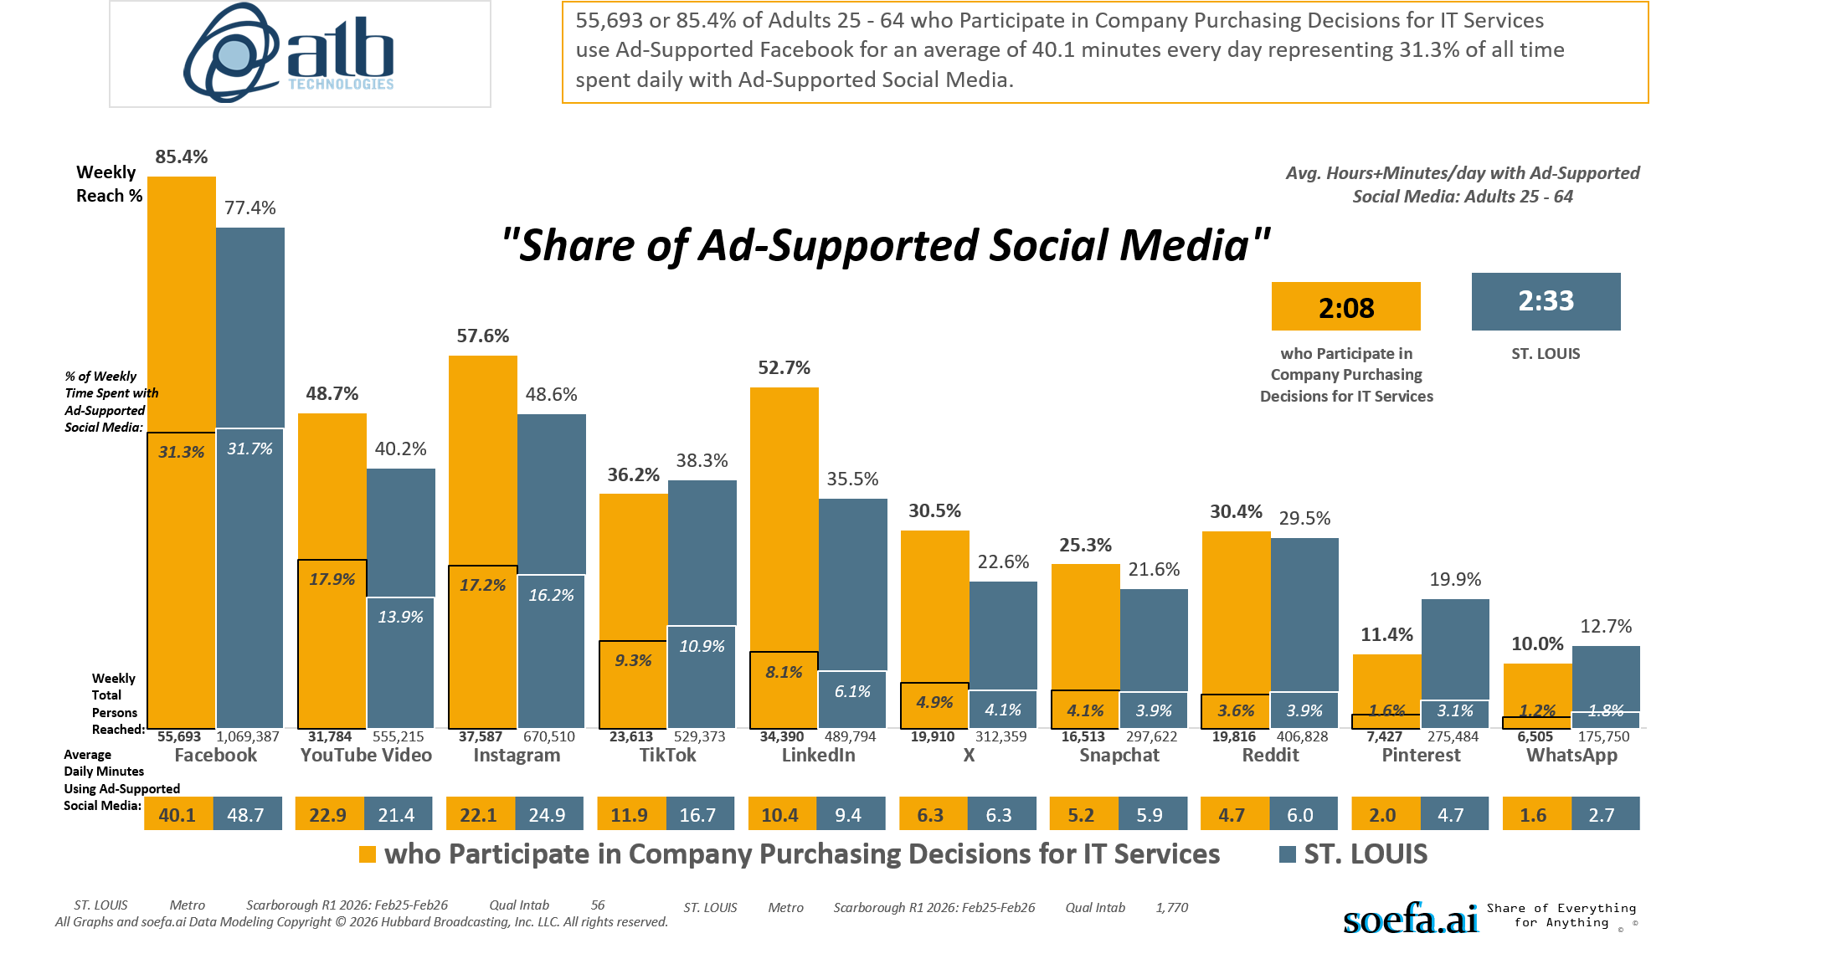
[((Lifestyle characteristics: Small business owner OR Lifestyle characteristics: Senior executive in your company (CEO, CFO, VP, etc.) OR Detailed occupation codes: Management OR Detailed occupation codes: Computer and Mathematical OR Occupation summary: White collar) AND Company purchasing decisions participated in past 12 months: Information technology (network/Internet))]

Slide 21
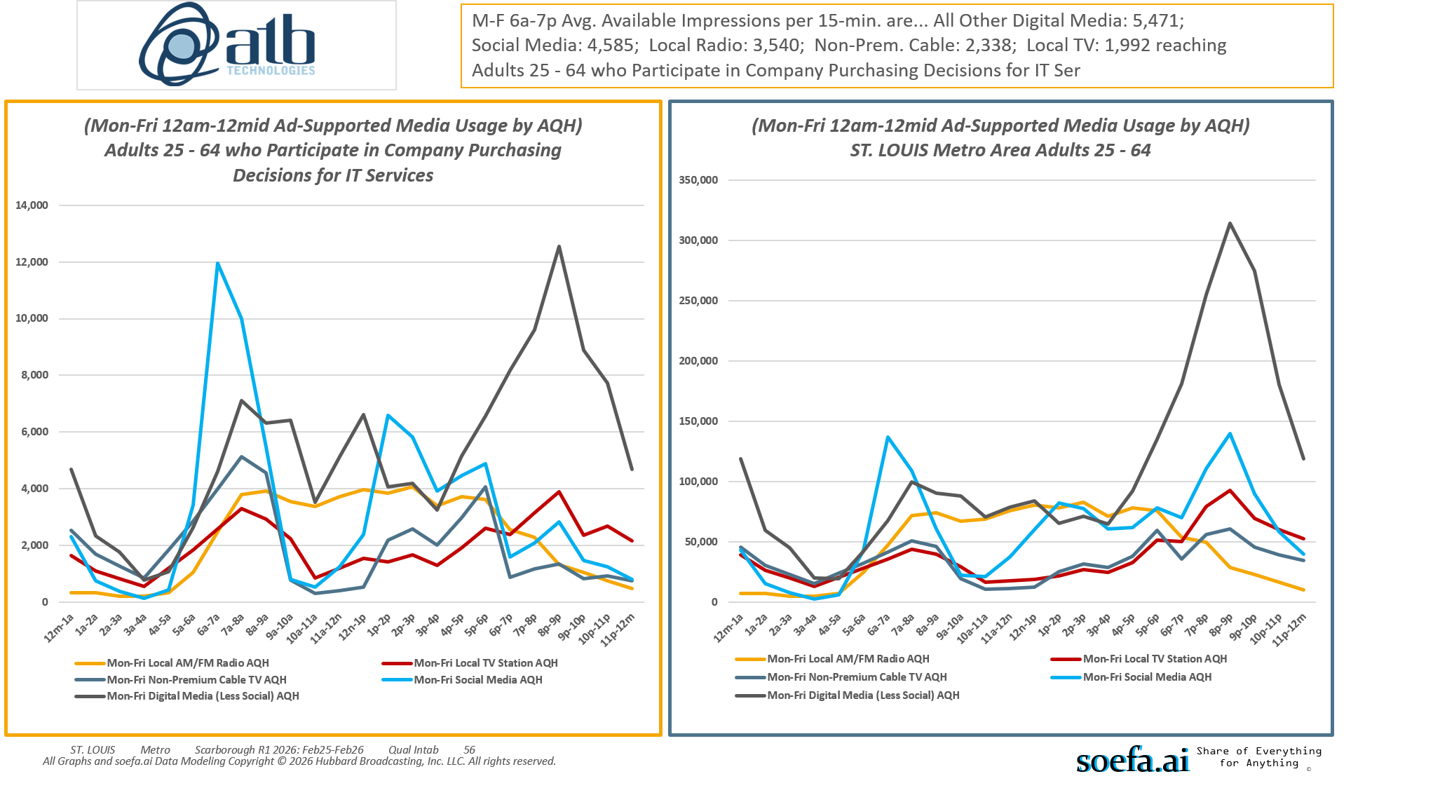
[((Lifestyle characteristics: Small business owner OR Lifestyle characteristics: Senior executive in your company (CEO, CFO, VP, etc.) OR Detailed occupation codes: Management OR Detailed occupation codes: Computer and Mathematical OR Occupation summary: White collar) AND Company purchasing decisions participated in past 12 months: Information technology (network/Internet))]

Slide 22
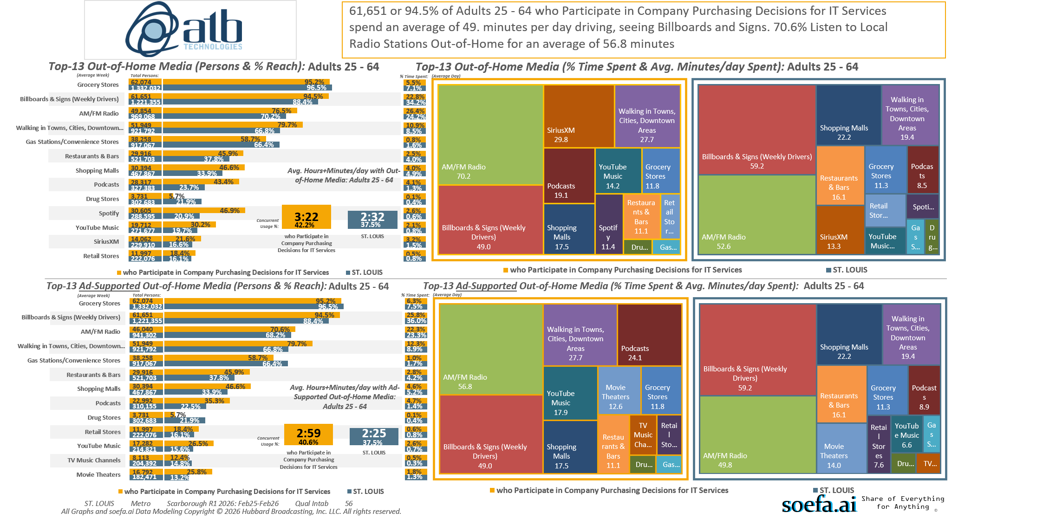
[((Lifestyle characteristics: Small business owner OR Lifestyle characteristics: Senior executive in your company (CEO, CFO, VP, etc.) OR Detailed occupation codes: Management OR Detailed occupation codes: Computer and Mathematical OR Occupation summary: White collar) AND Company purchasing decisions participated in past 12 months: Information technology (network/Internet))]

Slide 23
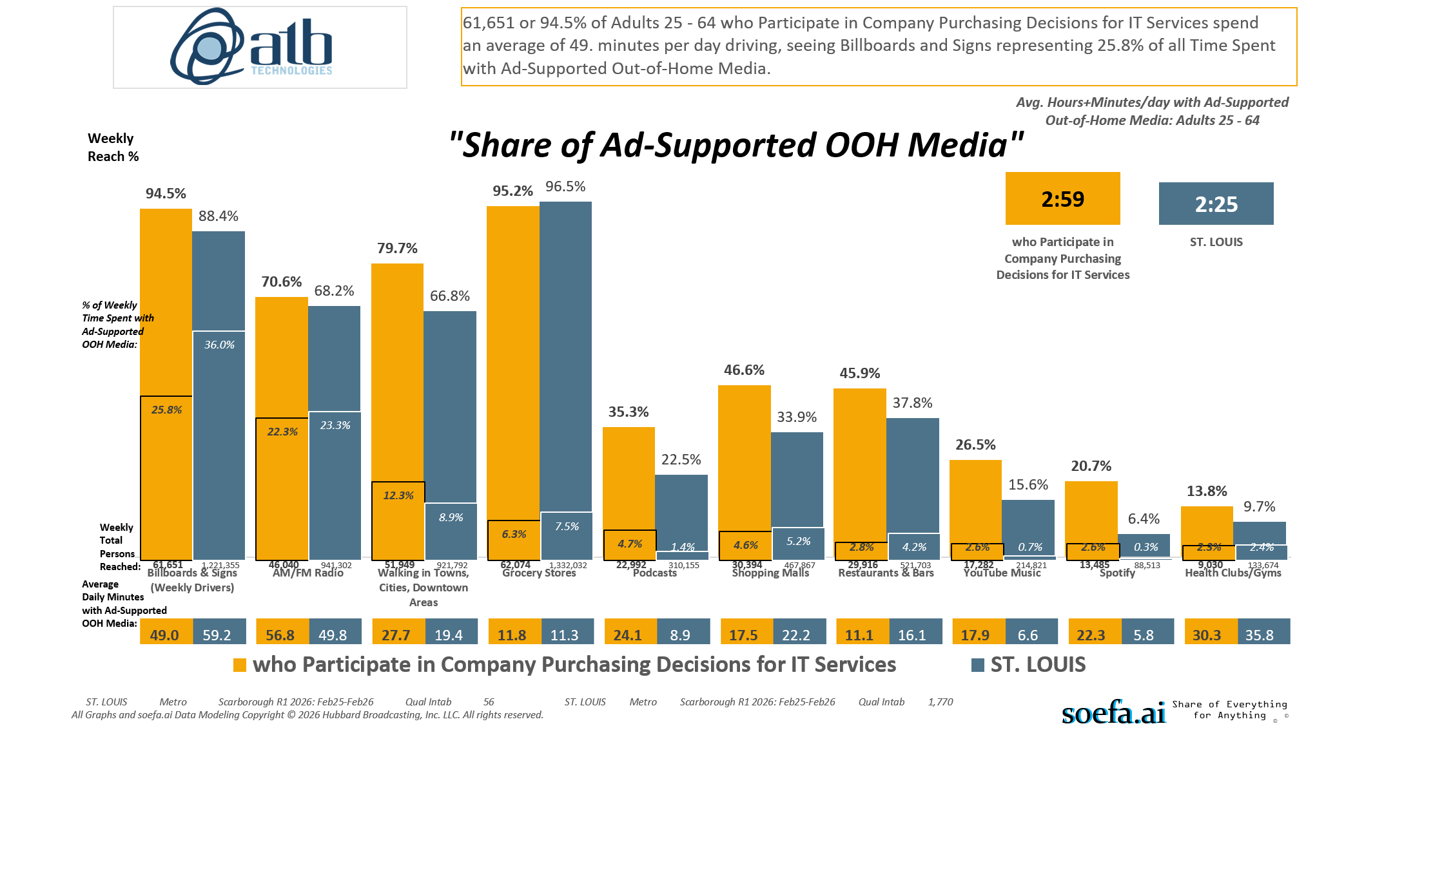
[((Lifestyle characteristics: Small business owner OR Lifestyle characteristics: Senior executive in your company (CEO, CFO, VP, etc.) OR Detailed occupation codes: Management OR Detailed occupation codes: Computer and Mathematical OR Occupation summary: White collar) AND Company purchasing decisions participated in past 12 months: Information technology (network/Internet))]

Slide 24
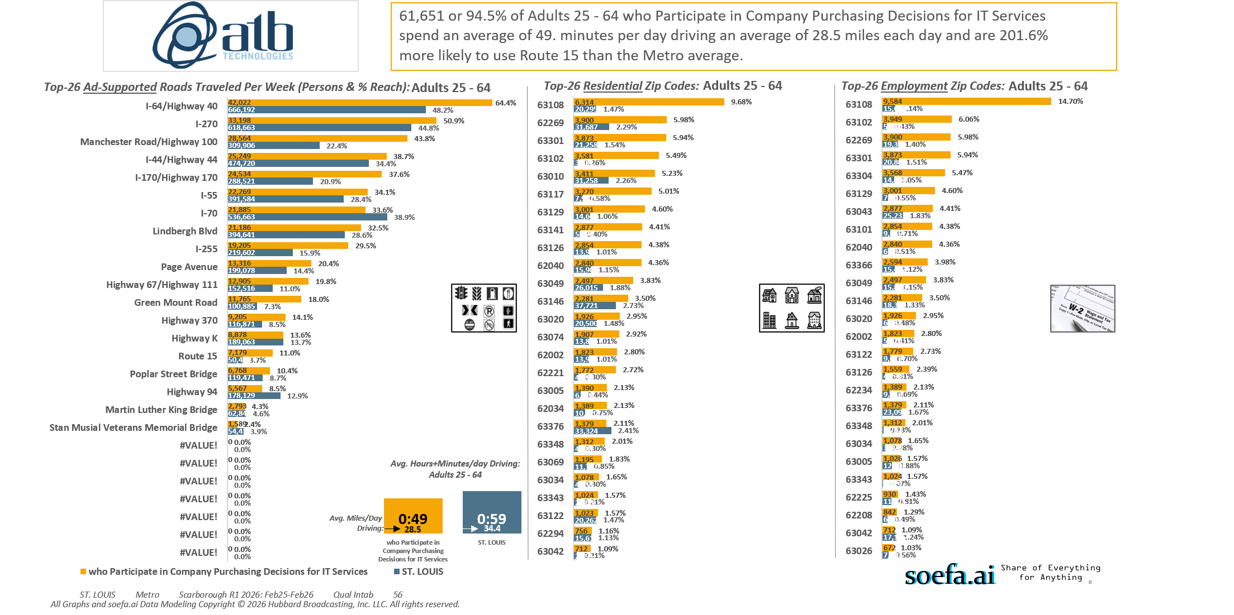
[((Lifestyle characteristics: Small business owner OR Lifestyle characteristics: Senior executive in your company (CEO, CFO, VP, etc.) OR Detailed occupation codes: Management OR Detailed occupation codes: Computer and Mathematical OR Occupation summary: White collar) AND Company purchasing decisions participated in past 12 months: Information technology (network/Internet))]

Slide 25
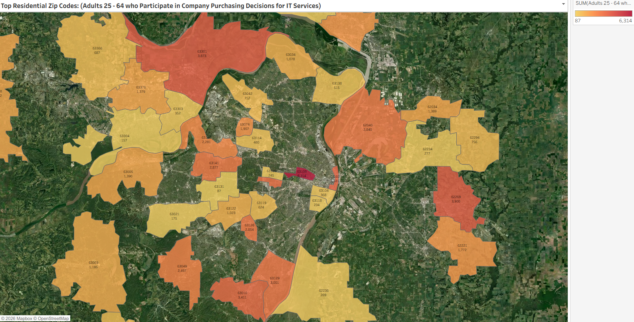
[((Lifestyle characteristics: Small business owner OR Lifestyle characteristics: Senior executive in your company (CEO, CFO, VP, etc.) OR Detailed occupation codes: Management OR Detailed occupation codes: Computer and Mathematical OR Occupation summary: White collar) AND Company purchasing decisions participated in past 12 months: Information technology (network/Internet))]

Slide 26
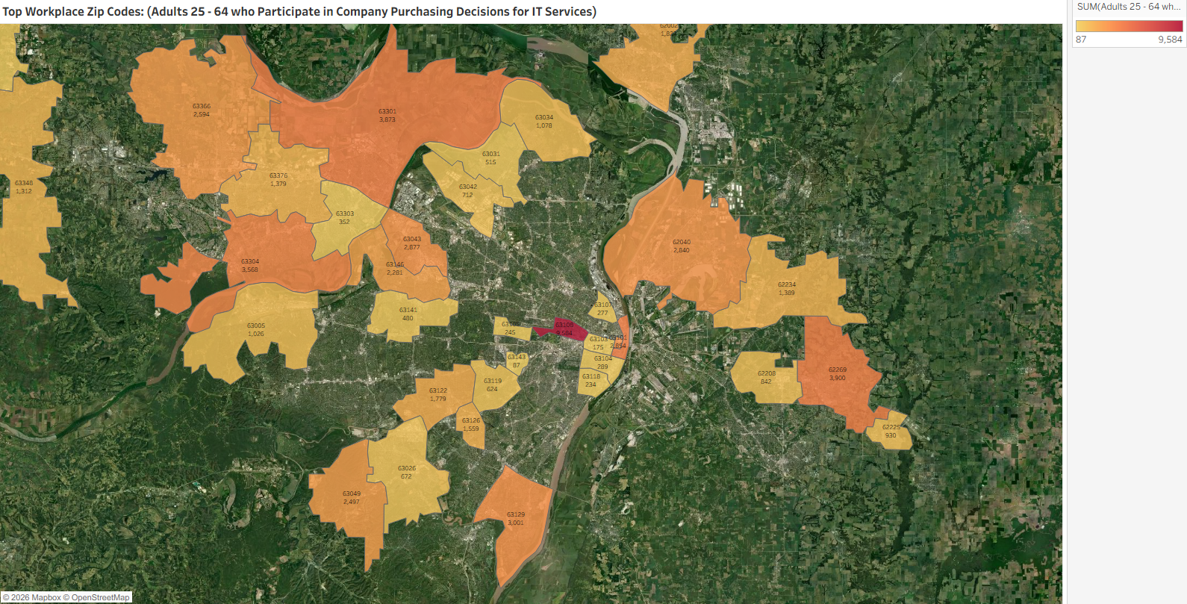
[((Lifestyle characteristics: Small business owner OR Lifestyle characteristics: Senior executive in your company (CEO, CFO, VP, etc.) OR Detailed occupation codes: Management OR Detailed occupation codes: Computer and Mathematical OR Occupation summary: White collar) AND Company purchasing decisions participated in past 12 months: Information technology (network/Internet))]

Slide 27
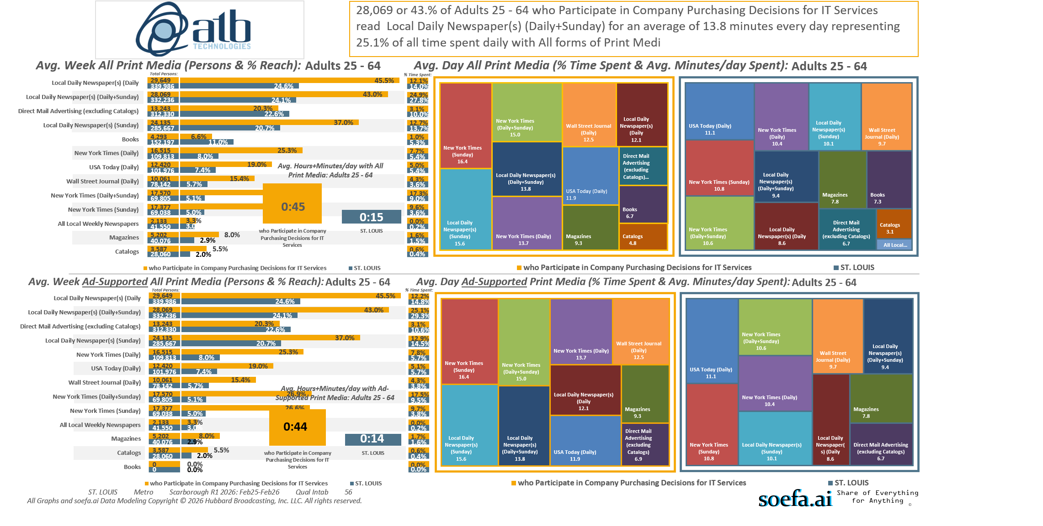
[((Lifestyle characteristics: Small business owner OR Lifestyle characteristics: Senior executive in your company (CEO, CFO, VP, etc.) OR Detailed occupation codes: Management OR Detailed occupation codes: Computer and Mathematical OR Occupation summary: White collar) AND Company purchasing decisions participated in past 12 months: Information technology (network/Internet))]

