Slide 1

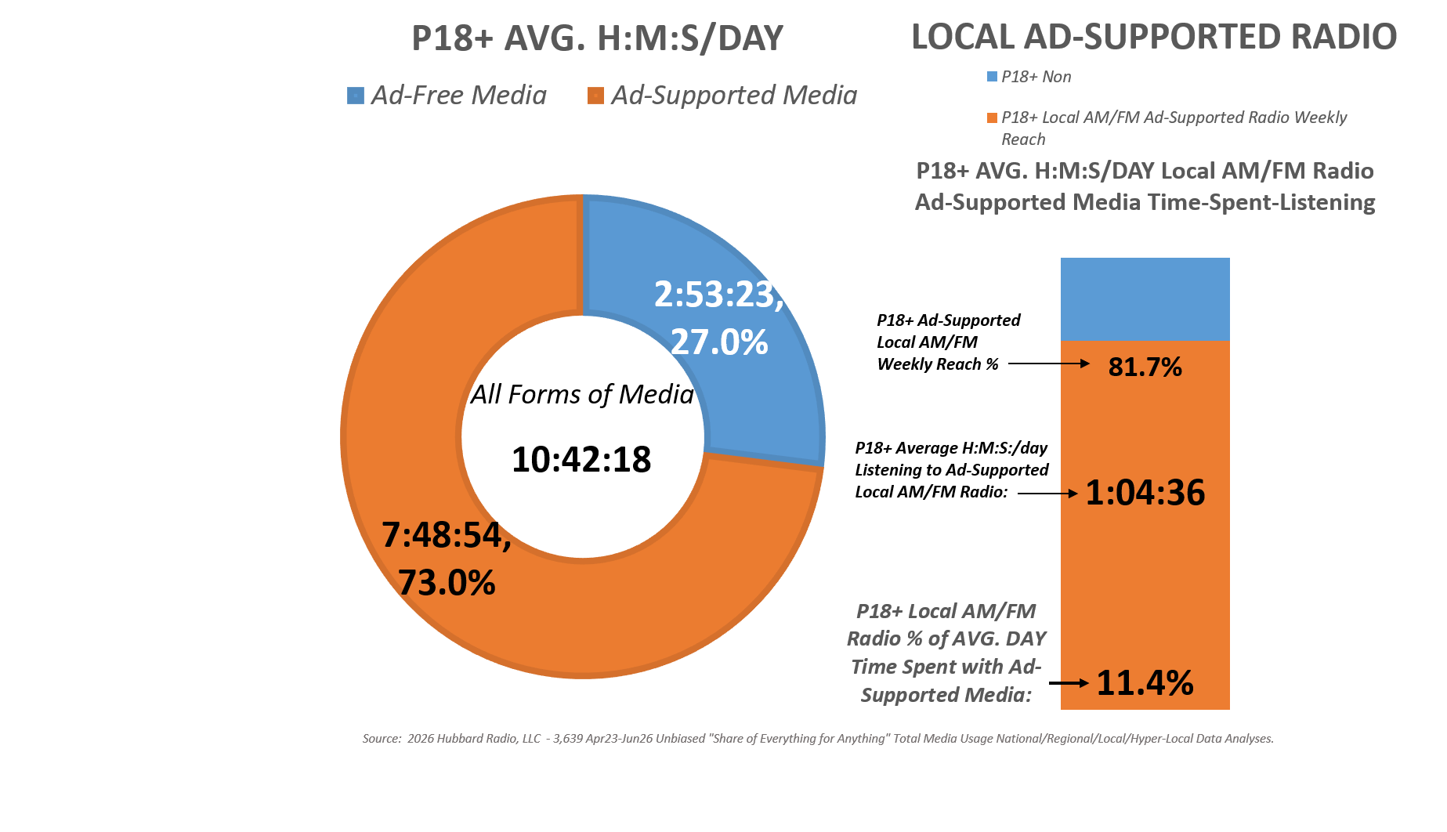
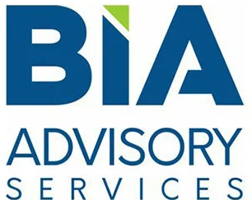
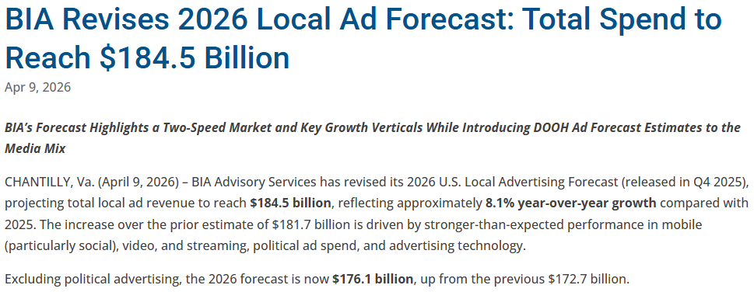
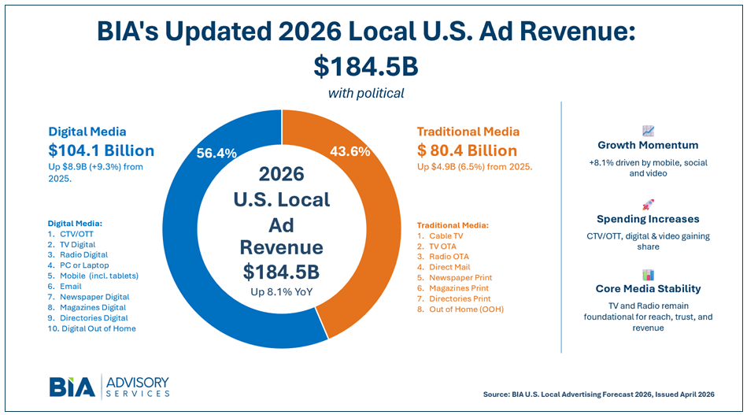

Average of
3,639 Decks
As of: 5 PM:
06/11/2026
Local Radio:
$10 Billion (excl. “Radio Digital”)
= 6% of Ad Spend

