Slide 1
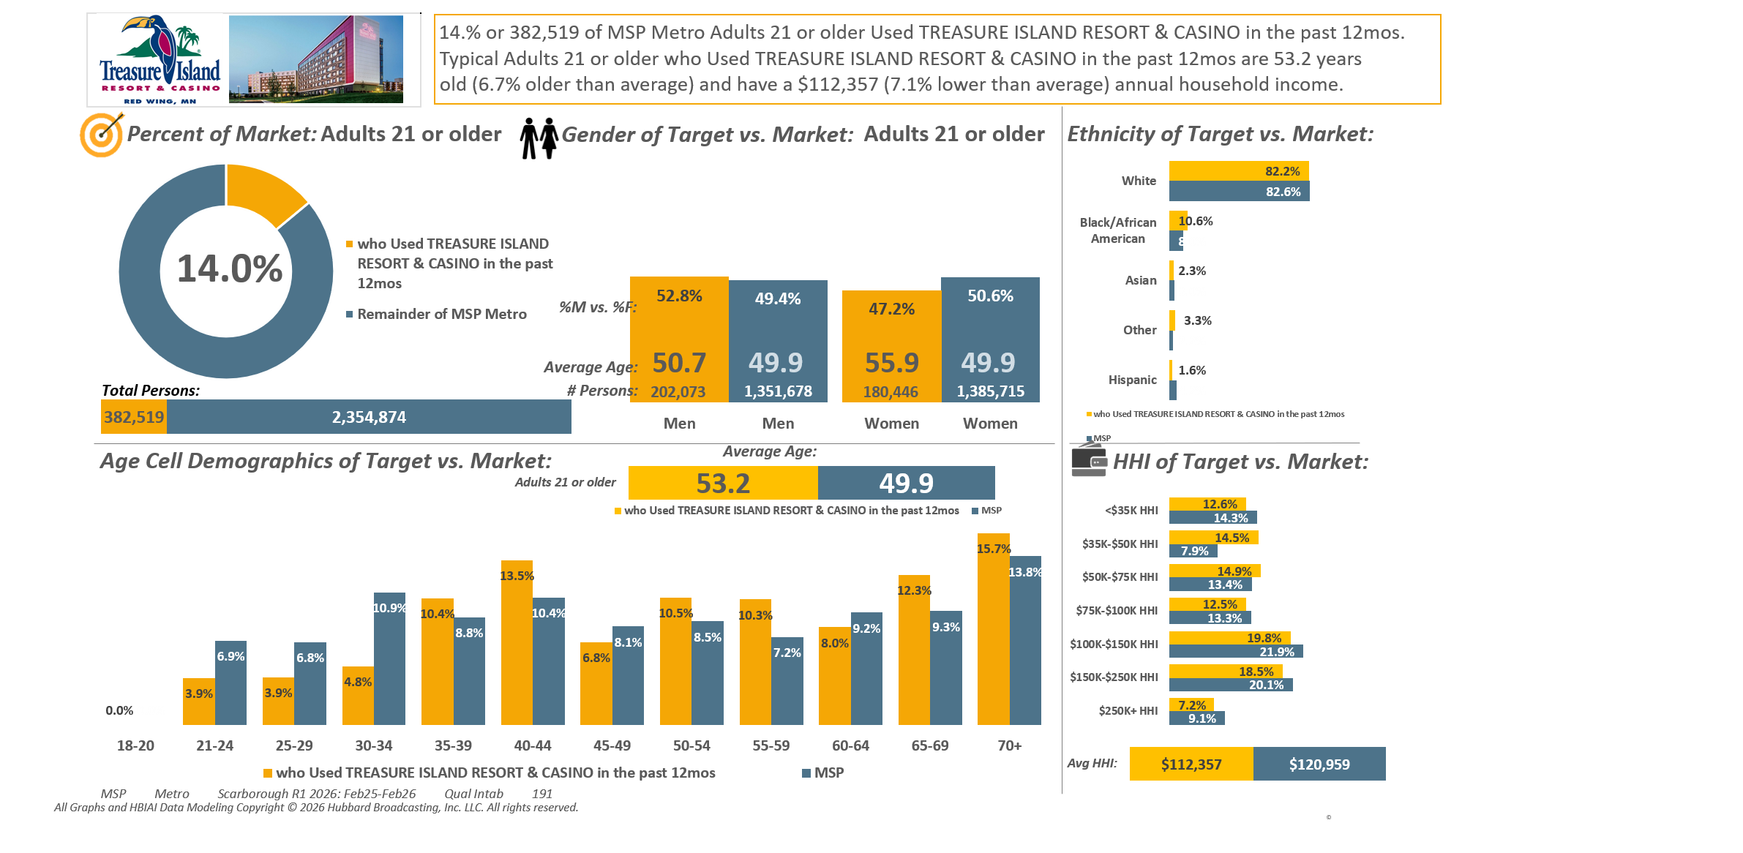





Note: For our Rankers we are going to use P35-64
Casinos visited past 12 months (by name): Treasure Island Resort & Casino

Slide 2
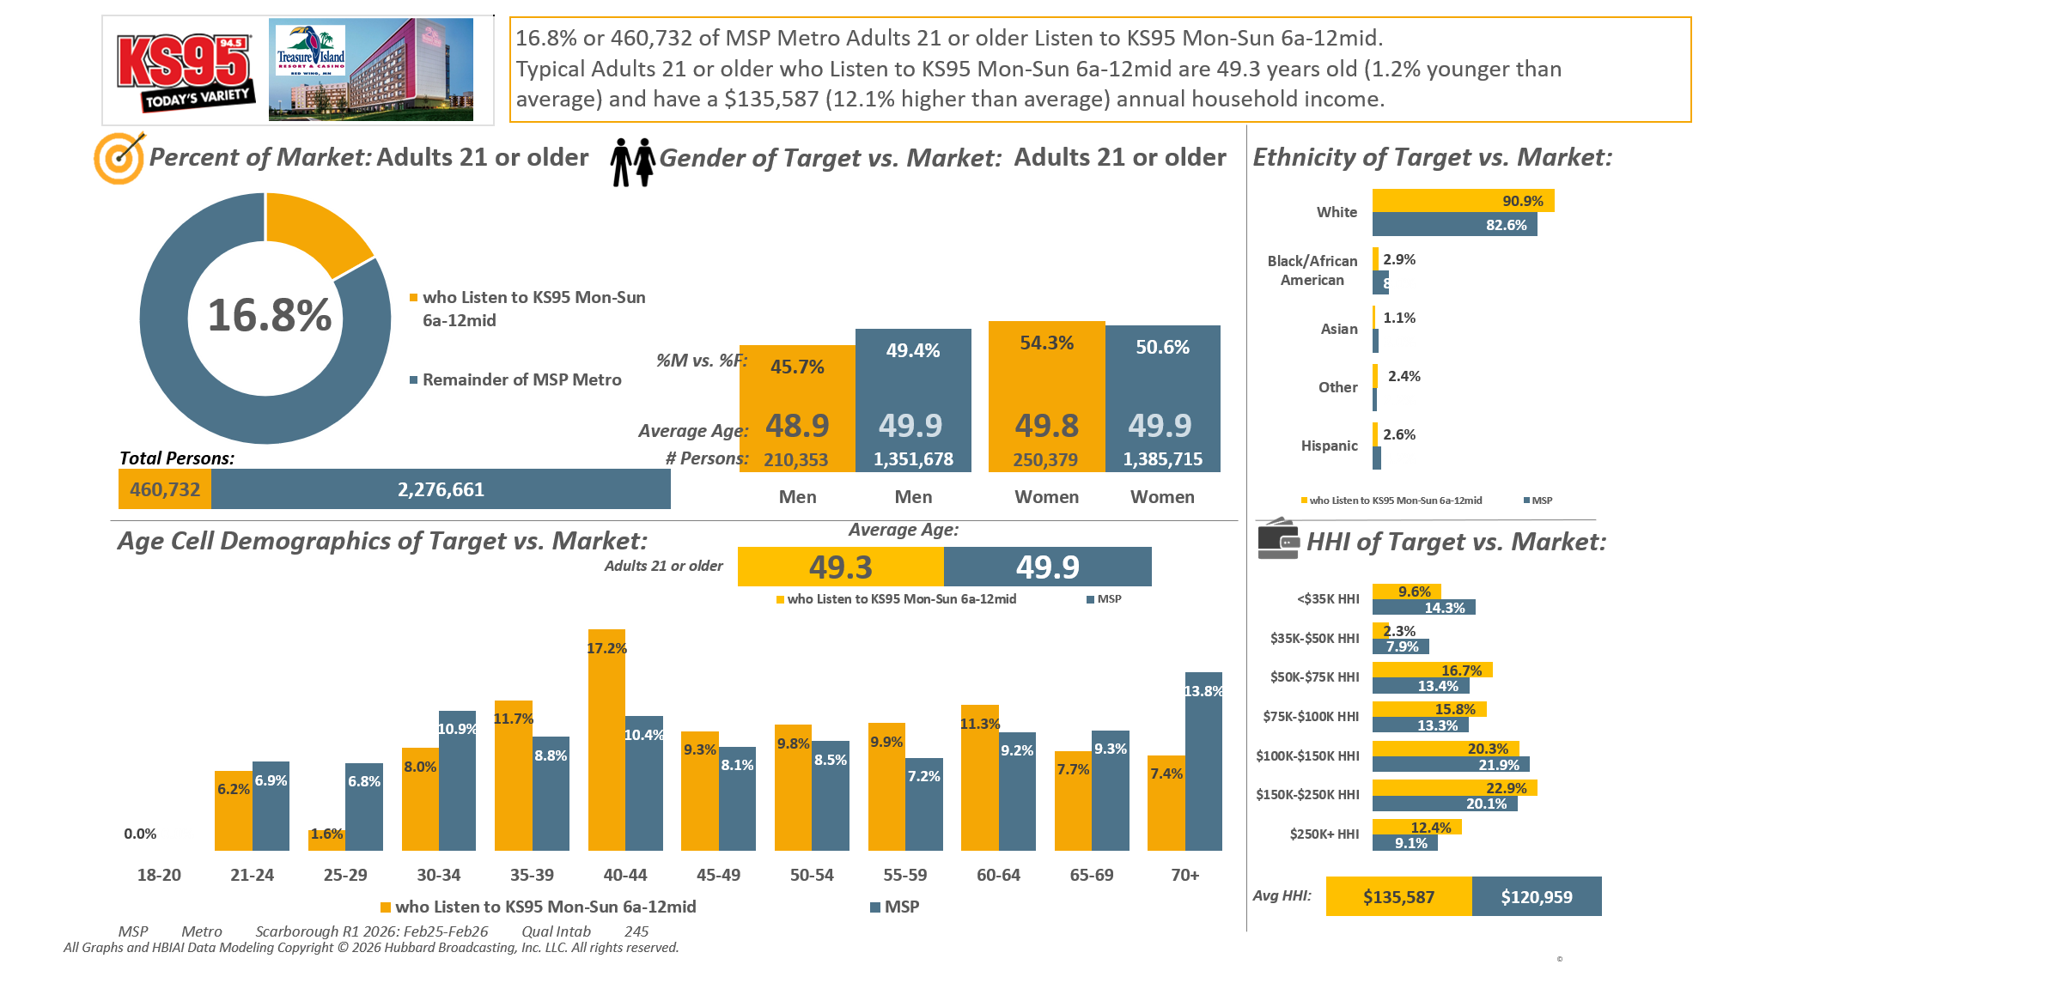
Note: For our Rankers we are going to use P35-64
M-S 6am-mid cume: KSTP-FM

Slide 3
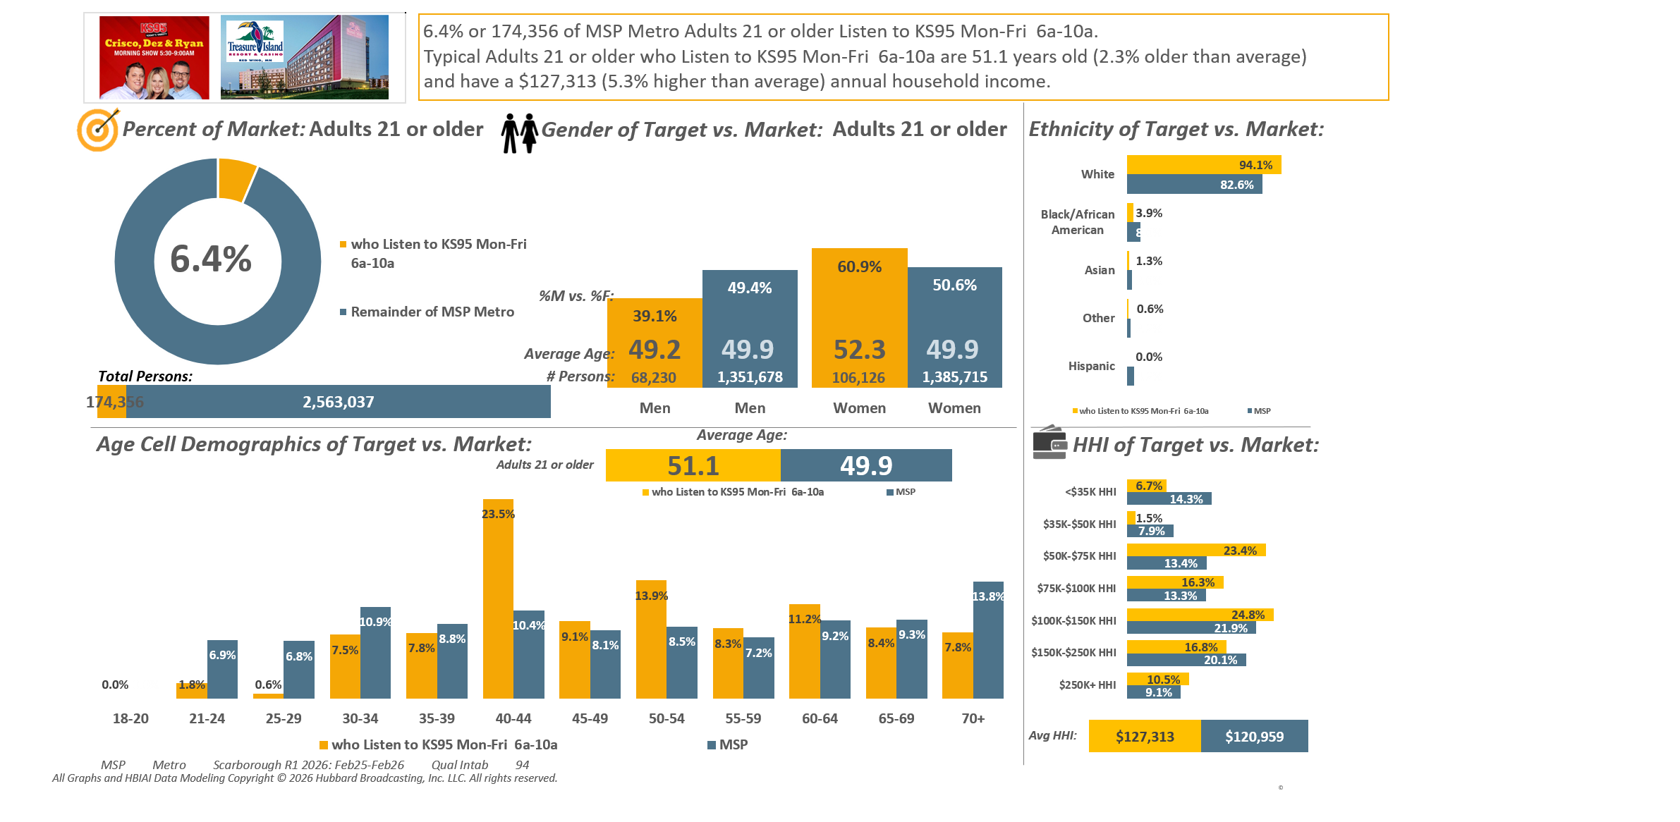
Note: For our Rankers we are going to use P35-64
M-F 6am-10am cume: KSTP-FM

Slide 4
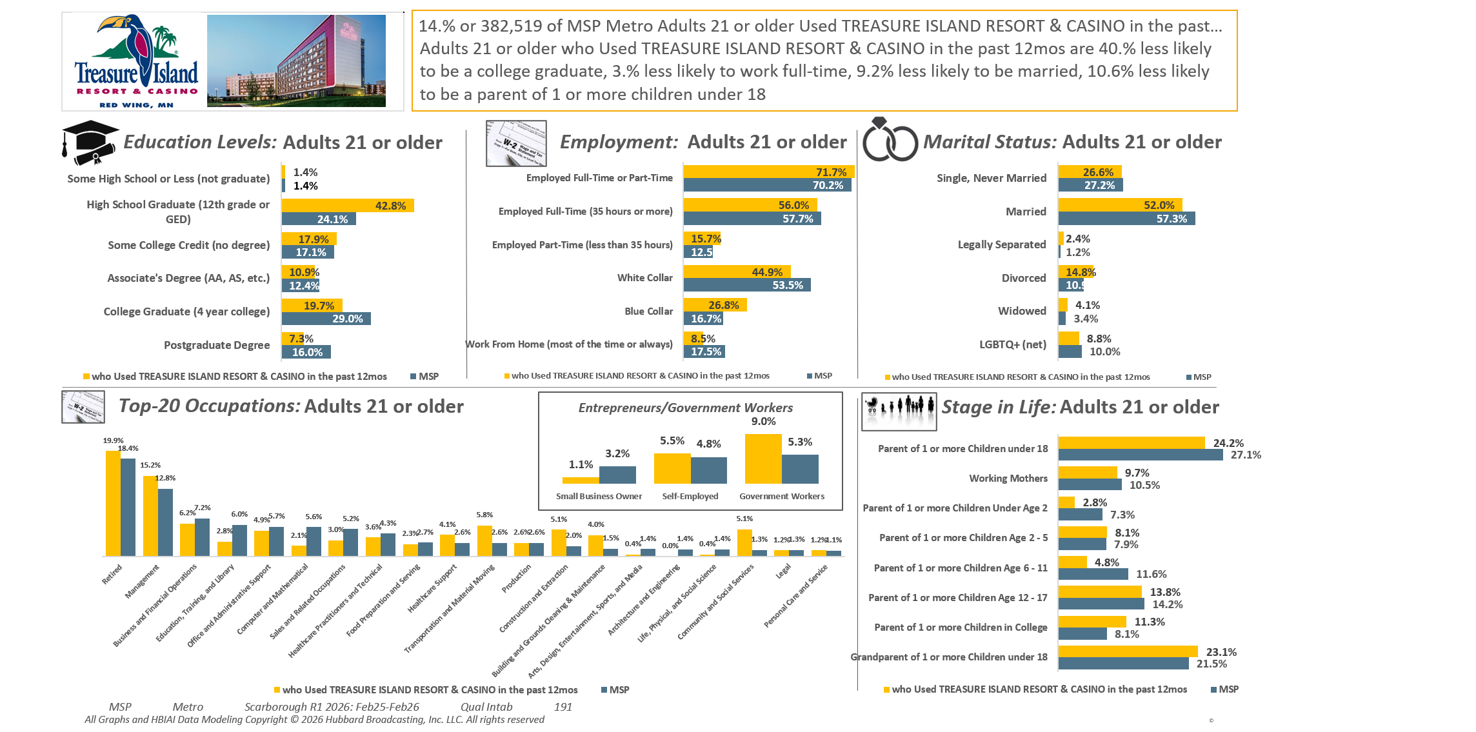
Casinos visited past 12 months (by name): Treasure Island Resort & Casino

Slide 5
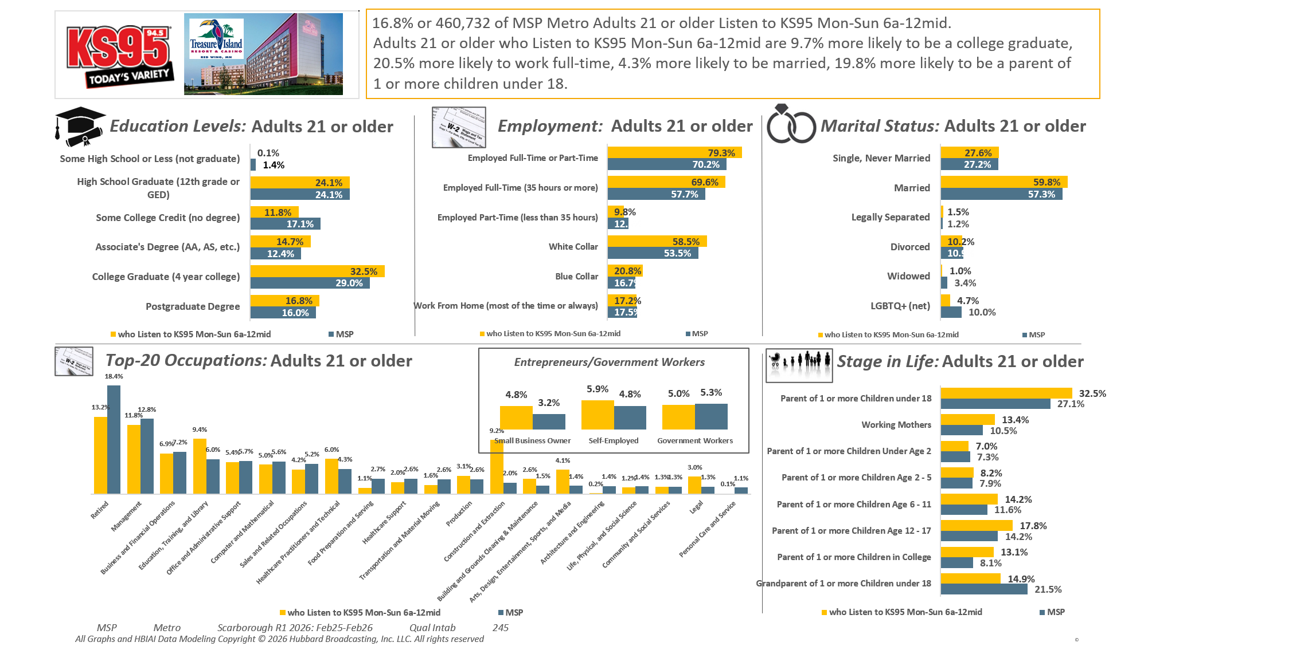
M-S 6am-mid cume: KSTP-FM

Slide 6
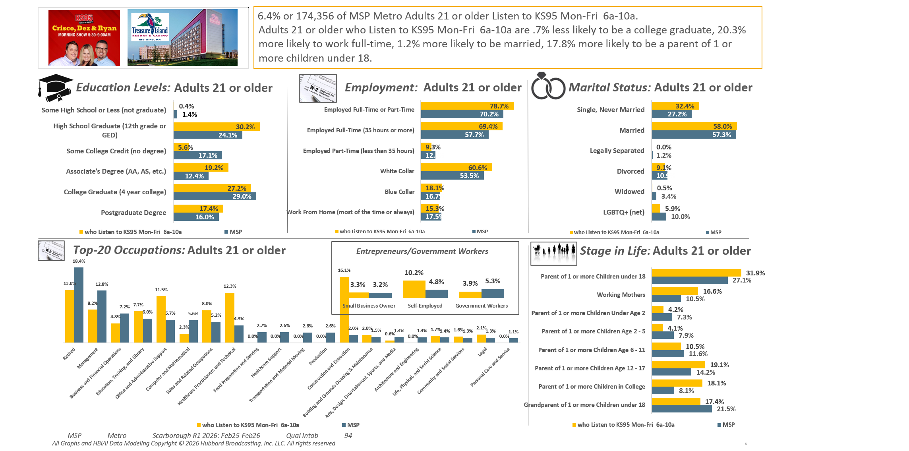
M-F 6am-10am cume: KSTP-FM

Slide 7
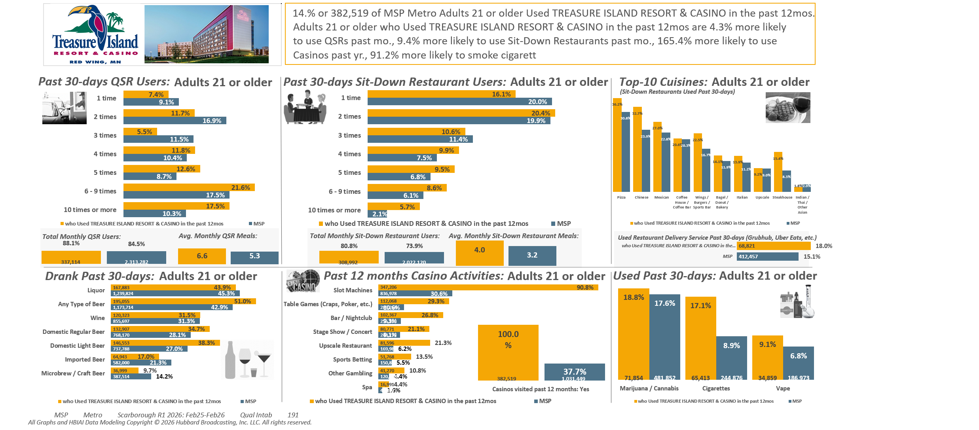
Casinos visited past 12 months (by name): Treasure Island Resort & Casino

Slide 8
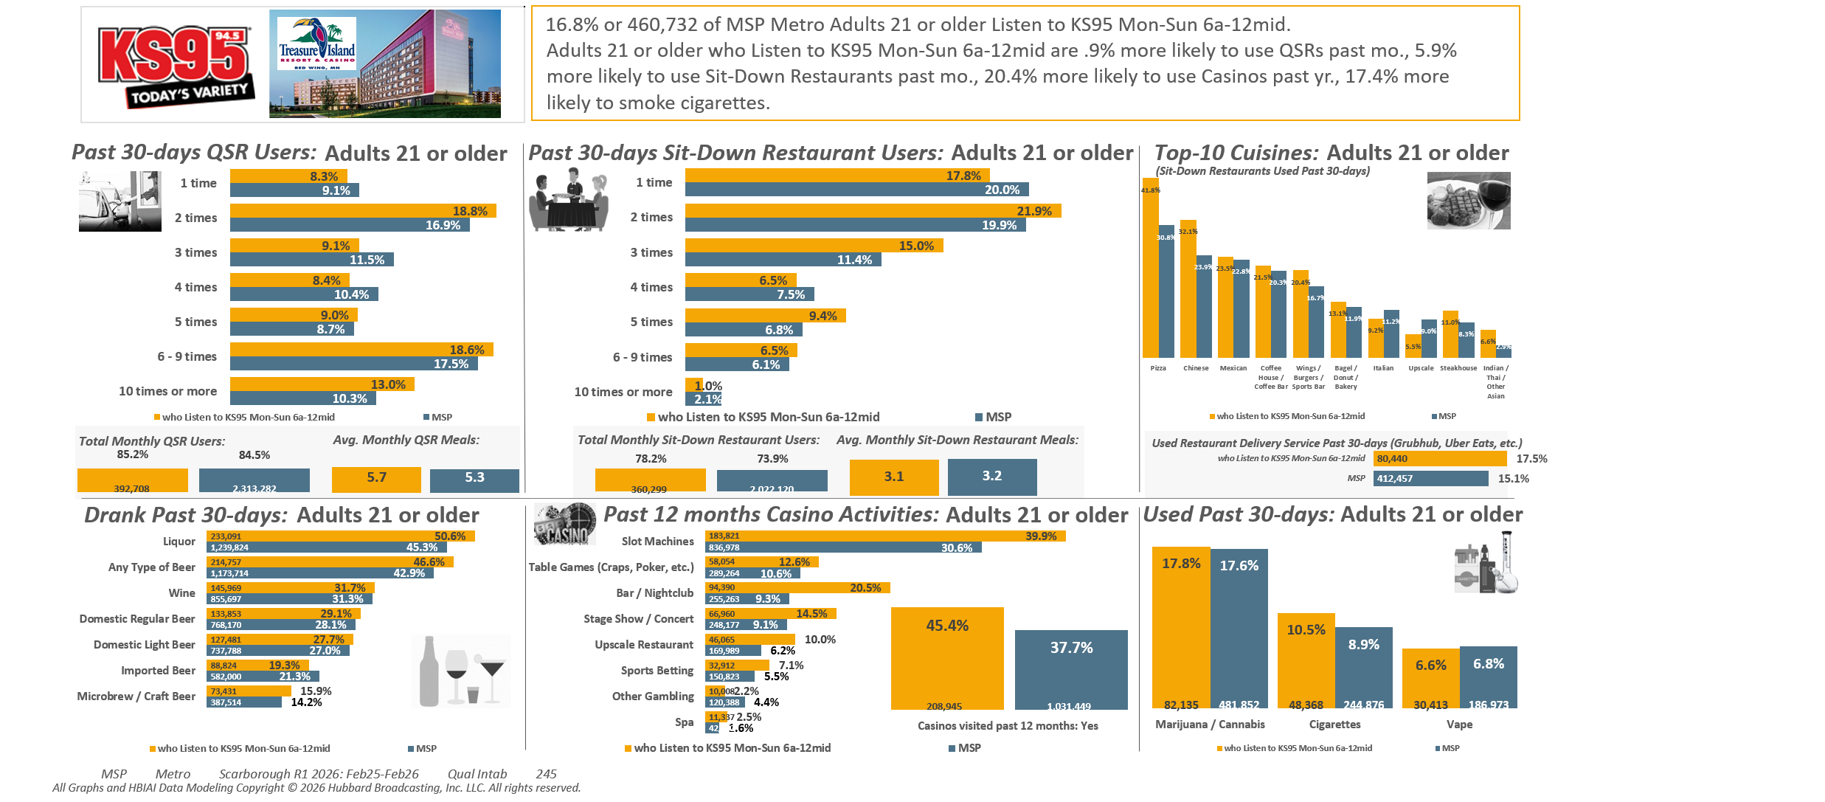
M-S 6am-mid cume: KSTP-FM

Slide 9
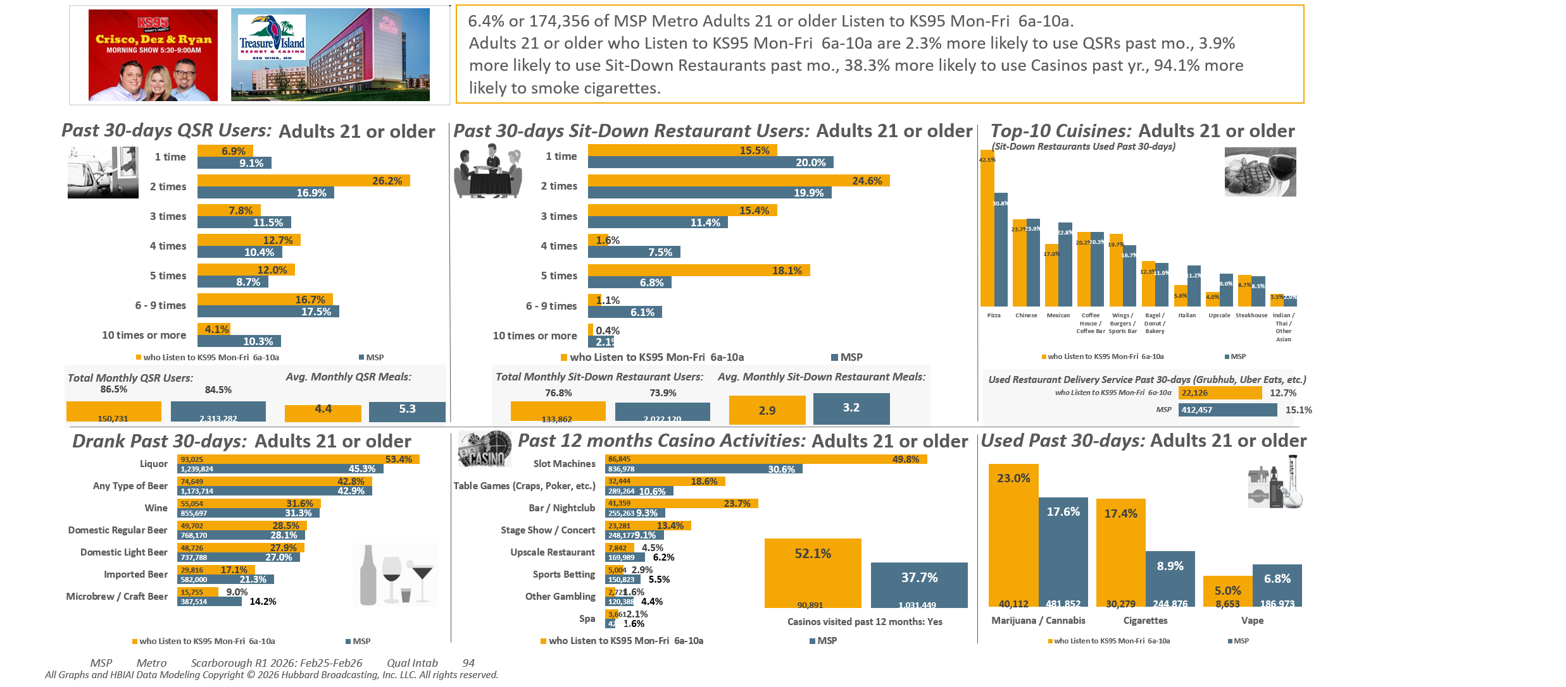

Slide 10

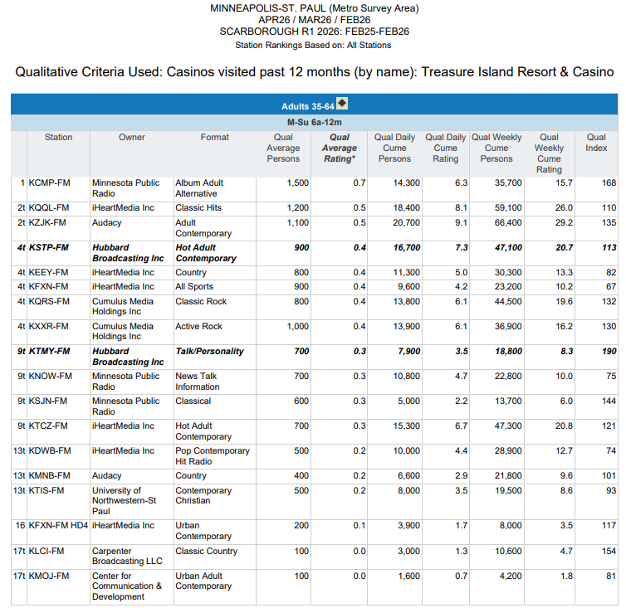

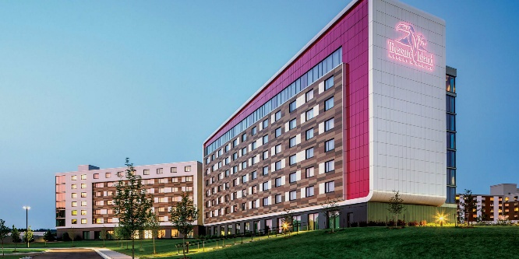

P35-64
Used TREASURE ISLAND RESORT & CASINO
in the past 12 months.
Mon-Sun 6a-12m

Slide 11
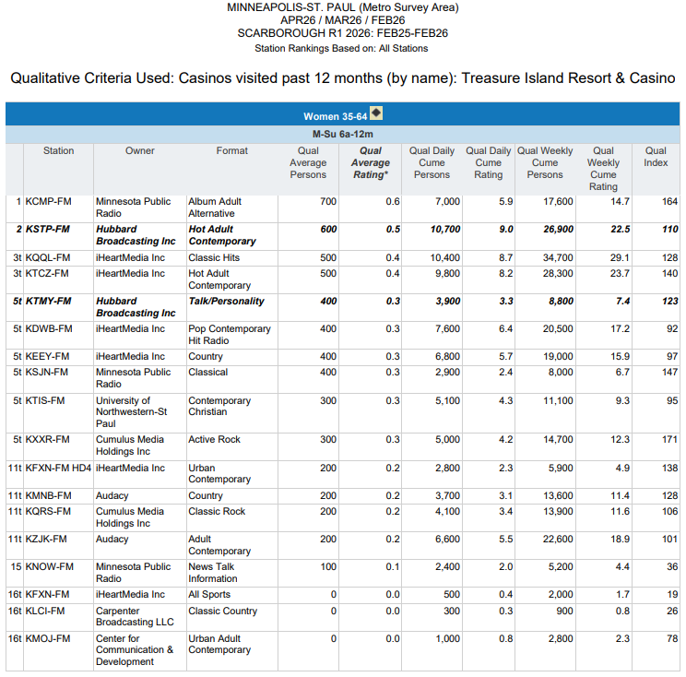
W35-64
Used TREASURE ISLAND RESORT & CASINO
in the past 12 months.
Mon-Sun 6a-12m

Slide 12
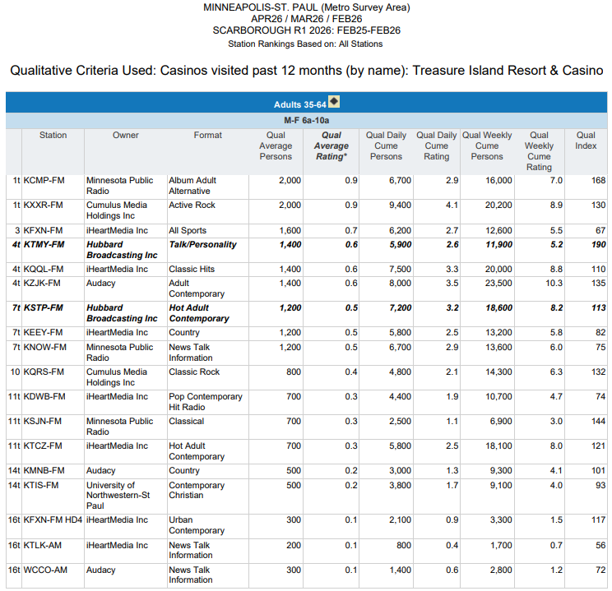
P35-64
Used TREASURE ISLAND RESORT & CASINO
in the past 12 months.
Mon-Fri 6a-10a

Slide 13
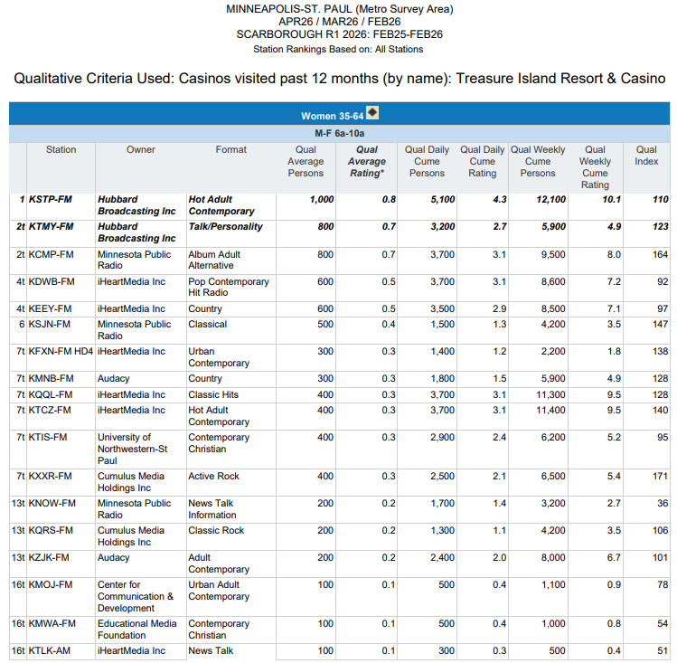
W35-64
Used TREASURE ISLAND RESORT & CASINO
in the past 12 months.
Mon-Fri 6a-10a

Slide 14
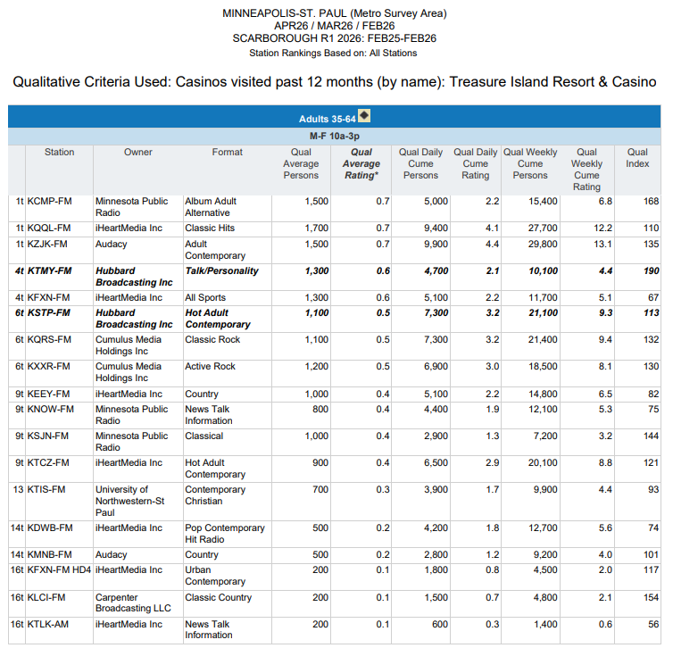
P35-64
Used TREASURE ISLAND RESORT & CASINO
in the past 12 months.
Mon-Fri 10a-3p

Slide 15
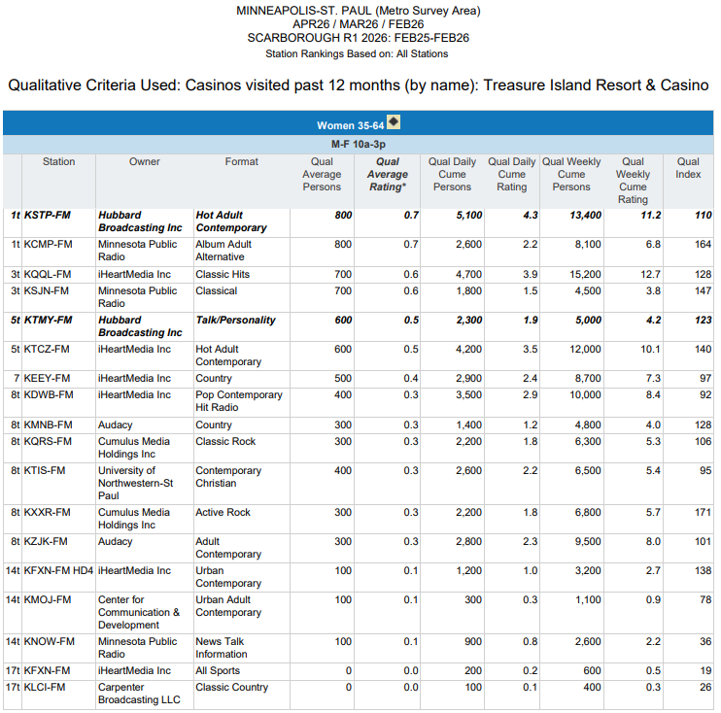
W35-64
Used TREASURE ISLAND RESORT & CASINO
in the past 12 months.
Mon-Fri 10a-3p

Slide 16
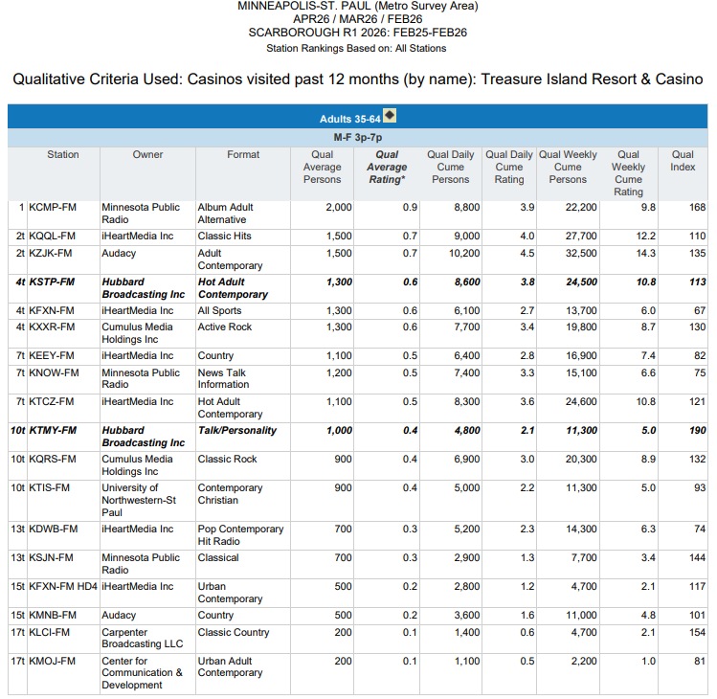
P35-64
Used TREASURE ISLAND RESORT & CASINO
in the past 12 months.
Mon-Fri 3p-7p

Slide 17
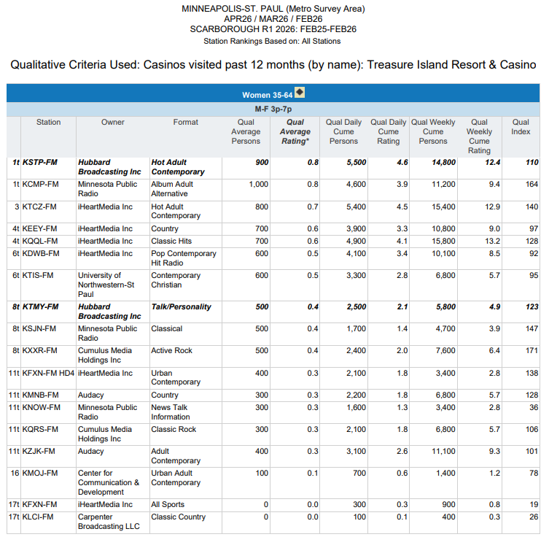
W35-64
Used TREASURE ISLAND RESORT & CASINO
in the past 12 months.
Mon-Fri 3p-7p

Slide 18
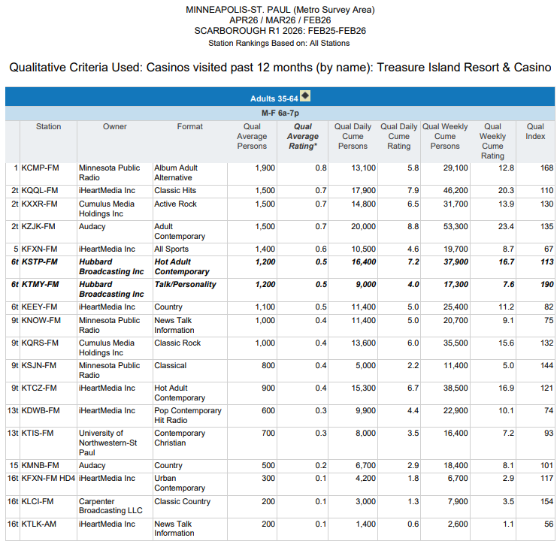
P35-64
Used TREASURE ISLAND RESORT & CASINO
in the past 12 months.
Mon-Fri 6a-7p

Slide 19
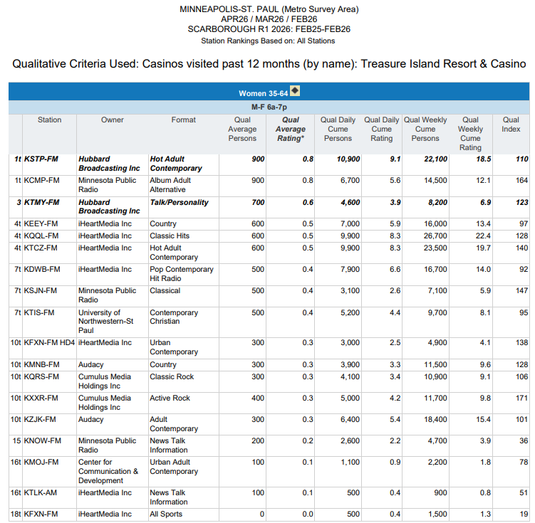
W35-64
Used TREASURE ISLAND RESORT & CASINO
in the past 12 months.
Mon-Fri 6a-7p

Slide 20
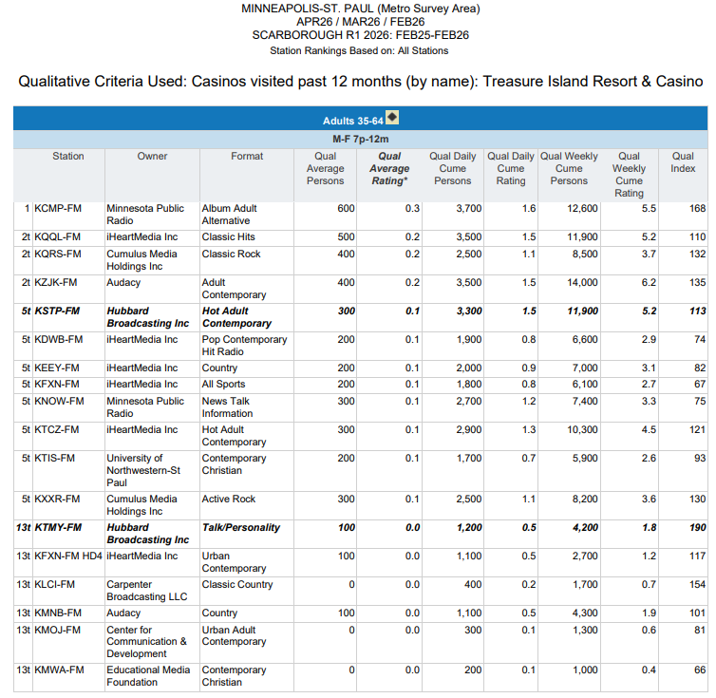
P35-64
Used TREASURE ISLAND RESORT & CASINO
in the past 12 months.
Mon-Fri 7p-12m

Slide 21
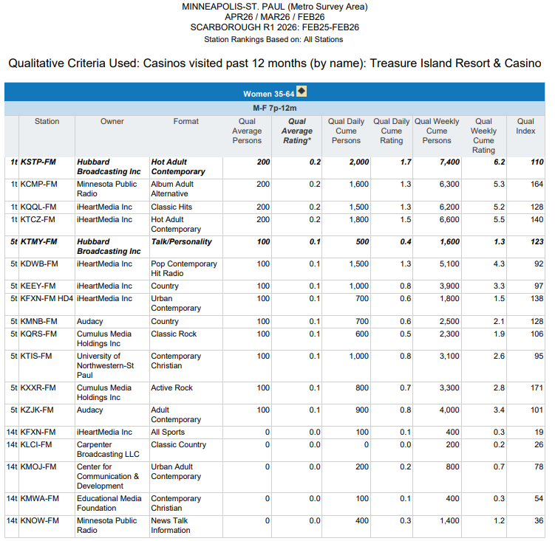
W35-64
Used TREASURE ISLAND RESORT & CASINO
in the past 12 months.
Mon-Fri 7p-12m

Slide 22
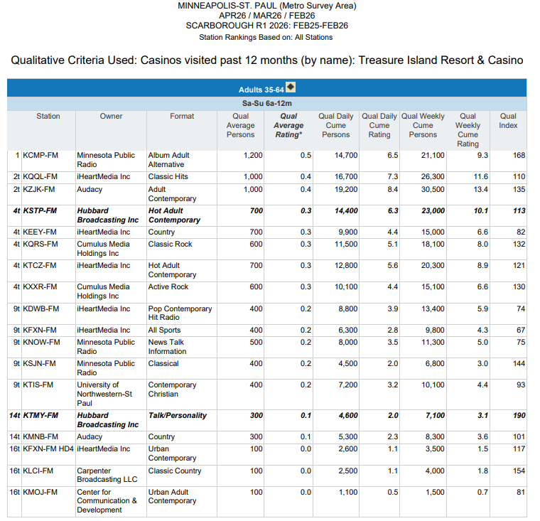
P35-64
Used TREASURE ISLAND RESORT & CASINO
in the past 12 months.
Weekends

Slide 23
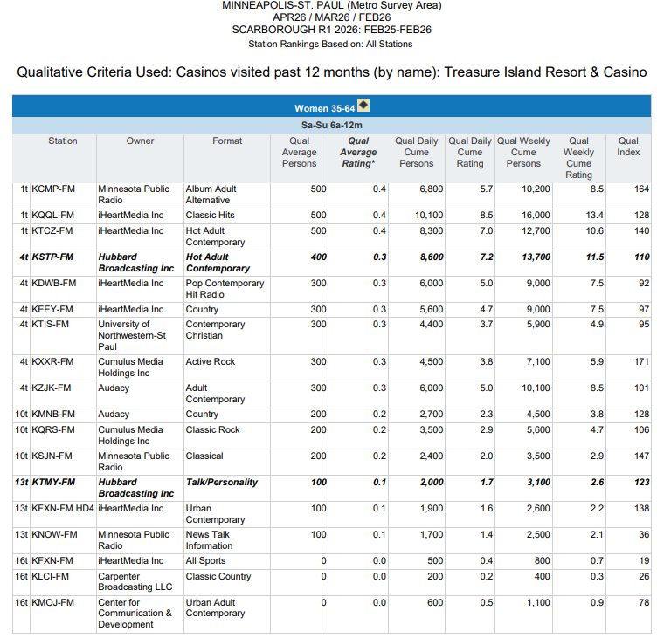
W35-64
Used TREASURE ISLAND RESORT & CASINO
in the past 12 months.
Weekends

Slide 24

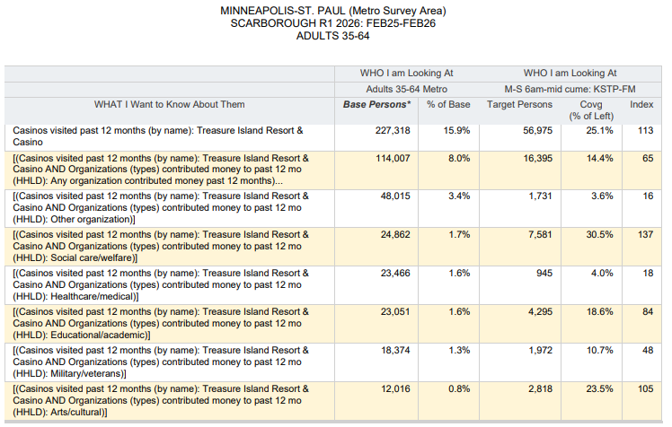
30.5% of P35-64 past 12 months TREASURE
ISLAND RESORT & CASINO Users who GIVE
MONEY to Social Care/Welfare Charities
Listen to KS95 every week (Index 137).

