Slide 1

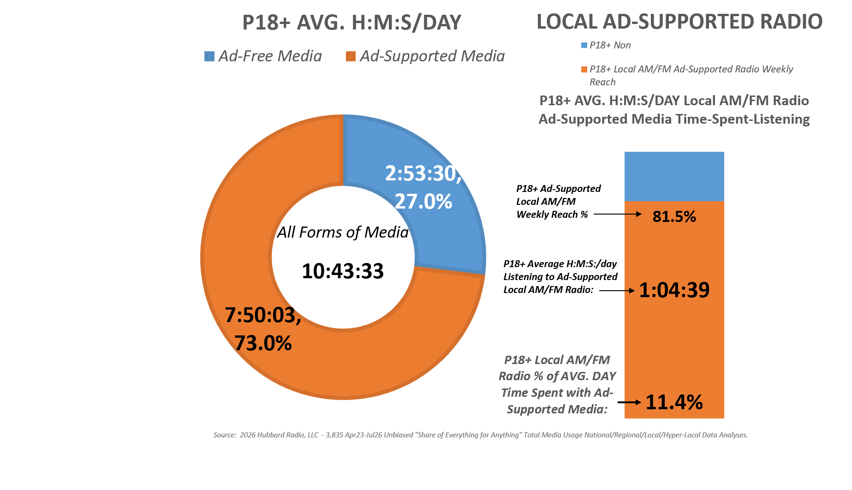
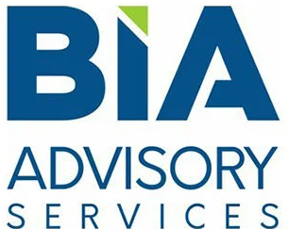
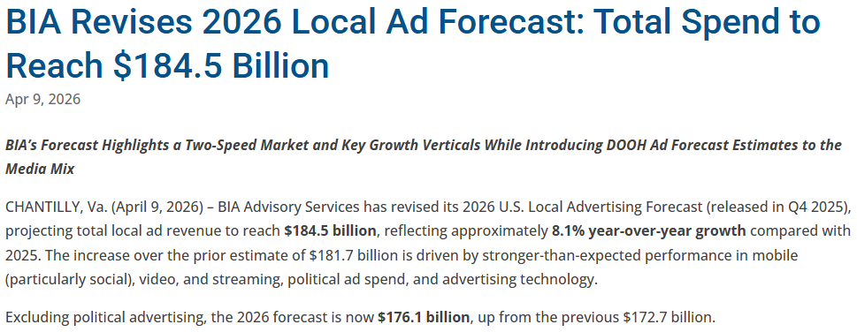
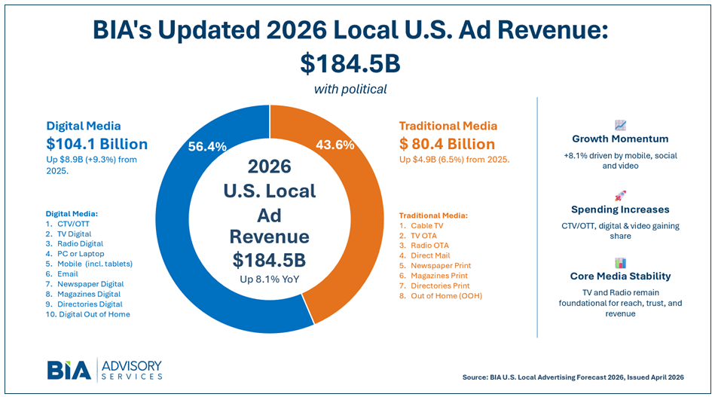

Average of
3,835 Decks
As of: 6 PM:
07/31/2026
Local Radio:
$10 Billion (excl. “Radio Digital”)
= 6% of Ad Spend

