Slide 1
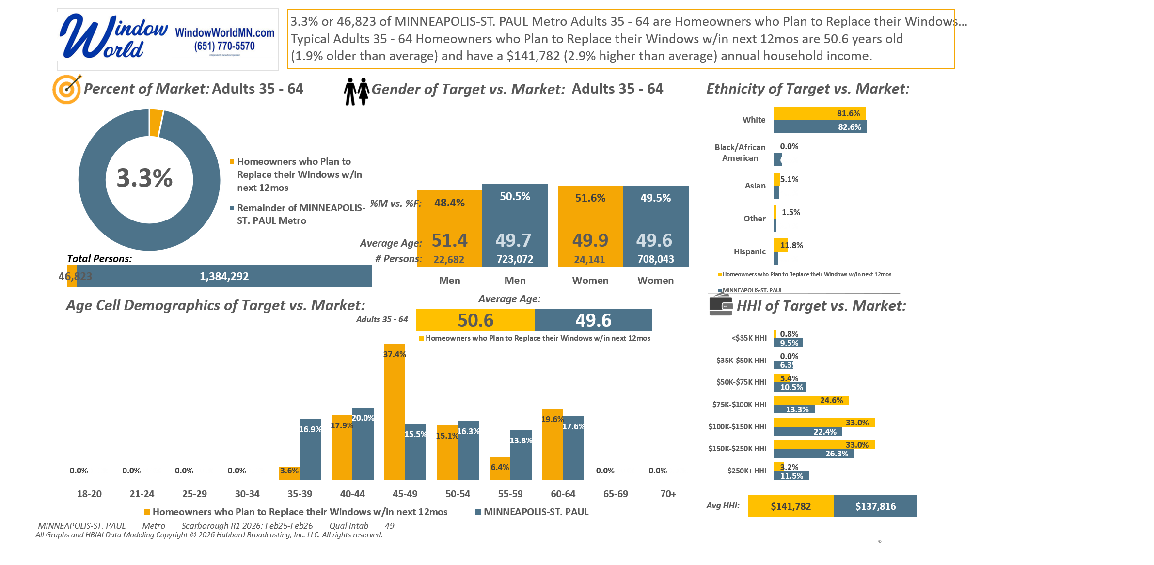





[((Own or rent residence (HHLD): Own AND (Type of dwelling (HHLD): Single family house (unattached) OR Type of dwelling (HHLD): Townhouse or attached home)) AND Type of home improvement plan to do next 12 months (HHLD): Replace windows or doors)]

Slide 2
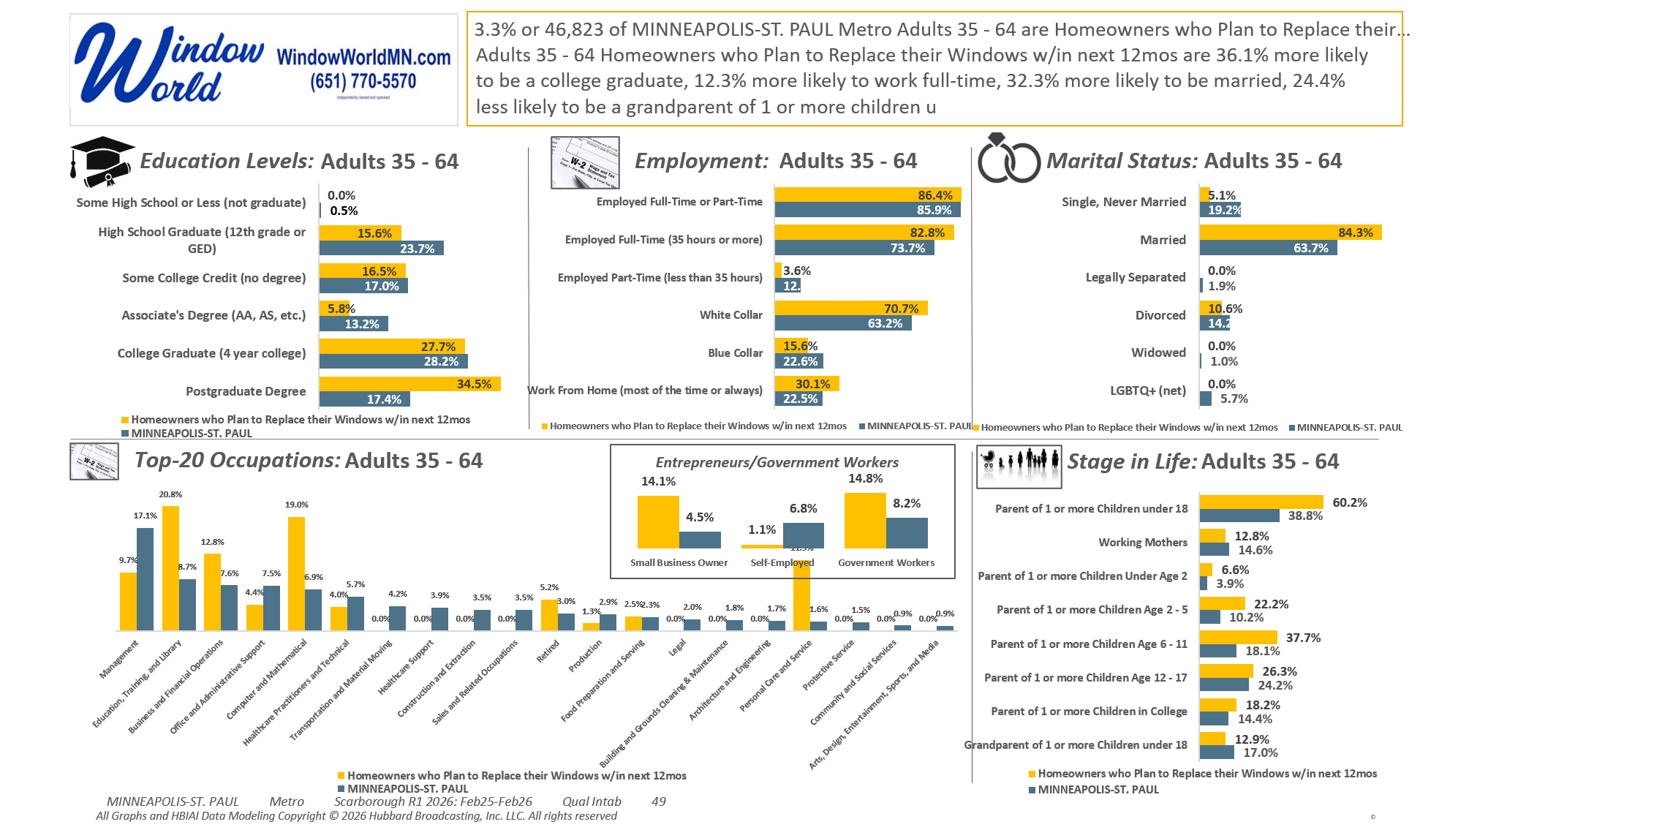
[((Own or rent residence (HHLD): Own AND (Type of dwelling (HHLD): Single family house (unattached) OR Type of dwelling (HHLD): Townhouse or attached home)) AND Type of home improvement plan to do next 12 months (HHLD): Replace windows or doors)]

Slide 3
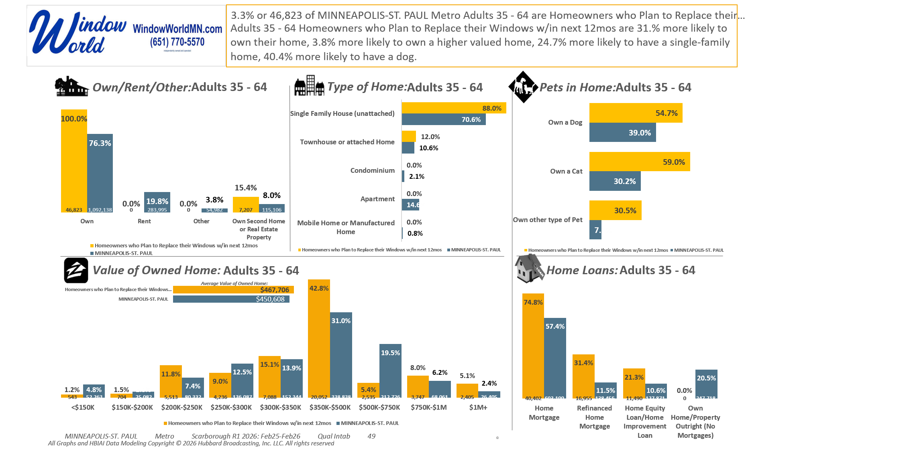
[((Own or rent residence (HHLD): Own AND (Type of dwelling (HHLD): Single family house (unattached) OR Type of dwelling (HHLD): Townhouse or attached home)) AND Type of home improvement plan to do next 12 months (HHLD): Replace windows or doors)]

Slide 4
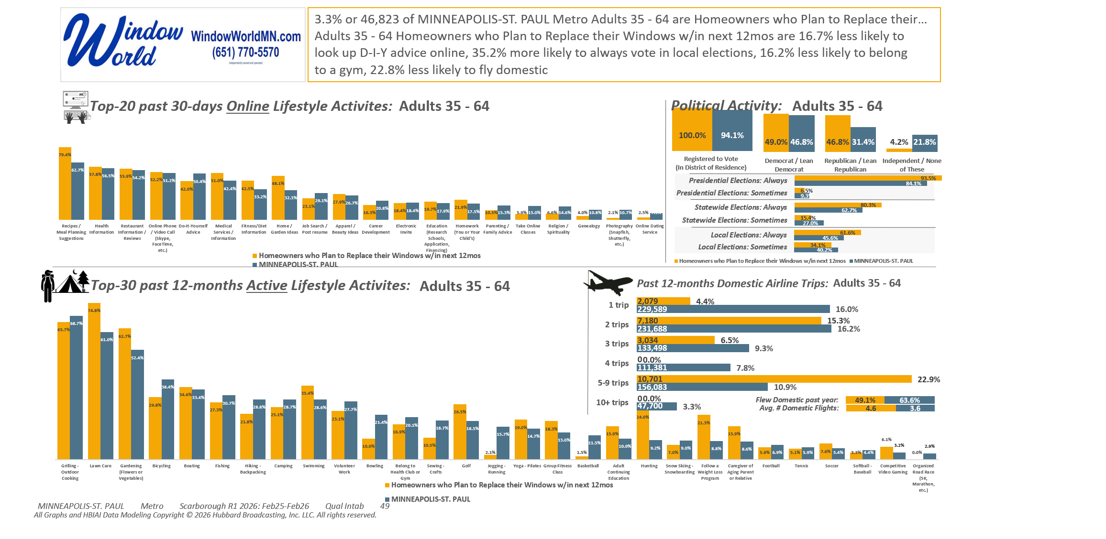
[((Own or rent residence (HHLD): Own AND (Type of dwelling (HHLD): Single family house (unattached) OR Type of dwelling (HHLD): Townhouse or attached home)) AND Type of home improvement plan to do next 12 months (HHLD): Replace windows or doors)]

Slide 5
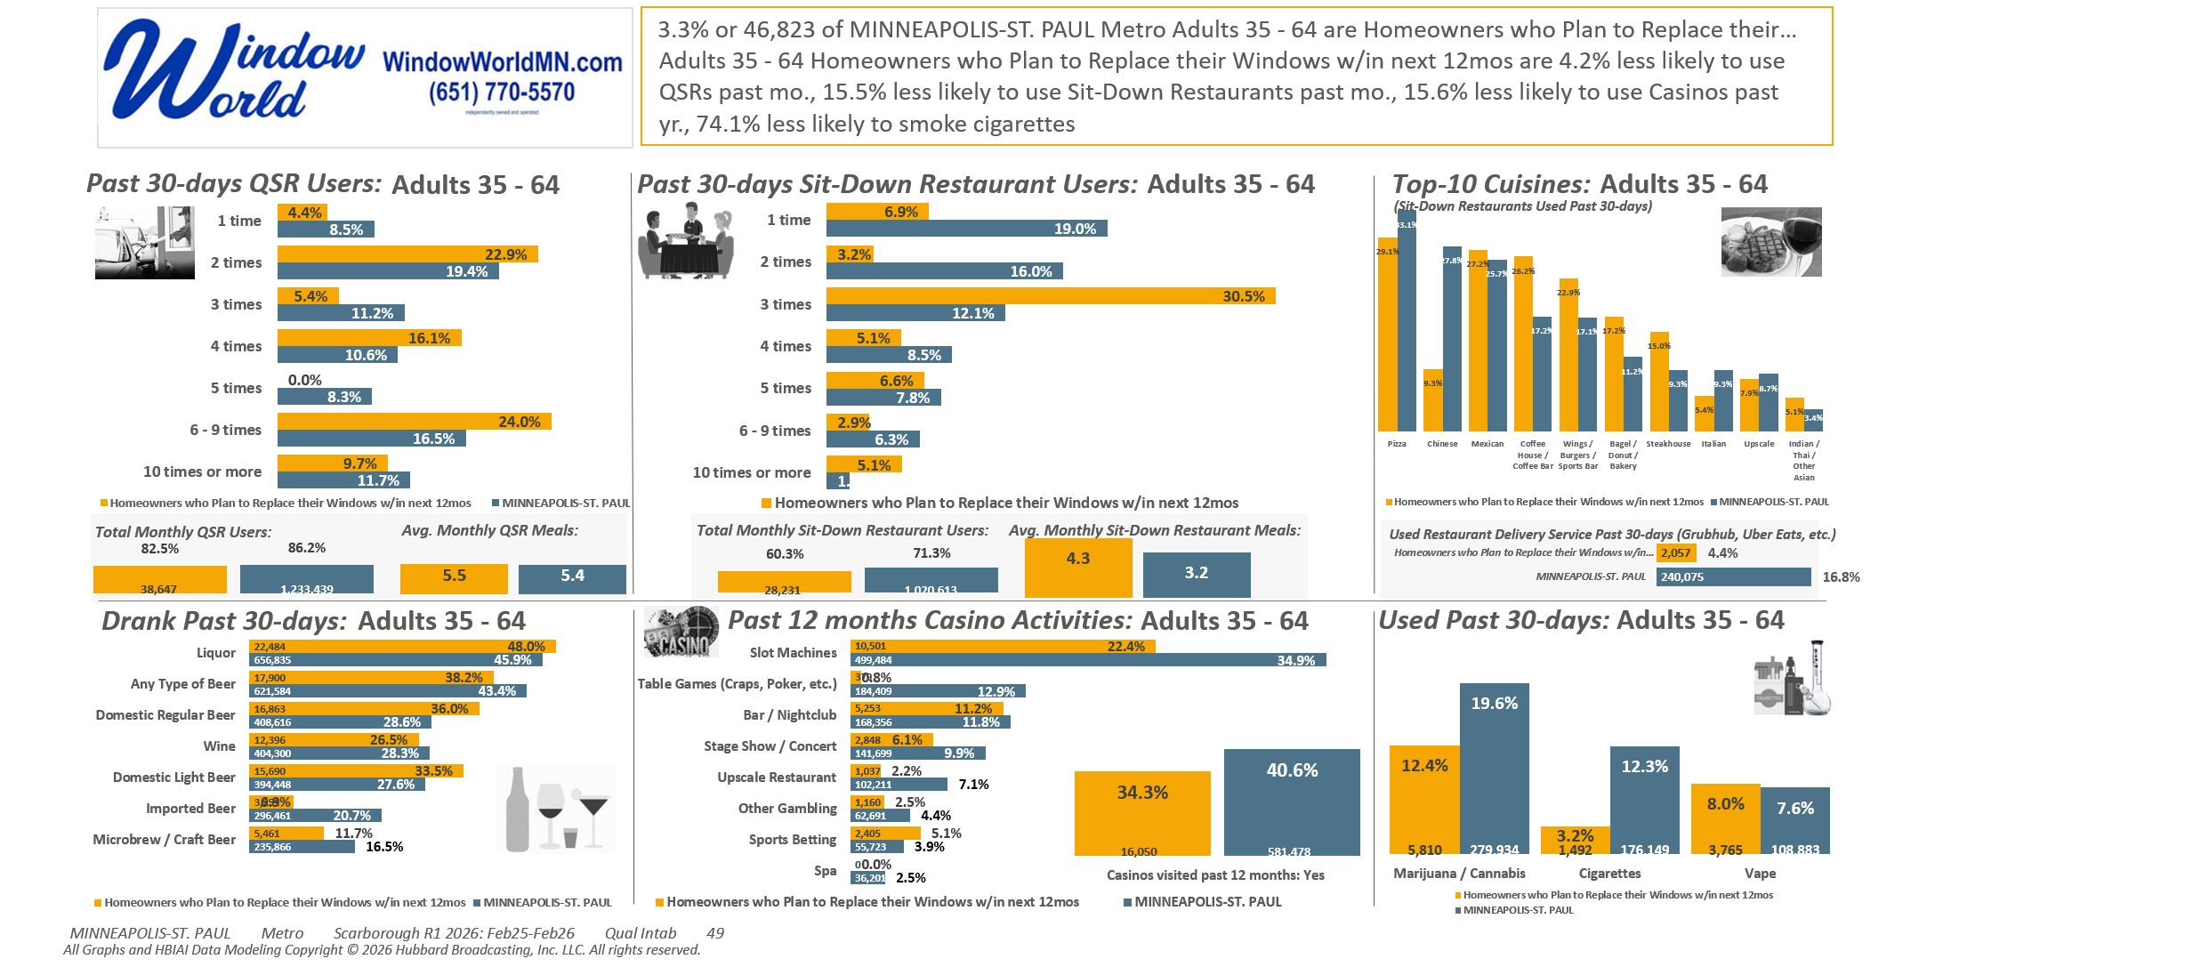
[((Own or rent residence (HHLD): Own AND (Type of dwelling (HHLD): Single family house (unattached) OR Type of dwelling (HHLD): Townhouse or attached home)) AND Type of home improvement plan to do next 12 months (HHLD): Replace windows or doors)]

Slide 6
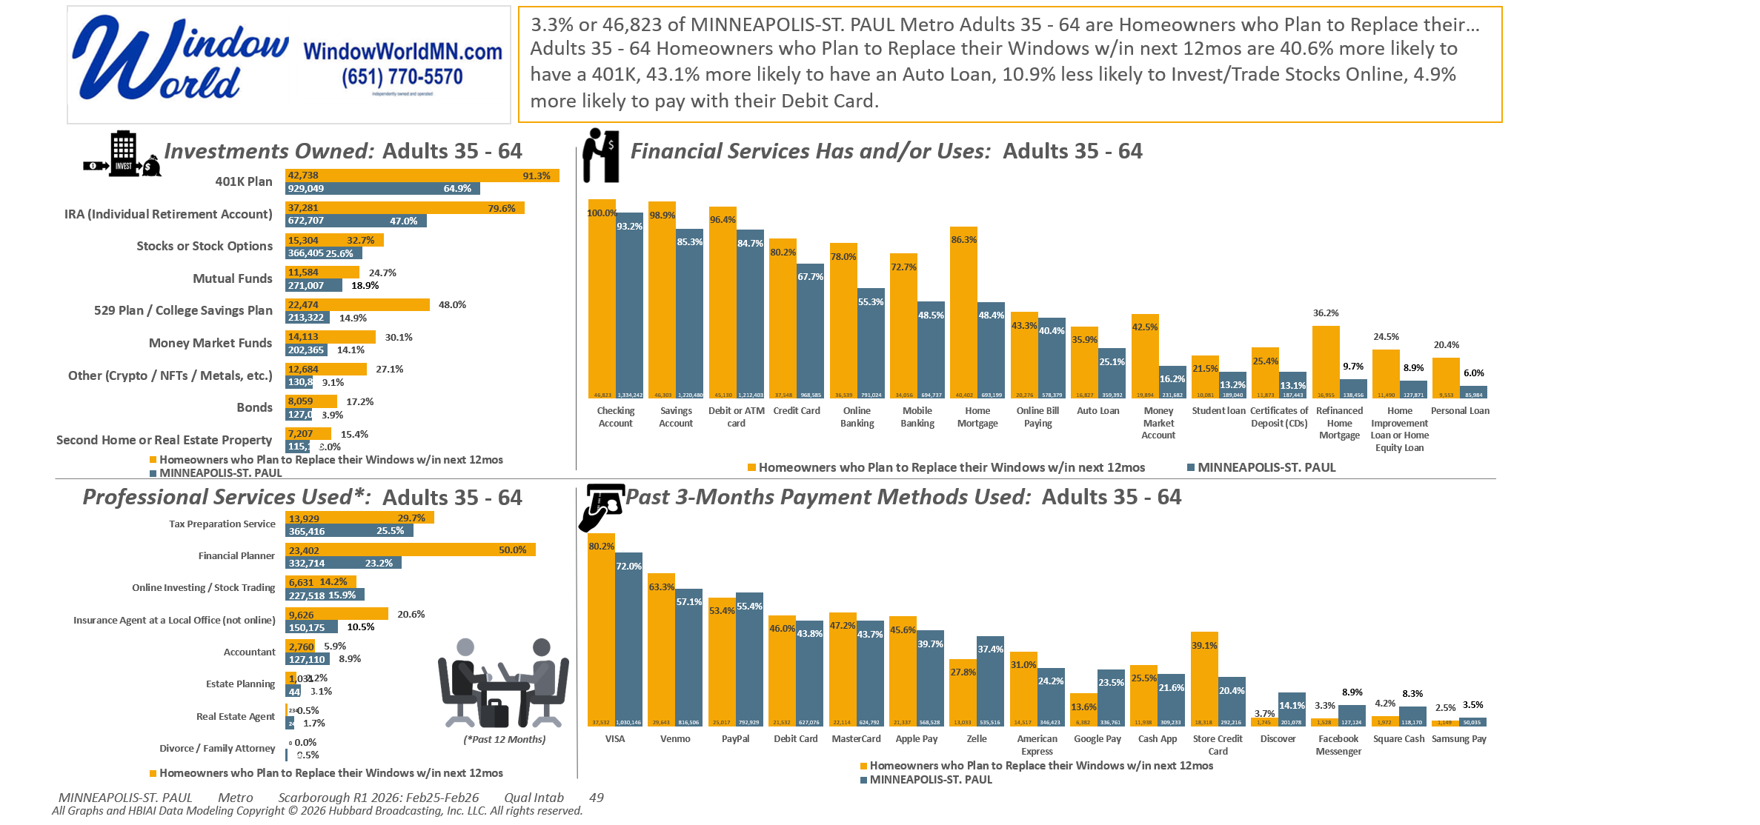
[((Own or rent residence (HHLD): Own AND (Type of dwelling (HHLD): Single family house (unattached) OR Type of dwelling (HHLD): Townhouse or attached home)) AND Type of home improvement plan to do next 12 months (HHLD): Replace windows or doors)]

Slide 7
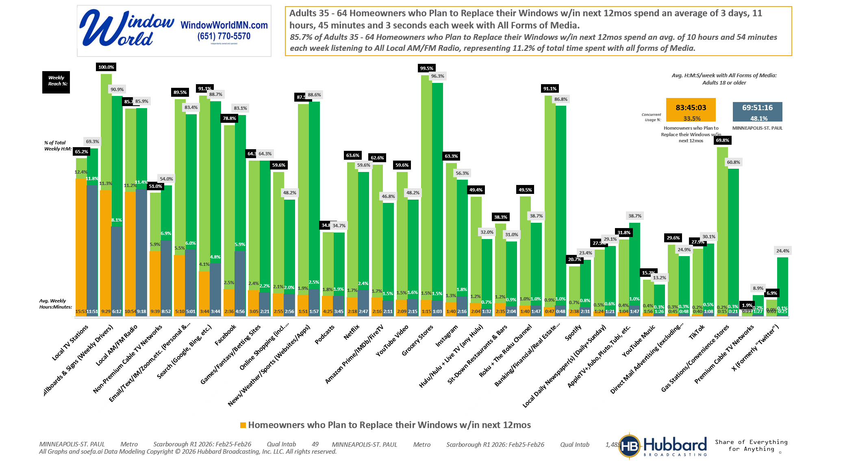
[((Own or rent residence (HHLD): Own AND (Type of dwelling (HHLD): Single family house (unattached) OR Type of dwelling (HHLD): Townhouse or attached home)) AND Type of home improvement plan to do next 12 months (HHLD): Replace windows or doors)]

Slide 8
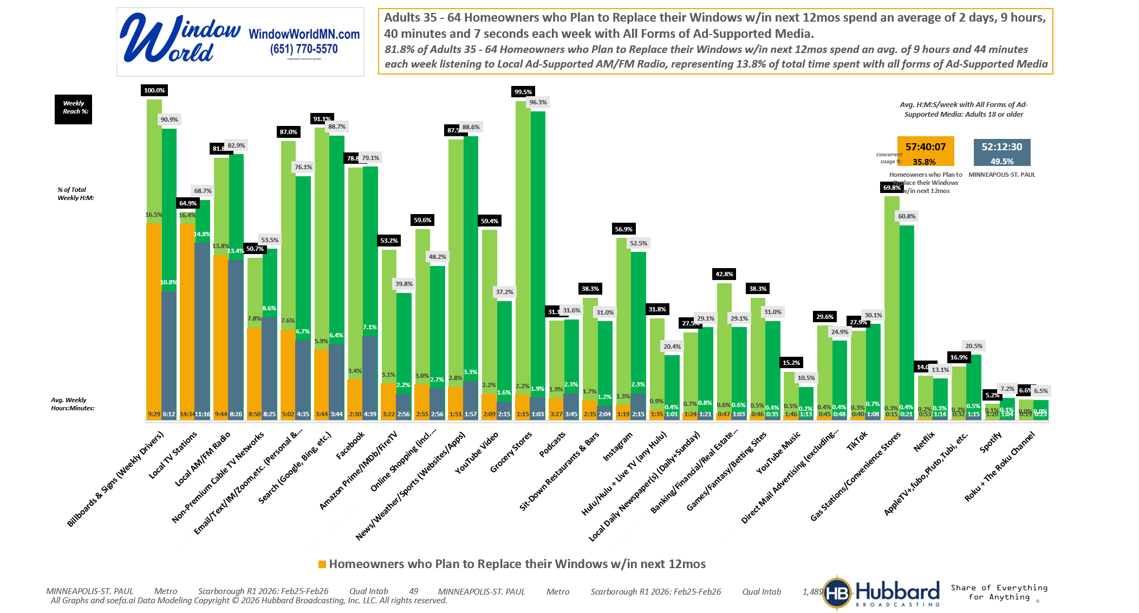
[((Own or rent residence (HHLD): Own AND (Type of dwelling (HHLD): Single family house (unattached) OR Type of dwelling (HHLD): Townhouse or attached home)) AND Type of home improvement plan to do next 12 months (HHLD): Replace windows or doors)]

Slide 9
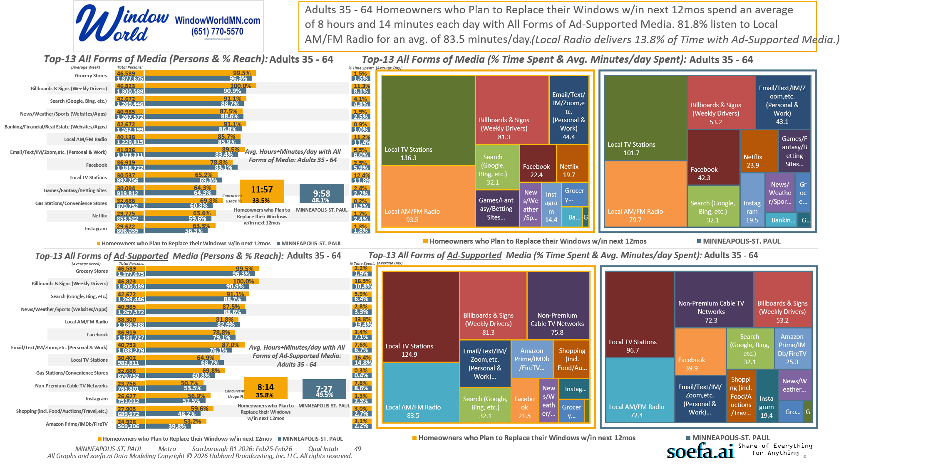
[((Own or rent residence (HHLD): Own AND (Type of dwelling (HHLD): Single family house (unattached) OR Type of dwelling (HHLD): Townhouse or attached home)) AND Type of home improvement plan to do next 12 months (HHLD): Replace windows or doors)]

Slide 10
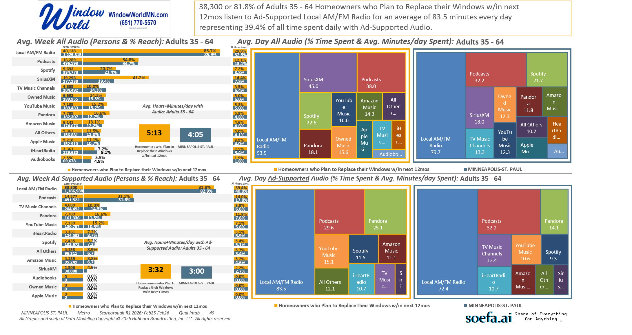
[((Own or rent residence (HHLD): Own AND (Type of dwelling (HHLD): Single family house (unattached) OR Type of dwelling (HHLD): Townhouse or attached home)) AND Type of home improvement plan to do next 12 months (HHLD): Replace windows or doors)]

Slide 11
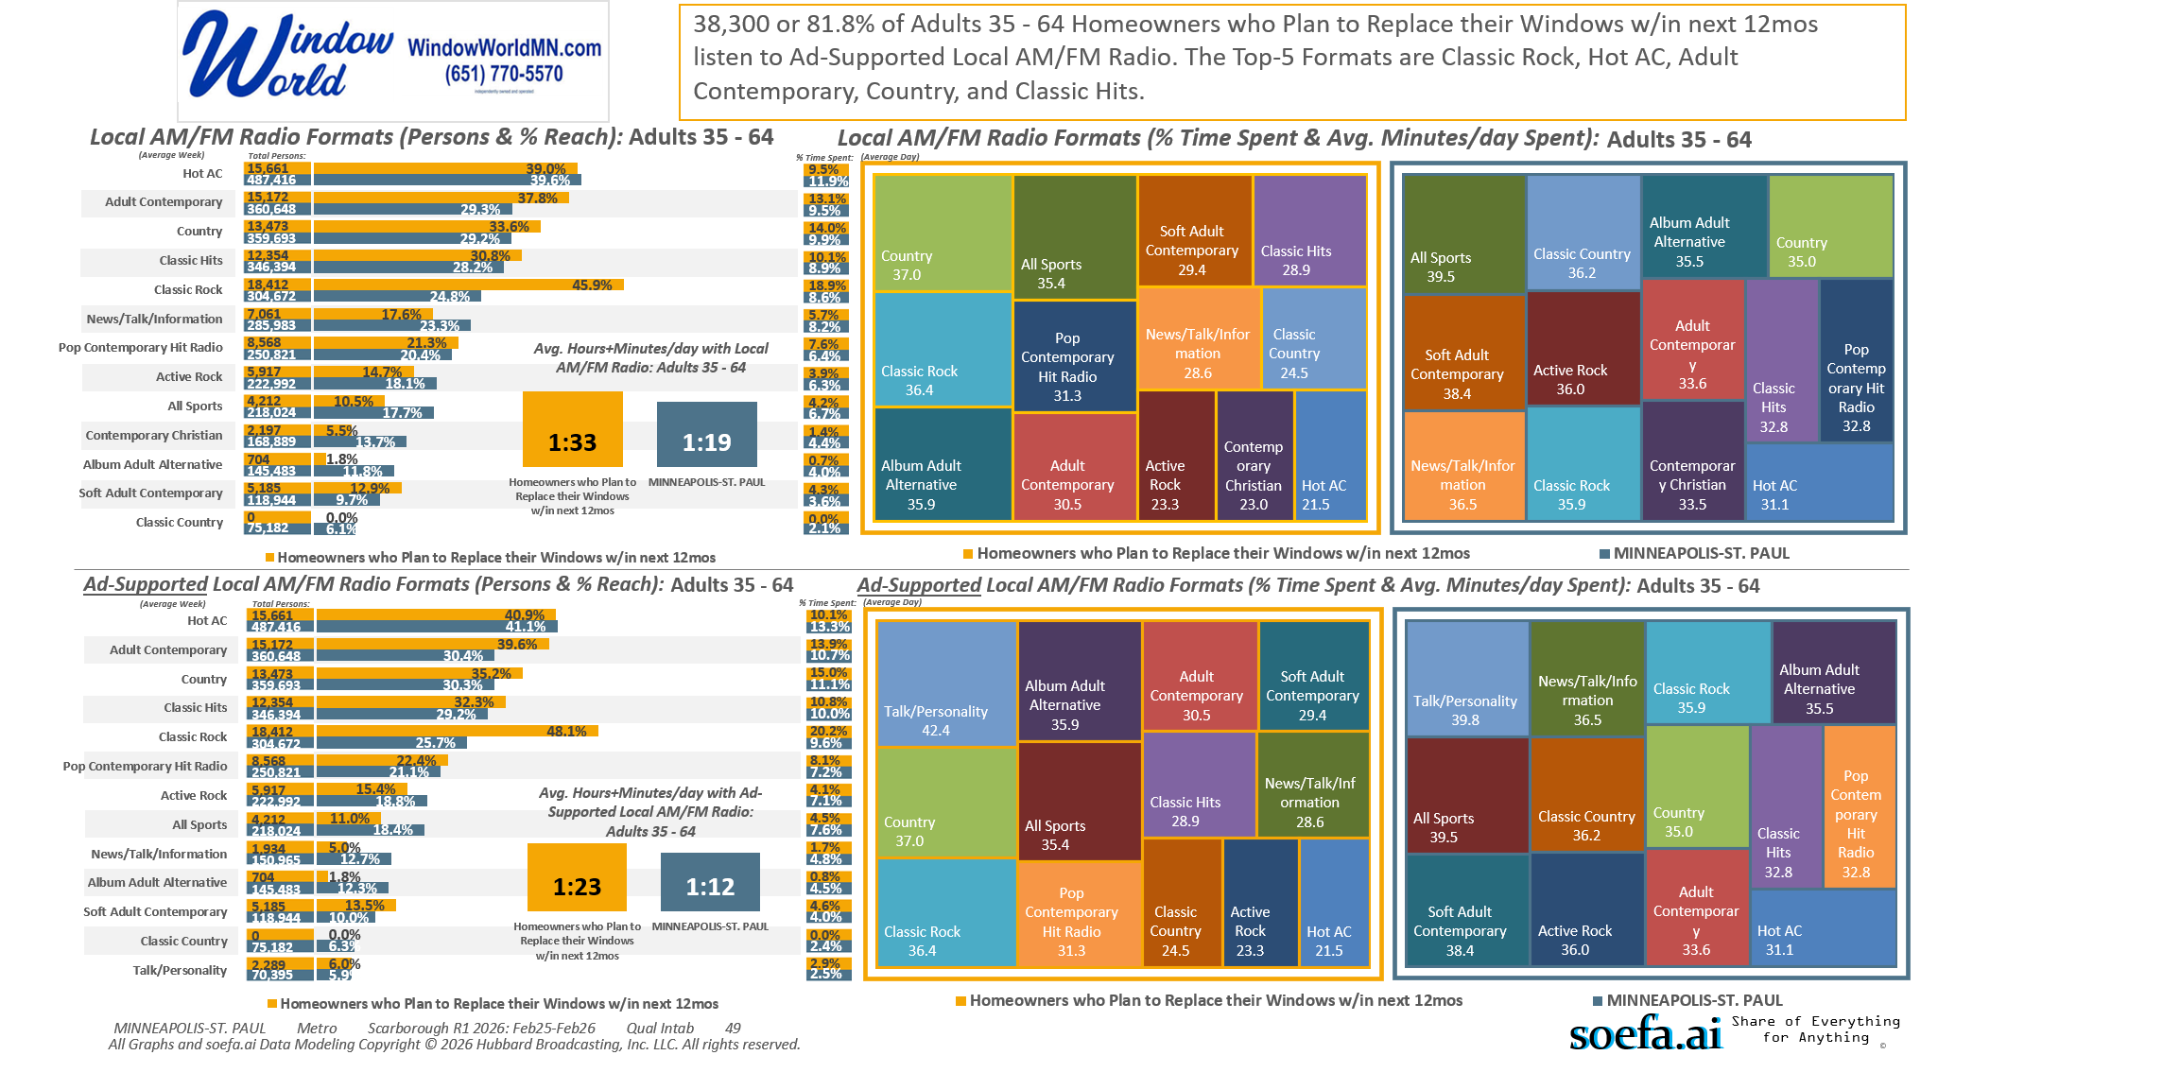
[((Own or rent residence (HHLD): Own AND (Type of dwelling (HHLD): Single family house (unattached) OR Type of dwelling (HHLD): Townhouse or attached home)) AND Type of home improvement plan to do next 12 months (HHLD): Replace windows or doors)]

Slide 12
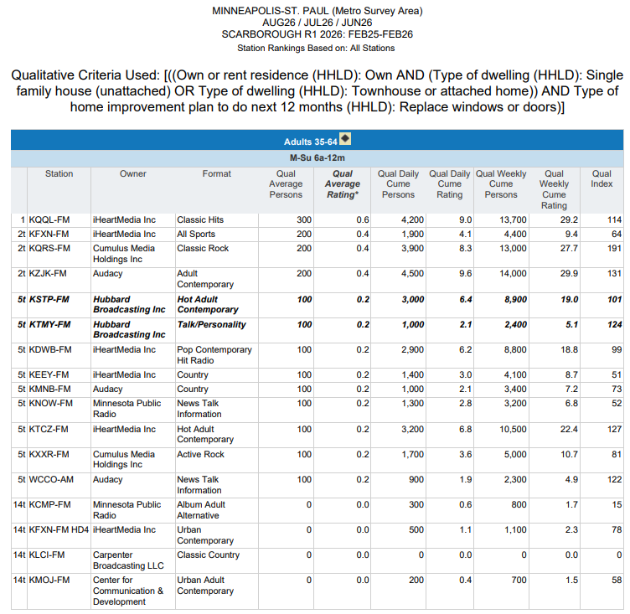


Top Radio Stations reaching...
Twin Cities Metro Area P35-64 who are…
Homeowners and… Plan to Replace their
WINDOWS in the next 12 months.
(Note: Insufficient Sample Size to Run this Report based on W35-64)
[((Own or rent residence (HHLD): Own AND (Type of dwelling (HHLD): Single family house (unattached) OR Type of dwelling (HHLD): Townhouse or attached home)) AND Type of home improvement plan to do next 12 months (HHLD): Replace windows or doors)]

Slide 13
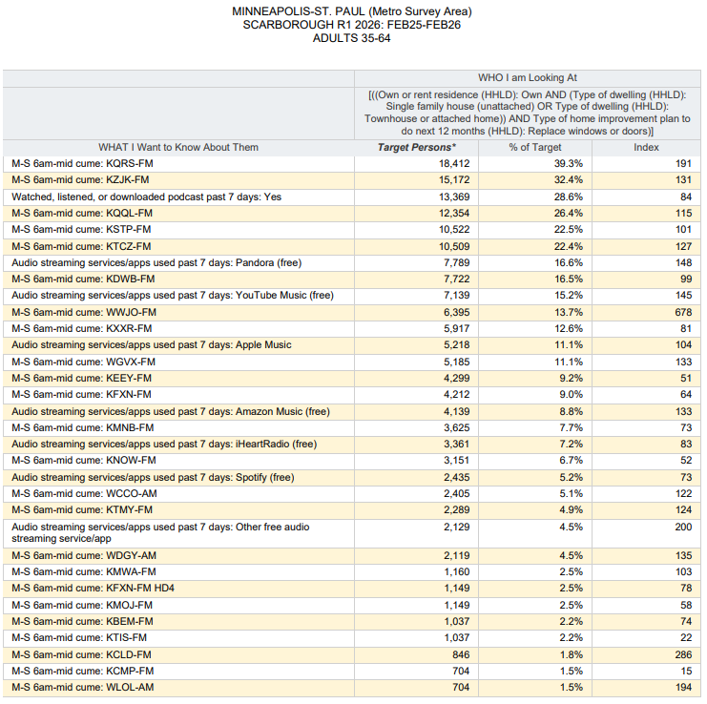
Top Audio Media reaching...
Twin Cities Metro Area P35-64 who are…
Homeowners and… Plan to Replace their
WINDOWS in the next 12 months.
(Note: Insufficient Sample Size to Run this Report based on W35-64)
[((Own or rent residence (HHLD): Own AND (Type of dwelling (HHLD): Single family house (unattached) OR Type of dwelling (HHLD): Townhouse or attached home)) AND Type of home improvement plan to do next 12 months (HHLD): Replace windows or doors)]

Slide 14
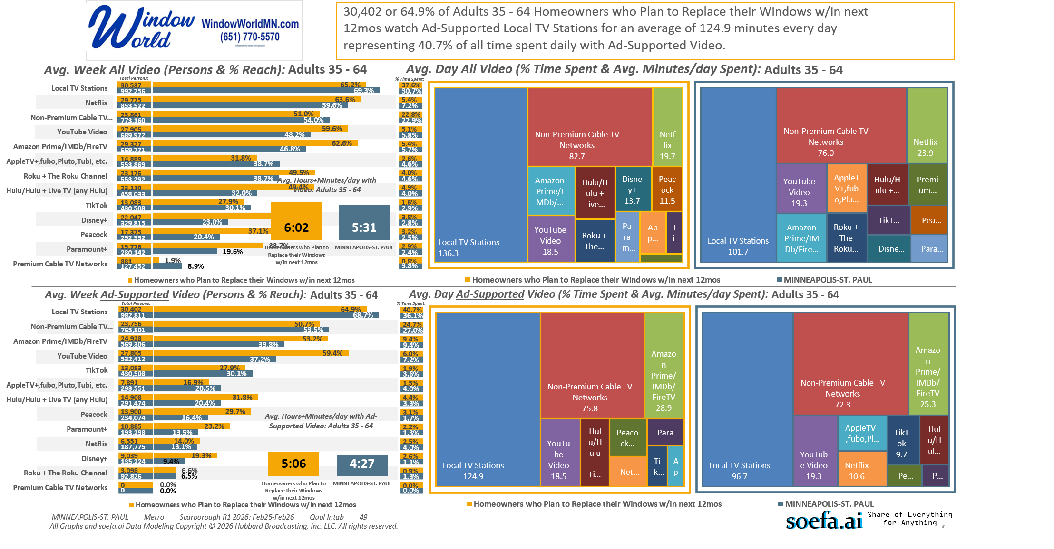
[((Own or rent residence (HHLD): Own AND (Type of dwelling (HHLD): Single family house (unattached) OR Type of dwelling (HHLD): Townhouse or attached home)) AND Type of home improvement plan to do next 12 months (HHLD): Replace windows or doors)]

Slide 15
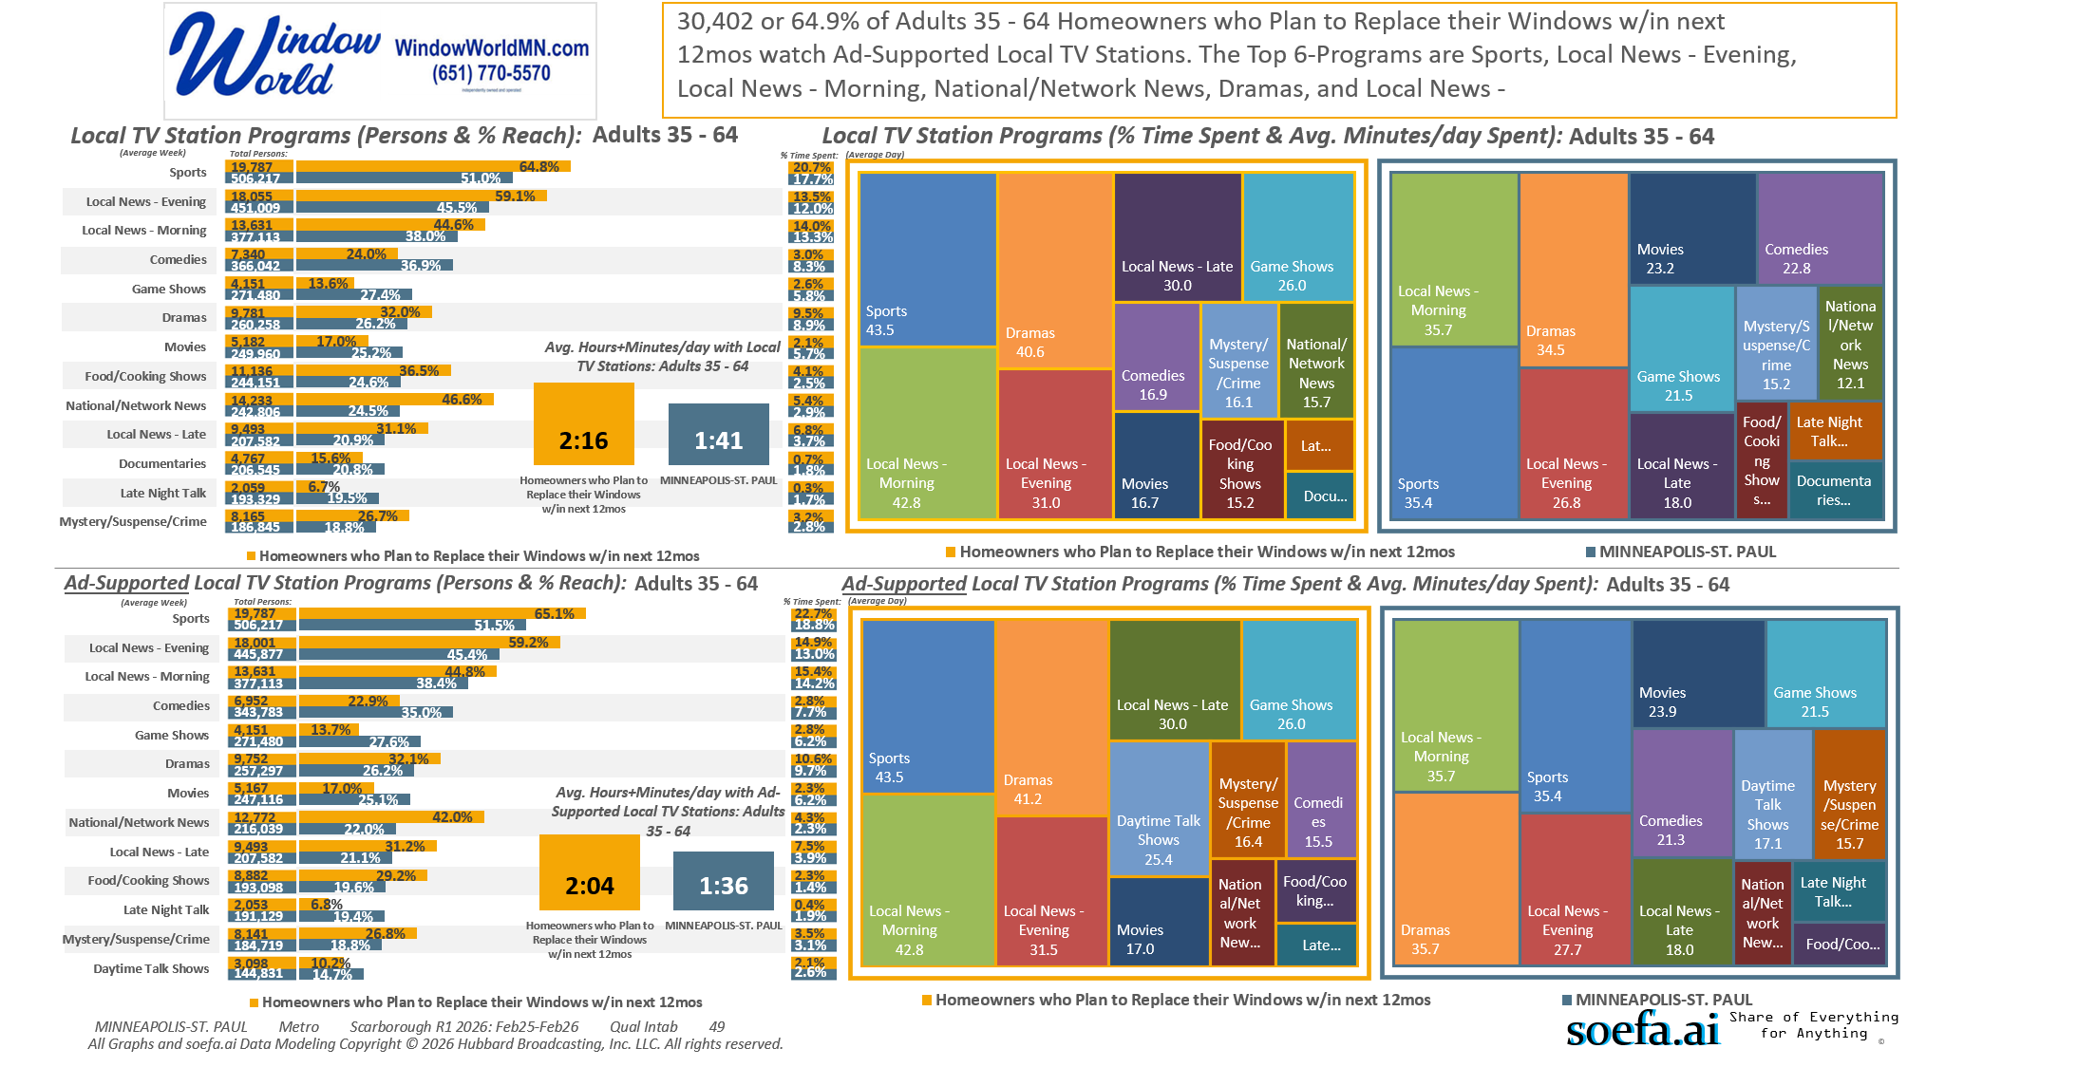
[((Own or rent residence (HHLD): Own AND (Type of dwelling (HHLD): Single family house (unattached) OR Type of dwelling (HHLD): Townhouse or attached home)) AND Type of home improvement plan to do next 12 months (HHLD): Replace windows or doors)]

Slide 16
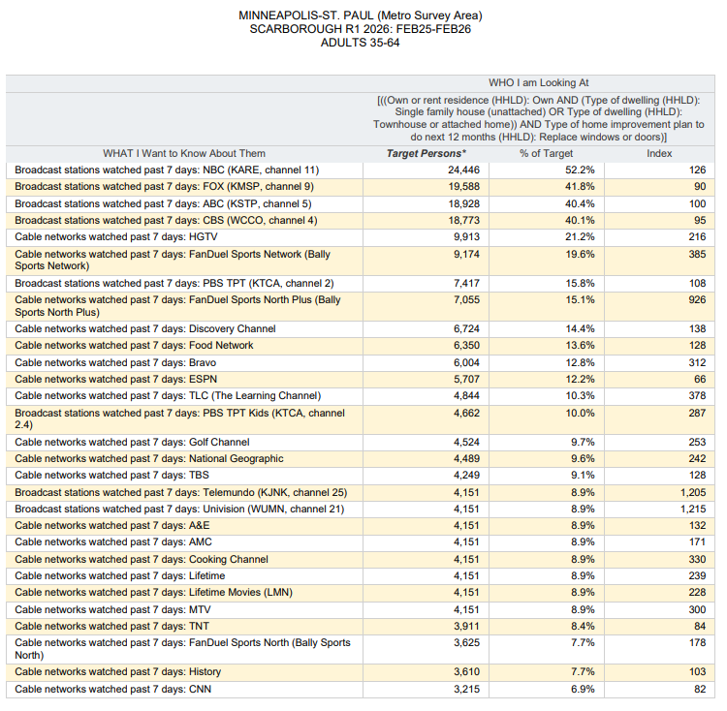
Top Local TV Stations and Cable Networks reaching...
Twin Cities Metro Area P35-64 who are…
Homeowners and… Plan to Replace their
WINDOWS in the next 12 months.
(Note: Insufficient Sample Size to Run this Report based on W35-64)
[((Own or rent residence (HHLD): Own AND (Type of dwelling (HHLD): Single family house (unattached) OR Type of dwelling (HHLD): Townhouse or attached home)) AND Type of home improvement plan to do next 12 months (HHLD): Replace windows or doors)]

Slide 17
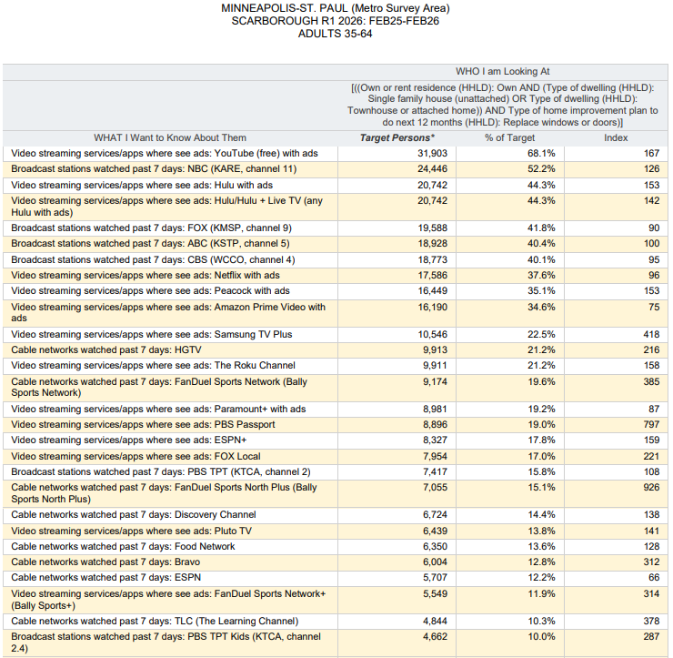
Top Local TV Stations, Cable Networks and
Streaming TV Services with Ads reaching…
Twin Cities Metro Area P35-64 who are…
Homeowners and… Plan to Replace their
WINDOWS in the next 12 months.
(Note: Insufficient Sample Size to Run this Report based on W35-64)
[((Own or rent residence (HHLD): Own AND (Type of dwelling (HHLD): Single family house (unattached) OR Type of dwelling (HHLD): Townhouse or attached home)) AND Type of home improvement plan to do next 12 months (HHLD): Replace windows or doors)]

Slide 18
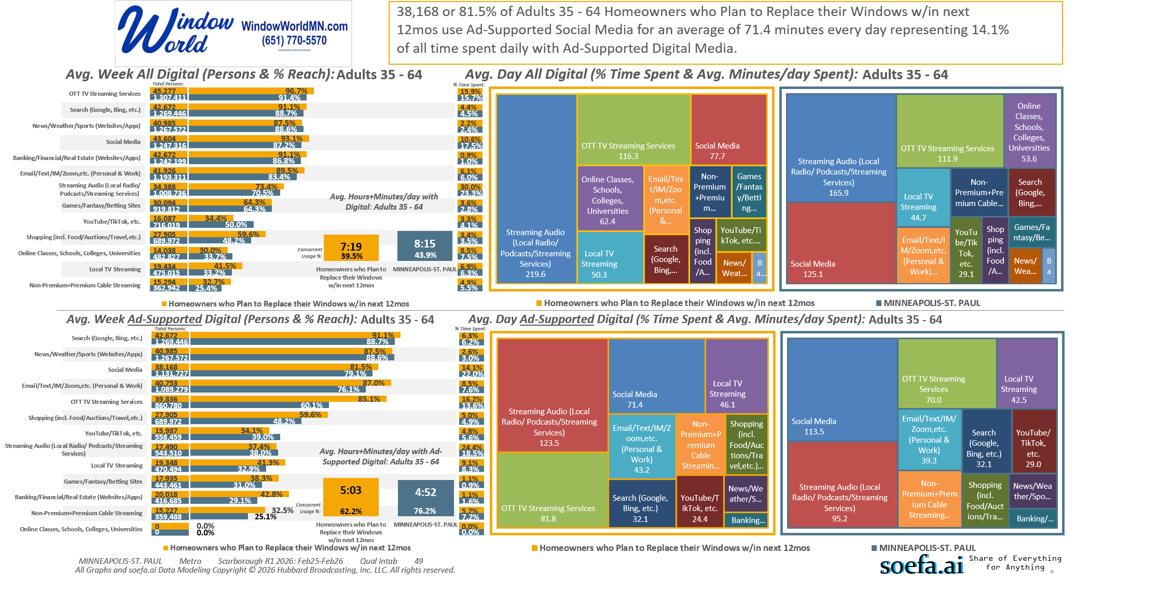
[((Own or rent residence (HHLD): Own AND (Type of dwelling (HHLD): Single family house (unattached) OR Type of dwelling (HHLD): Townhouse or attached home)) AND Type of home improvement plan to do next 12 months (HHLD): Replace windows or doors)]

Slide 19
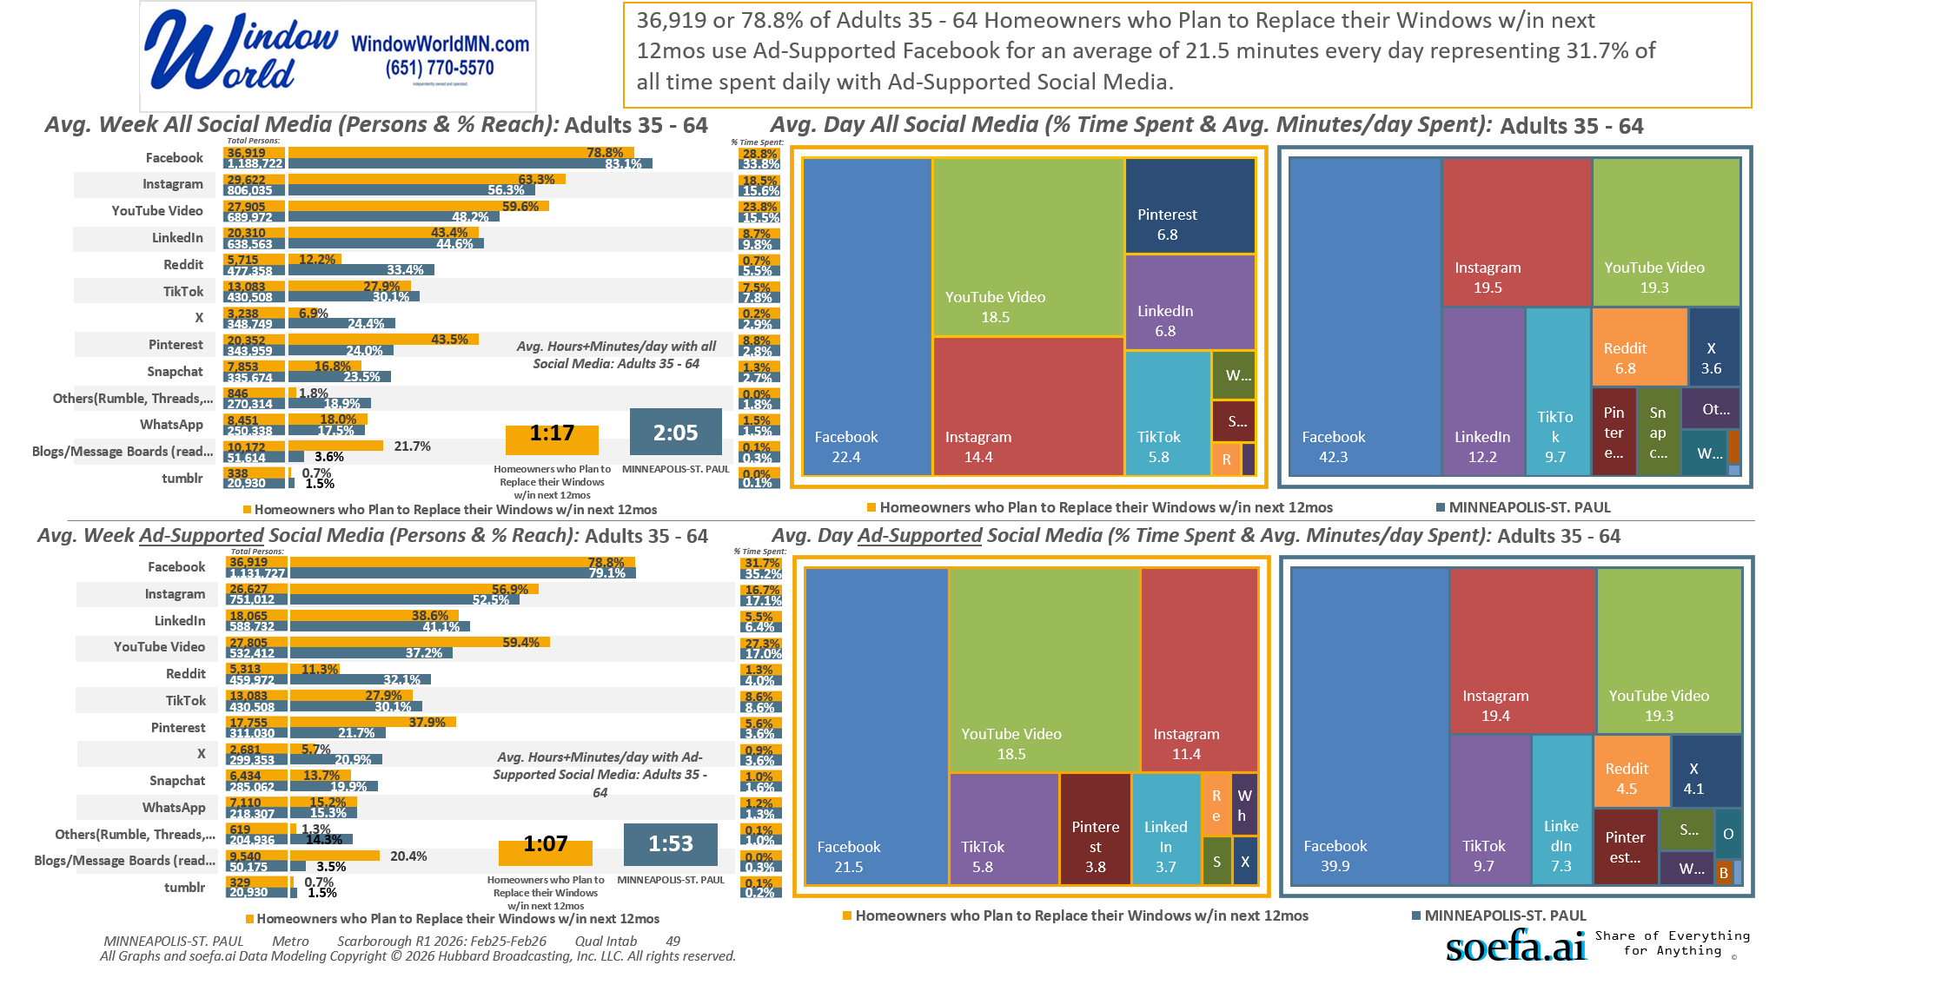
[((Own or rent residence (HHLD): Own AND (Type of dwelling (HHLD): Single family house (unattached) OR Type of dwelling (HHLD): Townhouse or attached home)) AND Type of home improvement plan to do next 12 months (HHLD): Replace windows or doors)]

Slide 20
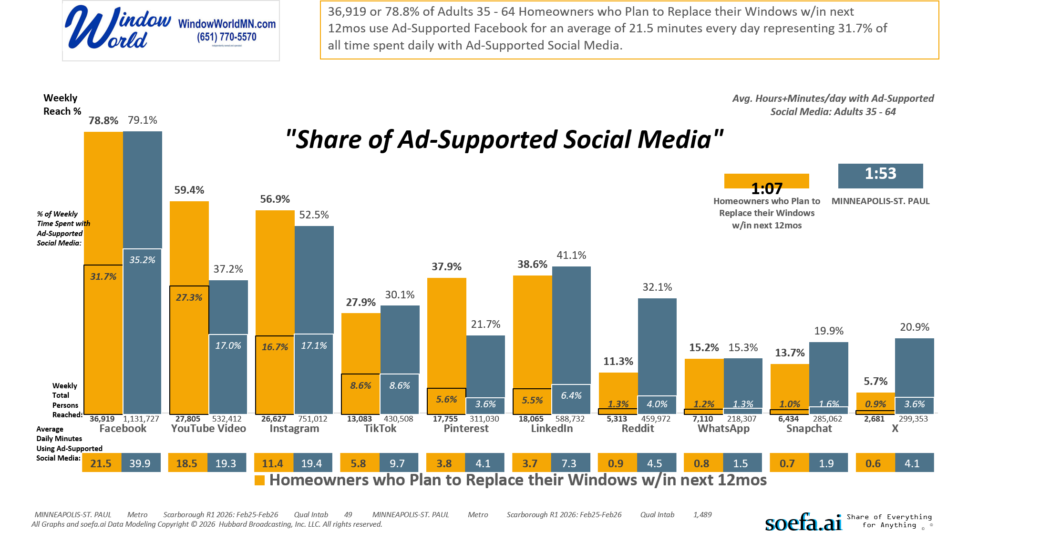
[((Own or rent residence (HHLD): Own AND (Type of dwelling (HHLD): Single family house (unattached) OR Type of dwelling (HHLD): Townhouse or attached home)) AND Type of home improvement plan to do next 12 months (HHLD): Replace windows or doors)]

Slide 21
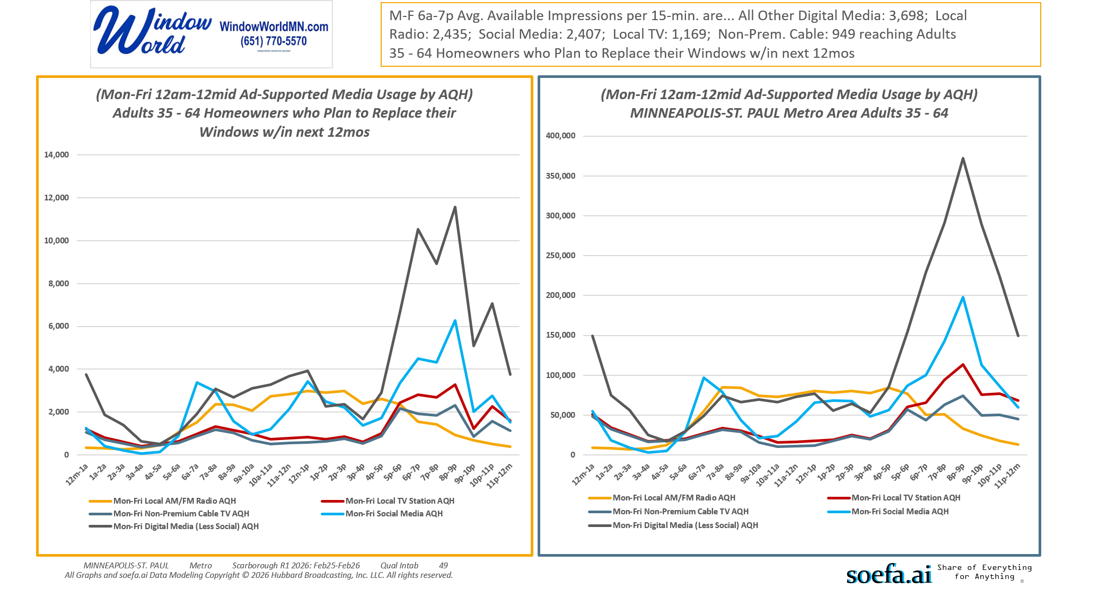
[((Own or rent residence (HHLD): Own AND (Type of dwelling (HHLD): Single family house (unattached) OR Type of dwelling (HHLD): Townhouse or attached home)) AND Type of home improvement plan to do next 12 months (HHLD): Replace windows or doors)]

Slide 22
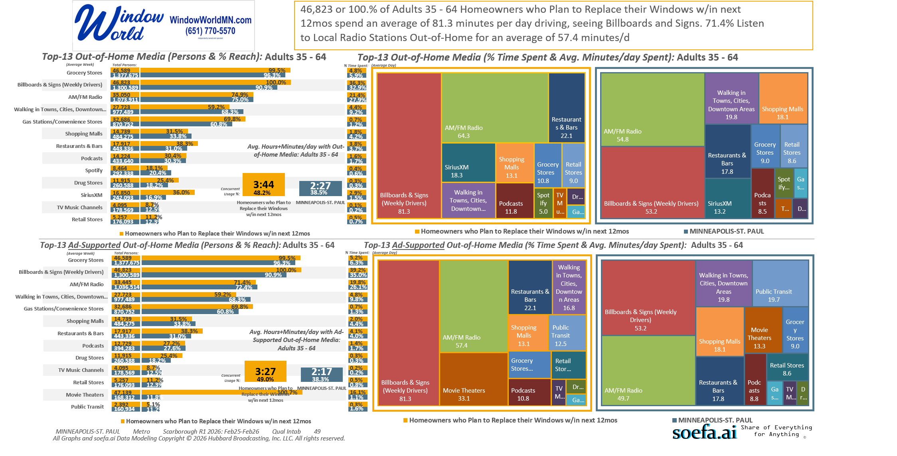
[((Own or rent residence (HHLD): Own AND (Type of dwelling (HHLD): Single family house (unattached) OR Type of dwelling (HHLD): Townhouse or attached home)) AND Type of home improvement plan to do next 12 months (HHLD): Replace windows or doors)]

Slide 23
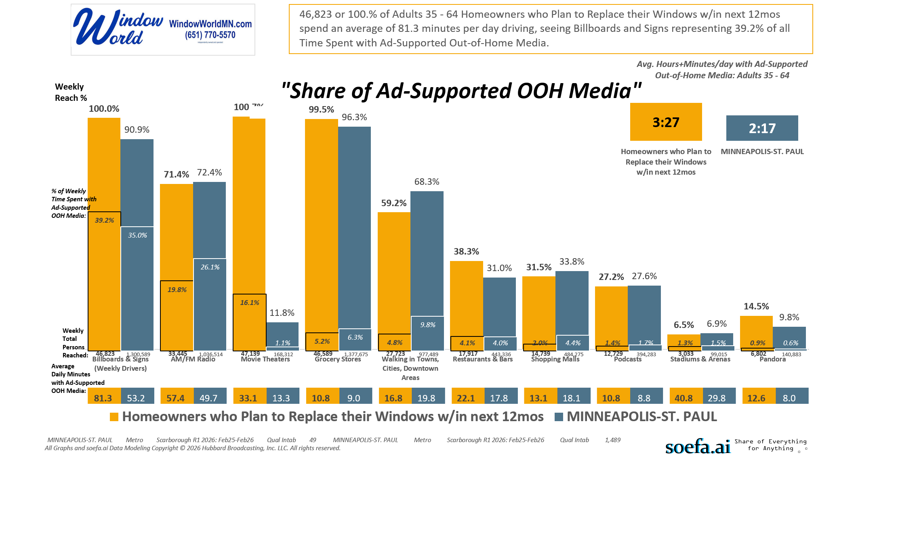
[((Own or rent residence (HHLD): Own AND (Type of dwelling (HHLD): Single family house (unattached) OR Type of dwelling (HHLD): Townhouse or attached home)) AND Type of home improvement plan to do next 12 months (HHLD): Replace windows or doors)]

Slide 24
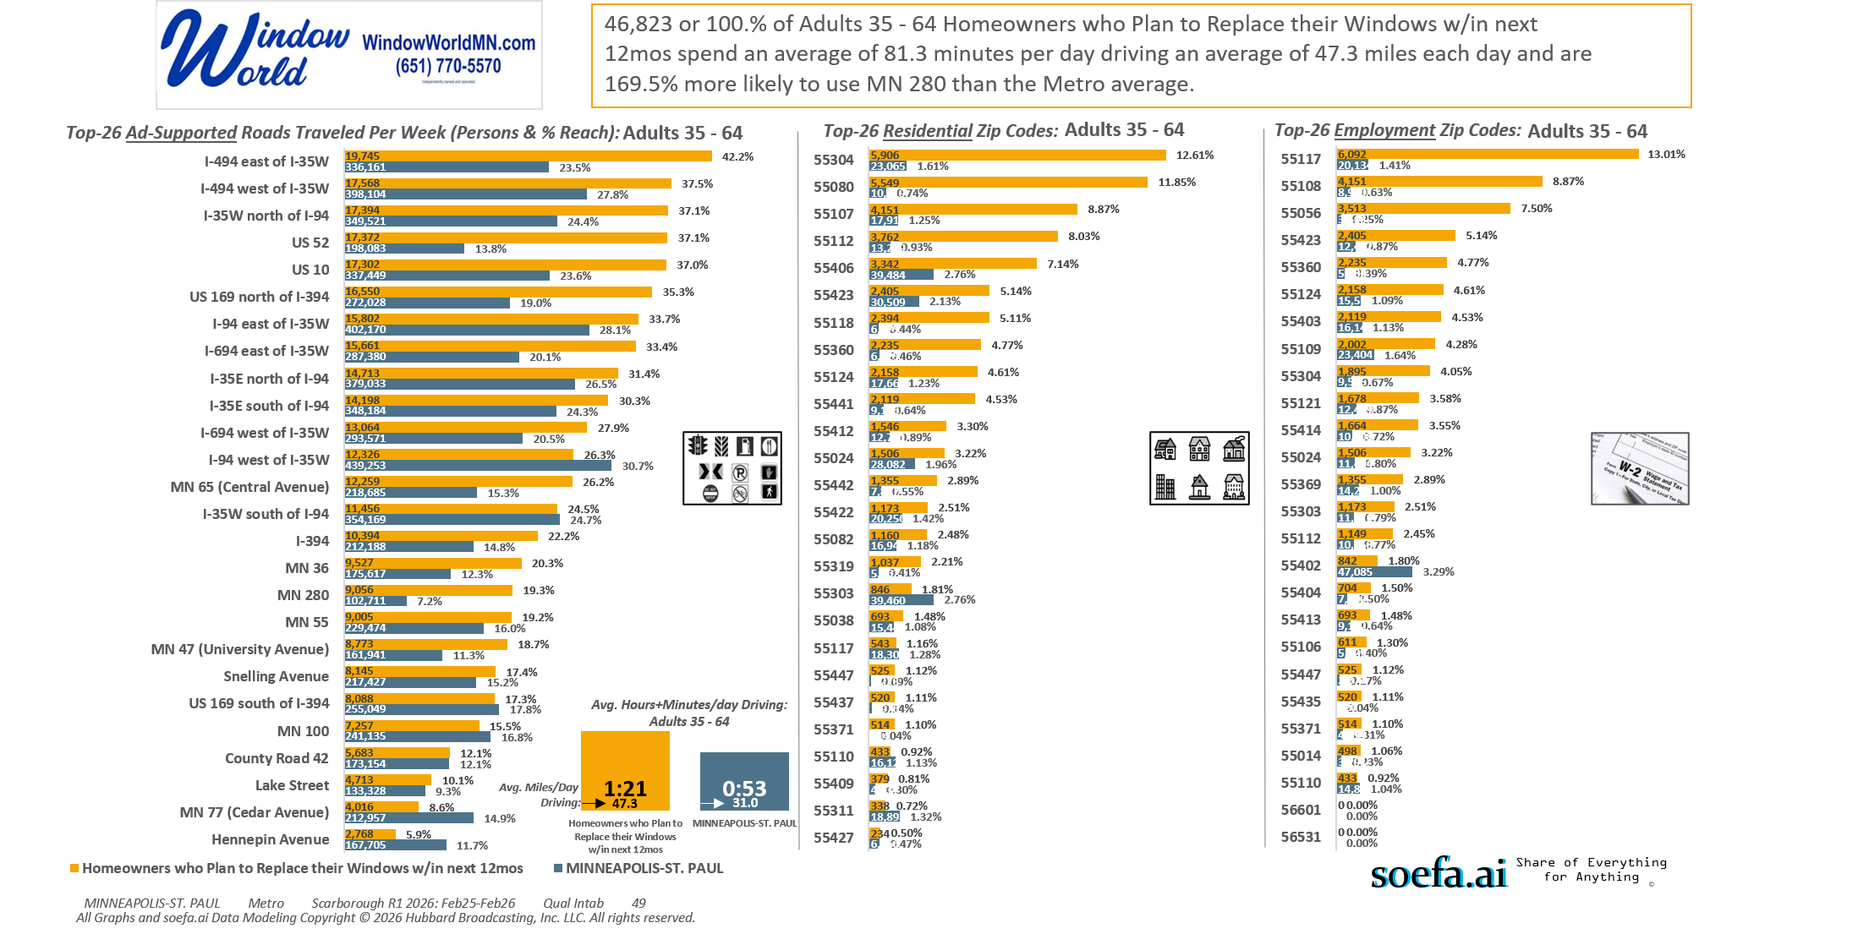
[((Own or rent residence (HHLD): Own AND (Type of dwelling (HHLD): Single family house (unattached) OR Type of dwelling (HHLD): Townhouse or attached home)) AND Type of home improvement plan to do next 12 months (HHLD): Replace windows or doors)]

Slide 25
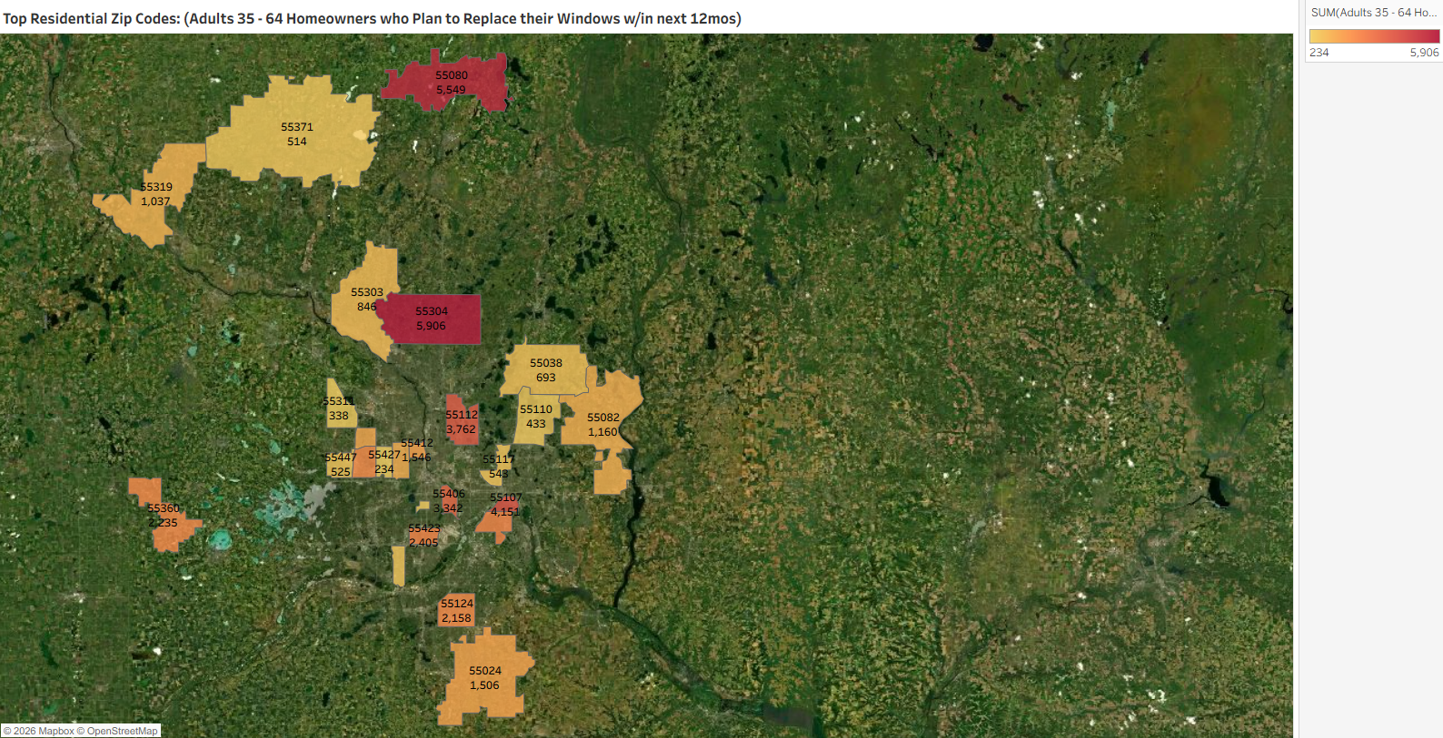
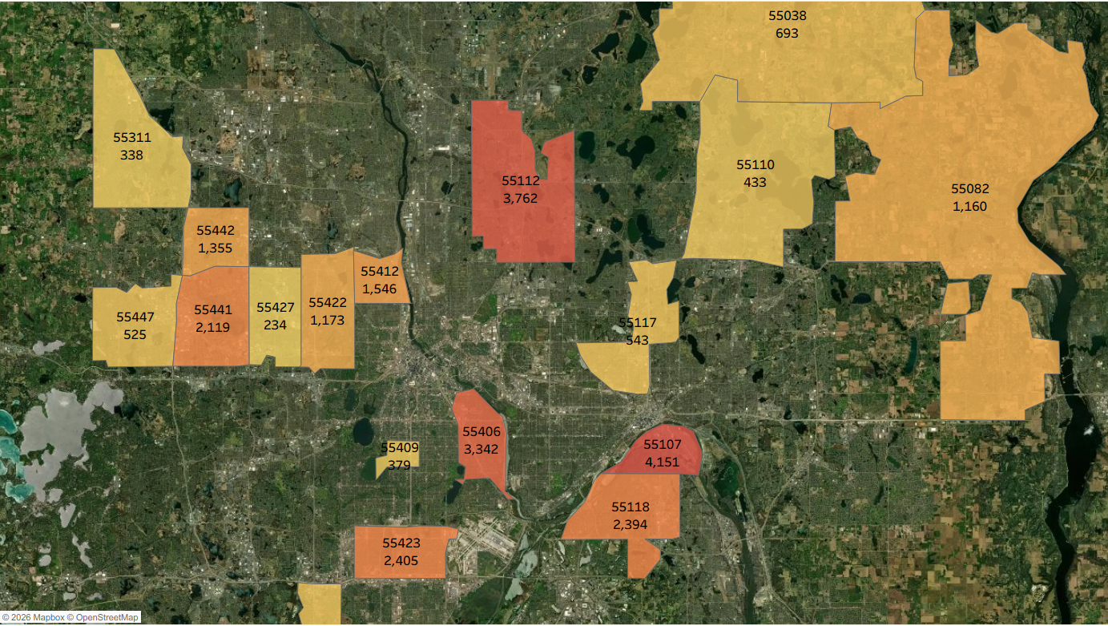

[((Own or rent residence (HHLD): Own AND (Type of dwelling (HHLD): Single family house (unattached) OR Type of dwelling (HHLD): Townhouse or attached home)) AND Type of home improvement plan to do next 12 months (HHLD): Replace windows or doors)]

Slide 26
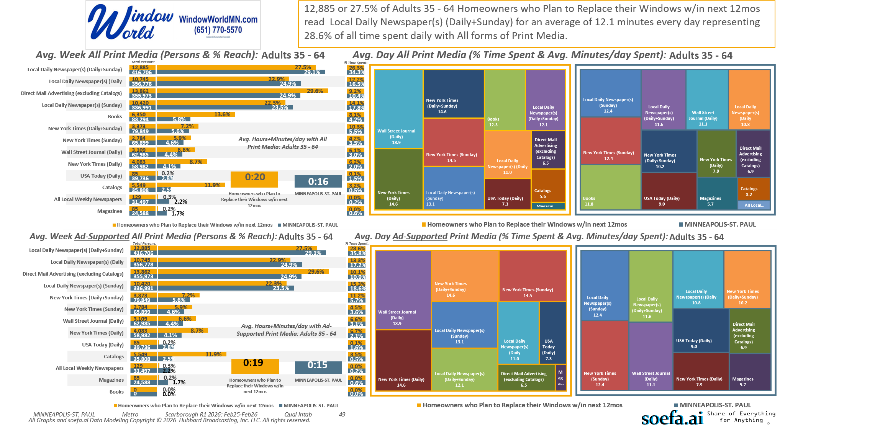
[((Own or rent residence (HHLD): Own AND (Type of dwelling (HHLD): Single family house (unattached) OR Type of dwelling (HHLD): Townhouse or attached home)) AND Type of home improvement plan to do next 12 months (HHLD): Replace windows or doors)]

