Slide 1

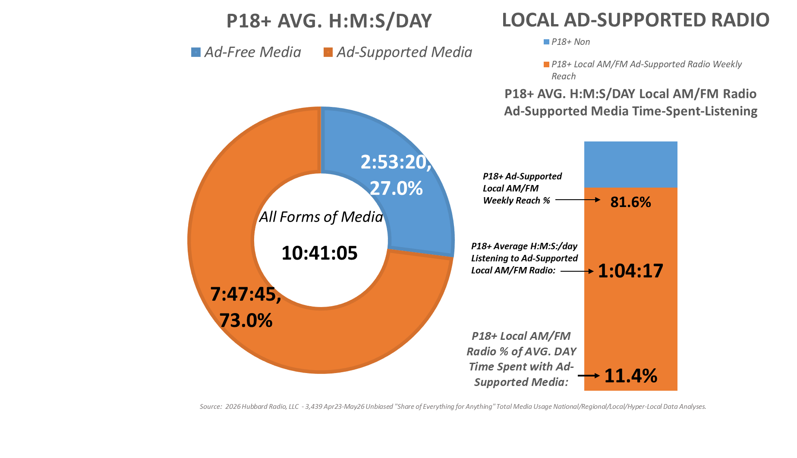
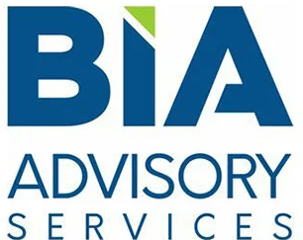
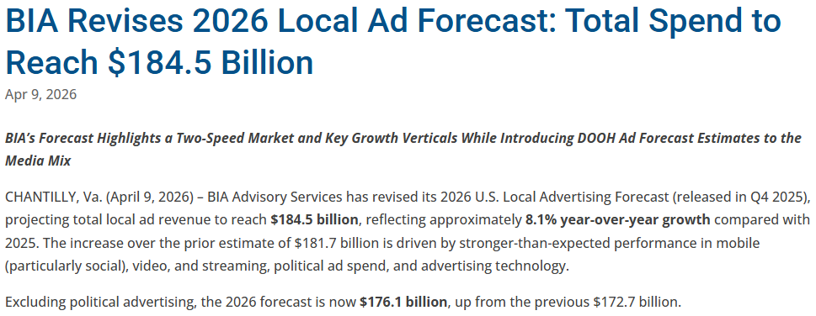
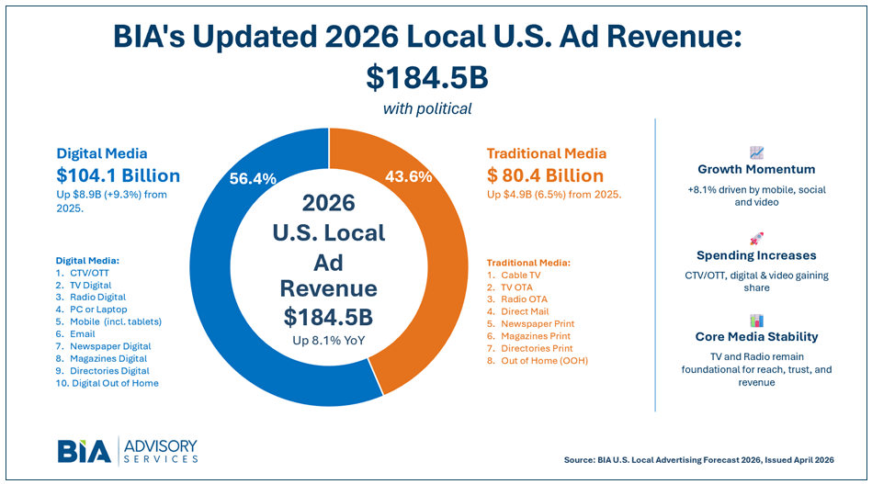

Average of
3,439 Decks
As of: 12 N:
05/05/2026
Local Radio:
$10 Billion (excl. “Radio Digital”)
= 6% of Ad Spend

