Slide 1
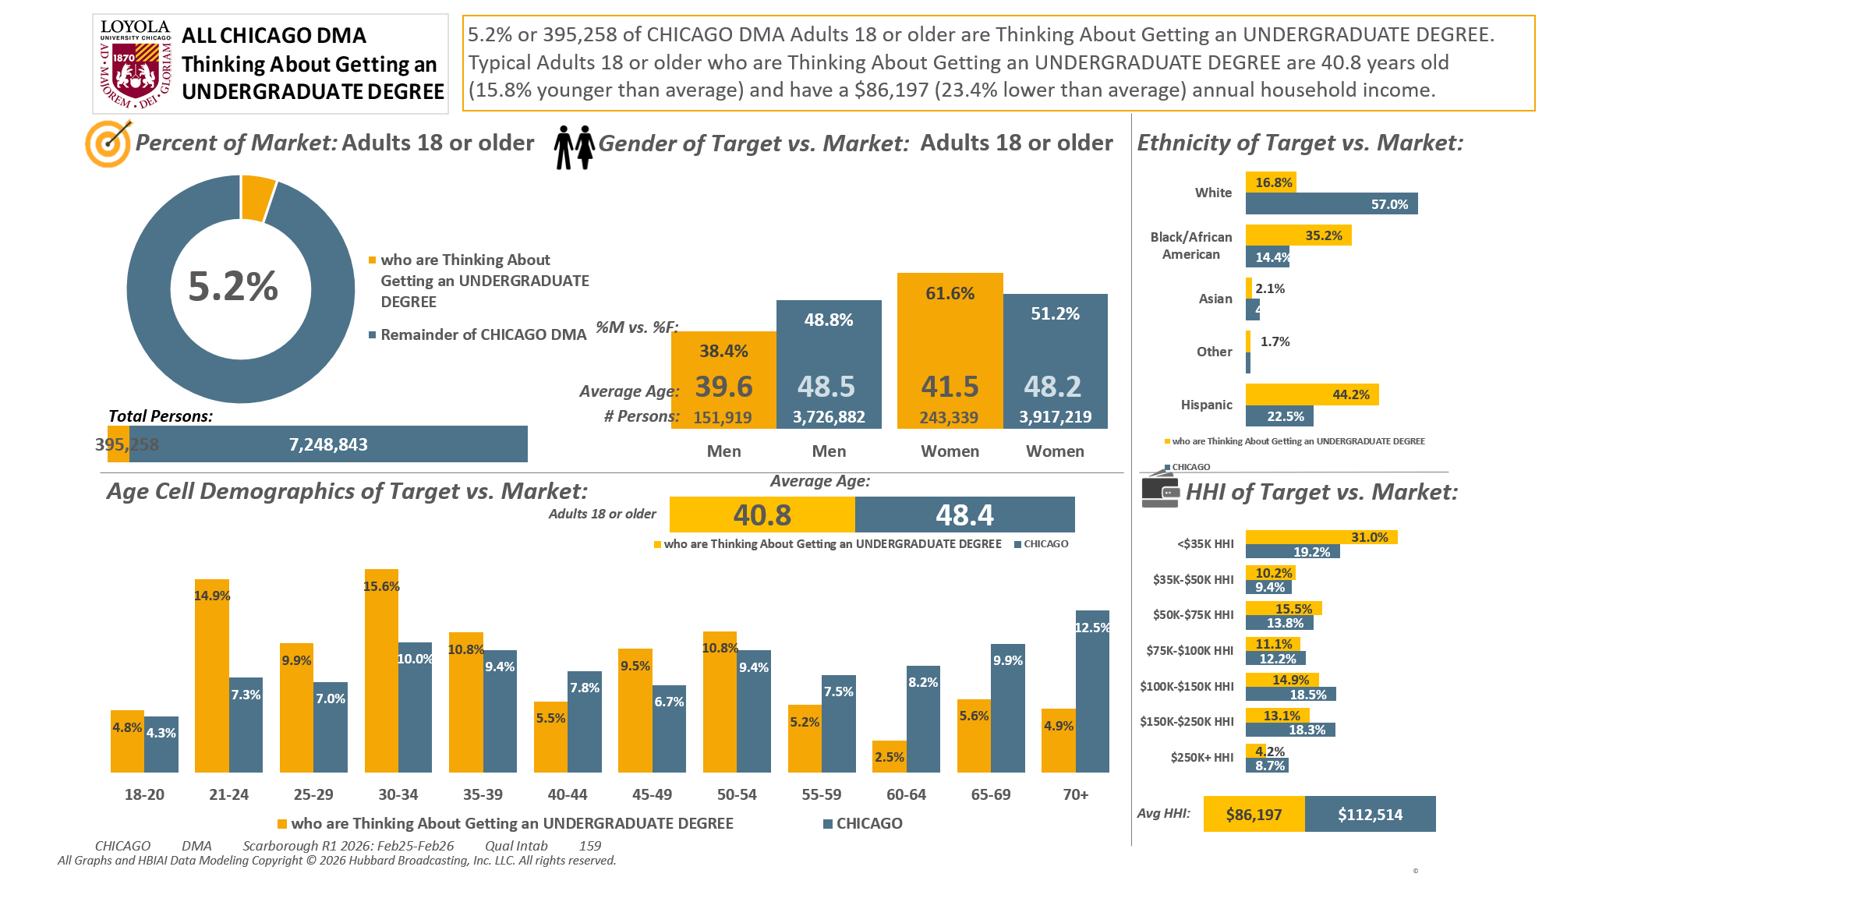





[(((Level of education: High school graduate (12th grade or GED) OR Level of education: Some college credit (no degree)) AND Ways used Internet/apps past 30 days on computer:Lifestyle: Education (research schools, application, financing)) AND Currently enrolled/attending classes at a college/university: No)]

Slide 2
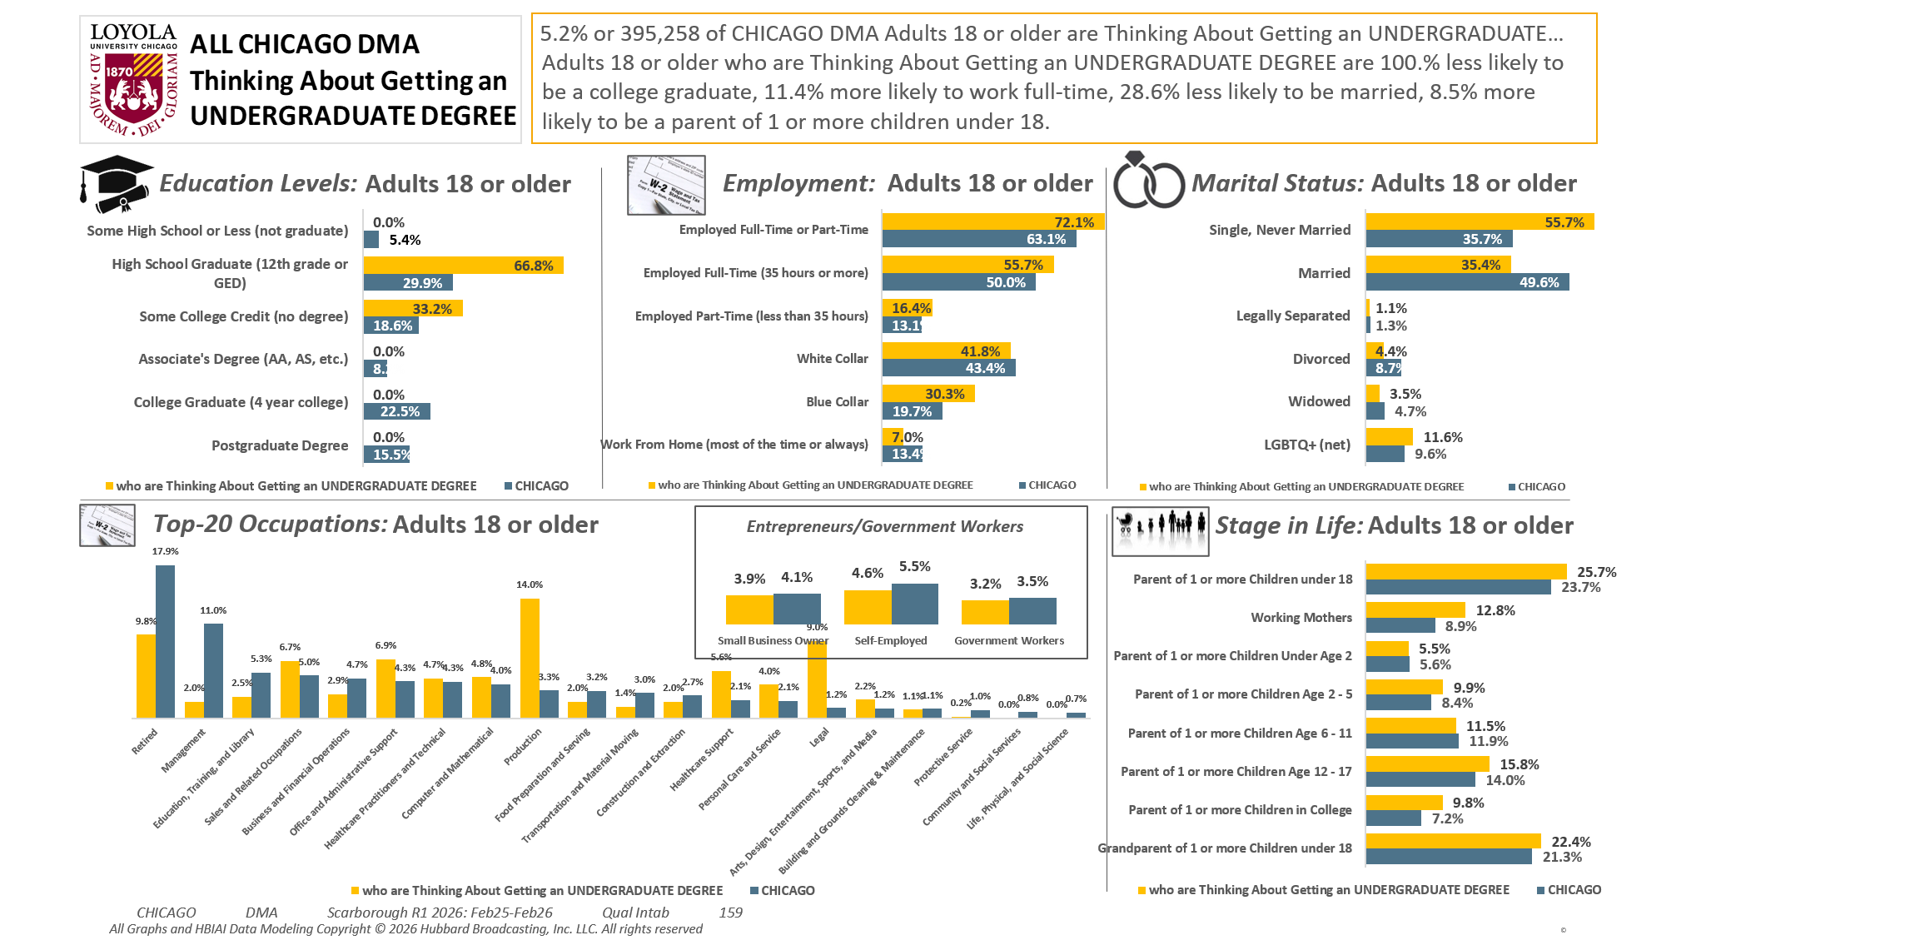
[(((Level of education: High school graduate (12th grade or GED) OR Level of education: Some college credit (no degree)) AND Ways used Internet/apps past 30 days on computer:Lifestyle: Education (research schools, application, financing)) AND Currently enrolled/attending classes at a college/university: No)]

Slide 3
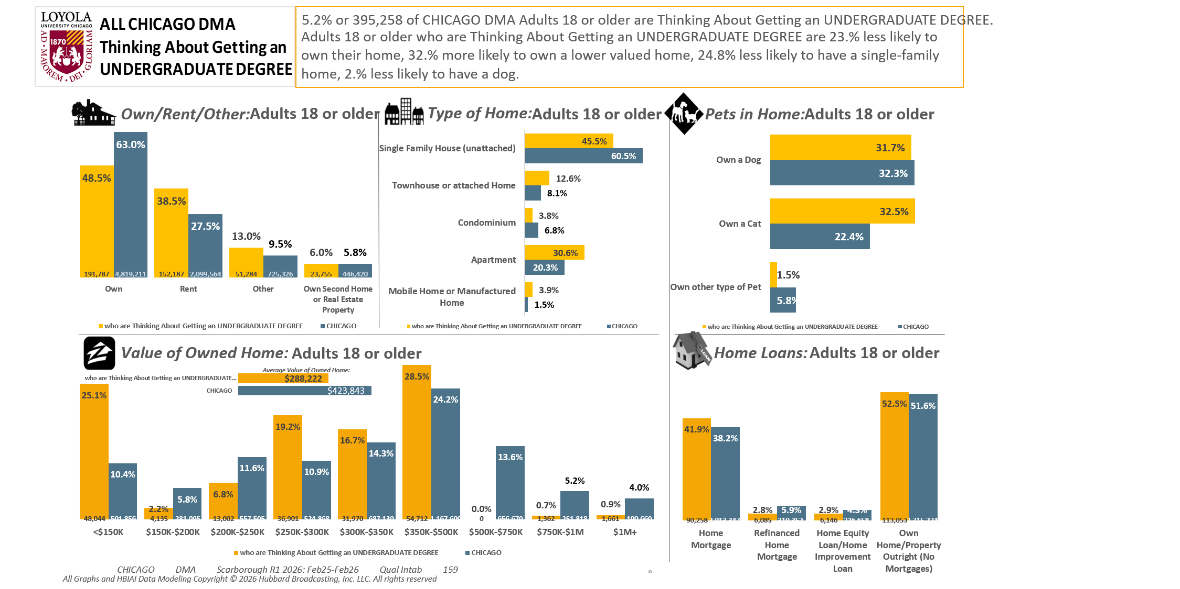
[(((Level of education: High school graduate (12th grade or GED) OR Level of education: Some college credit (no degree)) AND Ways used Internet/apps past 30 days on computer:Lifestyle: Education (research schools, application, financing)) AND Currently enrolled/attending classes at a college/university: No)]

Slide 4
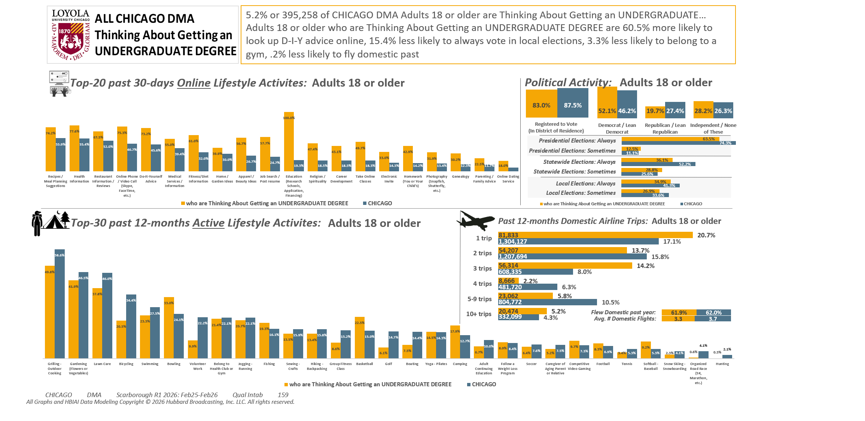
[(((Level of education: High school graduate (12th grade or GED) OR Level of education: Some college credit (no degree)) AND Ways used Internet/apps past 30 days on computer:Lifestyle: Education (research schools, application, financing)) AND Currently enrolled/attending classes at a college/university: No)]

Slide 5
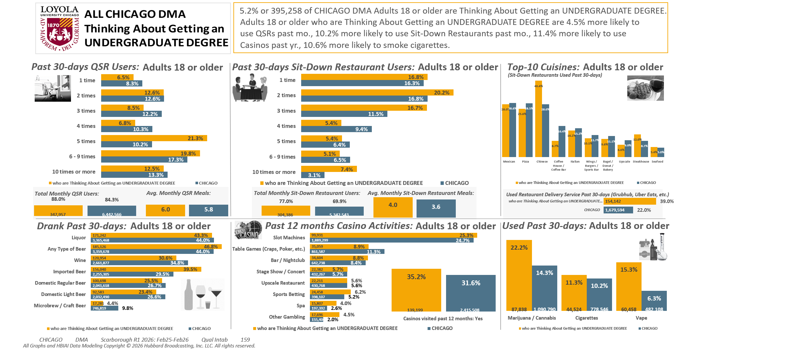
[(((Level of education: High school graduate (12th grade or GED) OR Level of education: Some college credit (no degree)) AND Ways used Internet/apps past 30 days on computer:Lifestyle: Education (research schools, application, financing)) AND Currently enrolled/attending classes at a college/university: No)]

Slide 6
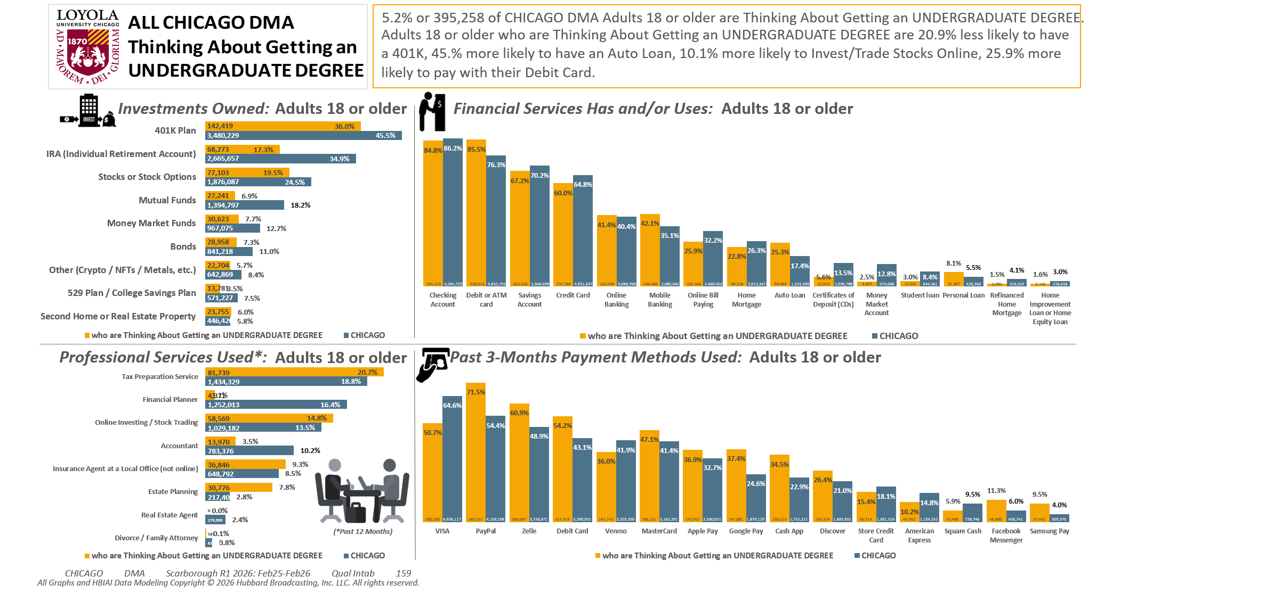
[(((Level of education: High school graduate (12th grade or GED) OR Level of education: Some college credit (no degree)) AND Ways used Internet/apps past 30 days on computer:Lifestyle: Education (research schools, application, financing)) AND Currently enrolled/attending classes at a college/university: No)]

Slide 7
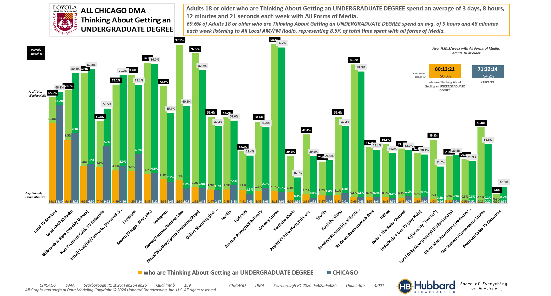

[(((Level of education: High school graduate (12th grade or GED) OR Level of education: Some college credit (no degree)) AND Ways used Internet/apps past 30 days on computer:Lifestyle: Education (research schools, application, financing)) AND Currently enrolled/attending classes at a college/university: No)]

Slide 8
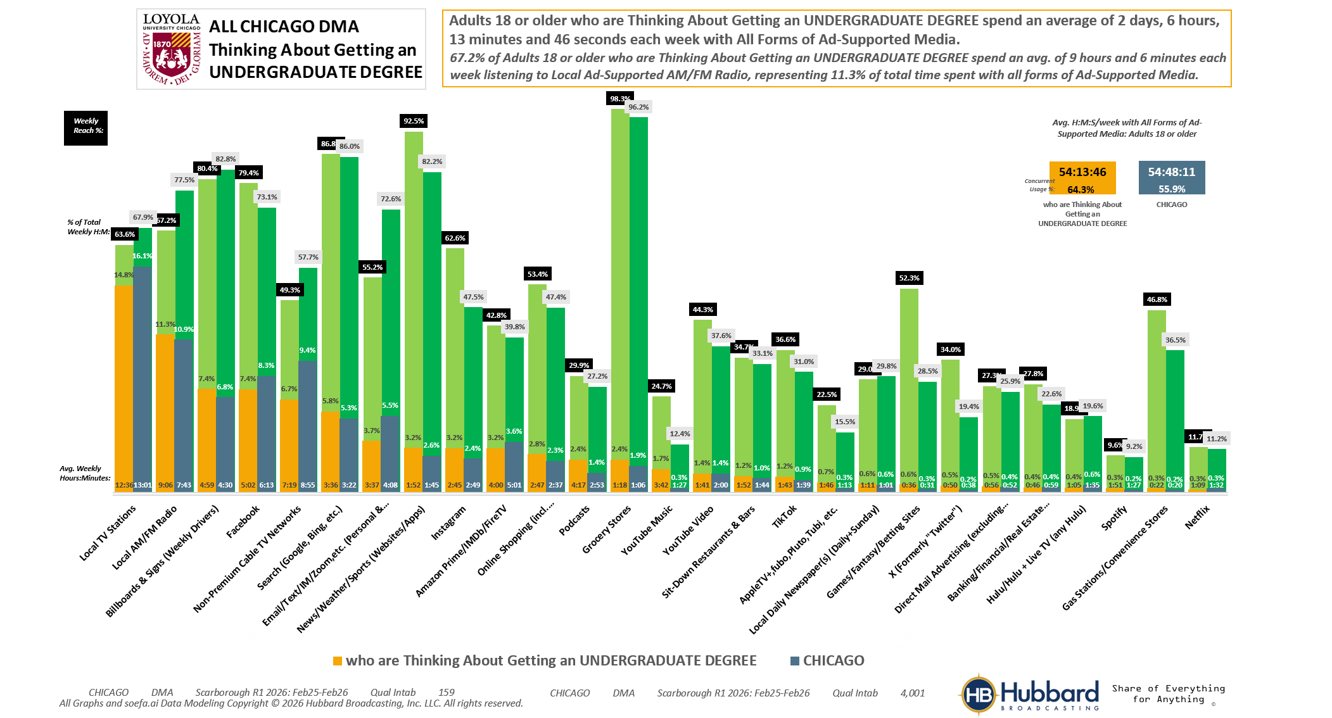
[(((Level of education: High school graduate (12th grade or GED) OR Level of education: Some college credit (no degree)) AND Ways used Internet/apps past 30 days on computer:Lifestyle: Education (research schools, application, financing)) AND Currently enrolled/attending classes at a college/university: No)]

Slide 9
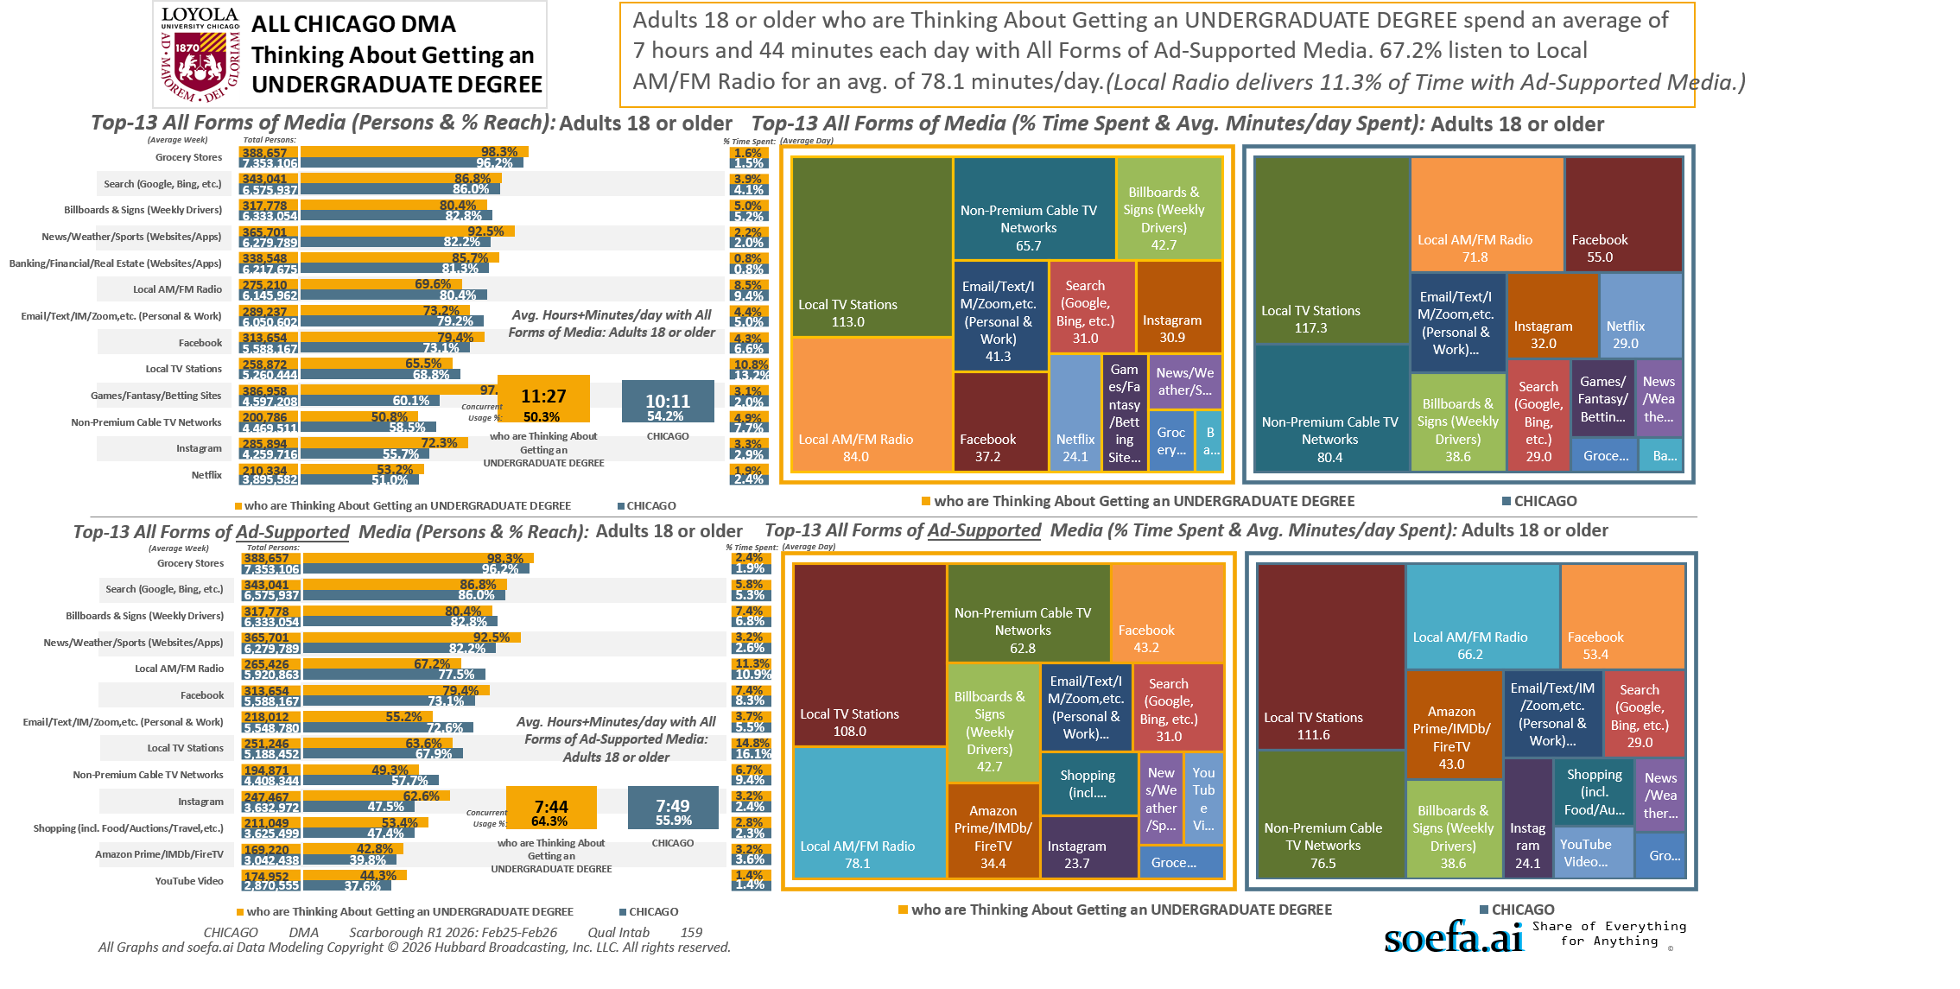
[(((Level of education: High school graduate (12th grade or GED) OR Level of education: Some college credit (no degree)) AND Ways used Internet/apps past 30 days on computer:Lifestyle: Education (research schools, application, financing)) AND Currently enrolled/attending classes at a college/university: No)]

Slide 10
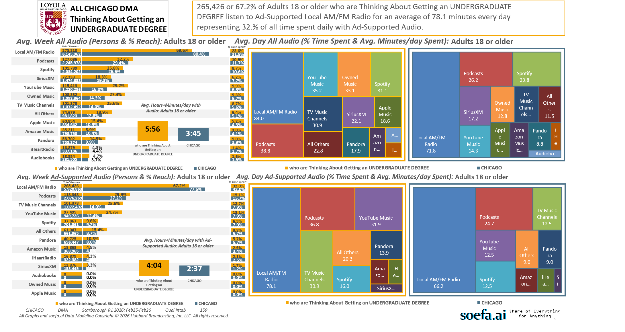
[(((Level of education: High school graduate (12th grade or GED) OR Level of education: Some college credit (no degree)) AND Ways used Internet/apps past 30 days on computer:Lifestyle: Education (research schools, application, financing)) AND Currently enrolled/attending classes at a college/university: No)]

Slide 11
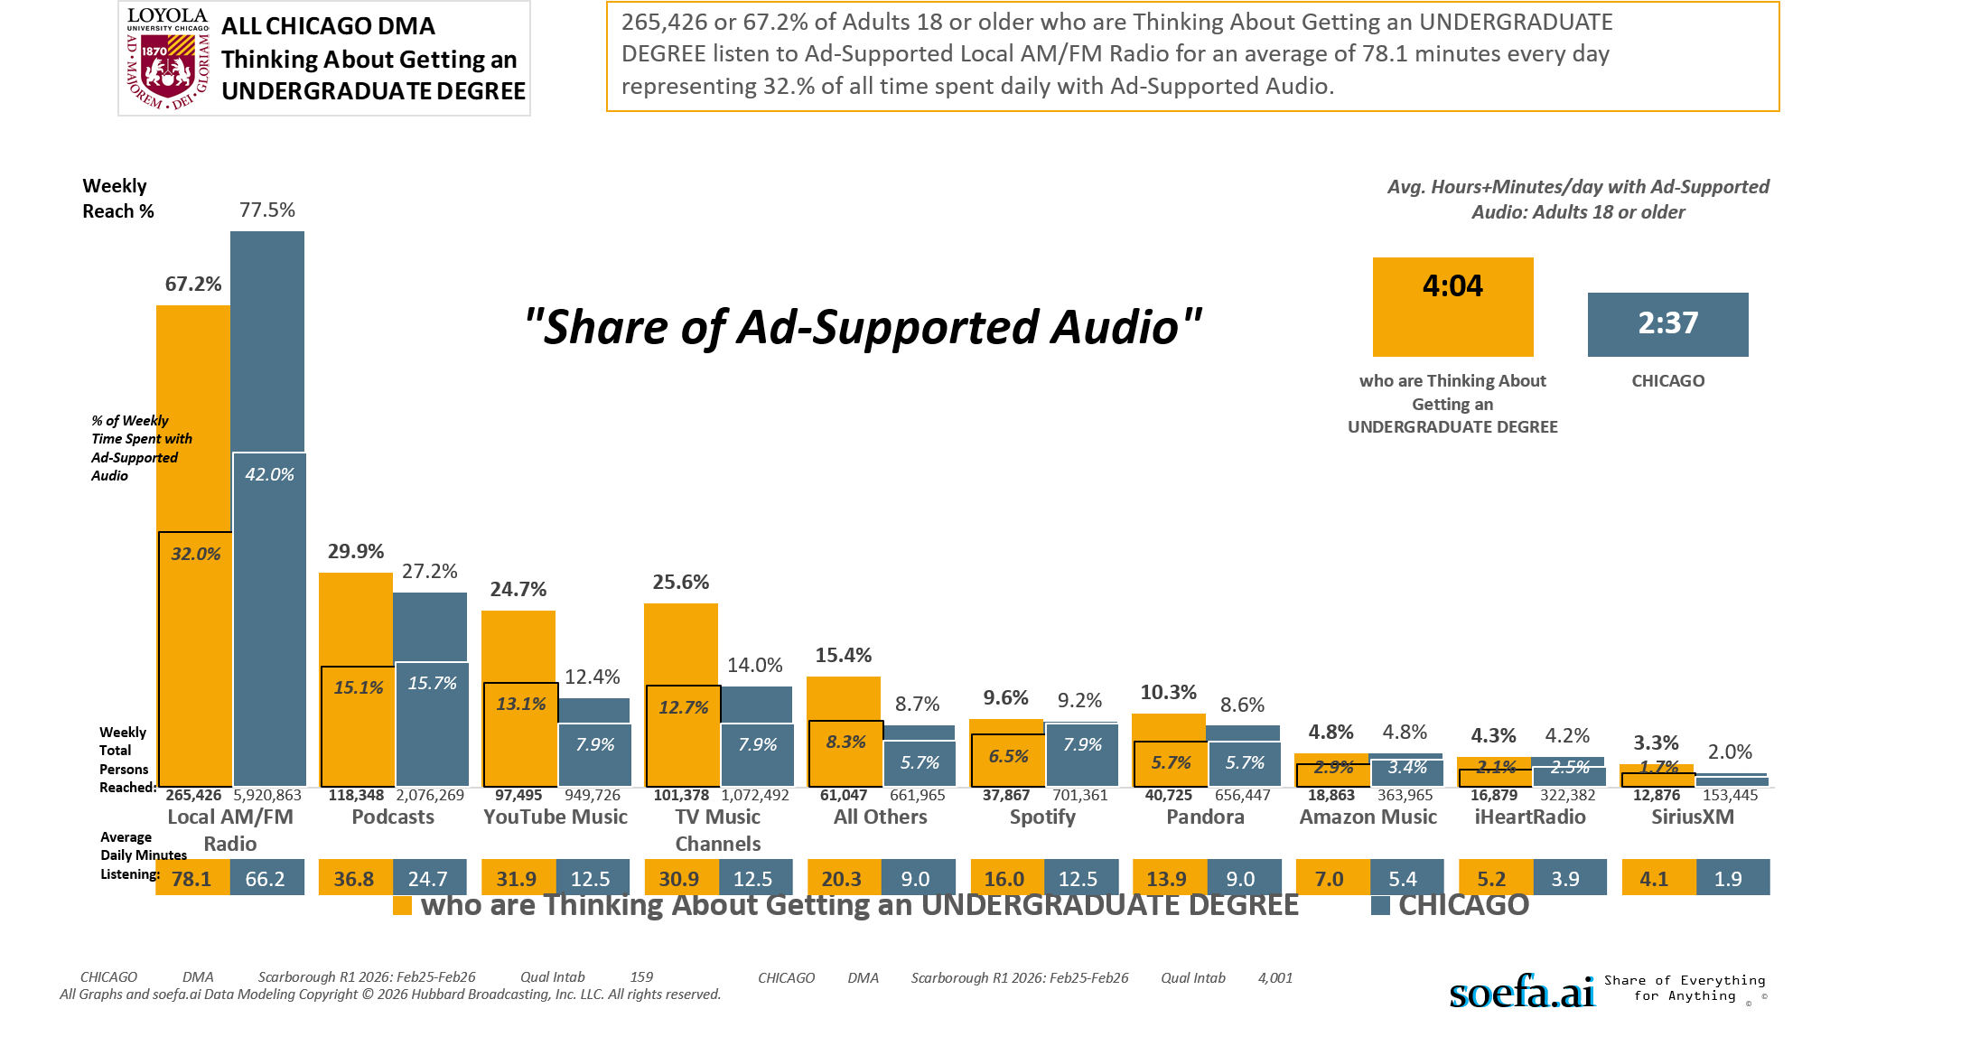
[(((Level of education: High school graduate (12th grade or GED) OR Level of education: Some college credit (no degree)) AND Ways used Internet/apps past 30 days on computer:Lifestyle: Education (research schools, application, financing)) AND Currently enrolled/attending classes at a college/university: No)]

Slide 12
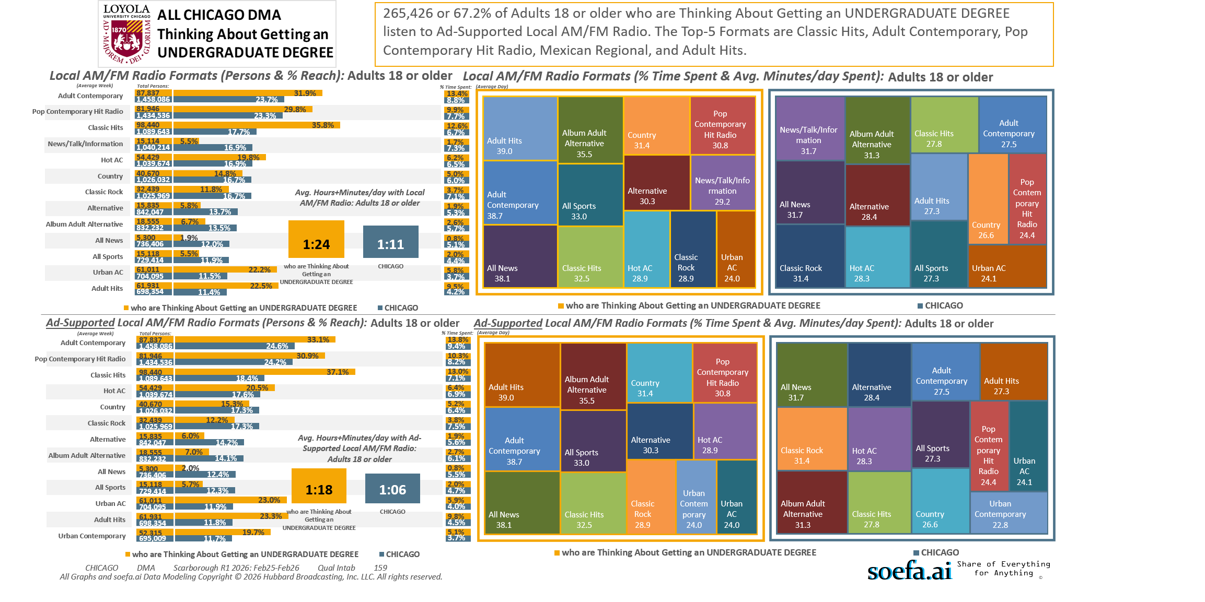
[(((Level of education: High school graduate (12th grade or GED) OR Level of education: Some college credit (no degree)) AND Ways used Internet/apps past 30 days on computer:Lifestyle: Education (research schools, application, financing)) AND Currently enrolled/attending classes at a college/university: No)]

Slide 13
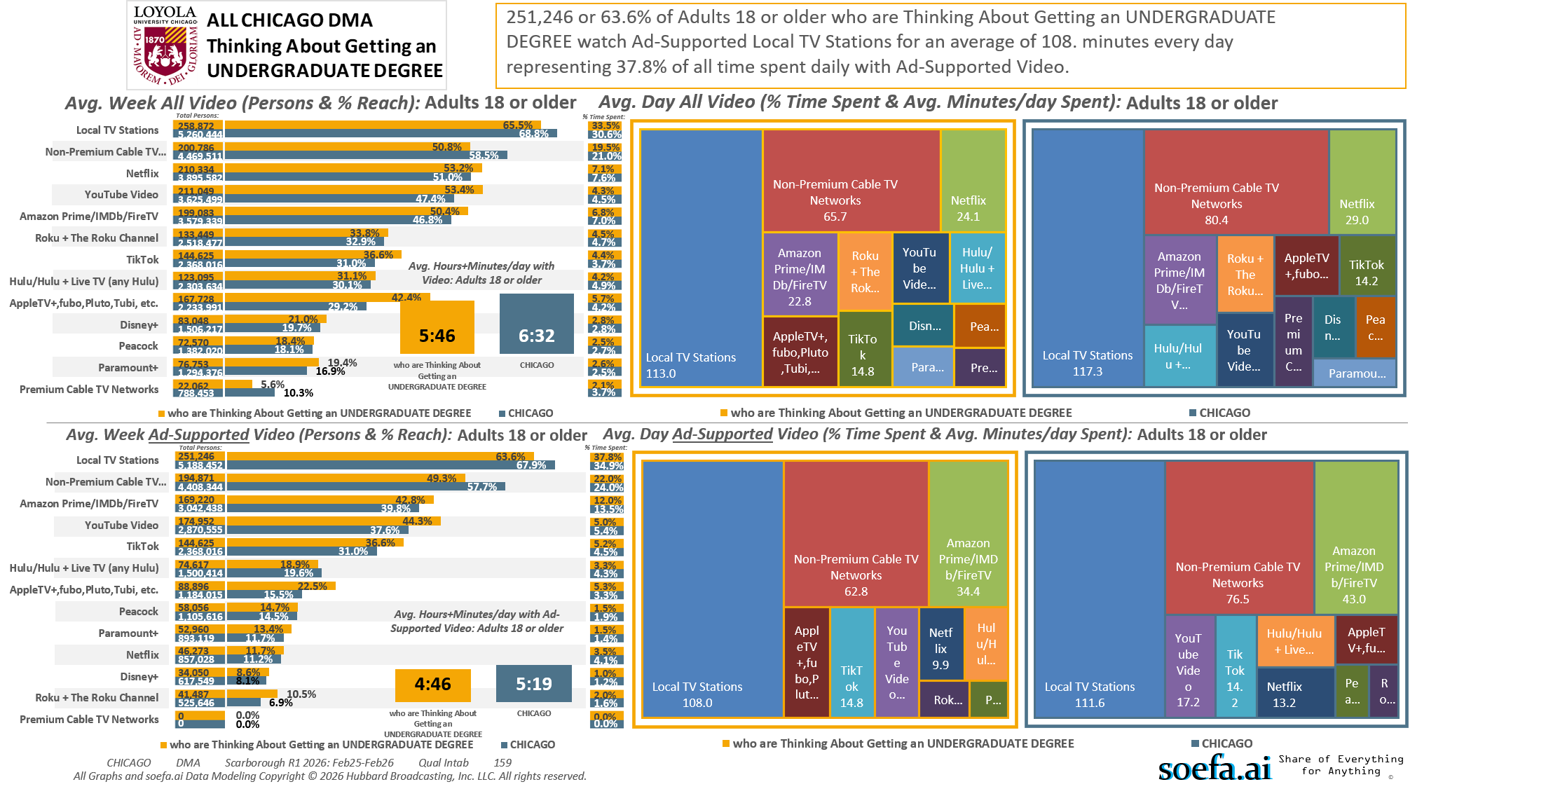
[(((Level of education: High school graduate (12th grade or GED) OR Level of education: Some college credit (no degree)) AND Ways used Internet/apps past 30 days on computer:Lifestyle: Education (research schools, application, financing)) AND Currently enrolled/attending classes at a college/university: No)]

Slide 14
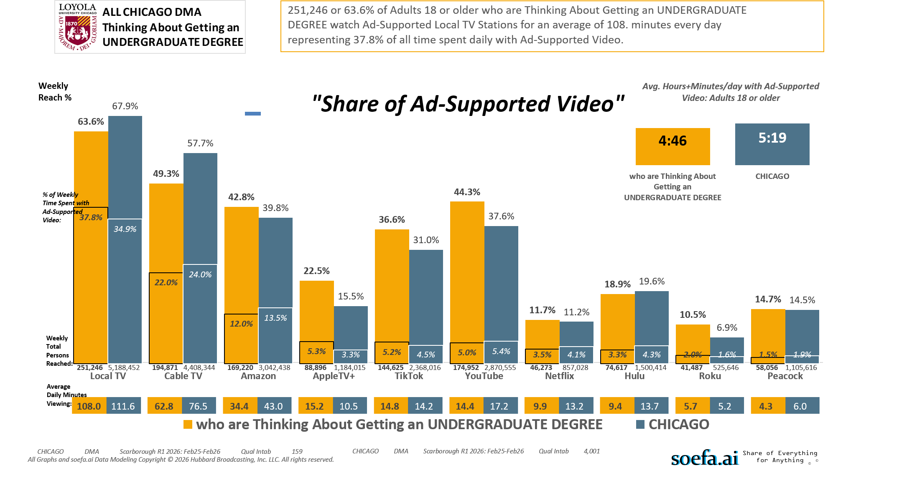
[(((Level of education: High school graduate (12th grade or GED) OR Level of education: Some college credit (no degree)) AND Ways used Internet/apps past 30 days on computer:Lifestyle: Education (research schools, application, financing)) AND Currently enrolled/attending classes at a college/university: No)]

Slide 15
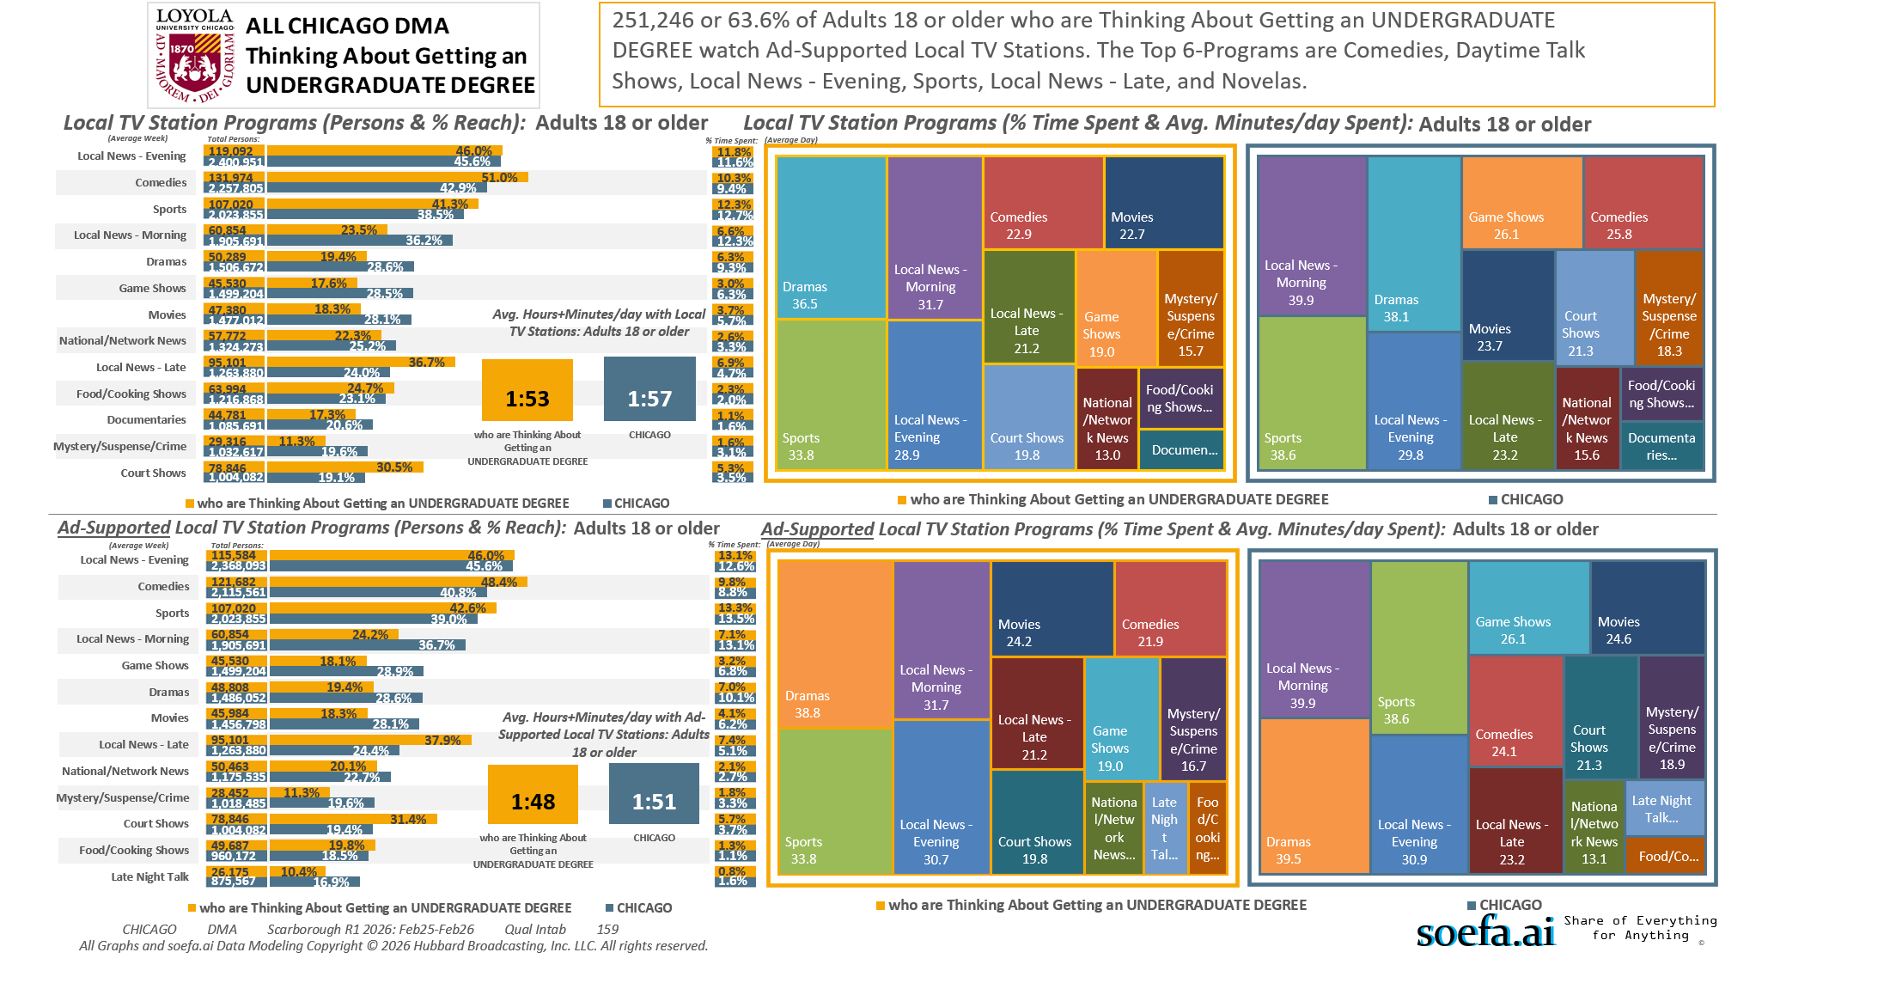
[(((Level of education: High school graduate (12th grade or GED) OR Level of education: Some college credit (no degree)) AND Ways used Internet/apps past 30 days on computer:Lifestyle: Education (research schools, application, financing)) AND Currently enrolled/attending classes at a college/university: No)]

Slide 16
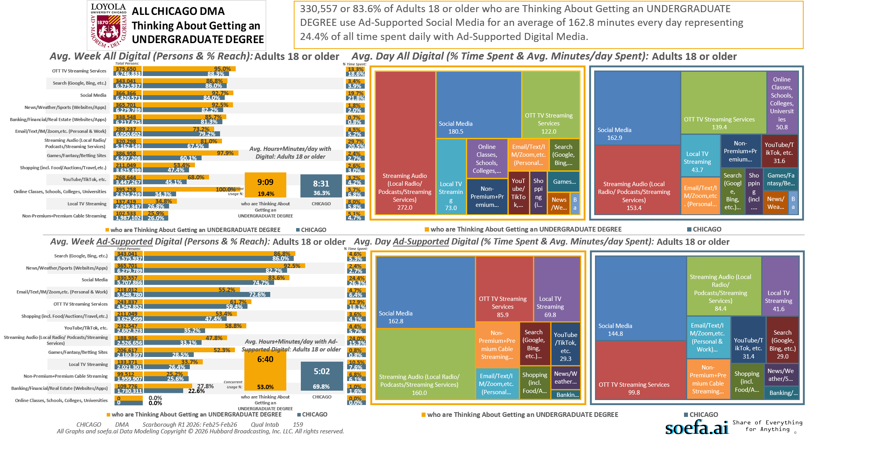
[(((Level of education: High school graduate (12th grade or GED) OR Level of education: Some college credit (no degree)) AND Ways used Internet/apps past 30 days on computer:Lifestyle: Education (research schools, application, financing)) AND Currently enrolled/attending classes at a college/university: No)]

Slide 17
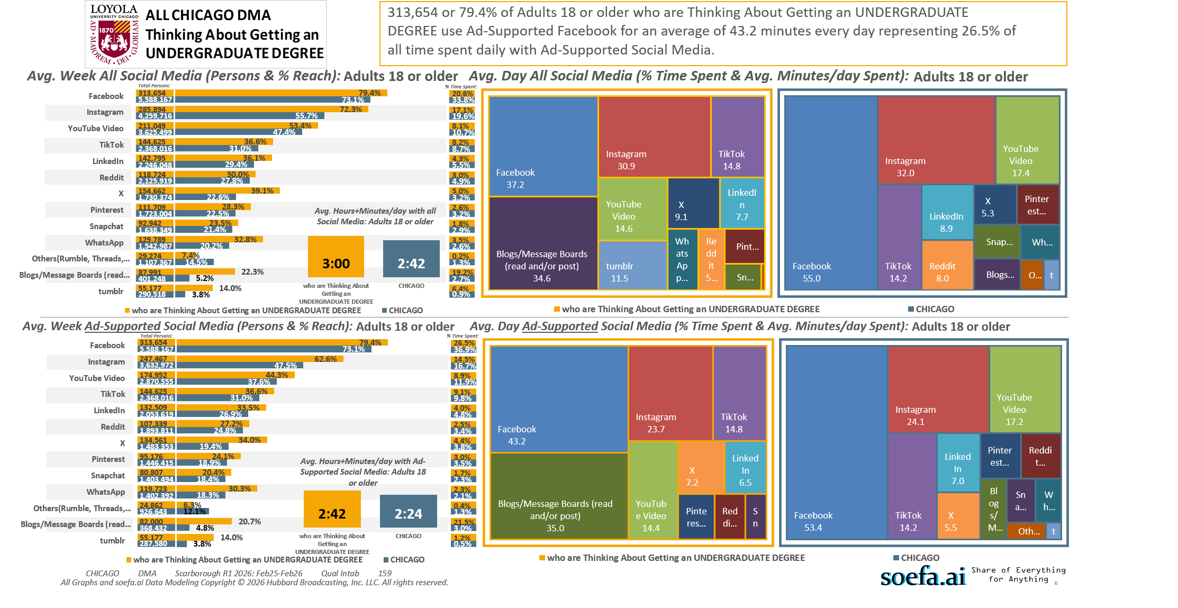
[(((Level of education: High school graduate (12th grade or GED) OR Level of education: Some college credit (no degree)) AND Ways used Internet/apps past 30 days on computer:Lifestyle: Education (research schools, application, financing)) AND Currently enrolled/attending classes at a college/university: No)]

Slide 18
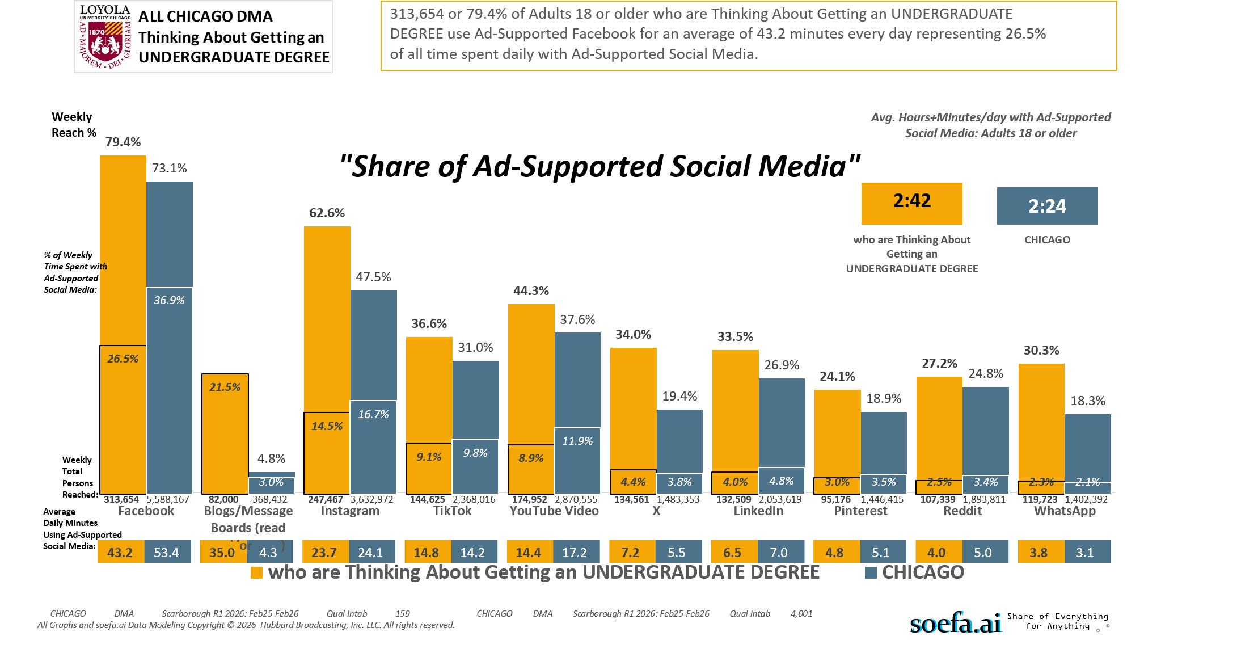
[(((Level of education: High school graduate (12th grade or GED) OR Level of education: Some college credit (no degree)) AND Ways used Internet/apps past 30 days on computer:Lifestyle: Education (research schools, application, financing)) AND Currently enrolled/attending classes at a college/university: No)]

Slide 19
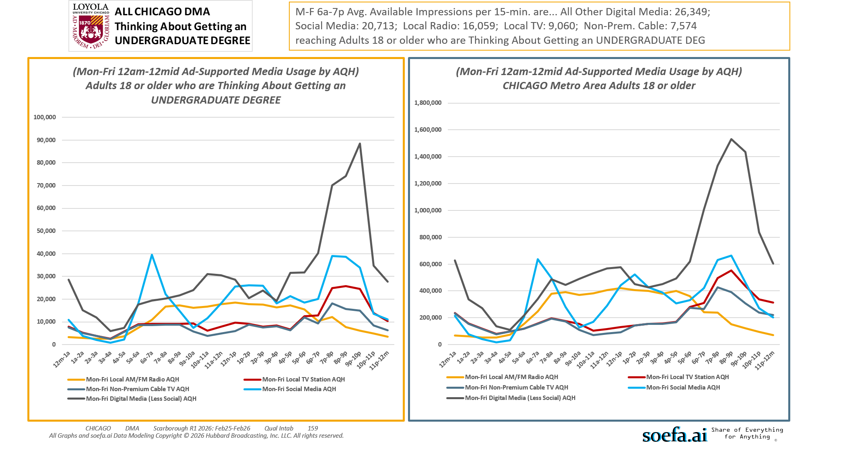
[(((Level of education: High school graduate (12th grade or GED) OR Level of education: Some college credit (no degree)) AND Ways used Internet/apps past 30 days on computer:Lifestyle: Education (research schools, application, financing)) AND Currently enrolled/attending classes at a college/university: No)]

Slide 20
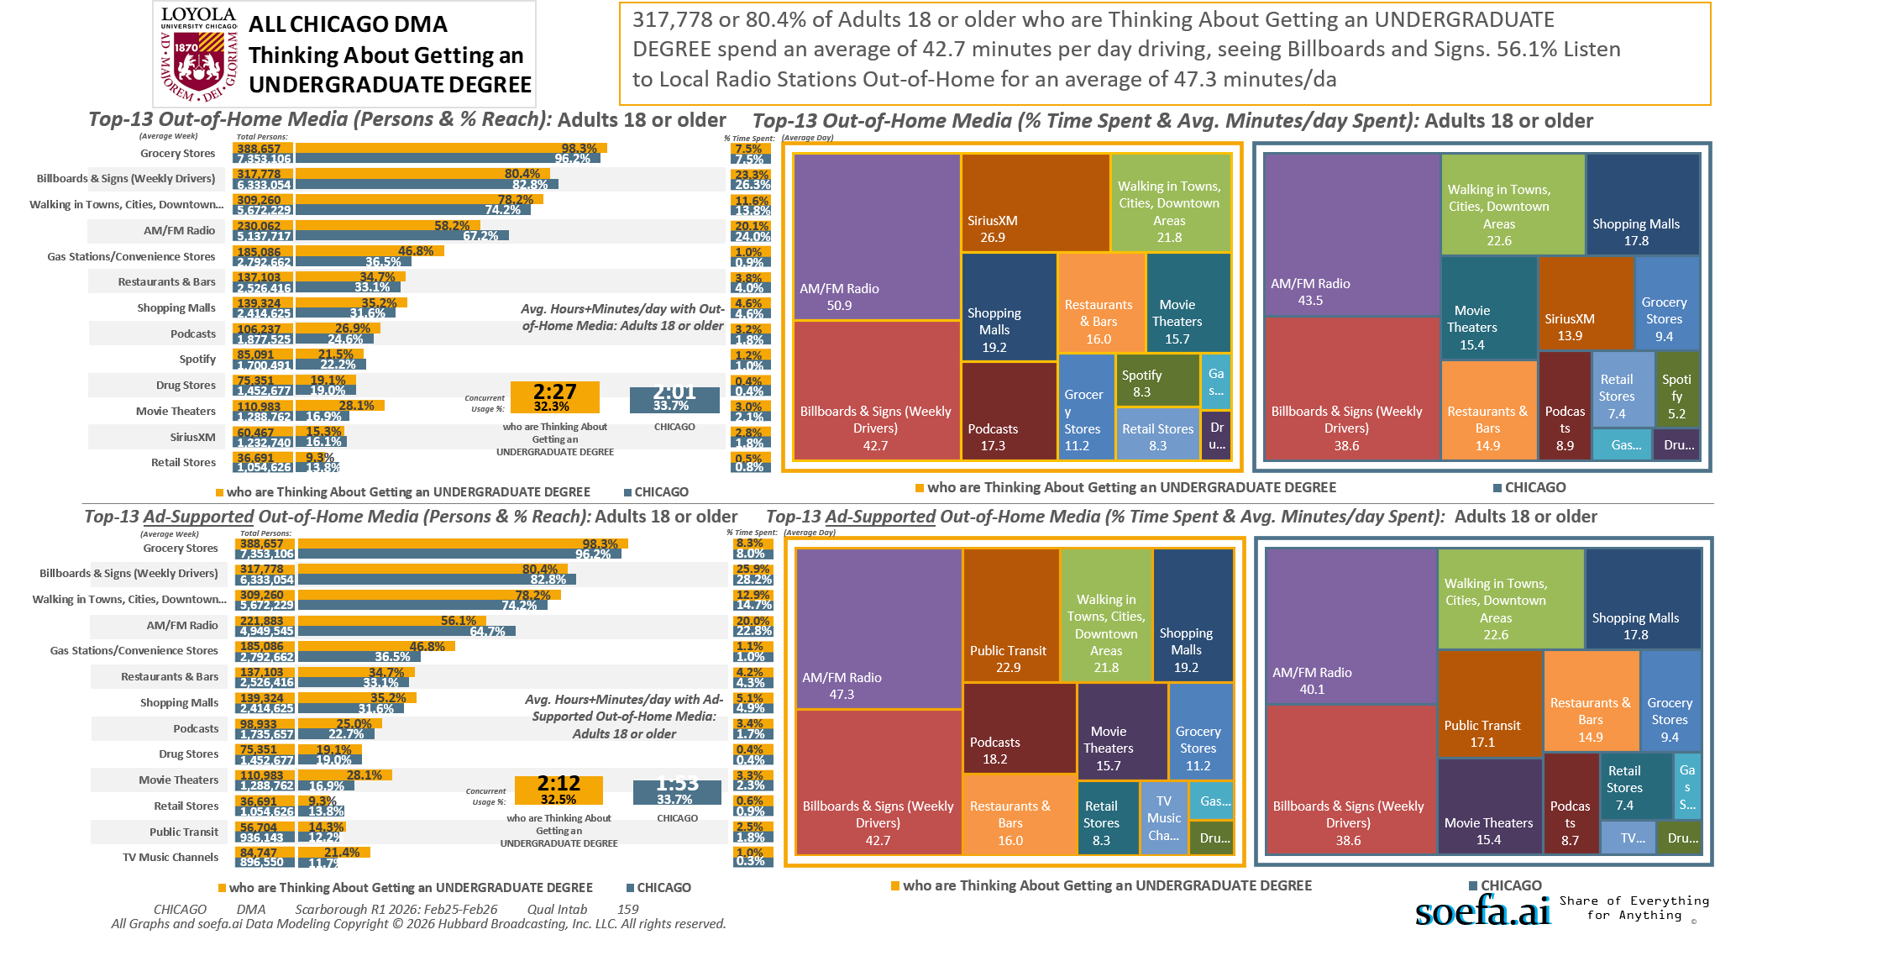
[(((Level of education: High school graduate (12th grade or GED) OR Level of education: Some college credit (no degree)) AND Ways used Internet/apps past 30 days on computer:Lifestyle: Education (research schools, application, financing)) AND Currently enrolled/attending classes at a college/university: No)]

Slide 21
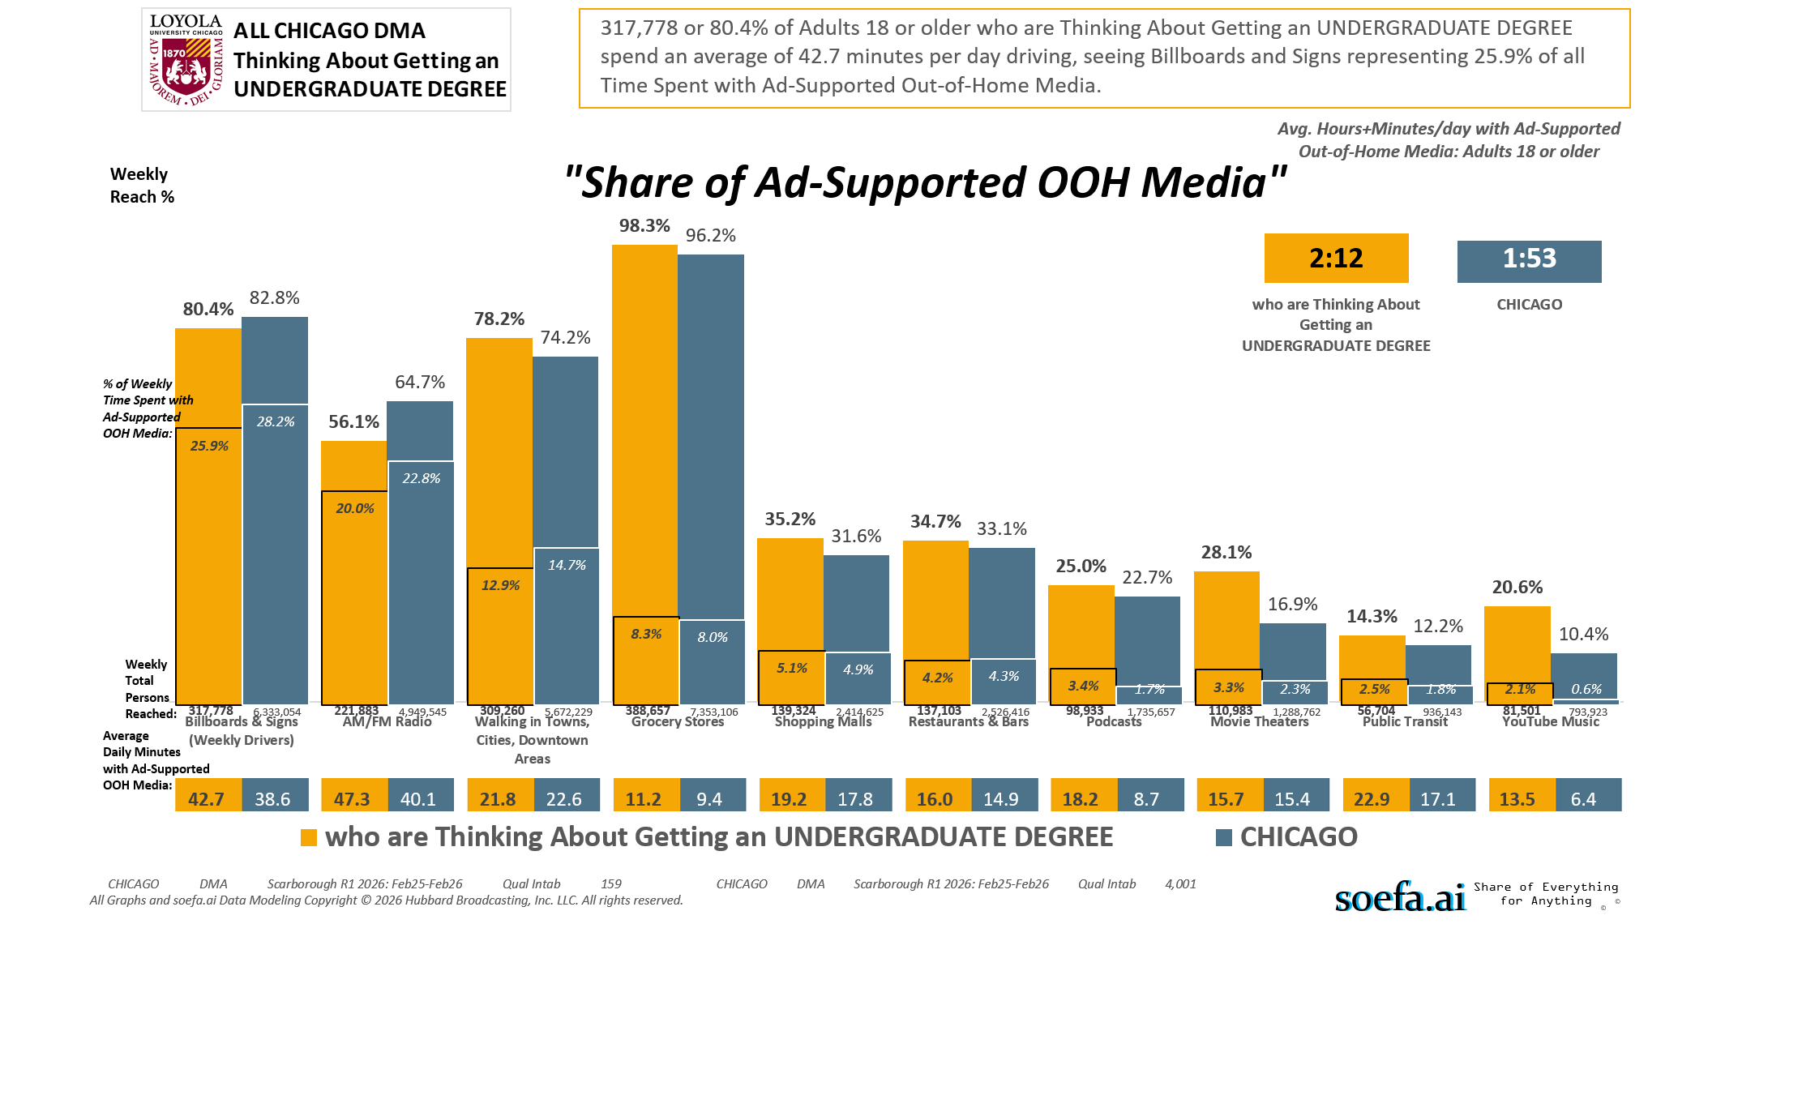
[(((Level of education: High school graduate (12th grade or GED) OR Level of education: Some college credit (no degree)) AND Ways used Internet/apps past 30 days on computer:Lifestyle: Education (research schools, application, financing)) AND Currently enrolled/attending classes at a college/university: No)]

Slide 22
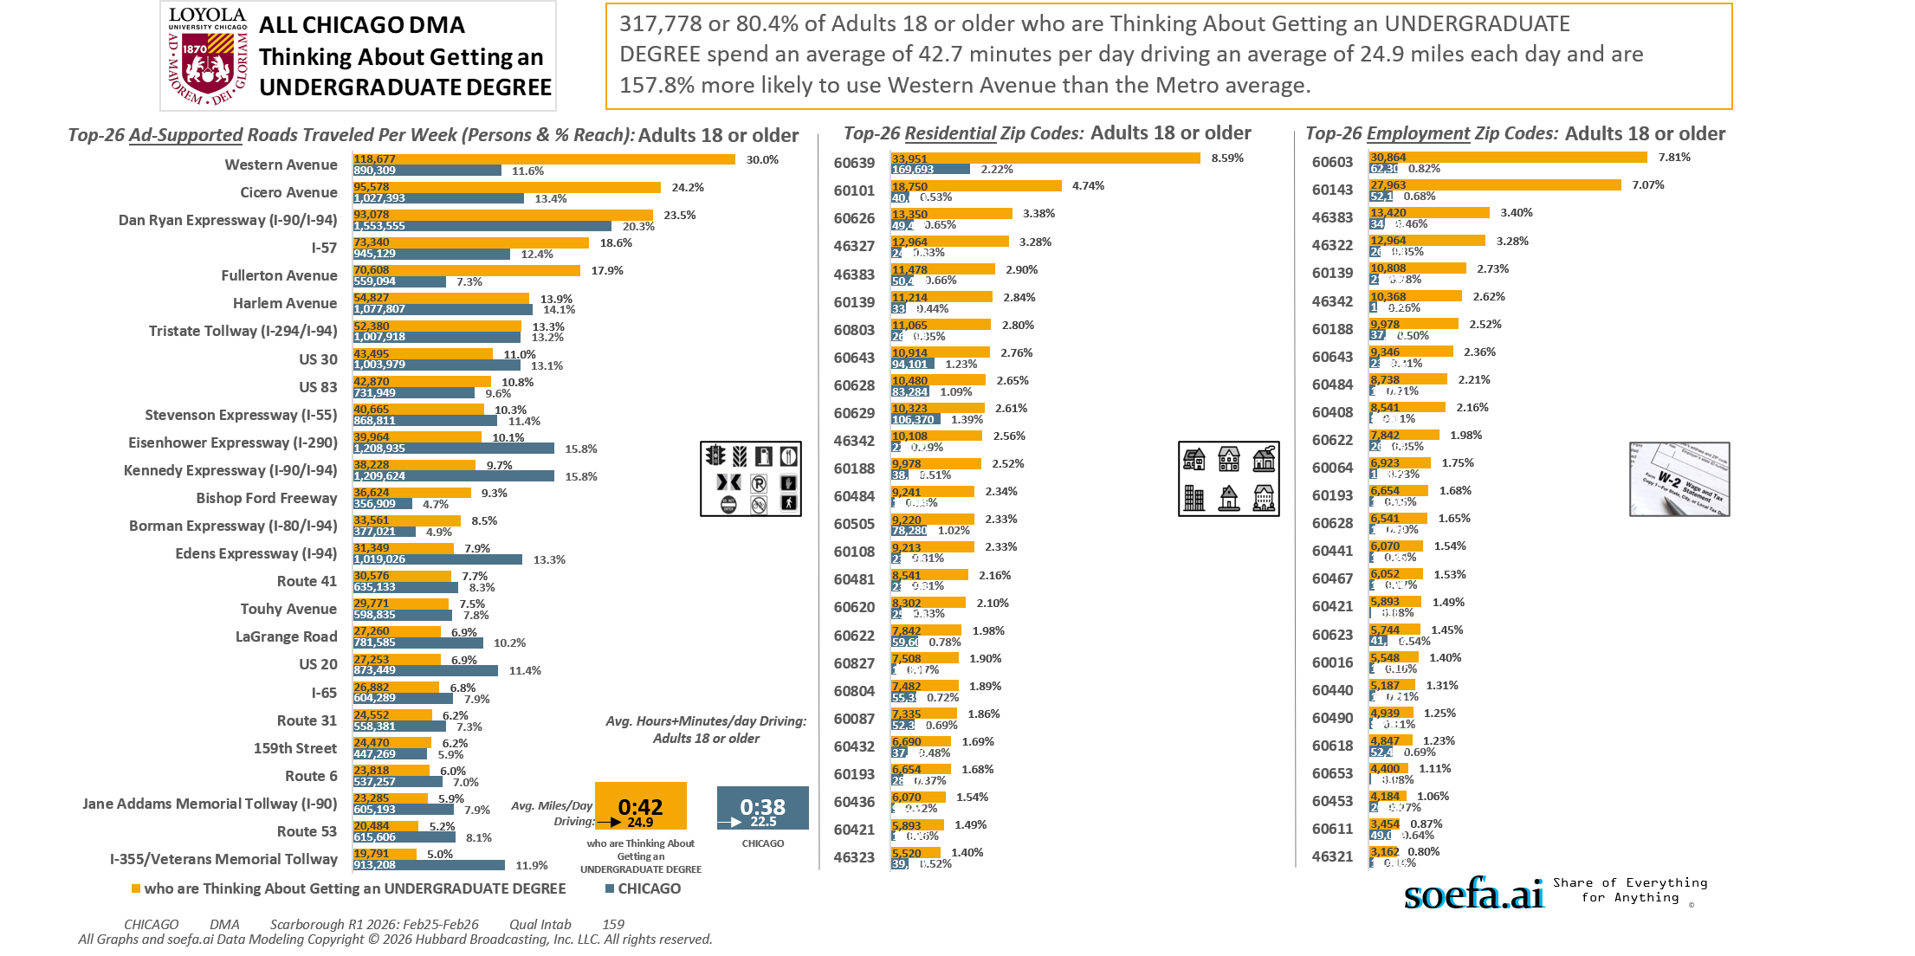
[(((Level of education: High school graduate (12th grade or GED) OR Level of education: Some college credit (no degree)) AND Ways used Internet/apps past 30 days on computer:Lifestyle: Education (research schools, application, financing)) AND Currently enrolled/attending classes at a college/university: No)]

Slide 23
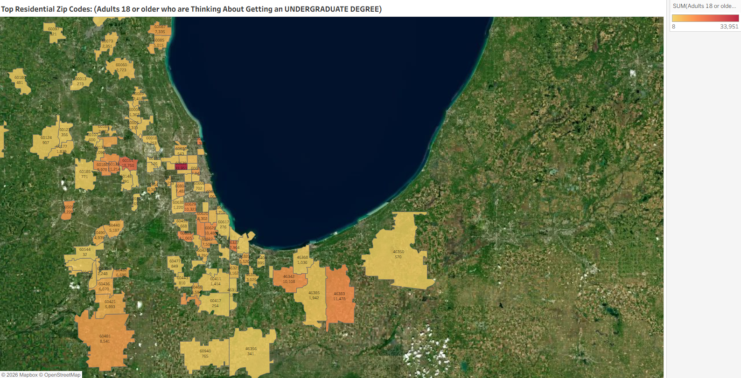
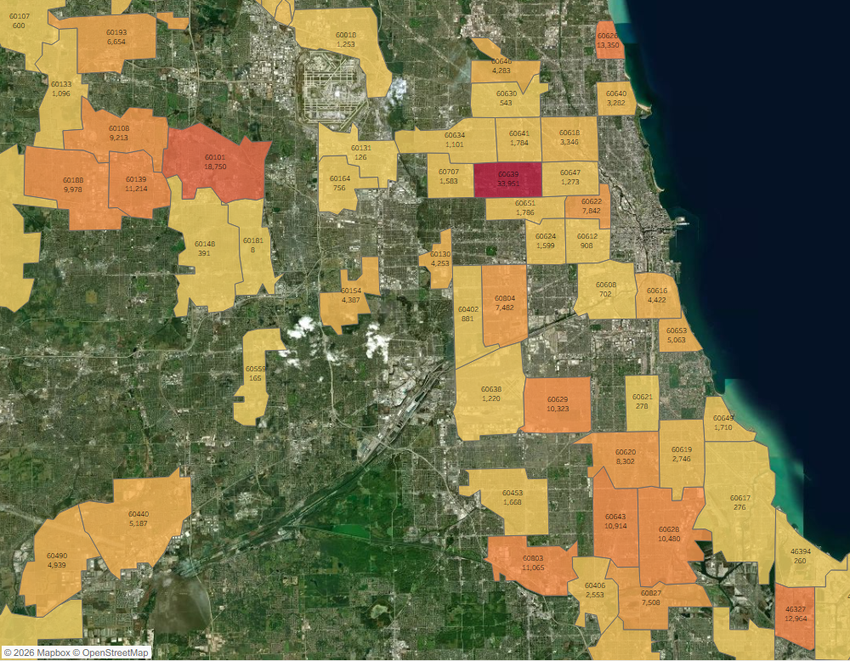
Zip Code Adults 18 or older who are Thinking About Getting an UNDERGRADUATE DEGREE
60639 33,951
60101 18,750
60626 13,350
46327 12,964
46383 11,478
60139 11,214
60803 11,065
60643 10,914
60628 10,480
60629 10,323
46342 10,108
60188 9,978
60484 9,241
60505 9,220
60108 9,213
60481 8,541
60620 8,302
60622 7,842
60827 7,508
60804 7,482
60087 7,335
60432 6,690
60193 6,654
60436 6,070
60421 5,893
46323 5,520
60440 5,187
60653 5,063
60085 5,015
60490 4,939
60466 4,594
60616 4,422
60154 4,387
60646 4,283
60130 4,253
60618 3,346
60426 3,291
60640 3,282
46321 3,162
46319 3,025
60619 2,746
60060 2,723
60406 2,553
60089 2,418
60073 2,351
60005 2,319
60431 2,286
60169 2,282
60435 2,248
46385 1,942
60177 1,839
60651 1,786
60641 1,784
60649 1,710
60453 1,668
60624 1,599
60707 1,583
60411 1,414
60178 1,399
60004 1,362
60647 1,273
60018 1,253
60638 1,220
60056 1,201
60586 1,157
60634 1,101
60133 1,096
46368 1,036
60409 974
60612 908
60124 907
46404 895
60402 881
60477 849
60443 810
60185 771
60940 765
60164 756
61373 739
60608 702
60915 696
60107 600
60429 596
46409 587
46350 570
60630 543
60180 481
60148 391
60123 356
46356 341
60097 321
46312 292
60621 278
60617 276
46394 260
60417 254
60013 233
60559 165
60131 126
46311 122
60002 40
60425 33
60544 32
60115 16
60181 8
[(((Level of education: High school graduate (12th grade or GED) OR Level of education: Some college credit (no degree)) AND Ways used Internet/apps past 30 days on computer:Lifestyle: Education (research schools, application, financing)) AND Currently enrolled/attending classes at a college/university: No)]

Slide 24
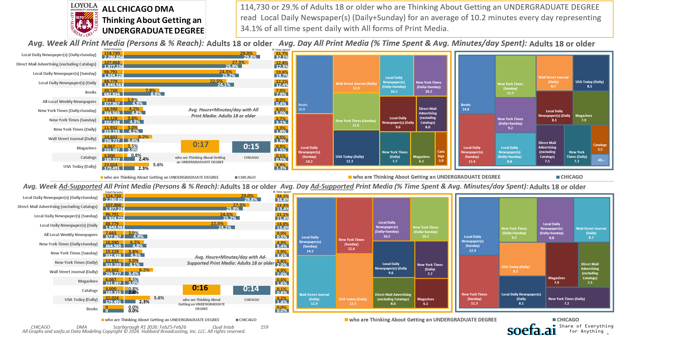
[(((Level of education: High school graduate (12th grade or GED) OR Level of education: Some college credit (no degree)) AND Ways used Internet/apps past 30 days on computer:Lifestyle: Education (research schools, application, financing)) AND Currently enrolled/attending classes at a college/university: No)]

Slide 25
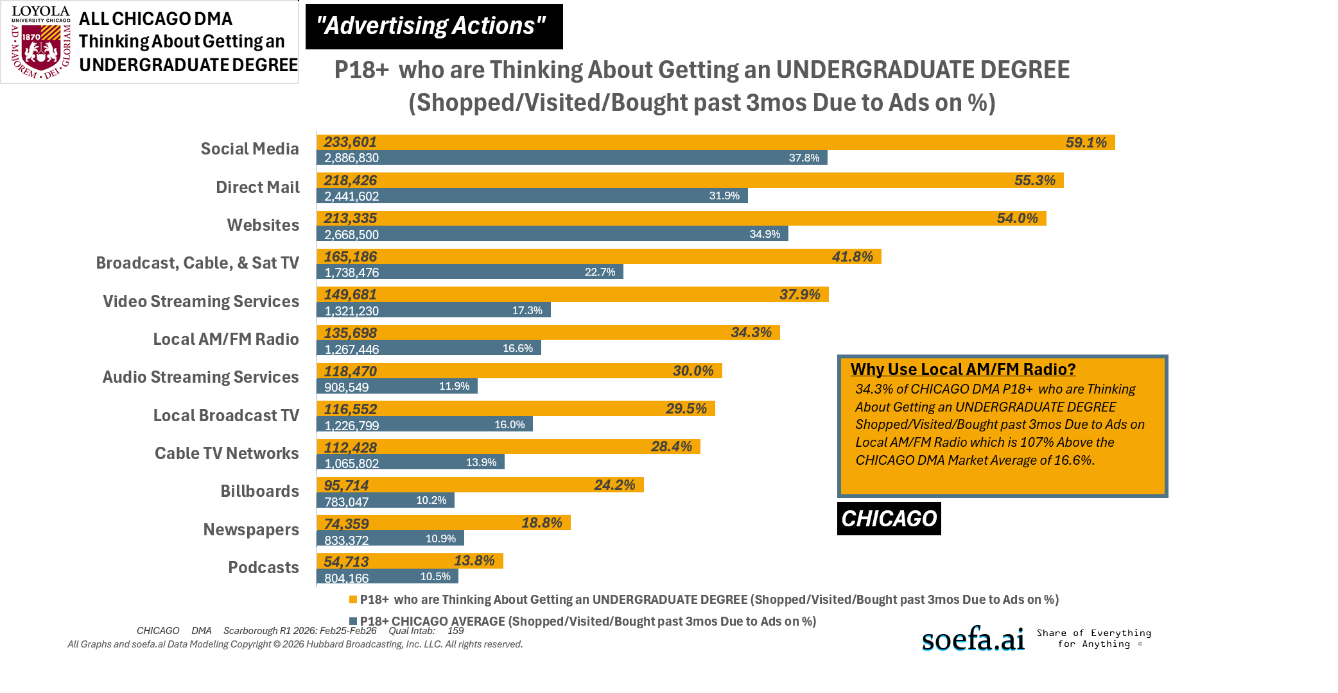
[(((Level of education: High school graduate (12th grade or GED) OR Level of education: Some college credit (no degree)) AND Ways used Internet/apps past 30 days on computer:Lifestyle: Education (research schools, application, financing)) AND Currently enrolled/attending classes at a college/university: No)]

