Slide 1
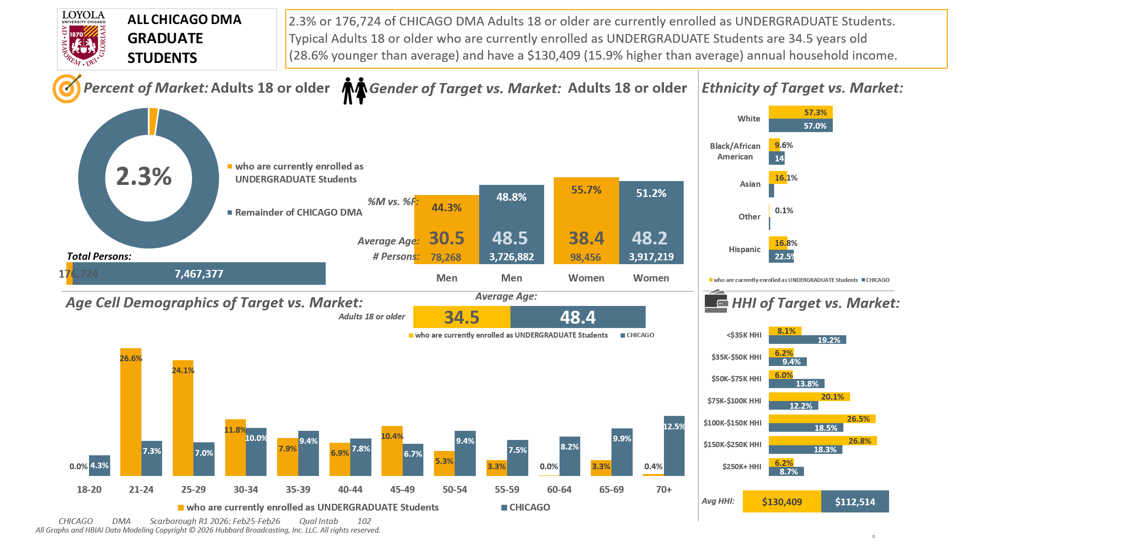





[(Currently enrolled/attending classes at a college/university: Yes AND (Level of education: Bachelor's degree (BA, BS, etc.) OR Level of education: Some postgraduate (no advanced degree) OR Level of education: Postgraduate degree))]

Slide 2
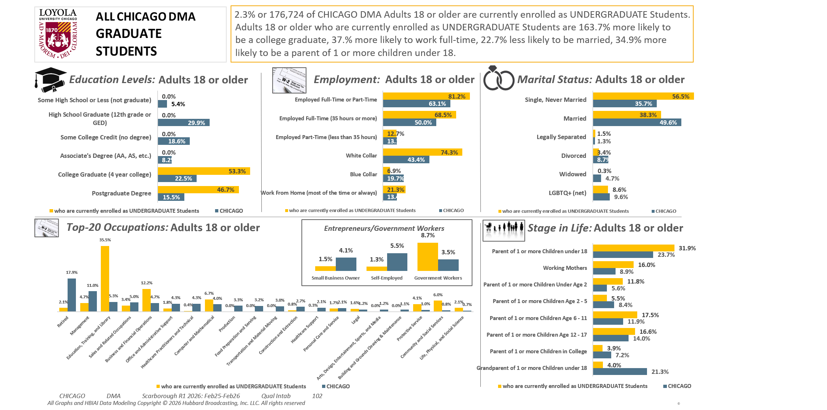
[(Currently enrolled/attending classes at a college/university: Yes AND (Level of education: Bachelor's degree (BA, BS, etc.) OR Level of education: Some postgraduate (no advanced degree) OR Level of education: Postgraduate degree))]

Slide 3
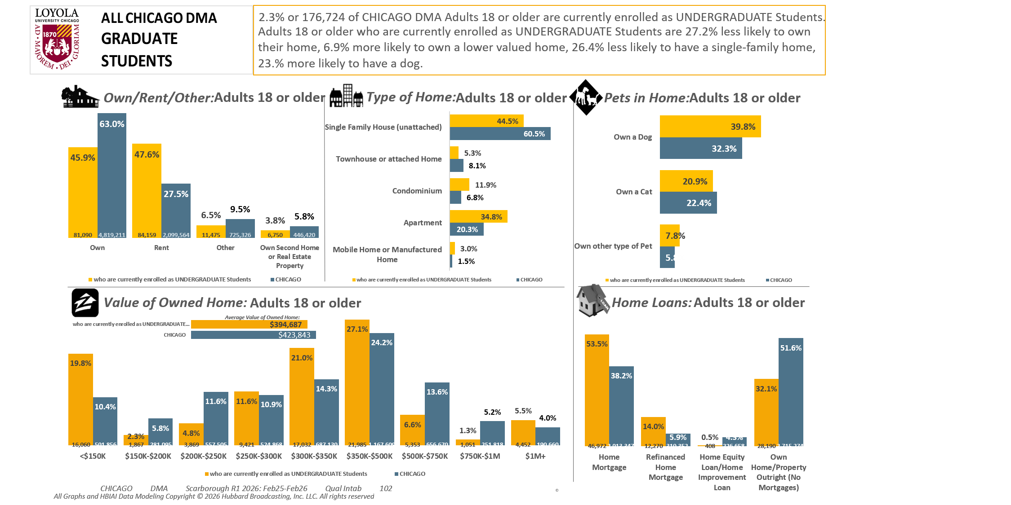
[(Currently enrolled/attending classes at a college/university: Yes AND (Level of education: Bachelor's degree (BA, BS, etc.) OR Level of education: Some postgraduate (no advanced degree) OR Level of education: Postgraduate degree))]

Slide 4
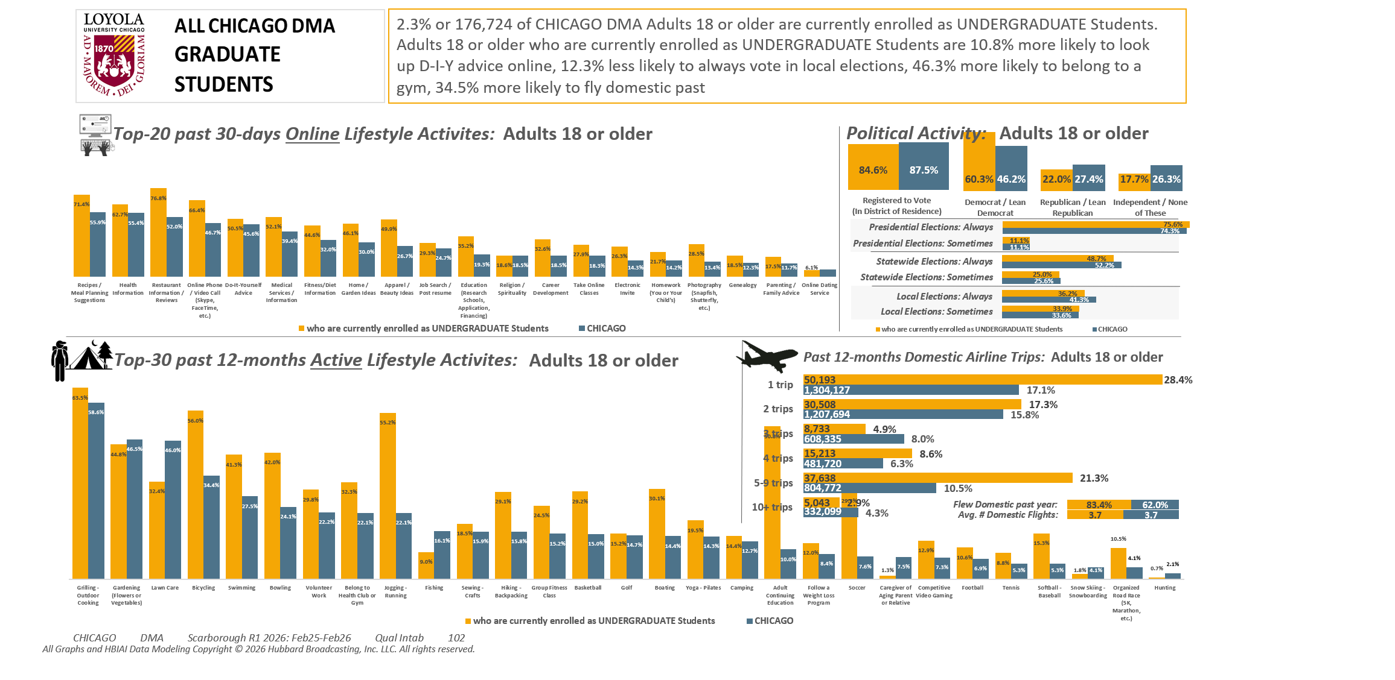
[(Currently enrolled/attending classes at a college/university: Yes AND (Level of education: Bachelor's degree (BA, BS, etc.) OR Level of education: Some postgraduate (no advanced degree) OR Level of education: Postgraduate degree))]

Slide 5
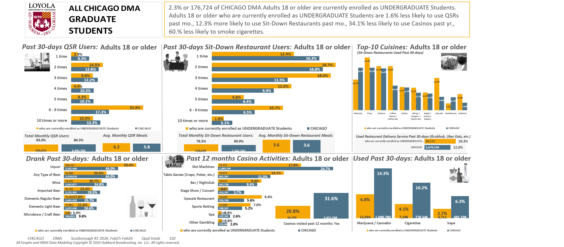
[(Currently enrolled/attending classes at a college/university: Yes AND (Level of education: Bachelor's degree (BA, BS, etc.) OR Level of education: Some postgraduate (no advanced degree) OR Level of education: Postgraduate degree))]

Slide 6
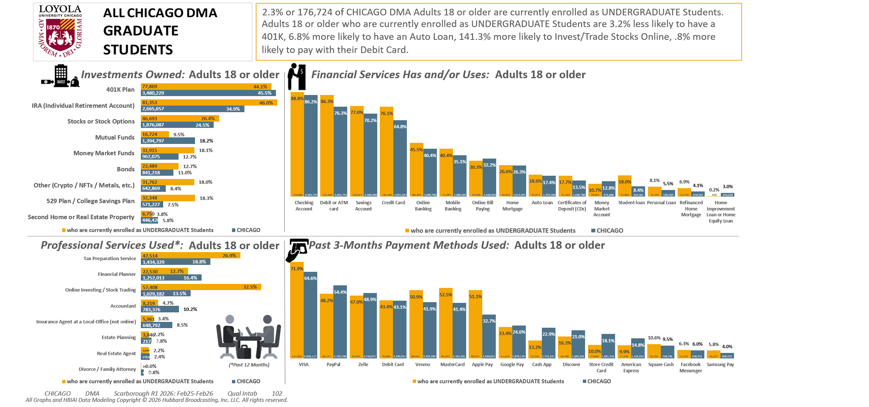
[(Currently enrolled/attending classes at a college/university: Yes AND (Level of education: Bachelor's degree (BA, BS, etc.) OR Level of education: Some postgraduate (no advanced degree) OR Level of education: Postgraduate degree))]

Slide 7
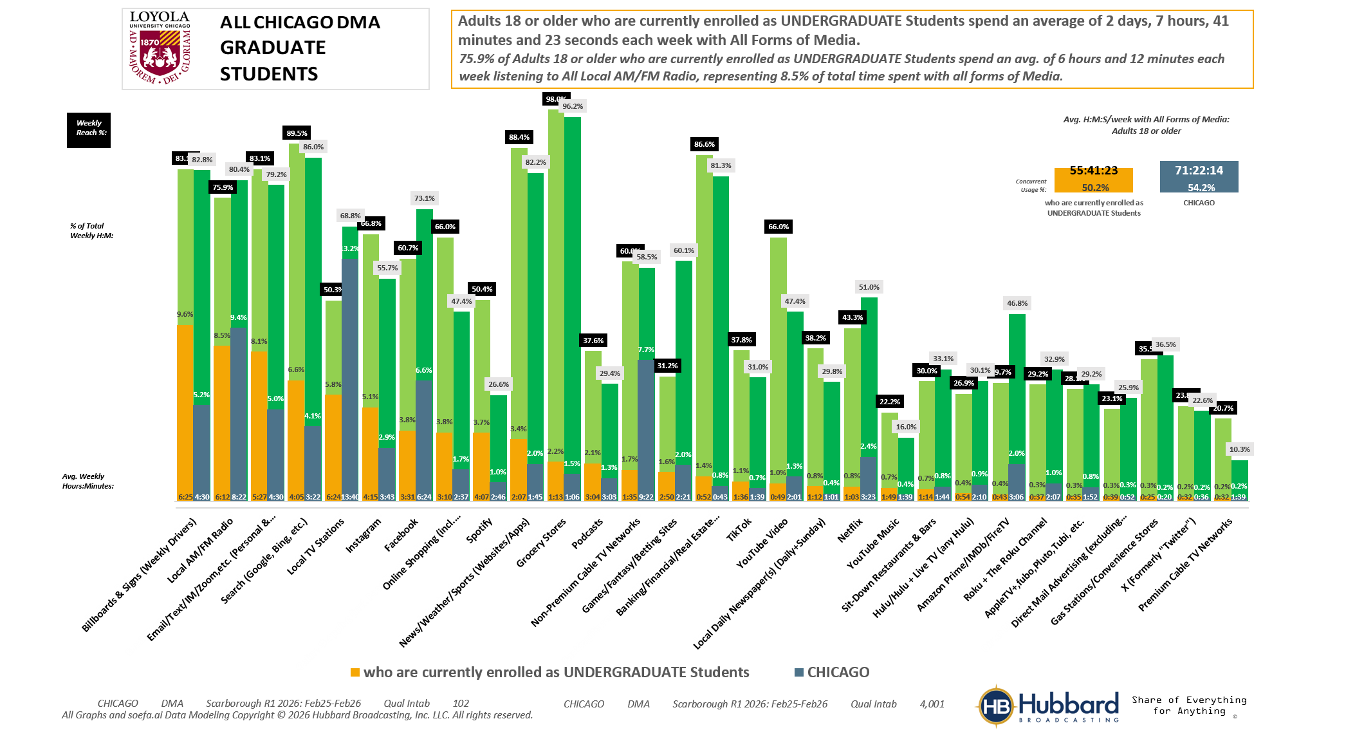

[(Currently enrolled/attending classes at a college/university: Yes AND (Level of education: Bachelor's degree (BA, BS, etc.) OR Level of education: Some postgraduate (no advanced degree) OR Level of education: Postgraduate degree))]

Slide 8
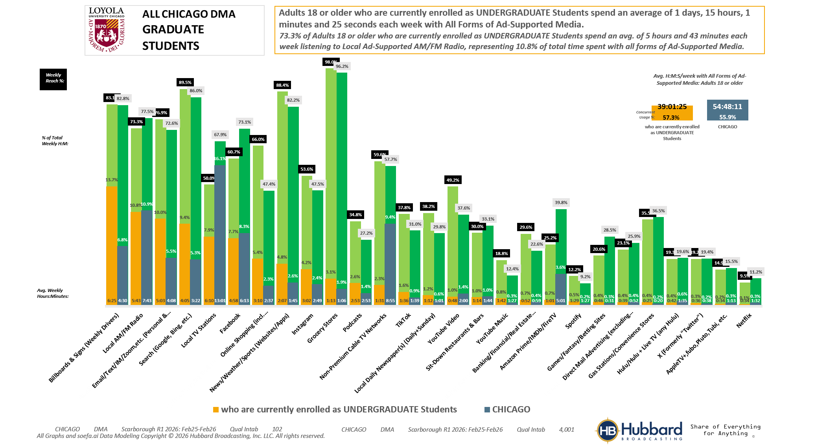
[(Currently enrolled/attending classes at a college/university: Yes AND (Level of education: Bachelor's degree (BA, BS, etc.) OR Level of education: Some postgraduate (no advanced degree) OR Level of education: Postgraduate degree))]

Slide 9
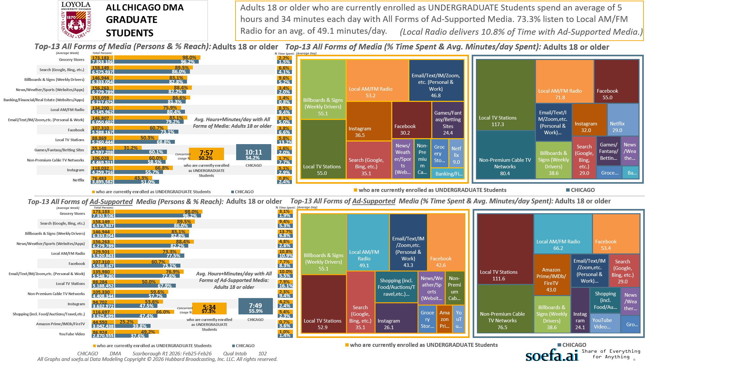
[(Currently enrolled/attending classes at a college/university: Yes AND (Level of education: Bachelor's degree (BA, BS, etc.) OR Level of education: Some postgraduate (no advanced degree) OR Level of education: Postgraduate degree))]

Slide 10
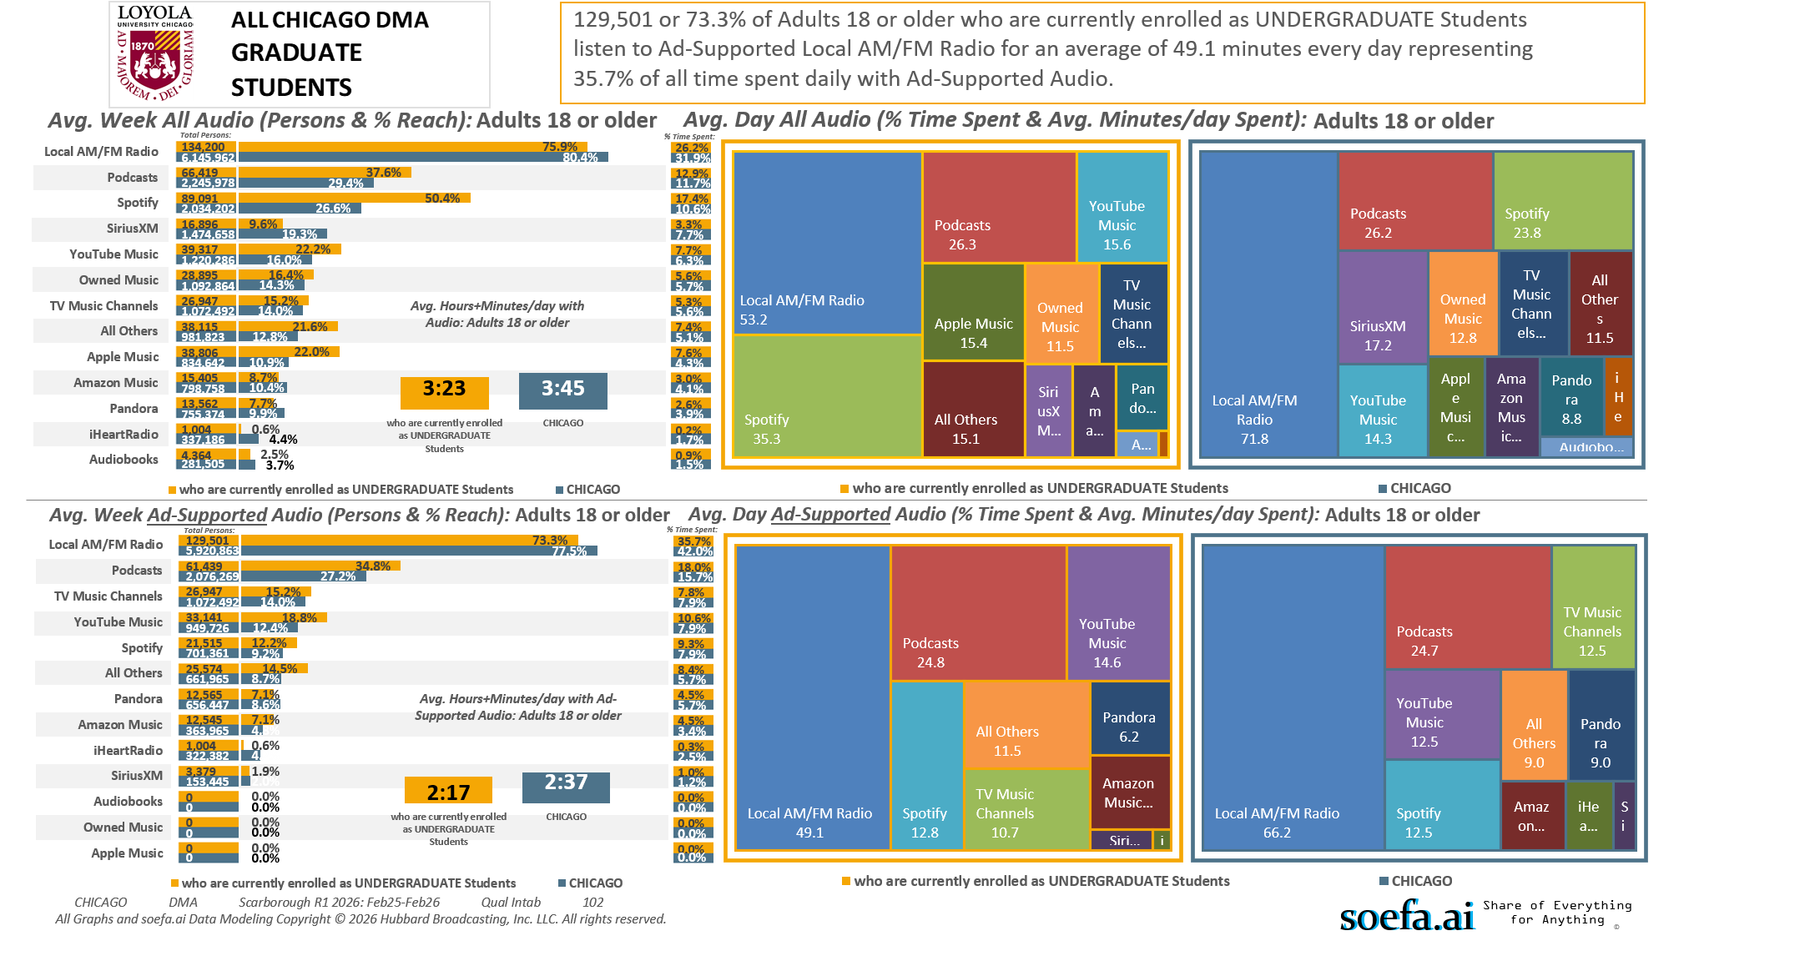
[(Currently enrolled/attending classes at a college/university: Yes AND (Level of education: Bachelor's degree (BA, BS, etc.) OR Level of education: Some postgraduate (no advanced degree) OR Level of education: Postgraduate degree))]

Slide 11
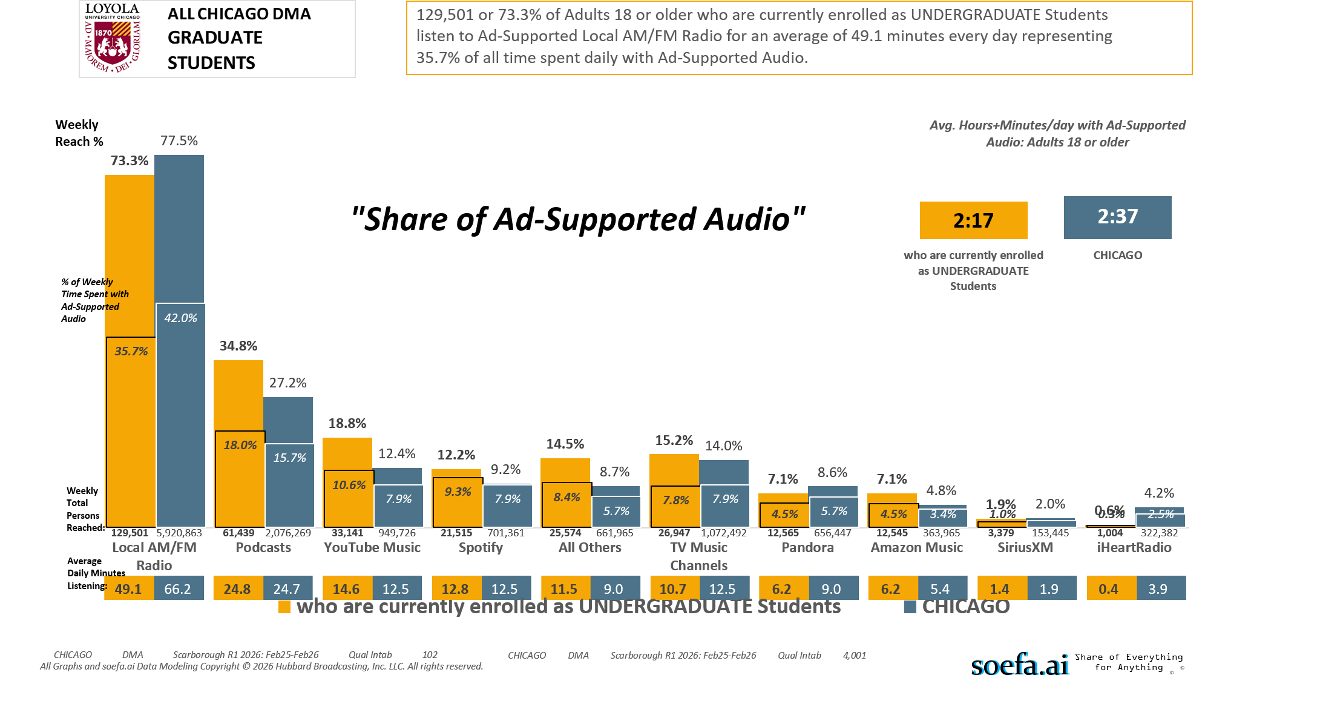
[(Currently enrolled/attending classes at a college/university: Yes AND (Level of education: Bachelor's degree (BA, BS, etc.) OR Level of education: Some postgraduate (no advanced degree) OR Level of education: Postgraduate degree))]

Slide 12
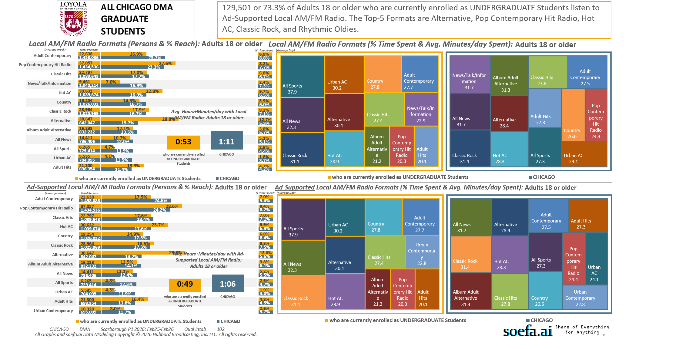
[(Currently enrolled/attending classes at a college/university: Yes AND (Level of education: Bachelor's degree (BA, BS, etc.) OR Level of education: Some postgraduate (no advanced degree) OR Level of education: Postgraduate degree))]

Slide 13
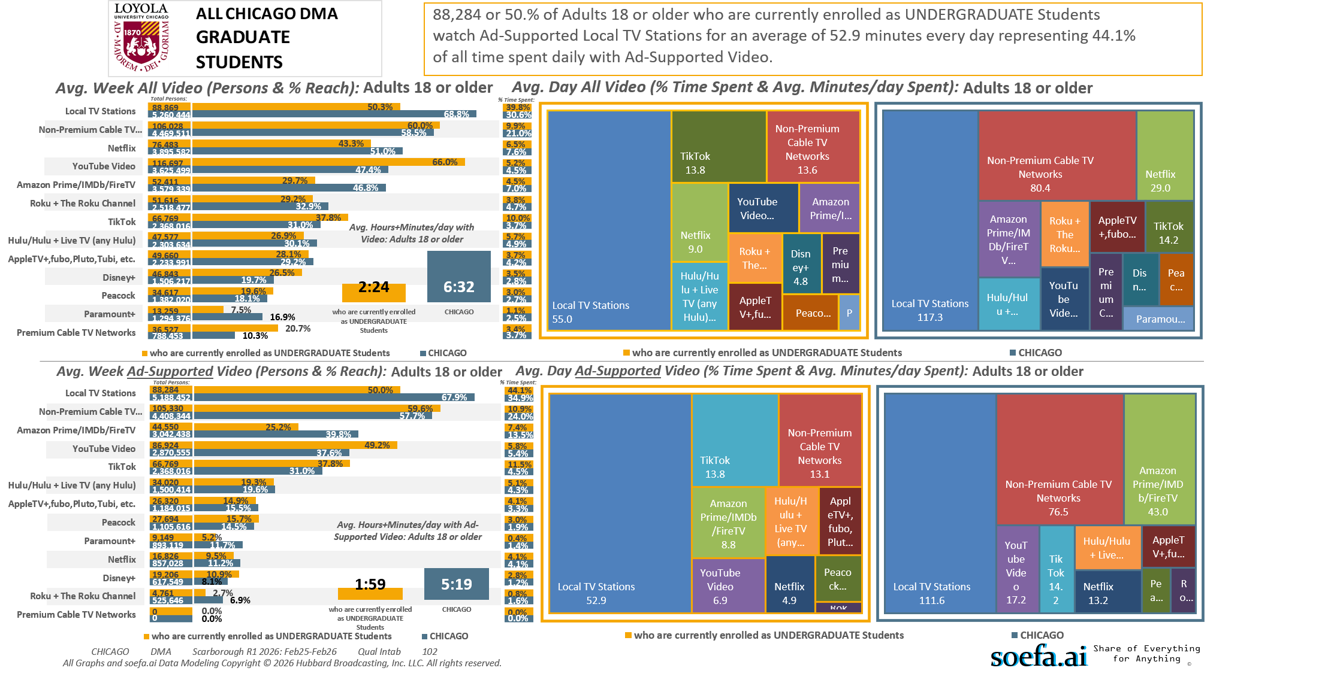
[(Currently enrolled/attending classes at a college/university: Yes AND (Level of education: Bachelor's degree (BA, BS, etc.) OR Level of education: Some postgraduate (no advanced degree) OR Level of education: Postgraduate degree))]

Slide 14
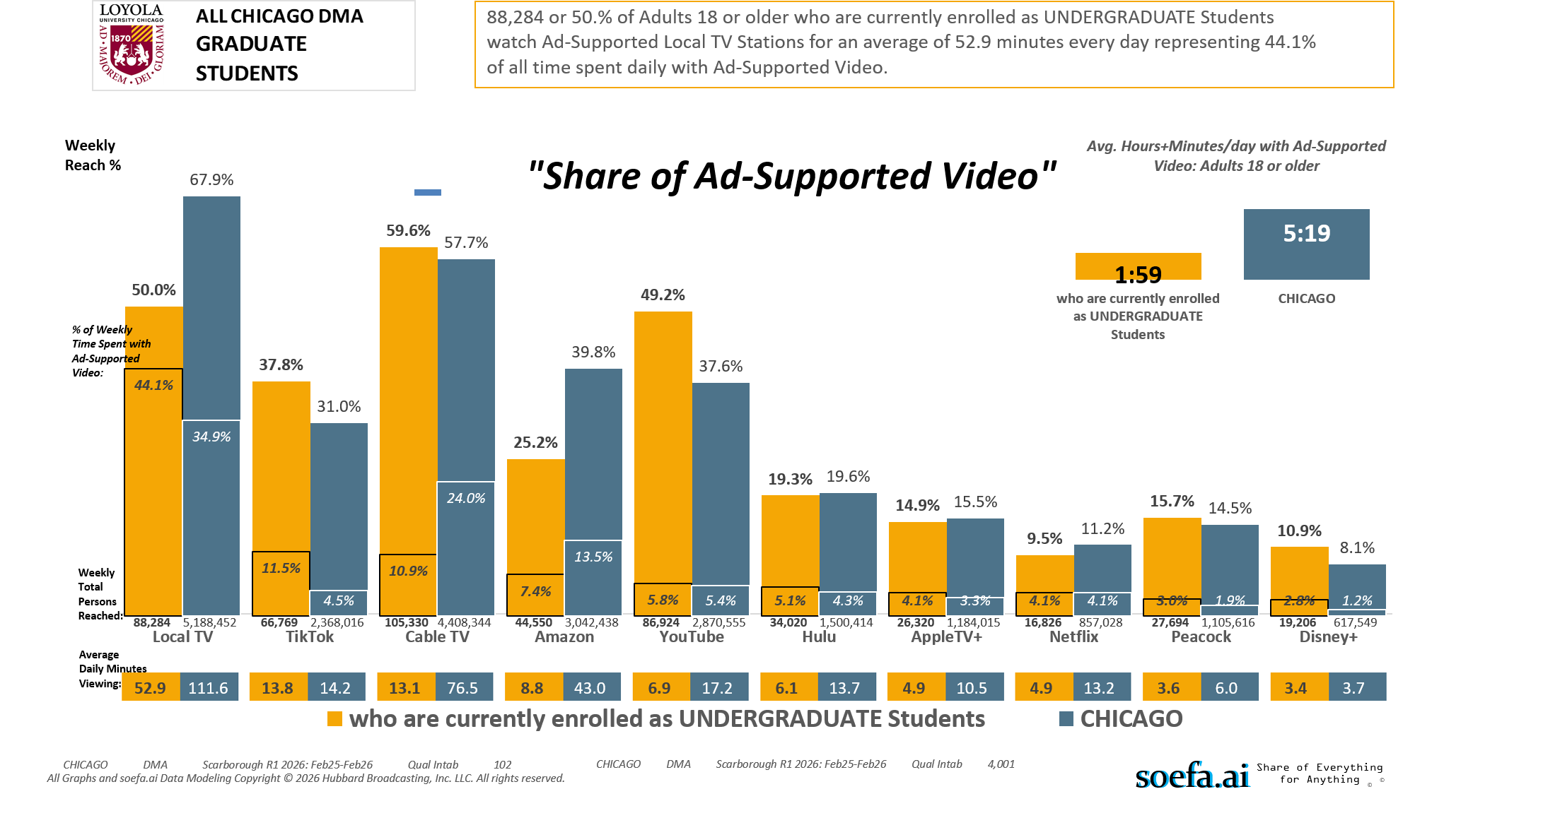
[(Currently enrolled/attending classes at a college/university: Yes AND (Level of education: Bachelor's degree (BA, BS, etc.) OR Level of education: Some postgraduate (no advanced degree) OR Level of education: Postgraduate degree))]

Slide 15
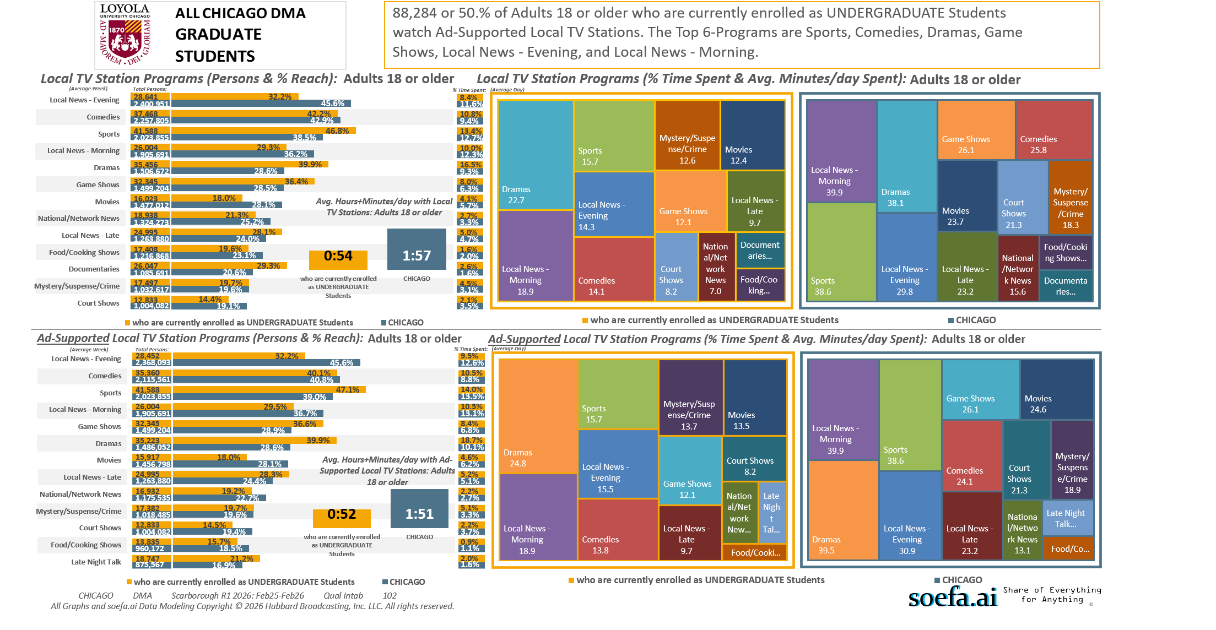
[(Currently enrolled/attending classes at a college/university: Yes AND (Level of education: Bachelor's degree (BA, BS, etc.) OR Level of education: Some postgraduate (no advanced degree) OR Level of education: Postgraduate degree))]

Slide 16
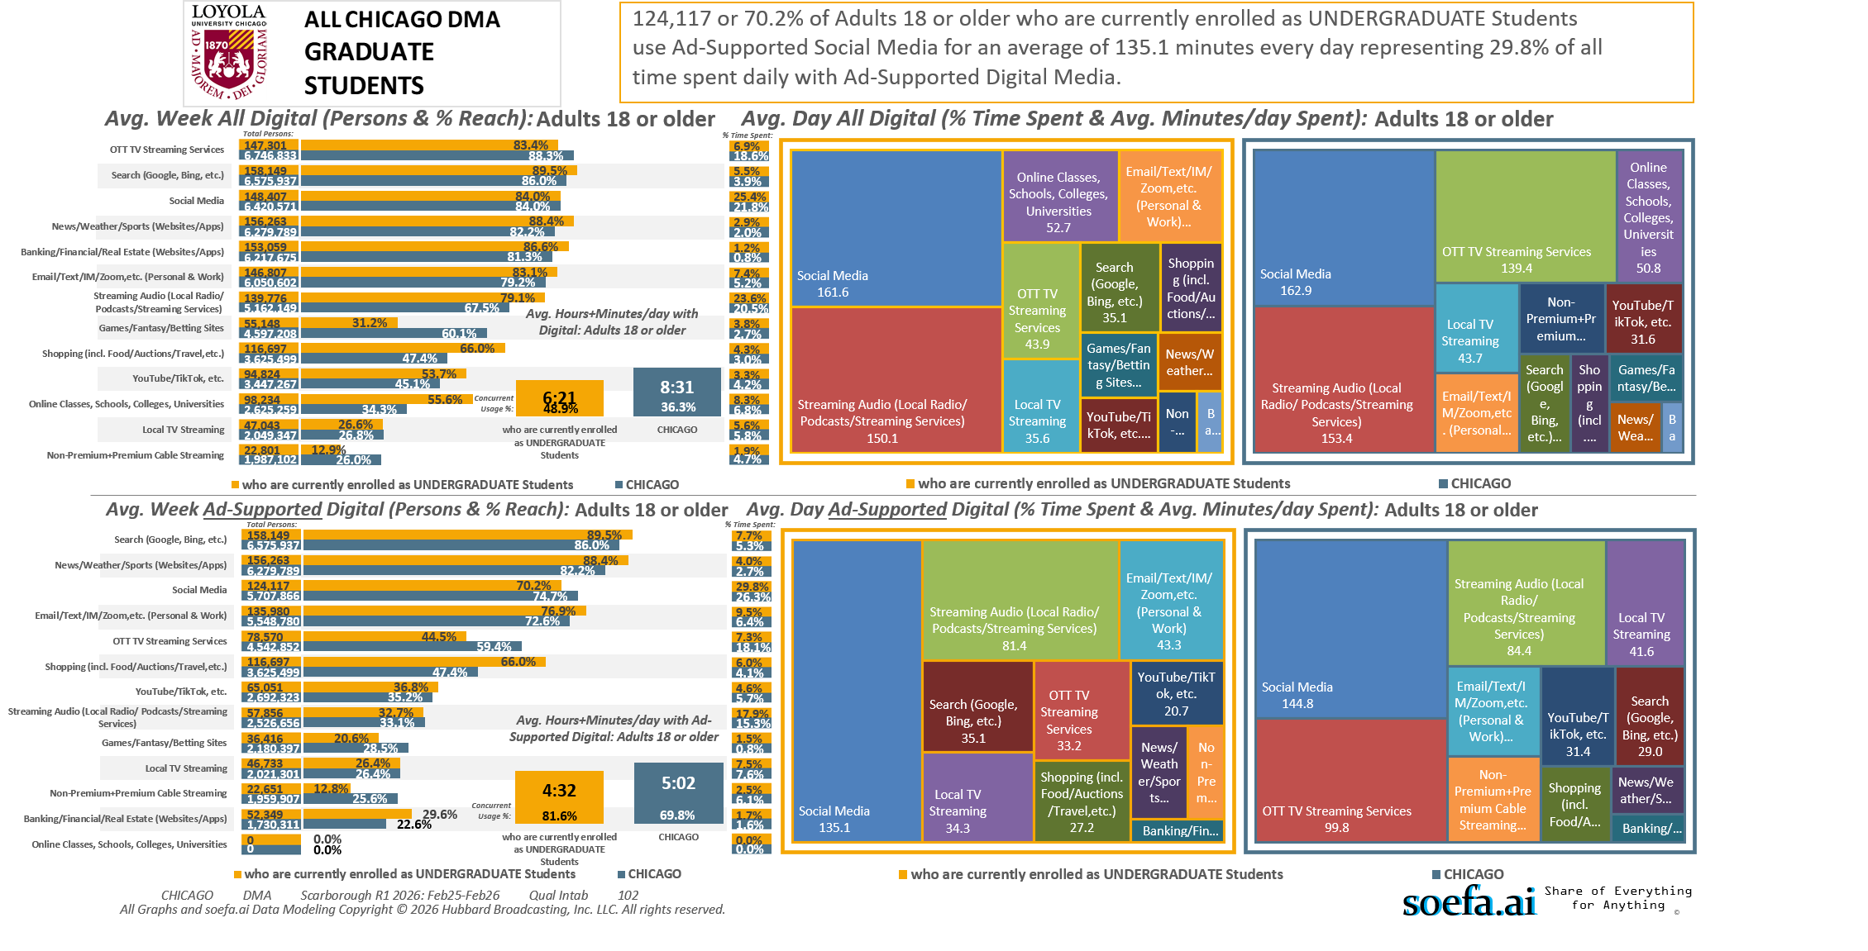
[(Currently enrolled/attending classes at a college/university: Yes AND (Level of education: Bachelor's degree (BA, BS, etc.) OR Level of education: Some postgraduate (no advanced degree) OR Level of education: Postgraduate degree))]

Slide 17
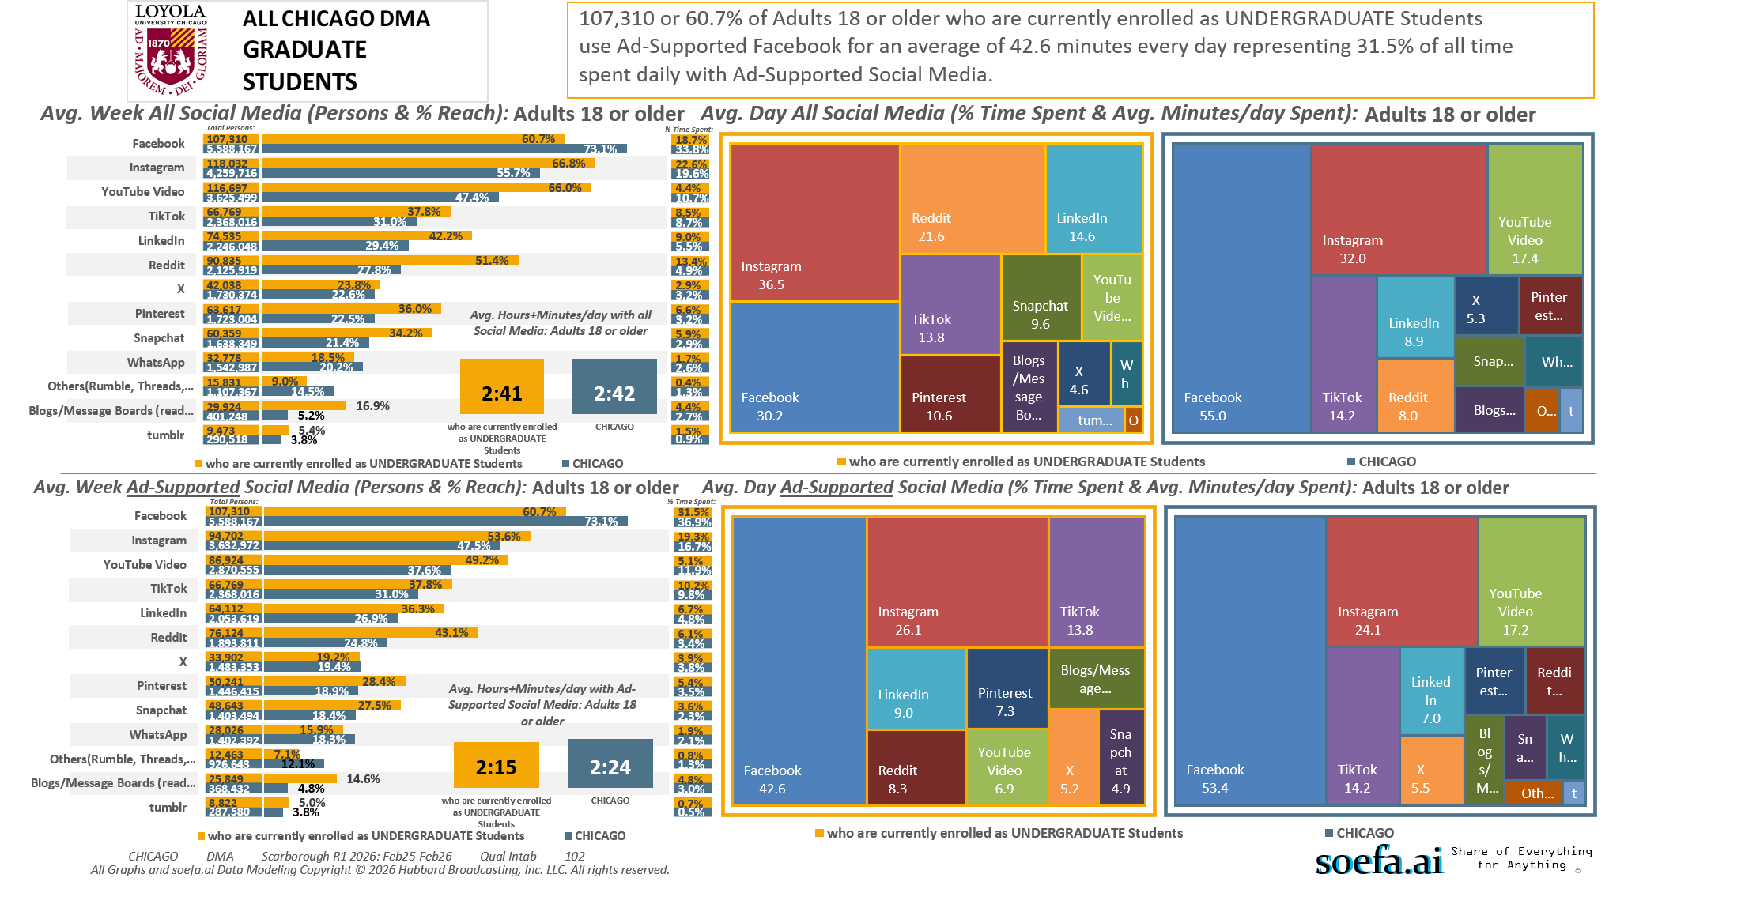
[(Currently enrolled/attending classes at a college/university: Yes AND (Level of education: Bachelor's degree (BA, BS, etc.) OR Level of education: Some postgraduate (no advanced degree) OR Level of education: Postgraduate degree))]

Slide 18
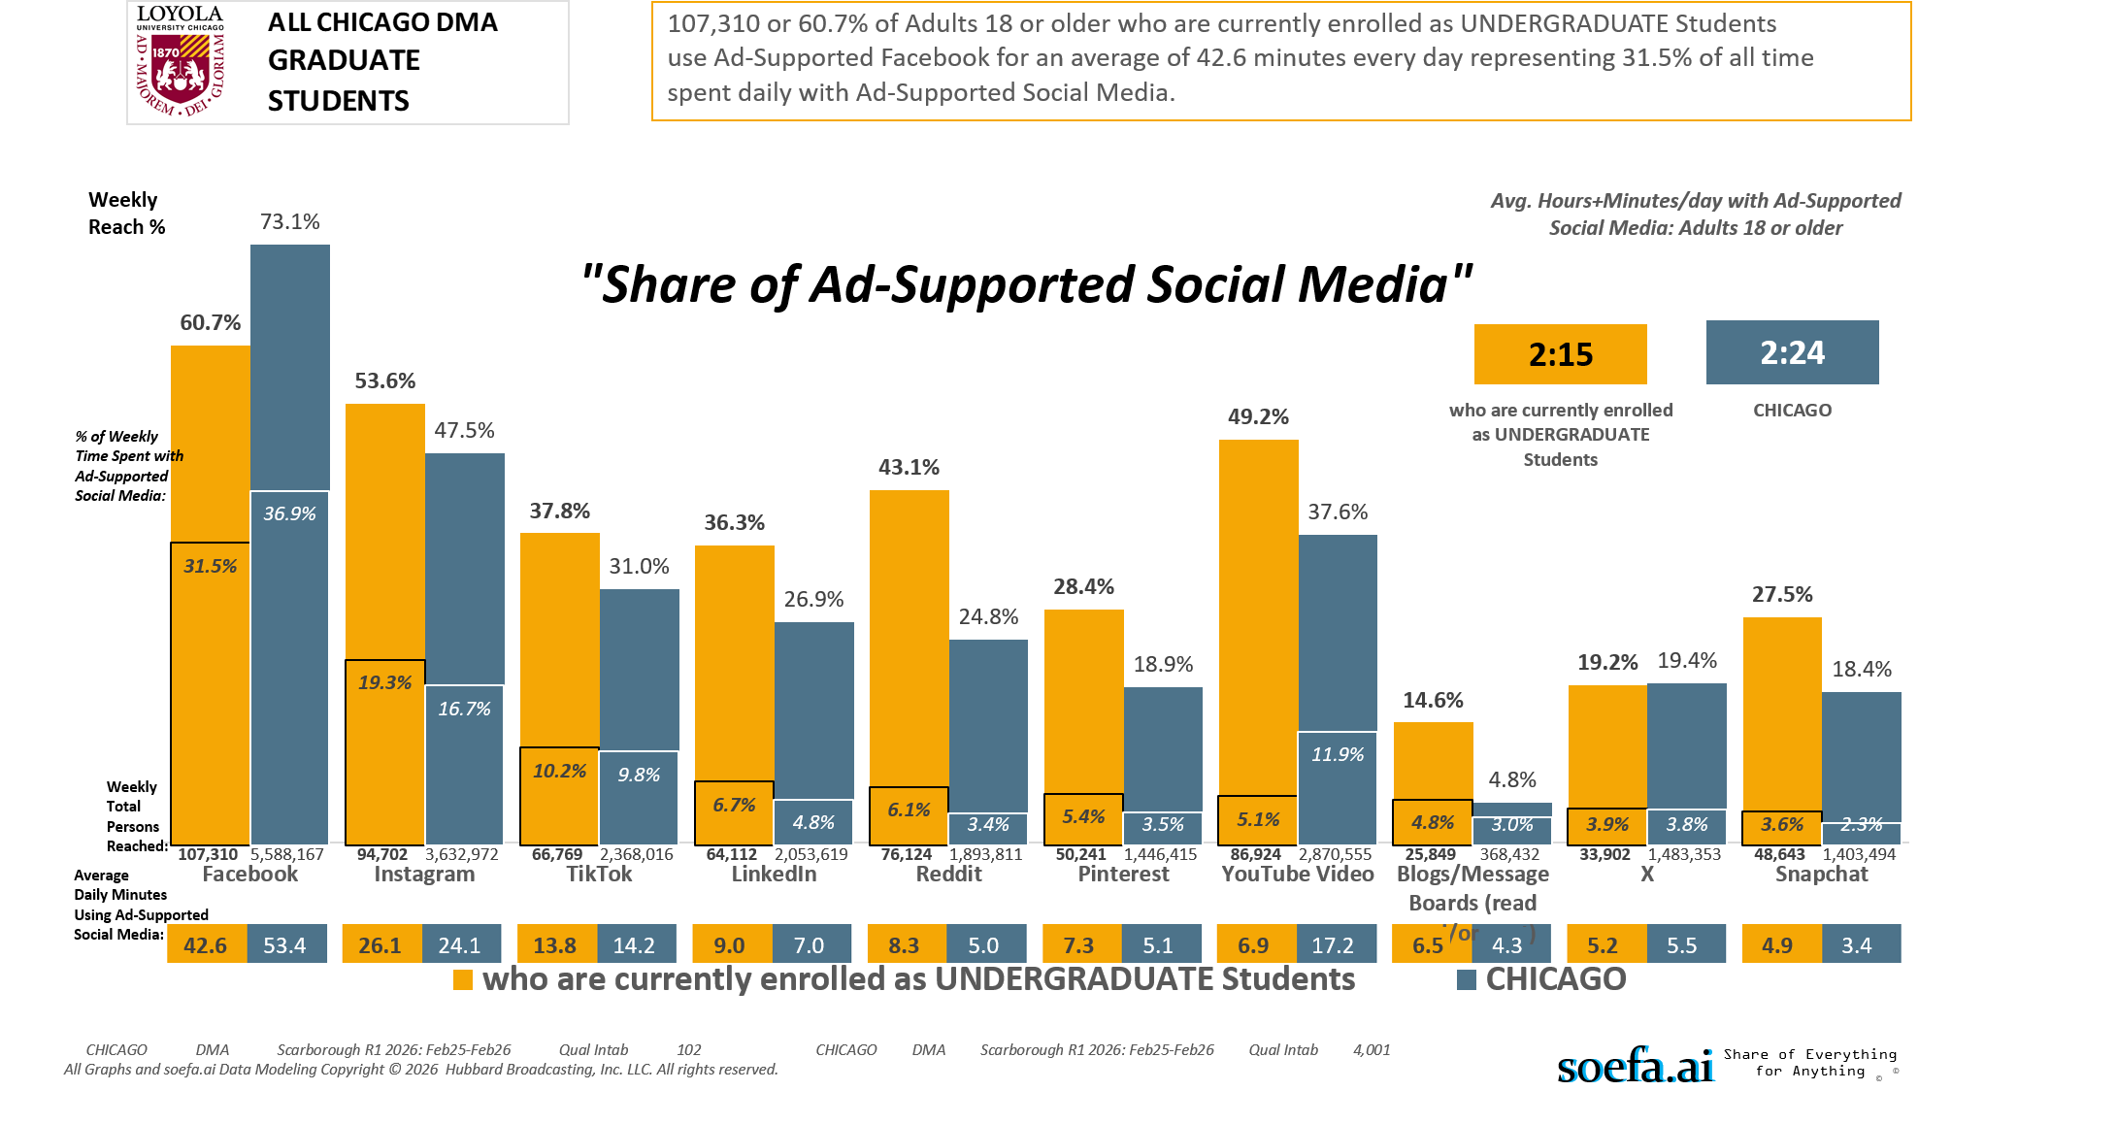
[(Currently enrolled/attending classes at a college/university: Yes AND (Level of education: Bachelor's degree (BA, BS, etc.) OR Level of education: Some postgraduate (no advanced degree) OR Level of education: Postgraduate degree))]

Slide 19
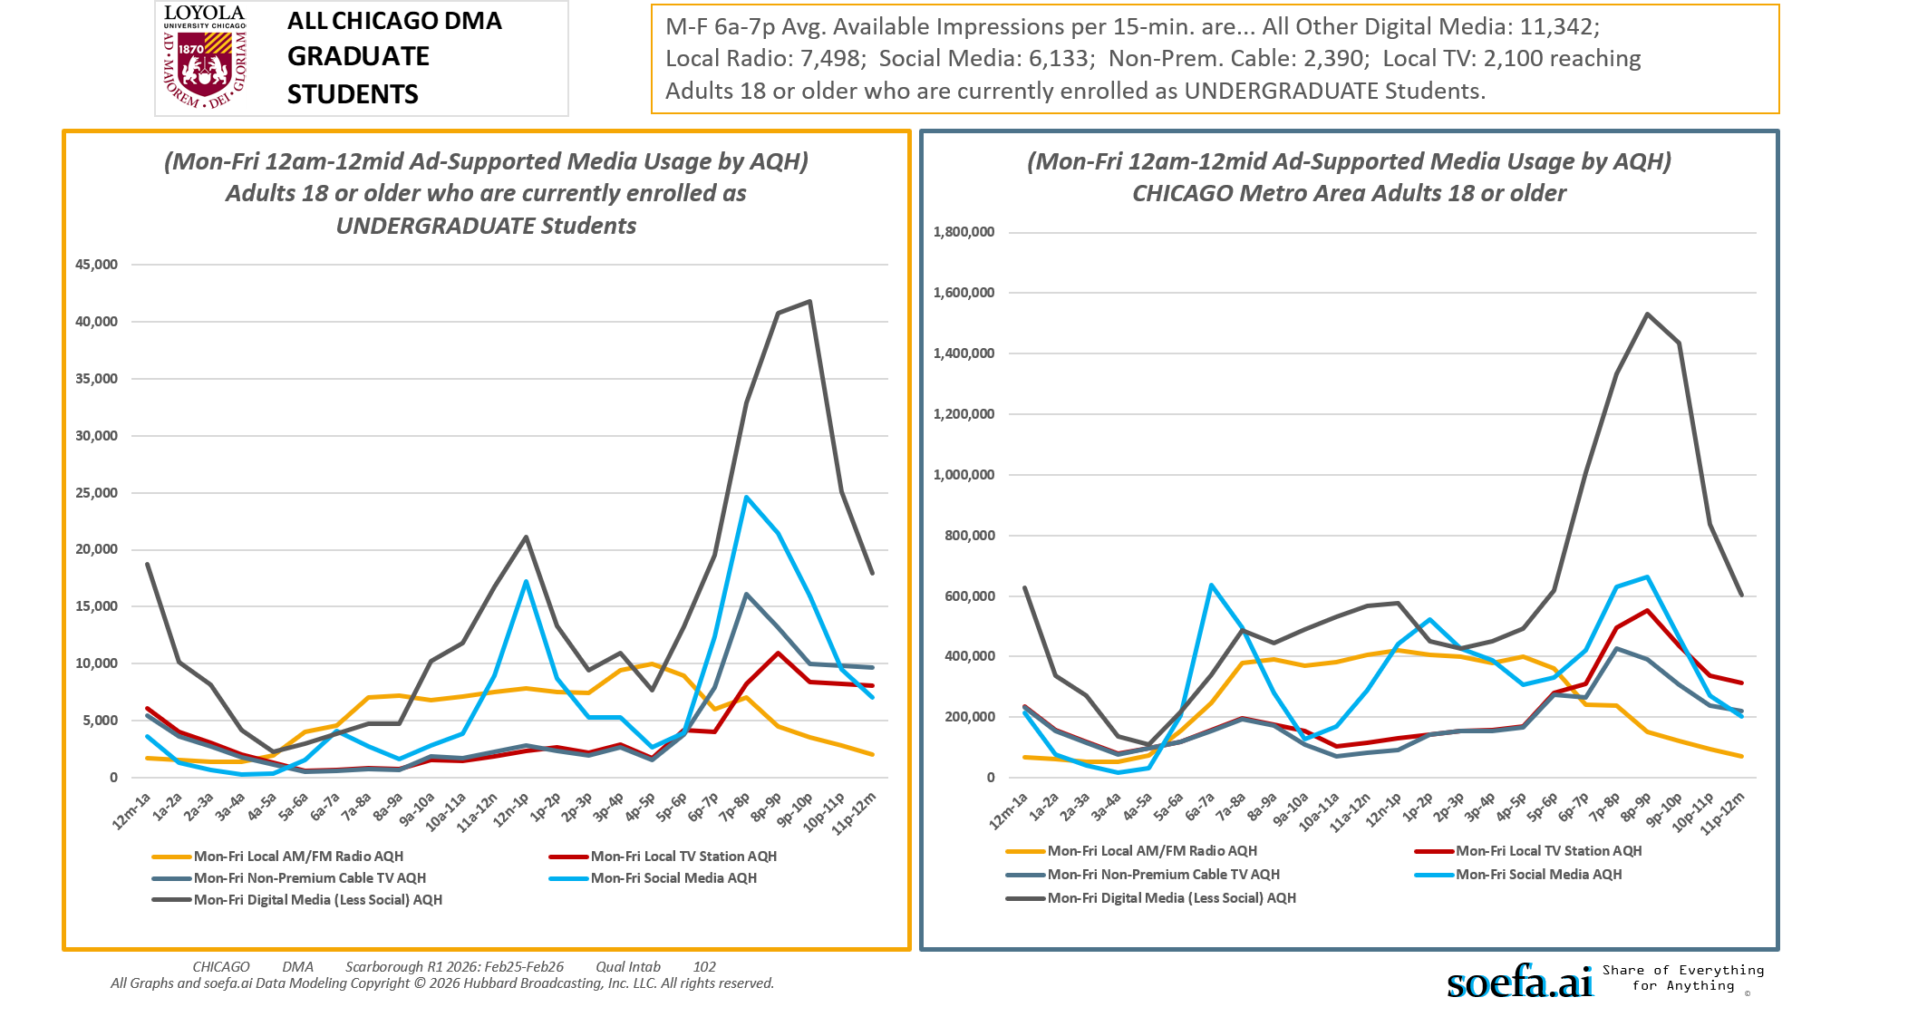
[(Currently enrolled/attending classes at a college/university: Yes AND (Level of education: Bachelor's degree (BA, BS, etc.) OR Level of education: Some postgraduate (no advanced degree) OR Level of education: Postgraduate degree))]

Slide 20
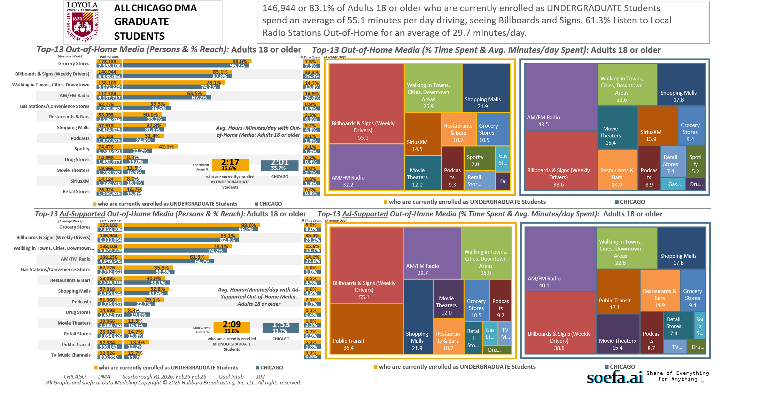
[(Currently enrolled/attending classes at a college/university: Yes AND (Level of education: Bachelor's degree (BA, BS, etc.) OR Level of education: Some postgraduate (no advanced degree) OR Level of education: Postgraduate degree))]

Slide 21
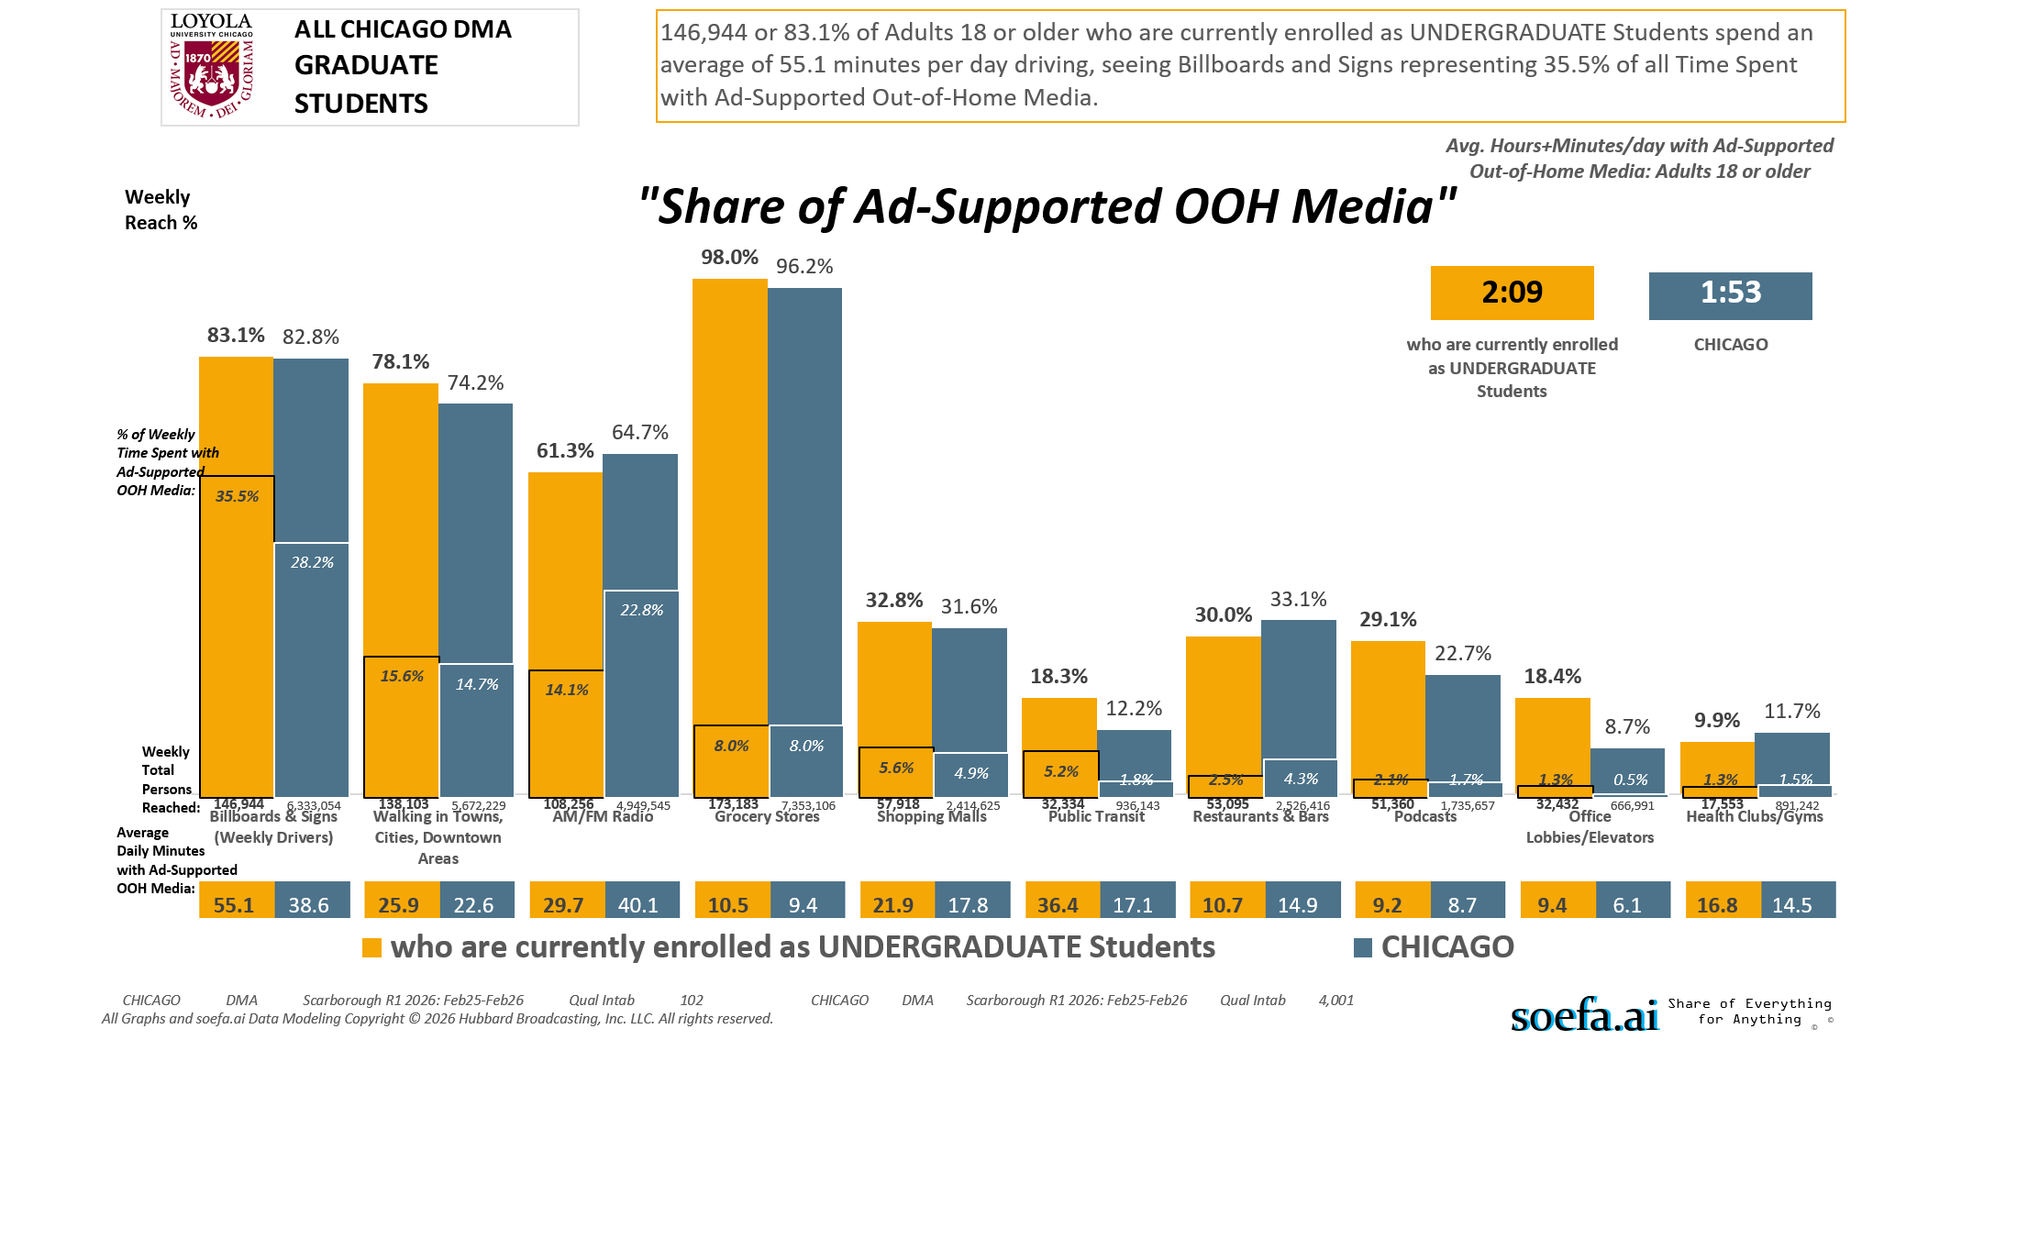
[(Currently enrolled/attending classes at a college/university: Yes AND (Level of education: Bachelor's degree (BA, BS, etc.) OR Level of education: Some postgraduate (no advanced degree) OR Level of education: Postgraduate degree))]

Slide 22
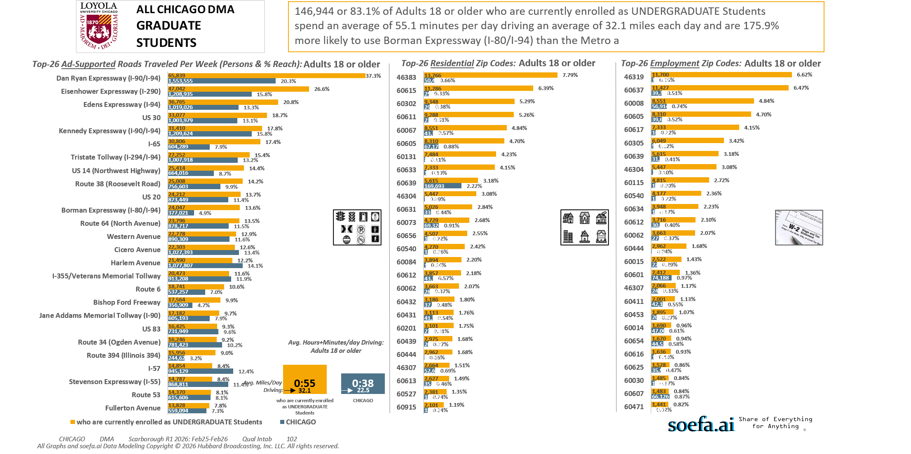
[(Currently enrolled/attending classes at a college/university: Yes AND (Level of education: Bachelor's degree (BA, BS, etc.) OR Level of education: Some postgraduate (no advanced degree) OR Level of education: Postgraduate degree))]

Slide 23
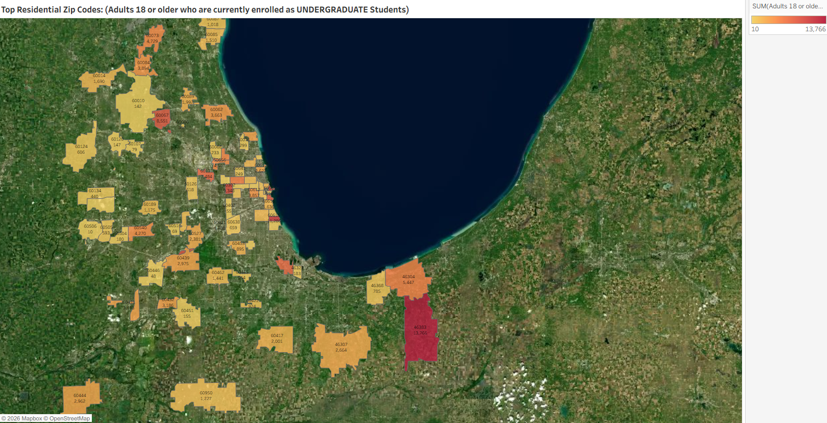
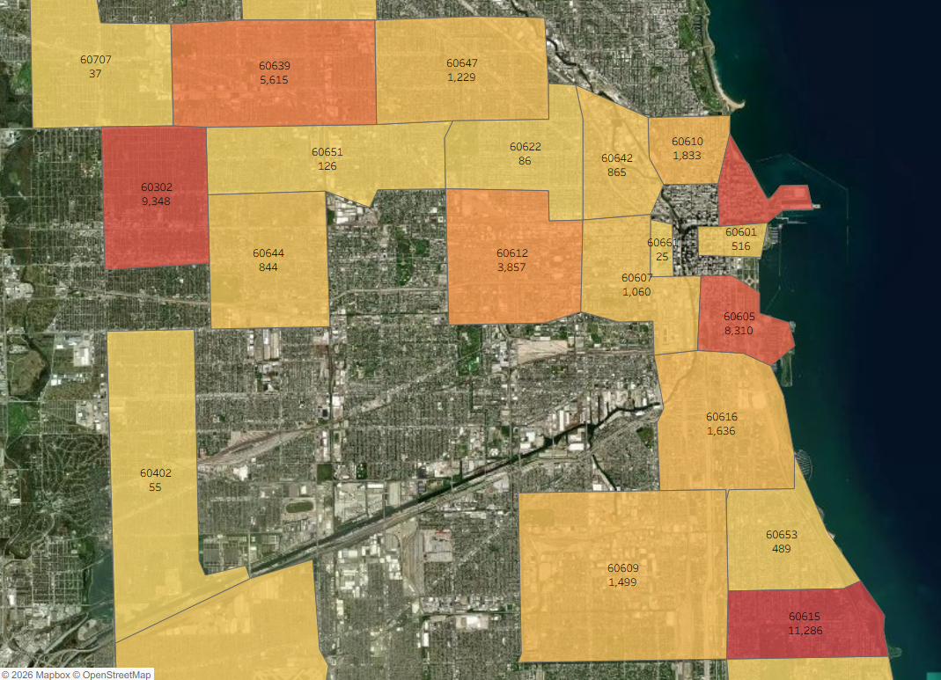
Zip Code Adults 18 or older who are currently enrolled as UNDERGRADUATE Students
46383 13,766
60615 11,286
60302 9,348
60611 9,288
60067 8,551
60605 8,310
60131 7,484
60633 7,333
60639 5,615
46304 5,447
60631 5,026
60073 4,729
60656 4,507
60540 4,270
60084 3,894
60612 3,857
60062 3,663
60432 3,186
60431 3,113
60201 3,101
60439 2,975
60444 2,962
46307 2,664
60613 2,627
60527 2,381
60915 2,101
60417 2,001
60089 1,992
60453 1,895
60610 1,833
60014 1,690
60616 1,636
60625 1,528
60085 1,510
60609 1,499
60462 1,441
60559 1,356
60647 1,229
60950 1,227
60189 1,175
60607 1,060
60087 1,018
60422 924
60642 865
60644 844
46368 785
60638 659
60126 618
60124 606
60505 593
60445 554
60601 516
60653 489
60134 440
60637 362
60006 352
60076 299
60641 249
60068 233
61354 200
46327 183
60504 180
60451 155
60120 147
60010 142
60660 127
60651 126
60622 86
60107 79
60516 69
60805 59
60402 55
60446 48
60707 37
60510 34
60661 25
60506 10
[(Currently enrolled/attending classes at a college/university: Yes AND (Level of education: Bachelor's degree (BA, BS, etc.) OR Level of education: Some postgraduate (no advanced degree) OR Level of education: Postgraduate degree))]

Slide 24
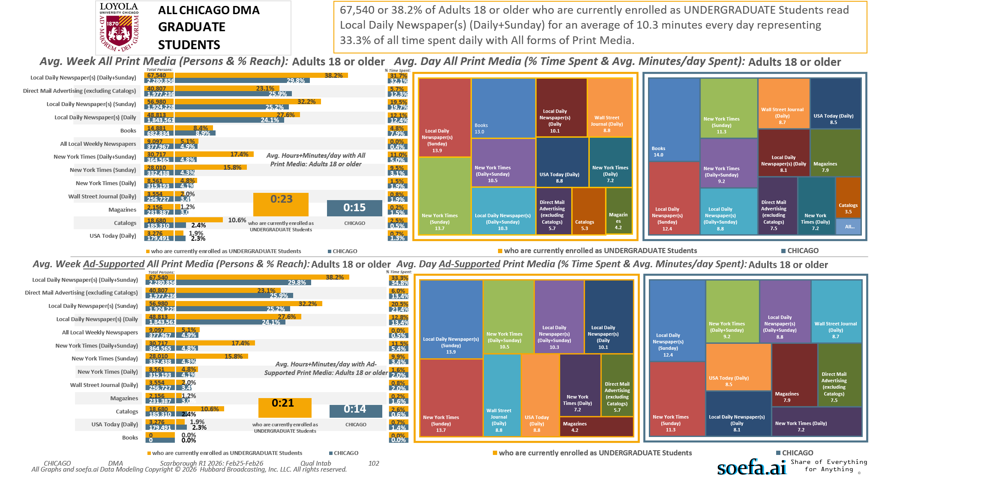
[(Currently enrolled/attending classes at a college/university: Yes AND (Level of education: Bachelor's degree (BA, BS, etc.) OR Level of education: Some postgraduate (no advanced degree) OR Level of education: Postgraduate degree))]

Slide 25
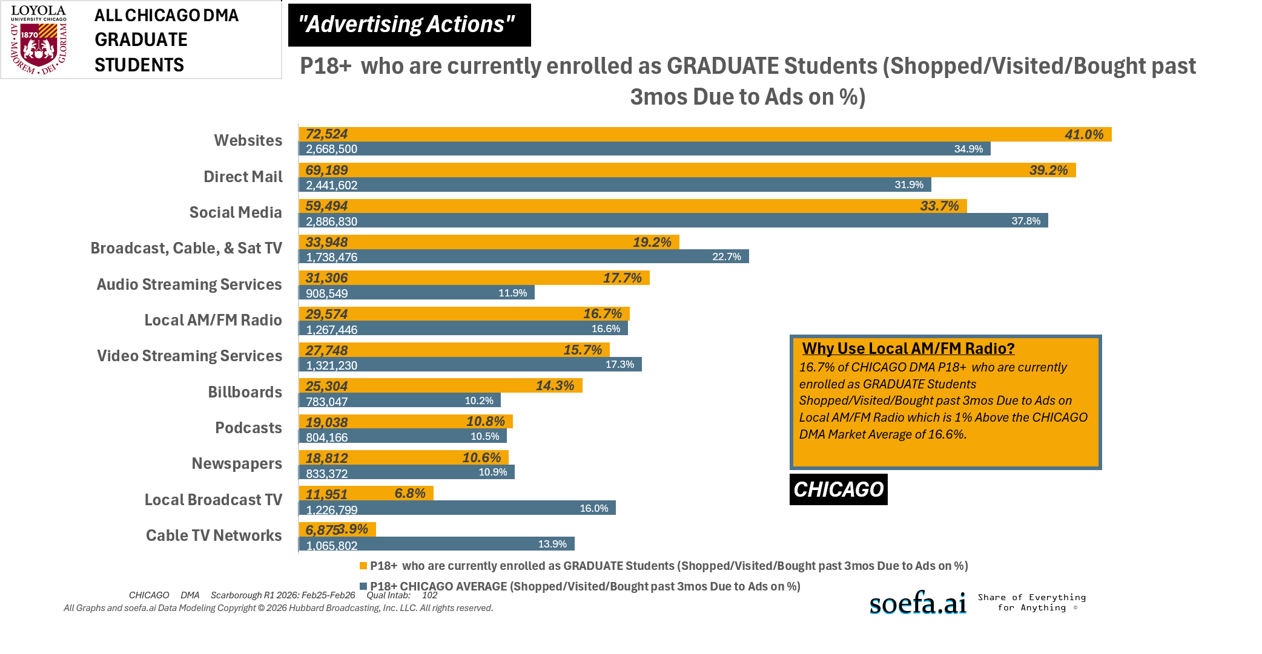
[(Currently enrolled/attending classes at a college/university: Yes AND (Level of education: Bachelor's degree (BA, BS, etc.) OR Level of education: Some postgraduate (no advanced degree) OR Level of education: Postgraduate degree))]

