Slide 1
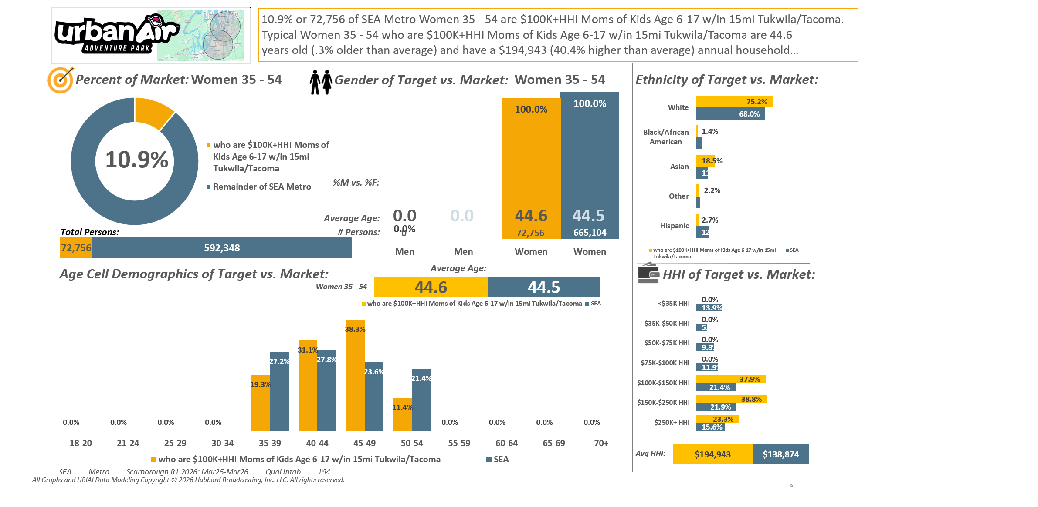






[((Household income summaries (HHLD): $100,000 or more AND Parent of child under 18: Yes) AND Presence of children by age (HHLD): Age 6 - 17)]
Custom Geo = 98188; 98057; 98178; 98055; 98168; 98148; 98031; 98032; 98056; 98166; 98198; 98146; 98118; 98108; 98058; 98030; 98040; 98059; 98106; 98006; 98136; 98126; 98134; 98144; 98070; 98042; 98001; 98002; 98104; 98003; 98116; 98122; 98101; 98004; 98121; 98005; 98023; 98112; 98038; 98008; 98007; 98027; 98102; 98109; 98029; 98422; 98092; 98119; 98075; 98047; 98105; 98354; 98404; 98408; 98443; 98409; 98444; 98445; 98402; 98424; 98371; 98499; 98405; 98446; 98373; 98467; 98466; 98406; 98439; 98465; 98498; 98375; 98372; 98407; 98390; 98374; 98388; 98387; 98391; 98433; 98335; 98338; 98327; 98303; 98332

Slide 2
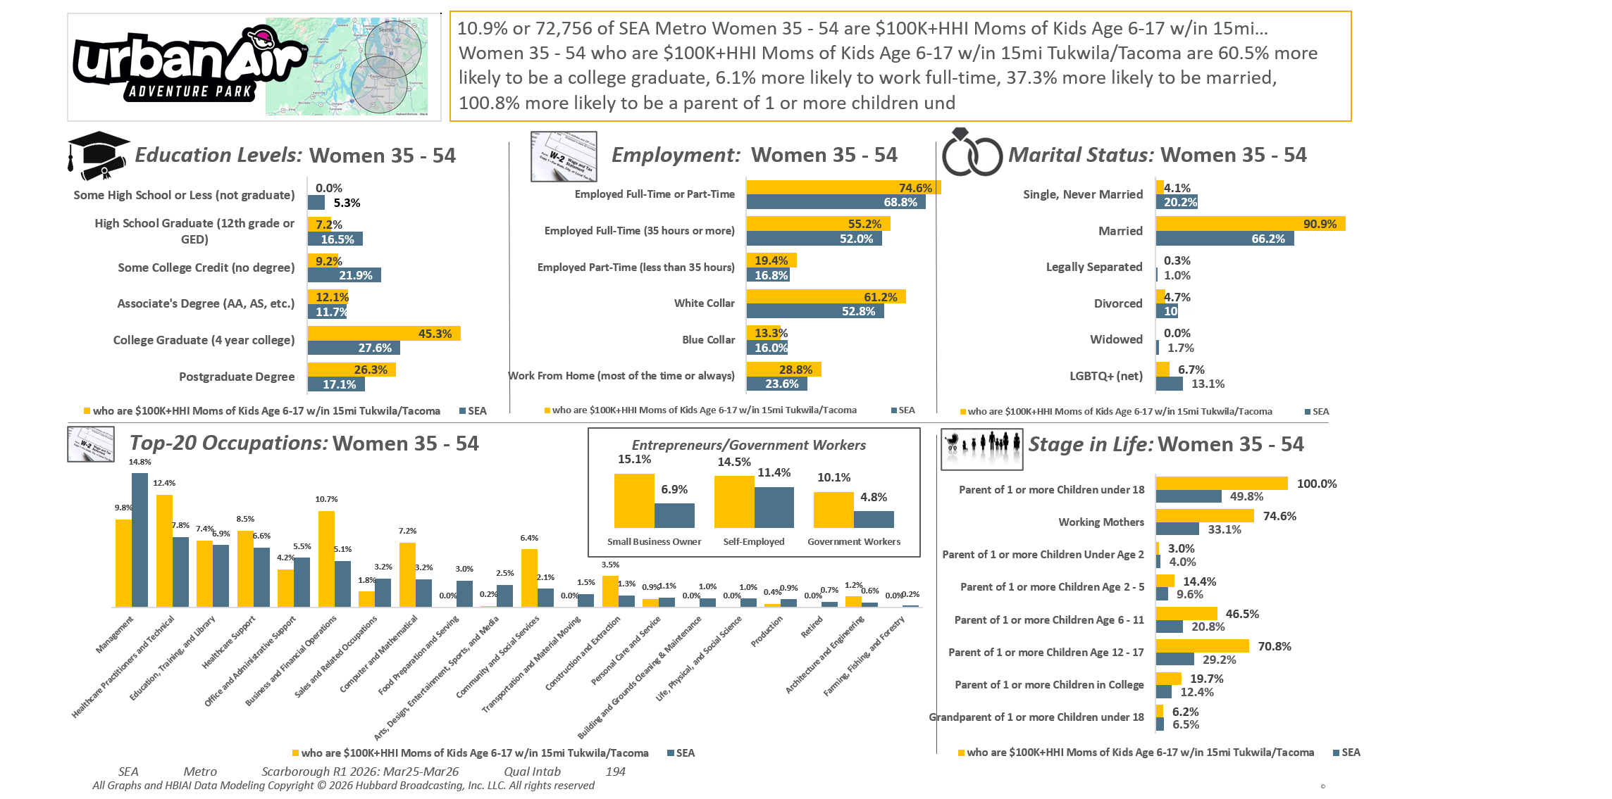
[((Household income summaries (HHLD): $100,000 or more AND Parent of child under 18: Yes) AND Presence of children by age (HHLD): Age 6 - 17)]
Custom Geo = 98188; 98057; 98178; 98055; 98168; 98148; 98031; 98032; 98056; 98166; 98198; 98146; 98118; 98108; 98058; 98030; 98040; 98059; 98106; 98006; 98136; 98126; 98134; 98144; 98070; 98042; 98001; 98002; 98104; 98003; 98116; 98122; 98101; 98004; 98121; 98005; 98023; 98112; 98038; 98008; 98007; 98027; 98102; 98109; 98029; 98422; 98092; 98119; 98075; 98047; 98105; 98354; 98404; 98408; 98443; 98409; 98444; 98445; 98402; 98424; 98371; 98499; 98405; 98446; 98373; 98467; 98466; 98406; 98439; 98465; 98498; 98375; 98372; 98407; 98390; 98374; 98388; 98387; 98391; 98433; 98335; 98338; 98327; 98303; 98332

Slide 3
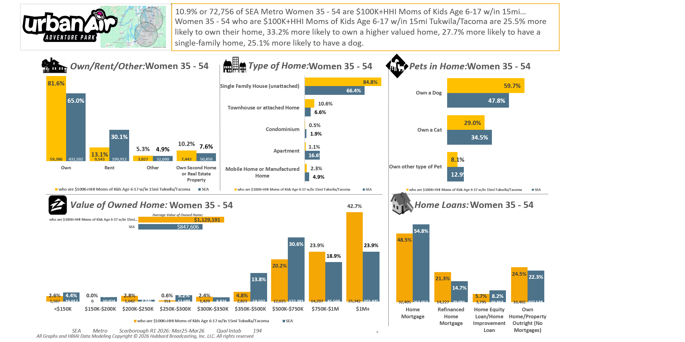
[((Household income summaries (HHLD): $100,000 or more AND Parent of child under 18: Yes) AND Presence of children by age (HHLD): Age 6 - 17)]
Custom Geo = 98188; 98057; 98178; 98055; 98168; 98148; 98031; 98032; 98056; 98166; 98198; 98146; 98118; 98108; 98058; 98030; 98040; 98059; 98106; 98006; 98136; 98126; 98134; 98144; 98070; 98042; 98001; 98002; 98104; 98003; 98116; 98122; 98101; 98004; 98121; 98005; 98023; 98112; 98038; 98008; 98007; 98027; 98102; 98109; 98029; 98422; 98092; 98119; 98075; 98047; 98105; 98354; 98404; 98408; 98443; 98409; 98444; 98445; 98402; 98424; 98371; 98499; 98405; 98446; 98373; 98467; 98466; 98406; 98439; 98465; 98498; 98375; 98372; 98407; 98390; 98374; 98388; 98387; 98391; 98433; 98335; 98338; 98327; 98303; 98332

Slide 4
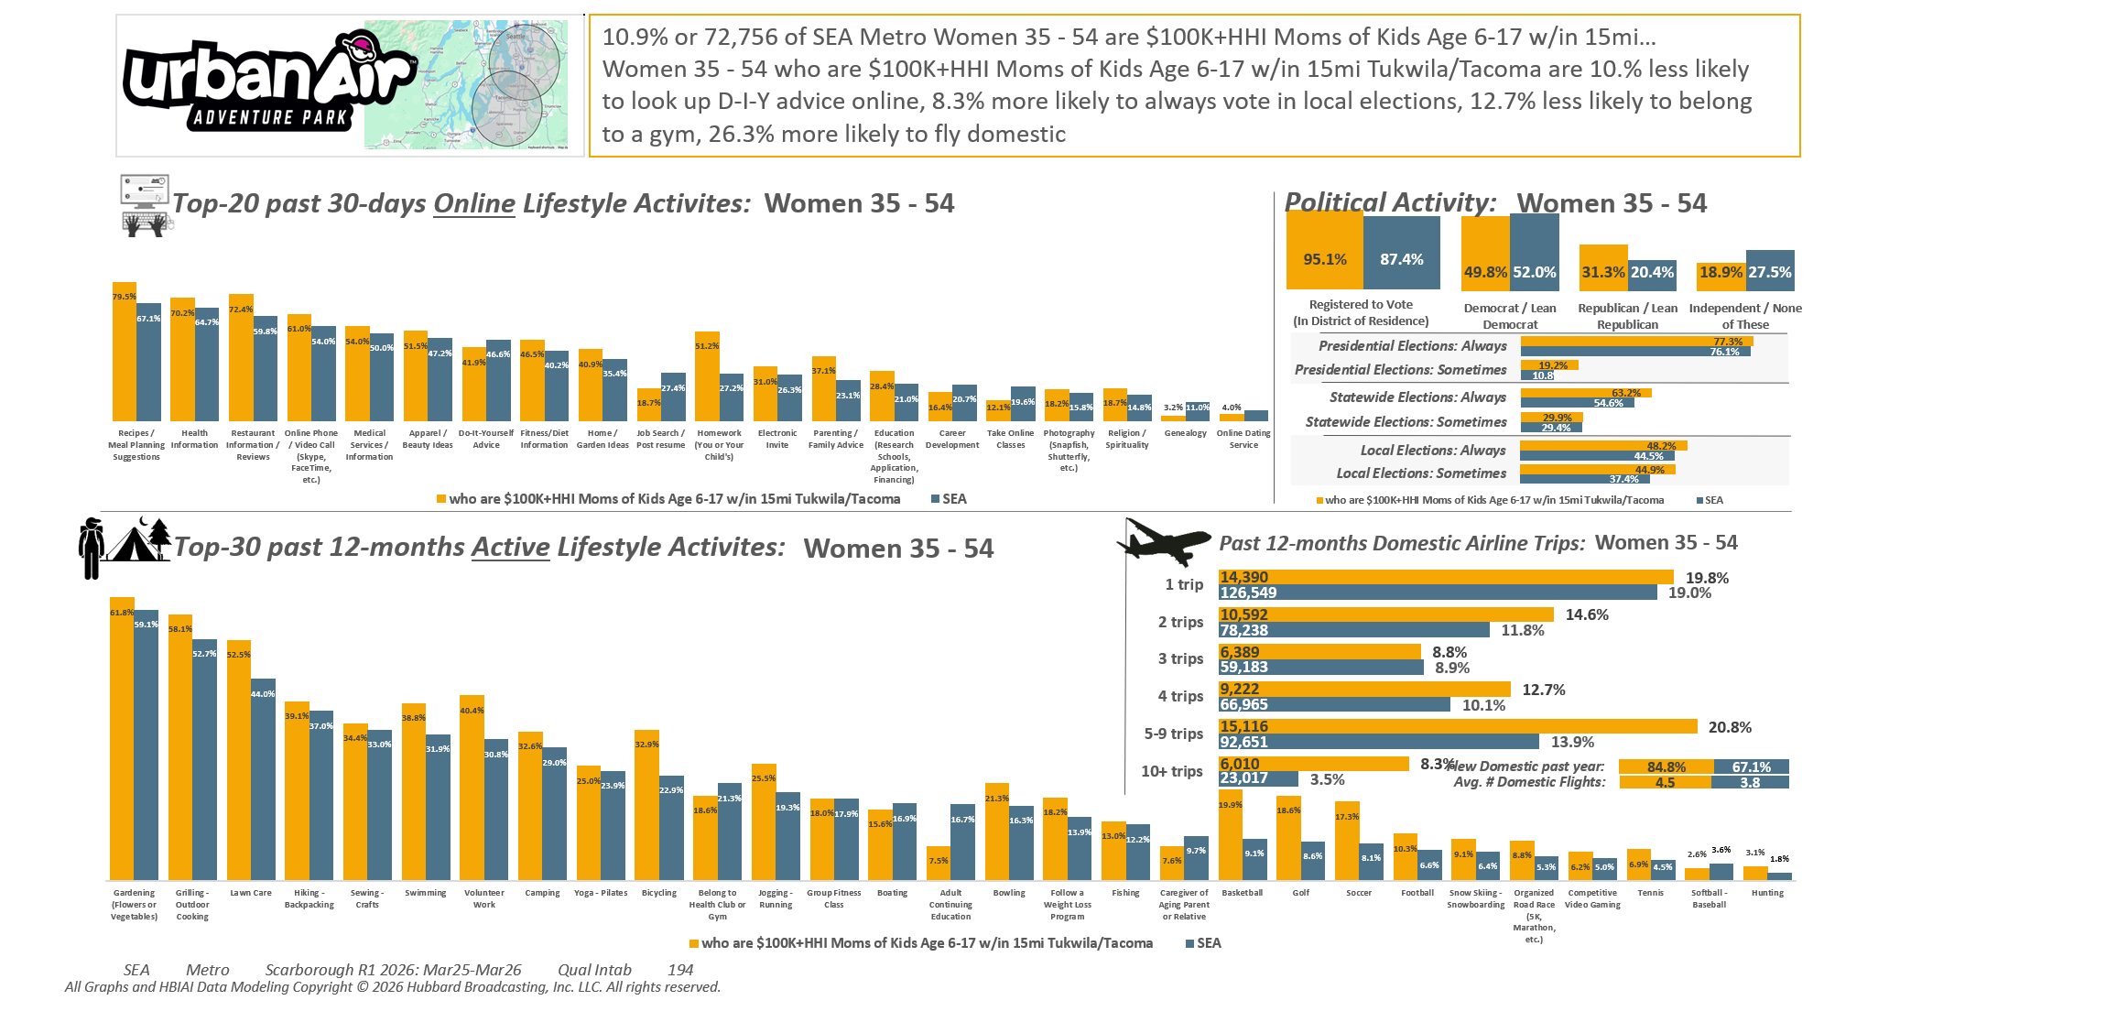
[((Household income summaries (HHLD): $100,000 or more AND Parent of child under 18: Yes) AND Presence of children by age (HHLD): Age 6 - 17)]
Custom Geo = 98188; 98057; 98178; 98055; 98168; 98148; 98031; 98032; 98056; 98166; 98198; 98146; 98118; 98108; 98058; 98030; 98040; 98059; 98106; 98006; 98136; 98126; 98134; 98144; 98070; 98042; 98001; 98002; 98104; 98003; 98116; 98122; 98101; 98004; 98121; 98005; 98023; 98112; 98038; 98008; 98007; 98027; 98102; 98109; 98029; 98422; 98092; 98119; 98075; 98047; 98105; 98354; 98404; 98408; 98443; 98409; 98444; 98445; 98402; 98424; 98371; 98499; 98405; 98446; 98373; 98467; 98466; 98406; 98439; 98465; 98498; 98375; 98372; 98407; 98390; 98374; 98388; 98387; 98391; 98433; 98335; 98338; 98327; 98303; 98332

Slide 5

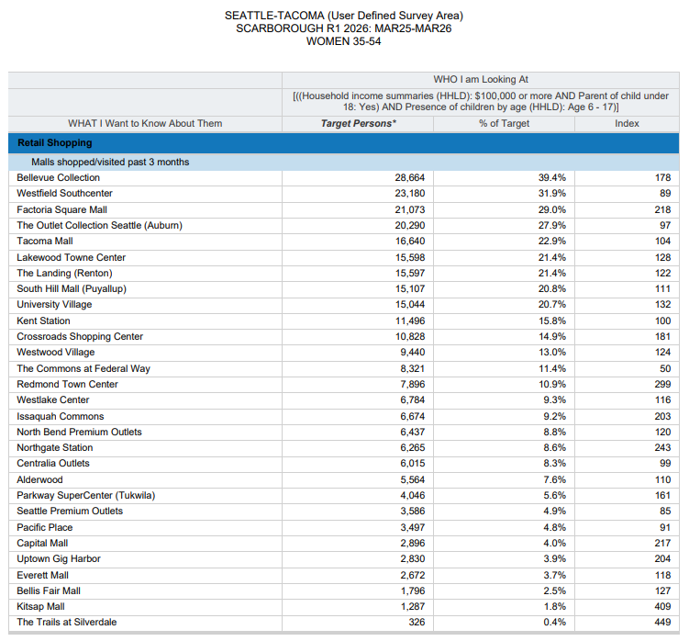

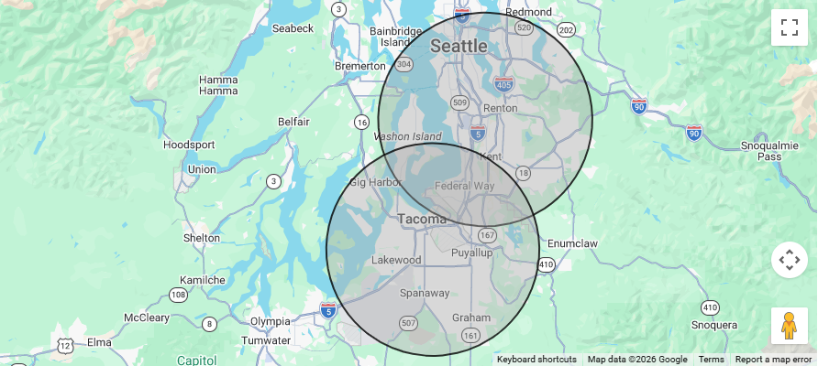
39.4% of $100K+HHI Age 35-54 MOMS
of Children Ages 6-17 within a 15-mile radius of…
URBAN AIR ADVENTURE PARKS in Tukwila and
Tacoma Shop at Bellevue Collection every 3 months
(Index 178).
[((Household income summaries (HHLD): $100,000 or more AND Parent of child under 18: Yes) AND Presence of children by age (HHLD): Age 6 - 17)]
Custom Geo = 98188; 98057; 98178; 98055; 98168; 98148; 98031; 98032; 98056; 98166; 98198; 98146; 98118; 98108; 98058; 98030; 98040; 98059; 98106; 98006; 98136; 98126; 98134; 98144; 98070; 98042; 98001; 98002; 98104; 98003; 98116; 98122; 98101; 98004; 98121; 98005; 98023; 98112; 98038; 98008; 98007; 98027; 98102; 98109; 98029; 98422; 98092; 98119; 98075; 98047; 98105; 98354; 98404; 98408; 98443; 98409; 98444; 98445; 98402; 98424; 98371; 98499; 98405; 98446; 98373; 98467; 98466; 98406; 98439; 98465; 98498; 98375; 98372; 98407; 98390; 98374; 98388; 98387; 98391; 98433; 98335; 98338; 98327; 98303; 98332

Slide 6
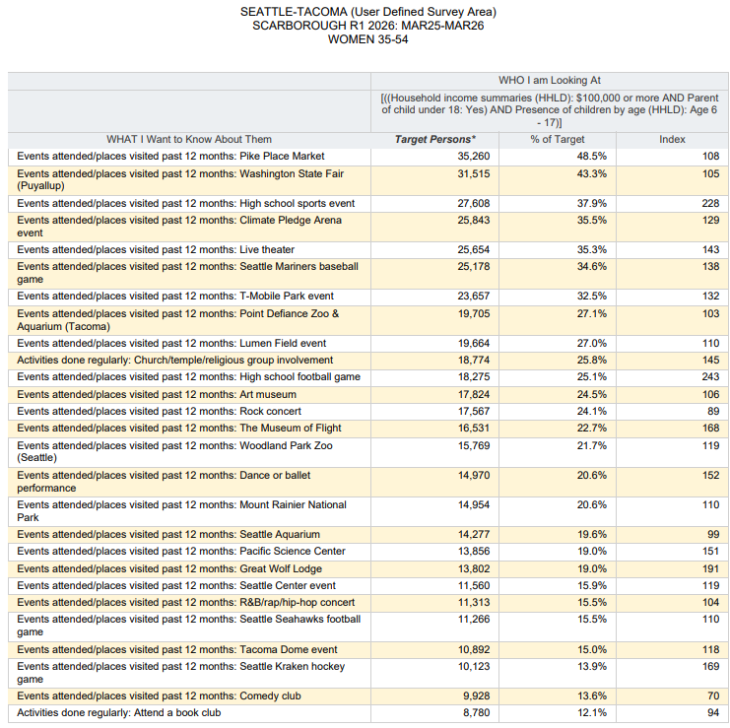
25.8% of $100K+HHI Age 35-54 MOMS
of Children Ages 6-17 within a 15-mile radius of…
URBAN AIR ADVENTURE PARKS in Tukwila and
Tacoma are Regular Church Attenders (Index 145).
[((Household income summaries (HHLD): $100,000 or more AND Parent of child under 18: Yes) AND Presence of children by age (HHLD): Age 6 - 17)]
Custom Geo = 98188; 98057; 98178; 98055; 98168; 98148; 98031; 98032; 98056; 98166; 98198; 98146; 98118; 98108; 98058; 98030; 98040; 98059; 98106; 98006; 98136; 98126; 98134; 98144; 98070; 98042; 98001; 98002; 98104; 98003; 98116; 98122; 98101; 98004; 98121; 98005; 98023; 98112; 98038; 98008; 98007; 98027; 98102; 98109; 98029; 98422; 98092; 98119; 98075; 98047; 98105; 98354; 98404; 98408; 98443; 98409; 98444; 98445; 98402; 98424; 98371; 98499; 98405; 98446; 98373; 98467; 98466; 98406; 98439; 98465; 98498; 98375; 98372; 98407; 98390; 98374; 98388; 98387; 98391; 98433; 98335; 98338; 98327; 98303; 98332

Slide 7
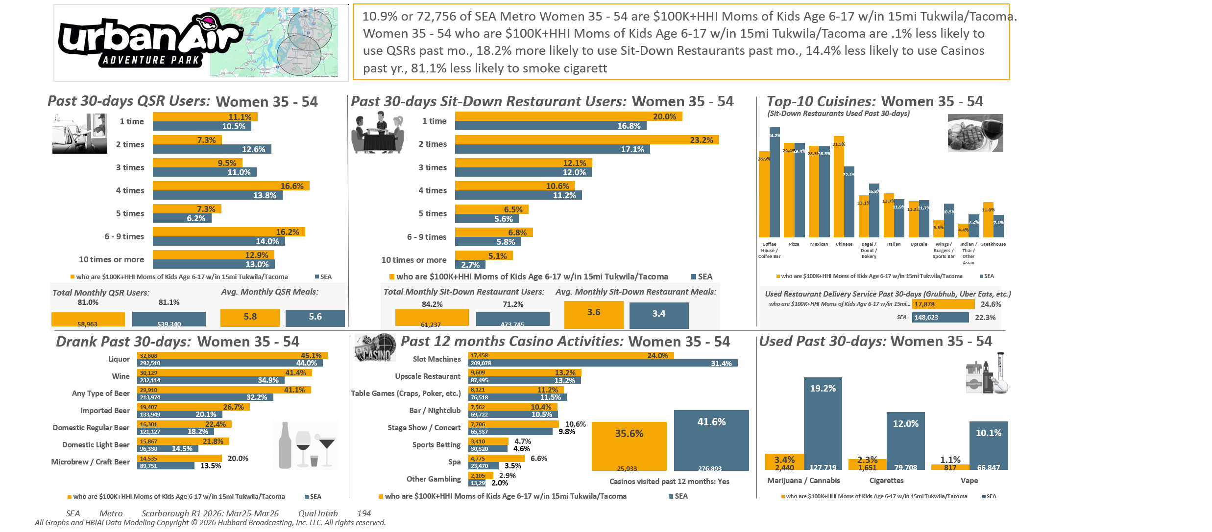
[((Household income summaries (HHLD): $100,000 or more AND Parent of child under 18: Yes) AND Presence of children by age (HHLD): Age 6 - 17)]
Custom Geo = 98188; 98057; 98178; 98055; 98168; 98148; 98031; 98032; 98056; 98166; 98198; 98146; 98118; 98108; 98058; 98030; 98040; 98059; 98106; 98006; 98136; 98126; 98134; 98144; 98070; 98042; 98001; 98002; 98104; 98003; 98116; 98122; 98101; 98004; 98121; 98005; 98023; 98112; 98038; 98008; 98007; 98027; 98102; 98109; 98029; 98422; 98092; 98119; 98075; 98047; 98105; 98354; 98404; 98408; 98443; 98409; 98444; 98445; 98402; 98424; 98371; 98499; 98405; 98446; 98373; 98467; 98466; 98406; 98439; 98465; 98498; 98375; 98372; 98407; 98390; 98374; 98388; 98387; 98391; 98433; 98335; 98338; 98327; 98303; 98332

Slide 8
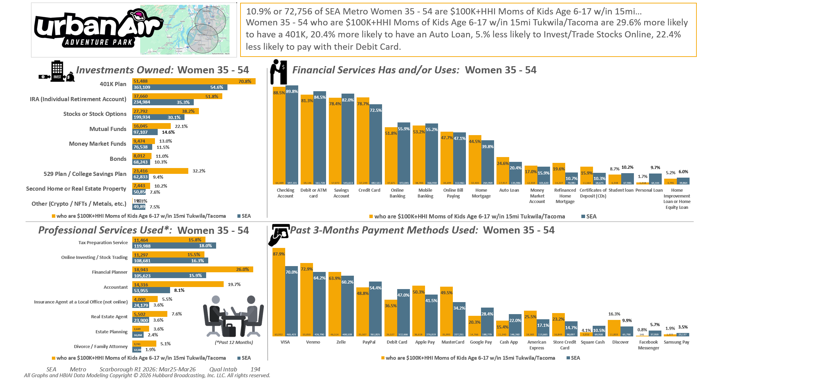
[((Household income summaries (HHLD): $100,000 or more AND Parent of child under 18: Yes) AND Presence of children by age (HHLD): Age 6 - 17)]
Custom Geo = 98188; 98057; 98178; 98055; 98168; 98148; 98031; 98032; 98056; 98166; 98198; 98146; 98118; 98108; 98058; 98030; 98040; 98059; 98106; 98006; 98136; 98126; 98134; 98144; 98070; 98042; 98001; 98002; 98104; 98003; 98116; 98122; 98101; 98004; 98121; 98005; 98023; 98112; 98038; 98008; 98007; 98027; 98102; 98109; 98029; 98422; 98092; 98119; 98075; 98047; 98105; 98354; 98404; 98408; 98443; 98409; 98444; 98445; 98402; 98424; 98371; 98499; 98405; 98446; 98373; 98467; 98466; 98406; 98439; 98465; 98498; 98375; 98372; 98407; 98390; 98374; 98388; 98387; 98391; 98433; 98335; 98338; 98327; 98303; 98332

Slide 9
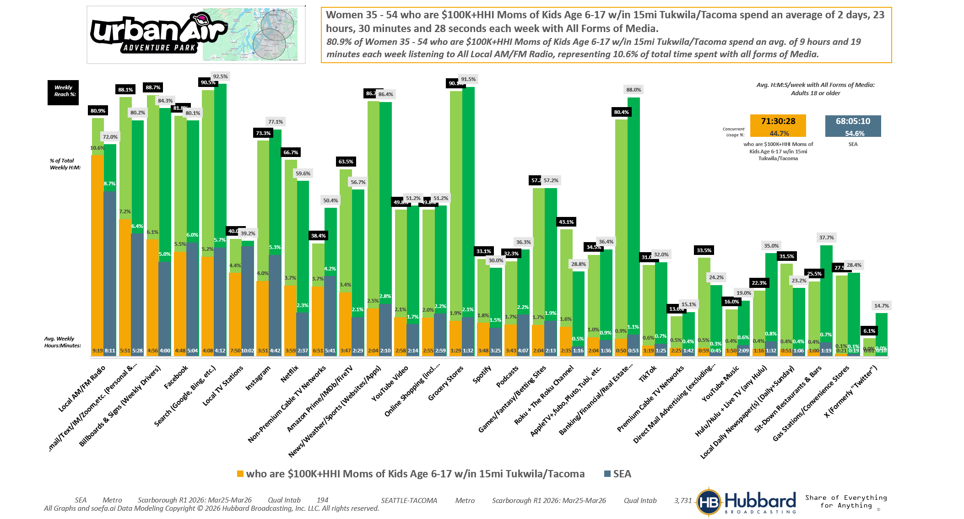

[((Household income summaries (HHLD): $100,000 or more AND Parent of child under 18: Yes) AND Presence of children by age (HHLD): Age 6 - 17)]
Custom Geo = 98188; 98057; 98178; 98055; 98168; 98148; 98031; 98032; 98056; 98166; 98198; 98146; 98118; 98108; 98058; 98030; 98040; 98059; 98106; 98006; 98136; 98126; 98134; 98144; 98070; 98042; 98001; 98002; 98104; 98003; 98116; 98122; 98101; 98004; 98121; 98005; 98023; 98112; 98038; 98008; 98007; 98027; 98102; 98109; 98029; 98422; 98092; 98119; 98075; 98047; 98105; 98354; 98404; 98408; 98443; 98409; 98444; 98445; 98402; 98424; 98371; 98499; 98405; 98446; 98373; 98467; 98466; 98406; 98439; 98465; 98498; 98375; 98372; 98407; 98390; 98374; 98388; 98387; 98391; 98433; 98335; 98338; 98327; 98303; 98332

Slide 10
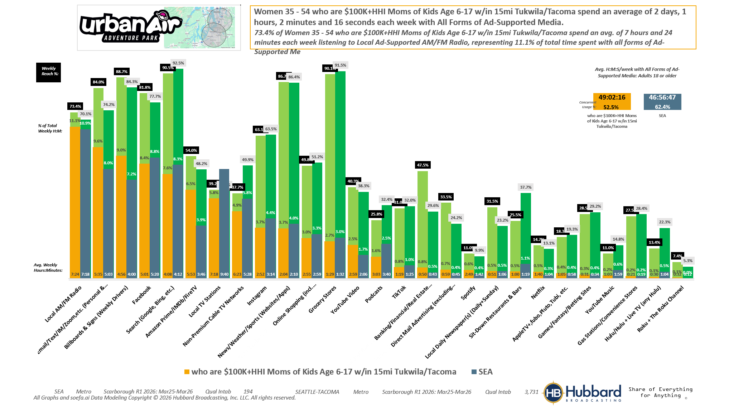
[((Household income summaries (HHLD): $100,000 or more AND Parent of child under 18: Yes) AND Presence of children by age (HHLD): Age 6 - 17)]
Custom Geo = 98188; 98057; 98178; 98055; 98168; 98148; 98031; 98032; 98056; 98166; 98198; 98146; 98118; 98108; 98058; 98030; 98040; 98059; 98106; 98006; 98136; 98126; 98134; 98144; 98070; 98042; 98001; 98002; 98104; 98003; 98116; 98122; 98101; 98004; 98121; 98005; 98023; 98112; 98038; 98008; 98007; 98027; 98102; 98109; 98029; 98422; 98092; 98119; 98075; 98047; 98105; 98354; 98404; 98408; 98443; 98409; 98444; 98445; 98402; 98424; 98371; 98499; 98405; 98446; 98373; 98467; 98466; 98406; 98439; 98465; 98498; 98375; 98372; 98407; 98390; 98374; 98388; 98387; 98391; 98433; 98335; 98338; 98327; 98303; 98332

Slide 11
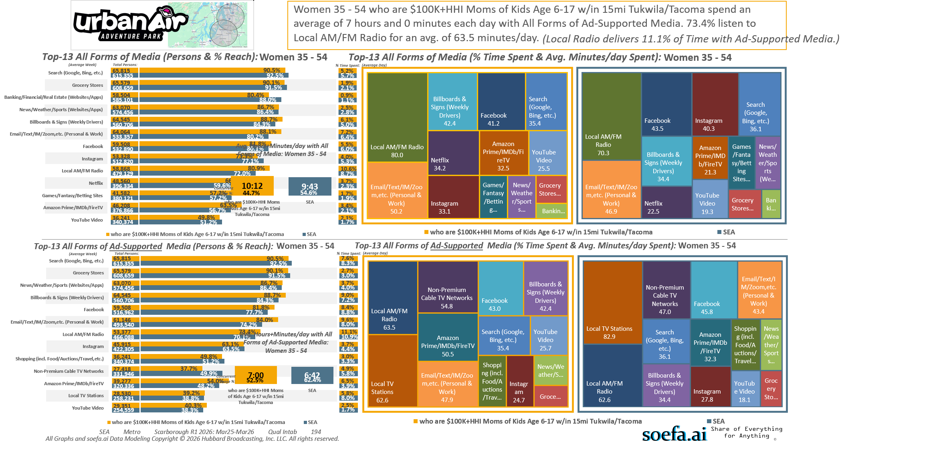
[((Household income summaries (HHLD): $100,000 or more AND Parent of child under 18: Yes) AND Presence of children by age (HHLD): Age 6 - 17)]
Custom Geo = 98188; 98057; 98178; 98055; 98168; 98148; 98031; 98032; 98056; 98166; 98198; 98146; 98118; 98108; 98058; 98030; 98040; 98059; 98106; 98006; 98136; 98126; 98134; 98144; 98070; 98042; 98001; 98002; 98104; 98003; 98116; 98122; 98101; 98004; 98121; 98005; 98023; 98112; 98038; 98008; 98007; 98027; 98102; 98109; 98029; 98422; 98092; 98119; 98075; 98047; 98105; 98354; 98404; 98408; 98443; 98409; 98444; 98445; 98402; 98424; 98371; 98499; 98405; 98446; 98373; 98467; 98466; 98406; 98439; 98465; 98498; 98375; 98372; 98407; 98390; 98374; 98388; 98387; 98391; 98433; 98335; 98338; 98327; 98303; 98332

Slide 12
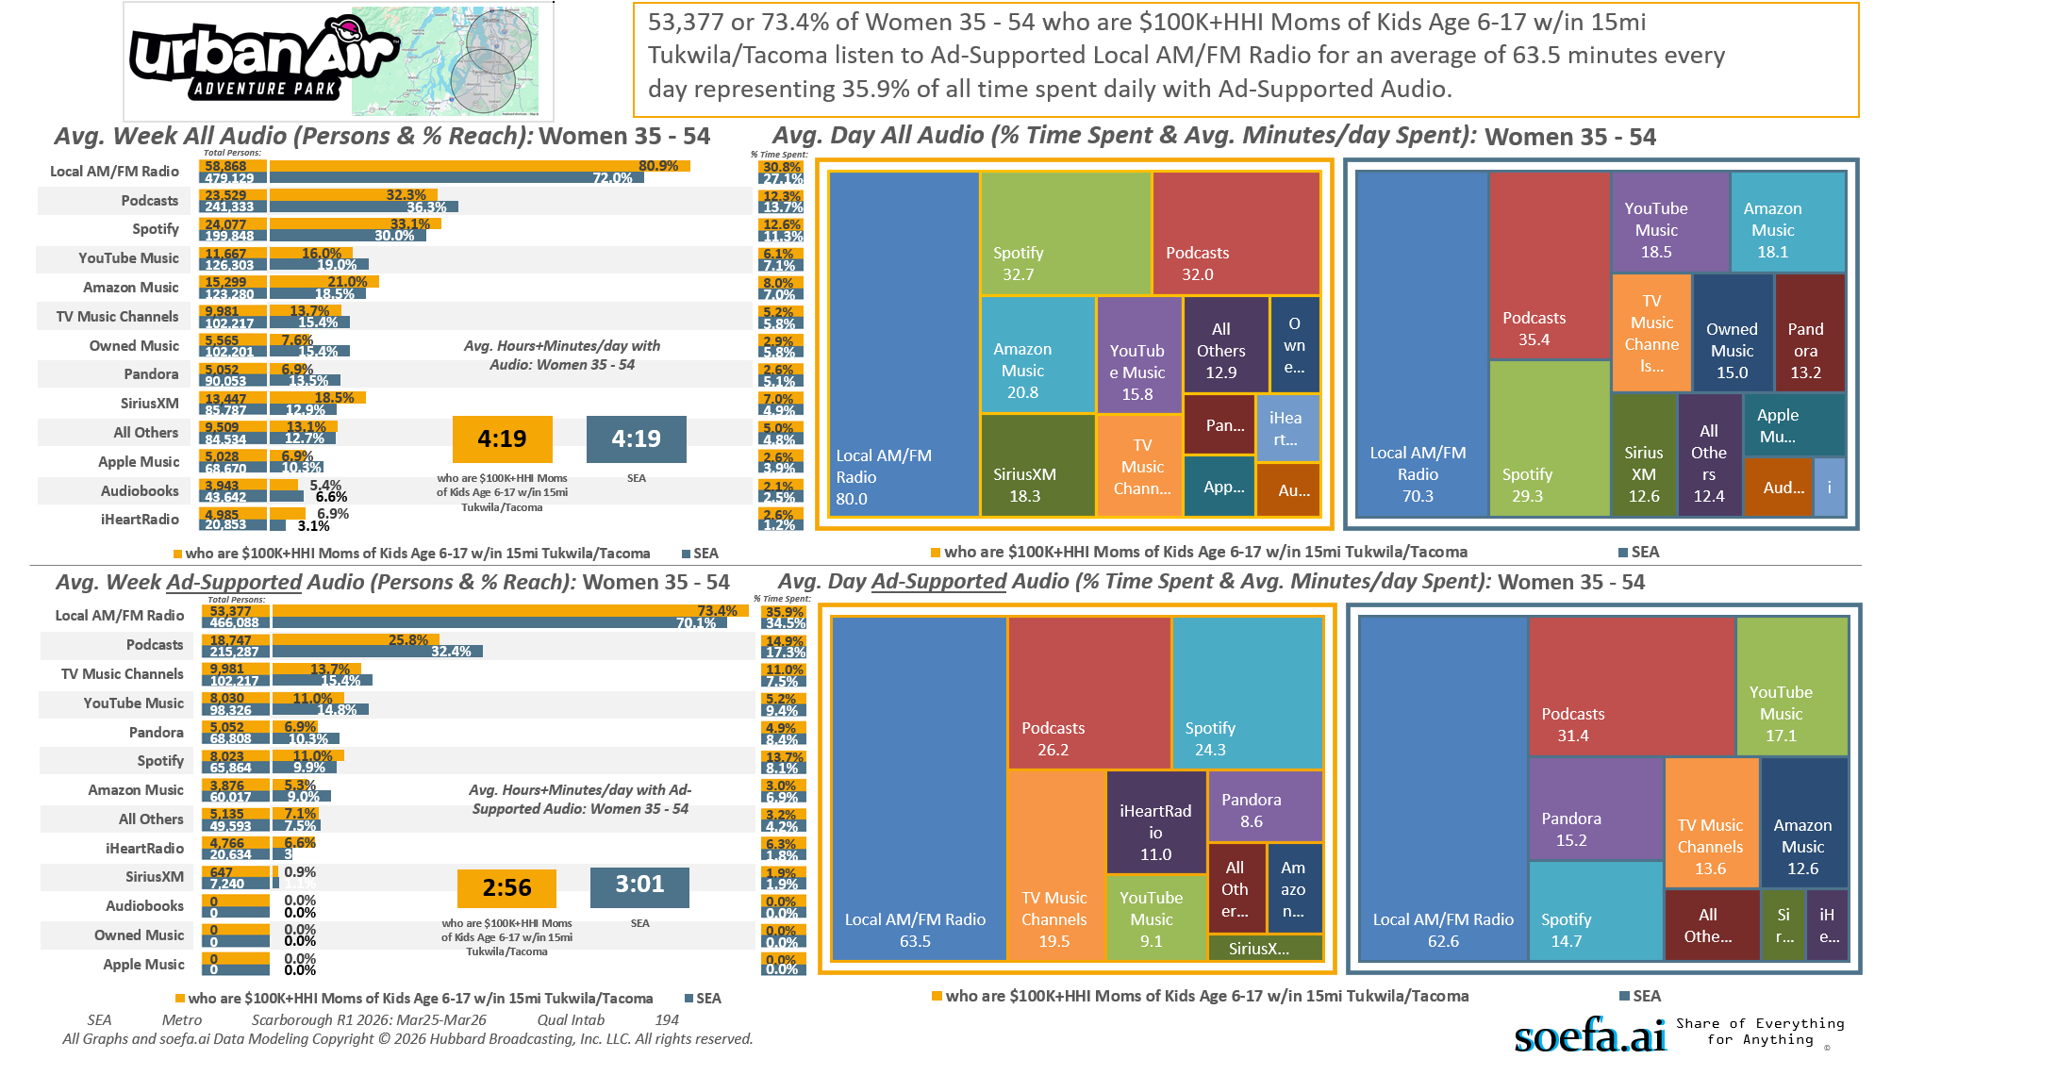
[((Household income summaries (HHLD): $100,000 or more AND Parent of child under 18: Yes) AND Presence of children by age (HHLD): Age 6 - 17)]
Custom Geo = 98188; 98057; 98178; 98055; 98168; 98148; 98031; 98032; 98056; 98166; 98198; 98146; 98118; 98108; 98058; 98030; 98040; 98059; 98106; 98006; 98136; 98126; 98134; 98144; 98070; 98042; 98001; 98002; 98104; 98003; 98116; 98122; 98101; 98004; 98121; 98005; 98023; 98112; 98038; 98008; 98007; 98027; 98102; 98109; 98029; 98422; 98092; 98119; 98075; 98047; 98105; 98354; 98404; 98408; 98443; 98409; 98444; 98445; 98402; 98424; 98371; 98499; 98405; 98446; 98373; 98467; 98466; 98406; 98439; 98465; 98498; 98375; 98372; 98407; 98390; 98374; 98388; 98387; 98391; 98433; 98335; 98338; 98327; 98303; 98332

Slide 13
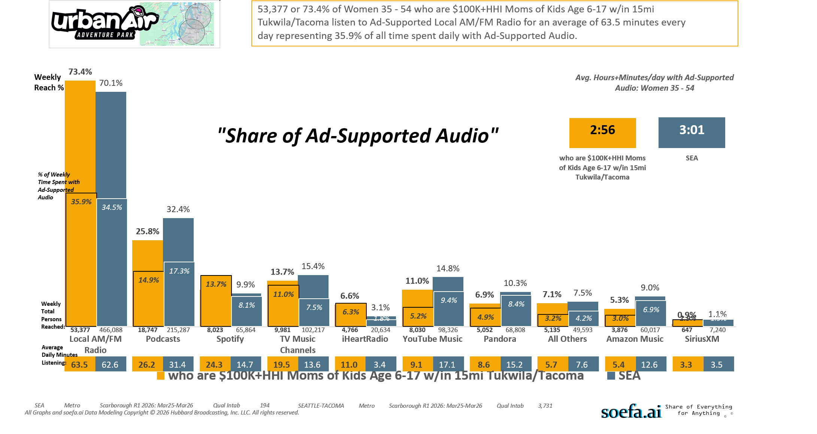
[((Household income summaries (HHLD): $100,000 or more AND Parent of child under 18: Yes) AND Presence of children by age (HHLD): Age 6 - 17)]
Custom Geo = 98188; 98057; 98178; 98055; 98168; 98148; 98031; 98032; 98056; 98166; 98198; 98146; 98118; 98108; 98058; 98030; 98040; 98059; 98106; 98006; 98136; 98126; 98134; 98144; 98070; 98042; 98001; 98002; 98104; 98003; 98116; 98122; 98101; 98004; 98121; 98005; 98023; 98112; 98038; 98008; 98007; 98027; 98102; 98109; 98029; 98422; 98092; 98119; 98075; 98047; 98105; 98354; 98404; 98408; 98443; 98409; 98444; 98445; 98402; 98424; 98371; 98499; 98405; 98446; 98373; 98467; 98466; 98406; 98439; 98465; 98498; 98375; 98372; 98407; 98390; 98374; 98388; 98387; 98391; 98433; 98335; 98338; 98327; 98303; 98332

Slide 14
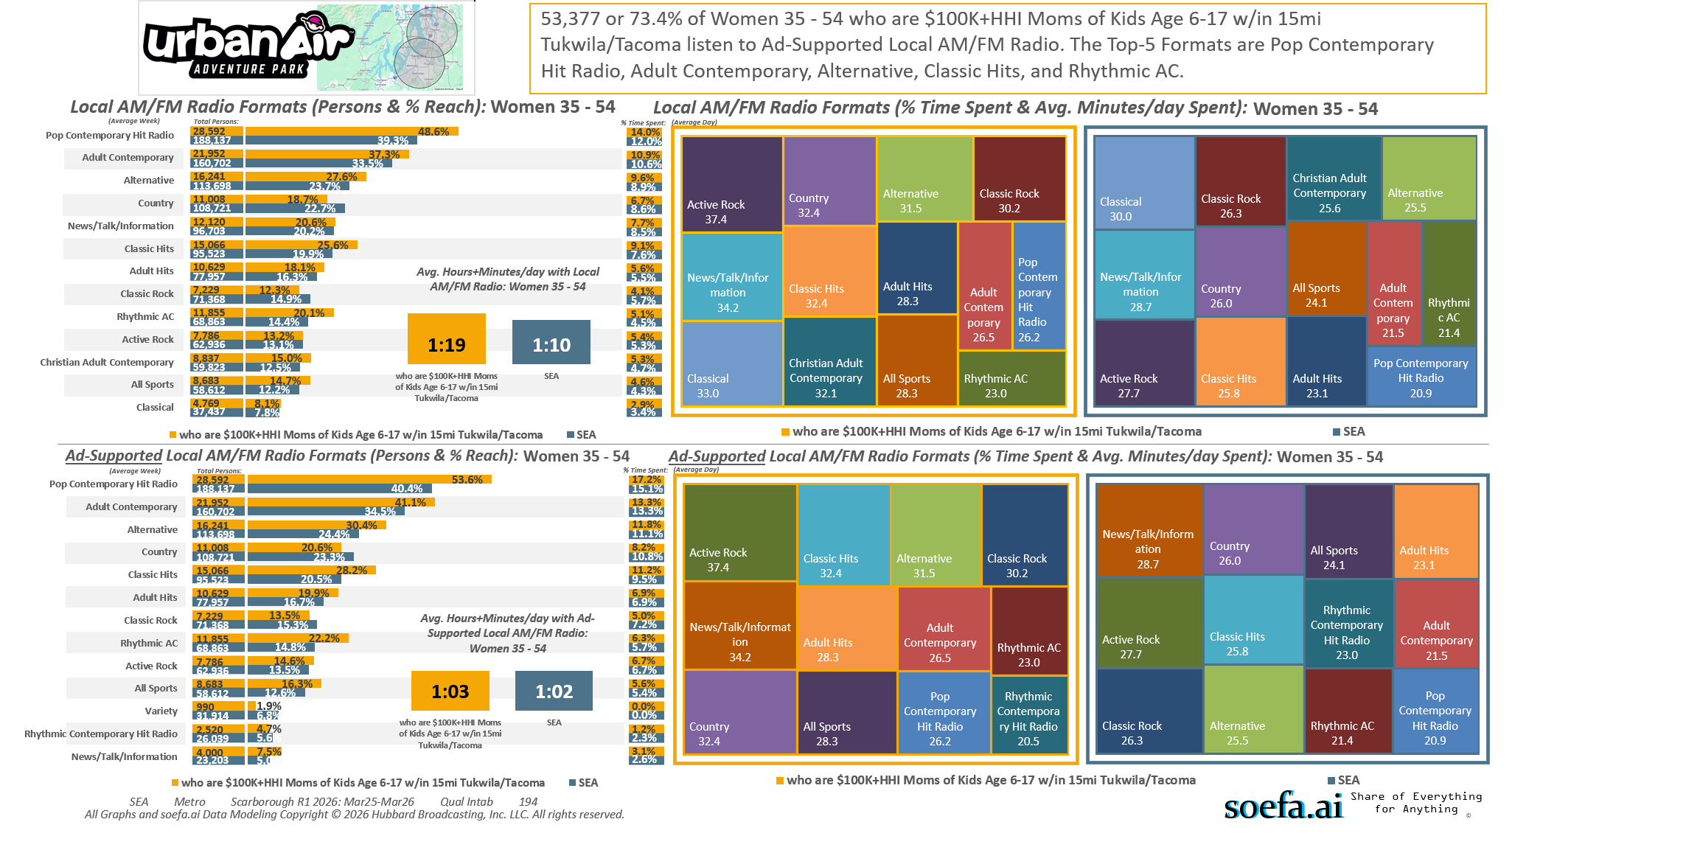
[((Household income summaries (HHLD): $100,000 or more AND Parent of child under 18: Yes) AND Presence of children by age (HHLD): Age 6 - 17)]
Custom Geo = 98188; 98057; 98178; 98055; 98168; 98148; 98031; 98032; 98056; 98166; 98198; 98146; 98118; 98108; 98058; 98030; 98040; 98059; 98106; 98006; 98136; 98126; 98134; 98144; 98070; 98042; 98001; 98002; 98104; 98003; 98116; 98122; 98101; 98004; 98121; 98005; 98023; 98112; 98038; 98008; 98007; 98027; 98102; 98109; 98029; 98422; 98092; 98119; 98075; 98047; 98105; 98354; 98404; 98408; 98443; 98409; 98444; 98445; 98402; 98424; 98371; 98499; 98405; 98446; 98373; 98467; 98466; 98406; 98439; 98465; 98498; 98375; 98372; 98407; 98390; 98374; 98388; 98387; 98391; 98433; 98335; 98338; 98327; 98303; 98332

Slide 15
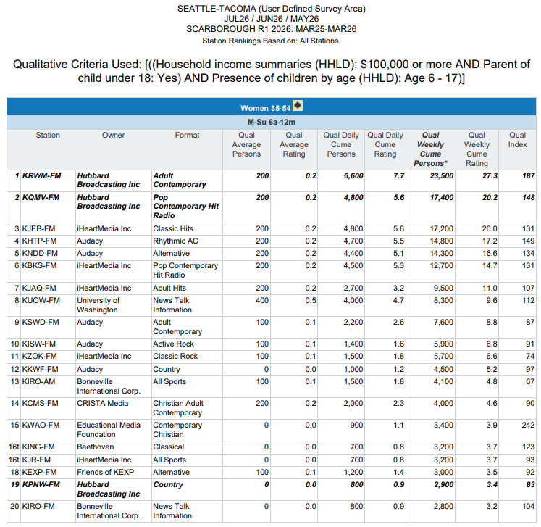
There are 86,200 $100K+HHI Age 35-54 MOMS
of Children Ages 6-17 within a 15-mile radius of…
URBAN AIR ADVENTURE PARKS in Tukwila and
Tacoma.
MORE (27.3% or 23,500) of them listen to…
WARM 106.9 every week (Index 187) than to
ANY Other Radio Station.
Custom Geo = 98188; 98057; 98178; 98055; 98168; 98148; 98031; 98032; 98056; 98166; 98198; 98146; 98118; 98108; 98058; 98030; 98040; 98059; 98106; 98006; 98136; 98126; 98134; 98144; 98070; 98042; 98001; 98002; 98104; 98003; 98116; 98122; 98101; 98004; 98121; 98005; 98023; 98112; 98038; 98008; 98007; 98027; 98102; 98109; 98029; 98422; 98092; 98119; 98075; 98047; 98105; 98354; 98404; 98408; 98443; 98409; 98444; 98445; 98402; 98424; 98371; 98499; 98405; 98446; 98373; 98467; 98466; 98406; 98439; 98465; 98498; 98375; 98372; 98407; 98390; 98374; 98388; 98387; 98391; 98433; 98335; 98338; 98327; 98303; 98332

Slide 16
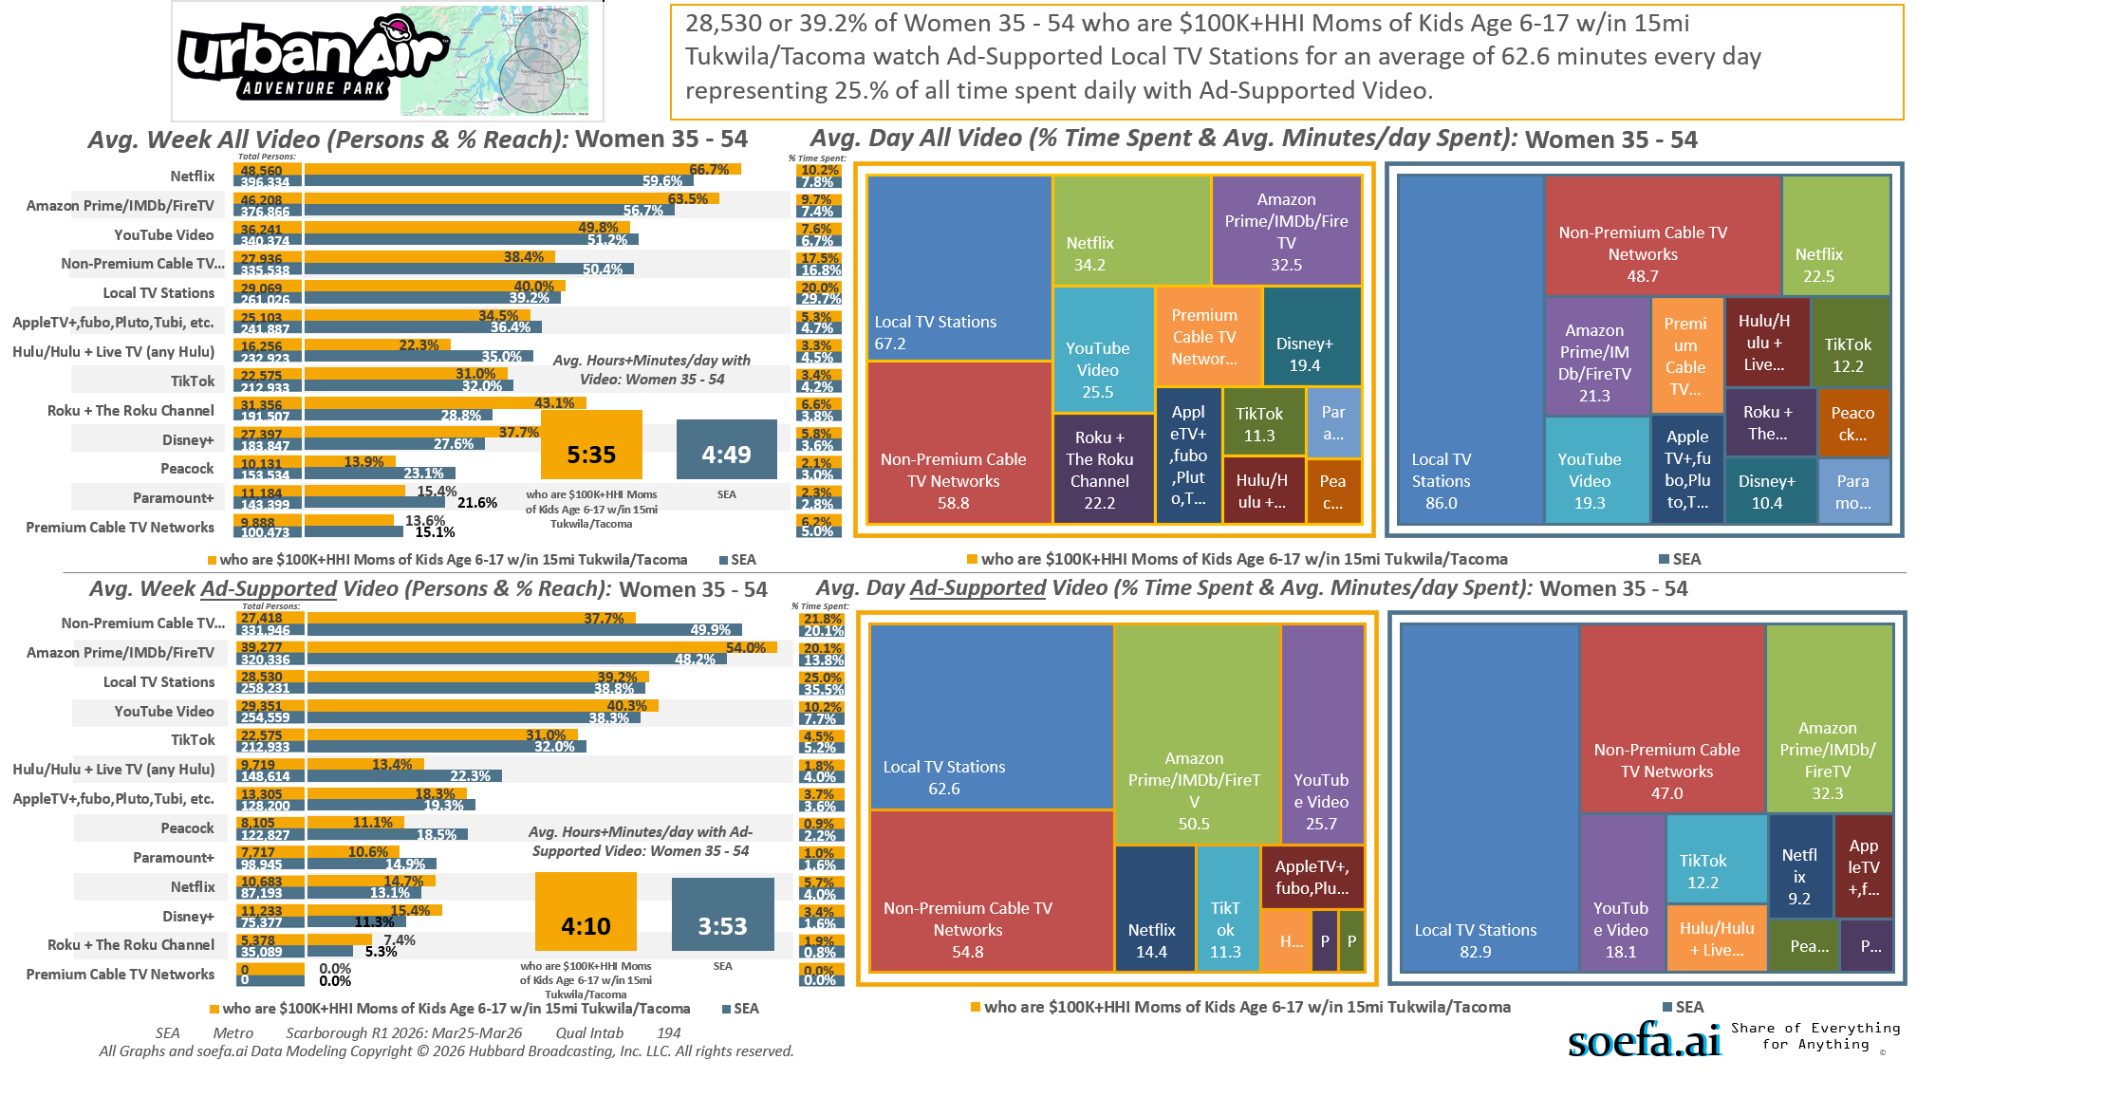
[((Household income summaries (HHLD): $100,000 or more AND Parent of child under 18: Yes) AND Presence of children by age (HHLD): Age 6 - 17)]
Custom Geo = 98188; 98057; 98178; 98055; 98168; 98148; 98031; 98032; 98056; 98166; 98198; 98146; 98118; 98108; 98058; 98030; 98040; 98059; 98106; 98006; 98136; 98126; 98134; 98144; 98070; 98042; 98001; 98002; 98104; 98003; 98116; 98122; 98101; 98004; 98121; 98005; 98023; 98112; 98038; 98008; 98007; 98027; 98102; 98109; 98029; 98422; 98092; 98119; 98075; 98047; 98105; 98354; 98404; 98408; 98443; 98409; 98444; 98445; 98402; 98424; 98371; 98499; 98405; 98446; 98373; 98467; 98466; 98406; 98439; 98465; 98498; 98375; 98372; 98407; 98390; 98374; 98388; 98387; 98391; 98433; 98335; 98338; 98327; 98303; 98332

Slide 17
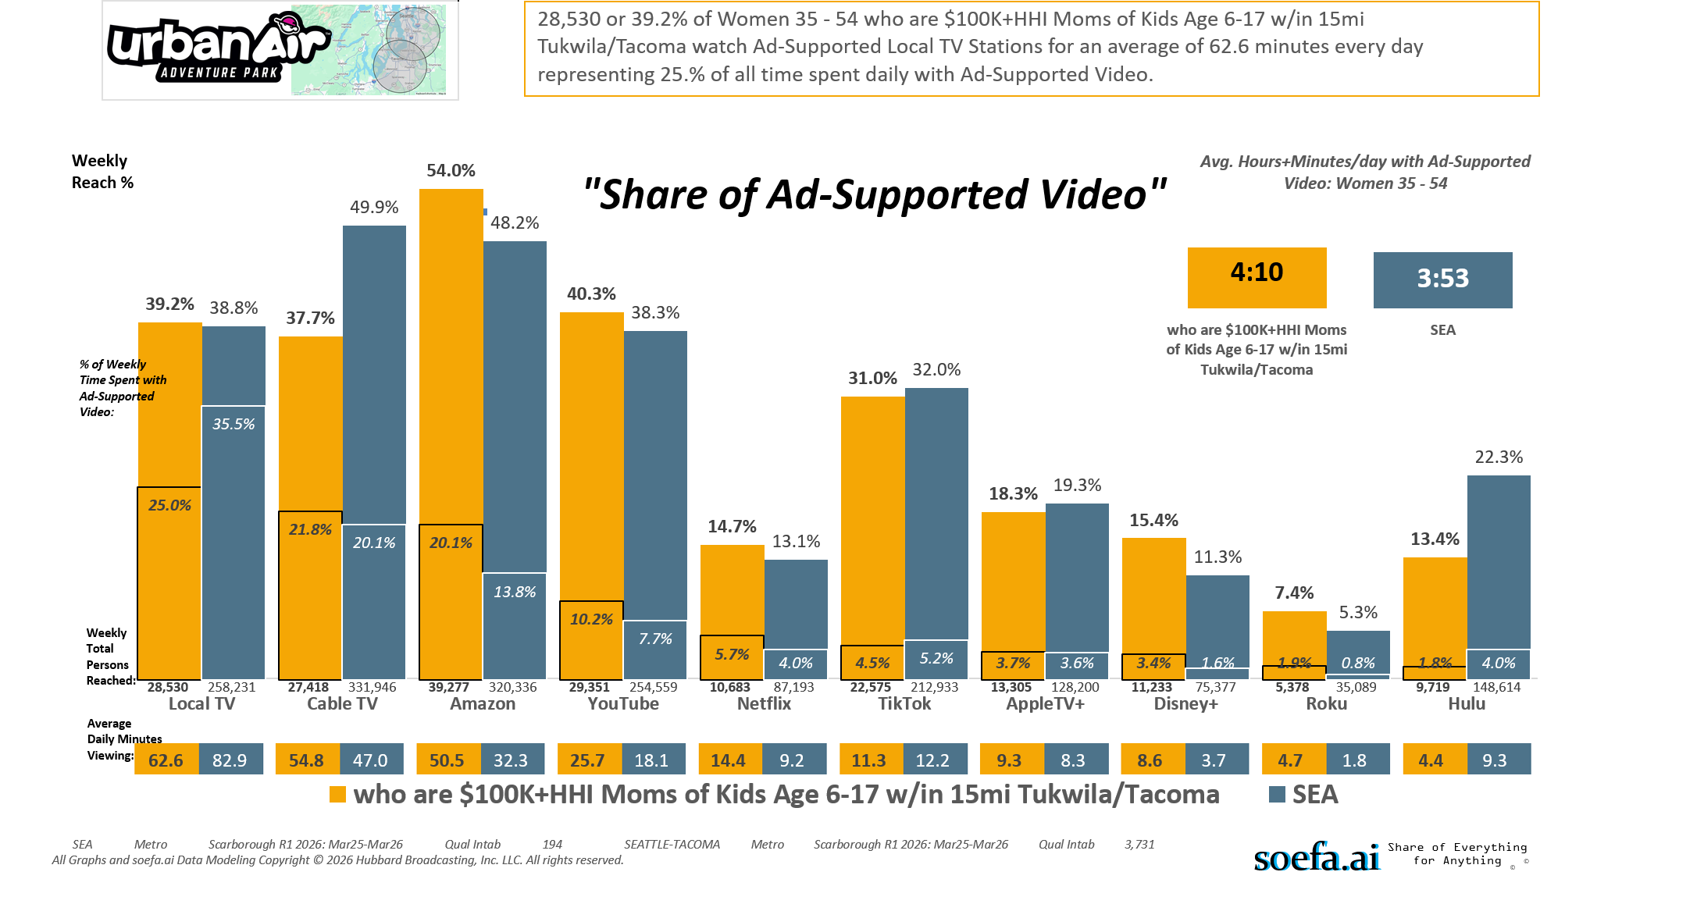
[((Household income summaries (HHLD): $100,000 or more AND Parent of child under 18: Yes) AND Presence of children by age (HHLD): Age 6 - 17)]
Custom Geo = 98188; 98057; 98178; 98055; 98168; 98148; 98031; 98032; 98056; 98166; 98198; 98146; 98118; 98108; 98058; 98030; 98040; 98059; 98106; 98006; 98136; 98126; 98134; 98144; 98070; 98042; 98001; 98002; 98104; 98003; 98116; 98122; 98101; 98004; 98121; 98005; 98023; 98112; 98038; 98008; 98007; 98027; 98102; 98109; 98029; 98422; 98092; 98119; 98075; 98047; 98105; 98354; 98404; 98408; 98443; 98409; 98444; 98445; 98402; 98424; 98371; 98499; 98405; 98446; 98373; 98467; 98466; 98406; 98439; 98465; 98498; 98375; 98372; 98407; 98390; 98374; 98388; 98387; 98391; 98433; 98335; 98338; 98327; 98303; 98332

Slide 18
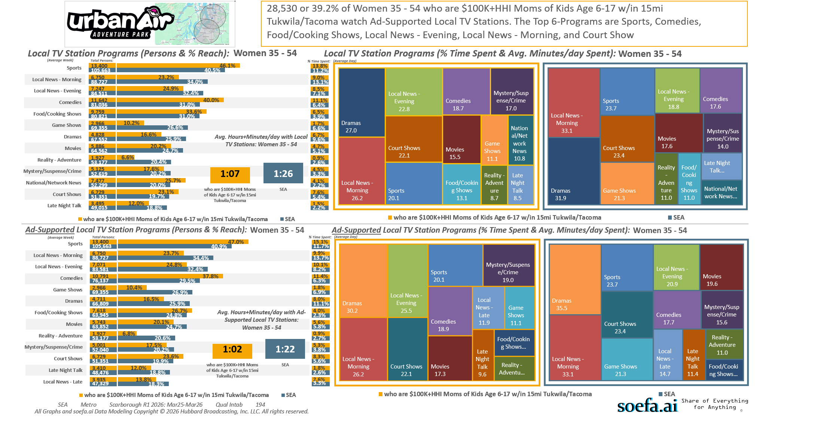
[((Household income summaries (HHLD): $100,000 or more AND Parent of child under 18: Yes) AND Presence of children by age (HHLD): Age 6 - 17)]
Custom Geo = 98188; 98057; 98178; 98055; 98168; 98148; 98031; 98032; 98056; 98166; 98198; 98146; 98118; 98108; 98058; 98030; 98040; 98059; 98106; 98006; 98136; 98126; 98134; 98144; 98070; 98042; 98001; 98002; 98104; 98003; 98116; 98122; 98101; 98004; 98121; 98005; 98023; 98112; 98038; 98008; 98007; 98027; 98102; 98109; 98029; 98422; 98092; 98119; 98075; 98047; 98105; 98354; 98404; 98408; 98443; 98409; 98444; 98445; 98402; 98424; 98371; 98499; 98405; 98446; 98373; 98467; 98466; 98406; 98439; 98465; 98498; 98375; 98372; 98407; 98390; 98374; 98388; 98387; 98391; 98433; 98335; 98338; 98327; 98303; 98332

Slide 19
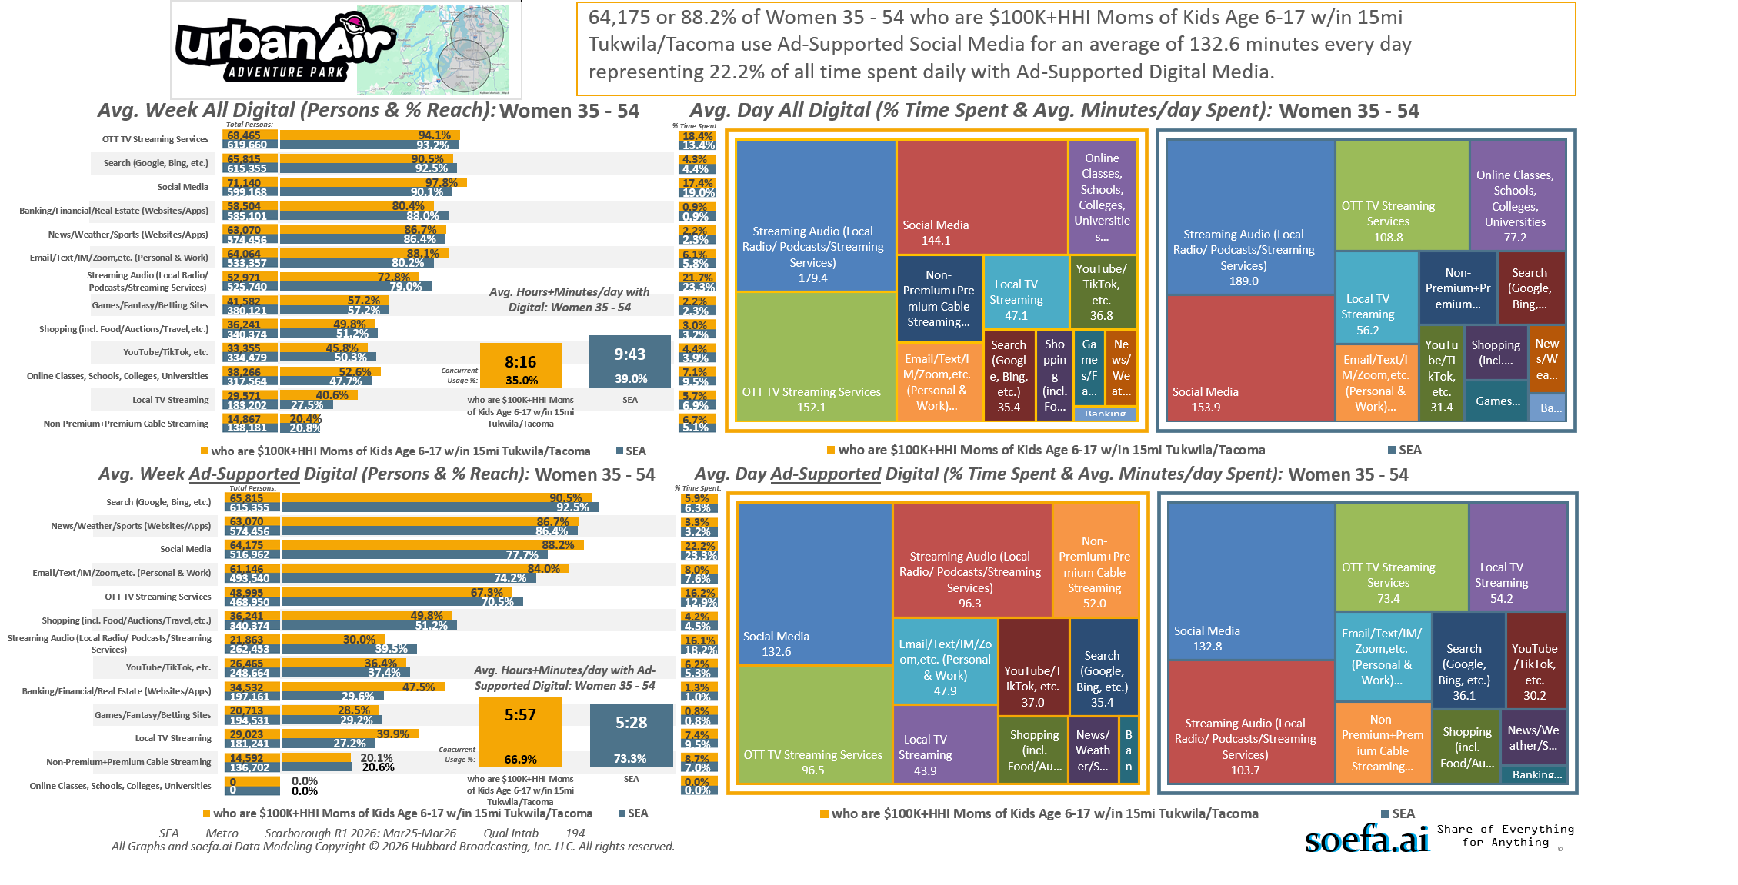
[((Household income summaries (HHLD): $100,000 or more AND Parent of child under 18: Yes) AND Presence of children by age (HHLD): Age 6 - 17)]
Custom Geo = 98188; 98057; 98178; 98055; 98168; 98148; 98031; 98032; 98056; 98166; 98198; 98146; 98118; 98108; 98058; 98030; 98040; 98059; 98106; 98006; 98136; 98126; 98134; 98144; 98070; 98042; 98001; 98002; 98104; 98003; 98116; 98122; 98101; 98004; 98121; 98005; 98023; 98112; 98038; 98008; 98007; 98027; 98102; 98109; 98029; 98422; 98092; 98119; 98075; 98047; 98105; 98354; 98404; 98408; 98443; 98409; 98444; 98445; 98402; 98424; 98371; 98499; 98405; 98446; 98373; 98467; 98466; 98406; 98439; 98465; 98498; 98375; 98372; 98407; 98390; 98374; 98388; 98387; 98391; 98433; 98335; 98338; 98327; 98303; 98332

Slide 20
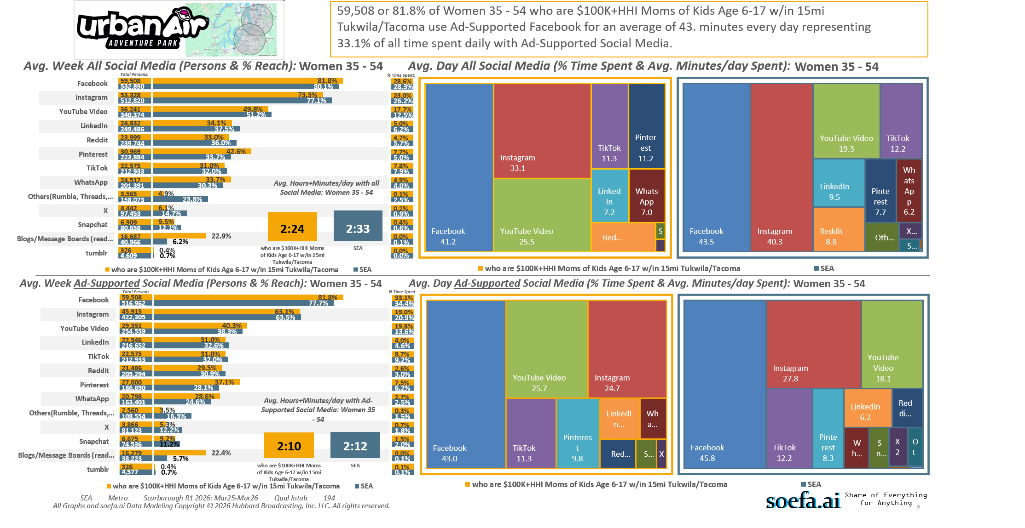
[((Household income summaries (HHLD): $100,000 or more AND Parent of child under 18: Yes) AND Presence of children by age (HHLD): Age 6 - 17)]
Custom Geo = 98188; 98057; 98178; 98055; 98168; 98148; 98031; 98032; 98056; 98166; 98198; 98146; 98118; 98108; 98058; 98030; 98040; 98059; 98106; 98006; 98136; 98126; 98134; 98144; 98070; 98042; 98001; 98002; 98104; 98003; 98116; 98122; 98101; 98004; 98121; 98005; 98023; 98112; 98038; 98008; 98007; 98027; 98102; 98109; 98029; 98422; 98092; 98119; 98075; 98047; 98105; 98354; 98404; 98408; 98443; 98409; 98444; 98445; 98402; 98424; 98371; 98499; 98405; 98446; 98373; 98467; 98466; 98406; 98439; 98465; 98498; 98375; 98372; 98407; 98390; 98374; 98388; 98387; 98391; 98433; 98335; 98338; 98327; 98303; 98332

Slide 21
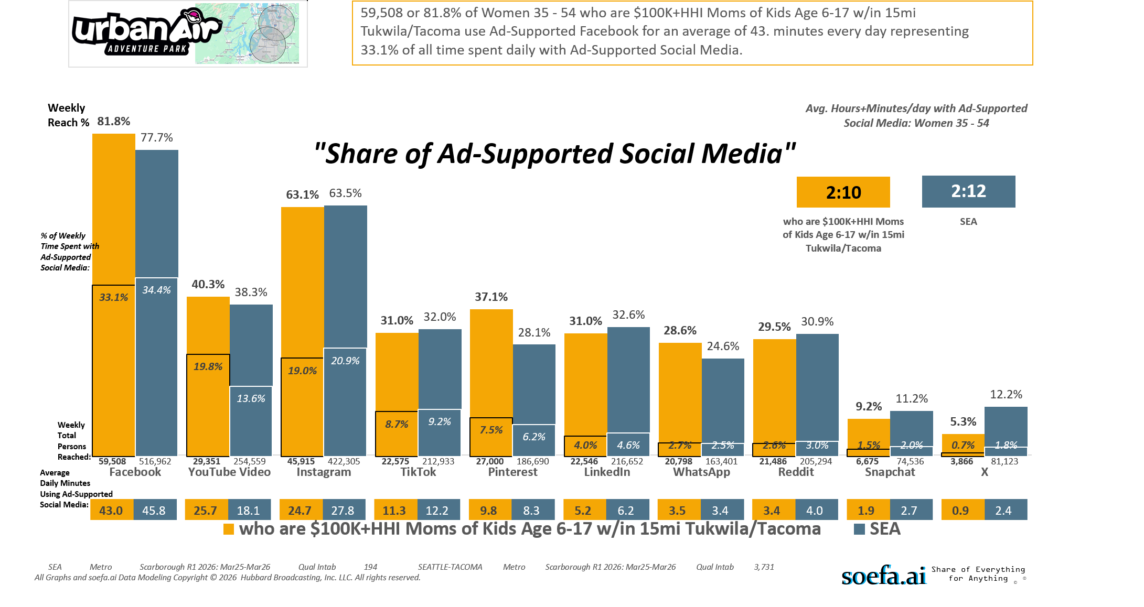
[((Household income summaries (HHLD): $100,000 or more AND Parent of child under 18: Yes) AND Presence of children by age (HHLD): Age 6 - 17)]
Custom Geo = 98188; 98057; 98178; 98055; 98168; 98148; 98031; 98032; 98056; 98166; 98198; 98146; 98118; 98108; 98058; 98030; 98040; 98059; 98106; 98006; 98136; 98126; 98134; 98144; 98070; 98042; 98001; 98002; 98104; 98003; 98116; 98122; 98101; 98004; 98121; 98005; 98023; 98112; 98038; 98008; 98007; 98027; 98102; 98109; 98029; 98422; 98092; 98119; 98075; 98047; 98105; 98354; 98404; 98408; 98443; 98409; 98444; 98445; 98402; 98424; 98371; 98499; 98405; 98446; 98373; 98467; 98466; 98406; 98439; 98465; 98498; 98375; 98372; 98407; 98390; 98374; 98388; 98387; 98391; 98433; 98335; 98338; 98327; 98303; 98332

Slide 22
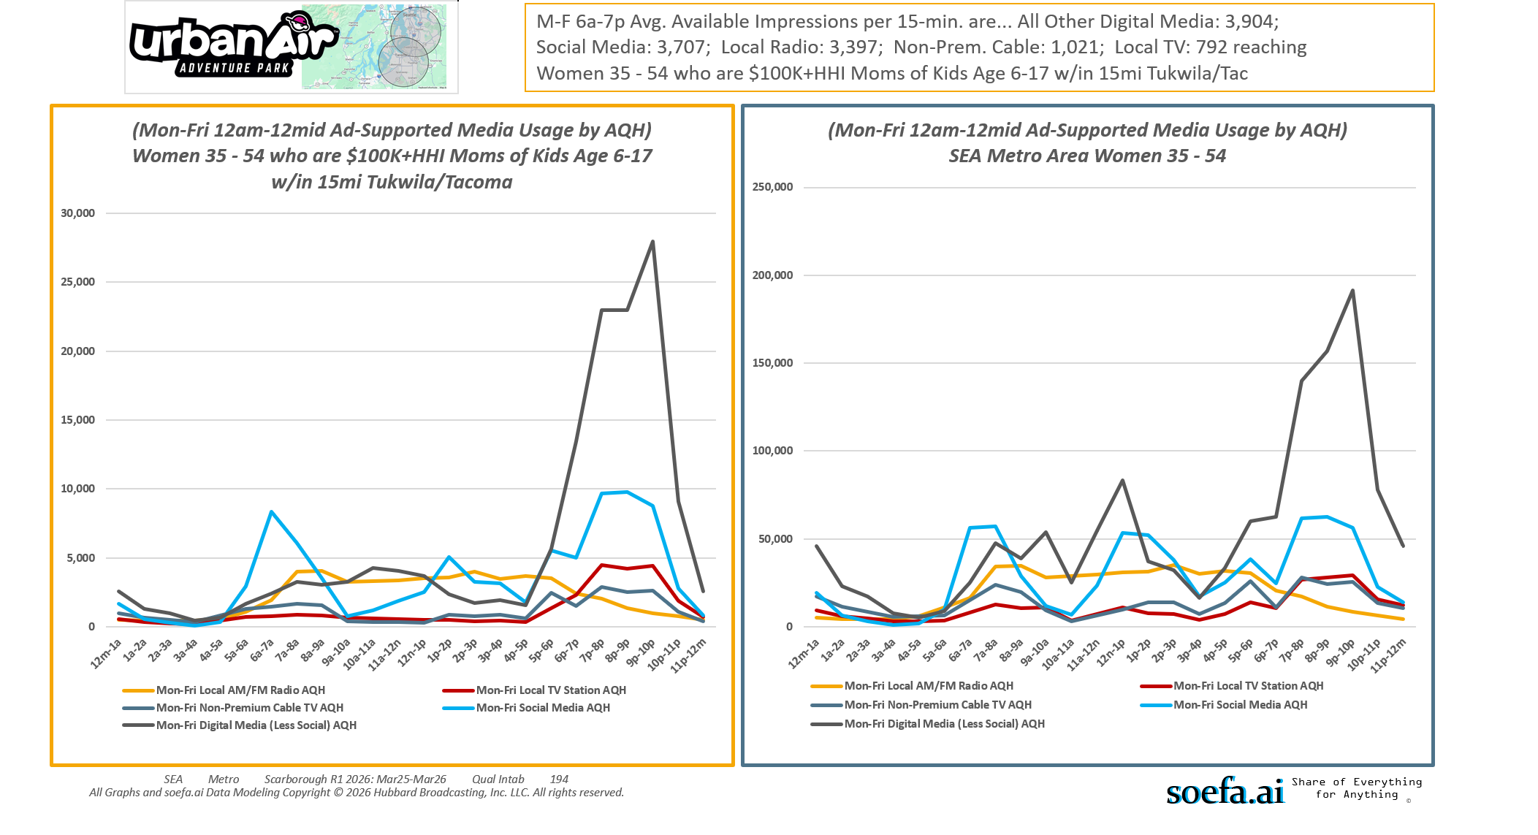
[((Household income summaries (HHLD): $100,000 or more AND Parent of child under 18: Yes) AND Presence of children by age (HHLD): Age 6 - 17)]
Custom Geo = 98188; 98057; 98178; 98055; 98168; 98148; 98031; 98032; 98056; 98166; 98198; 98146; 98118; 98108; 98058; 98030; 98040; 98059; 98106; 98006; 98136; 98126; 98134; 98144; 98070; 98042; 98001; 98002; 98104; 98003; 98116; 98122; 98101; 98004; 98121; 98005; 98023; 98112; 98038; 98008; 98007; 98027; 98102; 98109; 98029; 98422; 98092; 98119; 98075; 98047; 98105; 98354; 98404; 98408; 98443; 98409; 98444; 98445; 98402; 98424; 98371; 98499; 98405; 98446; 98373; 98467; 98466; 98406; 98439; 98465; 98498; 98375; 98372; 98407; 98390; 98374; 98388; 98387; 98391; 98433; 98335; 98338; 98327; 98303; 98332

Slide 23
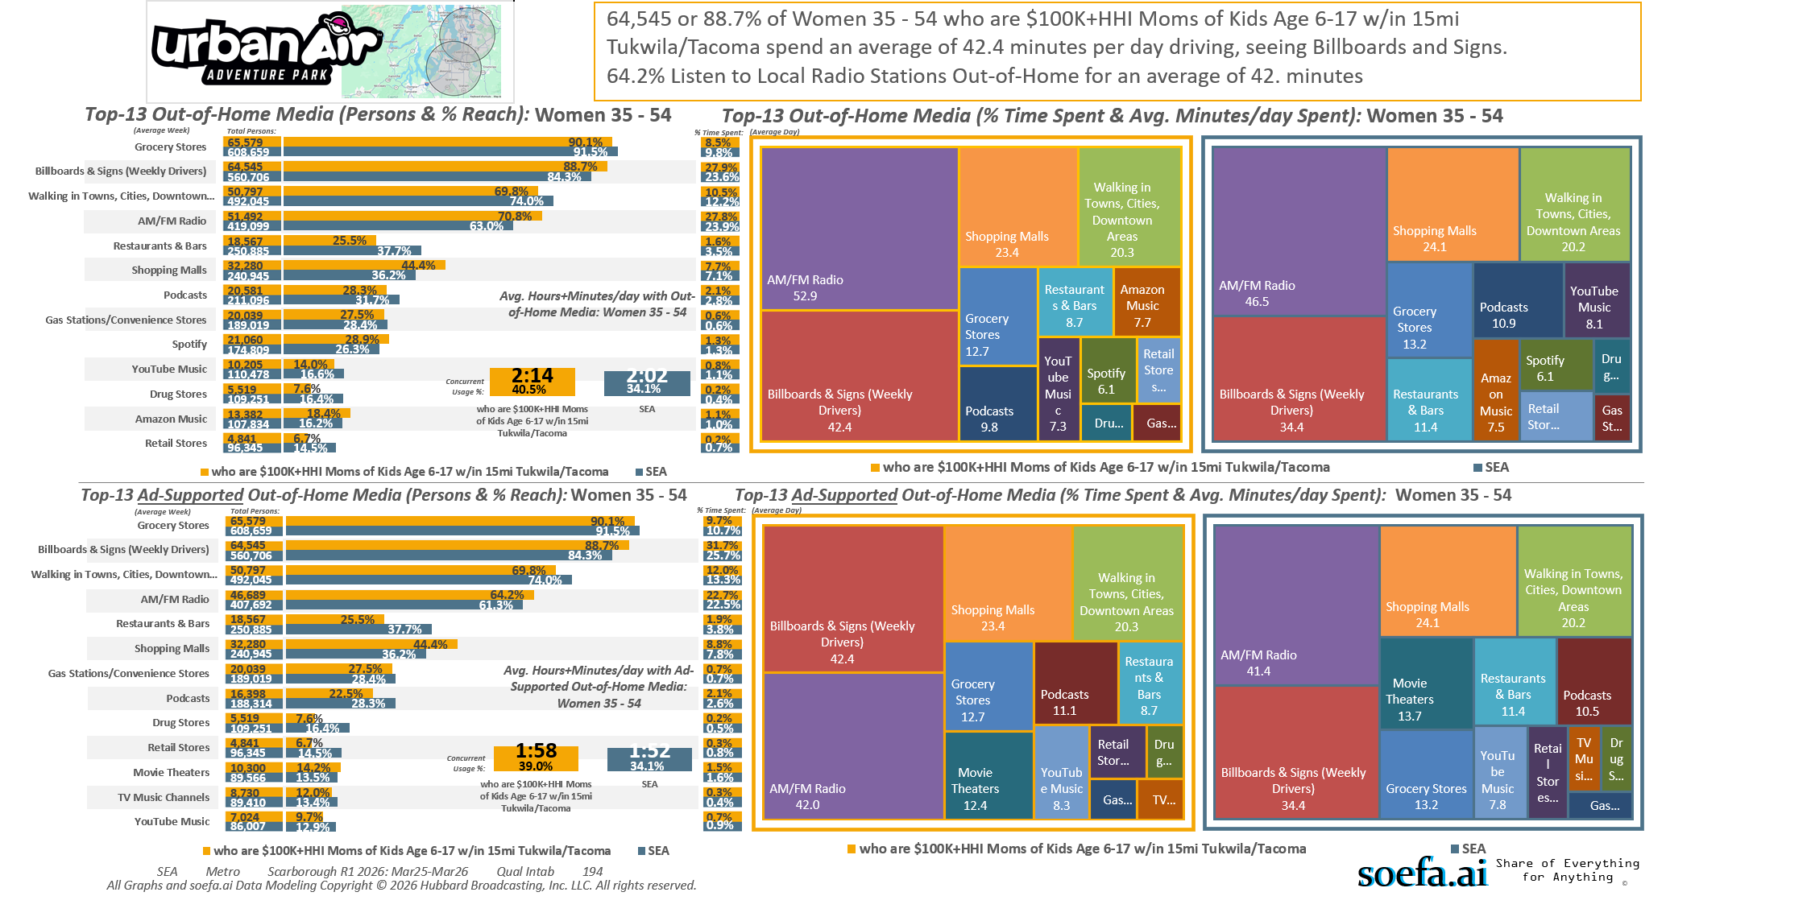
[((Household income summaries (HHLD): $100,000 or more AND Parent of child under 18: Yes) AND Presence of children by age (HHLD): Age 6 - 17)]
Custom Geo = 98188; 98057; 98178; 98055; 98168; 98148; 98031; 98032; 98056; 98166; 98198; 98146; 98118; 98108; 98058; 98030; 98040; 98059; 98106; 98006; 98136; 98126; 98134; 98144; 98070; 98042; 98001; 98002; 98104; 98003; 98116; 98122; 98101; 98004; 98121; 98005; 98023; 98112; 98038; 98008; 98007; 98027; 98102; 98109; 98029; 98422; 98092; 98119; 98075; 98047; 98105; 98354; 98404; 98408; 98443; 98409; 98444; 98445; 98402; 98424; 98371; 98499; 98405; 98446; 98373; 98467; 98466; 98406; 98439; 98465; 98498; 98375; 98372; 98407; 98390; 98374; 98388; 98387; 98391; 98433; 98335; 98338; 98327; 98303; 98332

Slide 24
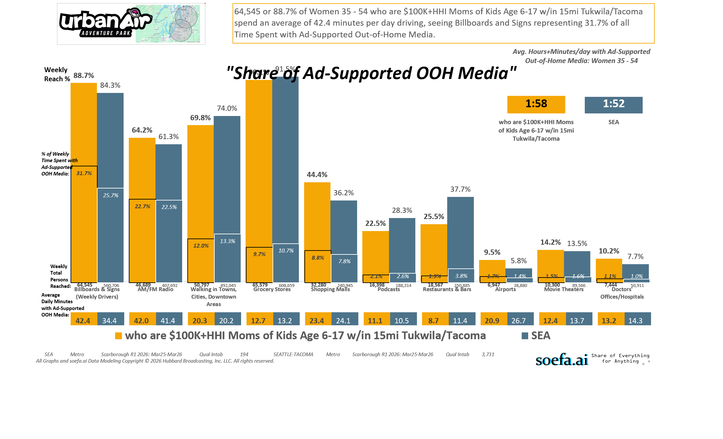
[((Household income summaries (HHLD): $100,000 or more AND Parent of child under 18: Yes) AND Presence of children by age (HHLD): Age 6 - 17)]
Custom Geo = 98188; 98057; 98178; 98055; 98168; 98148; 98031; 98032; 98056; 98166; 98198; 98146; 98118; 98108; 98058; 98030; 98040; 98059; 98106; 98006; 98136; 98126; 98134; 98144; 98070; 98042; 98001; 98002; 98104; 98003; 98116; 98122; 98101; 98004; 98121; 98005; 98023; 98112; 98038; 98008; 98007; 98027; 98102; 98109; 98029; 98422; 98092; 98119; 98075; 98047; 98105; 98354; 98404; 98408; 98443; 98409; 98444; 98445; 98402; 98424; 98371; 98499; 98405; 98446; 98373; 98467; 98466; 98406; 98439; 98465; 98498; 98375; 98372; 98407; 98390; 98374; 98388; 98387; 98391; 98433; 98335; 98338; 98327; 98303; 98332

Slide 25
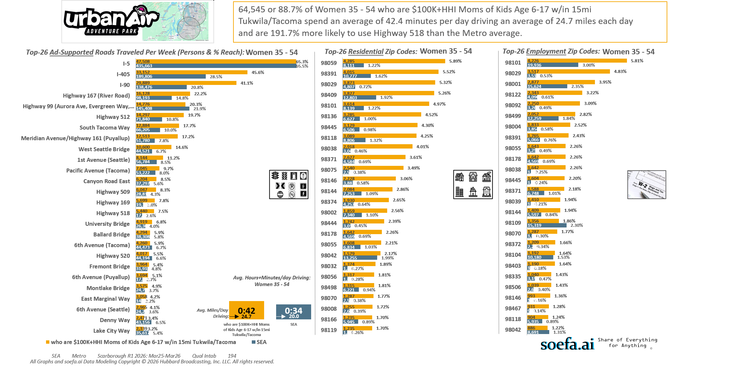
[((Household income summaries (HHLD): $100,000 or more AND Parent of child under 18: Yes) AND Presence of children by age (HHLD): Age 6 - 17)]
Custom Geo = 98188; 98057; 98178; 98055; 98168; 98148; 98031; 98032; 98056; 98166; 98198; 98146; 98118; 98108; 98058; 98030; 98040; 98059; 98106; 98006; 98136; 98126; 98134; 98144; 98070; 98042; 98001; 98002; 98104; 98003; 98116; 98122; 98101; 98004; 98121; 98005; 98023; 98112; 98038; 98008; 98007; 98027; 98102; 98109; 98029; 98422; 98092; 98119; 98075; 98047; 98105; 98354; 98404; 98408; 98443; 98409; 98444; 98445; 98402; 98424; 98371; 98499; 98405; 98446; 98373; 98467; 98466; 98406; 98439; 98465; 98498; 98375; 98372; 98407; 98390; 98374; 98388; 98387; 98391; 98433; 98335; 98338; 98327; 98303; 98332

Slide 26
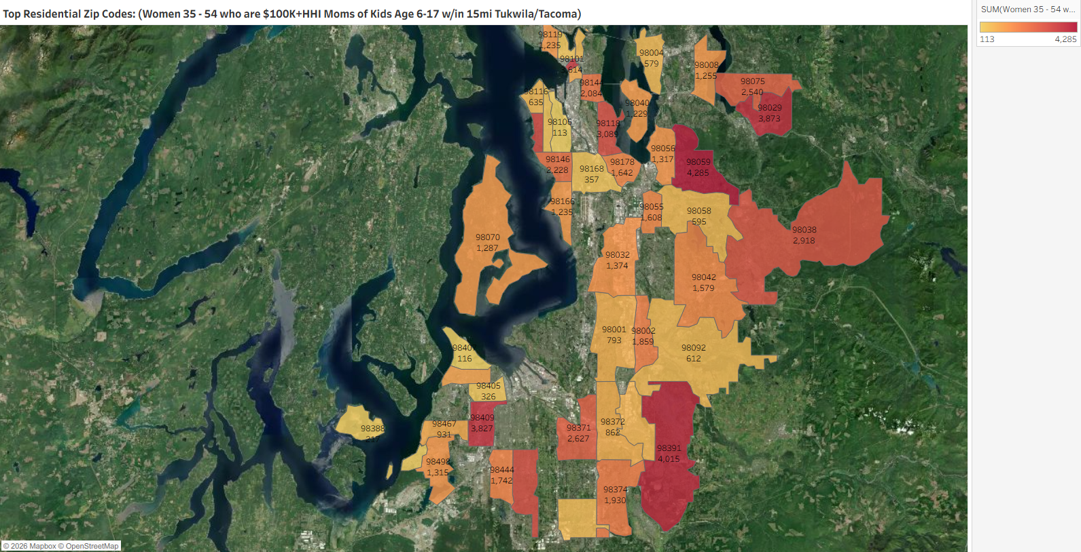
[((Household income summaries (HHLD): $100,000 or more AND Parent of child under 18: Yes) AND Presence of children by age (HHLD): Age 6 - 17)]
Custom Geo = 98188; 98057; 98178; 98055; 98168; 98148; 98031; 98032; 98056; 98166; 98198; 98146; 98118; 98108; 98058; 98030; 98040; 98059; 98106; 98006; 98136; 98126; 98134; 98144; 98070; 98042; 98001; 98002; 98104; 98003; 98116; 98122; 98101; 98004; 98121; 98005; 98023; 98112; 98038; 98008; 98007; 98027; 98102; 98109; 98029; 98422; 98092; 98119; 98075; 98047; 98105; 98354; 98404; 98408; 98443; 98409; 98444; 98445; 98402; 98424; 98371; 98499; 98405; 98446; 98373; 98467; 98466; 98406; 98439; 98465; 98498; 98375; 98372; 98407; 98390; 98374; 98388; 98387; 98391; 98433; 98335; 98338; 98327; 98303; 98332

Slide 27
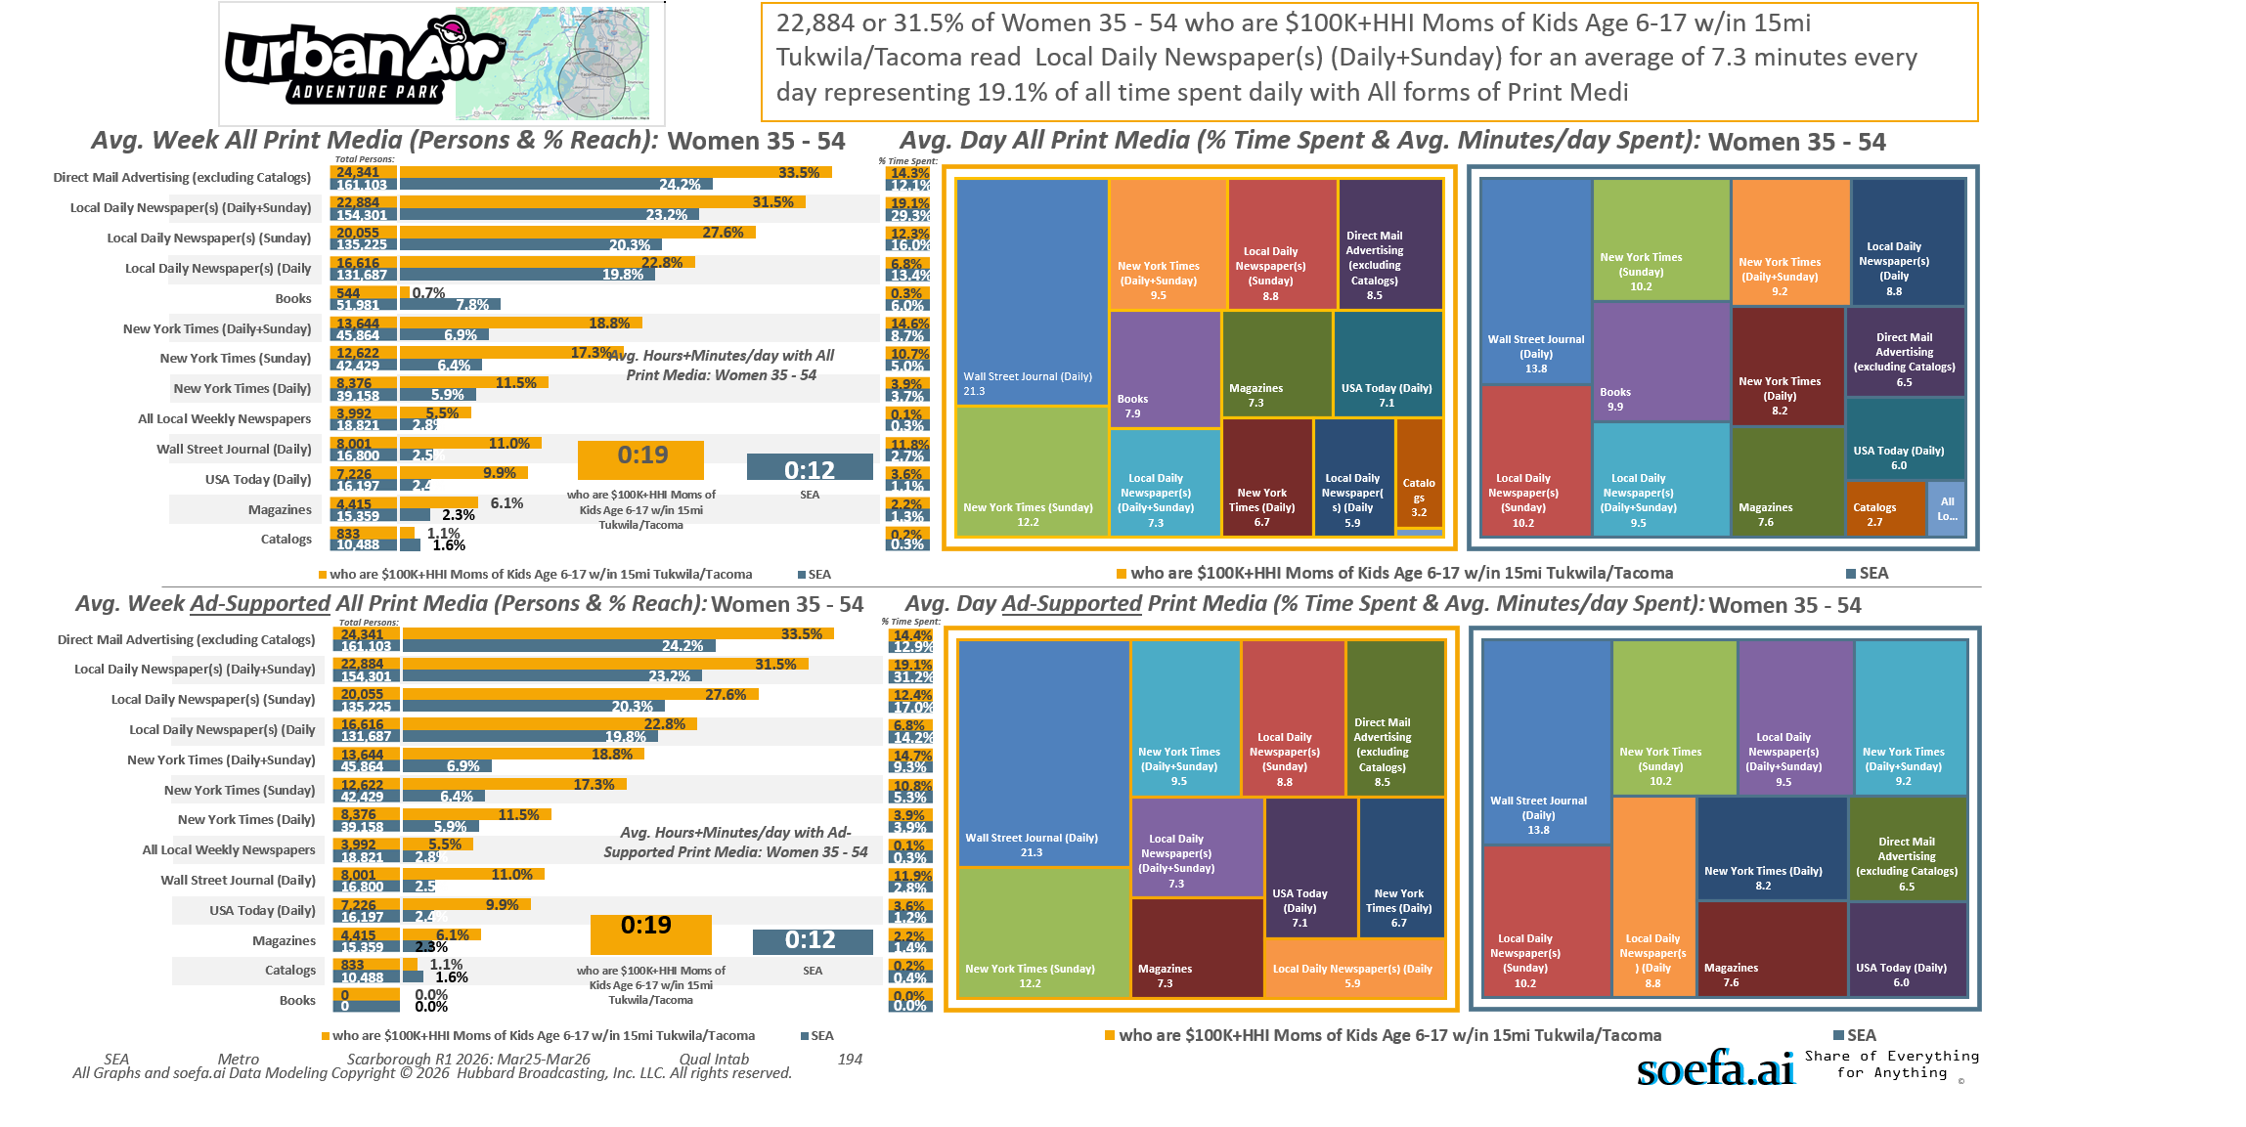
[((Household income summaries (HHLD): $100,000 or more AND Parent of child under 18: Yes) AND Presence of children by age (HHLD): Age 6 - 17)]
Custom Geo = 98188; 98057; 98178; 98055; 98168; 98148; 98031; 98032; 98056; 98166; 98198; 98146; 98118; 98108; 98058; 98030; 98040; 98059; 98106; 98006; 98136; 98126; 98134; 98144; 98070; 98042; 98001; 98002; 98104; 98003; 98116; 98122; 98101; 98004; 98121; 98005; 98023; 98112; 98038; 98008; 98007; 98027; 98102; 98109; 98029; 98422; 98092; 98119; 98075; 98047; 98105; 98354; 98404; 98408; 98443; 98409; 98444; 98445; 98402; 98424; 98371; 98499; 98405; 98446; 98373; 98467; 98466; 98406; 98439; 98465; 98498; 98375; 98372; 98407; 98390; 98374; 98388; 98387; 98391; 98433; 98335; 98338; 98327; 98303; 98332

