Slide 1

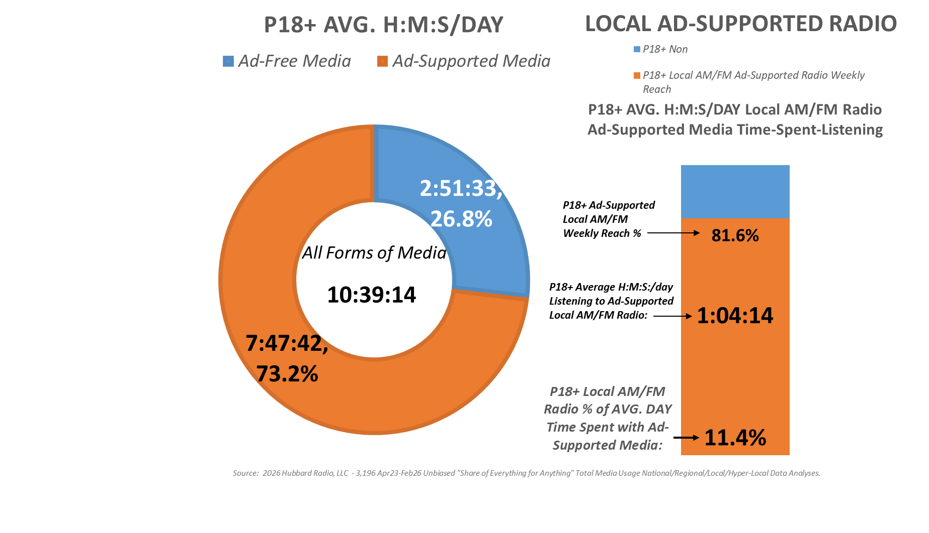
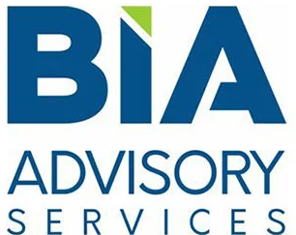

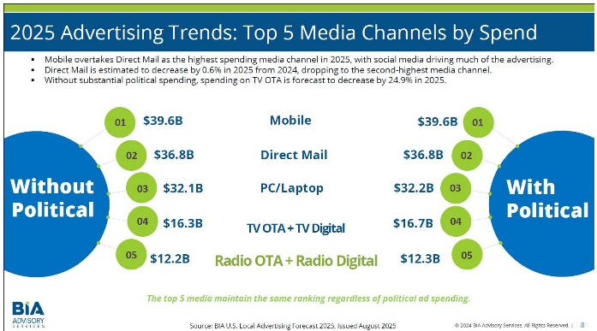

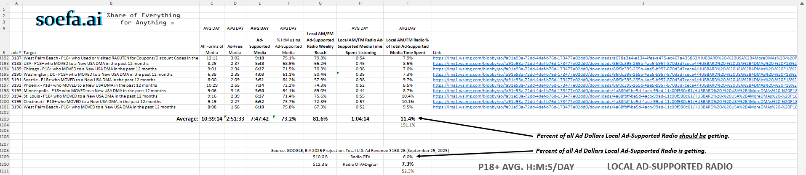
Average of
3,196 Decks
As of: 12 N:
03/02/2026
Total local advertising spending is projected to reach $168.2 billion in 2025 (ex. political), with local radio as the fifth-largest media in terms of ad spending. That’s according to BIA’s latest forecast, which finds local radio will generate $12.3 billion in 2025, with $2.3 billion coming from Radio Digital.
Local Radio:
$10 Billion (excl. “Radio Digital”)
= 6% of Ad Spend

