Slide 1
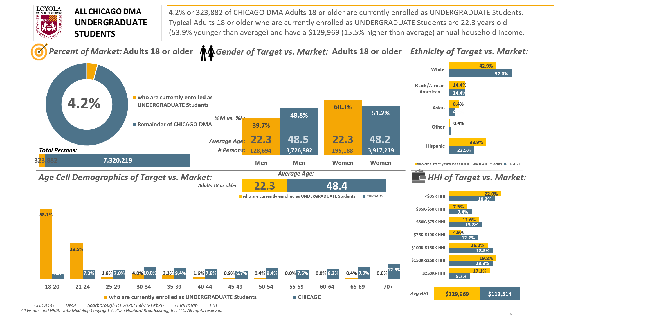





[(Currently enrolled/attending classes at a college/university: Yes AND (Level of education: High school graduate (12th grade or GED) OR Level of education: Some college credit (no degree)))]

Slide 2
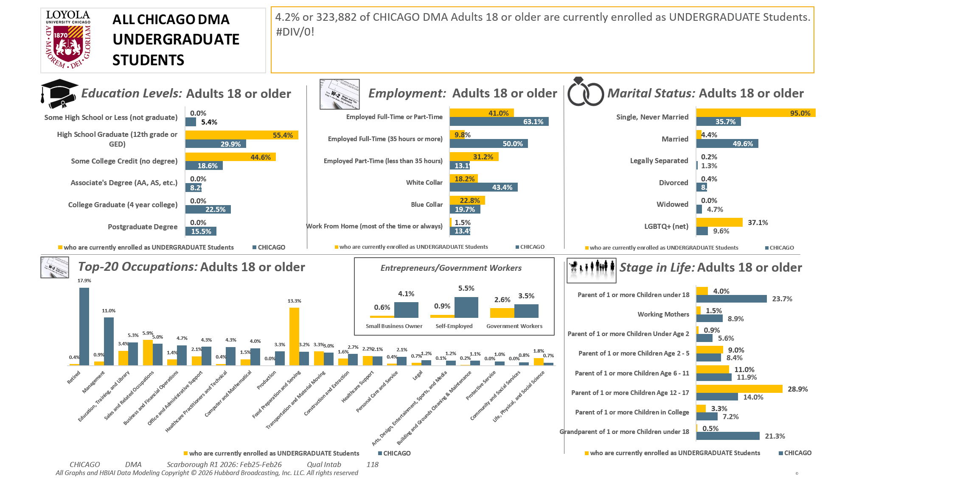
[(Currently enrolled/attending classes at a college/university: Yes AND (Level of education: High school graduate (12th grade or GED) OR Level of education: Some college credit (no degree)))]

Slide 3
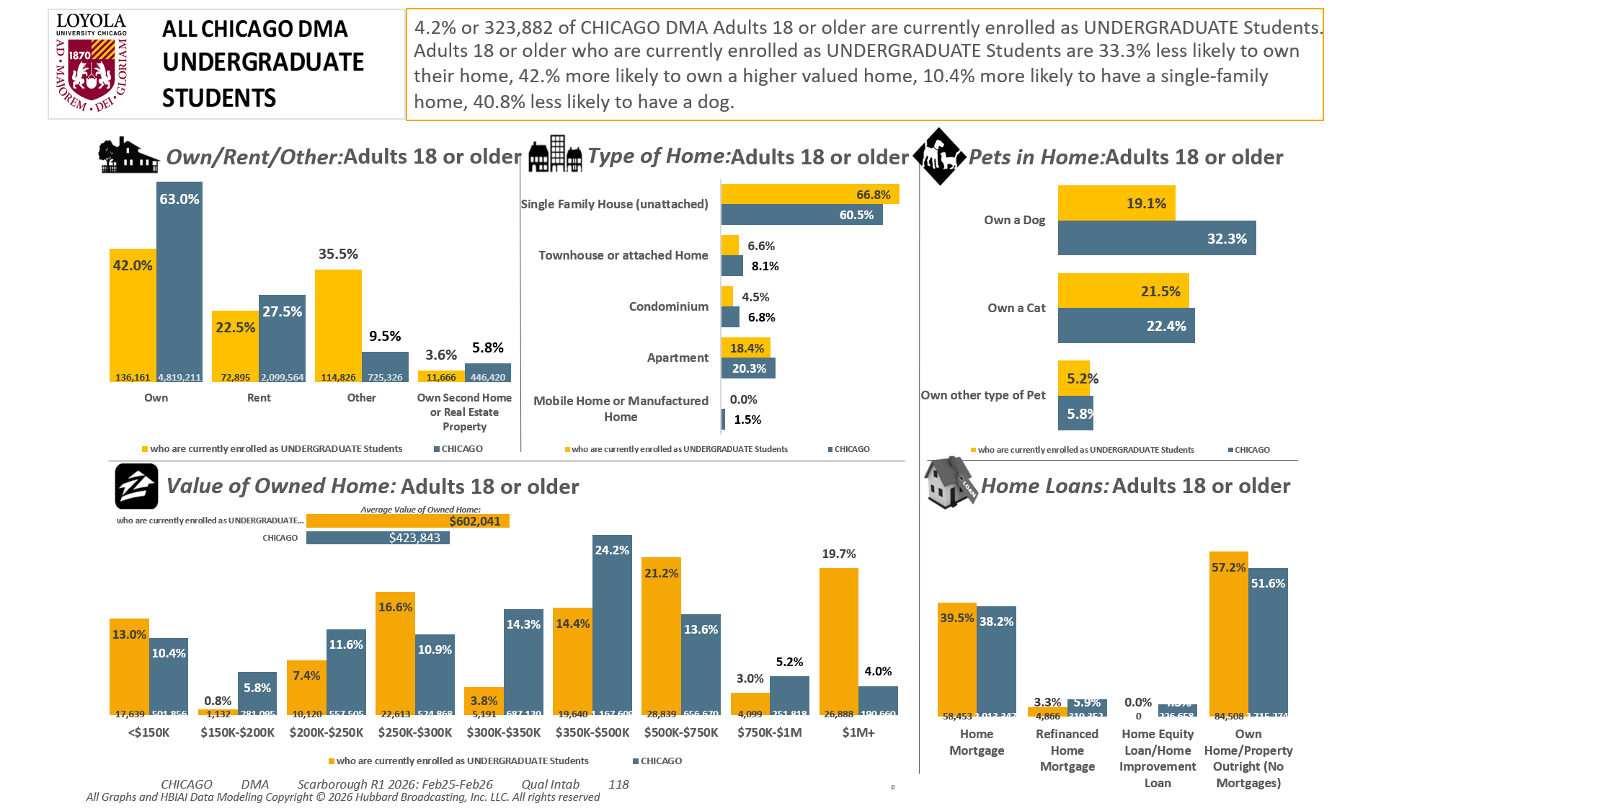
[(Currently enrolled/attending classes at a college/university: Yes AND (Level of education: High school graduate (12th grade or GED) OR Level of education: Some college credit (no degree)))]

Slide 4
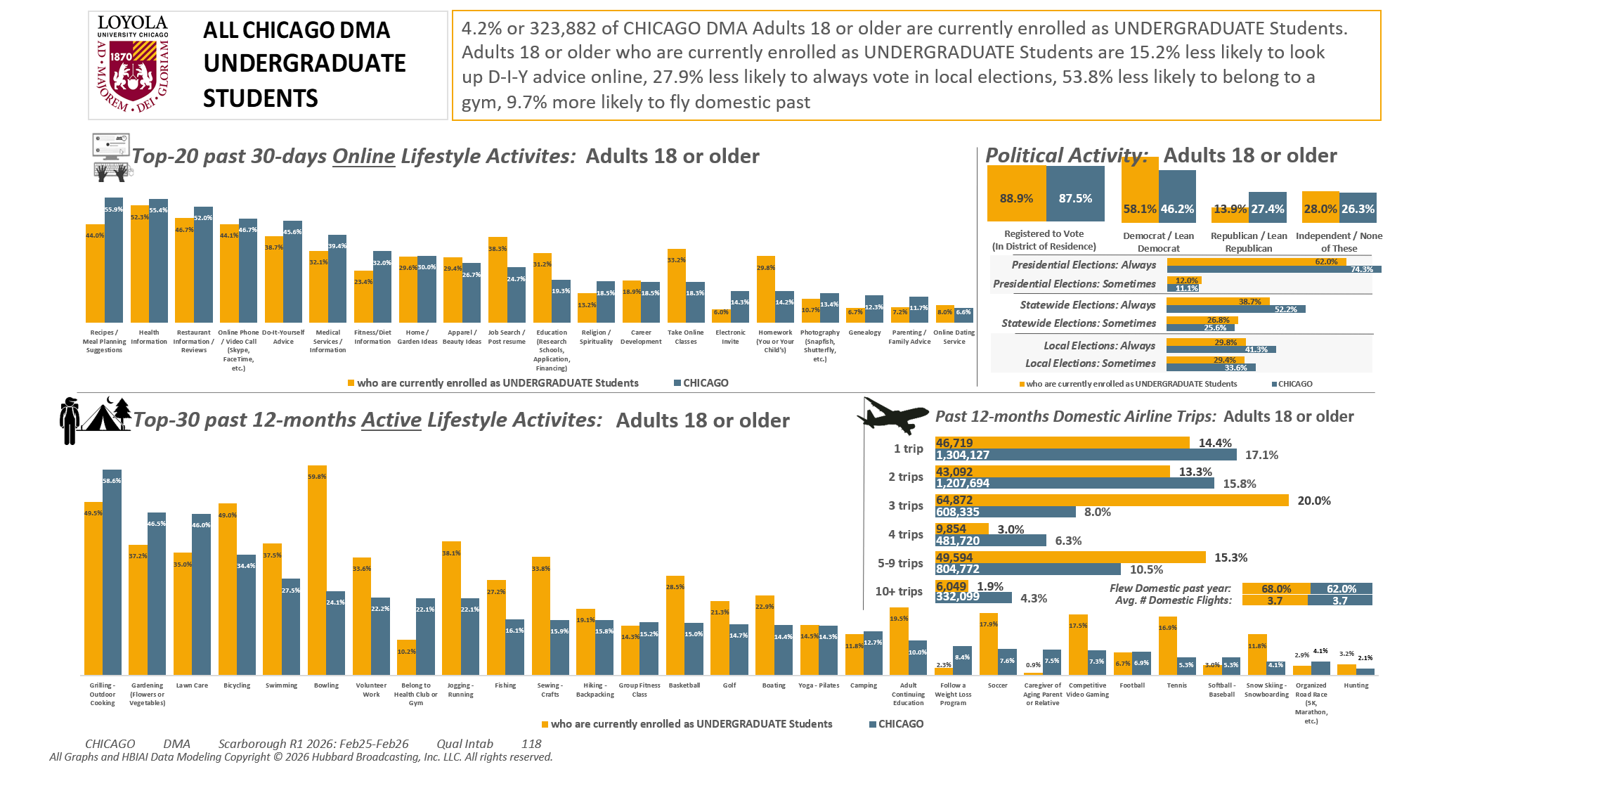
[(Currently enrolled/attending classes at a college/university: Yes AND (Level of education: High school graduate (12th grade or GED) OR Level of education: Some college credit (no degree)))]

Slide 5
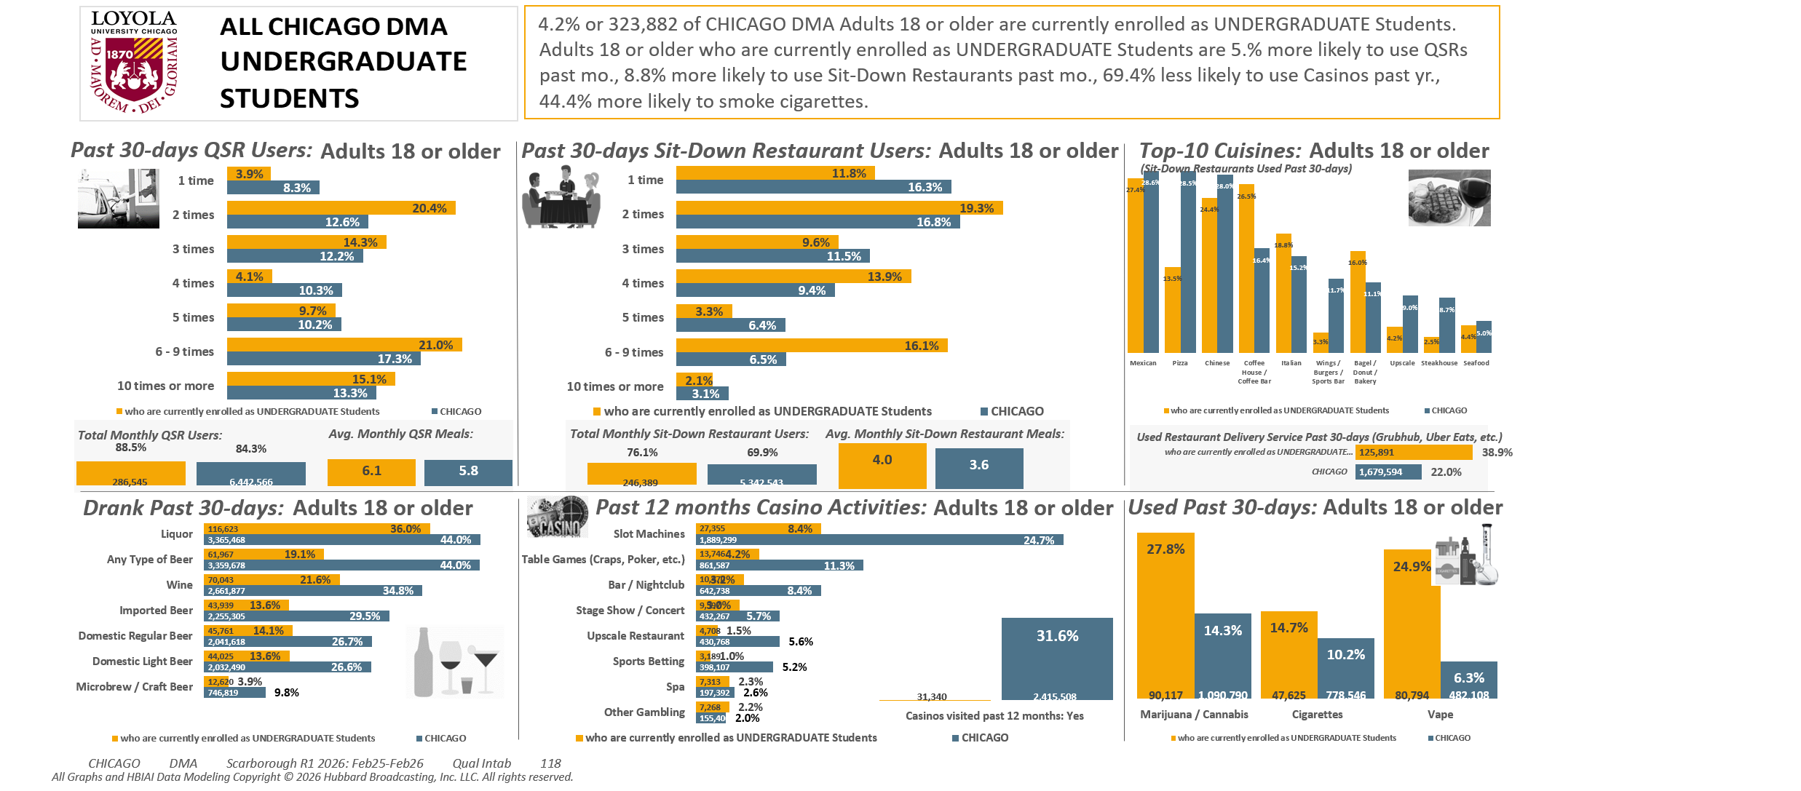
[(Currently enrolled/attending classes at a college/university: Yes AND (Level of education: High school graduate (12th grade or GED) OR Level of education: Some college credit (no degree)))]

Slide 6
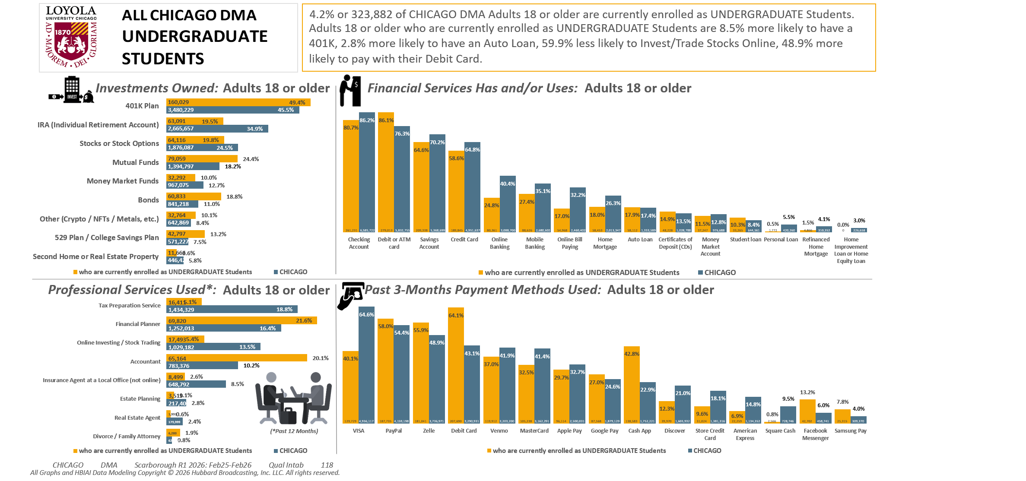
[(Currently enrolled/attending classes at a college/university: Yes AND (Level of education: High school graduate (12th grade or GED) OR Level of education: Some college credit (no degree)))]

Slide 7
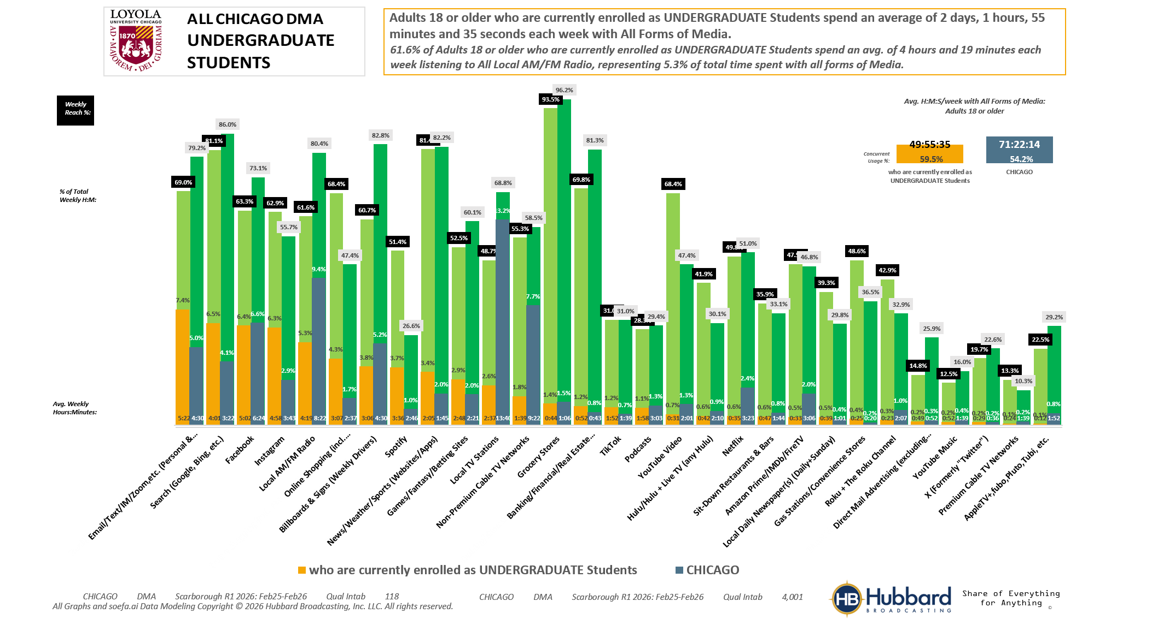

[(Currently enrolled/attending classes at a college/university: Yes AND (Level of education: High school graduate (12th grade or GED) OR Level of education: Some college credit (no degree)))]

Slide 8
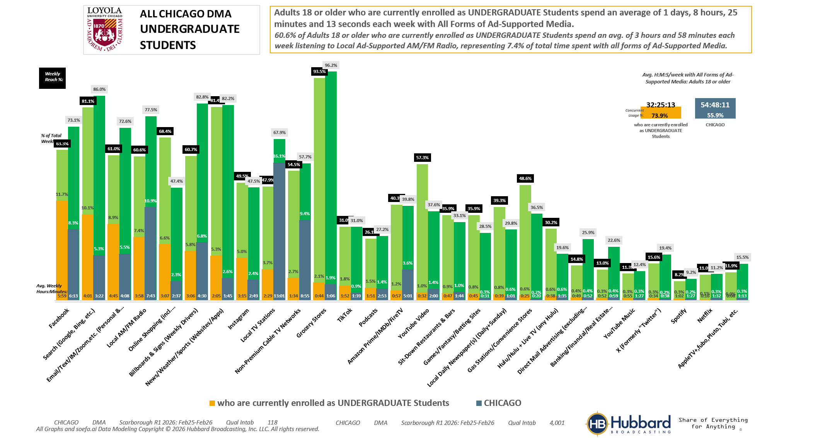
[(Currently enrolled/attending classes at a college/university: Yes AND (Level of education: High school graduate (12th grade or GED) OR Level of education: Some college credit (no degree)))]

Slide 9
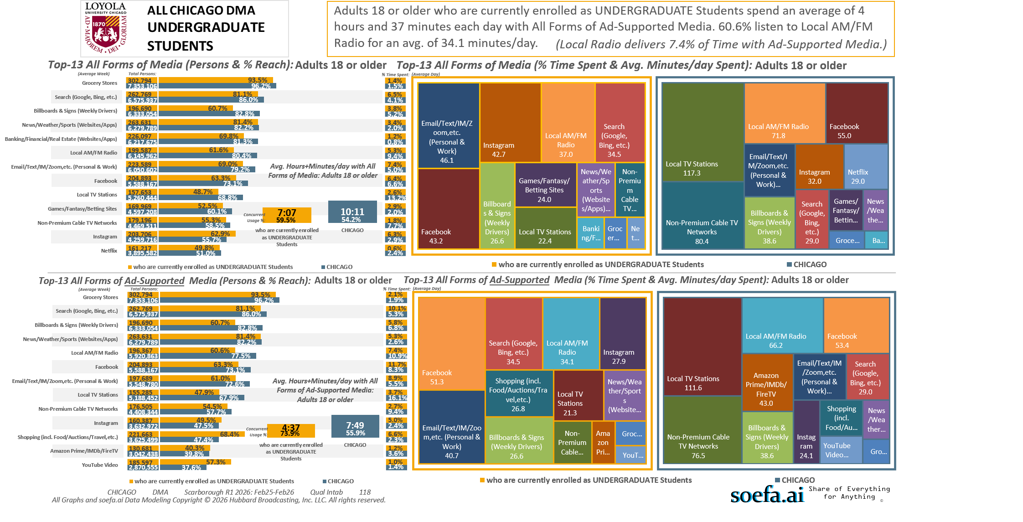
[(Currently enrolled/attending classes at a college/university: Yes AND (Level of education: High school graduate (12th grade or GED) OR Level of education: Some college credit (no degree)))]

Slide 10
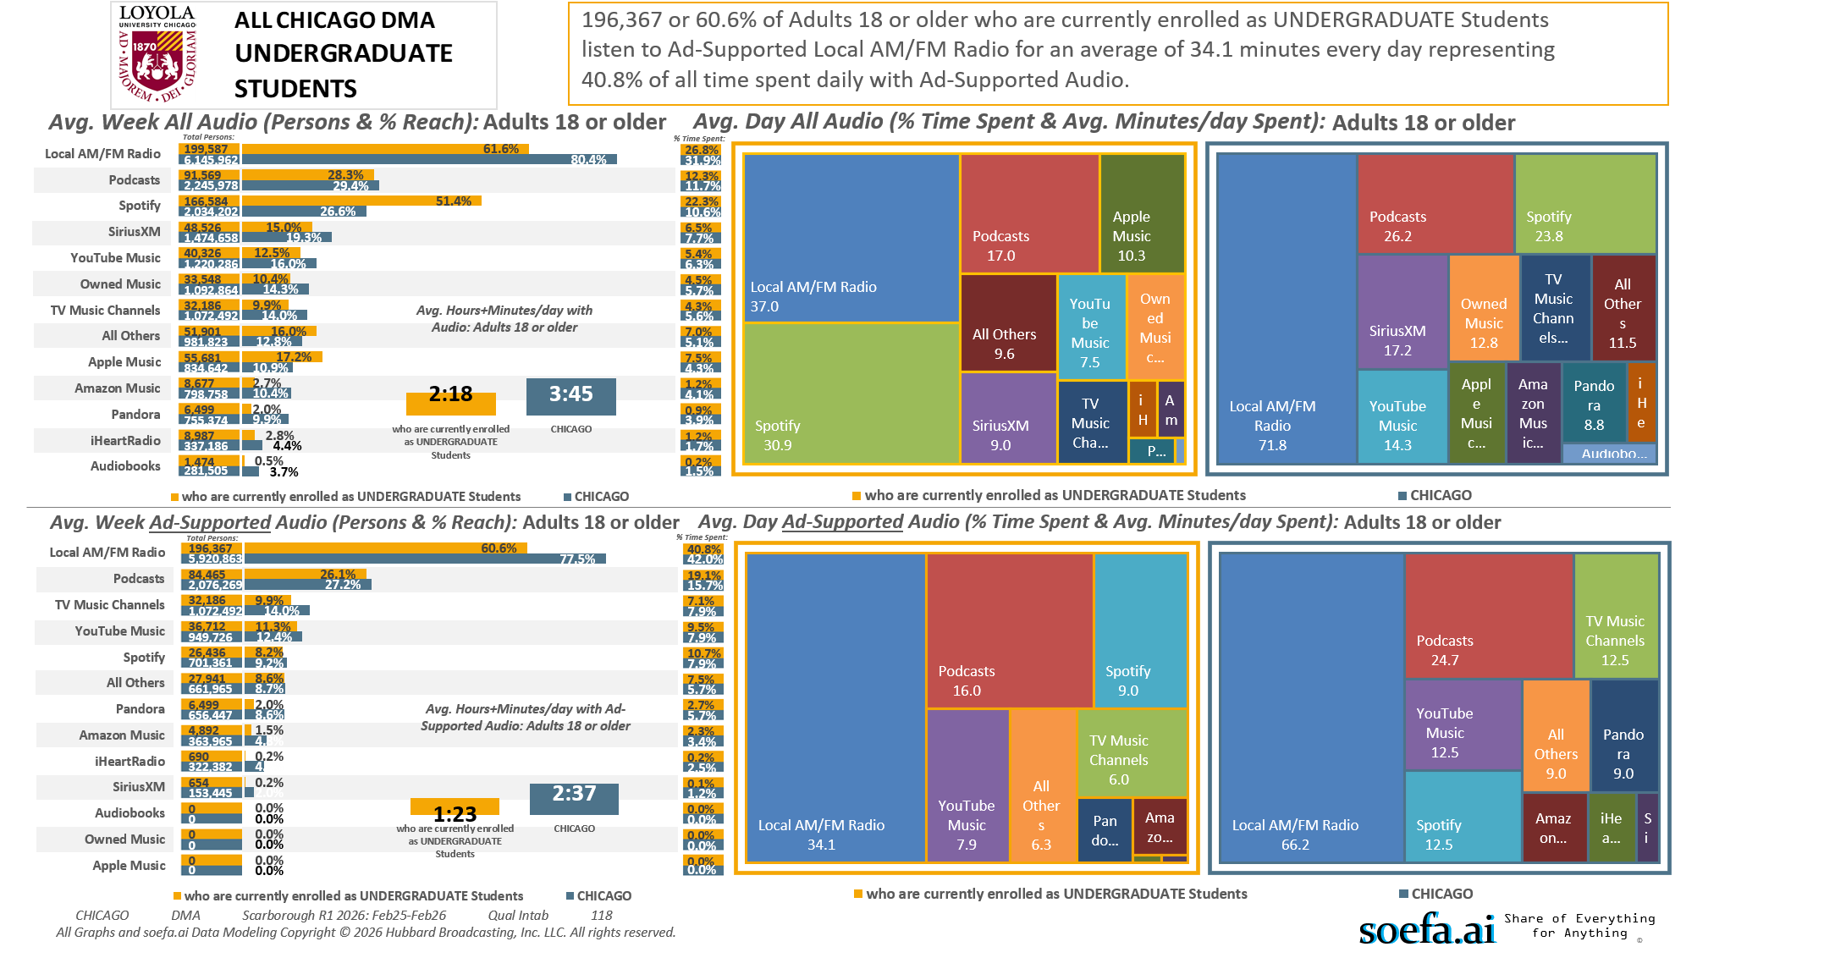
[(Currently enrolled/attending classes at a college/university: Yes AND (Level of education: High school graduate (12th grade or GED) OR Level of education: Some college credit (no degree)))]

Slide 11
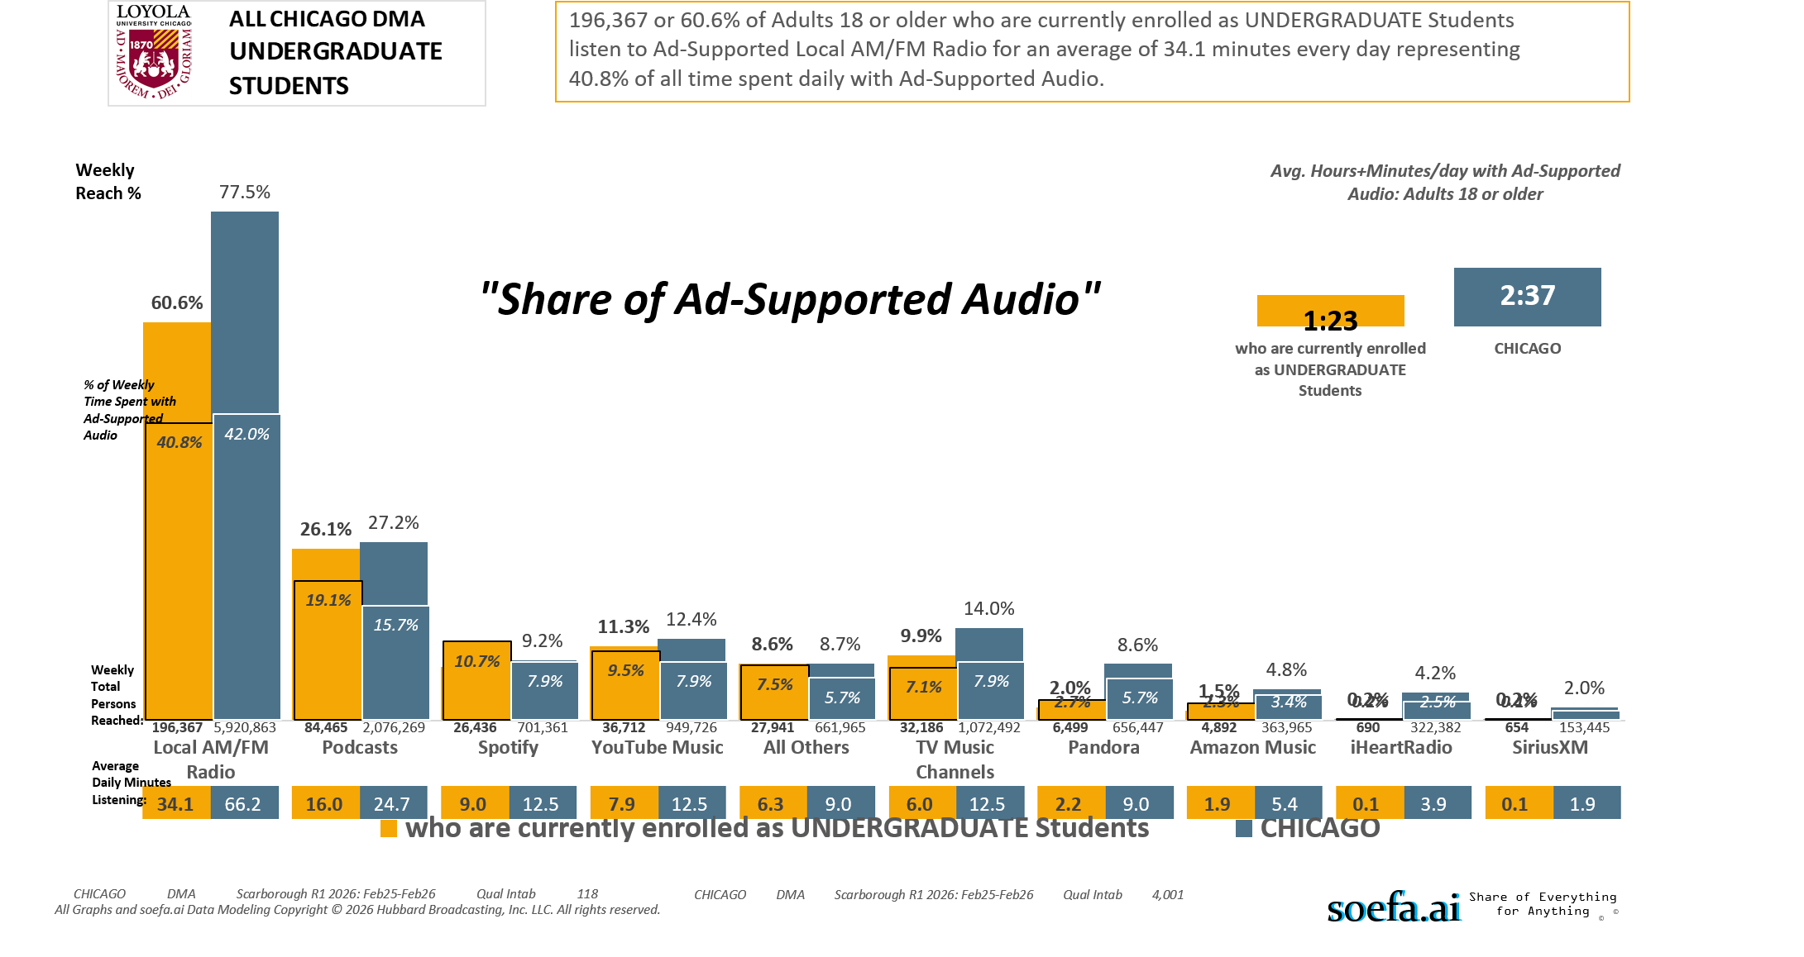
[(Currently enrolled/attending classes at a college/university: Yes AND (Level of education: High school graduate (12th grade or GED) OR Level of education: Some college credit (no degree)))]

Slide 12
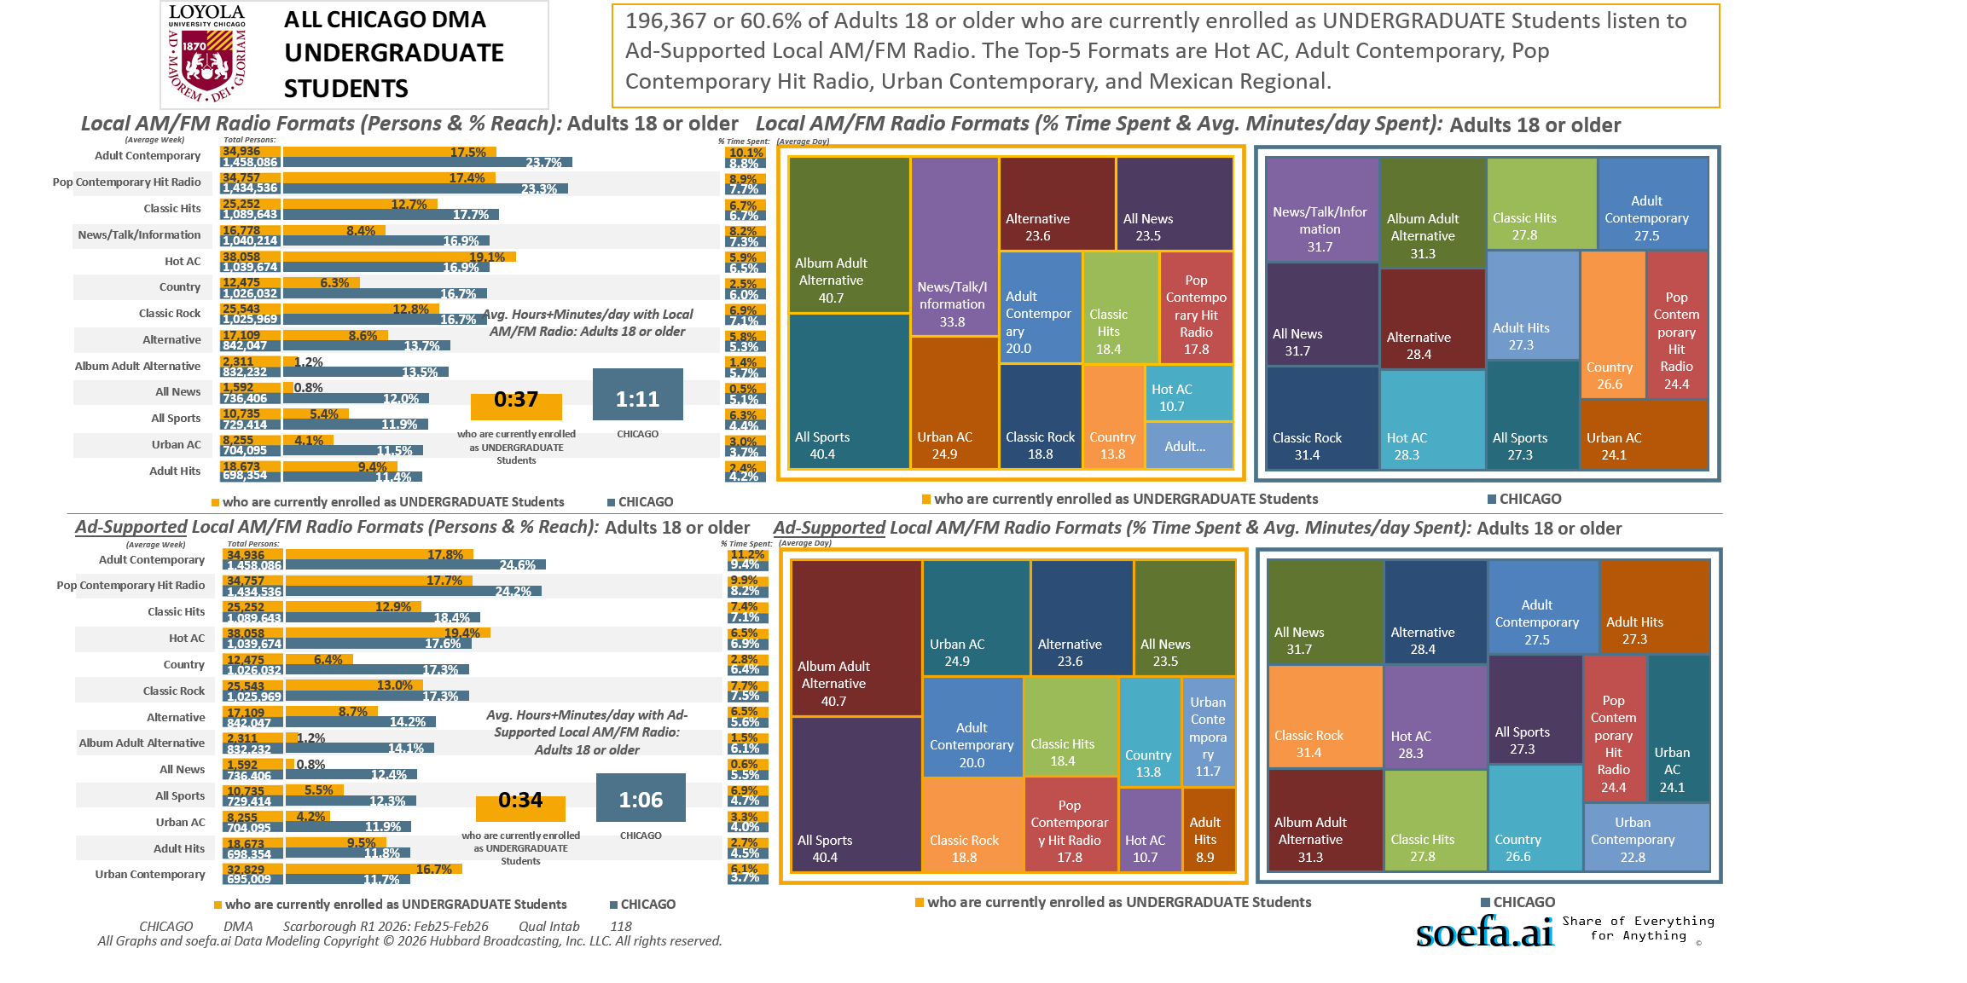
[(Currently enrolled/attending classes at a college/university: Yes AND (Level of education: High school graduate (12th grade or GED) OR Level of education: Some college credit (no degree)))]

Slide 13
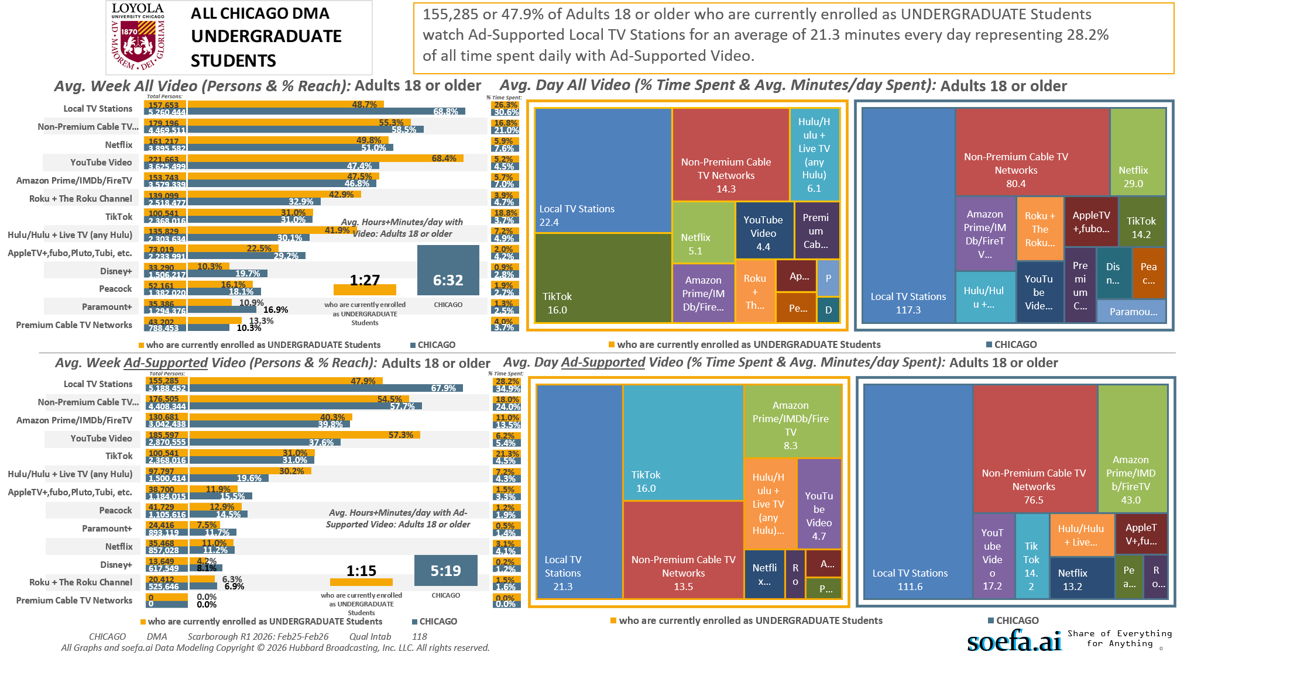
[(Currently enrolled/attending classes at a college/university: Yes AND (Level of education: High school graduate (12th grade or GED) OR Level of education: Some college credit (no degree)))]

Slide 14
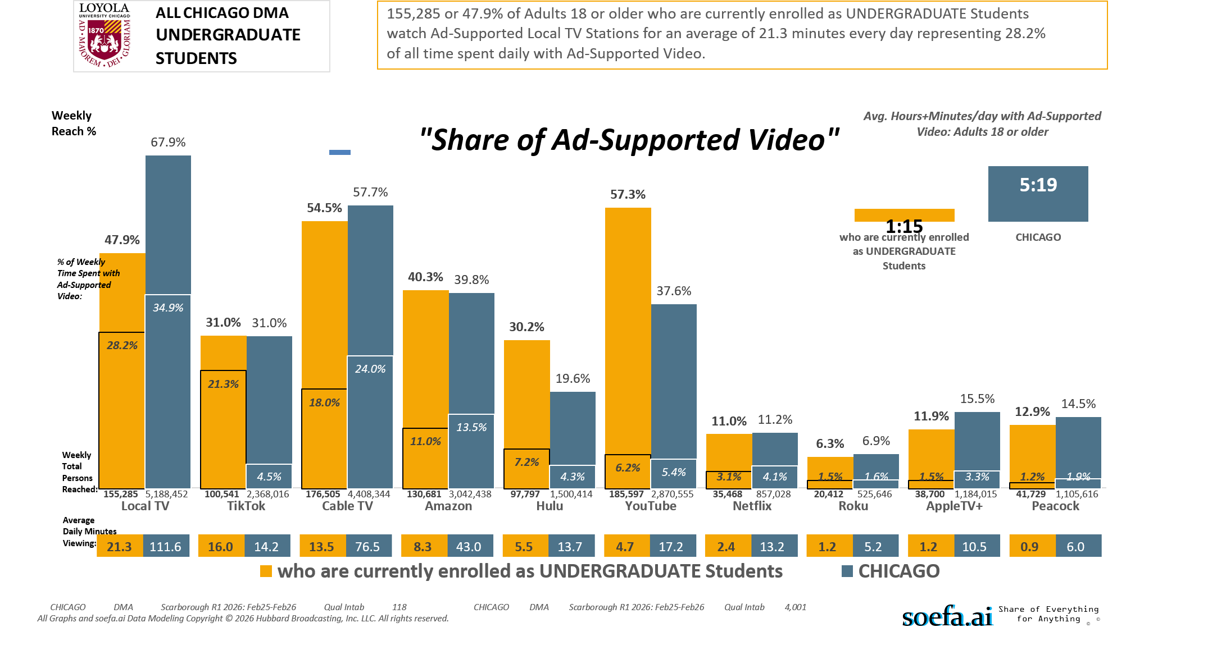
[(Currently enrolled/attending classes at a college/university: Yes AND (Level of education: High school graduate (12th grade or GED) OR Level of education: Some college credit (no degree)))]

Slide 15
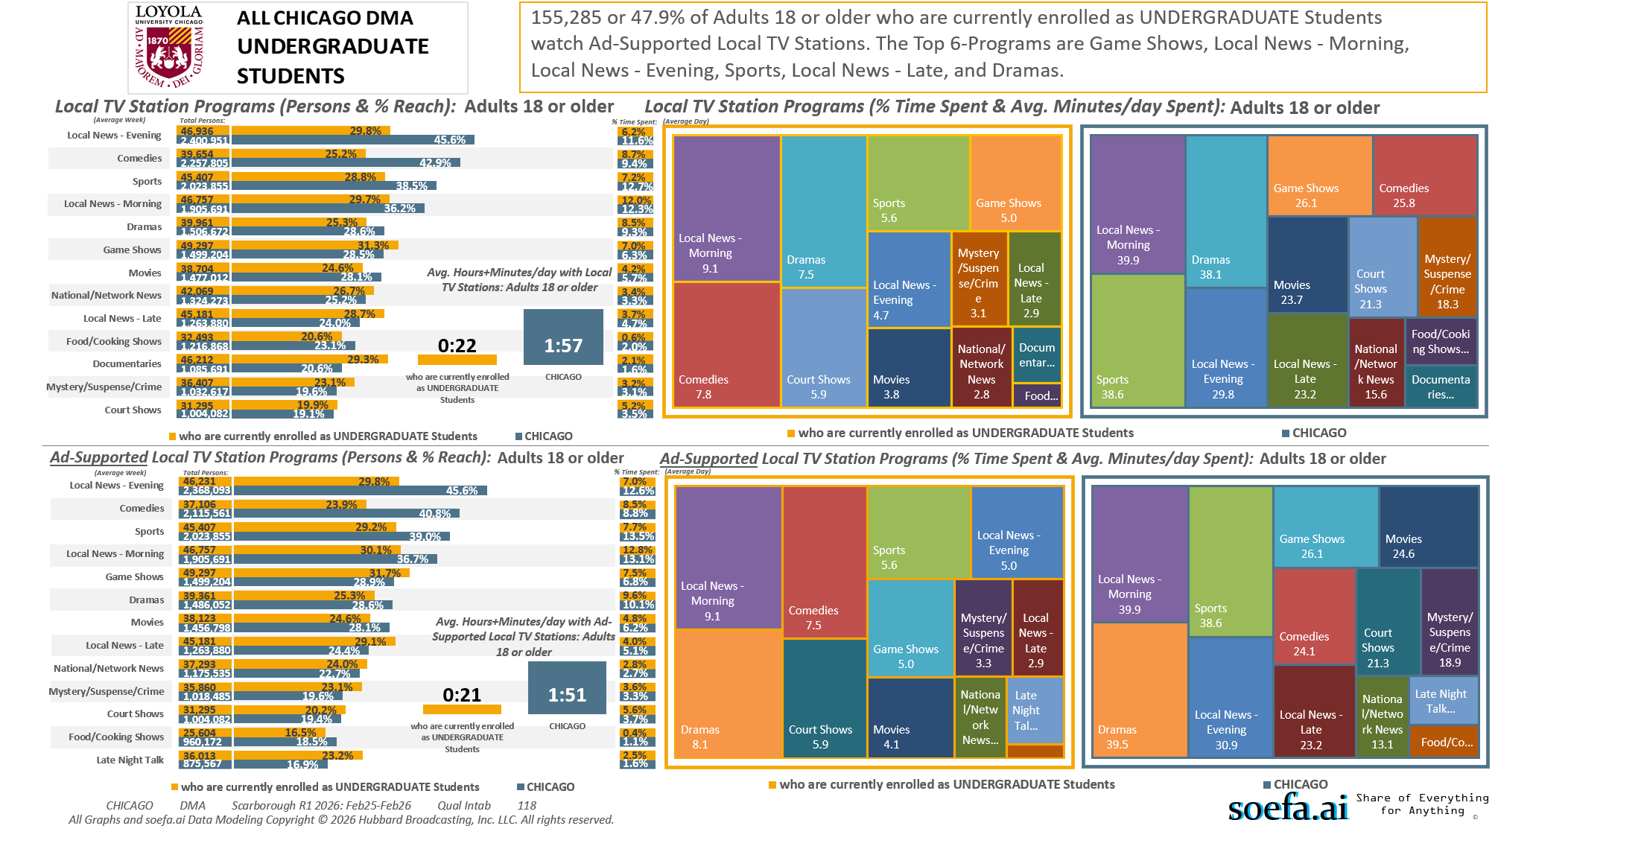
[(Currently enrolled/attending classes at a college/university: Yes AND (Level of education: High school graduate (12th grade or GED) OR Level of education: Some college credit (no degree)))]

Slide 16
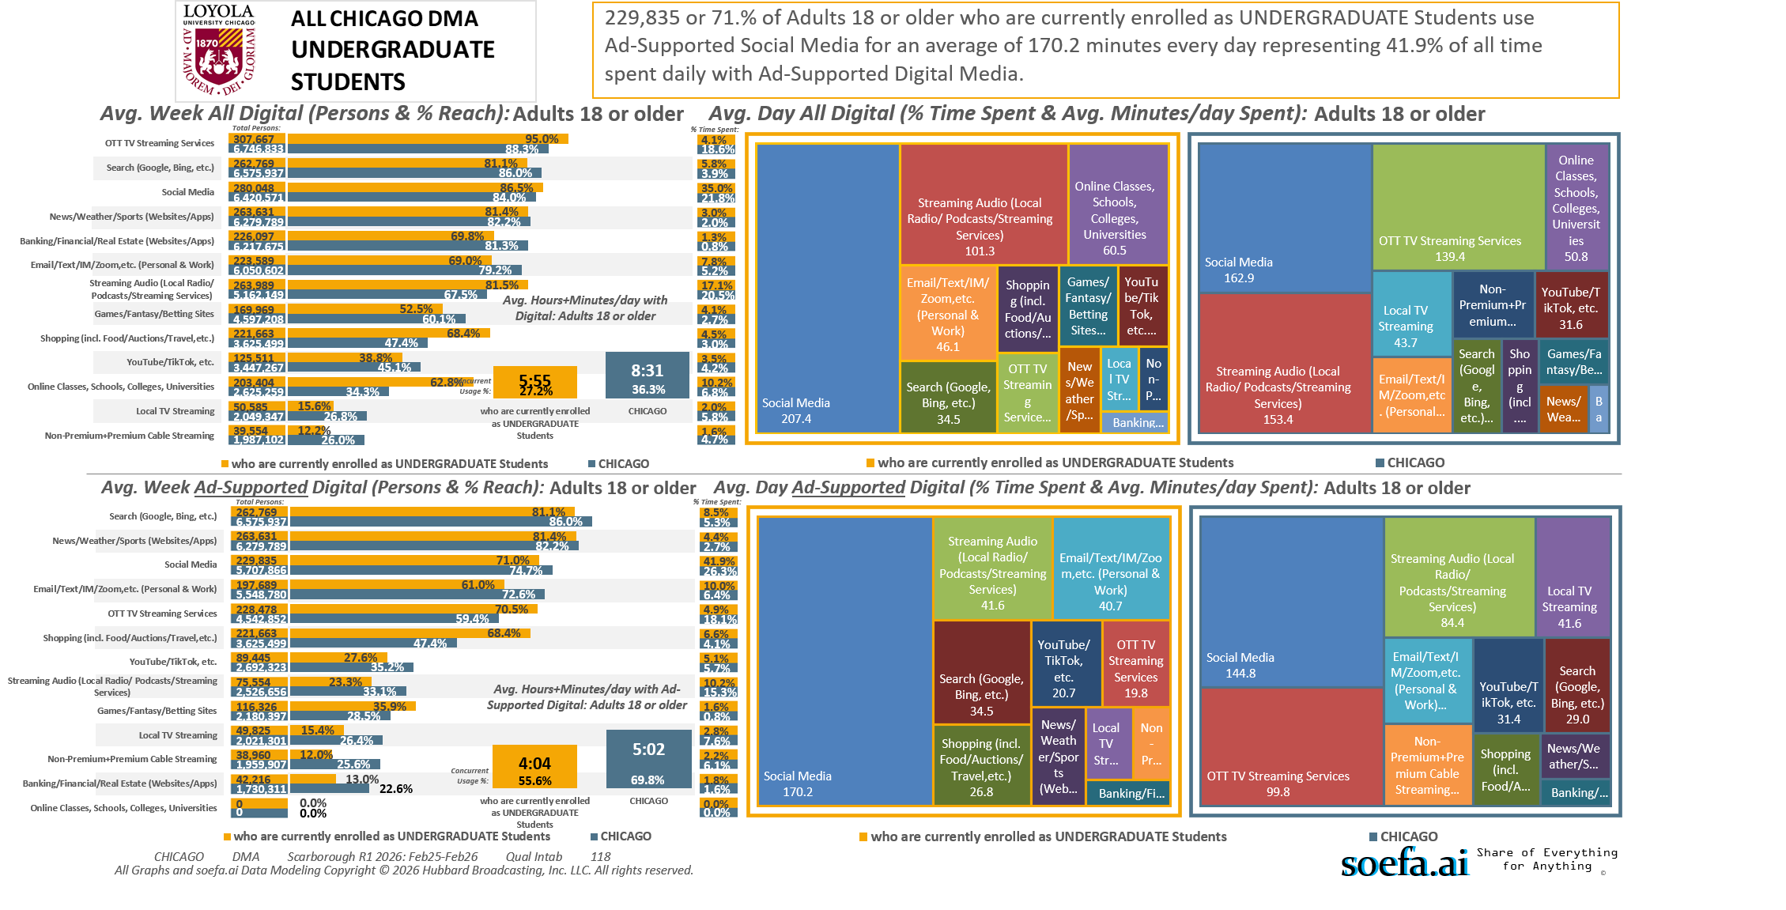
[(Currently enrolled/attending classes at a college/university: Yes AND (Level of education: High school graduate (12th grade or GED) OR Level of education: Some college credit (no degree)))]

Slide 17
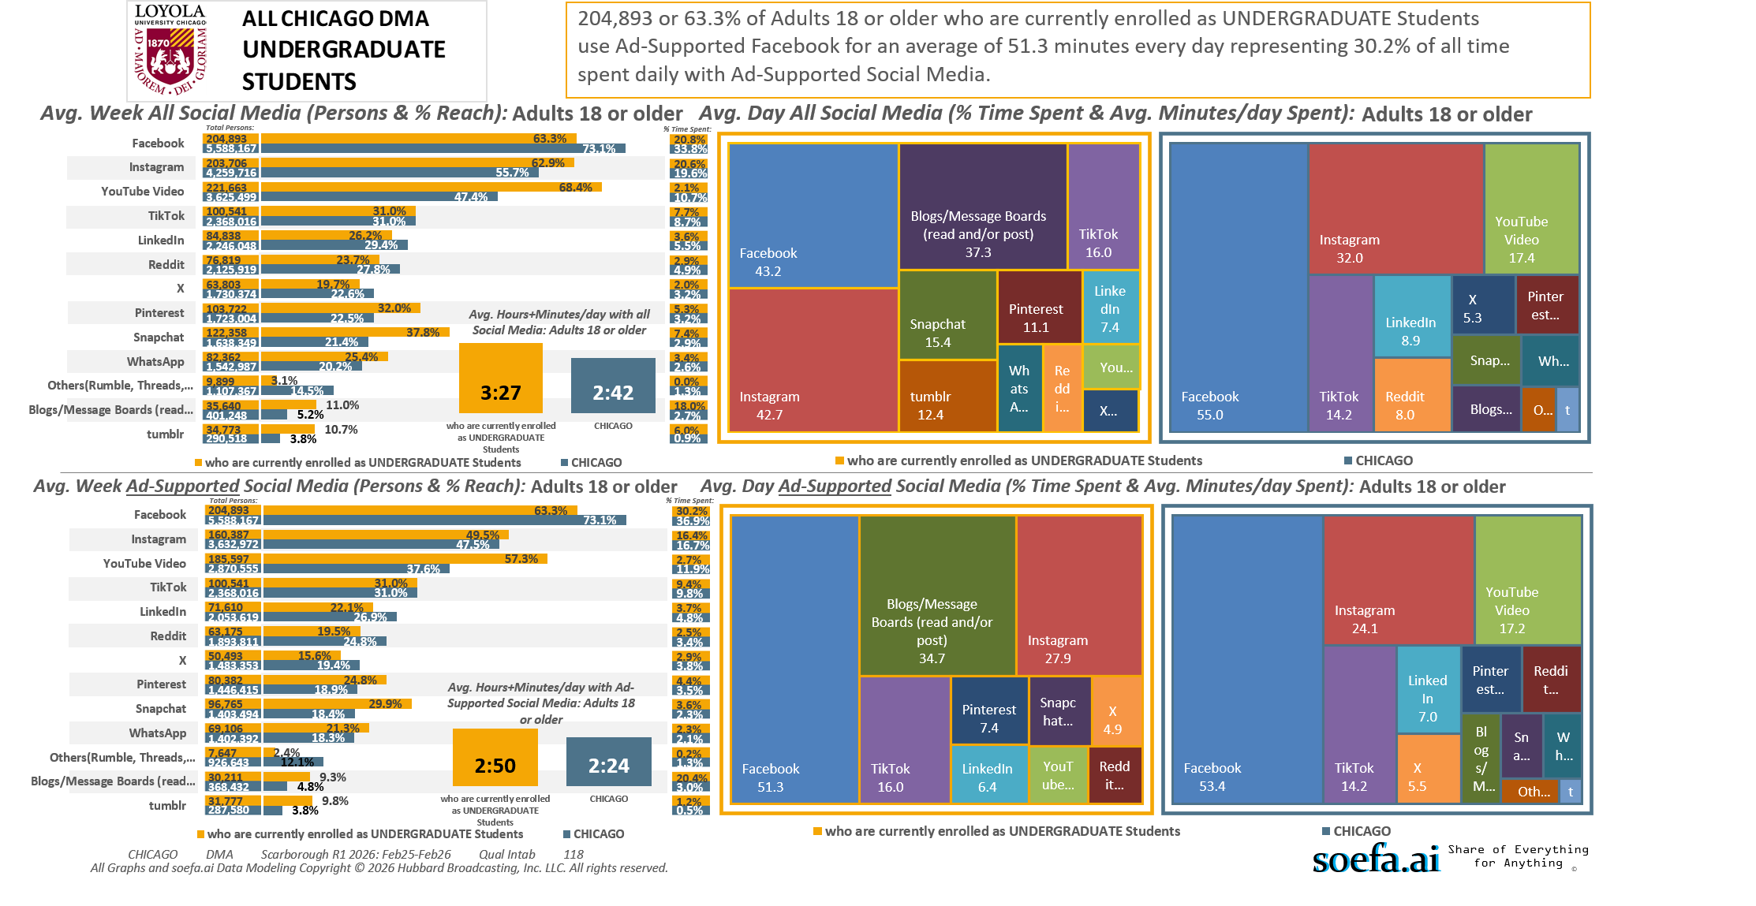
[(Currently enrolled/attending classes at a college/university: Yes AND (Level of education: High school graduate (12th grade or GED) OR Level of education: Some college credit (no degree)))]

Slide 18
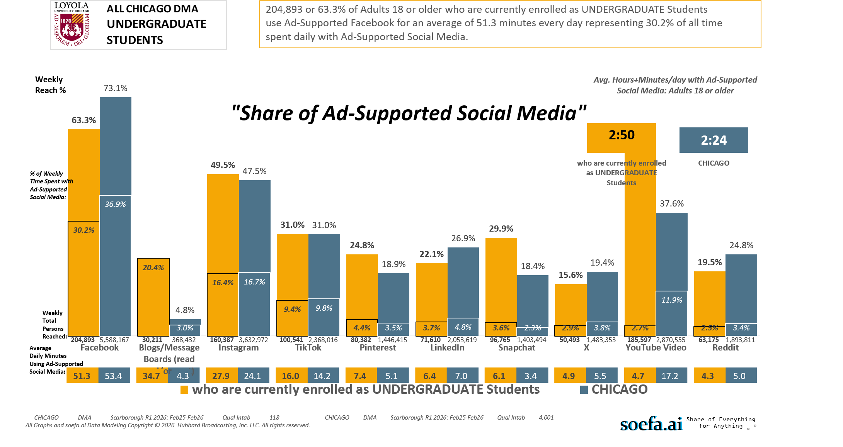
[(Currently enrolled/attending classes at a college/university: Yes AND (Level of education: High school graduate (12th grade or GED) OR Level of education: Some college credit (no degree)))]

Slide 19
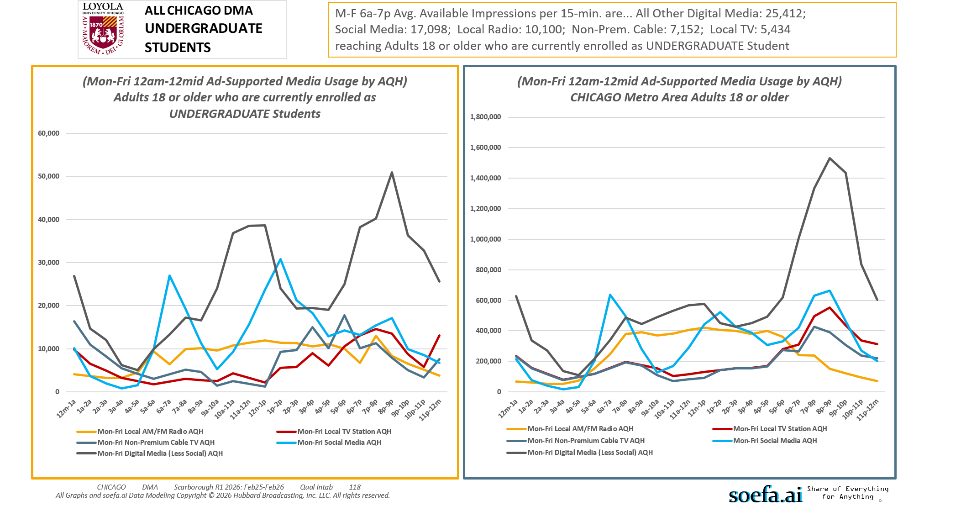
[(Currently enrolled/attending classes at a college/university: Yes AND (Level of education: High school graduate (12th grade or GED) OR Level of education: Some college credit (no degree)))]

Slide 20
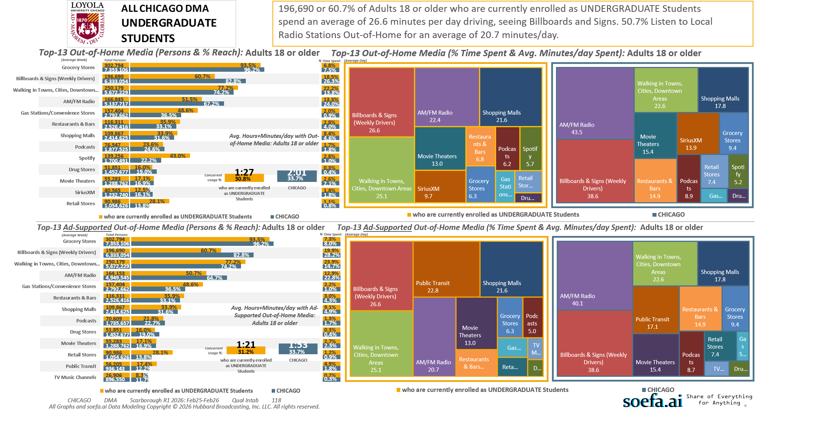
[(Currently enrolled/attending classes at a college/university: Yes AND (Level of education: High school graduate (12th grade or GED) OR Level of education: Some college credit (no degree)))]

Slide 21
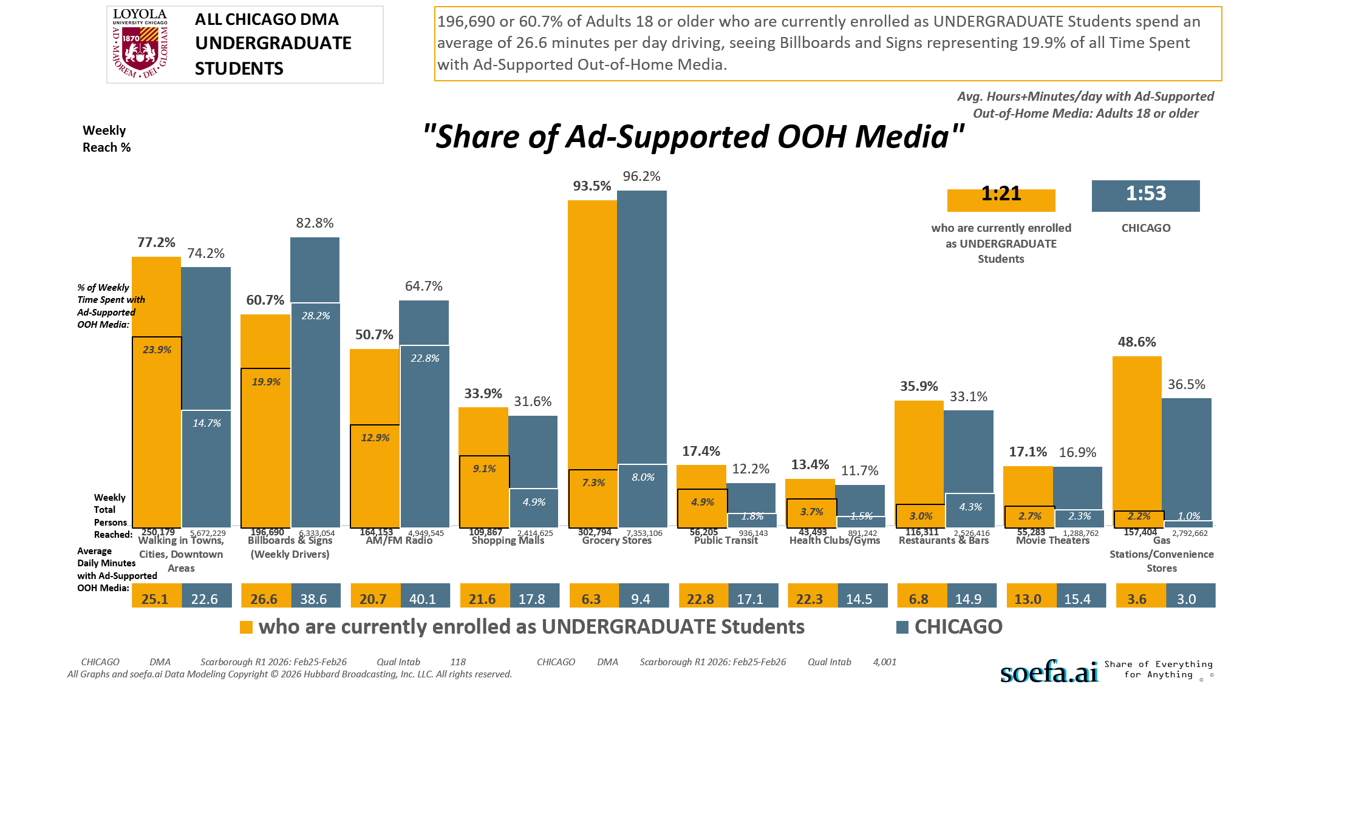
[(Currently enrolled/attending classes at a college/university: Yes AND (Level of education: High school graduate (12th grade or GED) OR Level of education: Some college credit (no degree)))]

Slide 22
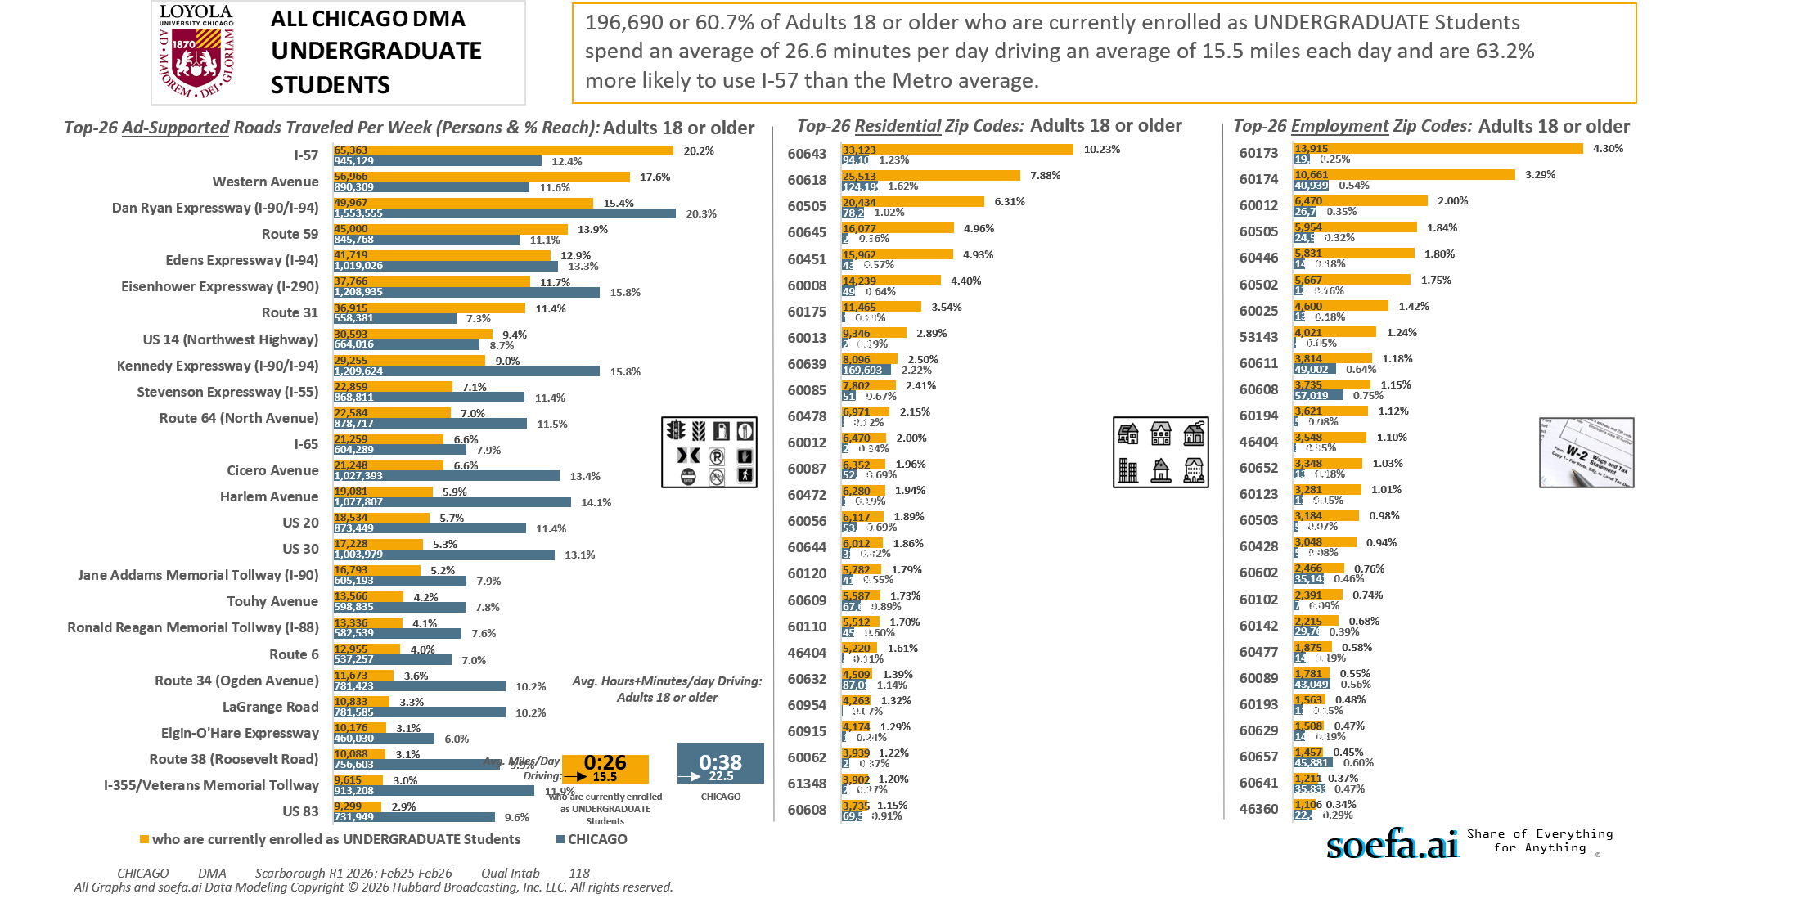
[(Currently enrolled/attending classes at a college/university: Yes AND (Level of education: High school graduate (12th grade or GED) OR Level of education: Some college credit (no degree)))]

Slide 23
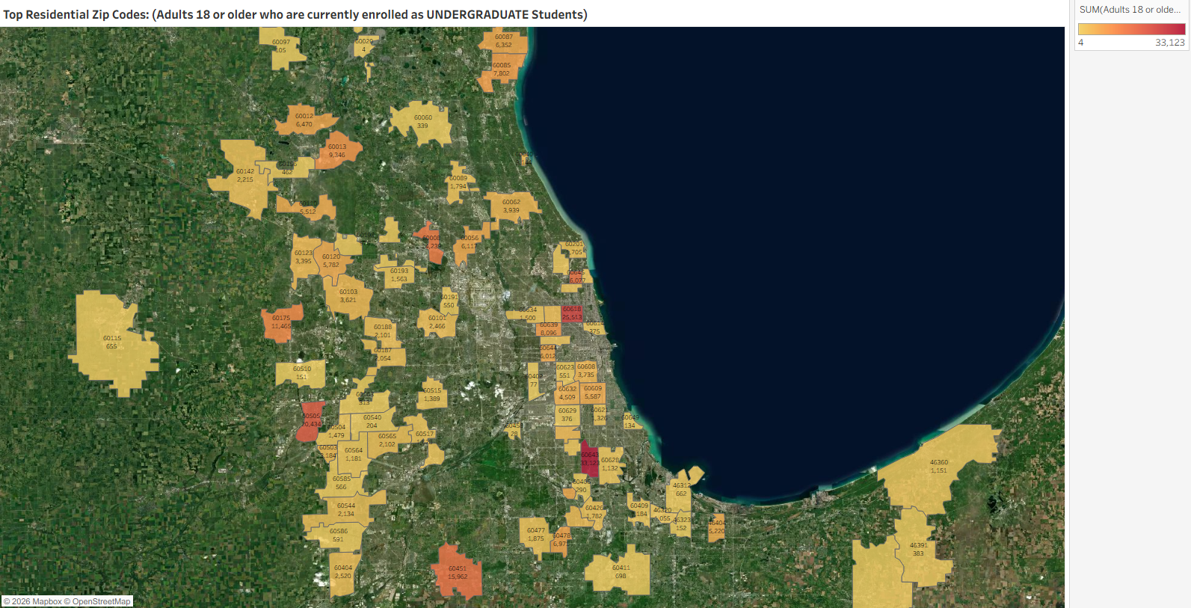
Zip Code Adults 18 or older who are currently enrolled as UNDERGRADUATE Students
60643 33,123
60618 25,513
60505 20,434
60645 16,077
60451 15,962
60008 14,239
60175 11,465
60013 9,346
60639 8,096
60085 7,802
60478 6,971
60012 6,470
60087 6,352
60472 6,280
60056 6,117
60644 6,012
60120 5,782
60609 5,587
60110 5,512
46404 5,220
60632 4,509
60954 4,263
60915 4,174
60062 3,939
61348 3,902
60608 3,735
60103 3,621
60123 3,395
60652 3,348
60503 3,184
60040 3,144
60428 3,048
60641 2,592
60404 2,520
60101 2,466
60142 2,215
60544 2,134
60565 2,102
60188 2,101
60187 2,054
60477 1,875
60089 1,794
60426 1,782
60201 1,705
60517 1,628
60193 1,563
60634 1,500
60504 1,479
60659 1,478
60626 1,457
60515 1,389
60950 1,375
60621 1,326
60805 1,280
60651 1,228
60409 1,184
60564 1,181
46360 1,151
60628 1,132
46320 1,055
60192 976
60076 702
60194 700
60411 698
46312 662
60115 655
60586 591
60585 566
60623 551
60191 550
46383 470
60156 462
46391 383
60629 376
60614 375
60060 339
60563 313
60406 290
60540 204
46323 152
60510 151
60649 134
60097 105
60402 77
60458 28
60020 4
[(Currently enrolled/attending classes at a college/university: Yes AND (Level of education: High school graduate (12th grade or GED) OR Level of education: Some college credit (no degree)))]

Slide 24
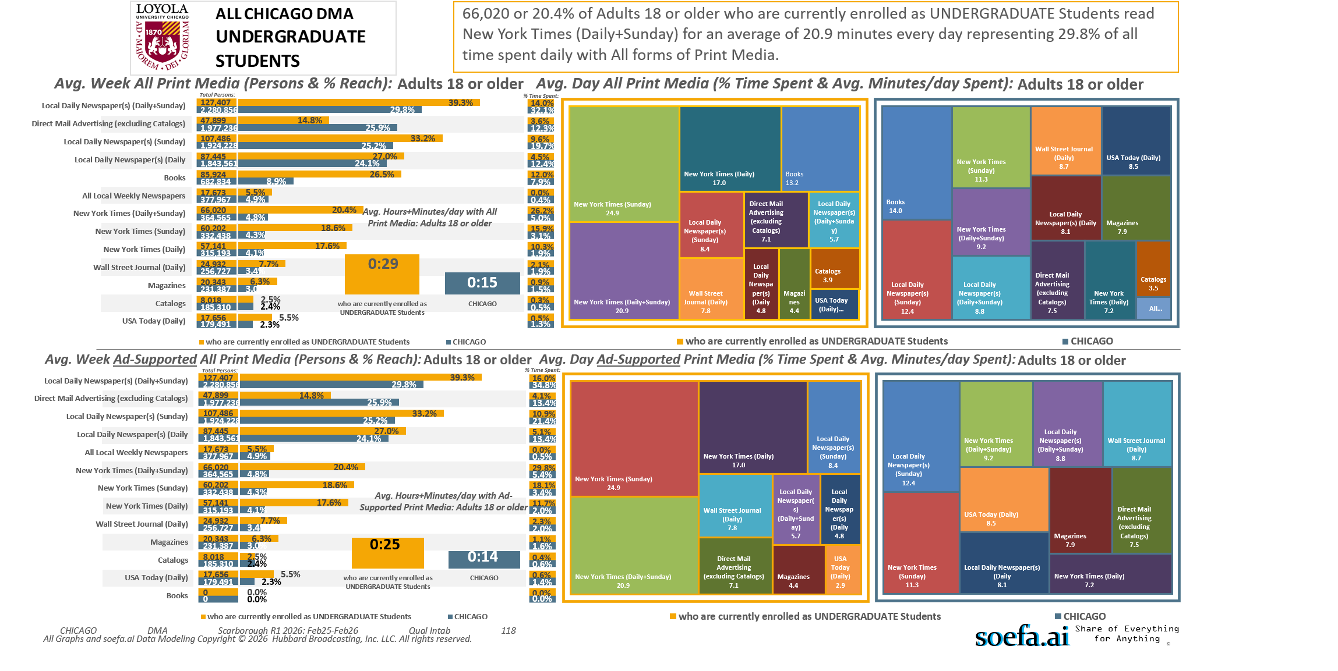
[(Currently enrolled/attending classes at a college/university: Yes AND (Level of education: High school graduate (12th grade or GED) OR Level of education: Some college credit (no degree)))]

Slide 25
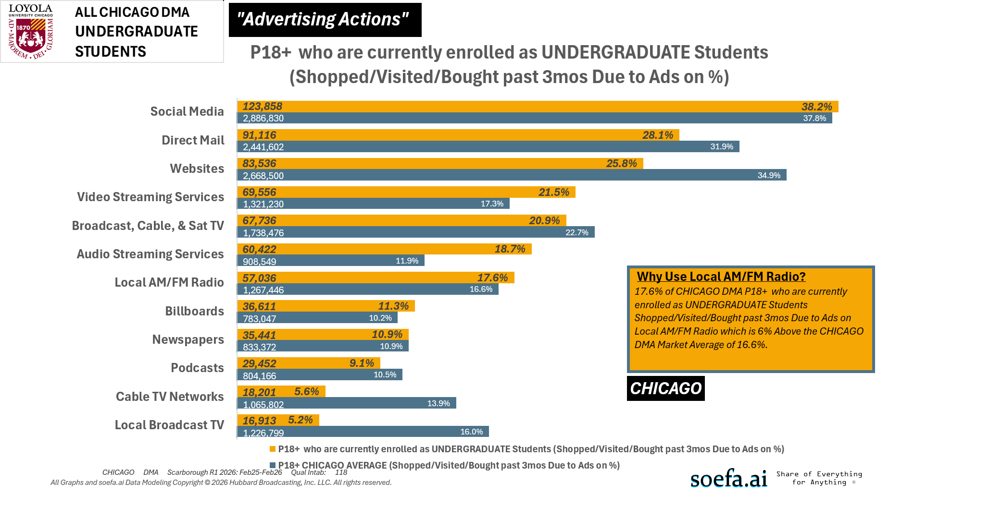
[(Currently enrolled/attending classes at a college/university: Yes AND (Level of education: High school graduate (12th grade or GED) OR Level of education: Some college credit (no degree)))]

