Slide 1
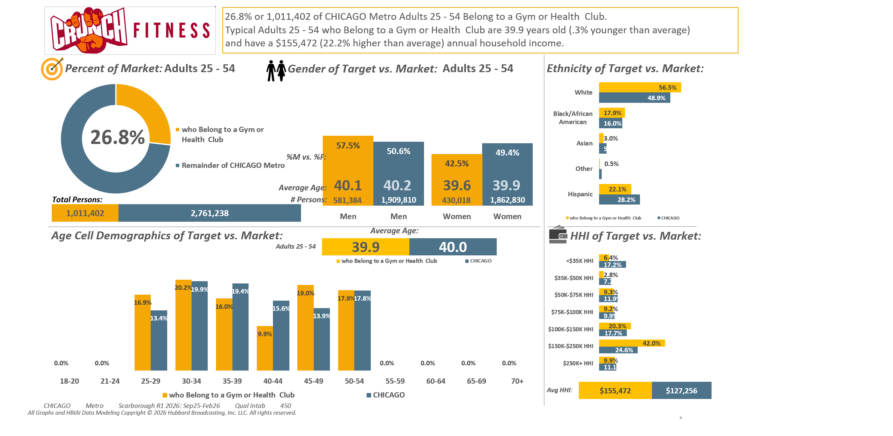





Lifestyle characteristics: Belong to health club or gym

Slide 2
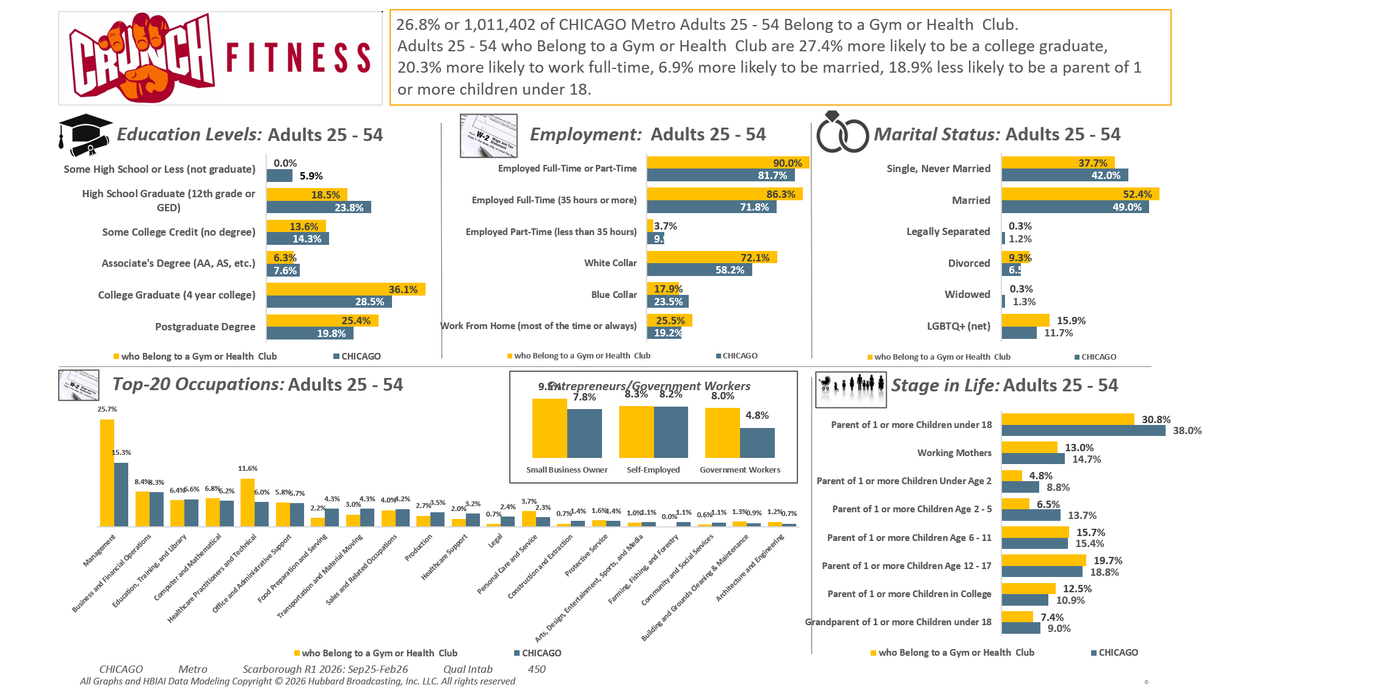
Lifestyle characteristics: Belong to health club or gym

Slide 3
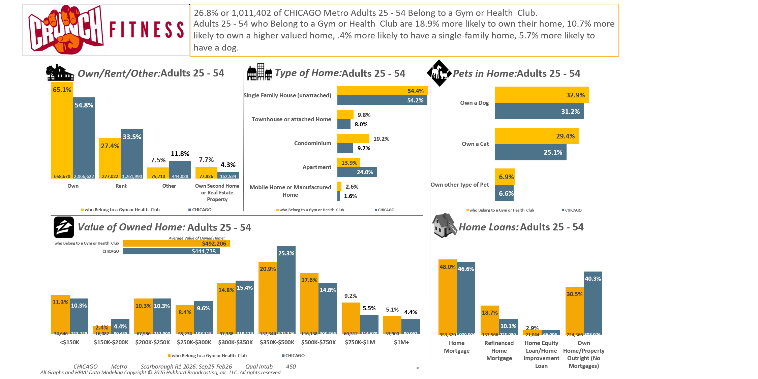
Lifestyle characteristics: Belong to health club or gym

Slide 4
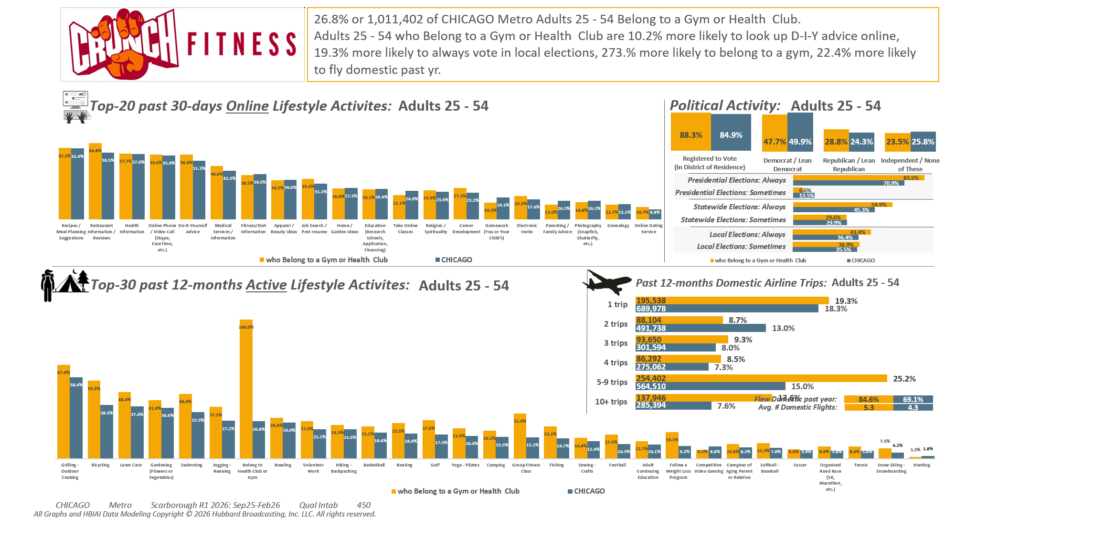
Lifestyle characteristics: Belong to health club or gym

Slide 5
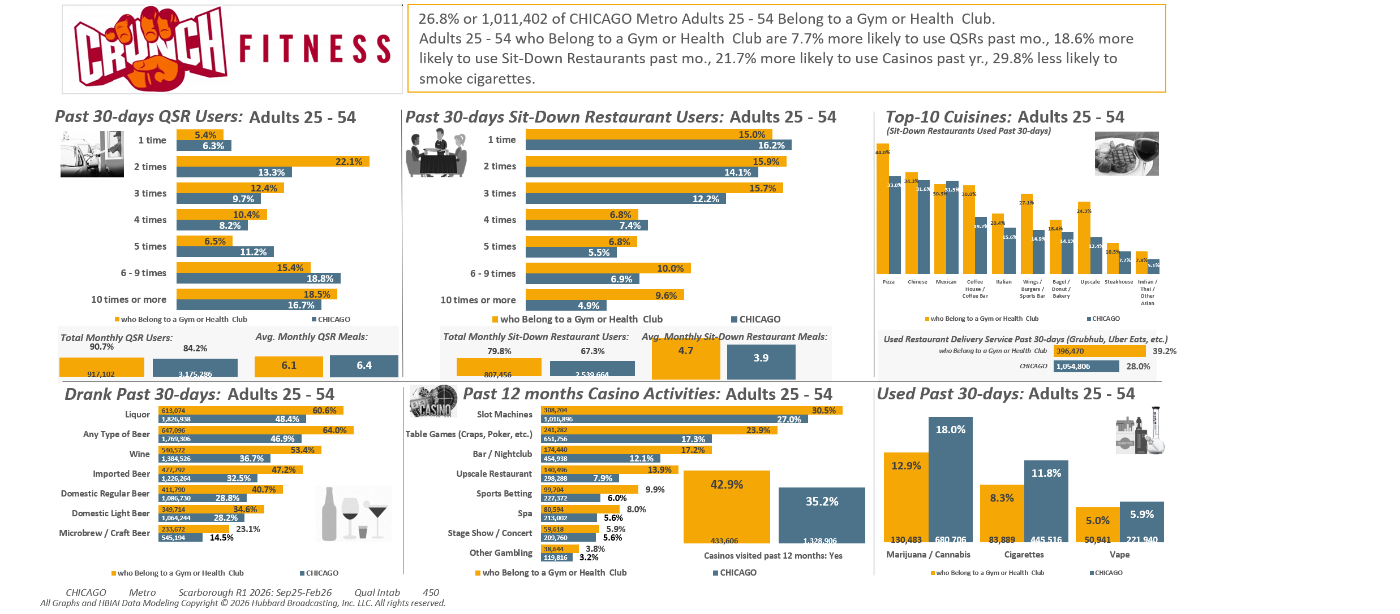
Lifestyle characteristics: Belong to health club or gym

Slide 6
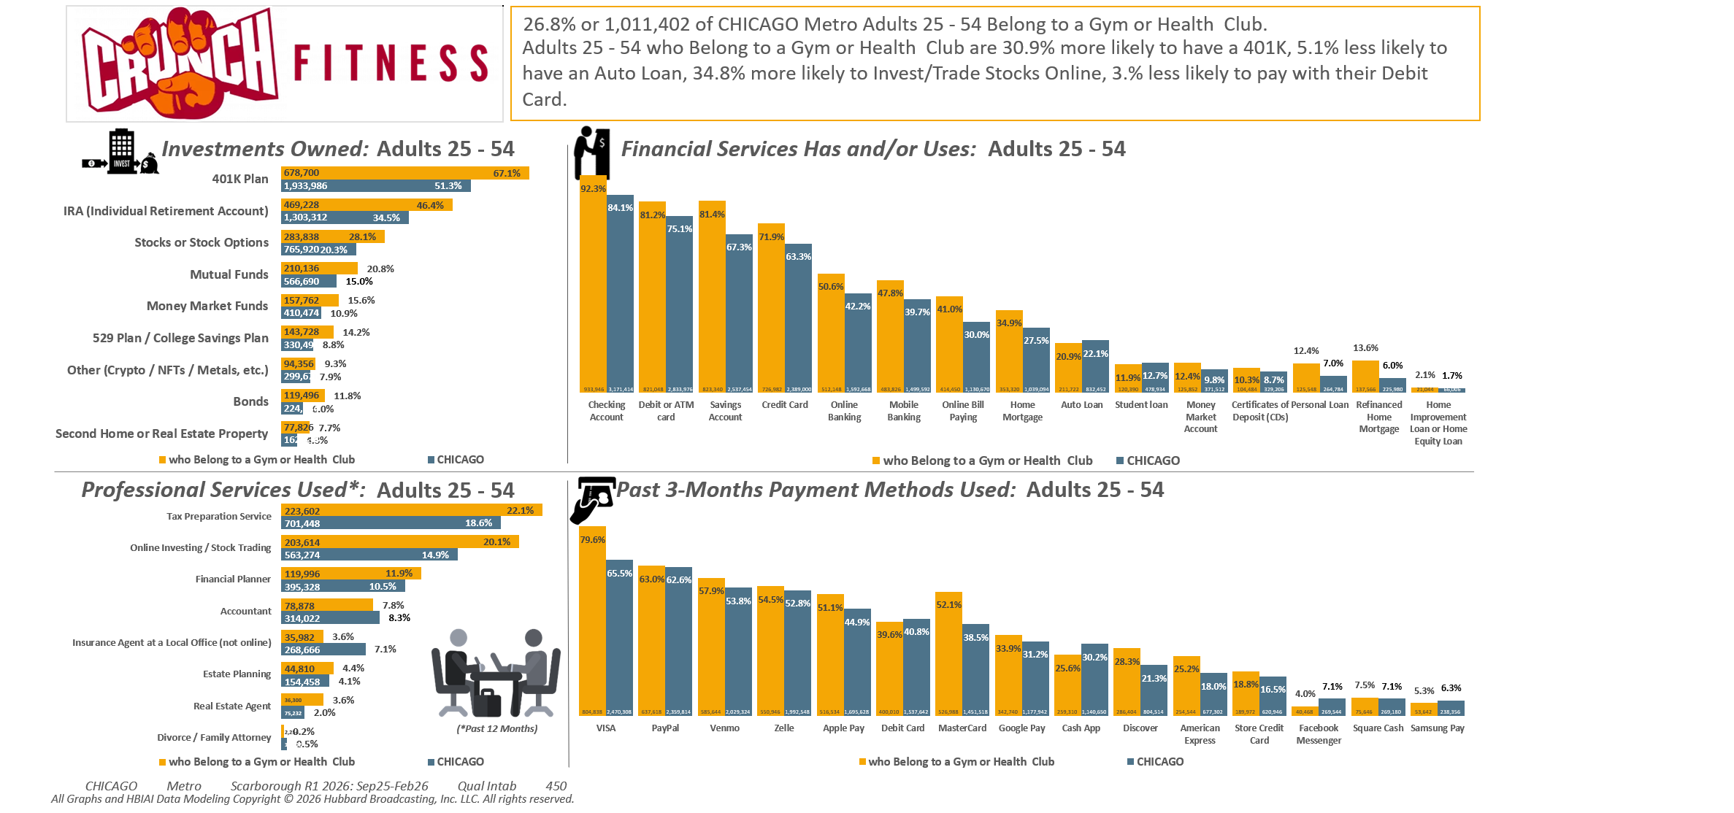
Lifestyle characteristics: Belong to health club or gym

Slide 7
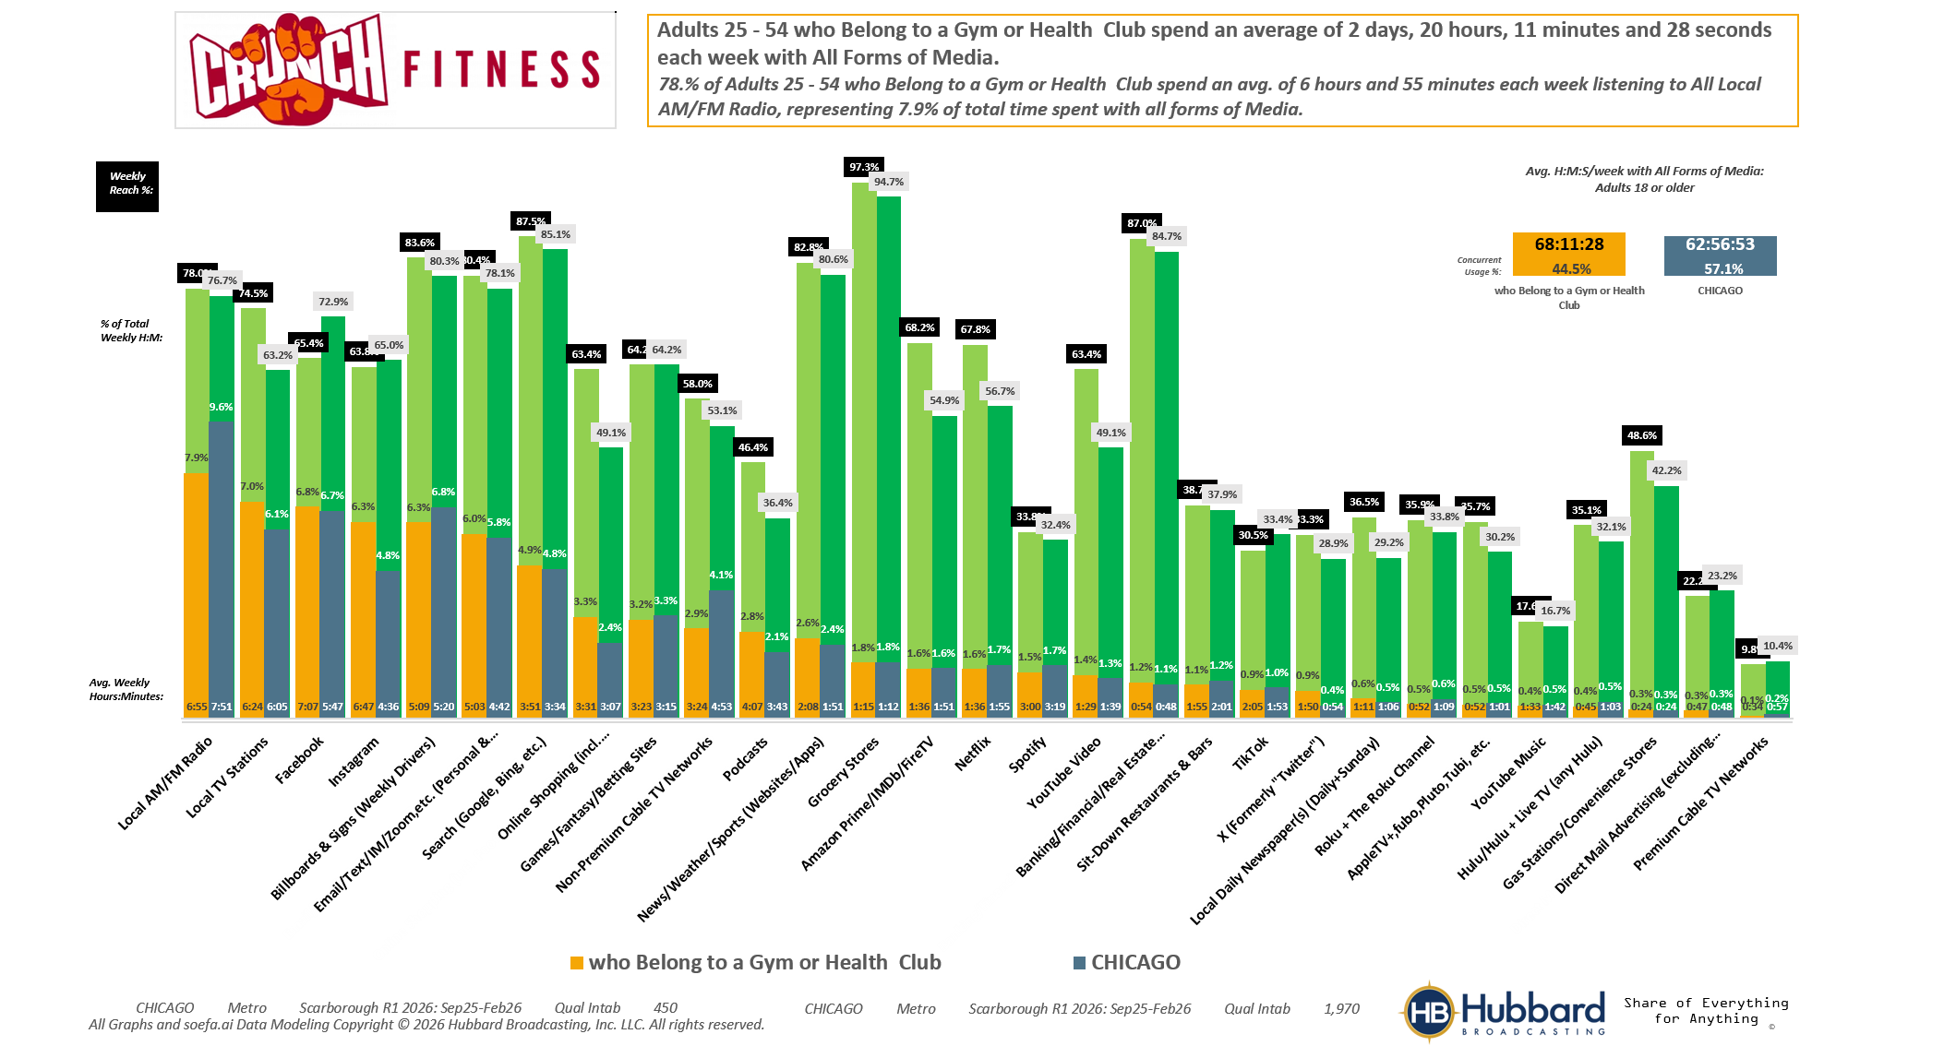

Lifestyle characteristics: Belong to health club or gym

Slide 8
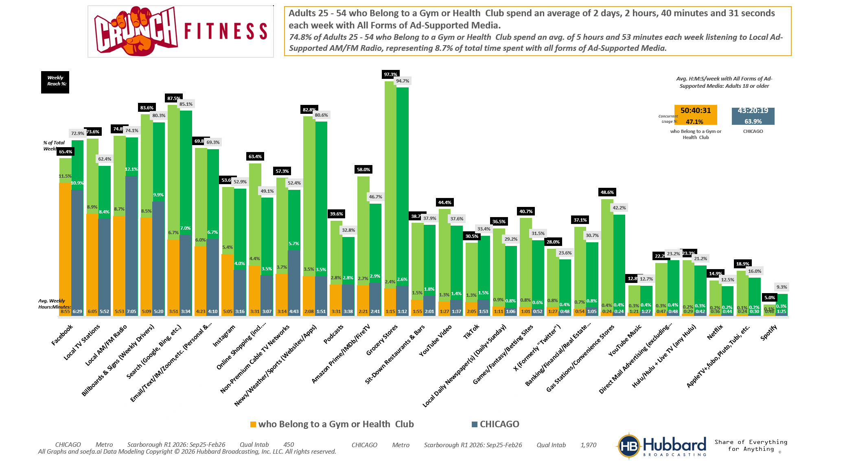
Lifestyle characteristics: Belong to health club or gym

Slide 9
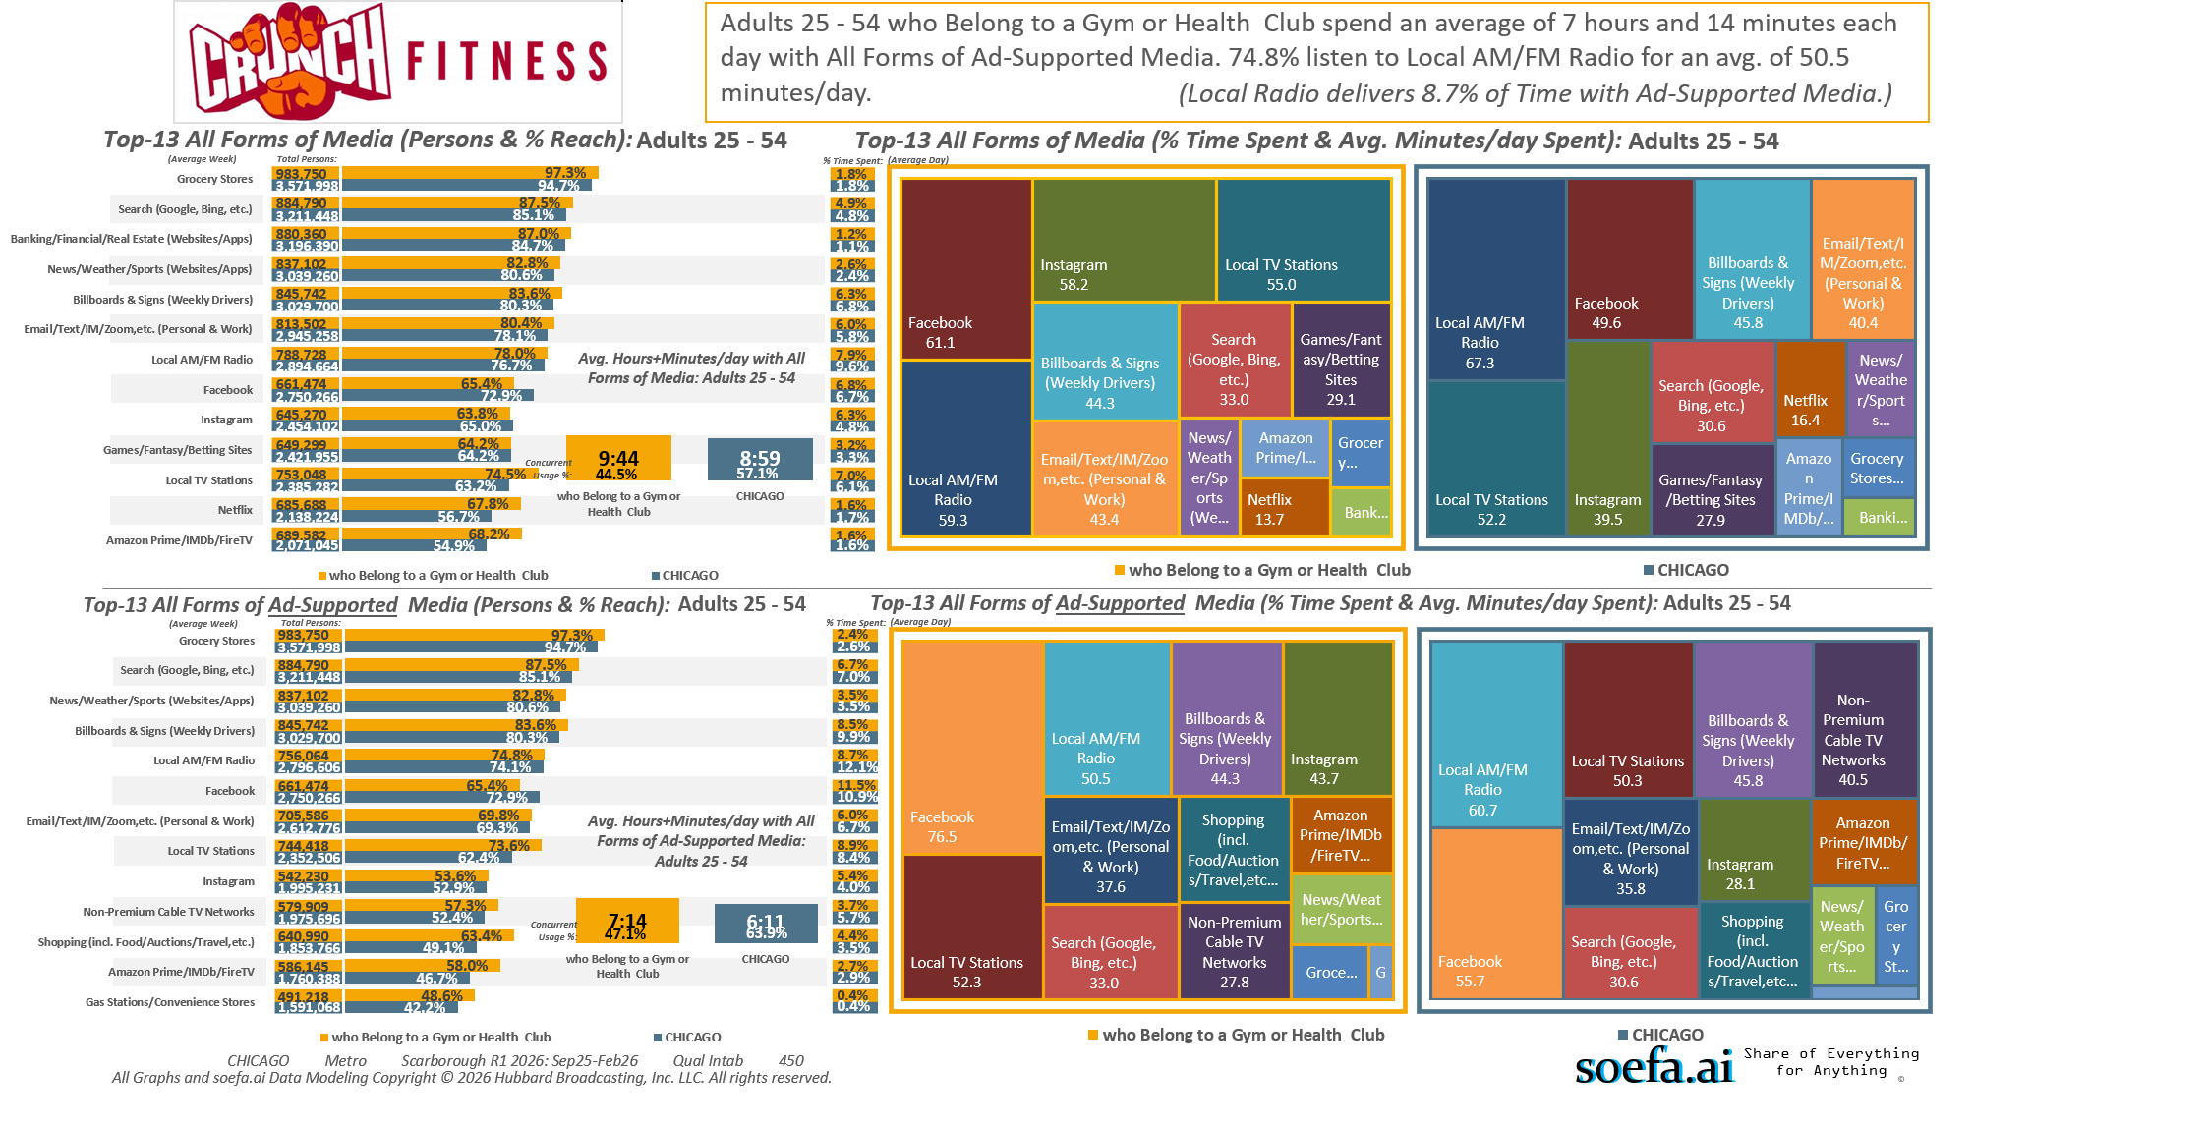
Lifestyle characteristics: Belong to health club or gym

Slide 10

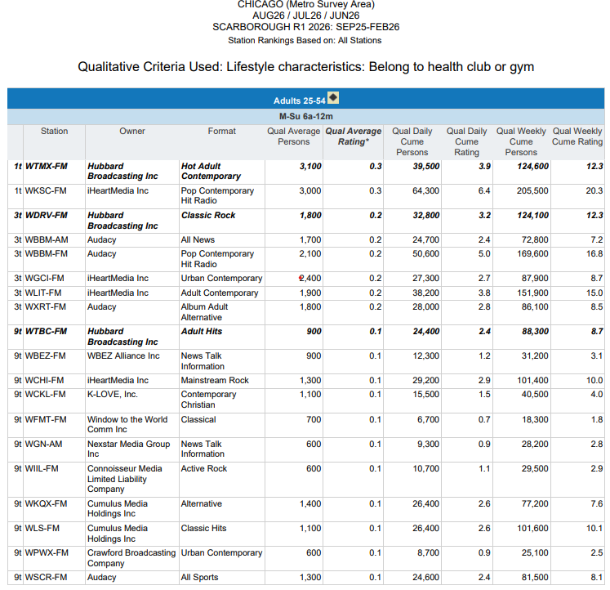

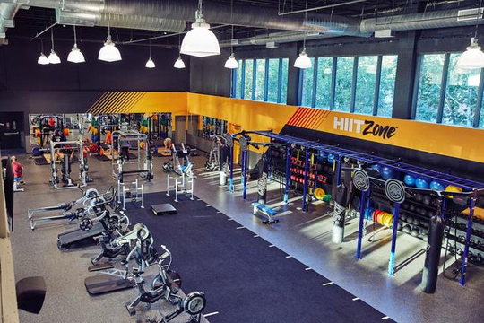
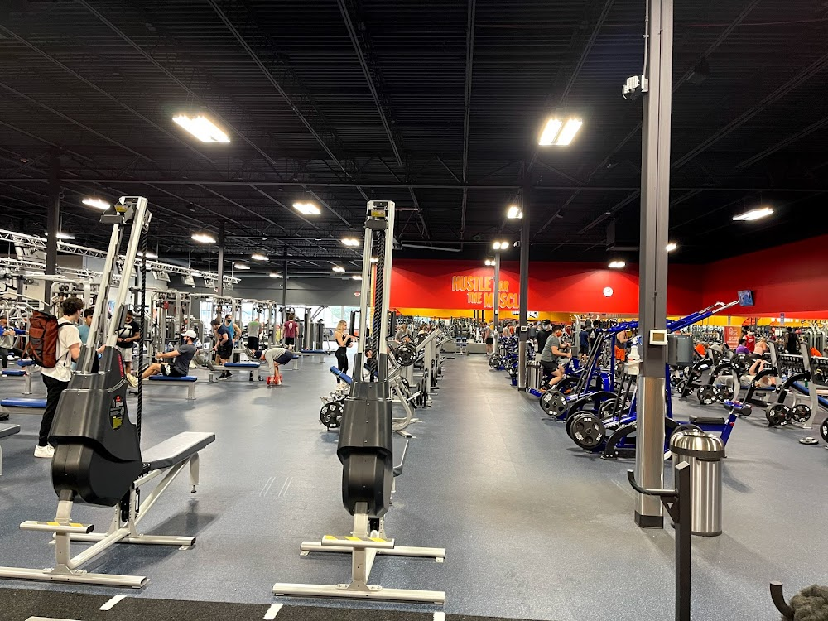
26.8% or 1,011,402 Chicago Metro Area
Age 25-54 Adults Belong to a Gym or Health Club.
Hubbard Radio’s 101.9 THE MIX and 97.1 THE DRIVE
are Two of the Top-3 Stations they Listen to
every week.

Slide 11
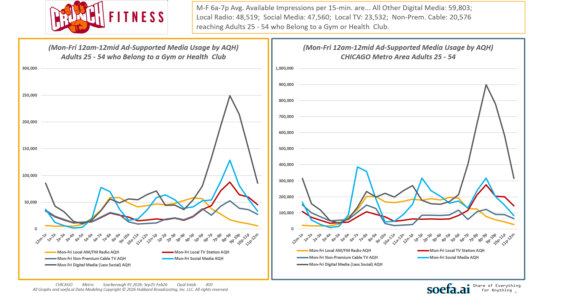
Lifestyle characteristics: Belong to health club or gym

Slide 12
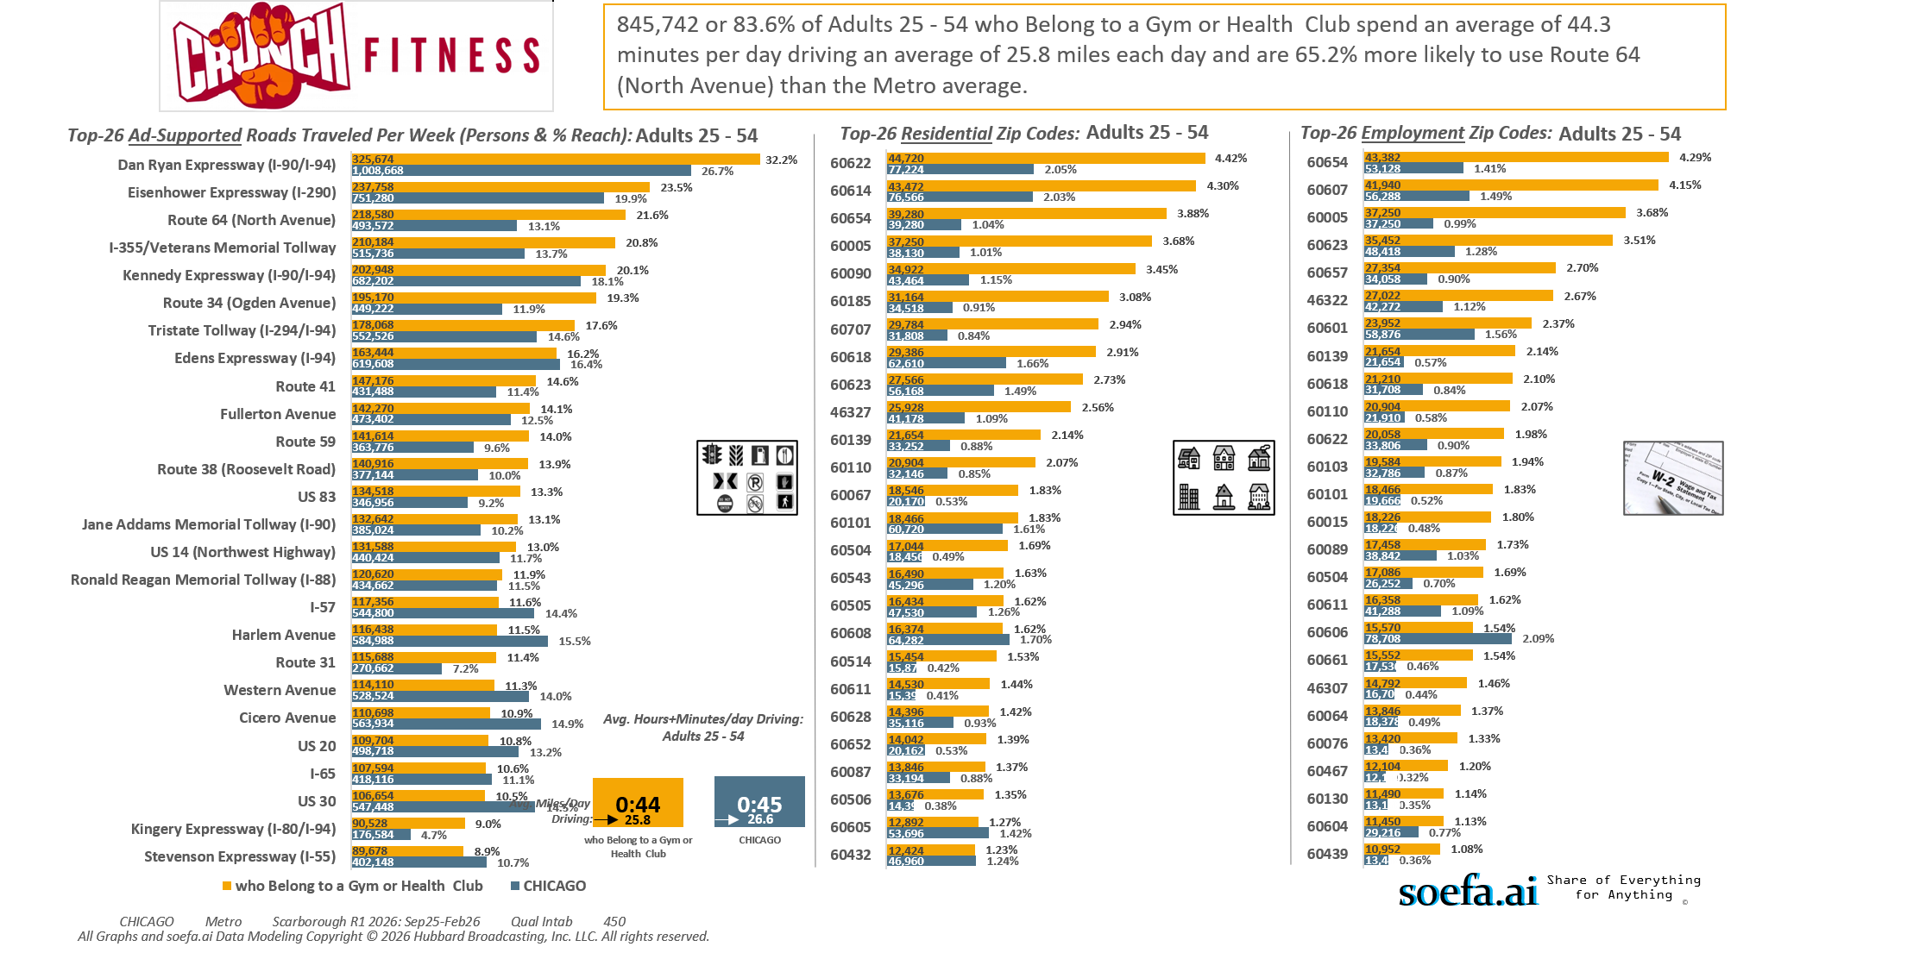
Lifestyle characteristics: Belong to health club or gym

Slide 13
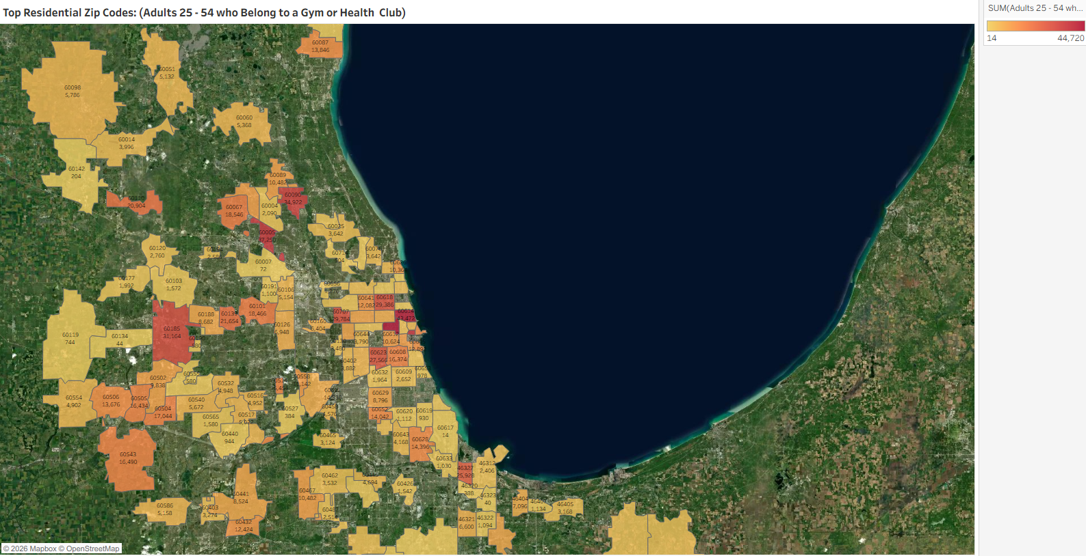
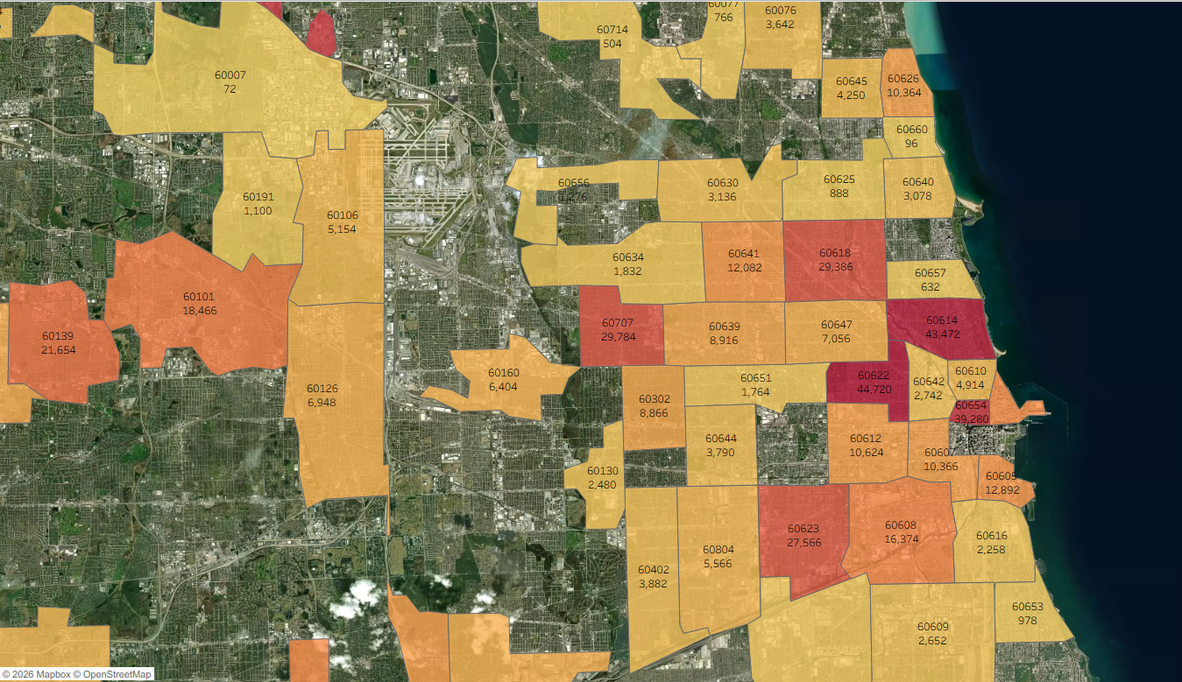
Lifestyle characteristics: Belong to health club or gym

Slide 14
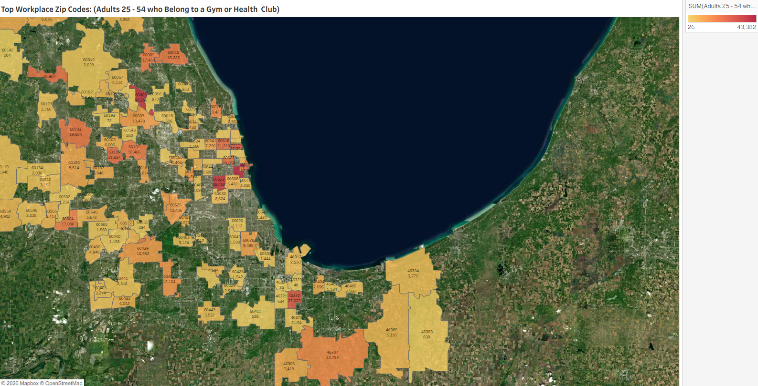
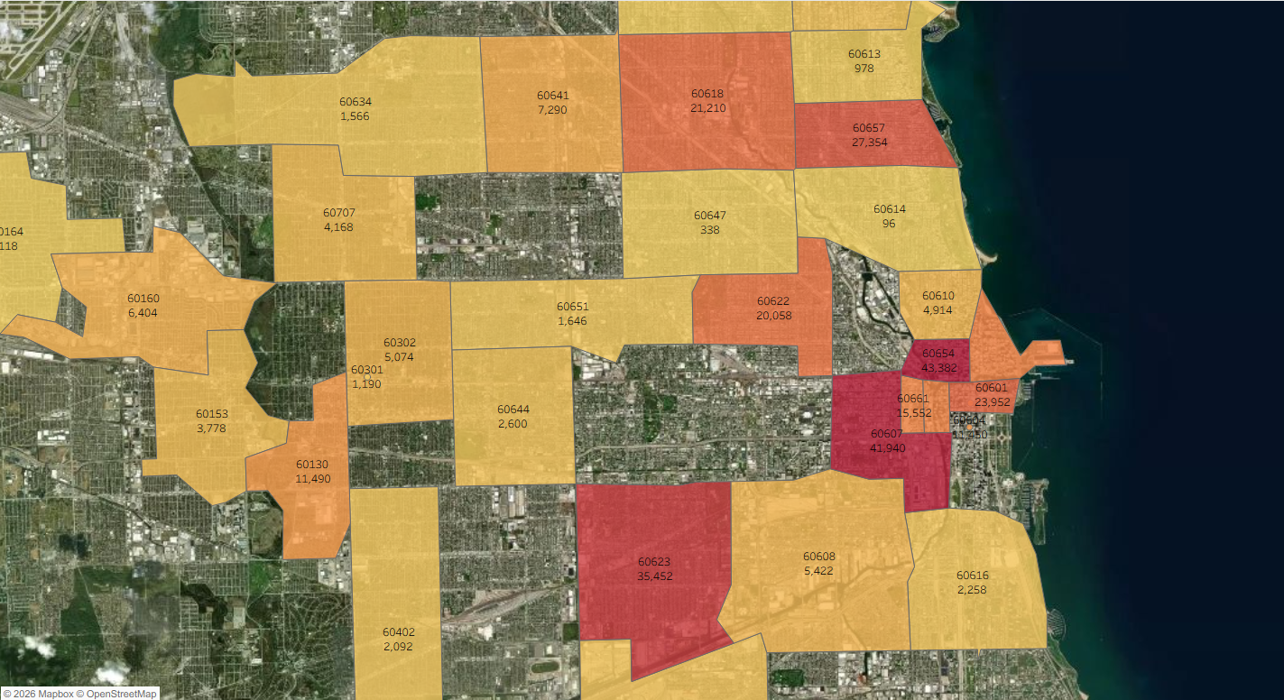
Lifestyle characteristics: Belong to health club or gym

