Slide 1
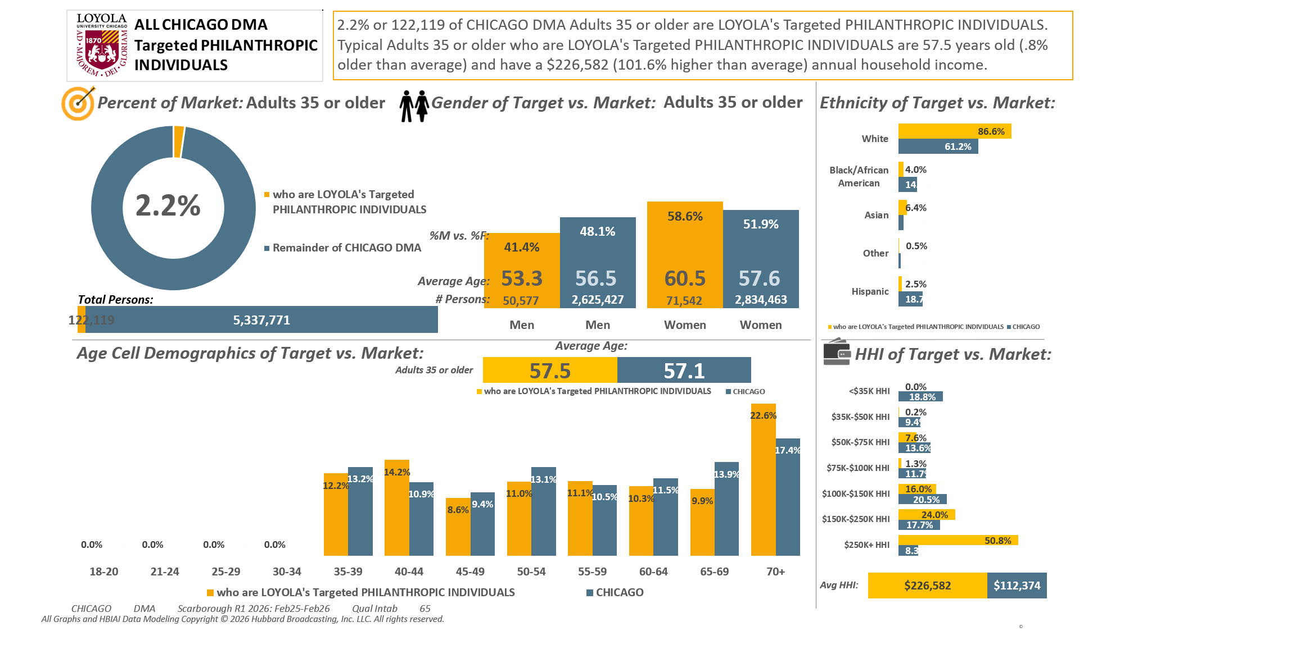





Adults 35+ DMA [(((Household income summaries (HHLD): $250,000 or more OR Acxiom NetWorth Gold (HHLD): $1,000,000 - $1,999,999 OR Acxiom NetWorth Gold (HHLD): $2,000,000 +) AND Organizations (types) contributed money to past 12 mo (HHLD): Religious) AND Organizations (types) contributed money to past 12 mo (HHLD): Educational/academic)]

Slide 2
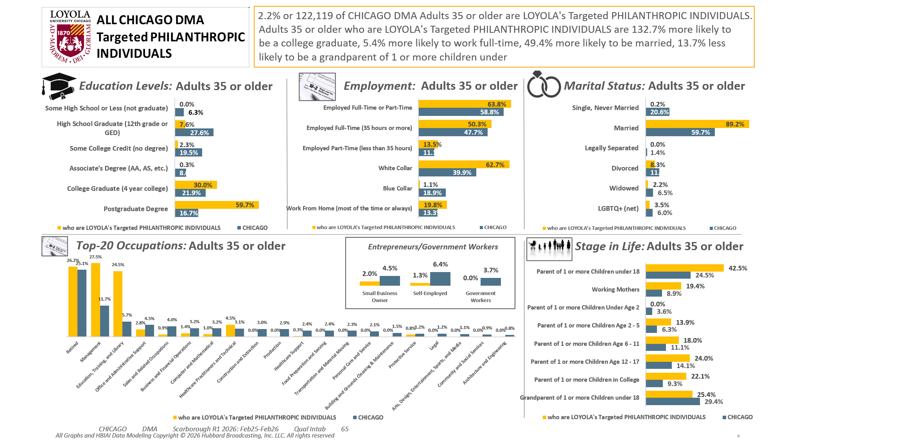
Adults 35+ DMA [(((Household income summaries (HHLD): $250,000 or more OR Acxiom NetWorth Gold (HHLD): $1,000,000 - $1,999,999 OR Acxiom NetWorth Gold (HHLD): $2,000,000 +) AND Organizations (types) contributed money to past 12 mo (HHLD): Religious) AND Organizations (types) contributed money to past 12 mo (HHLD): Educational/academic)]

Slide 3
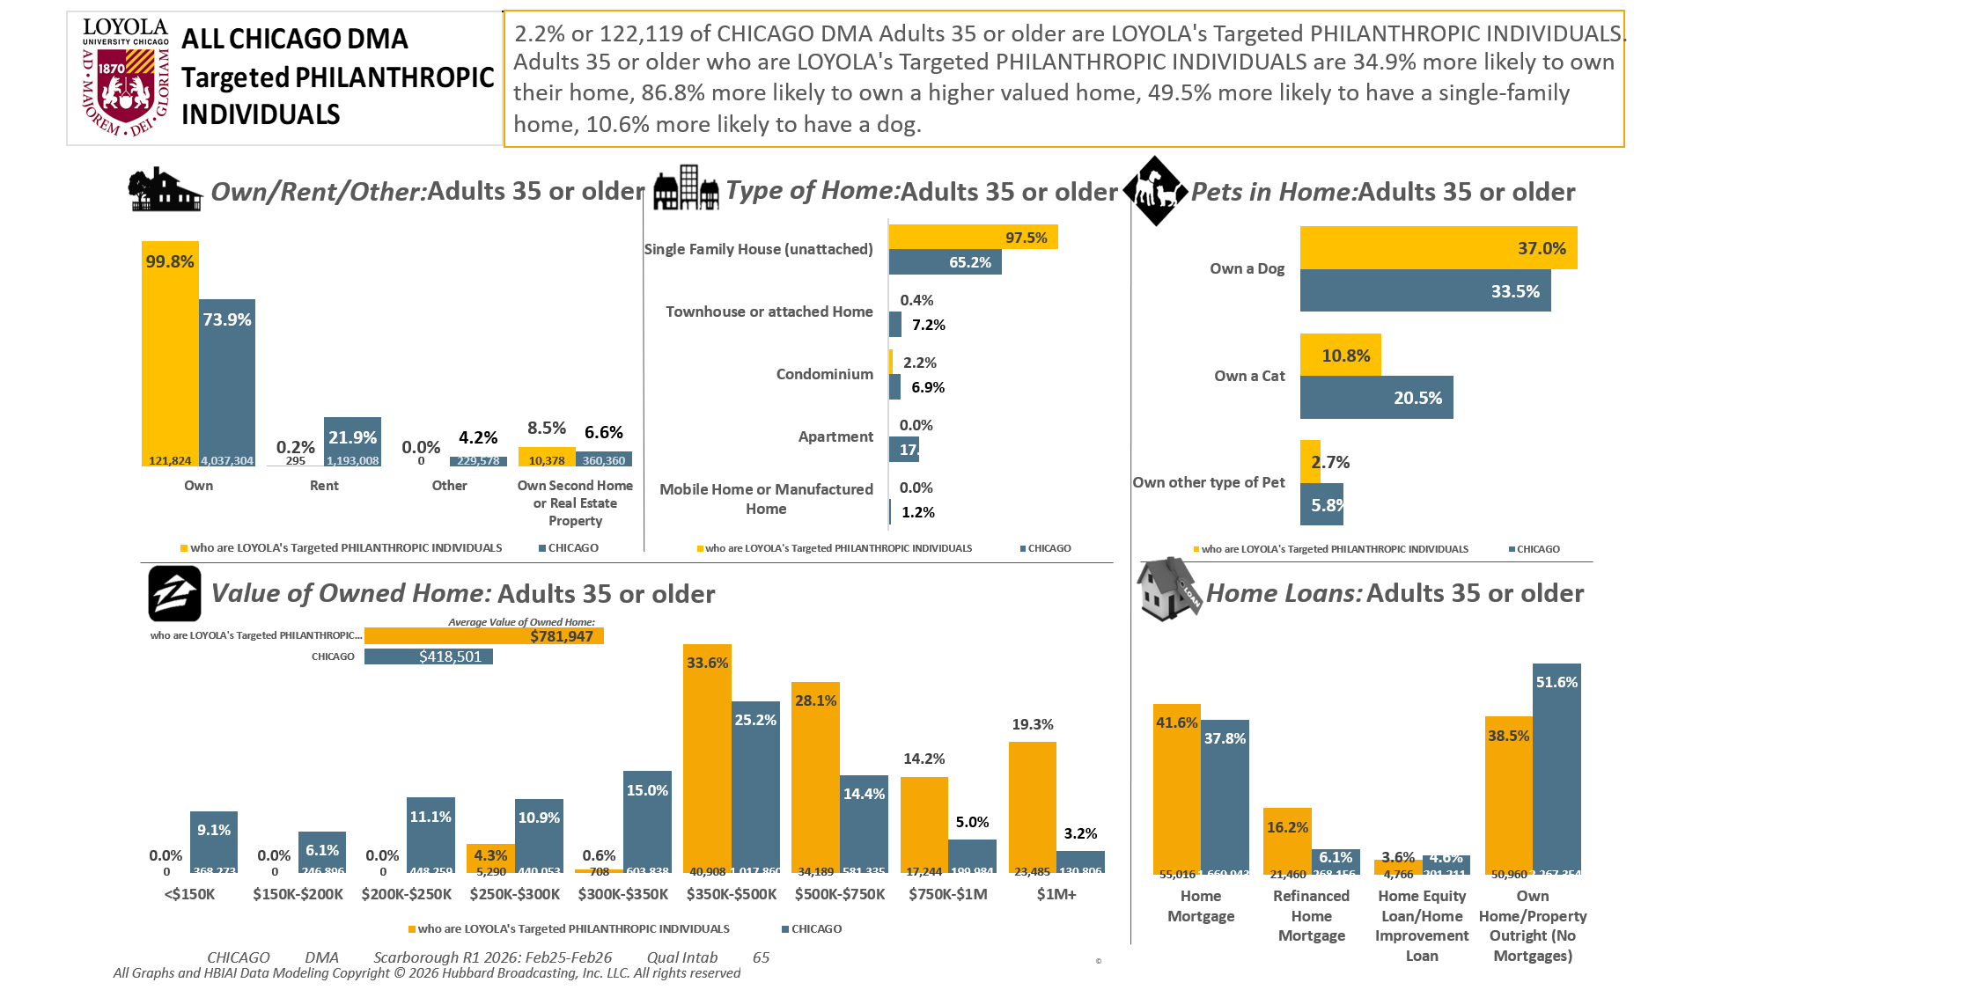
Adults 35+ DMA [(((Household income summaries (HHLD): $250,000 or more OR Acxiom NetWorth Gold (HHLD): $1,000,000 - $1,999,999 OR Acxiom NetWorth Gold (HHLD): $2,000,000 +) AND Organizations (types) contributed money to past 12 mo (HHLD): Religious) AND Organizations (types) contributed money to past 12 mo (HHLD): Educational/academic)]

Slide 4
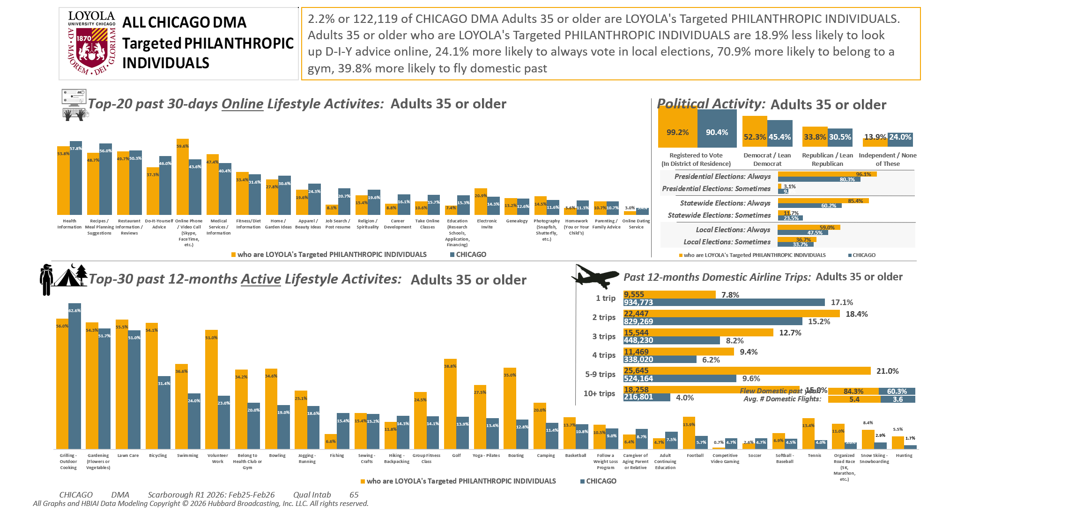
Adults 35+ DMA [(((Household income summaries (HHLD): $250,000 or more OR Acxiom NetWorth Gold (HHLD): $1,000,000 - $1,999,999 OR Acxiom NetWorth Gold (HHLD): $2,000,000 +) AND Organizations (types) contributed money to past 12 mo (HHLD): Religious) AND Organizations (types) contributed money to past 12 mo (HHLD): Educational/academic)]

Slide 5
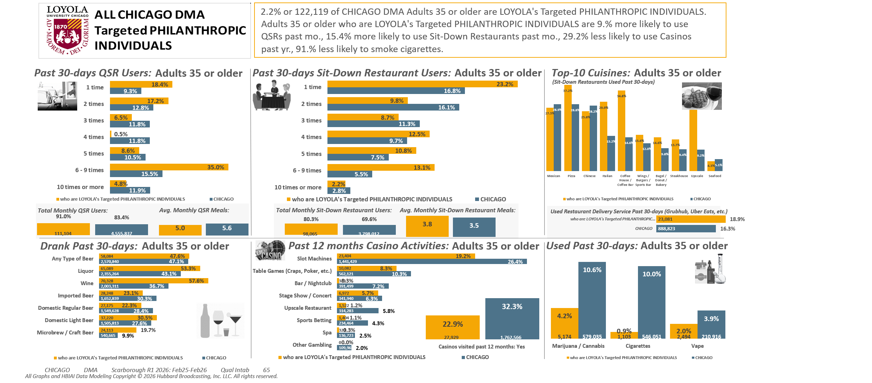
Adults 35+ DMA [(((Household income summaries (HHLD): $250,000 or more OR Acxiom NetWorth Gold (HHLD): $1,000,000 - $1,999,999 OR Acxiom NetWorth Gold (HHLD): $2,000,000 +) AND Organizations (types) contributed money to past 12 mo (HHLD): Religious) AND Organizations (types) contributed money to past 12 mo (HHLD): Educational/academic)]

Slide 6
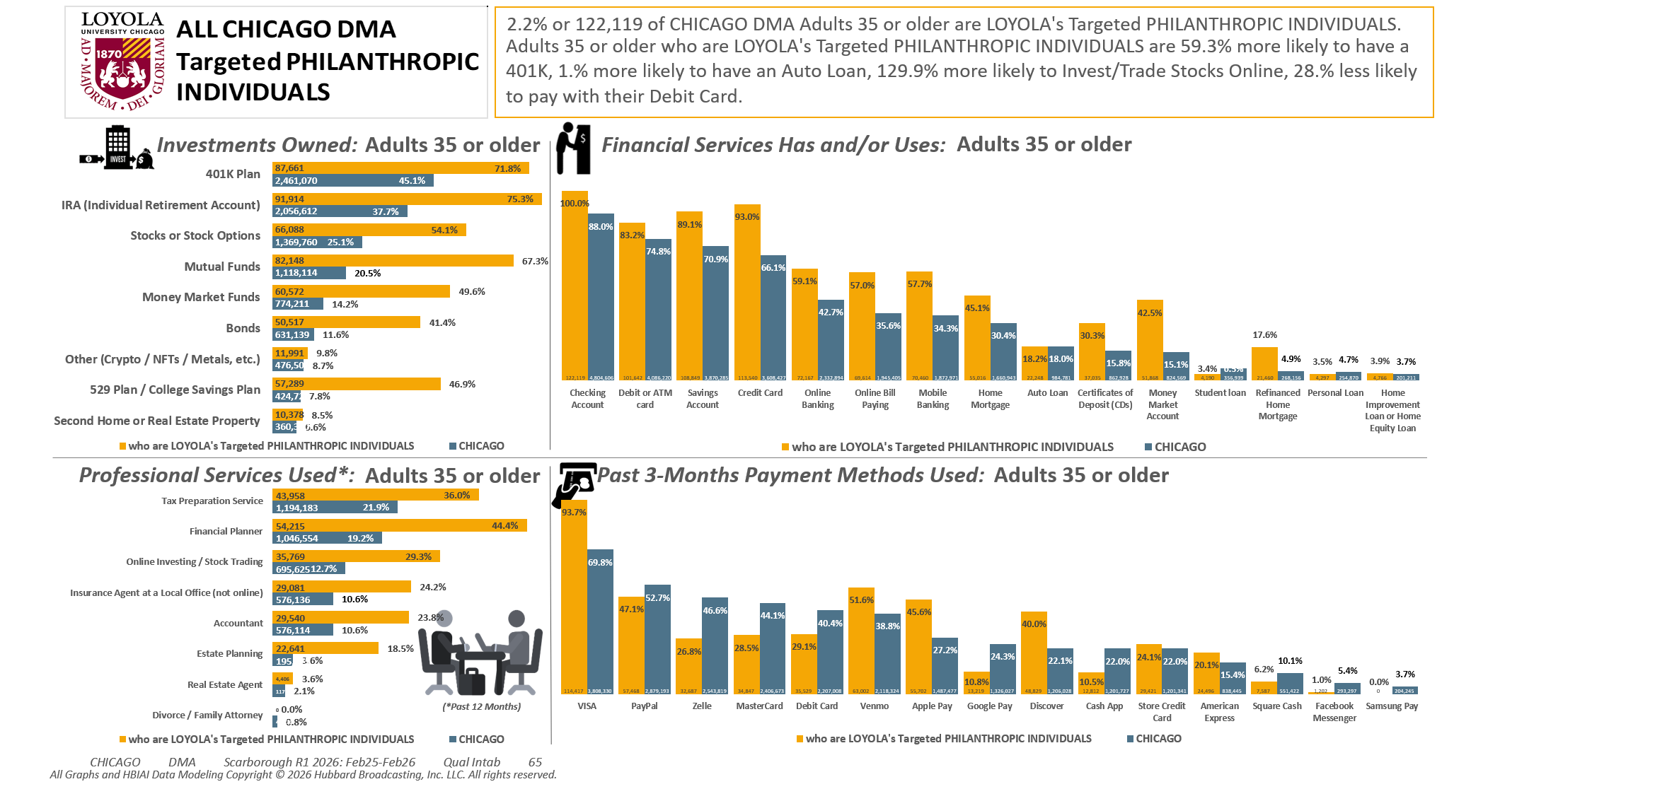
Adults 35+ DMA [(((Household income summaries (HHLD): $250,000 or more OR Acxiom NetWorth Gold (HHLD): $1,000,000 - $1,999,999 OR Acxiom NetWorth Gold (HHLD): $2,000,000 +) AND Organizations (types) contributed money to past 12 mo (HHLD): Religious) AND Organizations (types) contributed money to past 12 mo (HHLD): Educational/academic)]

Slide 7
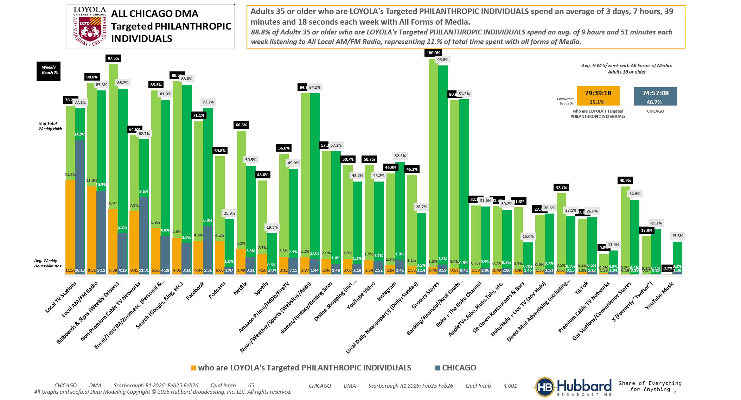

Adults 35+ DMA [(((Household income summaries (HHLD): $250,000 or more OR Acxiom NetWorth Gold (HHLD): $1,000,000 - $1,999,999 OR Acxiom NetWorth Gold (HHLD): $2,000,000 +) AND Organizations (types) contributed money to past 12 mo (HHLD): Religious) AND Organizations (types) contributed money to past 12 mo (HHLD): Educational/academic)]

Slide 8
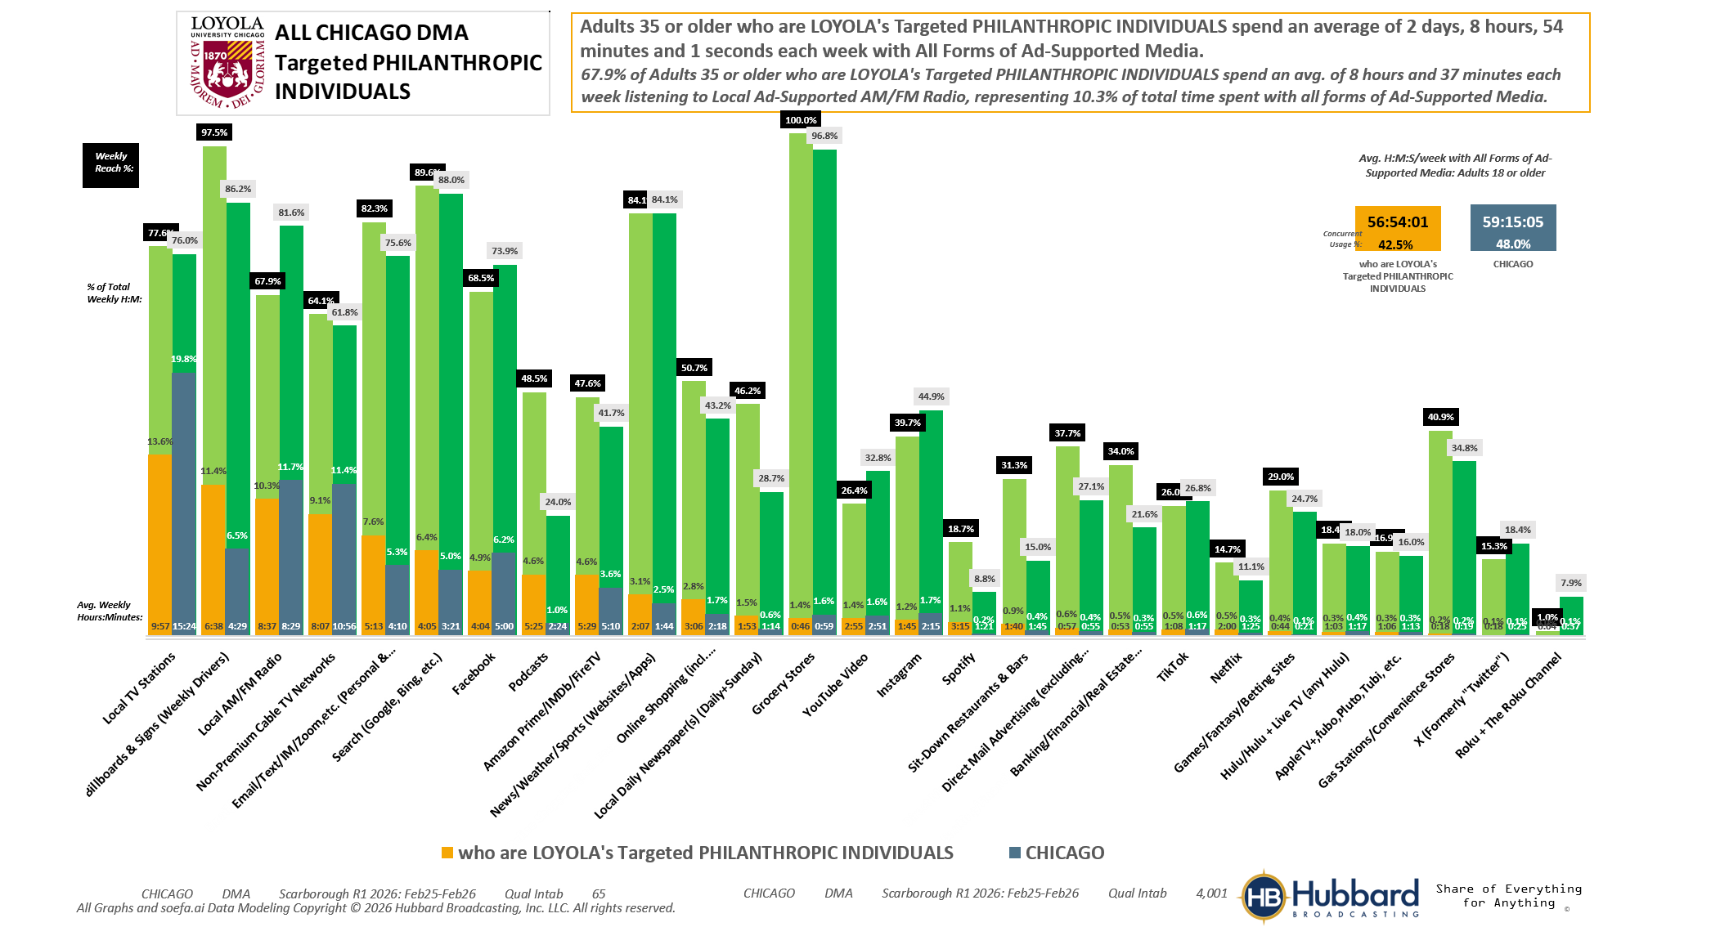
Adults 35+ DMA [(((Household income summaries (HHLD): $250,000 or more OR Acxiom NetWorth Gold (HHLD): $1,000,000 - $1,999,999 OR Acxiom NetWorth Gold (HHLD): $2,000,000 +) AND Organizations (types) contributed money to past 12 mo (HHLD): Religious) AND Organizations (types) contributed money to past 12 mo (HHLD): Educational/academic)]

Slide 9
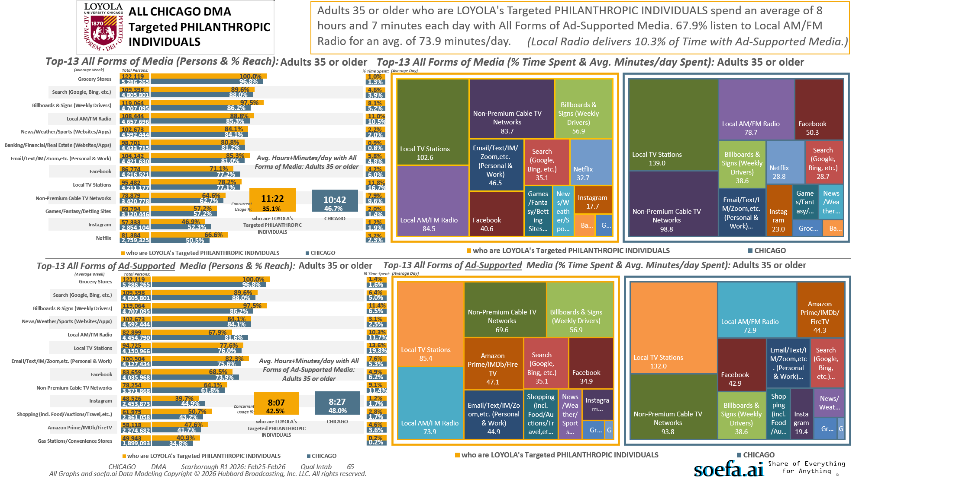
Adults 35+ DMA [(((Household income summaries (HHLD): $250,000 or more OR Acxiom NetWorth Gold (HHLD): $1,000,000 - $1,999,999 OR Acxiom NetWorth Gold (HHLD): $2,000,000 +) AND Organizations (types) contributed money to past 12 mo (HHLD): Religious) AND Organizations (types) contributed money to past 12 mo (HHLD): Educational/academic)]

Slide 10
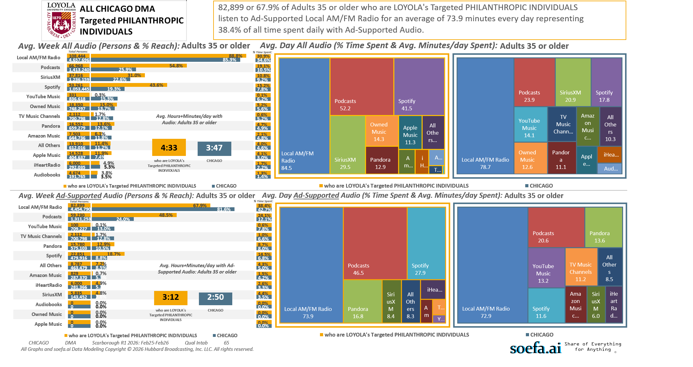
Adults 35+ DMA [(((Household income summaries (HHLD): $250,000 or more OR Acxiom NetWorth Gold (HHLD): $1,000,000 - $1,999,999 OR Acxiom NetWorth Gold (HHLD): $2,000,000 +) AND Organizations (types) contributed money to past 12 mo (HHLD): Religious) AND Organizations (types) contributed money to past 12 mo (HHLD): Educational/academic)]

Slide 11
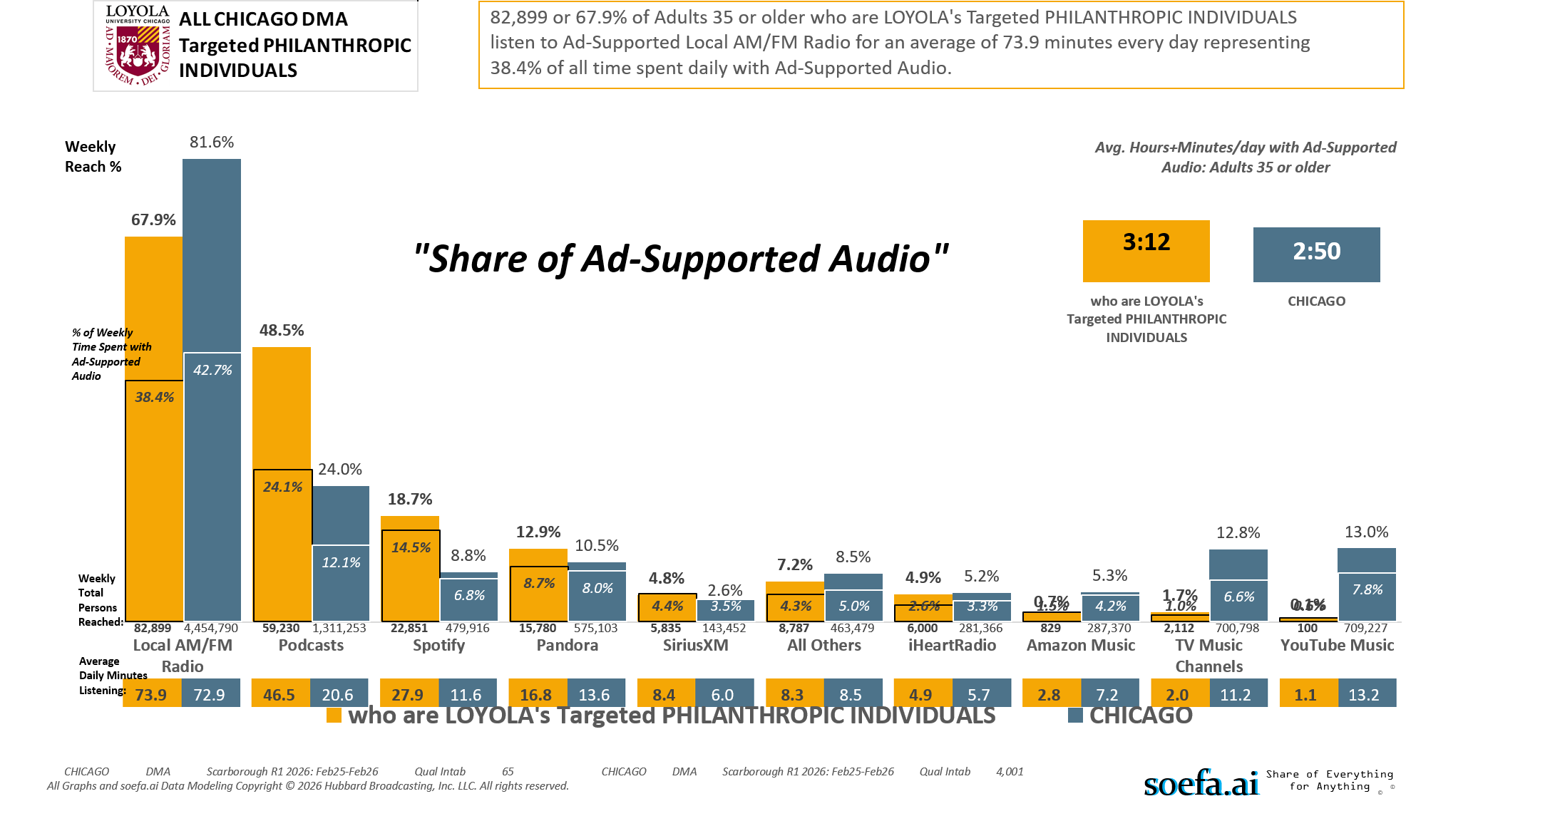
Adults 35+ DMA [(((Household income summaries (HHLD): $250,000 or more OR Acxiom NetWorth Gold (HHLD): $1,000,000 - $1,999,999 OR Acxiom NetWorth Gold (HHLD): $2,000,000 +) AND Organizations (types) contributed money to past 12 mo (HHLD): Religious) AND Organizations (types) contributed money to past 12 mo (HHLD): Educational/academic)]

Slide 12
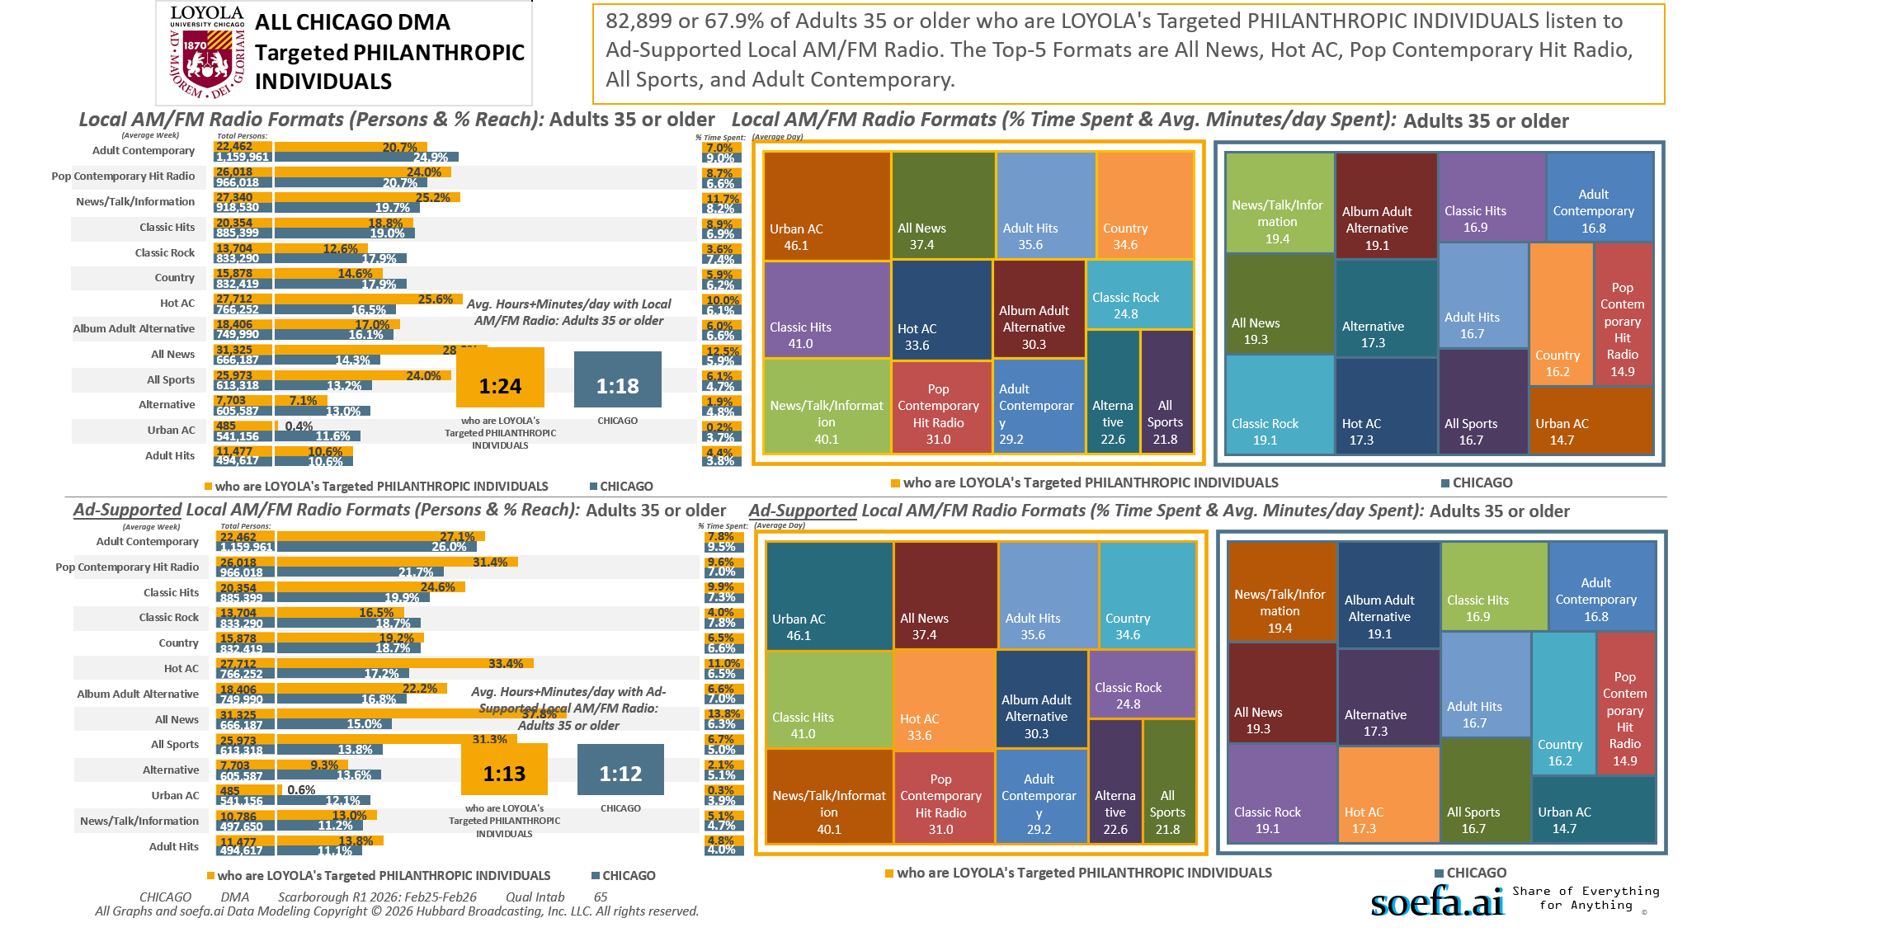
Adults 35+ DMA [(((Household income summaries (HHLD): $250,000 or more OR Acxiom NetWorth Gold (HHLD): $1,000,000 - $1,999,999 OR Acxiom NetWorth Gold (HHLD): $2,000,000 +) AND Organizations (types) contributed money to past 12 mo (HHLD): Religious) AND Organizations (types) contributed money to past 12 mo (HHLD): Educational/academic)]

Slide 13
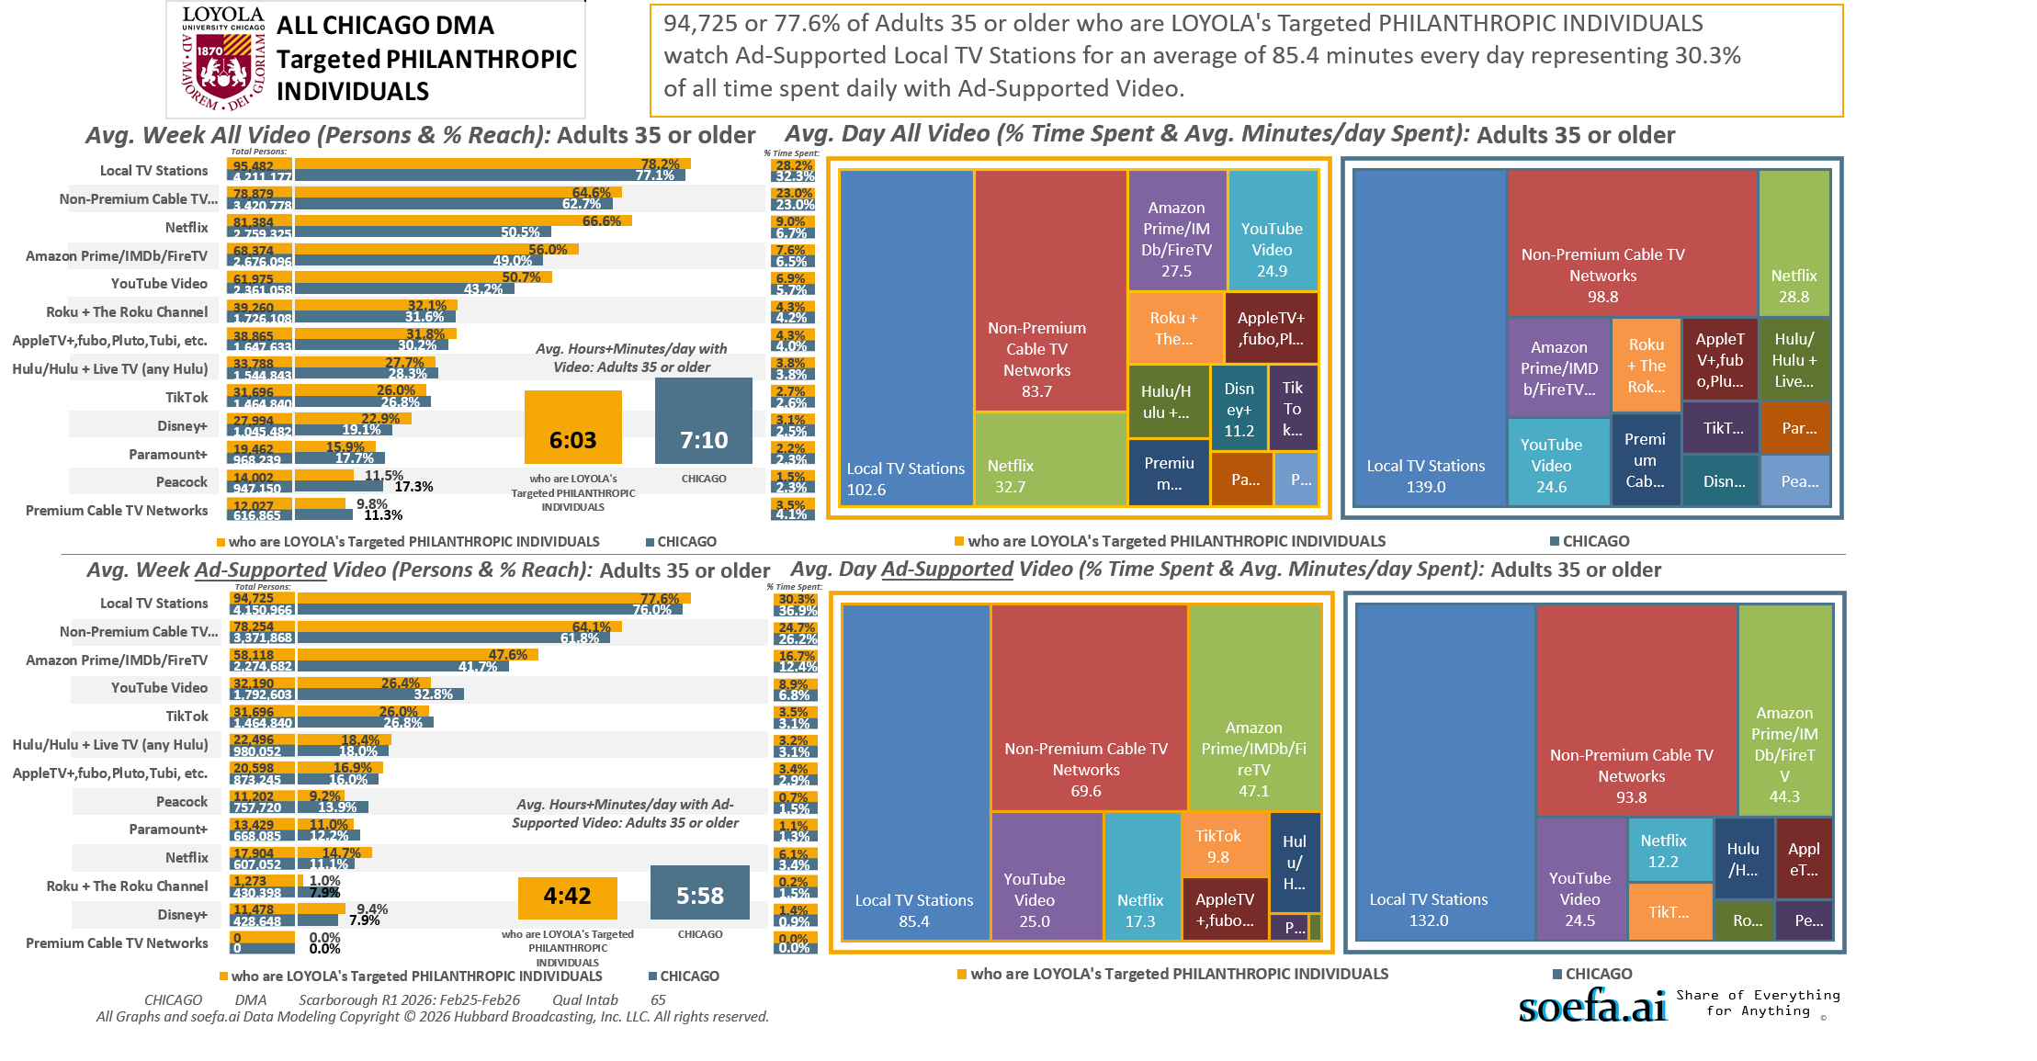
Adults 35+ DMA [(((Household income summaries (HHLD): $250,000 or more OR Acxiom NetWorth Gold (HHLD): $1,000,000 - $1,999,999 OR Acxiom NetWorth Gold (HHLD): $2,000,000 +) AND Organizations (types) contributed money to past 12 mo (HHLD): Religious) AND Organizations (types) contributed money to past 12 mo (HHLD): Educational/academic)]

Slide 14
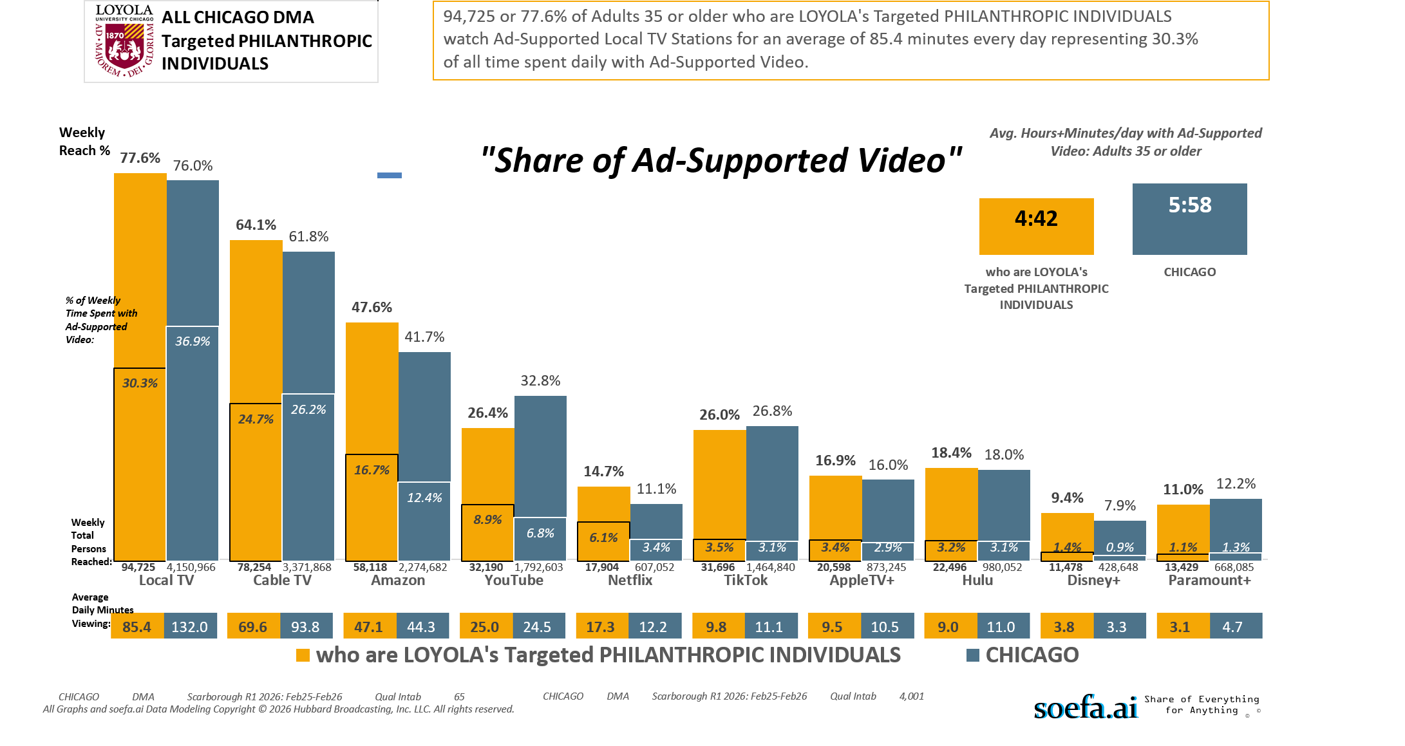
Adults 35+ DMA [(((Household income summaries (HHLD): $250,000 or more OR Acxiom NetWorth Gold (HHLD): $1,000,000 - $1,999,999 OR Acxiom NetWorth Gold (HHLD): $2,000,000 +) AND Organizations (types) contributed money to past 12 mo (HHLD): Religious) AND Organizations (types) contributed money to past 12 mo (HHLD): Educational/academic)]

Slide 15
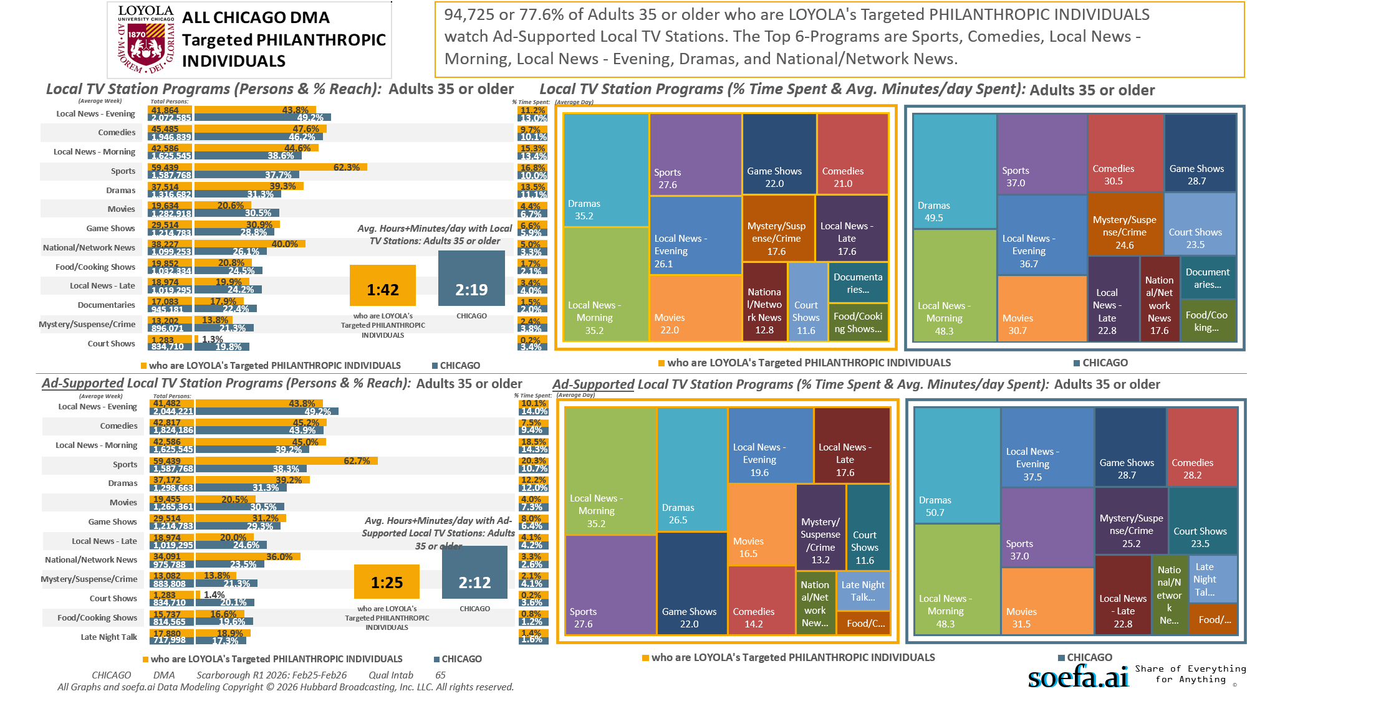
Adults 35+ DMA [(((Household income summaries (HHLD): $250,000 or more OR Acxiom NetWorth Gold (HHLD): $1,000,000 - $1,999,999 OR Acxiom NetWorth Gold (HHLD): $2,000,000 +) AND Organizations (types) contributed money to past 12 mo (HHLD): Religious) AND Organizations (types) contributed money to past 12 mo (HHLD): Educational/academic)]

Slide 16
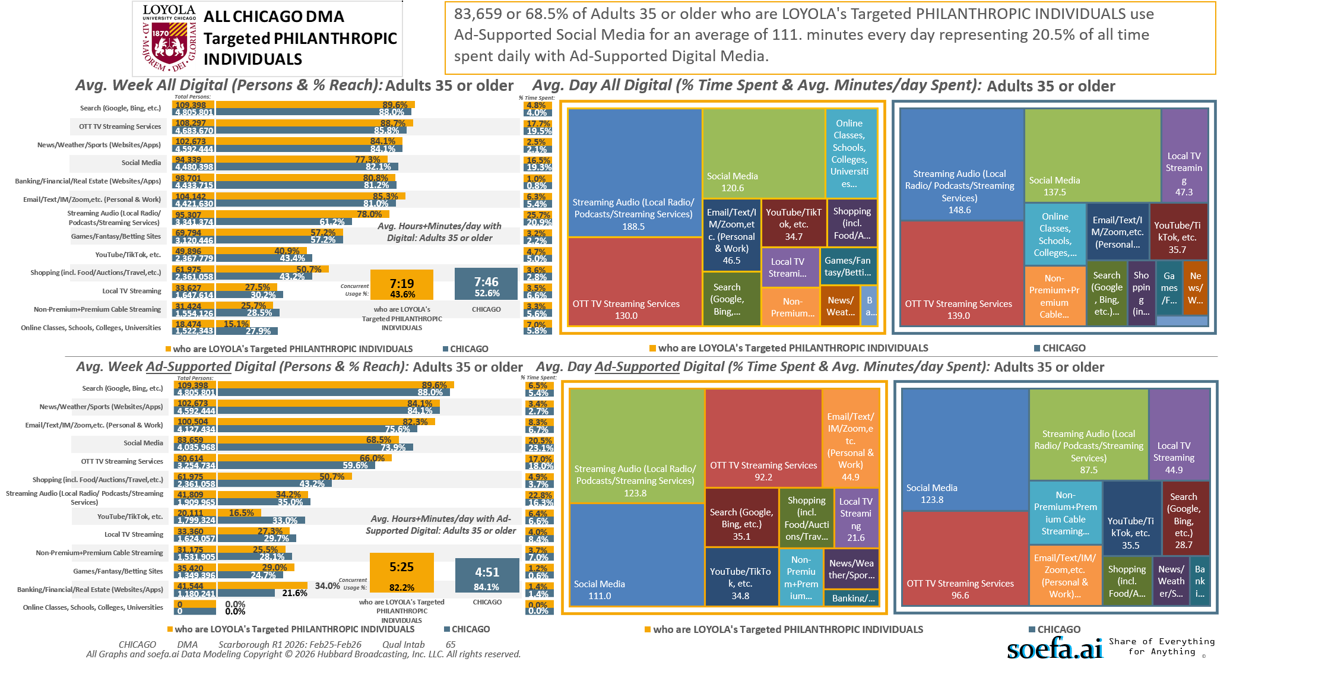
Adults 35+ DMA [(((Household income summaries (HHLD): $250,000 or more OR Acxiom NetWorth Gold (HHLD): $1,000,000 - $1,999,999 OR Acxiom NetWorth Gold (HHLD): $2,000,000 +) AND Organizations (types) contributed money to past 12 mo (HHLD): Religious) AND Organizations (types) contributed money to past 12 mo (HHLD): Educational/academic)]

Slide 17
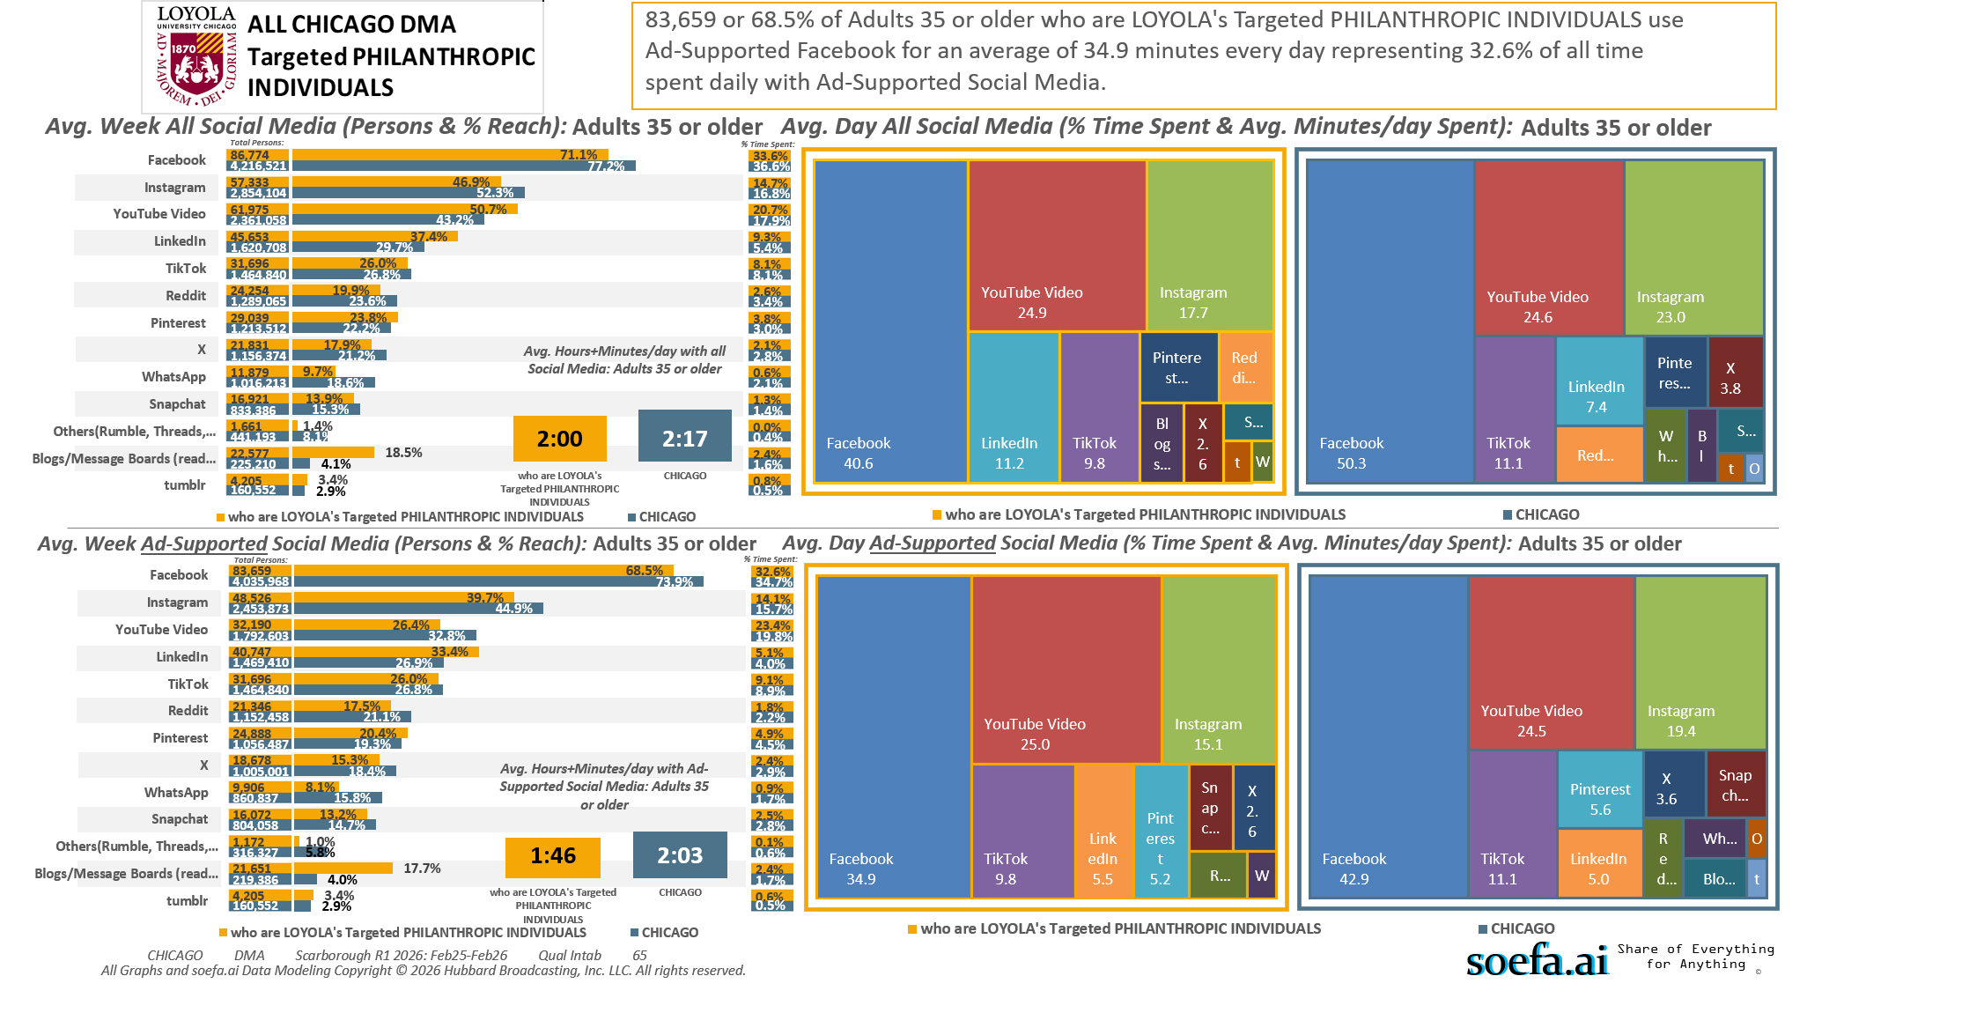
Adults 35+ DMA [(((Household income summaries (HHLD): $250,000 or more OR Acxiom NetWorth Gold (HHLD): $1,000,000 - $1,999,999 OR Acxiom NetWorth Gold (HHLD): $2,000,000 +) AND Organizations (types) contributed money to past 12 mo (HHLD): Religious) AND Organizations (types) contributed money to past 12 mo (HHLD): Educational/academic)]

Slide 18
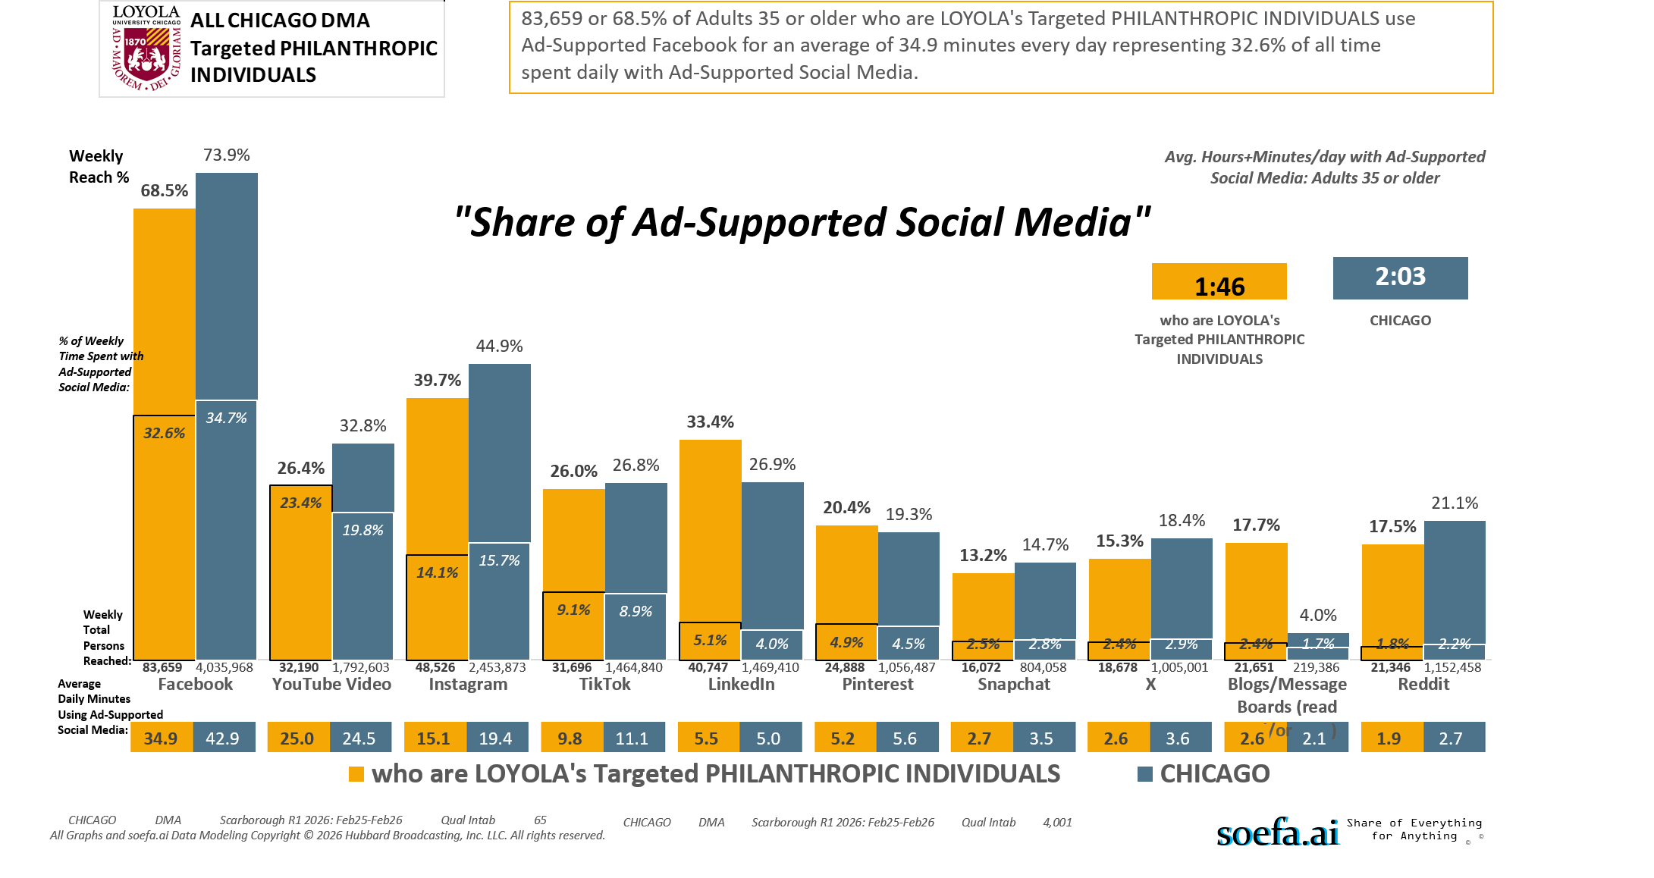
Adults 35+ DMA [(((Household income summaries (HHLD): $250,000 or more OR Acxiom NetWorth Gold (HHLD): $1,000,000 - $1,999,999 OR Acxiom NetWorth Gold (HHLD): $2,000,000 +) AND Organizations (types) contributed money to past 12 mo (HHLD): Religious) AND Organizations (types) contributed money to past 12 mo (HHLD): Educational/academic)]

Slide 19
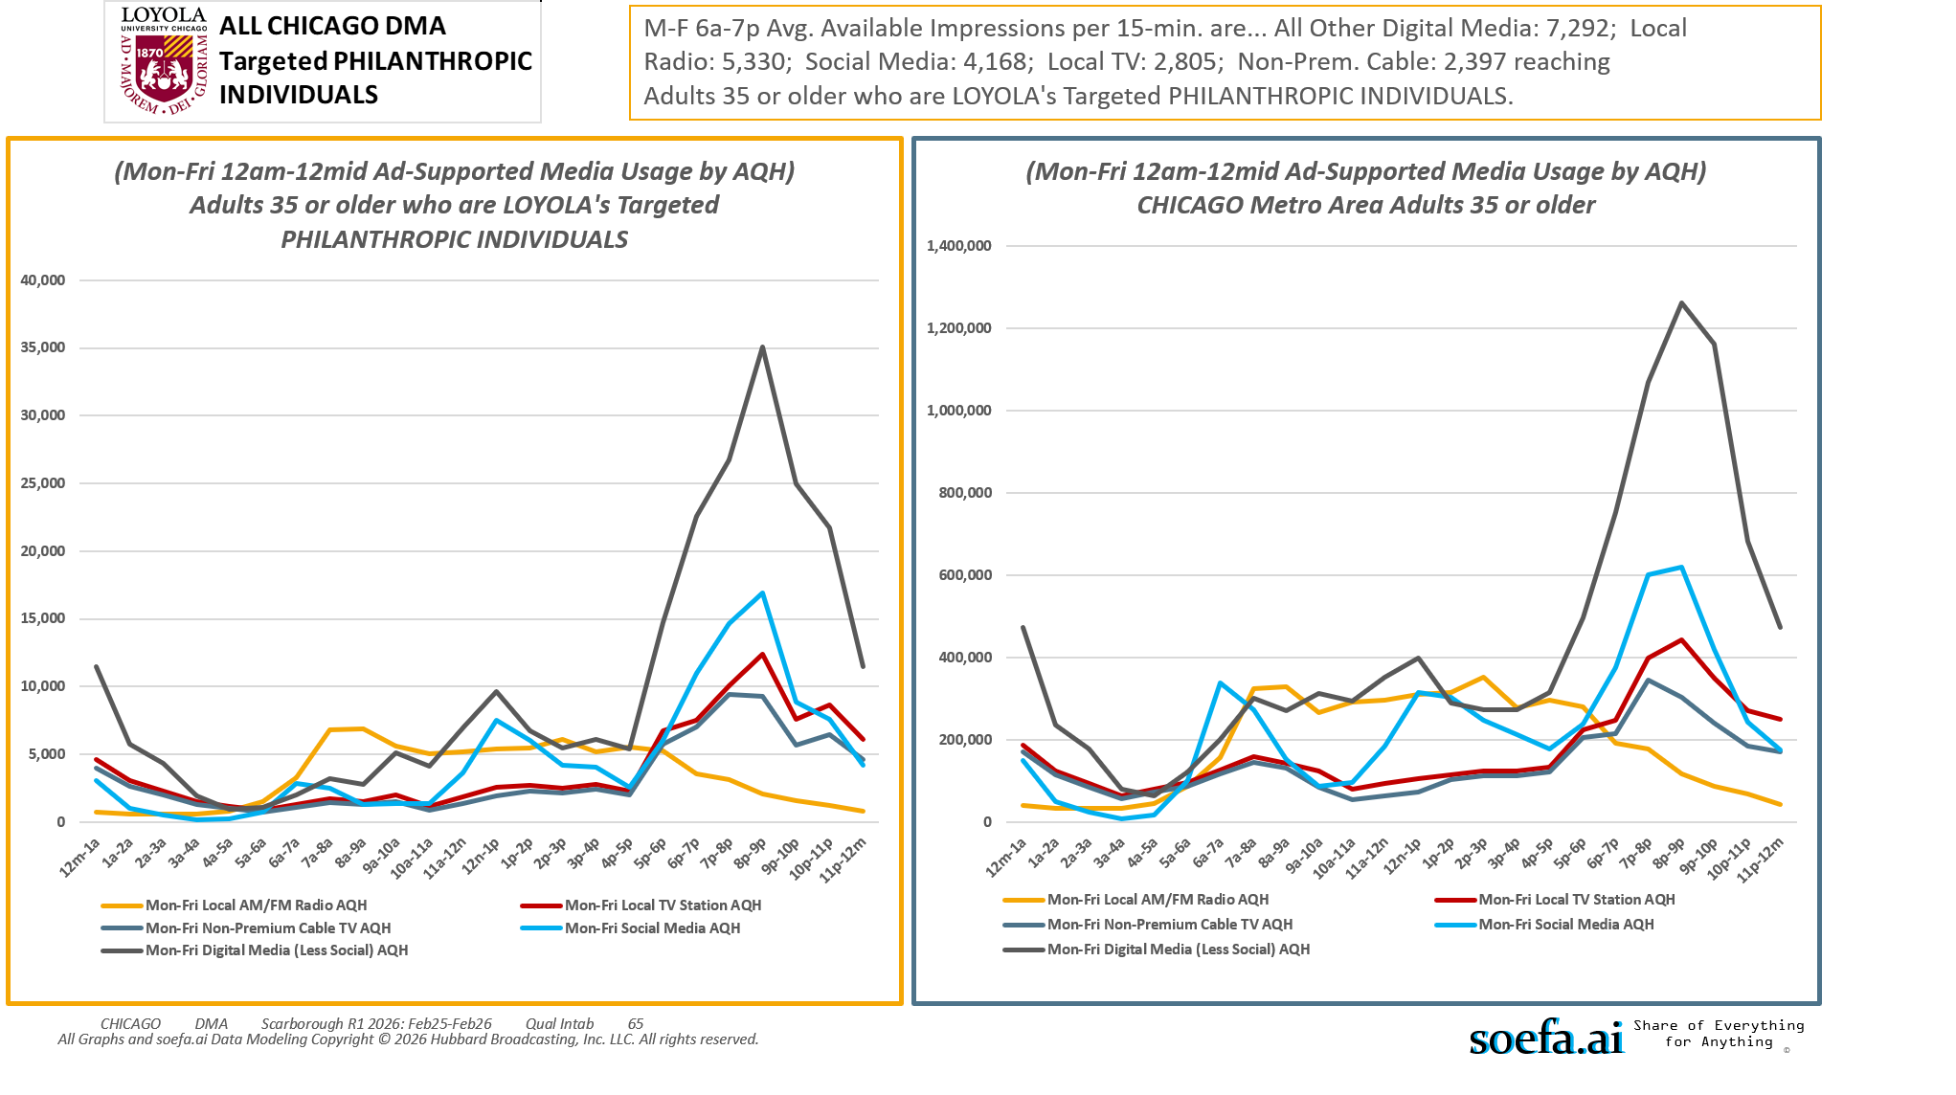
Adults 35+ DMA [(((Household income summaries (HHLD): $250,000 or more OR Acxiom NetWorth Gold (HHLD): $1,000,000 - $1,999,999 OR Acxiom NetWorth Gold (HHLD): $2,000,000 +) AND Organizations (types) contributed money to past 12 mo (HHLD): Religious) AND Organizations (types) contributed money to past 12 mo (HHLD): Educational/academic)]

Slide 20
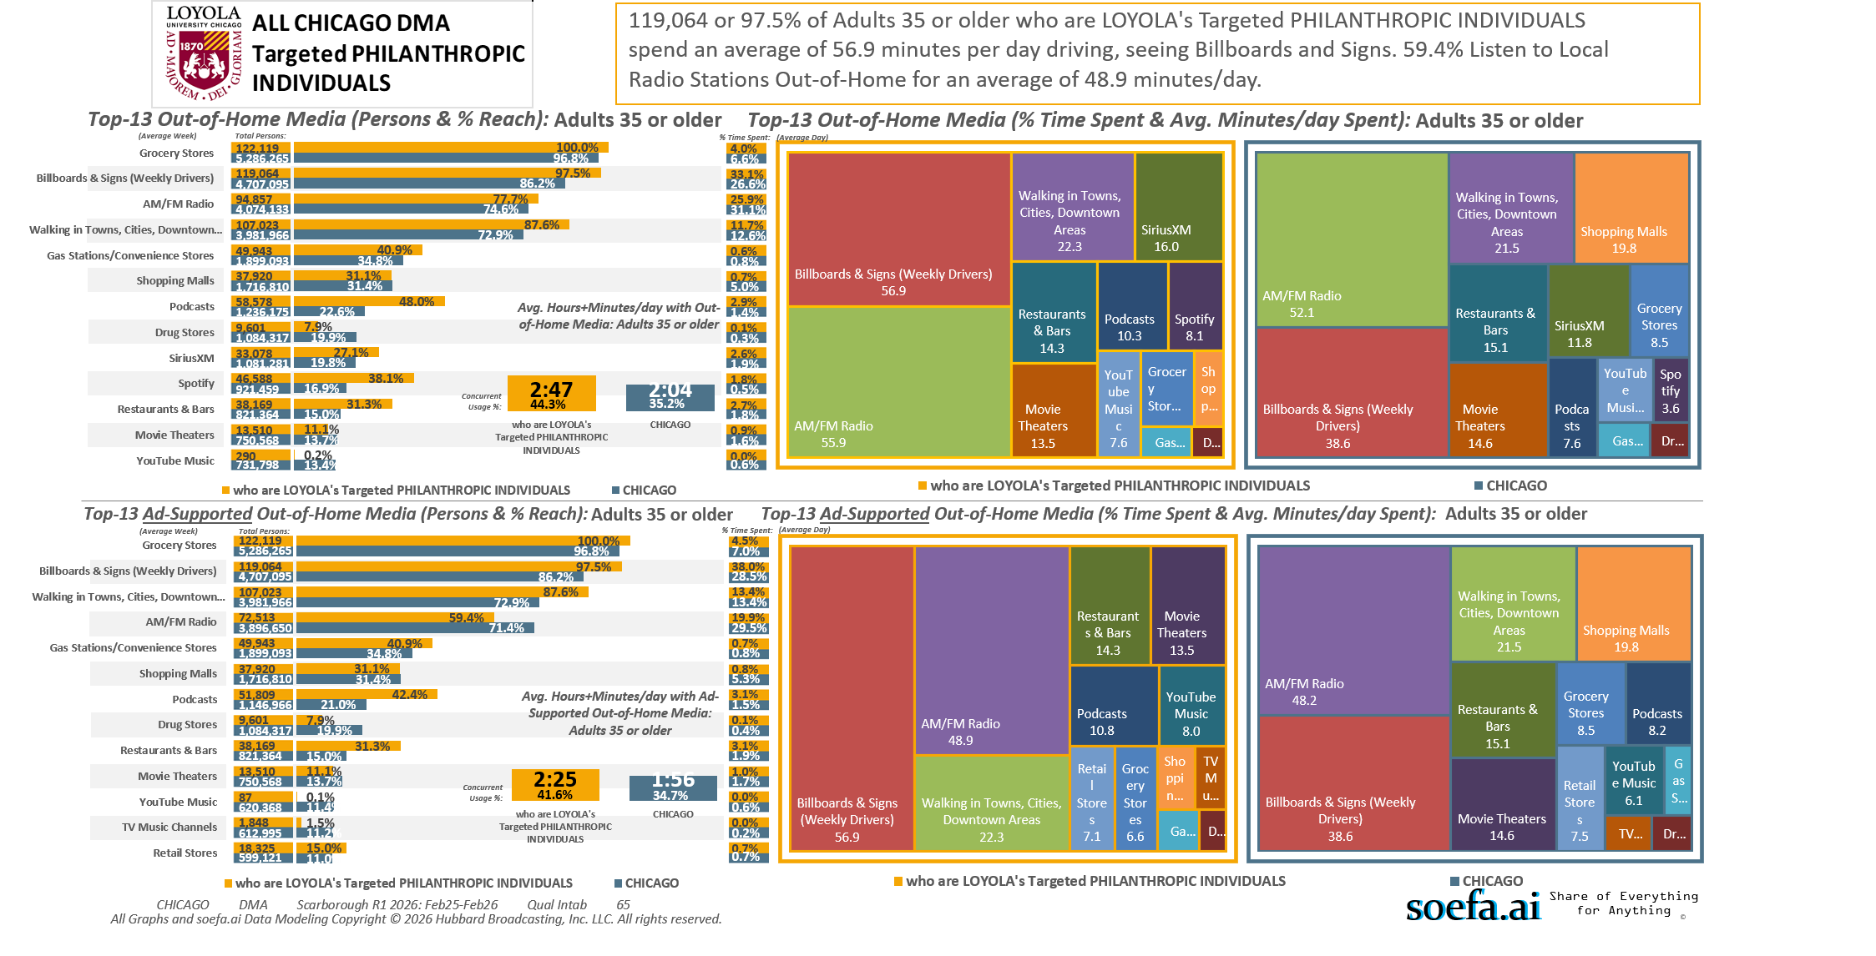
Adults 35+ DMA [(((Household income summaries (HHLD): $250,000 or more OR Acxiom NetWorth Gold (HHLD): $1,000,000 - $1,999,999 OR Acxiom NetWorth Gold (HHLD): $2,000,000 +) AND Organizations (types) contributed money to past 12 mo (HHLD): Religious) AND Organizations (types) contributed money to past 12 mo (HHLD): Educational/academic)]

Slide 21
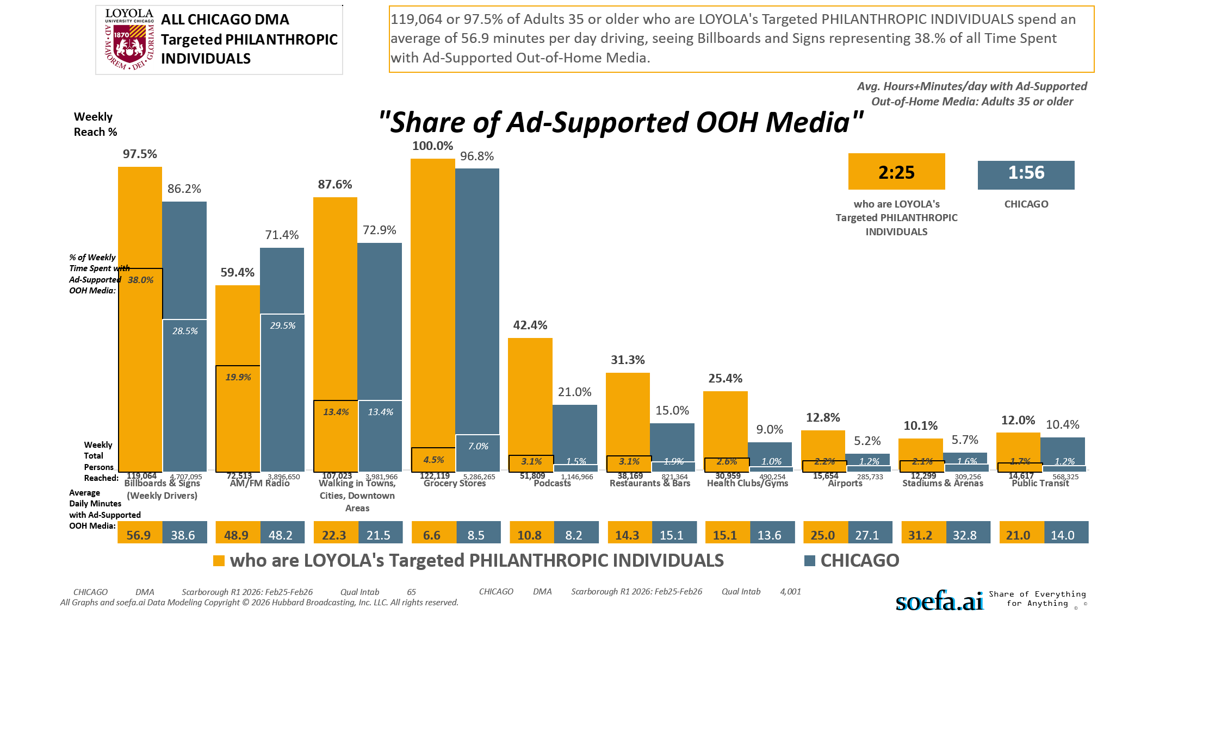
Adults 35+ DMA [(((Household income summaries (HHLD): $250,000 or more OR Acxiom NetWorth Gold (HHLD): $1,000,000 - $1,999,999 OR Acxiom NetWorth Gold (HHLD): $2,000,000 +) AND Organizations (types) contributed money to past 12 mo (HHLD): Religious) AND Organizations (types) contributed money to past 12 mo (HHLD): Educational/academic)]

Slide 22
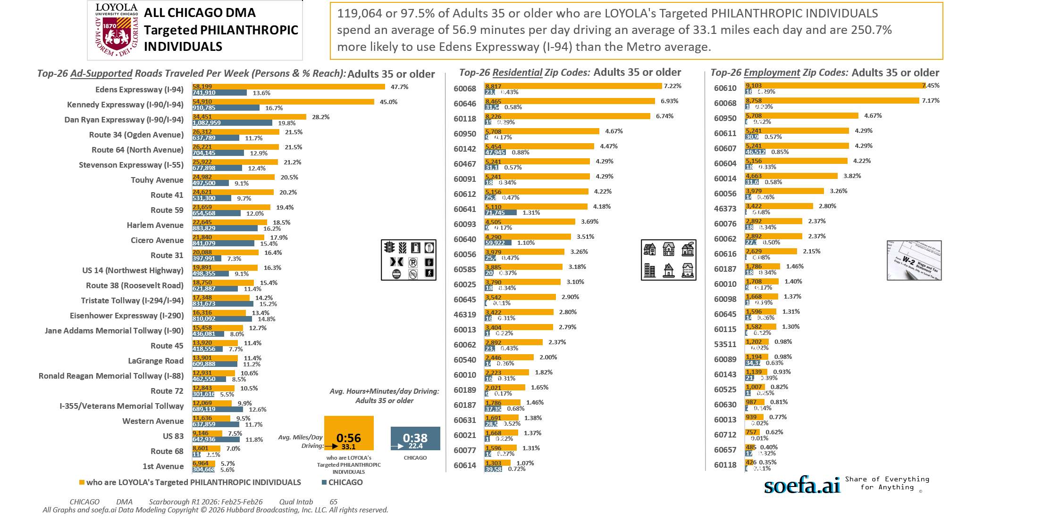
Adults 35+ DMA [(((Household income summaries (HHLD): $250,000 or more OR Acxiom NetWorth Gold (HHLD): $1,000,000 - $1,999,999 OR Acxiom NetWorth Gold (HHLD): $2,000,000 +) AND Organizations (types) contributed money to past 12 mo (HHLD): Religious) AND Organizations (types) contributed money to past 12 mo (HHLD): Educational/academic)]

Slide 23
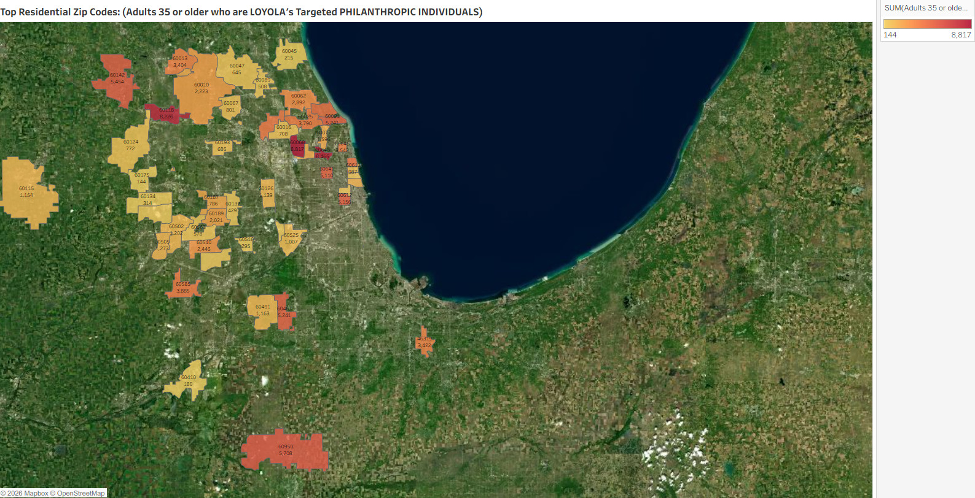
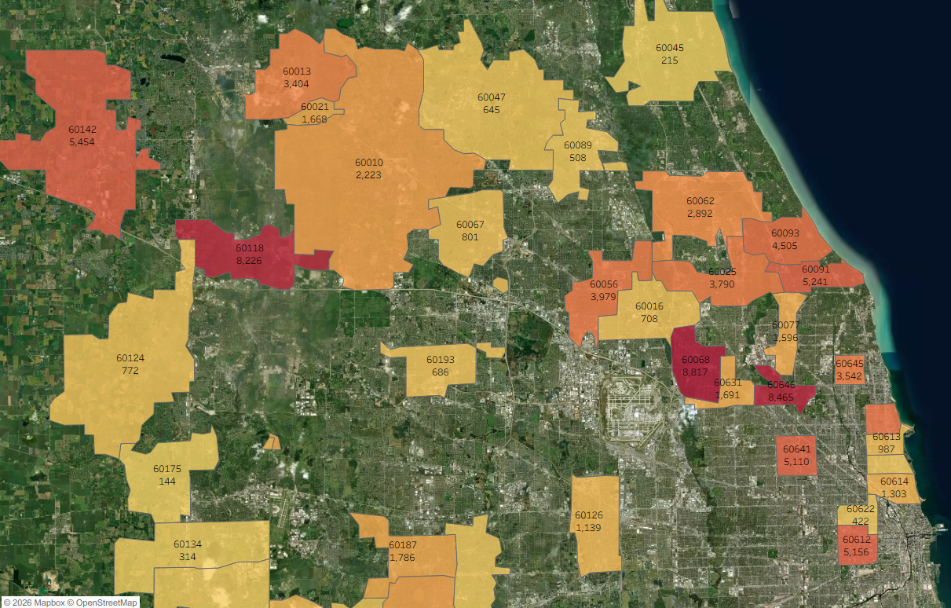
Zip Code Adults 35 or older who are LOYOLA's Targeted PHILANTHROPIC INDIVIDUALS
60068 8,817
60646 8,465
60118 8,226
60950 5,708
60142 5,454
60467 5,241
60091 5,241
60612 5,156
60641 5,110
60093 4,505
60640 4,290
60056 3,979
60585 3,885
60025 3,790
60645 3,542
46319 3,422
60013 3,404
60062 2,892
60540 2,446
60010 2,223
60189 2,021
60187 1,786
60631 1,691
60021 1,668
60077 1,596
60614 1,303
60505 1,273
60502 1,202
60491 1,163
60115 1,154
60126 1,139
60525 1,007
60613 987
60067 801
60124 772
60016 708
60193 686
60047 645
60563 578
60089 508
60657 485
60137 429
60622 422
60510 416
60565 405
60558 330
60134 314
60516 295
60045 215
60410 180
60175 144
Adults 35+ DMA [(((Household income summaries (HHLD): $250,000 or more OR Acxiom NetWorth Gold (HHLD): $1,000,000 - $1,999,999 OR Acxiom NetWorth Gold (HHLD): $2,000,000 +) AND Organizations (types) contributed money to past 12 mo (HHLD): Religious) AND Organizations (types) contributed money to past 12 mo (HHLD): Educational/academic)]

Slide 24
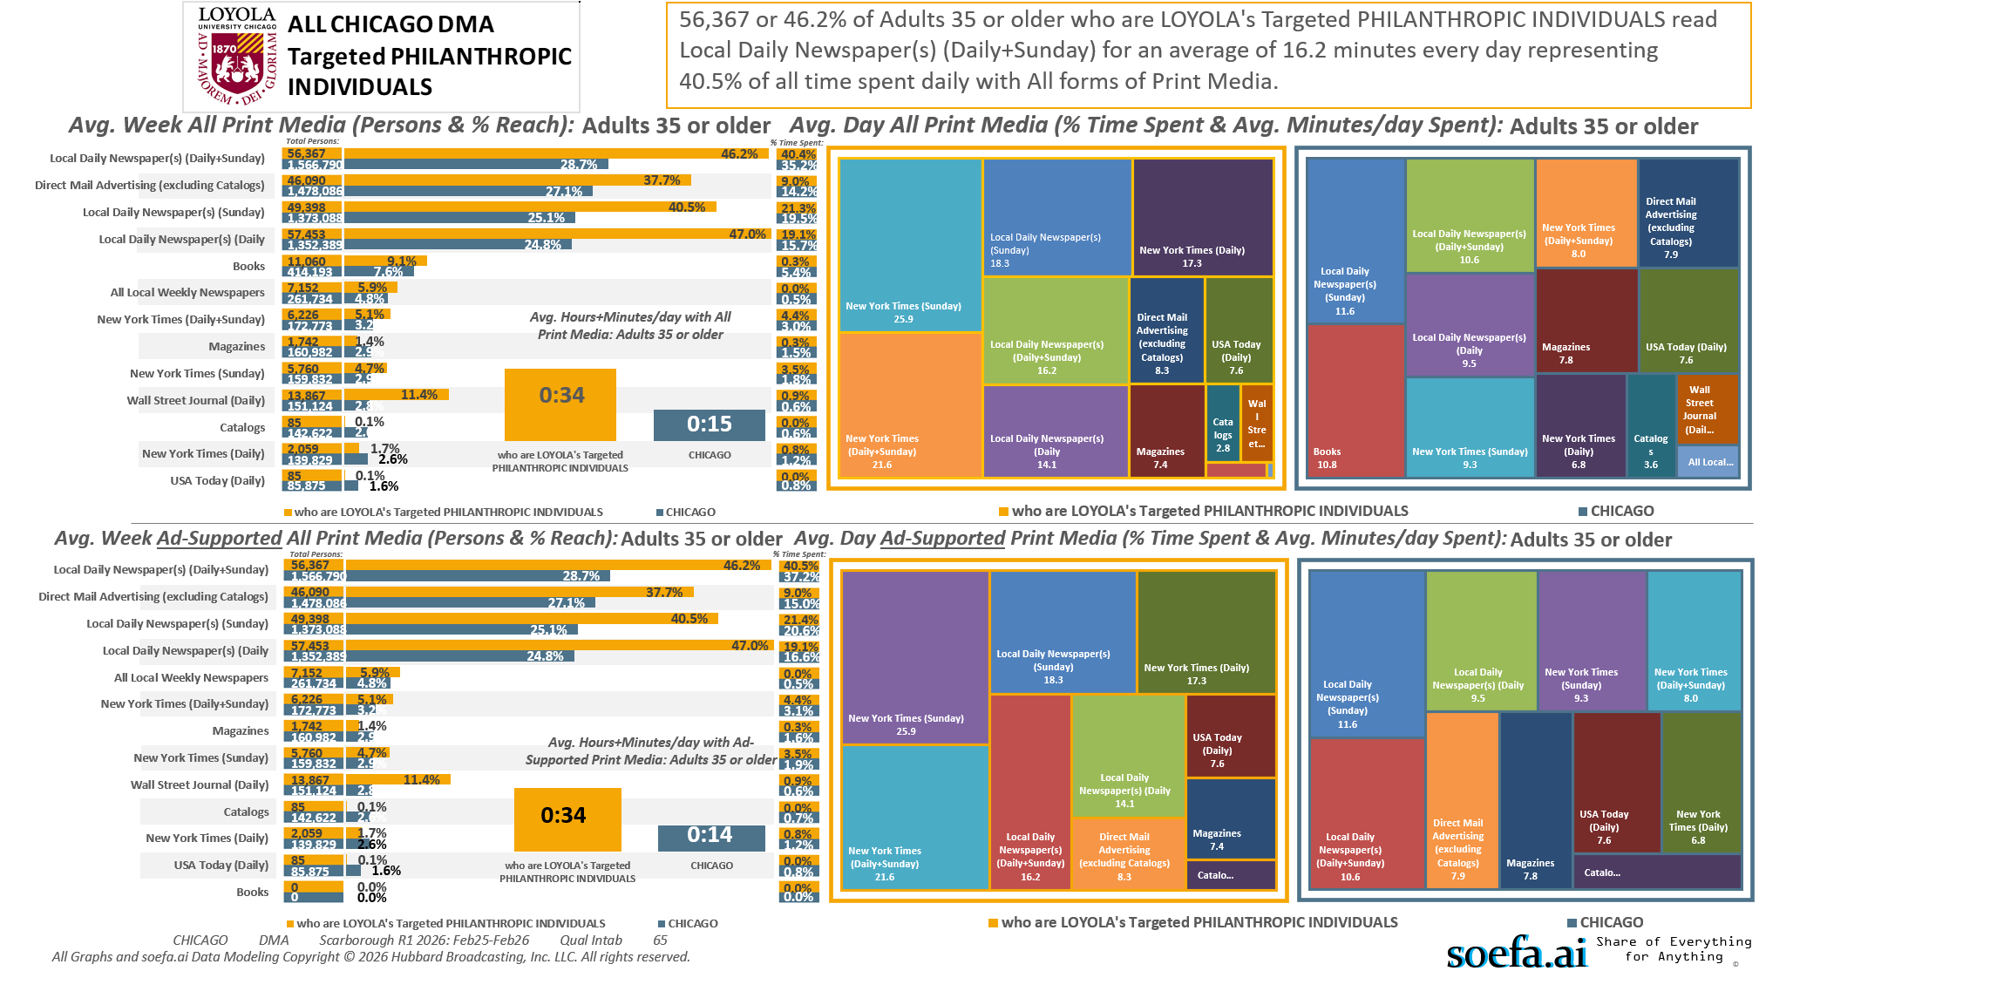
Adults 35+ DMA [(((Household income summaries (HHLD): $250,000 or more OR Acxiom NetWorth Gold (HHLD): $1,000,000 - $1,999,999 OR Acxiom NetWorth Gold (HHLD): $2,000,000 +) AND Organizations (types) contributed money to past 12 mo (HHLD): Religious) AND Organizations (types) contributed money to past 12 mo (HHLD): Educational/academic)]

Slide 25
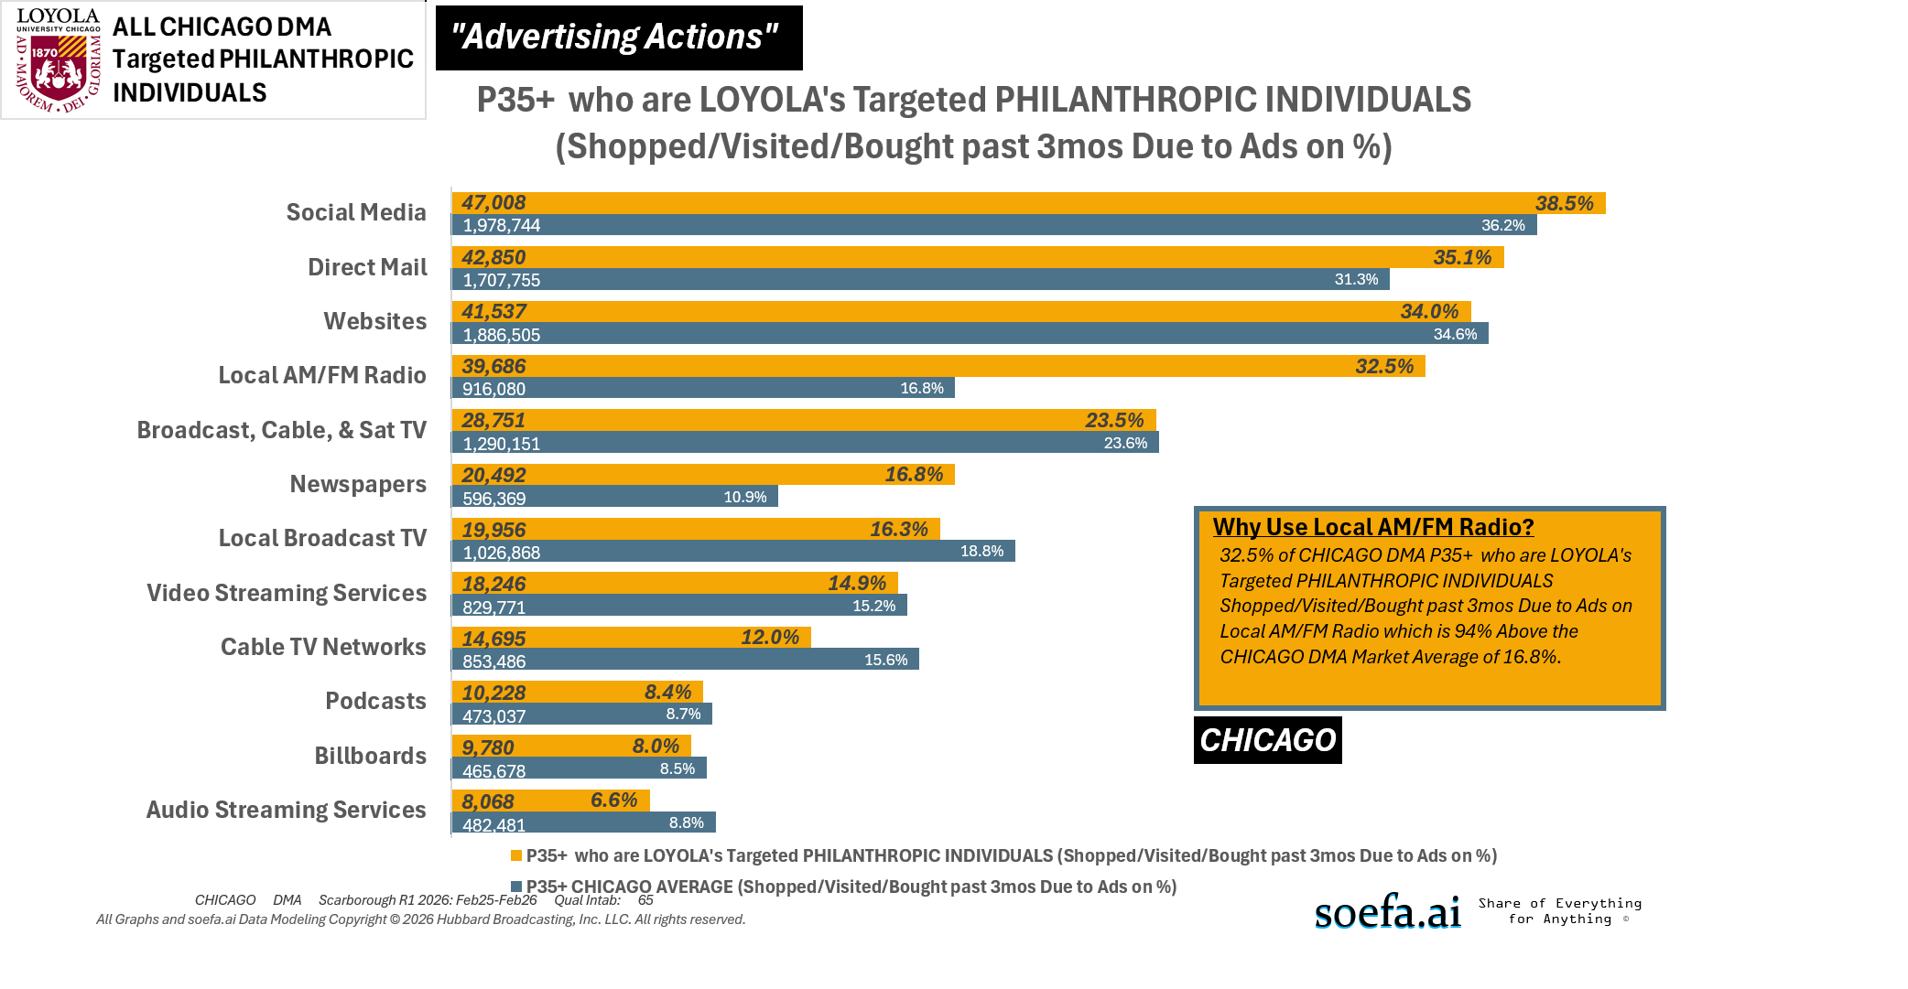
Adults 35+ DMA [(((Household income summaries (HHLD): $250,000 or more OR Acxiom NetWorth Gold (HHLD): $1,000,000 - $1,999,999 OR Acxiom NetWorth Gold (HHLD): $2,000,000 +) AND Organizations (types) contributed money to past 12 mo (HHLD): Religious) AND Organizations (types) contributed money to past 12 mo (HHLD): Educational/academic)]

