Slide 1
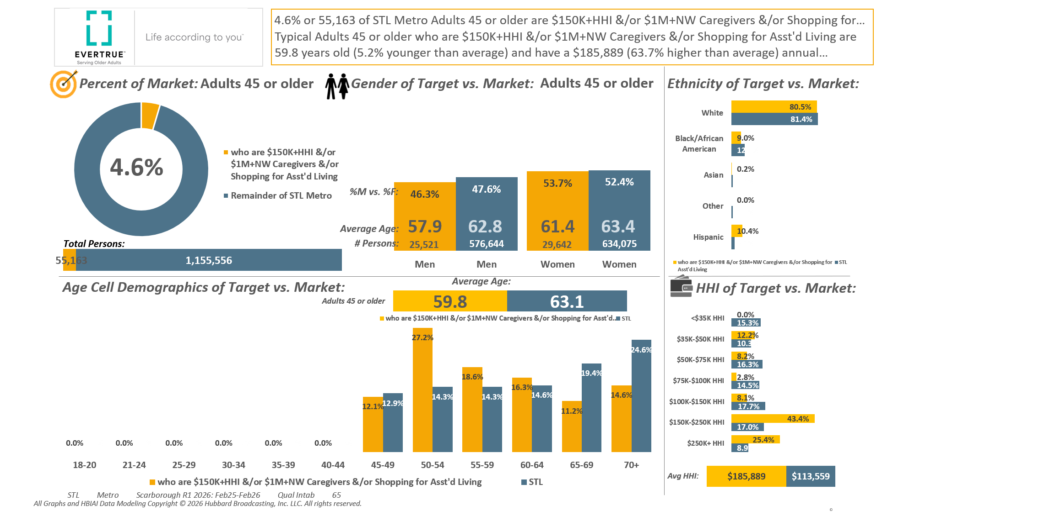







P45+ AND: [((Household income (HHLD): $150,000 - $249,999 OR Household income (HHLD): $250,000 or more OR Acxiom NetWorth Gold (HHLD): Less than or equal to $0 OR Acxiom NetWorth Gold (HHLD): $1,000,000 - $1,999,999 OR Acxiom NetWorth Gold (HHLD): $2,000,000 +) AND (Lifestyle characteristics: Caregiver of aging parent or relative OR Lifestyle changes household plans to do next 12 mths (HHLD): Shop for out-of-home nursing,assisted living,retire facility))]

Slide 2
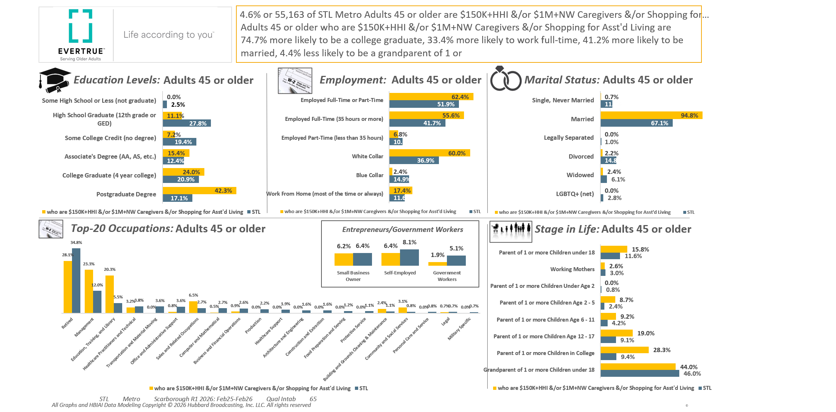
P45+ AND: [((Household income (HHLD): $150,000 - $249,999 OR Household income (HHLD): $250,000 or more OR Acxiom NetWorth Gold (HHLD): Less than or equal to $0 OR Acxiom NetWorth Gold (HHLD): $1,000,000 - $1,999,999 OR Acxiom NetWorth Gold (HHLD): $2,000,000 +) AND (Lifestyle characteristics: Caregiver of aging parent or relative OR Lifestyle changes household plans to do next 12 mths (HHLD): Shop for out-of-home nursing,assisted living,retire facility))]

Slide 3
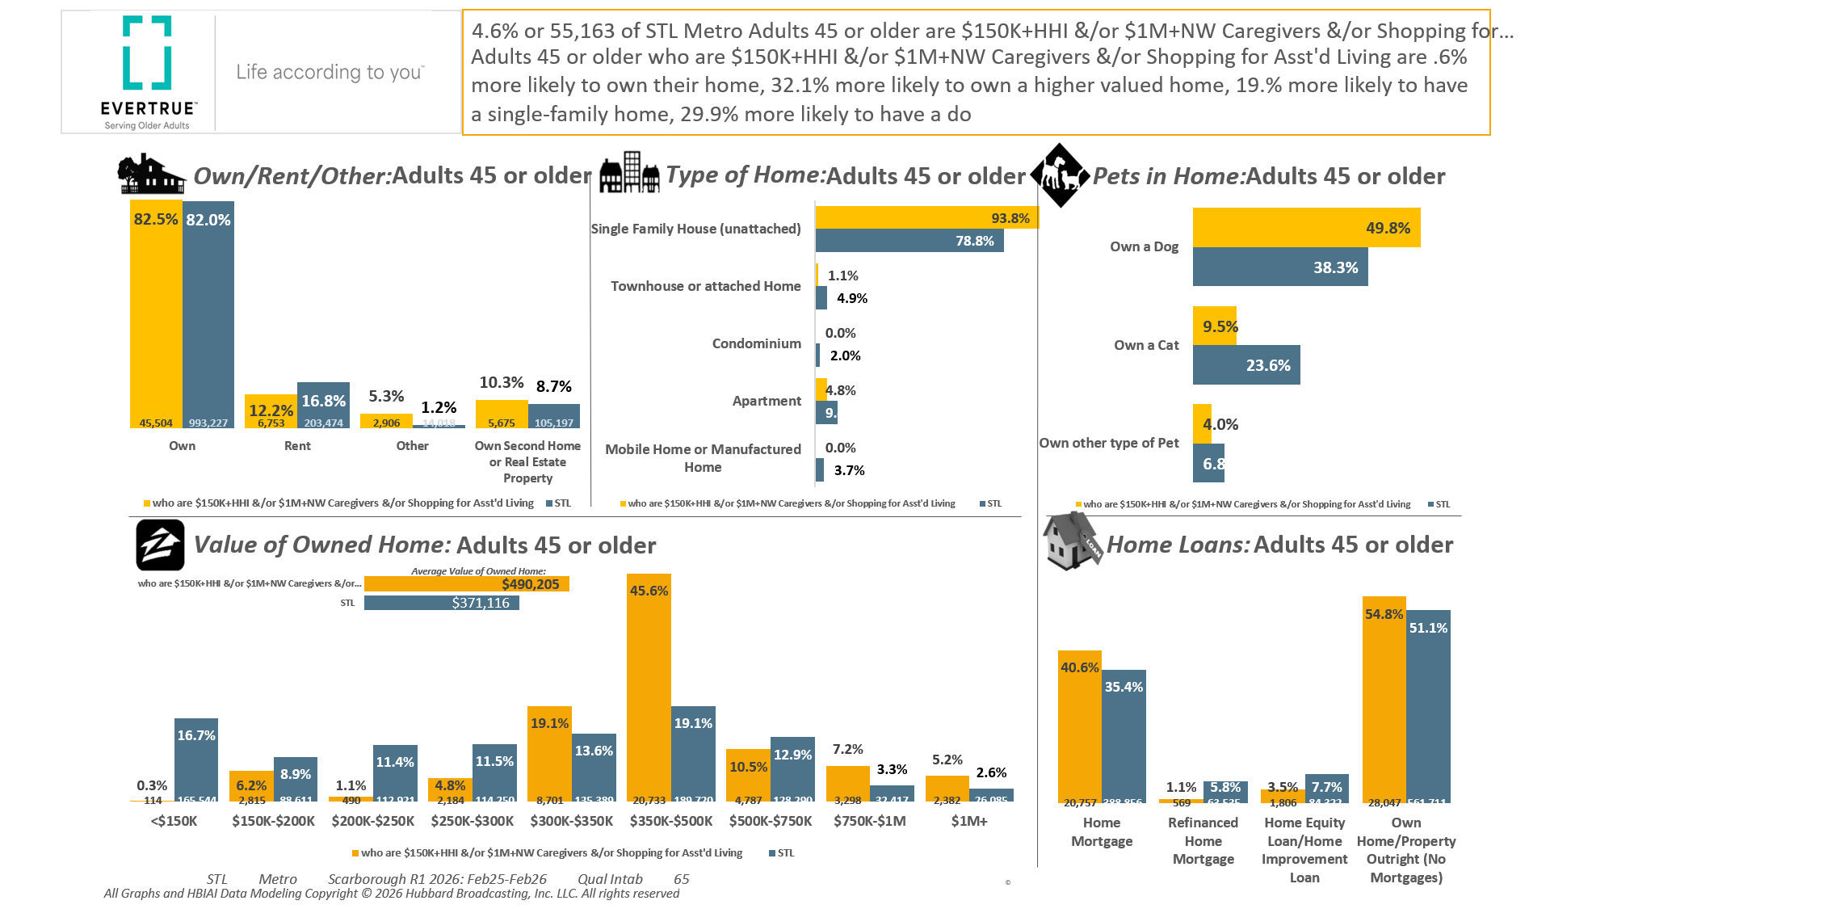
P45+ AND: [((Household income (HHLD): $150,000 - $249,999 OR Household income (HHLD): $250,000 or more OR Acxiom NetWorth Gold (HHLD): Less than or equal to $0 OR Acxiom NetWorth Gold (HHLD): $1,000,000 - $1,999,999 OR Acxiom NetWorth Gold (HHLD): $2,000,000 +) AND (Lifestyle characteristics: Caregiver of aging parent or relative OR Lifestyle changes household plans to do next 12 mths (HHLD): Shop for out-of-home nursing,assisted living,retire facility))]

Slide 4
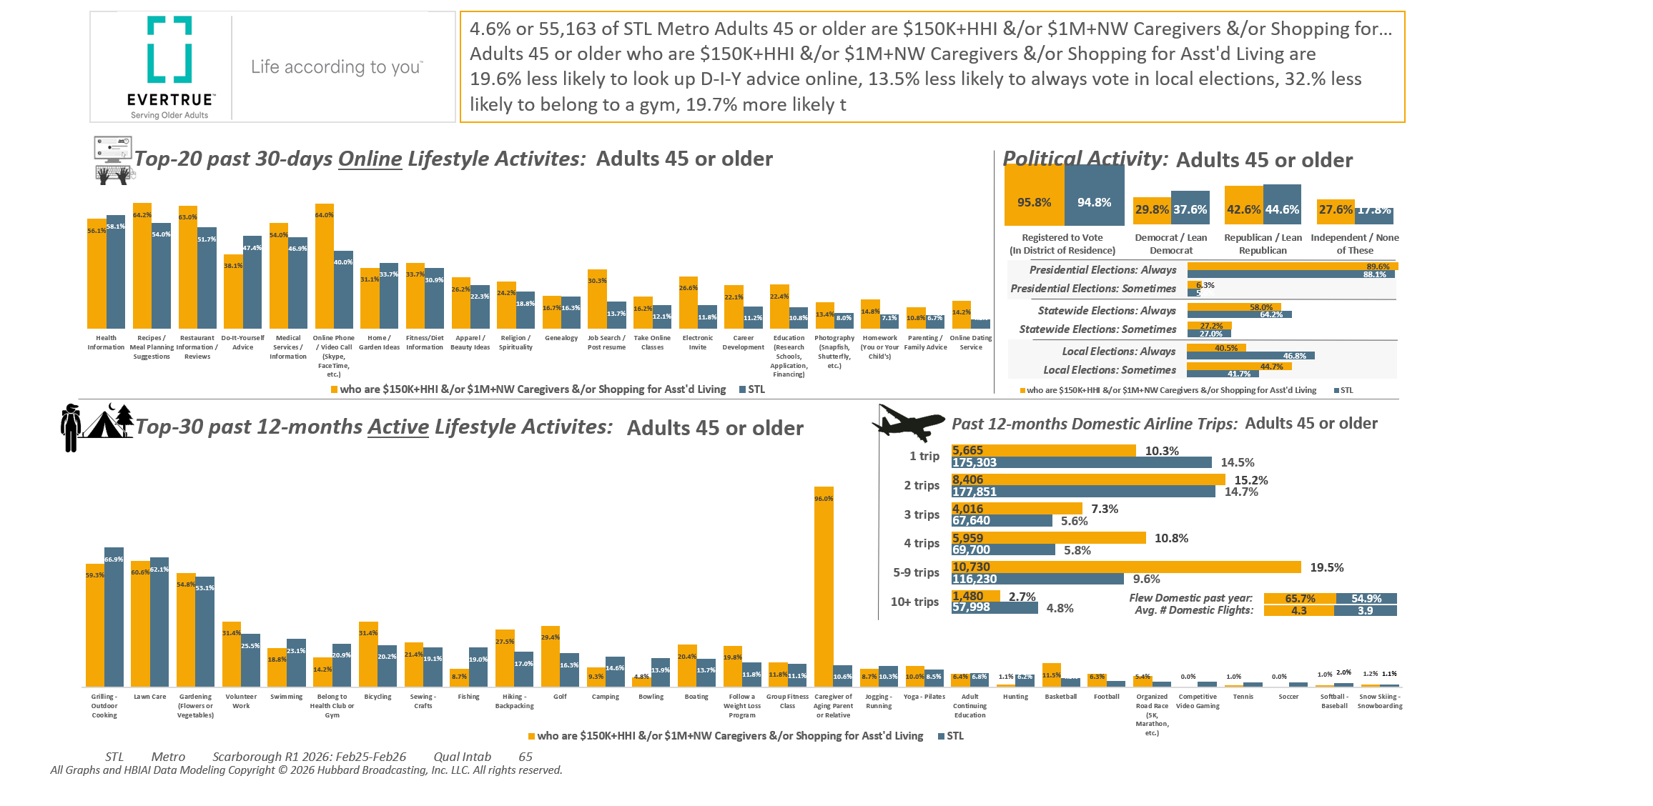
P45+ AND: [((Household income (HHLD): $150,000 - $249,999 OR Household income (HHLD): $250,000 or more OR Acxiom NetWorth Gold (HHLD): Less than or equal to $0 OR Acxiom NetWorth Gold (HHLD): $1,000,000 - $1,999,999 OR Acxiom NetWorth Gold (HHLD): $2,000,000 +) AND (Lifestyle characteristics: Caregiver of aging parent or relative OR Lifestyle changes household plans to do next 12 mths (HHLD): Shop for out-of-home nursing,assisted living,retire facility))]

Slide 5
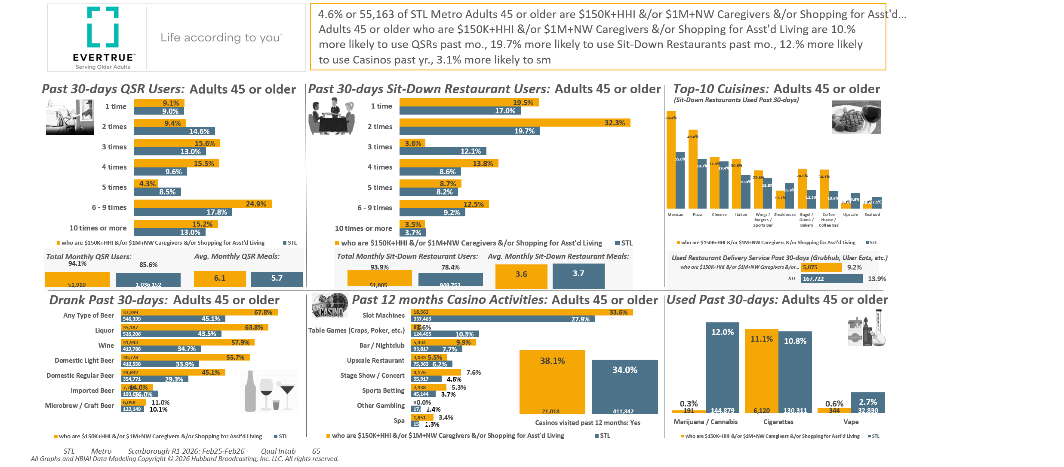
P45+ AND: [((Household income (HHLD): $150,000 - $249,999 OR Household income (HHLD): $250,000 or more OR Acxiom NetWorth Gold (HHLD): Less than or equal to $0 OR Acxiom NetWorth Gold (HHLD): $1,000,000 - $1,999,999 OR Acxiom NetWorth Gold (HHLD): $2,000,000 +) AND (Lifestyle characteristics: Caregiver of aging parent or relative OR Lifestyle changes household plans to do next 12 mths (HHLD): Shop for out-of-home nursing,assisted living,retire facility))]

Slide 6
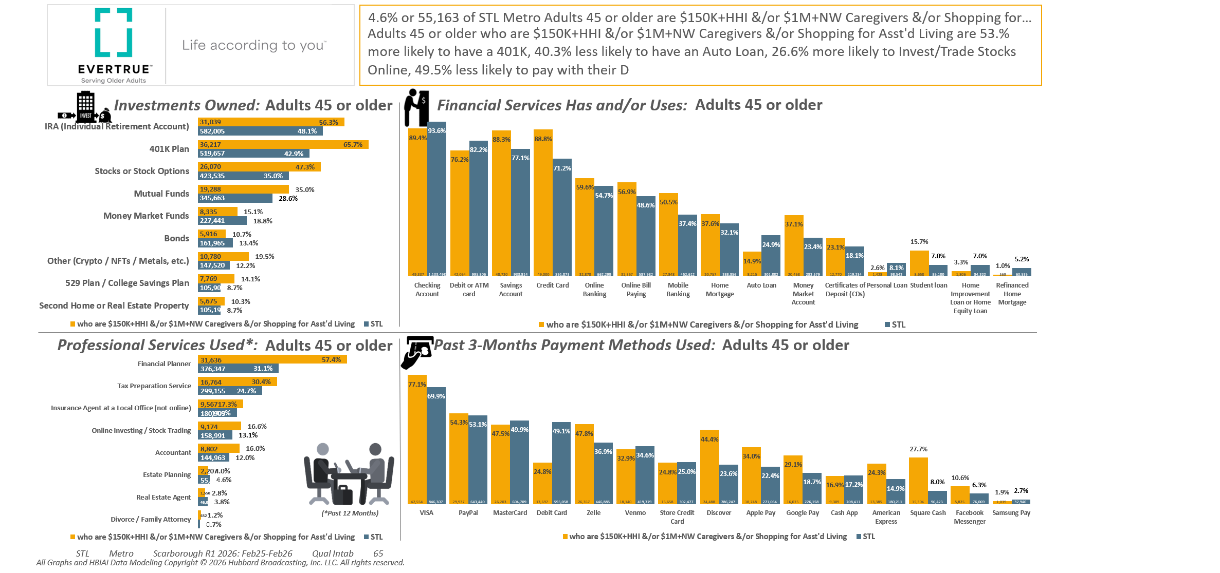
P45+ AND: [((Household income (HHLD): $150,000 - $249,999 OR Household income (HHLD): $250,000 or more OR Acxiom NetWorth Gold (HHLD): Less than or equal to $0 OR Acxiom NetWorth Gold (HHLD): $1,000,000 - $1,999,999 OR Acxiom NetWorth Gold (HHLD): $2,000,000 +) AND (Lifestyle characteristics: Caregiver of aging parent or relative OR Lifestyle changes household plans to do next 12 mths (HHLD): Shop for out-of-home nursing,assisted living,retire facility))]

Slide 7
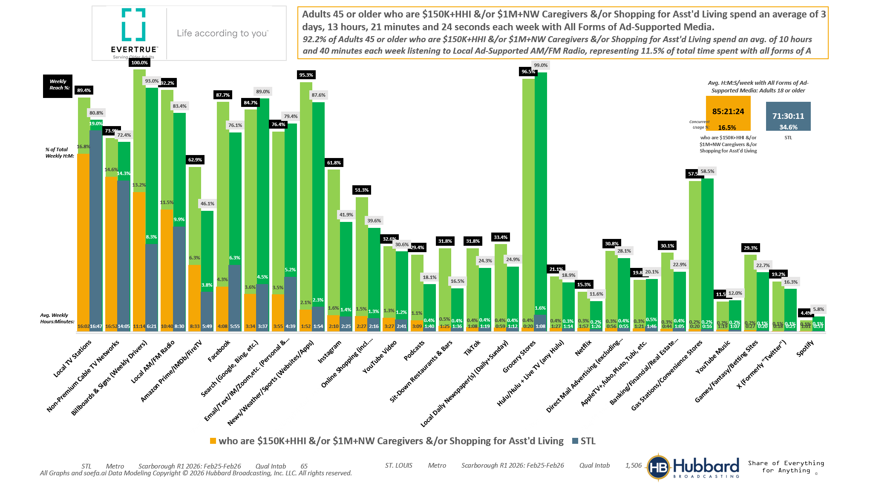
P45+ AND: [((Household income (HHLD): $150,000 - $249,999 OR Household income (HHLD): $250,000 or more OR Acxiom NetWorth Gold (HHLD): Less than or equal to $0 OR Acxiom NetWorth Gold (HHLD): $1,000,000 - $1,999,999 OR Acxiom NetWorth Gold (HHLD): $2,000,000 +) AND (Lifestyle characteristics: Caregiver of aging parent or relative OR Lifestyle changes household plans to do next 12 mths (HHLD): Shop for out-of-home nursing,assisted living,retire facility))]

Slide 8
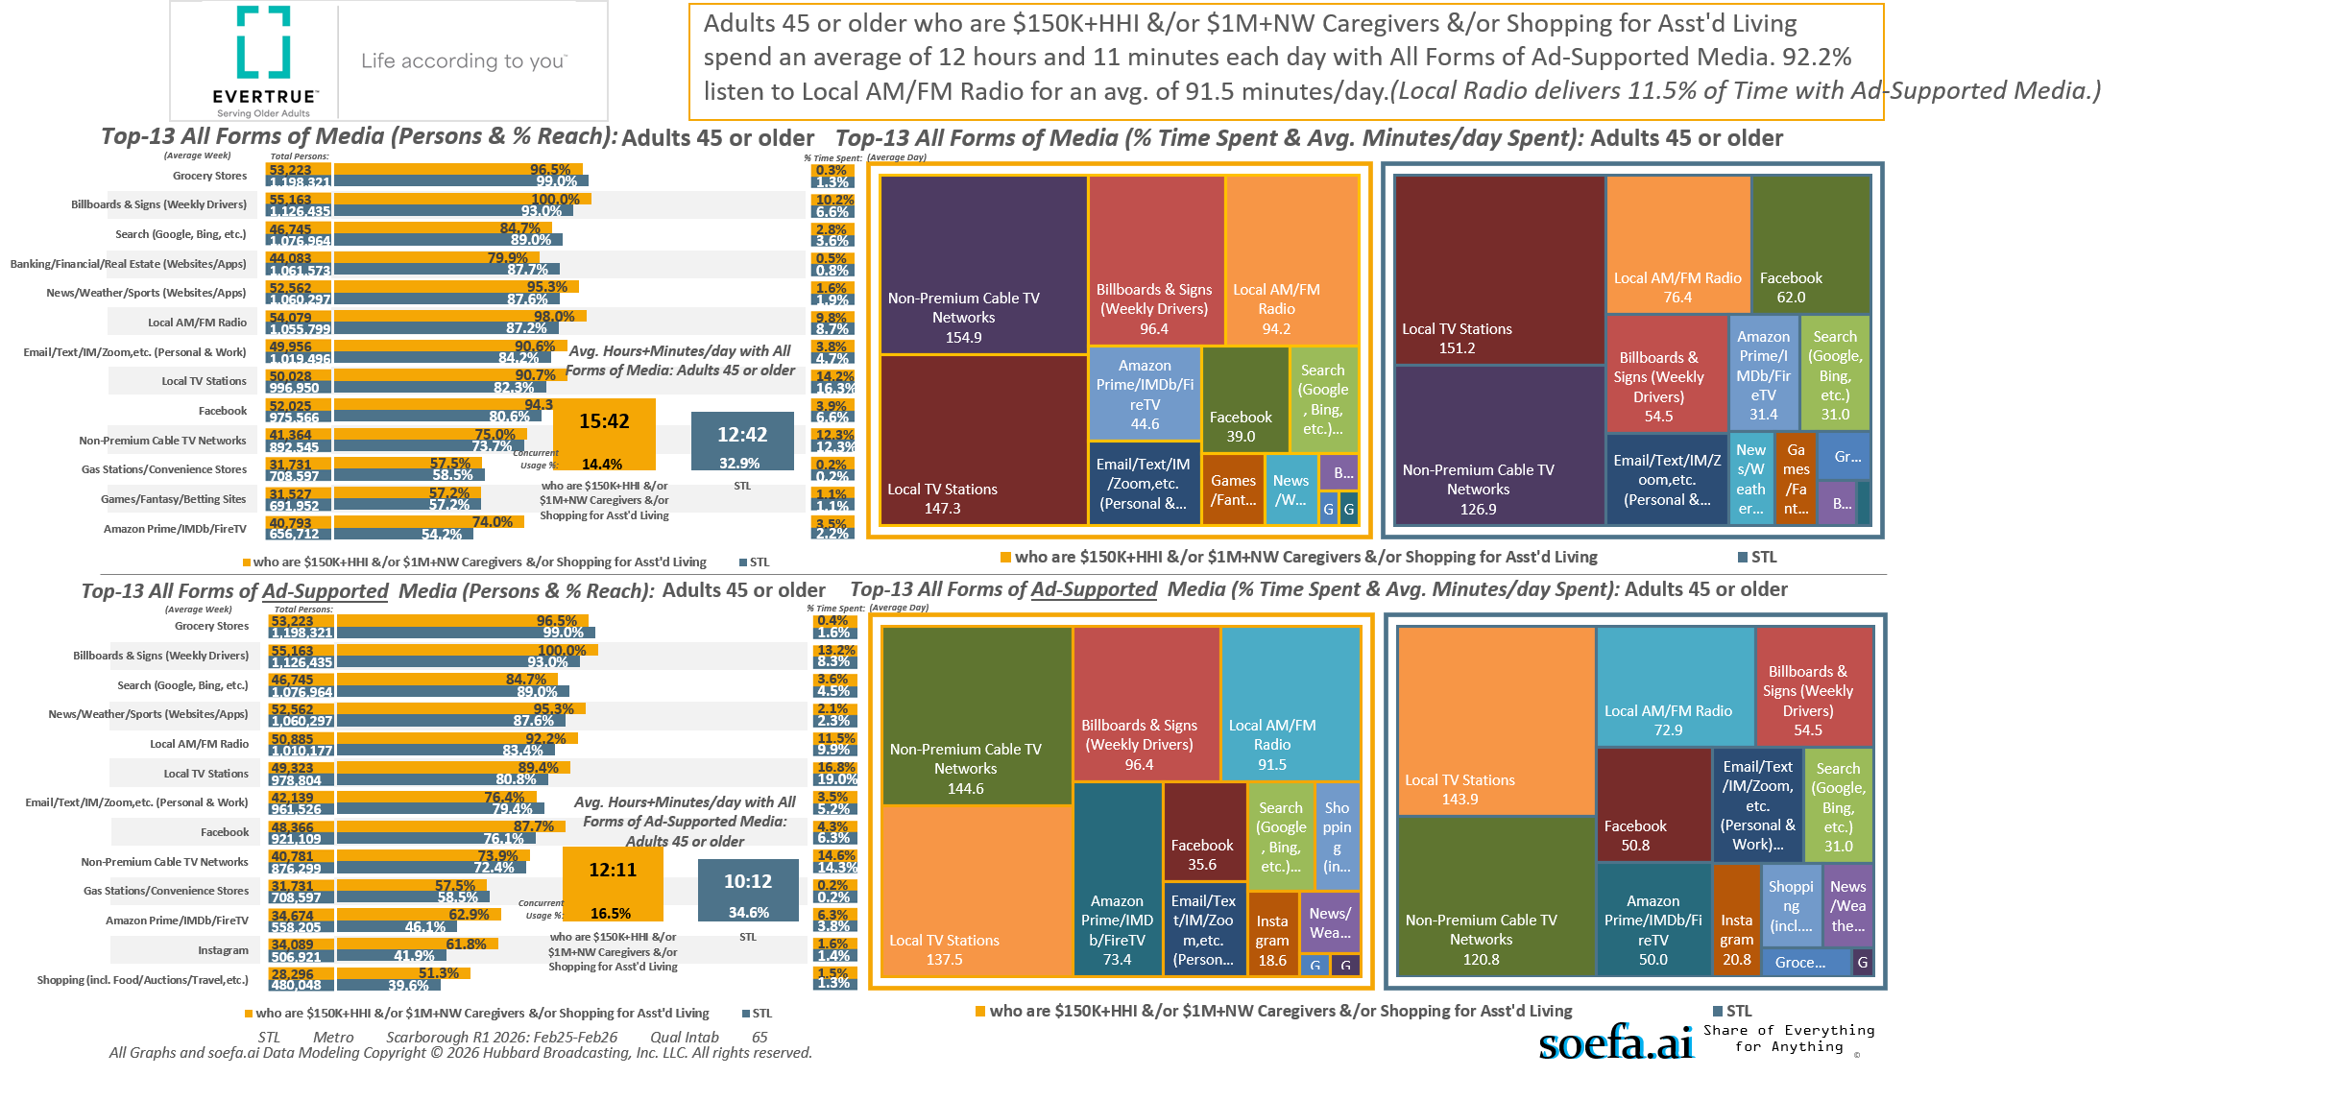
P45+ AND: [((Household income (HHLD): $150,000 - $249,999 OR Household income (HHLD): $250,000 or more OR Acxiom NetWorth Gold (HHLD): Less than or equal to $0 OR Acxiom NetWorth Gold (HHLD): $1,000,000 - $1,999,999 OR Acxiom NetWorth Gold (HHLD): $2,000,000 +) AND (Lifestyle characteristics: Caregiver of aging parent or relative OR Lifestyle changes household plans to do next 12 mths (HHLD): Shop for out-of-home nursing,assisted living,retire facility))]

Slide 9
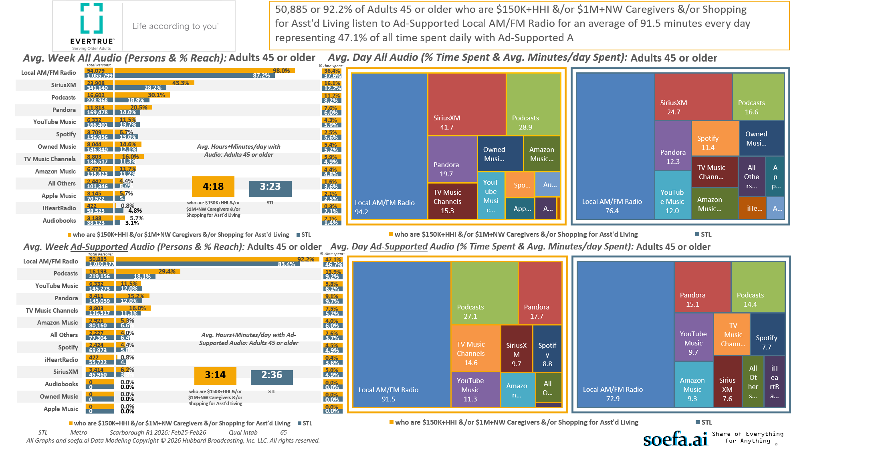
P45+ AND: [((Household income (HHLD): $150,000 - $249,999 OR Household income (HHLD): $250,000 or more OR Acxiom NetWorth Gold (HHLD): Less than or equal to $0 OR Acxiom NetWorth Gold (HHLD): $1,000,000 - $1,999,999 OR Acxiom NetWorth Gold (HHLD): $2,000,000 +) AND (Lifestyle characteristics: Caregiver of aging parent or relative OR Lifestyle changes household plans to do next 12 mths (HHLD): Shop for out-of-home nursing,assisted living,retire facility))]

Slide 10
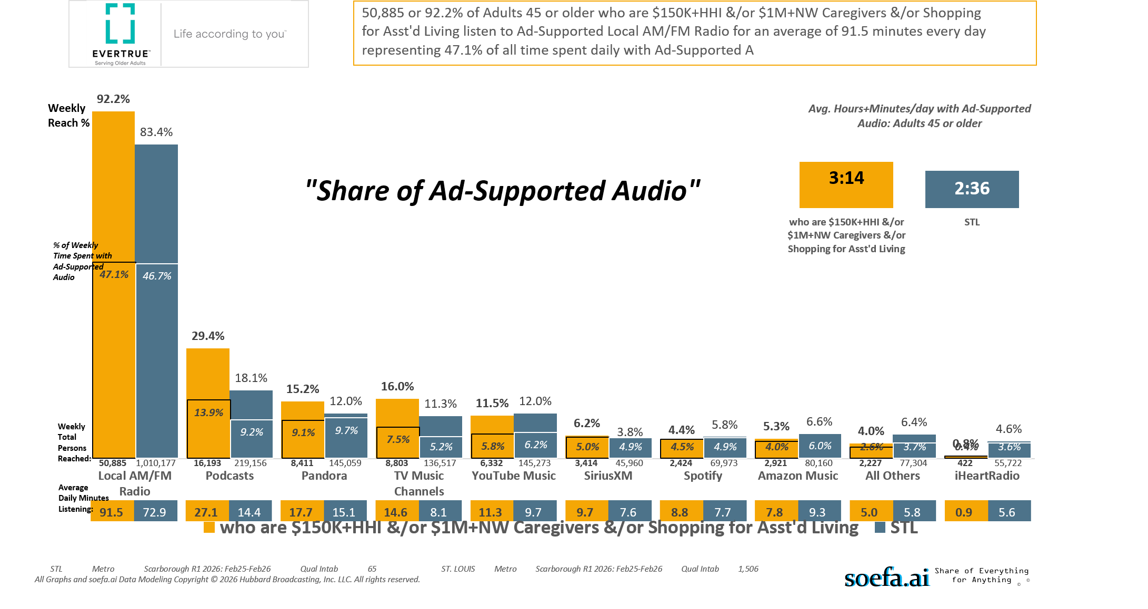
P45+ AND: [((Household income (HHLD): $150,000 - $249,999 OR Household income (HHLD): $250,000 or more OR Acxiom NetWorth Gold (HHLD): Less than or equal to $0 OR Acxiom NetWorth Gold (HHLD): $1,000,000 - $1,999,999 OR Acxiom NetWorth Gold (HHLD): $2,000,000 +) AND (Lifestyle characteristics: Caregiver of aging parent or relative OR Lifestyle changes household plans to do next 12 mths (HHLD): Shop for out-of-home nursing,assisted living,retire facility))]

Slide 11

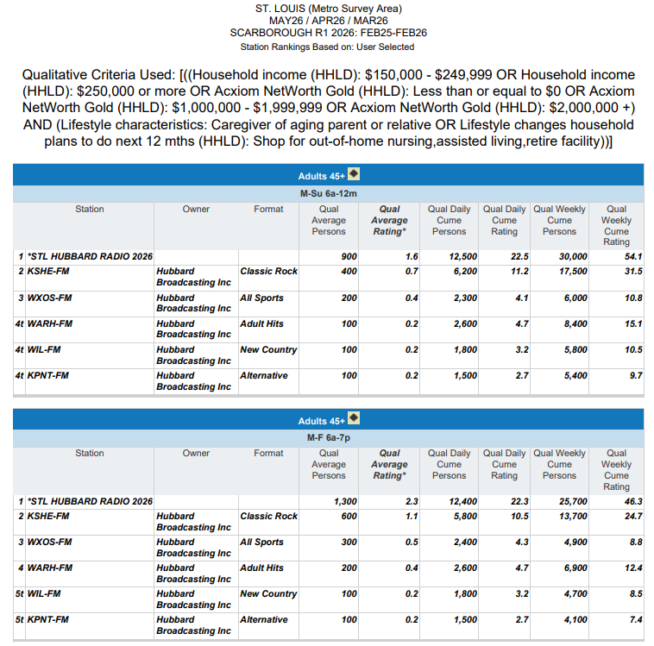

More than HALF (54.1% or 30,000) of
St. Louis Metro Area Age 45+ Adults with a
$150K+HHI and/or a $1Million+HH Net Worth
Who are CAREGIVERS of Aging Parents or
Loved Ones and/or are Shopping for an
ASSISTED LIVING FACILITY Listen to
HUBBARD RADIO every week.

Slide 12
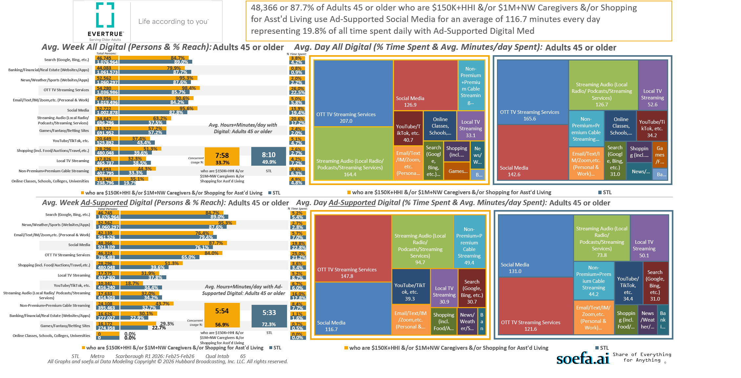
P45+ AND: [((Household income (HHLD): $150,000 - $249,999 OR Household income (HHLD): $250,000 or more OR Acxiom NetWorth Gold (HHLD): Less than or equal to $0 OR Acxiom NetWorth Gold (HHLD): $1,000,000 - $1,999,999 OR Acxiom NetWorth Gold (HHLD): $2,000,000 +) AND (Lifestyle characteristics: Caregiver of aging parent or relative OR Lifestyle changes household plans to do next 12 mths (HHLD): Shop for out-of-home nursing,assisted living,retire facility))]

Slide 13
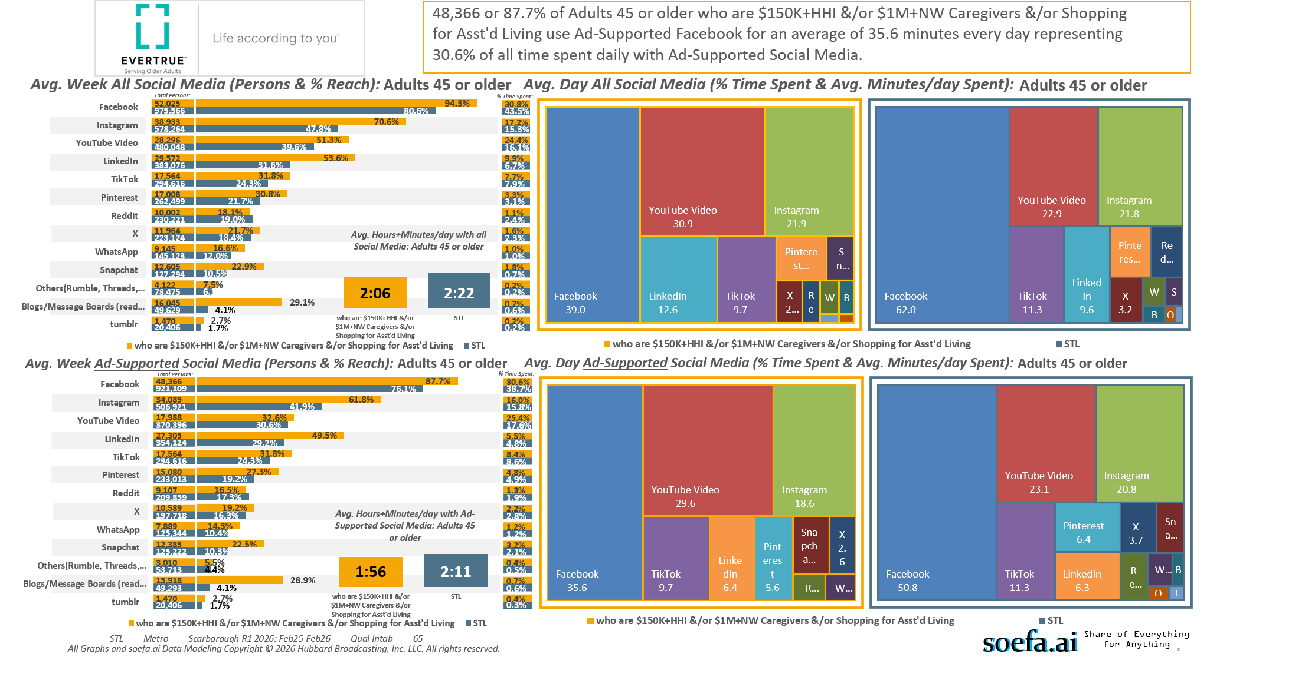
P45+ AND: [((Household income (HHLD): $150,000 - $249,999 OR Household income (HHLD): $250,000 or more OR Acxiom NetWorth Gold (HHLD): Less than or equal to $0 OR Acxiom NetWorth Gold (HHLD): $1,000,000 - $1,999,999 OR Acxiom NetWorth Gold (HHLD): $2,000,000 +) AND (Lifestyle characteristics: Caregiver of aging parent or relative OR Lifestyle changes household plans to do next 12 mths (HHLD): Shop for out-of-home nursing,assisted living,retire facility))]

Slide 14
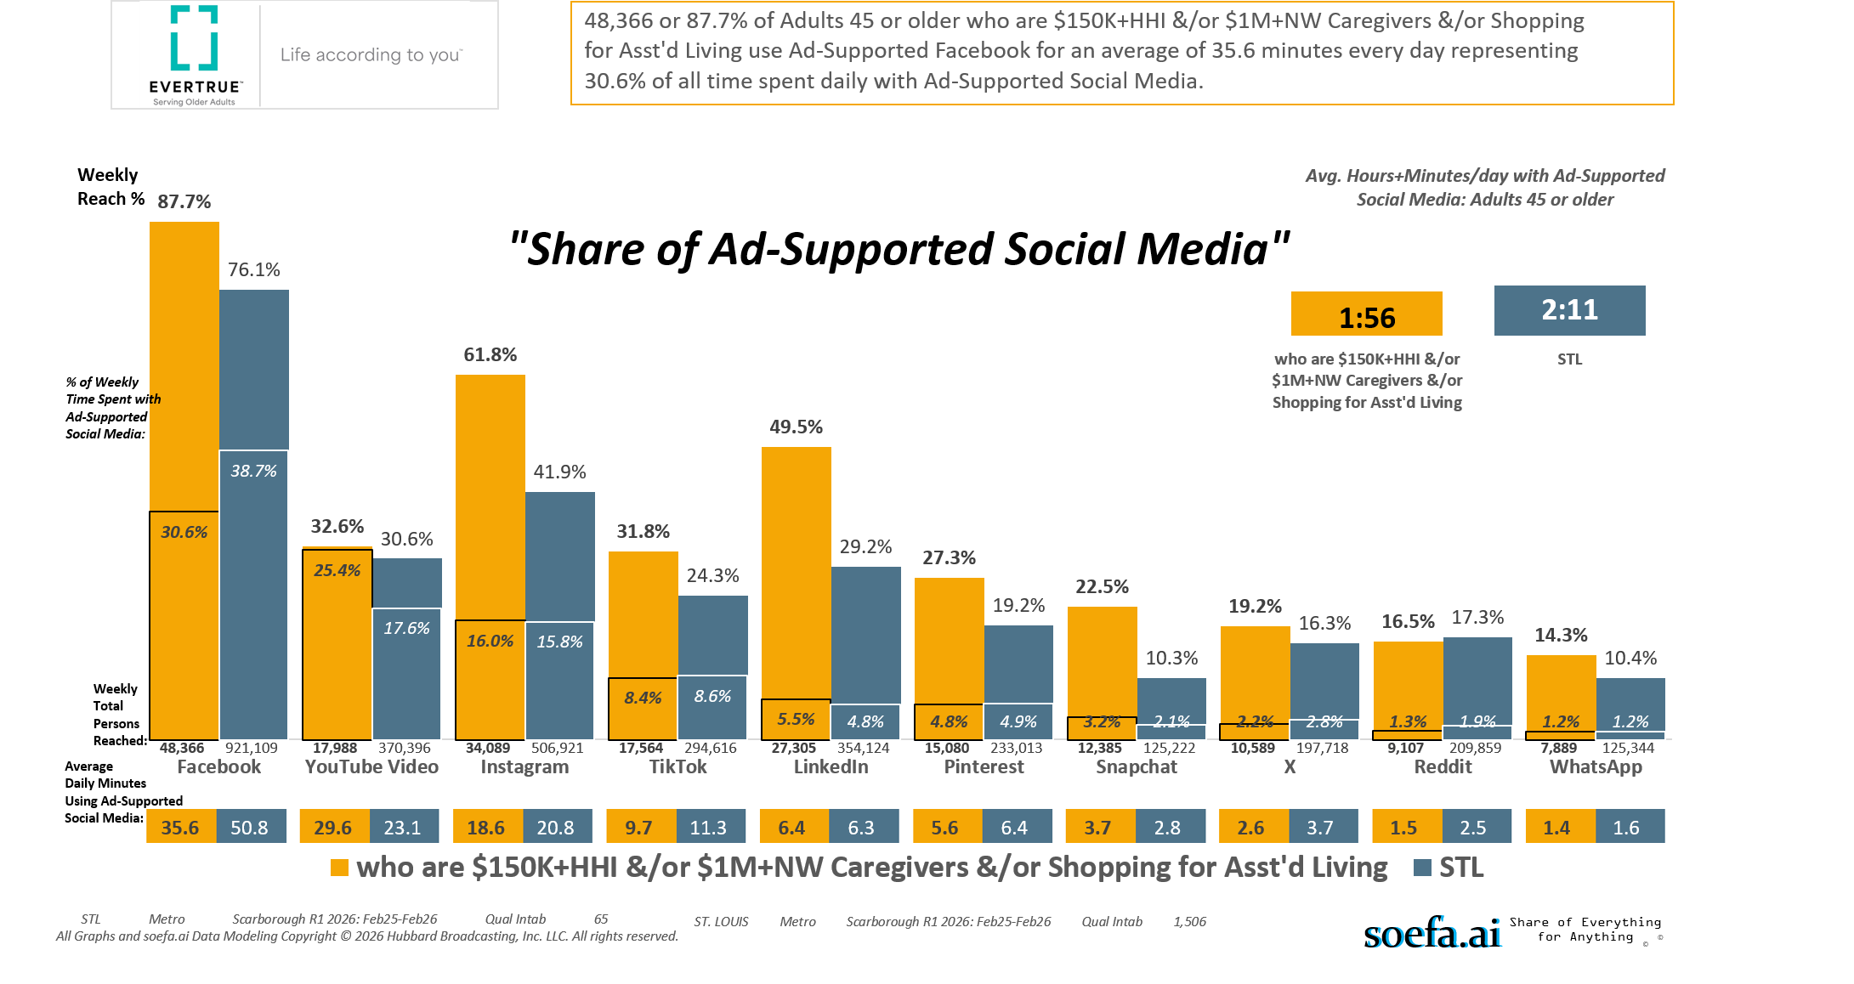
P45+ AND: [((Household income (HHLD): $150,000 - $249,999 OR Household income (HHLD): $250,000 or more OR Acxiom NetWorth Gold (HHLD): Less than or equal to $0 OR Acxiom NetWorth Gold (HHLD): $1,000,000 - $1,999,999 OR Acxiom NetWorth Gold (HHLD): $2,000,000 +) AND (Lifestyle characteristics: Caregiver of aging parent or relative OR Lifestyle changes household plans to do next 12 mths (HHLD): Shop for out-of-home nursing,assisted living,retire facility))]

Slide 15
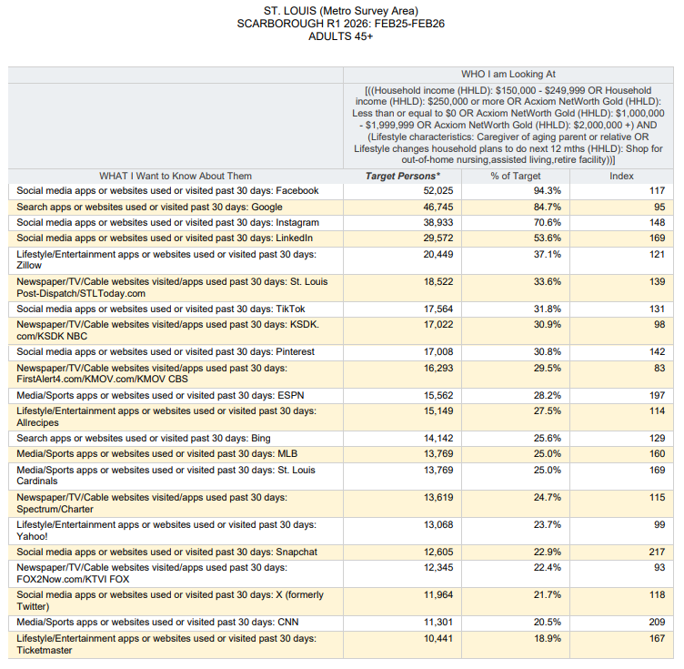
Top Websites/Apps Used by…
St. Louis Metro Area Age 45+ Adults with a
$150K+HHI and/or a $1Million+HH Net Worth
Who are CAREGIVERS of Aging Parents or
Loved Ones and/or are Shopping for an
ASSISTED LIVING FACILITY.

Slide 16
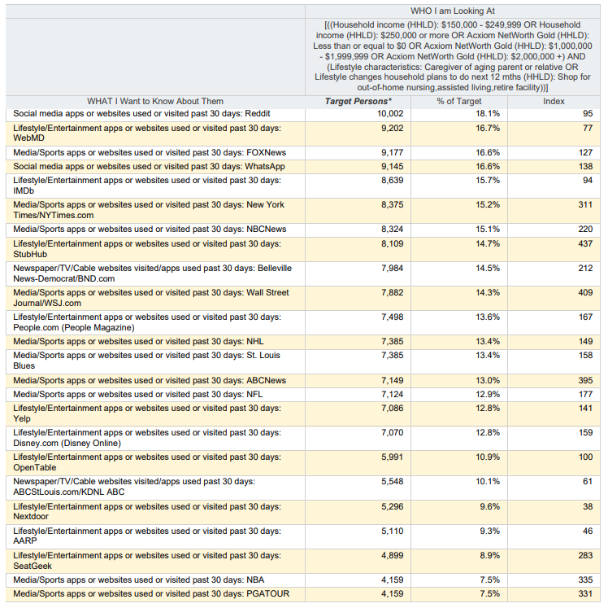
More Top Websites/Apps Used by…
St. Louis Metro Area Age 45+ Adults with a
$150K+HHI and/or a $1Million+HH Net Worth
Who are CAREGIVERS of Aging Parents or
Loved Ones and/or are Shopping for an
ASSISTED LIVING FACILITY.

Slide 17
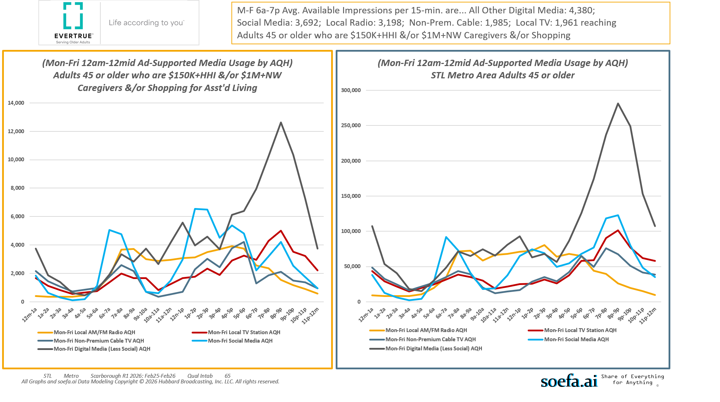
P45+ AND: [((Household income (HHLD): $150,000 - $249,999 OR Household income (HHLD): $250,000 or more OR Acxiom NetWorth Gold (HHLD): Less than or equal to $0 OR Acxiom NetWorth Gold (HHLD): $1,000,000 - $1,999,999 OR Acxiom NetWorth Gold (HHLD): $2,000,000 +) AND (Lifestyle characteristics: Caregiver of aging parent or relative OR Lifestyle changes household plans to do next 12 mths (HHLD): Shop for out-of-home nursing,assisted living,retire facility))]

Slide 18
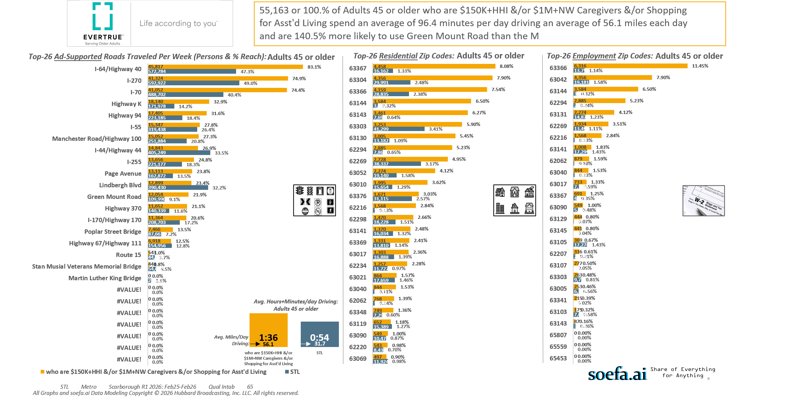
P45+ AND: [((Household income (HHLD): $150,000 - $249,999 OR Household income (HHLD): $250,000 or more OR Acxiom NetWorth Gold (HHLD): Less than or equal to $0 OR Acxiom NetWorth Gold (HHLD): $1,000,000 - $1,999,999 OR Acxiom NetWorth Gold (HHLD): $2,000,000 +) AND (Lifestyle characteristics: Caregiver of aging parent or relative OR Lifestyle changes household plans to do next 12 mths (HHLD): Shop for out-of-home nursing,assisted living,retire facility))]

Slide 19
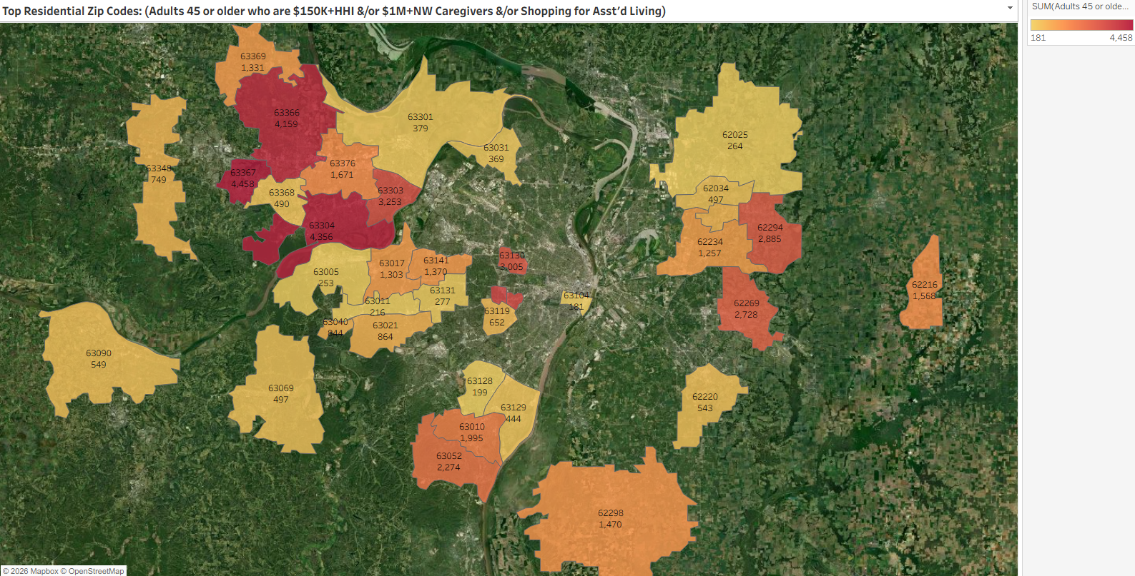
Zip Code | Adults 45 or older who are $150K+HHI &/or $1M+NW Caregivers &/or Shopping for Asst'd Living
63367 | 4458
63304 | 4356
63366 | 4159
63144 | 3584
63143 | 3461
63303 | 3253
63130 | 3005
62294 | 2885
62269 | 2728
63052 | 2274
63010 | 1995
63376 | 1671
62216 | 1568
62298 | 1470
63141 | 1370
63369 | 1331
63017 | 1303
62234 | 1257
63021 | 864
63040 | 844
62062 | 768
63348 | 749
63119 | 652
63090 | 549
62220 | 543
63069 | 497
62034 | 497
63368 | 490
63129 | 444
63301 | 379
63031 | 369
63131 | 277
62025 | 264
63005 | 253
63011 | 216
63128 | 199
63104 | 181
P45+ AND: [((Household income (HHLD): $150,000 - $249,999 OR Household income (HHLD): $250,000 or more OR Acxiom NetWorth Gold (HHLD): Less than or equal to $0 OR Acxiom NetWorth Gold (HHLD): $1,000,000 - $1,999,999 OR Acxiom NetWorth Gold (HHLD): $2,000,000 +) AND (Lifestyle characteristics: Caregiver of aging parent or relative OR Lifestyle changes household plans to do next 12 mths (HHLD): Shop for out-of-home nursing,assisted living,retire facility))]

