Slide 1
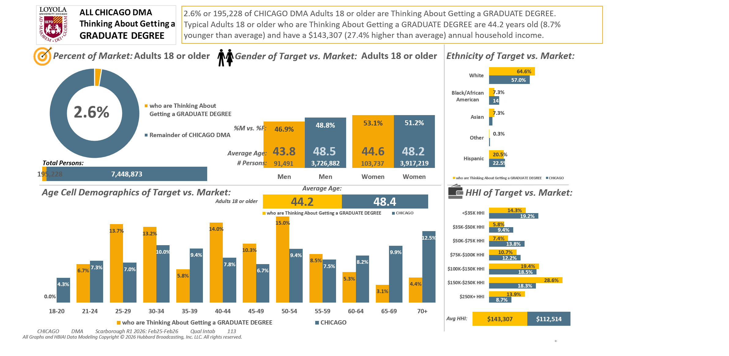





[(((Level of education: Bachelor's degree (BA, BS, etc.) OR Level of education: Some postgraduate (no advanced degree)) AND Ways used Internet/apps past 30 days on computer:Lifestyle: Education (research schools, application, financing)) AND Currently enrolled/attending classes at a college/university: No)]

Slide 2
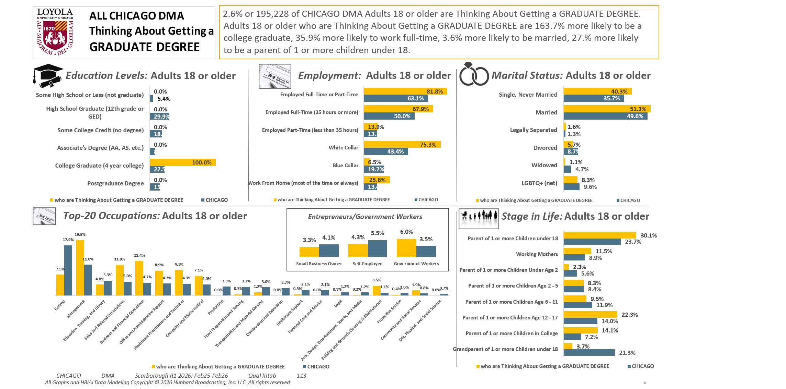
[(((Level of education: Bachelor's degree (BA, BS, etc.) OR Level of education: Some postgraduate (no advanced degree)) AND Ways used Internet/apps past 30 days on computer:Lifestyle: Education (research schools, application, financing)) AND Currently enrolled/attending classes at a college/university: No)]

Slide 3
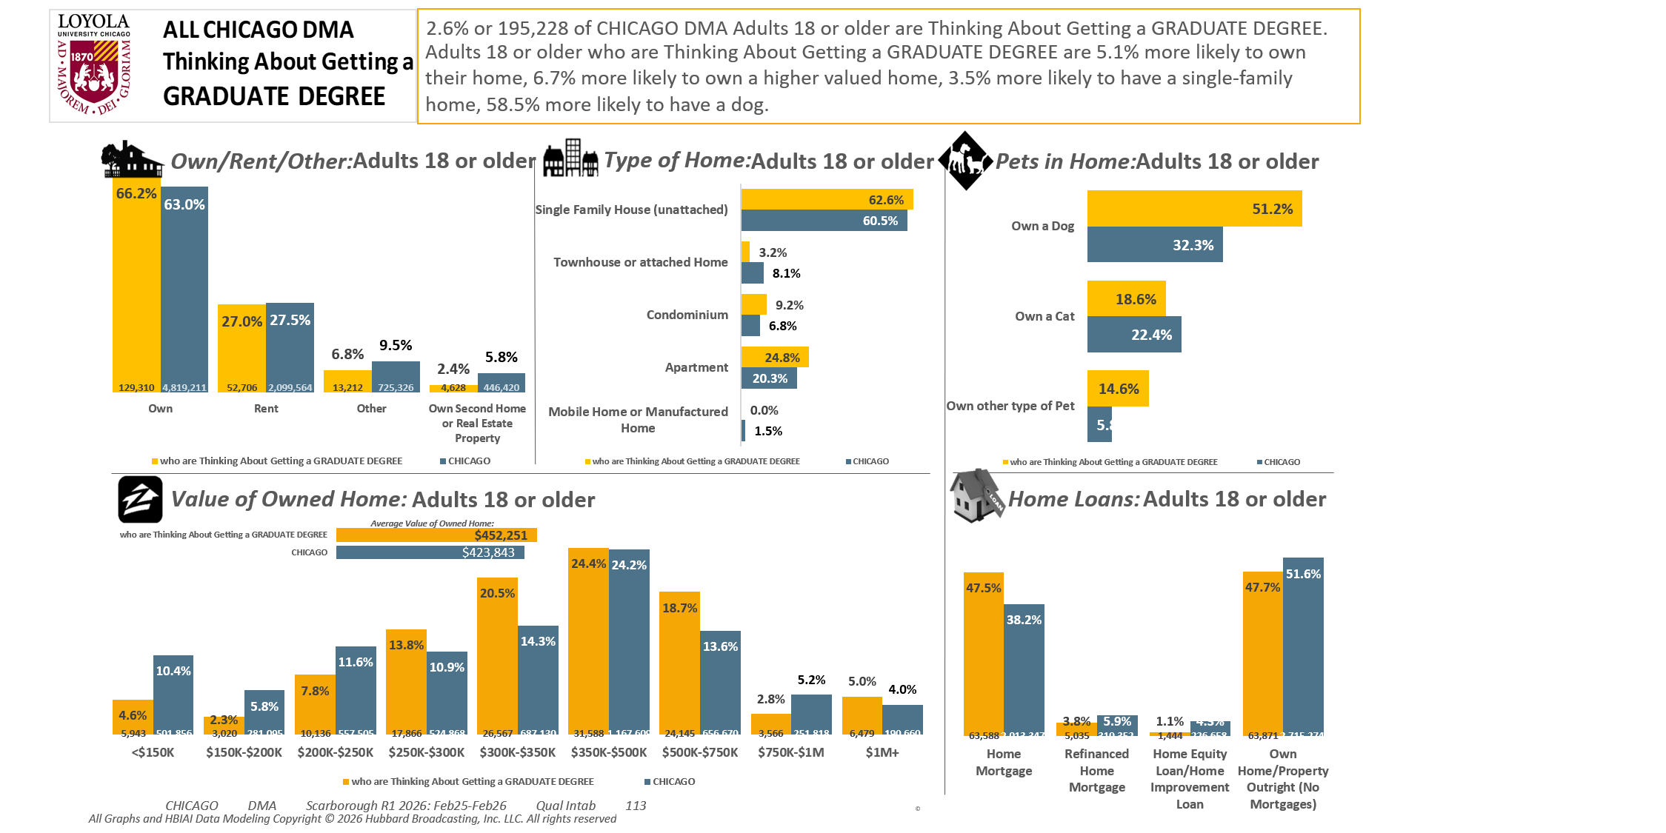
[(((Level of education: Bachelor's degree (BA, BS, etc.) OR Level of education: Some postgraduate (no advanced degree)) AND Ways used Internet/apps past 30 days on computer:Lifestyle: Education (research schools, application, financing)) AND Currently enrolled/attending classes at a college/university: No)]

Slide 4
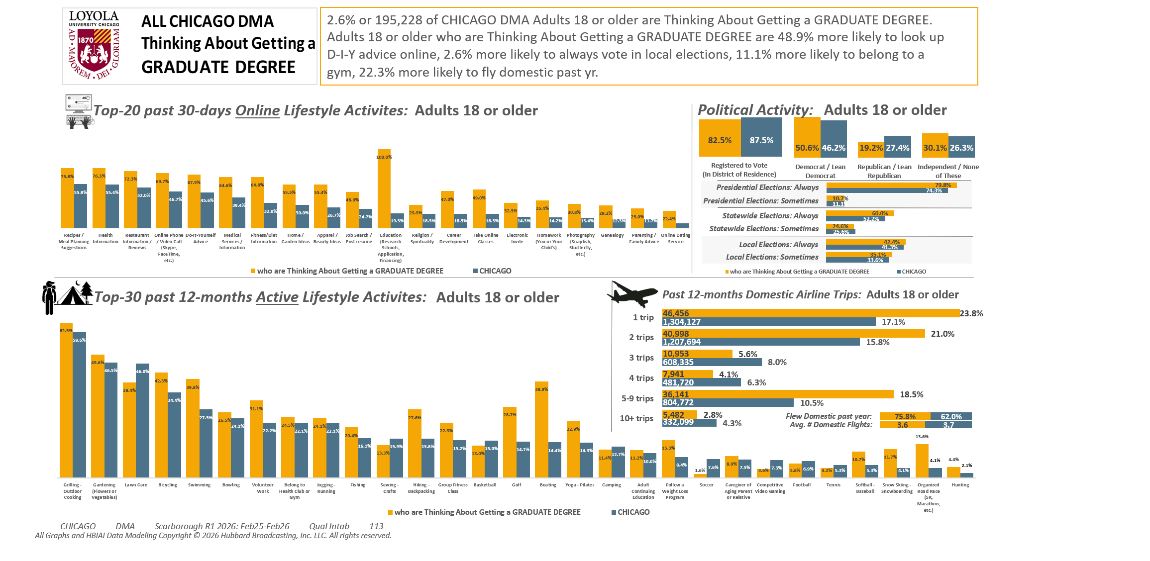
[(((Level of education: Bachelor's degree (BA, BS, etc.) OR Level of education: Some postgraduate (no advanced degree)) AND Ways used Internet/apps past 30 days on computer:Lifestyle: Education (research schools, application, financing)) AND Currently enrolled/attending classes at a college/university: No)]

Slide 5
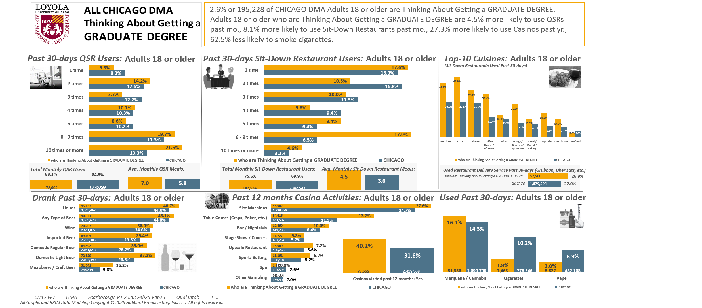
[(((Level of education: Bachelor's degree (BA, BS, etc.) OR Level of education: Some postgraduate (no advanced degree)) AND Ways used Internet/apps past 30 days on computer:Lifestyle: Education (research schools, application, financing)) AND Currently enrolled/attending classes at a college/university: No)]

Slide 6
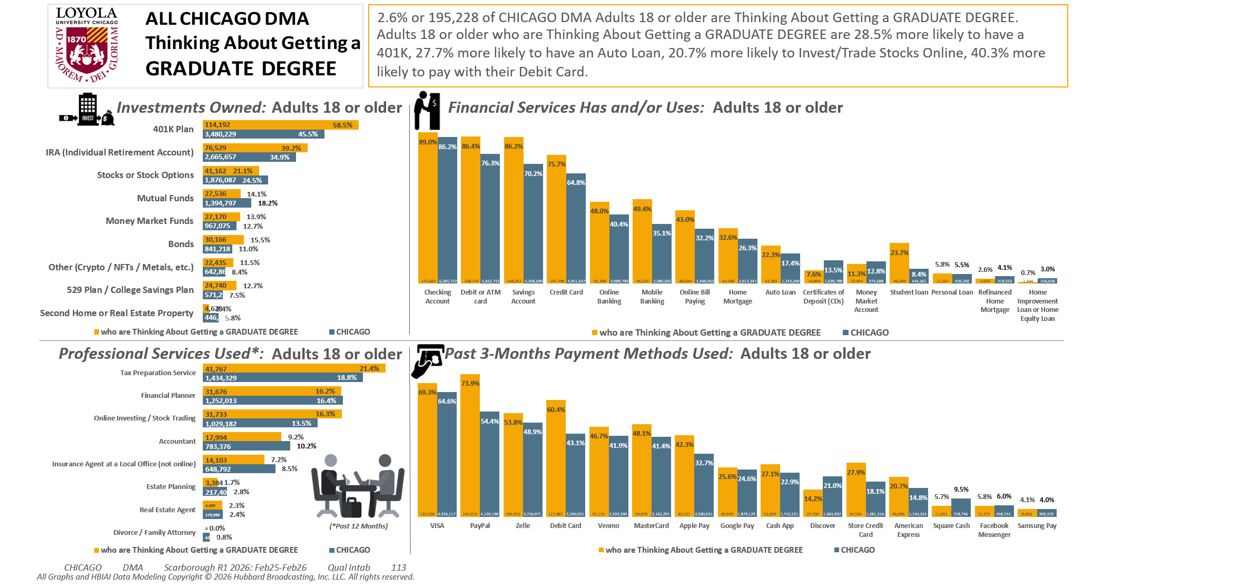
[(((Level of education: Bachelor's degree (BA, BS, etc.) OR Level of education: Some postgraduate (no advanced degree)) AND Ways used Internet/apps past 30 days on computer:Lifestyle: Education (research schools, application, financing)) AND Currently enrolled/attending classes at a college/university: No)]

Slide 7
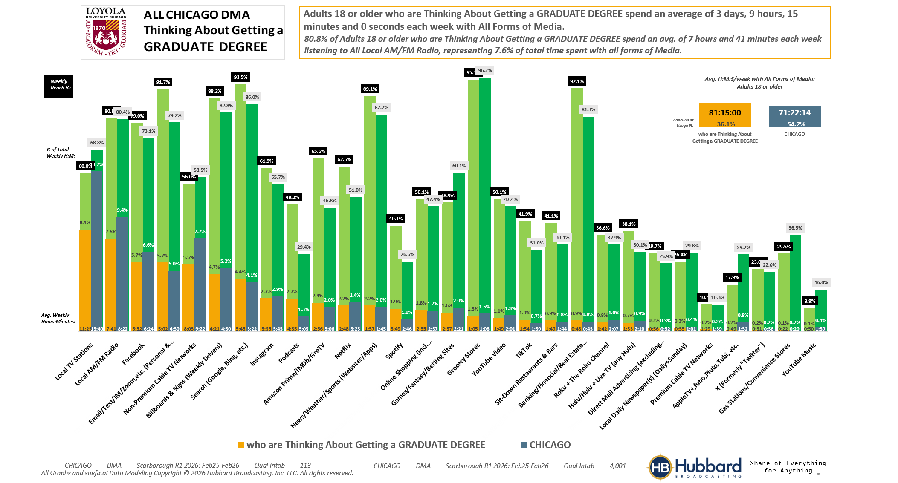

[(((Level of education: Bachelor's degree (BA, BS, etc.) OR Level of education: Some postgraduate (no advanced degree)) AND Ways used Internet/apps past 30 days on computer:Lifestyle: Education (research schools, application, financing)) AND Currently enrolled/attending classes at a college/university: No)]

Slide 8
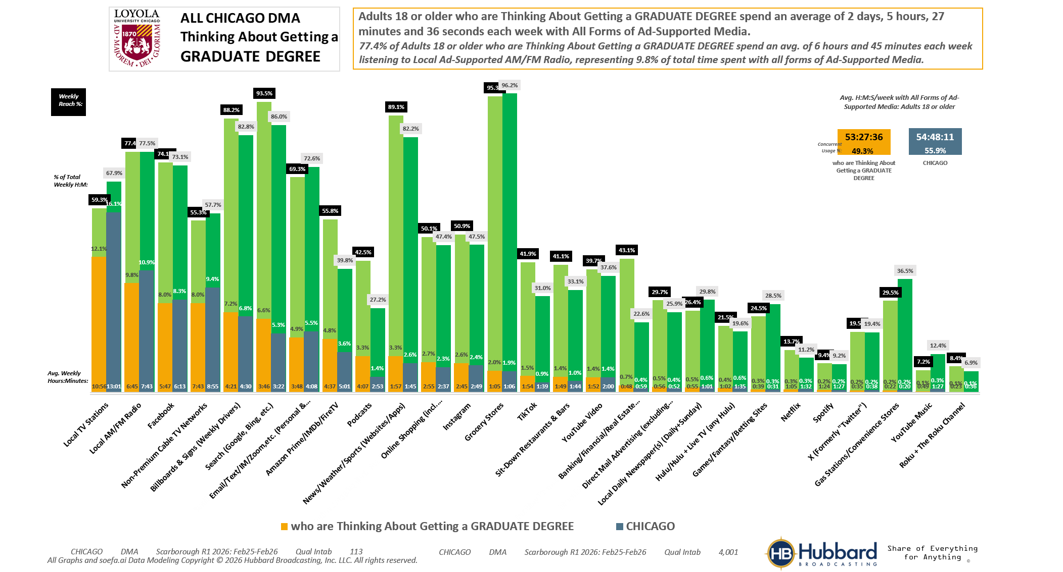
[(((Level of education: Bachelor's degree (BA, BS, etc.) OR Level of education: Some postgraduate (no advanced degree)) AND Ways used Internet/apps past 30 days on computer:Lifestyle: Education (research schools, application, financing)) AND Currently enrolled/attending classes at a college/university: No)]

Slide 9
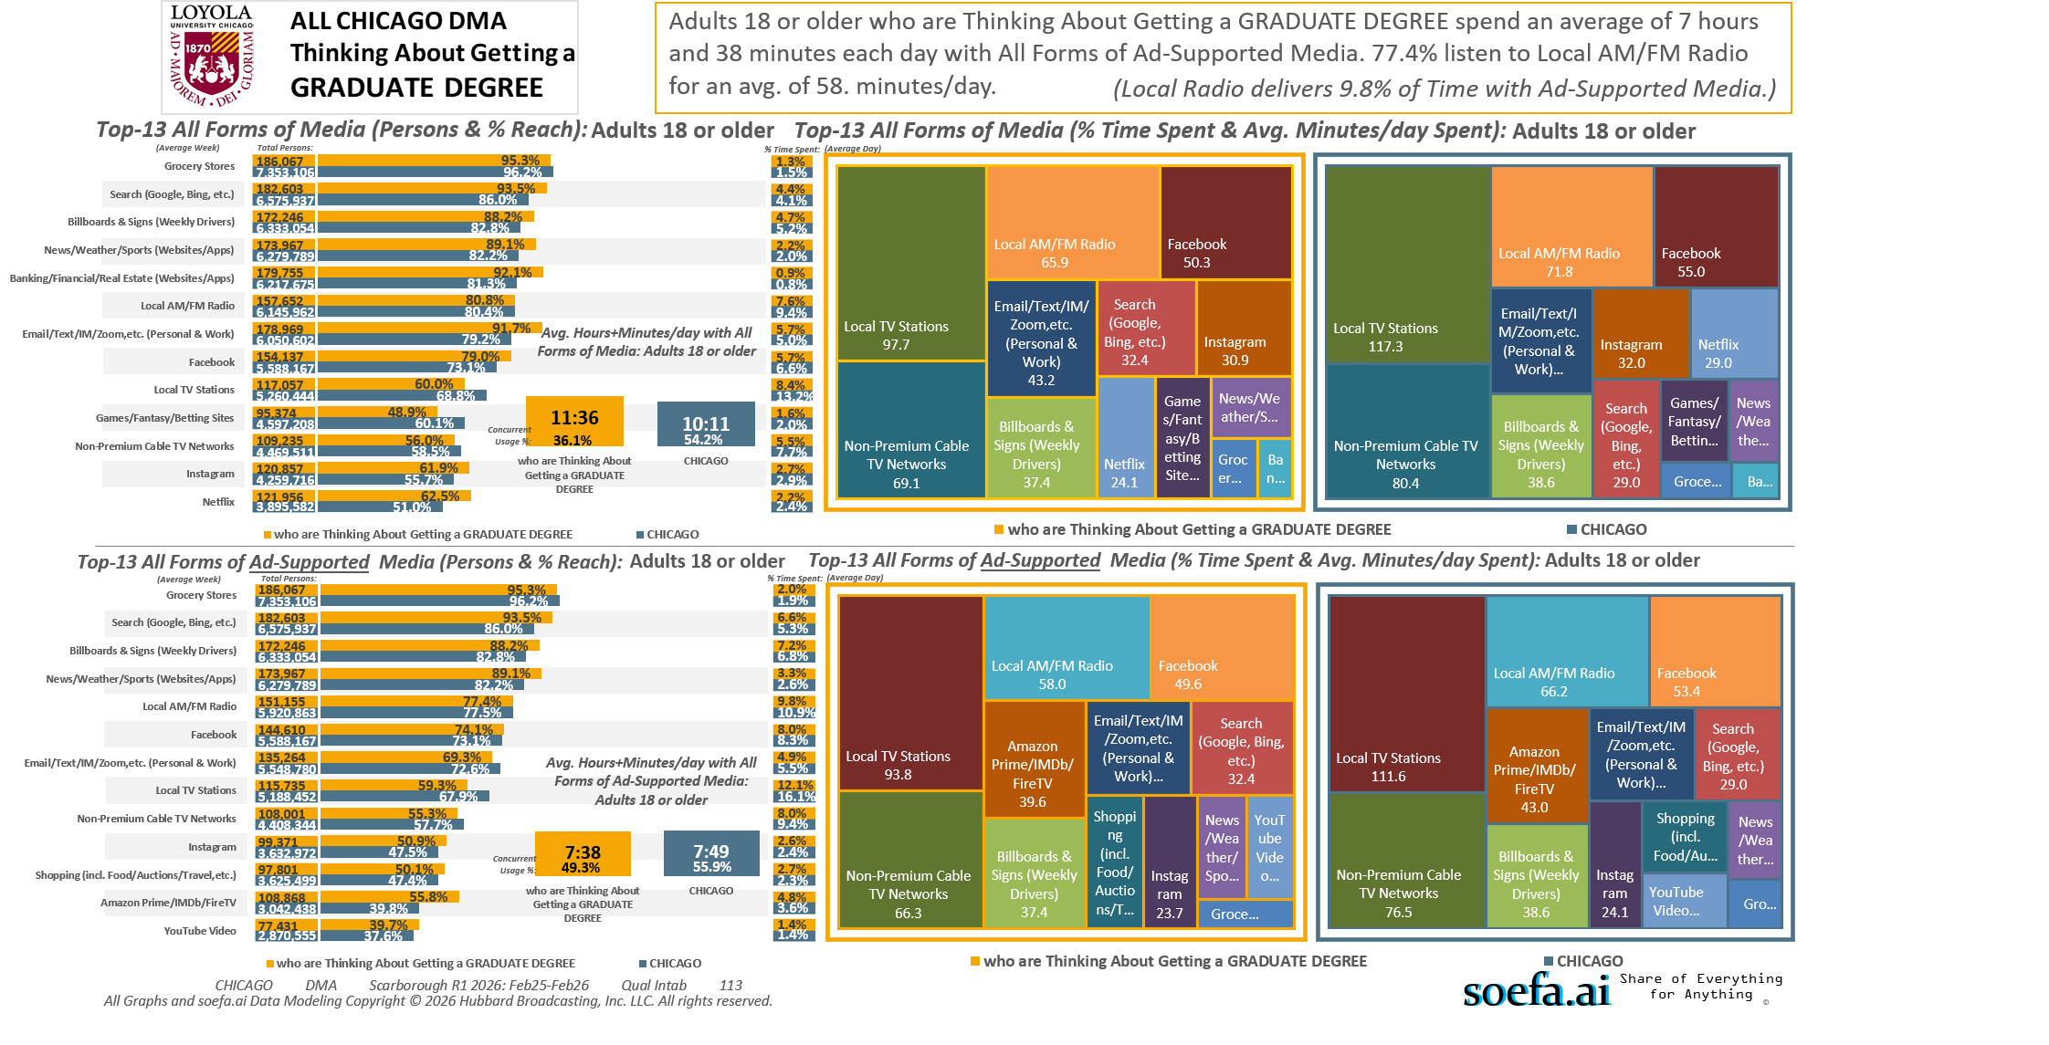
[(((Level of education: Bachelor's degree (BA, BS, etc.) OR Level of education: Some postgraduate (no advanced degree)) AND Ways used Internet/apps past 30 days on computer:Lifestyle: Education (research schools, application, financing)) AND Currently enrolled/attending classes at a college/university: No)]

Slide 10
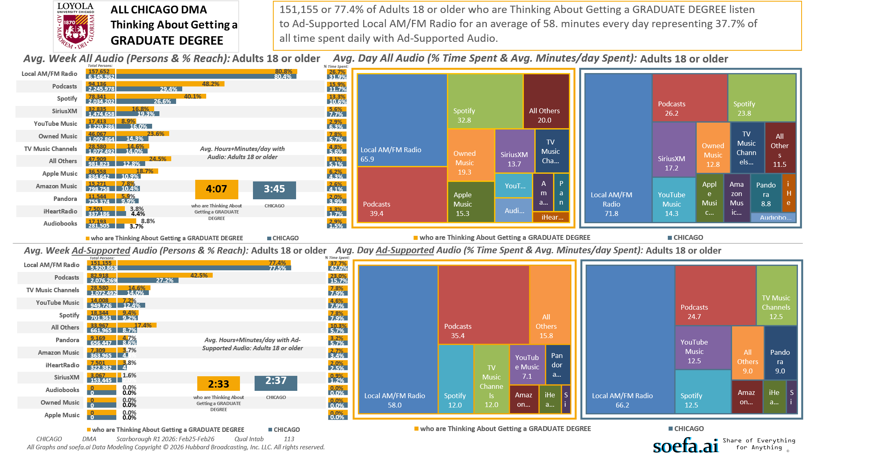
[(((Level of education: Bachelor's degree (BA, BS, etc.) OR Level of education: Some postgraduate (no advanced degree)) AND Ways used Internet/apps past 30 days on computer:Lifestyle: Education (research schools, application, financing)) AND Currently enrolled/attending classes at a college/university: No)]

Slide 11
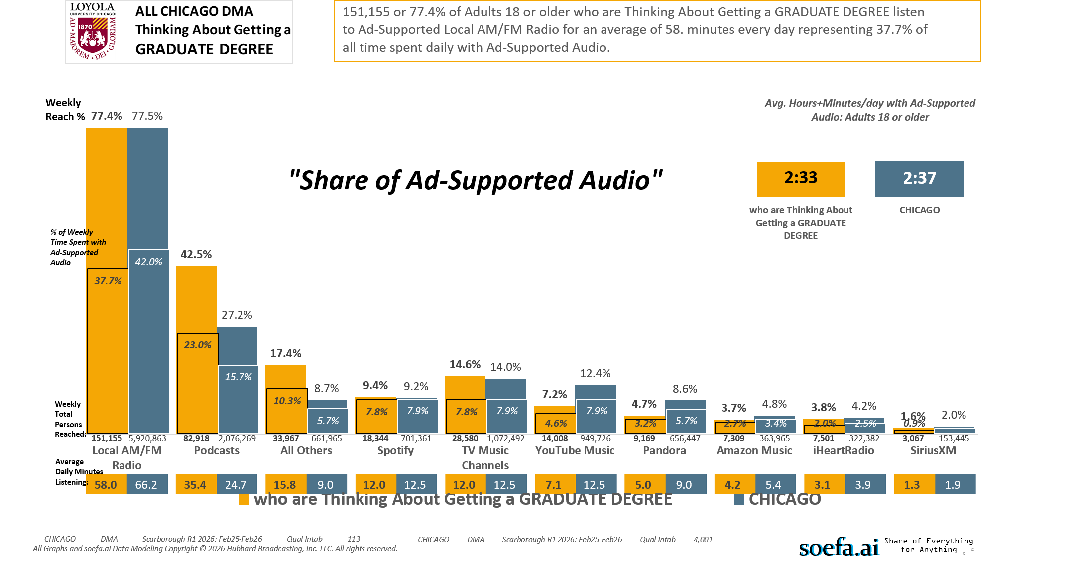
[(((Level of education: Bachelor's degree (BA, BS, etc.) OR Level of education: Some postgraduate (no advanced degree)) AND Ways used Internet/apps past 30 days on computer:Lifestyle: Education (research schools, application, financing)) AND Currently enrolled/attending classes at a college/university: No)]

Slide 12
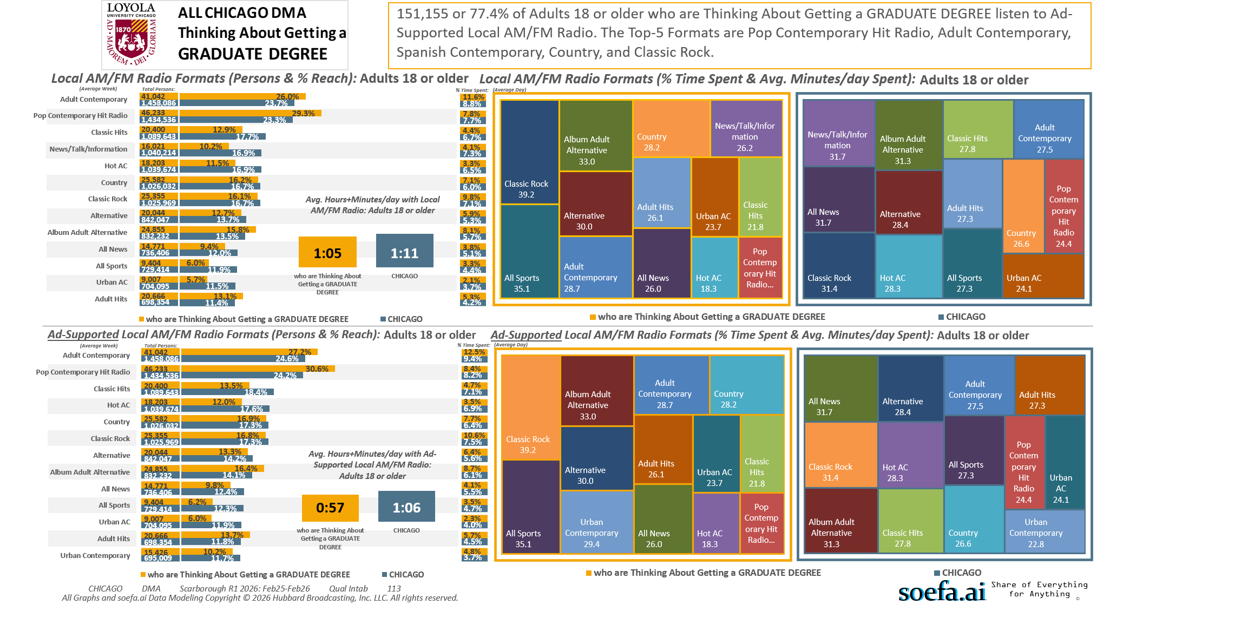
[(((Level of education: Bachelor's degree (BA, BS, etc.) OR Level of education: Some postgraduate (no advanced degree)) AND Ways used Internet/apps past 30 days on computer:Lifestyle: Education (research schools, application, financing)) AND Currently enrolled/attending classes at a college/university: No)]

Slide 13
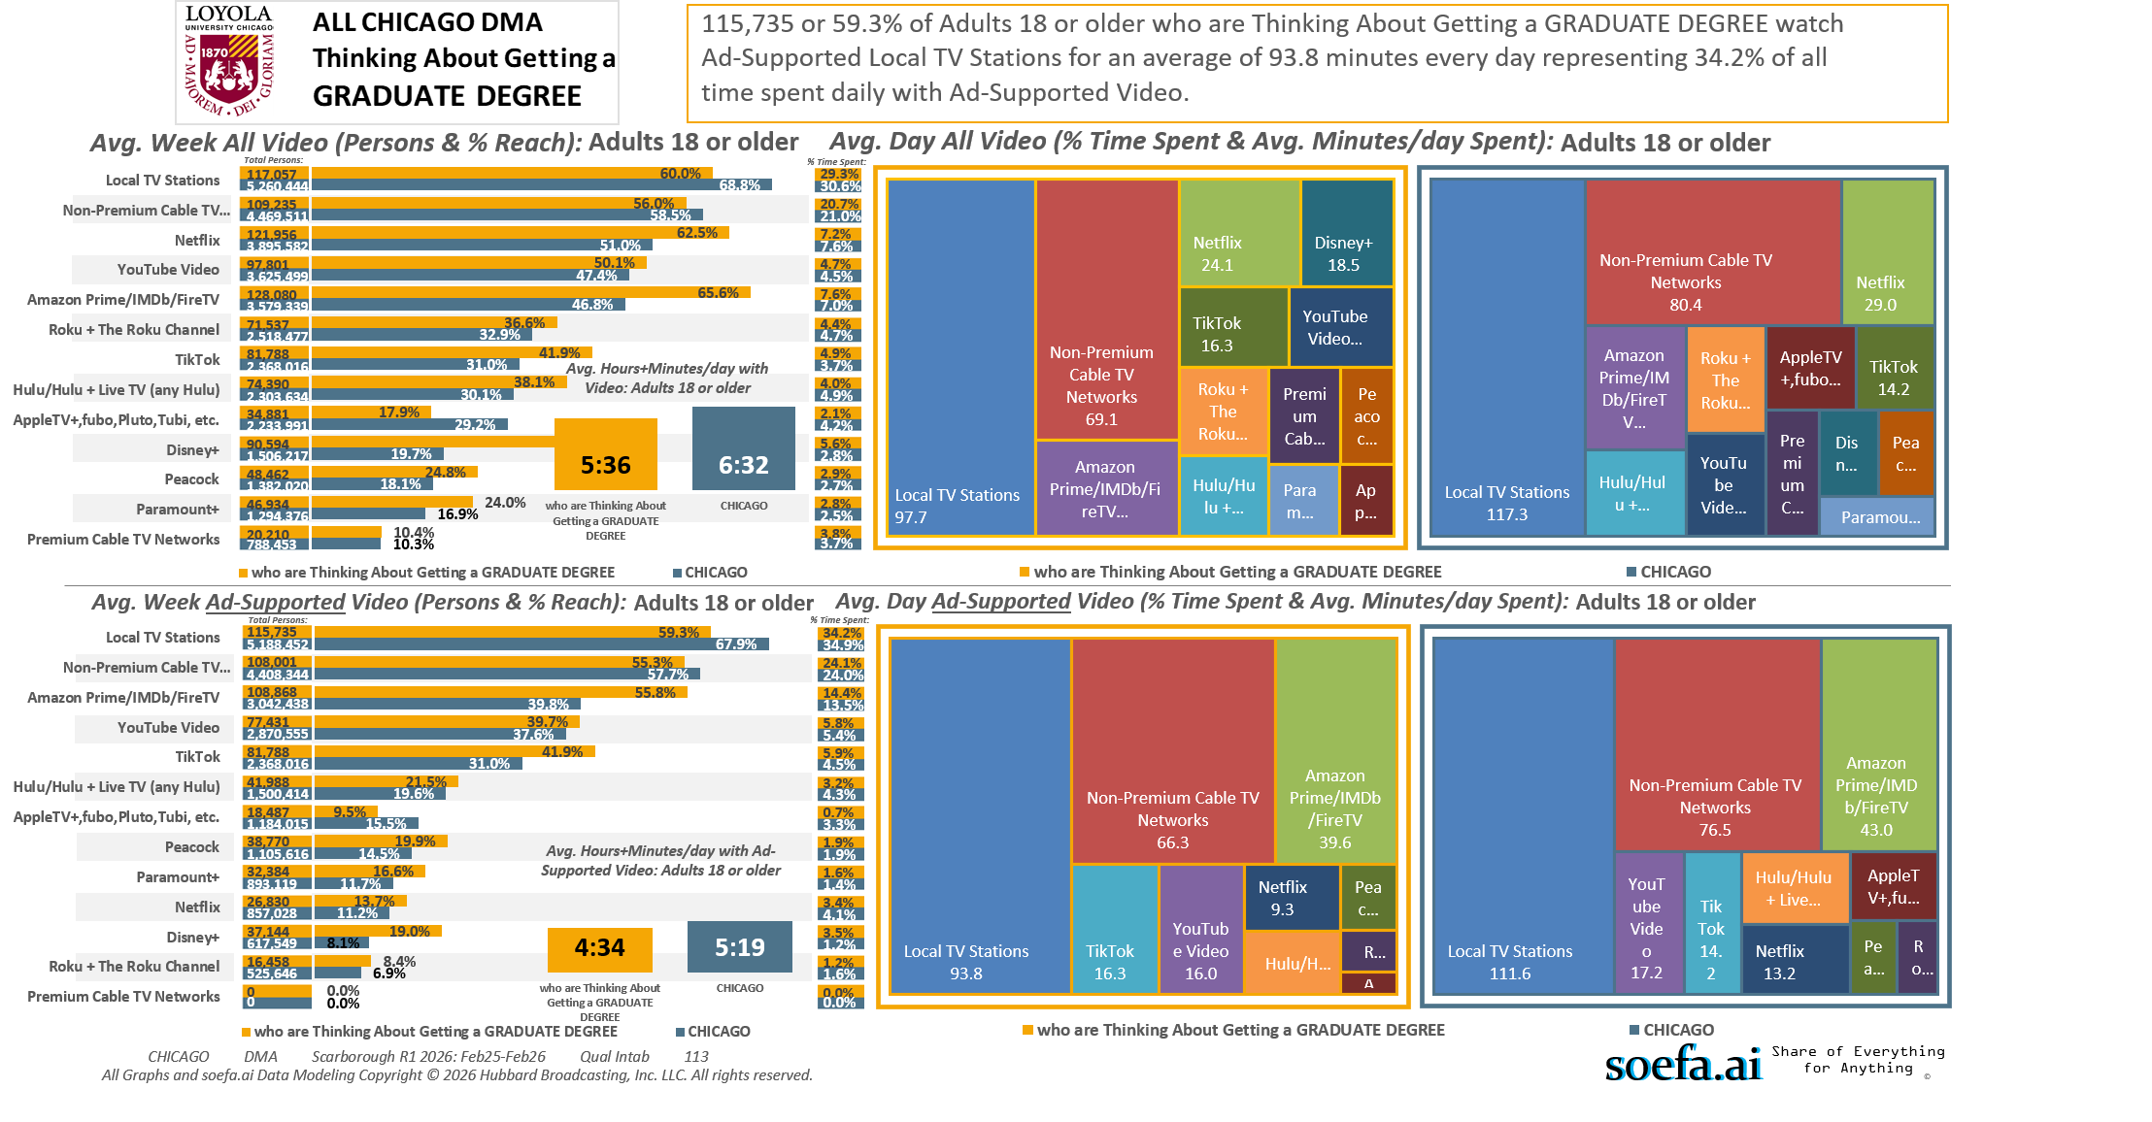
[(((Level of education: Bachelor's degree (BA, BS, etc.) OR Level of education: Some postgraduate (no advanced degree)) AND Ways used Internet/apps past 30 days on computer:Lifestyle: Education (research schools, application, financing)) AND Currently enrolled/attending classes at a college/university: No)]

Slide 14
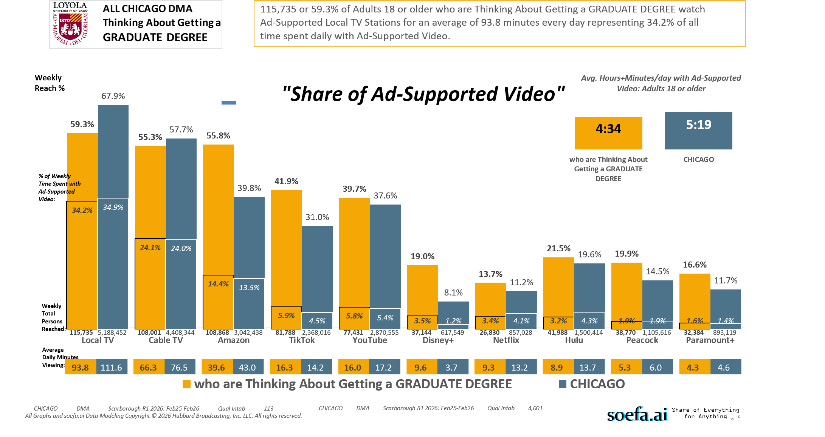
[(((Level of education: Bachelor's degree (BA, BS, etc.) OR Level of education: Some postgraduate (no advanced degree)) AND Ways used Internet/apps past 30 days on computer:Lifestyle: Education (research schools, application, financing)) AND Currently enrolled/attending classes at a college/university: No)]

Slide 15
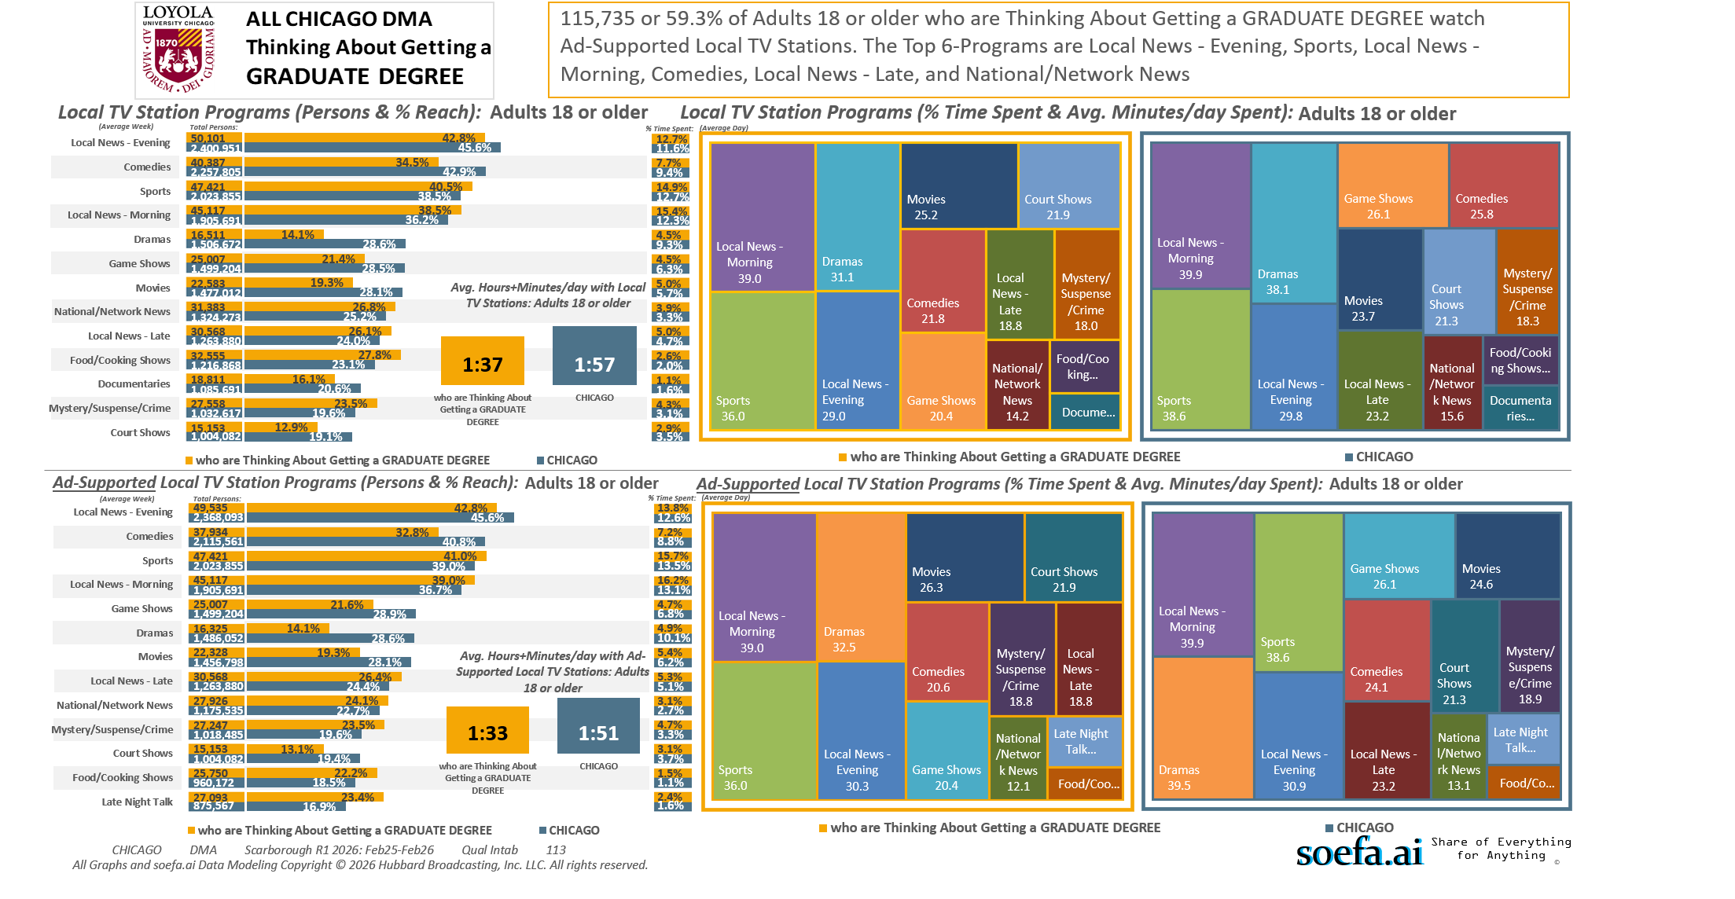
[(((Level of education: Bachelor's degree (BA, BS, etc.) OR Level of education: Some postgraduate (no advanced degree)) AND Ways used Internet/apps past 30 days on computer:Lifestyle: Education (research schools, application, financing)) AND Currently enrolled/attending classes at a college/university: No)]

Slide 16
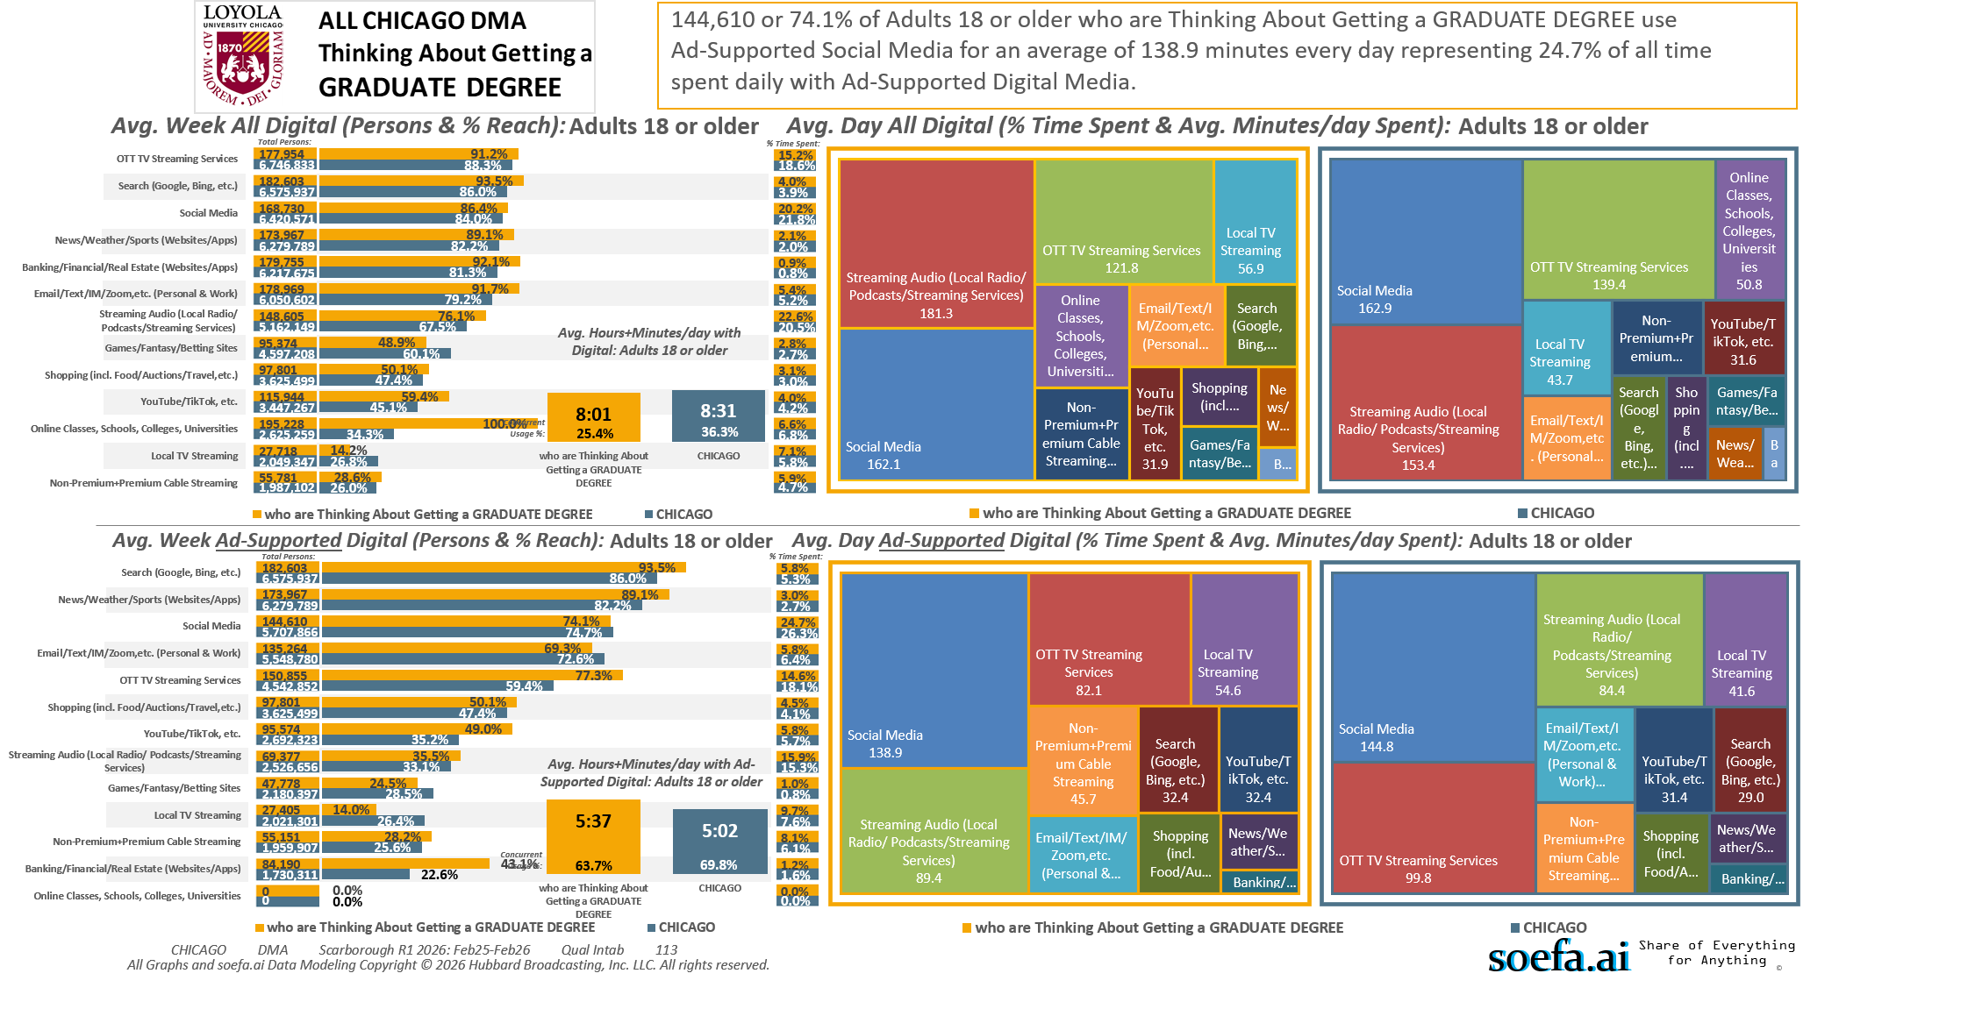
[(((Level of education: Bachelor's degree (BA, BS, etc.) OR Level of education: Some postgraduate (no advanced degree)) AND Ways used Internet/apps past 30 days on computer:Lifestyle: Education (research schools, application, financing)) AND Currently enrolled/attending classes at a college/university: No)]

Slide 17
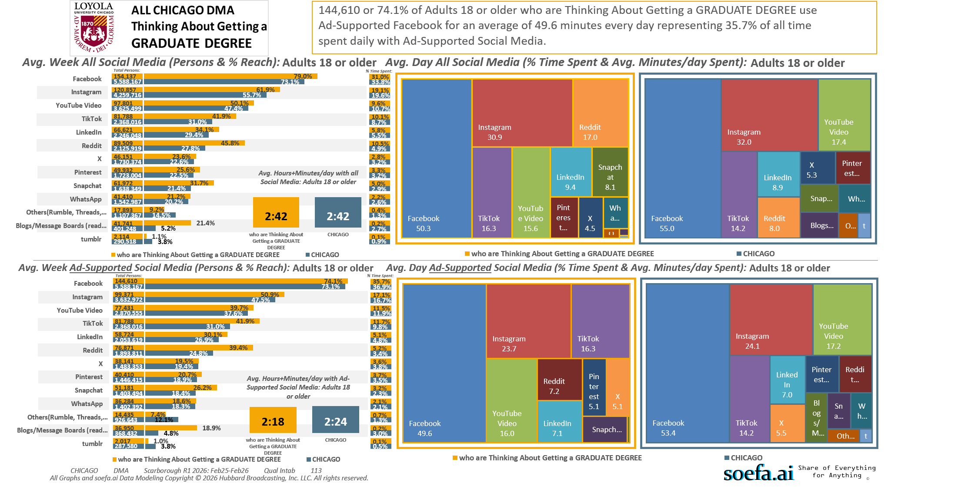
[(((Level of education: Bachelor's degree (BA, BS, etc.) OR Level of education: Some postgraduate (no advanced degree)) AND Ways used Internet/apps past 30 days on computer:Lifestyle: Education (research schools, application, financing)) AND Currently enrolled/attending classes at a college/university: No)]

Slide 18
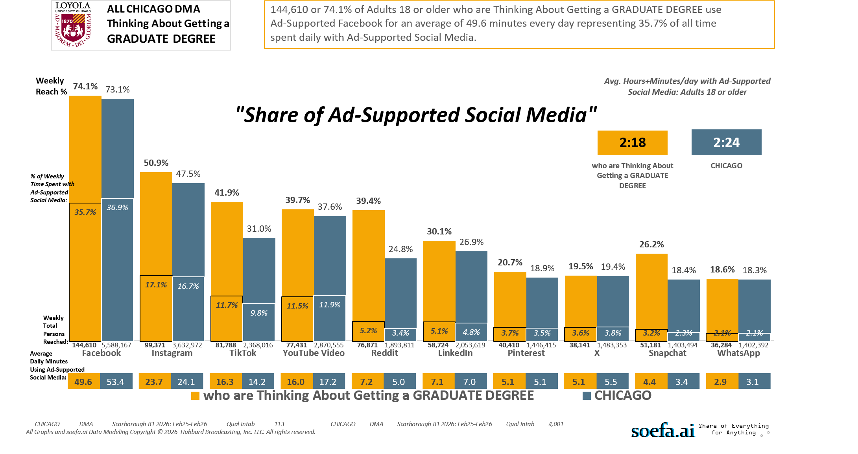
[(((Level of education: Bachelor's degree (BA, BS, etc.) OR Level of education: Some postgraduate (no advanced degree)) AND Ways used Internet/apps past 30 days on computer:Lifestyle: Education (research schools, application, financing)) AND Currently enrolled/attending classes at a college/university: No)]

Slide 19
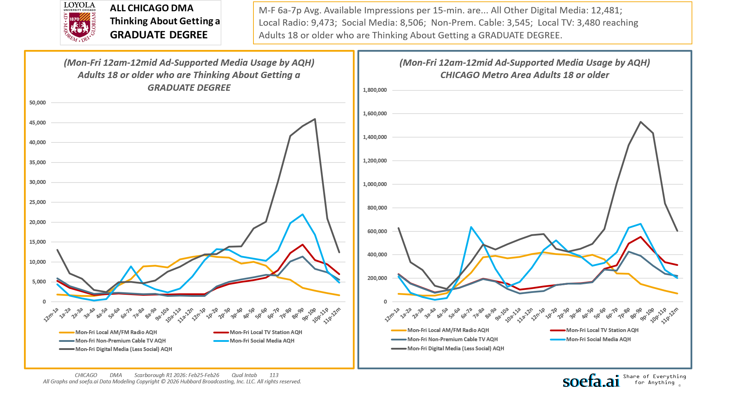
[(((Level of education: Bachelor's degree (BA, BS, etc.) OR Level of education: Some postgraduate (no advanced degree)) AND Ways used Internet/apps past 30 days on computer:Lifestyle: Education (research schools, application, financing)) AND Currently enrolled/attending classes at a college/university: No)]

Slide 20
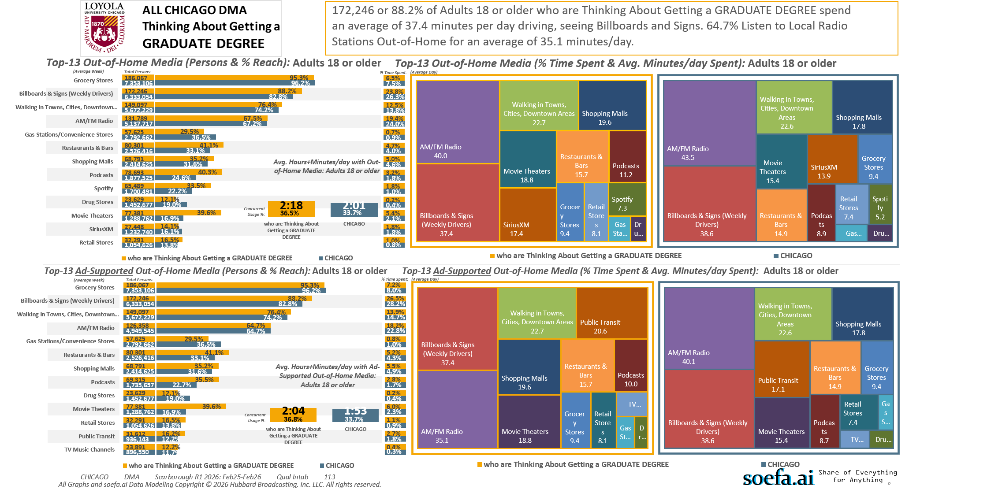
[(((Level of education: Bachelor's degree (BA, BS, etc.) OR Level of education: Some postgraduate (no advanced degree)) AND Ways used Internet/apps past 30 days on computer:Lifestyle: Education (research schools, application, financing)) AND Currently enrolled/attending classes at a college/university: No)]

Slide 21
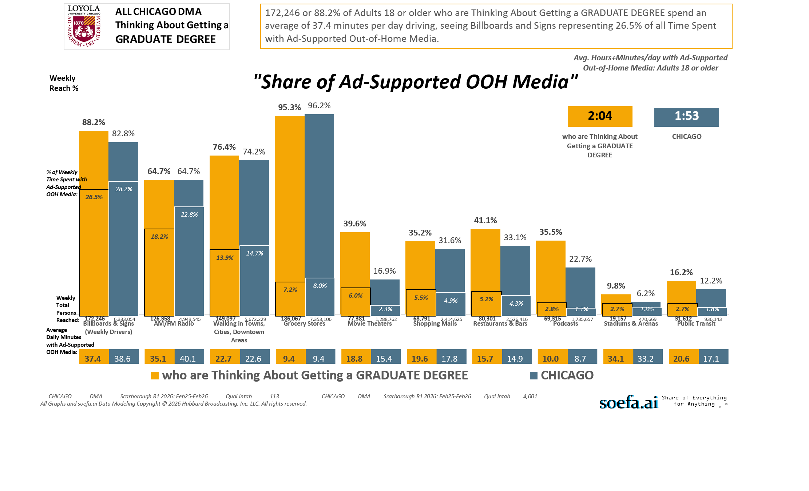
[(((Level of education: Bachelor's degree (BA, BS, etc.) OR Level of education: Some postgraduate (no advanced degree)) AND Ways used Internet/apps past 30 days on computer:Lifestyle: Education (research schools, application, financing)) AND Currently enrolled/attending classes at a college/university: No)]

Slide 22
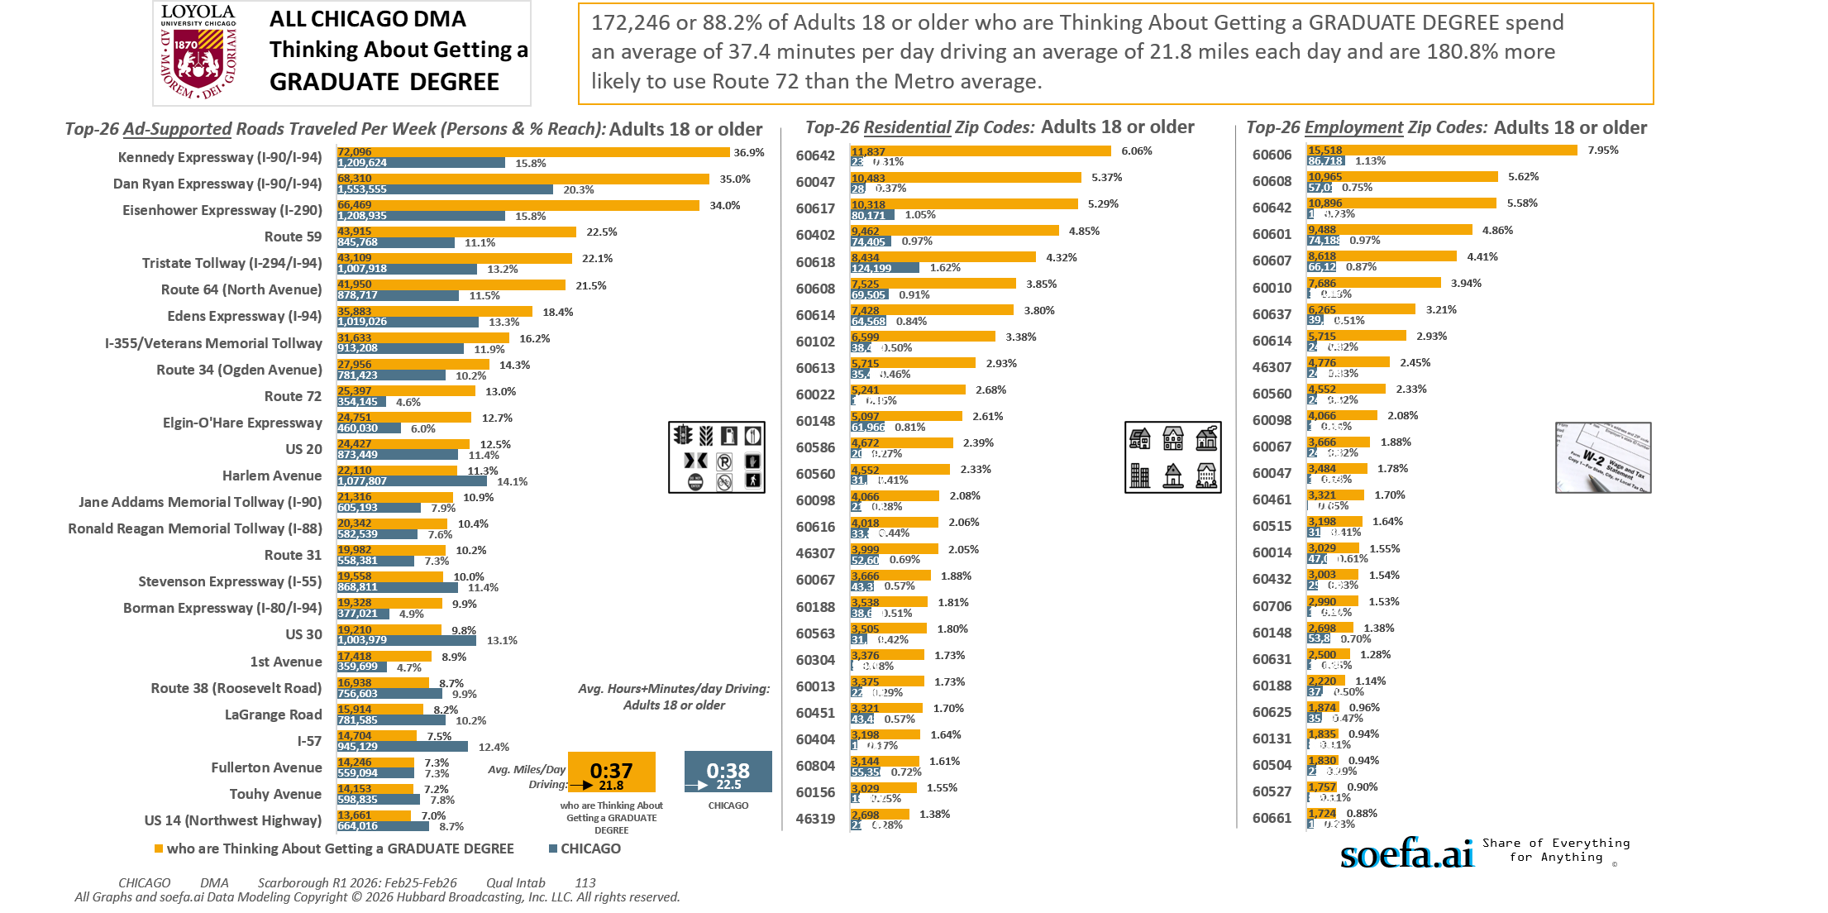
[(((Level of education: Bachelor's degree (BA, BS, etc.) OR Level of education: Some postgraduate (no advanced degree)) AND Ways used Internet/apps past 30 days on computer:Lifestyle: Education (research schools, application, financing)) AND Currently enrolled/attending classes at a college/university: No)]

Slide 23
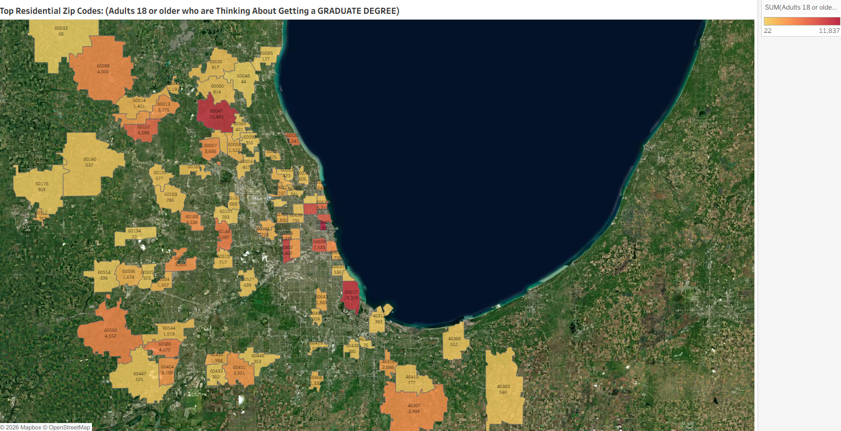
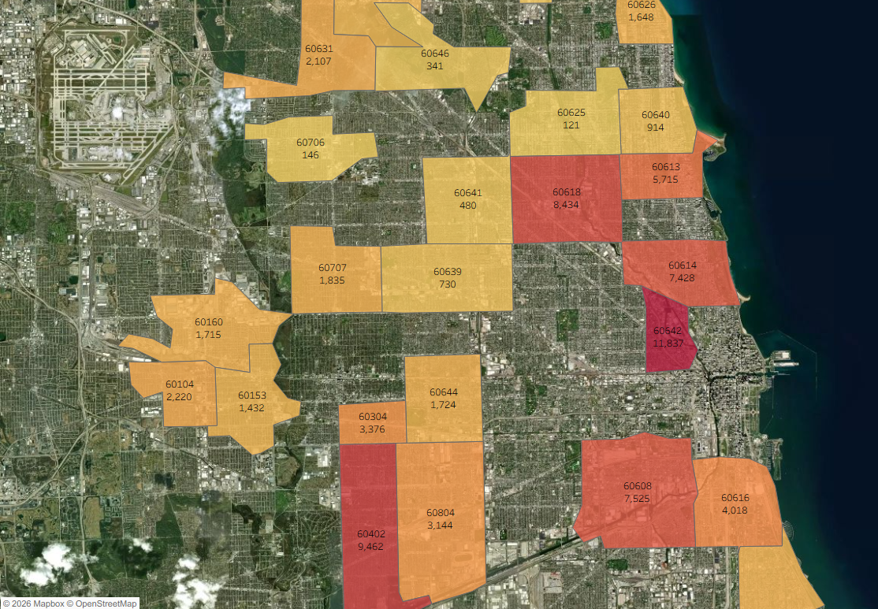
Zip Code Adults 18 or older who are Thinking About Getting a GRADUATE DEGREE
60642 11,837
60047 10,483
60617 10,318
60402 9,462
60618 8,434
60608 7,525
60614 7,428
60102 6,599
60613 5,715
60022 5,241
60148 5,097
60586 4,672
60560 4,552
60098 4,066
60616 4,018
46307 3,999
60067 3,666
60188 3,538
60563 3,505
60304 3,376
60013 3,375
60451 3,321
60404 3,198
60804 3,144
60156 3,029
46319 2,698
60104 2,220
60631 2,107
60432 1,984
60643 1,869
60707 1,835
60112 1,757
60653 1,728
60644 1,724
60160 1,715
60506 1,674
60626 1,648
60004 1,522
60504 1,507
60714 1,439
60153 1,432
60014 1,401
60466 1,332
60042 1,191
60074 1,181
60544 1,019
60026 975
60030 917
60640 914
60169 817
60060 814
60103 786
46410 777
60639 730
60515 717
60120 677
60191 668
60140 637
60406 609
60076 606
46383 590
46368 552
60637 536
60447 525
60429 523
60641 480
46310 468
60056 457
60527 439
60053 423
60089 421
60649 406
46312 393
60433 382
60438 380
60178 369
60090 356
60448 353
60646 341
60554 339
60505 323
60101 293
60085 177
60706 146
60625 121
46324 76
60033 68
60048 44
60134 22
[(((Level of education: Bachelor's degree (BA, BS, etc.) OR Level of education: Some postgraduate (no advanced degree)) AND Ways used Internet/apps past 30 days on computer:Lifestyle: Education (research schools, application, financing)) AND Currently enrolled/attending classes at a college/university: No)]

Slide 24
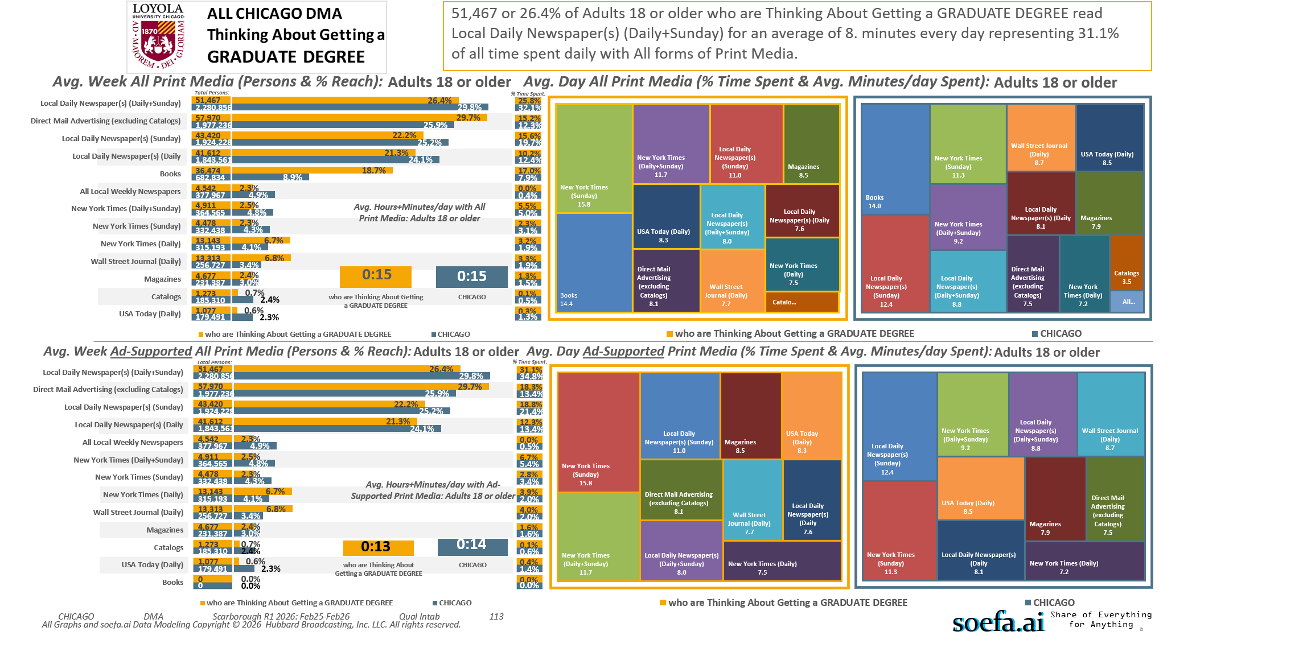
[(((Level of education: Bachelor's degree (BA, BS, etc.) OR Level of education: Some postgraduate (no advanced degree)) AND Ways used Internet/apps past 30 days on computer:Lifestyle: Education (research schools, application, financing)) AND Currently enrolled/attending classes at a college/university: No)]

Slide 25
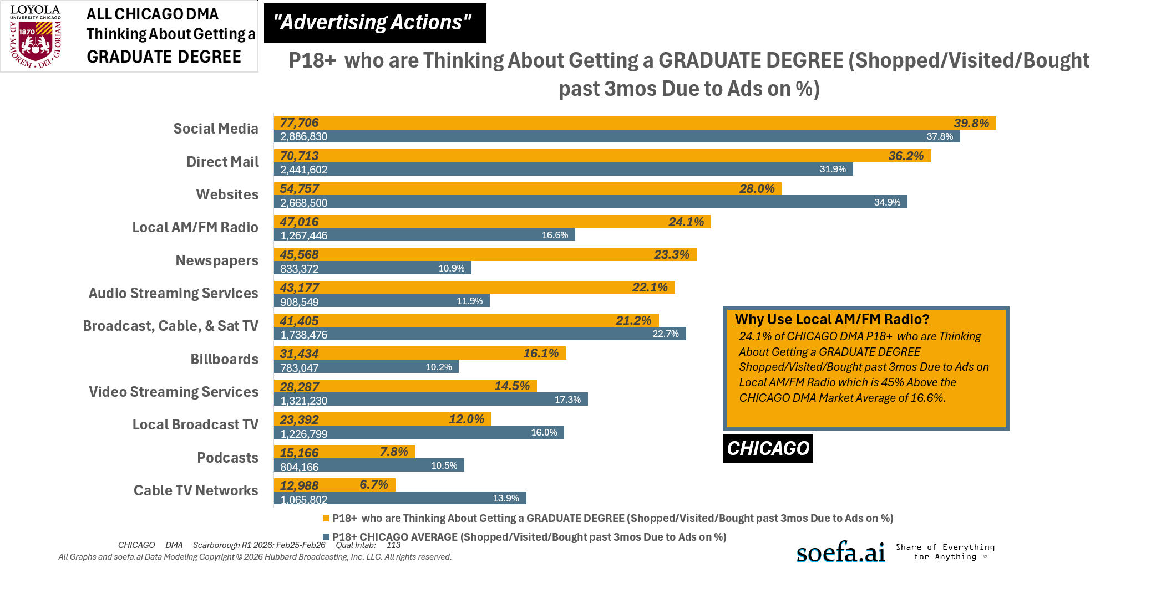
[(((Level of education: Bachelor's degree (BA, BS, etc.) OR Level of education: Some postgraduate (no advanced degree)) AND Ways used Internet/apps past 30 days on computer:Lifestyle: Education (research schools, application, financing)) AND Currently enrolled/attending classes at a college/university: No)]

