Slide 1
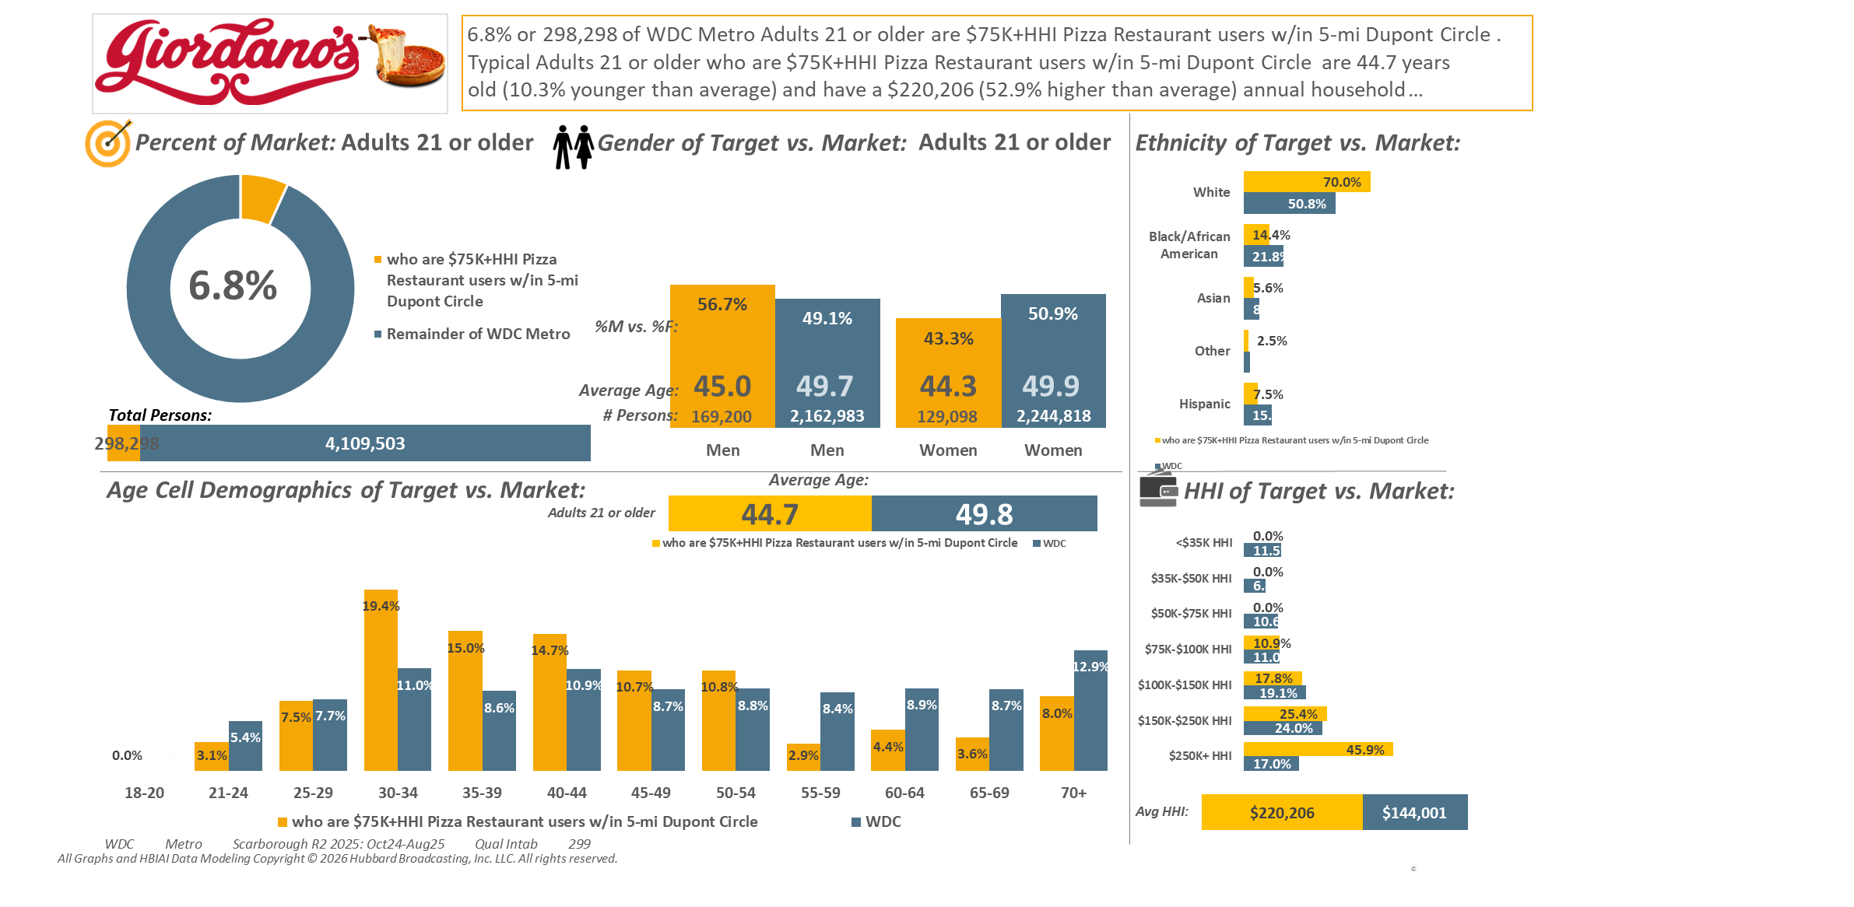
[((Household income summaries (HHLD): $75,000 or more AND Types of restaurants used past 30 days: Any pizza restaurant) AND (Zip code of residence: 20001 OR Zip code of residence: 20002 OR Zip code of residence: 20003 OR Zip code of residence: 20004 OR Zip code of residence: 20005 OR Zip code of residence: 20007 OR Zip code of residence: 20008 OR Zip code of residence: 20009 OR Zip code of residence: 20010 OR Zip code of residence: 20011 OR Zip code of residence: 20012 OR Zip code of residence: 20015 OR Zip code of residence: 20016 OR Zip code of residence: 20017 OR Zip code of residence: 20018 OR Zip code of residence: 20020 OR Zip code of residence: 20024 OR Zip code of residence: 20037 OR Zip code of residence: 20052 OR Zip code of residence: 20057 OR Zip code of residence: 20216 OR Zip code of residence: 20318 OR Zip code of residence: 20712 OR Zip code of residence: 22201 OR Zip code of residence: 22202 OR Zip code of residence: 22203 OR Zip code of residence: 22204 OR Zip code of residence: 22207 OR Zip code of residence: 22209 OR Zip code of residence: 22212 OR Zip code of employment: 20001 OR Zip code of employment: 20002 OR Zip code of employment: 20003 OR Zip code of employment: 20004 OR Zip code of employment: 20005 OR Zip code of employment: 20006 OR Zip code of employment: 20007 OR Zip code of employment: 20008 OR Zip code of employment: 20009 OR Zip code of employment: 20010 OR Zip code of employment: 20011 OR Zip code of employment: 20012 OR Zip code of employment: 20013 OR Zip code of employment: 20015 OR Zip code of employment: 20016 OR Zip code of employment: 20017 OR Zip code of employment: 20018 OR Zip code of employment: 20020 OR Zip code of employment: 20024 OR Zip code of employment: 20035 OR Zip code of employment: 20036 OR Zip code of employment: 20037 OR Zip code of employment: 20044 OR Zip code of employment: 20045 OR Zip code of employment: 20049 OR Zip code of employment: 20052 OR Zip code of employment: 20057 OR Zip code of employment: 20059 OR Zip code of employment: 20060 OR Zip code of employment: 20064 OR Zip code of employment: 20068 OR Zip code of employment: 20071 OR Zip code of employment: 20201 OR Zip code of employment: 20202 OR Zip code of employment: 20210 OR Zip code of employment: 20214 OR Zip code of employment: 20220 OR Zip code of employment: 20223 OR Zip code of employment: 20224 OR Zip code of employment: 20226 OR Zip code of employment: 20229 OR Zip code of employment: 20230 OR Zip code of employment: 20233 OR Zip code of employment: 20237 OR Zip code of employment: 20240 OR Zip code of employment: 20242 OR Zip code of employment: 20250 OR Zip code of employment: 20260 OR Zip code of employment: 20301 OR Zip code of employment: 20310 OR Zip code of employment: 20314 OR Zip code of employment: 20318 OR Zip code of employment: 20319 OR Zip code of employment: 20330 OR Zip code of employment: 20350 OR Zip code of employment: 20373 OR Zip code of employment: 20374 OR Zip code of employment: 20376 OR Zip code of employment: 20401 OR Zip code of employment: 20410 OR Zip code of employment: 20415 OR Zip code of employment: 20420 OR Zip code of employment: 20422 OR Zip code of employment: 20431 OR Zip code of employment: 20433 OR Zip code of employment: 20442 OR Zip code of employment: 20451 OR Zip code of employment: 20460 OR Zip code of employment: 20472 OR Zip code of employment: 20500 OR Zip code of employment: 20502 OR Zip code of employment: 20504 OR Zip code of employment: 20505 OR Zip code of employment: 20507 OR Zip code of employment: 20510 OR Zip code of employment: 20515 OR Zip code of employment: 20520 OR Zip code of employment: 20527 OR Zip code of employment: 20530 OR Zip code of employment: 20533 OR Zip code of employment: 20535 OR Zip code of employment: 20540 OR Zip code of employment: 20543 OR Zip code of employment: 20548 OR Zip code of employment: 20551 OR Zip code of employment: 20554 OR Zip code of employment: 20560 OR Zip code of employment: 20565 OR Zip code of employment: 20566 OR Zip code of employment: 20577 OR Zip code of employment: 20581 OR Zip code of employment: 20585 OR Zip code of employment: 20590 OR Zip code of employment: 20591 OR Zip code of employment: 20593 OR Zip code of employment: 22003 OR Zip code of employment: 22015 OR Zip code of employment: 22201 OR Zip code of employment: 22202 OR Zip code of employment: 22203 OR Zip code of employment: 22204 OR Zip code of employment: 22207 OR Zip code of employment: 22209))]

Slide 2
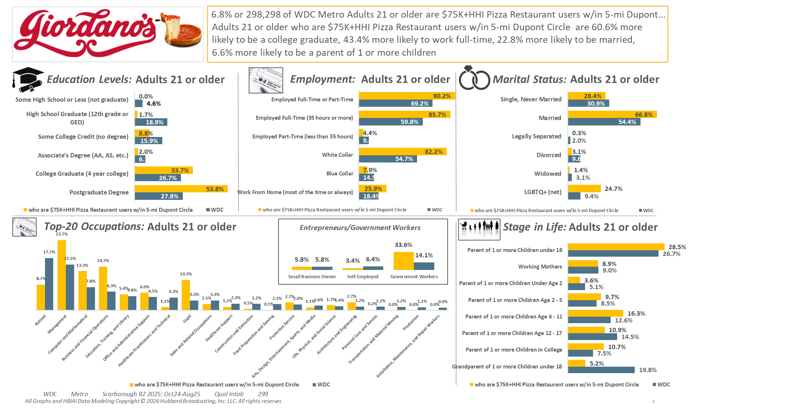
[((Household income summaries (HHLD): $75,000 or more AND Types of restaurants used past 30 days: Any pizza restaurant) AND (Zip code of residence: 20001 OR Zip code of residence: 20002 OR Zip code of residence: 20003 OR Zip code of residence: 20004 OR Zip code of residence: 20005 OR Zip code of residence: 20007 OR Zip code of residence: 20008 OR Zip code of residence: 20009 OR Zip code of residence: 20010 OR Zip code of residence: 20011 OR Zip code of residence: 20012 OR Zip code of residence: 20015 OR Zip code of residence: 20016 OR Zip code of residence: 20017 OR Zip code of residence: 20018 OR Zip code of residence: 20020 OR Zip code of residence: 20024 OR Zip code of residence: 20037 OR Zip code of residence: 20052 OR Zip code of residence: 20057 OR Zip code of residence: 20216 OR Zip code of residence: 20318 OR Zip code of residence: 20712 OR Zip code of residence: 22201 OR Zip code of residence: 22202 OR Zip code of residence: 22203 OR Zip code of residence: 22204 OR Zip code of residence: 22207 OR Zip code of residence: 22209 OR Zip code of residence: 22212 OR Zip code of employment: 20001 OR Zip code of employment: 20002 OR Zip code of employment: 20003 OR Zip code of employment: 20004 OR Zip code of employment: 20005 OR Zip code of employment: 20006 OR Zip code of employment: 20007 OR Zip code of employment: 20008 OR Zip code of employment: 20009 OR Zip code of employment: 20010 OR Zip code of employment: 20011 OR Zip code of employment: 20012 OR Zip code of employment: 20013 OR Zip code of employment: 20015 OR Zip code of employment: 20016 OR Zip code of employment: 20017 OR Zip code of employment: 20018 OR Zip code of employment: 20020 OR Zip code of employment: 20024 OR Zip code of employment: 20035 OR Zip code of employment: 20036 OR Zip code of employment: 20037 OR Zip code of employment: 20044 OR Zip code of employment: 20045 OR Zip code of employment: 20049 OR Zip code of employment: 20052 OR Zip code of employment: 20057 OR Zip code of employment: 20059 OR Zip code of employment: 20060 OR Zip code of employment: 20064 OR Zip code of employment: 20068 OR Zip code of employment: 20071 OR Zip code of employment: 20201 OR Zip code of employment: 20202 OR Zip code of employment: 20210 OR Zip code of employment: 20214 OR Zip code of employment: 20220 OR Zip code of employment: 20223 OR Zip code of employment: 20224 OR Zip code of employment: 20226 OR Zip code of employment: 20229 OR Zip code of employment: 20230 OR Zip code of employment: 20233 OR Zip code of employment: 20237 OR Zip code of employment: 20240 OR Zip code of employment: 20242 OR Zip code of employment: 20250 OR Zip code of employment: 20260 OR Zip code of employment: 20301 OR Zip code of employment: 20310 OR Zip code of employment: 20314 OR Zip code of employment: 20318 OR Zip code of employment: 20319 OR Zip code of employment: 20330 OR Zip code of employment: 20350 OR Zip code of employment: 20373 OR Zip code of employment: 20374 OR Zip code of employment: 20376 OR Zip code of employment: 20401 OR Zip code of employment: 20410 OR Zip code of employment: 20415 OR Zip code of employment: 20420 OR Zip code of employment: 20422 OR Zip code of employment: 20431 OR Zip code of employment: 20433 OR Zip code of employment: 20442 OR Zip code of employment: 20451 OR Zip code of employment: 20460 OR Zip code of employment: 20472 OR Zip code of employment: 20500 OR Zip code of employment: 20502 OR Zip code of employment: 20504 OR Zip code of employment: 20505 OR Zip code of employment: 20507 OR Zip code of employment: 20510 OR Zip code of employment: 20515 OR Zip code of employment: 20520 OR Zip code of employment: 20527 OR Zip code of employment: 20530 OR Zip code of employment: 20533 OR Zip code of employment: 20535 OR Zip code of employment: 20540 OR Zip code of employment: 20543 OR Zip code of employment: 20548 OR Zip code of employment: 20551 OR Zip code of employment: 20554 OR Zip code of employment: 20560 OR Zip code of employment: 20565 OR Zip code of employment: 20566 OR Zip code of employment: 20577 OR Zip code of employment: 20581 OR Zip code of employment: 20585 OR Zip code of employment: 20590 OR Zip code of employment: 20591 OR Zip code of employment: 20593 OR Zip code of employment: 22003 OR Zip code of employment: 22015 OR Zip code of employment: 22201 OR Zip code of employment: 22202 OR Zip code of employment: 22203 OR Zip code of employment: 22204 OR Zip code of employment: 22207 OR Zip code of employment: 22209))]

Slide 3
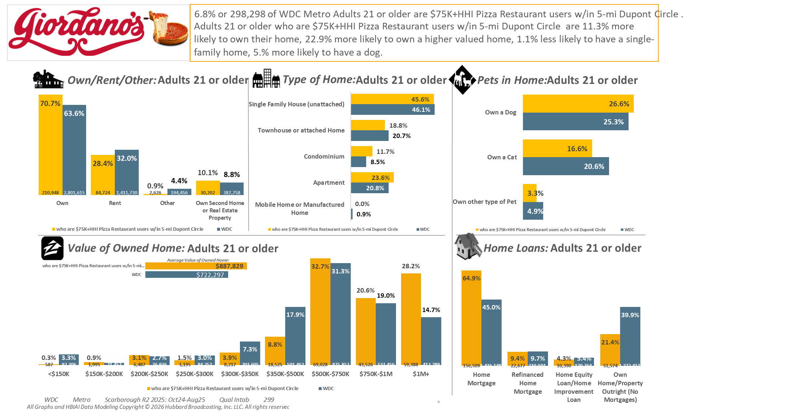
[((Household income summaries (HHLD): $75,000 or more AND Types of restaurants used past 30 days: Any pizza restaurant) AND (Zip code of residence: 20001 OR Zip code of residence: 20002 OR Zip code of residence: 20003 OR Zip code of residence: 20004 OR Zip code of residence: 20005 OR Zip code of residence: 20007 OR Zip code of residence: 20008 OR Zip code of residence: 20009 OR Zip code of residence: 20010 OR Zip code of residence: 20011 OR Zip code of residence: 20012 OR Zip code of residence: 20015 OR Zip code of residence: 20016 OR Zip code of residence: 20017 OR Zip code of residence: 20018 OR Zip code of residence: 20020 OR Zip code of residence: 20024 OR Zip code of residence: 20037 OR Zip code of residence: 20052 OR Zip code of residence: 20057 OR Zip code of residence: 20216 OR Zip code of residence: 20318 OR Zip code of residence: 20712 OR Zip code of residence: 22201 OR Zip code of residence: 22202 OR Zip code of residence: 22203 OR Zip code of residence: 22204 OR Zip code of residence: 22207 OR Zip code of residence: 22209 OR Zip code of residence: 22212 OR Zip code of employment: 20001 OR Zip code of employment: 20002 OR Zip code of employment: 20003 OR Zip code of employment: 20004 OR Zip code of employment: 20005 OR Zip code of employment: 20006 OR Zip code of employment: 20007 OR Zip code of employment: 20008 OR Zip code of employment: 20009 OR Zip code of employment: 20010 OR Zip code of employment: 20011 OR Zip code of employment: 20012 OR Zip code of employment: 20013 OR Zip code of employment: 20015 OR Zip code of employment: 20016 OR Zip code of employment: 20017 OR Zip code of employment: 20018 OR Zip code of employment: 20020 OR Zip code of employment: 20024 OR Zip code of employment: 20035 OR Zip code of employment: 20036 OR Zip code of employment: 20037 OR Zip code of employment: 20044 OR Zip code of employment: 20045 OR Zip code of employment: 20049 OR Zip code of employment: 20052 OR Zip code of employment: 20057 OR Zip code of employment: 20059 OR Zip code of employment: 20060 OR Zip code of employment: 20064 OR Zip code of employment: 20068 OR Zip code of employment: 20071 OR Zip code of employment: 20201 OR Zip code of employment: 20202 OR Zip code of employment: 20210 OR Zip code of employment: 20214 OR Zip code of employment: 20220 OR Zip code of employment: 20223 OR Zip code of employment: 20224 OR Zip code of employment: 20226 OR Zip code of employment: 20229 OR Zip code of employment: 20230 OR Zip code of employment: 20233 OR Zip code of employment: 20237 OR Zip code of employment: 20240 OR Zip code of employment: 20242 OR Zip code of employment: 20250 OR Zip code of employment: 20260 OR Zip code of employment: 20301 OR Zip code of employment: 20310 OR Zip code of employment: 20314 OR Zip code of employment: 20318 OR Zip code of employment: 20319 OR Zip code of employment: 20330 OR Zip code of employment: 20350 OR Zip code of employment: 20373 OR Zip code of employment: 20374 OR Zip code of employment: 20376 OR Zip code of employment: 20401 OR Zip code of employment: 20410 OR Zip code of employment: 20415 OR Zip code of employment: 20420 OR Zip code of employment: 20422 OR Zip code of employment: 20431 OR Zip code of employment: 20433 OR Zip code of employment: 20442 OR Zip code of employment: 20451 OR Zip code of employment: 20460 OR Zip code of employment: 20472 OR Zip code of employment: 20500 OR Zip code of employment: 20502 OR Zip code of employment: 20504 OR Zip code of employment: 20505 OR Zip code of employment: 20507 OR Zip code of employment: 20510 OR Zip code of employment: 20515 OR Zip code of employment: 20520 OR Zip code of employment: 20527 OR Zip code of employment: 20530 OR Zip code of employment: 20533 OR Zip code of employment: 20535 OR Zip code of employment: 20540 OR Zip code of employment: 20543 OR Zip code of employment: 20548 OR Zip code of employment: 20551 OR Zip code of employment: 20554 OR Zip code of employment: 20560 OR Zip code of employment: 20565 OR Zip code of employment: 20566 OR Zip code of employment: 20577 OR Zip code of employment: 20581 OR Zip code of employment: 20585 OR Zip code of employment: 20590 OR Zip code of employment: 20591 OR Zip code of employment: 20593 OR Zip code of employment: 22003 OR Zip code of employment: 22015 OR Zip code of employment: 22201 OR Zip code of employment: 22202 OR Zip code of employment: 22203 OR Zip code of employment: 22204 OR Zip code of employment: 22207 OR Zip code of employment: 22209))]

Slide 4
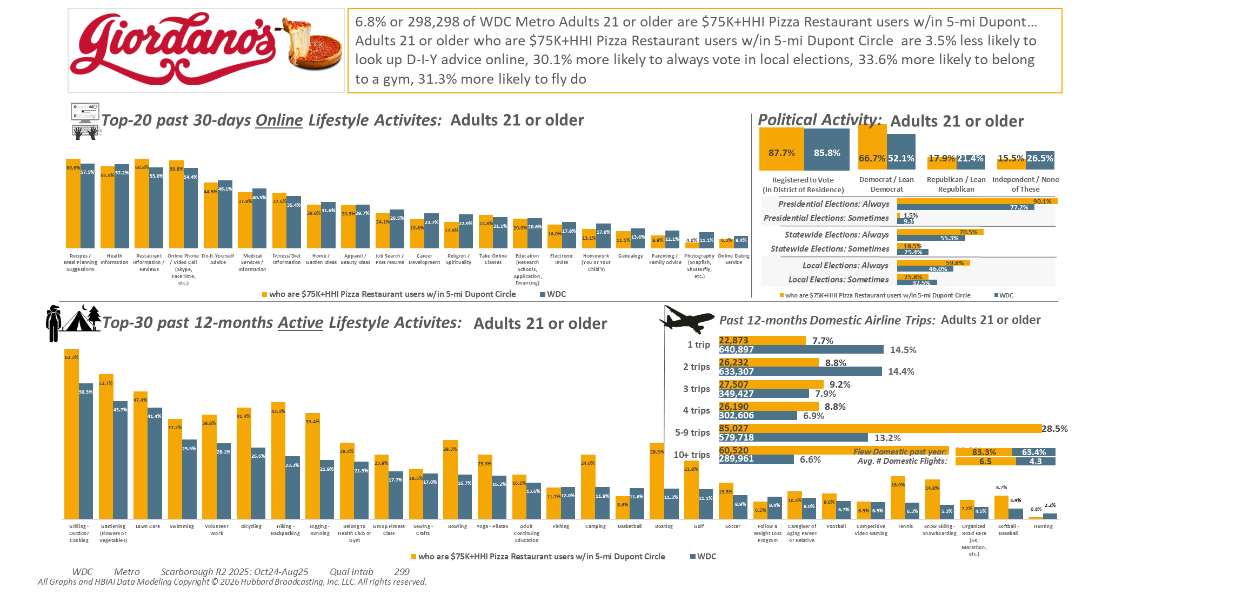
[((Household income summaries (HHLD): $75,000 or more AND Types of restaurants used past 30 days: Any pizza restaurant) AND (Zip code of residence: 20001 OR Zip code of residence: 20002 OR Zip code of residence: 20003 OR Zip code of residence: 20004 OR Zip code of residence: 20005 OR Zip code of residence: 20007 OR Zip code of residence: 20008 OR Zip code of residence: 20009 OR Zip code of residence: 20010 OR Zip code of residence: 20011 OR Zip code of residence: 20012 OR Zip code of residence: 20015 OR Zip code of residence: 20016 OR Zip code of residence: 20017 OR Zip code of residence: 20018 OR Zip code of residence: 20020 OR Zip code of residence: 20024 OR Zip code of residence: 20037 OR Zip code of residence: 20052 OR Zip code of residence: 20057 OR Zip code of residence: 20216 OR Zip code of residence: 20318 OR Zip code of residence: 20712 OR Zip code of residence: 22201 OR Zip code of residence: 22202 OR Zip code of residence: 22203 OR Zip code of residence: 22204 OR Zip code of residence: 22207 OR Zip code of residence: 22209 OR Zip code of residence: 22212 OR Zip code of employment: 20001 OR Zip code of employment: 20002 OR Zip code of employment: 20003 OR Zip code of employment: 20004 OR Zip code of employment: 20005 OR Zip code of employment: 20006 OR Zip code of employment: 20007 OR Zip code of employment: 20008 OR Zip code of employment: 20009 OR Zip code of employment: 20010 OR Zip code of employment: 20011 OR Zip code of employment: 20012 OR Zip code of employment: 20013 OR Zip code of employment: 20015 OR Zip code of employment: 20016 OR Zip code of employment: 20017 OR Zip code of employment: 20018 OR Zip code of employment: 20020 OR Zip code of employment: 20024 OR Zip code of employment: 20035 OR Zip code of employment: 20036 OR Zip code of employment: 20037 OR Zip code of employment: 20044 OR Zip code of employment: 20045 OR Zip code of employment: 20049 OR Zip code of employment: 20052 OR Zip code of employment: 20057 OR Zip code of employment: 20059 OR Zip code of employment: 20060 OR Zip code of employment: 20064 OR Zip code of employment: 20068 OR Zip code of employment: 20071 OR Zip code of employment: 20201 OR Zip code of employment: 20202 OR Zip code of employment: 20210 OR Zip code of employment: 20214 OR Zip code of employment: 20220 OR Zip code of employment: 20223 OR Zip code of employment: 20224 OR Zip code of employment: 20226 OR Zip code of employment: 20229 OR Zip code of employment: 20230 OR Zip code of employment: 20233 OR Zip code of employment: 20237 OR Zip code of employment: 20240 OR Zip code of employment: 20242 OR Zip code of employment: 20250 OR Zip code of employment: 20260 OR Zip code of employment: 20301 OR Zip code of employment: 20310 OR Zip code of employment: 20314 OR Zip code of employment: 20318 OR Zip code of employment: 20319 OR Zip code of employment: 20330 OR Zip code of employment: 20350 OR Zip code of employment: 20373 OR Zip code of employment: 20374 OR Zip code of employment: 20376 OR Zip code of employment: 20401 OR Zip code of employment: 20410 OR Zip code of employment: 20415 OR Zip code of employment: 20420 OR Zip code of employment: 20422 OR Zip code of employment: 20431 OR Zip code of employment: 20433 OR Zip code of employment: 20442 OR Zip code of employment: 20451 OR Zip code of employment: 20460 OR Zip code of employment: 20472 OR Zip code of employment: 20500 OR Zip code of employment: 20502 OR Zip code of employment: 20504 OR Zip code of employment: 20505 OR Zip code of employment: 20507 OR Zip code of employment: 20510 OR Zip code of employment: 20515 OR Zip code of employment: 20520 OR Zip code of employment: 20527 OR Zip code of employment: 20530 OR Zip code of employment: 20533 OR Zip code of employment: 20535 OR Zip code of employment: 20540 OR Zip code of employment: 20543 OR Zip code of employment: 20548 OR Zip code of employment: 20551 OR Zip code of employment: 20554 OR Zip code of employment: 20560 OR Zip code of employment: 20565 OR Zip code of employment: 20566 OR Zip code of employment: 20577 OR Zip code of employment: 20581 OR Zip code of employment: 20585 OR Zip code of employment: 20590 OR Zip code of employment: 20591 OR Zip code of employment: 20593 OR Zip code of employment: 22003 OR Zip code of employment: 22015 OR Zip code of employment: 22201 OR Zip code of employment: 22202 OR Zip code of employment: 22203 OR Zip code of employment: 22204 OR Zip code of employment: 22207 OR Zip code of employment: 22209))]

Slide 5
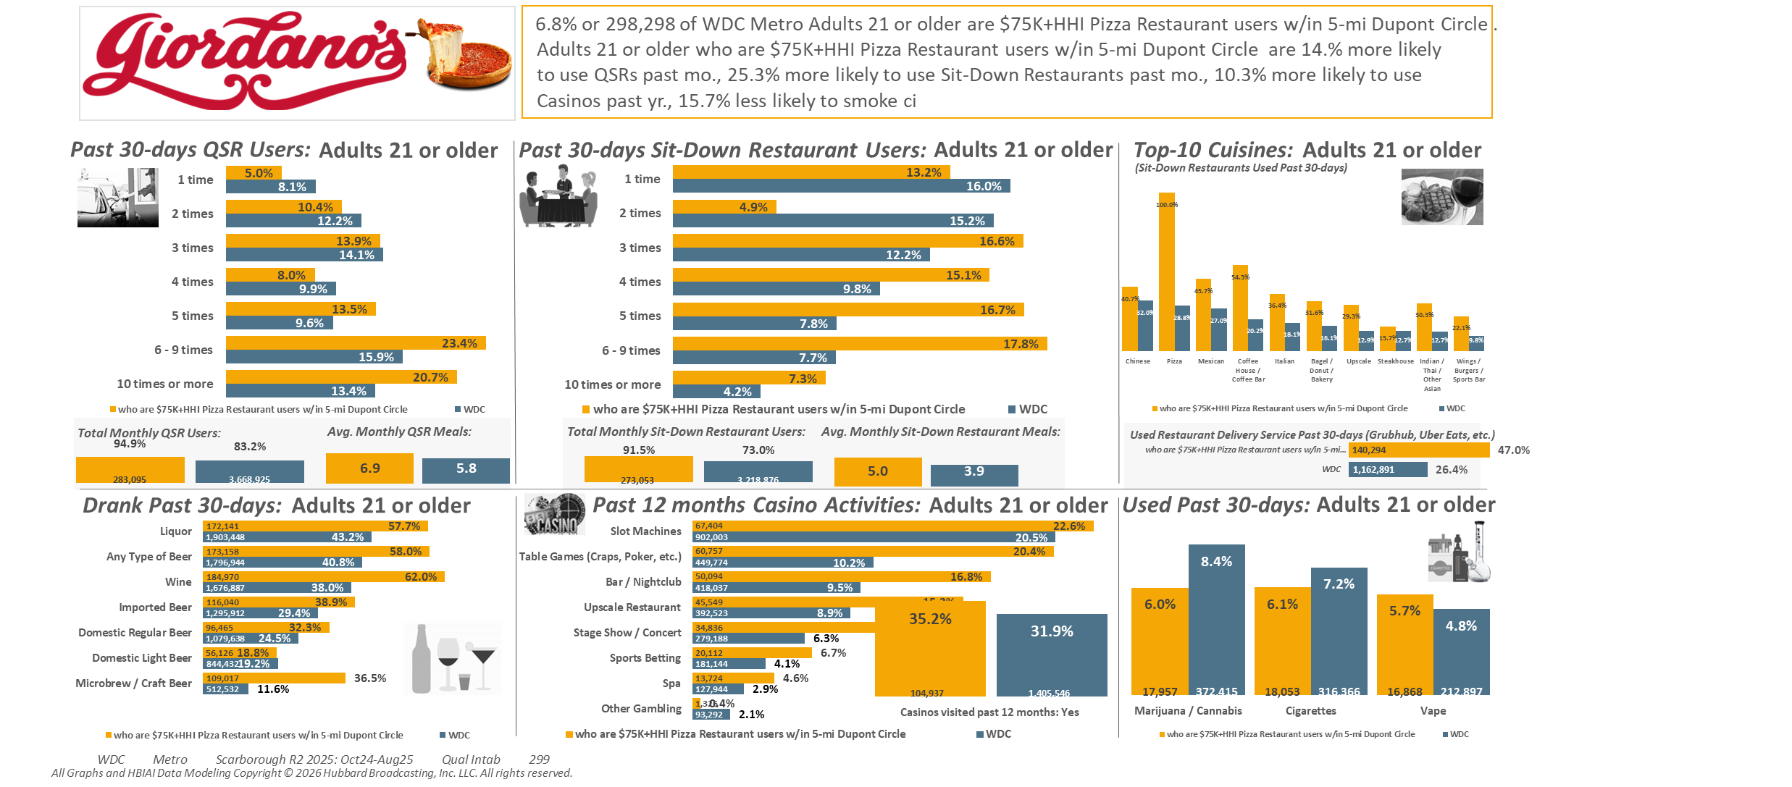
[((Household income summaries (HHLD): $75,000 or more AND Types of restaurants used past 30 days: Any pizza restaurant) AND (Zip code of residence: 20001 OR Zip code of residence: 20002 OR Zip code of residence: 20003 OR Zip code of residence: 20004 OR Zip code of residence: 20005 OR Zip code of residence: 20007 OR Zip code of residence: 20008 OR Zip code of residence: 20009 OR Zip code of residence: 20010 OR Zip code of residence: 20011 OR Zip code of residence: 20012 OR Zip code of residence: 20015 OR Zip code of residence: 20016 OR Zip code of residence: 20017 OR Zip code of residence: 20018 OR Zip code of residence: 20020 OR Zip code of residence: 20024 OR Zip code of residence: 20037 OR Zip code of residence: 20052 OR Zip code of residence: 20057 OR Zip code of residence: 20216 OR Zip code of residence: 20318 OR Zip code of residence: 20712 OR Zip code of residence: 22201 OR Zip code of residence: 22202 OR Zip code of residence: 22203 OR Zip code of residence: 22204 OR Zip code of residence: 22207 OR Zip code of residence: 22209 OR Zip code of residence: 22212 OR Zip code of employment: 20001 OR Zip code of employment: 20002 OR Zip code of employment: 20003 OR Zip code of employment: 20004 OR Zip code of employment: 20005 OR Zip code of employment: 20006 OR Zip code of employment: 20007 OR Zip code of employment: 20008 OR Zip code of employment: 20009 OR Zip code of employment: 20010 OR Zip code of employment: 20011 OR Zip code of employment: 20012 OR Zip code of employment: 20013 OR Zip code of employment: 20015 OR Zip code of employment: 20016 OR Zip code of employment: 20017 OR Zip code of employment: 20018 OR Zip code of employment: 20020 OR Zip code of employment: 20024 OR Zip code of employment: 20035 OR Zip code of employment: 20036 OR Zip code of employment: 20037 OR Zip code of employment: 20044 OR Zip code of employment: 20045 OR Zip code of employment: 20049 OR Zip code of employment: 20052 OR Zip code of employment: 20057 OR Zip code of employment: 20059 OR Zip code of employment: 20060 OR Zip code of employment: 20064 OR Zip code of employment: 20068 OR Zip code of employment: 20071 OR Zip code of employment: 20201 OR Zip code of employment: 20202 OR Zip code of employment: 20210 OR Zip code of employment: 20214 OR Zip code of employment: 20220 OR Zip code of employment: 20223 OR Zip code of employment: 20224 OR Zip code of employment: 20226 OR Zip code of employment: 20229 OR Zip code of employment: 20230 OR Zip code of employment: 20233 OR Zip code of employment: 20237 OR Zip code of employment: 20240 OR Zip code of employment: 20242 OR Zip code of employment: 20250 OR Zip code of employment: 20260 OR Zip code of employment: 20301 OR Zip code of employment: 20310 OR Zip code of employment: 20314 OR Zip code of employment: 20318 OR Zip code of employment: 20319 OR Zip code of employment: 20330 OR Zip code of employment: 20350 OR Zip code of employment: 20373 OR Zip code of employment: 20374 OR Zip code of employment: 20376 OR Zip code of employment: 20401 OR Zip code of employment: 20410 OR Zip code of employment: 20415 OR Zip code of employment: 20420 OR Zip code of employment: 20422 OR Zip code of employment: 20431 OR Zip code of employment: 20433 OR Zip code of employment: 20442 OR Zip code of employment: 20451 OR Zip code of employment: 20460 OR Zip code of employment: 20472 OR Zip code of employment: 20500 OR Zip code of employment: 20502 OR Zip code of employment: 20504 OR Zip code of employment: 20505 OR Zip code of employment: 20507 OR Zip code of employment: 20510 OR Zip code of employment: 20515 OR Zip code of employment: 20520 OR Zip code of employment: 20527 OR Zip code of employment: 20530 OR Zip code of employment: 20533 OR Zip code of employment: 20535 OR Zip code of employment: 20540 OR Zip code of employment: 20543 OR Zip code of employment: 20548 OR Zip code of employment: 20551 OR Zip code of employment: 20554 OR Zip code of employment: 20560 OR Zip code of employment: 20565 OR Zip code of employment: 20566 OR Zip code of employment: 20577 OR Zip code of employment: 20581 OR Zip code of employment: 20585 OR Zip code of employment: 20590 OR Zip code of employment: 20591 OR Zip code of employment: 20593 OR Zip code of employment: 22003 OR Zip code of employment: 22015 OR Zip code of employment: 22201 OR Zip code of employment: 22202 OR Zip code of employment: 22203 OR Zip code of employment: 22204 OR Zip code of employment: 22207 OR Zip code of employment: 22209))]

Slide 6
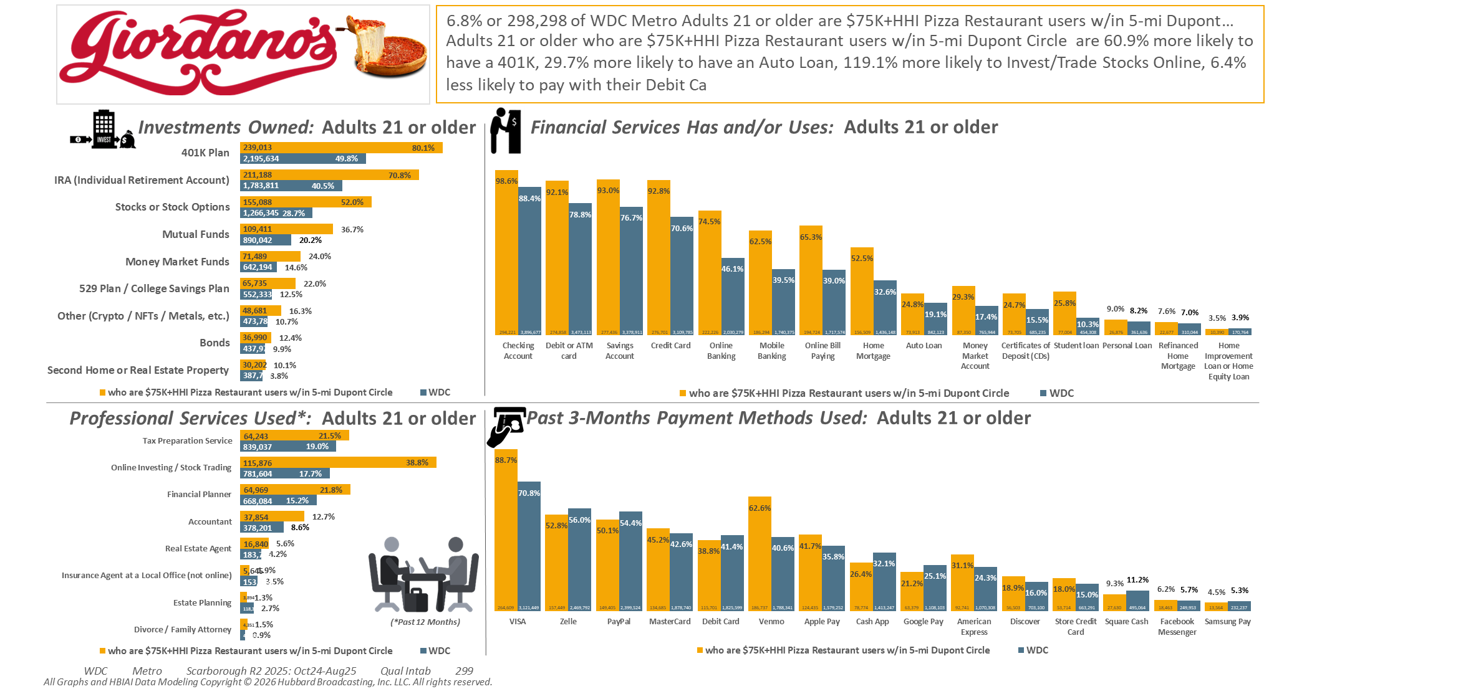
[((Household income summaries (HHLD): $75,000 or more AND Types of restaurants used past 30 days: Any pizza restaurant) AND (Zip code of residence: 20001 OR Zip code of residence: 20002 OR Zip code of residence: 20003 OR Zip code of residence: 20004 OR Zip code of residence: 20005 OR Zip code of residence: 20007 OR Zip code of residence: 20008 OR Zip code of residence: 20009 OR Zip code of residence: 20010 OR Zip code of residence: 20011 OR Zip code of residence: 20012 OR Zip code of residence: 20015 OR Zip code of residence: 20016 OR Zip code of residence: 20017 OR Zip code of residence: 20018 OR Zip code of residence: 20020 OR Zip code of residence: 20024 OR Zip code of residence: 20037 OR Zip code of residence: 20052 OR Zip code of residence: 20057 OR Zip code of residence: 20216 OR Zip code of residence: 20318 OR Zip code of residence: 20712 OR Zip code of residence: 22201 OR Zip code of residence: 22202 OR Zip code of residence: 22203 OR Zip code of residence: 22204 OR Zip code of residence: 22207 OR Zip code of residence: 22209 OR Zip code of residence: 22212 OR Zip code of employment: 20001 OR Zip code of employment: 20002 OR Zip code of employment: 20003 OR Zip code of employment: 20004 OR Zip code of employment: 20005 OR Zip code of employment: 20006 OR Zip code of employment: 20007 OR Zip code of employment: 20008 OR Zip code of employment: 20009 OR Zip code of employment: 20010 OR Zip code of employment: 20011 OR Zip code of employment: 20012 OR Zip code of employment: 20013 OR Zip code of employment: 20015 OR Zip code of employment: 20016 OR Zip code of employment: 20017 OR Zip code of employment: 20018 OR Zip code of employment: 20020 OR Zip code of employment: 20024 OR Zip code of employment: 20035 OR Zip code of employment: 20036 OR Zip code of employment: 20037 OR Zip code of employment: 20044 OR Zip code of employment: 20045 OR Zip code of employment: 20049 OR Zip code of employment: 20052 OR Zip code of employment: 20057 OR Zip code of employment: 20059 OR Zip code of employment: 20060 OR Zip code of employment: 20064 OR Zip code of employment: 20068 OR Zip code of employment: 20071 OR Zip code of employment: 20201 OR Zip code of employment: 20202 OR Zip code of employment: 20210 OR Zip code of employment: 20214 OR Zip code of employment: 20220 OR Zip code of employment: 20223 OR Zip code of employment: 20224 OR Zip code of employment: 20226 OR Zip code of employment: 20229 OR Zip code of employment: 20230 OR Zip code of employment: 20233 OR Zip code of employment: 20237 OR Zip code of employment: 20240 OR Zip code of employment: 20242 OR Zip code of employment: 20250 OR Zip code of employment: 20260 OR Zip code of employment: 20301 OR Zip code of employment: 20310 OR Zip code of employment: 20314 OR Zip code of employment: 20318 OR Zip code of employment: 20319 OR Zip code of employment: 20330 OR Zip code of employment: 20350 OR Zip code of employment: 20373 OR Zip code of employment: 20374 OR Zip code of employment: 20376 OR Zip code of employment: 20401 OR Zip code of employment: 20410 OR Zip code of employment: 20415 OR Zip code of employment: 20420 OR Zip code of employment: 20422 OR Zip code of employment: 20431 OR Zip code of employment: 20433 OR Zip code of employment: 20442 OR Zip code of employment: 20451 OR Zip code of employment: 20460 OR Zip code of employment: 20472 OR Zip code of employment: 20500 OR Zip code of employment: 20502 OR Zip code of employment: 20504 OR Zip code of employment: 20505 OR Zip code of employment: 20507 OR Zip code of employment: 20510 OR Zip code of employment: 20515 OR Zip code of employment: 20520 OR Zip code of employment: 20527 OR Zip code of employment: 20530 OR Zip code of employment: 20533 OR Zip code of employment: 20535 OR Zip code of employment: 20540 OR Zip code of employment: 20543 OR Zip code of employment: 20548 OR Zip code of employment: 20551 OR Zip code of employment: 20554 OR Zip code of employment: 20560 OR Zip code of employment: 20565 OR Zip code of employment: 20566 OR Zip code of employment: 20577 OR Zip code of employment: 20581 OR Zip code of employment: 20585 OR Zip code of employment: 20590 OR Zip code of employment: 20591 OR Zip code of employment: 20593 OR Zip code of employment: 22003 OR Zip code of employment: 22015 OR Zip code of employment: 22201 OR Zip code of employment: 22202 OR Zip code of employment: 22203 OR Zip code of employment: 22204 OR Zip code of employment: 22207 OR Zip code of employment: 22209))]

Slide 7
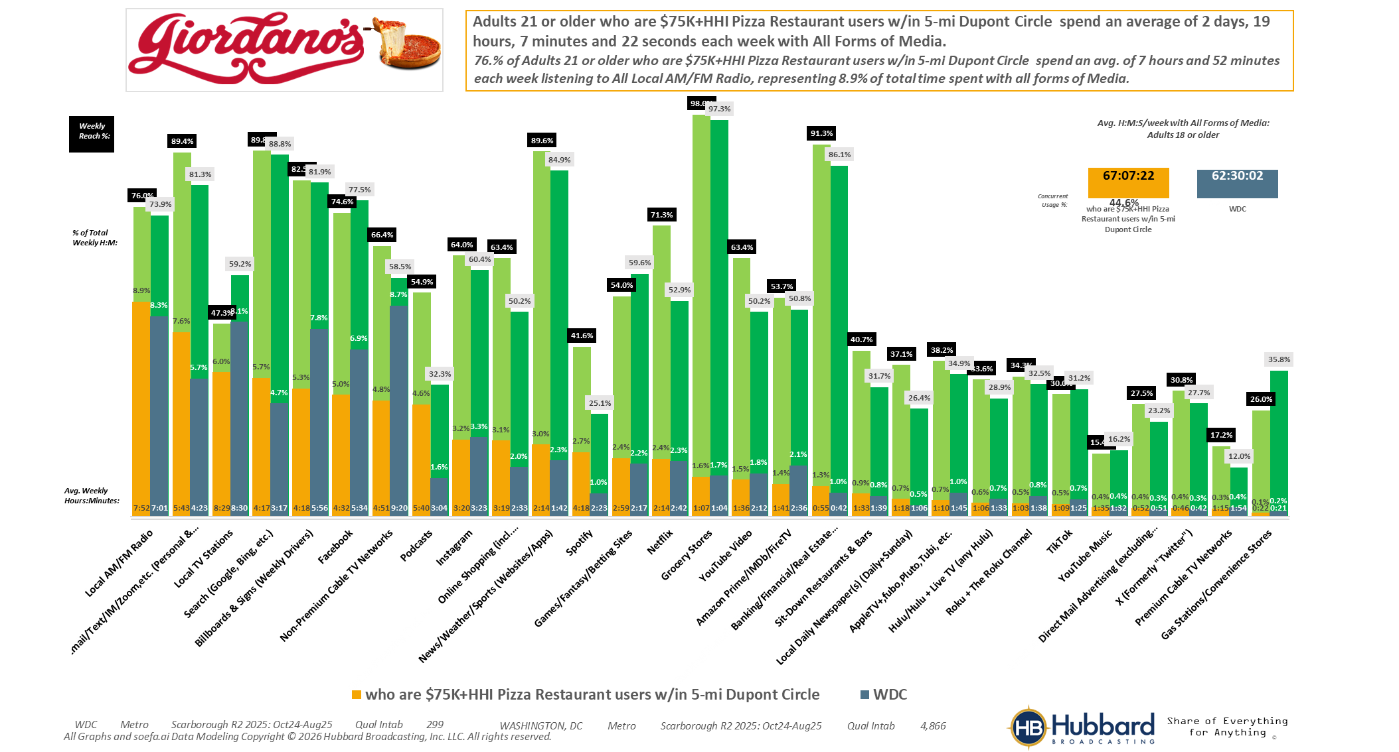
[((Household income summaries (HHLD): $75,000 or more AND Types of restaurants used past 30 days: Any pizza restaurant) AND (Zip code of residence: 20001 OR Zip code of residence: 20002 OR Zip code of residence: 20003 OR Zip code of residence: 20004 OR Zip code of residence: 20005 OR Zip code of residence: 20007 OR Zip code of residence: 20008 OR Zip code of residence: 20009 OR Zip code of residence: 20010 OR Zip code of residence: 20011 OR Zip code of residence: 20012 OR Zip code of residence: 20015 OR Zip code of residence: 20016 OR Zip code of residence: 20017 OR Zip code of residence: 20018 OR Zip code of residence: 20020 OR Zip code of residence: 20024 OR Zip code of residence: 20037 OR Zip code of residence: 20052 OR Zip code of residence: 20057 OR Zip code of residence: 20216 OR Zip code of residence: 20318 OR Zip code of residence: 20712 OR Zip code of residence: 22201 OR Zip code of residence: 22202 OR Zip code of residence: 22203 OR Zip code of residence: 22204 OR Zip code of residence: 22207 OR Zip code of residence: 22209 OR Zip code of residence: 22212 OR Zip code of employment: 20001 OR Zip code of employment: 20002 OR Zip code of employment: 20003 OR Zip code of employment: 20004 OR Zip code of employment: 20005 OR Zip code of employment: 20006 OR Zip code of employment: 20007 OR Zip code of employment: 20008 OR Zip code of employment: 20009 OR Zip code of employment: 20010 OR Zip code of employment: 20011 OR Zip code of employment: 20012 OR Zip code of employment: 20013 OR Zip code of employment: 20015 OR Zip code of employment: 20016 OR Zip code of employment: 20017 OR Zip code of employment: 20018 OR Zip code of employment: 20020 OR Zip code of employment: 20024 OR Zip code of employment: 20035 OR Zip code of employment: 20036 OR Zip code of employment: 20037 OR Zip code of employment: 20044 OR Zip code of employment: 20045 OR Zip code of employment: 20049 OR Zip code of employment: 20052 OR Zip code of employment: 20057 OR Zip code of employment: 20059 OR Zip code of employment: 20060 OR Zip code of employment: 20064 OR Zip code of employment: 20068 OR Zip code of employment: 20071 OR Zip code of employment: 20201 OR Zip code of employment: 20202 OR Zip code of employment: 20210 OR Zip code of employment: 20214 OR Zip code of employment: 20220 OR Zip code of employment: 20223 OR Zip code of employment: 20224 OR Zip code of employment: 20226 OR Zip code of employment: 20229 OR Zip code of employment: 20230 OR Zip code of employment: 20233 OR Zip code of employment: 20237 OR Zip code of employment: 20240 OR Zip code of employment: 20242 OR Zip code of employment: 20250 OR Zip code of employment: 20260 OR Zip code of employment: 20301 OR Zip code of employment: 20310 OR Zip code of employment: 20314 OR Zip code of employment: 20318 OR Zip code of employment: 20319 OR Zip code of employment: 20330 OR Zip code of employment: 20350 OR Zip code of employment: 20373 OR Zip code of employment: 20374 OR Zip code of employment: 20376 OR Zip code of employment: 20401 OR Zip code of employment: 20410 OR Zip code of employment: 20415 OR Zip code of employment: 20420 OR Zip code of employment: 20422 OR Zip code of employment: 20431 OR Zip code of employment: 20433 OR Zip code of employment: 20442 OR Zip code of employment: 20451 OR Zip code of employment: 20460 OR Zip code of employment: 20472 OR Zip code of employment: 20500 OR Zip code of employment: 20502 OR Zip code of employment: 20504 OR Zip code of employment: 20505 OR Zip code of employment: 20507 OR Zip code of employment: 20510 OR Zip code of employment: 20515 OR Zip code of employment: 20520 OR Zip code of employment: 20527 OR Zip code of employment: 20530 OR Zip code of employment: 20533 OR Zip code of employment: 20535 OR Zip code of employment: 20540 OR Zip code of employment: 20543 OR Zip code of employment: 20548 OR Zip code of employment: 20551 OR Zip code of employment: 20554 OR Zip code of employment: 20560 OR Zip code of employment: 20565 OR Zip code of employment: 20566 OR Zip code of employment: 20577 OR Zip code of employment: 20581 OR Zip code of employment: 20585 OR Zip code of employment: 20590 OR Zip code of employment: 20591 OR Zip code of employment: 20593 OR Zip code of employment: 22003 OR Zip code of employment: 22015 OR Zip code of employment: 22201 OR Zip code of employment: 22202 OR Zip code of employment: 22203 OR Zip code of employment: 22204 OR Zip code of employment: 22207 OR Zip code of employment: 22209))]

Slide 8
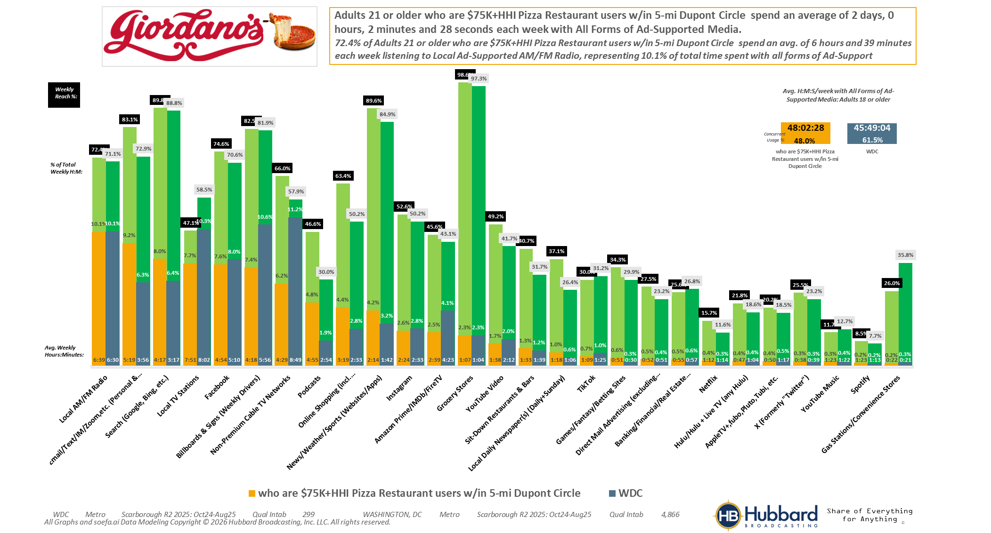
[((Household income summaries (HHLD): $75,000 or more AND Types of restaurants used past 30 days: Any pizza restaurant) AND (Zip code of residence: 20001 OR Zip code of residence: 20002 OR Zip code of residence: 20003 OR Zip code of residence: 20004 OR Zip code of residence: 20005 OR Zip code of residence: 20007 OR Zip code of residence: 20008 OR Zip code of residence: 20009 OR Zip code of residence: 20010 OR Zip code of residence: 20011 OR Zip code of residence: 20012 OR Zip code of residence: 20015 OR Zip code of residence: 20016 OR Zip code of residence: 20017 OR Zip code of residence: 20018 OR Zip code of residence: 20020 OR Zip code of residence: 20024 OR Zip code of residence: 20037 OR Zip code of residence: 20052 OR Zip code of residence: 20057 OR Zip code of residence: 20216 OR Zip code of residence: 20318 OR Zip code of residence: 20712 OR Zip code of residence: 22201 OR Zip code of residence: 22202 OR Zip code of residence: 22203 OR Zip code of residence: 22204 OR Zip code of residence: 22207 OR Zip code of residence: 22209 OR Zip code of residence: 22212 OR Zip code of employment: 20001 OR Zip code of employment: 20002 OR Zip code of employment: 20003 OR Zip code of employment: 20004 OR Zip code of employment: 20005 OR Zip code of employment: 20006 OR Zip code of employment: 20007 OR Zip code of employment: 20008 OR Zip code of employment: 20009 OR Zip code of employment: 20010 OR Zip code of employment: 20011 OR Zip code of employment: 20012 OR Zip code of employment: 20013 OR Zip code of employment: 20015 OR Zip code of employment: 20016 OR Zip code of employment: 20017 OR Zip code of employment: 20018 OR Zip code of employment: 20020 OR Zip code of employment: 20024 OR Zip code of employment: 20035 OR Zip code of employment: 20036 OR Zip code of employment: 20037 OR Zip code of employment: 20044 OR Zip code of employment: 20045 OR Zip code of employment: 20049 OR Zip code of employment: 20052 OR Zip code of employment: 20057 OR Zip code of employment: 20059 OR Zip code of employment: 20060 OR Zip code of employment: 20064 OR Zip code of employment: 20068 OR Zip code of employment: 20071 OR Zip code of employment: 20201 OR Zip code of employment: 20202 OR Zip code of employment: 20210 OR Zip code of employment: 20214 OR Zip code of employment: 20220 OR Zip code of employment: 20223 OR Zip code of employment: 20224 OR Zip code of employment: 20226 OR Zip code of employment: 20229 OR Zip code of employment: 20230 OR Zip code of employment: 20233 OR Zip code of employment: 20237 OR Zip code of employment: 20240 OR Zip code of employment: 20242 OR Zip code of employment: 20250 OR Zip code of employment: 20260 OR Zip code of employment: 20301 OR Zip code of employment: 20310 OR Zip code of employment: 20314 OR Zip code of employment: 20318 OR Zip code of employment: 20319 OR Zip code of employment: 20330 OR Zip code of employment: 20350 OR Zip code of employment: 20373 OR Zip code of employment: 20374 OR Zip code of employment: 20376 OR Zip code of employment: 20401 OR Zip code of employment: 20410 OR Zip code of employment: 20415 OR Zip code of employment: 20420 OR Zip code of employment: 20422 OR Zip code of employment: 20431 OR Zip code of employment: 20433 OR Zip code of employment: 20442 OR Zip code of employment: 20451 OR Zip code of employment: 20460 OR Zip code of employment: 20472 OR Zip code of employment: 20500 OR Zip code of employment: 20502 OR Zip code of employment: 20504 OR Zip code of employment: 20505 OR Zip code of employment: 20507 OR Zip code of employment: 20510 OR Zip code of employment: 20515 OR Zip code of employment: 20520 OR Zip code of employment: 20527 OR Zip code of employment: 20530 OR Zip code of employment: 20533 OR Zip code of employment: 20535 OR Zip code of employment: 20540 OR Zip code of employment: 20543 OR Zip code of employment: 20548 OR Zip code of employment: 20551 OR Zip code of employment: 20554 OR Zip code of employment: 20560 OR Zip code of employment: 20565 OR Zip code of employment: 20566 OR Zip code of employment: 20577 OR Zip code of employment: 20581 OR Zip code of employment: 20585 OR Zip code of employment: 20590 OR Zip code of employment: 20591 OR Zip code of employment: 20593 OR Zip code of employment: 22003 OR Zip code of employment: 22015 OR Zip code of employment: 22201 OR Zip code of employment: 22202 OR Zip code of employment: 22203 OR Zip code of employment: 22204 OR Zip code of employment: 22207 OR Zip code of employment: 22209))]

Slide 9
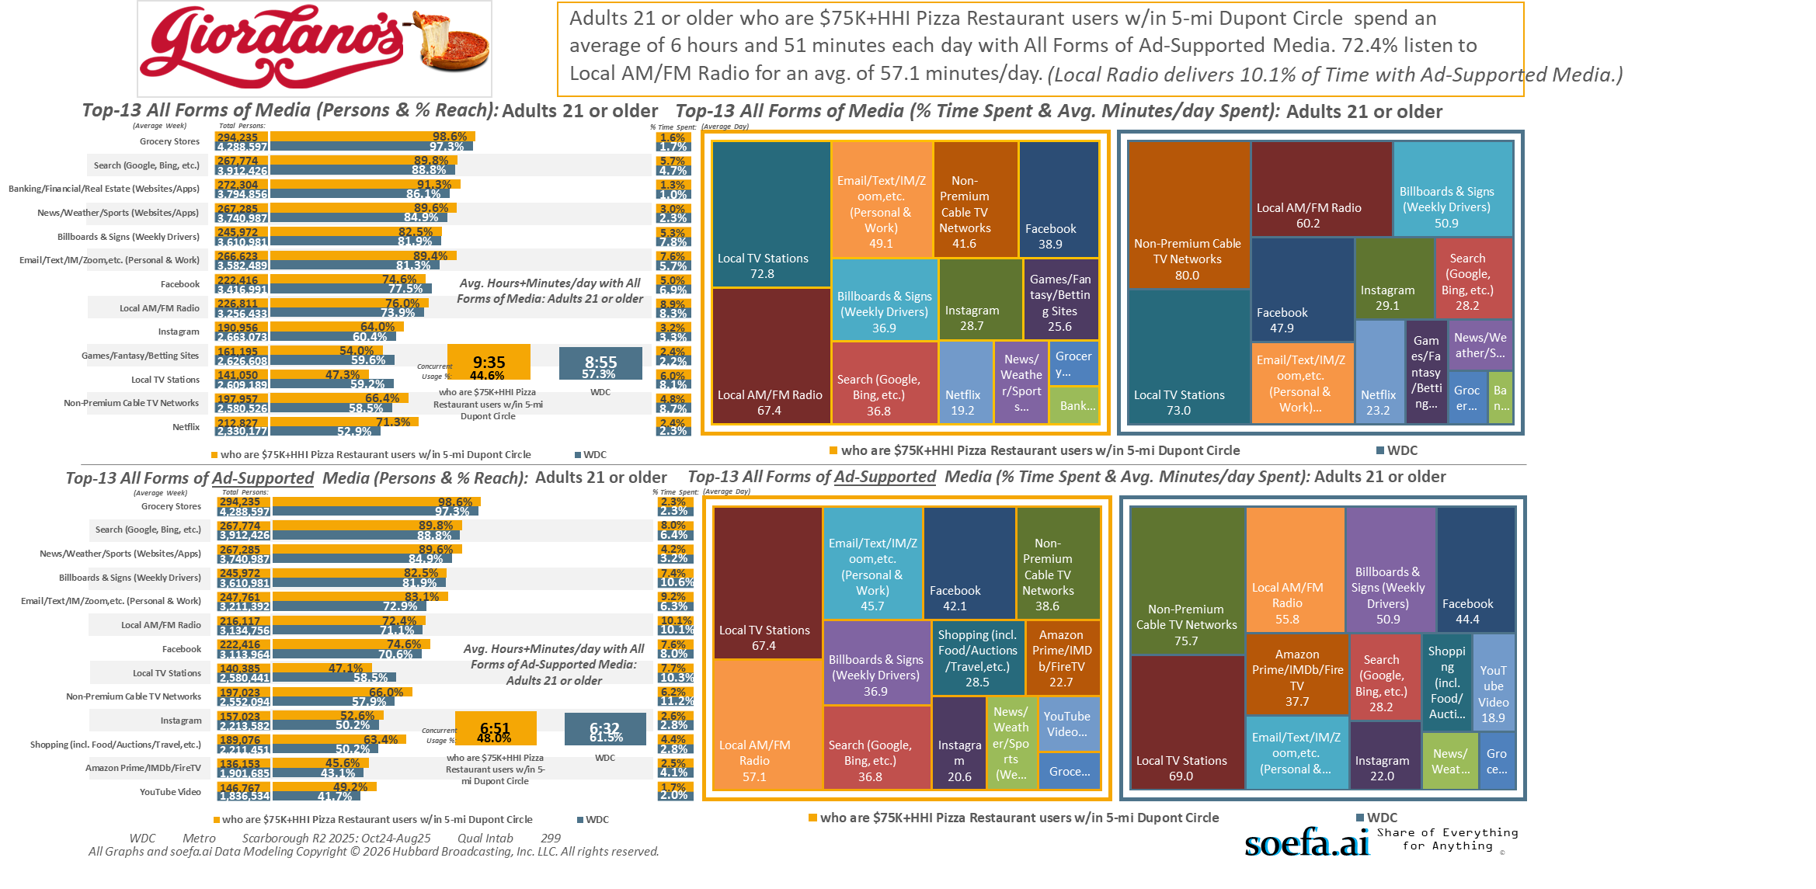
[((Household income summaries (HHLD): $75,000 or more AND Types of restaurants used past 30 days: Any pizza restaurant) AND (Zip code of residence: 20001 OR Zip code of residence: 20002 OR Zip code of residence: 20003 OR Zip code of residence: 20004 OR Zip code of residence: 20005 OR Zip code of residence: 20007 OR Zip code of residence: 20008 OR Zip code of residence: 20009 OR Zip code of residence: 20010 OR Zip code of residence: 20011 OR Zip code of residence: 20012 OR Zip code of residence: 20015 OR Zip code of residence: 20016 OR Zip code of residence: 20017 OR Zip code of residence: 20018 OR Zip code of residence: 20020 OR Zip code of residence: 20024 OR Zip code of residence: 20037 OR Zip code of residence: 20052 OR Zip code of residence: 20057 OR Zip code of residence: 20216 OR Zip code of residence: 20318 OR Zip code of residence: 20712 OR Zip code of residence: 22201 OR Zip code of residence: 22202 OR Zip code of residence: 22203 OR Zip code of residence: 22204 OR Zip code of residence: 22207 OR Zip code of residence: 22209 OR Zip code of residence: 22212 OR Zip code of employment: 20001 OR Zip code of employment: 20002 OR Zip code of employment: 20003 OR Zip code of employment: 20004 OR Zip code of employment: 20005 OR Zip code of employment: 20006 OR Zip code of employment: 20007 OR Zip code of employment: 20008 OR Zip code of employment: 20009 OR Zip code of employment: 20010 OR Zip code of employment: 20011 OR Zip code of employment: 20012 OR Zip code of employment: 20013 OR Zip code of employment: 20015 OR Zip code of employment: 20016 OR Zip code of employment: 20017 OR Zip code of employment: 20018 OR Zip code of employment: 20020 OR Zip code of employment: 20024 OR Zip code of employment: 20035 OR Zip code of employment: 20036 OR Zip code of employment: 20037 OR Zip code of employment: 20044 OR Zip code of employment: 20045 OR Zip code of employment: 20049 OR Zip code of employment: 20052 OR Zip code of employment: 20057 OR Zip code of employment: 20059 OR Zip code of employment: 20060 OR Zip code of employment: 20064 OR Zip code of employment: 20068 OR Zip code of employment: 20071 OR Zip code of employment: 20201 OR Zip code of employment: 20202 OR Zip code of employment: 20210 OR Zip code of employment: 20214 OR Zip code of employment: 20220 OR Zip code of employment: 20223 OR Zip code of employment: 20224 OR Zip code of employment: 20226 OR Zip code of employment: 20229 OR Zip code of employment: 20230 OR Zip code of employment: 20233 OR Zip code of employment: 20237 OR Zip code of employment: 20240 OR Zip code of employment: 20242 OR Zip code of employment: 20250 OR Zip code of employment: 20260 OR Zip code of employment: 20301 OR Zip code of employment: 20310 OR Zip code of employment: 20314 OR Zip code of employment: 20318 OR Zip code of employment: 20319 OR Zip code of employment: 20330 OR Zip code of employment: 20350 OR Zip code of employment: 20373 OR Zip code of employment: 20374 OR Zip code of employment: 20376 OR Zip code of employment: 20401 OR Zip code of employment: 20410 OR Zip code of employment: 20415 OR Zip code of employment: 20420 OR Zip code of employment: 20422 OR Zip code of employment: 20431 OR Zip code of employment: 20433 OR Zip code of employment: 20442 OR Zip code of employment: 20451 OR Zip code of employment: 20460 OR Zip code of employment: 20472 OR Zip code of employment: 20500 OR Zip code of employment: 20502 OR Zip code of employment: 20504 OR Zip code of employment: 20505 OR Zip code of employment: 20507 OR Zip code of employment: 20510 OR Zip code of employment: 20515 OR Zip code of employment: 20520 OR Zip code of employment: 20527 OR Zip code of employment: 20530 OR Zip code of employment: 20533 OR Zip code of employment: 20535 OR Zip code of employment: 20540 OR Zip code of employment: 20543 OR Zip code of employment: 20548 OR Zip code of employment: 20551 OR Zip code of employment: 20554 OR Zip code of employment: 20560 OR Zip code of employment: 20565 OR Zip code of employment: 20566 OR Zip code of employment: 20577 OR Zip code of employment: 20581 OR Zip code of employment: 20585 OR Zip code of employment: 20590 OR Zip code of employment: 20591 OR Zip code of employment: 20593 OR Zip code of employment: 22003 OR Zip code of employment: 22015 OR Zip code of employment: 22201 OR Zip code of employment: 22202 OR Zip code of employment: 22203 OR Zip code of employment: 22204 OR Zip code of employment: 22207 OR Zip code of employment: 22209))]

Slide 10
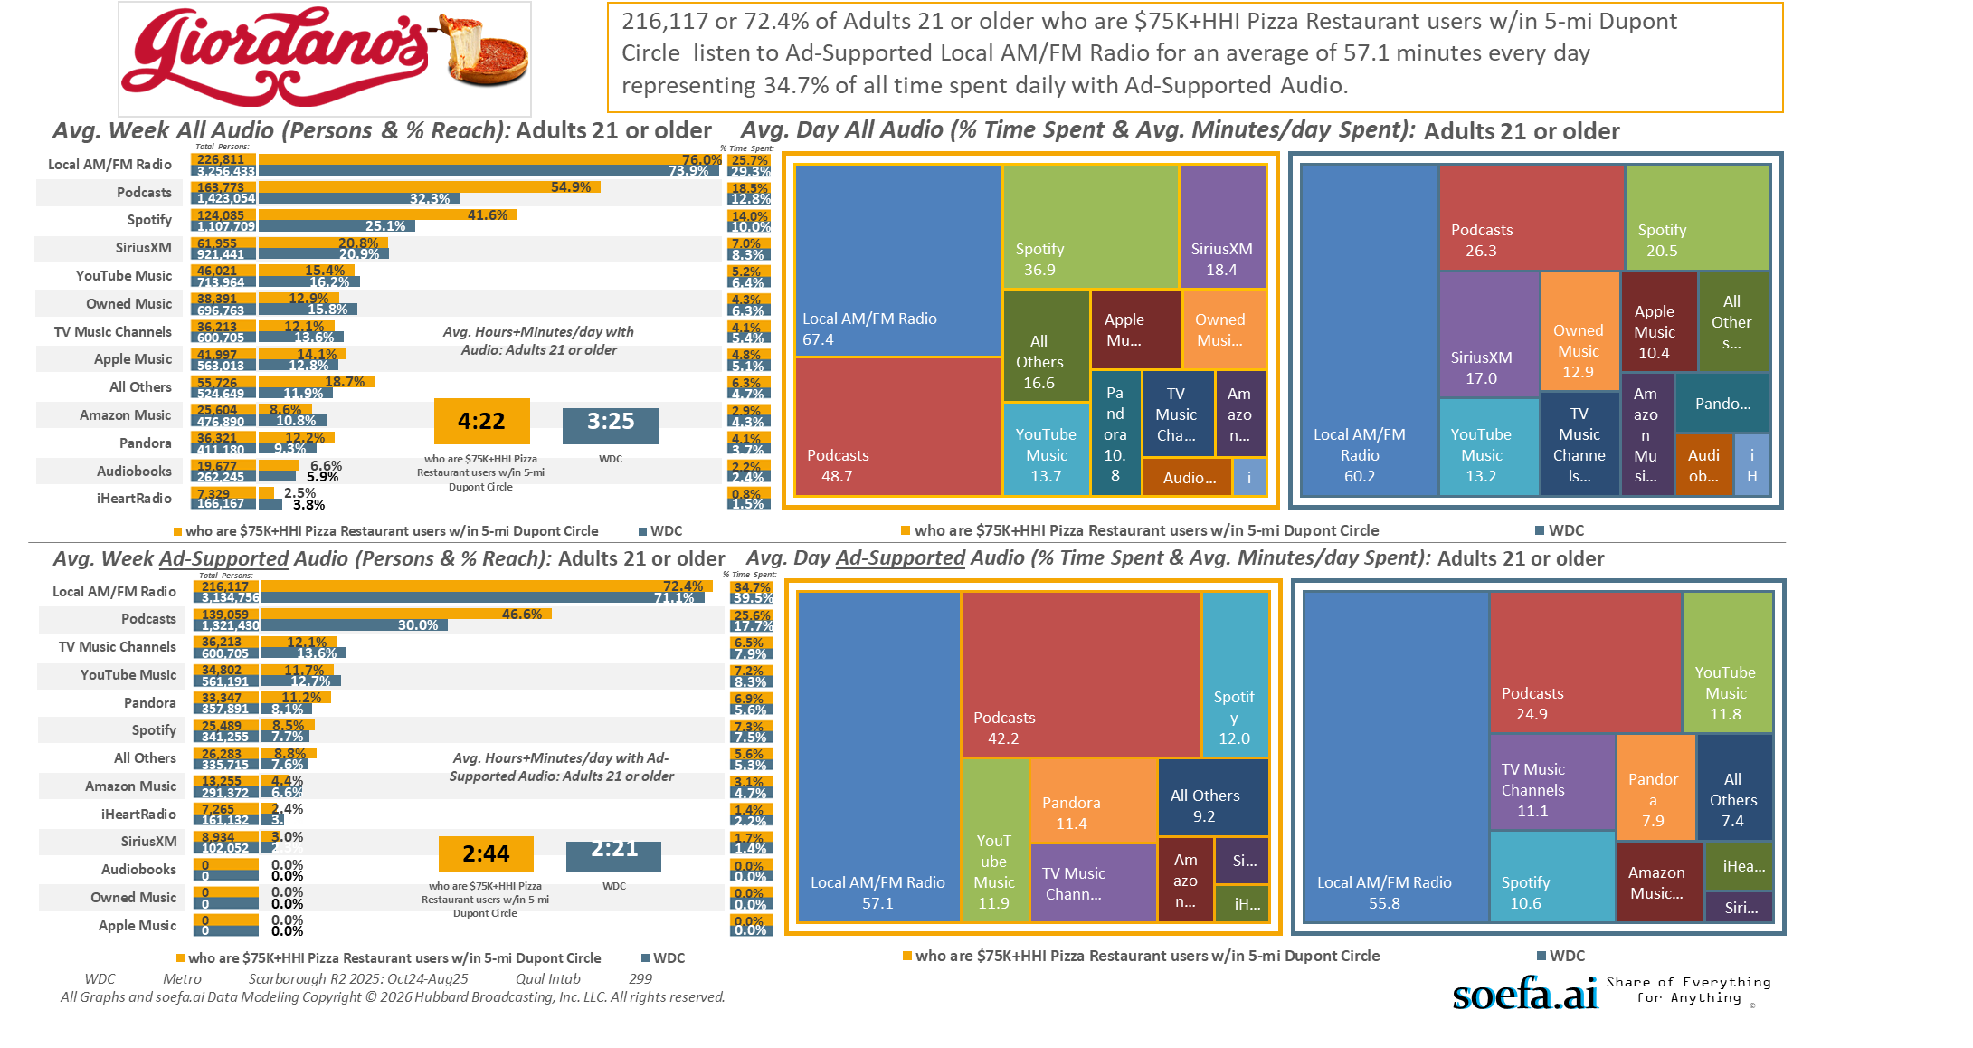
[((Household income summaries (HHLD): $75,000 or more AND Types of restaurants used past 30 days: Any pizza restaurant) AND (Zip code of residence: 20001 OR Zip code of residence: 20002 OR Zip code of residence: 20003 OR Zip code of residence: 20004 OR Zip code of residence: 20005 OR Zip code of residence: 20007 OR Zip code of residence: 20008 OR Zip code of residence: 20009 OR Zip code of residence: 20010 OR Zip code of residence: 20011 OR Zip code of residence: 20012 OR Zip code of residence: 20015 OR Zip code of residence: 20016 OR Zip code of residence: 20017 OR Zip code of residence: 20018 OR Zip code of residence: 20020 OR Zip code of residence: 20024 OR Zip code of residence: 20037 OR Zip code of residence: 20052 OR Zip code of residence: 20057 OR Zip code of residence: 20216 OR Zip code of residence: 20318 OR Zip code of residence: 20712 OR Zip code of residence: 22201 OR Zip code of residence: 22202 OR Zip code of residence: 22203 OR Zip code of residence: 22204 OR Zip code of residence: 22207 OR Zip code of residence: 22209 OR Zip code of residence: 22212 OR Zip code of employment: 20001 OR Zip code of employment: 20002 OR Zip code of employment: 20003 OR Zip code of employment: 20004 OR Zip code of employment: 20005 OR Zip code of employment: 20006 OR Zip code of employment: 20007 OR Zip code of employment: 20008 OR Zip code of employment: 20009 OR Zip code of employment: 20010 OR Zip code of employment: 20011 OR Zip code of employment: 20012 OR Zip code of employment: 20013 OR Zip code of employment: 20015 OR Zip code of employment: 20016 OR Zip code of employment: 20017 OR Zip code of employment: 20018 OR Zip code of employment: 20020 OR Zip code of employment: 20024 OR Zip code of employment: 20035 OR Zip code of employment: 20036 OR Zip code of employment: 20037 OR Zip code of employment: 20044 OR Zip code of employment: 20045 OR Zip code of employment: 20049 OR Zip code of employment: 20052 OR Zip code of employment: 20057 OR Zip code of employment: 20059 OR Zip code of employment: 20060 OR Zip code of employment: 20064 OR Zip code of employment: 20068 OR Zip code of employment: 20071 OR Zip code of employment: 20201 OR Zip code of employment: 20202 OR Zip code of employment: 20210 OR Zip code of employment: 20214 OR Zip code of employment: 20220 OR Zip code of employment: 20223 OR Zip code of employment: 20224 OR Zip code of employment: 20226 OR Zip code of employment: 20229 OR Zip code of employment: 20230 OR Zip code of employment: 20233 OR Zip code of employment: 20237 OR Zip code of employment: 20240 OR Zip code of employment: 20242 OR Zip code of employment: 20250 OR Zip code of employment: 20260 OR Zip code of employment: 20301 OR Zip code of employment: 20310 OR Zip code of employment: 20314 OR Zip code of employment: 20318 OR Zip code of employment: 20319 OR Zip code of employment: 20330 OR Zip code of employment: 20350 OR Zip code of employment: 20373 OR Zip code of employment: 20374 OR Zip code of employment: 20376 OR Zip code of employment: 20401 OR Zip code of employment: 20410 OR Zip code of employment: 20415 OR Zip code of employment: 20420 OR Zip code of employment: 20422 OR Zip code of employment: 20431 OR Zip code of employment: 20433 OR Zip code of employment: 20442 OR Zip code of employment: 20451 OR Zip code of employment: 20460 OR Zip code of employment: 20472 OR Zip code of employment: 20500 OR Zip code of employment: 20502 OR Zip code of employment: 20504 OR Zip code of employment: 20505 OR Zip code of employment: 20507 OR Zip code of employment: 20510 OR Zip code of employment: 20515 OR Zip code of employment: 20520 OR Zip code of employment: 20527 OR Zip code of employment: 20530 OR Zip code of employment: 20533 OR Zip code of employment: 20535 OR Zip code of employment: 20540 OR Zip code of employment: 20543 OR Zip code of employment: 20548 OR Zip code of employment: 20551 OR Zip code of employment: 20554 OR Zip code of employment: 20560 OR Zip code of employment: 20565 OR Zip code of employment: 20566 OR Zip code of employment: 20577 OR Zip code of employment: 20581 OR Zip code of employment: 20585 OR Zip code of employment: 20590 OR Zip code of employment: 20591 OR Zip code of employment: 20593 OR Zip code of employment: 22003 OR Zip code of employment: 22015 OR Zip code of employment: 22201 OR Zip code of employment: 22202 OR Zip code of employment: 22203 OR Zip code of employment: 22204 OR Zip code of employment: 22207 OR Zip code of employment: 22209))]

Slide 11
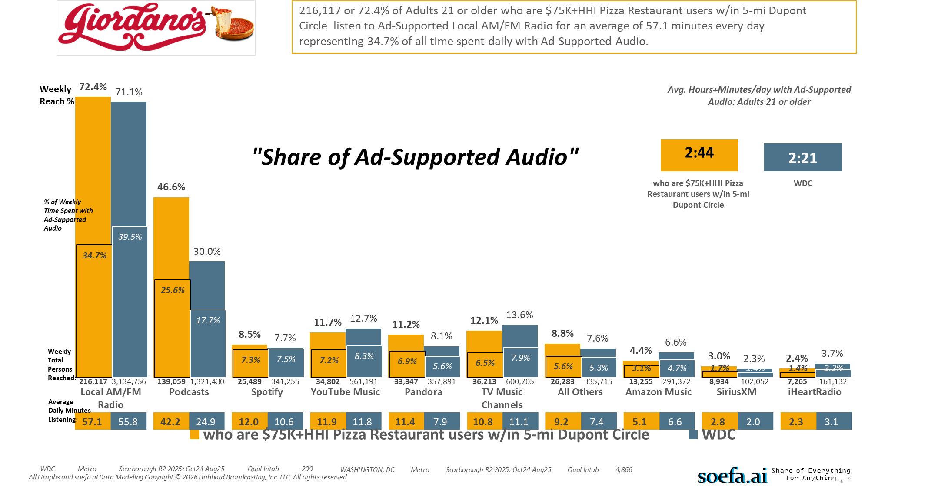
[((Household income summaries (HHLD): $75,000 or more AND Types of restaurants used past 30 days: Any pizza restaurant) AND (Zip code of residence: 20001 OR Zip code of residence: 20002 OR Zip code of residence: 20003 OR Zip code of residence: 20004 OR Zip code of residence: 20005 OR Zip code of residence: 20007 OR Zip code of residence: 20008 OR Zip code of residence: 20009 OR Zip code of residence: 20010 OR Zip code of residence: 20011 OR Zip code of residence: 20012 OR Zip code of residence: 20015 OR Zip code of residence: 20016 OR Zip code of residence: 20017 OR Zip code of residence: 20018 OR Zip code of residence: 20020 OR Zip code of residence: 20024 OR Zip code of residence: 20037 OR Zip code of residence: 20052 OR Zip code of residence: 20057 OR Zip code of residence: 20216 OR Zip code of residence: 20318 OR Zip code of residence: 20712 OR Zip code of residence: 22201 OR Zip code of residence: 22202 OR Zip code of residence: 22203 OR Zip code of residence: 22204 OR Zip code of residence: 22207 OR Zip code of residence: 22209 OR Zip code of residence: 22212 OR Zip code of employment: 20001 OR Zip code of employment: 20002 OR Zip code of employment: 20003 OR Zip code of employment: 20004 OR Zip code of employment: 20005 OR Zip code of employment: 20006 OR Zip code of employment: 20007 OR Zip code of employment: 20008 OR Zip code of employment: 20009 OR Zip code of employment: 20010 OR Zip code of employment: 20011 OR Zip code of employment: 20012 OR Zip code of employment: 20013 OR Zip code of employment: 20015 OR Zip code of employment: 20016 OR Zip code of employment: 20017 OR Zip code of employment: 20018 OR Zip code of employment: 20020 OR Zip code of employment: 20024 OR Zip code of employment: 20035 OR Zip code of employment: 20036 OR Zip code of employment: 20037 OR Zip code of employment: 20044 OR Zip code of employment: 20045 OR Zip code of employment: 20049 OR Zip code of employment: 20052 OR Zip code of employment: 20057 OR Zip code of employment: 20059 OR Zip code of employment: 20060 OR Zip code of employment: 20064 OR Zip code of employment: 20068 OR Zip code of employment: 20071 OR Zip code of employment: 20201 OR Zip code of employment: 20202 OR Zip code of employment: 20210 OR Zip code of employment: 20214 OR Zip code of employment: 20220 OR Zip code of employment: 20223 OR Zip code of employment: 20224 OR Zip code of employment: 20226 OR Zip code of employment: 20229 OR Zip code of employment: 20230 OR Zip code of employment: 20233 OR Zip code of employment: 20237 OR Zip code of employment: 20240 OR Zip code of employment: 20242 OR Zip code of employment: 20250 OR Zip code of employment: 20260 OR Zip code of employment: 20301 OR Zip code of employment: 20310 OR Zip code of employment: 20314 OR Zip code of employment: 20318 OR Zip code of employment: 20319 OR Zip code of employment: 20330 OR Zip code of employment: 20350 OR Zip code of employment: 20373 OR Zip code of employment: 20374 OR Zip code of employment: 20376 OR Zip code of employment: 20401 OR Zip code of employment: 20410 OR Zip code of employment: 20415 OR Zip code of employment: 20420 OR Zip code of employment: 20422 OR Zip code of employment: 20431 OR Zip code of employment: 20433 OR Zip code of employment: 20442 OR Zip code of employment: 20451 OR Zip code of employment: 20460 OR Zip code of employment: 20472 OR Zip code of employment: 20500 OR Zip code of employment: 20502 OR Zip code of employment: 20504 OR Zip code of employment: 20505 OR Zip code of employment: 20507 OR Zip code of employment: 20510 OR Zip code of employment: 20515 OR Zip code of employment: 20520 OR Zip code of employment: 20527 OR Zip code of employment: 20530 OR Zip code of employment: 20533 OR Zip code of employment: 20535 OR Zip code of employment: 20540 OR Zip code of employment: 20543 OR Zip code of employment: 20548 OR Zip code of employment: 20551 OR Zip code of employment: 20554 OR Zip code of employment: 20560 OR Zip code of employment: 20565 OR Zip code of employment: 20566 OR Zip code of employment: 20577 OR Zip code of employment: 20581 OR Zip code of employment: 20585 OR Zip code of employment: 20590 OR Zip code of employment: 20591 OR Zip code of employment: 20593 OR Zip code of employment: 22003 OR Zip code of employment: 22015 OR Zip code of employment: 22201 OR Zip code of employment: 22202 OR Zip code of employment: 22203 OR Zip code of employment: 22204 OR Zip code of employment: 22207 OR Zip code of employment: 22209))]

Slide 12
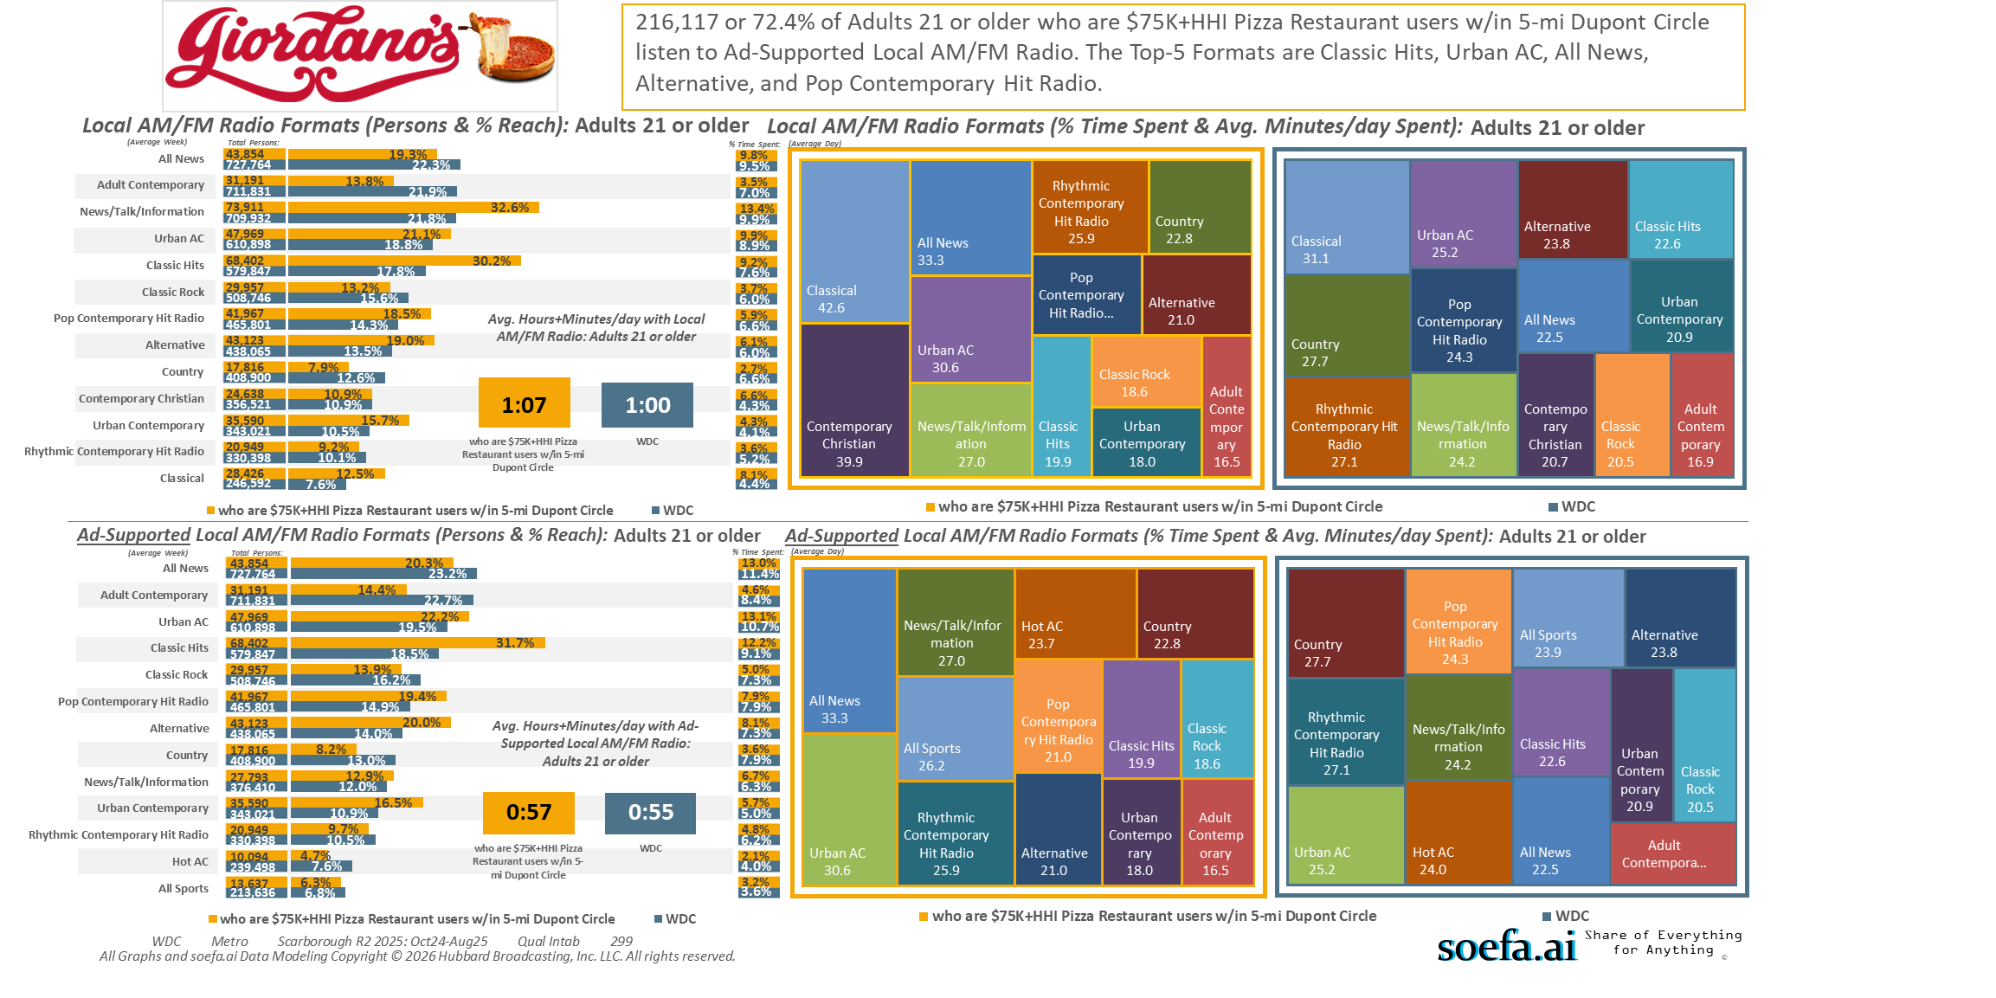
[((Household income summaries (HHLD): $75,000 or more AND Types of restaurants used past 30 days: Any pizza restaurant) AND (Zip code of residence: 20001 OR Zip code of residence: 20002 OR Zip code of residence: 20003 OR Zip code of residence: 20004 OR Zip code of residence: 20005 OR Zip code of residence: 20007 OR Zip code of residence: 20008 OR Zip code of residence: 20009 OR Zip code of residence: 20010 OR Zip code of residence: 20011 OR Zip code of residence: 20012 OR Zip code of residence: 20015 OR Zip code of residence: 20016 OR Zip code of residence: 20017 OR Zip code of residence: 20018 OR Zip code of residence: 20020 OR Zip code of residence: 20024 OR Zip code of residence: 20037 OR Zip code of residence: 20052 OR Zip code of residence: 20057 OR Zip code of residence: 20216 OR Zip code of residence: 20318 OR Zip code of residence: 20712 OR Zip code of residence: 22201 OR Zip code of residence: 22202 OR Zip code of residence: 22203 OR Zip code of residence: 22204 OR Zip code of residence: 22207 OR Zip code of residence: 22209 OR Zip code of residence: 22212 OR Zip code of employment: 20001 OR Zip code of employment: 20002 OR Zip code of employment: 20003 OR Zip code of employment: 20004 OR Zip code of employment: 20005 OR Zip code of employment: 20006 OR Zip code of employment: 20007 OR Zip code of employment: 20008 OR Zip code of employment: 20009 OR Zip code of employment: 20010 OR Zip code of employment: 20011 OR Zip code of employment: 20012 OR Zip code of employment: 20013 OR Zip code of employment: 20015 OR Zip code of employment: 20016 OR Zip code of employment: 20017 OR Zip code of employment: 20018 OR Zip code of employment: 20020 OR Zip code of employment: 20024 OR Zip code of employment: 20035 OR Zip code of employment: 20036 OR Zip code of employment: 20037 OR Zip code of employment: 20044 OR Zip code of employment: 20045 OR Zip code of employment: 20049 OR Zip code of employment: 20052 OR Zip code of employment: 20057 OR Zip code of employment: 20059 OR Zip code of employment: 20060 OR Zip code of employment: 20064 OR Zip code of employment: 20068 OR Zip code of employment: 20071 OR Zip code of employment: 20201 OR Zip code of employment: 20202 OR Zip code of employment: 20210 OR Zip code of employment: 20214 OR Zip code of employment: 20220 OR Zip code of employment: 20223 OR Zip code of employment: 20224 OR Zip code of employment: 20226 OR Zip code of employment: 20229 OR Zip code of employment: 20230 OR Zip code of employment: 20233 OR Zip code of employment: 20237 OR Zip code of employment: 20240 OR Zip code of employment: 20242 OR Zip code of employment: 20250 OR Zip code of employment: 20260 OR Zip code of employment: 20301 OR Zip code of employment: 20310 OR Zip code of employment: 20314 OR Zip code of employment: 20318 OR Zip code of employment: 20319 OR Zip code of employment: 20330 OR Zip code of employment: 20350 OR Zip code of employment: 20373 OR Zip code of employment: 20374 OR Zip code of employment: 20376 OR Zip code of employment: 20401 OR Zip code of employment: 20410 OR Zip code of employment: 20415 OR Zip code of employment: 20420 OR Zip code of employment: 20422 OR Zip code of employment: 20431 OR Zip code of employment: 20433 OR Zip code of employment: 20442 OR Zip code of employment: 20451 OR Zip code of employment: 20460 OR Zip code of employment: 20472 OR Zip code of employment: 20500 OR Zip code of employment: 20502 OR Zip code of employment: 20504 OR Zip code of employment: 20505 OR Zip code of employment: 20507 OR Zip code of employment: 20510 OR Zip code of employment: 20515 OR Zip code of employment: 20520 OR Zip code of employment: 20527 OR Zip code of employment: 20530 OR Zip code of employment: 20533 OR Zip code of employment: 20535 OR Zip code of employment: 20540 OR Zip code of employment: 20543 OR Zip code of employment: 20548 OR Zip code of employment: 20551 OR Zip code of employment: 20554 OR Zip code of employment: 20560 OR Zip code of employment: 20565 OR Zip code of employment: 20566 OR Zip code of employment: 20577 OR Zip code of employment: 20581 OR Zip code of employment: 20585 OR Zip code of employment: 20590 OR Zip code of employment: 20591 OR Zip code of employment: 20593 OR Zip code of employment: 22003 OR Zip code of employment: 22015 OR Zip code of employment: 22201 OR Zip code of employment: 22202 OR Zip code of employment: 22203 OR Zip code of employment: 22204 OR Zip code of employment: 22207 OR Zip code of employment: 22209))]

Slide 13
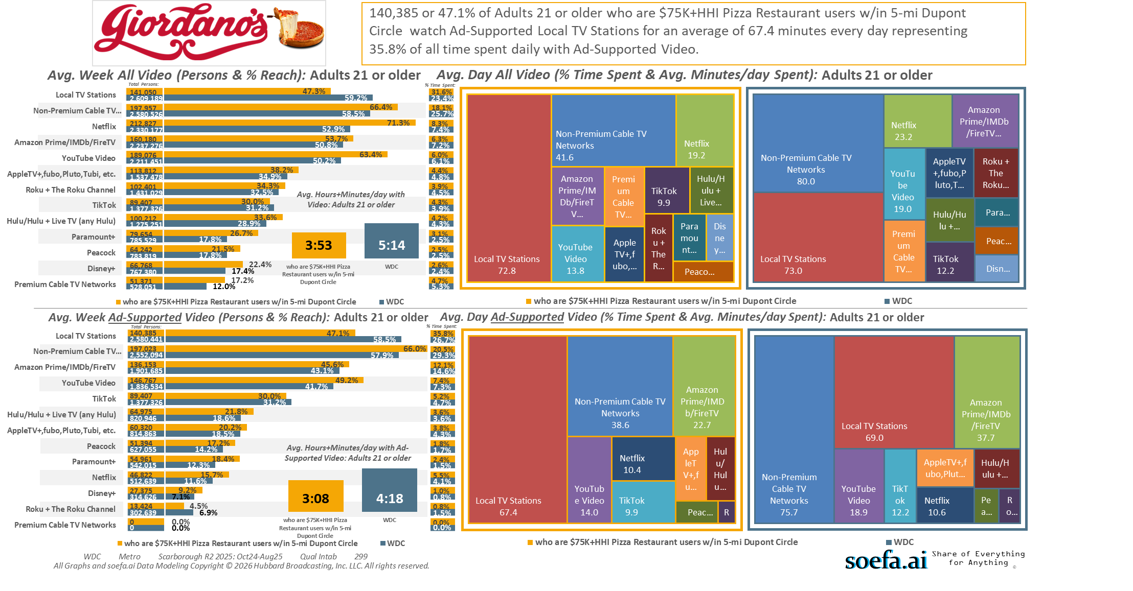
[((Household income summaries (HHLD): $75,000 or more AND Types of restaurants used past 30 days: Any pizza restaurant) AND (Zip code of residence: 20001 OR Zip code of residence: 20002 OR Zip code of residence: 20003 OR Zip code of residence: 20004 OR Zip code of residence: 20005 OR Zip code of residence: 20007 OR Zip code of residence: 20008 OR Zip code of residence: 20009 OR Zip code of residence: 20010 OR Zip code of residence: 20011 OR Zip code of residence: 20012 OR Zip code of residence: 20015 OR Zip code of residence: 20016 OR Zip code of residence: 20017 OR Zip code of residence: 20018 OR Zip code of residence: 20020 OR Zip code of residence: 20024 OR Zip code of residence: 20037 OR Zip code of residence: 20052 OR Zip code of residence: 20057 OR Zip code of residence: 20216 OR Zip code of residence: 20318 OR Zip code of residence: 20712 OR Zip code of residence: 22201 OR Zip code of residence: 22202 OR Zip code of residence: 22203 OR Zip code of residence: 22204 OR Zip code of residence: 22207 OR Zip code of residence: 22209 OR Zip code of residence: 22212 OR Zip code of employment: 20001 OR Zip code of employment: 20002 OR Zip code of employment: 20003 OR Zip code of employment: 20004 OR Zip code of employment: 20005 OR Zip code of employment: 20006 OR Zip code of employment: 20007 OR Zip code of employment: 20008 OR Zip code of employment: 20009 OR Zip code of employment: 20010 OR Zip code of employment: 20011 OR Zip code of employment: 20012 OR Zip code of employment: 20013 OR Zip code of employment: 20015 OR Zip code of employment: 20016 OR Zip code of employment: 20017 OR Zip code of employment: 20018 OR Zip code of employment: 20020 OR Zip code of employment: 20024 OR Zip code of employment: 20035 OR Zip code of employment: 20036 OR Zip code of employment: 20037 OR Zip code of employment: 20044 OR Zip code of employment: 20045 OR Zip code of employment: 20049 OR Zip code of employment: 20052 OR Zip code of employment: 20057 OR Zip code of employment: 20059 OR Zip code of employment: 20060 OR Zip code of employment: 20064 OR Zip code of employment: 20068 OR Zip code of employment: 20071 OR Zip code of employment: 20201 OR Zip code of employment: 20202 OR Zip code of employment: 20210 OR Zip code of employment: 20214 OR Zip code of employment: 20220 OR Zip code of employment: 20223 OR Zip code of employment: 20224 OR Zip code of employment: 20226 OR Zip code of employment: 20229 OR Zip code of employment: 20230 OR Zip code of employment: 20233 OR Zip code of employment: 20237 OR Zip code of employment: 20240 OR Zip code of employment: 20242 OR Zip code of employment: 20250 OR Zip code of employment: 20260 OR Zip code of employment: 20301 OR Zip code of employment: 20310 OR Zip code of employment: 20314 OR Zip code of employment: 20318 OR Zip code of employment: 20319 OR Zip code of employment: 20330 OR Zip code of employment: 20350 OR Zip code of employment: 20373 OR Zip code of employment: 20374 OR Zip code of employment: 20376 OR Zip code of employment: 20401 OR Zip code of employment: 20410 OR Zip code of employment: 20415 OR Zip code of employment: 20420 OR Zip code of employment: 20422 OR Zip code of employment: 20431 OR Zip code of employment: 20433 OR Zip code of employment: 20442 OR Zip code of employment: 20451 OR Zip code of employment: 20460 OR Zip code of employment: 20472 OR Zip code of employment: 20500 OR Zip code of employment: 20502 OR Zip code of employment: 20504 OR Zip code of employment: 20505 OR Zip code of employment: 20507 OR Zip code of employment: 20510 OR Zip code of employment: 20515 OR Zip code of employment: 20520 OR Zip code of employment: 20527 OR Zip code of employment: 20530 OR Zip code of employment: 20533 OR Zip code of employment: 20535 OR Zip code of employment: 20540 OR Zip code of employment: 20543 OR Zip code of employment: 20548 OR Zip code of employment: 20551 OR Zip code of employment: 20554 OR Zip code of employment: 20560 OR Zip code of employment: 20565 OR Zip code of employment: 20566 OR Zip code of employment: 20577 OR Zip code of employment: 20581 OR Zip code of employment: 20585 OR Zip code of employment: 20590 OR Zip code of employment: 20591 OR Zip code of employment: 20593 OR Zip code of employment: 22003 OR Zip code of employment: 22015 OR Zip code of employment: 22201 OR Zip code of employment: 22202 OR Zip code of employment: 22203 OR Zip code of employment: 22204 OR Zip code of employment: 22207 OR Zip code of employment: 22209))]

Slide 14
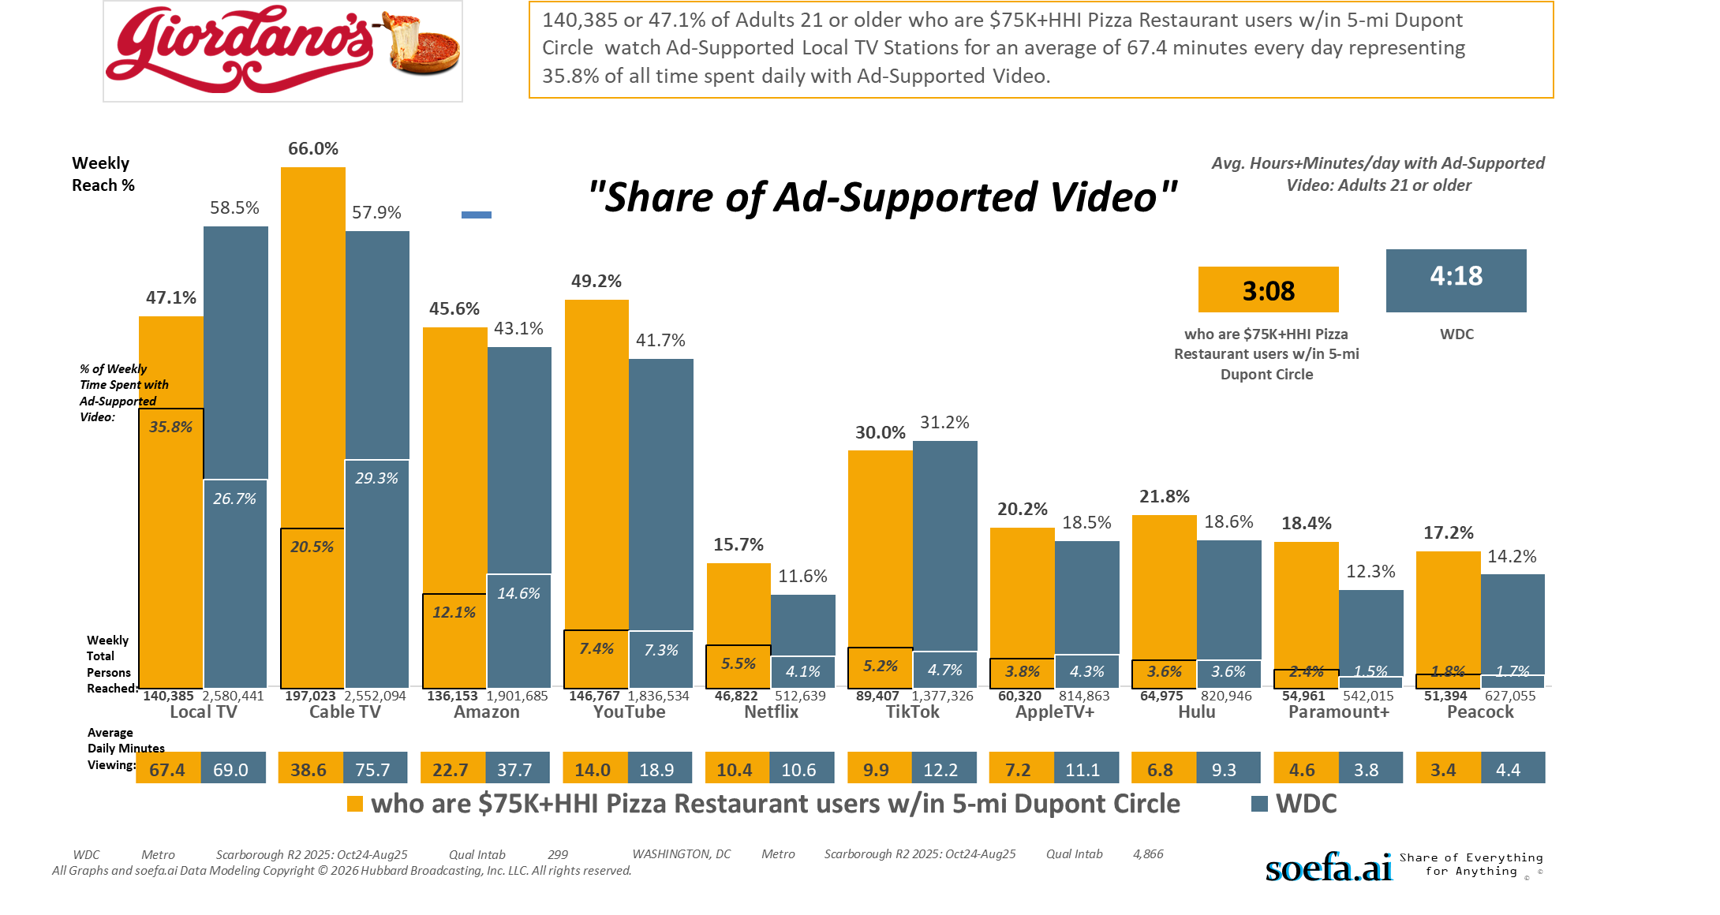
[((Household income summaries (HHLD): $75,000 or more AND Types of restaurants used past 30 days: Any pizza restaurant) AND (Zip code of residence: 20001 OR Zip code of residence: 20002 OR Zip code of residence: 20003 OR Zip code of residence: 20004 OR Zip code of residence: 20005 OR Zip code of residence: 20007 OR Zip code of residence: 20008 OR Zip code of residence: 20009 OR Zip code of residence: 20010 OR Zip code of residence: 20011 OR Zip code of residence: 20012 OR Zip code of residence: 20015 OR Zip code of residence: 20016 OR Zip code of residence: 20017 OR Zip code of residence: 20018 OR Zip code of residence: 20020 OR Zip code of residence: 20024 OR Zip code of residence: 20037 OR Zip code of residence: 20052 OR Zip code of residence: 20057 OR Zip code of residence: 20216 OR Zip code of residence: 20318 OR Zip code of residence: 20712 OR Zip code of residence: 22201 OR Zip code of residence: 22202 OR Zip code of residence: 22203 OR Zip code of residence: 22204 OR Zip code of residence: 22207 OR Zip code of residence: 22209 OR Zip code of residence: 22212 OR Zip code of employment: 20001 OR Zip code of employment: 20002 OR Zip code of employment: 20003 OR Zip code of employment: 20004 OR Zip code of employment: 20005 OR Zip code of employment: 20006 OR Zip code of employment: 20007 OR Zip code of employment: 20008 OR Zip code of employment: 20009 OR Zip code of employment: 20010 OR Zip code of employment: 20011 OR Zip code of employment: 20012 OR Zip code of employment: 20013 OR Zip code of employment: 20015 OR Zip code of employment: 20016 OR Zip code of employment: 20017 OR Zip code of employment: 20018 OR Zip code of employment: 20020 OR Zip code of employment: 20024 OR Zip code of employment: 20035 OR Zip code of employment: 20036 OR Zip code of employment: 20037 OR Zip code of employment: 20044 OR Zip code of employment: 20045 OR Zip code of employment: 20049 OR Zip code of employment: 20052 OR Zip code of employment: 20057 OR Zip code of employment: 20059 OR Zip code of employment: 20060 OR Zip code of employment: 20064 OR Zip code of employment: 20068 OR Zip code of employment: 20071 OR Zip code of employment: 20201 OR Zip code of employment: 20202 OR Zip code of employment: 20210 OR Zip code of employment: 20214 OR Zip code of employment: 20220 OR Zip code of employment: 20223 OR Zip code of employment: 20224 OR Zip code of employment: 20226 OR Zip code of employment: 20229 OR Zip code of employment: 20230 OR Zip code of employment: 20233 OR Zip code of employment: 20237 OR Zip code of employment: 20240 OR Zip code of employment: 20242 OR Zip code of employment: 20250 OR Zip code of employment: 20260 OR Zip code of employment: 20301 OR Zip code of employment: 20310 OR Zip code of employment: 20314 OR Zip code of employment: 20318 OR Zip code of employment: 20319 OR Zip code of employment: 20330 OR Zip code of employment: 20350 OR Zip code of employment: 20373 OR Zip code of employment: 20374 OR Zip code of employment: 20376 OR Zip code of employment: 20401 OR Zip code of employment: 20410 OR Zip code of employment: 20415 OR Zip code of employment: 20420 OR Zip code of employment: 20422 OR Zip code of employment: 20431 OR Zip code of employment: 20433 OR Zip code of employment: 20442 OR Zip code of employment: 20451 OR Zip code of employment: 20460 OR Zip code of employment: 20472 OR Zip code of employment: 20500 OR Zip code of employment: 20502 OR Zip code of employment: 20504 OR Zip code of employment: 20505 OR Zip code of employment: 20507 OR Zip code of employment: 20510 OR Zip code of employment: 20515 OR Zip code of employment: 20520 OR Zip code of employment: 20527 OR Zip code of employment: 20530 OR Zip code of employment: 20533 OR Zip code of employment: 20535 OR Zip code of employment: 20540 OR Zip code of employment: 20543 OR Zip code of employment: 20548 OR Zip code of employment: 20551 OR Zip code of employment: 20554 OR Zip code of employment: 20560 OR Zip code of employment: 20565 OR Zip code of employment: 20566 OR Zip code of employment: 20577 OR Zip code of employment: 20581 OR Zip code of employment: 20585 OR Zip code of employment: 20590 OR Zip code of employment: 20591 OR Zip code of employment: 20593 OR Zip code of employment: 22003 OR Zip code of employment: 22015 OR Zip code of employment: 22201 OR Zip code of employment: 22202 OR Zip code of employment: 22203 OR Zip code of employment: 22204 OR Zip code of employment: 22207 OR Zip code of employment: 22209))]

Slide 15
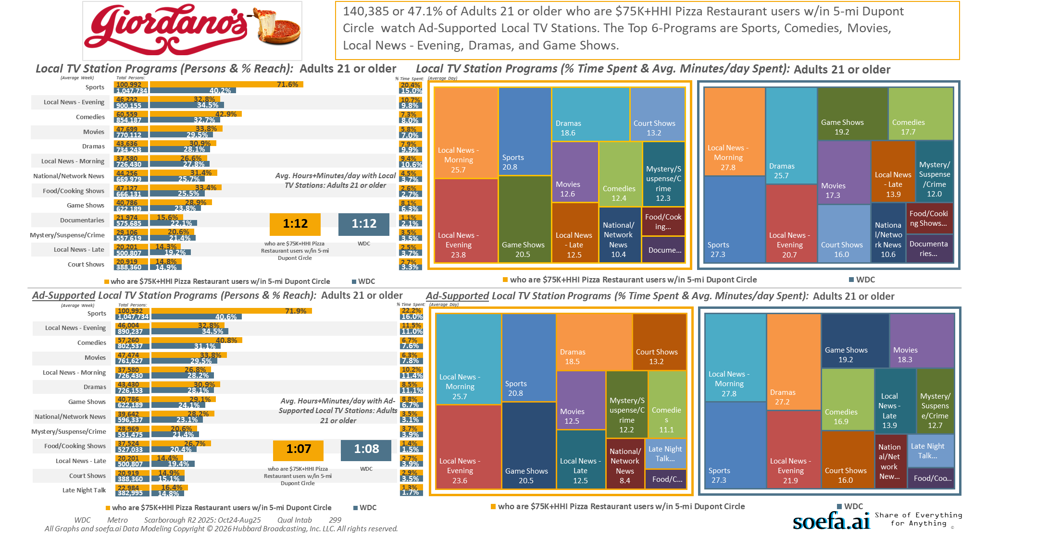
[((Household income summaries (HHLD): $75,000 or more AND Types of restaurants used past 30 days: Any pizza restaurant) AND (Zip code of residence: 20001 OR Zip code of residence: 20002 OR Zip code of residence: 20003 OR Zip code of residence: 20004 OR Zip code of residence: 20005 OR Zip code of residence: 20007 OR Zip code of residence: 20008 OR Zip code of residence: 20009 OR Zip code of residence: 20010 OR Zip code of residence: 20011 OR Zip code of residence: 20012 OR Zip code of residence: 20015 OR Zip code of residence: 20016 OR Zip code of residence: 20017 OR Zip code of residence: 20018 OR Zip code of residence: 20020 OR Zip code of residence: 20024 OR Zip code of residence: 20037 OR Zip code of residence: 20052 OR Zip code of residence: 20057 OR Zip code of residence: 20216 OR Zip code of residence: 20318 OR Zip code of residence: 20712 OR Zip code of residence: 22201 OR Zip code of residence: 22202 OR Zip code of residence: 22203 OR Zip code of residence: 22204 OR Zip code of residence: 22207 OR Zip code of residence: 22209 OR Zip code of residence: 22212 OR Zip code of employment: 20001 OR Zip code of employment: 20002 OR Zip code of employment: 20003 OR Zip code of employment: 20004 OR Zip code of employment: 20005 OR Zip code of employment: 20006 OR Zip code of employment: 20007 OR Zip code of employment: 20008 OR Zip code of employment: 20009 OR Zip code of employment: 20010 OR Zip code of employment: 20011 OR Zip code of employment: 20012 OR Zip code of employment: 20013 OR Zip code of employment: 20015 OR Zip code of employment: 20016 OR Zip code of employment: 20017 OR Zip code of employment: 20018 OR Zip code of employment: 20020 OR Zip code of employment: 20024 OR Zip code of employment: 20035 OR Zip code of employment: 20036 OR Zip code of employment: 20037 OR Zip code of employment: 20044 OR Zip code of employment: 20045 OR Zip code of employment: 20049 OR Zip code of employment: 20052 OR Zip code of employment: 20057 OR Zip code of employment: 20059 OR Zip code of employment: 20060 OR Zip code of employment: 20064 OR Zip code of employment: 20068 OR Zip code of employment: 20071 OR Zip code of employment: 20201 OR Zip code of employment: 20202 OR Zip code of employment: 20210 OR Zip code of employment: 20214 OR Zip code of employment: 20220 OR Zip code of employment: 20223 OR Zip code of employment: 20224 OR Zip code of employment: 20226 OR Zip code of employment: 20229 OR Zip code of employment: 20230 OR Zip code of employment: 20233 OR Zip code of employment: 20237 OR Zip code of employment: 20240 OR Zip code of employment: 20242 OR Zip code of employment: 20250 OR Zip code of employment: 20260 OR Zip code of employment: 20301 OR Zip code of employment: 20310 OR Zip code of employment: 20314 OR Zip code of employment: 20318 OR Zip code of employment: 20319 OR Zip code of employment: 20330 OR Zip code of employment: 20350 OR Zip code of employment: 20373 OR Zip code of employment: 20374 OR Zip code of employment: 20376 OR Zip code of employment: 20401 OR Zip code of employment: 20410 OR Zip code of employment: 20415 OR Zip code of employment: 20420 OR Zip code of employment: 20422 OR Zip code of employment: 20431 OR Zip code of employment: 20433 OR Zip code of employment: 20442 OR Zip code of employment: 20451 OR Zip code of employment: 20460 OR Zip code of employment: 20472 OR Zip code of employment: 20500 OR Zip code of employment: 20502 OR Zip code of employment: 20504 OR Zip code of employment: 20505 OR Zip code of employment: 20507 OR Zip code of employment: 20510 OR Zip code of employment: 20515 OR Zip code of employment: 20520 OR Zip code of employment: 20527 OR Zip code of employment: 20530 OR Zip code of employment: 20533 OR Zip code of employment: 20535 OR Zip code of employment: 20540 OR Zip code of employment: 20543 OR Zip code of employment: 20548 OR Zip code of employment: 20551 OR Zip code of employment: 20554 OR Zip code of employment: 20560 OR Zip code of employment: 20565 OR Zip code of employment: 20566 OR Zip code of employment: 20577 OR Zip code of employment: 20581 OR Zip code of employment: 20585 OR Zip code of employment: 20590 OR Zip code of employment: 20591 OR Zip code of employment: 20593 OR Zip code of employment: 22003 OR Zip code of employment: 22015 OR Zip code of employment: 22201 OR Zip code of employment: 22202 OR Zip code of employment: 22203 OR Zip code of employment: 22204 OR Zip code of employment: 22207 OR Zip code of employment: 22209))]

Slide 16
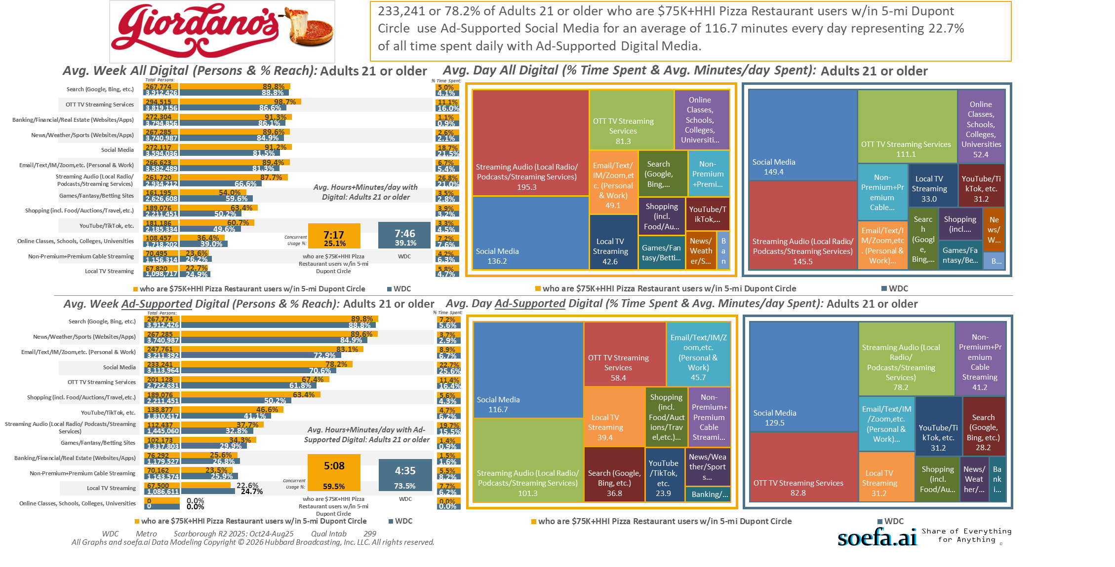
[((Household income summaries (HHLD): $75,000 or more AND Types of restaurants used past 30 days: Any pizza restaurant) AND (Zip code of residence: 20001 OR Zip code of residence: 20002 OR Zip code of residence: 20003 OR Zip code of residence: 20004 OR Zip code of residence: 20005 OR Zip code of residence: 20007 OR Zip code of residence: 20008 OR Zip code of residence: 20009 OR Zip code of residence: 20010 OR Zip code of residence: 20011 OR Zip code of residence: 20012 OR Zip code of residence: 20015 OR Zip code of residence: 20016 OR Zip code of residence: 20017 OR Zip code of residence: 20018 OR Zip code of residence: 20020 OR Zip code of residence: 20024 OR Zip code of residence: 20037 OR Zip code of residence: 20052 OR Zip code of residence: 20057 OR Zip code of residence: 20216 OR Zip code of residence: 20318 OR Zip code of residence: 20712 OR Zip code of residence: 22201 OR Zip code of residence: 22202 OR Zip code of residence: 22203 OR Zip code of residence: 22204 OR Zip code of residence: 22207 OR Zip code of residence: 22209 OR Zip code of residence: 22212 OR Zip code of employment: 20001 OR Zip code of employment: 20002 OR Zip code of employment: 20003 OR Zip code of employment: 20004 OR Zip code of employment: 20005 OR Zip code of employment: 20006 OR Zip code of employment: 20007 OR Zip code of employment: 20008 OR Zip code of employment: 20009 OR Zip code of employment: 20010 OR Zip code of employment: 20011 OR Zip code of employment: 20012 OR Zip code of employment: 20013 OR Zip code of employment: 20015 OR Zip code of employment: 20016 OR Zip code of employment: 20017 OR Zip code of employment: 20018 OR Zip code of employment: 20020 OR Zip code of employment: 20024 OR Zip code of employment: 20035 OR Zip code of employment: 20036 OR Zip code of employment: 20037 OR Zip code of employment: 20044 OR Zip code of employment: 20045 OR Zip code of employment: 20049 OR Zip code of employment: 20052 OR Zip code of employment: 20057 OR Zip code of employment: 20059 OR Zip code of employment: 20060 OR Zip code of employment: 20064 OR Zip code of employment: 20068 OR Zip code of employment: 20071 OR Zip code of employment: 20201 OR Zip code of employment: 20202 OR Zip code of employment: 20210 OR Zip code of employment: 20214 OR Zip code of employment: 20220 OR Zip code of employment: 20223 OR Zip code of employment: 20224 OR Zip code of employment: 20226 OR Zip code of employment: 20229 OR Zip code of employment: 20230 OR Zip code of employment: 20233 OR Zip code of employment: 20237 OR Zip code of employment: 20240 OR Zip code of employment: 20242 OR Zip code of employment: 20250 OR Zip code of employment: 20260 OR Zip code of employment: 20301 OR Zip code of employment: 20310 OR Zip code of employment: 20314 OR Zip code of employment: 20318 OR Zip code of employment: 20319 OR Zip code of employment: 20330 OR Zip code of employment: 20350 OR Zip code of employment: 20373 OR Zip code of employment: 20374 OR Zip code of employment: 20376 OR Zip code of employment: 20401 OR Zip code of employment: 20410 OR Zip code of employment: 20415 OR Zip code of employment: 20420 OR Zip code of employment: 20422 OR Zip code of employment: 20431 OR Zip code of employment: 20433 OR Zip code of employment: 20442 OR Zip code of employment: 20451 OR Zip code of employment: 20460 OR Zip code of employment: 20472 OR Zip code of employment: 20500 OR Zip code of employment: 20502 OR Zip code of employment: 20504 OR Zip code of employment: 20505 OR Zip code of employment: 20507 OR Zip code of employment: 20510 OR Zip code of employment: 20515 OR Zip code of employment: 20520 OR Zip code of employment: 20527 OR Zip code of employment: 20530 OR Zip code of employment: 20533 OR Zip code of employment: 20535 OR Zip code of employment: 20540 OR Zip code of employment: 20543 OR Zip code of employment: 20548 OR Zip code of employment: 20551 OR Zip code of employment: 20554 OR Zip code of employment: 20560 OR Zip code of employment: 20565 OR Zip code of employment: 20566 OR Zip code of employment: 20577 OR Zip code of employment: 20581 OR Zip code of employment: 20585 OR Zip code of employment: 20590 OR Zip code of employment: 20591 OR Zip code of employment: 20593 OR Zip code of employment: 22003 OR Zip code of employment: 22015 OR Zip code of employment: 22201 OR Zip code of employment: 22202 OR Zip code of employment: 22203 OR Zip code of employment: 22204 OR Zip code of employment: 22207 OR Zip code of employment: 22209))]

Slide 17
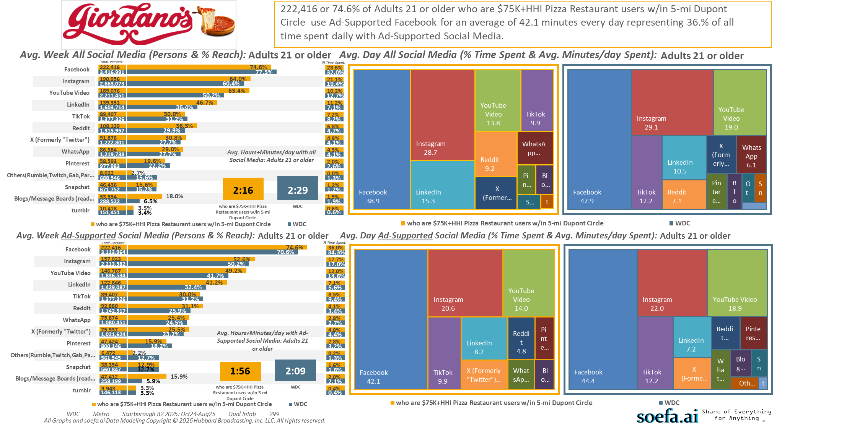
[((Household income summaries (HHLD): $75,000 or more AND Types of restaurants used past 30 days: Any pizza restaurant) AND (Zip code of residence: 20001 OR Zip code of residence: 20002 OR Zip code of residence: 20003 OR Zip code of residence: 20004 OR Zip code of residence: 20005 OR Zip code of residence: 20007 OR Zip code of residence: 20008 OR Zip code of residence: 20009 OR Zip code of residence: 20010 OR Zip code of residence: 20011 OR Zip code of residence: 20012 OR Zip code of residence: 20015 OR Zip code of residence: 20016 OR Zip code of residence: 20017 OR Zip code of residence: 20018 OR Zip code of residence: 20020 OR Zip code of residence: 20024 OR Zip code of residence: 20037 OR Zip code of residence: 20052 OR Zip code of residence: 20057 OR Zip code of residence: 20216 OR Zip code of residence: 20318 OR Zip code of residence: 20712 OR Zip code of residence: 22201 OR Zip code of residence: 22202 OR Zip code of residence: 22203 OR Zip code of residence: 22204 OR Zip code of residence: 22207 OR Zip code of residence: 22209 OR Zip code of residence: 22212 OR Zip code of employment: 20001 OR Zip code of employment: 20002 OR Zip code of employment: 20003 OR Zip code of employment: 20004 OR Zip code of employment: 20005 OR Zip code of employment: 20006 OR Zip code of employment: 20007 OR Zip code of employment: 20008 OR Zip code of employment: 20009 OR Zip code of employment: 20010 OR Zip code of employment: 20011 OR Zip code of employment: 20012 OR Zip code of employment: 20013 OR Zip code of employment: 20015 OR Zip code of employment: 20016 OR Zip code of employment: 20017 OR Zip code of employment: 20018 OR Zip code of employment: 20020 OR Zip code of employment: 20024 OR Zip code of employment: 20035 OR Zip code of employment: 20036 OR Zip code of employment: 20037 OR Zip code of employment: 20044 OR Zip code of employment: 20045 OR Zip code of employment: 20049 OR Zip code of employment: 20052 OR Zip code of employment: 20057 OR Zip code of employment: 20059 OR Zip code of employment: 20060 OR Zip code of employment: 20064 OR Zip code of employment: 20068 OR Zip code of employment: 20071 OR Zip code of employment: 20201 OR Zip code of employment: 20202 OR Zip code of employment: 20210 OR Zip code of employment: 20214 OR Zip code of employment: 20220 OR Zip code of employment: 20223 OR Zip code of employment: 20224 OR Zip code of employment: 20226 OR Zip code of employment: 20229 OR Zip code of employment: 20230 OR Zip code of employment: 20233 OR Zip code of employment: 20237 OR Zip code of employment: 20240 OR Zip code of employment: 20242 OR Zip code of employment: 20250 OR Zip code of employment: 20260 OR Zip code of employment: 20301 OR Zip code of employment: 20310 OR Zip code of employment: 20314 OR Zip code of employment: 20318 OR Zip code of employment: 20319 OR Zip code of employment: 20330 OR Zip code of employment: 20350 OR Zip code of employment: 20373 OR Zip code of employment: 20374 OR Zip code of employment: 20376 OR Zip code of employment: 20401 OR Zip code of employment: 20410 OR Zip code of employment: 20415 OR Zip code of employment: 20420 OR Zip code of employment: 20422 OR Zip code of employment: 20431 OR Zip code of employment: 20433 OR Zip code of employment: 20442 OR Zip code of employment: 20451 OR Zip code of employment: 20460 OR Zip code of employment: 20472 OR Zip code of employment: 20500 OR Zip code of employment: 20502 OR Zip code of employment: 20504 OR Zip code of employment: 20505 OR Zip code of employment: 20507 OR Zip code of employment: 20510 OR Zip code of employment: 20515 OR Zip code of employment: 20520 OR Zip code of employment: 20527 OR Zip code of employment: 20530 OR Zip code of employment: 20533 OR Zip code of employment: 20535 OR Zip code of employment: 20540 OR Zip code of employment: 20543 OR Zip code of employment: 20548 OR Zip code of employment: 20551 OR Zip code of employment: 20554 OR Zip code of employment: 20560 OR Zip code of employment: 20565 OR Zip code of employment: 20566 OR Zip code of employment: 20577 OR Zip code of employment: 20581 OR Zip code of employment: 20585 OR Zip code of employment: 20590 OR Zip code of employment: 20591 OR Zip code of employment: 20593 OR Zip code of employment: 22003 OR Zip code of employment: 22015 OR Zip code of employment: 22201 OR Zip code of employment: 22202 OR Zip code of employment: 22203 OR Zip code of employment: 22204 OR Zip code of employment: 22207 OR Zip code of employment: 22209))]

Slide 18
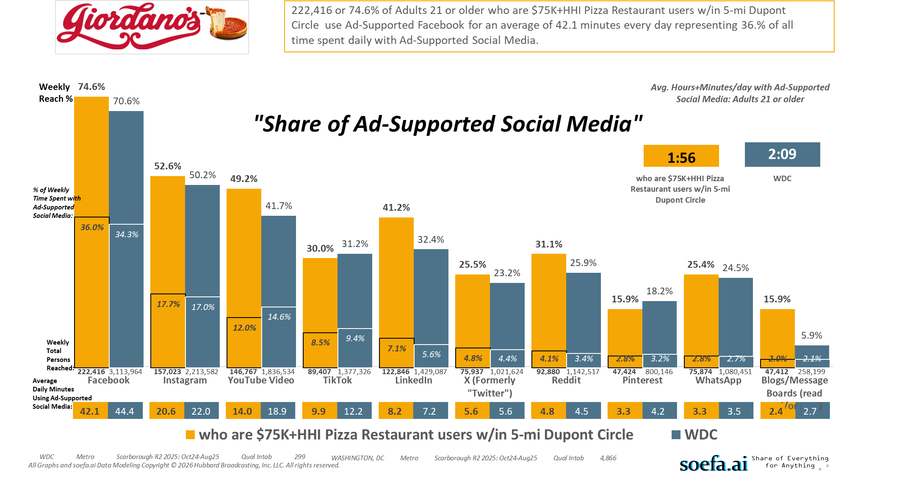
[((Household income summaries (HHLD): $75,000 or more AND Types of restaurants used past 30 days: Any pizza restaurant) AND (Zip code of residence: 20001 OR Zip code of residence: 20002 OR Zip code of residence: 20003 OR Zip code of residence: 20004 OR Zip code of residence: 20005 OR Zip code of residence: 20007 OR Zip code of residence: 20008 OR Zip code of residence: 20009 OR Zip code of residence: 20010 OR Zip code of residence: 20011 OR Zip code of residence: 20012 OR Zip code of residence: 20015 OR Zip code of residence: 20016 OR Zip code of residence: 20017 OR Zip code of residence: 20018 OR Zip code of residence: 20020 OR Zip code of residence: 20024 OR Zip code of residence: 20037 OR Zip code of residence: 20052 OR Zip code of residence: 20057 OR Zip code of residence: 20216 OR Zip code of residence: 20318 OR Zip code of residence: 20712 OR Zip code of residence: 22201 OR Zip code of residence: 22202 OR Zip code of residence: 22203 OR Zip code of residence: 22204 OR Zip code of residence: 22207 OR Zip code of residence: 22209 OR Zip code of residence: 22212 OR Zip code of employment: 20001 OR Zip code of employment: 20002 OR Zip code of employment: 20003 OR Zip code of employment: 20004 OR Zip code of employment: 20005 OR Zip code of employment: 20006 OR Zip code of employment: 20007 OR Zip code of employment: 20008 OR Zip code of employment: 20009 OR Zip code of employment: 20010 OR Zip code of employment: 20011 OR Zip code of employment: 20012 OR Zip code of employment: 20013 OR Zip code of employment: 20015 OR Zip code of employment: 20016 OR Zip code of employment: 20017 OR Zip code of employment: 20018 OR Zip code of employment: 20020 OR Zip code of employment: 20024 OR Zip code of employment: 20035 OR Zip code of employment: 20036 OR Zip code of employment: 20037 OR Zip code of employment: 20044 OR Zip code of employment: 20045 OR Zip code of employment: 20049 OR Zip code of employment: 20052 OR Zip code of employment: 20057 OR Zip code of employment: 20059 OR Zip code of employment: 20060 OR Zip code of employment: 20064 OR Zip code of employment: 20068 OR Zip code of employment: 20071 OR Zip code of employment: 20201 OR Zip code of employment: 20202 OR Zip code of employment: 20210 OR Zip code of employment: 20214 OR Zip code of employment: 20220 OR Zip code of employment: 20223 OR Zip code of employment: 20224 OR Zip code of employment: 20226 OR Zip code of employment: 20229 OR Zip code of employment: 20230 OR Zip code of employment: 20233 OR Zip code of employment: 20237 OR Zip code of employment: 20240 OR Zip code of employment: 20242 OR Zip code of employment: 20250 OR Zip code of employment: 20260 OR Zip code of employment: 20301 OR Zip code of employment: 20310 OR Zip code of employment: 20314 OR Zip code of employment: 20318 OR Zip code of employment: 20319 OR Zip code of employment: 20330 OR Zip code of employment: 20350 OR Zip code of employment: 20373 OR Zip code of employment: 20374 OR Zip code of employment: 20376 OR Zip code of employment: 20401 OR Zip code of employment: 20410 OR Zip code of employment: 20415 OR Zip code of employment: 20420 OR Zip code of employment: 20422 OR Zip code of employment: 20431 OR Zip code of employment: 20433 OR Zip code of employment: 20442 OR Zip code of employment: 20451 OR Zip code of employment: 20460 OR Zip code of employment: 20472 OR Zip code of employment: 20500 OR Zip code of employment: 20502 OR Zip code of employment: 20504 OR Zip code of employment: 20505 OR Zip code of employment: 20507 OR Zip code of employment: 20510 OR Zip code of employment: 20515 OR Zip code of employment: 20520 OR Zip code of employment: 20527 OR Zip code of employment: 20530 OR Zip code of employment: 20533 OR Zip code of employment: 20535 OR Zip code of employment: 20540 OR Zip code of employment: 20543 OR Zip code of employment: 20548 OR Zip code of employment: 20551 OR Zip code of employment: 20554 OR Zip code of employment: 20560 OR Zip code of employment: 20565 OR Zip code of employment: 20566 OR Zip code of employment: 20577 OR Zip code of employment: 20581 OR Zip code of employment: 20585 OR Zip code of employment: 20590 OR Zip code of employment: 20591 OR Zip code of employment: 20593 OR Zip code of employment: 22003 OR Zip code of employment: 22015 OR Zip code of employment: 22201 OR Zip code of employment: 22202 OR Zip code of employment: 22203 OR Zip code of employment: 22204 OR Zip code of employment: 22207 OR Zip code of employment: 22209))]

Slide 19
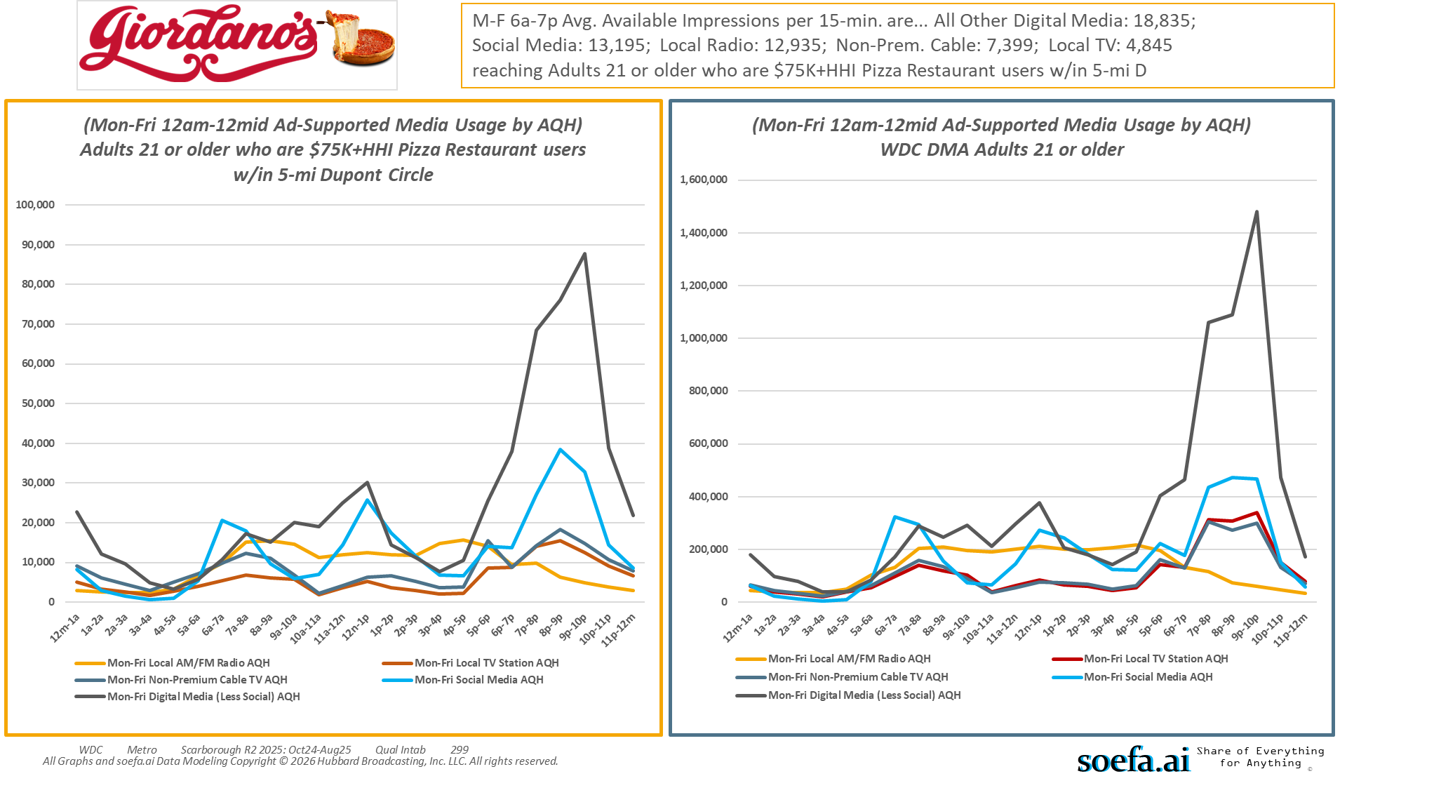
[((Household income summaries (HHLD): $75,000 or more AND Types of restaurants used past 30 days: Any pizza restaurant) AND (Zip code of residence: 20001 OR Zip code of residence: 20002 OR Zip code of residence: 20003 OR Zip code of residence: 20004 OR Zip code of residence: 20005 OR Zip code of residence: 20007 OR Zip code of residence: 20008 OR Zip code of residence: 20009 OR Zip code of residence: 20010 OR Zip code of residence: 20011 OR Zip code of residence: 20012 OR Zip code of residence: 20015 OR Zip code of residence: 20016 OR Zip code of residence: 20017 OR Zip code of residence: 20018 OR Zip code of residence: 20020 OR Zip code of residence: 20024 OR Zip code of residence: 20037 OR Zip code of residence: 20052 OR Zip code of residence: 20057 OR Zip code of residence: 20216 OR Zip code of residence: 20318 OR Zip code of residence: 20712 OR Zip code of residence: 22201 OR Zip code of residence: 22202 OR Zip code of residence: 22203 OR Zip code of residence: 22204 OR Zip code of residence: 22207 OR Zip code of residence: 22209 OR Zip code of residence: 22212 OR Zip code of employment: 20001 OR Zip code of employment: 20002 OR Zip code of employment: 20003 OR Zip code of employment: 20004 OR Zip code of employment: 20005 OR Zip code of employment: 20006 OR Zip code of employment: 20007 OR Zip code of employment: 20008 OR Zip code of employment: 20009 OR Zip code of employment: 20010 OR Zip code of employment: 20011 OR Zip code of employment: 20012 OR Zip code of employment: 20013 OR Zip code of employment: 20015 OR Zip code of employment: 20016 OR Zip code of employment: 20017 OR Zip code of employment: 20018 OR Zip code of employment: 20020 OR Zip code of employment: 20024 OR Zip code of employment: 20035 OR Zip code of employment: 20036 OR Zip code of employment: 20037 OR Zip code of employment: 20044 OR Zip code of employment: 20045 OR Zip code of employment: 20049 OR Zip code of employment: 20052 OR Zip code of employment: 20057 OR Zip code of employment: 20059 OR Zip code of employment: 20060 OR Zip code of employment: 20064 OR Zip code of employment: 20068 OR Zip code of employment: 20071 OR Zip code of employment: 20201 OR Zip code of employment: 20202 OR Zip code of employment: 20210 OR Zip code of employment: 20214 OR Zip code of employment: 20220 OR Zip code of employment: 20223 OR Zip code of employment: 20224 OR Zip code of employment: 20226 OR Zip code of employment: 20229 OR Zip code of employment: 20230 OR Zip code of employment: 20233 OR Zip code of employment: 20237 OR Zip code of employment: 20240 OR Zip code of employment: 20242 OR Zip code of employment: 20250 OR Zip code of employment: 20260 OR Zip code of employment: 20301 OR Zip code of employment: 20310 OR Zip code of employment: 20314 OR Zip code of employment: 20318 OR Zip code of employment: 20319 OR Zip code of employment: 20330 OR Zip code of employment: 20350 OR Zip code of employment: 20373 OR Zip code of employment: 20374 OR Zip code of employment: 20376 OR Zip code of employment: 20401 OR Zip code of employment: 20410 OR Zip code of employment: 20415 OR Zip code of employment: 20420 OR Zip code of employment: 20422 OR Zip code of employment: 20431 OR Zip code of employment: 20433 OR Zip code of employment: 20442 OR Zip code of employment: 20451 OR Zip code of employment: 20460 OR Zip code of employment: 20472 OR Zip code of employment: 20500 OR Zip code of employment: 20502 OR Zip code of employment: 20504 OR Zip code of employment: 20505 OR Zip code of employment: 20507 OR Zip code of employment: 20510 OR Zip code of employment: 20515 OR Zip code of employment: 20520 OR Zip code of employment: 20527 OR Zip code of employment: 20530 OR Zip code of employment: 20533 OR Zip code of employment: 20535 OR Zip code of employment: 20540 OR Zip code of employment: 20543 OR Zip code of employment: 20548 OR Zip code of employment: 20551 OR Zip code of employment: 20554 OR Zip code of employment: 20560 OR Zip code of employment: 20565 OR Zip code of employment: 20566 OR Zip code of employment: 20577 OR Zip code of employment: 20581 OR Zip code of employment: 20585 OR Zip code of employment: 20590 OR Zip code of employment: 20591 OR Zip code of employment: 20593 OR Zip code of employment: 22003 OR Zip code of employment: 22015 OR Zip code of employment: 22201 OR Zip code of employment: 22202 OR Zip code of employment: 22203 OR Zip code of employment: 22204 OR Zip code of employment: 22207 OR Zip code of employment: 22209))]

Slide 20
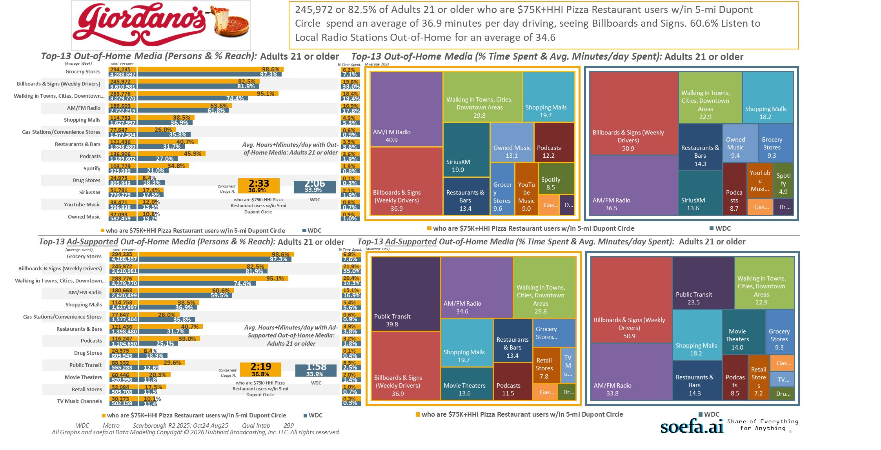
[((Household income summaries (HHLD): $75,000 or more AND Types of restaurants used past 30 days: Any pizza restaurant) AND (Zip code of residence: 20001 OR Zip code of residence: 20002 OR Zip code of residence: 20003 OR Zip code of residence: 20004 OR Zip code of residence: 20005 OR Zip code of residence: 20007 OR Zip code of residence: 20008 OR Zip code of residence: 20009 OR Zip code of residence: 20010 OR Zip code of residence: 20011 OR Zip code of residence: 20012 OR Zip code of residence: 20015 OR Zip code of residence: 20016 OR Zip code of residence: 20017 OR Zip code of residence: 20018 OR Zip code of residence: 20020 OR Zip code of residence: 20024 OR Zip code of residence: 20037 OR Zip code of residence: 20052 OR Zip code of residence: 20057 OR Zip code of residence: 20216 OR Zip code of residence: 20318 OR Zip code of residence: 20712 OR Zip code of residence: 22201 OR Zip code of residence: 22202 OR Zip code of residence: 22203 OR Zip code of residence: 22204 OR Zip code of residence: 22207 OR Zip code of residence: 22209 OR Zip code of residence: 22212 OR Zip code of employment: 20001 OR Zip code of employment: 20002 OR Zip code of employment: 20003 OR Zip code of employment: 20004 OR Zip code of employment: 20005 OR Zip code of employment: 20006 OR Zip code of employment: 20007 OR Zip code of employment: 20008 OR Zip code of employment: 20009 OR Zip code of employment: 20010 OR Zip code of employment: 20011 OR Zip code of employment: 20012 OR Zip code of employment: 20013 OR Zip code of employment: 20015 OR Zip code of employment: 20016 OR Zip code of employment: 20017 OR Zip code of employment: 20018 OR Zip code of employment: 20020 OR Zip code of employment: 20024 OR Zip code of employment: 20035 OR Zip code of employment: 20036 OR Zip code of employment: 20037 OR Zip code of employment: 20044 OR Zip code of employment: 20045 OR Zip code of employment: 20049 OR Zip code of employment: 20052 OR Zip code of employment: 20057 OR Zip code of employment: 20059 OR Zip code of employment: 20060 OR Zip code of employment: 20064 OR Zip code of employment: 20068 OR Zip code of employment: 20071 OR Zip code of employment: 20201 OR Zip code of employment: 20202 OR Zip code of employment: 20210 OR Zip code of employment: 20214 OR Zip code of employment: 20220 OR Zip code of employment: 20223 OR Zip code of employment: 20224 OR Zip code of employment: 20226 OR Zip code of employment: 20229 OR Zip code of employment: 20230 OR Zip code of employment: 20233 OR Zip code of employment: 20237 OR Zip code of employment: 20240 OR Zip code of employment: 20242 OR Zip code of employment: 20250 OR Zip code of employment: 20260 OR Zip code of employment: 20301 OR Zip code of employment: 20310 OR Zip code of employment: 20314 OR Zip code of employment: 20318 OR Zip code of employment: 20319 OR Zip code of employment: 20330 OR Zip code of employment: 20350 OR Zip code of employment: 20373 OR Zip code of employment: 20374 OR Zip code of employment: 20376 OR Zip code of employment: 20401 OR Zip code of employment: 20410 OR Zip code of employment: 20415 OR Zip code of employment: 20420 OR Zip code of employment: 20422 OR Zip code of employment: 20431 OR Zip code of employment: 20433 OR Zip code of employment: 20442 OR Zip code of employment: 20451 OR Zip code of employment: 20460 OR Zip code of employment: 20472 OR Zip code of employment: 20500 OR Zip code of employment: 20502 OR Zip code of employment: 20504 OR Zip code of employment: 20505 OR Zip code of employment: 20507 OR Zip code of employment: 20510 OR Zip code of employment: 20515 OR Zip code of employment: 20520 OR Zip code of employment: 20527 OR Zip code of employment: 20530 OR Zip code of employment: 20533 OR Zip code of employment: 20535 OR Zip code of employment: 20540 OR Zip code of employment: 20543 OR Zip code of employment: 20548 OR Zip code of employment: 20551 OR Zip code of employment: 20554 OR Zip code of employment: 20560 OR Zip code of employment: 20565 OR Zip code of employment: 20566 OR Zip code of employment: 20577 OR Zip code of employment: 20581 OR Zip code of employment: 20585 OR Zip code of employment: 20590 OR Zip code of employment: 20591 OR Zip code of employment: 20593 OR Zip code of employment: 22003 OR Zip code of employment: 22015 OR Zip code of employment: 22201 OR Zip code of employment: 22202 OR Zip code of employment: 22203 OR Zip code of employment: 22204 OR Zip code of employment: 22207 OR Zip code of employment: 22209))]

Slide 21
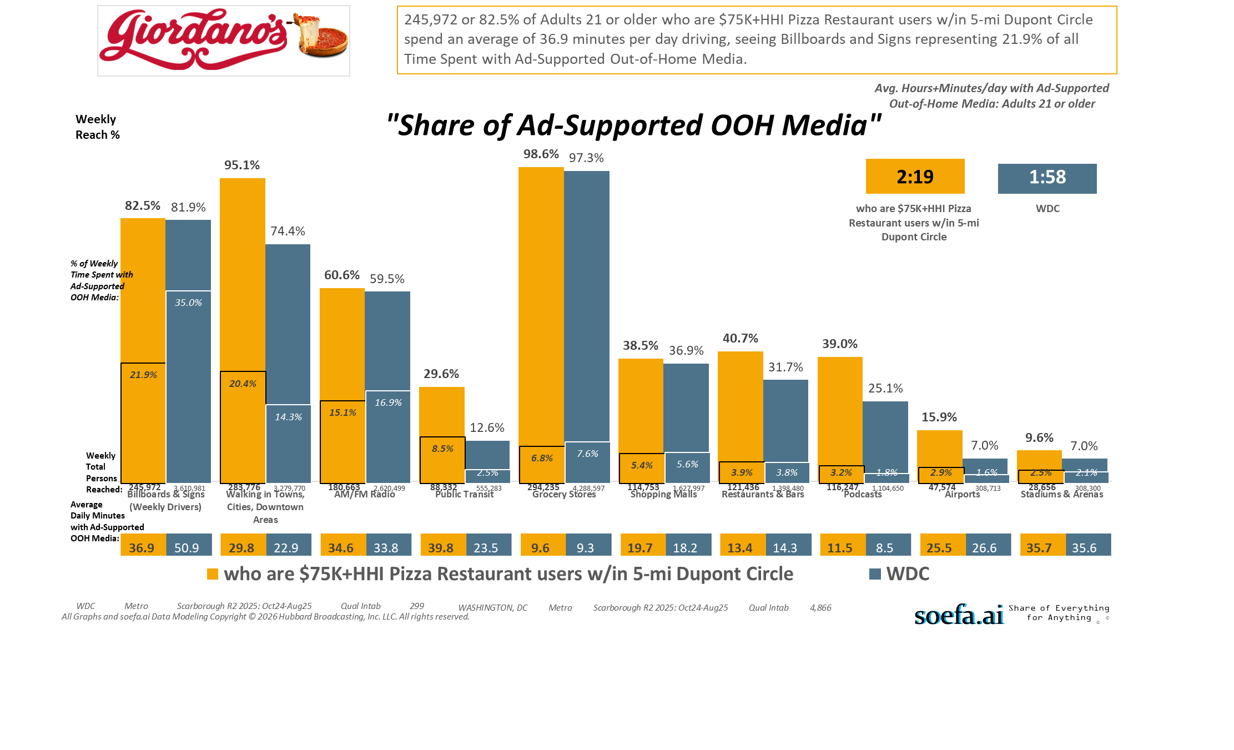
[((Household income summaries (HHLD): $75,000 or more AND Types of restaurants used past 30 days: Any pizza restaurant) AND (Zip code of residence: 20001 OR Zip code of residence: 20002 OR Zip code of residence: 20003 OR Zip code of residence: 20004 OR Zip code of residence: 20005 OR Zip code of residence: 20007 OR Zip code of residence: 20008 OR Zip code of residence: 20009 OR Zip code of residence: 20010 OR Zip code of residence: 20011 OR Zip code of residence: 20012 OR Zip code of residence: 20015 OR Zip code of residence: 20016 OR Zip code of residence: 20017 OR Zip code of residence: 20018 OR Zip code of residence: 20020 OR Zip code of residence: 20024 OR Zip code of residence: 20037 OR Zip code of residence: 20052 OR Zip code of residence: 20057 OR Zip code of residence: 20216 OR Zip code of residence: 20318 OR Zip code of residence: 20712 OR Zip code of residence: 22201 OR Zip code of residence: 22202 OR Zip code of residence: 22203 OR Zip code of residence: 22204 OR Zip code of residence: 22207 OR Zip code of residence: 22209 OR Zip code of residence: 22212 OR Zip code of employment: 20001 OR Zip code of employment: 20002 OR Zip code of employment: 20003 OR Zip code of employment: 20004 OR Zip code of employment: 20005 OR Zip code of employment: 20006 OR Zip code of employment: 20007 OR Zip code of employment: 20008 OR Zip code of employment: 20009 OR Zip code of employment: 20010 OR Zip code of employment: 20011 OR Zip code of employment: 20012 OR Zip code of employment: 20013 OR Zip code of employment: 20015 OR Zip code of employment: 20016 OR Zip code of employment: 20017 OR Zip code of employment: 20018 OR Zip code of employment: 20020 OR Zip code of employment: 20024 OR Zip code of employment: 20035 OR Zip code of employment: 20036 OR Zip code of employment: 20037 OR Zip code of employment: 20044 OR Zip code of employment: 20045 OR Zip code of employment: 20049 OR Zip code of employment: 20052 OR Zip code of employment: 20057 OR Zip code of employment: 20059 OR Zip code of employment: 20060 OR Zip code of employment: 20064 OR Zip code of employment: 20068 OR Zip code of employment: 20071 OR Zip code of employment: 20201 OR Zip code of employment: 20202 OR Zip code of employment: 20210 OR Zip code of employment: 20214 OR Zip code of employment: 20220 OR Zip code of employment: 20223 OR Zip code of employment: 20224 OR Zip code of employment: 20226 OR Zip code of employment: 20229 OR Zip code of employment: 20230 OR Zip code of employment: 20233 OR Zip code of employment: 20237 OR Zip code of employment: 20240 OR Zip code of employment: 20242 OR Zip code of employment: 20250 OR Zip code of employment: 20260 OR Zip code of employment: 20301 OR Zip code of employment: 20310 OR Zip code of employment: 20314 OR Zip code of employment: 20318 OR Zip code of employment: 20319 OR Zip code of employment: 20330 OR Zip code of employment: 20350 OR Zip code of employment: 20373 OR Zip code of employment: 20374 OR Zip code of employment: 20376 OR Zip code of employment: 20401 OR Zip code of employment: 20410 OR Zip code of employment: 20415 OR Zip code of employment: 20420 OR Zip code of employment: 20422 OR Zip code of employment: 20431 OR Zip code of employment: 20433 OR Zip code of employment: 20442 OR Zip code of employment: 20451 OR Zip code of employment: 20460 OR Zip code of employment: 20472 OR Zip code of employment: 20500 OR Zip code of employment: 20502 OR Zip code of employment: 20504 OR Zip code of employment: 20505 OR Zip code of employment: 20507 OR Zip code of employment: 20510 OR Zip code of employment: 20515 OR Zip code of employment: 20520 OR Zip code of employment: 20527 OR Zip code of employment: 20530 OR Zip code of employment: 20533 OR Zip code of employment: 20535 OR Zip code of employment: 20540 OR Zip code of employment: 20543 OR Zip code of employment: 20548 OR Zip code of employment: 20551 OR Zip code of employment: 20554 OR Zip code of employment: 20560 OR Zip code of employment: 20565 OR Zip code of employment: 20566 OR Zip code of employment: 20577 OR Zip code of employment: 20581 OR Zip code of employment: 20585 OR Zip code of employment: 20590 OR Zip code of employment: 20591 OR Zip code of employment: 20593 OR Zip code of employment: 22003 OR Zip code of employment: 22015 OR Zip code of employment: 22201 OR Zip code of employment: 22202 OR Zip code of employment: 22203 OR Zip code of employment: 22204 OR Zip code of employment: 22207 OR Zip code of employment: 22209))]

Slide 22
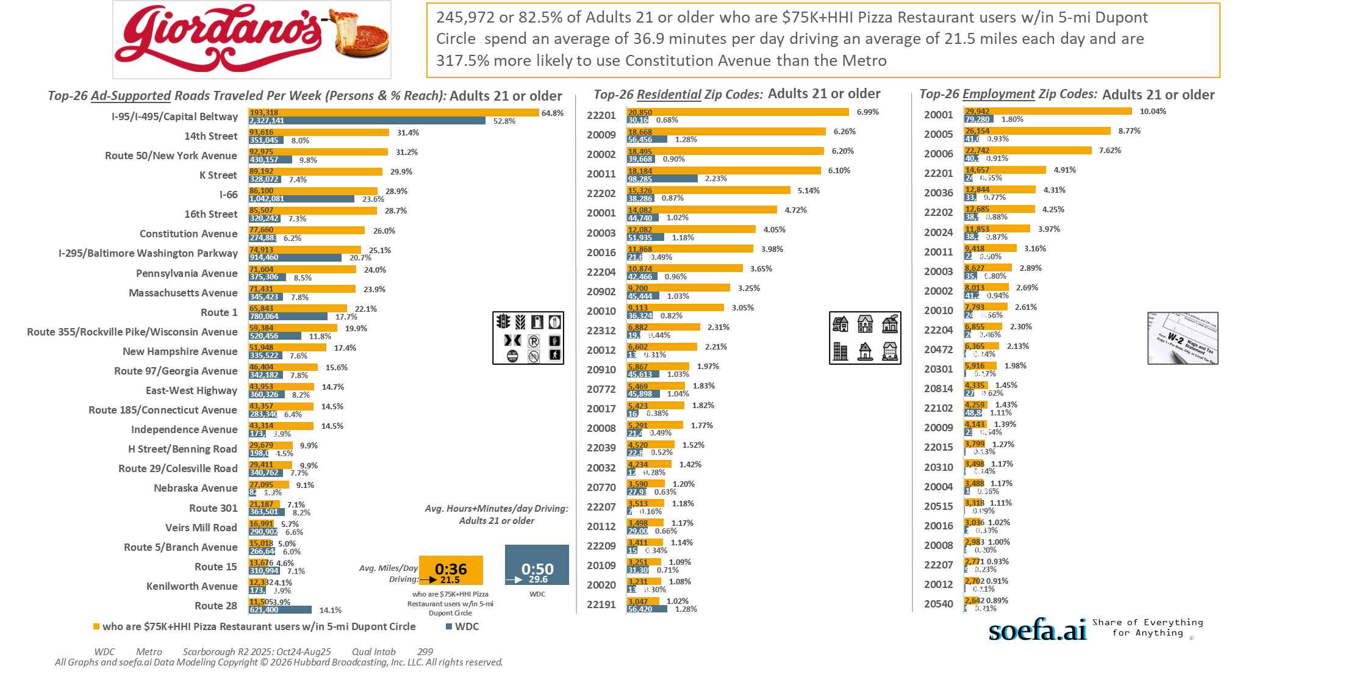
[((Household income summaries (HHLD): $75,000 or more AND Types of restaurants used past 30 days: Any pizza restaurant) AND (Zip code of residence: 20001 OR Zip code of residence: 20002 OR Zip code of residence: 20003 OR Zip code of residence: 20004 OR Zip code of residence: 20005 OR Zip code of residence: 20007 OR Zip code of residence: 20008 OR Zip code of residence: 20009 OR Zip code of residence: 20010 OR Zip code of residence: 20011 OR Zip code of residence: 20012 OR Zip code of residence: 20015 OR Zip code of residence: 20016 OR Zip code of residence: 20017 OR Zip code of residence: 20018 OR Zip code of residence: 20020 OR Zip code of residence: 20024 OR Zip code of residence: 20037 OR Zip code of residence: 20052 OR Zip code of residence: 20057 OR Zip code of residence: 20216 OR Zip code of residence: 20318 OR Zip code of residence: 20712 OR Zip code of residence: 22201 OR Zip code of residence: 22202 OR Zip code of residence: 22203 OR Zip code of residence: 22204 OR Zip code of residence: 22207 OR Zip code of residence: 22209 OR Zip code of residence: 22212 OR Zip code of employment: 20001 OR Zip code of employment: 20002 OR Zip code of employment: 20003 OR Zip code of employment: 20004 OR Zip code of employment: 20005 OR Zip code of employment: 20006 OR Zip code of employment: 20007 OR Zip code of employment: 20008 OR Zip code of employment: 20009 OR Zip code of employment: 20010 OR Zip code of employment: 20011 OR Zip code of employment: 20012 OR Zip code of employment: 20013 OR Zip code of employment: 20015 OR Zip code of employment: 20016 OR Zip code of employment: 20017 OR Zip code of employment: 20018 OR Zip code of employment: 20020 OR Zip code of employment: 20024 OR Zip code of employment: 20035 OR Zip code of employment: 20036 OR Zip code of employment: 20037 OR Zip code of employment: 20044 OR Zip code of employment: 20045 OR Zip code of employment: 20049 OR Zip code of employment: 20052 OR Zip code of employment: 20057 OR Zip code of employment: 20059 OR Zip code of employment: 20060 OR Zip code of employment: 20064 OR Zip code of employment: 20068 OR Zip code of employment: 20071 OR Zip code of employment: 20201 OR Zip code of employment: 20202 OR Zip code of employment: 20210 OR Zip code of employment: 20214 OR Zip code of employment: 20220 OR Zip code of employment: 20223 OR Zip code of employment: 20224 OR Zip code of employment: 20226 OR Zip code of employment: 20229 OR Zip code of employment: 20230 OR Zip code of employment: 20233 OR Zip code of employment: 20237 OR Zip code of employment: 20240 OR Zip code of employment: 20242 OR Zip code of employment: 20250 OR Zip code of employment: 20260 OR Zip code of employment: 20301 OR Zip code of employment: 20310 OR Zip code of employment: 20314 OR Zip code of employment: 20318 OR Zip code of employment: 20319 OR Zip code of employment: 20330 OR Zip code of employment: 20350 OR Zip code of employment: 20373 OR Zip code of employment: 20374 OR Zip code of employment: 20376 OR Zip code of employment: 20401 OR Zip code of employment: 20410 OR Zip code of employment: 20415 OR Zip code of employment: 20420 OR Zip code of employment: 20422 OR Zip code of employment: 20431 OR Zip code of employment: 20433 OR Zip code of employment: 20442 OR Zip code of employment: 20451 OR Zip code of employment: 20460 OR Zip code of employment: 20472 OR Zip code of employment: 20500 OR Zip code of employment: 20502 OR Zip code of employment: 20504 OR Zip code of employment: 20505 OR Zip code of employment: 20507 OR Zip code of employment: 20510 OR Zip code of employment: 20515 OR Zip code of employment: 20520 OR Zip code of employment: 20527 OR Zip code of employment: 20530 OR Zip code of employment: 20533 OR Zip code of employment: 20535 OR Zip code of employment: 20540 OR Zip code of employment: 20543 OR Zip code of employment: 20548 OR Zip code of employment: 20551 OR Zip code of employment: 20554 OR Zip code of employment: 20560 OR Zip code of employment: 20565 OR Zip code of employment: 20566 OR Zip code of employment: 20577 OR Zip code of employment: 20581 OR Zip code of employment: 20585 OR Zip code of employment: 20590 OR Zip code of employment: 20591 OR Zip code of employment: 20593 OR Zip code of employment: 22003 OR Zip code of employment: 22015 OR Zip code of employment: 22201 OR Zip code of employment: 22202 OR Zip code of employment: 22203 OR Zip code of employment: 22204 OR Zip code of employment: 22207 OR Zip code of employment: 22209))]

Slide 23
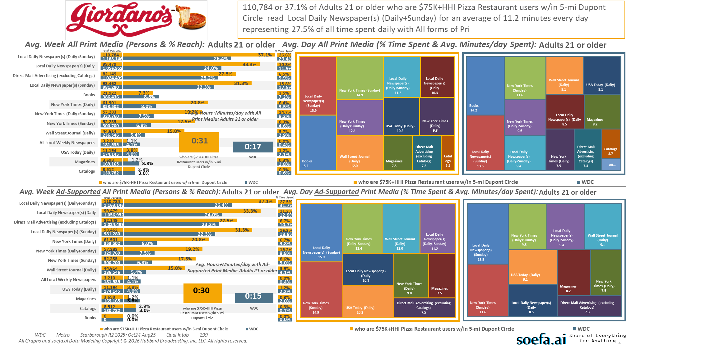
[((Household income summaries (HHLD): $75,000 or more AND Types of restaurants used past 30 days: Any pizza restaurant) AND (Zip code of residence: 20001 OR Zip code of residence: 20002 OR Zip code of residence: 20003 OR Zip code of residence: 20004 OR Zip code of residence: 20005 OR Zip code of residence: 20007 OR Zip code of residence: 20008 OR Zip code of residence: 20009 OR Zip code of residence: 20010 OR Zip code of residence: 20011 OR Zip code of residence: 20012 OR Zip code of residence: 20015 OR Zip code of residence: 20016 OR Zip code of residence: 20017 OR Zip code of residence: 20018 OR Zip code of residence: 20020 OR Zip code of residence: 20024 OR Zip code of residence: 20037 OR Zip code of residence: 20052 OR Zip code of residence: 20057 OR Zip code of residence: 20216 OR Zip code of residence: 20318 OR Zip code of residence: 20712 OR Zip code of residence: 22201 OR Zip code of residence: 22202 OR Zip code of residence: 22203 OR Zip code of residence: 22204 OR Zip code of residence: 22207 OR Zip code of residence: 22209 OR Zip code of residence: 22212 OR Zip code of employment: 20001 OR Zip code of employment: 20002 OR Zip code of employment: 20003 OR Zip code of employment: 20004 OR Zip code of employment: 20005 OR Zip code of employment: 20006 OR Zip code of employment: 20007 OR Zip code of employment: 20008 OR Zip code of employment: 20009 OR Zip code of employment: 20010 OR Zip code of employment: 20011 OR Zip code of employment: 20012 OR Zip code of employment: 20013 OR Zip code of employment: 20015 OR Zip code of employment: 20016 OR Zip code of employment: 20017 OR Zip code of employment: 20018 OR Zip code of employment: 20020 OR Zip code of employment: 20024 OR Zip code of employment: 20035 OR Zip code of employment: 20036 OR Zip code of employment: 20037 OR Zip code of employment: 20044 OR Zip code of employment: 20045 OR Zip code of employment: 20049 OR Zip code of employment: 20052 OR Zip code of employment: 20057 OR Zip code of employment: 20059 OR Zip code of employment: 20060 OR Zip code of employment: 20064 OR Zip code of employment: 20068 OR Zip code of employment: 20071 OR Zip code of employment: 20201 OR Zip code of employment: 20202 OR Zip code of employment: 20210 OR Zip code of employment: 20214 OR Zip code of employment: 20220 OR Zip code of employment: 20223 OR Zip code of employment: 20224 OR Zip code of employment: 20226 OR Zip code of employment: 20229 OR Zip code of employment: 20230 OR Zip code of employment: 20233 OR Zip code of employment: 20237 OR Zip code of employment: 20240 OR Zip code of employment: 20242 OR Zip code of employment: 20250 OR Zip code of employment: 20260 OR Zip code of employment: 20301 OR Zip code of employment: 20310 OR Zip code of employment: 20314 OR Zip code of employment: 20318 OR Zip code of employment: 20319 OR Zip code of employment: 20330 OR Zip code of employment: 20350 OR Zip code of employment: 20373 OR Zip code of employment: 20374 OR Zip code of employment: 20376 OR Zip code of employment: 20401 OR Zip code of employment: 20410 OR Zip code of employment: 20415 OR Zip code of employment: 20420 OR Zip code of employment: 20422 OR Zip code of employment: 20431 OR Zip code of employment: 20433 OR Zip code of employment: 20442 OR Zip code of employment: 20451 OR Zip code of employment: 20460 OR Zip code of employment: 20472 OR Zip code of employment: 20500 OR Zip code of employment: 20502 OR Zip code of employment: 20504 OR Zip code of employment: 20505 OR Zip code of employment: 20507 OR Zip code of employment: 20510 OR Zip code of employment: 20515 OR Zip code of employment: 20520 OR Zip code of employment: 20527 OR Zip code of employment: 20530 OR Zip code of employment: 20533 OR Zip code of employment: 20535 OR Zip code of employment: 20540 OR Zip code of employment: 20543 OR Zip code of employment: 20548 OR Zip code of employment: 20551 OR Zip code of employment: 20554 OR Zip code of employment: 20560 OR Zip code of employment: 20565 OR Zip code of employment: 20566 OR Zip code of employment: 20577 OR Zip code of employment: 20581 OR Zip code of employment: 20585 OR Zip code of employment: 20590 OR Zip code of employment: 20591 OR Zip code of employment: 20593 OR Zip code of employment: 22003 OR Zip code of employment: 22015 OR Zip code of employment: 22201 OR Zip code of employment: 22202 OR Zip code of employment: 22203 OR Zip code of employment: 22204 OR Zip code of employment: 22207 OR Zip code of employment: 22209))]

Slide 24
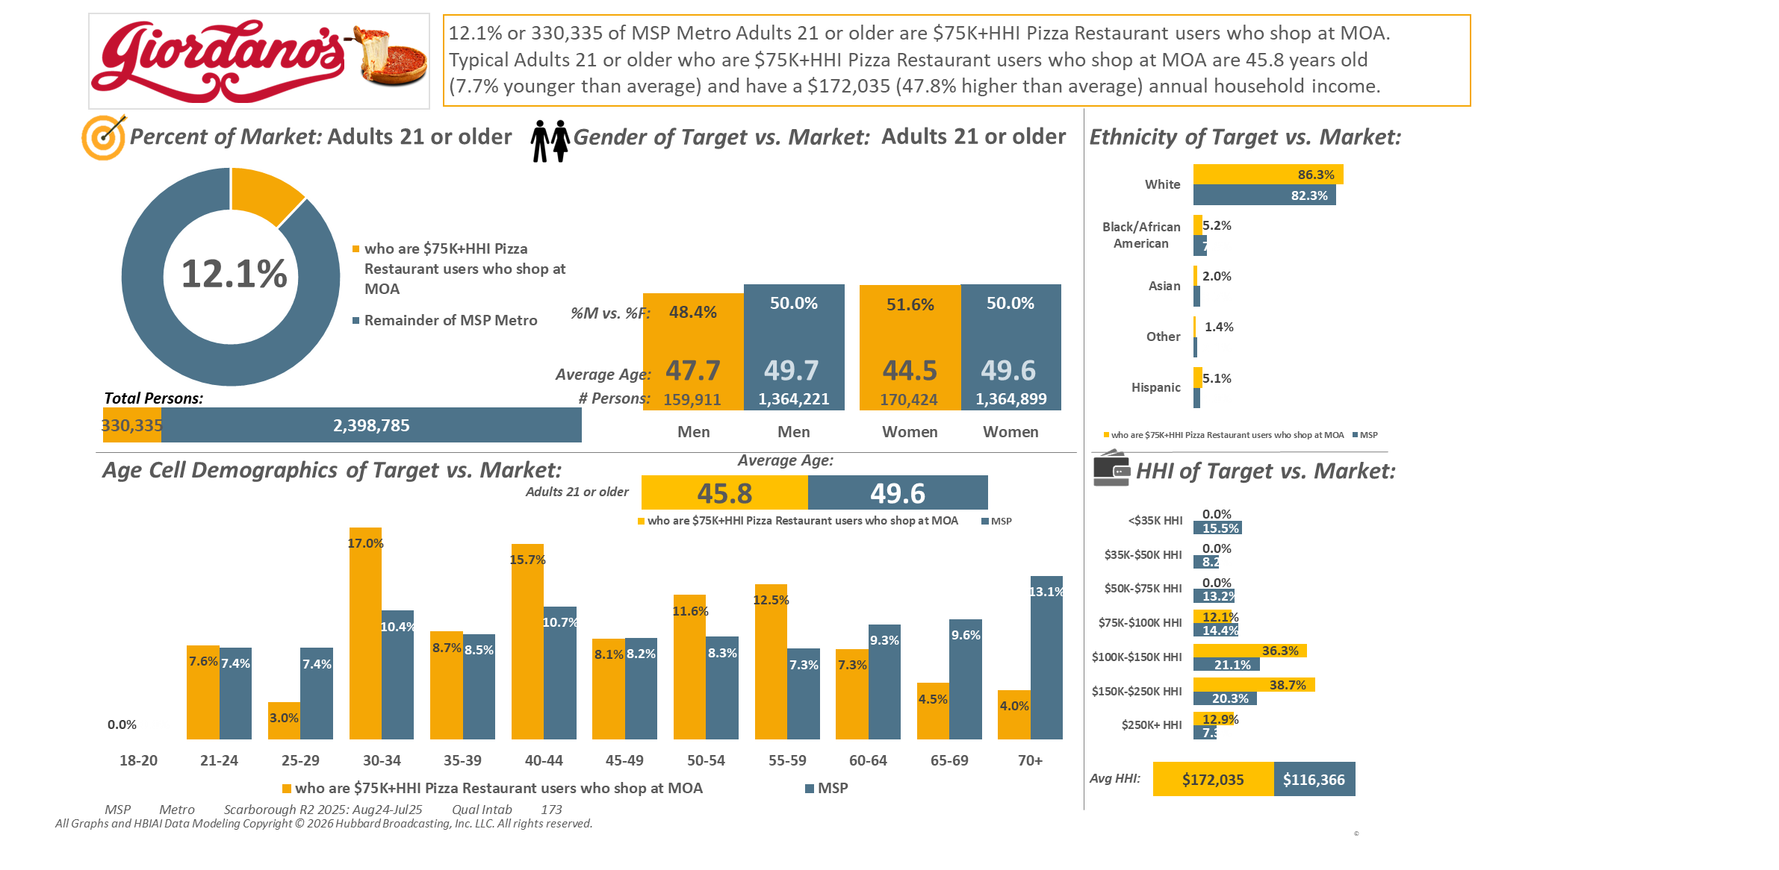
[((Household income summaries (HHLD): $75,000 or more AND Types of restaurants used past 30 days: Any pizza restaurant) AND Malls shopped/visited past 3 months: Mall of America)]

Slide 25
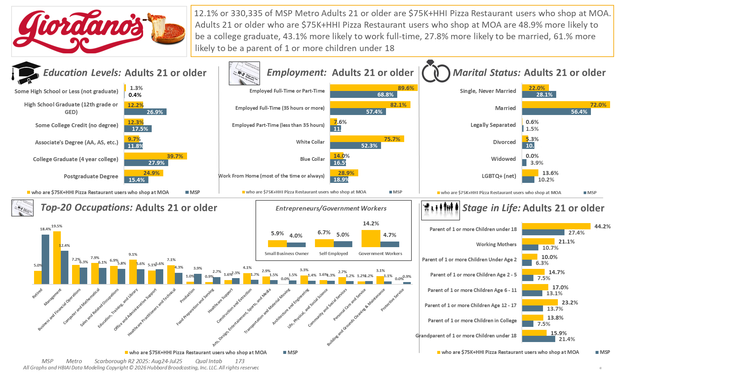
[((Household income summaries (HHLD): $75,000 or more AND Types of restaurants used past 30 days: Any pizza restaurant) AND Malls shopped/visited past 3 months: Mall of America)]

Slide 26
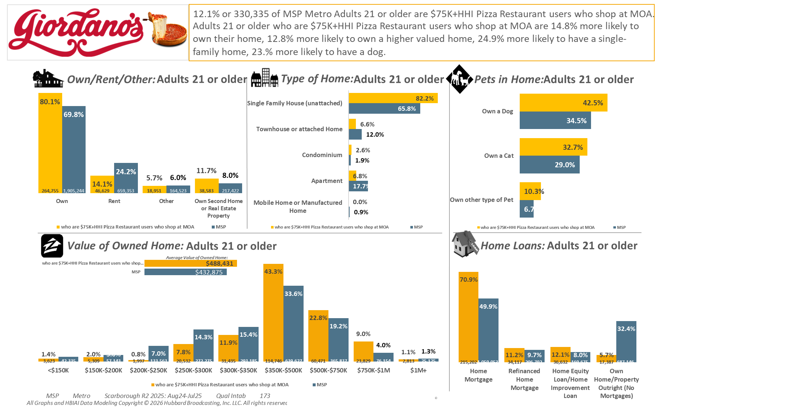
[((Household income summaries (HHLD): $75,000 or more AND Types of restaurants used past 30 days: Any pizza restaurant) AND Malls shopped/visited past 3 months: Mall of America)]

Slide 27
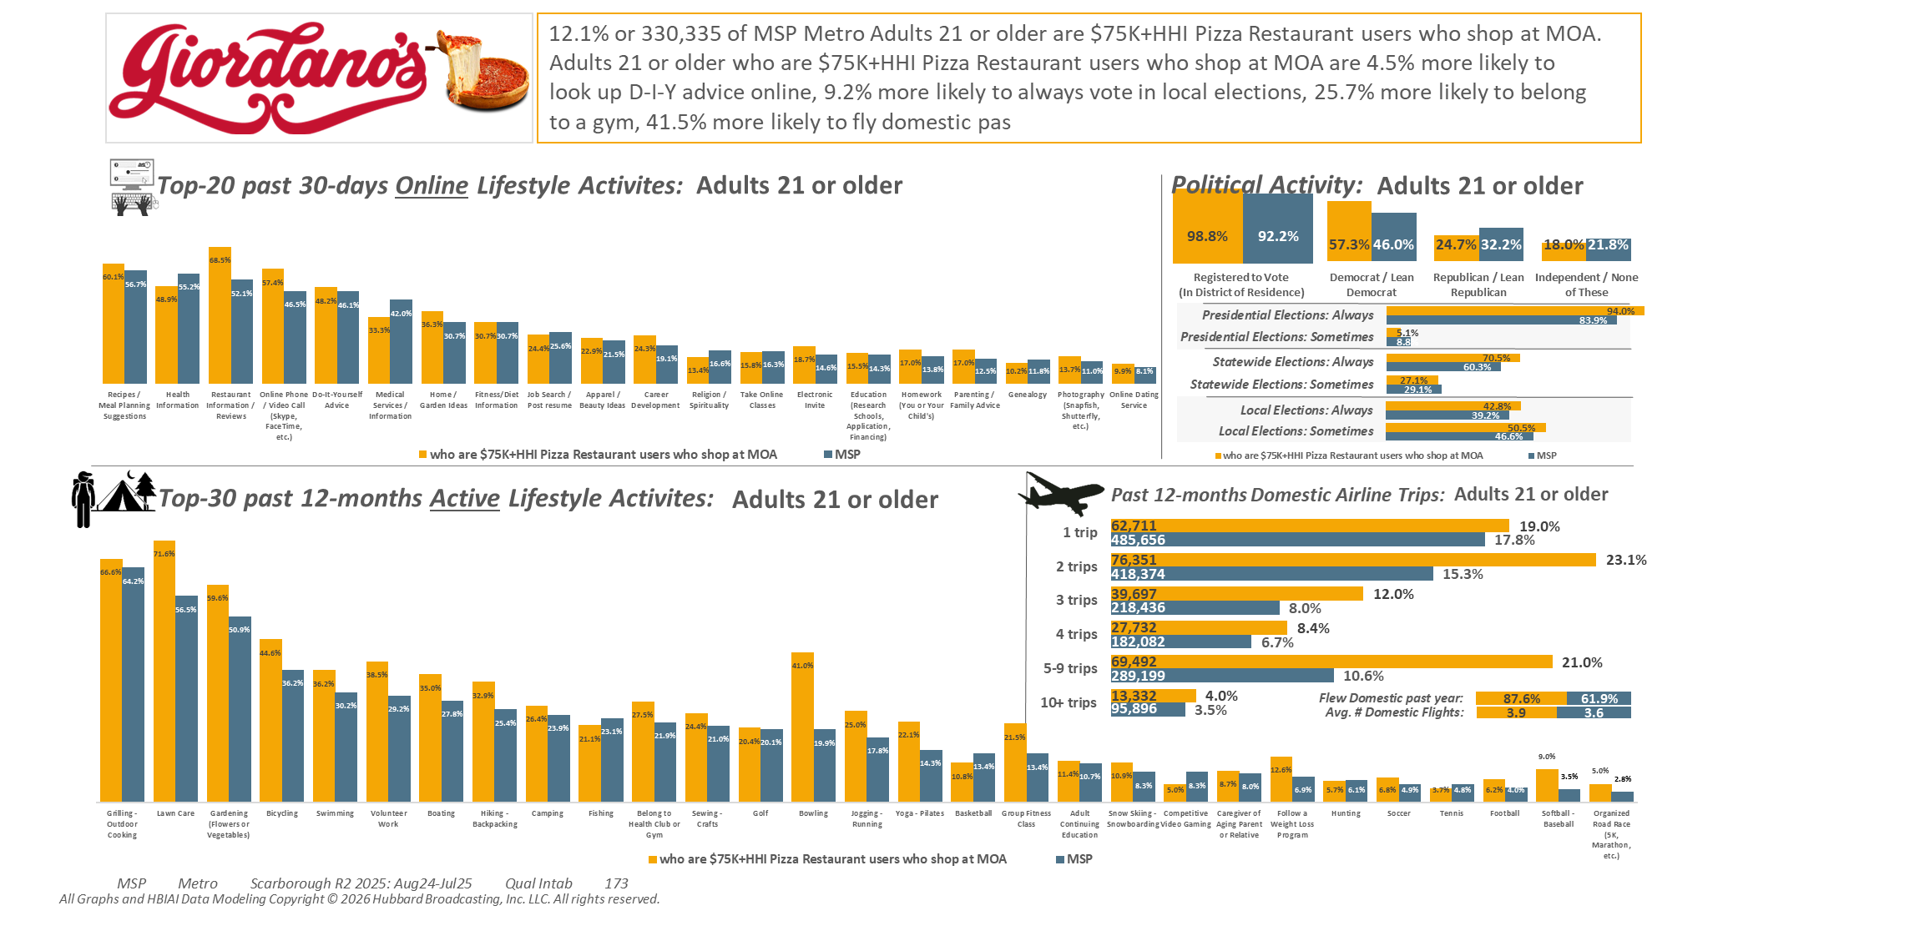
[((Household income summaries (HHLD): $75,000 or more AND Types of restaurants used past 30 days: Any pizza restaurant) AND Malls shopped/visited past 3 months: Mall of America)]

Slide 28
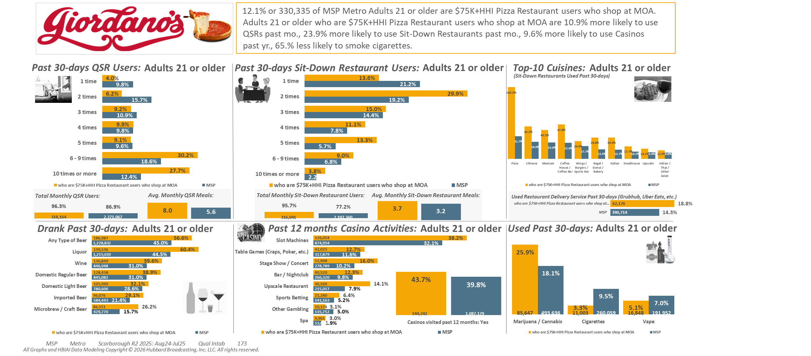
[((Household income summaries (HHLD): $75,000 or more AND Types of restaurants used past 30 days: Any pizza restaurant) AND Malls shopped/visited past 3 months: Mall of America)]

Slide 29
[((Household income summaries (HHLD): $75,000 or more AND Types of restaurants used past 30 days: Any pizza restaurant) AND Malls shopped/visited past 3 months: Mall of America)]

Slide 30
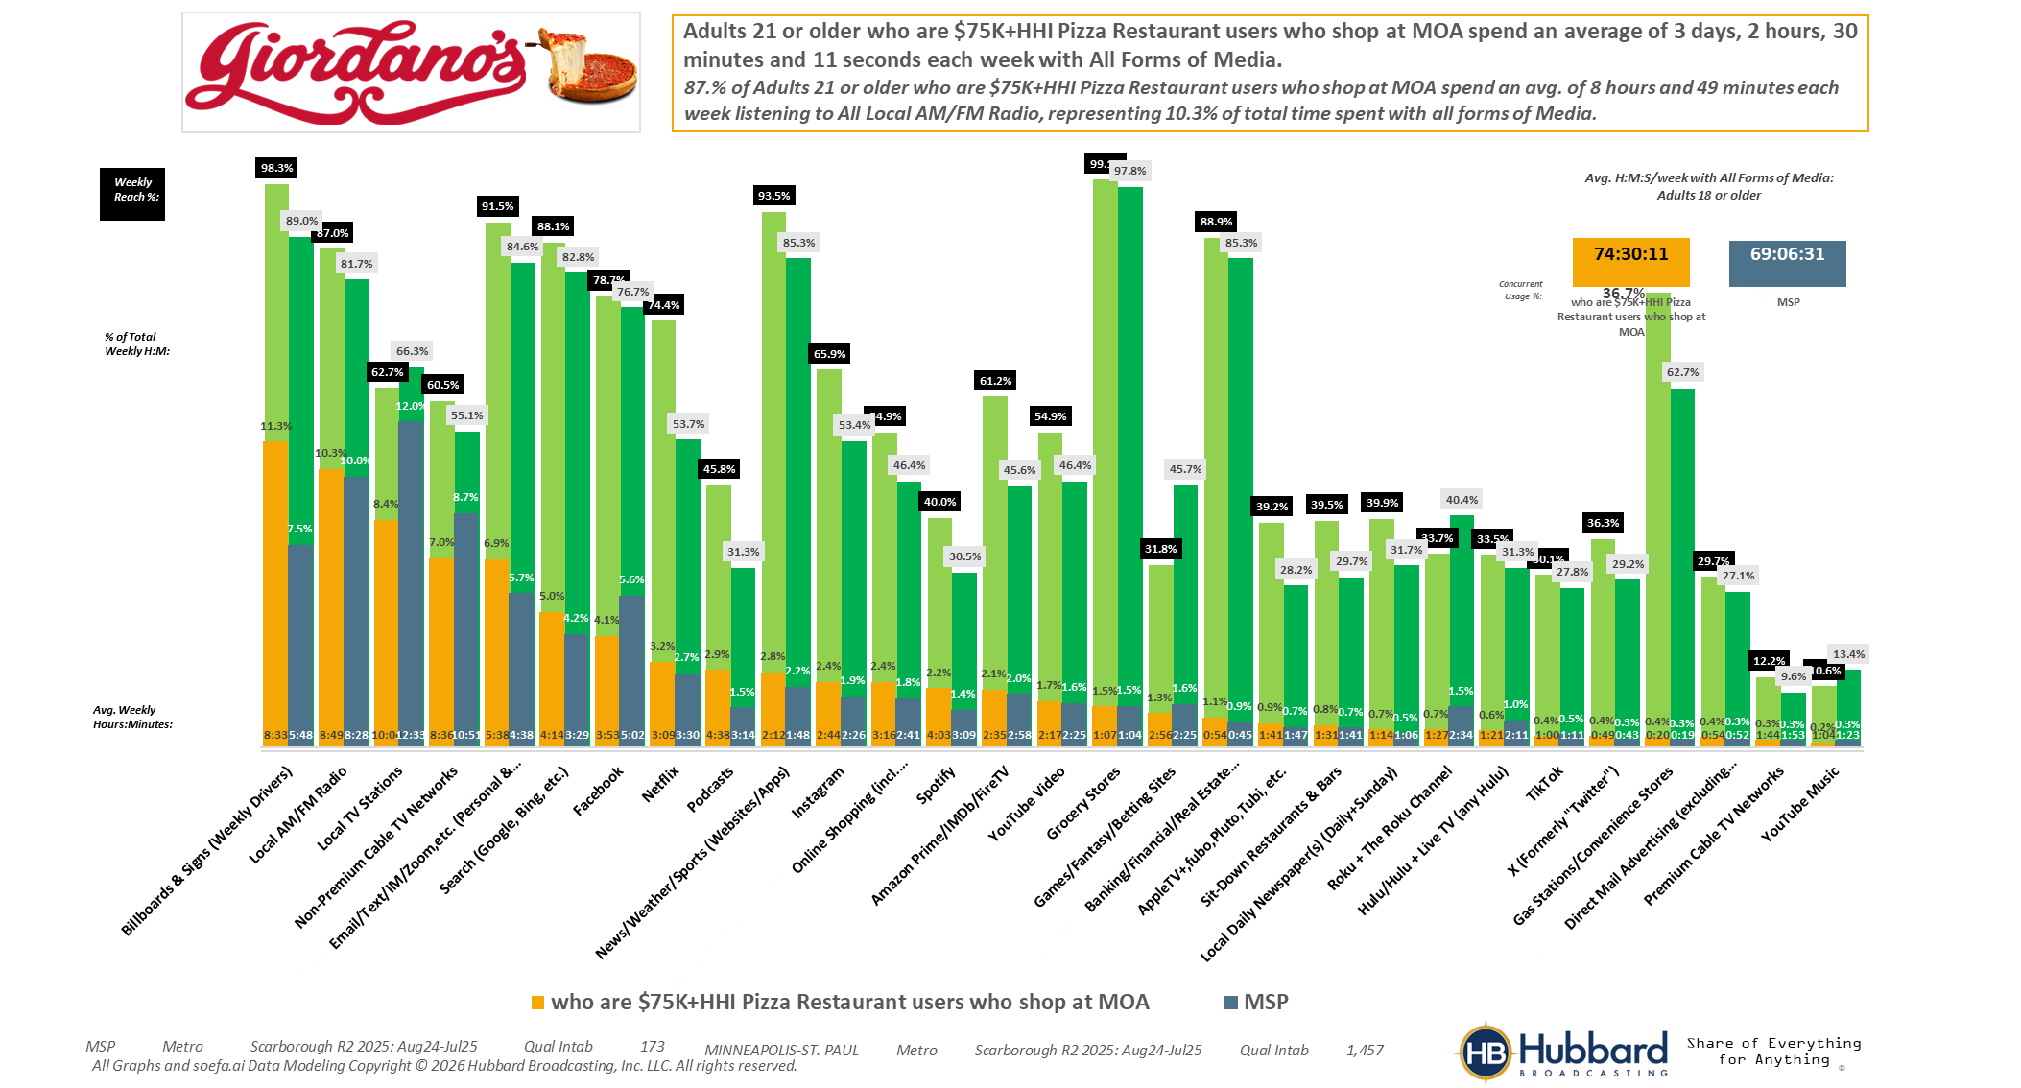

[((Household income summaries (HHLD): $75,000 or more AND Types of restaurants used past 30 days: Any pizza restaurant) AND Malls shopped/visited past 3 months: Mall of America)]

Slide 31
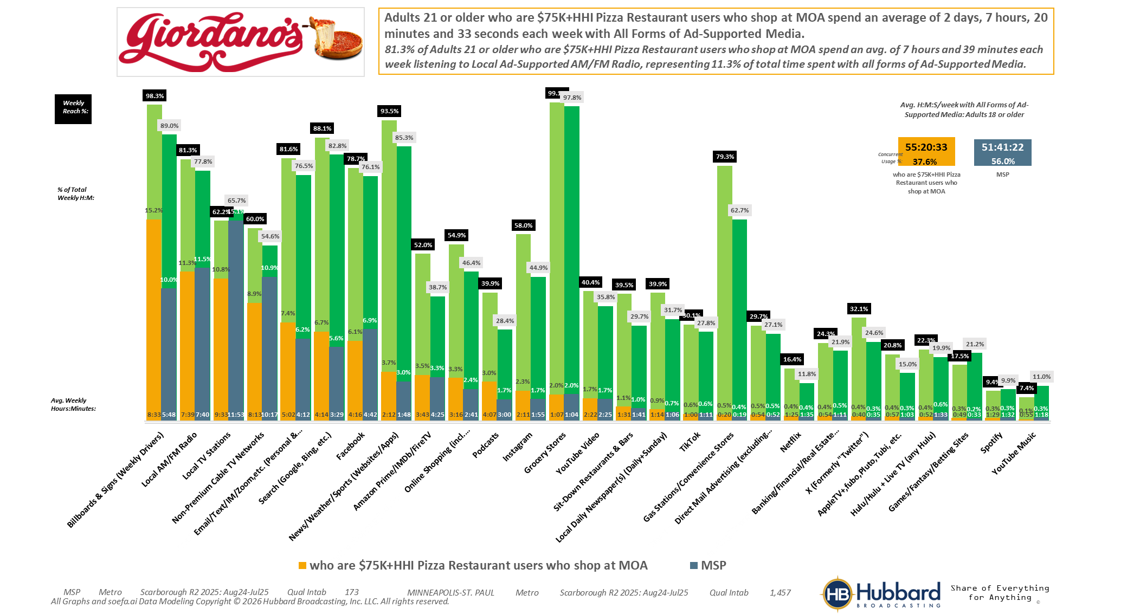
[((Household income summaries (HHLD): $75,000 or more AND Types of restaurants used past 30 days: Any pizza restaurant) AND Malls shopped/visited past 3 months: Mall of America)]

Slide 32
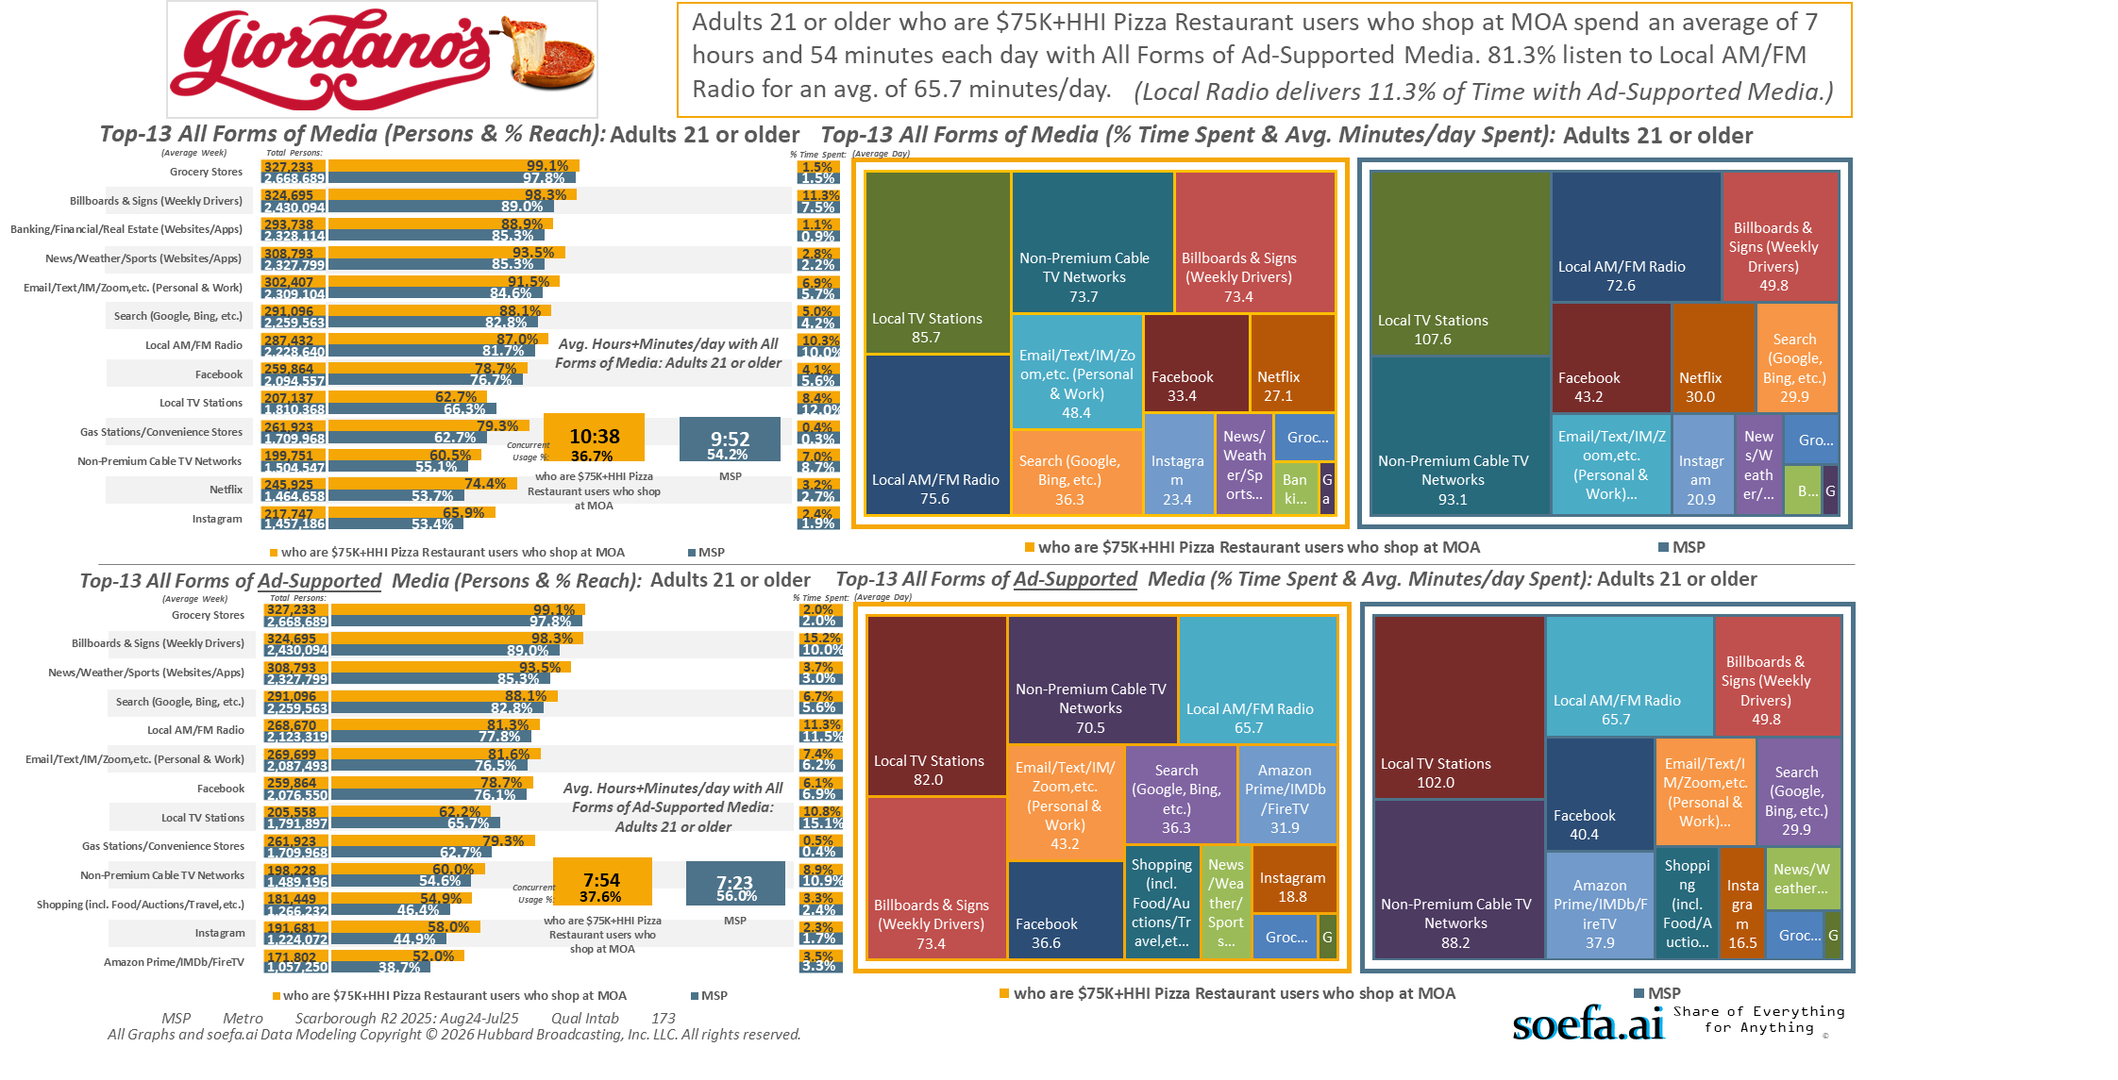
[((Household income summaries (HHLD): $75,000 or more AND Types of restaurants used past 30 days: Any pizza restaurant) AND Malls shopped/visited past 3 months: Mall of America)]

Slide 33
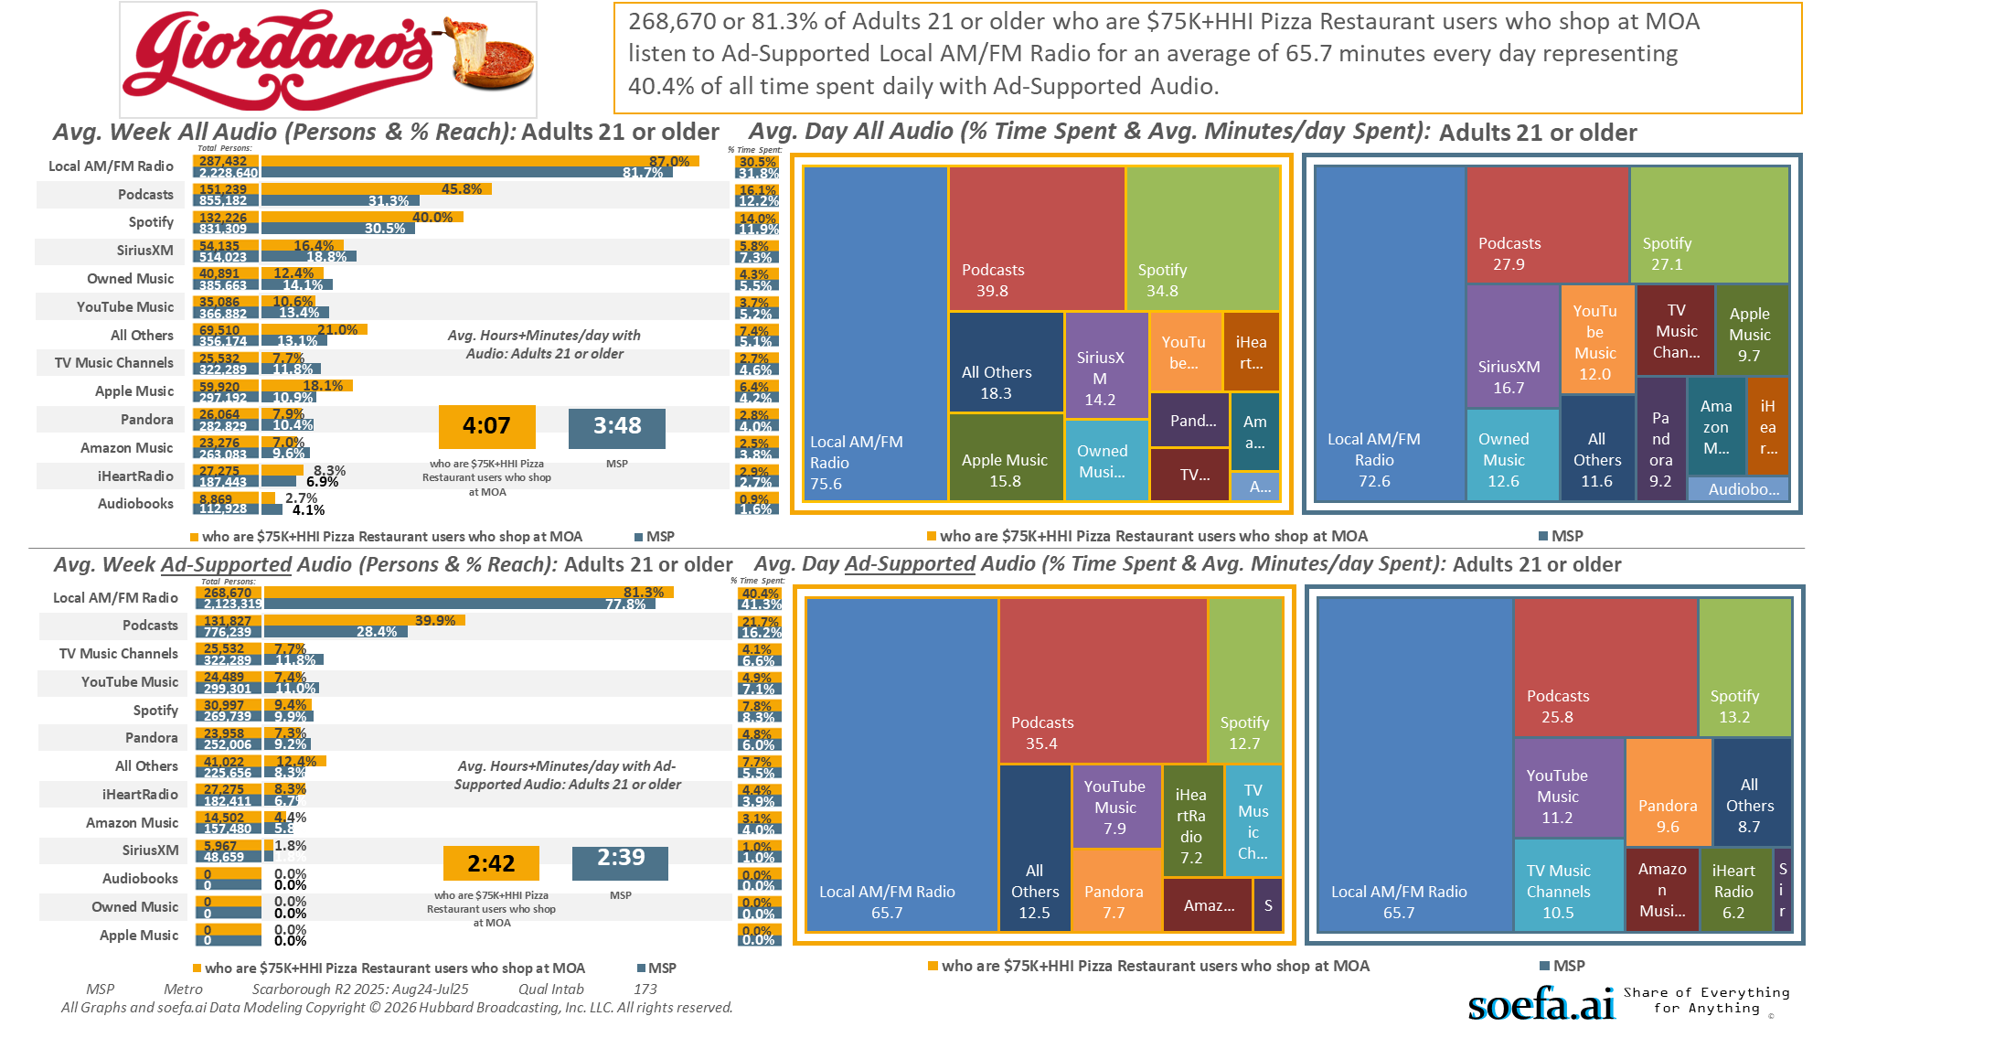
[((Household income summaries (HHLD): $75,000 or more AND Types of restaurants used past 30 days: Any pizza restaurant) AND Malls shopped/visited past 3 months: Mall of America)]

Slide 34
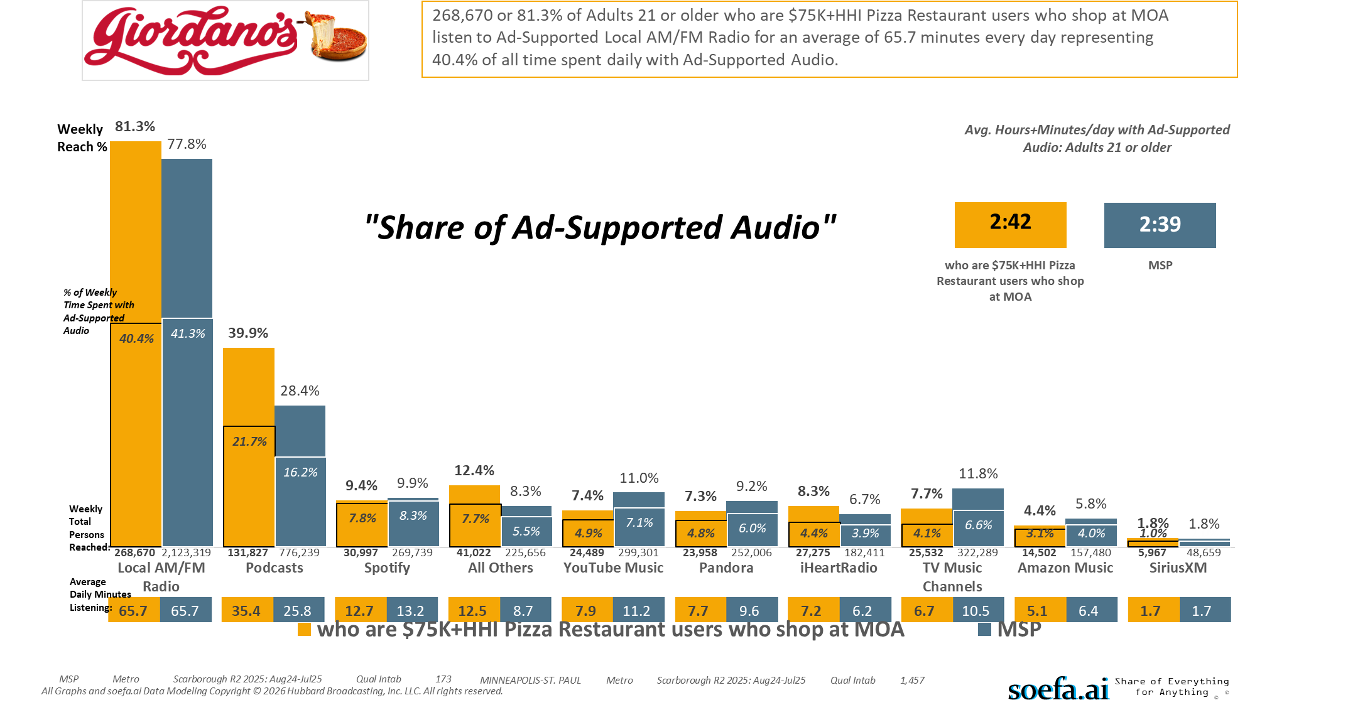
[((Household income summaries (HHLD): $75,000 or more AND Types of restaurants used past 30 days: Any pizza restaurant) AND Malls shopped/visited past 3 months: Mall of America)]

Slide 35
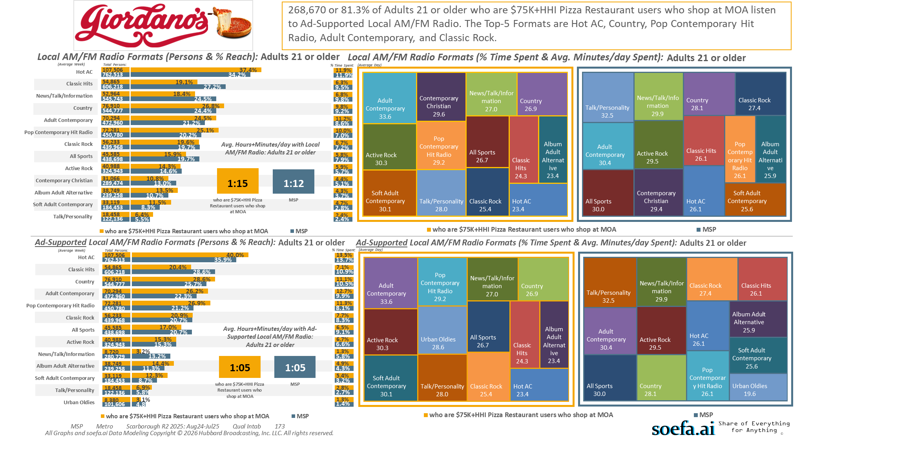
[((Household income summaries (HHLD): $75,000 or more AND Types of restaurants used past 30 days: Any pizza restaurant) AND Malls shopped/visited past 3 months: Mall of America)]

Slide 36
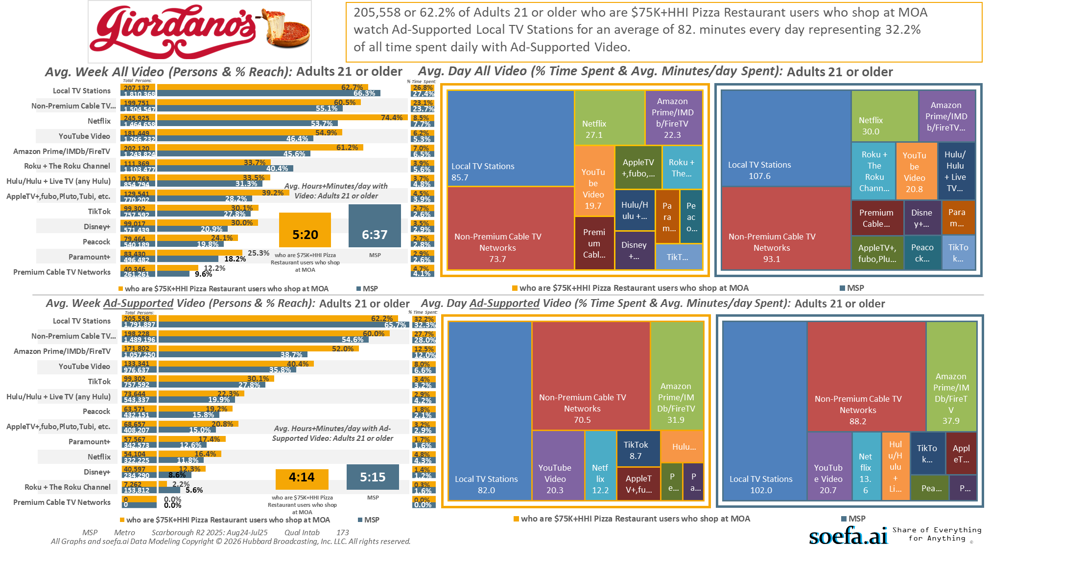
[((Household income summaries (HHLD): $75,000 or more AND Types of restaurants used past 30 days: Any pizza restaurant) AND Malls shopped/visited past 3 months: Mall of America)]

Slide 37
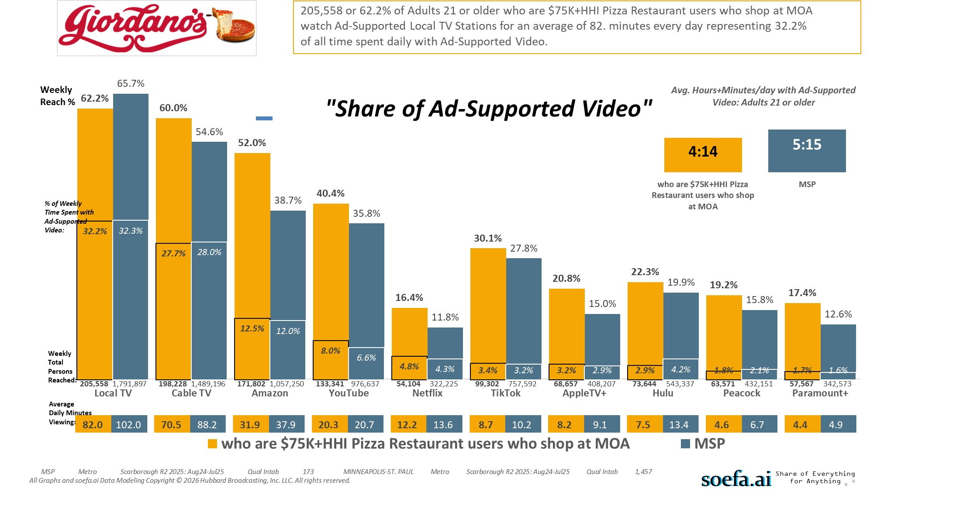
[((Household income summaries (HHLD): $75,000 or more AND Types of restaurants used past 30 days: Any pizza restaurant) AND Malls shopped/visited past 3 months: Mall of America)]

Slide 38
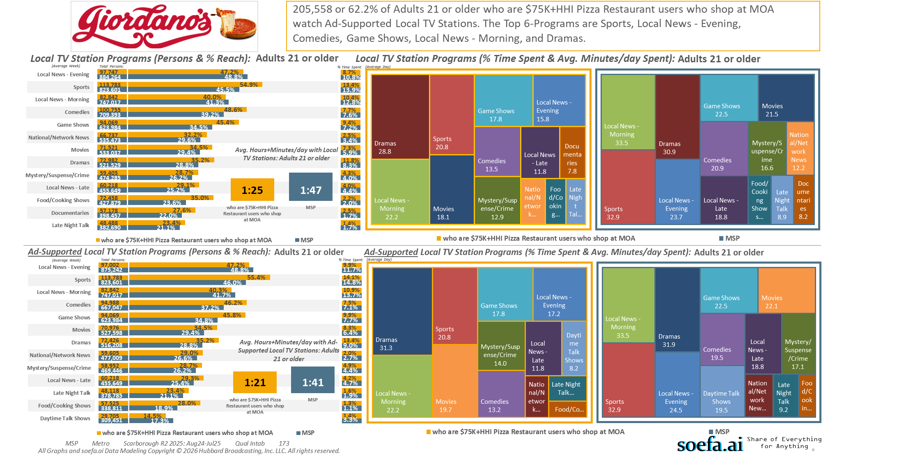
[((Household income summaries (HHLD): $75,000 or more AND Types of restaurants used past 30 days: Any pizza restaurant) AND Malls shopped/visited past 3 months: Mall of America)]

Slide 39
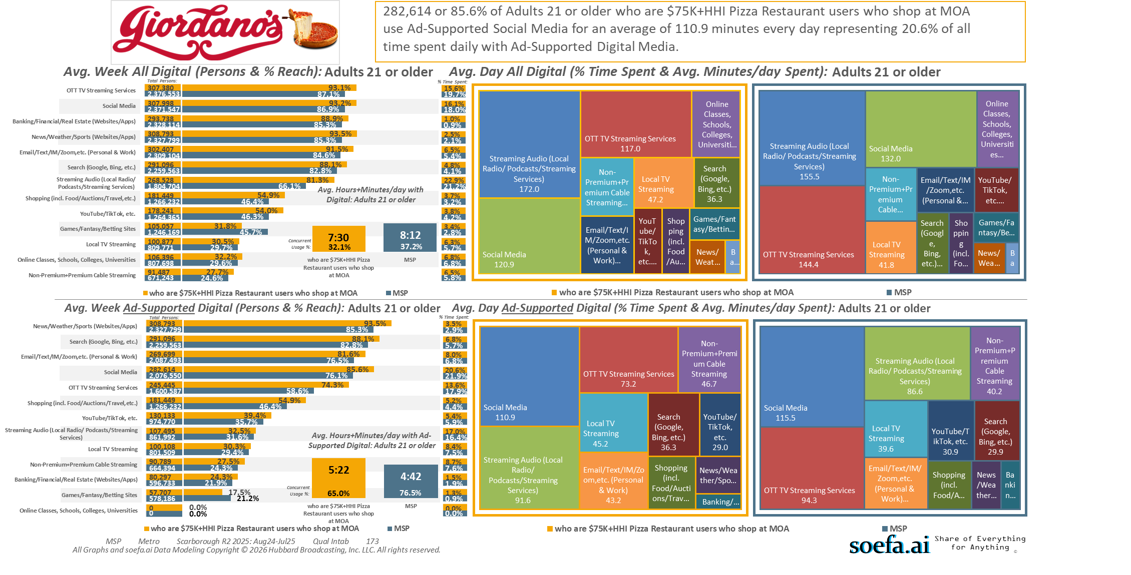
[((Household income summaries (HHLD): $75,000 or more AND Types of restaurants used past 30 days: Any pizza restaurant) AND Malls shopped/visited past 3 months: Mall of America)]

Slide 40
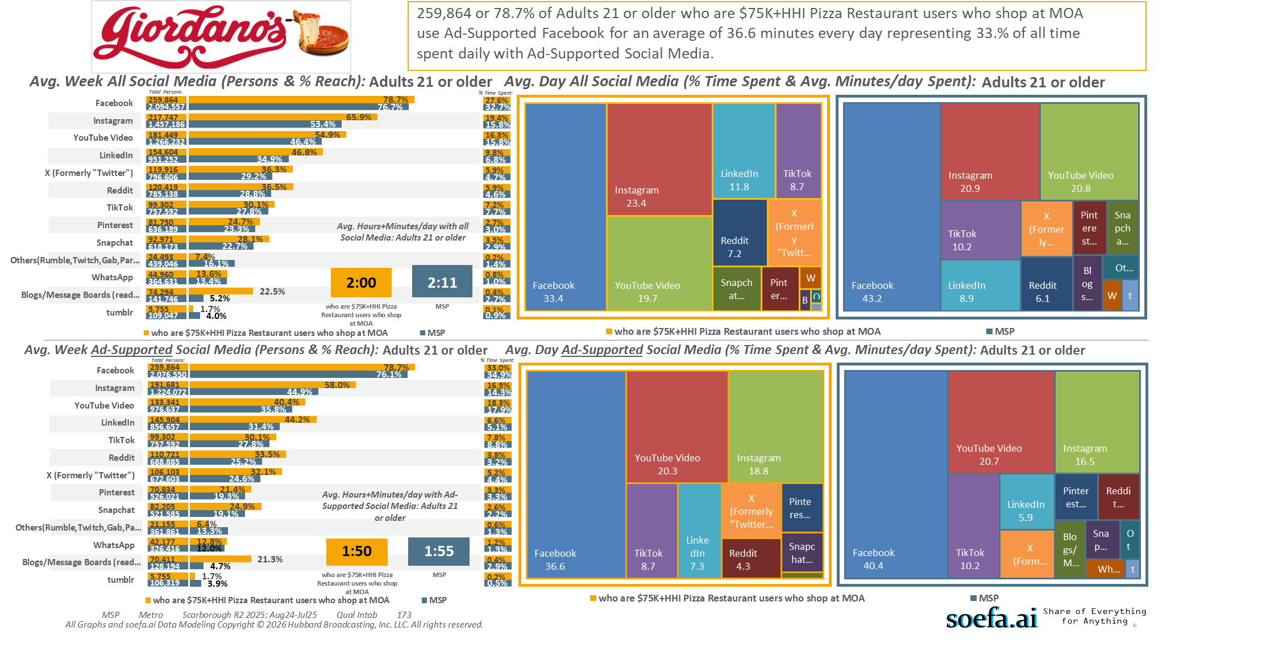
[((Household income summaries (HHLD): $75,000 or more AND Types of restaurants used past 30 days: Any pizza restaurant) AND Malls shopped/visited past 3 months: Mall of America)]

Slide 41

[((Household income summaries (HHLD): $75,000 or more AND Types of restaurants used past 30 days: Any pizza restaurant) AND Malls shopped/visited past 3 months: Mall of America)]

Slide 42
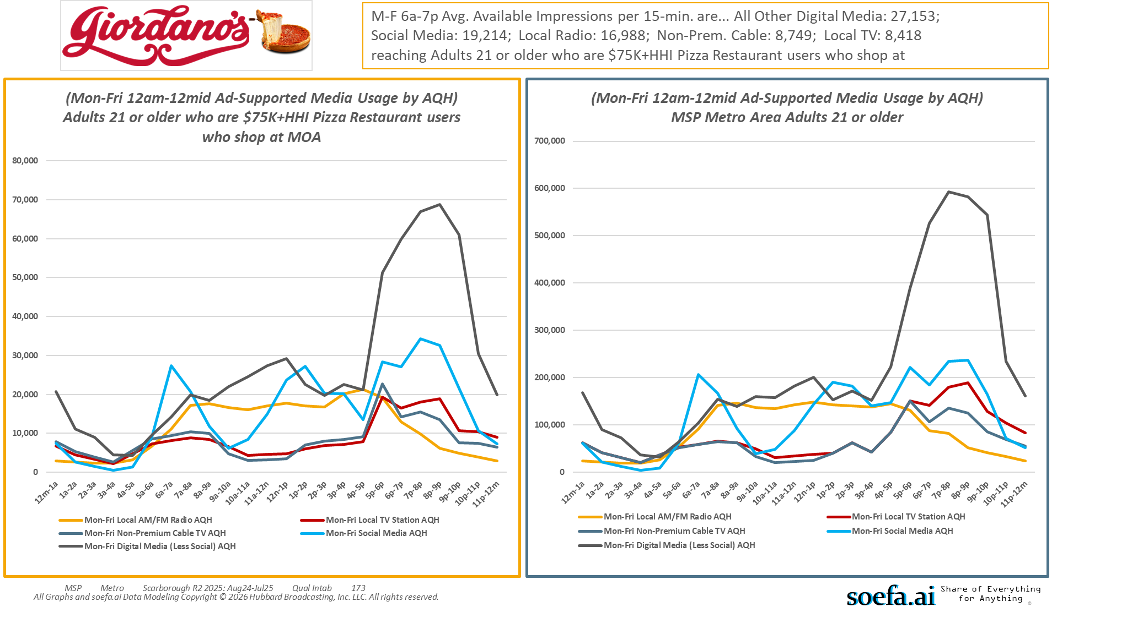
[((Household income summaries (HHLD): $75,000 or more AND Types of restaurants used past 30 days: Any pizza restaurant) AND Malls shopped/visited past 3 months: Mall of America)]

Slide 43
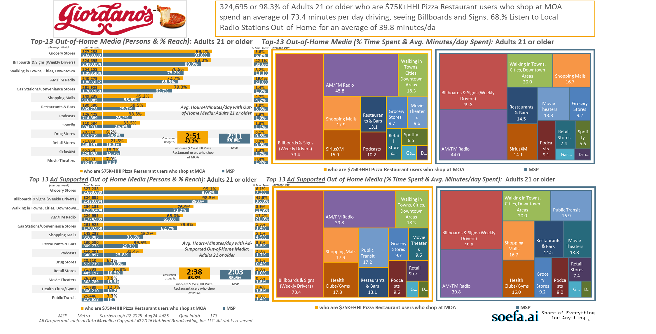
[((Household income summaries (HHLD): $75,000 or more AND Types of restaurants used past 30 days: Any pizza restaurant) AND Malls shopped/visited past 3 months: Mall of America)]

Slide 44
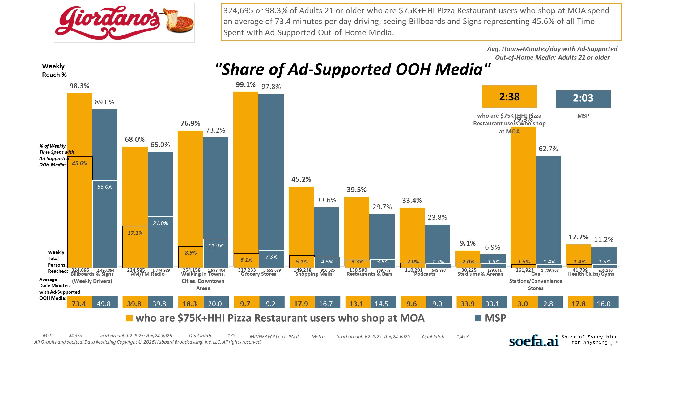
[((Household income summaries (HHLD): $75,000 or more AND Types of restaurants used past 30 days: Any pizza restaurant) AND Malls shopped/visited past 3 months: Mall of America)]

Slide 45
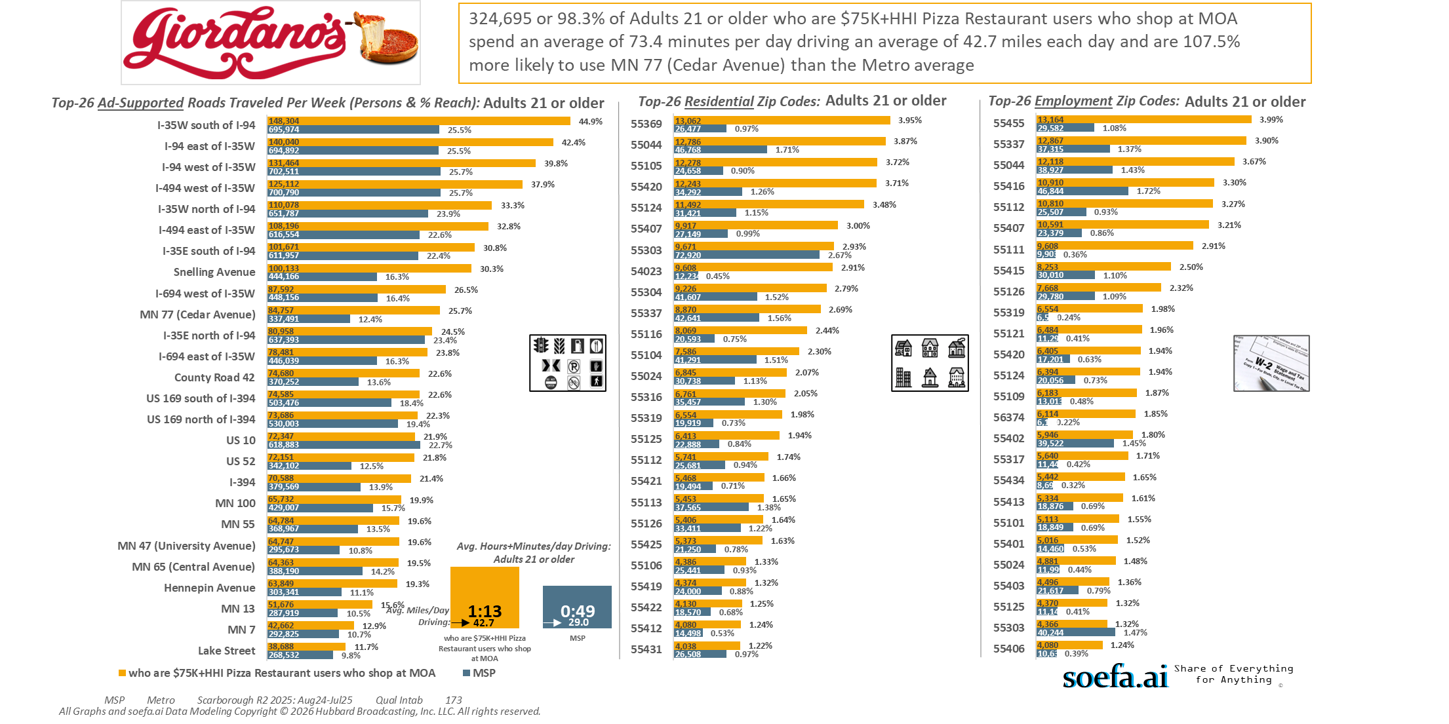
[((Household income summaries (HHLD): $75,000 or more AND Types of restaurants used past 30 days: Any pizza restaurant) AND Malls shopped/visited past 3 months: Mall of America)]

Slide 46
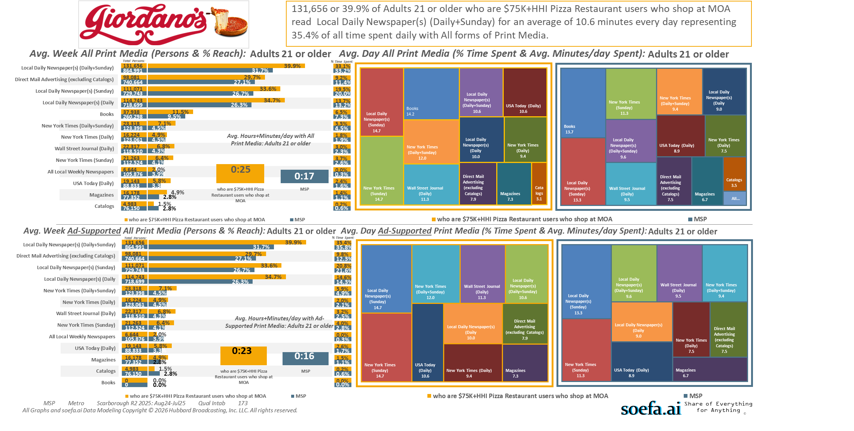
[((Household income summaries (HHLD): $75,000 or more AND Types of restaurants used past 30 days: Any pizza restaurant) AND Malls shopped/visited past 3 months: Mall of America)]

