Slide 1

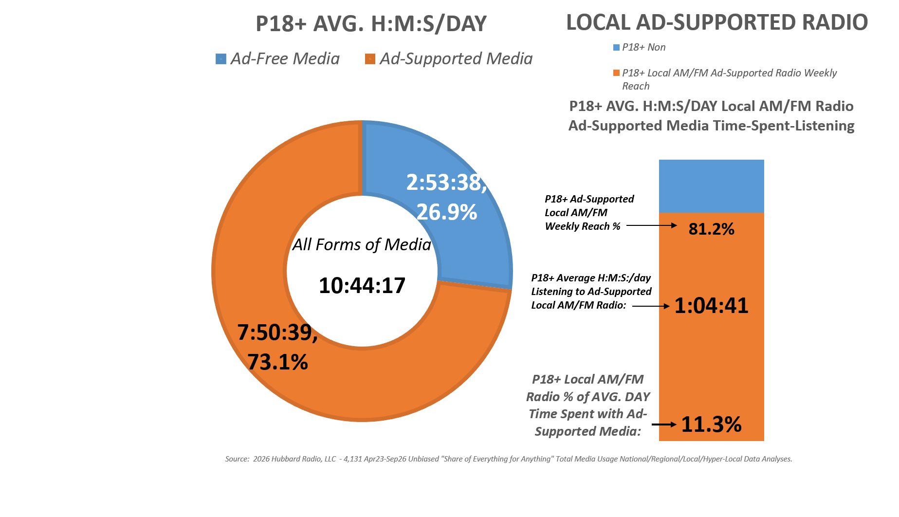
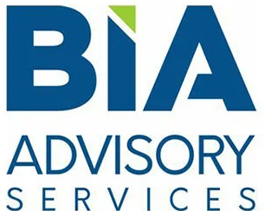
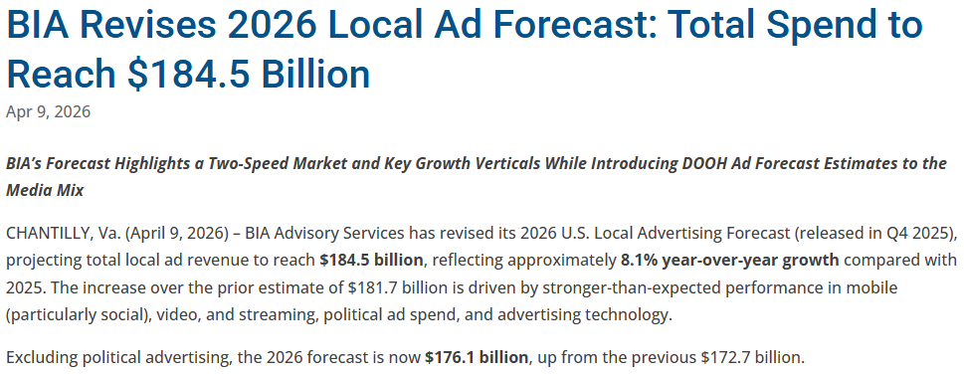
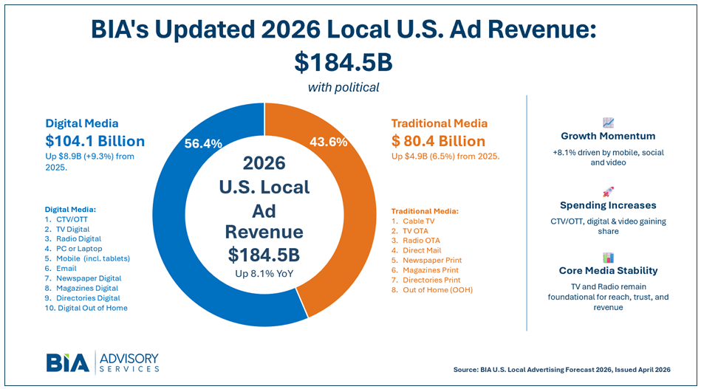

Average of
4,131 Decks
As of: 6 PM:
09/29/2026
Local Radio:
$10 Billion (excl. “Radio Digital”)
= 6% of Ad Spend

