Slide 1
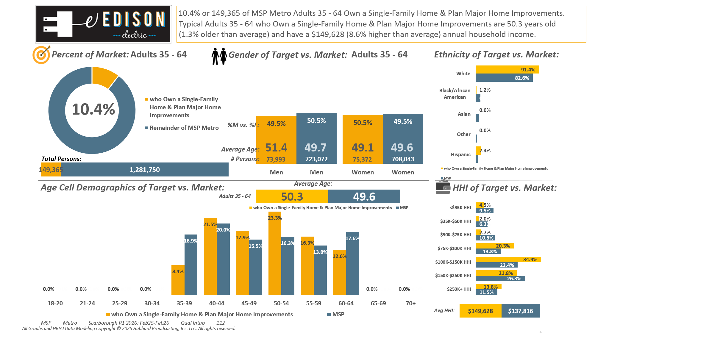





[((Own or rent residence (HHLD): Own AND Type of dwelling (HHLD): Single family house (unattached)) AND (Type of home improvement plan to do next 12 months (HHLD): Remodel kitchen OR Type of home improvement plan to do next 12 months (HHLD): Remodel bathroom OR Type of home improvement plan to do next 12 months (HHLD): Any addition OR Type of home improvement plan to do next 12 months (HHLD): Home generator))]

Slide 2
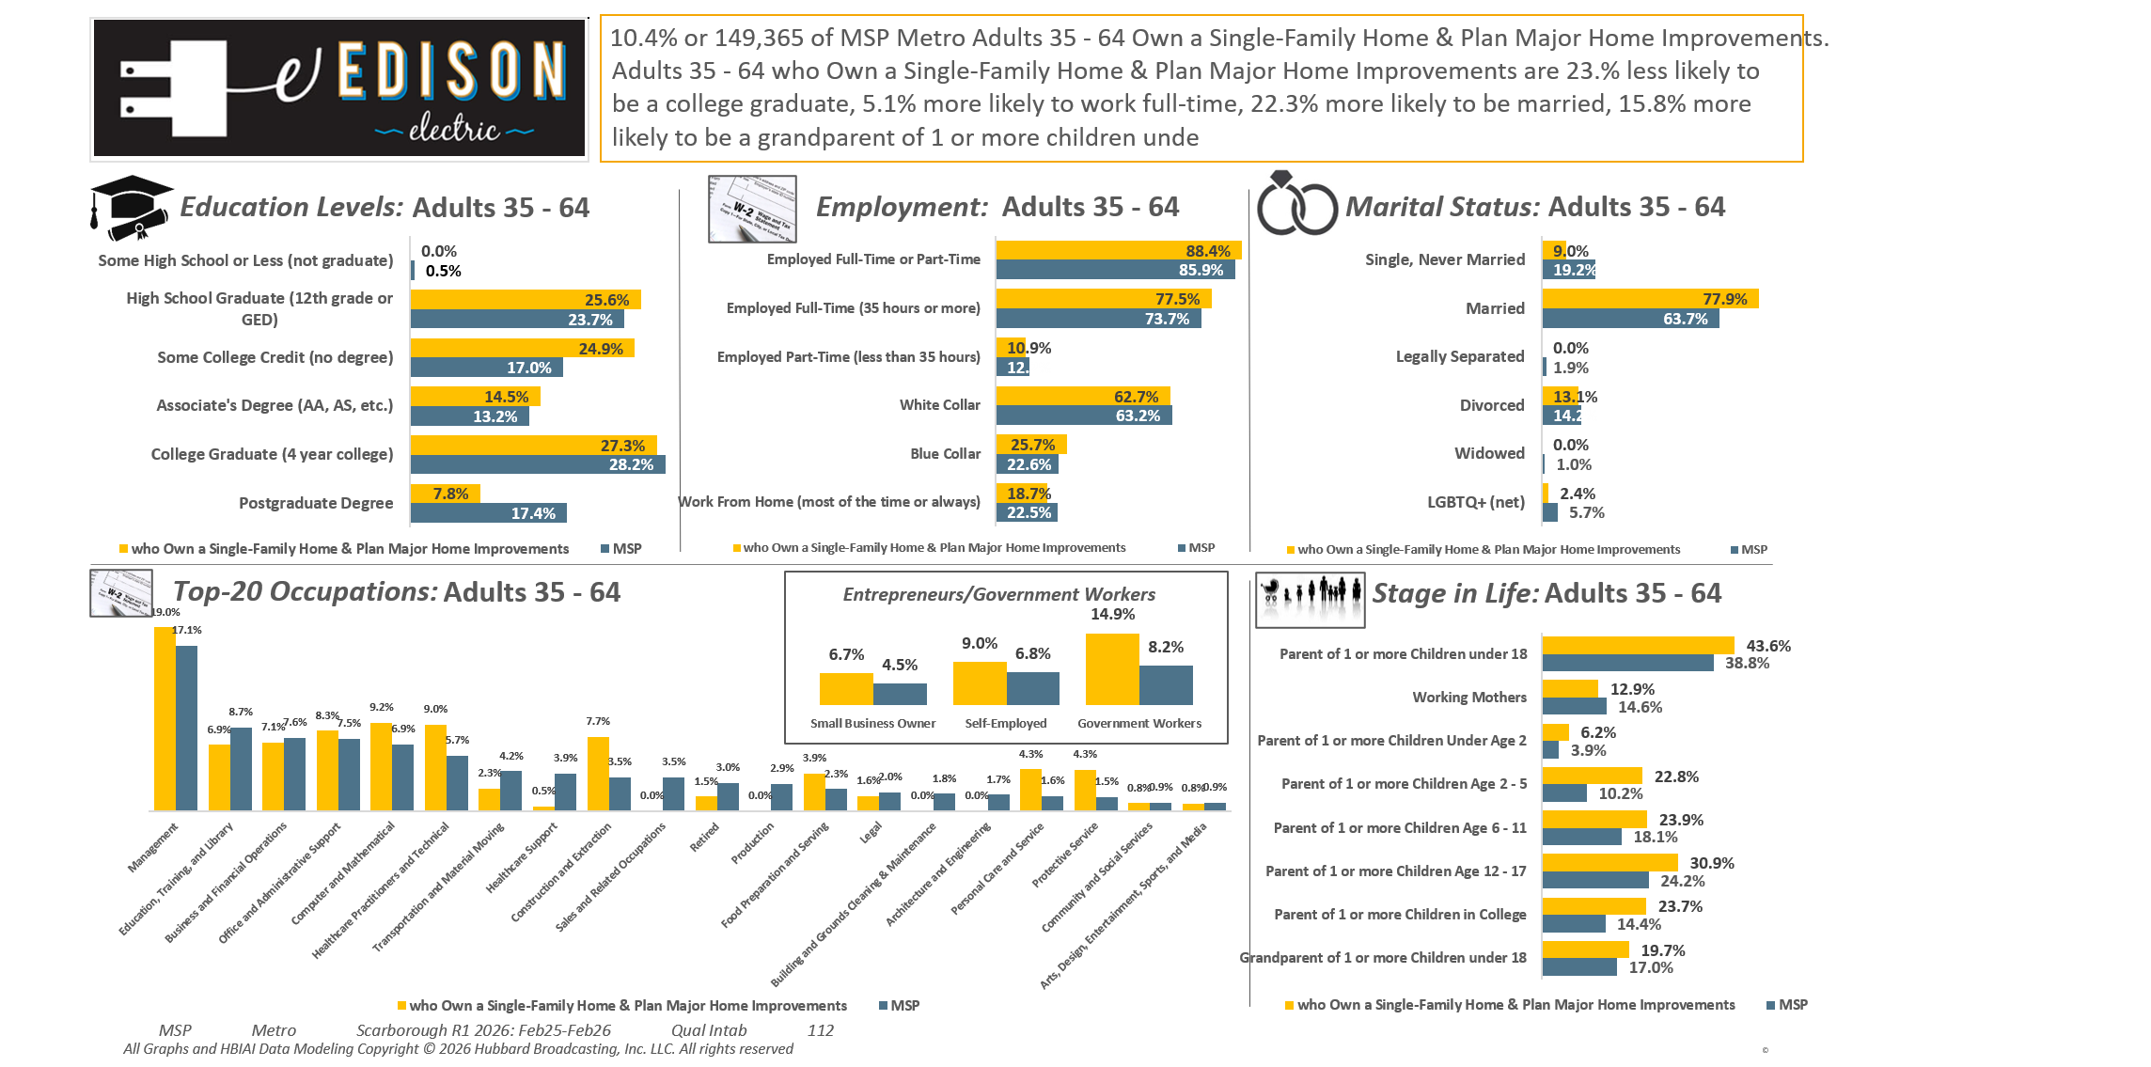
[((Own or rent residence (HHLD): Own AND Type of dwelling (HHLD): Single family house (unattached)) AND (Type of home improvement plan to do next 12 months (HHLD): Remodel kitchen OR Type of home improvement plan to do next 12 months (HHLD): Remodel bathroom OR Type of home improvement plan to do next 12 months (HHLD): Any addition OR Type of home improvement plan to do next 12 months (HHLD): Home generator))]

Slide 3
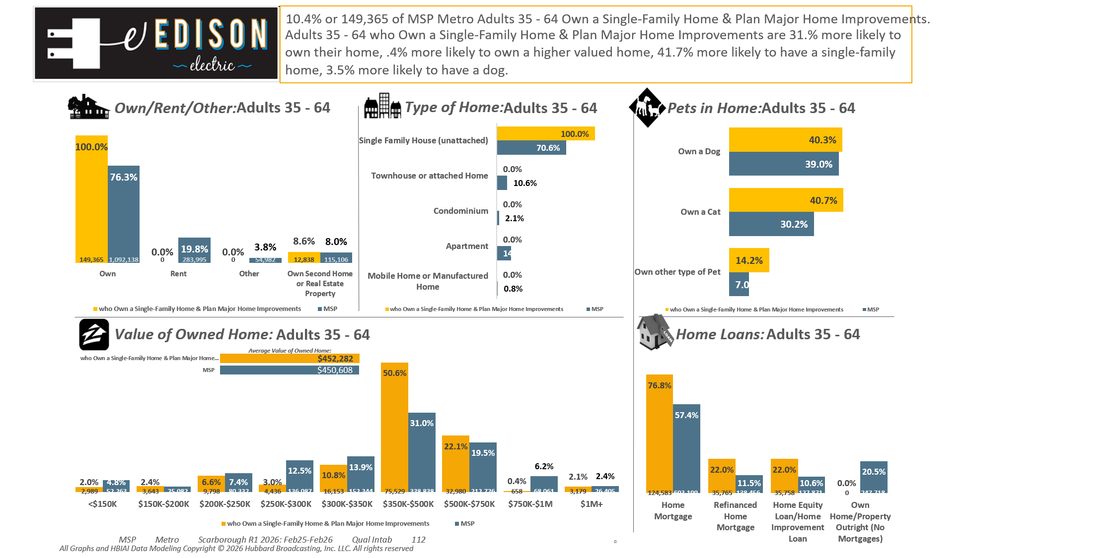
[((Own or rent residence (HHLD): Own AND Type of dwelling (HHLD): Single family house (unattached)) AND (Type of home improvement plan to do next 12 months (HHLD): Remodel kitchen OR Type of home improvement plan to do next 12 months (HHLD): Remodel bathroom OR Type of home improvement plan to do next 12 months (HHLD): Any addition OR Type of home improvement plan to do next 12 months (HHLD): Home generator))]

Slide 4

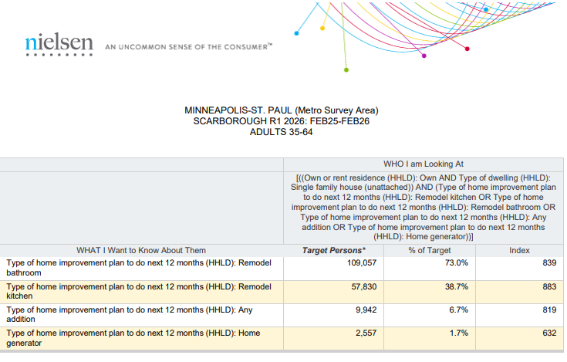
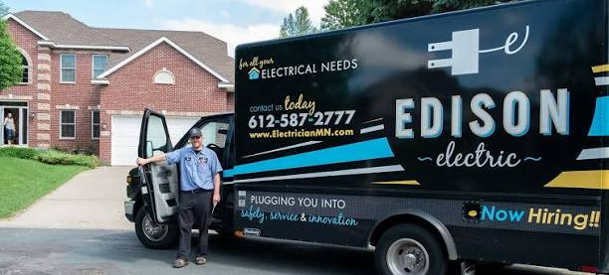
Projects Planned quantified...
Twin Cities Metro Area P35-64 who…
Own a Single-Family Home And…
Plan Major Home Improvements in the next 12mos.
[((Own or rent residence (HHLD): Own AND Type of dwelling (HHLD): Single family house (unattached)) AND (Type of home improvement plan to do next 12 months (HHLD): Remodel kitchen OR Type of home improvement plan to do next 12 months (HHLD): Remodel bathroom OR Type of home improvement plan to do next 12 months (HHLD): Any addition OR Type of home improvement plan to do next 12 months (HHLD): Home generator))]

Slide 5
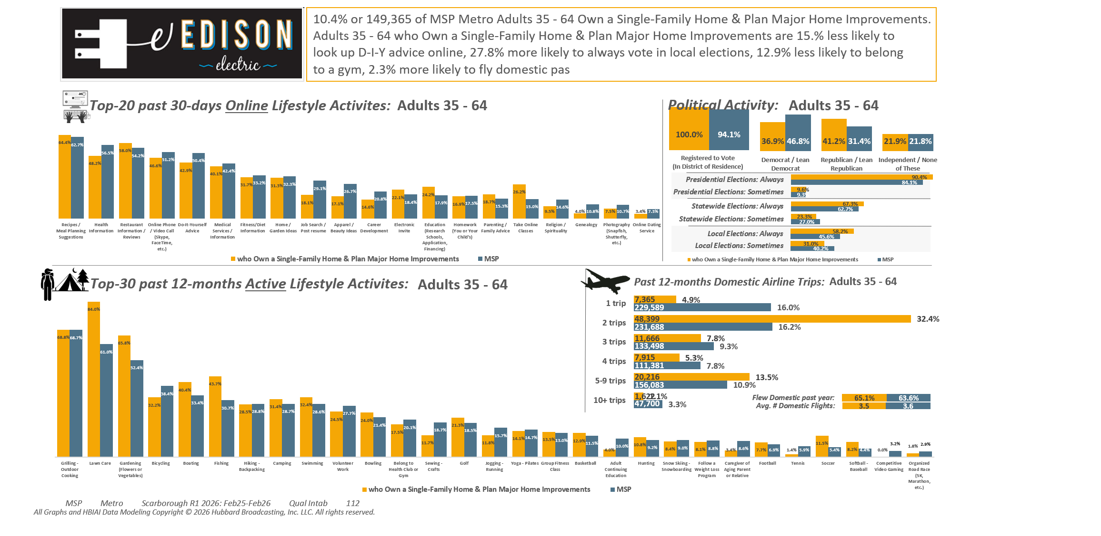
[((Own or rent residence (HHLD): Own AND Type of dwelling (HHLD): Single family house (unattached)) AND (Type of home improvement plan to do next 12 months (HHLD): Remodel kitchen OR Type of home improvement plan to do next 12 months (HHLD): Remodel bathroom OR Type of home improvement plan to do next 12 months (HHLD): Any addition OR Type of home improvement plan to do next 12 months (HHLD): Home generator))]

Slide 6
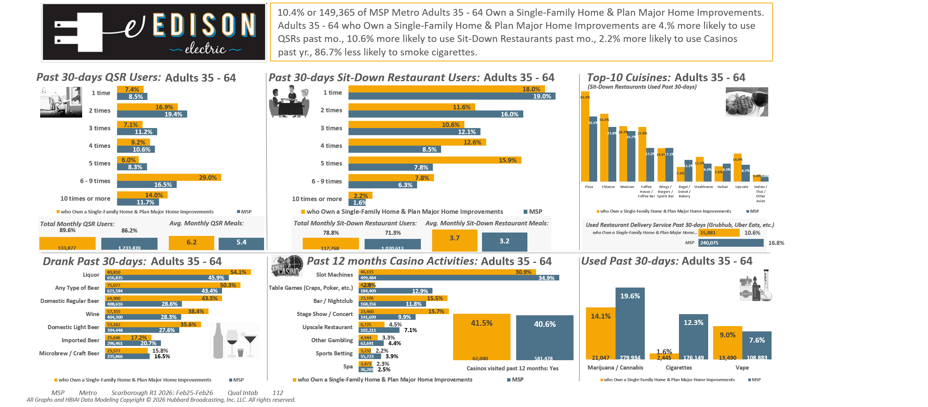
[((Own or rent residence (HHLD): Own AND Type of dwelling (HHLD): Single family house (unattached)) AND (Type of home improvement plan to do next 12 months (HHLD): Remodel kitchen OR Type of home improvement plan to do next 12 months (HHLD): Remodel bathroom OR Type of home improvement plan to do next 12 months (HHLD): Any addition OR Type of home improvement plan to do next 12 months (HHLD): Home generator))]

Slide 7
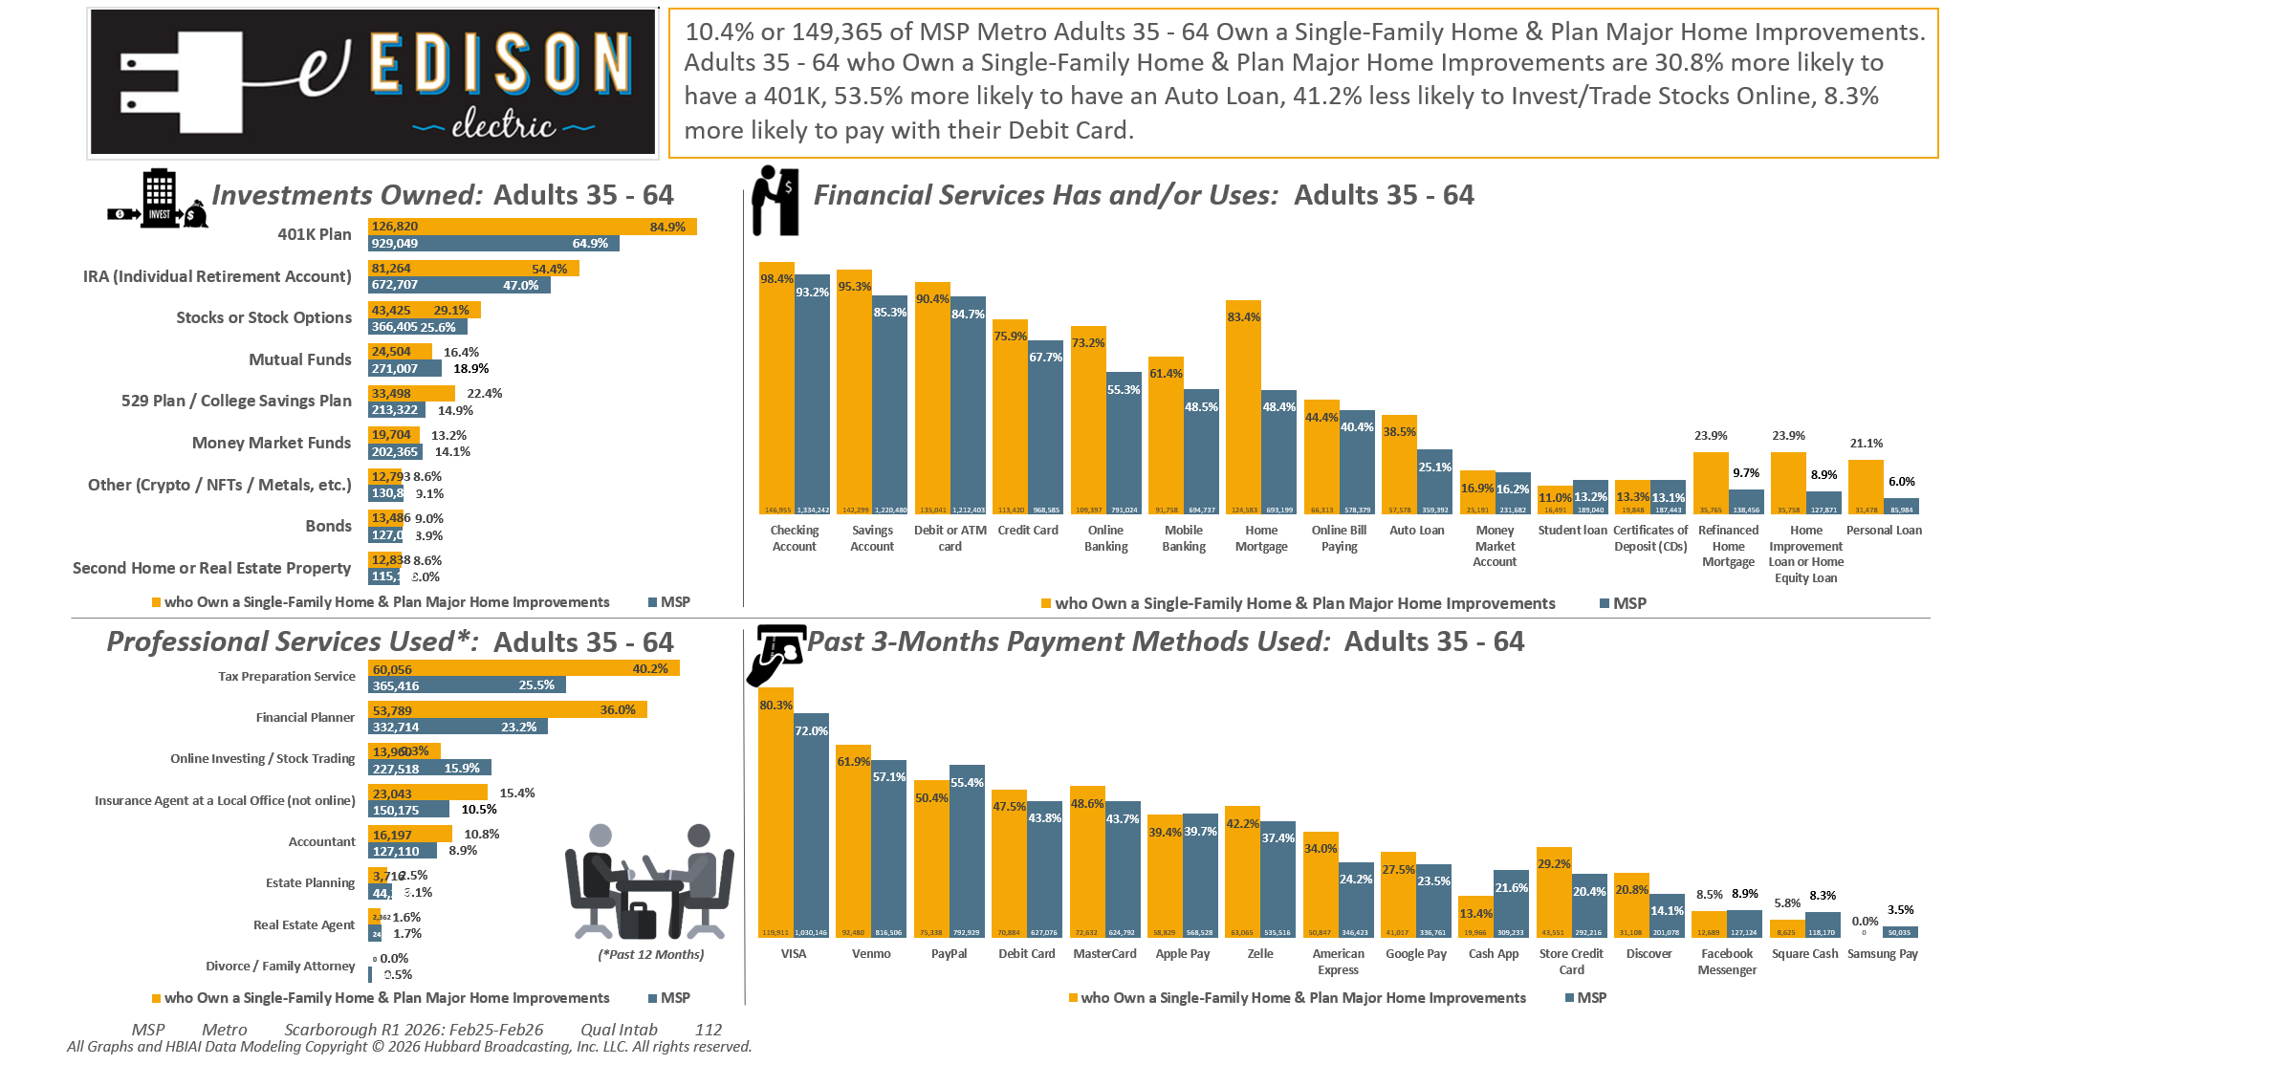
[((Own or rent residence (HHLD): Own AND Type of dwelling (HHLD): Single family house (unattached)) AND (Type of home improvement plan to do next 12 months (HHLD): Remodel kitchen OR Type of home improvement plan to do next 12 months (HHLD): Remodel bathroom OR Type of home improvement plan to do next 12 months (HHLD): Any addition OR Type of home improvement plan to do next 12 months (HHLD): Home generator))]

Slide 8
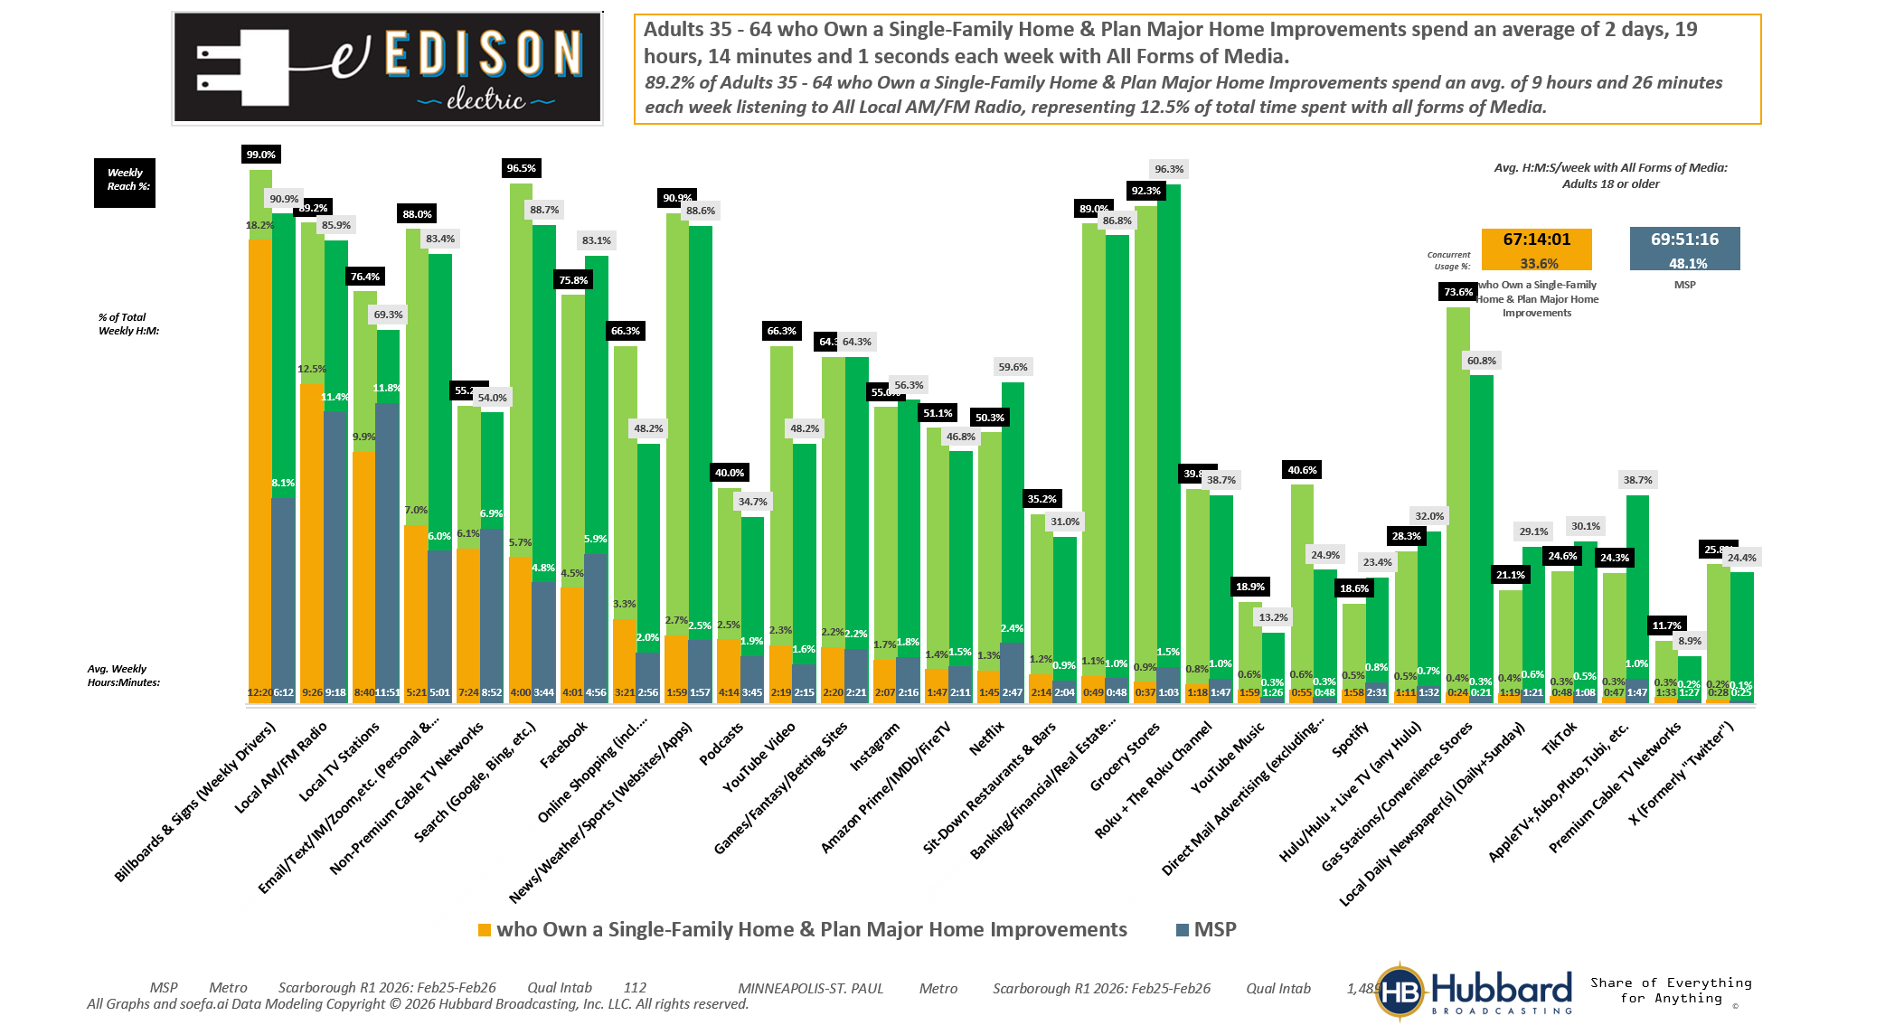
[((Own or rent residence (HHLD): Own AND Type of dwelling (HHLD): Single family house (unattached)) AND (Type of home improvement plan to do next 12 months (HHLD): Remodel kitchen OR Type of home improvement plan to do next 12 months (HHLD): Remodel bathroom OR Type of home improvement plan to do next 12 months (HHLD): Any addition OR Type of home improvement plan to do next 12 months (HHLD): Home generator))]

Slide 9
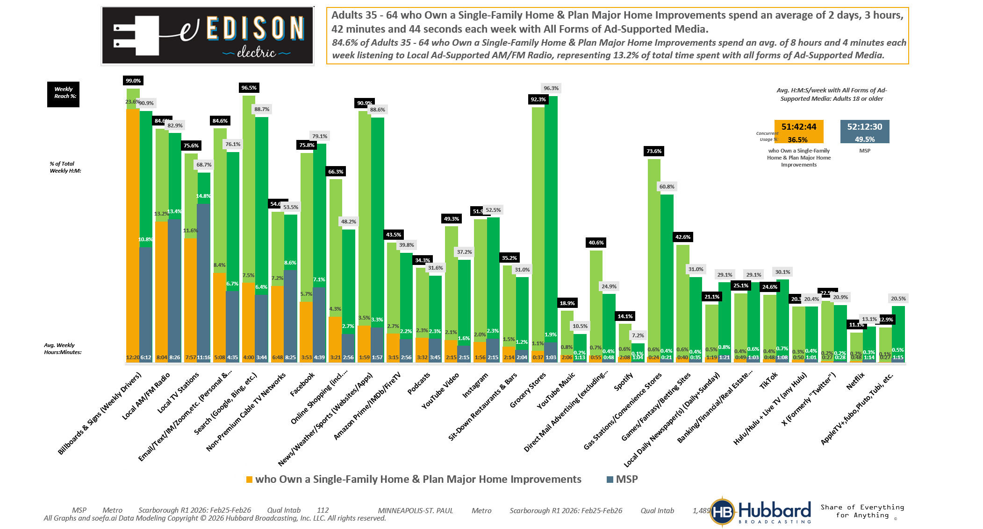
[((Own or rent residence (HHLD): Own AND Type of dwelling (HHLD): Single family house (unattached)) AND (Type of home improvement plan to do next 12 months (HHLD): Remodel kitchen OR Type of home improvement plan to do next 12 months (HHLD): Remodel bathroom OR Type of home improvement plan to do next 12 months (HHLD): Any addition OR Type of home improvement plan to do next 12 months (HHLD): Home generator))]

Slide 10
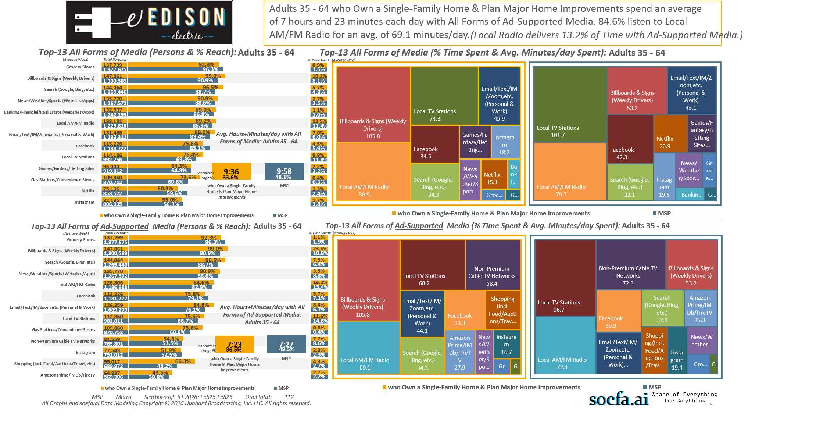
[((Own or rent residence (HHLD): Own AND Type of dwelling (HHLD): Single family house (unattached)) AND (Type of home improvement plan to do next 12 months (HHLD): Remodel kitchen OR Type of home improvement plan to do next 12 months (HHLD): Remodel bathroom OR Type of home improvement plan to do next 12 months (HHLD): Any addition OR Type of home improvement plan to do next 12 months (HHLD): Home generator))]

Slide 11
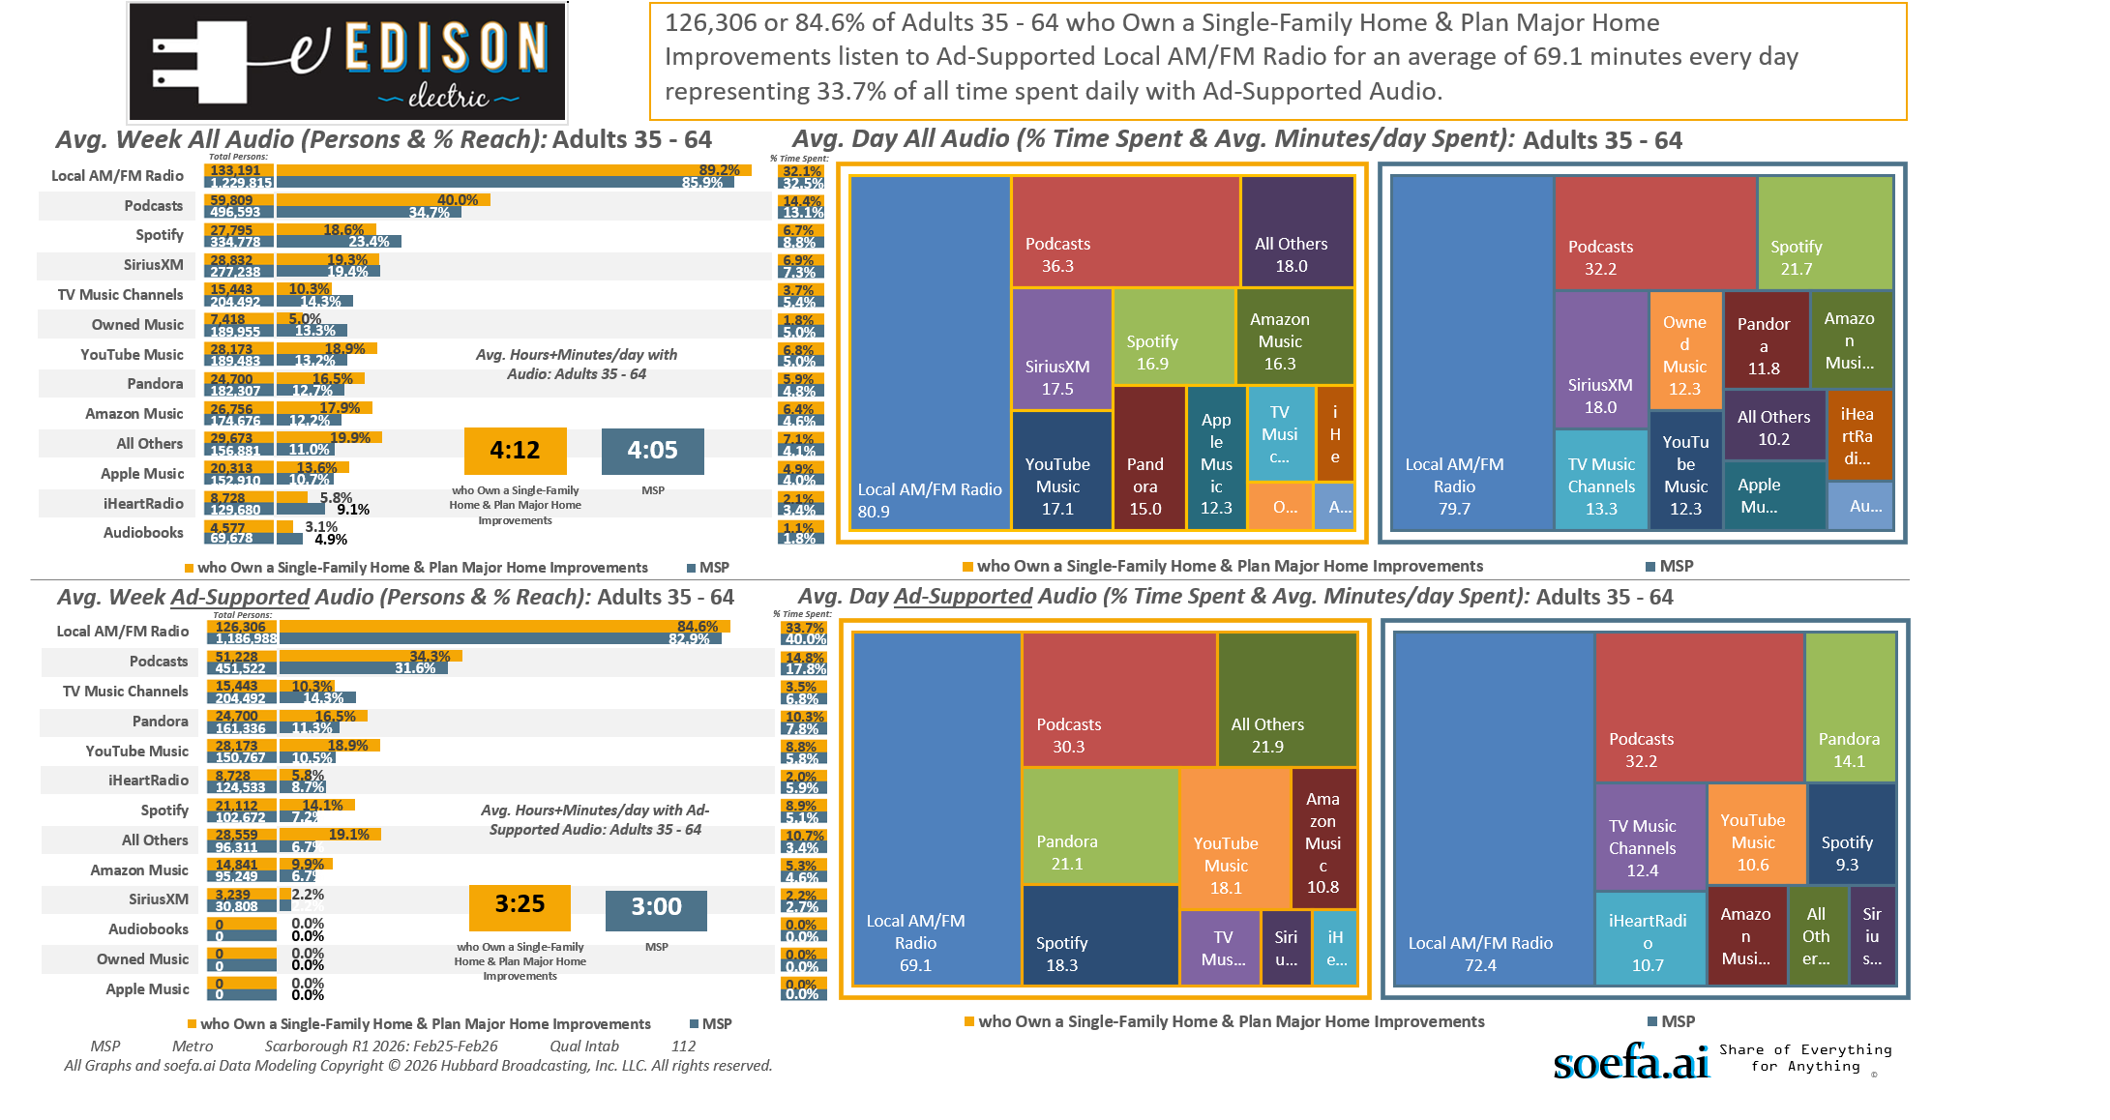
[((Own or rent residence (HHLD): Own AND Type of dwelling (HHLD): Single family house (unattached)) AND (Type of home improvement plan to do next 12 months (HHLD): Remodel kitchen OR Type of home improvement plan to do next 12 months (HHLD): Remodel bathroom OR Type of home improvement plan to do next 12 months (HHLD): Any addition OR Type of home improvement plan to do next 12 months (HHLD): Home generator))]

Slide 12
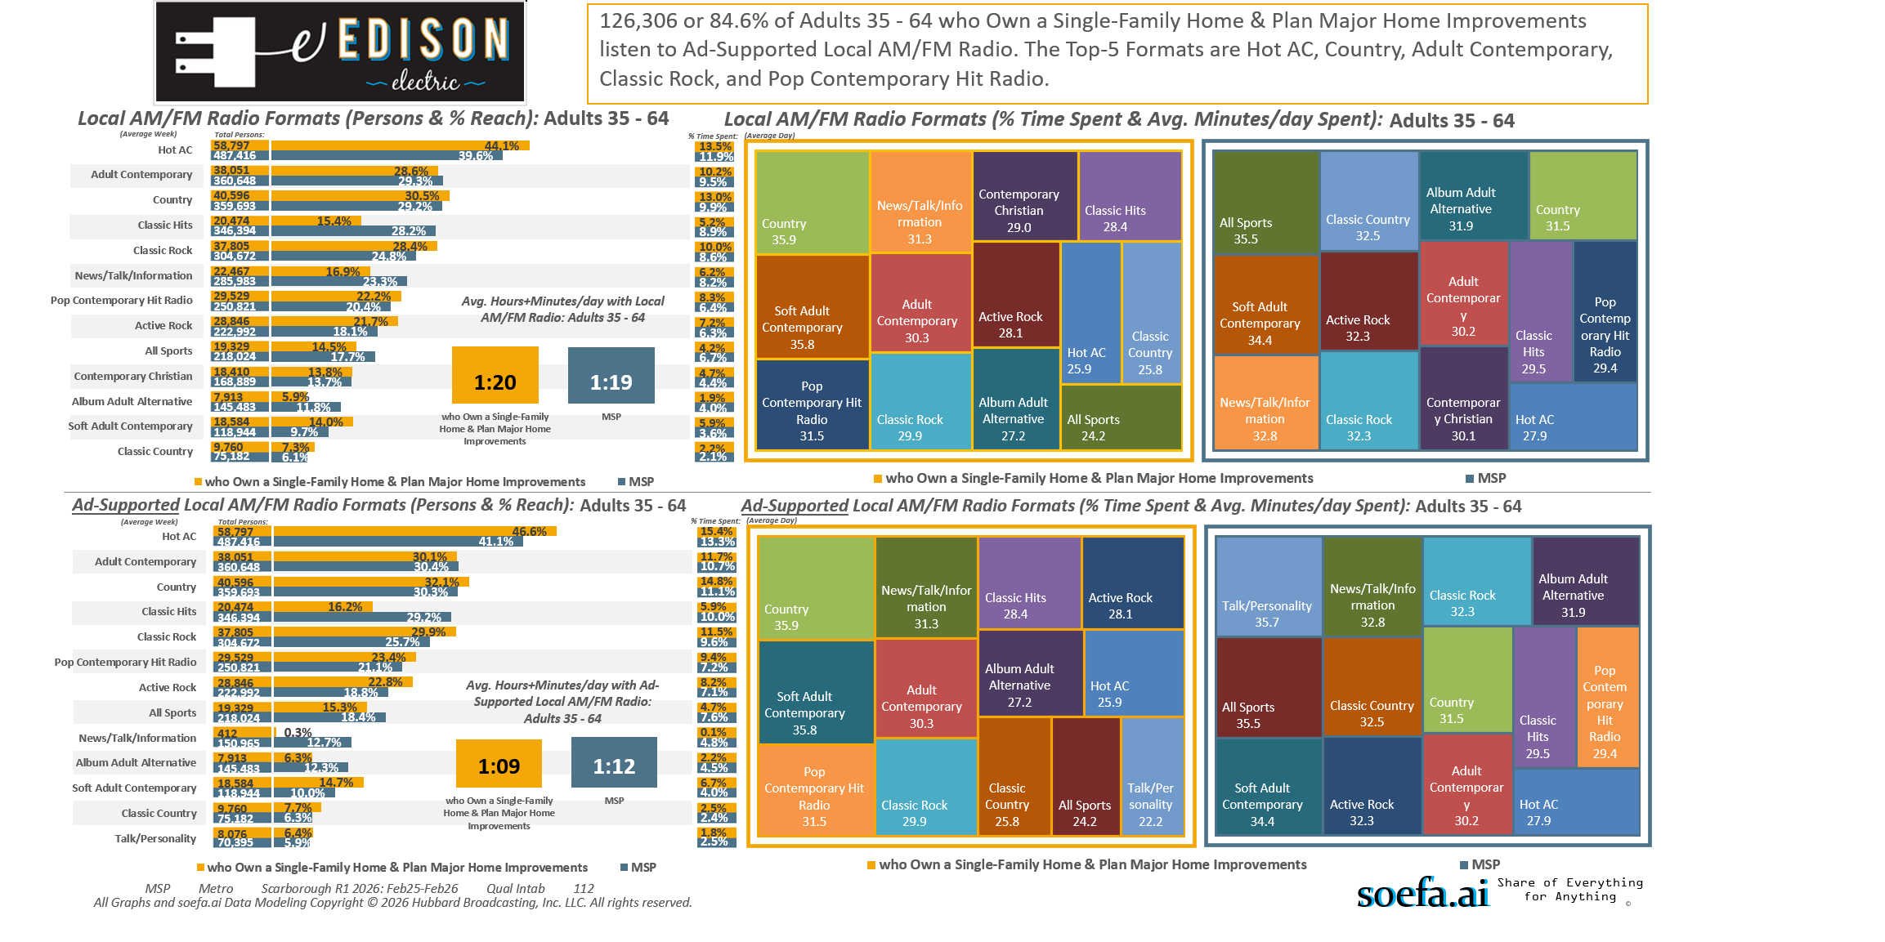
[((Own or rent residence (HHLD): Own AND Type of dwelling (HHLD): Single family house (unattached)) AND (Type of home improvement plan to do next 12 months (HHLD): Remodel kitchen OR Type of home improvement plan to do next 12 months (HHLD): Remodel bathroom OR Type of home improvement plan to do next 12 months (HHLD): Any addition OR Type of home improvement plan to do next 12 months (HHLD): Home generator))]

Slide 13
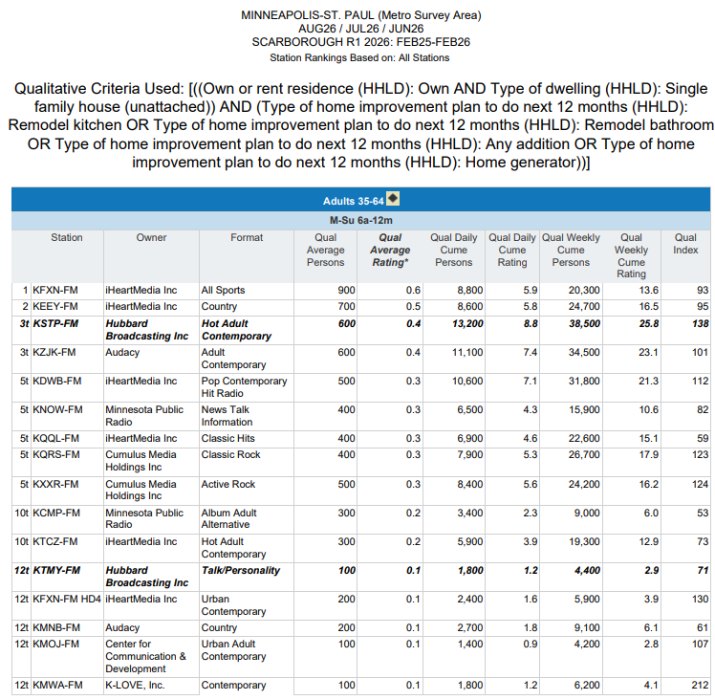
Top Radio Stations reaching...
Twin Cities Metro Area P35-64 who…
Own a Single-Family Home And…
Plan Major Home Improvements in the next 12mos.
[((Own or rent residence (HHLD): Own AND Type of dwelling (HHLD): Single family house (unattached)) AND (Type of home improvement plan to do next 12 months (HHLD): Remodel kitchen OR Type of home improvement plan to do next 12 months (HHLD): Remodel bathroom OR Type of home improvement plan to do next 12 months (HHLD): Any addition OR Type of home improvement plan to do next 12 months (HHLD): Home generator))]

Slide 14
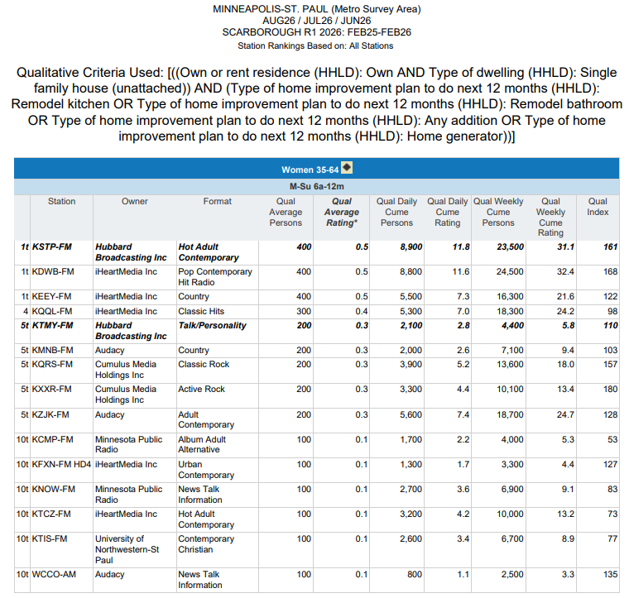
Top Radio Stations reaching...
Twin Cities Metro Area W35-64 who…
Own a Single-Family Home And…
Plan Major Home Improvements in the next 12mos.
[((Own or rent residence (HHLD): Own AND Type of dwelling (HHLD): Single family house (unattached)) AND (Type of home improvement plan to do next 12 months (HHLD): Remodel kitchen OR Type of home improvement plan to do next 12 months (HHLD): Remodel bathroom OR Type of home improvement plan to do next 12 months (HHLD): Any addition OR Type of home improvement plan to do next 12 months (HHLD): Home generator))]

Slide 15
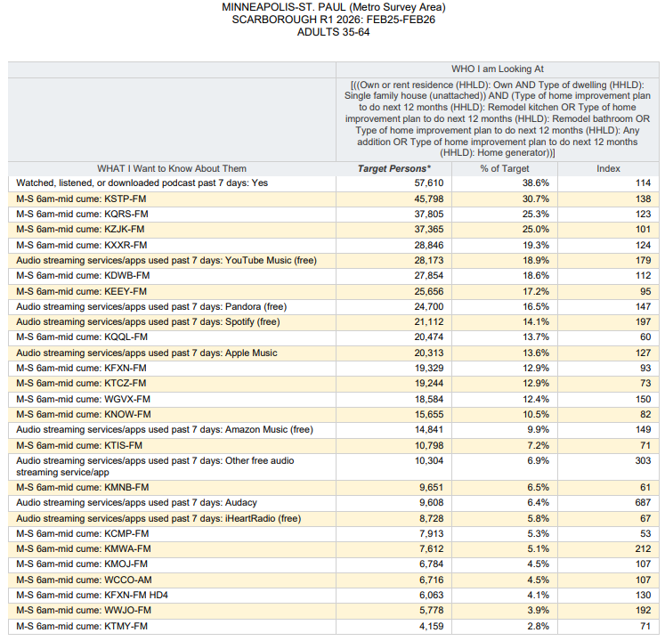
Top Audio Media reaching...
Twin Cities Metro Area P35-64 who…
Own a Single-Family Home And…
Plan Major Home Improvements in the next 12mos.
[((Own or rent residence (HHLD): Own AND Type of dwelling (HHLD): Single family house (unattached)) AND (Type of home improvement plan to do next 12 months (HHLD): Remodel kitchen OR Type of home improvement plan to do next 12 months (HHLD): Remodel bathroom OR Type of home improvement plan to do next 12 months (HHLD): Any addition OR Type of home improvement plan to do next 12 months (HHLD): Home generator))]

Slide 16
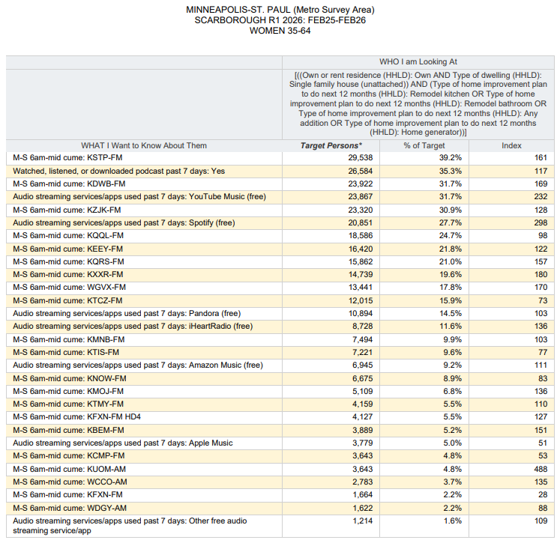
Top Audio Media reaching...
Twin Cities Metro Area W35-64 who…
Own a Single-Family Home And…
Plan Major Home Improvements in the next 12mos.
[((Own or rent residence (HHLD): Own AND Type of dwelling (HHLD): Single family house (unattached)) AND (Type of home improvement plan to do next 12 months (HHLD): Remodel kitchen OR Type of home improvement plan to do next 12 months (HHLD): Remodel bathroom OR Type of home improvement plan to do next 12 months (HHLD): Any addition OR Type of home improvement plan to do next 12 months (HHLD): Home generator))]

Slide 17
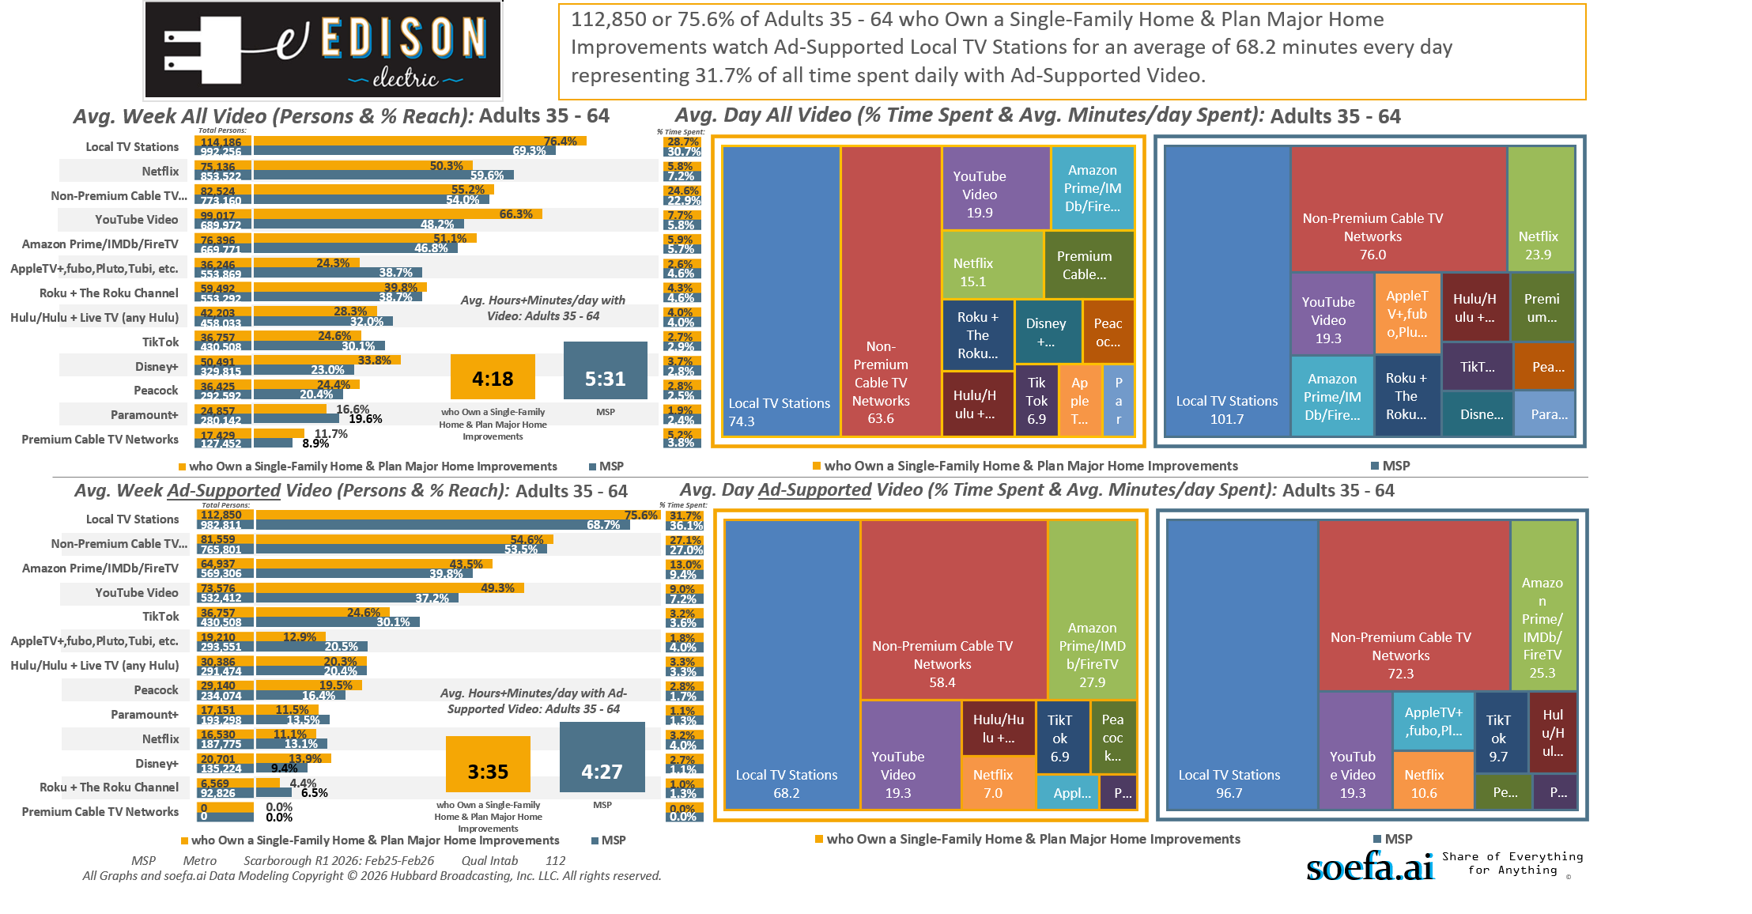
[((Own or rent residence (HHLD): Own AND Type of dwelling (HHLD): Single family house (unattached)) AND (Type of home improvement plan to do next 12 months (HHLD): Remodel kitchen OR Type of home improvement plan to do next 12 months (HHLD): Remodel bathroom OR Type of home improvement plan to do next 12 months (HHLD): Any addition OR Type of home improvement plan to do next 12 months (HHLD): Home generator))]

Slide 18
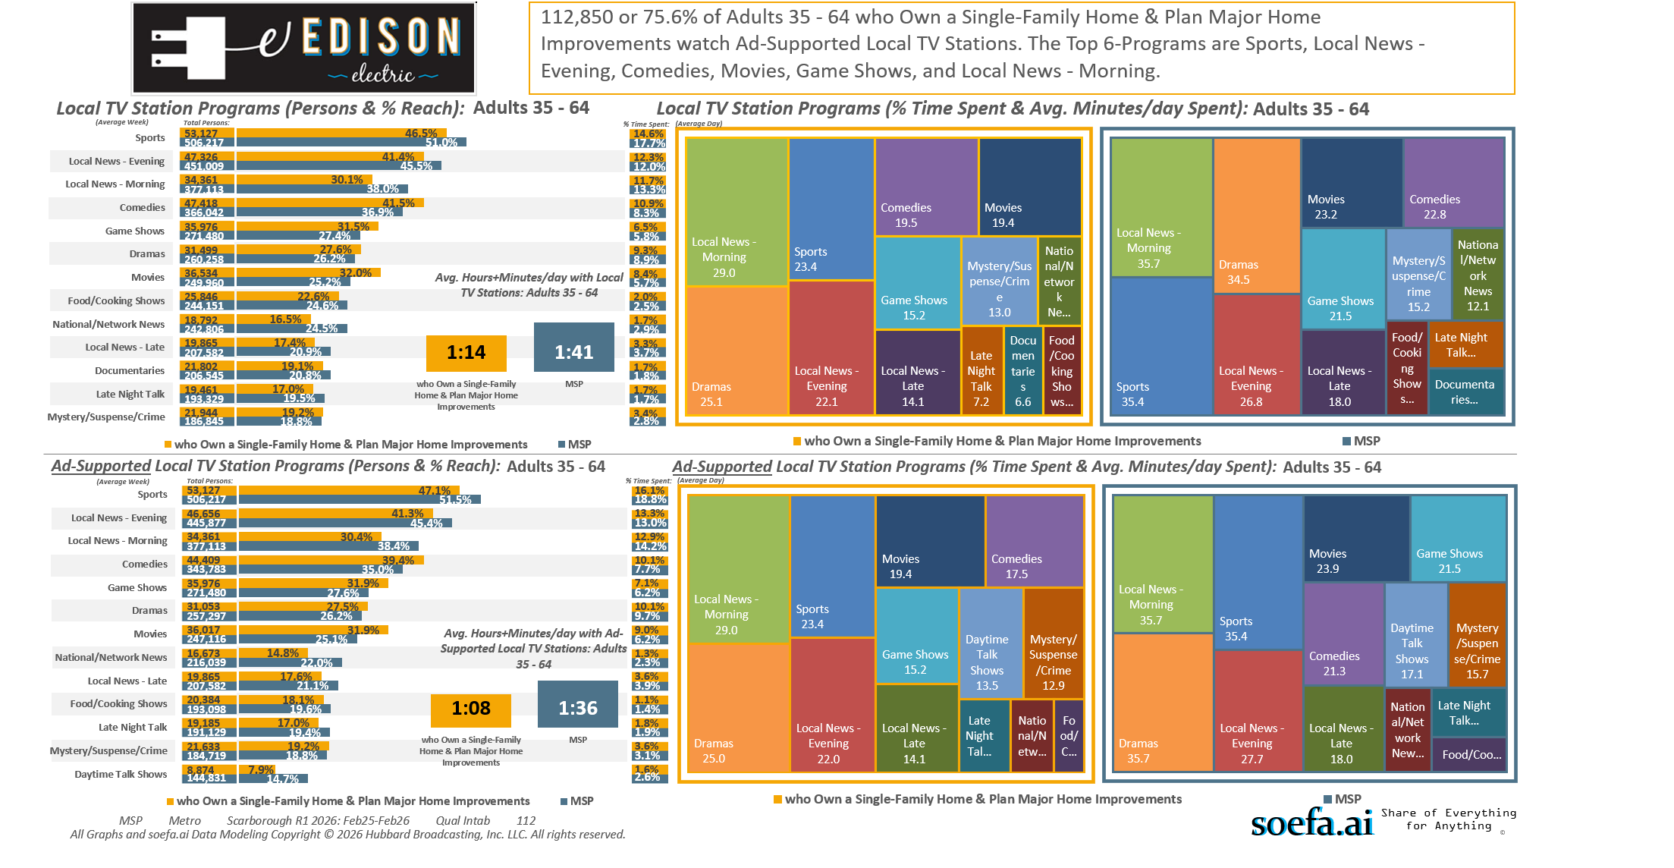
[((Own or rent residence (HHLD): Own AND Type of dwelling (HHLD): Single family house (unattached)) AND (Type of home improvement plan to do next 12 months (HHLD): Remodel kitchen OR Type of home improvement plan to do next 12 months (HHLD): Remodel bathroom OR Type of home improvement plan to do next 12 months (HHLD): Any addition OR Type of home improvement plan to do next 12 months (HHLD): Home generator))]

Slide 19
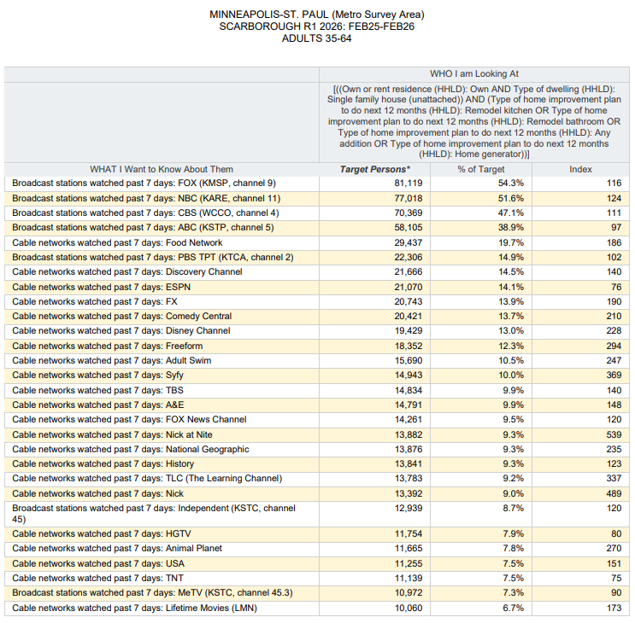
Top Local TV Stations and Cable Networks reaching...
Twin Cities Metro Area P35-64 who…
Own a Single-Family Home And…
Plan Major Home Improvements in the next 12mos.
[((Own or rent residence (HHLD): Own AND Type of dwelling (HHLD): Single family house (unattached)) AND (Type of home improvement plan to do next 12 months (HHLD): Remodel kitchen OR Type of home improvement plan to do next 12 months (HHLD): Remodel bathroom OR Type of home improvement plan to do next 12 months (HHLD): Any addition OR Type of home improvement plan to do next 12 months (HHLD): Home generator))]

Slide 20
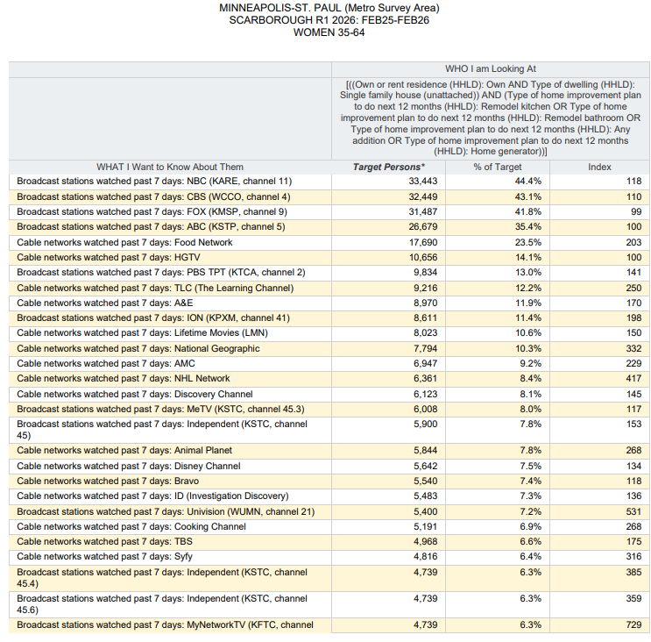
Top Local TV Stations and Cable Networks reaching...
Twin Cities Metro Area W35-64 who…
Own a Single-Family Home And…
Plan Major Home Improvements in the next 12mos.
[((Own or rent residence (HHLD): Own AND Type of dwelling (HHLD): Single family house (unattached)) AND (Type of home improvement plan to do next 12 months (HHLD): Remodel kitchen OR Type of home improvement plan to do next 12 months (HHLD): Remodel bathroom OR Type of home improvement plan to do next 12 months (HHLD): Any addition OR Type of home improvement plan to do next 12 months (HHLD): Home generator))]

Slide 21
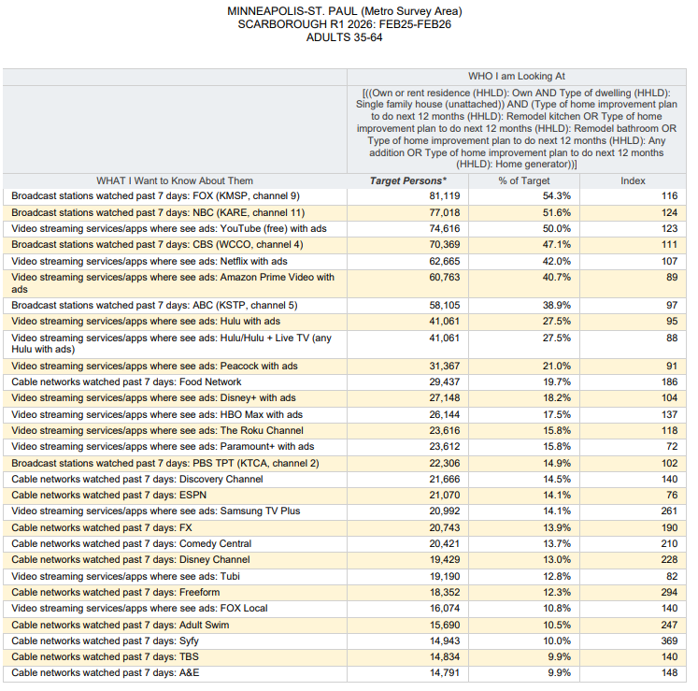
Top Local TV Stations, Cable Networks and
Streaming TV Services with Ads reaching…
Twin Cities Metro Area P35-64 who…
Own a Single-Family Home And…
Plan Major Home Improvements in the next 12mos.
[((Own or rent residence (HHLD): Own AND Type of dwelling (HHLD): Single family house (unattached)) AND (Type of home improvement plan to do next 12 months (HHLD): Remodel kitchen OR Type of home improvement plan to do next 12 months (HHLD): Remodel bathroom OR Type of home improvement plan to do next 12 months (HHLD): Any addition OR Type of home improvement plan to do next 12 months (HHLD): Home generator))]

Slide 22
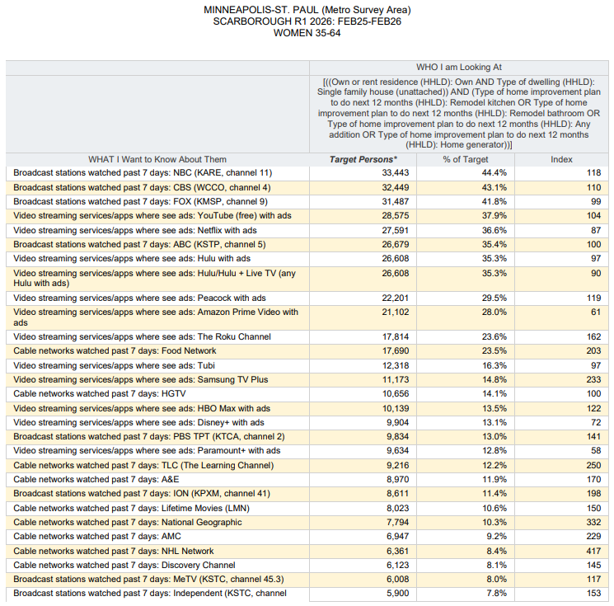
Top Local TV Stations, Cable Networks and
Streaming TV Services with Ads reaching…
Twin Cities Metro Area w35-64 who…
Own a Single-Family Home And…
Plan Major Home Improvements in the next 12mos.
[((Own or rent residence (HHLD): Own AND Type of dwelling (HHLD): Single family house (unattached)) AND (Type of home improvement plan to do next 12 months (HHLD): Remodel kitchen OR Type of home improvement plan to do next 12 months (HHLD): Remodel bathroom OR Type of home improvement plan to do next 12 months (HHLD): Any addition OR Type of home improvement plan to do next 12 months (HHLD): Home generator))]

Slide 23
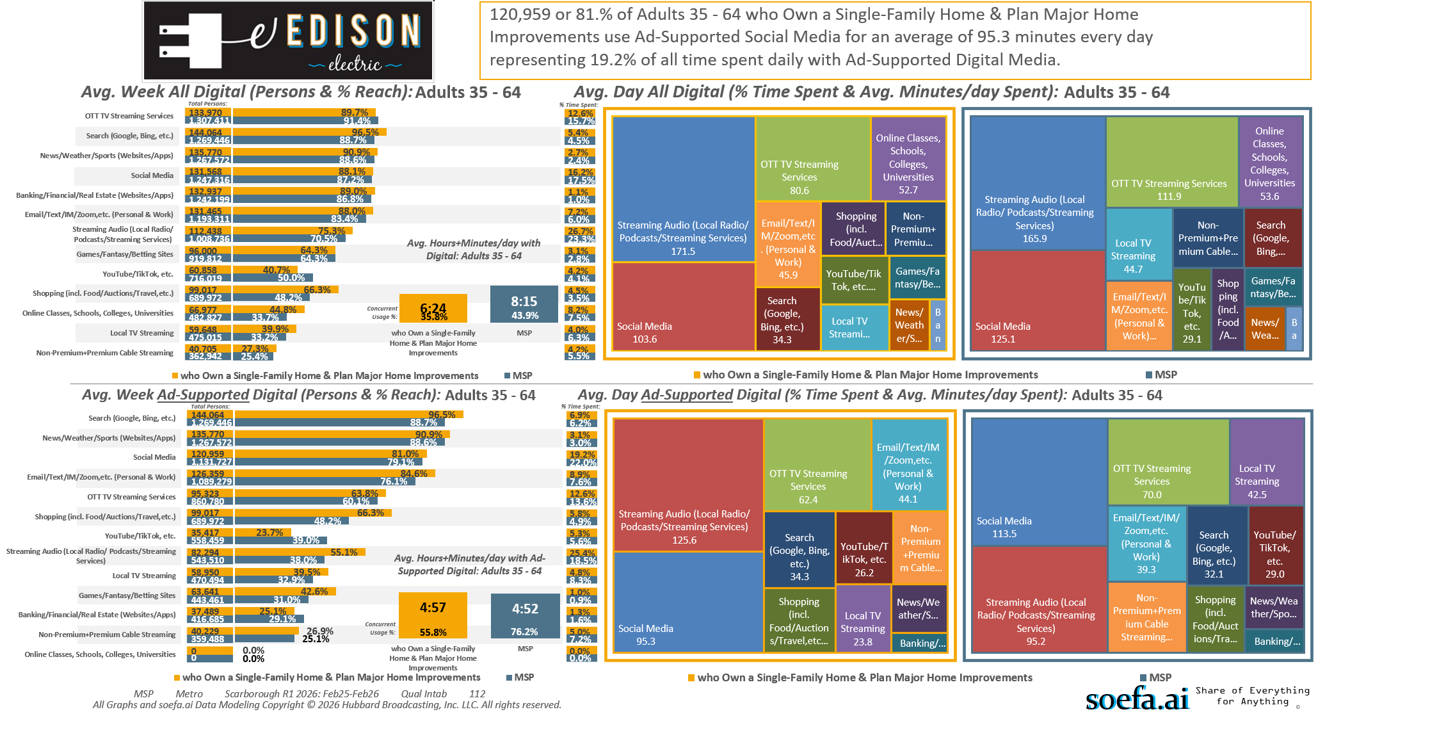
[((Own or rent residence (HHLD): Own AND Type of dwelling (HHLD): Single family house (unattached)) AND (Type of home improvement plan to do next 12 months (HHLD): Remodel kitchen OR Type of home improvement plan to do next 12 months (HHLD): Remodel bathroom OR Type of home improvement plan to do next 12 months (HHLD): Any addition OR Type of home improvement plan to do next 12 months (HHLD): Home generator))]

Slide 24
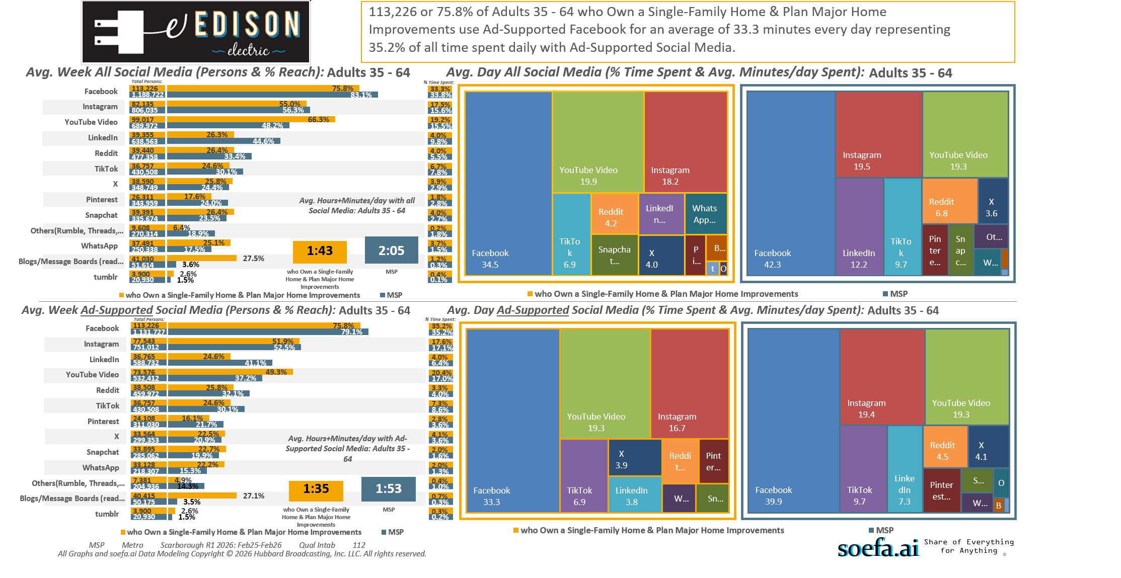
[((Own or rent residence (HHLD): Own AND Type of dwelling (HHLD): Single family house (unattached)) AND (Type of home improvement plan to do next 12 months (HHLD): Remodel kitchen OR Type of home improvement plan to do next 12 months (HHLD): Remodel bathroom OR Type of home improvement plan to do next 12 months (HHLD): Any addition OR Type of home improvement plan to do next 12 months (HHLD): Home generator))]

Slide 25
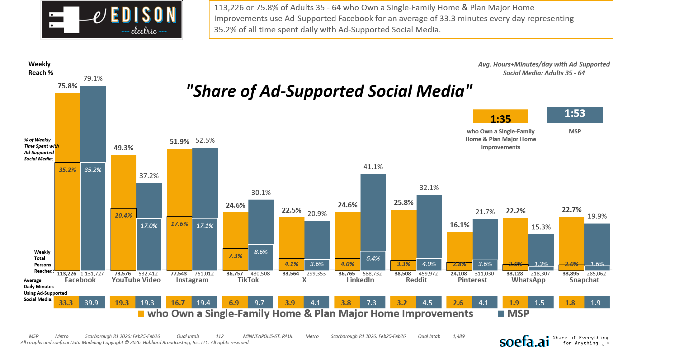
[((Own or rent residence (HHLD): Own AND Type of dwelling (HHLD): Single family house (unattached)) AND (Type of home improvement plan to do next 12 months (HHLD): Remodel kitchen OR Type of home improvement plan to do next 12 months (HHLD): Remodel bathroom OR Type of home improvement plan to do next 12 months (HHLD): Any addition OR Type of home improvement plan to do next 12 months (HHLD): Home generator))]

Slide 26
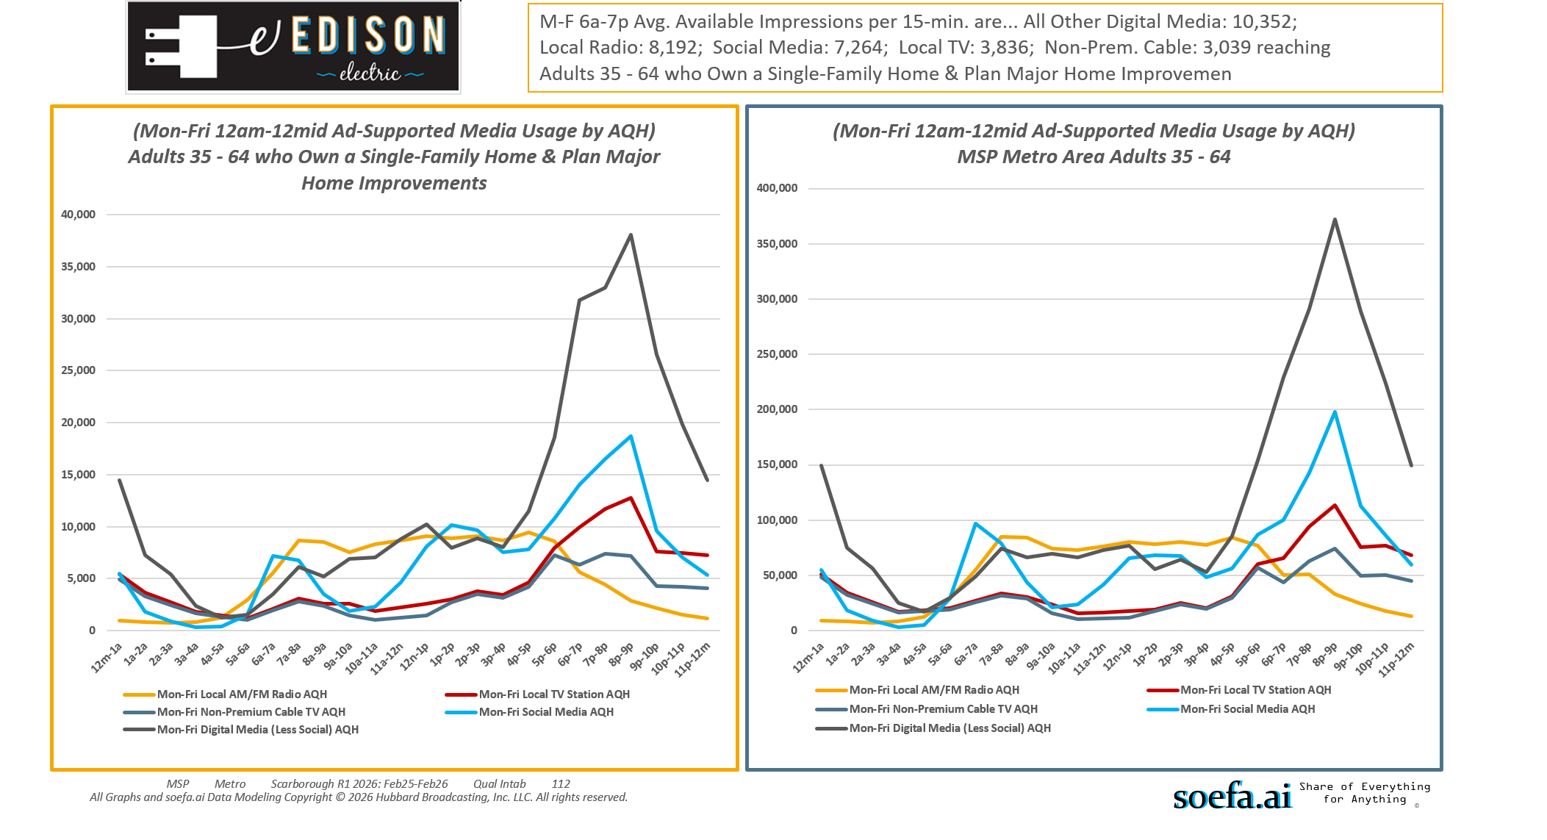
[((Own or rent residence (HHLD): Own AND Type of dwelling (HHLD): Single family house (unattached)) AND (Type of home improvement plan to do next 12 months (HHLD): Remodel kitchen OR Type of home improvement plan to do next 12 months (HHLD): Remodel bathroom OR Type of home improvement plan to do next 12 months (HHLD): Any addition OR Type of home improvement plan to do next 12 months (HHLD): Home generator))]

Slide 27
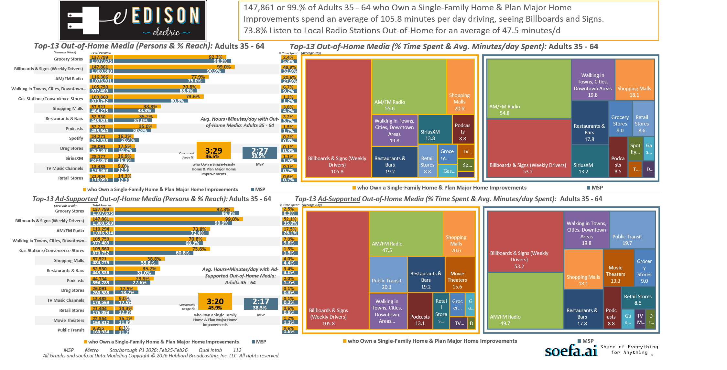
[((Own or rent residence (HHLD): Own AND Type of dwelling (HHLD): Single family house (unattached)) AND (Type of home improvement plan to do next 12 months (HHLD): Remodel kitchen OR Type of home improvement plan to do next 12 months (HHLD): Remodel bathroom OR Type of home improvement plan to do next 12 months (HHLD): Any addition OR Type of home improvement plan to do next 12 months (HHLD): Home generator))]

Slide 28
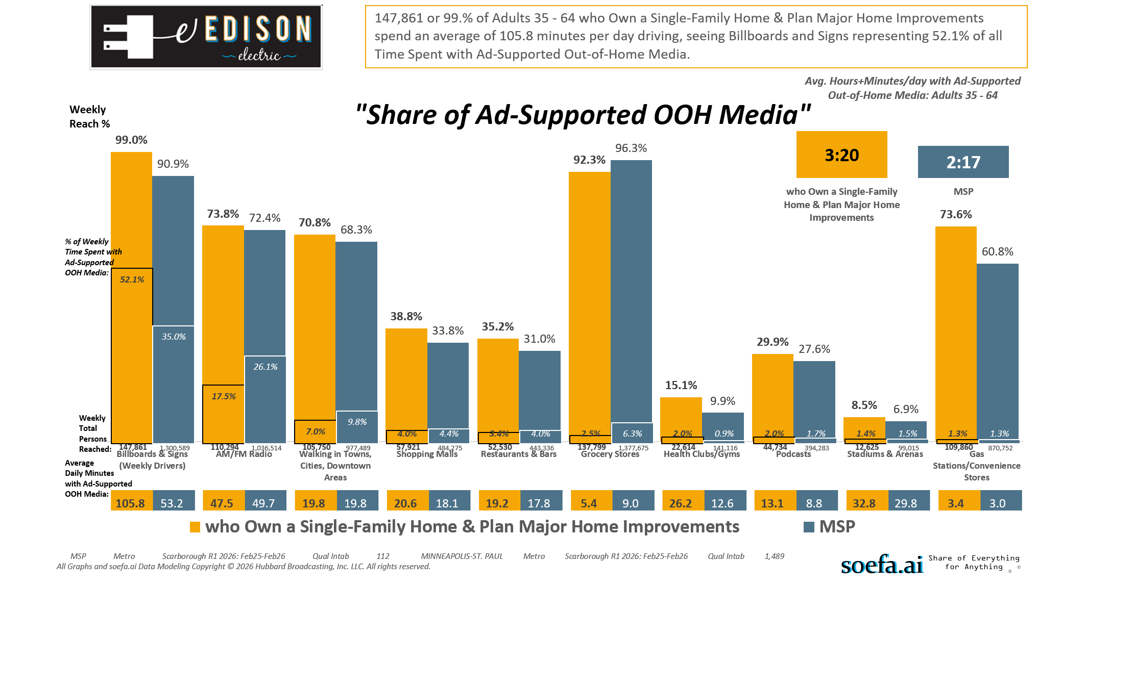
[((Own or rent residence (HHLD): Own AND Type of dwelling (HHLD): Single family house (unattached)) AND (Type of home improvement plan to do next 12 months (HHLD): Remodel kitchen OR Type of home improvement plan to do next 12 months (HHLD): Remodel bathroom OR Type of home improvement plan to do next 12 months (HHLD): Any addition OR Type of home improvement plan to do next 12 months (HHLD): Home generator))]

Slide 29
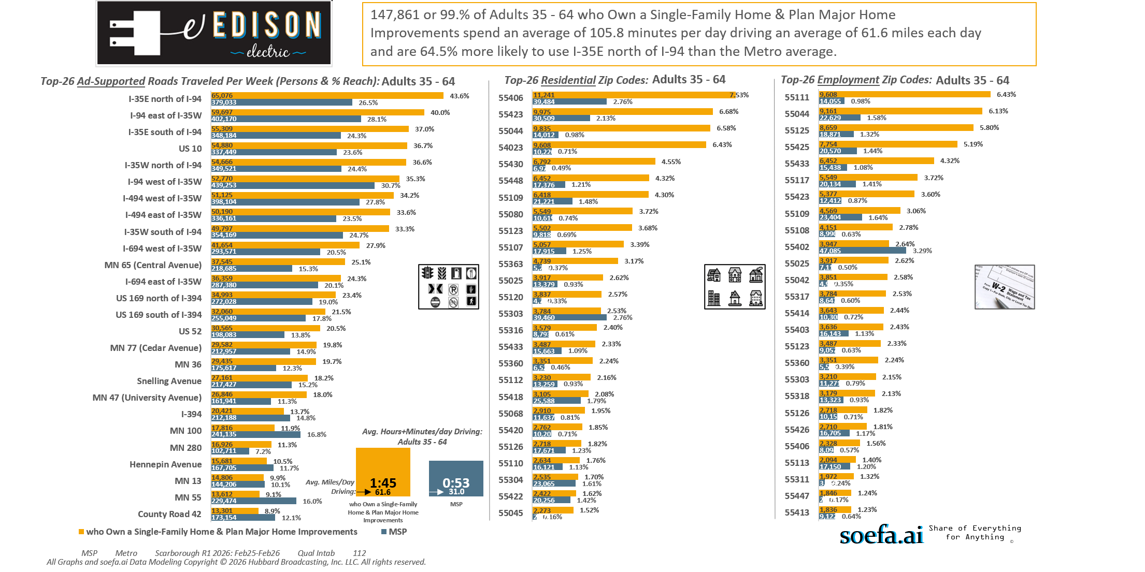
[((Own or rent residence (HHLD): Own AND Type of dwelling (HHLD): Single family house (unattached)) AND (Type of home improvement plan to do next 12 months (HHLD): Remodel kitchen OR Type of home improvement plan to do next 12 months (HHLD): Remodel bathroom OR Type of home improvement plan to do next 12 months (HHLD): Any addition OR Type of home improvement plan to do next 12 months (HHLD): Home generator))]

Slide 30
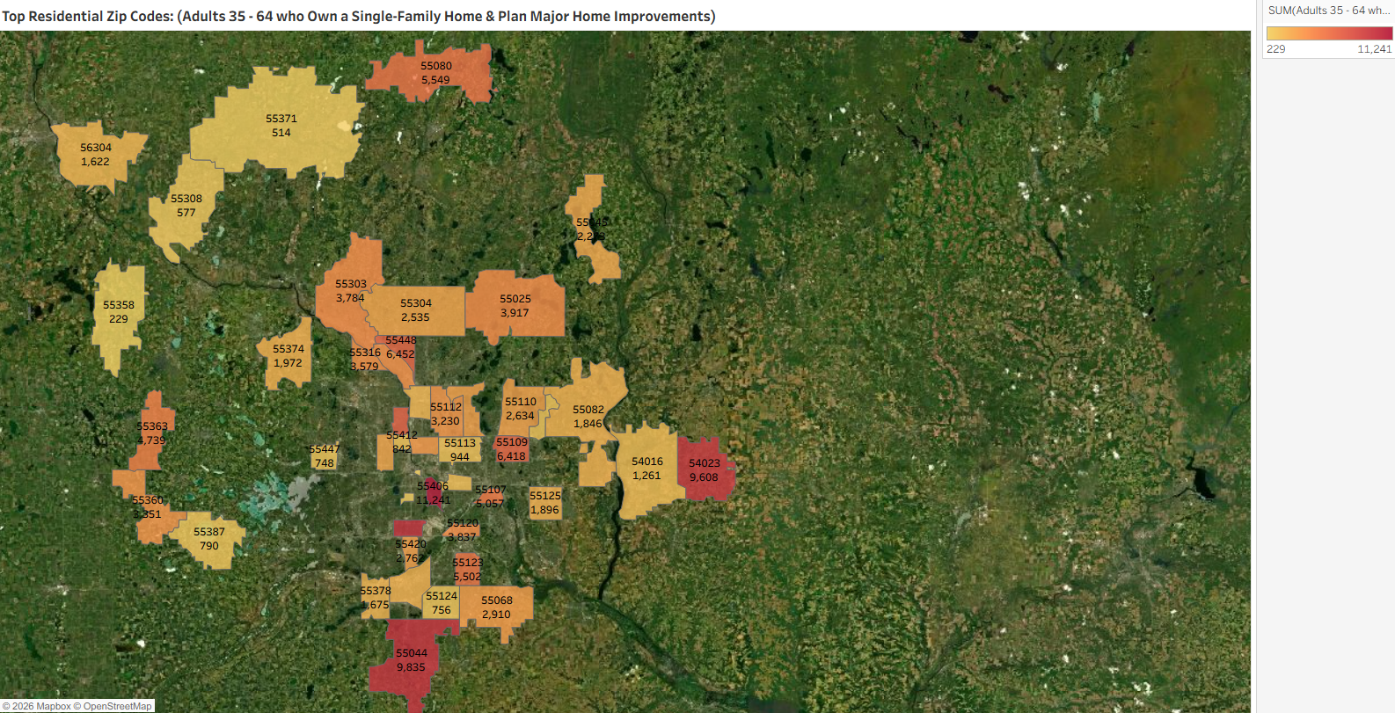
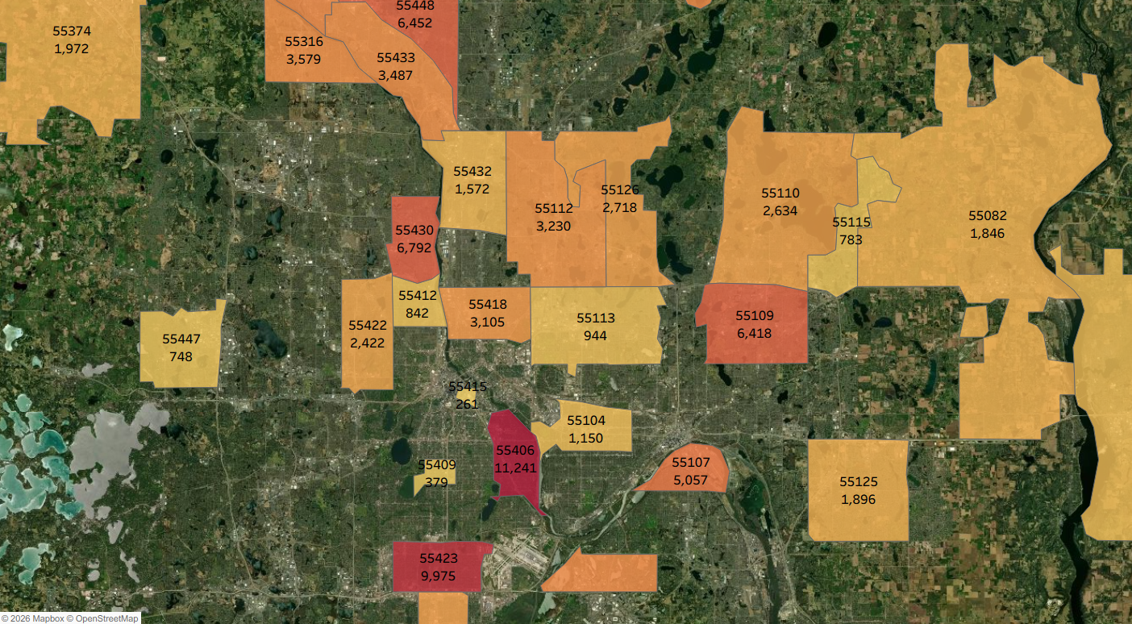
[((Own or rent residence (HHLD): Own AND Type of dwelling (HHLD): Single family house (unattached)) AND (Type of home improvement plan to do next 12 months (HHLD): Remodel kitchen OR Type of home improvement plan to do next 12 months (HHLD): Remodel bathroom OR Type of home improvement plan to do next 12 months (HHLD): Any addition OR Type of home improvement plan to do next 12 months (HHLD): Home generator))]

Slide 31
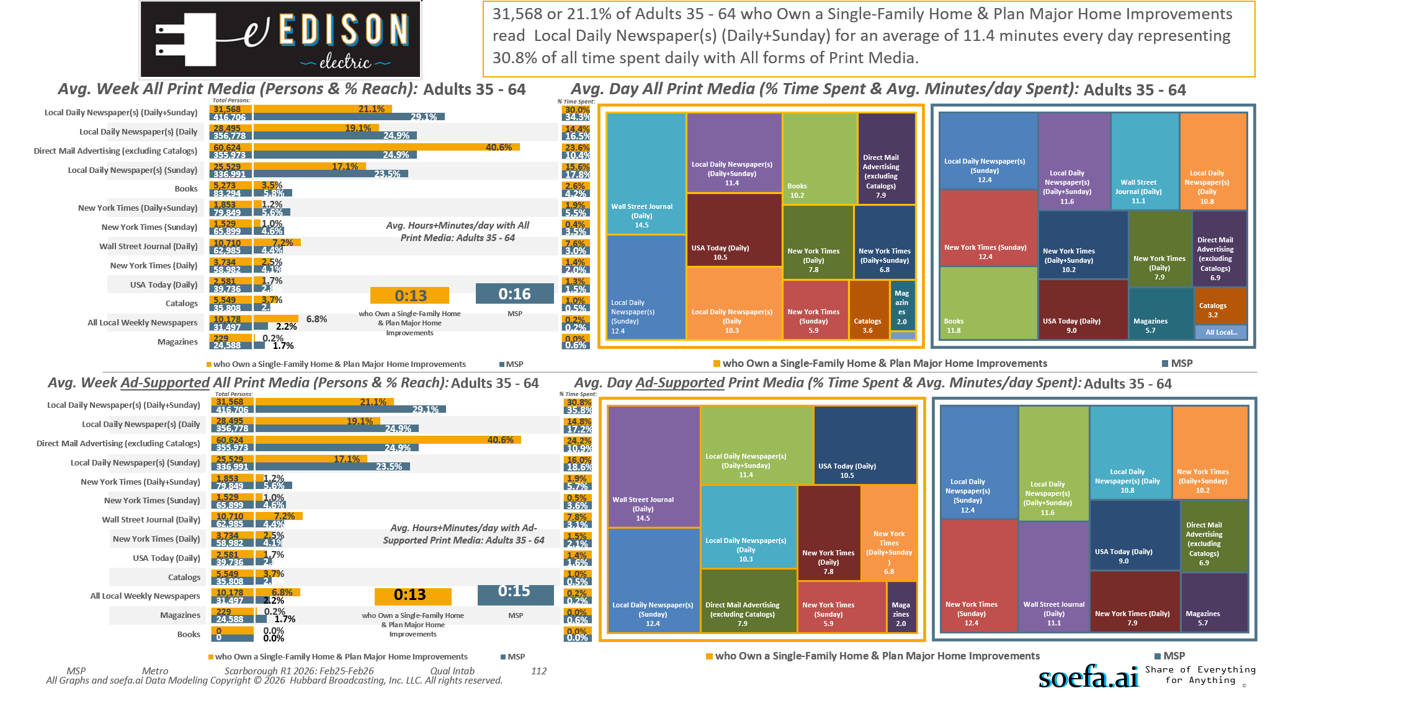
[((Own or rent residence (HHLD): Own AND Type of dwelling (HHLD): Single family house (unattached)) AND (Type of home improvement plan to do next 12 months (HHLD): Remodel kitchen OR Type of home improvement plan to do next 12 months (HHLD): Remodel bathroom OR Type of home improvement plan to do next 12 months (HHLD): Any addition OR Type of home improvement plan to do next 12 months (HHLD): Home generator))]

