Slide 1
Riesling Trocken
Desire
Tasting Notes
German Riesling is the finest and best known of Germany's
white varieties. This dry Riesling is a crisp and refreshing
wine, a delicacy for wine connoisseurs.
Food Pairing
Serve chilled with light meat and seafood.
Origin
Wine Growing Area
Variety
Quality Category
Taste
Serving Temp
Alcohol
Sugar
Acidity
Deutschland
Nahe
Riesling
Qualitätswein
Dry
8-10ºC
13%
4.6 g/l
6.1 g/l

Slide 2
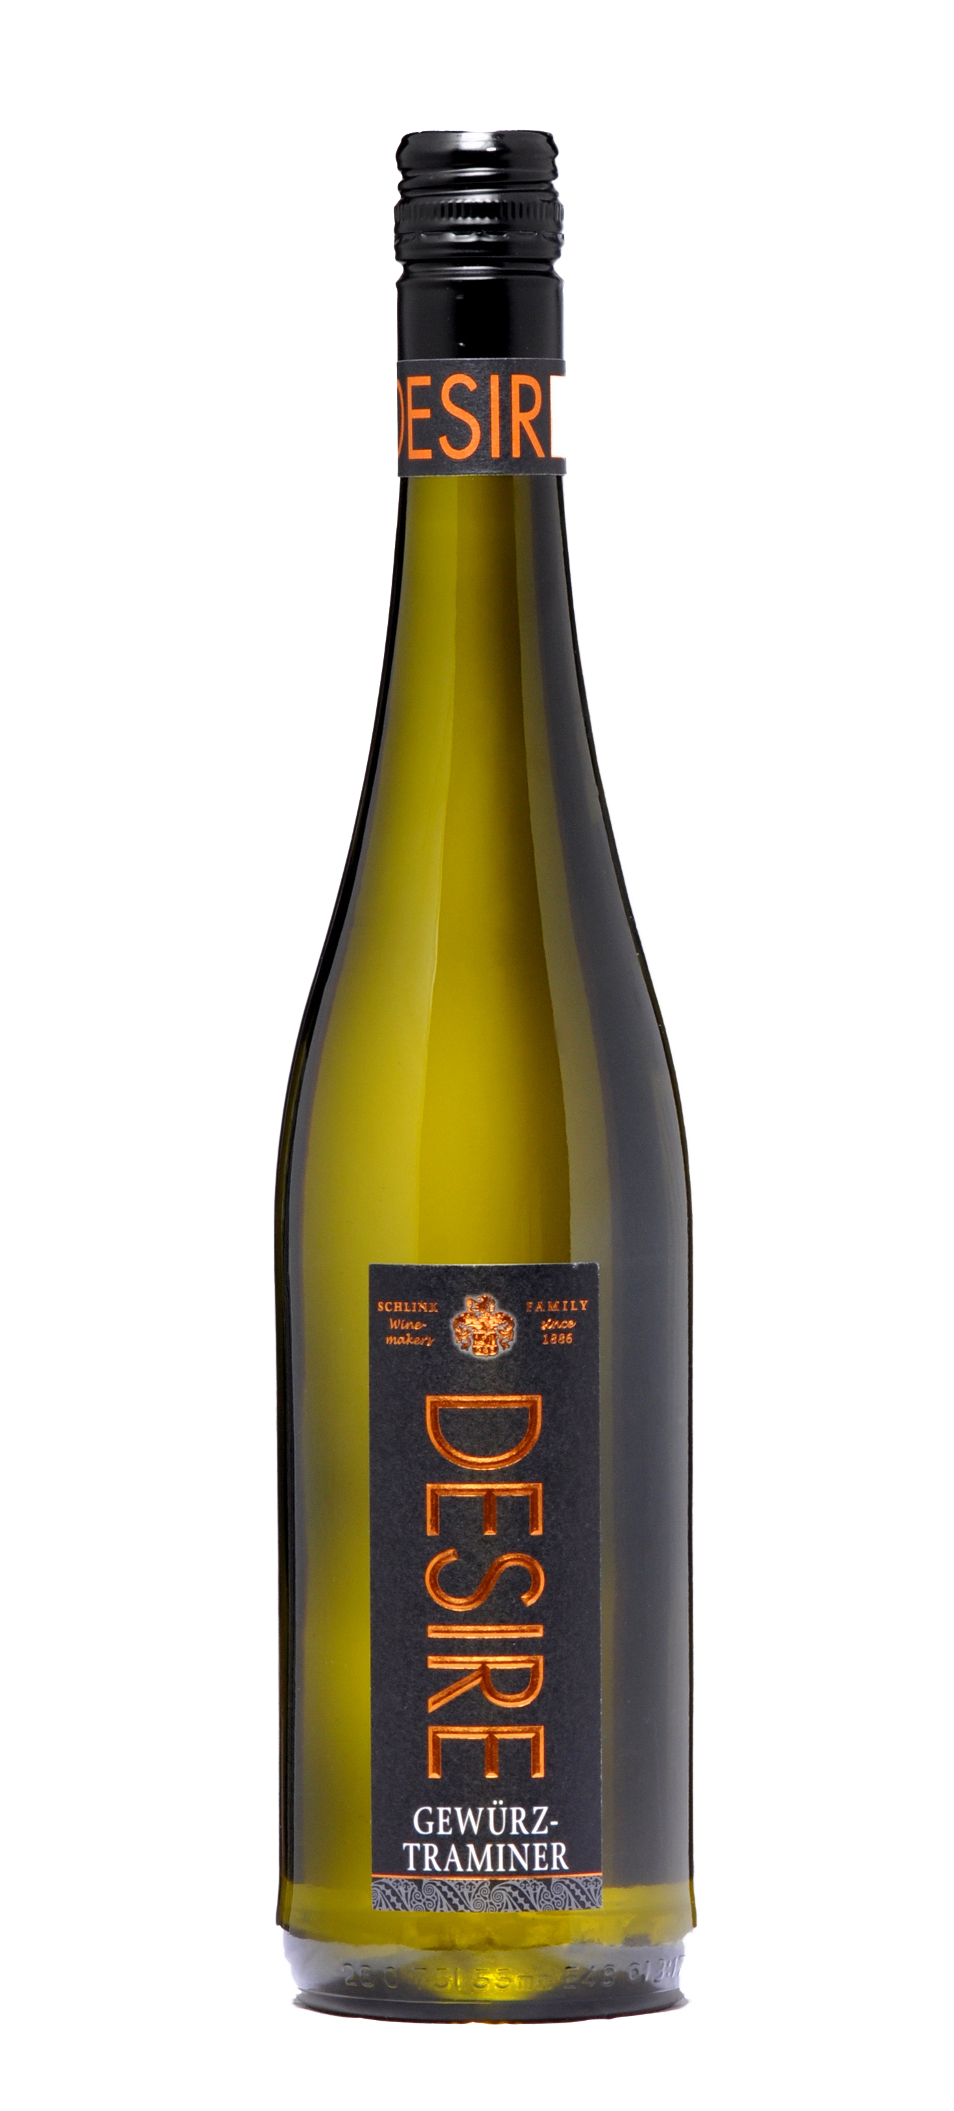
Gewürztraminer
Desire
Tasting Notes
The noble Gewürztraminer aroma is reflected in this wine.
Seductive flavors reminiscent of the gentle scent of roses
and ripe peaches fill the senses. A favorite among gourmets.
Food Pairing
Serve chilled with game pâté, poultry with aromatic sauces
and ragouts. This sweet wine also compliments fresh fruit
tarts, cakes and cookies.
Origin
Wine Growing Area
Variety
Quality Category
Taste
Serving Temp
Alcohol
Sugar
Acidity
Deutschland
Nahe
Riesling
Gewürztraminer
Sweet
8-10ºC
9.5%
51.7 g/l
5.6 g/l

Slide 3
Regent Sweet Red
Desire
Tasting Notes
This sweet dream from the grape Regent is a fiery, dark red,
high Quality Wine. Flavors reminiscent of cherries and black
currants fill the senses.
Food Pairing
We recommend this wine especially with sweet dishes, desserts,
cookies or simply solo.
Origin
Wine Growing Area
Variety
Quality Category
Taste
Serving Temp
Alcohol
Sugar
Acidity
Deutschland
Nahe
Regent
Qualitätswein
Sweet
14-16ºC
10%
58.7 g/l
4.6 g/l

