Slide 1
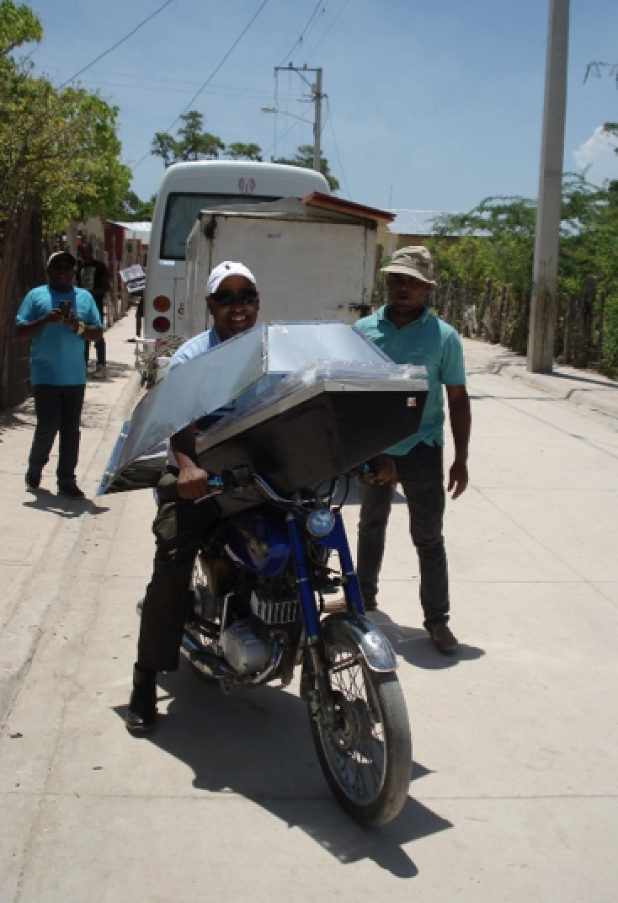
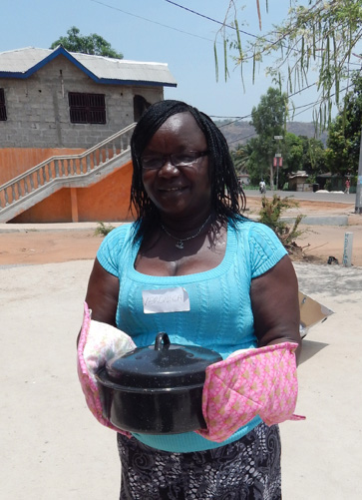
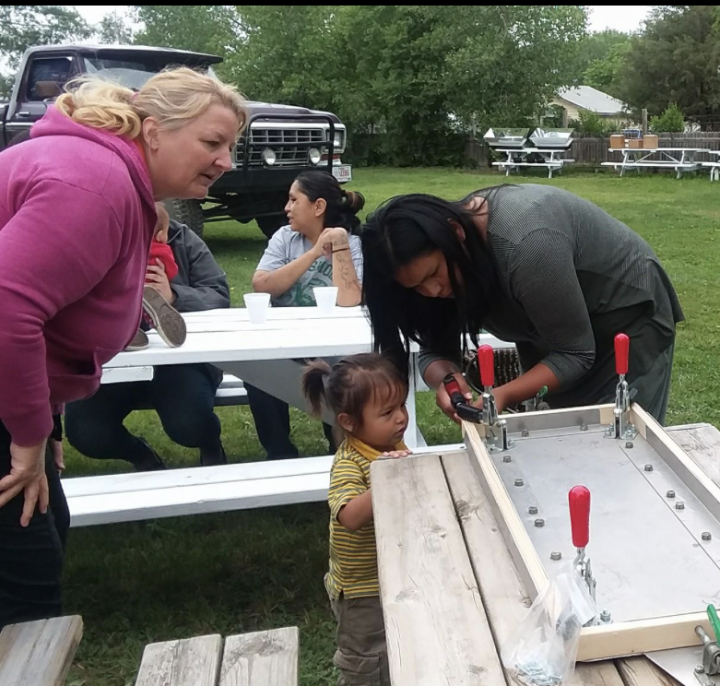
This Advent—Give Hope
Give a gift —or ask for a gift — a Solar Oven!
Use the SOP brochure to give a gift.
Pass it to someone who’s planning to shop for you.
Check solarovenpartnersumc.org for more information.

