Slide 1


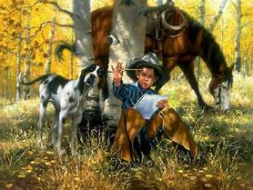
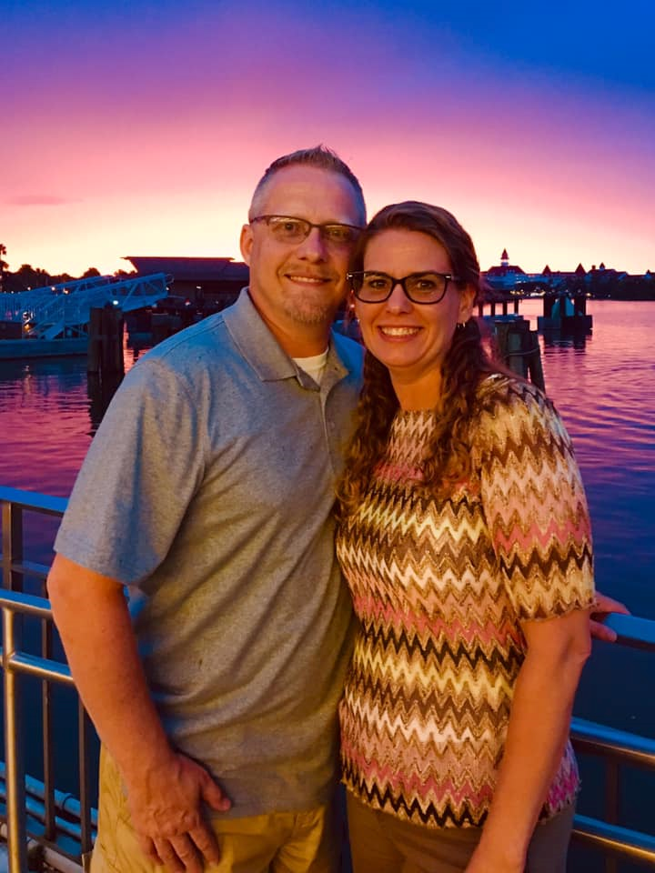


2020 OHIO POW WOW
JUNE 12 - 14, 2020
THEME: WESTERN ROUNDUP
THE CATTLE ROUNDUP
Young Riders
Pow Wow Speaker
Pastor Eric Diehl

Slide 2
2020 POW WOW STAFF
Pow Wow Speaker Pastor Eric Diehl
GMA Recipient (Gold and Silver Buffalo)
District Commander Rev. Harry Hunt
    Pow Wow Events Coord. Ed Kuzmick and
Jon Miltenberger
Registration Paul Hickman, RRA
Health and Safety Coordinator Dr. John Coleman
Swimming Pool Coordinator Heartland Staff
Music and Worship Leader Dog Gone Cowboys
Sound Equipment Cincinnati Section, Gary Bayes
Security Coordinator Randy Hammill / Aaron Hunt
Patch Design/Packet Cover Jerry Yoder
Chaplain Rev. Harry Hunt
Snack Bar Cincinnati Section
Prayer Coordinator Rev. Harry Hunt
Communion Randy Fetters

Slide 3

Pastor Eric Diehl
Graduate of Central Bible College
GMA Recipient (Gold and Silver Buffalo)
20 + years as a Youth/Asst. Pastor in Va., Pa., and Fl.
Currently serving the past 5 years as Lead Pastor at Covenant Life in Hubbard, Ohio
Instructor at the Crucible – A Father’s Blessing- Raising Men of Honor

Slide 4
Cost . . . . . . . . . . . . . . . . . . . . .
The cost for each person will be $38.00 per person, which covers camp fees, insurance, Pow Wow patch, trophies, and guest speaker. The cost for an unchartered person will be $45.00. If you have 2 or more boys from the same family, we want to discount their registration. There will be a $5.00 discount for the 2nd brother and a $10.00 discount for the 3rd brother. Fees can pile up fast when there’s several in a family and we want all boys to be able to attend.
Activities . . . . . . . . . . . . . . . . . . . . . . . . . . .
Commanders, all activities have been designed with fun and adventure in mind.
Swimming will be available on Friday and Saturday. When swimming, your Rangers must be accompanied by a Commander.

Slide 5
Zip Line - There is a $7.00 cost for this event and you will need to preregister by May 30 2020. You can e-mail me at jonmiltenberger@aol.com or call 937-602-8095 .
Minimum height/weight of 42″ and 45 lbs. and maximum height/weight of 75″ and 275 lbs.
Friday Activities Schedule
Registration 10:00AM – 10:00PM
Lunch Noon – 1 pm
Swimming See schedule
Paintball 2:00 - 5:30 pm
Dinner 5:30 - 7:00 pm
Council Fire Service 8:00 pm
Lights out 11:30 pm

Slide 6
Saturday Activities Schedule
Breakfast 6:45 - 8:00 am
Morning Devotion 8:30 am (sharp)
Pow Wow Events continue 9:00 am-Noon
Lunch Noon – 1 pm
Pow Wow Events continue 1:00am - 4:30 pm
Zip Line 1:00pm – 2:00 pm
Swimming See schedule
Dinner 5:30 - 7:00 pm
Council Fire Service 7:30 pm
Lights out 11:30 pm
Sunday Activities Schedule
Breakfast 6:45 - 8:00am
Morning Devotion and Communion 9:00 am (sharp)
Closing Ceremony 9:30 am
Break Camp and Head Home 10:00 am

Slide 7
2020 POW WOW - Events
Quick Draw Pistol
Bull Riding
Cattle Roping
9 Squire
Hawk Throw
Knife Throw
BB gun
Archery
Swimming – check the schedule
Paint Ball –For Adventure and Expedition Rangers Only
Plus Other Events
Archery Postal Shoot NATIONAL COMPETITION
      There is a charge for this event

Slide 8
Swimming Schedule
When swimming, your Rangers must be accompanied by a Commander
Greater Columbus East, Greater Columbus West, North Central, Northwest, Greater Cleveland, Northeast, and Youngstown / Warren
Friday 2:30 - 3:15 Saturday 2:15 - 3:00
West Central, Greater Dayton, Greater Cincinnati, South Central, Southwest, East Central, and Greater Akron
Friday 3:30 - 4:15 Saturday 3:15 - 4:00

Slide 10
Heartland Conference Retreat Center Activities & Program Participation Agreement Date of Event: June 13, 2020 YOU MUST HAVE THIS FORM TO DO ZIP LINE
Print Participant Name____________________________________________________
Name of Group: Royal Rangers: Zip Line
INSTRUCTIONS: Please read this entire form carefully. Each participant and/or their custodial parent/guardian must read, complete, sign and submit this agreement to Heartland so that Heartland receives all completed and signed forms at least one business day before the Event Date. Without an appropriately signed form delivered to Heartland in advance, the individual will not be permitted to participate in the Program. I have read, and do understand, the Participation Is Voluntary statement accompanying this form. I understand that my/my child's participation in all activities offered by Heartland Conference Retreat Center (Heartland) is based on the Participation Is Voluntary philosophy. These activities include, but are not limited to: High Ropes, Zip Line, Paintball, Team Challenge, Group Problem Solving, Archery, Night Hike, Nature Center, Large Group Game, Orienteering, Living History, Wagon Ride, Bird Blind, Climbing Wall and Wilderness Rush. I recognize that the Heartland Activities are designed to utilize experiential and engaging teaching techniques, and that my participation is purely voluntary. At all times I will choose my level of participation in any activity, and I agree to follow all guidelines and instructions as presented. I do understand that the staff of Heartland have received extensive training, and will work to protect the emotional and physical safety of myself/my child. I understand that participation in Heartland activity in which I/my child have enrolled, may entail certain risks. I elect to participate in spite of these risks. I do understand that safe participation in Heartland Activities requires reasonably good health, and I certify that I have/my child has no medical, emotional and/or physical conditions which could interfere with my/my child's safety in this activity/these activities. I grant to Heartland and all persons acting through them, the rights to use, reproduce, assign, and/or distribute photographs, films, videotapes, and sound recordings of myself/my child for use in materials they may create. I have read and do understand and accept the terms and conditions stated herein and acknowledge that this agreement shall be effective and binding upon my heirs, assigns, personal representatives and estate and for all members of my family, including minor children. Therefore, for myself/my child, I knowingly and voluntarily assume all risks involved in my/my child's participation, and do hereby release and promise to defend, indemnify, and hold harmless, Heartland and its members, trustees, officers, employees, volunteers, independent contractors, and agents from any and all liability, damages, costs and expenses arising out of or relating to bodily or psychological injury, or loss that may occur as a result of participation in Heartland Activities, whether such injury arises out of the negligence of Heartland, myself/my child, or otherwise. I hereby give my permission to Heartland, Licensed by the State of Ohio and Morrow County, to secure emergency medical and surgical treatment.
Signature of Participant (Required) ___________________________Date: __________
Signature of Custodial Parent/Guardian (Required if participant is a minor) ______________________________________________________________________ Address City State Zip: ___________________________________________________
Phone: _____________________________Age of Participant if a minor ________
2020 Ohio Pow Wow, June 13, 2020

Slide 11
OHIO NETWORK ROYAL RANGERS
INDIVIDUAL REGISTRATION FORM
----------------------------------- ---------------------------------------------
(DATE) (NAME OF EVENT)
(This entire form MUST be filled out, turned in to your senior commander, and then brought with you to the District Royal Ranger event!)
PLEASE PRINT
NAME _________________________________________ AGE ______ OUTPOST NO._______
ADDRESS ______________________________________ PHONE (_____) __________________
CITY__________________________________________ STATE _________ ZIP ___________
CHURCH________________________CITY________________PASTOR__________________
NAME OF COMMANDER RESPONSIBLE_________________________________________
PARENT PERMISSION FORM
I hereby authorize ___________________________________ to accompany the Royal Rangers to a District Event. I understand the arrangements and feel that adequate precautions for the safety of my child, have been, and will continue to be taken. I will not hold the local church or its leaders, or the District Staff, or the Ohio District Council, Inc. of the Assemblies of God, responsible for any accidents. I understand insurance will be provided by the District and that there will be an emergency First Aid Station on location. Insurance coverage is a secondary coverage. All claims will go through the family’s primary provider first then will be sent through HCRC.
SIGNATURE_____________________________________________DATE ________________
(Parent or Guardian)
EMERGENCY MEDICAL INFORMATION AND AUTHORIZATION
This form must be signed by parent or guardian, and accompany the child to the event. The purpose of the form is to make it possible for parents and guardians to authorize the provisions of emergency treatment for MINOR Royal Rangers who may become ill or injured at a District Event. You can authorize such emergency treatment for your child, by completing this form:
I,__________________________ (Parent or Guardian) of ____________________(city) ______(state), the_________________ (Father, Mother ,Guardian) of _______________(name of child), a MINOR, WHO IS ATTENDING A ROYAL RANGERS DISTRICT EVENT, DO HEREBY GIVE MY CONSENT, IN THE EVENT THE ADMINISTRATION OF ANY TREATMENT DEEMED NECESSARY BY LICENSED PHYSICIANS, DENTISTS OR EMERGENCY PERSONNEL SERVING THE OHIO DISTRICT COUNCIL AT SAID EVENT.
(SIGNED) ___________________________________________
Home Phone (____) ___________Business Phone (____) ___________Doctor’s Name ________________Phone (____) ___________
CHILD’S MEDICAL HISTORY: Good Health? _________________ Allergies? ________________________ Physical Impairments, (Heart, Epilepsy, etc.)? __________________________________________________________ SPECIFY ANY MEDICATION THAT MUST BE ADMINISTERED: __________________________________________________________
Date last TETANUS shot: ______________________________ ANY SPECIAL INSTRUCTIONS? (Use other side of necessary)_______________________________________________________________________________
__________________________________________________________________________________________
__________________________________________________________________________________________

Slide 12
POW WOW PERSONAL EQUIPMENT
The following are items that we feel are desirable to take on a Pow Wow. Some of the items may not be available to a boy, so a substitute or deletion may be made at the discretion of the parents. Your son’s Commander will be able to help you in making those decisions. We suggest you check off each item as you pack it. Please mark all items with your son’s name.
CLOTHING PERSONAL ITEMS
[ ] Medium weight jacket [ ] Toilet kit – soap in a case,
[ ] Class B Ranger uniform or dress clothes toothbrush in a case, small tube
[ ] One or two RR T-shirts of toothpaste, comb, towel, and
wash cloth
[ ] Extra pair of shoes (tennis OK) [ ] Sleeping bag or two blankets
[ ] Extra change of clothing [ ] Dirty clothes bag
[ ] Four pairs of underclothing [ ] Royal Ranger Handbook
[ ] Poncho or raincoat (a must) [ ] Bible (small RR OK)
[ ] Royal Ranger Handbook
OPTIONAL ITEMS
[ ] Pen or pencil
[ ] Sweat shirt or sweater (may get cool at night)
[ ] Air mattress / Cot and pillow
[ ] Mess kit or plate, utensils
[ ] Bathing suit
[ ] Insect repellent
[ ] Sweat pants
[ ] Spending money for Snack Bar

Slide 13
2020 OHIO ROYAL RANGER POW WOW
Registration Form
(Bring this completed form with you to Pow Wow)
CHURCH NAME_____________________________________________ OUTPOST # _______
CITY ____________________________________CHURCH PHONE # (_____) _____________
PASTOR_________________________________PASTOR'S PHONE# (_____) _____________
SENIOR COMMANDER _____________________________ PHONE # (_____) _____________
ADDRESS ______________________________ CITY______________________ ZIP__________
SECTION/AREA ________________________________
Discovery Rangers Adventure Rangers Expedition Rangers Leaders/Dads
________________ ________________ ________________ _______________
________________ ________________ ________________ _______________
________________ ________________ ________________ _______________
________________ ________________ ________________ _______________
________________ ________________ ________________ _______________
________________ ________________ ________________ _______________
________________ ________________ ________________ _______________
________________ ________________ ________________ _______________
________________ ________________ ________________ _______________
________________ ________________ ________________ _______________
________________ ________________ ________________ _______________
________________ ________________ ________________ _______________
________________ ________________ ________________ _______________
________________ ________________ ________________ _______________
TOTAL Discovery Rangers -----------
TOTAL Adventure Rangers -----------
TOTAL Expedition Rangers ______
TOTAL Brother discount $5.00 or $10.00 ______
TOTAL Leaders/Dads ______
TOTAL Camp outdoors @ $38.00 = $ ________ TOTAL $ _______
TOTAL Discounted Boys $5.00or $10.00 $ ________
Un-Chartered Outposts @ $45.00 = $_________
Grand Total $____________
**********************************************************************************
FOR STAFF USE ONLY: Up-to-date Charter ................[ ] Yes [ ] No

Slide 14
Campsite Clearance Checklist
Senior Commander, please check your entire area for cleanliness. After checking and signing the following form, have it signed by your Area / Sectional Commander, or his designate.
CHECK LIST ITEM CHECKED
All paper, food, string, cans, etc., picked up. _________
All firewood picked up, stacked in the edge of the woods. _________
Rocks & soil from the fire ring returned to original location _________
All holes, fire rings, etc. filled in. _________
All sod replaced. Grass seed on disturbed areas. _________
All lashings removed from the campsite and lashed projects disassembled _________
All garbage removed from campsite. _________
No outpost equipment left in camp _________
Any equipment borrowed from Heartland Center (Picnic tables, litter barrels , _________
Tools, etc.) returned to proper place.
CHURCH AND OUTPOST NUMBER______________________________________________
CAMPSITE IN GOOD SHAPE________________________________________SR COMMANDER
CAMPSITE IN GOOD SHAPE________________________________________SEC CMMANDER

Slide 15
