Slide 1
OPS IT Strategy Overview
November 29, 2010

Slide 2
Operations – Core Initiatives 2011
Improve Product Quality and Reliability
Provide Effective Support to the WW Sales Teams, LOB’s, Channel Partners and End User
Drive Supply Chain Performance Improvements
Drive Initiatives that will enable Operations to Scale effectively
Establish Polycom as a best place to work

Slide 3
Current State
We have an opportunity to leverage PS9 now that the technical upgrade is behind us. Currently, many manual processes exist that need to be automated to gain efficiencies. Primary issues include:
  Quote to order (too many manual checks and rework) e.g. pricing, contract management, NST processing, compliance checking
  Lack of Available to Promise capability
  Lack of Supply Chain Planning capability
Business Processes need reengineering in order to support scaling the company to $2+B. Primary areas of concern are:
  Lack of a comprehensive E-Business strategy/plan for the company
  Lack of Sales/Demand forecast - S&OP planning process

Slide 4
Enterprise Processes
Supply Chain - Enterprise
Planning & Execution
Product/Process
Development
E-Business
Customer
Sales &
Marketing
Warehouse
Management
Product
Development
Shop Floor &
Quality Cntrl
Supply Chain -
Customer/Reps.
Pricing/
Contract
Management
Transportation
Mgmt/
Compliance
Material
Requirements
Planning
Inventory
Management
Order
Management
Forecasting
Demand/
Supply Plan
Purchasing
Systems
fully supports
Systems
partially support
Known problem
area for Systems
Outsourced
Financial Mgmt
Billing
Financial
Management
Info
Payroll
& HR
Accounts
Payable
Administration & HR
Accounts
Receivable
General
Ledger
E-Business
Supplier

Slide 5
Process Assessment
Summary
CURRENT
STATE STATUS
FUTURE STATE
NEED
BUSINESS
IMPACT
Order Process/Ebusiness/Pricing 2 4 High
Order Fulfillment/Quality
2 4 High
Demand Planning 2 3 High
Supply Planning 2 2 Medium
Procurement 3 3 Low
Compliance 2 3 High
Key: 4 = Best Practice 3 = Highly Competitive 2 = Competitive 1 = Non-competitive

Slide 6
Process Importance
OPS 2011 Objectives
Legend
H
High investment impact = 9
Medium investment impact = 5
Low investment impact = 1
Improve Product
Quality & Reliability
2) Effective Support to
Customers & Partners
3) Supply Chain
improvements
4) Enable Ops to
Scale
5) Best Place to Work
Impact Summary
M
L
OPS Major Processes
Order Process/E-business/Pricing
L
H
H
H
M
33
1
Order Fulfillment/Quality
M
M
H
H
L
29
Demand Planning
L
H
H
H
L
29
Supply Planning
L
H
M
H
L
25
Procurement
L
M
M
M
L
17
Compliance
L
H
M
M
L
21

Slide 7
Situation Analysis – Order Processing/E-Business/Pricing
Issues
Actions
No Business Sponsor & Scattered IT Resources
Current capabilities (Transact)
    Online product orders (w. bundled service) with PO or CC
    EDI product orders
Lack of business requirements to support SMB and SP
Manual hand offs of orders and NST pricing
Out of scope (not addressed in current investment proposal)
  Quoting, configuring, ATP/CTP, Bill Presentment, Landed Cost, Combined Product & Service Orders, Global Fulfillment, EDI Invoice, EDI Payment, Integration with provisioning, etc
Appoint a small dedicated exploratory Team & Engage with the LOBs
Assign Business Champion & Form Exec Steering Committee
Clear IT Ownership established
Support EPM and NST Automation/Touchless Order Processing
Extend EDI capability to:
  Service ONLY Orders (Includes New & Renewals)
  Rain Maker Service Renewal Orders
  Automated Contract Creation and entitlement
Extend Online capability to:
  Online new service orders (no renewals)
  Enhance EDI for change orders, catalog, etc.

Slide 8
Situation Analysis – Fulfillment/Quality
Issues
Actions
Challenged by end of quarter volume (lack of linearity)
Need additional efficiencies to scale
Business is becoming more complex e.g. global fulfillment
LOBs demand new processes
Enhance FDM:
  Direct fulfillment extensions
  Direct fulfillment for EMEA & Mexico
  Cross Dock (all regions)
  Merge in-transit at cross dock

Slide 9
Situation Analysis – Demand Planning
Issues
Actions
SFDC is being used to track opportunities, but not at a SKU level
The Sales forecasting process has not been designed to support supply based planning
We do not require certain information (like quantities and product line) to be captured as the opportunity moves along in the sales funnel
We do not measure and report on the accuracy of forecasts/ opportunities
Revise the sales forecasting process to capture data needed by Operations (document definitions and monitor progress)
Adopt best practices of opportunity management/sales forecasting for multi-channel distribution
Research options to enhance SFDC to assist in forecasting
Research demand planning tools once the process is defined and working

Slide 10
Situation Analysis – Supply Planning
Issues
Actions
Sales forecasts/demand plans do not exist at a level that Ops can work with for Supply Planning purposes
Ops lacks Supply Planning tools
Ops relies heavily on spreadsheets to communicate build plan requirements to Celestica and other manufacturing partners
Revise the sales forecasting process to capture data needed by Operations
Develop a S&OP process to leverage into a demand plan
Research supply planning tools once the demand planning process is defined and working
FDM Enhancements:
  Supply –demand match (Shortage workbench and pegging)
  Item Setup workflow
  Standard inventory replenishment
  Use of incoming inspection

Slide 11
Situation Analysis - Procurement
Issues
Actions
Need to increase efficiency to scale
Enhance FDM:
  Workflow re-design
  Deploy Requisition Globally

Slide 12
Situation Analysis - Compliance
Issues
Actions
Business complexity is creating higher risks
LOBs will drive a different mix of end user accounts (SMB customers) creating a need for more due diligence
Need to be able to scale the business by automating manual tasks
Enhance FDM:
  Workflow to assure product reference data is created
  Globally compliant commercial invoice
  Packing sessions/standards based shipping labels
  Holds management (multiple)
  Request date (multiple)

Slide 13
OPS IT Investments - 2011
Sales Forecast and S & OP Planning Process (Business design) – 1 PM and 1 BA for 6 months = $150K
E-Business Corporate Strategy Formation – 1 PM and Booze Allen Consulting Work for 60 days = $100K
FDM Internal Staff (supplemented with consultants as necessary):
  Order Automation/Touchless Orders
  Fulfillment Methods
  Compliance Automation (several enhancements)
  Contracts Database
  Procurement (Workflow/Reqs.)
  Planning (Supply-Demand Match – Workbench/Pegging)

Slide 14
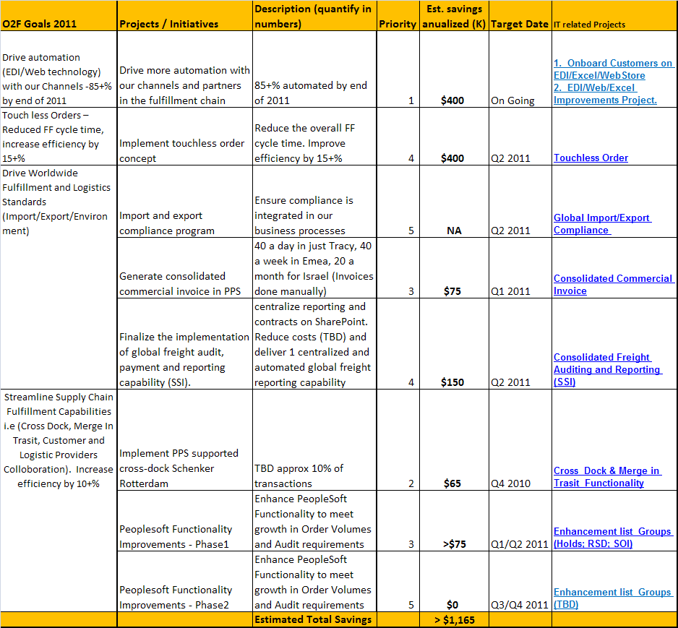
Order Fulfillment Projects and Initiatives for Efficiency

Slide 15
2011 Approach (OPS and PGS)
Key =
OPS
PGS
Month 1
Month 2
Month 3
Month 4
Month 5
Month 6
Month 7
Month 8
Month 9
Month 10
Month 11
Month 12
Compliance Automation
Procurement – Workflow & Reqs
Forecasting
Process
Design
Enhance Supply-Demand Match
(Shortage Workbench & Order Pegging)
Available to
promise
Adoption
& Stabilization
Phase 1
Implement
Sales Forecast
Fulfillment Capabilities (Cross dock,
Merge & Collaboration)
Service Spares Planning and
Demand Forecasting for Spares
Operations Order Promising
and Planning Analytics
Professional Services Automation
Advanced
Supply Chain Planning RFP
Selection Process
Phase 3
Siebel 8.1 Upgrade – Knowledge Base
BCG 13
Service Safety Stock Optimization
and Planning Analytics
BCG 14 Support – BI Analysis & Scorecards
Corporate
E-Business
Strategy
Order Automation – Touchless
Orders & Fulfillment Standards
Contracts Database
Phase 2
Service EDI Order
Processing
Support Portal
Enhancements

Slide 16
Dependencies
EPM (Factor in Operations Execution requirements)
CDI (Factor in Operations Execution requirements)
Salesforce.com enhancements e.g. SKU level planning, NST automation
Sales participation in the Forecasting/Demand Planning business process work
Executive Sponsorship of E-Business Plan

Slide 17
PGS IT Projects

Slide 18
PGS Situation Analysis
Issues
Actions
Peoplesoft was not configured to handle a complex service logistics business… many manual workarounds exist to run the business
PGS does all of its supply chain planning outside of FDM
The current webstore does not handle stand alone service orders or renewals
Siebel PM module is no longer supported… Pro Services growth plan requires a replacement
Transaction processing with outside vendors does not meet business requirements
Support portal requires additional features to support SMB customers
We could prevent RMAs with a better knowledge base for partners and internal Tech Support
Need BI to help with quality improvement
Implement new functionality available in FDM to support services business model
Implement a SaaS model for spares/repair planning
Build EDI capability to handle service orders and renewals
Turn on PS9 Project Accounting & integrate with Microsoft Project Server
Fix XML transaction processing
Add “My Account” feature on the support portal
Upgrade Siebel to better support the knowledge base integration
BI Repairs Scorecard and quality analysis

Slide 19
Strategic PGS IT Focus Areas
Initiative | Benefits
#1: Improve PGS Supply Chain Performance | CSAT & LOS Inventory Cost Audit concern
# 2: Improve service request data collection and knowledge base integration | Product quality Cost CSAT BCG # 13
# 3: Implement best-in class professional services management environment | Improved staff utilization Profitability
# 4: Create an integrated eBusiness environment for services and products | Cost reduction Order to cash cycle time improvement Audit concern
# 5: Extend support.polycom to support end-customers and LoBs | Cost reduction CSAT
# 6: Improve PGS Business Intelligence and align with Corporate Data Warehouse | Product quality Services profitability BCG #14

Slide 20
PGS IT Project Impact Matrix

Slide 21
eBusiness Phase I – High Volume EDI
Scope:
  Automate 60% - 70% of the 40,000+ service orders handled manually today (91% of orders for less than $5k)
  Extend EDI capability to support service orders (new & renewal) and RainMaker
Cost: $451K
Project duration: 6 months (IT development)
ROI:
  Within 12 months of go-live
  Annualized cost savings of up to $1.088M (2013)
Acceleration option
  Dedicated EDI deployment project manager to on-board partners
  Acceleration cost (2011): $100K
  Impact: ROI within 9-12 months; full impact by end of 2012

Slide 22
Service Parts Planning
Scope:
  Demand Planning, Supply Planning, Inventory Planning for Service Parts Business
  Support rapidly growing number of Advanced Depots and diversified service offerings
  Achieve 97% LOS without explosive growth of spare parts inventory and/or planning staff
Cost:
  One-time implementation cost: $395K
  Annual SaaS fees: $230K
ROI:
  Within 12 months of go-live
  Annualized cost savings of $1.2M (2013) due to head count avoidance, repair cost reduction and reduction of new buys

Slide 23
Professional Services Automation
Scope
  Management of cost, schedules, resources and profitability for the Professional Services Business
  Reporting on backlog, revenue, profitability and resource utilization
Cost
  Implementation and license cost: $509K
ROI (based on best practice results driven by PSA implementation)
  Increase resource utilization by 8%
  Reduce revenue leakage by 2%
  Improve project margin by 10%

Slide 24
Support.xyz
Scope
  Support LoB Strategy
  “My Account” for End Customers and Tier 2 Partners
  Localization to support APAC
  Integration with Social Media and support for Rich Media
  Partner tools and integration (eBonding)
Cost:
  $331K (Capital & OpEx)
Business Driver
  CSAT & LoB strategic support

Slide 25
BCG #13 – Knowledge Management Quality Initiative
Scope (PGS IT sub-scope)
  Siebel 8.1 Upgrade to support task-based UI and allow for better data collection in support of quality initiative
  Upgrade support.polycom to support task-based UI and quality-driven data collection
  Integration of JIRA into knowledge base search
  Translation of key knowledge base entries into Japanese, Korean and Simplified Chinese
Cost (PGS IT sub-scope):
  $327K
ROI (of the overall BCG #13 Initiative)
  $1.288M – $2.676M (Year 4)

Slide 26
BCG # 14 - Quality Incentives and Monitoring for Repair Vendors
Scope (PGS IT sub-scope) :
  Provides quantitative insight into failures, capturing serialized failure information, and implementing data driven quality / cost / delivery improvements.
Cost (PGS IT sub-scope)
  $245K
ROI (of the overall BCG #14 Initiative)
  $5.9M (Year 4)

