Slide 1

¡Bienvenidos! y capítulo 1
Template by Jared Speight
Content by Beatrice Tseng
con la Profesora Tseng

Slide 2

COLORES | ROPA | DESCRIPCIÓN DE PERSONAS | ARTÍCULOS (el, la, los, las) | MANDATOS
100 | 100 | 100 | 100 | 100
200 | 200 | 200 | 200 | 200
300 | 300 | 300 | 300 | 300
400 | 400 | 400 | 400 | 400
500 | 500 | 500 | 500 | 500

Slide 3

MÁS ROPA | NÚMEROS | OPUESTOS | CONCORDANCIA sustantivo/adjetivo | CULTURA
200 | 200 | 200 | 200 | 200
400 | 400 | 400 | 400 | 400
600 | 600 | 600 | 600 | 600
800 | 800 | 800 | 800 | 800
1000 | 1000 | 1000 | 1000 | 1000

Slide 4
¿Qué color es?
CHECK

Slide 5

rojo

Slide 6
¿Qué color es?
CHECK

Slide 7
blanco

Slide 8
¿Qué color es?
CHECK

Slide 9
amarillo

Slide 10
¿Qué color es?
CHECK

Slide 11
verde

Slide 12
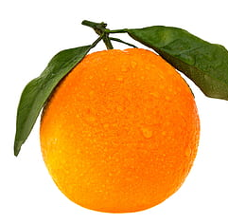
¿Qué color es?
CHECK

Slide 13
anaranjado

Slide 14
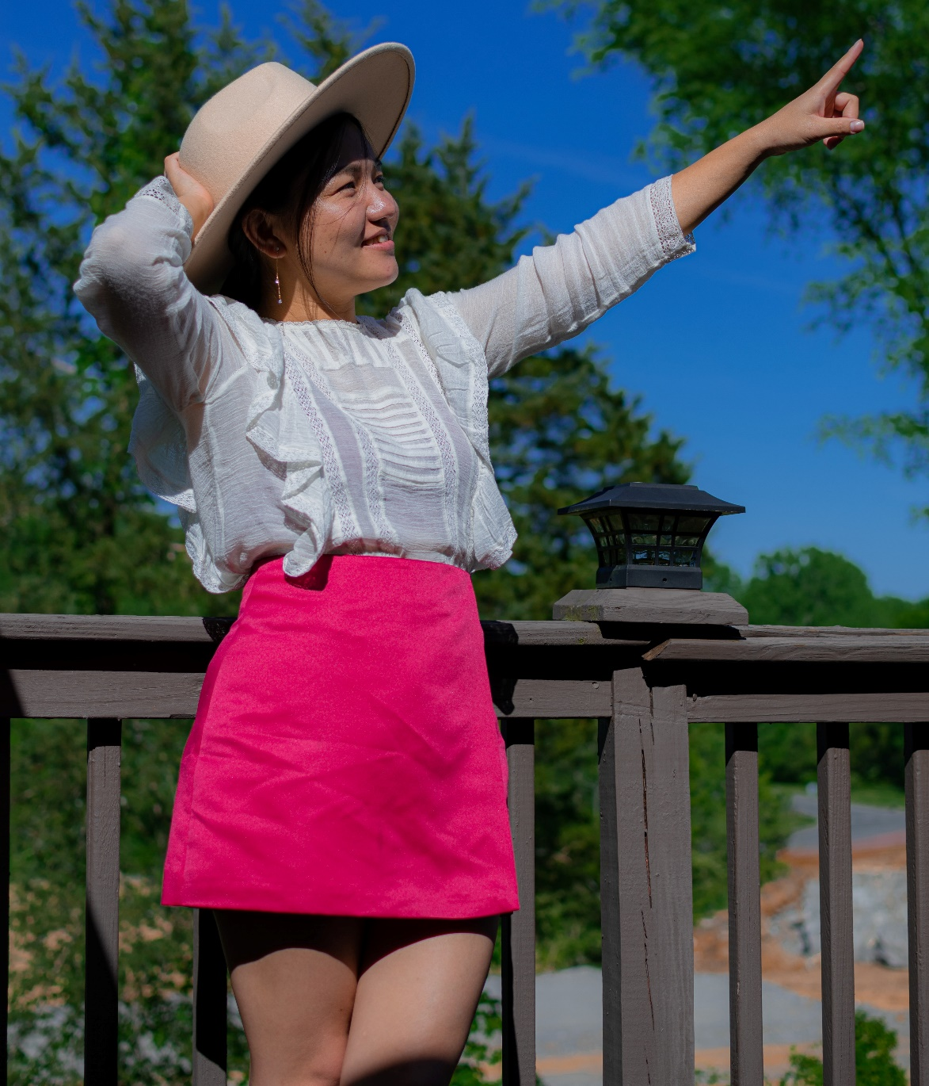
CHECK
Photo by JP Pau on Unsplash

Slide 15
falda

Slide 16
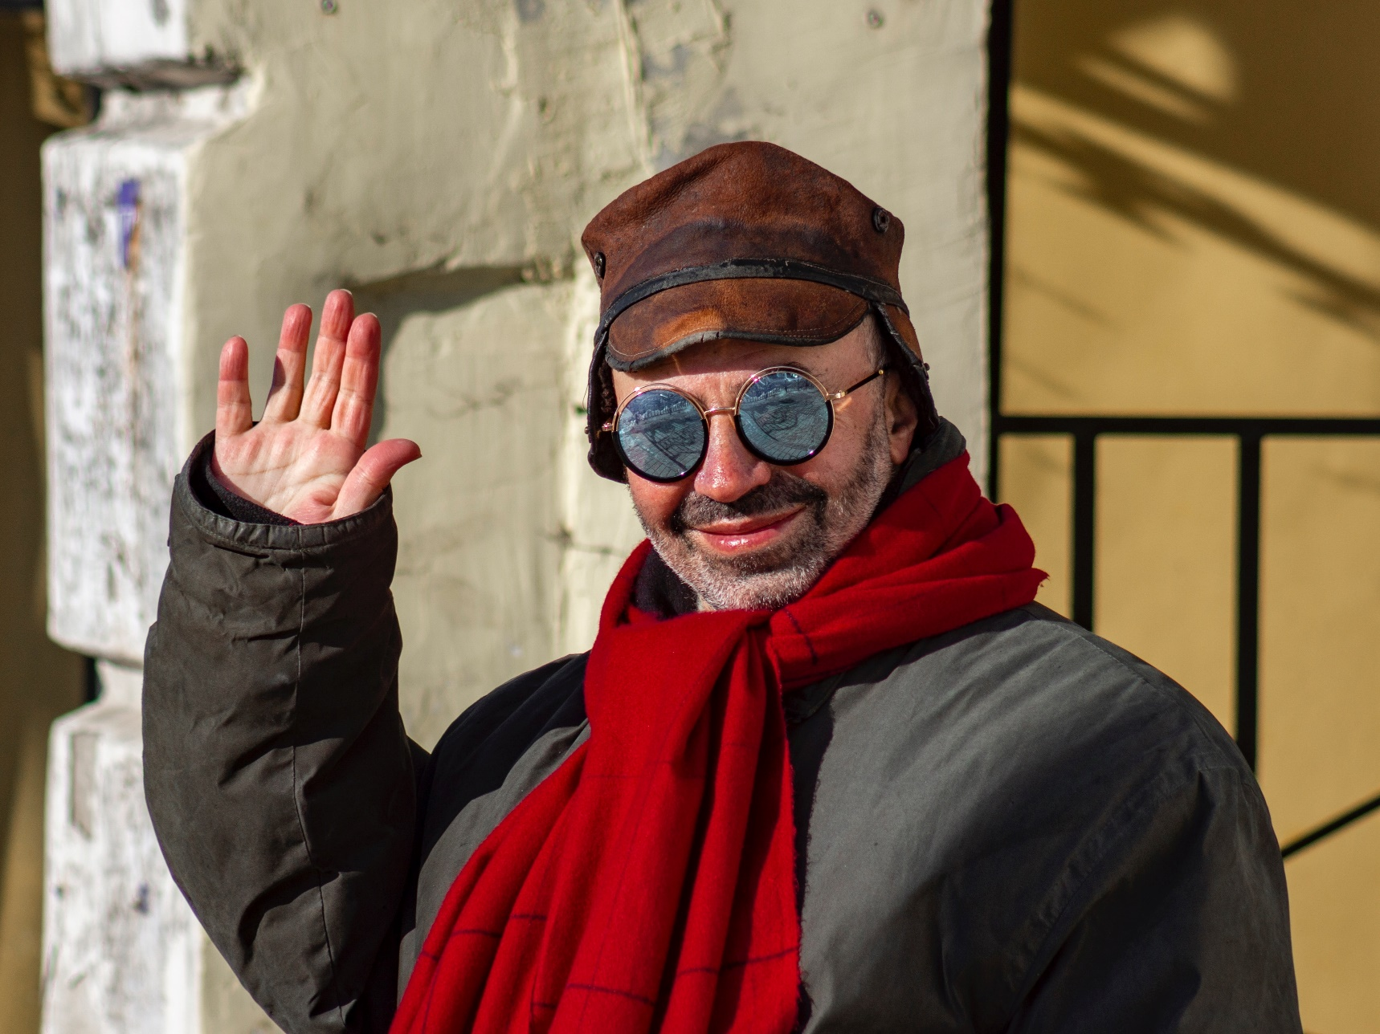
Photo by Alex Devera on Unsplash
CHECK

Slide 17
bufanda

Slide 18

Photo by Brayan Espitia on Unsplash
CHECK

Slide 19
blusa

Slide 20
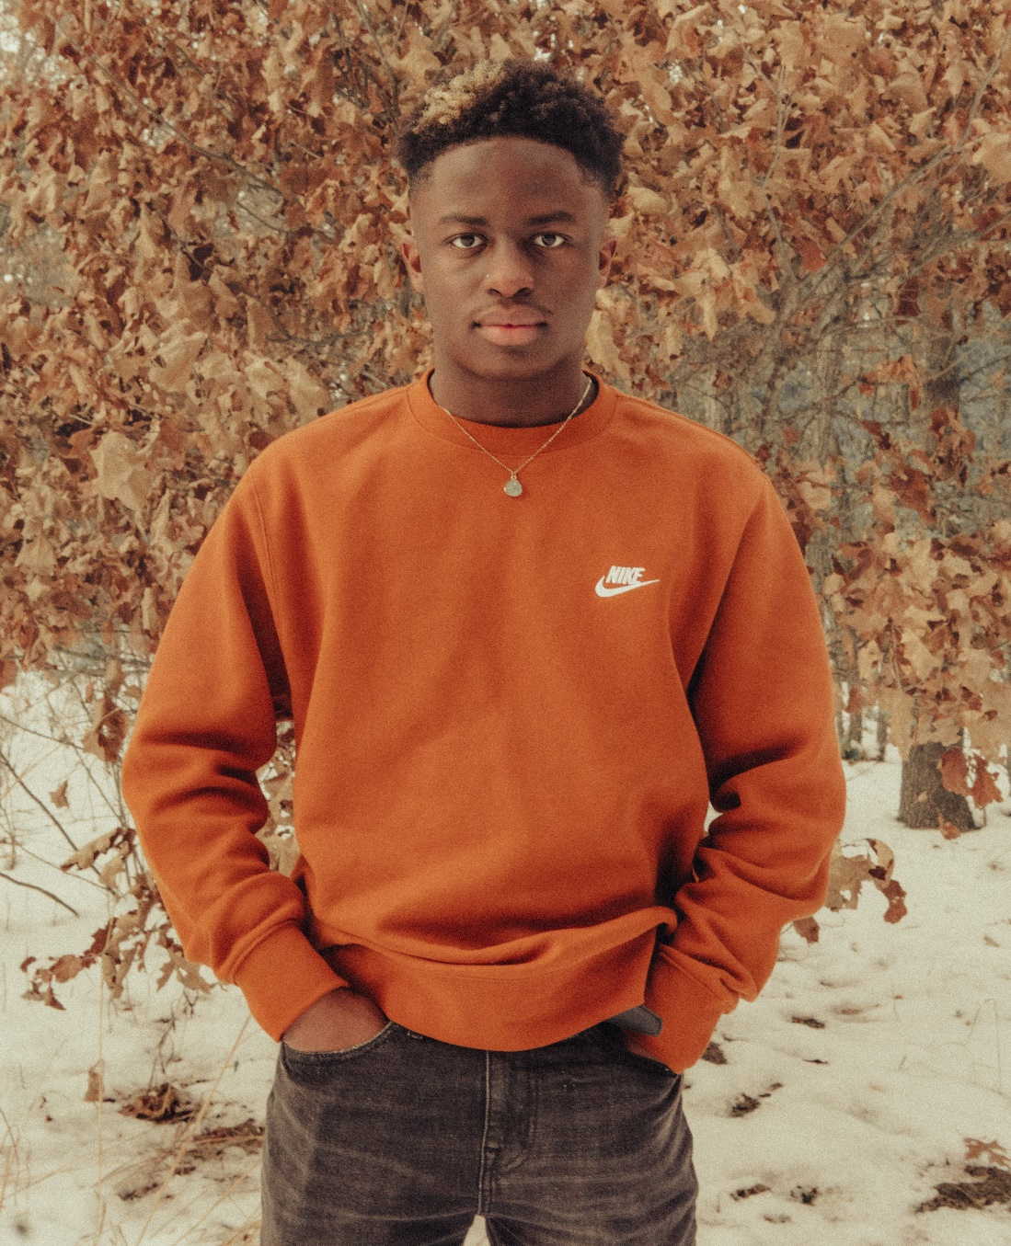
Photo by danny protas on Unsplash
CHECK

Slide 21
sudadera

Slide 22
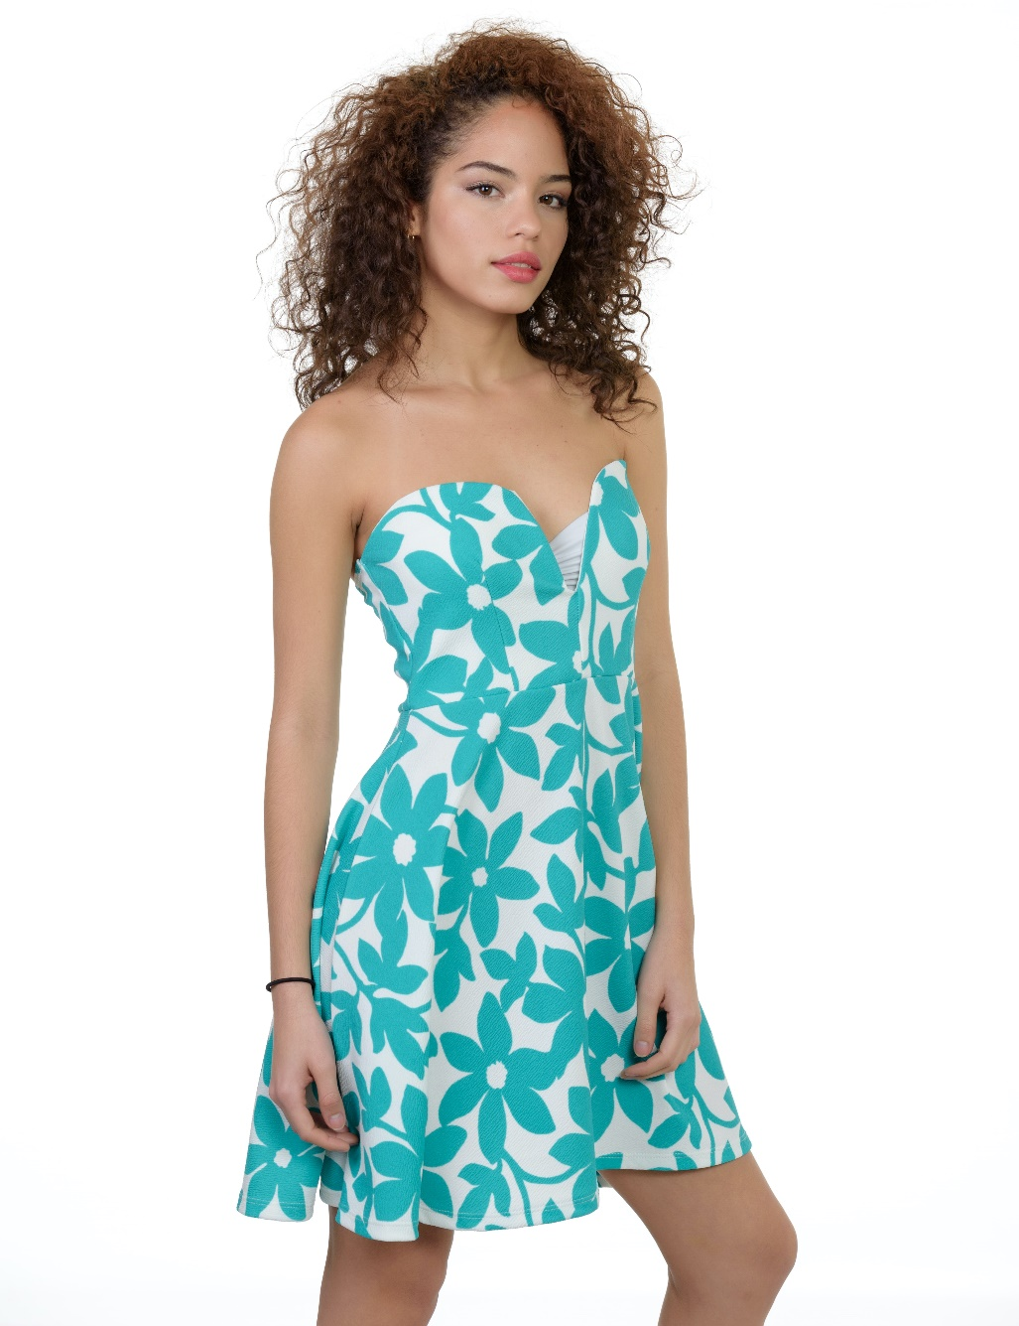
Photo by Rome Wilkerson on Unsplash
CHECK

Slide 23
vestido

Slide 24
Una persona que no habla mucho es ___.
CHECK

Slide 25
callada

Slide 26
Una persona que no es vieja es ___.
CHECK

Slide 27
joven

Slide 28
Una persona que no es fea es ___.
CHECK

Slide 29
bonita

Slide 30


Third Category - 400
INSERT QUESTION HERE
CHECK
Notes:
You will have to move the Daily Double picture out of the way to write the question. If you do not wish to have the Daily Double in the game, delete it and the sound clip (speaker) from this slide. For a Daily Double, the contestant has to wager at least $5 and at most the highest point value of any player/team at that point in the game. It is considered a True Daily Double if they wager all of their points and go “double or nothing”.

Slide 31
Una persona que no es trabajadora es _____.
CHECK
Notes:
You will have to move the Daily Double picture out of the way to write the question. If you do not wish to have the Daily Double in the game, delete it and the sound clip (speaker) from this slide. For a Daily Double, the contestant has to wager at least $5 and at most the highest point value of any player/team at that point in the game. It is considered a True Daily Double if they wager all of their points and go “double or nothing”.

Slide 32
perezosa

Slide 33
pelo blanco = pelo ____
CHECK

Slide 34
canoso

Slide 35
___ suéter
CHECK

Slide 36
el suéter

Slide 37
___ clases
CHECK

Slide 38
las clases

Slide 39
___ universidad
CHECK

Slide 40
la universidad

Slide 41
___ traje
CHECK

Slide 42
el traje

Slide 43
___ lentes
CHECK

Slide 44
los lentes

Slide 45
Actúe:
Levante la mano
CHECK

Slide 46
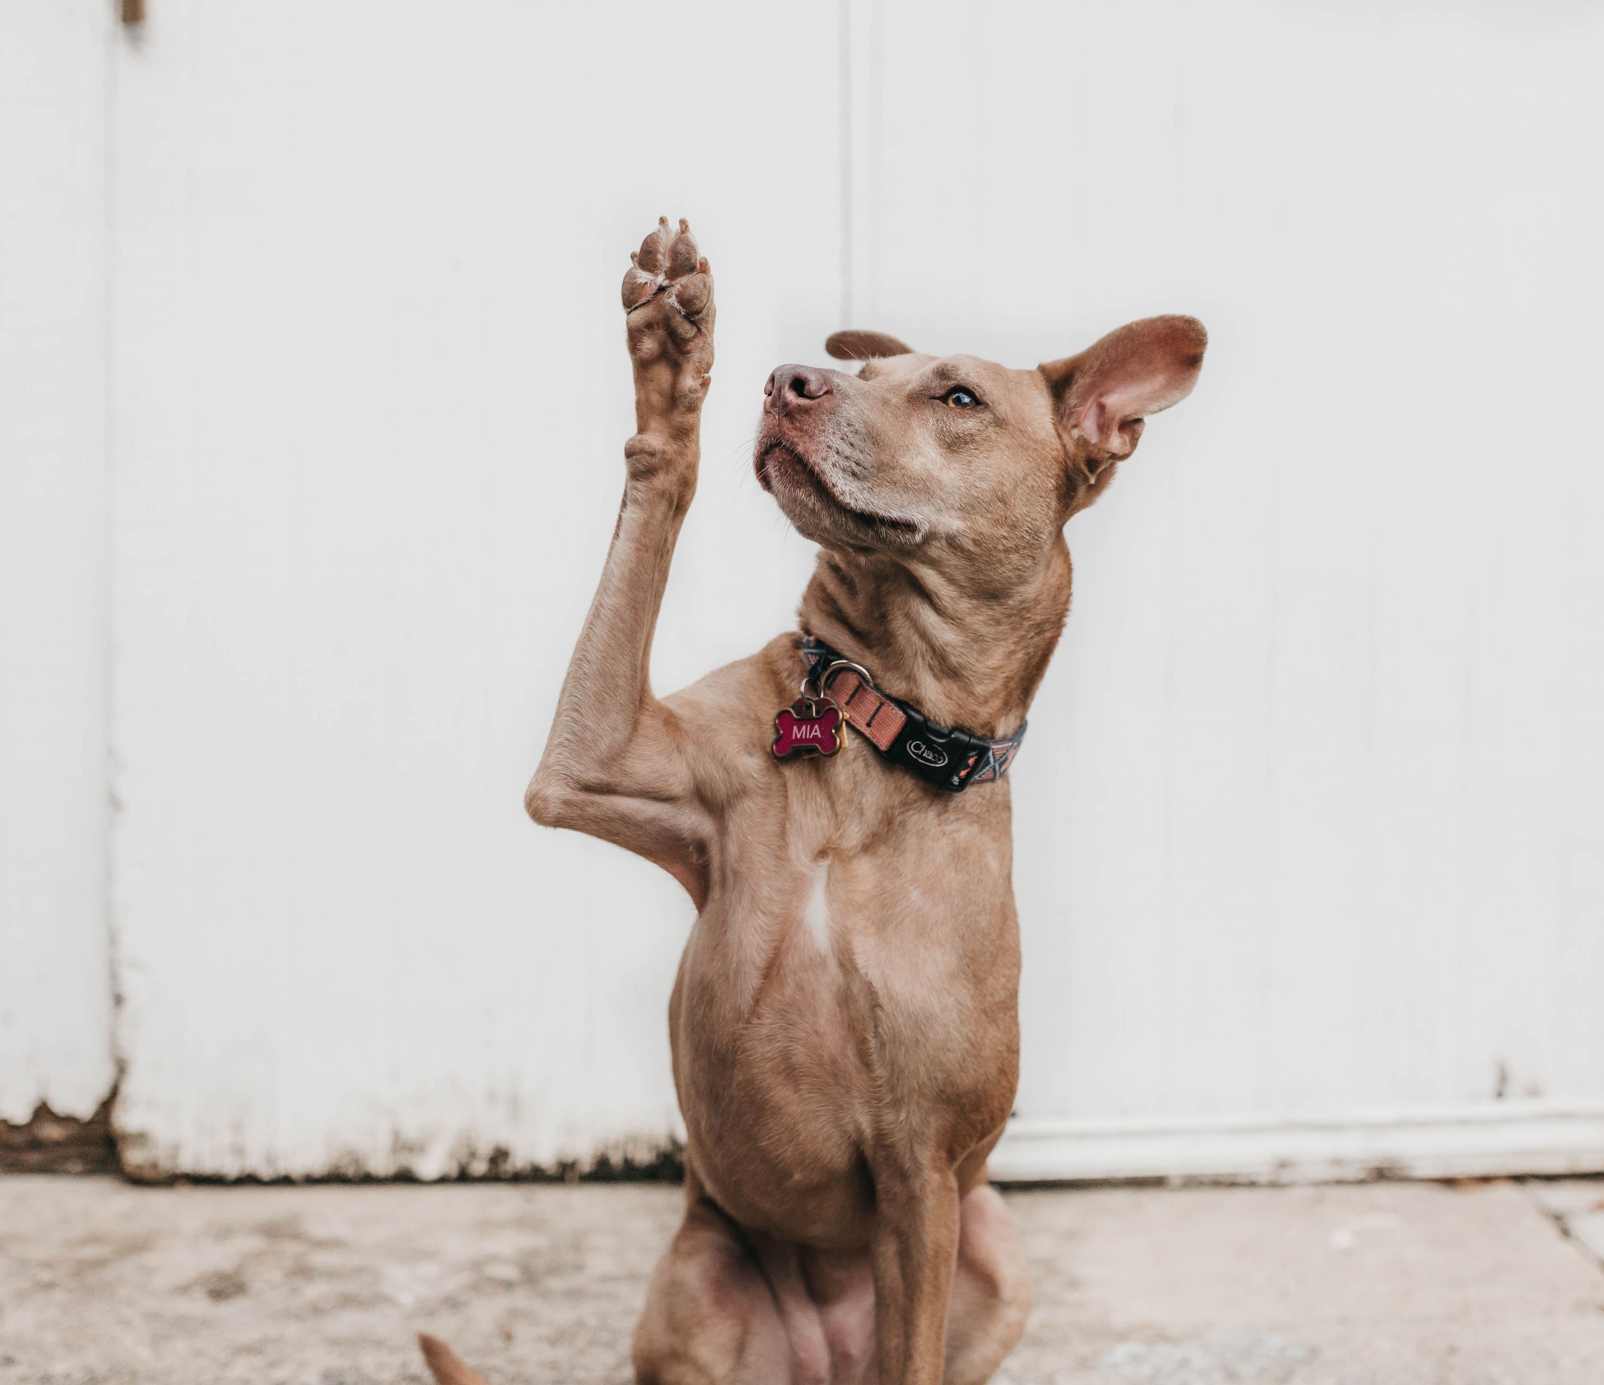
Photo by Camylla Battani on Unsplash

Slide 47
Actúe:
Corra
CHECK

Slide 48
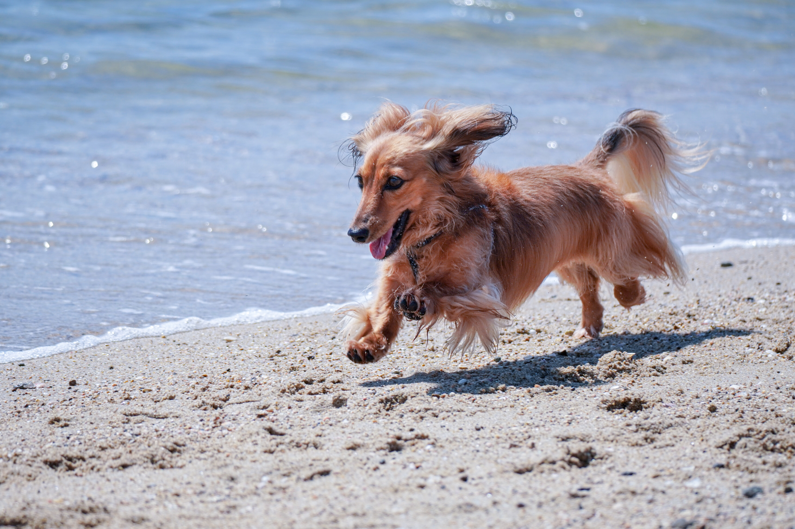
Photo by Kojirou Sasaki on Unsplash

Slide 49
Actúe:
Saque un bolígrafo
CHECK

Slide 50
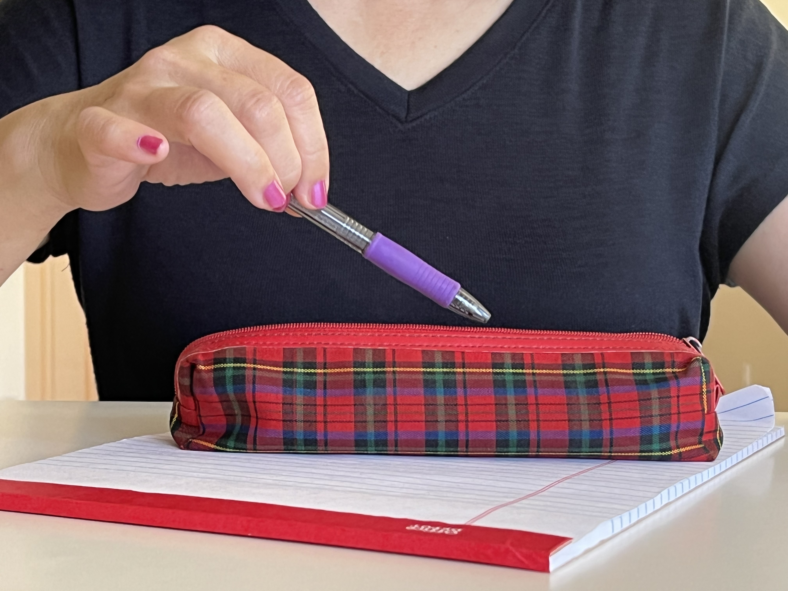
Photo by Beatrice Tseng

Slide 51
Actúe:
Cierre el libro
CHECK

Slide 52
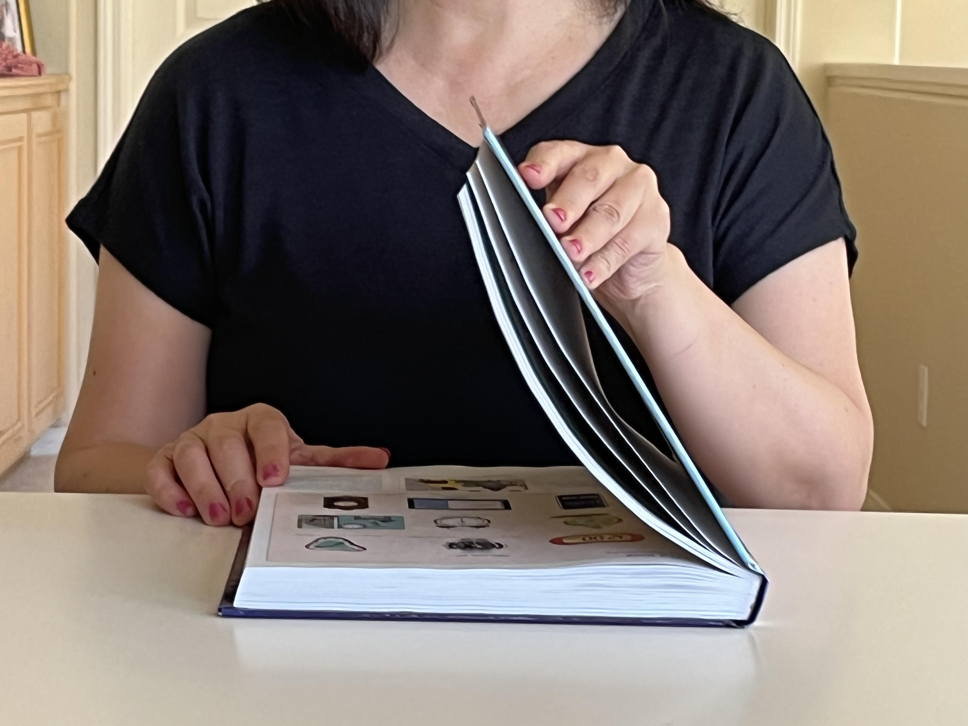
Photo by Beatrice Tseng

Slide 53
Actúe:
Escuche
CHECK

Slide 54
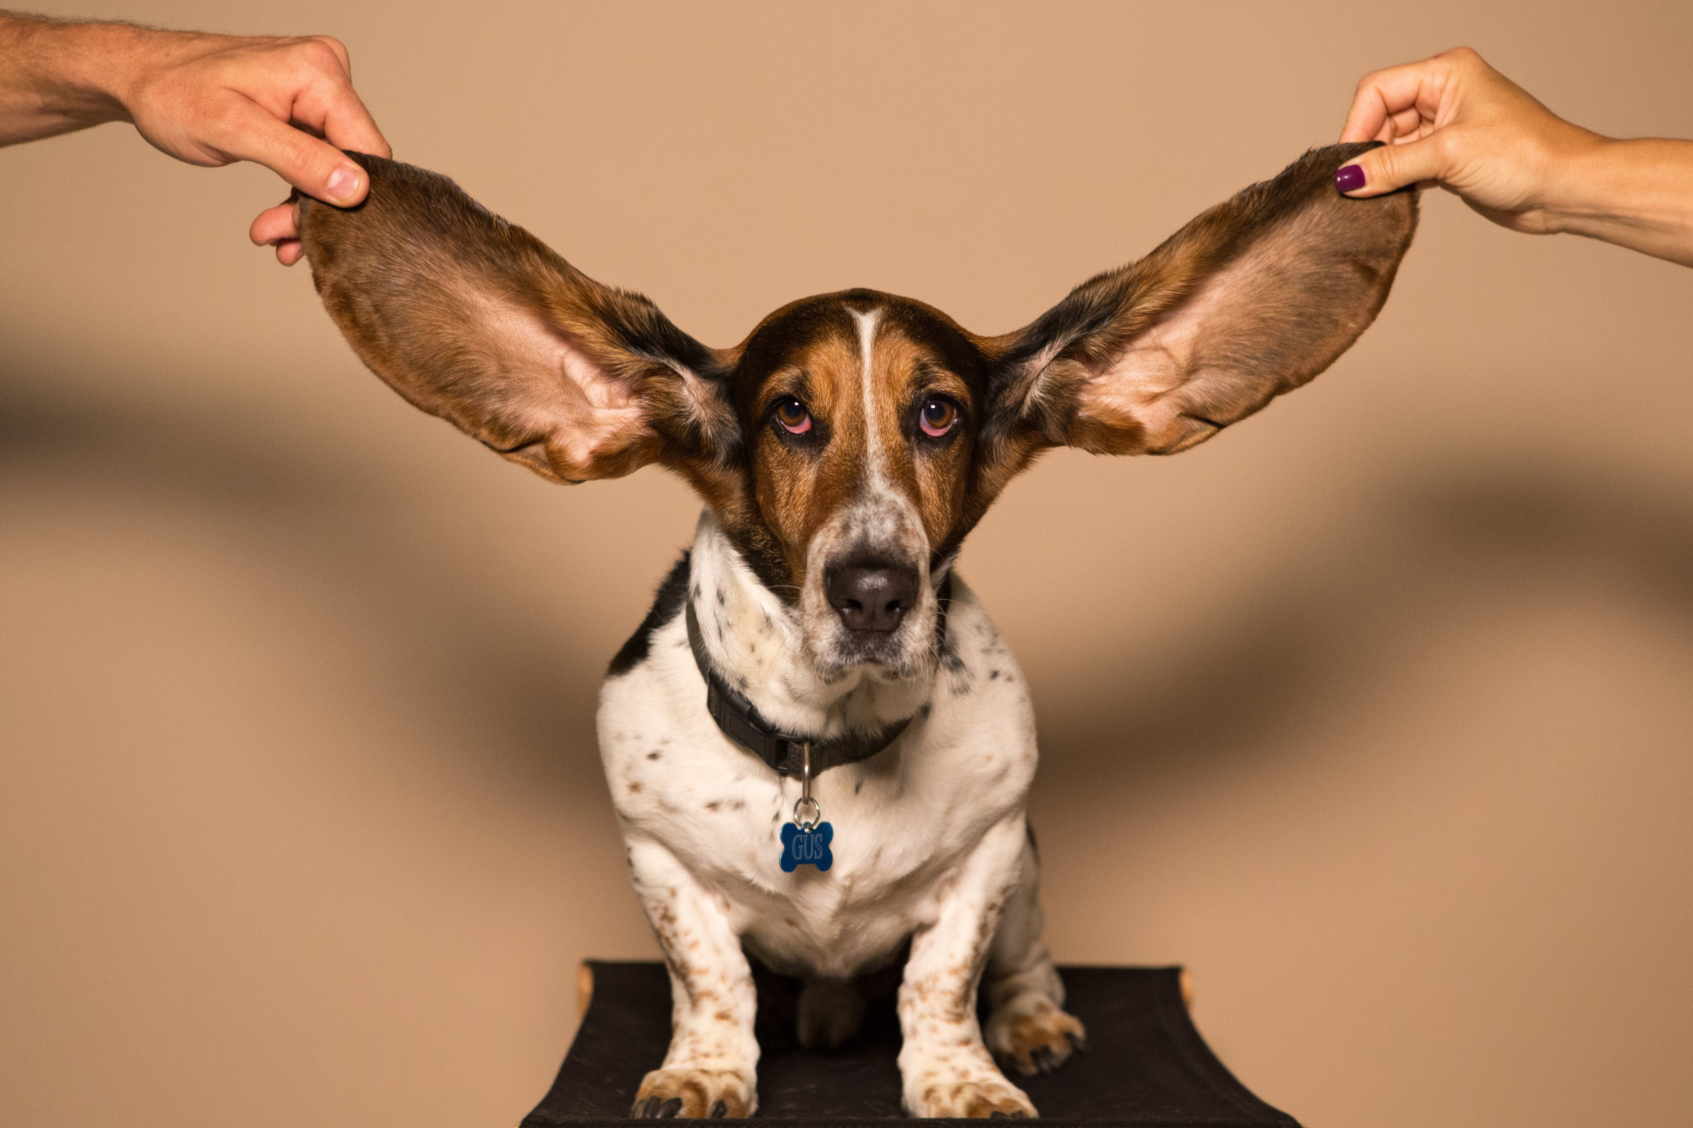
Photo by kyle smith on Unsplash

Slide 55
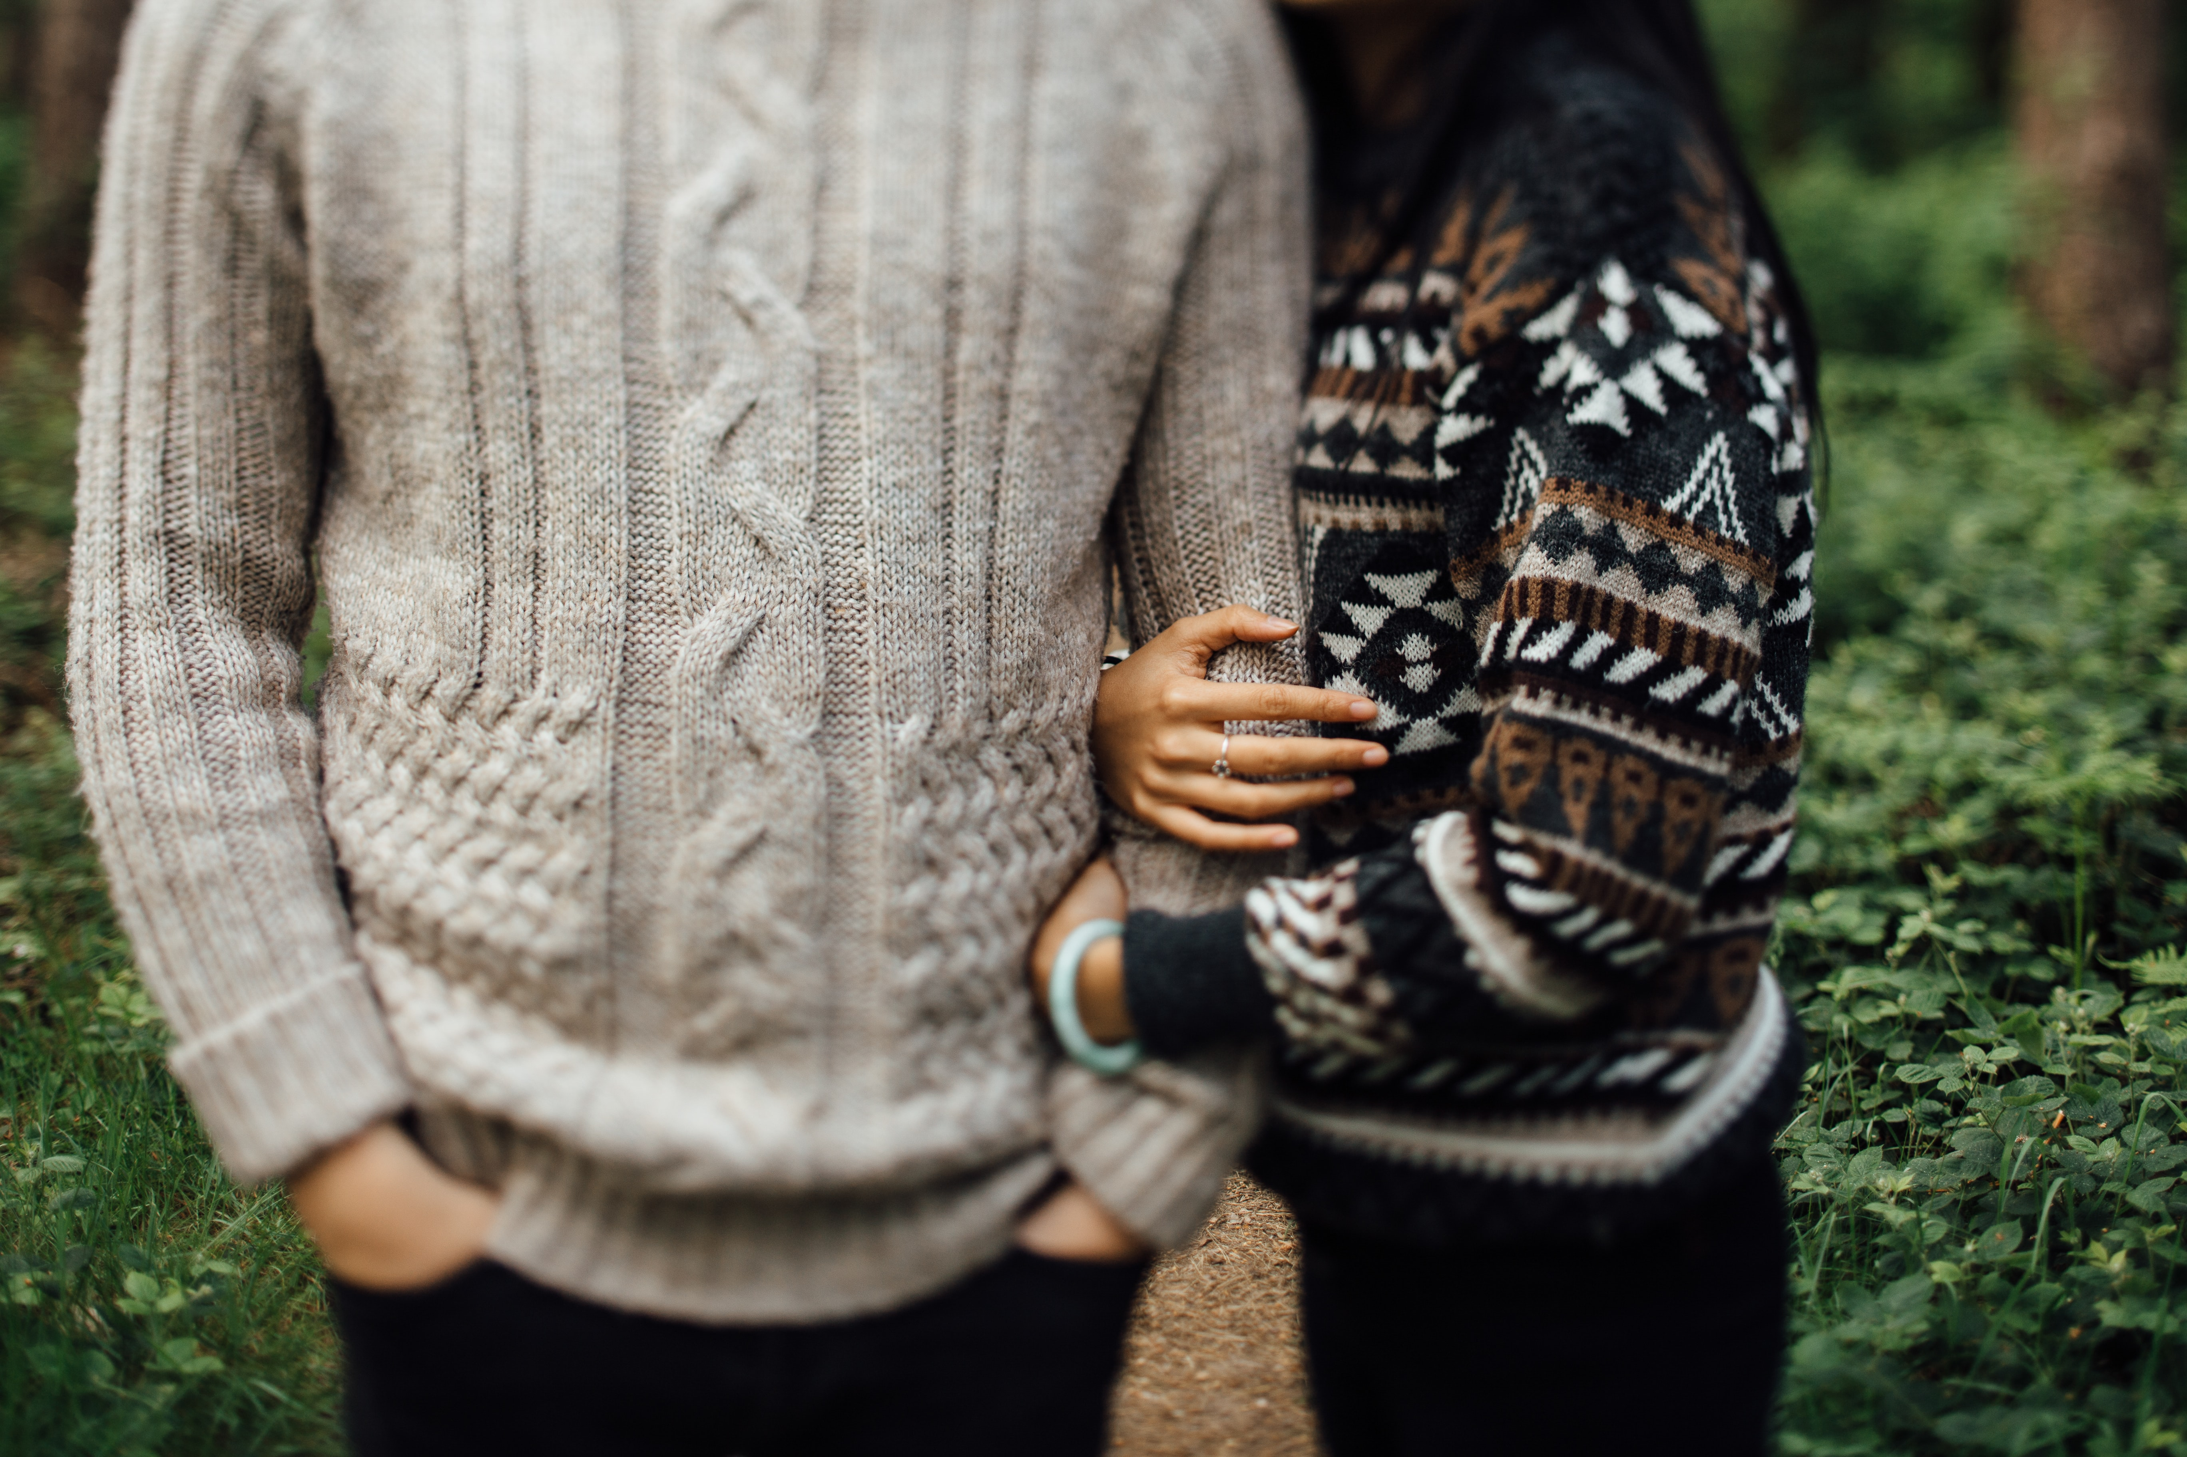
Photo by Tom The Photographer on Unsplash
CHECK

Slide 56
suéter(es)

Slide 57
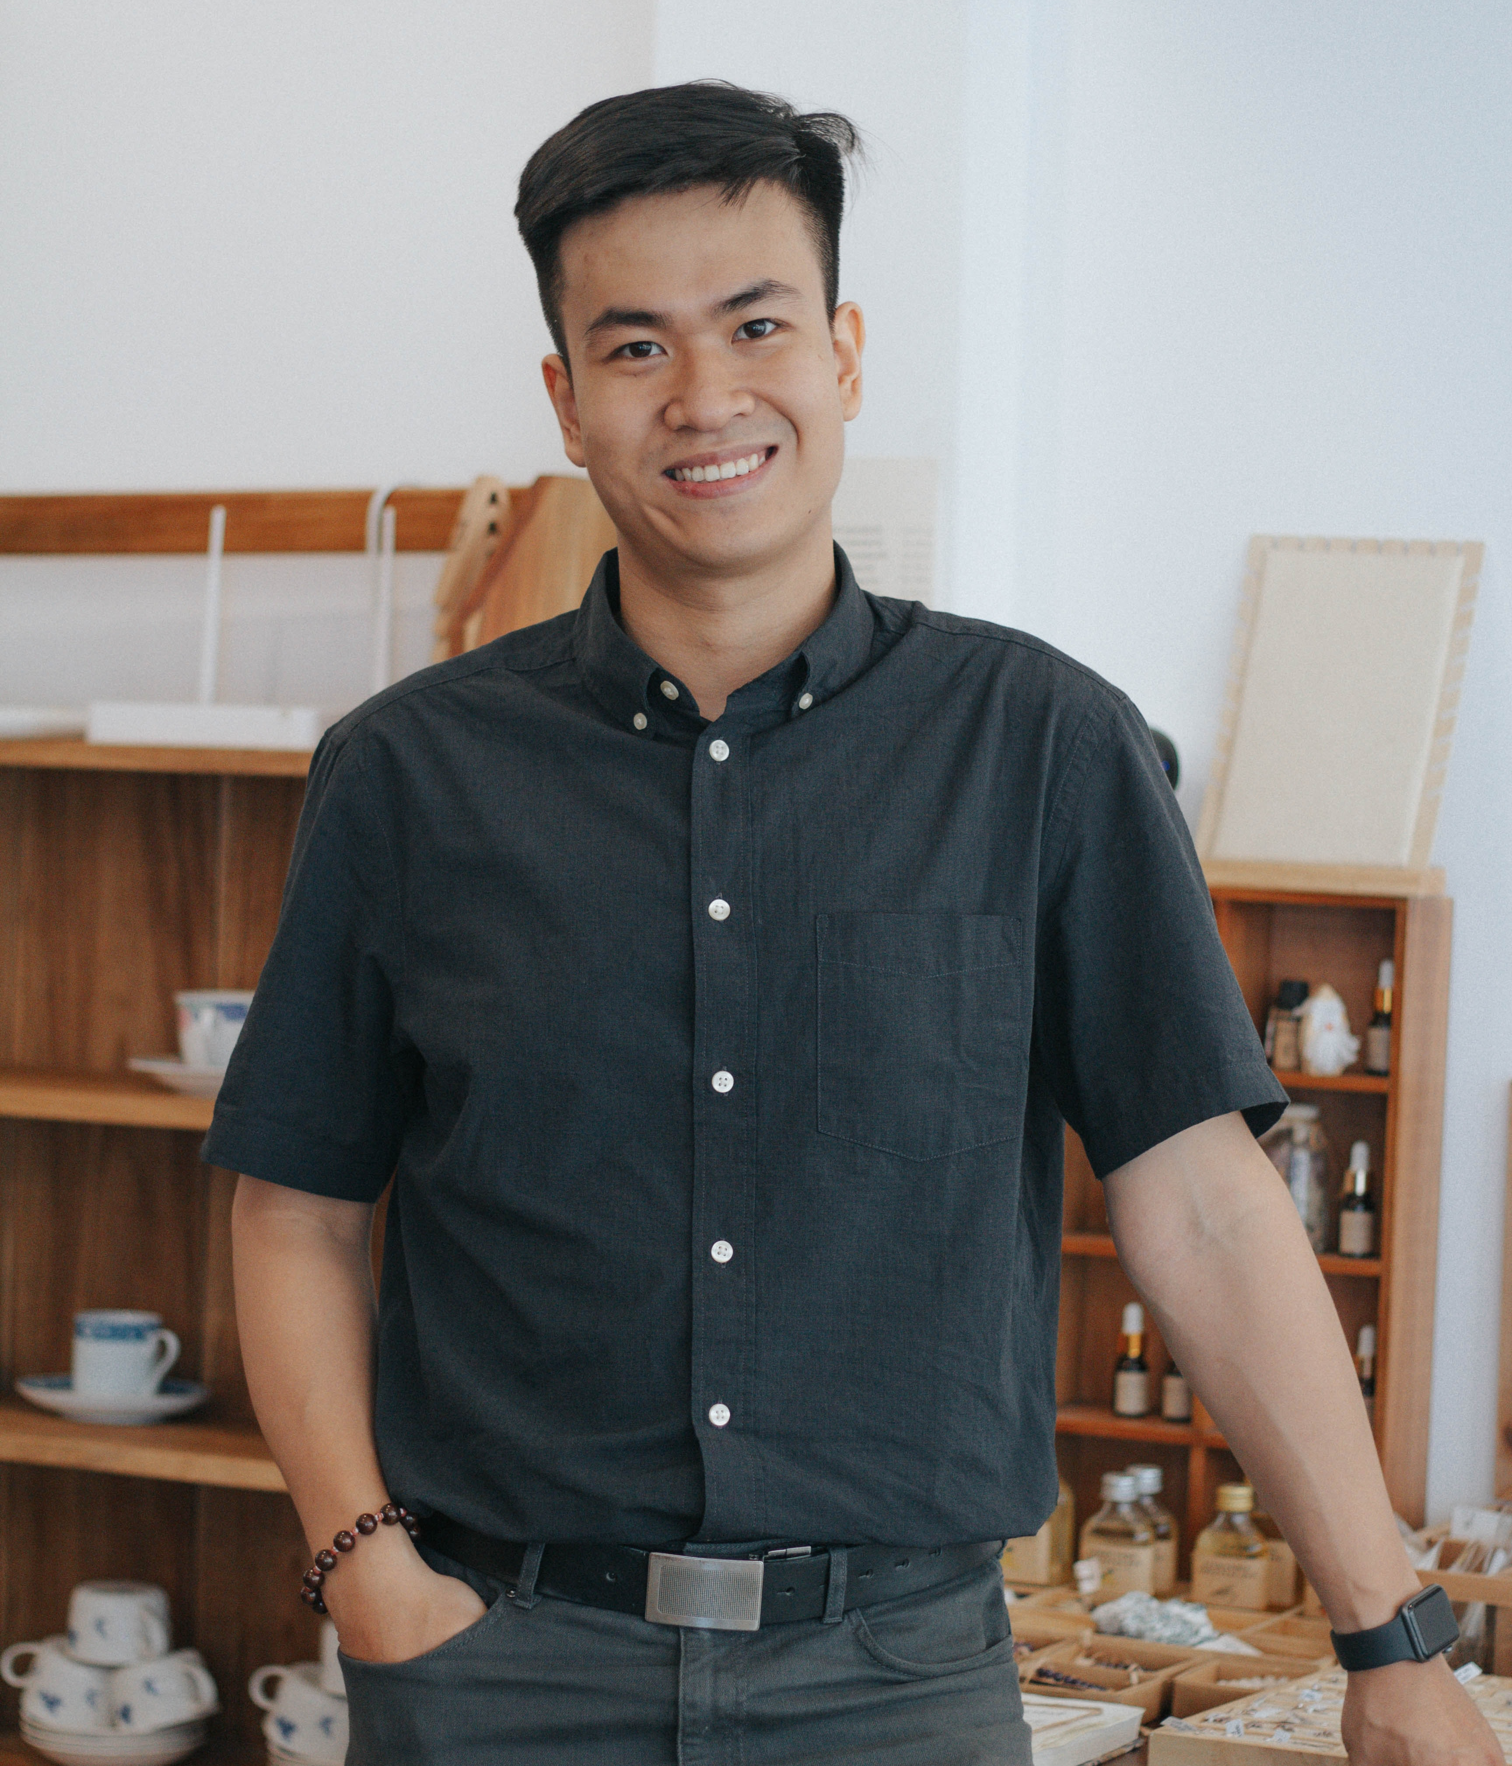
Photo by Nguyen Dang Hoang Nhu on Unsplash
CHECK

Slide 58
camisa

Slide 59
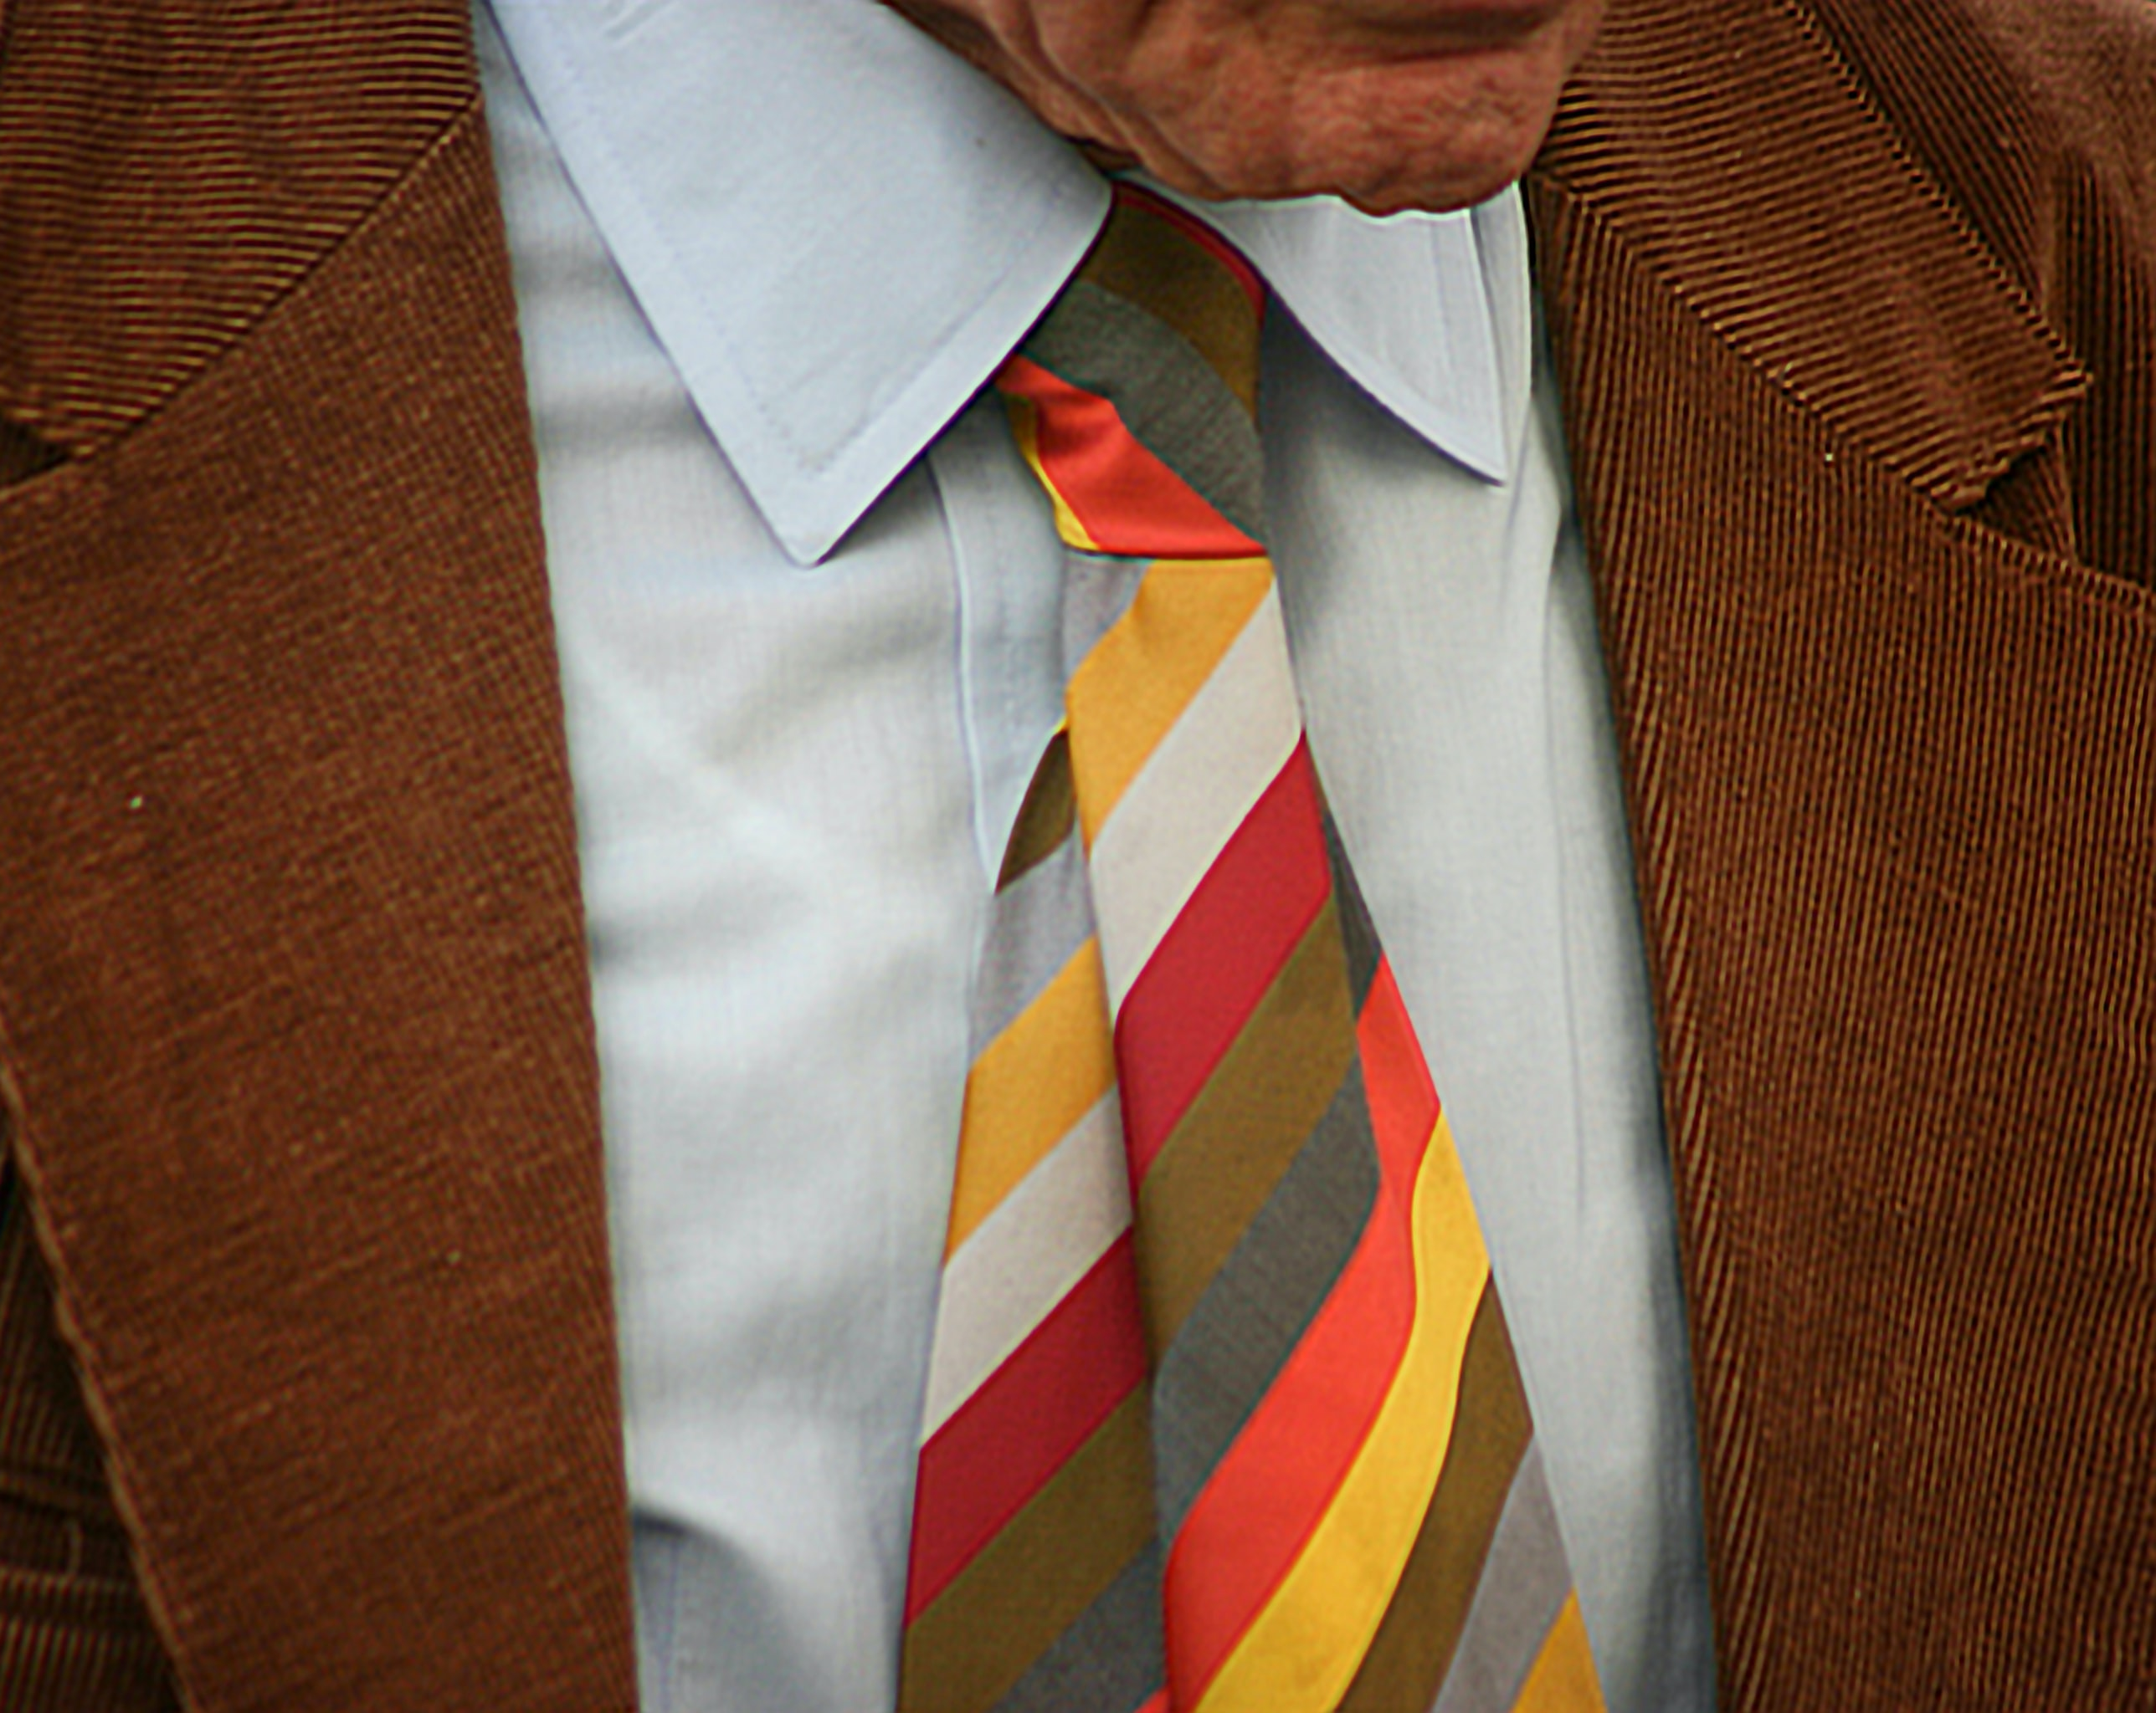
Photo by JACQUELINE BRANDWAYN on Unsplash
CHECK

Slide 60
corbata

Slide 61
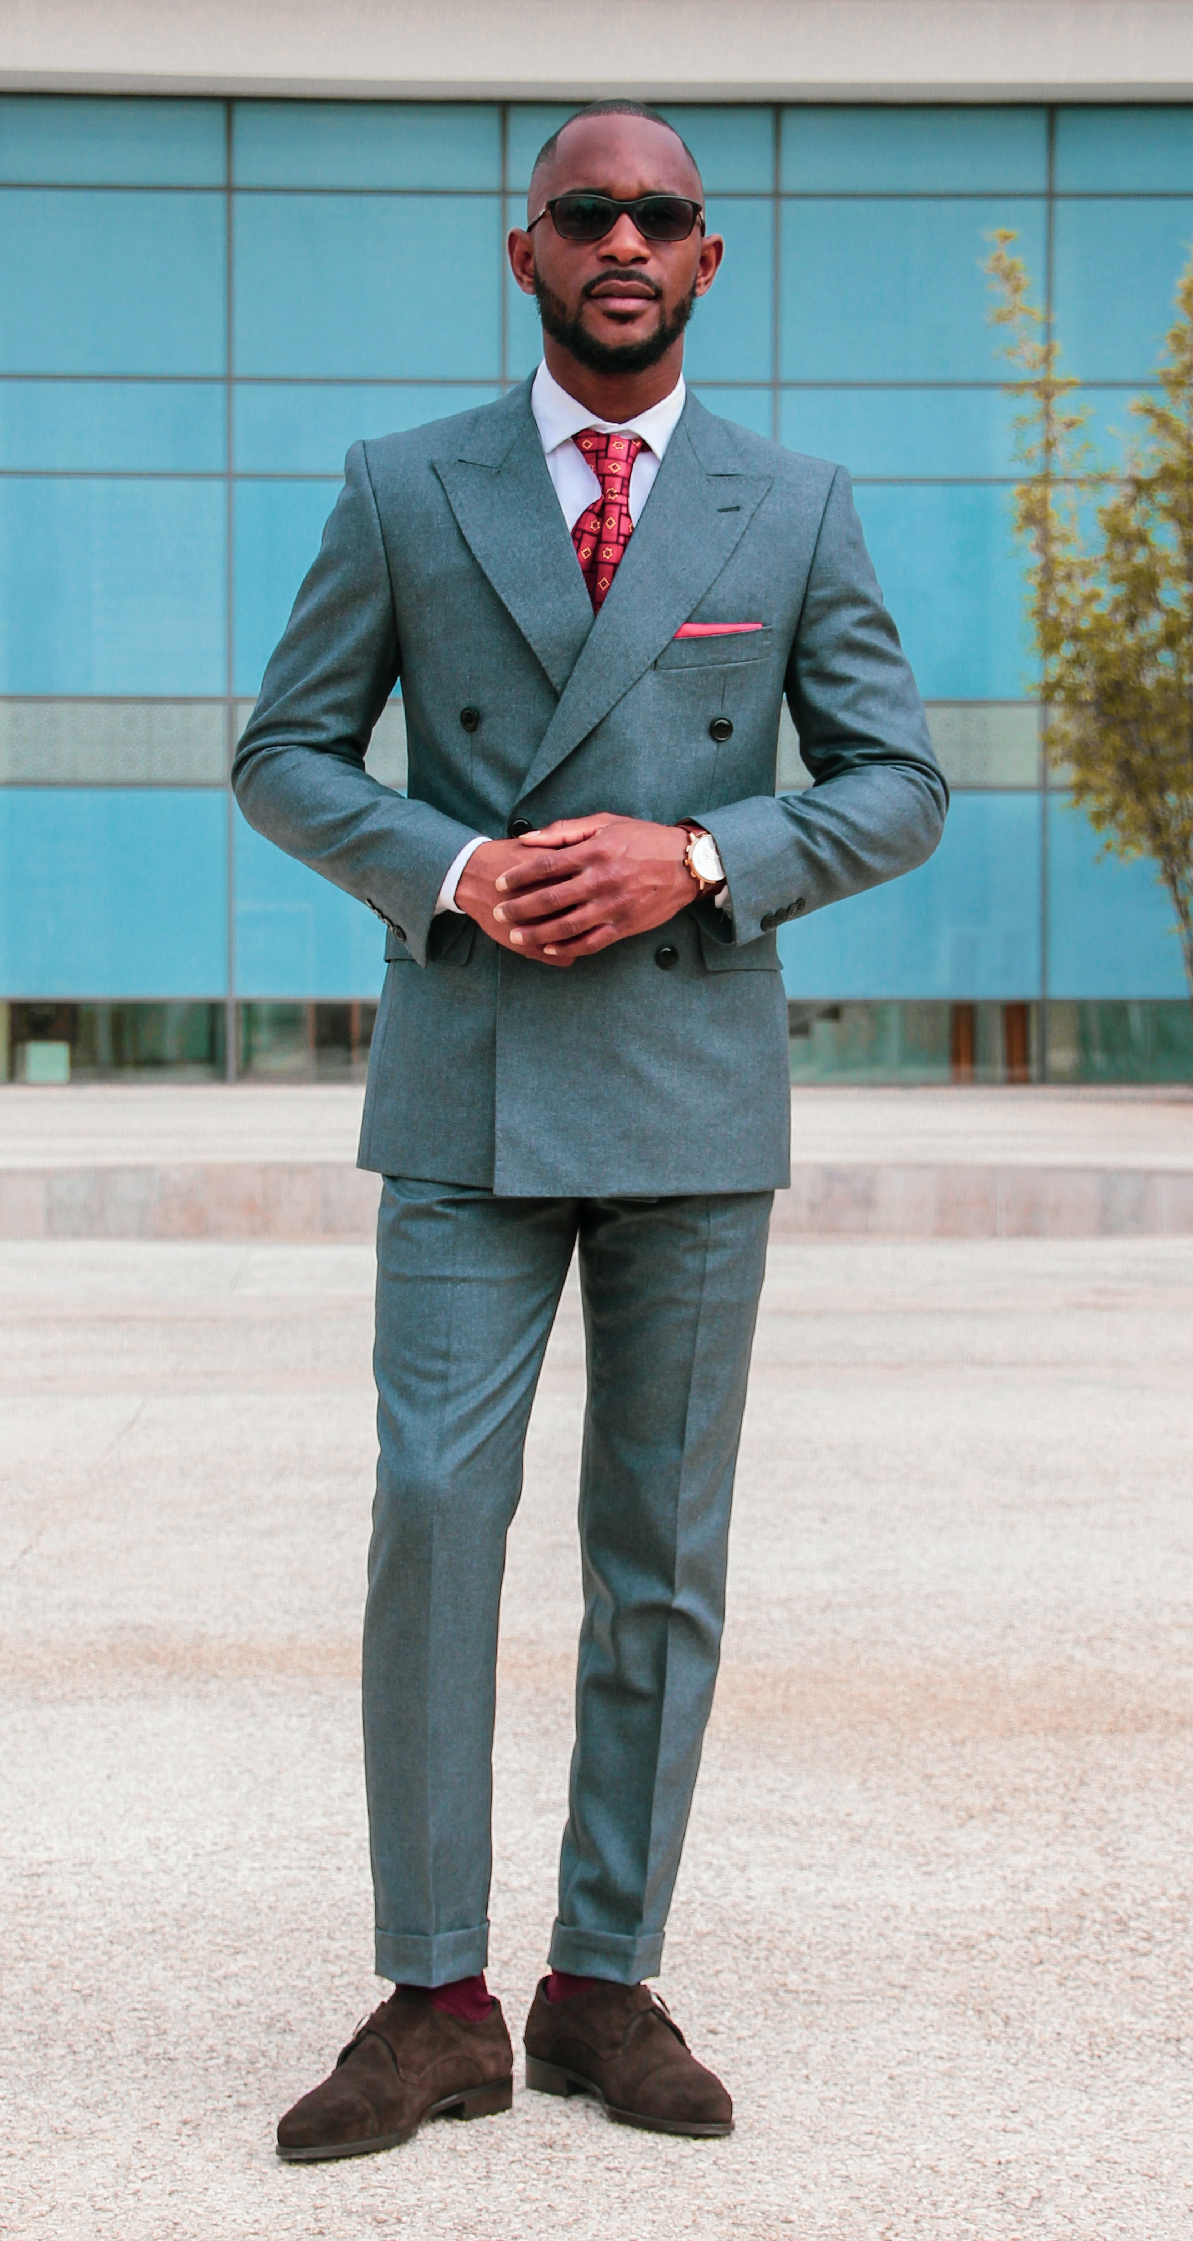
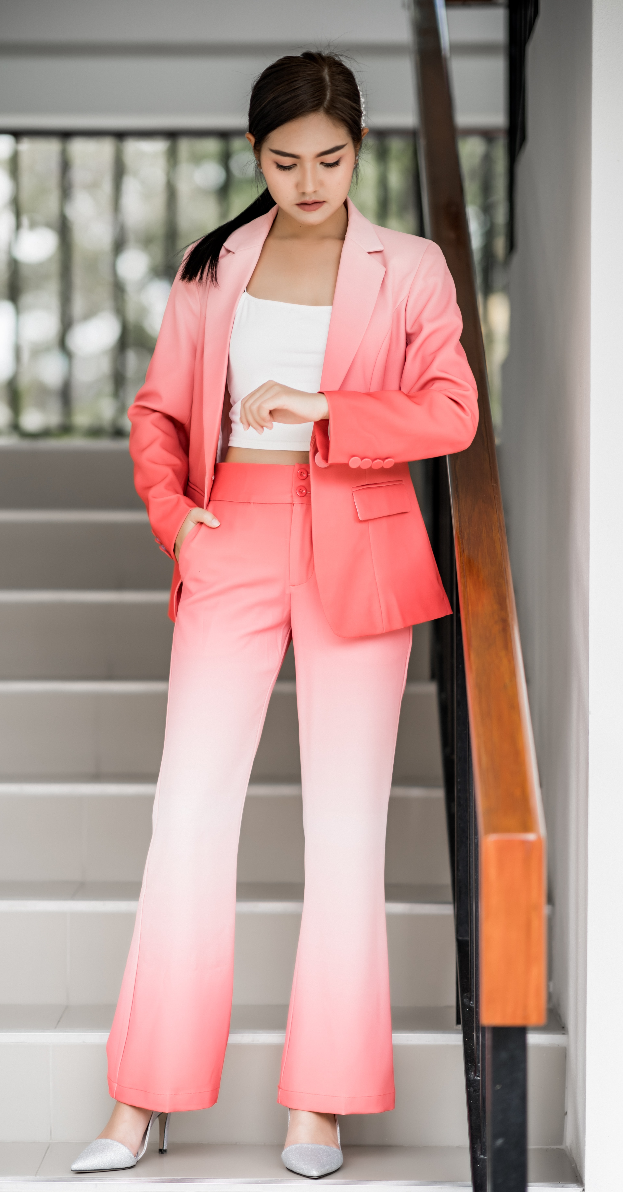
Photo by Khalid Boutchich on Unsplash Photo by Napat Saeng on Unsplash
CHECK

Slide 62
traje(s)

Slide 63
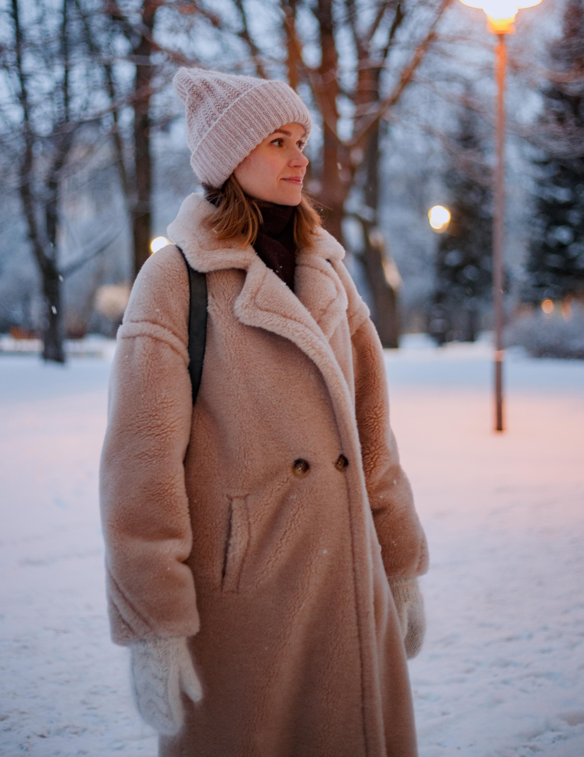
Photo by DNK.PHOTO on Unsplash
CHECK

Slide 64
abrigo

Slide 65
53 + 34 = ?
CHECK

Slide 66
87 ochenta y siete

Slide 67
32 x 2 = ?
CHECK

Slide 68
64 sesenta y cuatro

Slide 69
SEVENTH Category - 600
INSERT QUESTION HERE
CHECK
Notes:
You will have to move the Daily Double picture out of the way to write the question. If you do not wish to have the Daily Double in the game, delete it and the sound clip (speaker) from this slide. For a Daily Double, the contestant has to wager at least $5 and at most the highest point value of any player/team at that point in the game. It is considered a True Daily Double if they wager all of their points and go “double or nothing”.

Slide 70
300 ÷ 3 = ?
CHECK
Notes:
You will have to move the Daily Double picture out of the way to write the question. If you do not wish to have the Daily Double in the game, delete it and the sound clip (speaker) from this slide. For a Daily Double, the contestant has to wager at least $5 and at most the highest point value of any player/team at that point in the game. It is considered a True Daily Double if they wager all of their points and go “double or nothing”.

Slide 71
100 cien

Slide 72
90 + 15 = ?
CHECK

Slide 73
105 ciento cinco

Slide 74
250 + 46 = ?
CHECK

Slide 75
296 doscientos noventa y seis

Slide 76
largo
CHECK

Slide 77
corto

Slide 78
alto
CHECK

Slide 79
bajo

Slide 80
rizado/ondulado
CHECK

Slide 81
lacio

Slide 82
gordo
CHECK

Slide 83
delgado

Slide 84
generoso
CHECK

Slide 85
tacaño

Slide 86
barba : largo
CHECK

Slide 87
barba larga

Slide 88
mujeres : trabajador
CHECK

Slide 89
mujeres trabajadoras

Slide 90
niños : entusiasta
CHECK

Slide 91
niños entusiastas

Slide 92
pantalones : pequeño
CHECK

Slide 93
pantalones pequeños

Slide 94
sandalias : elegante
CHECK

Slide 95
sandalias elegantes

Slide 96
Tenth Category 200
INSERT QUESTION HERE
CHECK
Notes:
You will have to move the Daily Double picture out of the way to write the question. If you do not wish to have the Daily Double in the game, delete it and the sound clip (speaker) from this slide. For a Daily Double, the contestant has to wager at least $5 and at most the highest point value of any player/team at that point in the game. It is considered a True Daily Double if they wager all of their points and go “double or nothing”.

Slide 97
Los hispanos tienen ___ apellidos.
CHECK
Notes:
You will have to move the Daily Double picture out of the way to write the question. If you do not wish to have the Daily Double in the game, delete it and the sound clip (speaker) from this slide. For a Daily Double, the contestant has to wager at least $5 and at most the highest point value of any player/team at that point in the game. It is considered a True Daily Double if they wager all of their points and go “double or nothing”.

Slide 98
dos (2)

Slide 99
Es común saludar a una persona con un abrazo y un ___.
CHECK

Slide 100

beso

Slide 101
La Placita Olvera está en ___.
(nombre de la ciudad)
CHECK

Slide 102
Los Ángeles

Slide 103
El Festival de la Calle Ocho se celebra en ___.
(nombre del estado)
CHECK

Slide 104
Florida

Slide 105
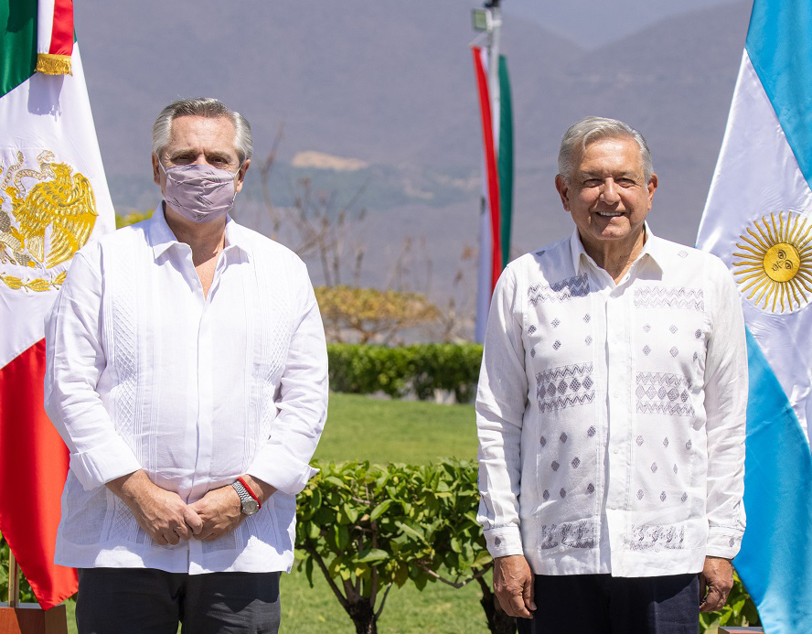
Nombe de esta ropa popular en el Caribe.
CHECK
Photo by Casa Rosada in Wikimedia

Slide 106
guayabera

Slide 107
JEOPARDY FINAL
Categoría:
LUGAR
CHECK

Slide 108

El Festival de la
Parada Puertorriqueña
se celebra en ___.
(nombre de la ciudad)
CHECK

Slide 109
Nueva York

