Slide 1

Capítulo 2
Template by Jared Speight
Content by Beatrice Tseng
con la Profesora Tseng

Slide 2

PARTES del CUERPO | MESES | PREPOSICIONES | IDIOMAS | NACIONALIDADES
100 | 100 | 100 | 100 | 100
200 | 200 | 200 | 200 | 200
300 | 300 | 300 | 300 | 300
400 | 400 | 400 | 400 | 400
500 | 500 | 500 | 500 | 500

Slide 3

COSAS en el SALÓN de CLASE | ESTACIONES | NÚMEROS | ACTIVIDADES FAVORITAS | PARAGUAY
200 | 200 | 200 | 200 | 200
400 | 400 | 400 | 400 | 400
600 | 600 | 600 | 600 | 600
800 | 800 | 800 | 800 | 800
1000 | 1000 | 1000 | 1000 | 1000

Slide 4
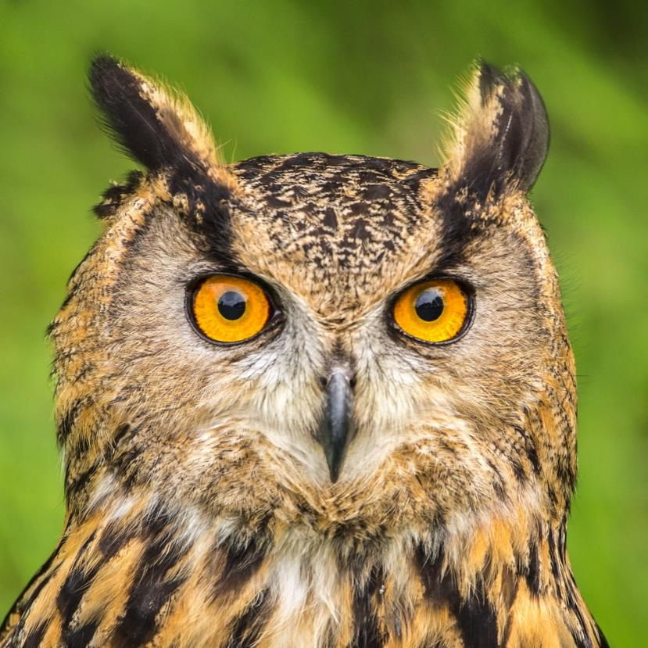
Photo by Dirk van Wolferen on Unsplash
CHECK

Slide 5

ojo(s)

Slide 6
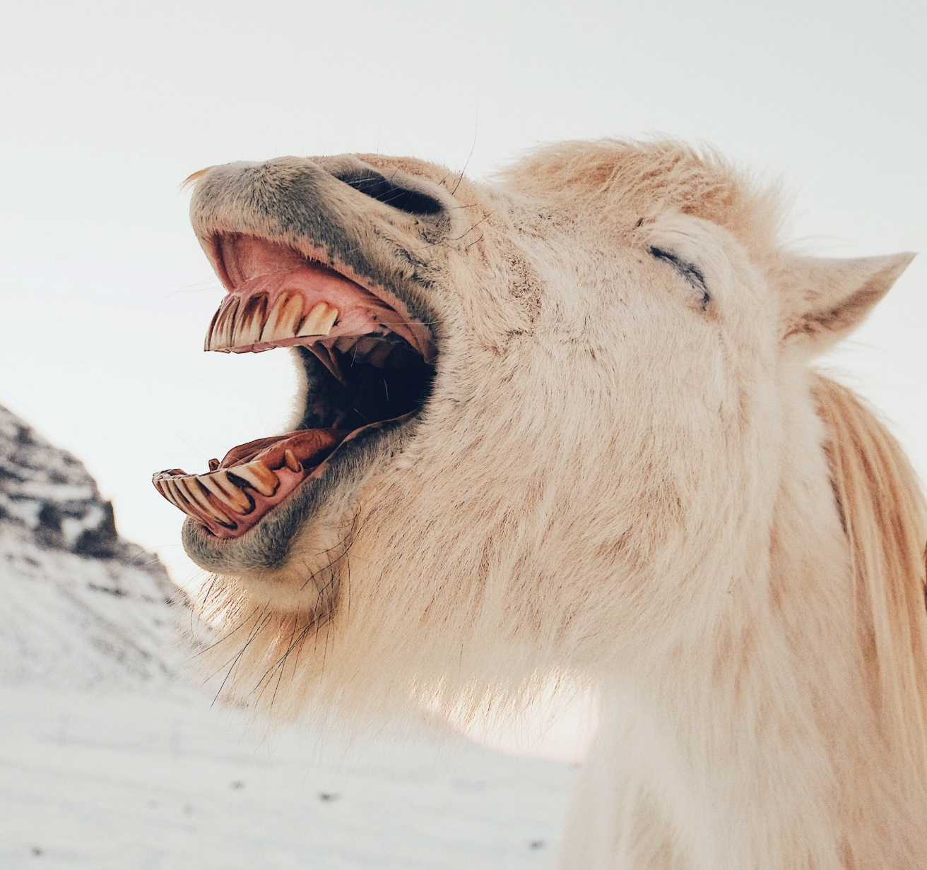
Photo by Dan Cook on Unsplash
CHECK

Slide 7
boca

Slide 8
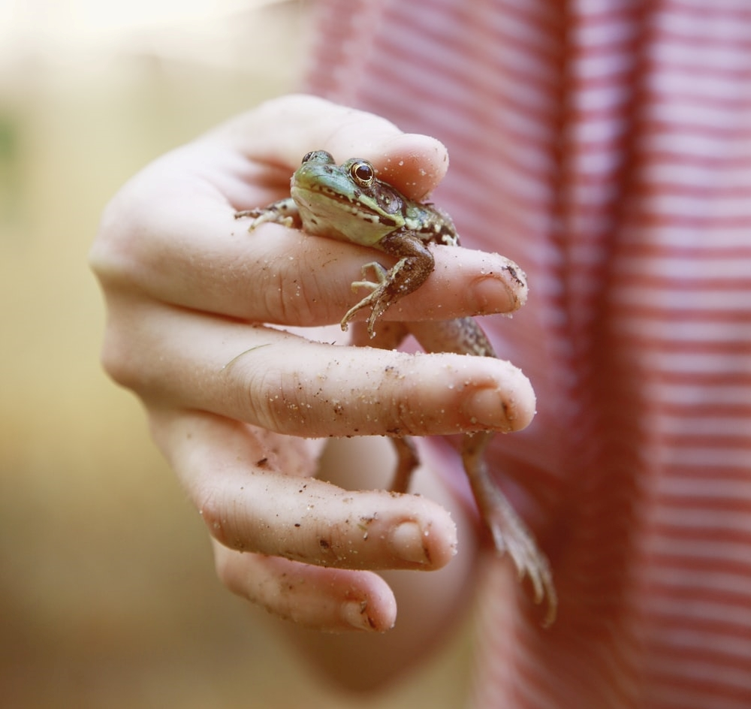
Photo by Tsunami Green on Unsplash
CHECK

Slide 9
dedo(s)

Slide 10
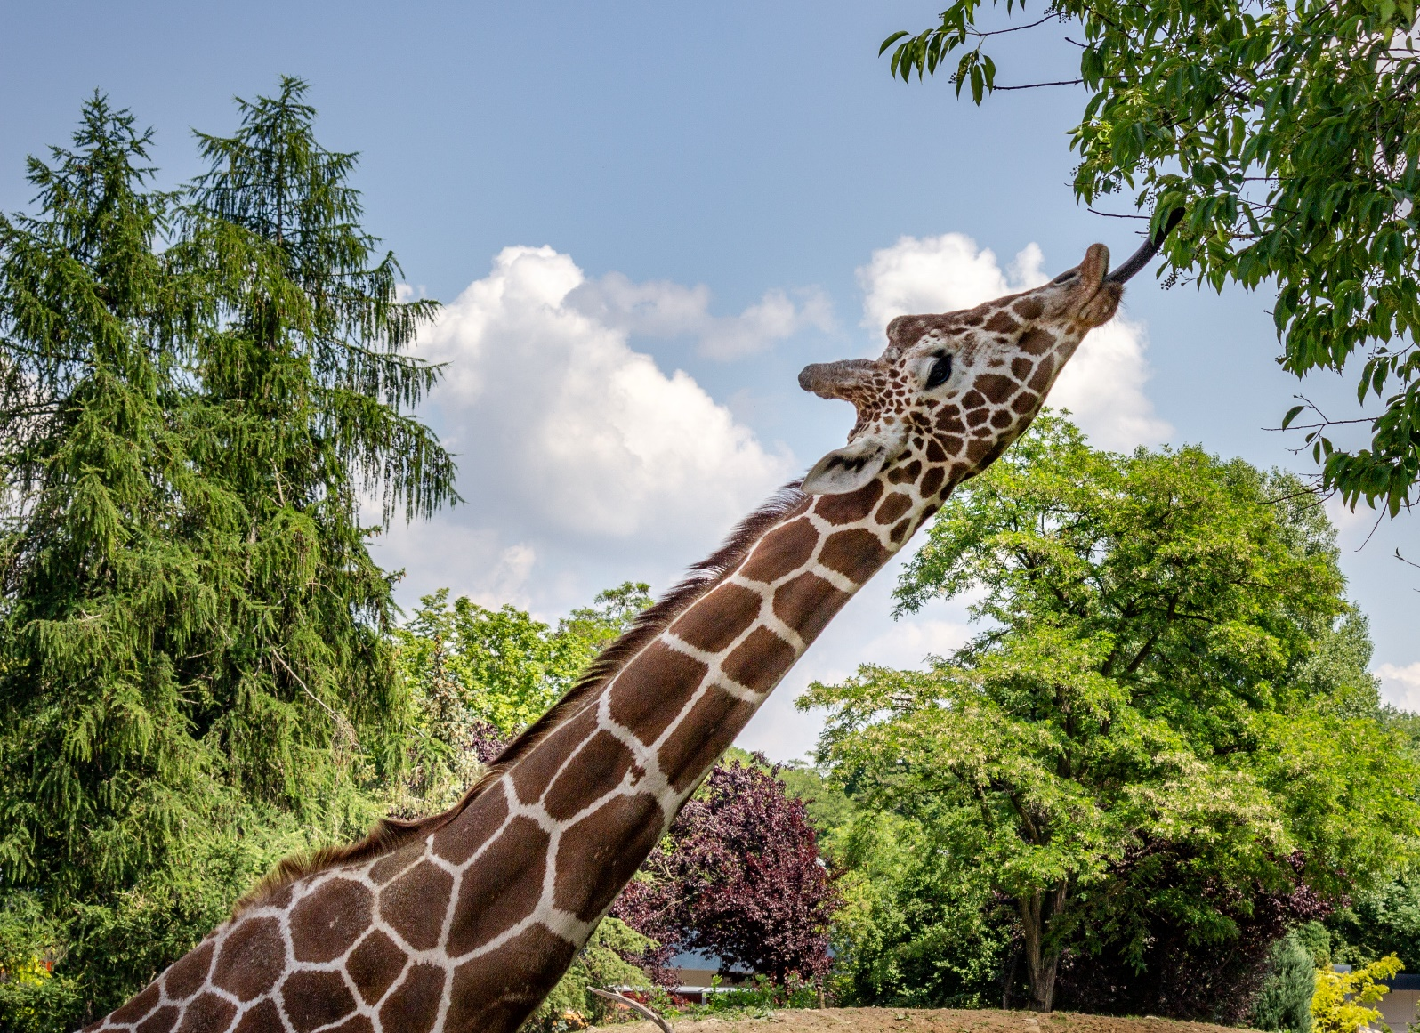
Photo by Slawek K on Unsplash
CHECK

Slide 11
cuello

Slide 12
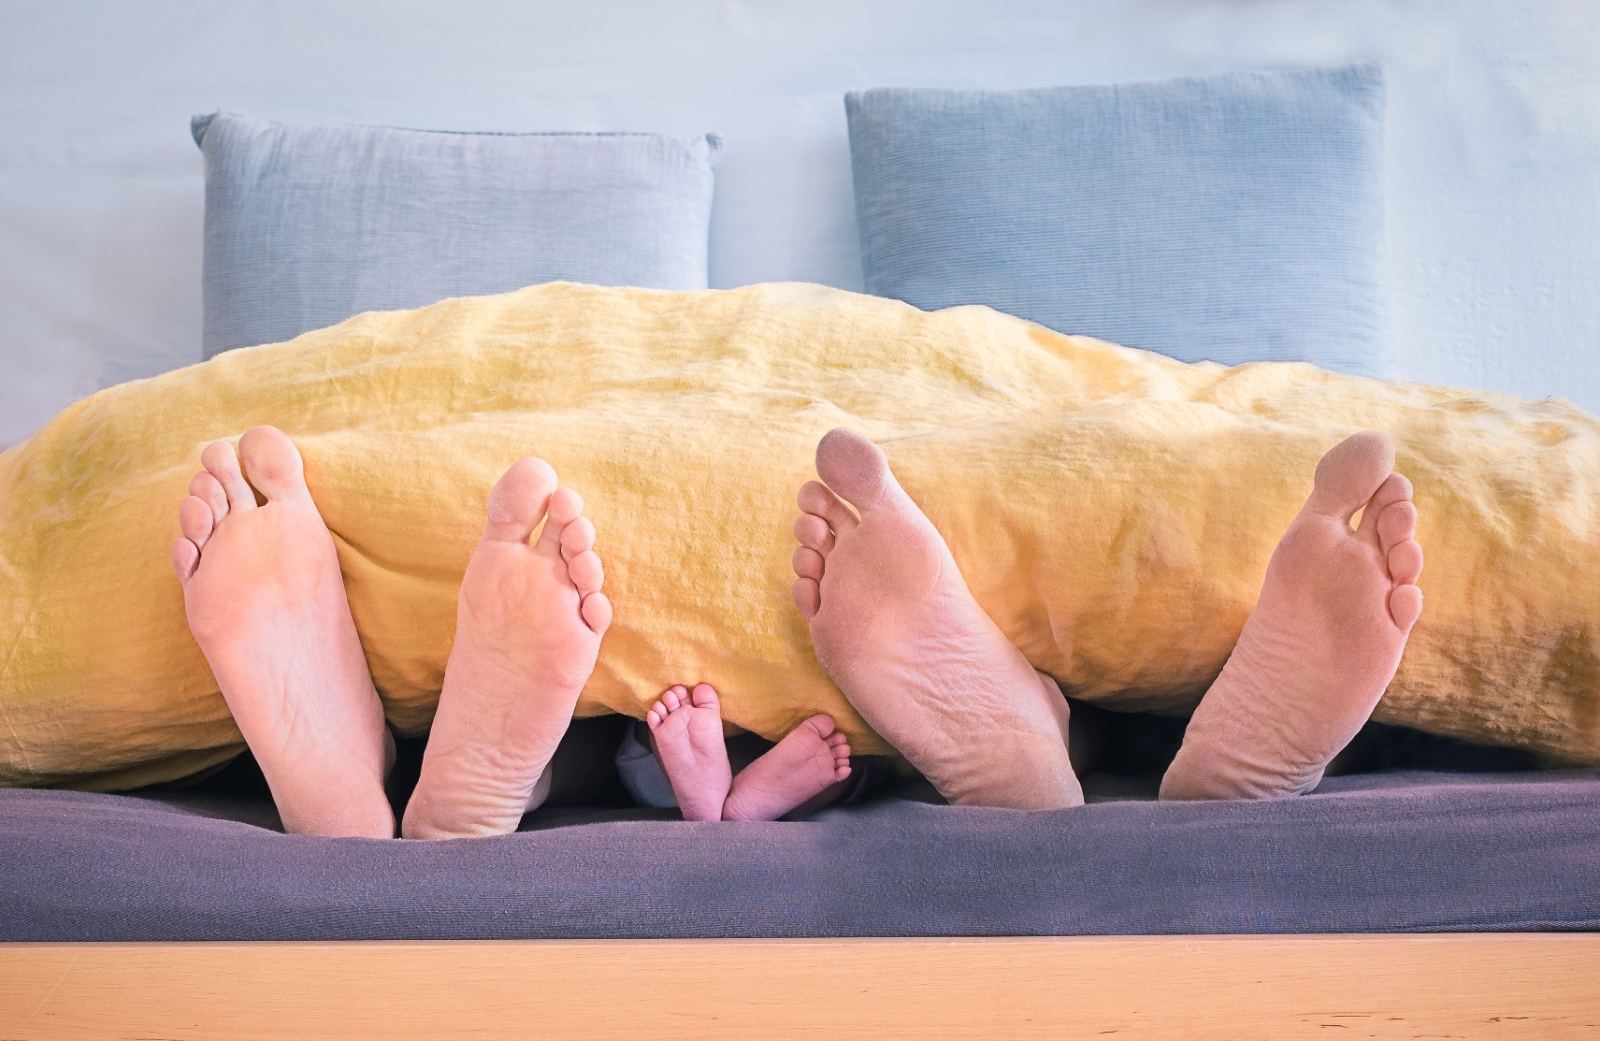
Photo by Simon Berger on Unsplash
CHECK

Slide 13
pies

Slide 14

¿En qué mes se celebra la Navidad?
CHECK

Slide 15
diciembre

Slide 16
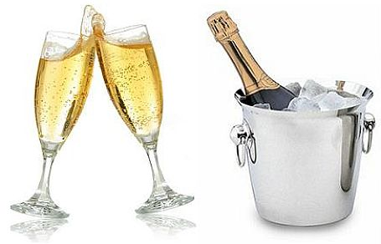
¿En qué mes se celebra el Año Nuevo?
CHECK

Slide 17
enero

Slide 18
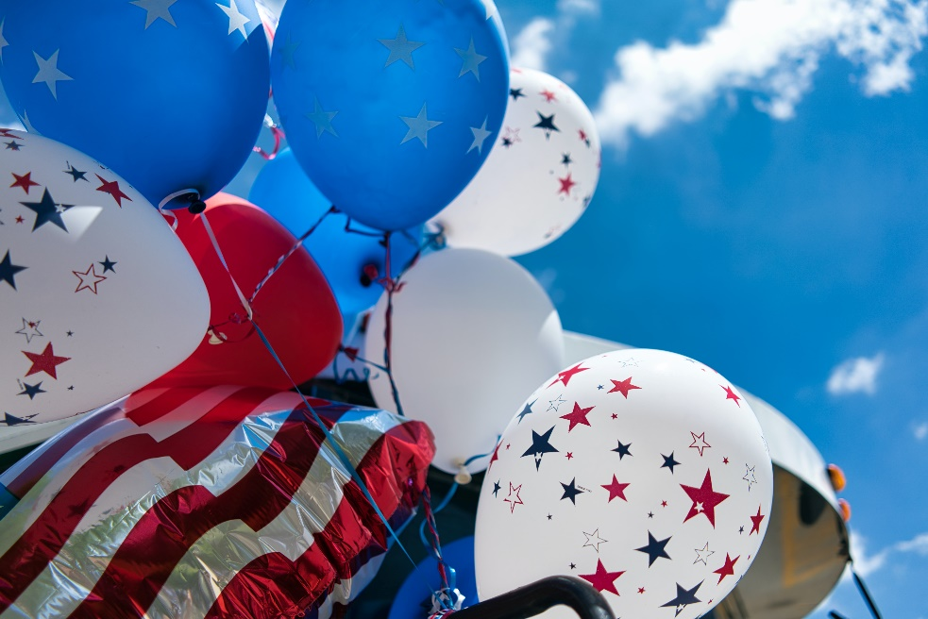
¿En qué mes se celebra el Día de la Independencia de los Estados Unidos?
Photo by Tom Dahm on Unsplash
CHECK

Slide 19
julio

Slide 20
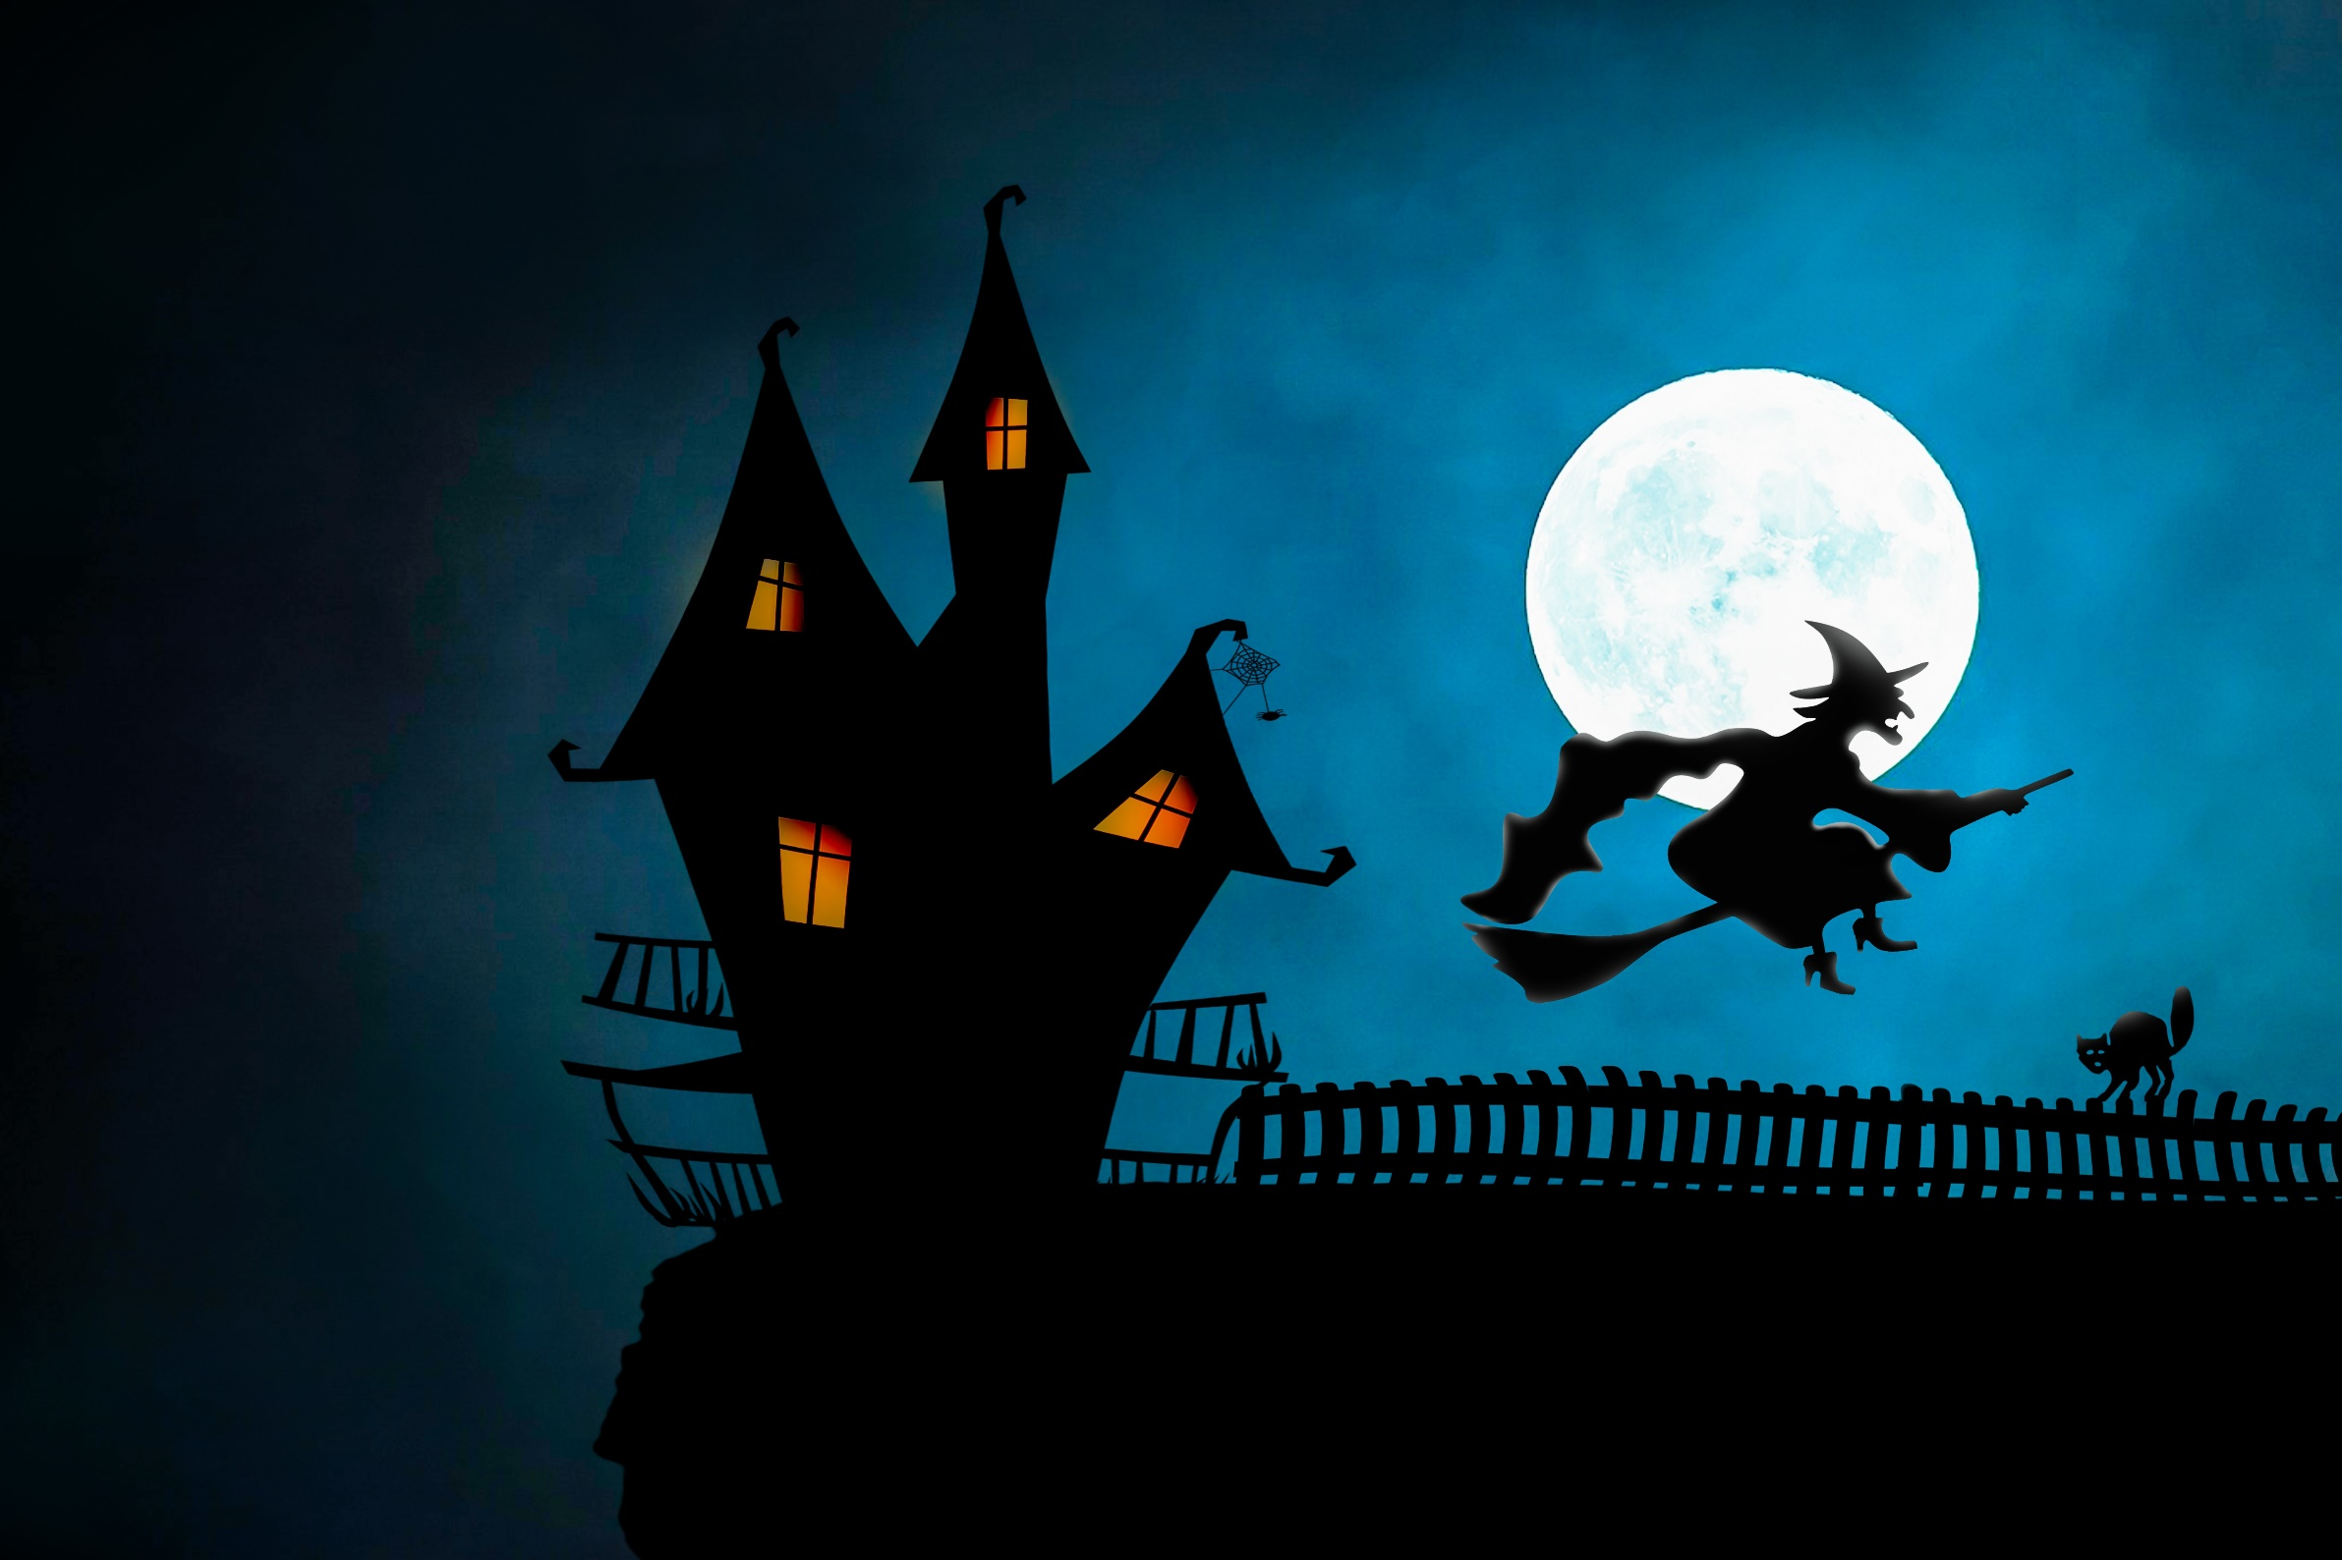
¿En qué mes se celebra el Día de las Brujas?
CHECK
Imagen de Myriams-Fotos en Pixabay

Slide 21
octubre

Slide 22

¿En qué mes se celebra el Día de San Valentín?
Photo by Ivana La on Unsplash
CHECK

Slide 23
febrero

Slide 24
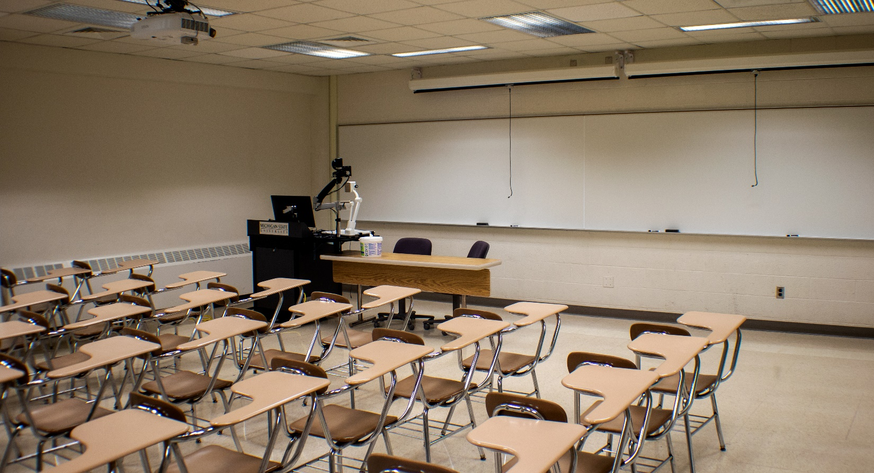
La pizarra está ___ de los pupitres.
Photo by David Moruzzi on Unsplash
CHECK

Slide 25
delante

Slide 26
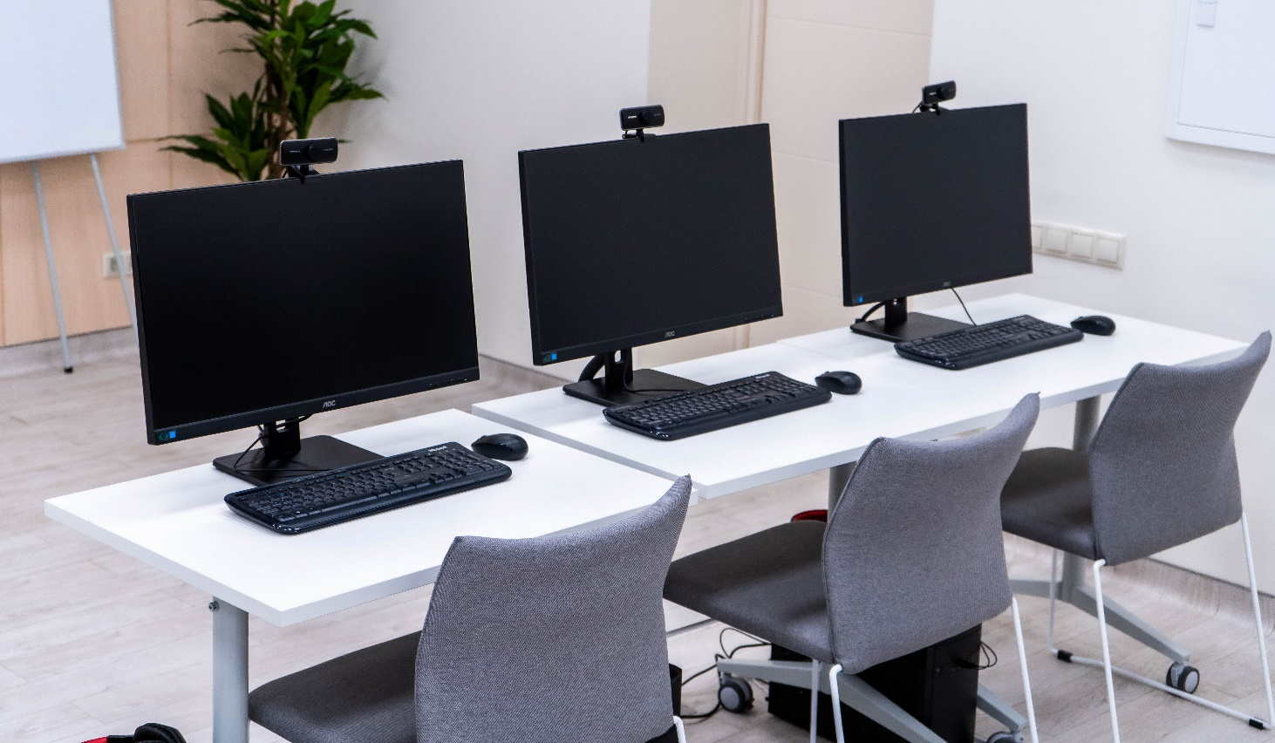
Las pantallas están ___ de las mesas.
Photo by RUT MIIT on Unsplash
CHECK

Slide 27
encima

Slide 28
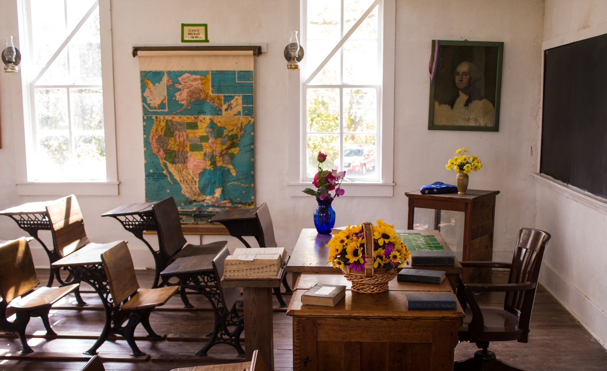
El mapa está ___ las ventanas.
Photo by Jeffrey Hamilton on Unsplash
CHECK

Slide 29
entre

Slide 30


Third Category - 400
INSERT QUESTION HERE
CHECK
Notes:
You will have to move the Daily Double picture out of the way to write the question. If you do not wish to have the Daily Double in the game, delete it and the sound clip (speaker) from this slide. For a Daily Double, the contestant has to wager at least $5 and at most the highest point value of any player/team at that point in the game. It is considered a True Daily Double if they wager all of their points and go “double or nothing”.

Slide 31

El cuaderno está ___ de la computadora portátil.
Photo by Avel Chuklanov on Unsplash
CHECK
Notes:
You will have to move the Daily Double picture out of the way to write the question. If you do not wish to have the Daily Double in the game, delete it and the sound clip (speaker) from this slide. For a Daily Double, the contestant has to wager at least $5 and at most the highest point value of any player/team at that point in the game. It is considered a True Daily Double if they wager all of their points and go “double or nothing”.

Slide 32
al lado (izquierdo) o cerca

Slide 33
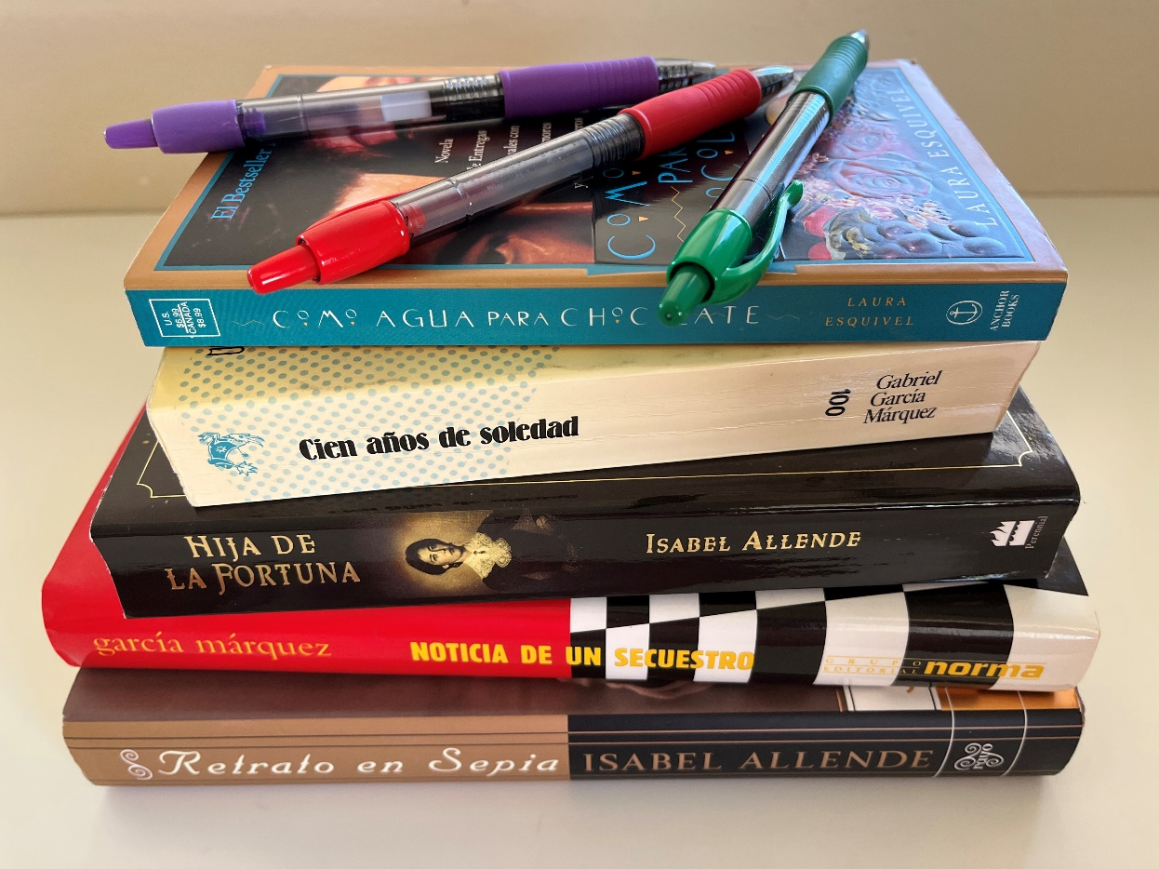
Los libros están ___ de los bolígrafos.
CHECK

Slide 34
debajo

Slide 35
Álgebra, barrio y alcohol son palabras de ___.
CHECK

Slide 36
el árabe

Slide 37
Idioma de los aztecas
CHECK

Slide 38
el náhuatl

Slide 39
Idioma de los indígenas en
Guatemala y El Salvador
CHECK

Slide 40
el maya

Slide 41
Idioma de los incas
CHECK

Slide 42
el quechua

Slide 43
Idioma de los indígenas en Bolivia y Paraguay
CHECK

Slide 44
el guaraní

Slide 45
Hombre de Perú
CHECK

Slide 46
peruano

Slide 47
Hombre de Uruguay
CHECK

Slide 48
uruguayo

Slide 49
Hombre de El Salvador
CHECK

Slide 50
salvadoreño

Slide 51
Hombre de Nicaragua
CHECK

Slide 52
Nicaragüense

Slide 53
Hombre de Guatemala
CHECK

Slide 54
guatemalteco

Slide 55
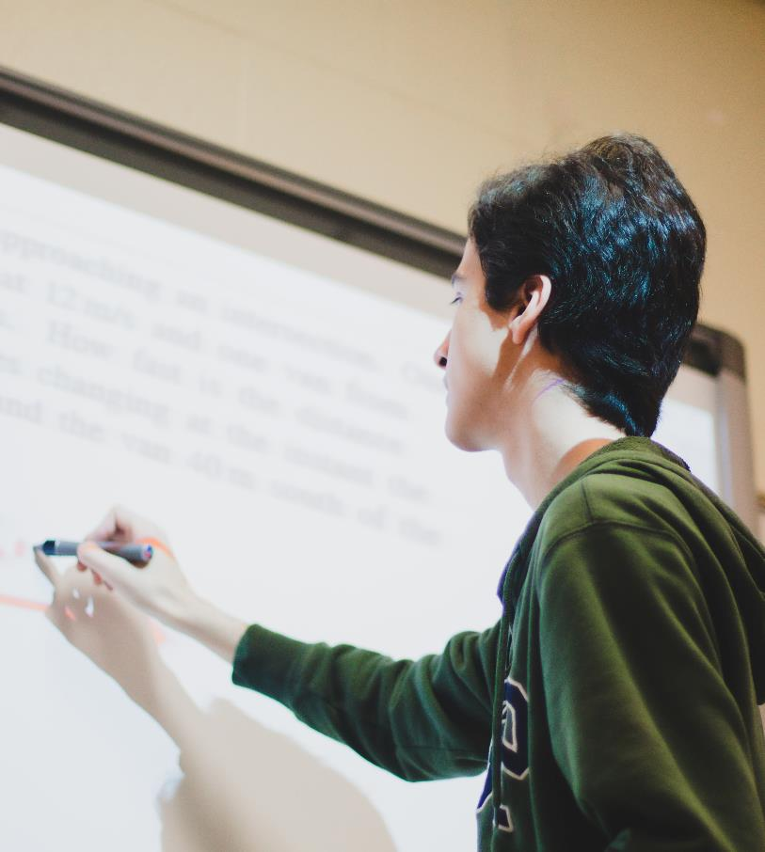
Photo by Jeswin Thomas on Unsplash
CHECK

Slide 56
pizarra

Slide 57
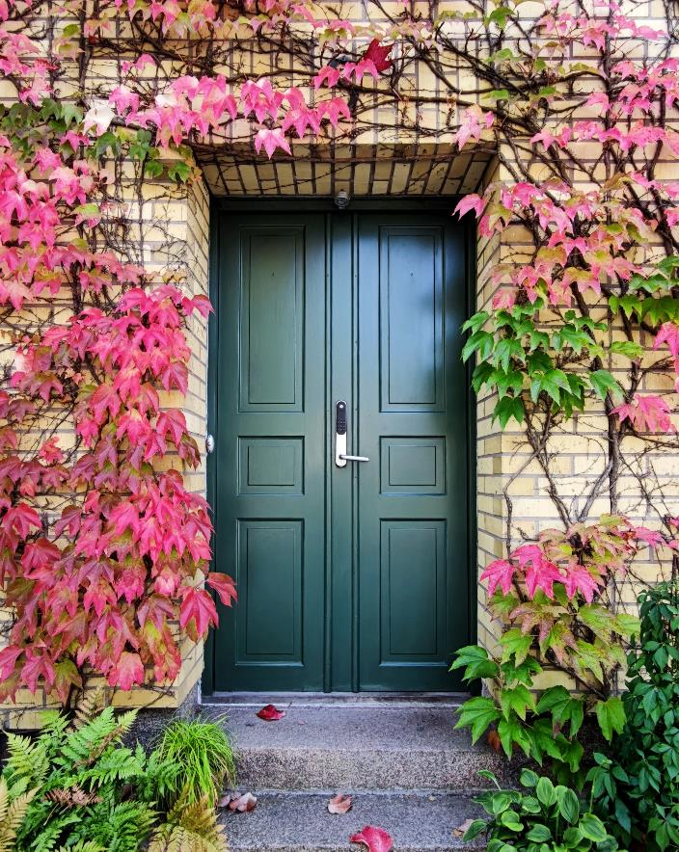
Photo by Nazrin Babashova on Unsplash
CHECK

Slide 58
puerta

Slide 59
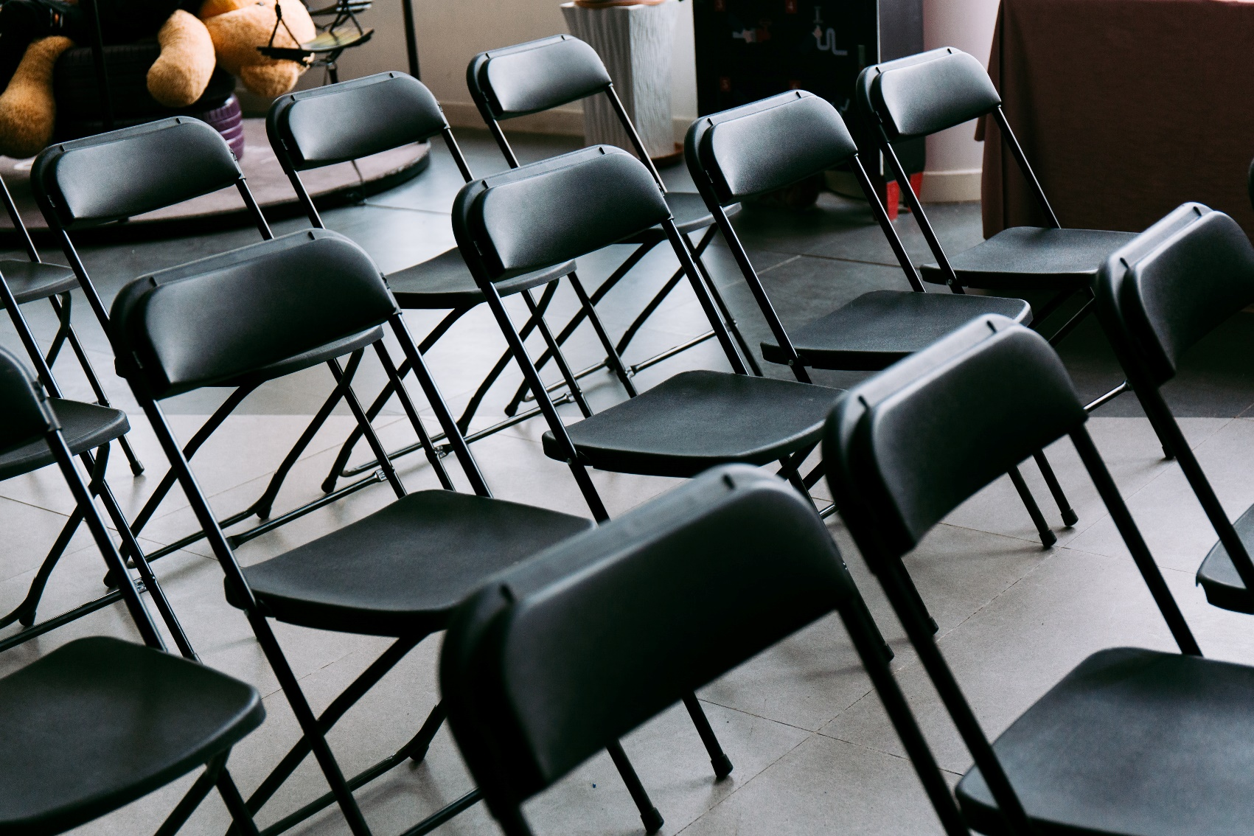
Photo by wu yi on Unsplash
CHECK

Slide 60
sillas

Slide 61
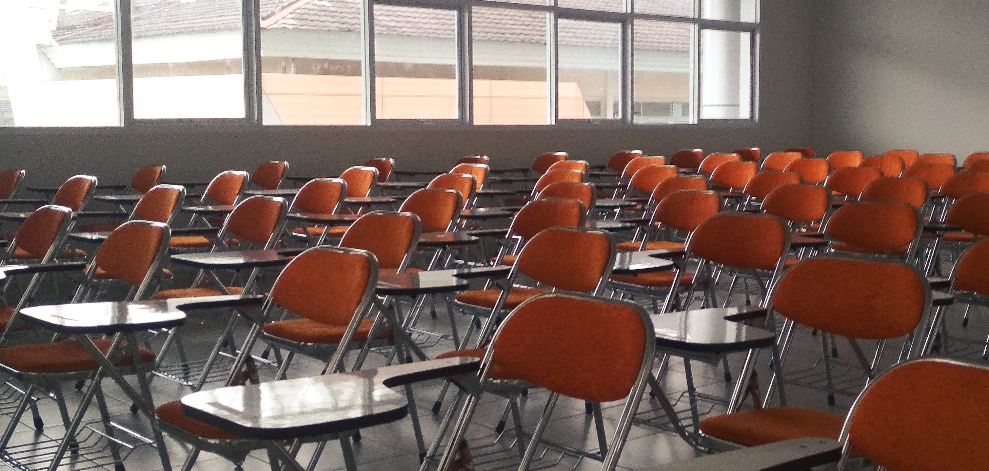
Photo by Bima Rahmanda on Unsplash
CHECK

Slide 62
pupitres

Slide 63
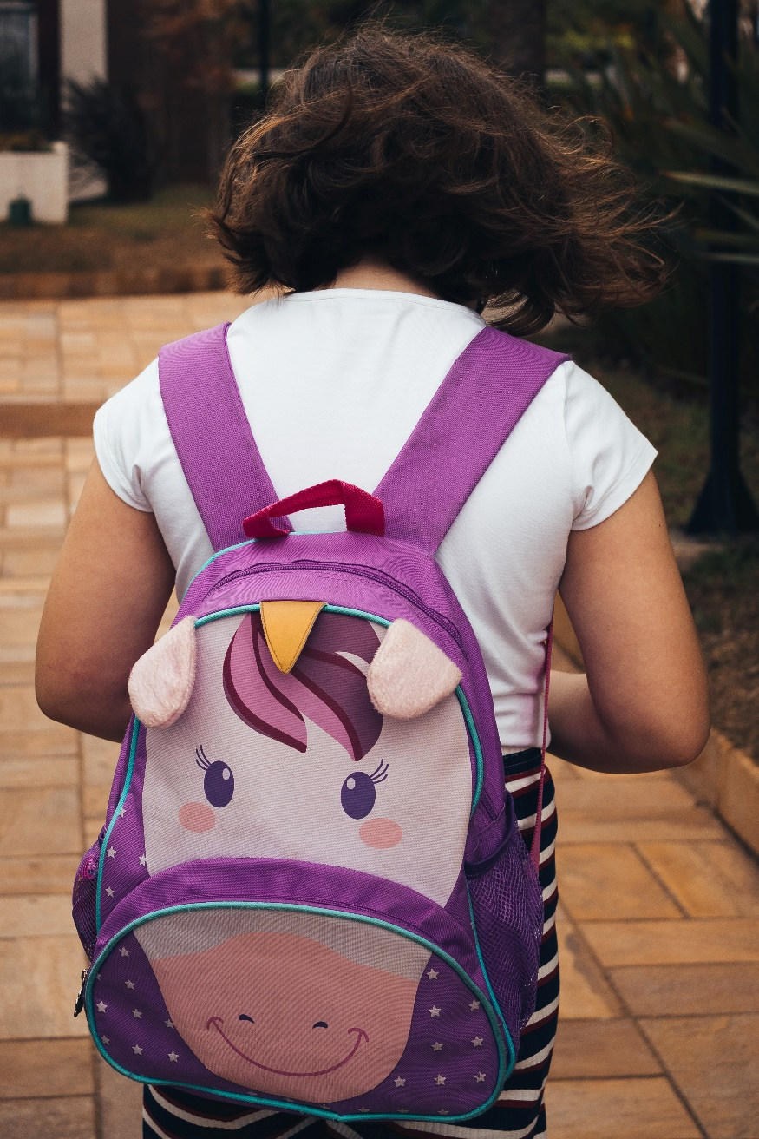
Photo by Antonino Visalli on Unsplash
CHECK

Slide 64
mochila

Slide 65
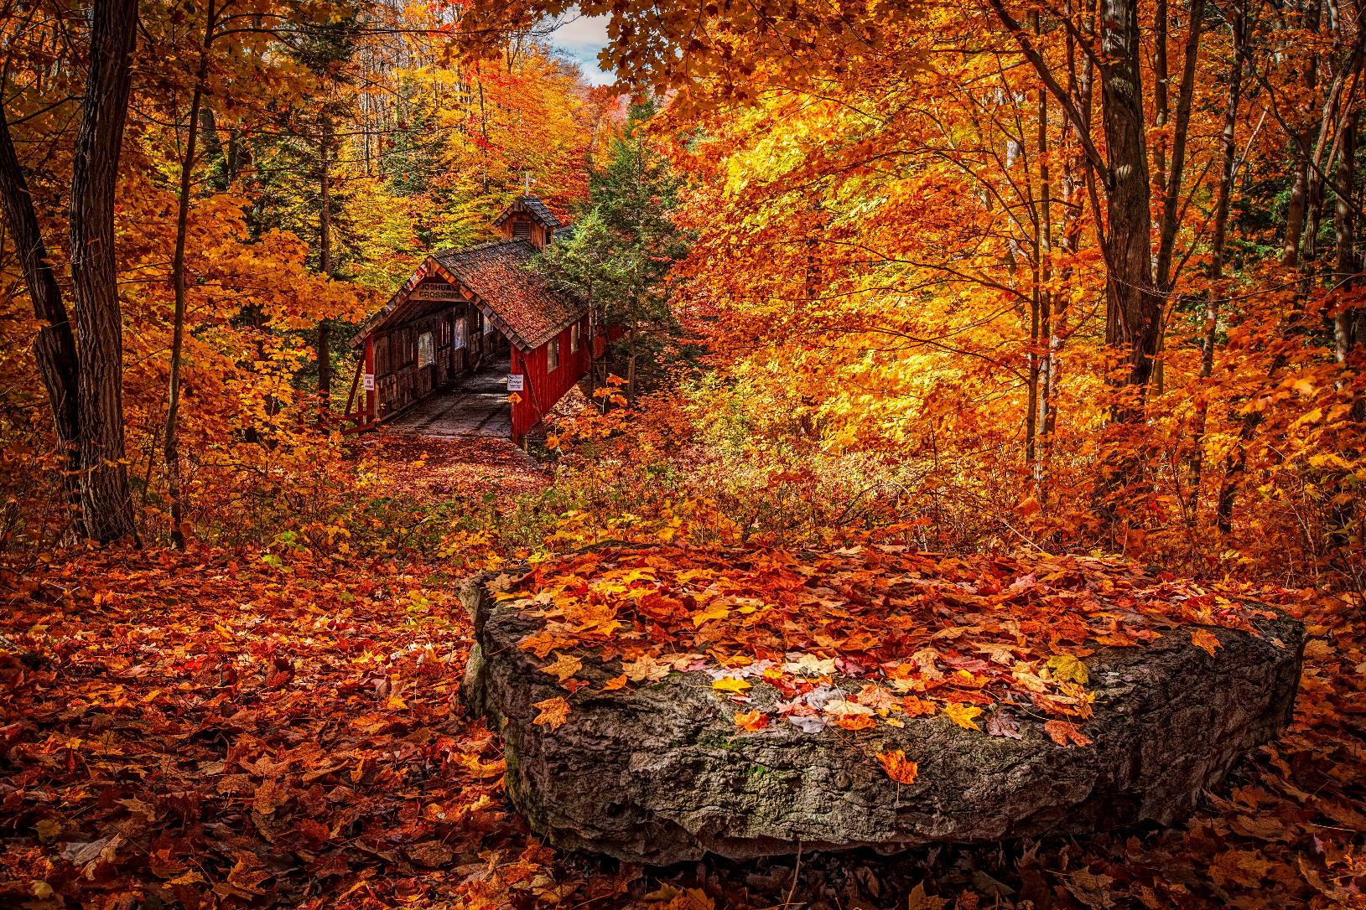
CHECK
Photo by Dennis Buchner on Unsplash

Slide 66
otoño

Slide 67
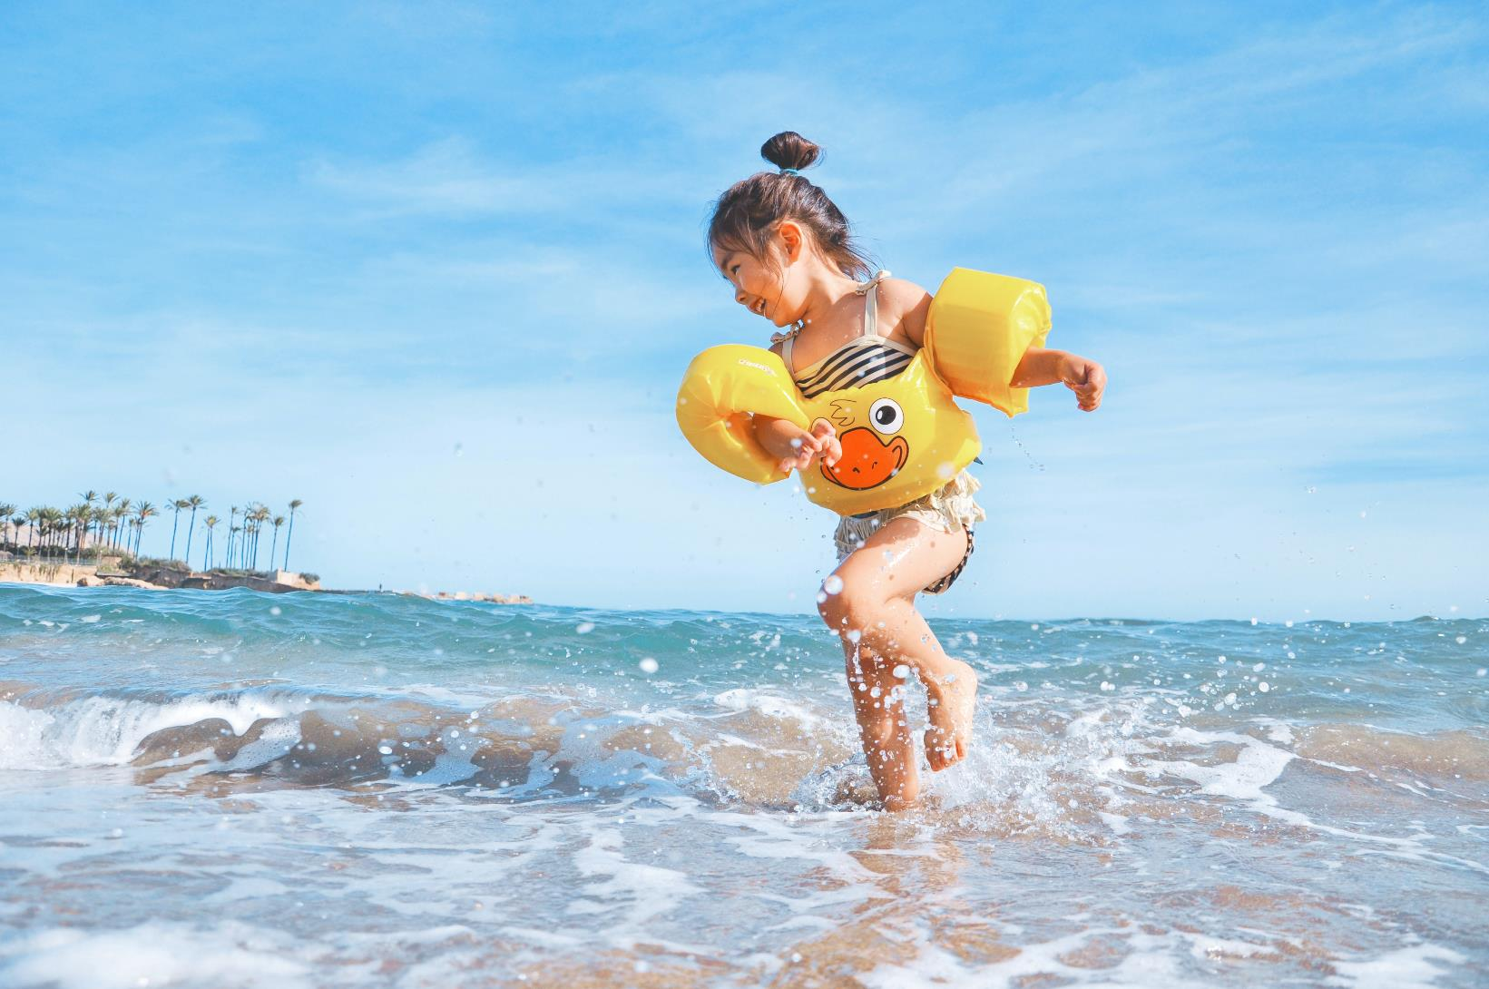
Photo by Leo Rivas on Unsplash
CHECK

Slide 68
verano

Slide 69
SEVENTH Category - 600
INSERT QUESTION HERE
CHECK
Notes:
You will have to move the Daily Double picture out of the way to write the question. If you do not wish to have the Daily Double in the game, delete it and the sound clip (speaker) from this slide. For a Daily Double, the contestant has to wager at least $5 and at most the highest point value of any player/team at that point in the game. It is considered a True Daily Double if they wager all of their points and go “double or nothing”.

Slide 70
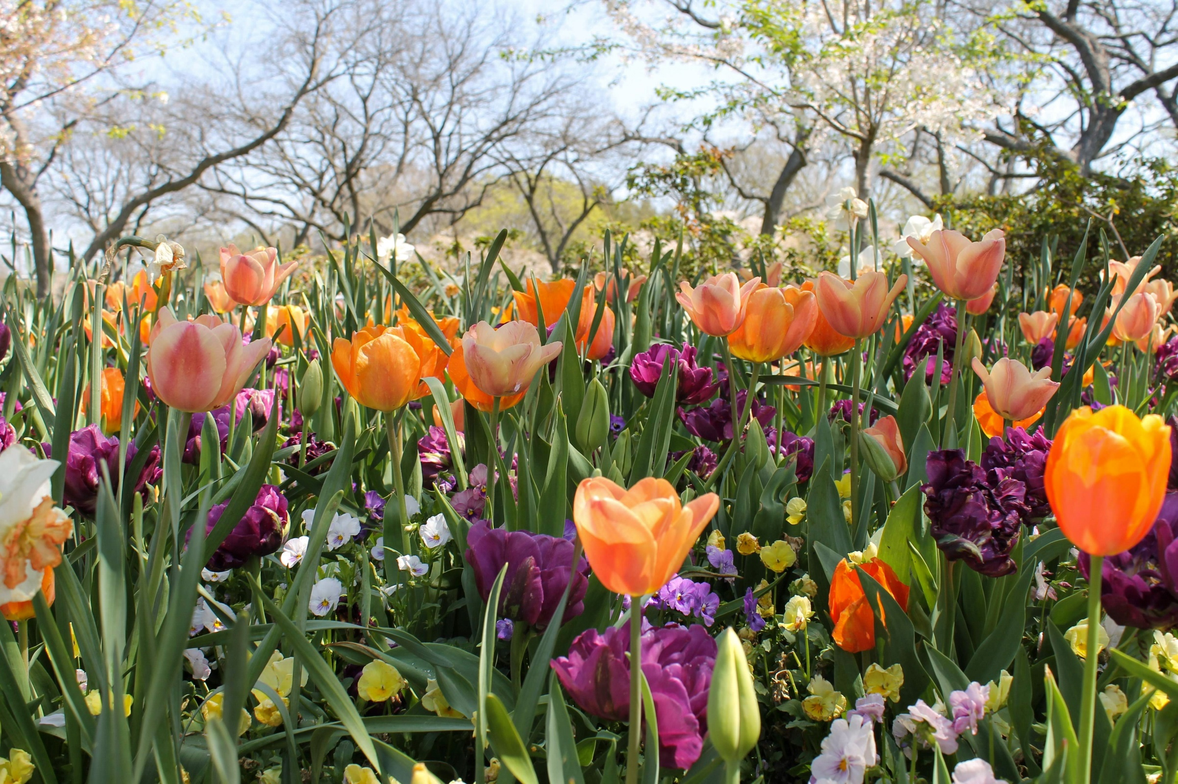
CHECK
Photo by Maddie H. on Unsplash
Notes:
You will have to move the Daily Double picture out of the way to write the question. If you do not wish to have the Daily Double in the game, delete it and the sound clip (speaker) from this slide. For a Daily Double, the contestant has to wager at least $5 and at most the highest point value of any player/team at that point in the game. It is considered a True Daily Double if they wager all of their points and go “double or nothing”.

Slide 71
primavera

Slide 72
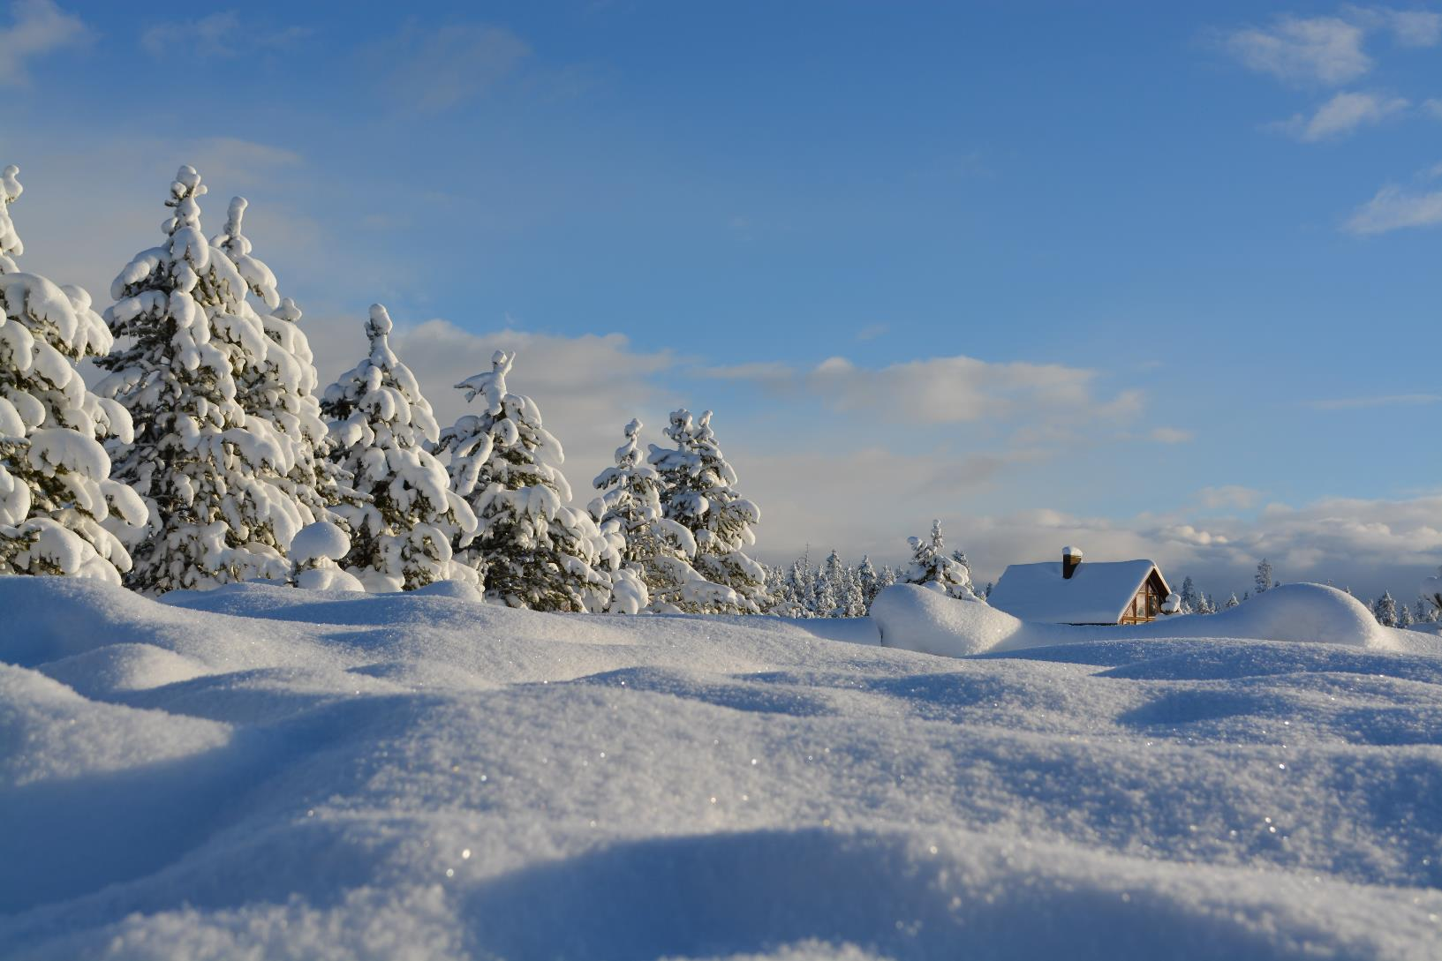
CHECK
Photo by Filip Bunkens on Unsplash

Slide 73
invierno

Slide 74
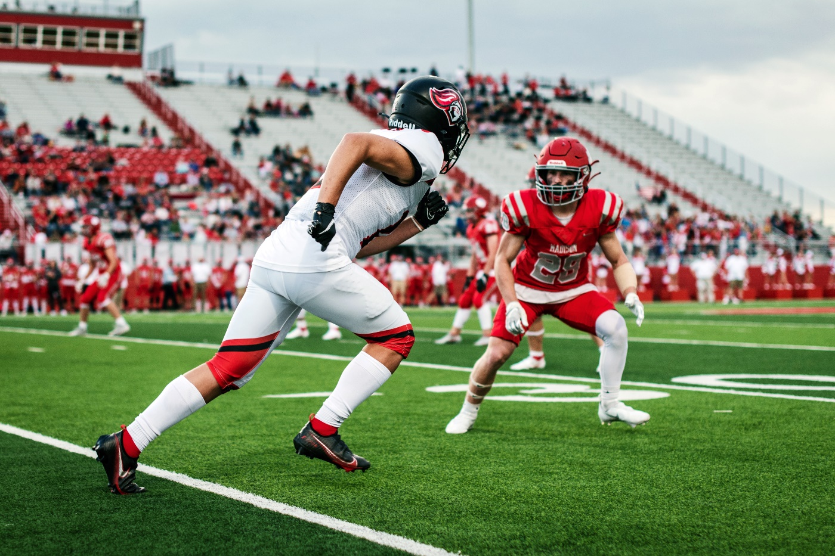
La temporada (season) del fútbol americano
CHECK
Photo by Tim Mossholder on Unsplash

Slide 75
otoño

Slide 76
600 – 100 = ?
CHECK

Slide 77
500 quinientos

Slide 78
476
CHECK

Slide 79
476 cuatrocientos setenta y seis

Slide 80
837
CHECK

Slide 81
837 ochocientos treinta y siete

Slide 82
1.359
CHECK

Slide 83
1.359 mil trescientos cincuenta y nueve

Slide 84
2.114
CHECK

Slide 85
2.114 dos mil ciento catorce

Slide 86
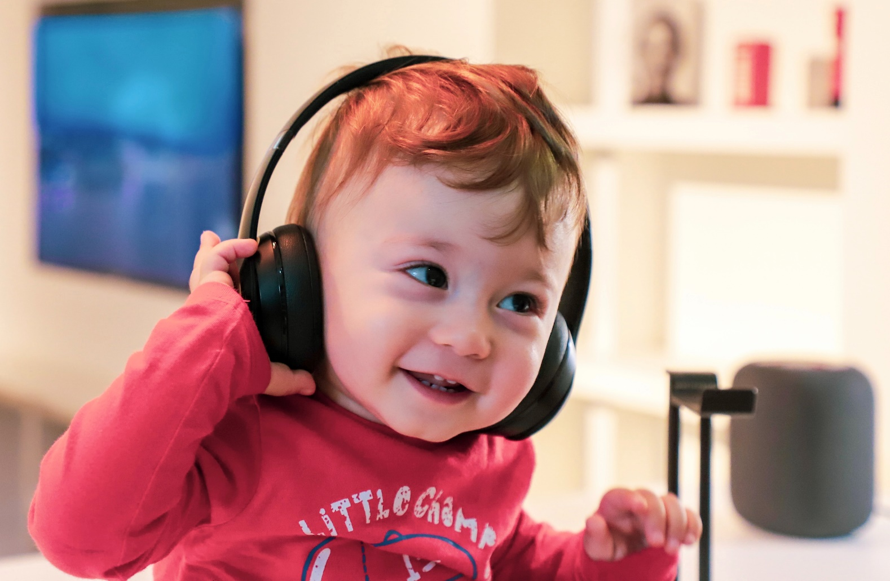
¿Qué le gusta hacer al niño?
Photo by Alireza Attari on Unsplash
CHECK

Slide 87
Le gusta escuchar música.

Slide 88

¿Qué le gusta hacer a la chica?
Photo by freestocks on Unsplash
CHECK

Slide 89
Le gusta ir de compras.

Slide 90

¿Qué le gusta hacer a esta joven?
Photo by Benigno Hoyuela on Unsplash
CHECK

Slide 91
Le gusta leer (una novela).

Slide 92
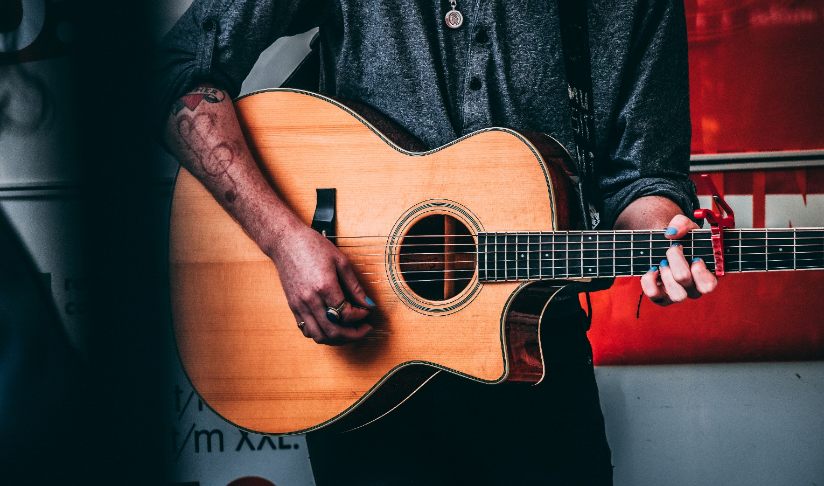
¿Qué le gusta hacer al joven?
Photo by TOMMY VAN KESSEL on Unsplash
CHECK

Slide 93
Le gusta tocar la guitarra.

Slide 94
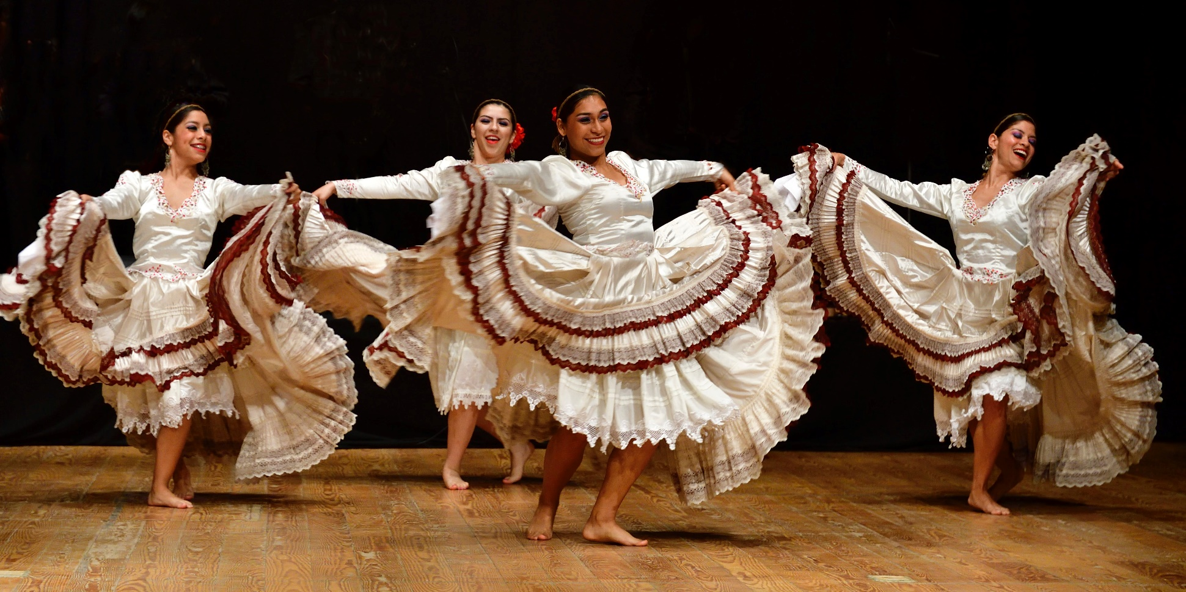
¿Qué les gusta hacer?
Photo by Joost Crop on Unsplash
CHECK

Slide 95
Les gusta bailar.

Slide 96
Tenth Category 200
INSERT QUESTION HERE
CHECK
Notes:
You will have to move the Daily Double picture out of the way to write the question. If you do not wish to have the Daily Double in the game, delete it and the sound clip (speaker) from this slide. For a Daily Double, the contestant has to wager at least $5 and at most the highest point value of any player/team at that point in the game. It is considered a True Daily Double if they wager all of their points and go “double or nothing”.

Slide 97
Norte de Paraguay donde
no hay muchas personas
CHECK
Notes:
You will have to move the Daily Double picture out of the way to write the question. If you do not wish to have the Daily Double in the game, delete it and the sound clip (speaker) from this slide. For a Daily Double, the contestant has to wager at least $5 and at most the highest point value of any player/team at that point in the game. It is considered a True Daily Double if they wager all of their points and go “double or nothing”.

Slide 98
El (Gran) Chaco

Slide 99
Catarata más alta
de Paraguay
CHECK

Slide 100
Salto Cristal

Slide 101
Río que genera electricidad para Paraguay y Brasil en el Centro Itaipú.
CHECK

Slide 102
río Paraná

Slide 103
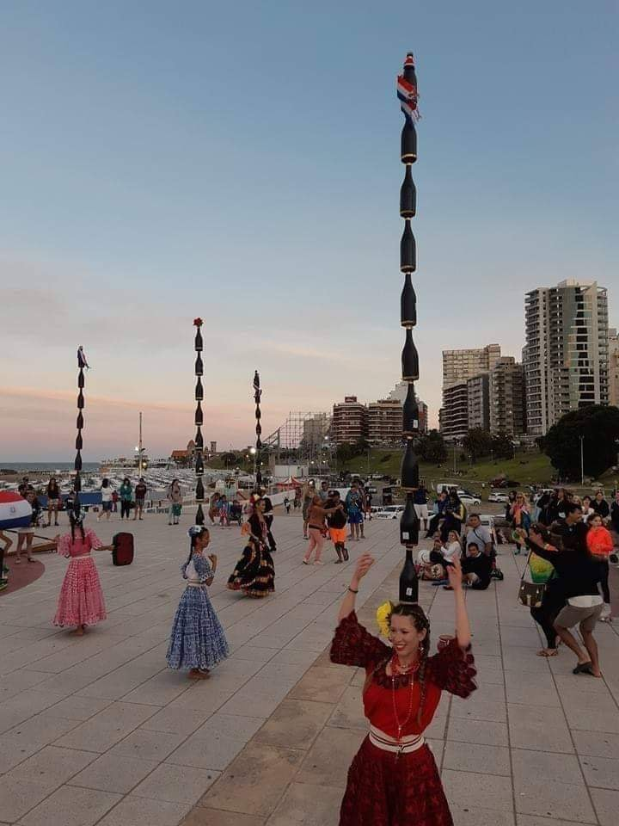
Nombre de este baile
Photo in Demasiadas Noches
CHECK

Slide 104
Danza o baile de las botellas

Slide 105
En la Guerra de la Triple
Alianza, Paraguay hace guerra contra (war against)
Argentina, Brasil y ___.
CHECK

Slide 106
Uruguay

Slide 107
JEOPARDY FINAL
Categoría:
Lugar
CHECK

Slide 108

Las cataratas del Iguazú están en la frontera (border) de tres países:
Paraguay, Brasil y ___.
CHECK

Slide 109
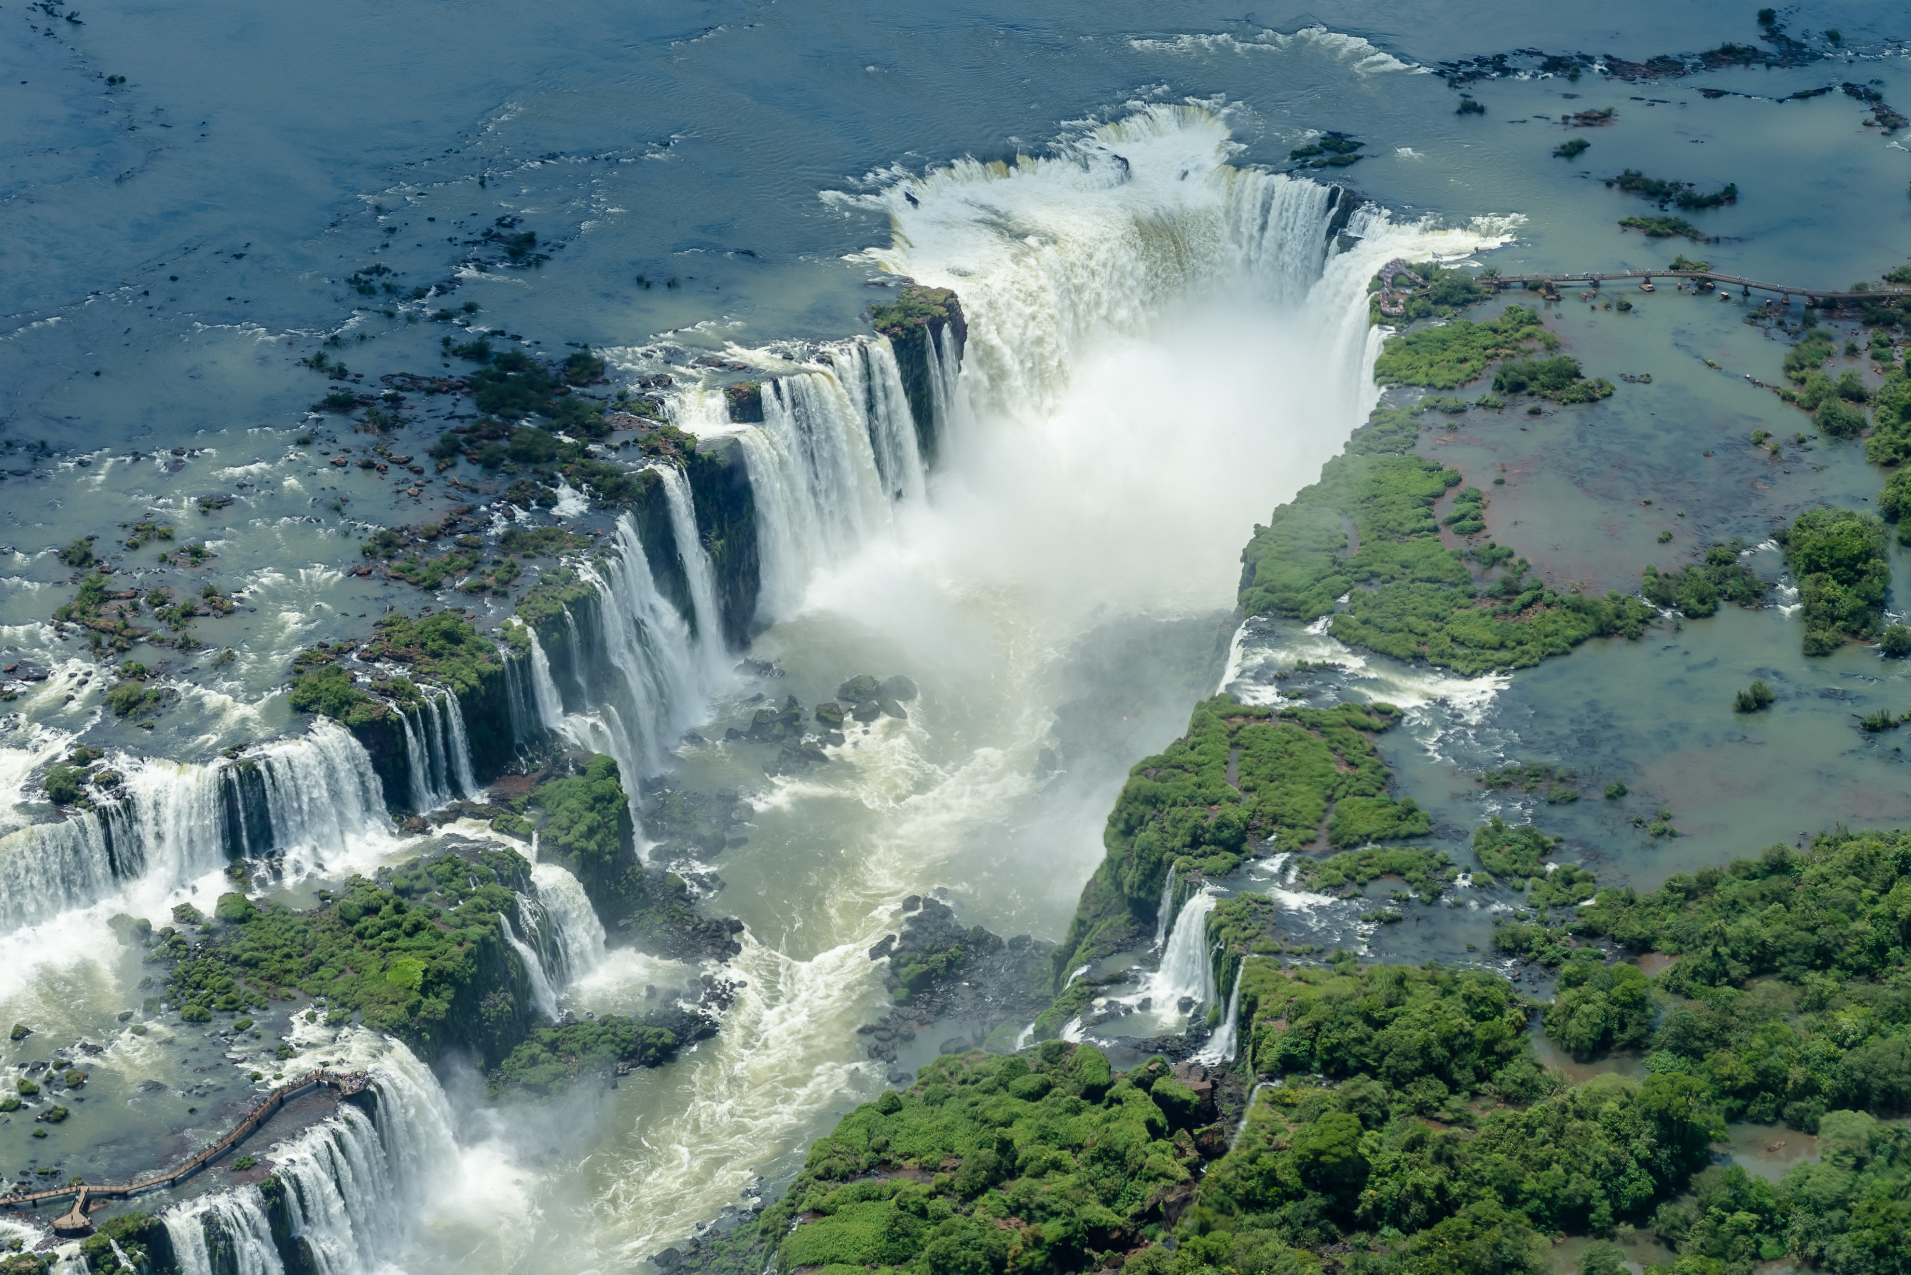
Argentina
Photo by Enaldo Valadares in Wikimedia

