Slide 1
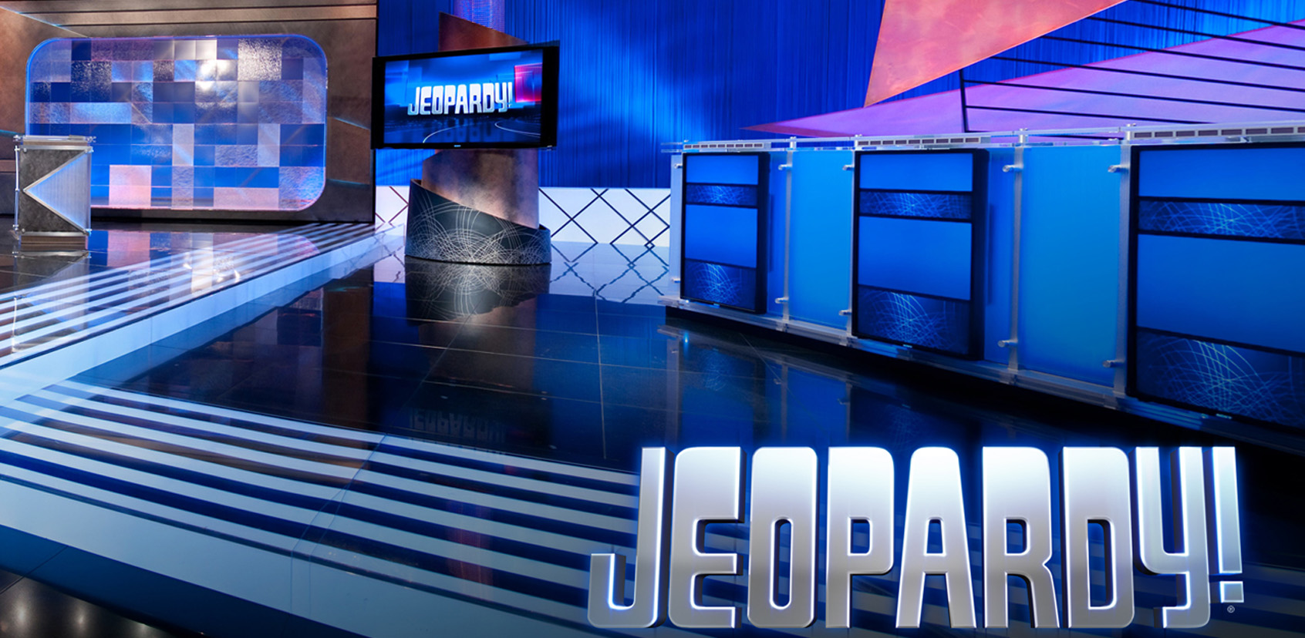
Capítulo 4
Template by Jared Speight
Content by Beatrice Tseng
con la Profesora Tseng

Slide 2
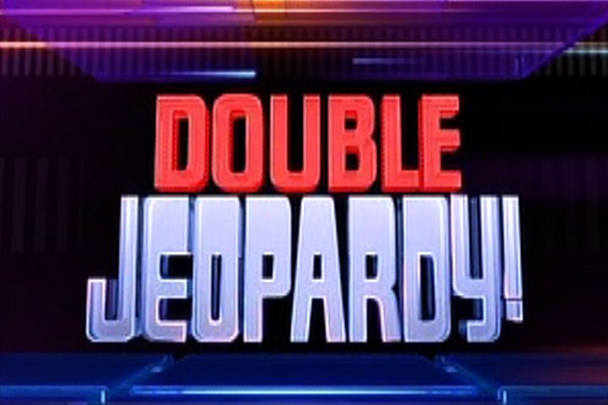
IDIOMAS | RUTINA DIARIA | OBJETOS | DATOS PERSONALES | ACCIÓN (VERBOS)
100 | 100 | 100 | 100 | 100
200 | 200 | 200 | 200 | 200
300 | 300 | 300 | 300 | 300
400 | 400 | 400 | 400 | 400
500 | 500 | 500 | 500 | 500

Slide 3

LUGARES | MÁS RUTINA DIARIA | MÁS OBJETOS | NÚMEROS ORDINALES | ECUADOR
200 | 200 | 200 | 200 | 200
400 | 400 | 400 | 400 | 400
600 | 600 | 600 | 600 | 600
800 | 800 | 800 | 800 | 800
1000 | 1000 | 1000 | 1000 | 1000

Slide 4
Los canadienses hablan inglés y ____.
CHECK

Slide 5

francés

Slide 6
Los brasileños hablan ___.
CHECK

Slide 7
portugués

Slide 8
Los iraníes hablan ___.
CHECK

Slide 9
farsi o persa

Slide 10
Los iraquíes hablan ___.
CHECK

Slide 11
árabe

Slide 12
En Berlín hablan ___.
CHECK

Slide 13
alemán

Slide 14
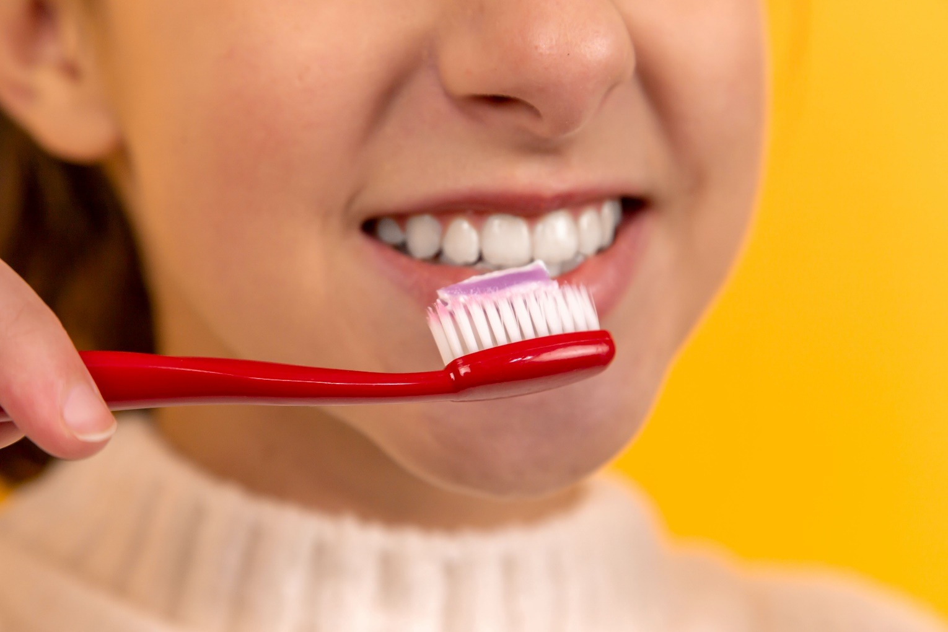
¿Qué hace la muchacha?
Photo by Diana Polekhina on Unsplash
CHECK

Slide 15
Ella se lava los dientes.

Slide 16
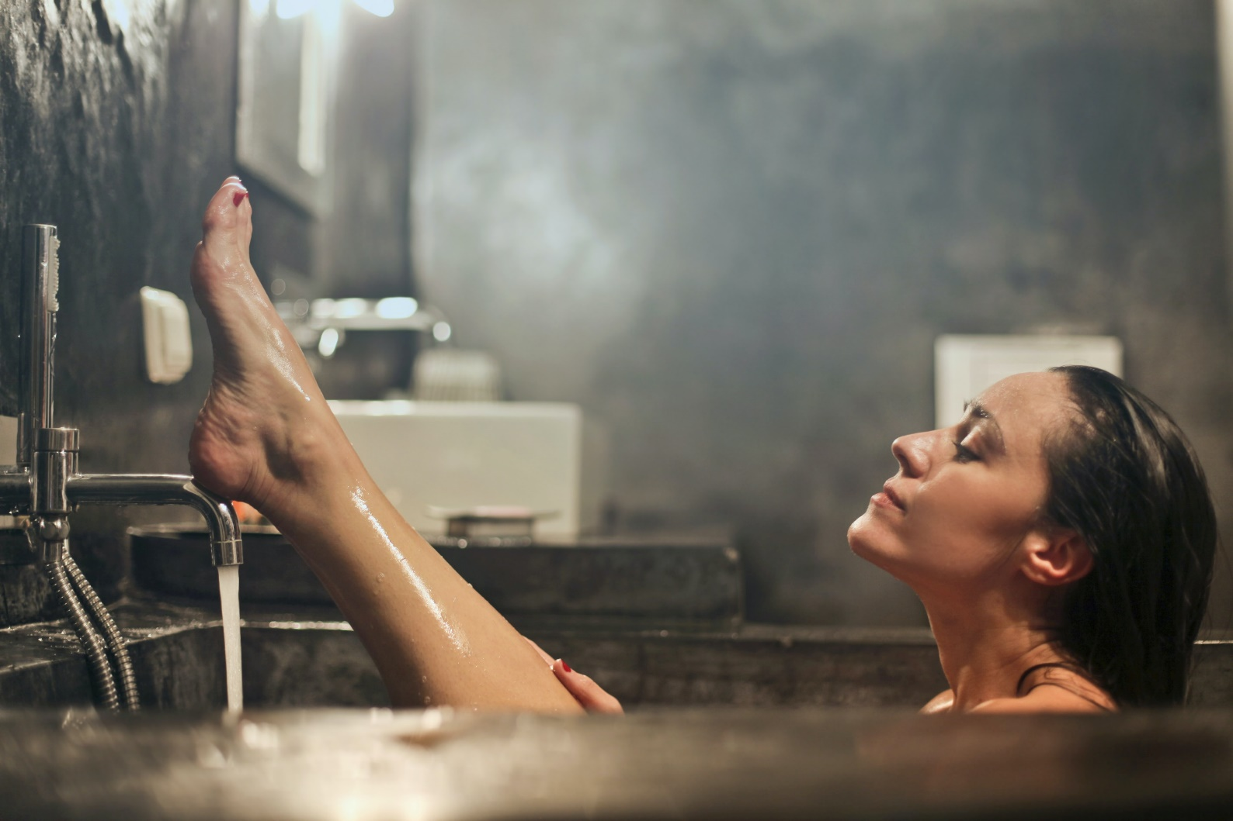
¿Qué hace esta mujer?
Photo by bruce mars on Unsplash
CHECK

Slide 17
Ella se baña.

Slide 18
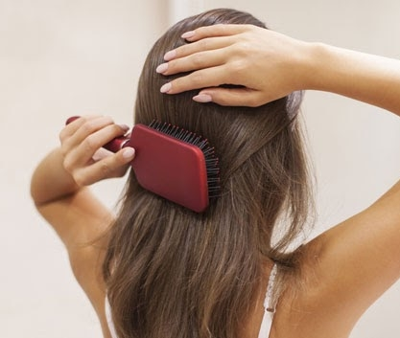
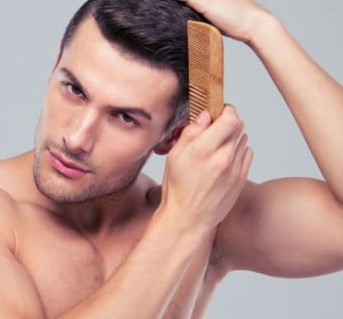
¿Qué hacen estos jóvenes?
Photo by Andrea Calvete
Photo by Rebel Barber
CHECK

Slide 19
Ella se cepilla el pelo.
Él se peina el pelo.

Slide 20
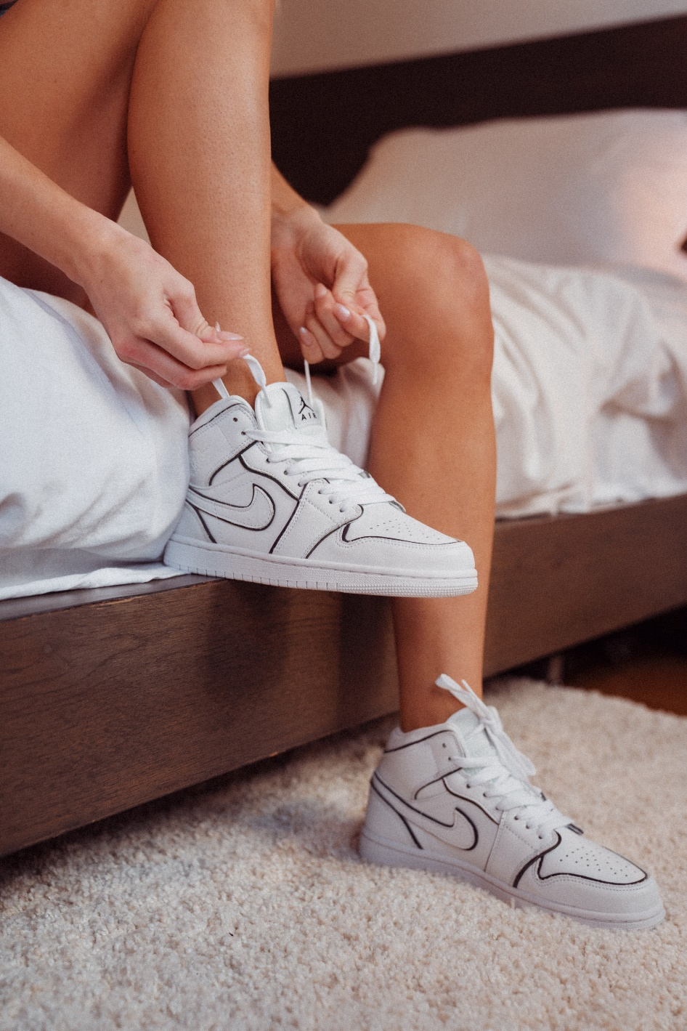
¿Qué hace la chica?
Photo by dusan jovic on Unsplash
CHECK

Slide 21
Ella se pone los zapatos de tenis.

Slide 22
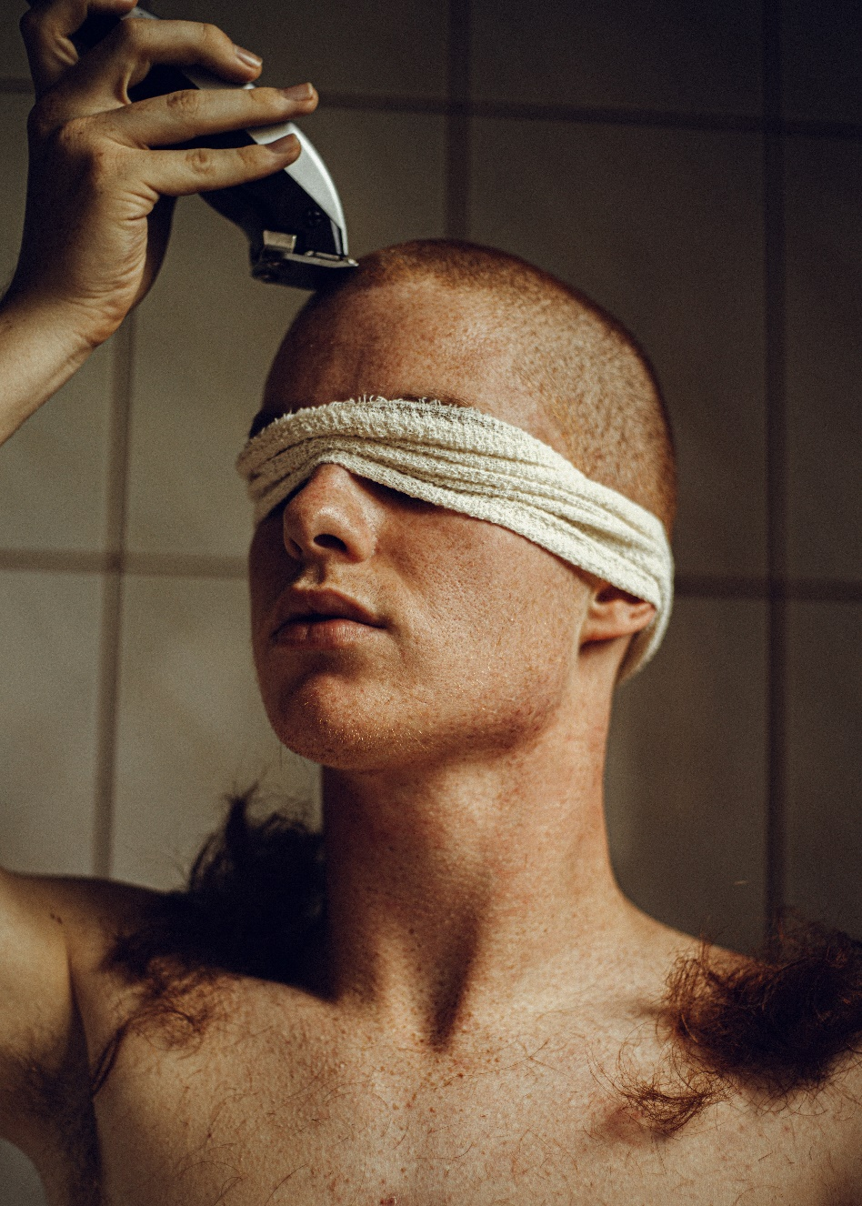
¿Qué hace el joven?
Photo by Altin Ferreira on Unsplash
CHECK

Slide 23
Él se afeita el pelo con una afeitadora eléctrica.

Slide 24
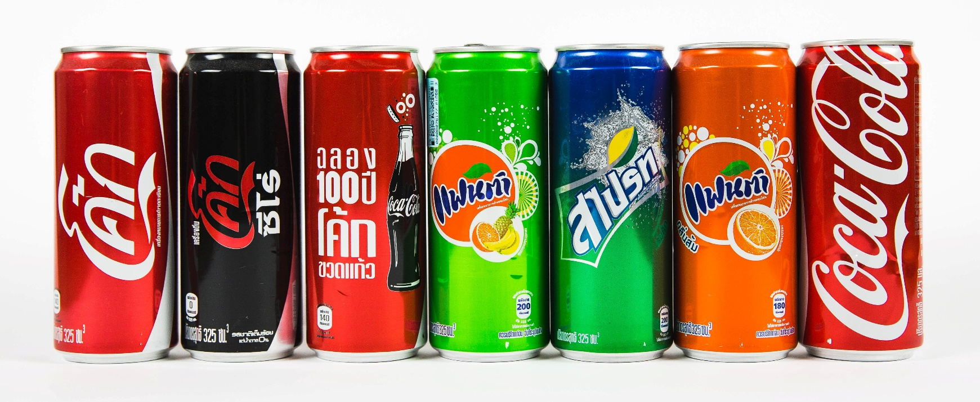
¿Qué son?
Photo by Jonny Caspari on Unsplash
CHECK

Slide 25
refrescos

Slide 26
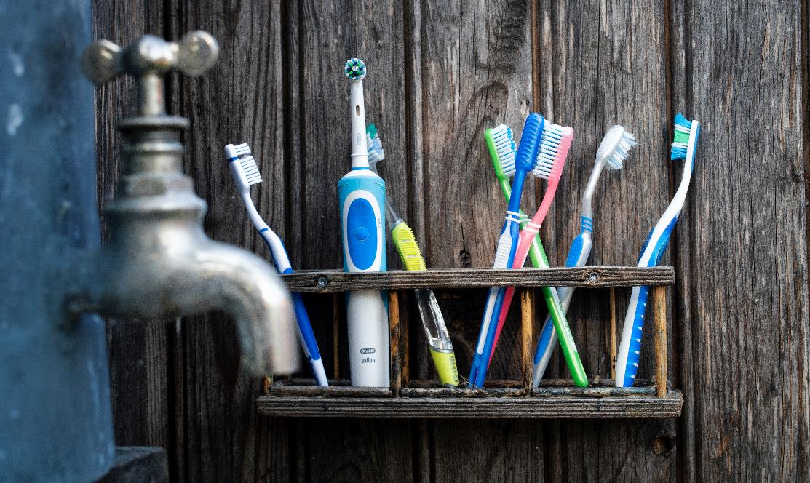
¿Qué son?
Photo by Henrik Lagercrantz on Unsplash
CHECK

Slide 27
cepillos de dientes

Slide 28
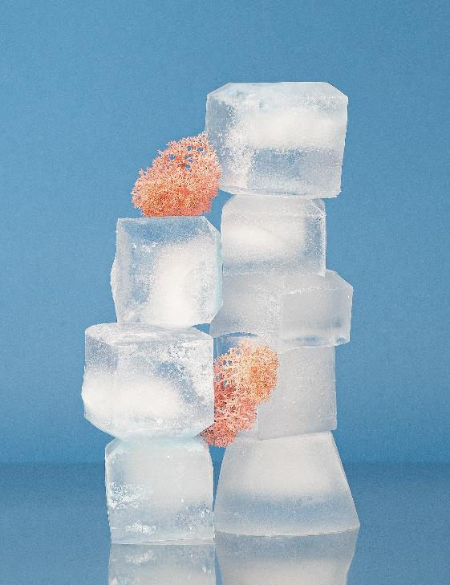
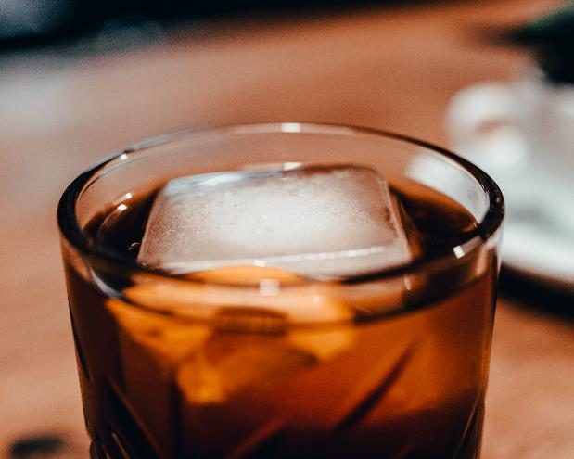
¿Qué son?
Photo by Chris Kursikowski on Unsplash
Photo by Vika Wendish on Unsplash
CHECK

Slide 29
(cubitos de) hielo

Slide 30


Third Category - 400
INSERT QUESTION HERE
CHECK
Notes:
You will have to move the Daily Double picture out of the way to write the question. If you do not wish to have the Daily Double in the game, delete it and the sound clip (speaker) from this slide. For a Daily Double, the contestant has to wager at least $5 and at most the highest point value of any player/team at that point in the game. It is considered a True Daily Double if they wager all of their points and go “double or nothing”.

Slide 31
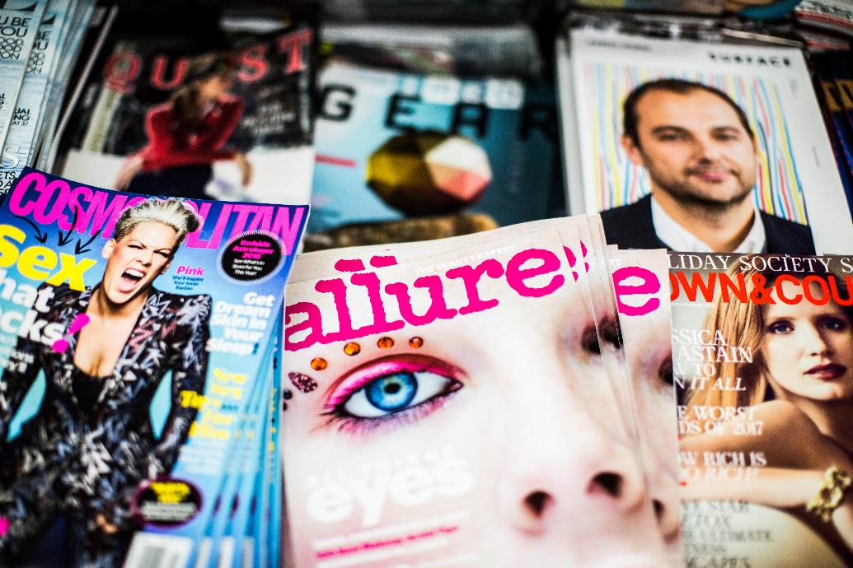
¿Qué son?
Photo by Charisse Kenion on Unsplash
CHECK
Notes:
You will have to move the Daily Double picture out of the way to write the question. If you do not wish to have the Daily Double in the game, delete it and the sound clip (speaker) from this slide. For a Daily Double, the contestant has to wager at least $5 and at most the highest point value of any player/team at that point in the game. It is considered a True Daily Double if they wager all of their points and go “double or nothing”.

Slide 32
revistas

Slide 33
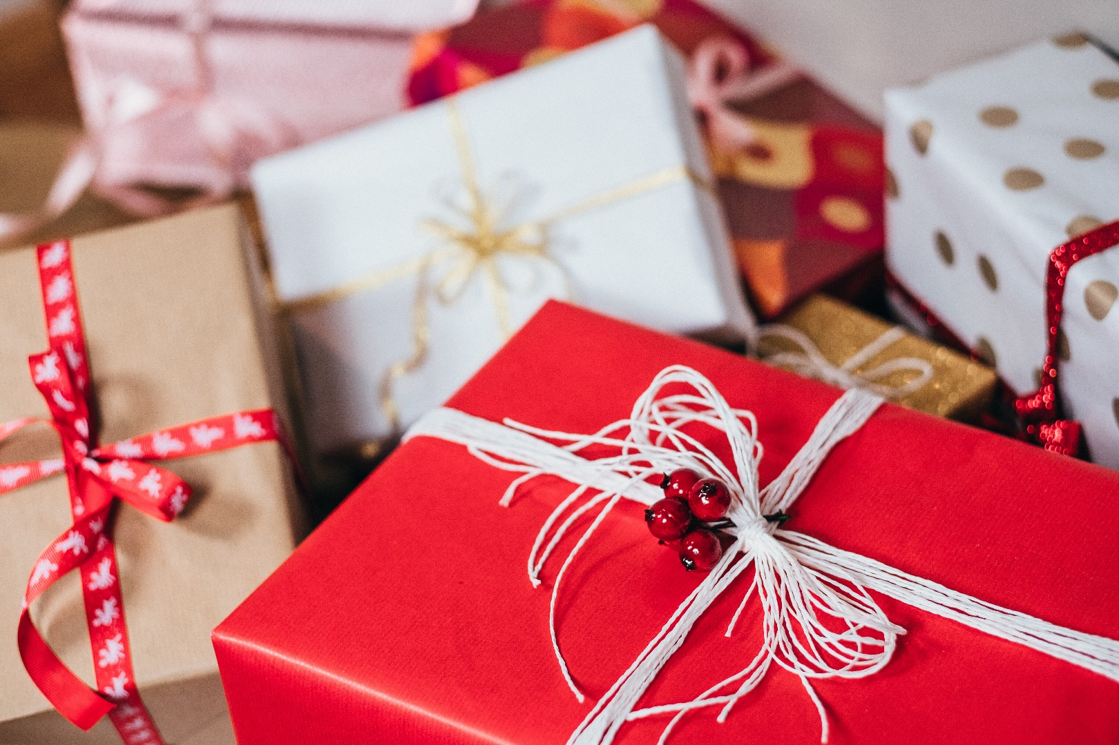
¿Qué son?
Photo by freestocks on Unsplash
CHEC

Slide 34
regalos

Slide 35
Mi ___ es Calle Andalucía, número 598.
CHECK

Slide 36
dirección

Slide 37
Mi ___ es el 22 de marzo de 2005.
CHECK

Slide 38
fecha de nacimiento

Slide 39
Mi ___ es soltero.
CHECK

Slide 40
estado civil

Slide 41
Mi ___ es Los Ángeles,
California, EEUU.
CHECK

Slide 42
lugar de nacimiento

Slide 43
Mi ___ es estadounidense.
CHECK

Slide 44
ciudadanía/nacionalidad

Slide 45
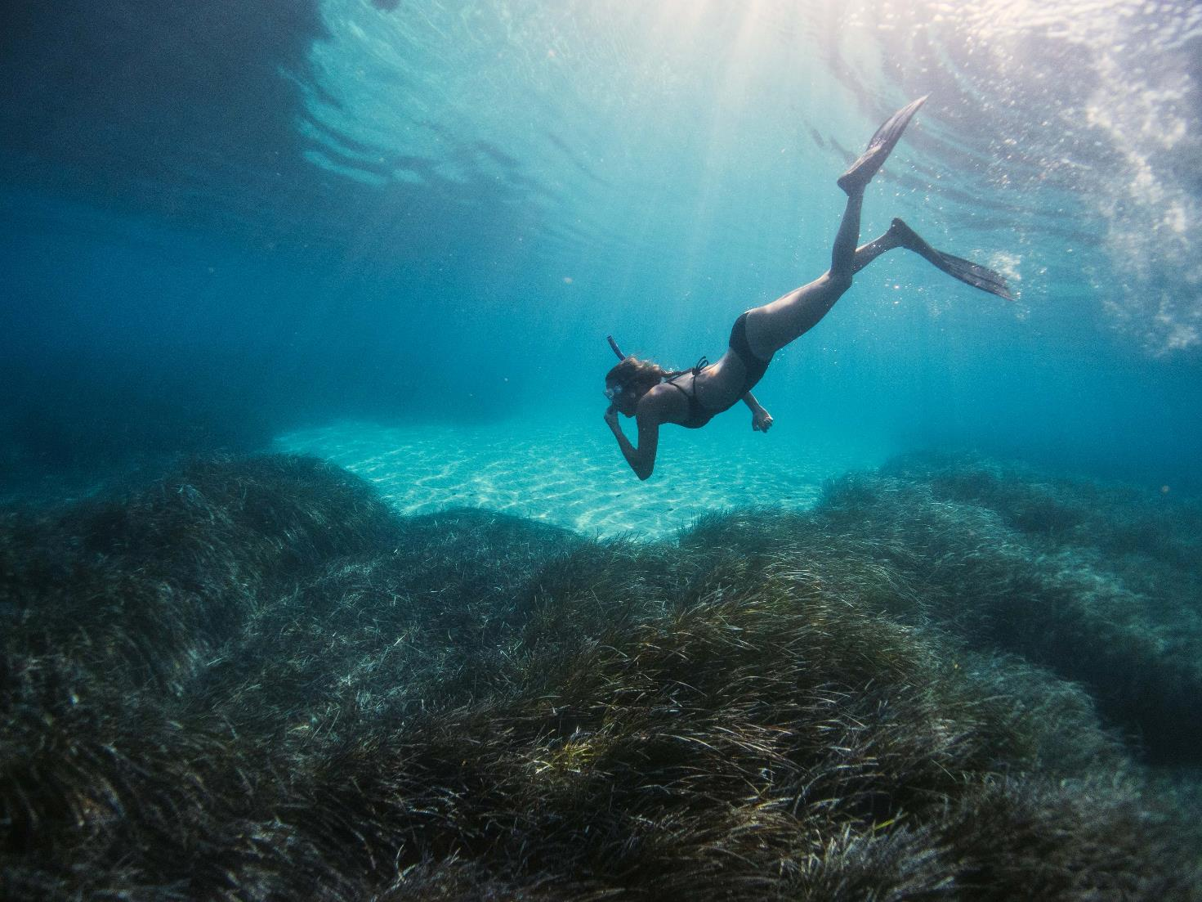
¿Qué hace la joven?
Photo by Benjamin L. Jones on Unsplash
CHECK

Slide 46
La joven bucea.

Slide 47
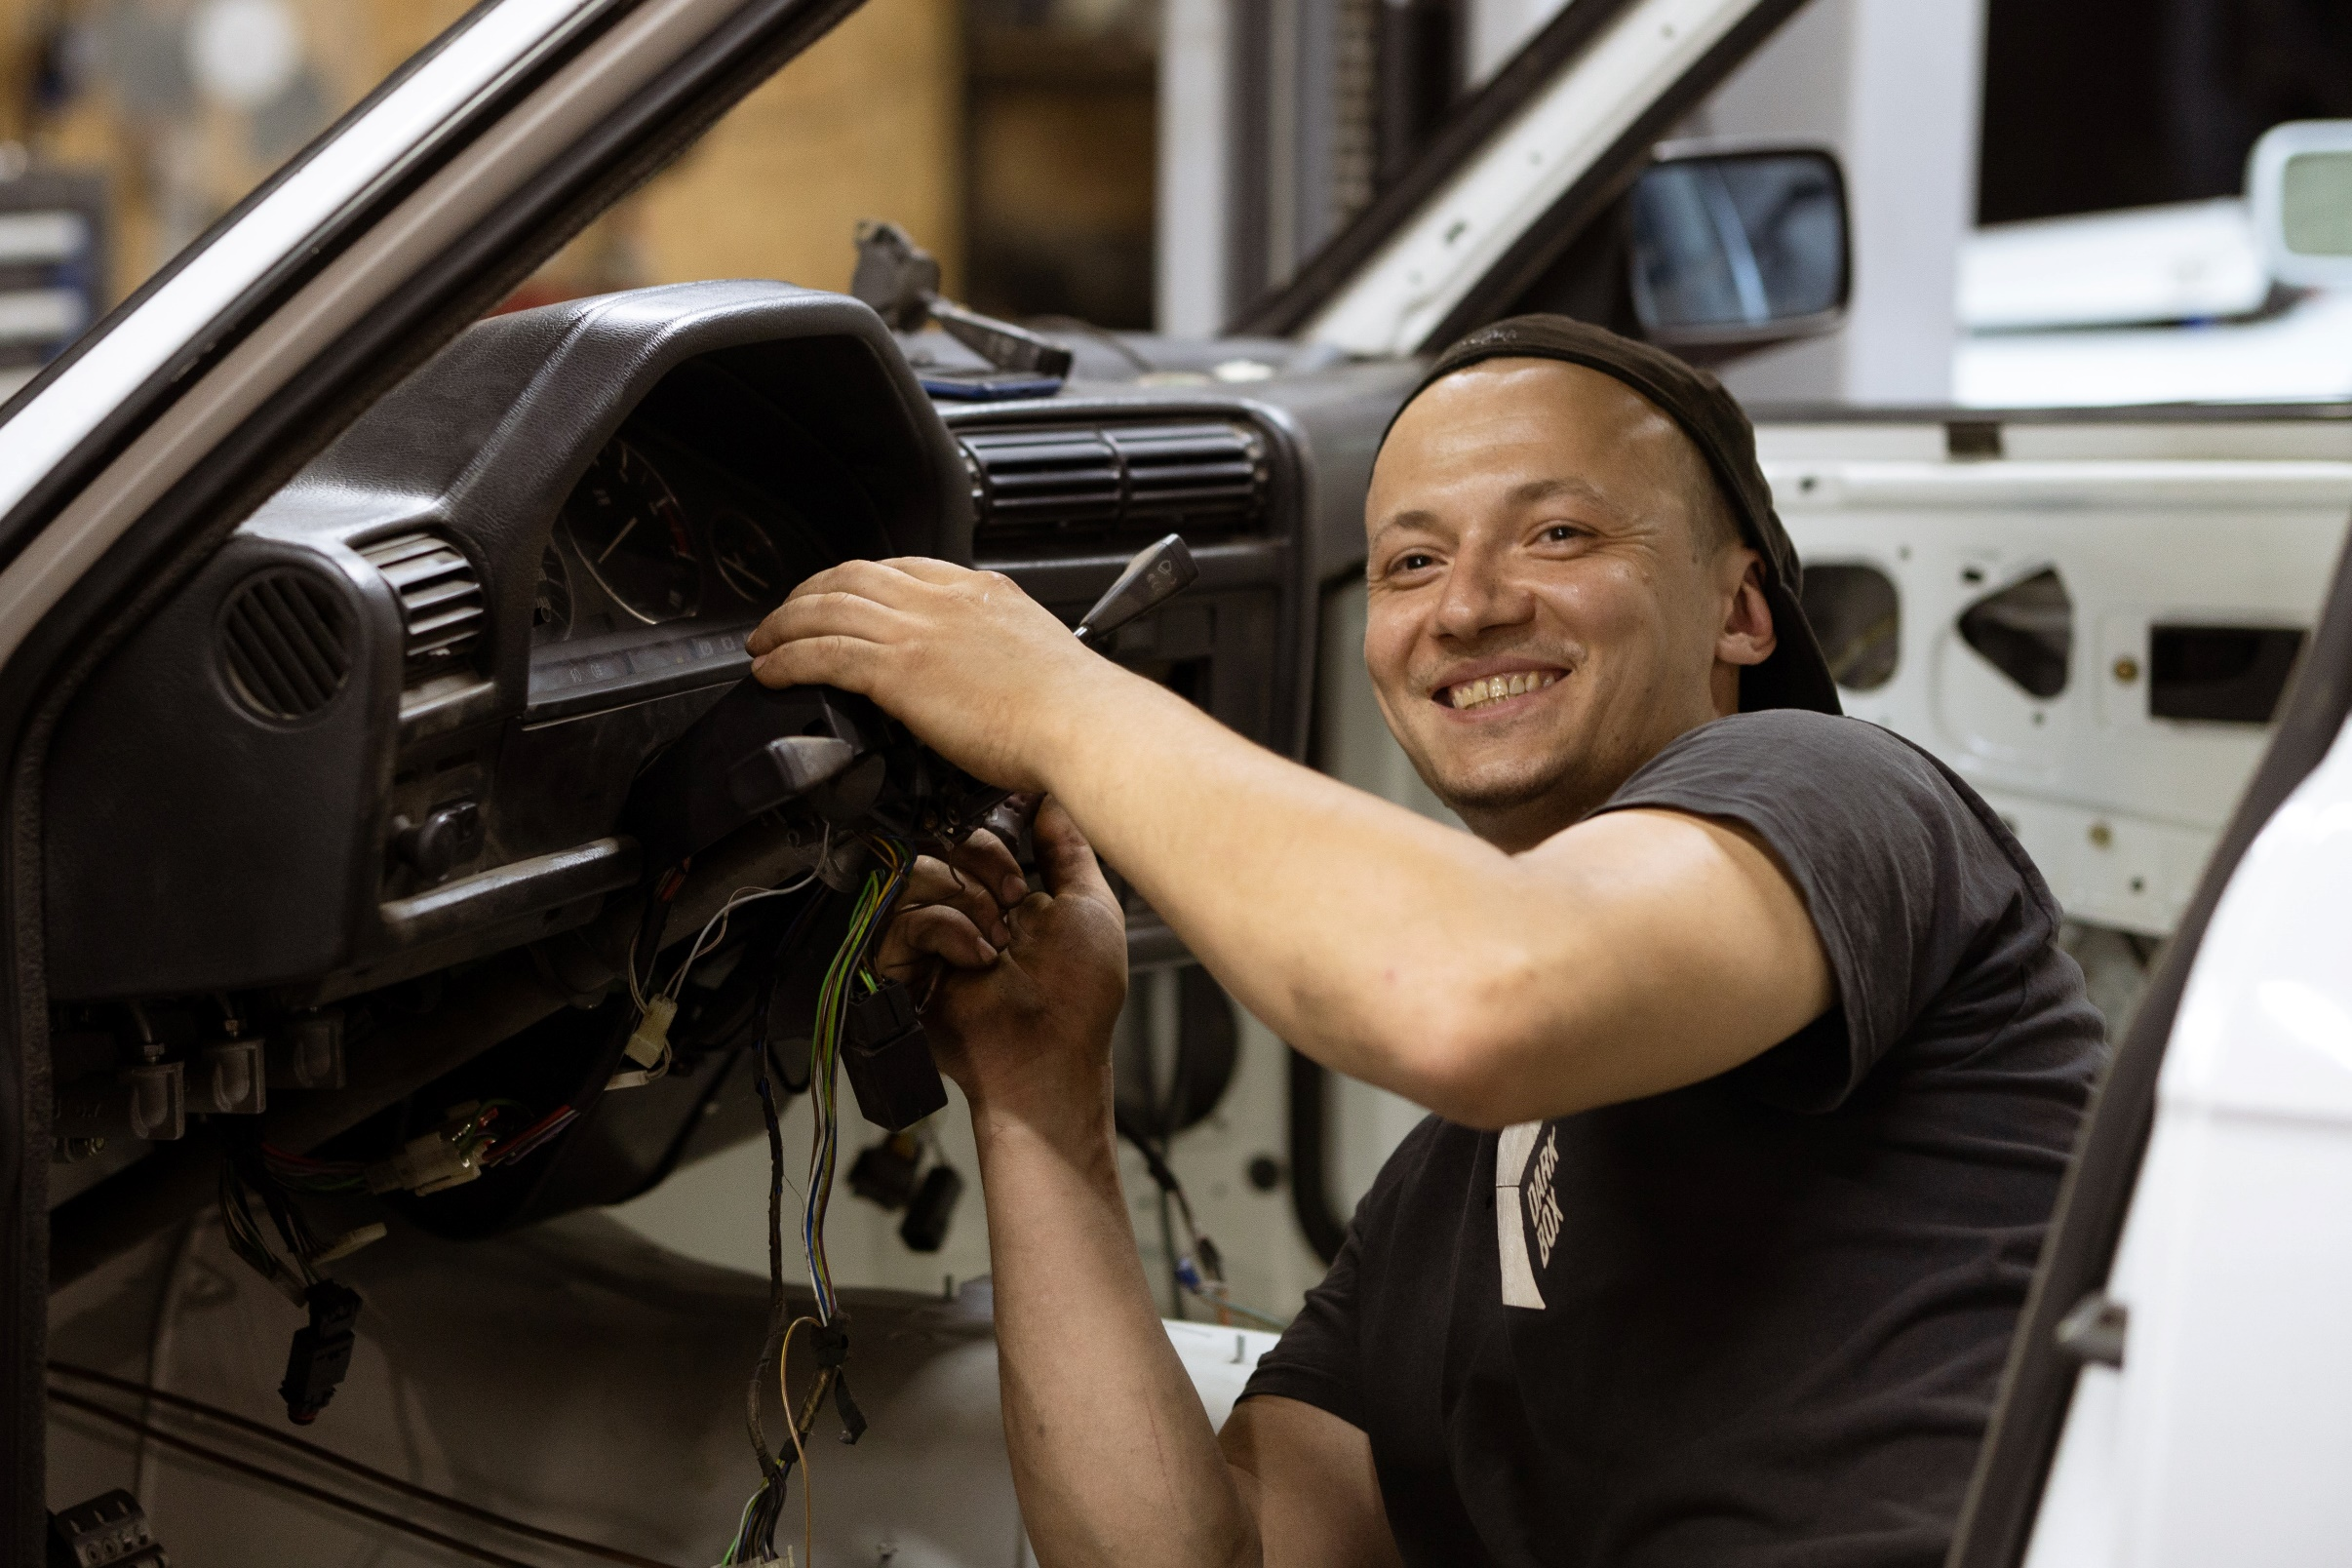
¿Qué hace el joven?
CHECK
Photo by Kato Blackmore on Unsplash

Slide 48
El joven repara el coche.

Slide 49
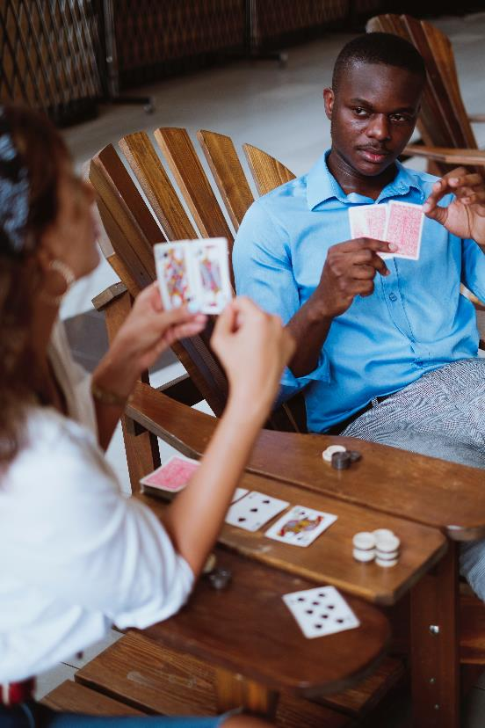
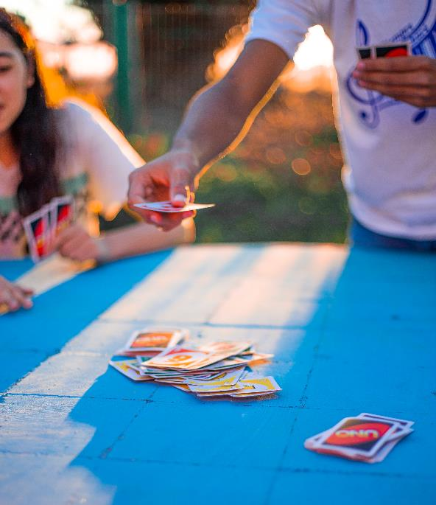
¿Qué hacen ellos?
Photo by Ezequiel Garrido on Unsplash
CHECK
Photo by Tyrell James on Unsplash

Slide 50
Ellos juegan a las cartas.

Slide 51
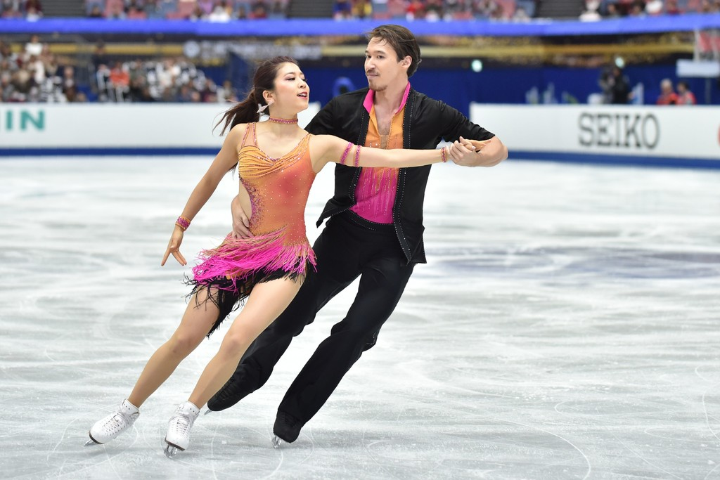
¿Qué hace la pareja?
AFP Photo by Kazuhiro Nogi on Zimbio
CHECK

Slide 52
La pareja patina en el hielo.

Slide 53
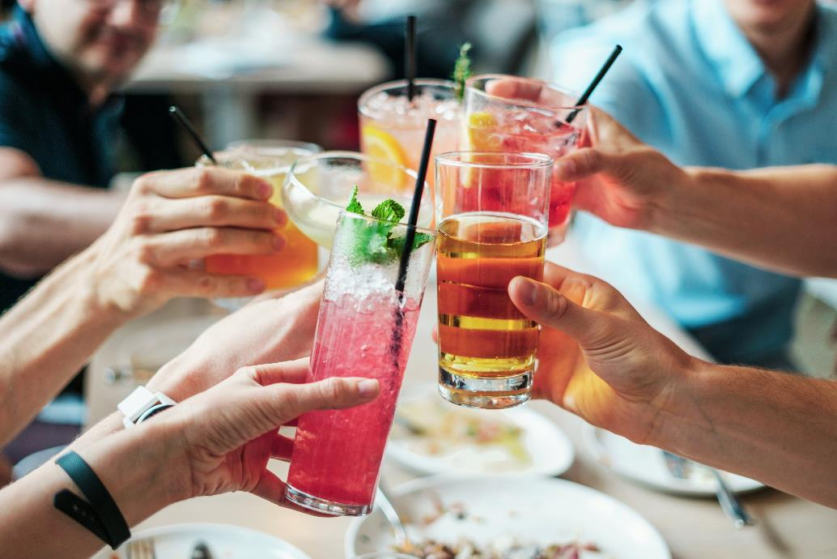
Quiero ___ una fiesta para celebrar mi cumpleaños.
CHECK
Photo by Bridgesward on Pixabay

Slide 54
Quiero dar una fiesta.

Slide 55
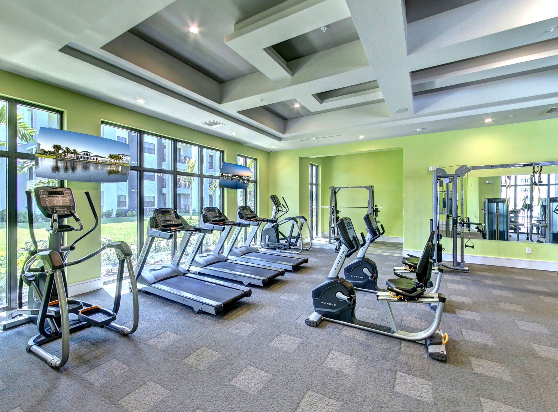
CHECK

Slide 56
gimnasio

Slide 57
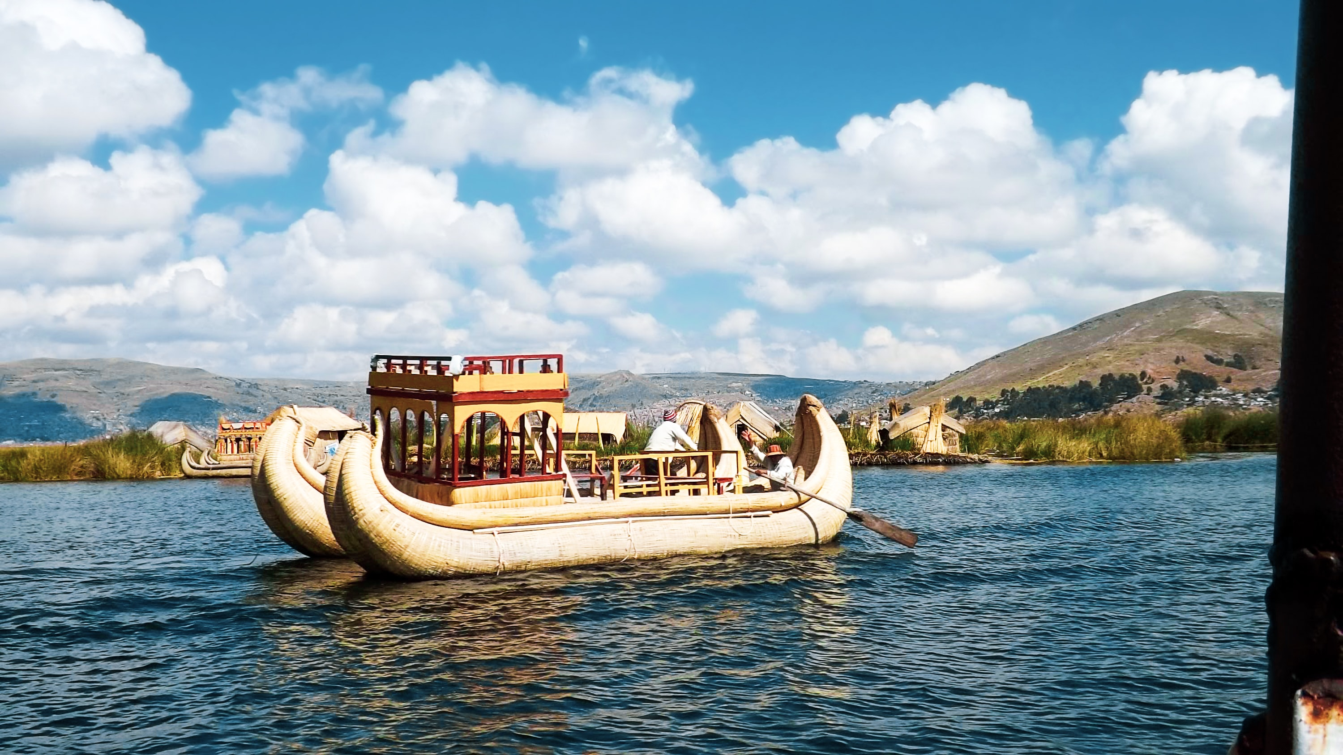
Barcos de totora en el ___ Titicaca
Photo by WILLIAN REIS on Unsplash
CHECK

Slide 58
lago Titicaca

Slide 59
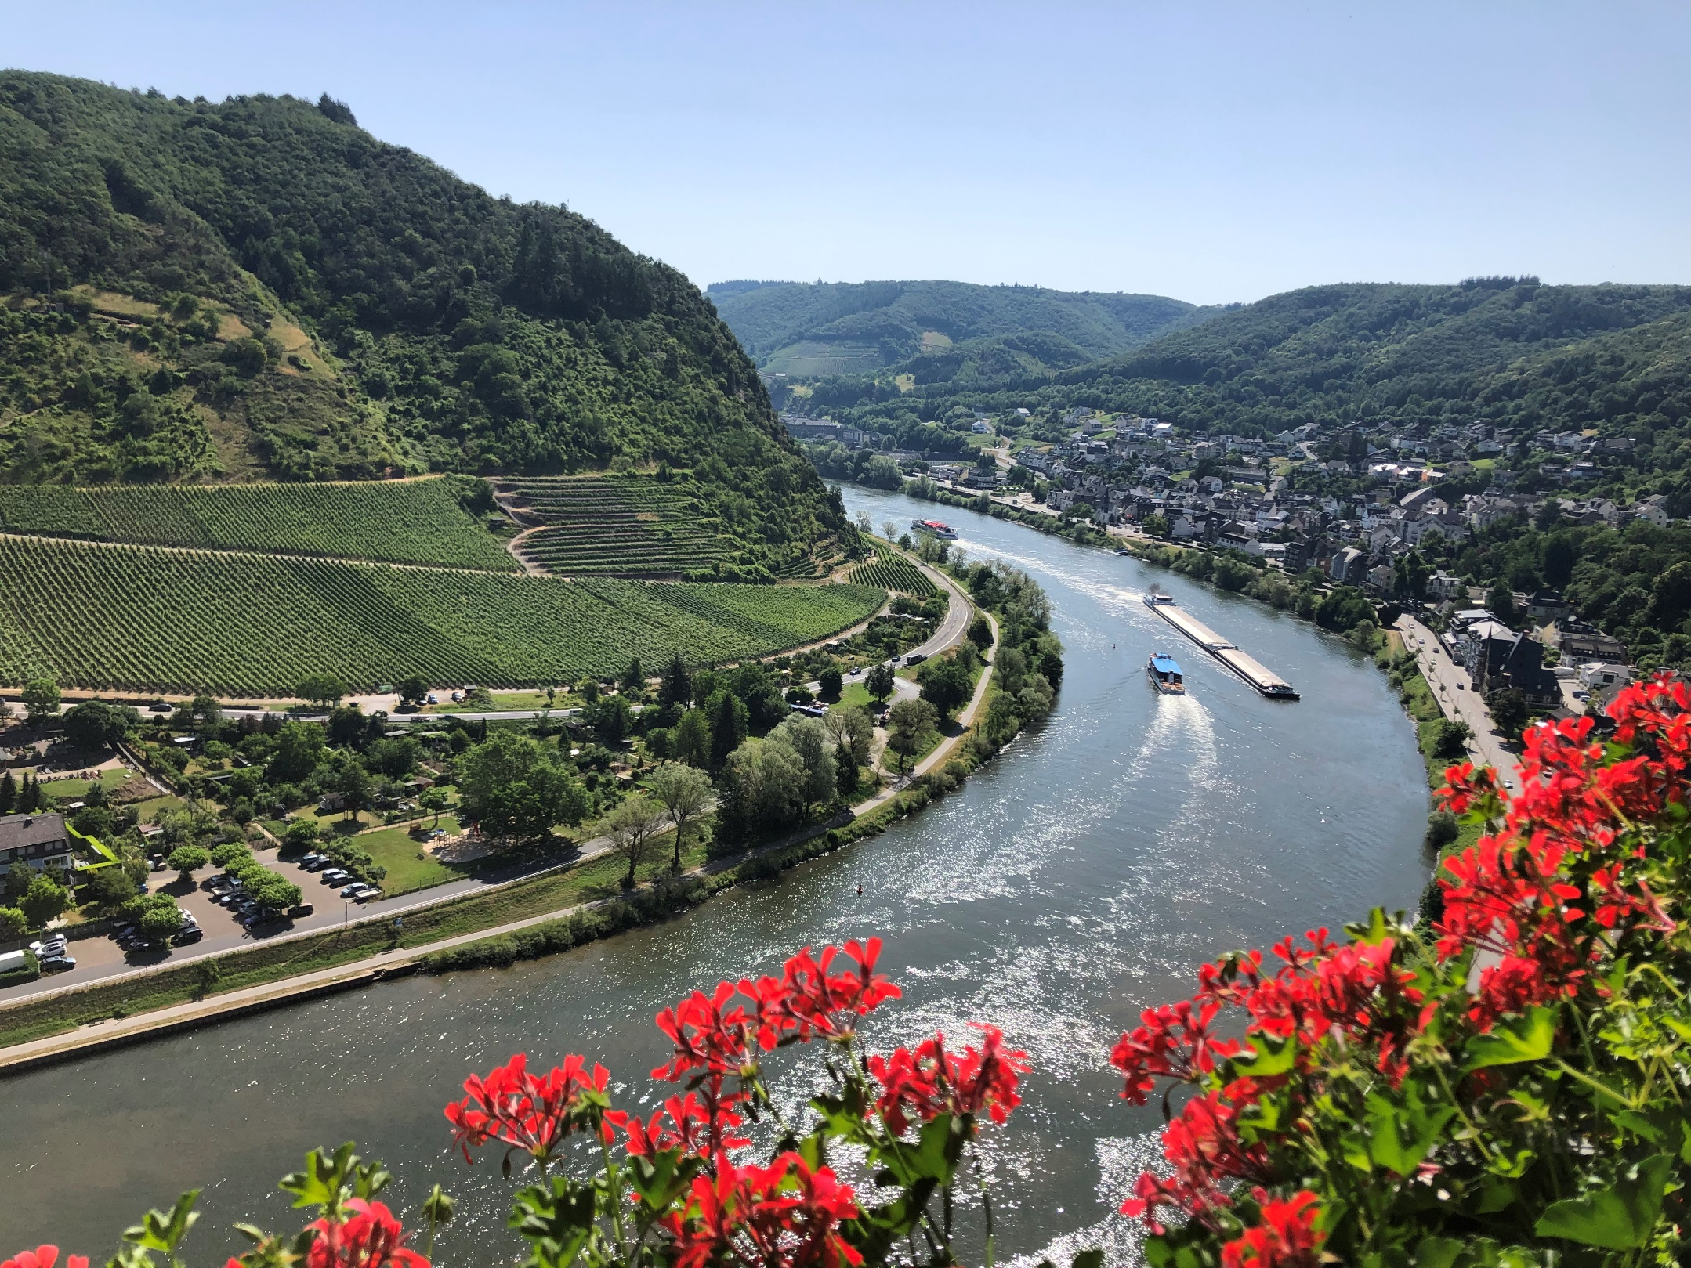
CHECK
Photo by Beatrice Tseng

Slide 60
Río Mosela, Alemania

Slide 61
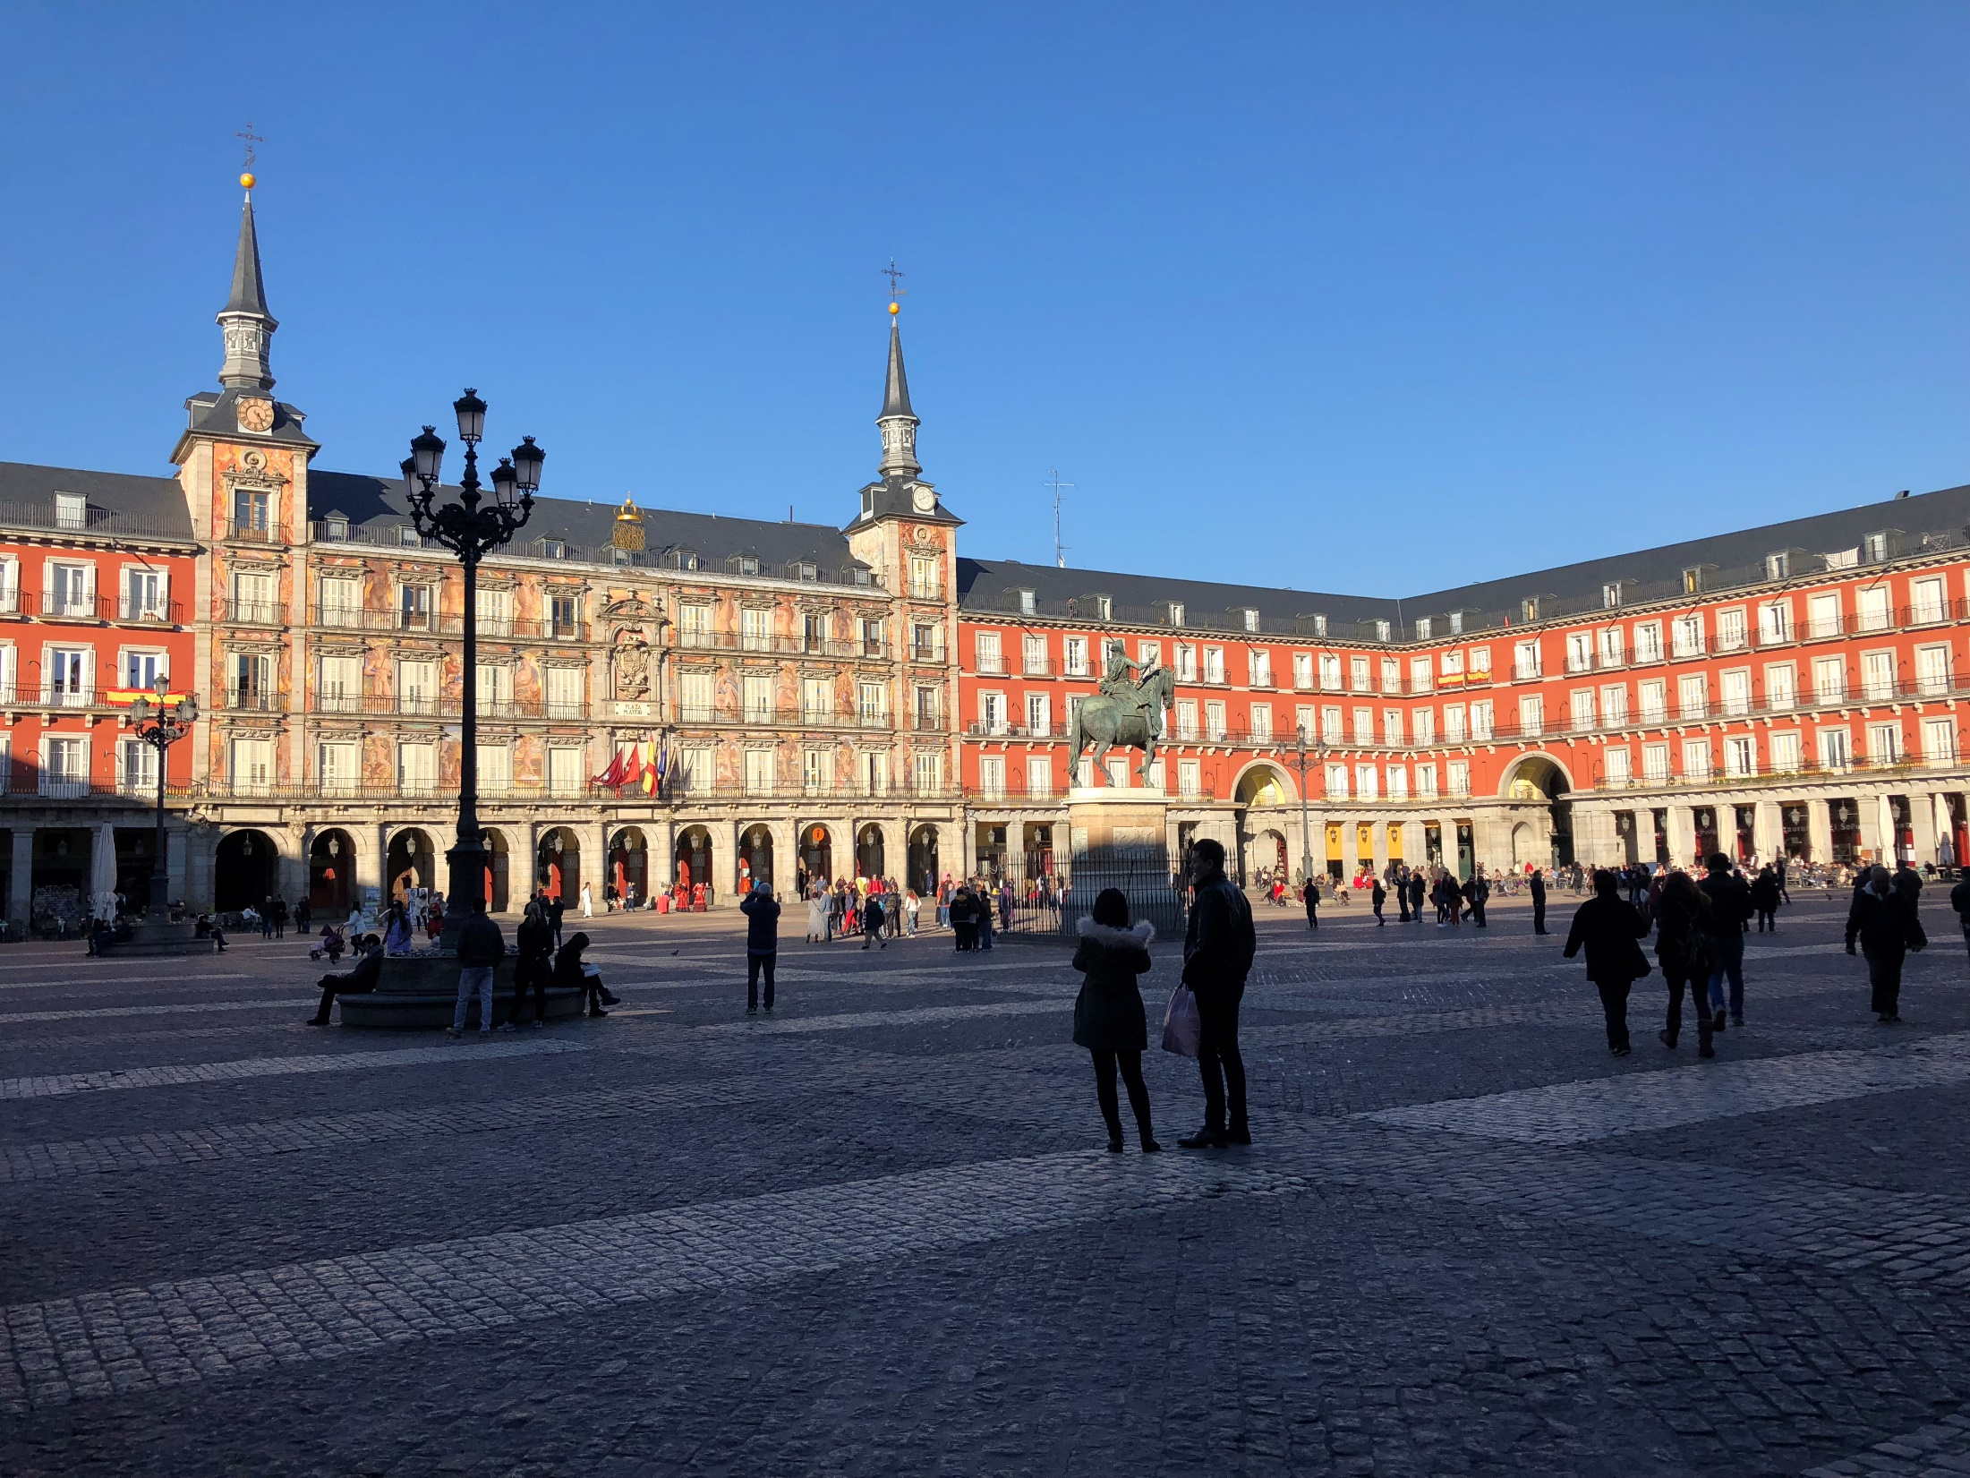
____ Mayor en Madrid
CHECK

Slide 62
Plaza Mayor

Slide 63
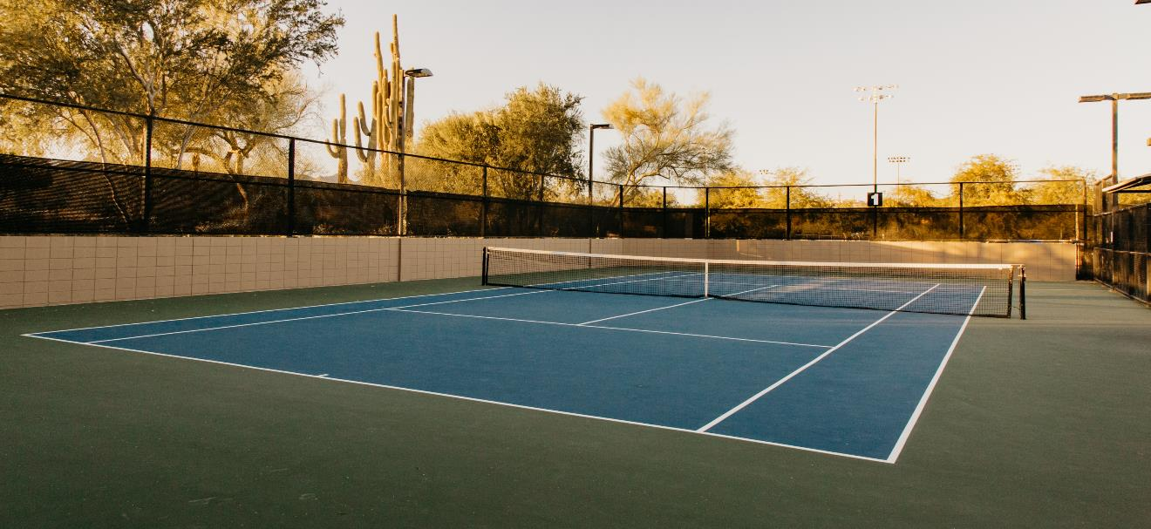
____ de tenis
Photo by Tim Chow on Unsplash
CHECK

Slide 64
cancha de tenis

Slide 65
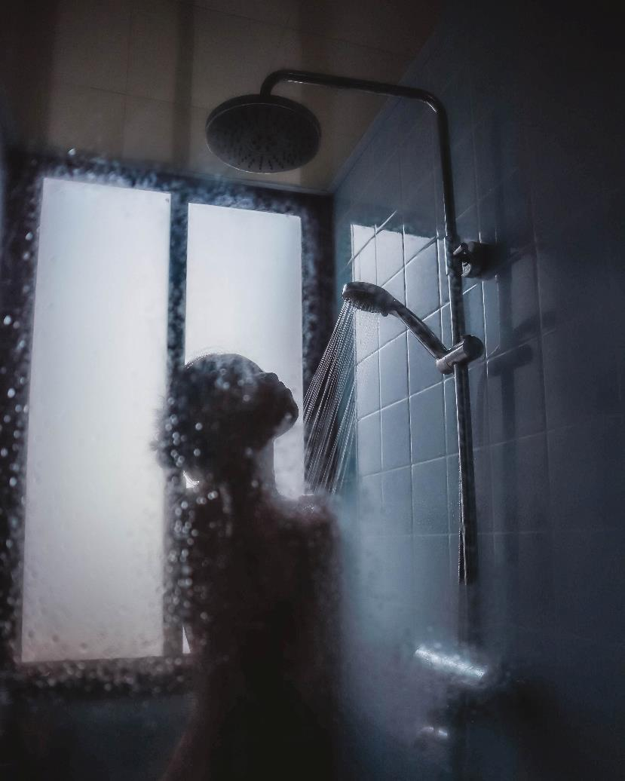
Photo by Hannah Xu
on Unsplash
CHECK

Slide 66
Ella se ducha.

Slide 67
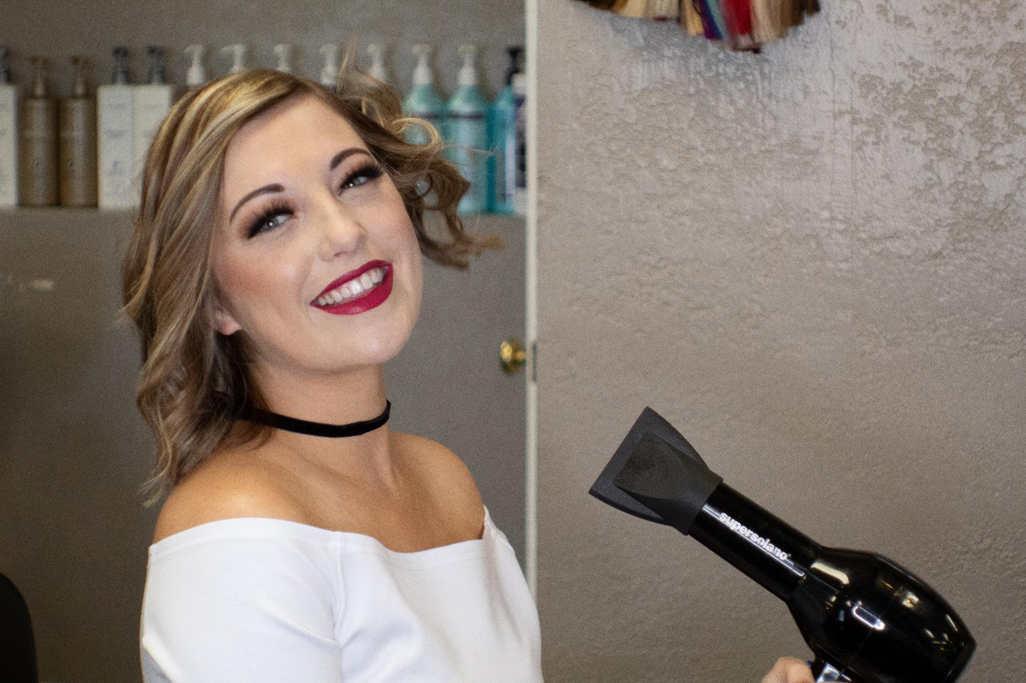
Photo by Brian Wangenheim on Unsplash
CHECK

Slide 68
Ella se seca el pelo.

Slide 69
SEVENTH Category - 600
INSERT QUESTION HERE
CHECK
Notes:
You will have to move the Daily Double picture out of the way to write the question. If you do not wish to have the Daily Double in the game, delete it and the sound clip (speaker) from this slide. For a Daily Double, the contestant has to wager at least $5 and at most the highest point value of any player/team at that point in the game. It is considered a True Daily Double if they wager all of their points and go “double or nothing”.

Slide 70
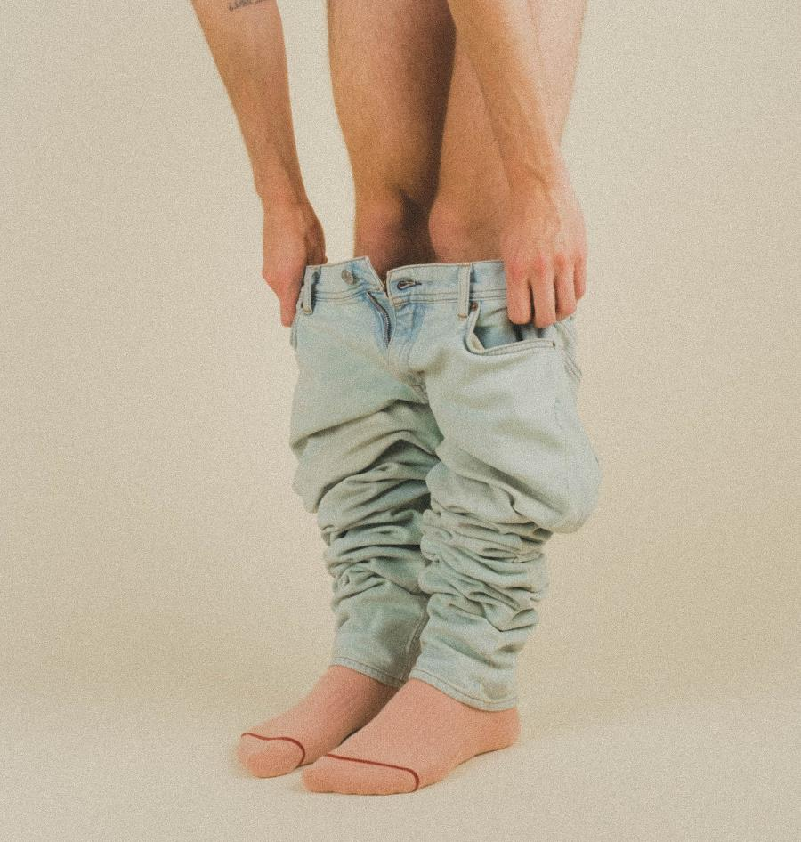
CHECK
Photo by Noah Buscher on Unsplash
Notes:
You will have to move the Daily Double picture out of the way to write the question. If you do not wish to have the Daily Double in the game, delete it and the sound clip (speaker) from this slide. For a Daily Double, the contestant has to wager at least $5 and at most the highest point value of any player/team at that point in the game. It is considered a True Daily Double if they wager all of their points and go “double or nothing”.

Slide 71
Él se quita los pantalones.

Slide 72
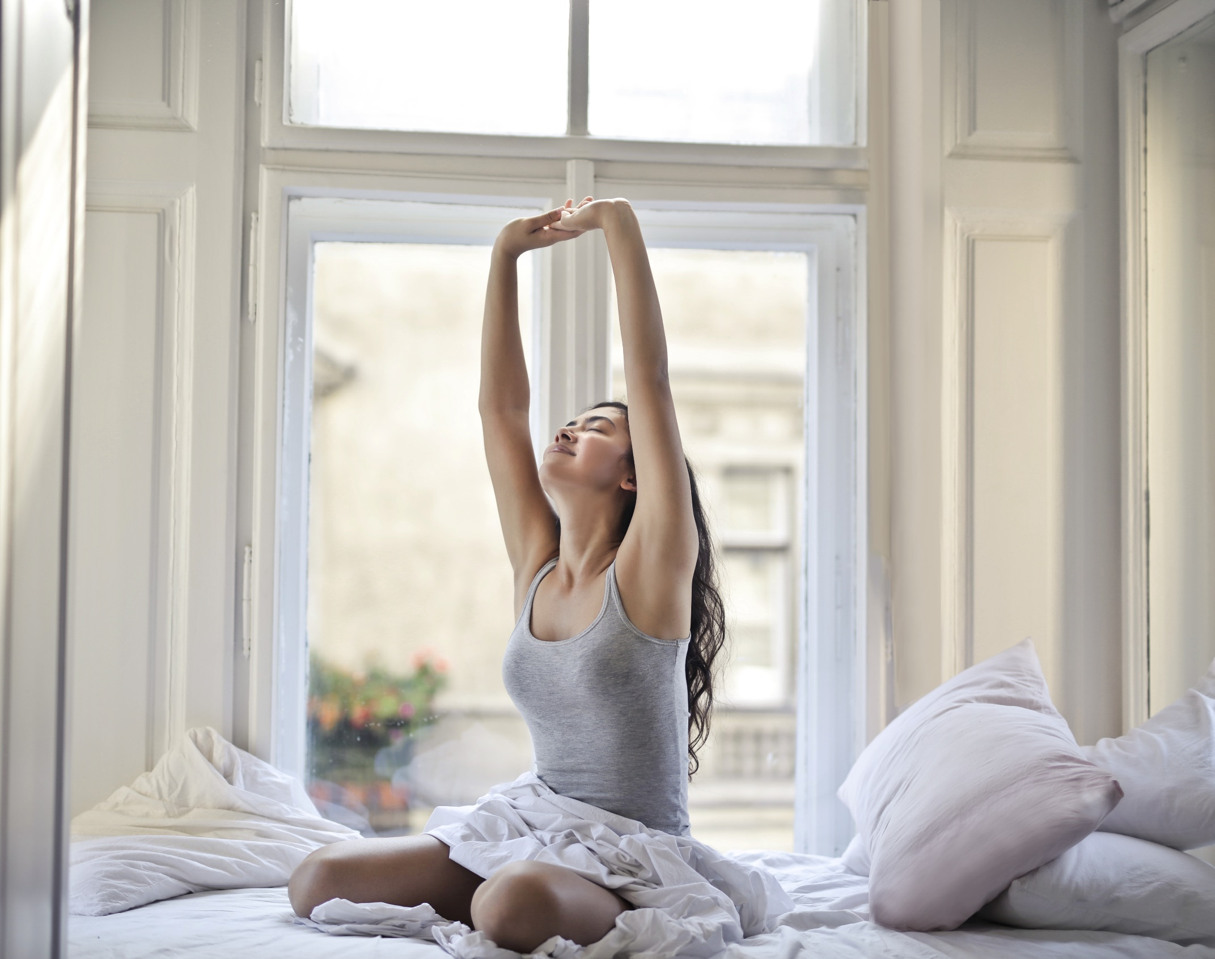
Photo by bruce mars on Unsplash
CHECK

Slide 73
La muchacha se despierta.

Slide 74
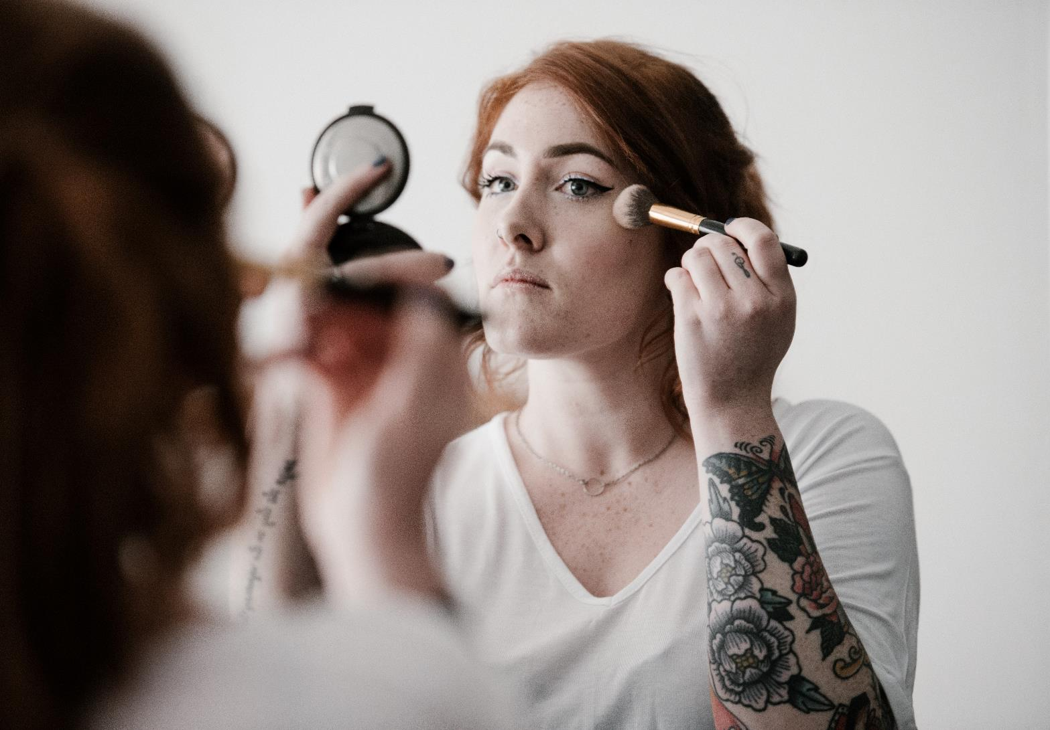
CHECK
Photo by Annie Spratt on Unsplash

Slide 75
La joven se maquilla.

Slide 76
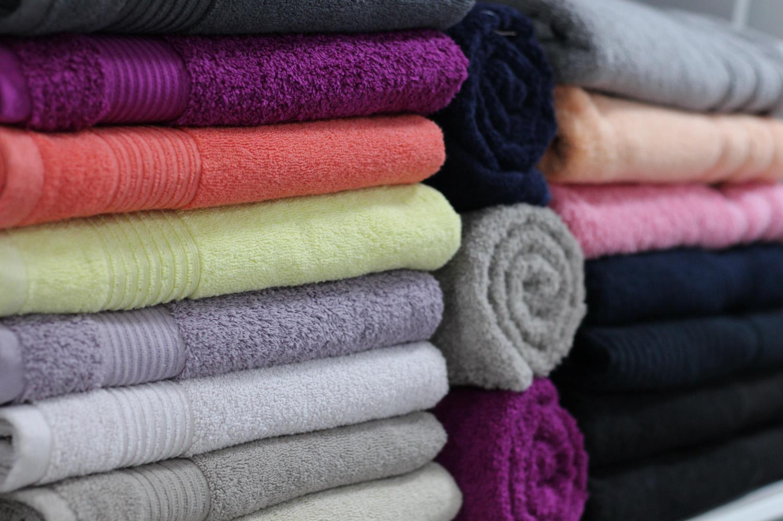
CHECK
Image by Gentelle_Linen from Pixabay

Slide 77
toallas

Slide 78
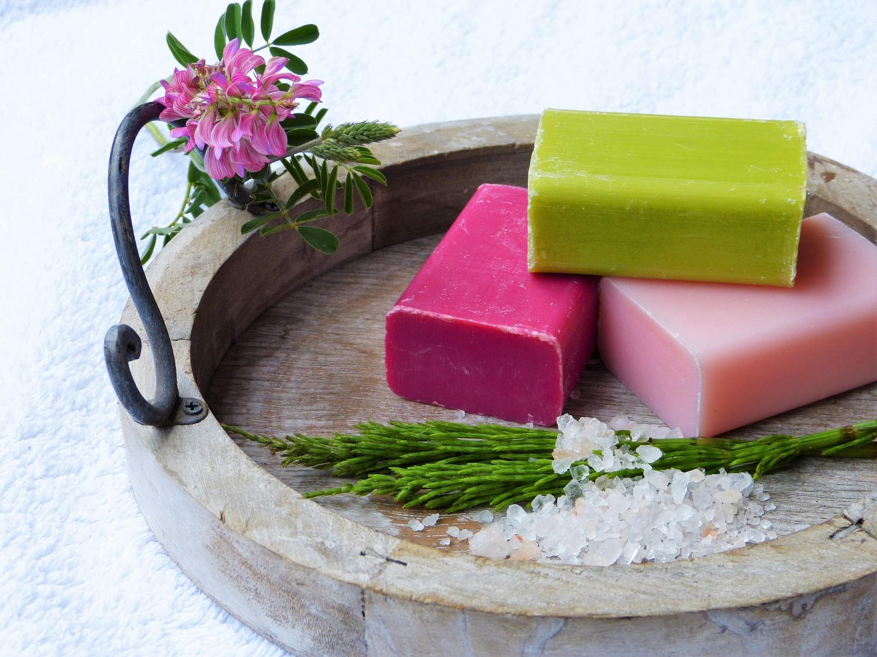
CHECK
Image by silviarita from Pixabay

Slide 79
jabón

Slide 80
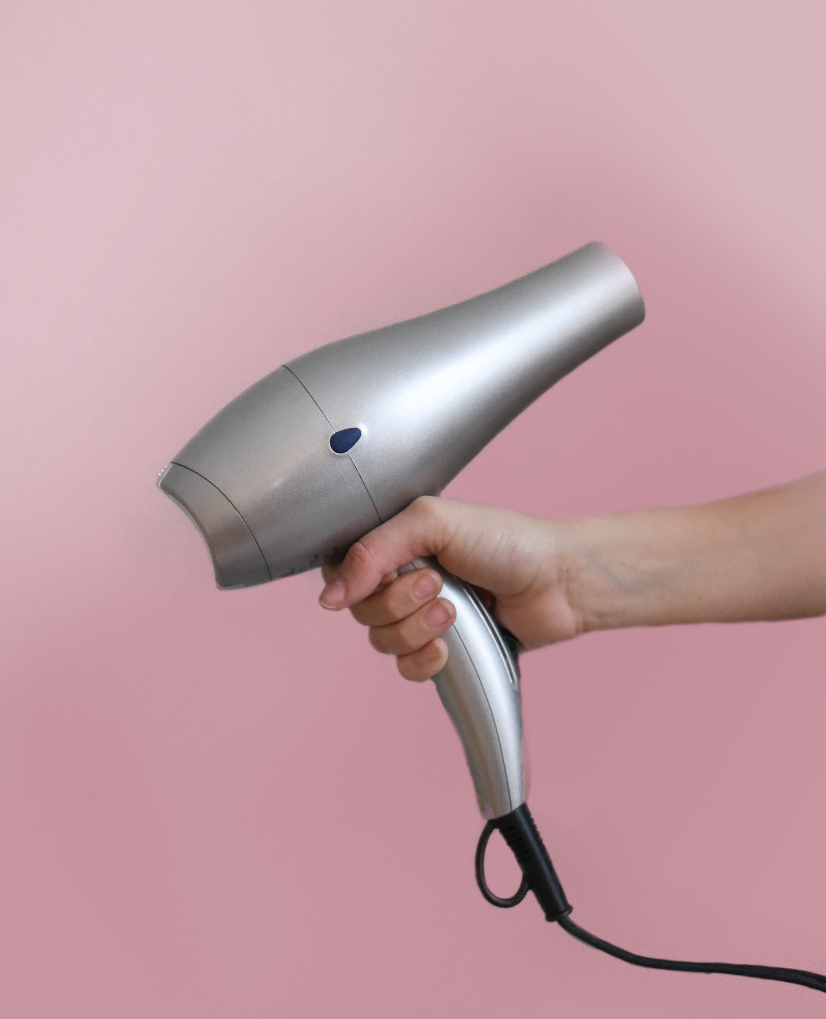
CHECK
Photo by Element5 Digital on Unsplash

Slide 81
secador

Slide 82
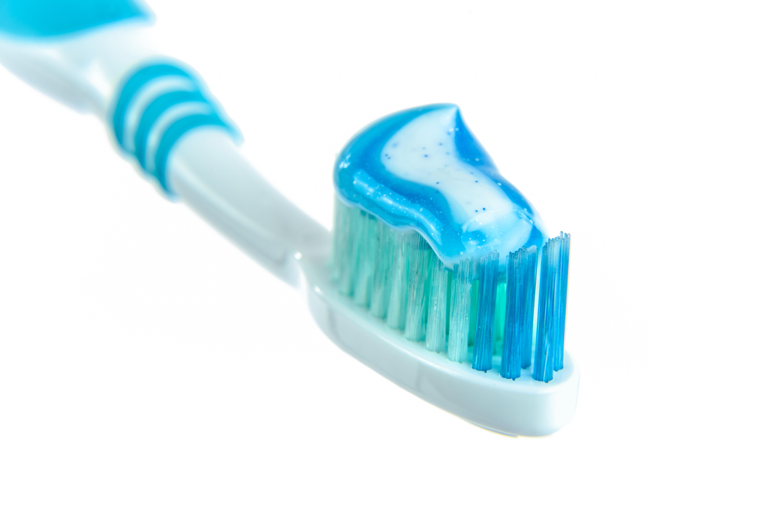
CHECK
Image by Photo Mix from Pixabay

Slide 83
pasta dental

Slide 84
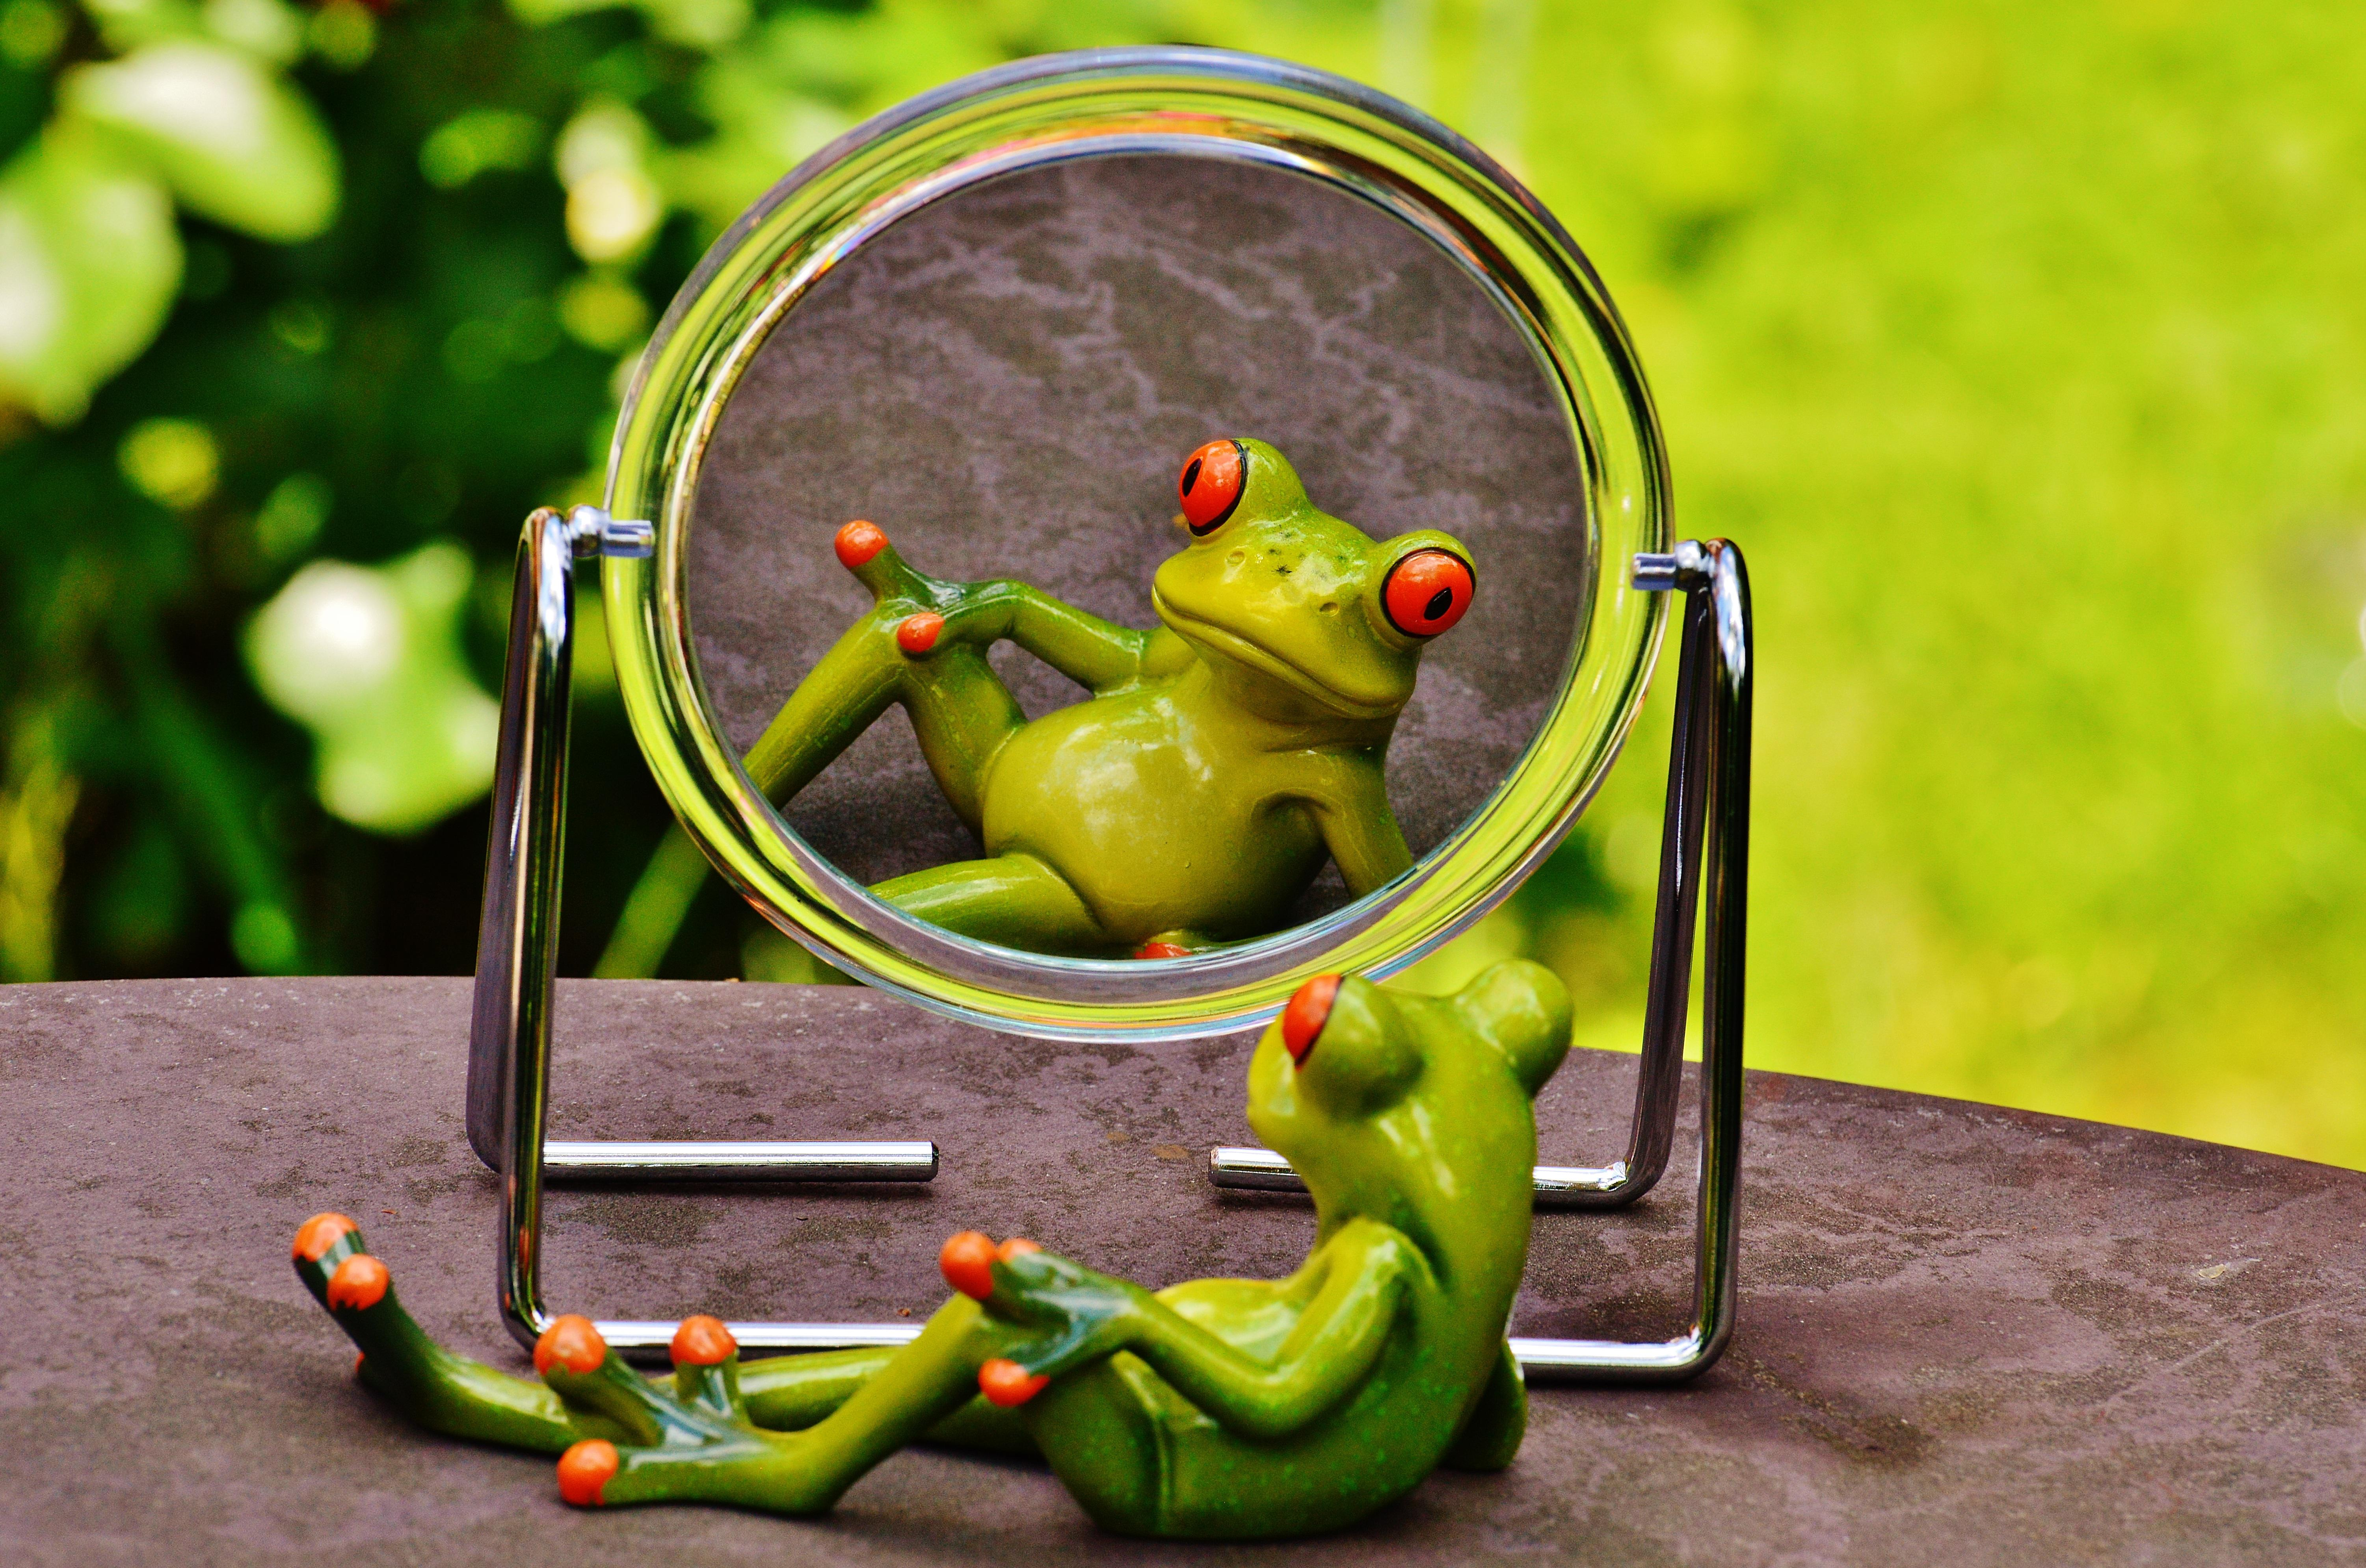
CHECK
Image by Alexas_Fotos from Pixabay

Slide 85
espejo

Slide 86
2°
CHECK

Slide 87
2° - segundo

Slide 88
5°
CHECK

Slide 89
5° - quinto

Slide 90
8°
CHECK

Slide 91
8° - octavo

Slide 92
6°
CHECK

Slide 93
6° - sexto

Slide 94
10°
CHECK

Slide 95
10° - décimo

Slide 96
Tenth Category 200
INSERT QUESTION HERE
CHECK
Notes:
You will have to move the Daily Double picture out of the way to write the question. If you do not wish to have the Daily Double in the game, delete it and the sound clip (speaker) from this slide. For a Daily Double, the contestant has to wager at least $5 and at most the highest point value of any player/team at that point in the game. It is considered a True Daily Double if they wager all of their points and go “double or nothing”.

Slide 97
En ___ hay tortugas gigantes.
CHECK
Notes:
You will have to move the Daily Double picture out of the way to write the question. If you do not wish to have the Daily Double in the game, delete it and the sound clip (speaker) from this slide. For a Daily Double, the contestant has to wager at least $5 and at most the highest point value of any player/team at that point in the game. It is considered a True Daily Double if they wager all of their points and go “double or nothing”.

Slide 98
las islas Galápagos

Slide 99
Quilotoa, Pichincha y
Cotopaxi son ____.
CHECK

Slide 100
volcanes

Slide 101
El ____ es el idioma de los incas.
CHECK

Slide 102
quechua

Slide 103
En Otovalo hay
un ____ indígena
grande y famoso.
CHECK

Slide 104
mercado

Slide 105
Papallacta es famosa por sus ____ de agua caliente que fluyen de dos volcanes.
CHECK

Slide 106
termas

Slide 107
JEOPARDY FINAL
Categoría:
Lugar
CHECK

Slide 108

En esta ciudad hay una línea que marca la división entre el hemisferio norte y el sur.
CHECK

Slide 109
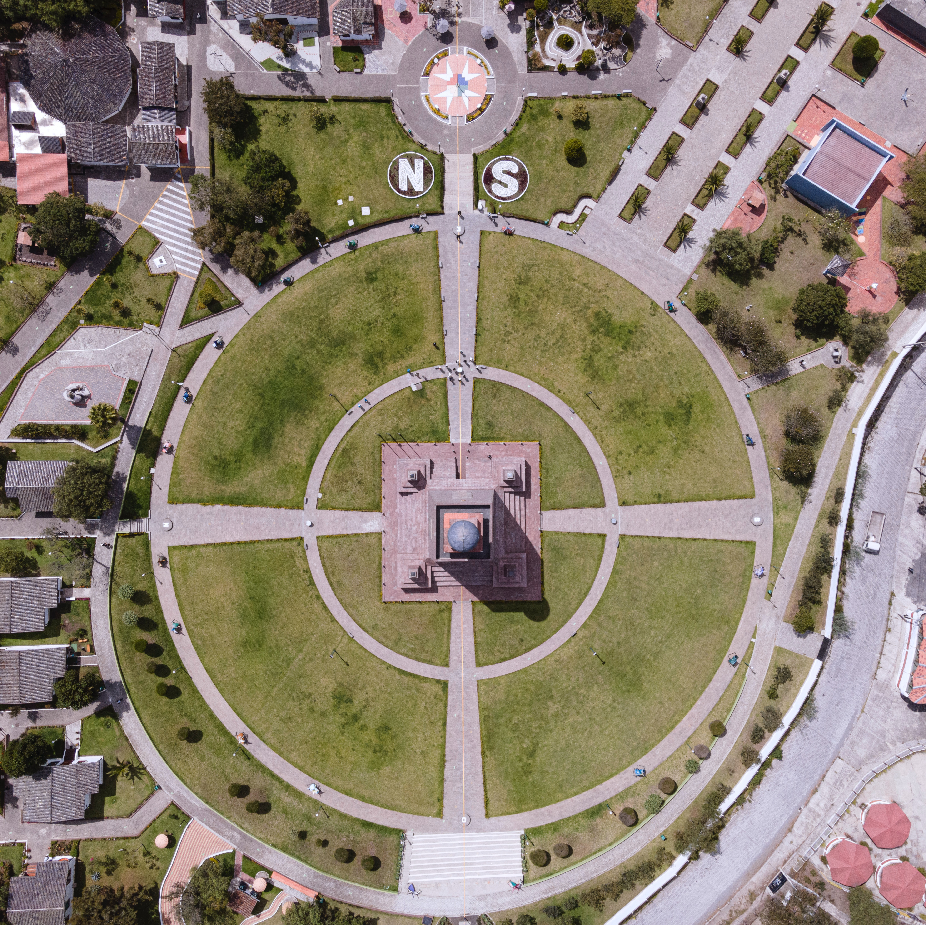
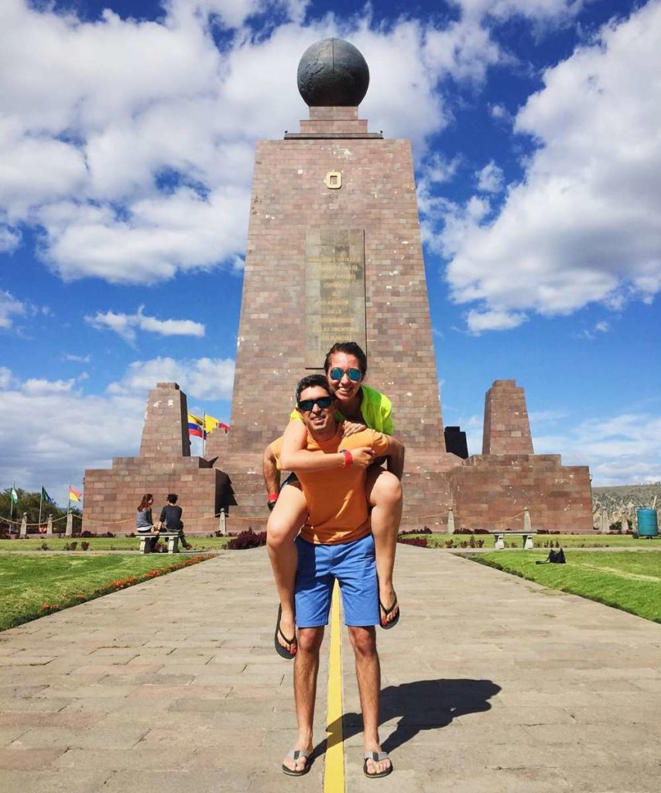
Mitad del Mundo
Photo by Andrés Medina on Unsplash
Photo by Quito Tour Bus

