Slide 1

Capítulo 5
Template by Jared Speight
Content by Beatrice Tseng
con la Profesora Tseng

Slide 2

DESAYUNO | BEBIDAS | ESTADOS FÍSICOS y ANÍMICOS | ACCIÓN (verbos) | DÍAS FERIADOS
100 | 100 | 100 | 100 | 100
200 | 200 | 200 | 200 | 200
300 | 300 | 300 | 300 | 300
400 | 400 | 400 | 400 | 400
500 | 500 | 500 | 500 | 500

Slide 3

COMIDA | SUSTANTIVOS | MÁS ESTADOS FÍSICOS y ANÍMICOS | MÁS ACCIÓN | EL SALVADOR, HONDURAS y NICARAGUA
200 | 200 | 200 | 200 | 200
400 | 400 | 400 | 400 | 400
600 | 600 | 600 | 600 | 600
800 | 800 | 800 | 800 | 800
1000 | 1000 | 1000 | 1000 | 1000

Slide 4
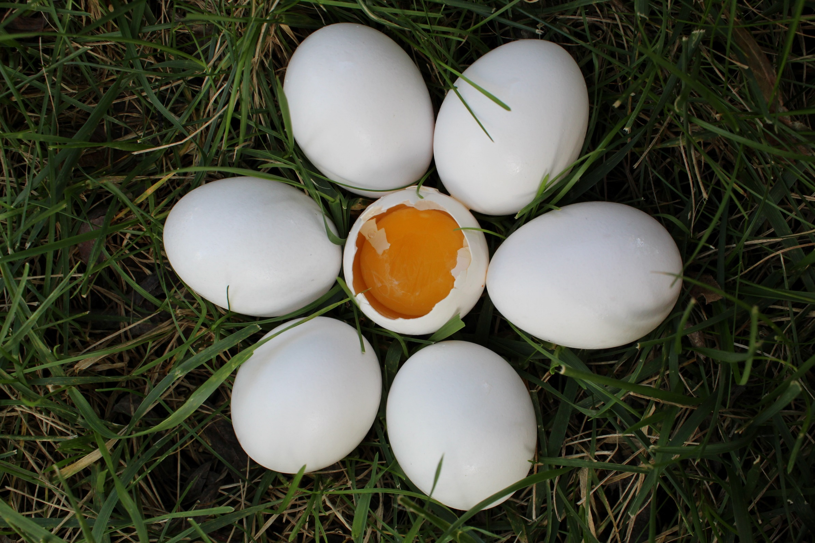
CHECK
Photo by Haley Hamilton on Unsplash

Slide 5

huevos

Slide 6
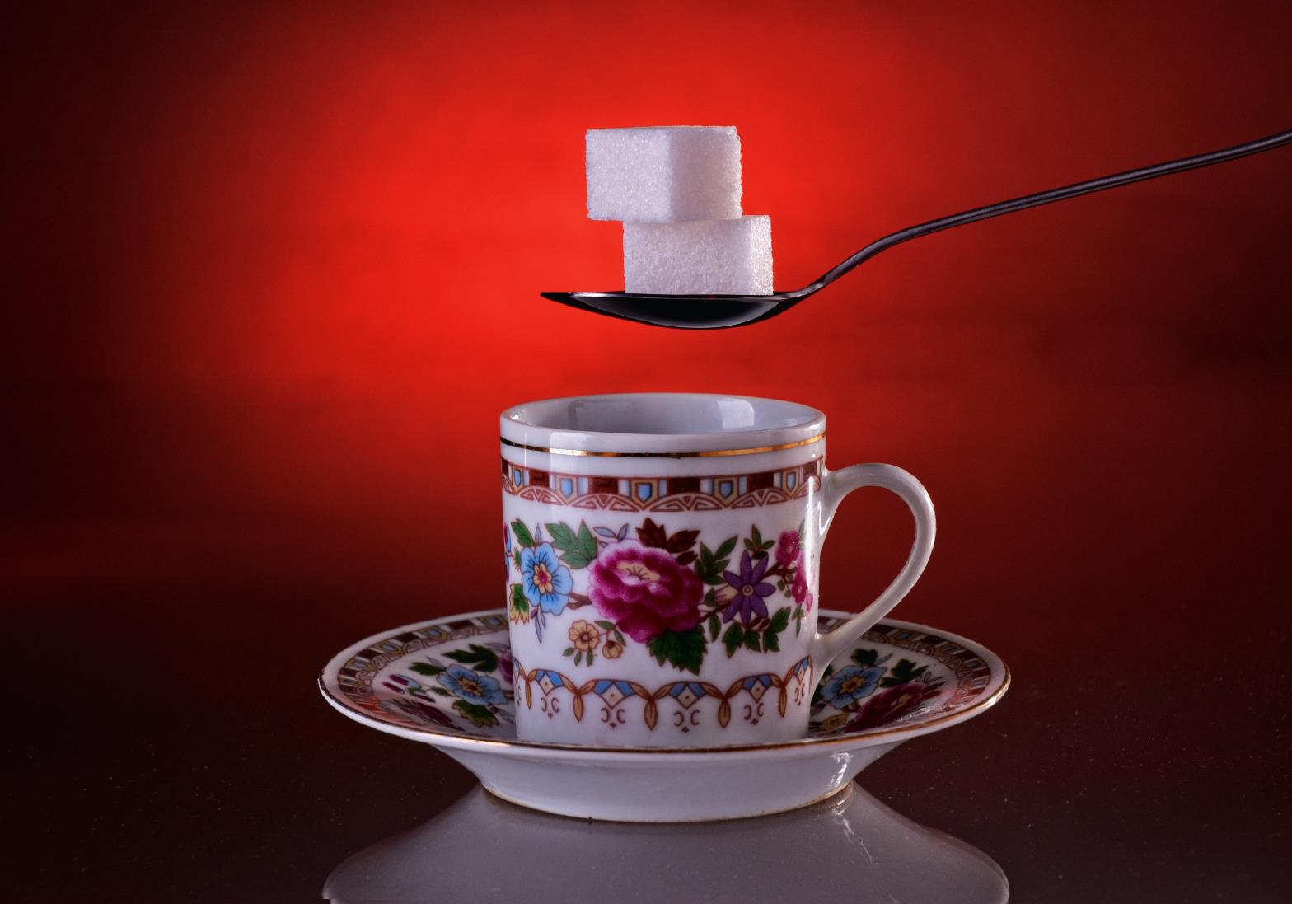
CHECK
Image by ds_30 from Pixabay

Slide 7
azúcar

Slide 8
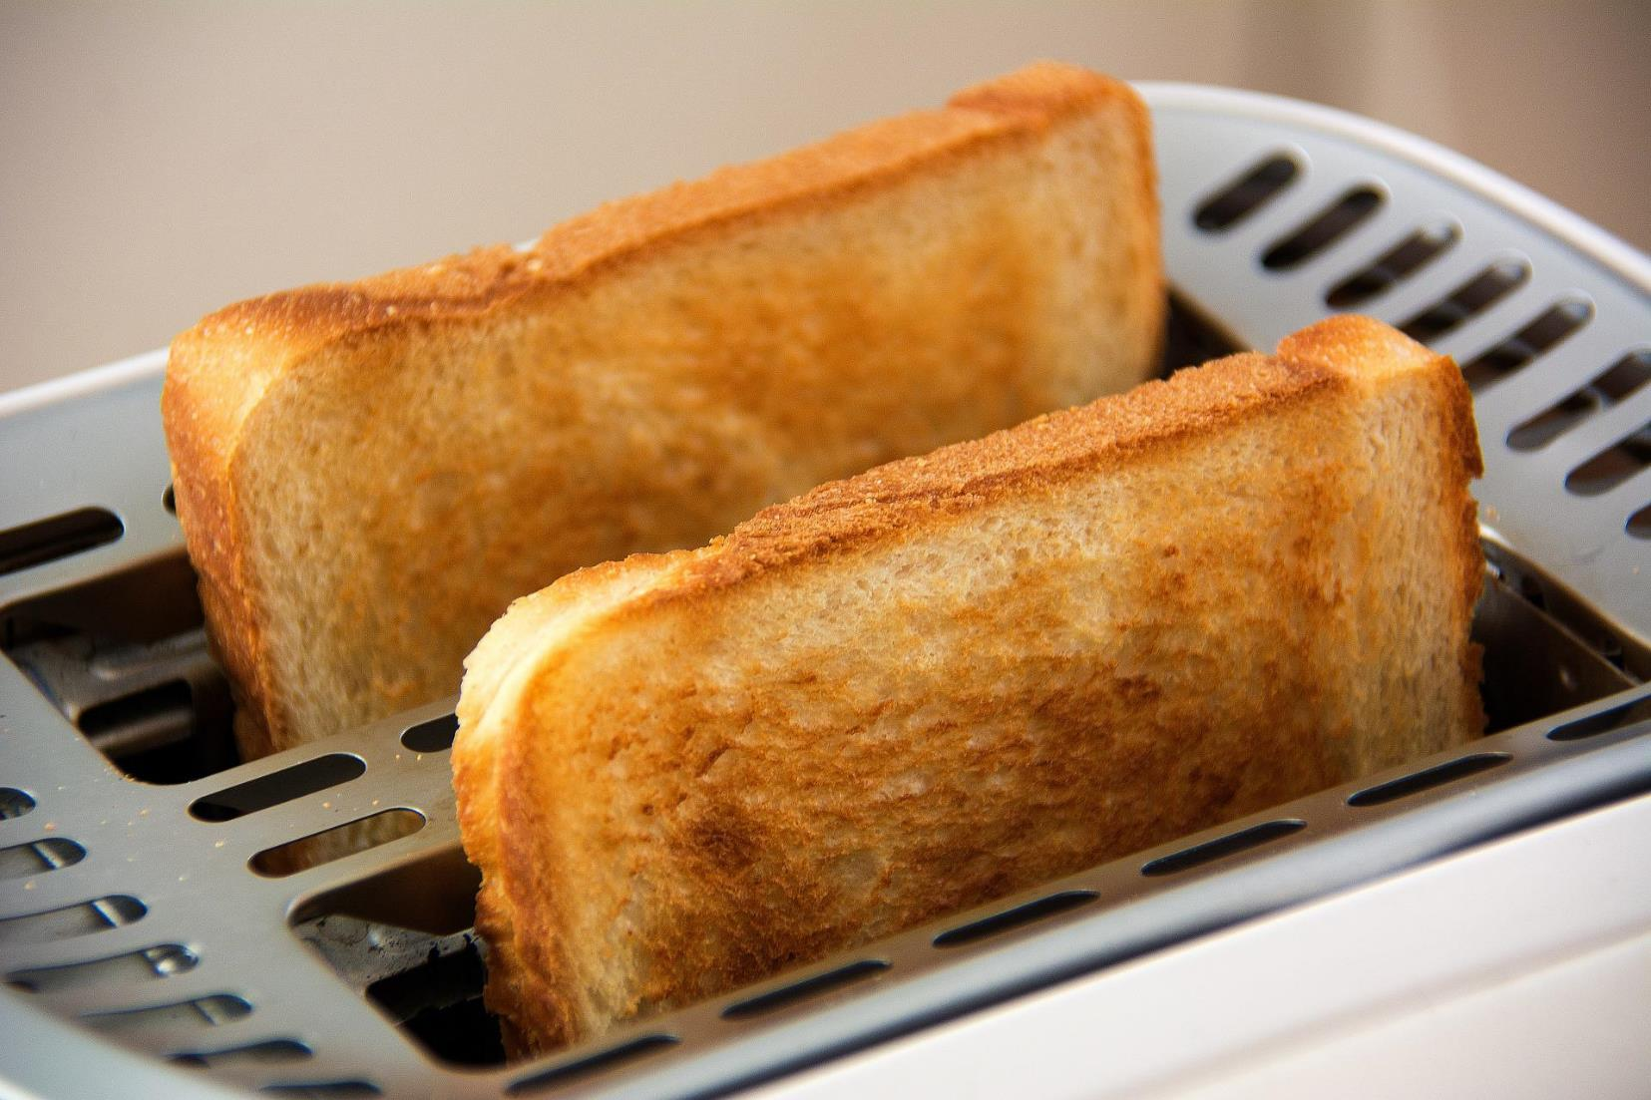
Image by Frank Oschatz from Pixabay
CHECK

Slide 9
pan tostado

Slide 10
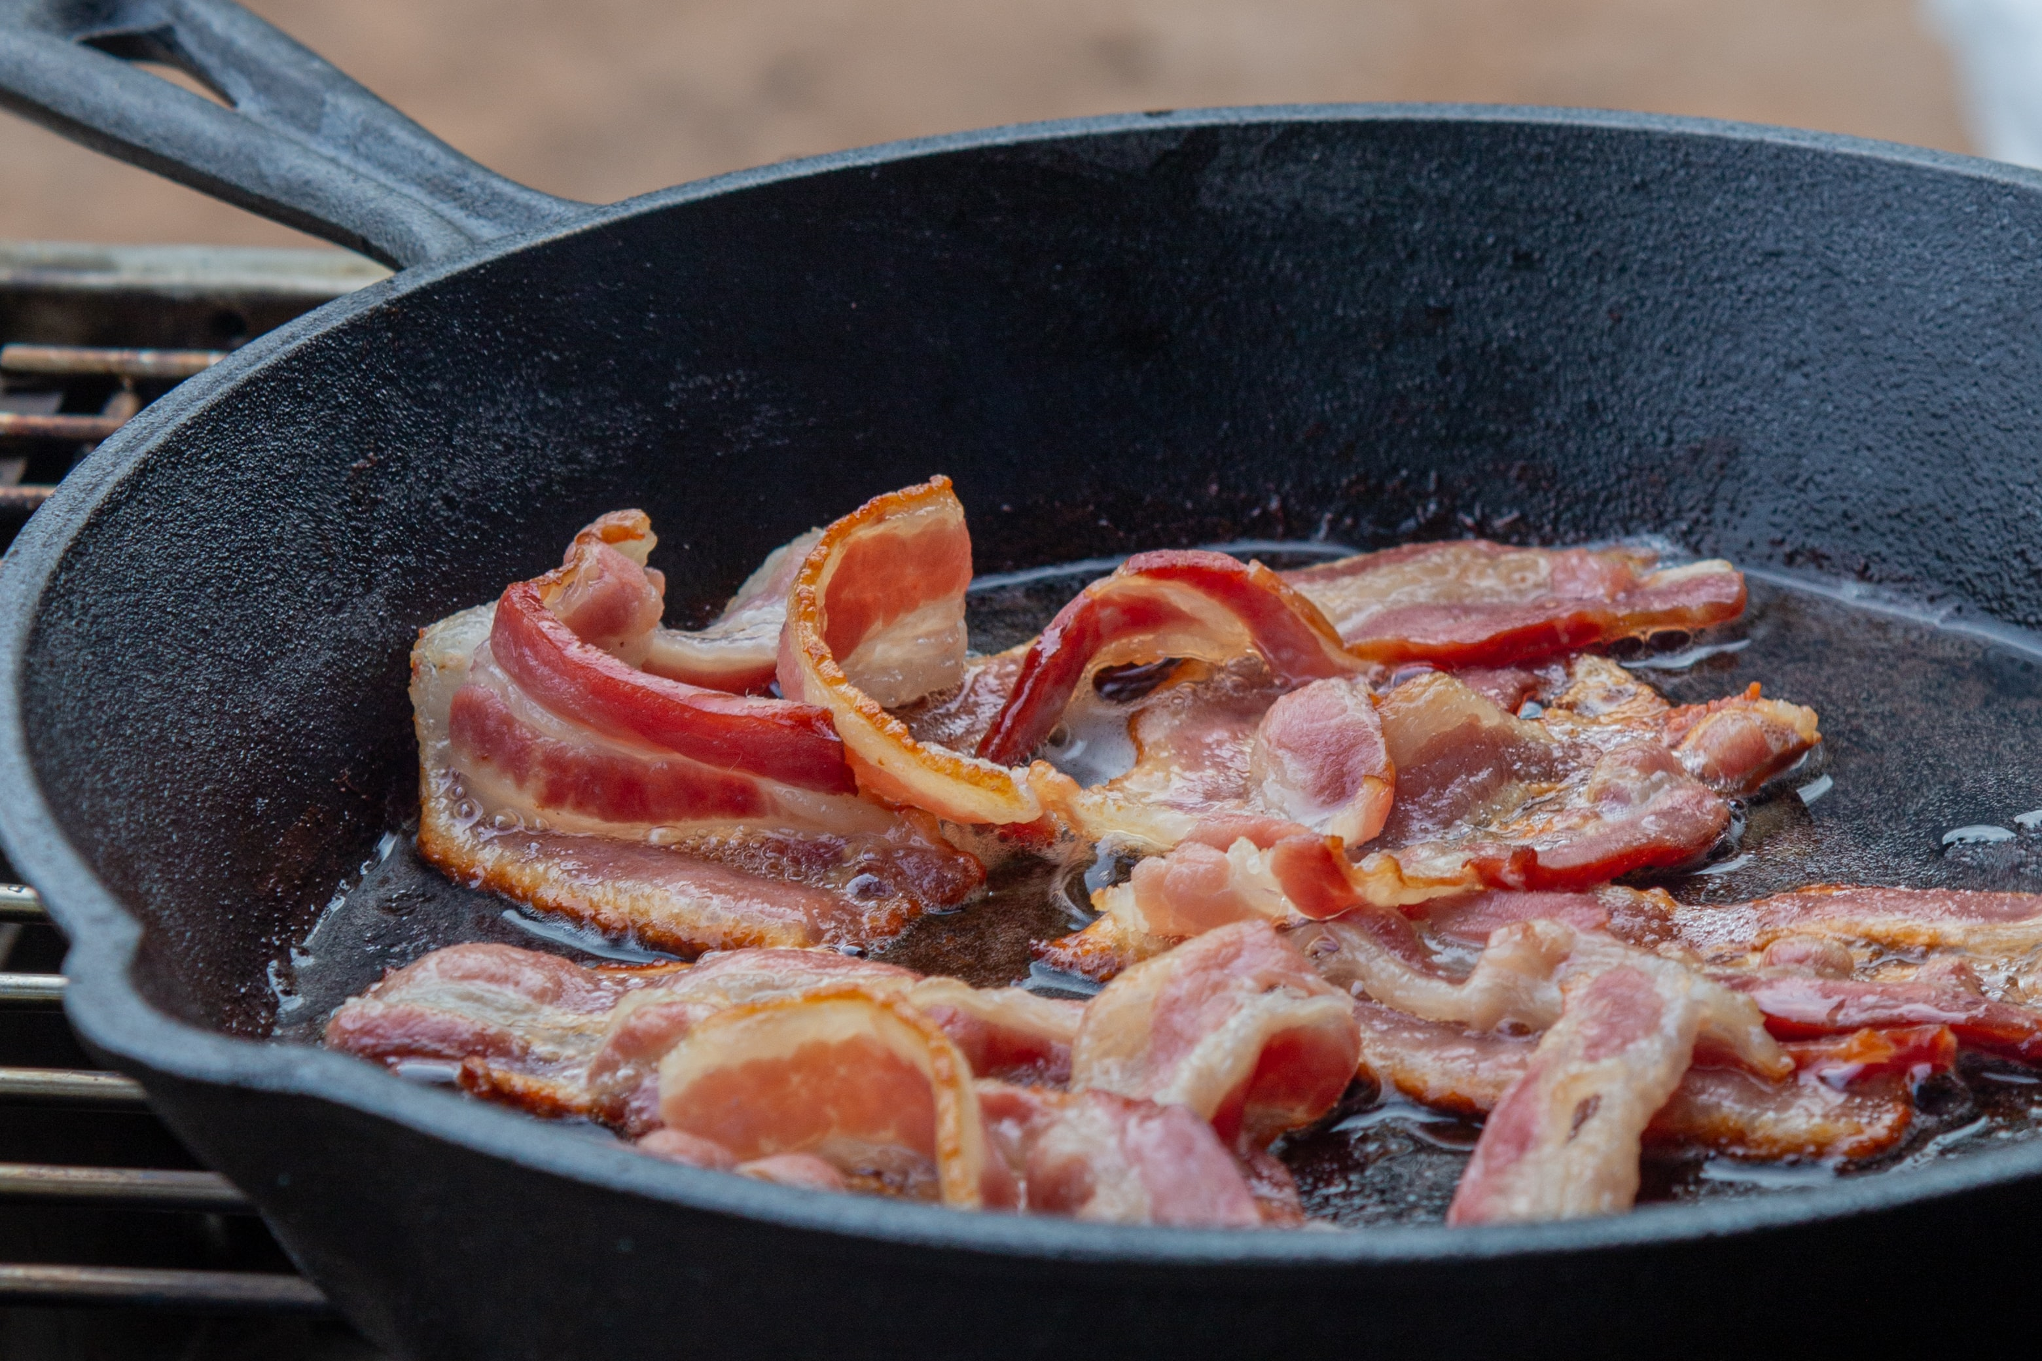
Photo by Michelle @New Layer Photography on Unsplash
CHECK

Slide 11
tocino

Slide 12
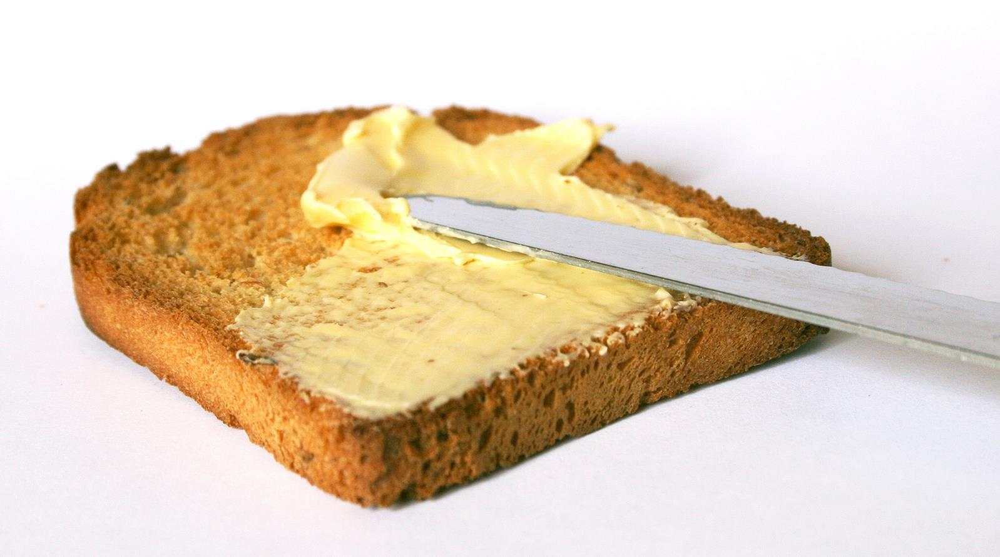
Image by lou_zeni from Pixabay
CHECK

Slide 13
mantequilla

Slide 14
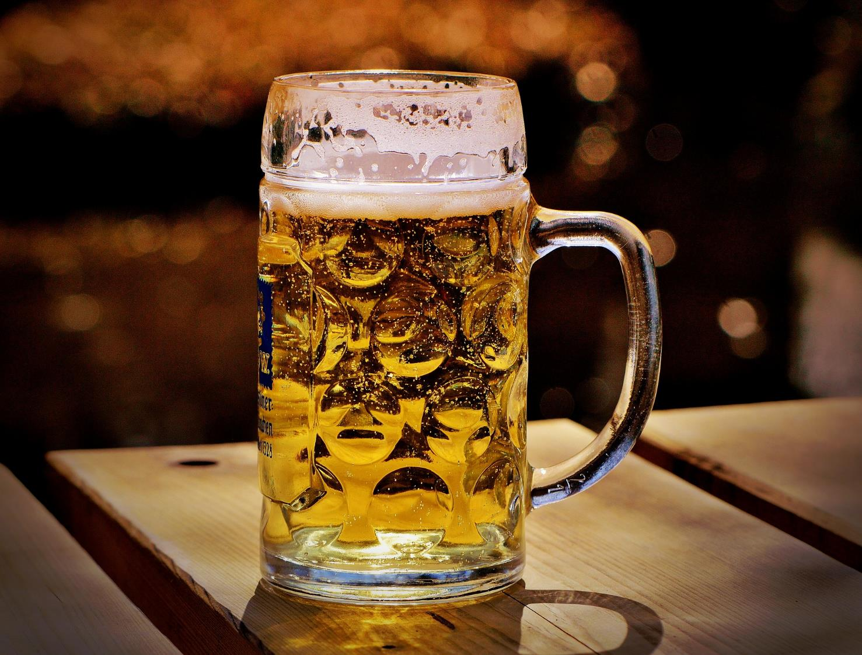
Image by Alexas_Fotos from Pixabay
CHECK

Slide 15
cerveza

Slide 16
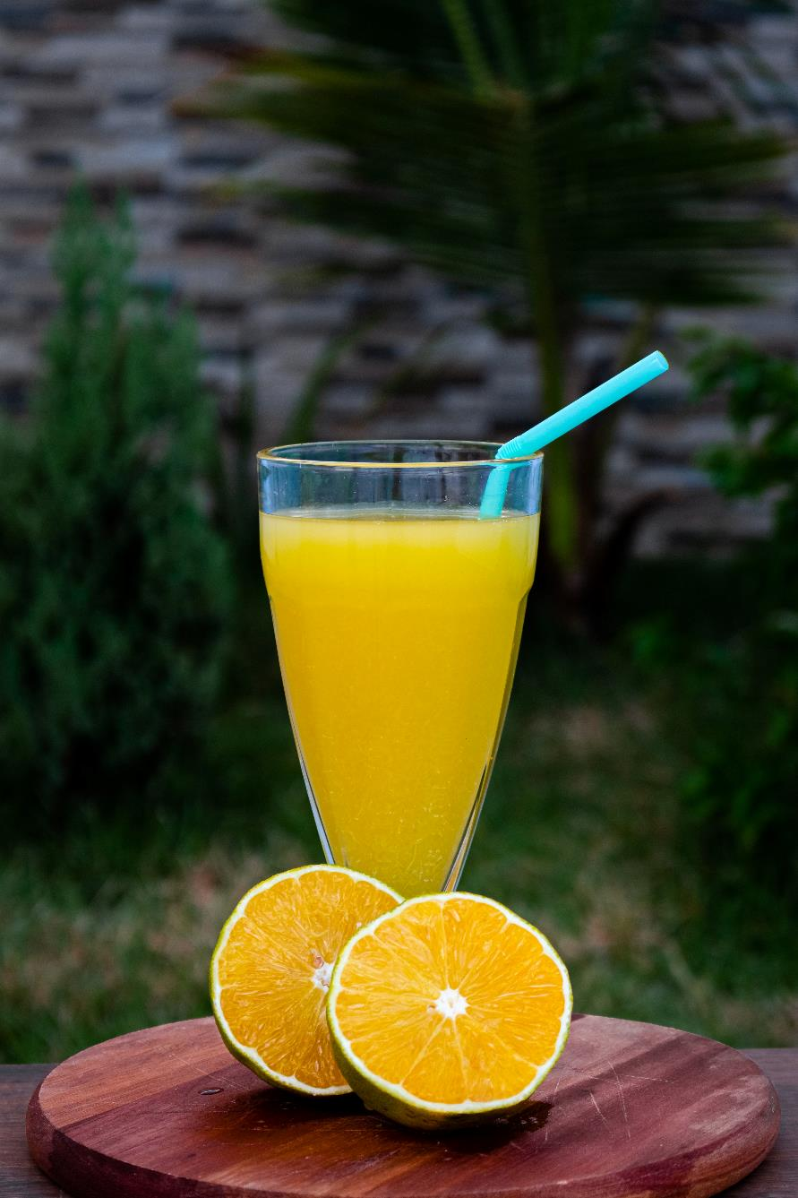
Photo by Nathália Arantes on Unsplash
CHECK

Slide 17
jugo de naranja

Slide 18
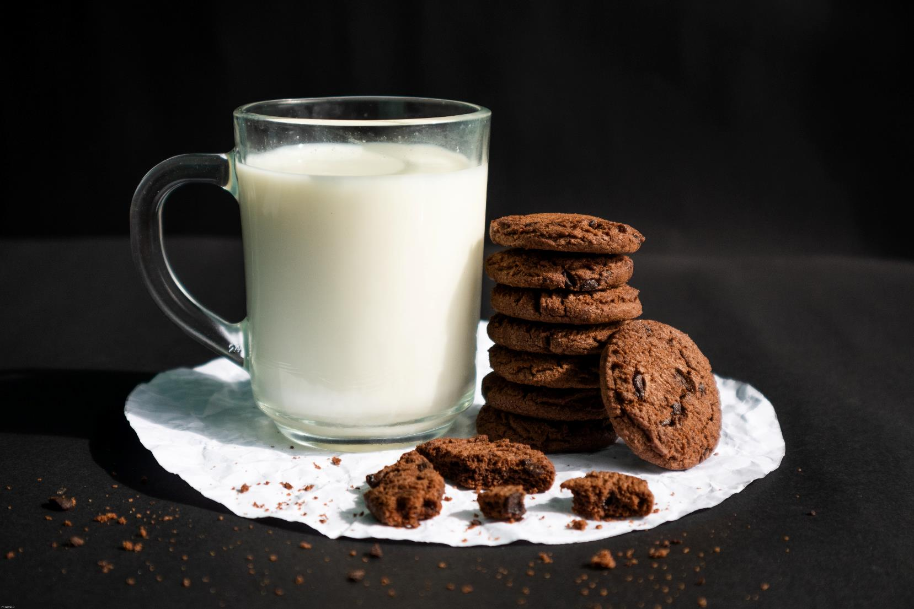
CHECK
Photo by Mirza Mustofa on Unsplash

Slide 19
leche

Slide 20
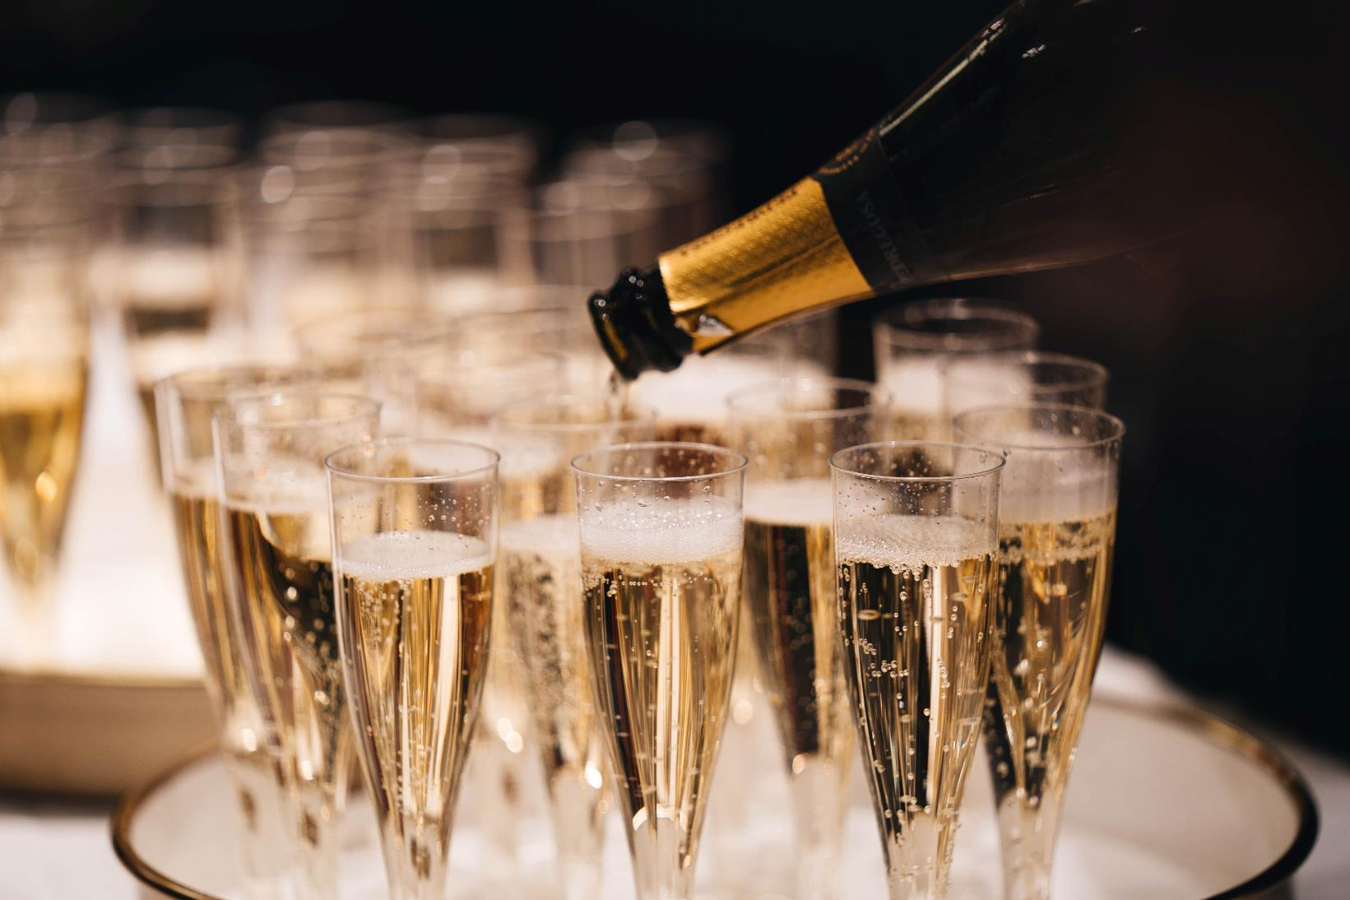
Photo by Alexander Naglestad on Unsplash
CHECK

Slide 21
champaña

Slide 22
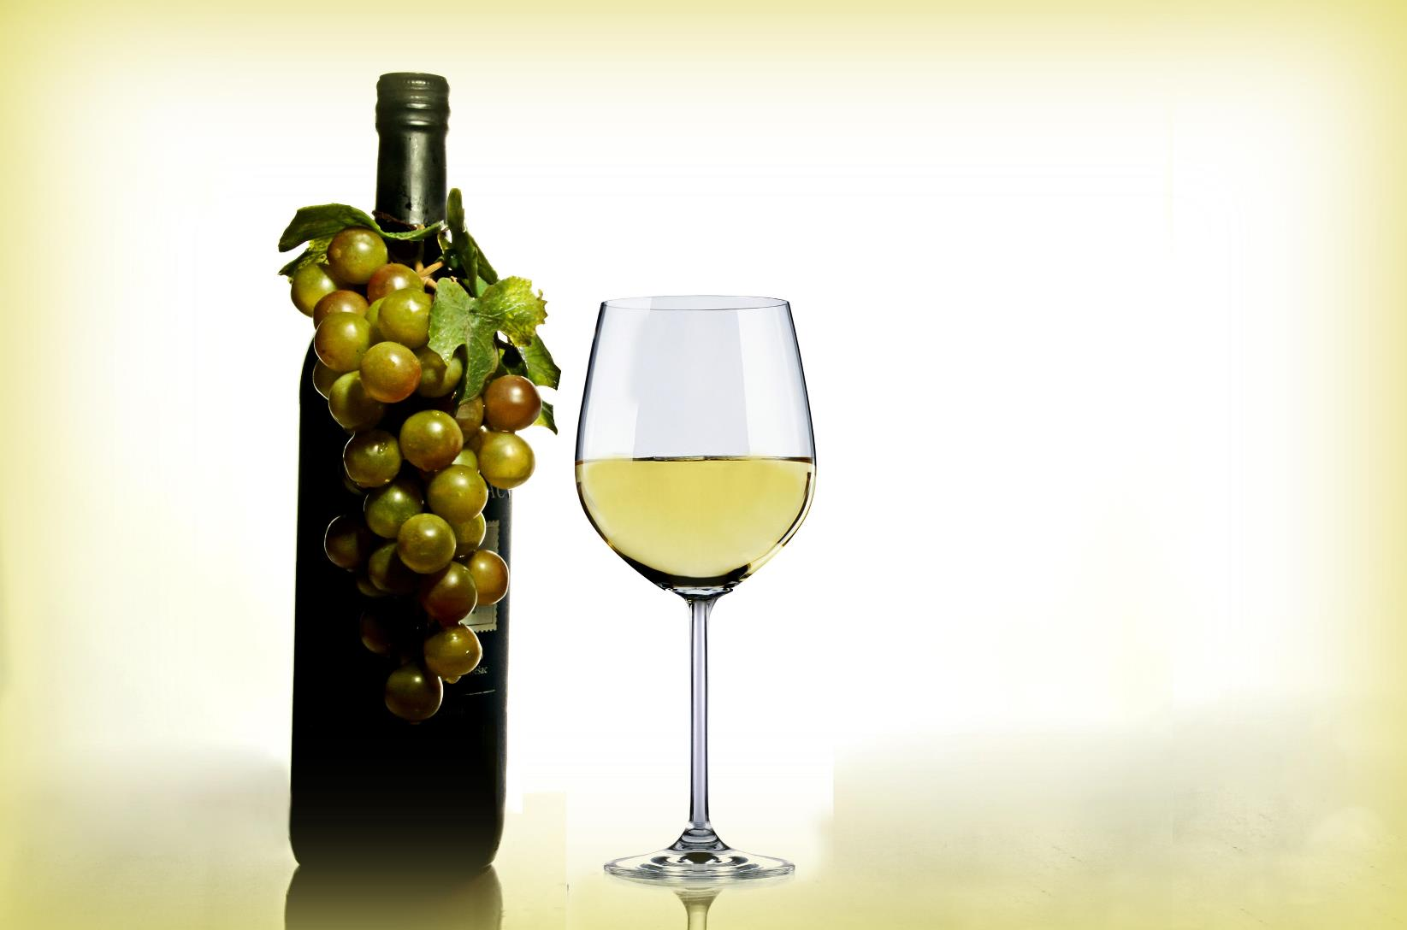
Image by 955169 from Pixabay
CHECK

Slide 23
vino

Slide 24
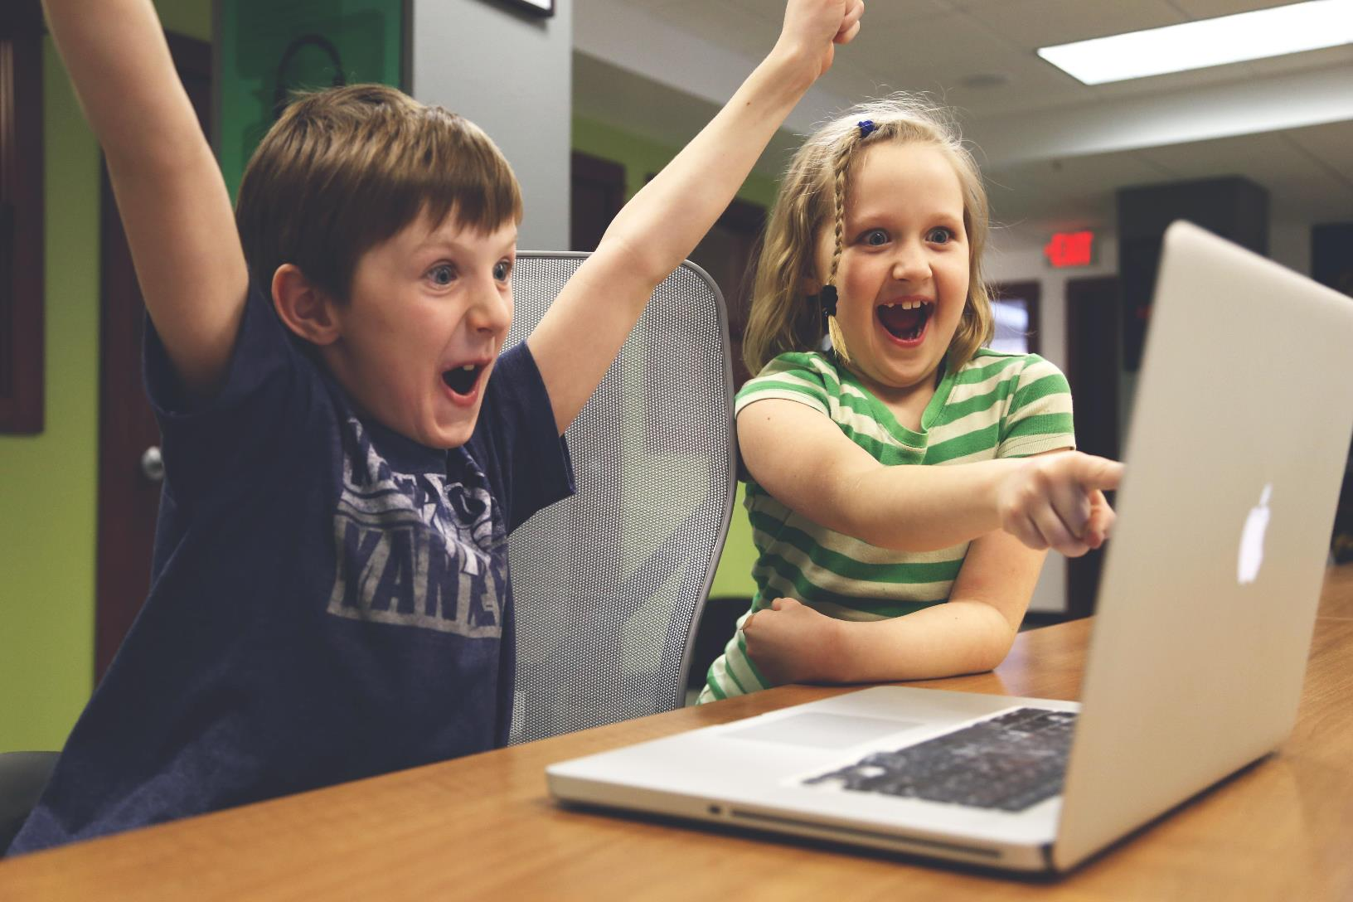
CHECK
Image by StartupStockPhotos from Pixabay

Slide 25
Los niños están contentos.

Slide 26
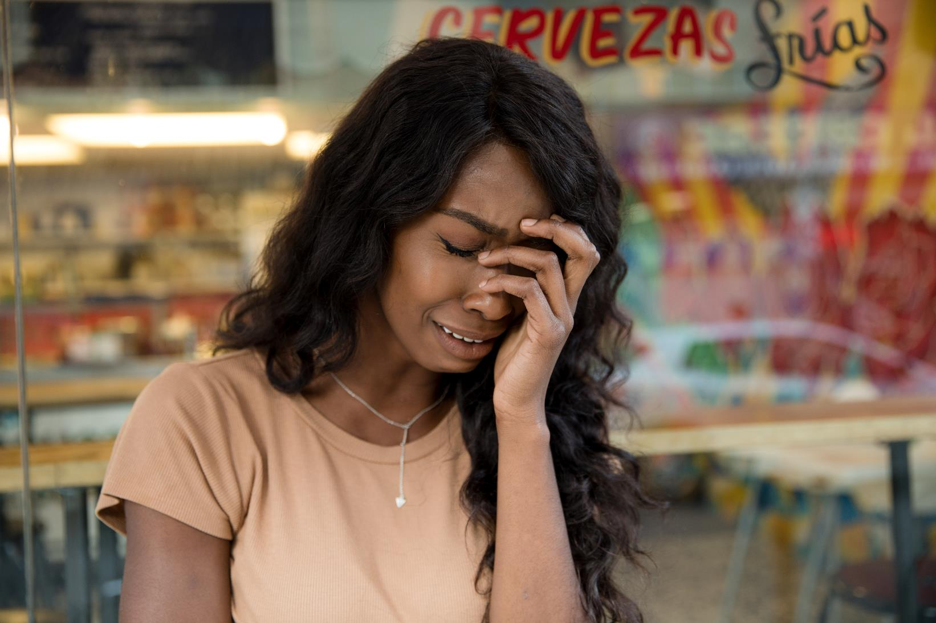
Photo by Thought Catalog on Unsplash
CHECK

Slide 27
La joven está triste.

Slide 28
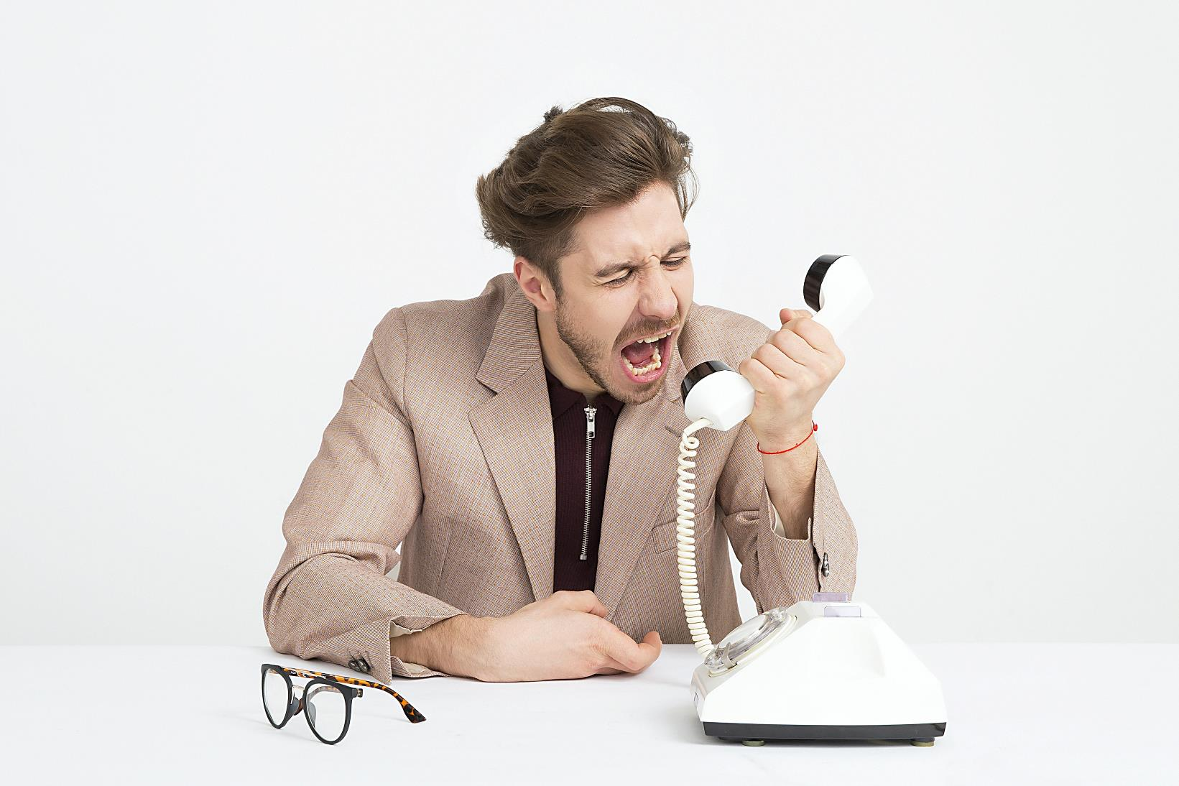
Photo by Icons8 Team on Unsplash
CHECK

Slide 29
El hombre está enojado.

Slide 30


Third Category - 400
INSERT QUESTION HERE
CHECK
Notes:
You will have to move the Daily Double picture out of the way to write the question. If you do not wish to have the Daily Double in the game, delete it and the sound clip (speaker) from this slide. For a Daily Double, the contestant has to wager at least $5 and at most the highest point value of any player/team at that point in the game. It is considered a True Daily Double if they wager all of their points and go “double or nothing”.

Slide 31
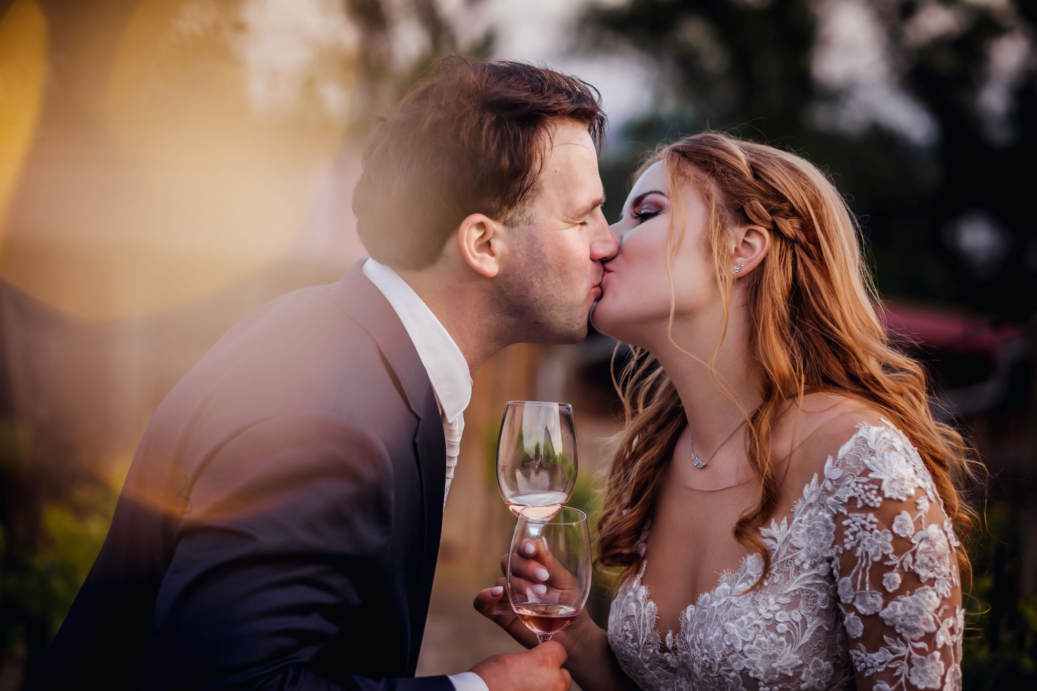

CHECK
Photo by Victoria Priessnitz on Unsplash
Notes:
You will have to move the Daily Double picture out of the way to write the question. If you do not wish to have the Daily Double in the game, delete it and the sound clip (speaker) from this slide. For a Daily Double, the contestant has to wager at least $5 and at most the highest point value of any player/team at that point in the game. It is considered a True Daily Double if they wager all of their points and go “double or nothing”.

Slide 32
Los novios están enamorados.

Slide 33
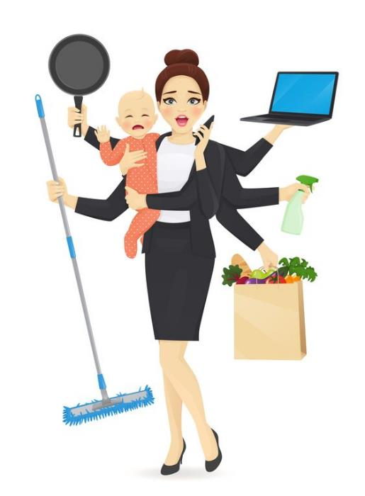
CHECK
Image from Pinterest

Slide 34
La mamá está muy ocupada..

Slide 35
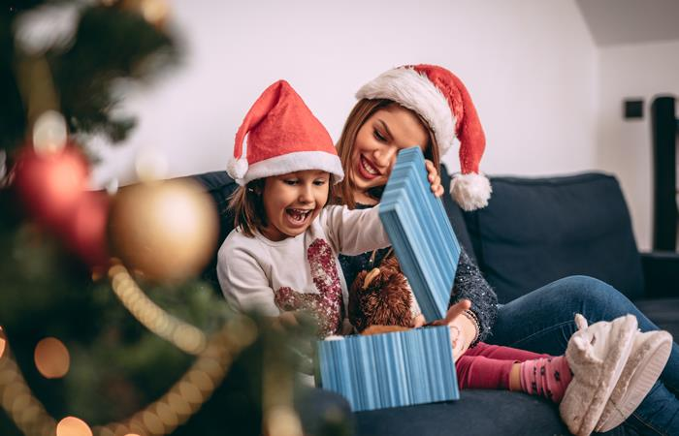
La niña ___ un regalo.
CHECK
Image from Colombia.com

Slide 36
abre

Slide 37
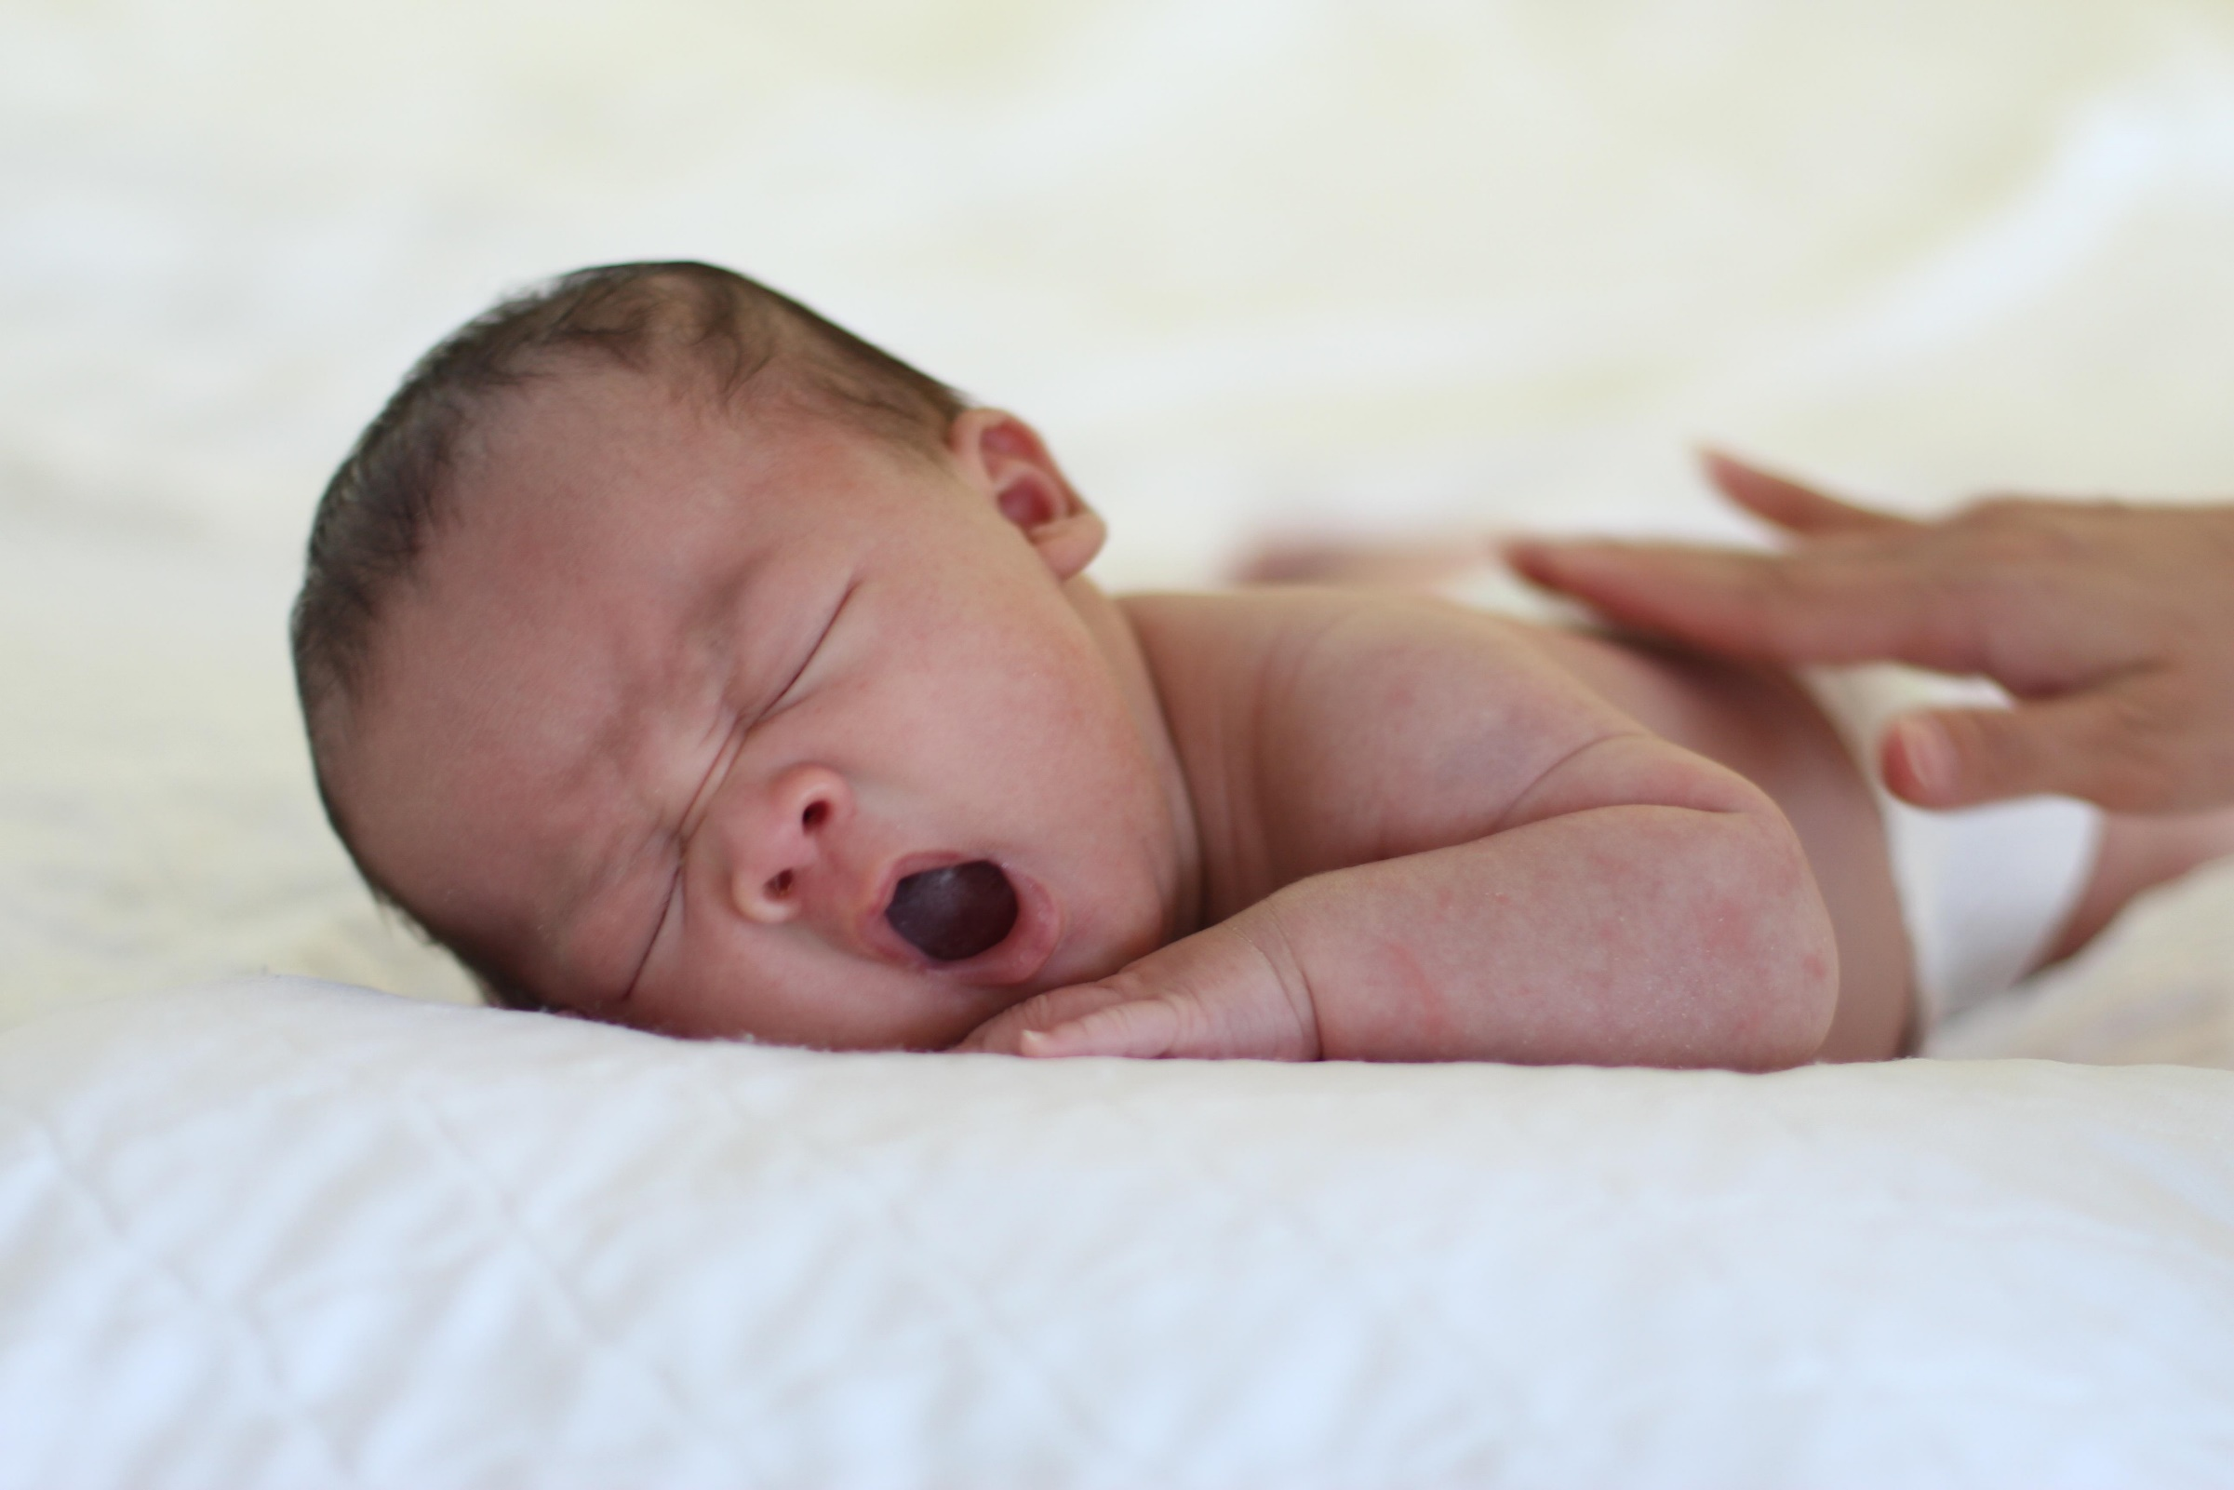
El bebé ____.
CHECK
Image by tung256 from Pixabay

Slide 38
bosteza

Slide 39
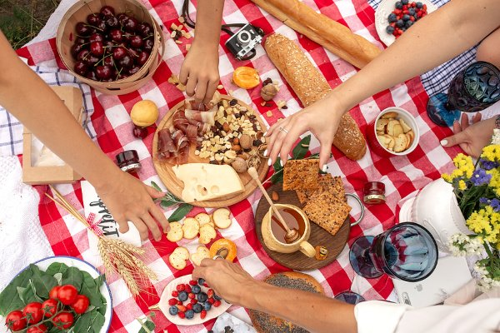
La familia ___ en el parque.
Image from Meraki Lane
CHECK

Slide 40
merienda

Slide 41
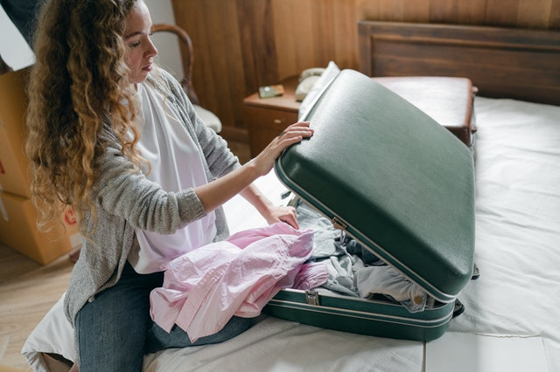
La chica va a viajar y tiene que ___
Image from Exytures
CHECK

Slide 42
hacer la maleta

Slide 43
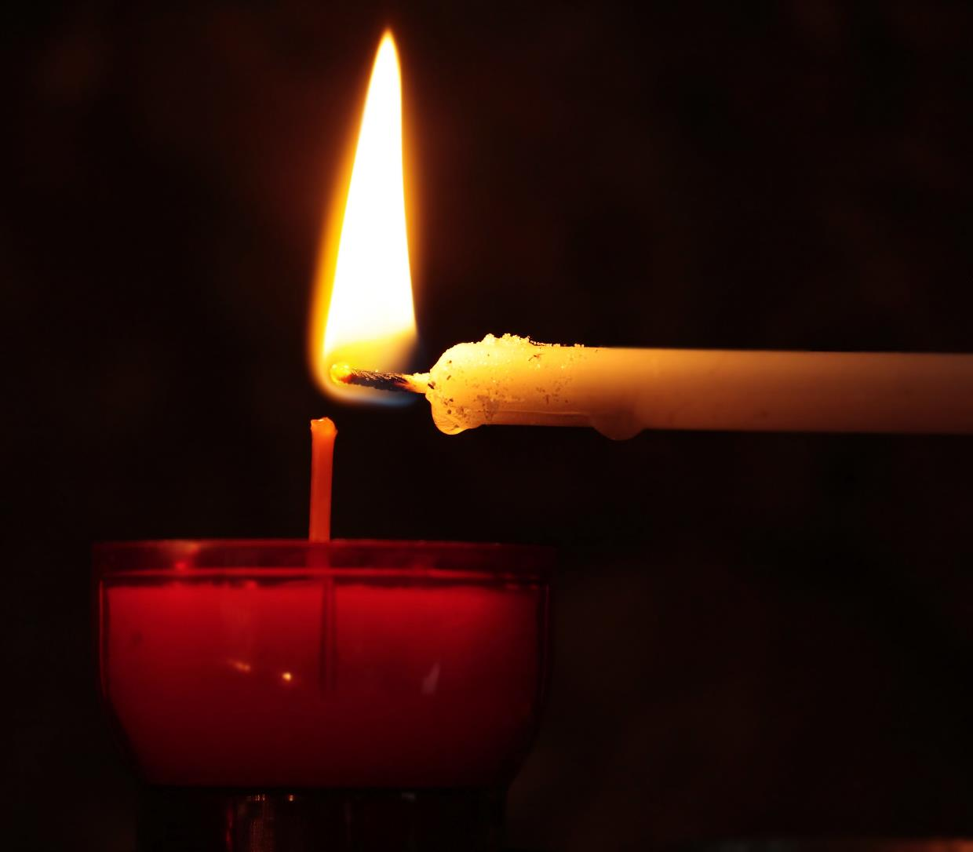
Una persona ___ la vela.
CHECK
Image by S. Hermann & F. Richter from Pixabay

Slide 44
enciende

Slide 45
Mucha gente celebra este día con un pavo y pasa tiempo con la familia y los amigos.
CHECK

Slide 46
Día de Acción de Gracias
(4° jueves de noviembre)

Slide 47
Los niños van de casa en casa y piden dulces.
CHECK

Slide 48
Día de las Brujas
(31 de octubre)

Slide 49
Este día es para celebrar a los parientes difuntos.
CHECK

Slide 50
Día de los Muertos
(2 de noviembre)

Slide 51
En este día, las familias se reúnen, hay mucha comida y bebida, y a medianoche, todos van a una misa especial.
CHECK

Slide 52
La Nochebuena
(24 de diciembre)

Slide 53
Tres hombres en camello
les traen regalos a los niños.
CHECK

Slide 54
Día de los Reyes Magos
(6 de enero)

Slide 55
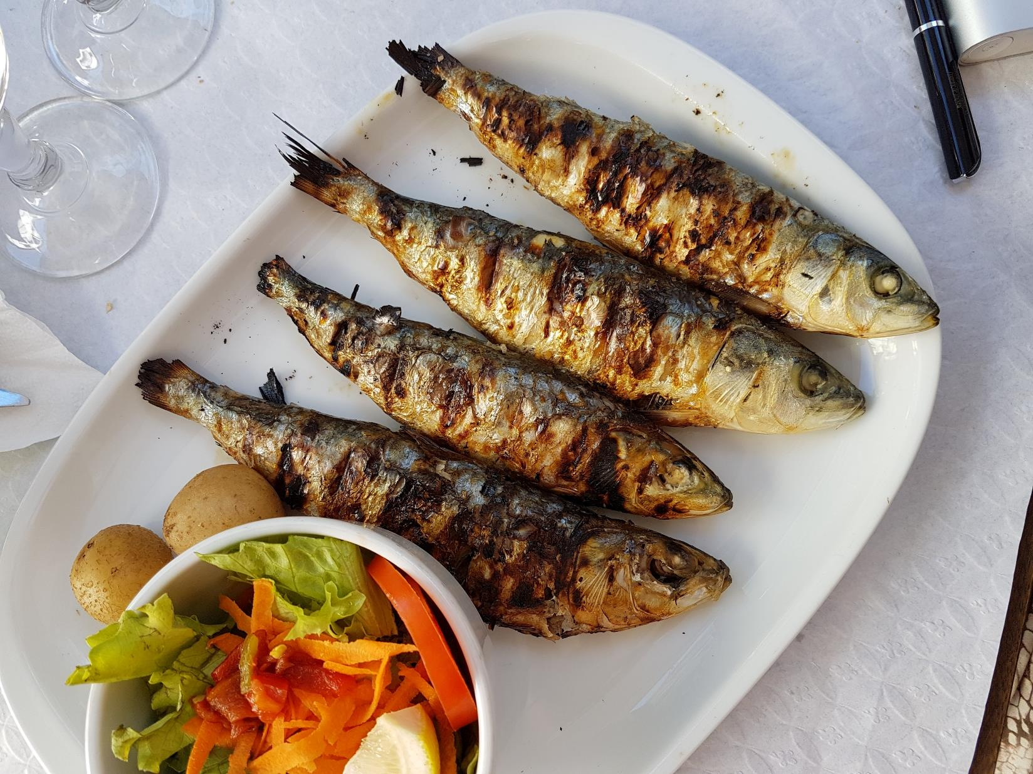
Photo by Alex Teixeira on Unsplash
CHECK

Slide 56
pescado

Slide 57
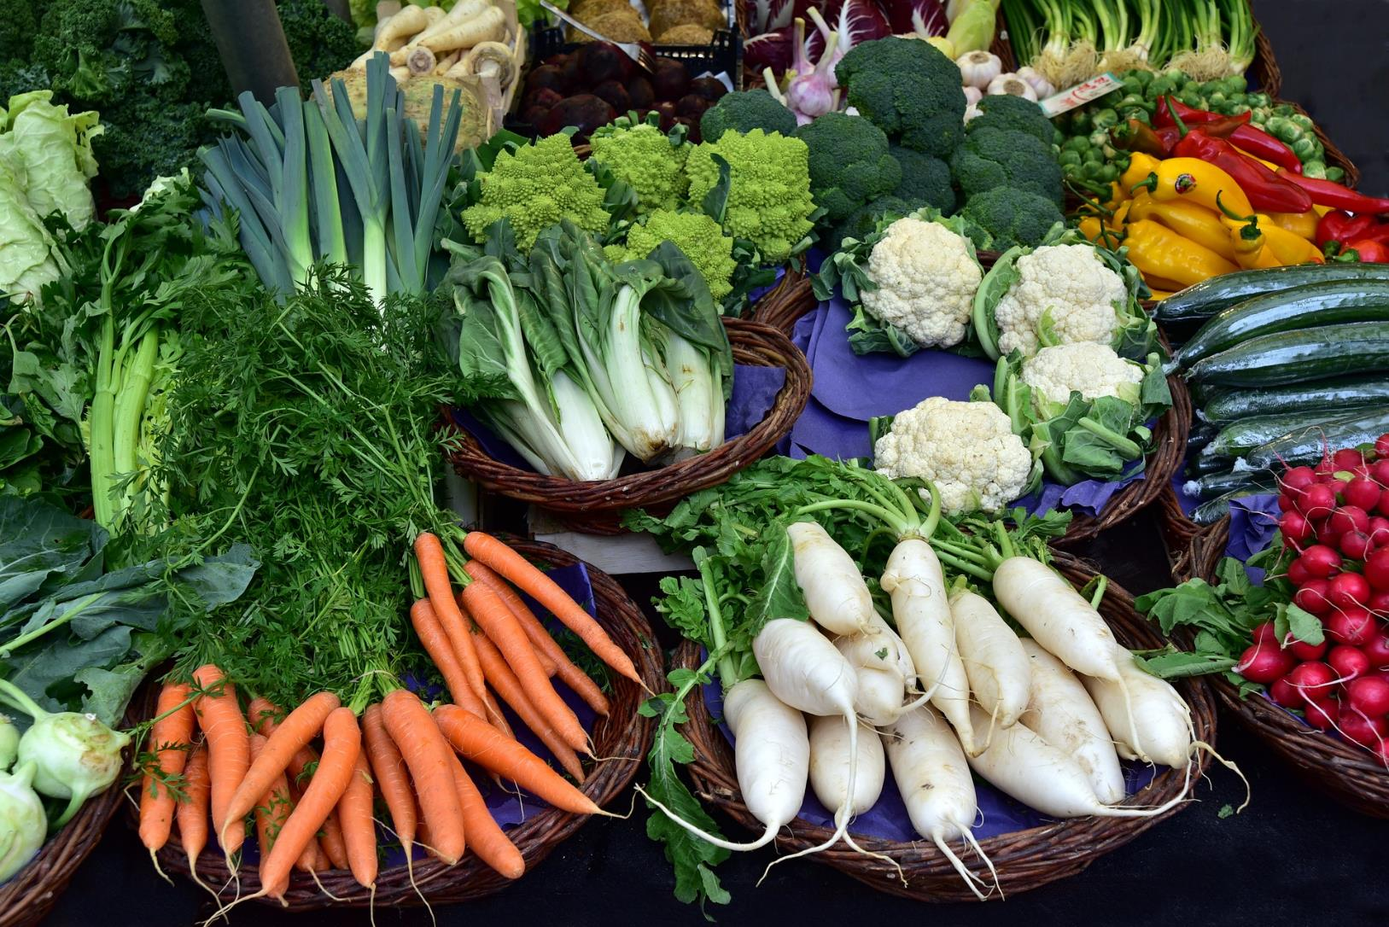
CHECK
Imagen de Ulrike Leone en Pixabay

Slide 58
verduras

Slide 59
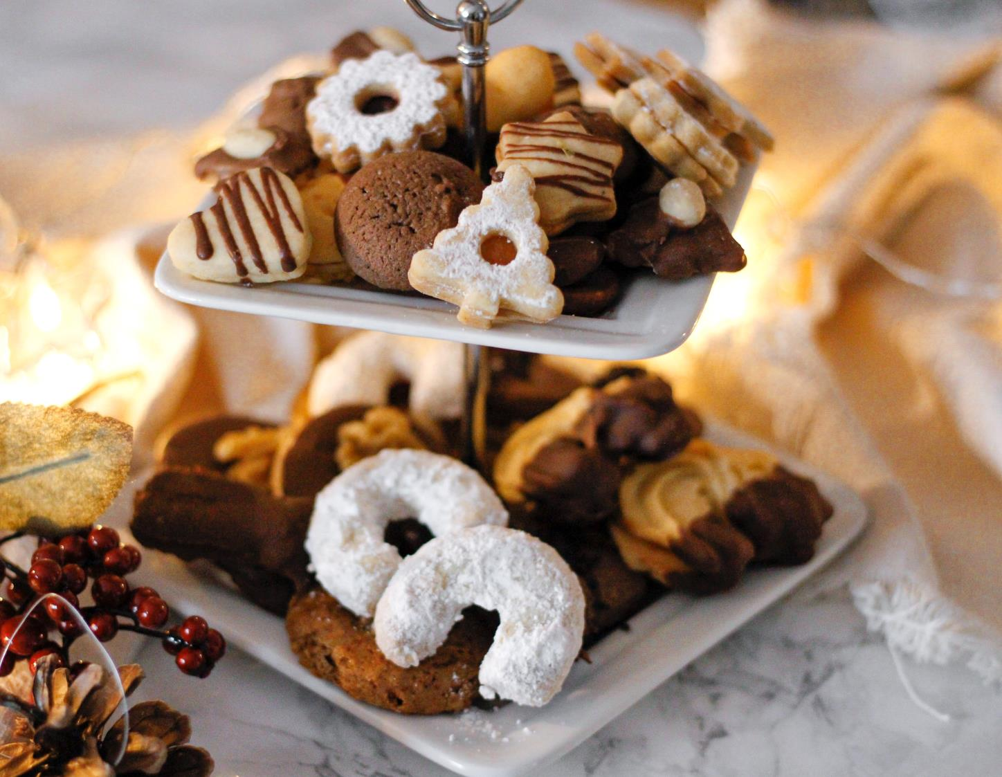
CHECK
Photo by Nina Plobner on Unsplash

Slide 60
galletas

Slide 61
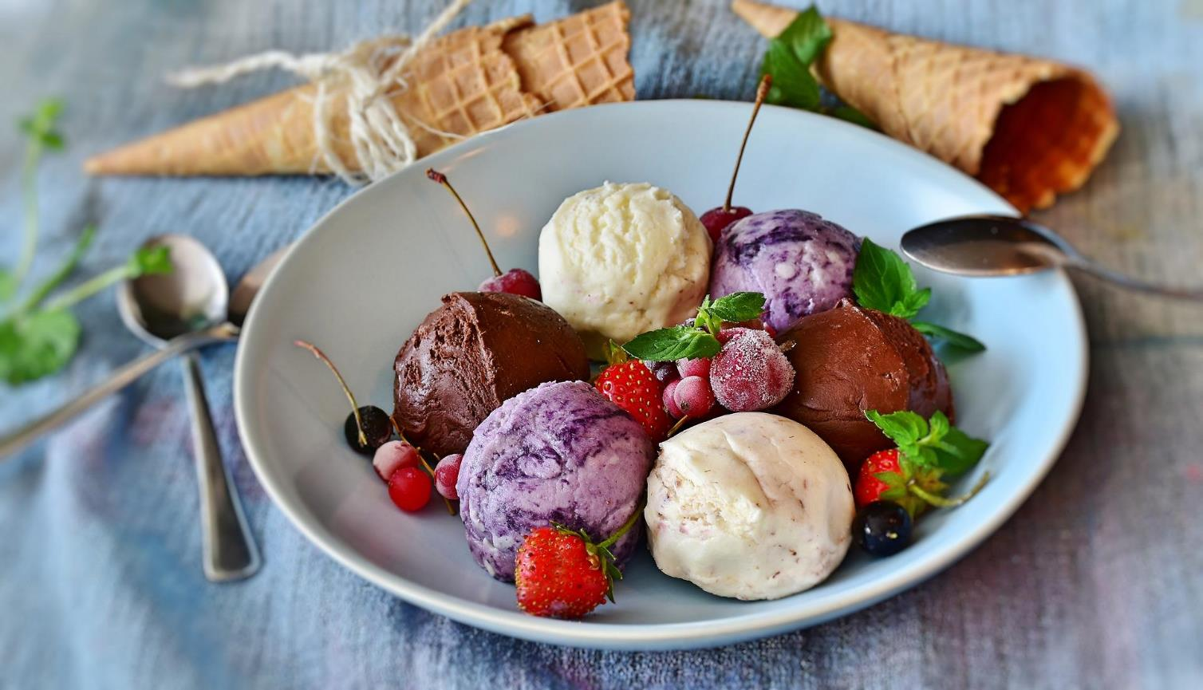
Imagen de RitaE en Pixabay
CHECK

Slide 62
helados

Slide 63
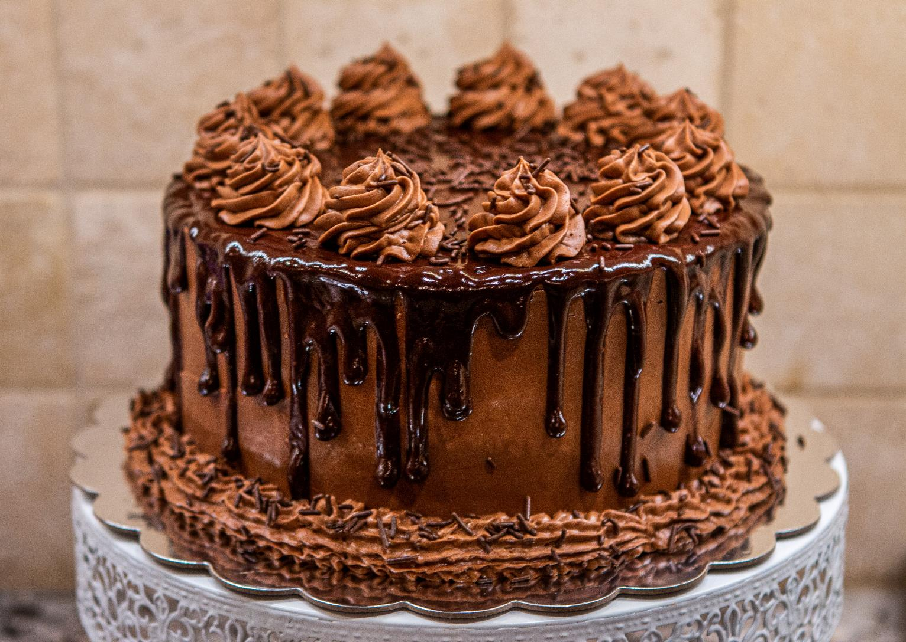
Photo by Phinehas Adams on Unsplash
CHECK

Slide 64
pastel

Slide 65
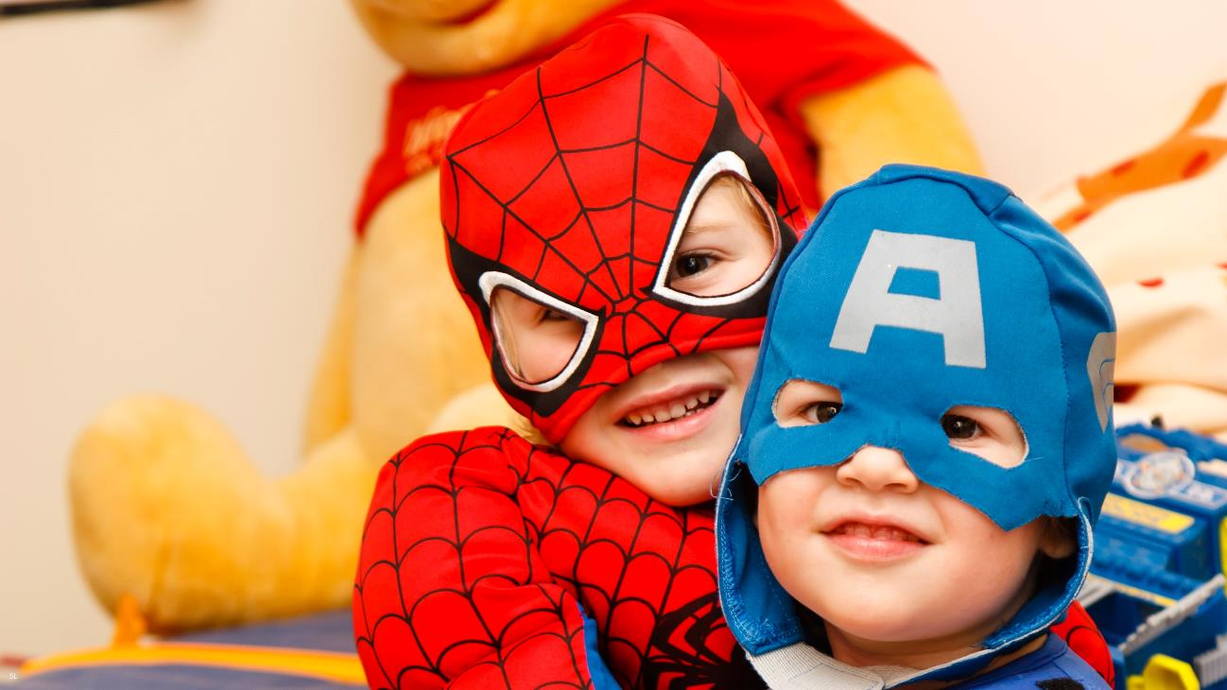
Los niños llevan un ___.
Photo by Steven Libralon on Unsplash
CHECK

Slide 66
disfraz

Slide 67
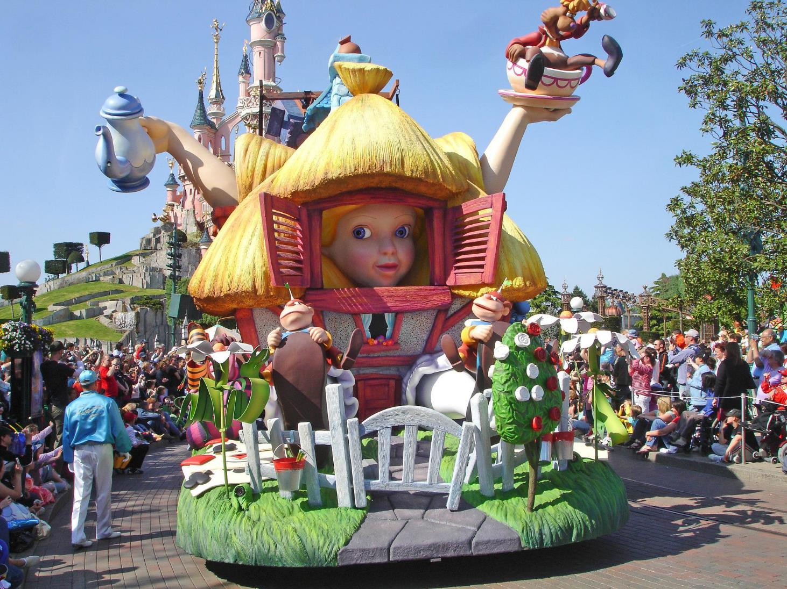
Todos los días hay un ___ en Disneylandia.
CHECK
Imagen de Aline Dassel en Pixabay

Slide 68
desfile

Slide 69
SEVENTH Category - 600
INSERT QUESTION HERE
CHECK
Notes:
You will have to move the Daily Double picture out of the way to write the question. If you do not wish to have the Daily Double in the game, delete it and the sound clip (speaker) from this slide. For a Daily Double, the contestant has to wager at least $5 and at most the highest point value of any player/team at that point in the game. It is considered a True Daily Double if they wager all of their points and go “double or nothing”.

Slide 70
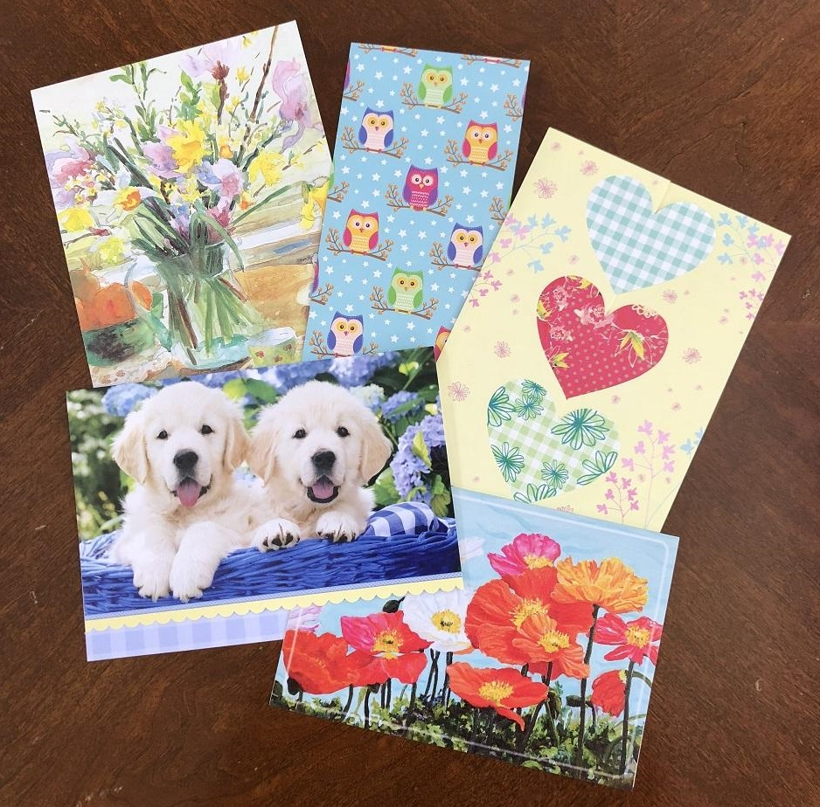
CHECK
Imagen de Beatrice Tseng
Notes:
You will have to move the Daily Double picture out of the way to write the question. If you do not wish to have the Daily Double in the game, delete it and the sound clip (speaker) from this slide. For a Daily Double, the contestant has to wager at least $5 and at most the highest point value of any player/team at that point in the game. It is considered a True Daily Double if they wager all of their points and go “double or nothing”.

Slide 71
tarjetas

Slide 72
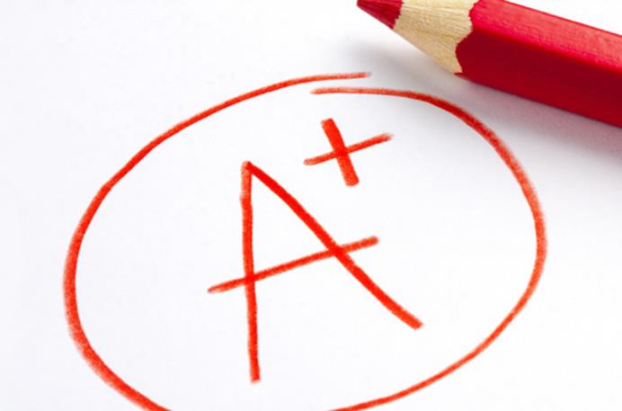
SEVENTH Category ?- 800
Imagen por Universia
CHECK

Slide 73
nota

Slide 74
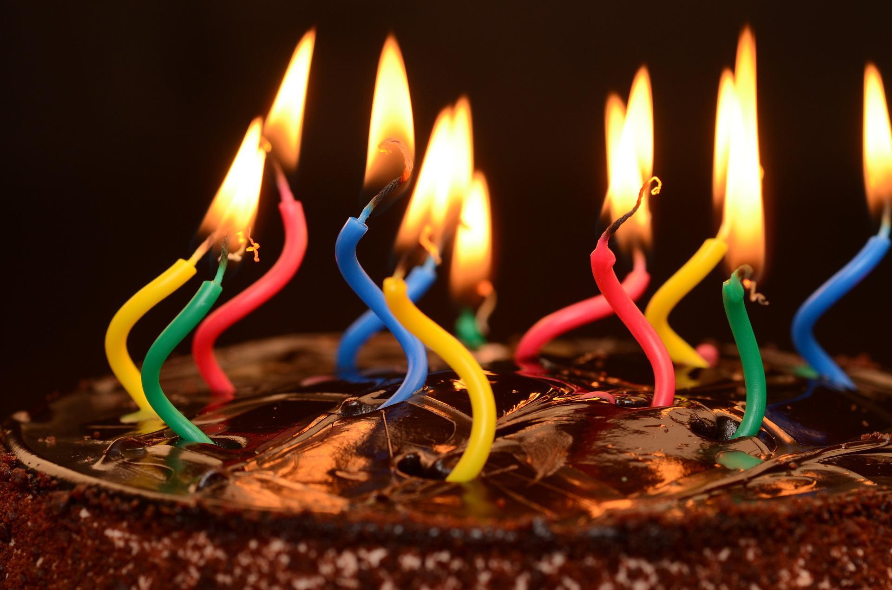
CHECK
Imagen de diapicard en Pixabay

Slide 75
velas

Slide 76
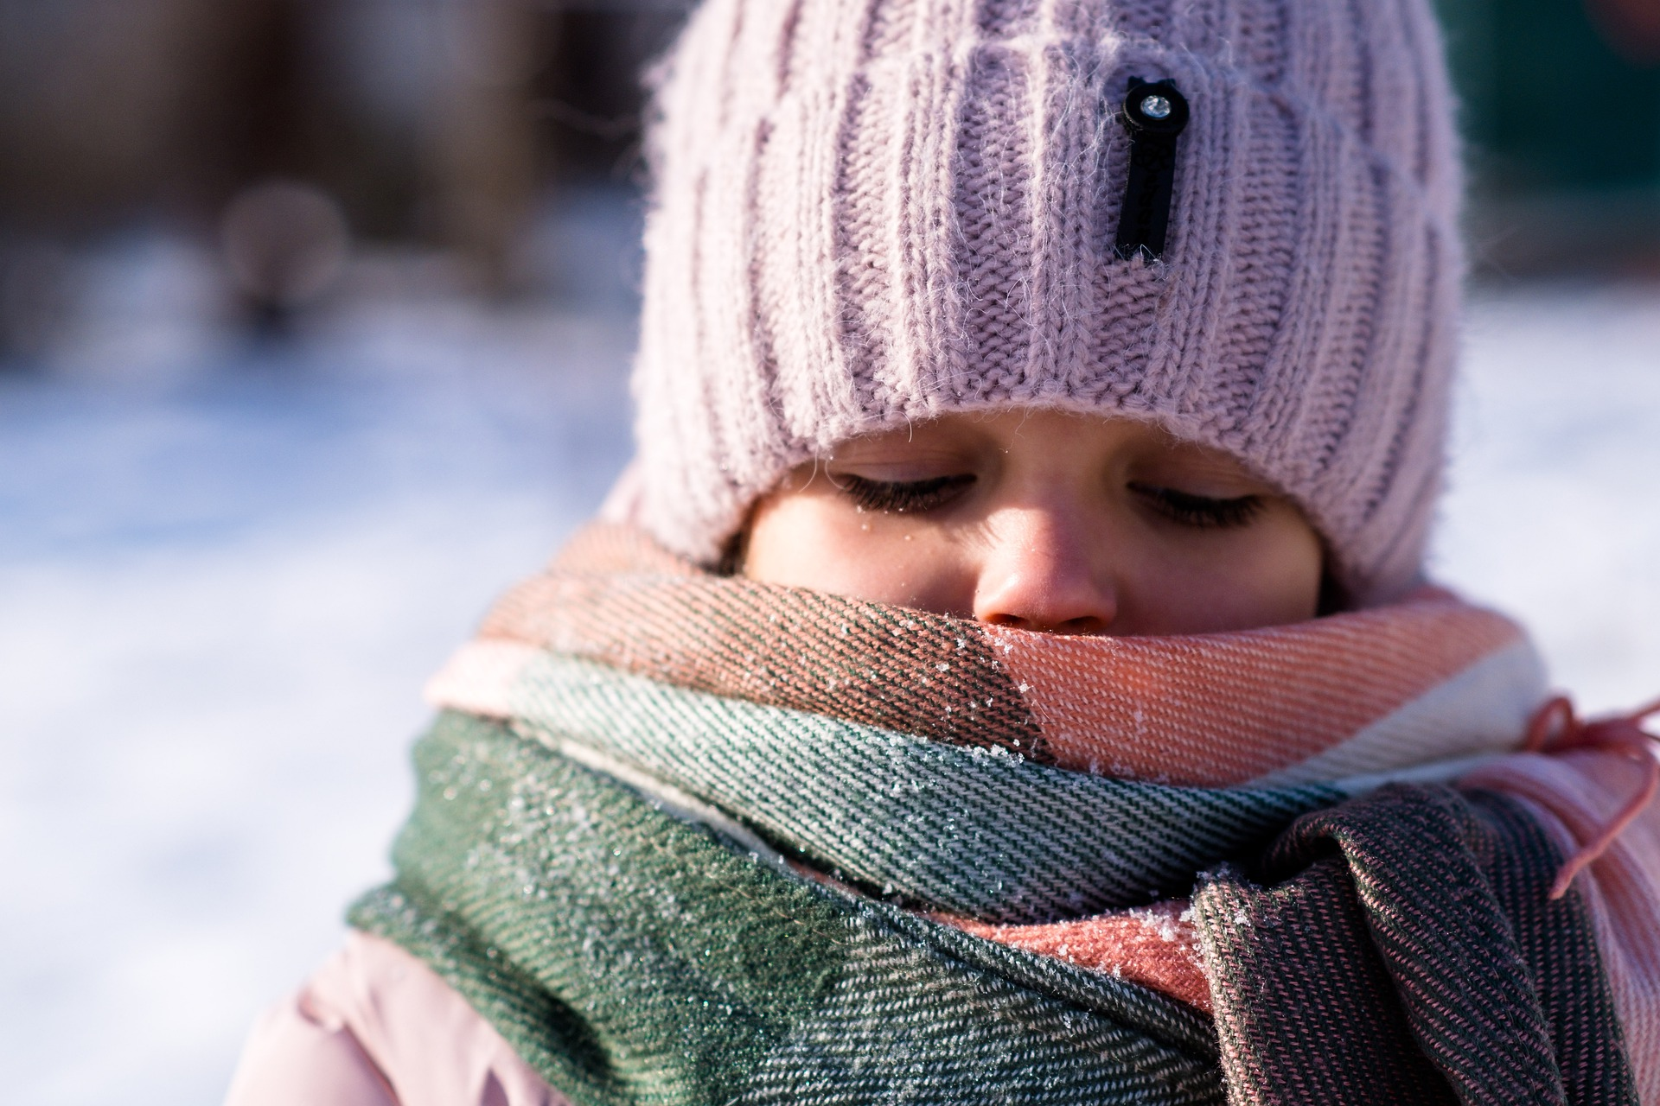
Imagen de Dmitriy Gutarev en Pixabay
CHECK

Slide 77
El niño tiene frío.

Slide 78
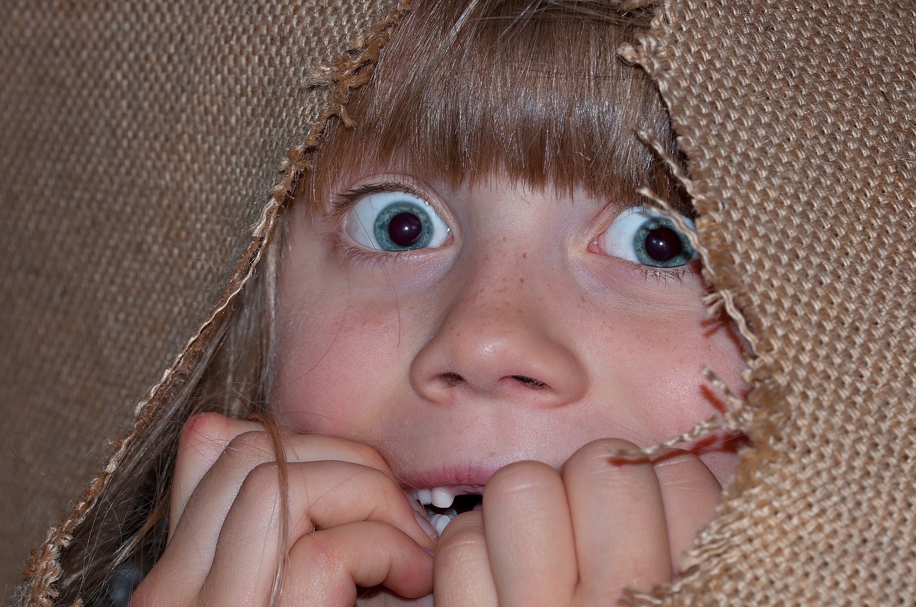
Imagen de Pezibear en Pixabay
CHECK

Slide 79
El niño tiene miedo.

Slide 80
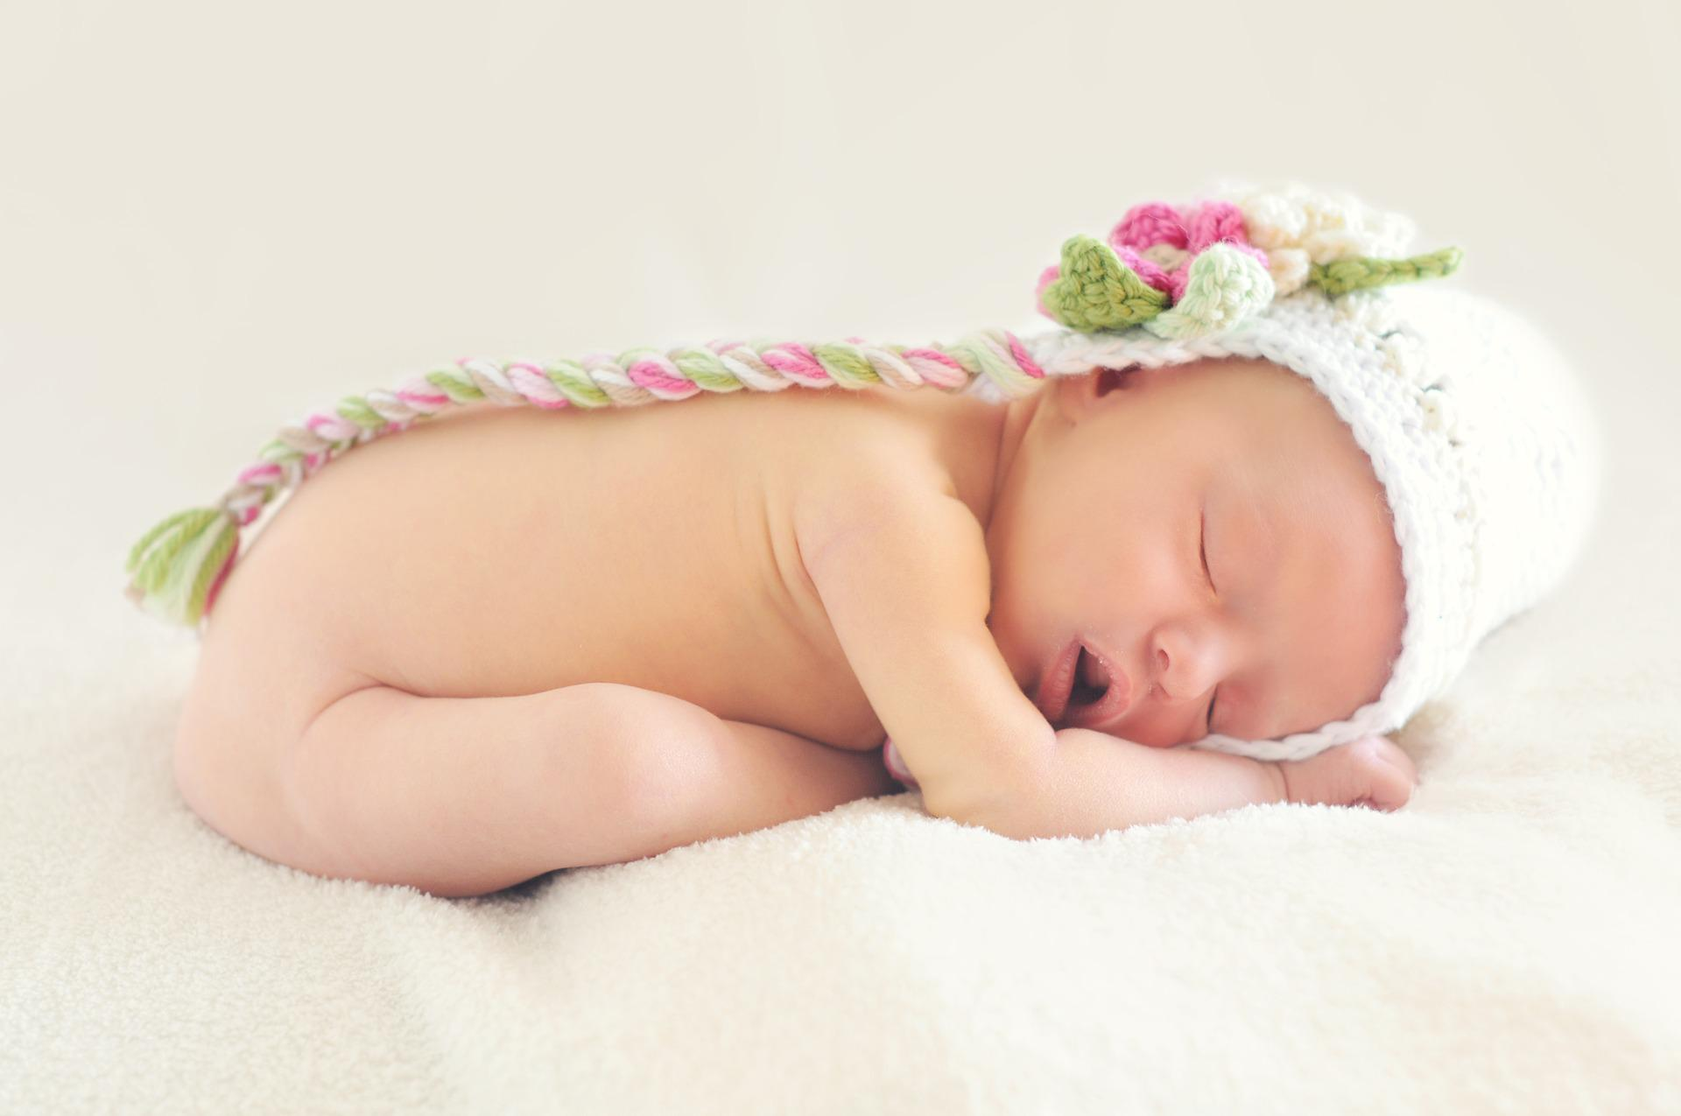
CHECK
Imagen de Tawny Nina Botha en Pixabay

Slide 81
La bebé tiene sueño.

Slide 82
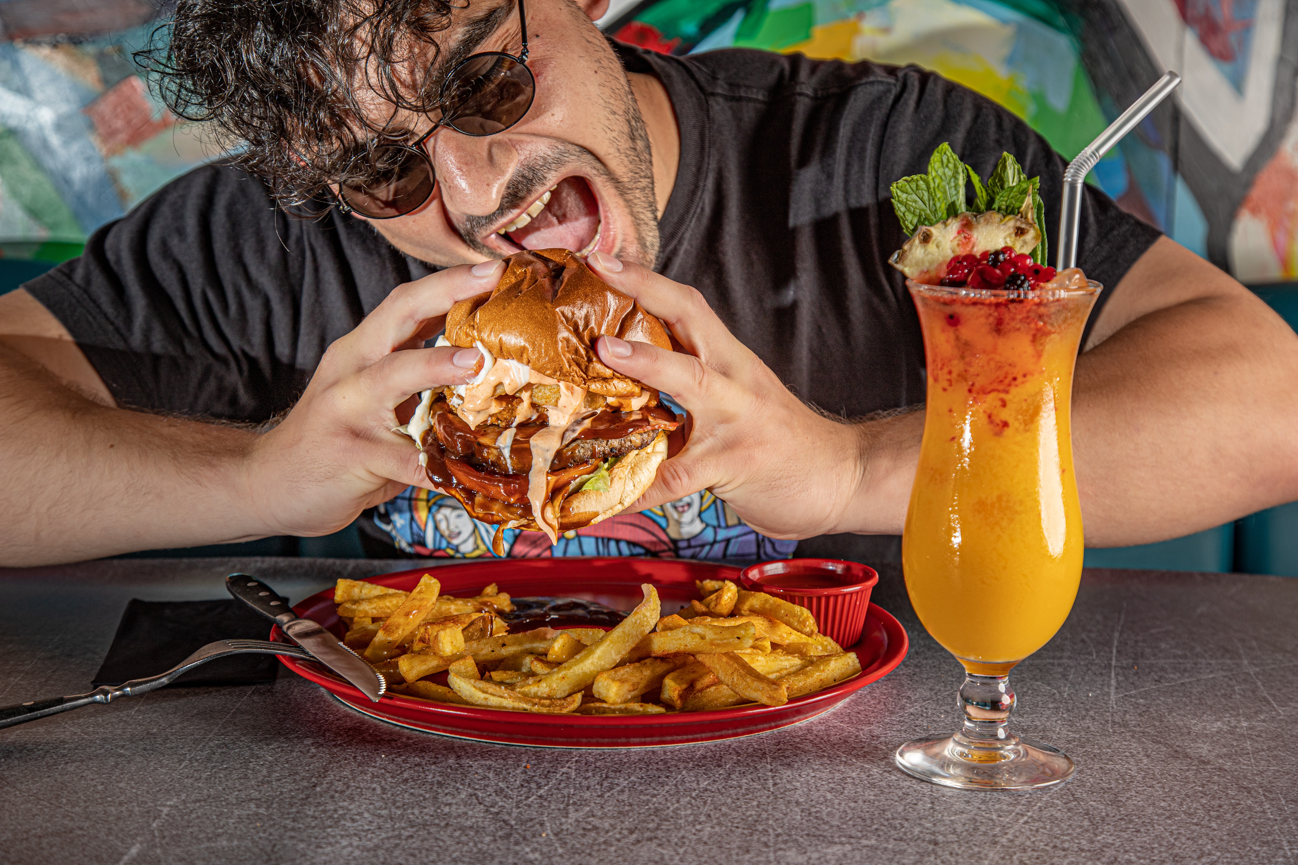
CHECK
Photo by The BlackRabbit on Unsplash

Slide 83
Este hombre tiene hambre.

Slide 84
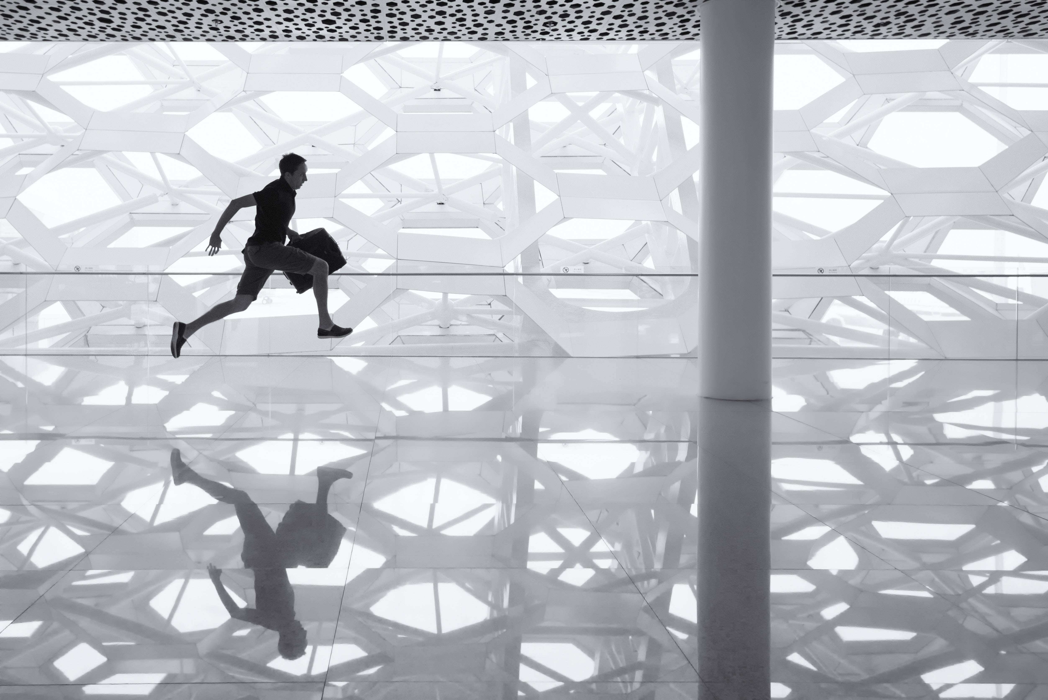
Photo by Andy Beales on Unsplash
CHECK

Slide 85
El hombre tiene prisa.

Slide 86
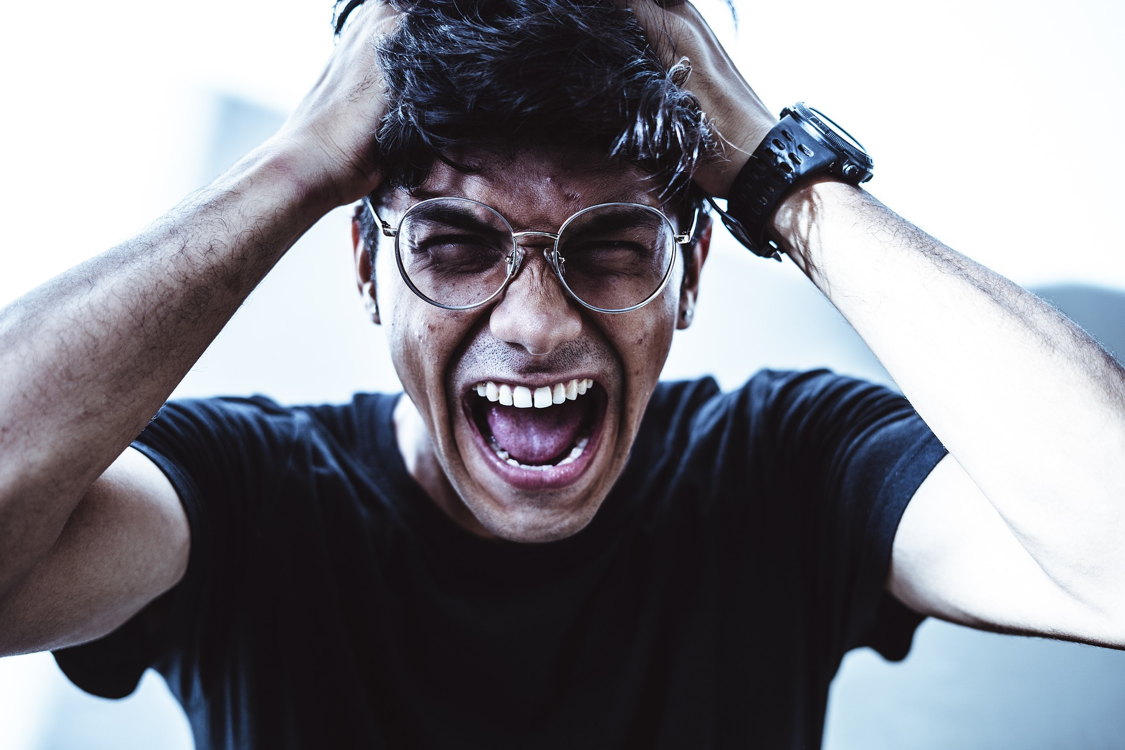
CHECK
Imagen de Yogendra Singh en Pixabay

Slide 87
El hombre grita.

Slide 88
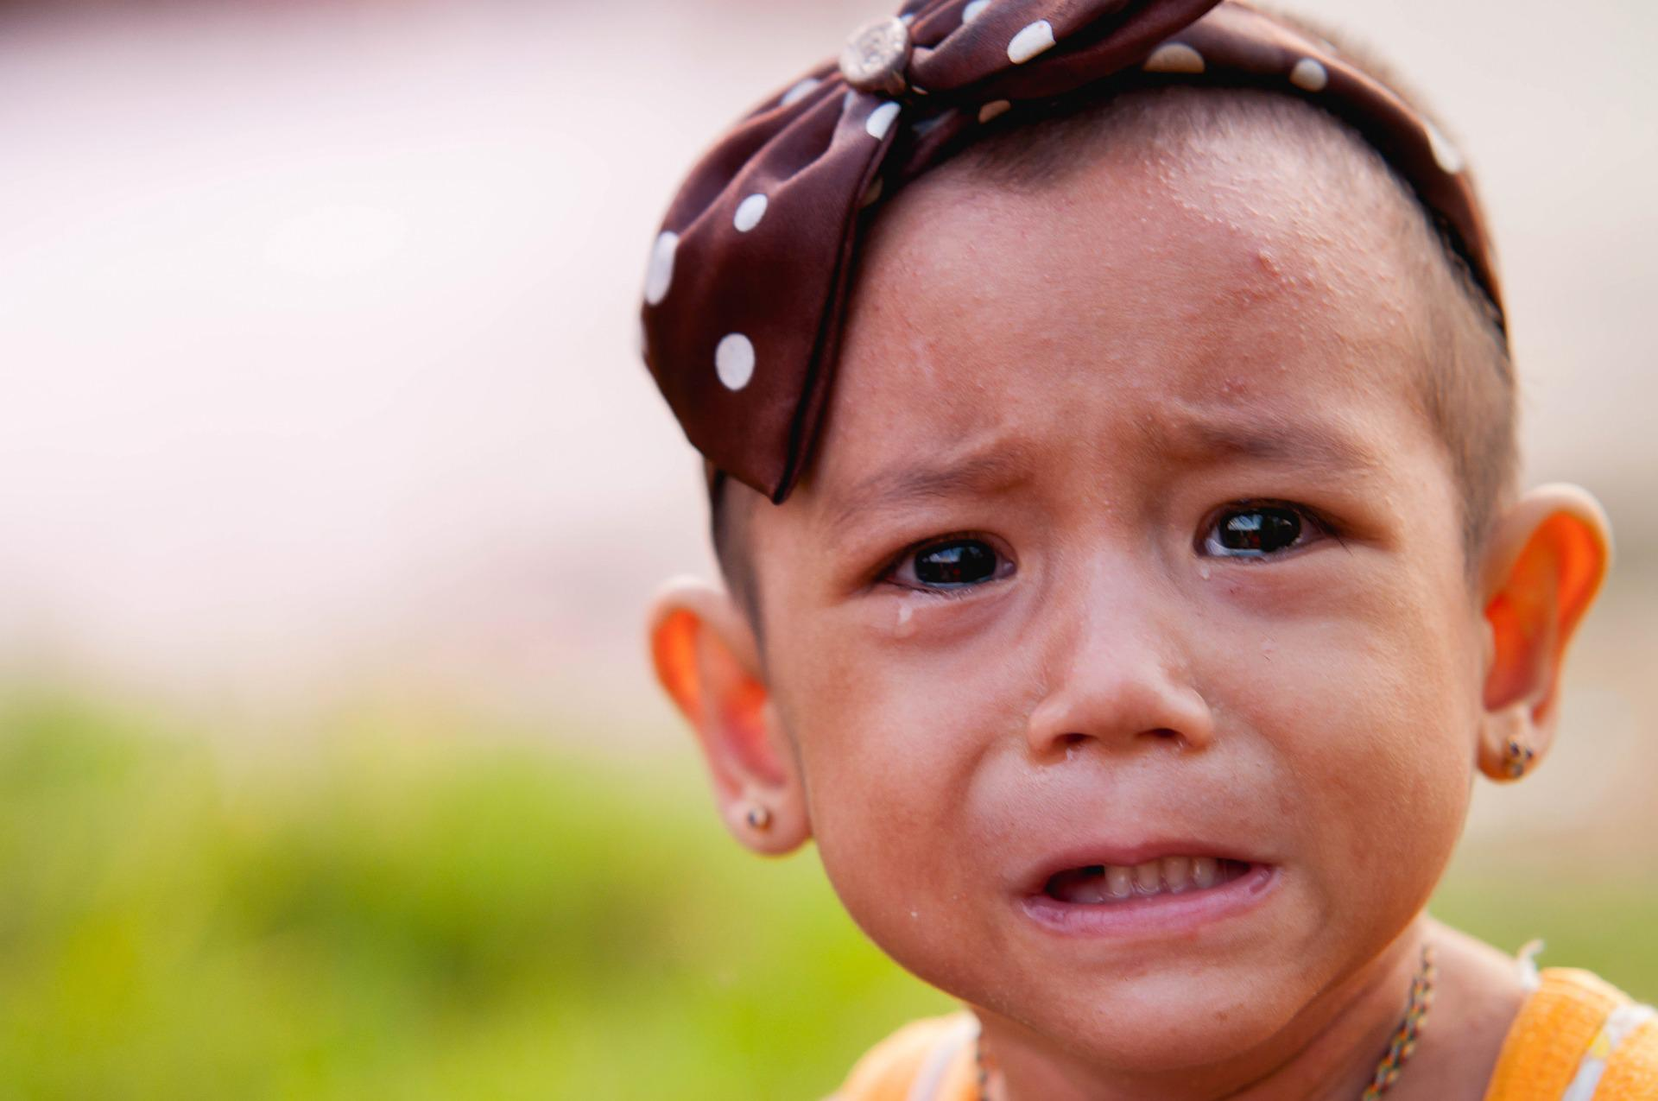
CHECK
Imagen de NOK NAKORN en Pixabay

Slide 89
La niña llora.

Slide 90
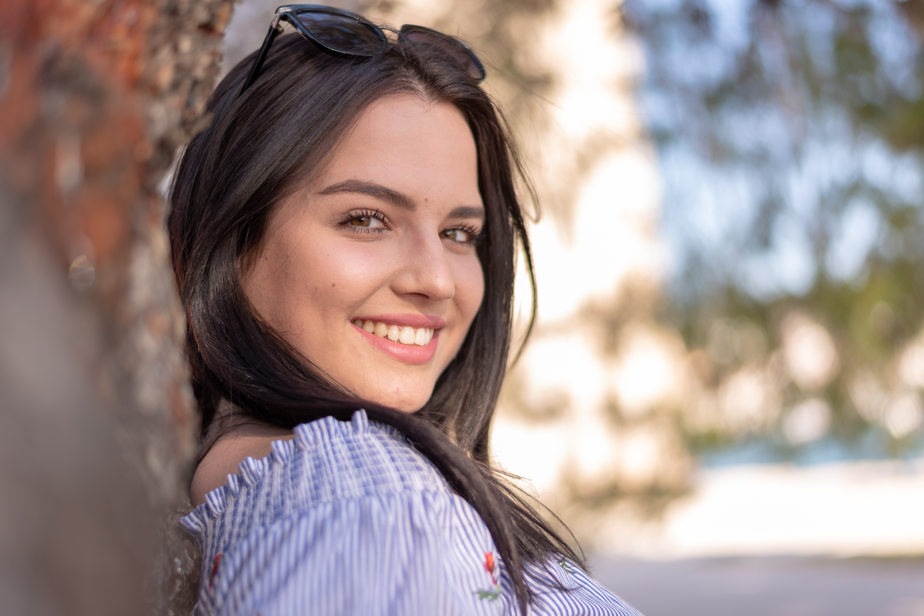

CHECK
Photo by Zoran Borojevic on Unsplash

Slide 91
La joven sonríe.

Slide 92
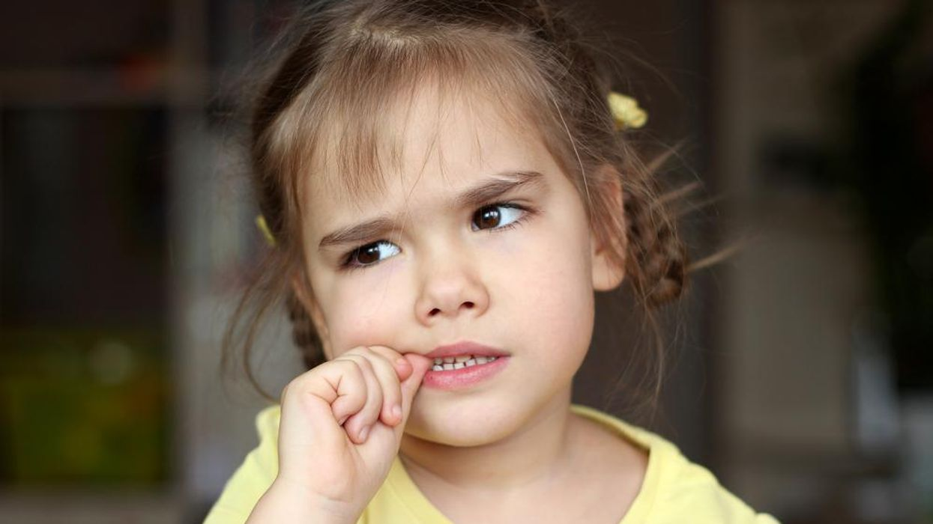
Image from Consumer Health Day
CHECK

Slide 93
La niña se come las uñas.

Slide 94
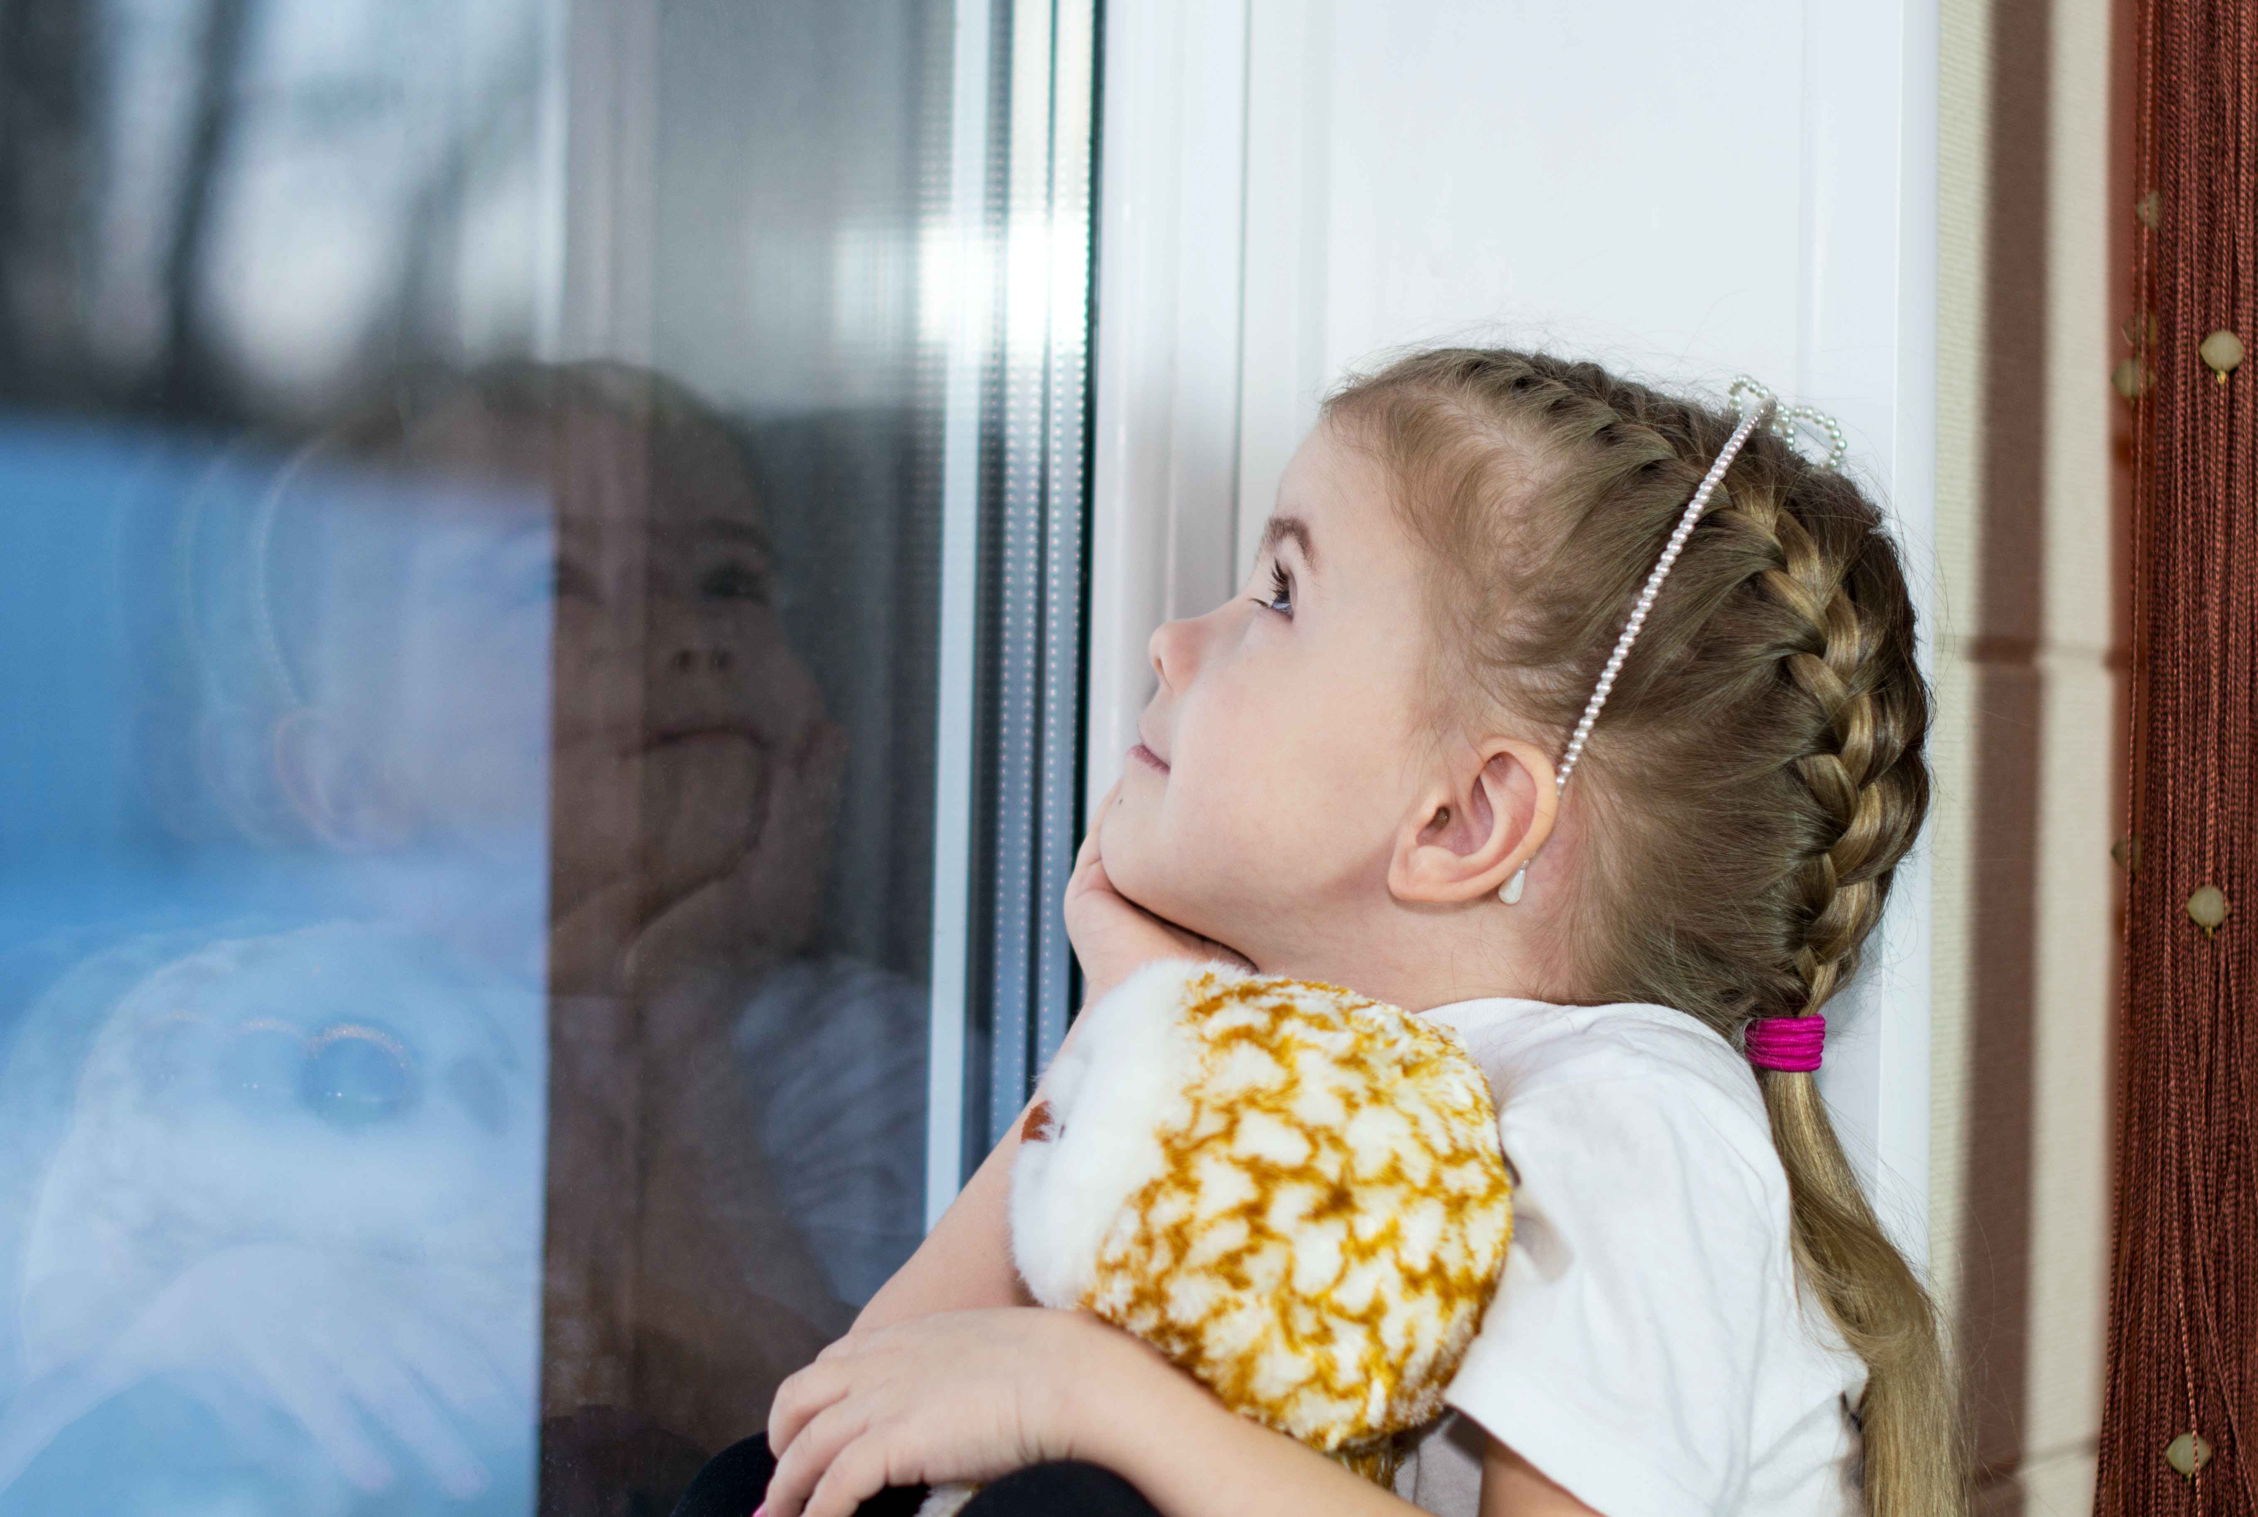

¿Cuándo van a
venir los Reyes
Magos?
CHECK
Photo by Bermix Studio on Unsplash

Slide 95
La niña sueña despierta.

Slide 96
Tenth Category 200
INSERT QUESTION HERE
CHECK
Notes:
You will have to move the Daily Double picture out of the way to write the question. If you do not wish to have the Daily Double in the game, delete it and the sound clip (speaker) from this slide. For a Daily Double, the contestant has to wager at least $5 and at most the highest point value of any player/team at that point in the game. It is considered a True Daily Double if they wager all of their points and go “double or nothing”.

Slide 97
Plato nacional salvadoreño.
CHECK
Notes:
You will have to move the Daily Double picture out of the way to write the question. If you do not wish to have the Daily Double in the game, delete it and the sound clip (speaker) from this slide. For a Daily Double, the contestant has to wager at least $5 and at most the highest point value of any player/team at that point in the game. It is considered a True Daily Double if they wager all of their points and go “double or nothing”.

Slide 98
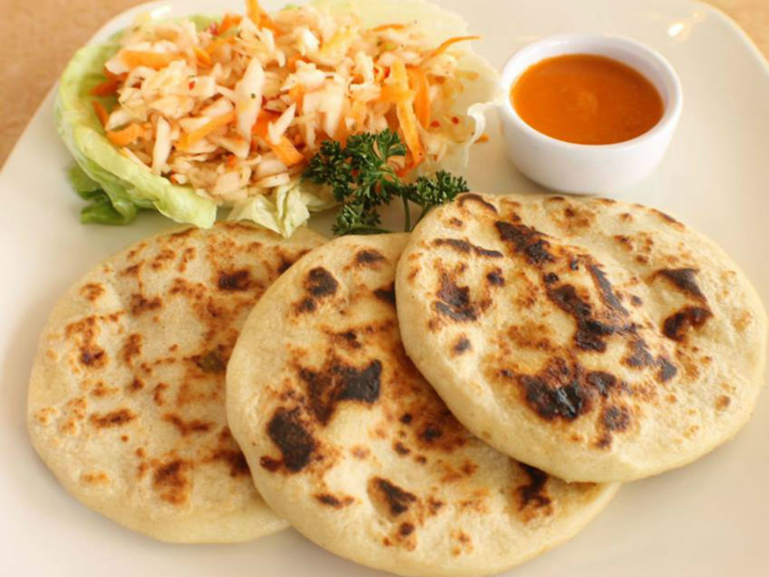
Las pupusas
Image from CultureMap Fort Worth

Slide 99
Izalco en El Salvador y
Momotombo en Nicaragua son ____.
CHECK

Slide 100
volcanes

Slide 101
Muchos países hispanos celebran la Nochevieja comiendo 12 ____ a medianoche.
CHECK

Slide 102
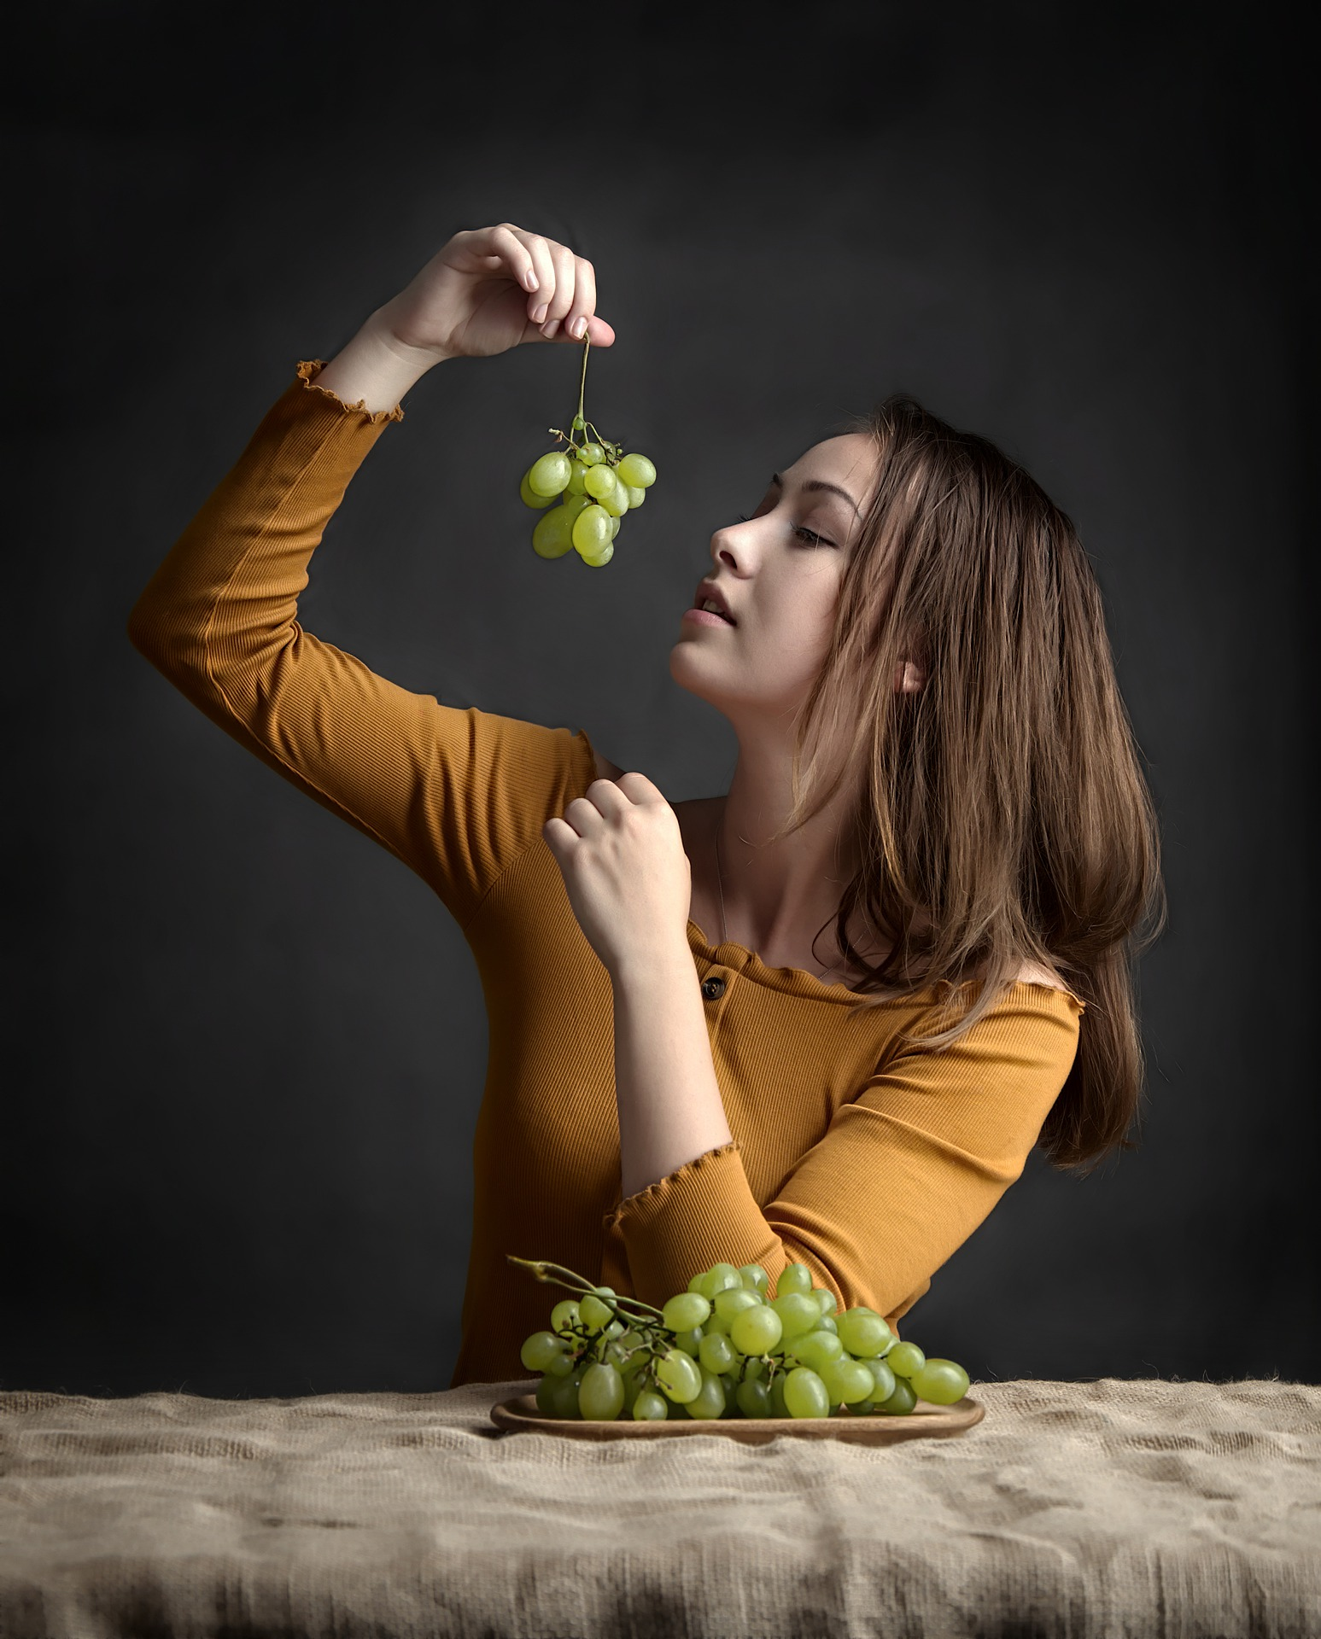
uvas
Imagen de Jerzy Górecki en Pixabay

Slide 103
En Copán, (país)__, están las ruinas y los jeroglíficos mayas más grandes del mundo.
CHECK

Slide 104
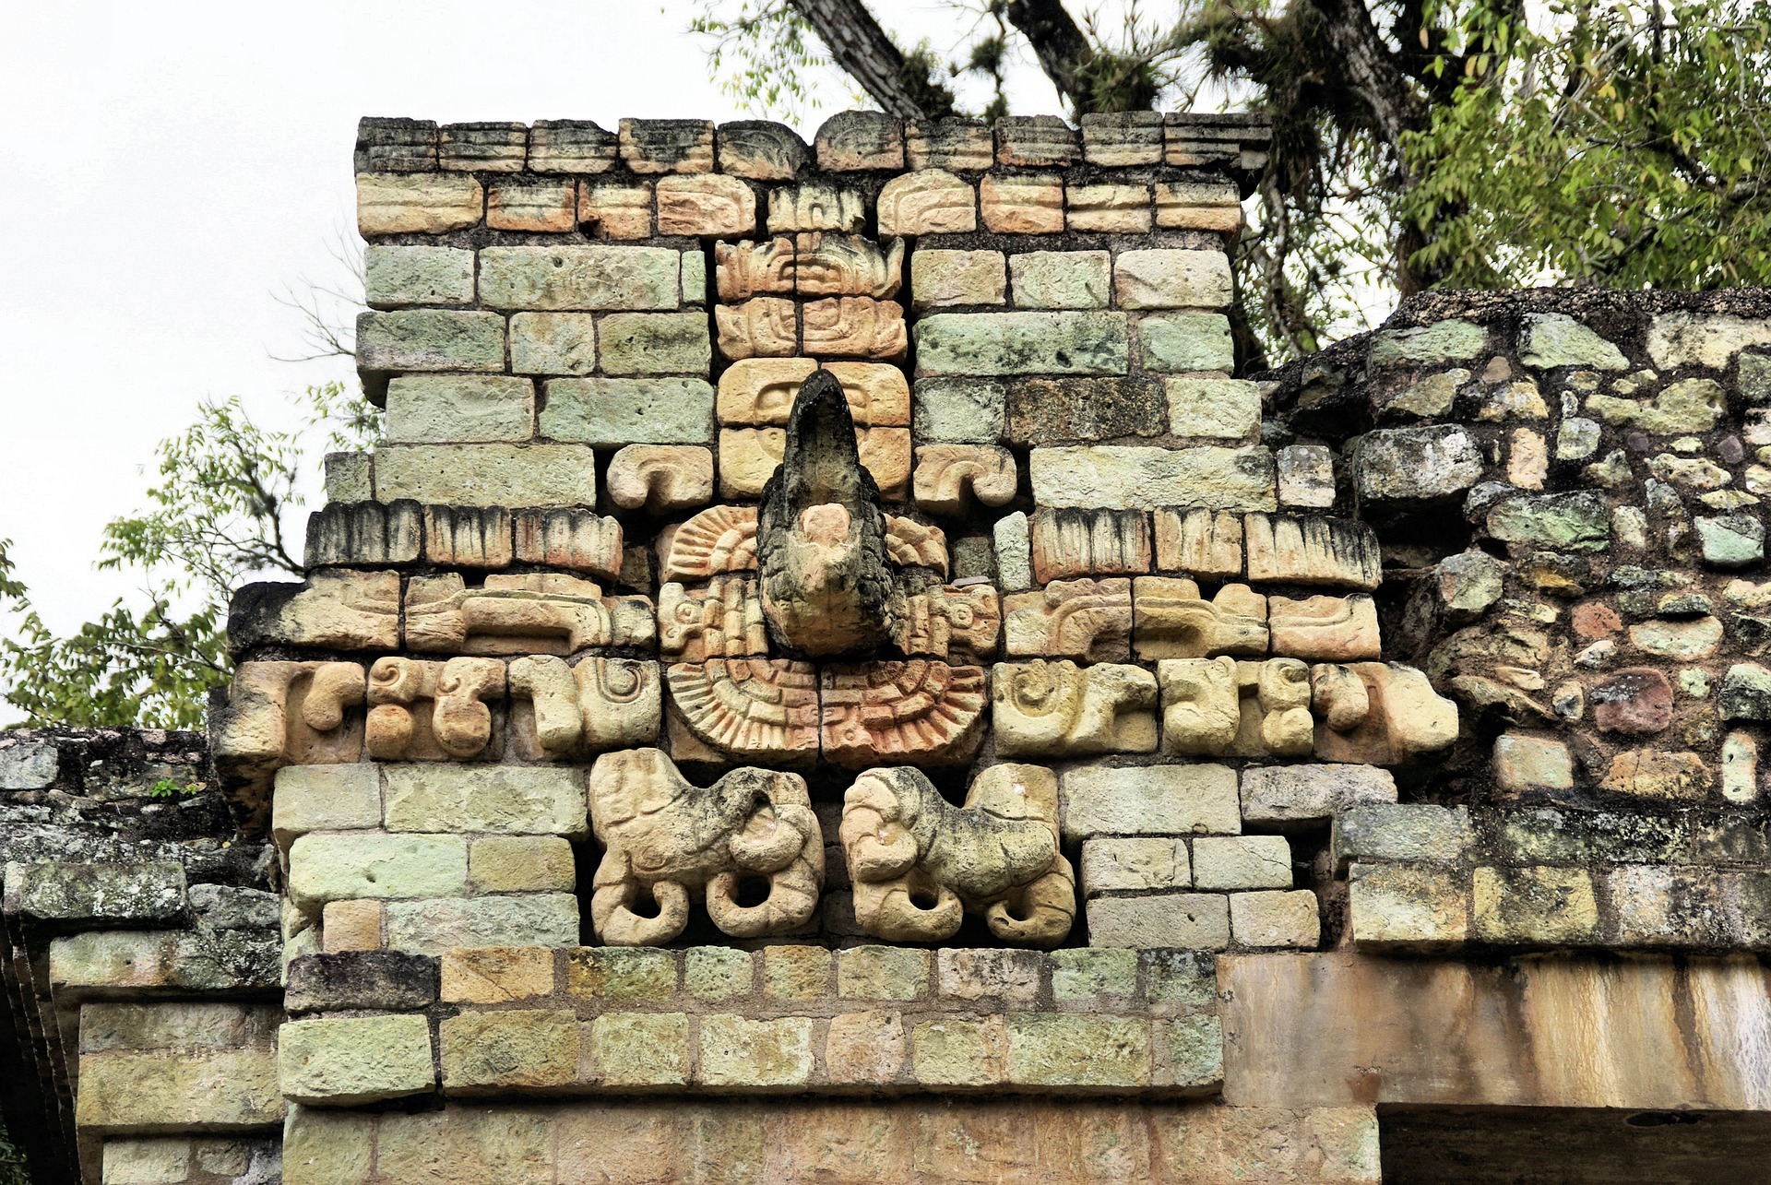
Honduras
Imagen de DEZALB en Pixabay

Slide 105
El 1° de octubre se celebra el Día ___ en toda Latinoamérica.
CHECK

Slide 106
Día del Niño

Slide 107
JEOPARDY FINAL
Categoría:
Celebraciones
CHECK

Slide 108

¿Qué se celebra el
1° de noviembre?
CHECK

Slide 109
El Día de Todos los Santos

